Slide 1
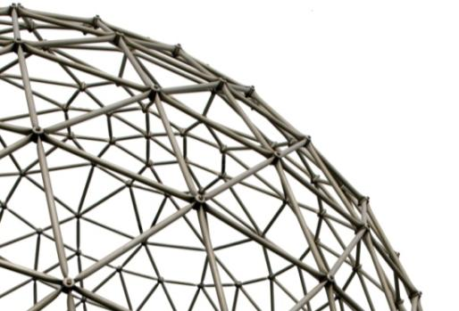
Colpex
The Cold Pooling Experiment
Prof. Peter Clark
Mathematics / CCE

Slide 2
Peter Clark - Background
Theoretical Physicist (University of Cambridge)
1979-1992 research on atmospheric pollution problems in (then public) electricity industry.
  Acid rain
  Photochemical oxidants
  Modelling and field measurement (aircraft, ground-based) – collaboration with Met Office and various universities.
1992-2010 Met Office career largely focussed on small-scale and short-range forecasting:
  1993-1995 responsibility for improving operational UK mesoscale forecast model,
  1995-1998 Leader of Local Forecasting R&D Group responsible for developing ‘Site Specific Forecast Model’ (SSFM).
  1998-2008 Leader of Mesoscale Modelling group (JCMM, Reading) responsible for developing convective-scale non-hydrostatic model, especially forecasting thunderstorms and flash floods.
  2008-2010 Head of Joint Research Centres (JCMM at Reading University and JCHMR at CEH Wallingford).
Joined Surrey (Maths and Engineering) July 2010: Chair in Environmental Flow Modelling

Slide 3
Outline
What is Colpex?
Some revision on atmospheric boundary-layer turbulence.
The Colpex experimental setup.
Modelling with the Unified Model
  Strategy
  Setup
  A case study.
Questions

Slide 4
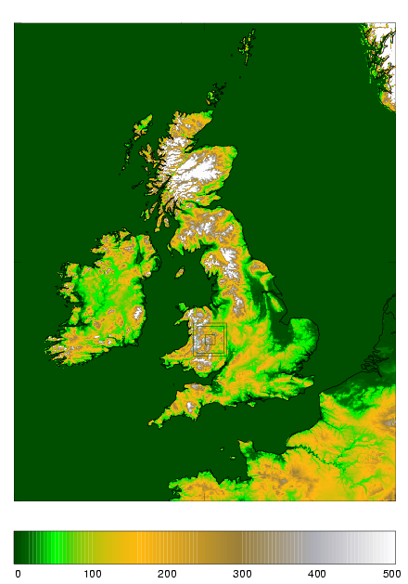
COLPEX
Cold Air Pooling Experiment
  Formation of cold air pools in/near Clun Valley, Shropshire, England: small-scale, rolling terrain ~200 m valley-summit, ~1 km wide
  Field campaign: June 2009 – April 2010
  Collaboration between Met Office and Universities of Leeds and Surrey
  Intensive ground-based network combined with upper-air and remote sensing measurements
  Extensive modelling at very high resolution

Slide 5
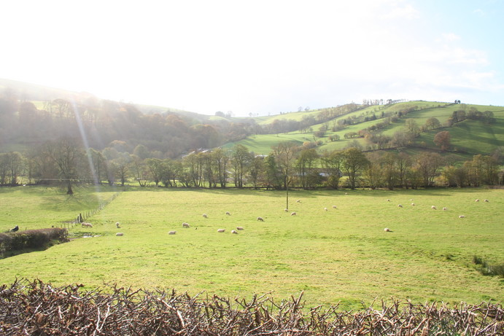
Terrain
Jeremy Price

Slide 6
Acknowledgements
Met Office
  Cardington: Jeremy Price, Bernie Claxton, Volker Horlacher.
  Exeter: Simon Vosper, Adrian Lock, Peter Sheridan, Aurore Porson, Andy Brown.
  JCMM Reading: Emilie Carter, Humphrey Lean
Leeds
  Andrew Ross, Bradley Jemmett-Smith, Fay Davies
31st ICAM (International Conference on Alpine Meteorology), Aviemore, May 2011. (Esp. paper presented by Simon Vosper co-authored by many of the above including myself).

Slide 7
Motivation and aims
Hazards - ice, fog
(Regional climate, pollution, crop exposure)
Small scale, difficult to forecast
Mechanisms/factors involved in cold pool formation at these scales (sheltering, drainage?)
How well does forecast model, running at very high resolution, simulate these cold pools?
Parametrization of surface exchange in larger scale models.
Temperature downscaling techniques in complex terrain

Slide 8
Horizontally-Homogeneous (1D) steady state TKE budget
Reynolds Averaging
Shear Prod.
Bouyant Prod.
Transport
Dissipation
TKE production =
No production if sufficiently stable

Slide 9
Eddy Diffusivity and Mixing Length Theory (Prandtl)
Assume:
Transport~0
So:
‘Equilibrium’ TKE given by:
No turbulence if sufficiently stable

Slide 10
Surface Energy Budgets
‘Surface’ energy budget
LW_out-LW_in+H+λE-G=SW_in-SW_out
SW_out
or
LW_out
H+λE-G=R_{N}
H
λE
At night, clear sky, light wind, surface temperature dominated by balance of radiative cooling and ground heat flux, with (perhaps) some turbulent flux to surface.
LW_in
SW_in
G
Surface
H=Turbulent ‘sensible’ heat flux.
λE=Turbulent ‘latent’ heat flux.
G=‘Ground’ heat flux

Slide 11
Surface-layer similarity
(Monin-Obukhov)
Three length scales: U_{g}/f (very large), z₀ (very small), L:
Non-dimensional Shear
Non-dimensional Profiles
No solution if sufficiently stable

Slide 12
Eddy Diffusivity and Mixing Length Theory
Thus
Unknowns:
C_{X} (just a constant), mixing length (Blakadar formula) and ‘stability function’ f(Ri).
No equilibrium turbulence exists for R_{f}>1.
Kelvin-Helmholtz instability (etc.) leads to idea of critical Ri~0.25.
f(Ri)
1
These ‘simple’ parametrizations work well if surface heat flux or temperature specified.
0
0.25
Ri

Slide 13
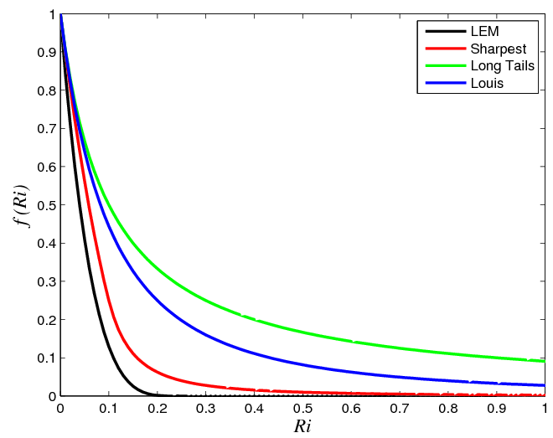
Stable Boundary Layer Parametrization in
Real Climate and NWP models
Using ‘correct’ (local) stability functions in real models leads to problems, usually associated with excessive surface cooling and too great a tendency to ‘cut-off’ or ‘decouple’ the surface.
  Climate models may decouple much of extra-tropical winter land.
  An experiment in the ECMWF forecast model using ‘correct’ stability functions reduced skill by the equivalent of 10 years improvement!
  Even 1.5 km operational forecast model does not use ‘ideal’ function.
  Area-averaged fluxes from 1 km model over S England with ‘sharpest’ function do not follow this function.
Some stability functions used in the Met Office UM; only the ‘LEM’ function shows true critical Ri behaviour. Other functions retain vertical mixing far beyond that theoretically expected.

Slide 14
‘Real’ Stable Boundary Layers
Surface fluxes radiatively coupled to BL cooling as well as through turbulence.
LW_in
LW_in
LW_out
LW_out
H
λE
H
λE
Surface
Surface
G
G
And then there are slopes…

Slide 15
Cold Pools
The ‘traditional’ view – drainage flows.
Problems:
Actually promotes downwards transport of warm air.
- What about ambient wind?
U
H
Key parameter =
Sheltered
Brown and Vosper, 2008

Slide 16
Instrumentation
Main Cardington MRU masts:
  Detailed measurement of atmospheric variables at multiple heights (wind, temperature, pressure, moisture, turbulence)
  Radiative (LW and SW) and soil measurements (moisture, temperature and heat flux); component fluxes available to reconstruct full energy budget
  Data logged at 10 Hz, averaged up to 1, 5, 10 and 30 min
Network of ~20 Hobo temperature sensors; transect and along-valley coverage
~10 Leeds AWS instruments: atmospheric variables and ground temperature
Valley volume and profile measurements:
  1.5μm pulsed Doppler LIDAR (70x30m range gates), continuously operating
  IOPs: radiosondes hourly at mast locations; temperature survey car

Slide 17
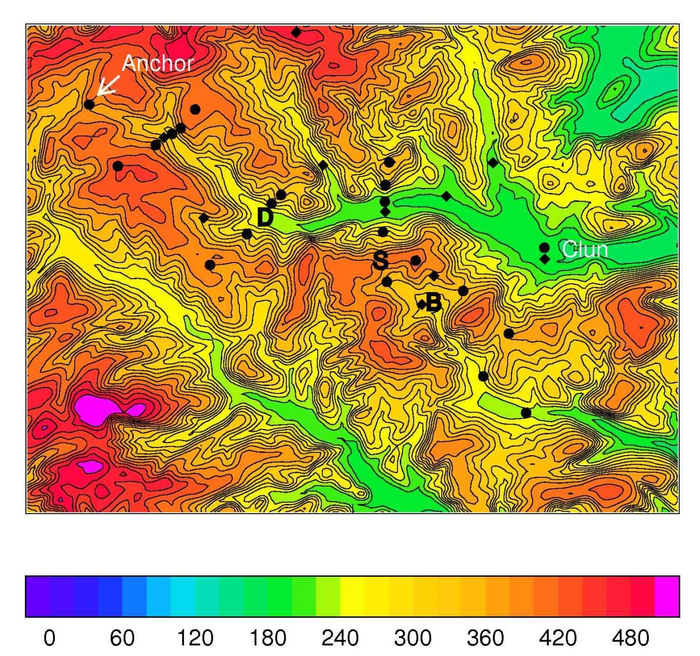
Instrument sites
3 main mast sites
Instrumented transects
Along-valley coverage
General sampling of the terrain
2 km

Slide 18
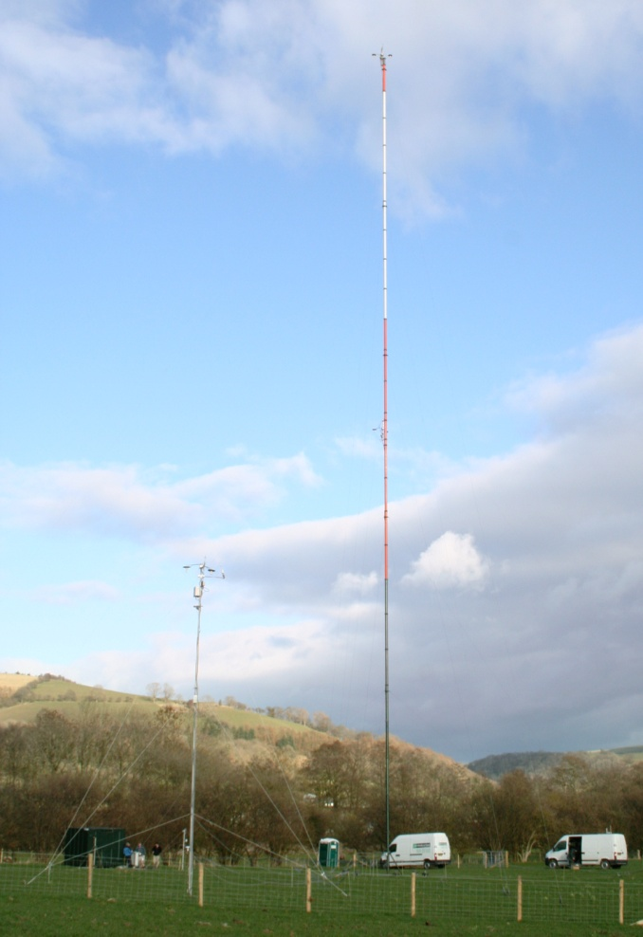
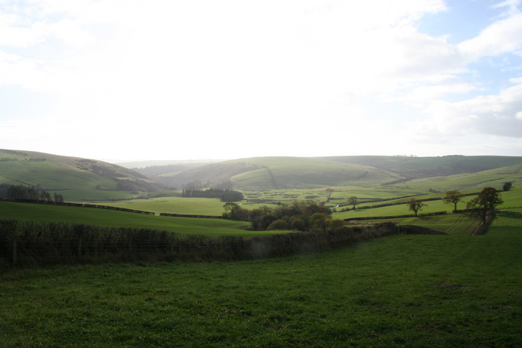
Main mast sites
Duffryn (Clun valley)
50m mast
Burfield valley, 30m mast
Springhill farm, 30m mast (exposed hilltop site)
Photos: Jeremy Price, Peter Clark

Slide 19
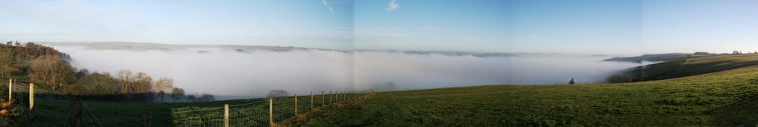
Intensive Observation Periods (IOPs)
Seventeen IOP nights:
View over Clun valley, 10/12/2009 (Jeremy Price)

Slide 20
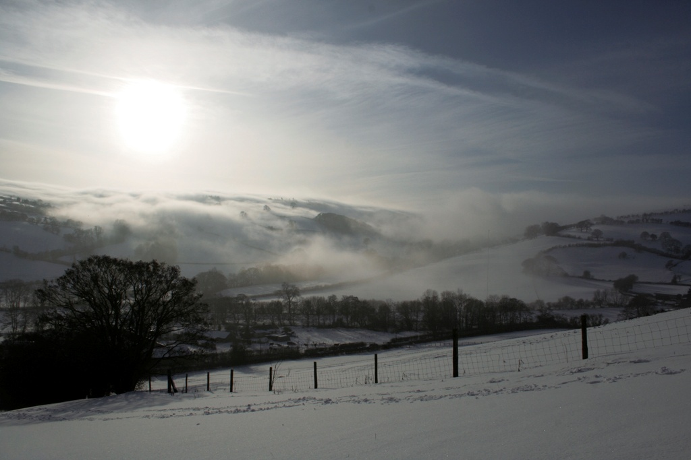
Snow and fog, January 2010
Jeremy Price

Slide 21
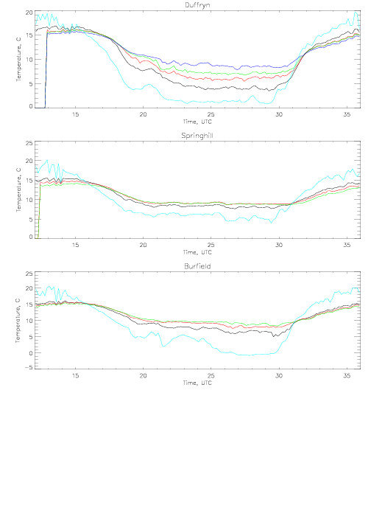
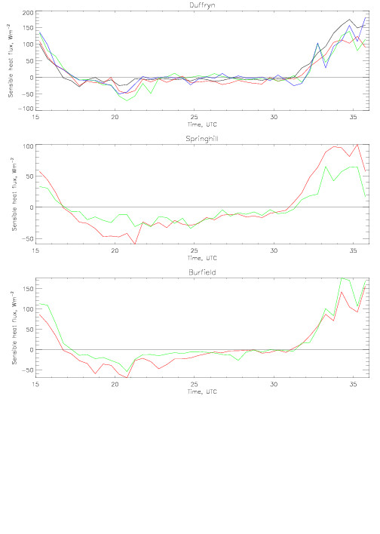
Cold pool example – 9-10/9/2009
Mast temperature (°C) and sensible heat flux
surface screen 10m 25m 50m
20
200
Temperature (°C)
Sens. Ht. fx (Wm⁻²)
0
-100
25
100
Temperature (°C)
Sens. Ht. fx (Wm⁻²)
0
-50
Strong inversion forms at Duffryn after sunset
Inversion shallow at Springhill
Negative peak of sensible heat flux after which temperatures relatively static at Duffryn
Overnight wind: Duffryn < 1 ms⁻¹ Springhill ~ 3 ms⁻¹
midday
midday
3pm
midday

Slide 22
Numerical modelling strategy
Test and optimise model configuration using IOP nights before running for entire winter period 2009-2010.
  Sensitivity studies examining the dependence of results on vertical resolution, time step, sub-grid mixing schemes, soil moisture content etc..
Simulation of the period as a whole to help:
  characterise the encountered cold pools generally
  elucidate, alongside observations, the dominant processes, parameters involved in cold pool formation
Extra simulations of IOPs, increasing resolution or adjusting parameterisations to examine cold pooling process in detail.

Slide 23
IOP Case study
Key Questions
How well can an operational forecast model simulate cold-air pooling on sub-kilometre scales?
Which physical processes (in the model) dominate the formation and evolution of cold air pools?
  Advection
  Sheltering (suppression of turbulent mixing aloft)
  Radiative cooling

Slide 24
Model Configuration
Met Office Unified Model:
  Non-hydrostatic deep atmosphere fully compressible dynamical core
  Semi-implicit semi-Lagrangian dynamical (SISL) core
  Comprehensive parametrizations – sub-surface temperature and moisture, tiled surface-exchange, boundary-layer (see below), radiation (includes slope but not sheltering), clouds and 5 phase precipitation.
100 m (0.0009 degree rotated lat/long) horizontal resolution over 30 km square.
Variable resolution outside stretching (5.5%) to 1.5 km. (412x412 domain covering ~100 km square).
70/140 levels, 5 s timestep.
3D Smagorinsky, LEM stability functions, Cs=0.15.
RHcrit=0.99 in first 10 layers then gradual increase – 0.9 above level 30.

Slide 25
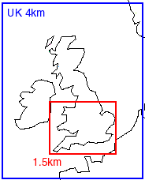
COLPEX_100 Run Configuration
Operational UK 4 km:
Analysis (3D VAR+LHN) every 3 h
Output LBCs T+1 to T+4 every 15 min
‘HRTM’ 1.5 km:
Starting from reconfigured 4 km T+1 every 3 h.
LBCs every 10 min
COLPEX_100 run continuously:
Case study started from 16 UTC doubly reconfigured UK 4 km.
Own previous run thereafter.
Only impact of observations is through LBCs.

Slide 26

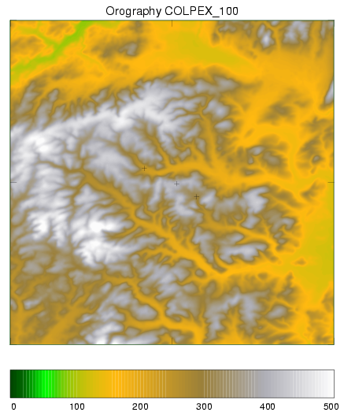
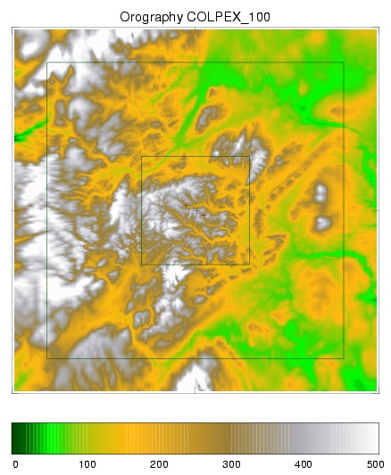
COLPEX_100 Orography
Δ=100m
Δ=1.5km
Clun vallley
Stretching zone
Spring Hill
30 km
Upper Dyffryn
30 km
Burfield
Δ=100m
Colpex_100
Domain
100 m inner
Domain
DTED ~100 m source data

Slide 27
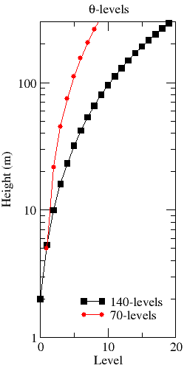
Vertical grid and timestep
Operational grid: 70 levels up to 40 km
  5 θ-levels below 112m
Enhanced resolution: 140 levels up to 40km
  12 θ-levels below 112 m
100m model uses a 5 second timestep
  For 20 ms⁻¹ winds aloft, this implies a horizontal Courant number of 1.
Made possible via SISL formulation of model

Slide 28
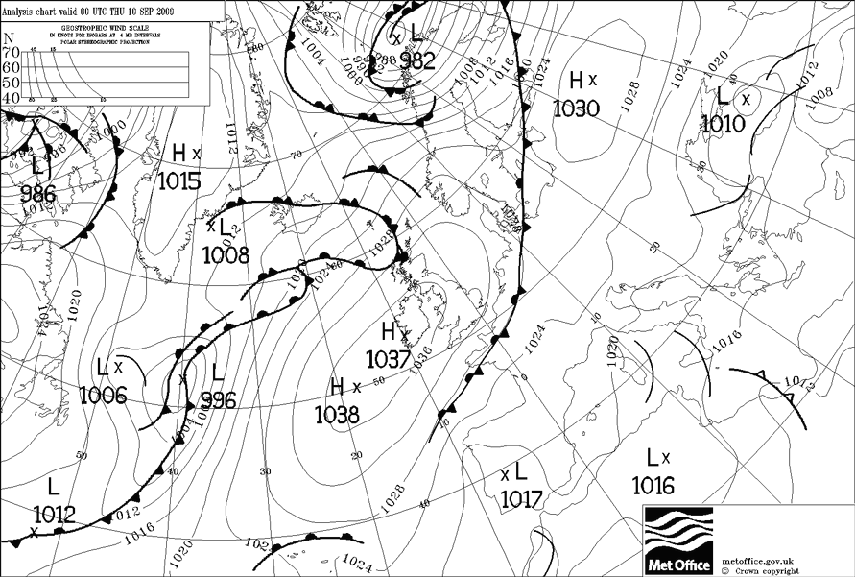
9th September 2009 IOP
Initial focus on the clear-sky COLPEX IOP
Simulation from 15UTC 09 to 15 UTC 13 September 2009
00 UTC 10/09/2009
© Crown copyright Met Office

Slide 29
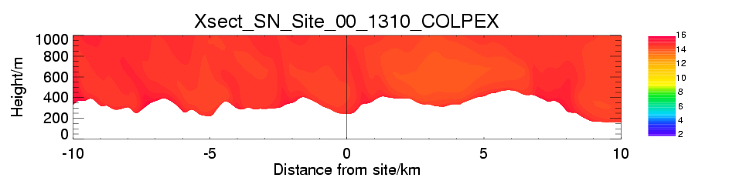
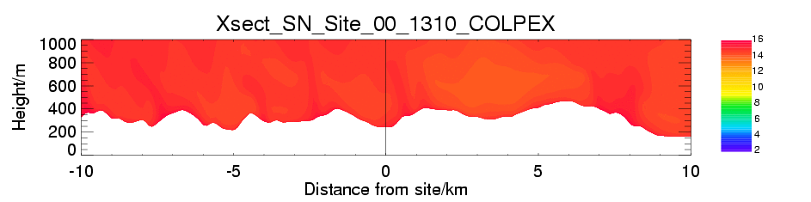
20090909-10
70L
140L

Slide 30
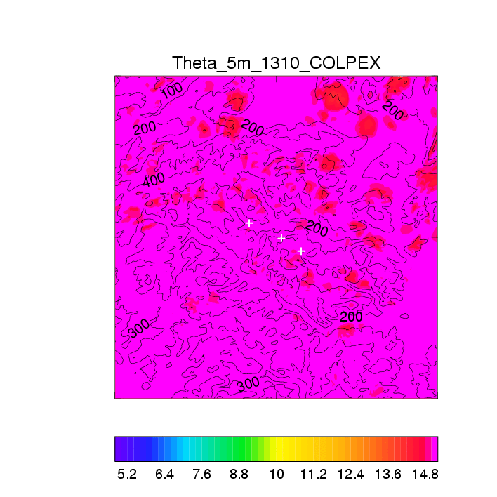
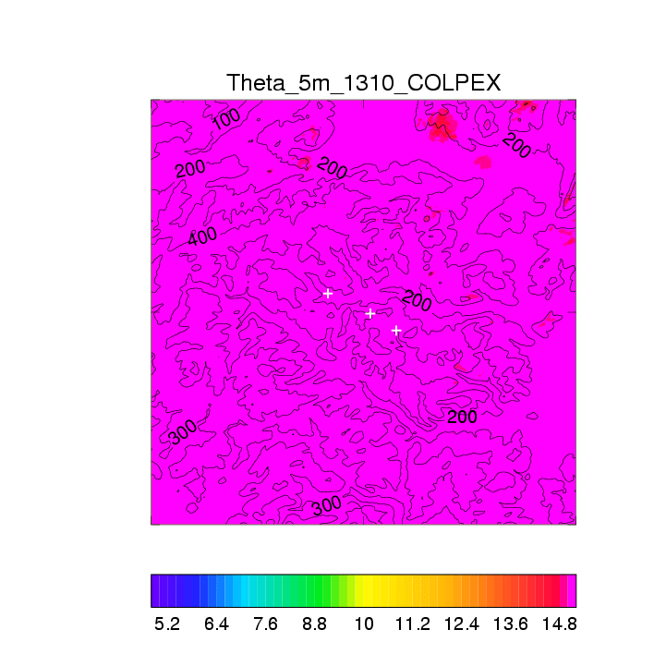
20090909-10
70L
140L

Slide 31
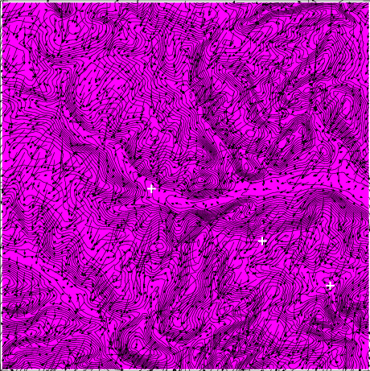
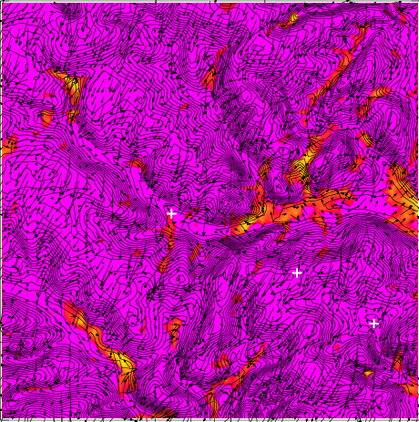

Potential temperature at 2m
2009/09/09 1800 UTC
2009/09/09 1900 UTC

Slide 32
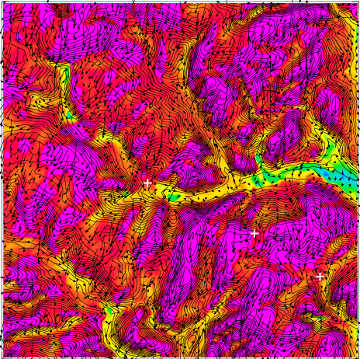
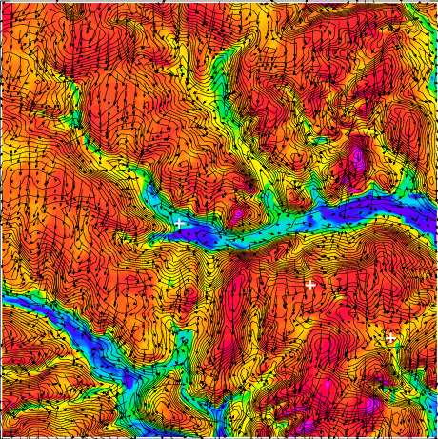
Potential temperature at 2m
2009/09/09 2000 UTC
2009/09/09 2100 UTC
2009/09/09 1800 UTC
2009/09/09 1900 UTC

Slide 33
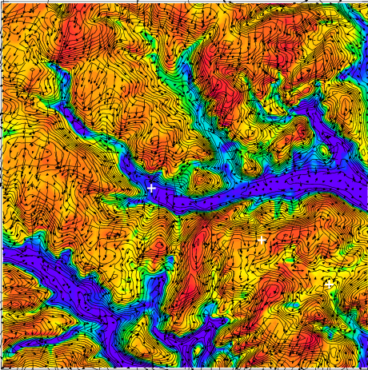
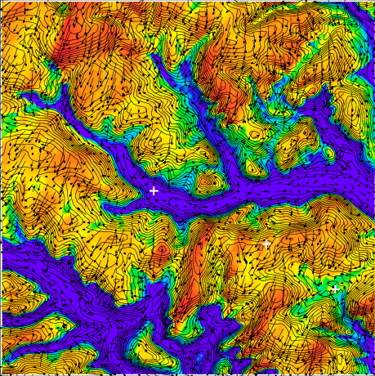
Potential temperature at 2m
2009/09/09 2200 UTC
2009/09/09 2300 UTC

Slide 34
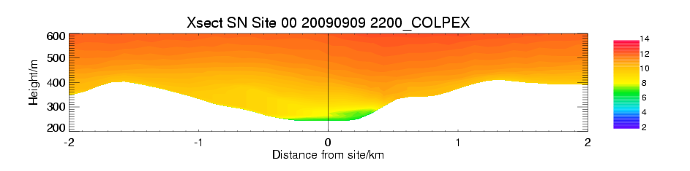
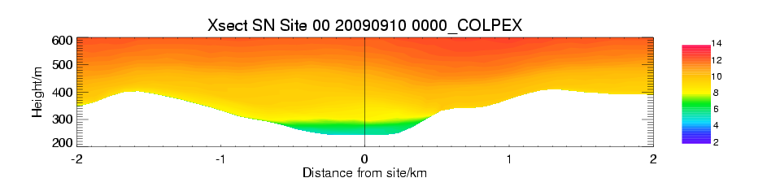
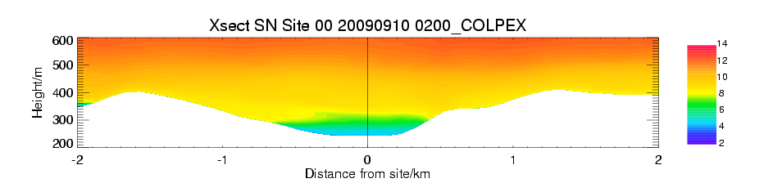
North-South section through Upper Dyffryn, Clun Valley
θ (ºC)

Slide 35
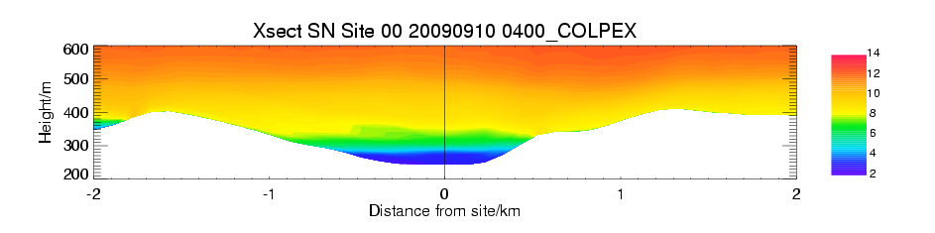
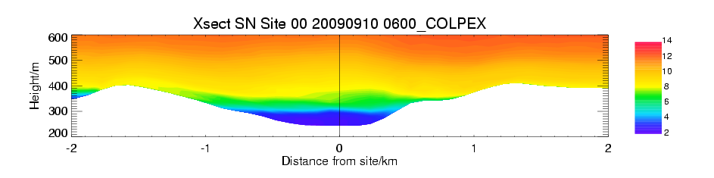
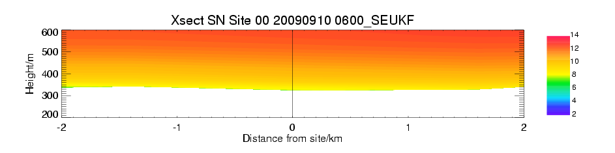
North-South section through Upper Dyffryn, Clun Valley
θ (ºC)
Δx=1.5 km
Clearly 1.5km resolution is inadequate!

Slide 36
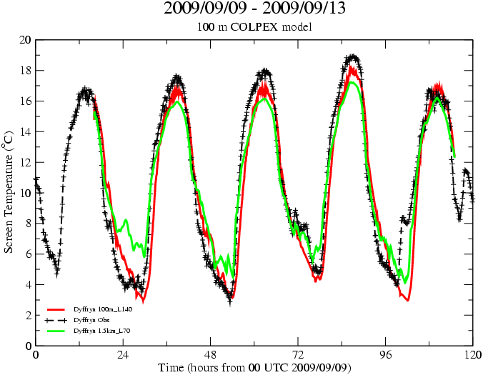
Model screen temperature: Δ=100m L140 vs Δ=1.5km L70
Temperature minima well represented
Daytime temperatures too cold
Clear benefit of 100m resolution over 1.5km
Duffryn
© Crown copyright Met Office

Slide 37
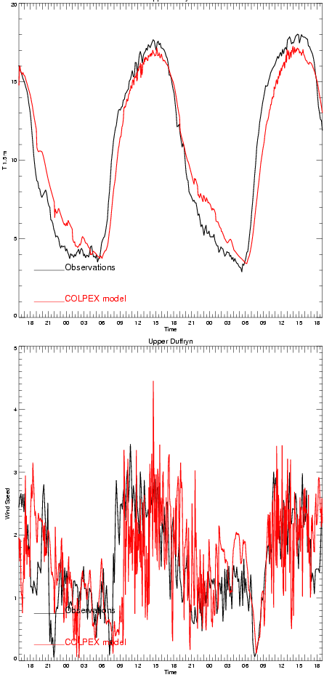
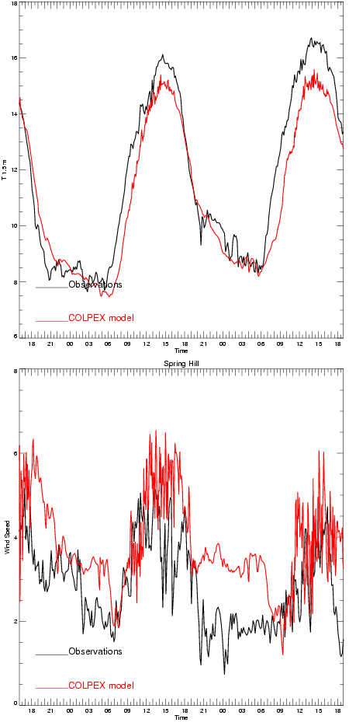
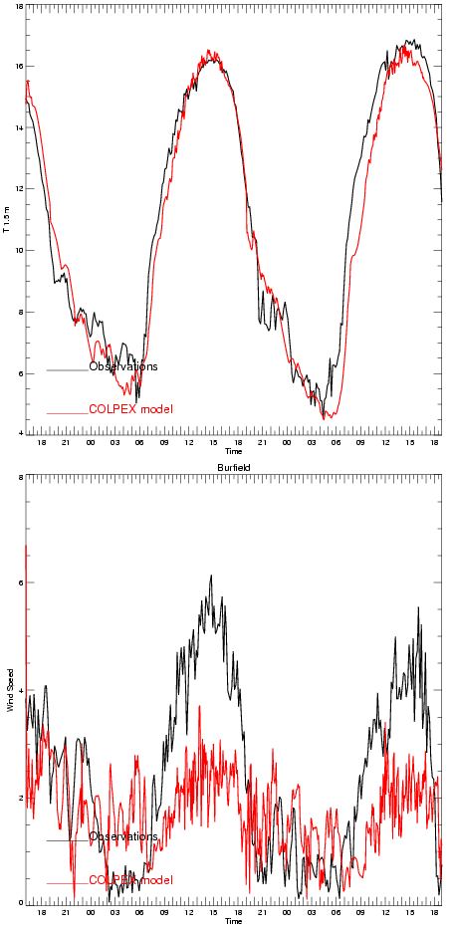
140-level 100 m model results
Duffryn (Clun valley) Springhill (hill-top) Burfield (valley)
T(ºC)
T(ºC)
T(ºC)
7
9
7
3
7
5
5
8
8
Wind speed (ms⁻¹)
Wind speed (ms⁻¹)
Wind speed (ms⁻¹)
-model
-obs
0
0
0
© Crown copyright Met Office

Slide 38
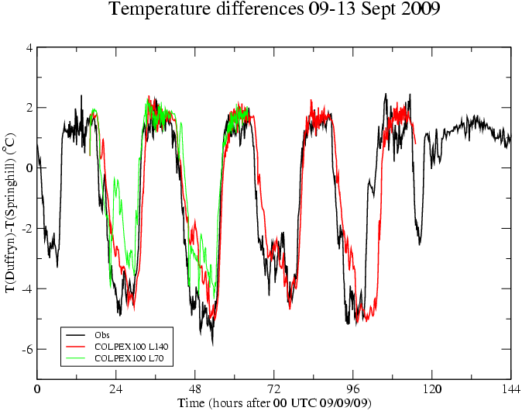
Cold pool strength
Repeatable nighttime ΔT of approx. -4 K
100m L140 model gives good prediction of ΔT amplitude
Coarser vertical resolution (L70) results in weaker cold pools
© Crown copyright Met Office

Slide 39
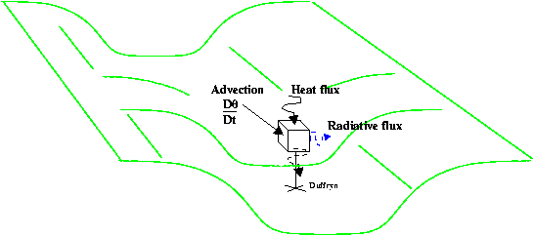
Heat budget
Q: What are the dominant sources of cooling?
Can use the model θ budget to identify which are the important processes at different times during the night.

Slide 40
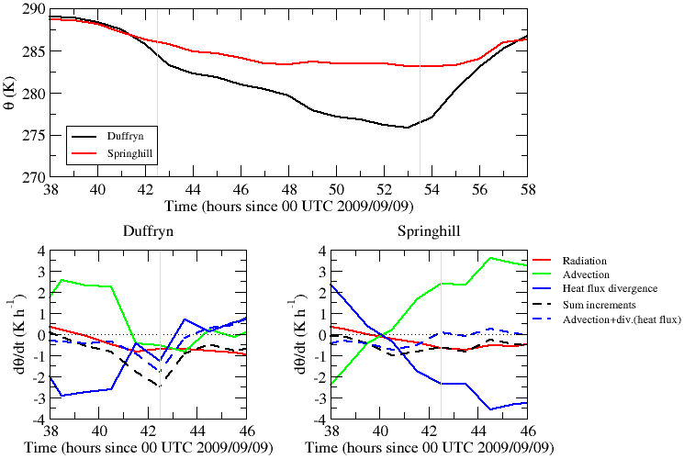
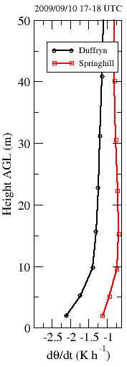
Model level 2 ~5m
(Advection and div.(heat flux) * 0.2)
Cooling in valley is relatively rapid around sunset.
Later on, hill-top and valley cooling rates are similar
Model heat budget suggests early rapid cooling in valley is largely due to greater turbulent heat flux divergence (relative to advection)

Slide 41
Conclusions
The model provides a credible simulation of clear-sky cold-pool cases observed during COLPEX
  Some room for improvement still.
  Foggy cases are more challenging!
The results show clear benefit of using enhanced vertical resolution. 100m horizontal resolution appears to be sufficient, but further refinement might be beneficial.
Results show some small sensitivity to stability functions used in turbulence parametrization scheme.

Slide 42
Conclusions (contd)
Analysis of the model near-surface θ evolution in and outside the valley suggests that:
In agreement with the observations, relatively rapid cooling occurs in the valley around sunset. Following this, the hill-top and valley cooling rates are similar.
This rapid valley cooling rate is largely due to large turbulent heat flux divergence. This is presumably due to:
  Strong surface cooling and reduced downward turbulent heat flux aloft, due to sheltering in the valley.

Slide 43
Next?
‘Physics’ issues
  Turbulence scheme:
    Stability functions.
    Mixing lengths in shallow drainage flows.
    True horizontal mixing.
    Performance of TKE scheme.
  Surface exchange:
    Single tile at 100 m?
    Rivers and wet soil treatment.
    Land-use accuracy – esp. deciduous trees.
    Canopy impacts on drainage flows.
  Cloud scheme
    RhCrit
Dynamics settings
Long runs
  Statistical comparisons with observation data.
  Evolution of sub-surface.
  Downscaling.
  Parametrization.

Slide 44
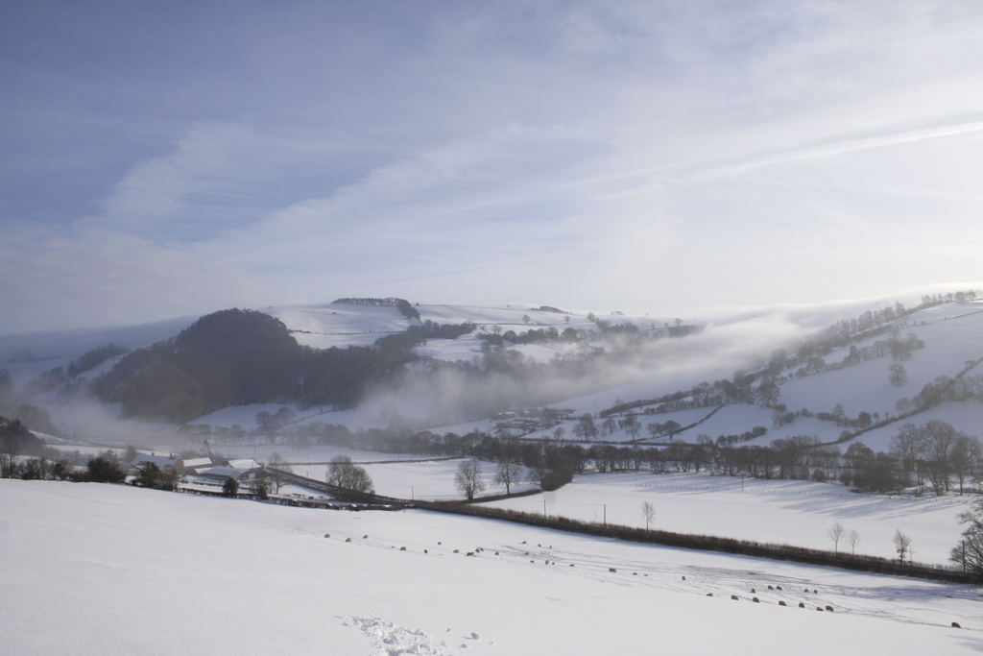
Thank you for Listening
Any questions?

Slide 45
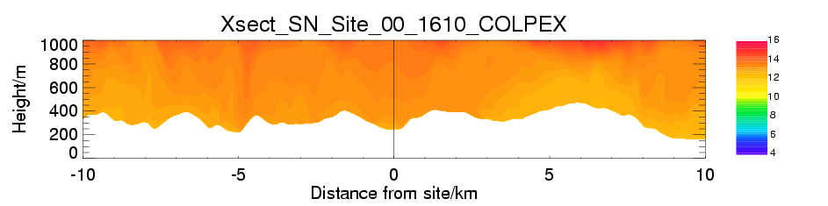
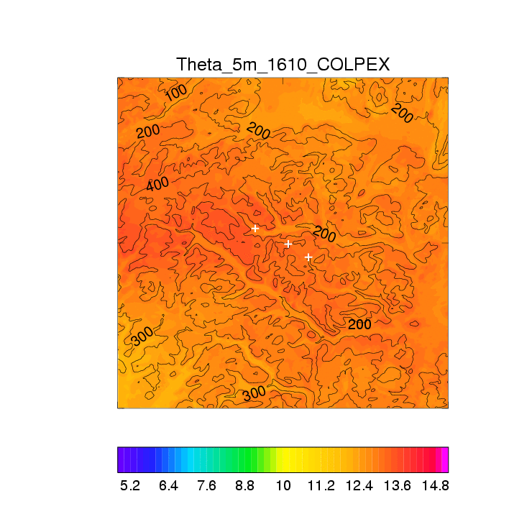
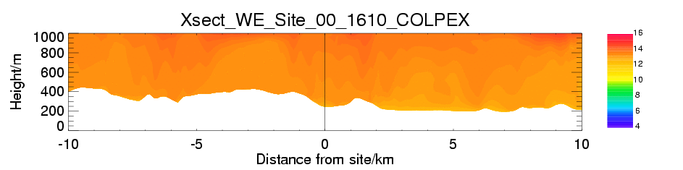
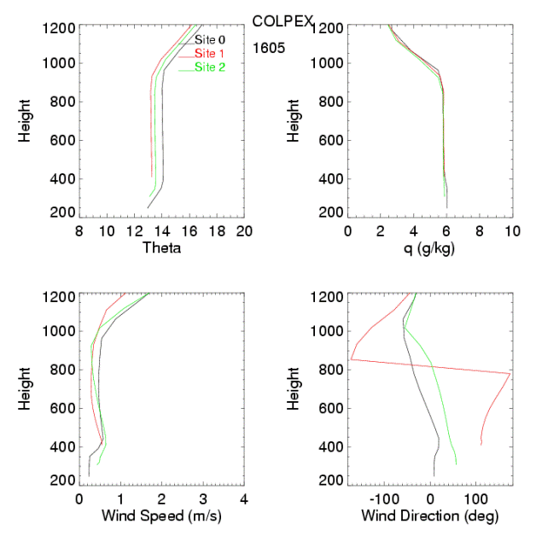
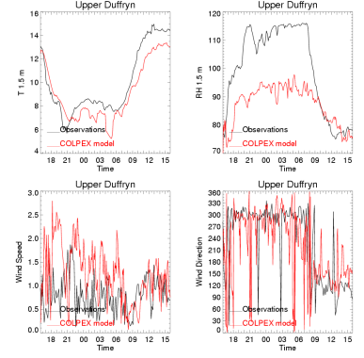
COLPEX: Example case study
14-15 October 2009

Slide 46
Thank you for listening
Any Questions?

Slide 47
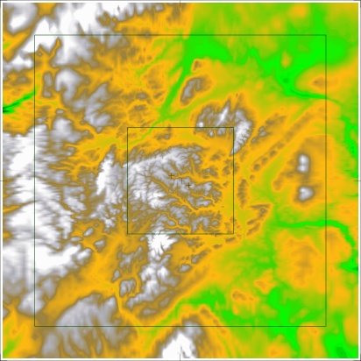

Very Stable Valley Flows: COLPEX
Met Office Site
100 km
Clun valley
Duffryn (Clun valley)
50m mast
Variable resolution MetUM 1.5 km -> 100 m

Slide 48
Very Stable Valley Flows: COLPEX
Met Office Site
100 km
Clun valley
Duffryn (Clun valley)
50m mast
Variable resolution MetUM 1.5 km -> 100 m

Slide 49
100 m resolution orography dataset
50 m resolution land-use dataset
Δ=1.5km
Δ=100m
Clun vallley
Stretching zone
30 km
Spring Hill
Upper Dyffryn
30 km
Burfield
Δ=100m

Slide 50
Preliminary Results

Slide 51
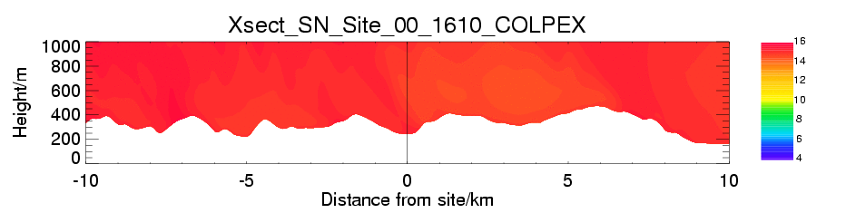
IOP model output
09-10 September 2009, potential temperature cross-section through Duffryn

Slide 52
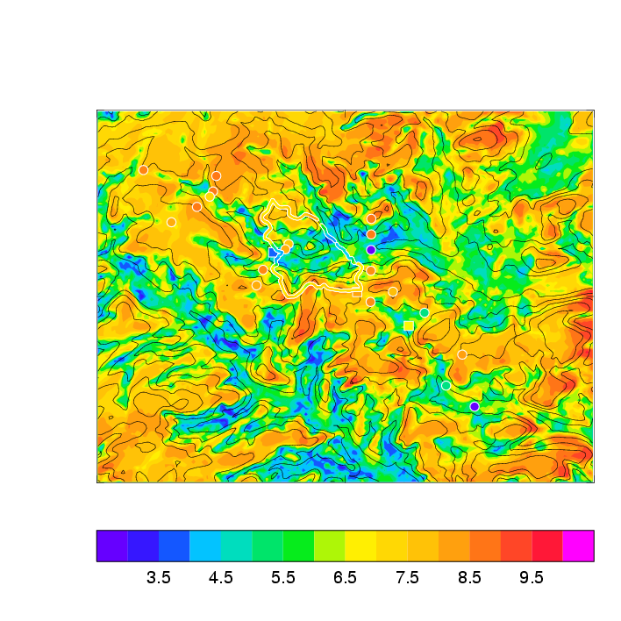
Observed and simulated cold pool,
09-10 September 2009
Screen temperature, 0500 UTC 10 Sept 2009
Mature cold pool, strong inversion
Broad agreement
Observed inversion more intense?

Slide 53
Current status and future plans
Current
  Overview paper submitted to BAMS
  Optimisation of 100m resolution model
  Assessment of 4 km driving model forecast (cloud/radiation)
  “Climatology” of the observation period
Planned
  Run optimised model for full period
  Analysis of the full instrument and model datasets to identify controlling parameters
  Detailed study of cold pool formation in individual cases (IOPs)

Slide 54
Synoptic influences - background
Form in presence of strong nocturnal radiative deficit
Inhibited by turbulent mixing (disturbs temperature gradients, drainage)
Aided by synoptically weak situations, terrain sheltering
Vosper & Brown (2008): flow coupling through gravity wave motion; in situ cooling, no drainage required
Seek straightforward rules to connect unresolved scales to resolved scales - downscaling development

Slide 55
Summary
Dependence of cold pool intensity on background wind and radiative balance
Decoupling of valley atmosphere from large scale
Nocturnal averages, case studies
Future work

Slide 56
Parameters
“Cold pool intensity”:
ΔT=T_{Duffryn} - T_{Springhill} (mast screen temperatures)
Radiative deficit:
F_{lw} = LWDN / LWUP (mast 2m radiative measurements)
Background wind:
U from UK 4km operational forecast, lowest 150m
Non-dimensional valley depth:
NH/U from UK 4km operational forecast, lowest 150m
Nocturnal averages

Slide 57
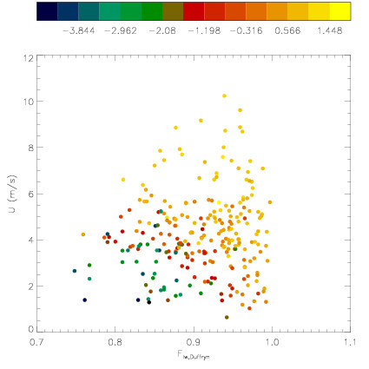

Cold pool intensity, ΔT vs. U, F_{lw}
Colour → ΔT
Contrast increases with decreasing U, F_{lw}
Sharp change in ΔT

Slide 58

Decoupling - Duffryn
Colour → log(NH/U)
log(NH/U) tightly correlated with U, F_{lw}
Enough scatter to study independent effect of NH/U on ΔT?
Sharp change in ΔT is at NH/U > 0.4

Slide 59


Decoupling - Duffryn
Colour → F_{lw}
Observed ΔT diverges later than in model
NH/U for decoupling also larger?

Slide 60
Decoupling – valley depth
Vosper and Brown (2008) vary valley depth for given ambient conditions
Clun (Duffryn) and Burfield valleys have different depths (and shapes!)
Look for decoupling at:
  Neither location
  Duffryn only
  Both Duffryn and Burfield
Springhill
Δθ
~90m
NH/U
Burfield
~150m
Duffryn (Clun)
H_{c}

Slide 61
Initial MetUM setup:
COLPEX_100
100 m (0.0009 degree rotated lat/long) horizontal resolution over 30 km square.
Variable resolution outside stretching (5.5%) to 1.5 km. (412x412 domain covering ~100 km square).
70 levels, 5 s timestep (both might need improvement).
3D Smagorinsky, LEM stability functions, Cs-0.15. Dry static adjustment above level 30.
RHcrit=0.99 in first 10 layers then gradual increase – 0.9 above level 30.

Slide 62







COLPEX_100 Land Use
Deciduous Trees
Coniferous Trees
C3 Grass
Shrubs
Source:
CEH
LCM1990
25 m
Landsat-based.
Urban
Lakes
Bare Soil

Slide 63
Run configuration
Free run interior. New LBCs every 4 km analysis/short forecast.
1.5 km reference reconfigured from analysis every 3 h.
Why free run?
  Purpose of model is physics response to best larger scale forcing.
  Soil temperature / moisture free to evolve properly.
  No spin-up issues (risk with soil moisture – consider nudge).
Free run 1.5 km reference too?

Slide 64


Example case study
14-15 October 2009

Slide 65


Comparison with 1.5 km
Note – not synchronised

