Slide 1
Jet streams and persistent mid-latitude weather
Department of Meteorology
John Methven,
Department of Meteorology,
University of Reading
Thanks to Mike Blackburn , Hans de Leeuw and Ben Harvey

Slide 2
Outline
Wet summers for England & Wales in the last decade
Relation to undulations of the westerly jet stream
Rossby (1940) – potential vorticity and Rossby waves
Prediction of Rossby waves and systematic errors
Research outlook

Slide 3
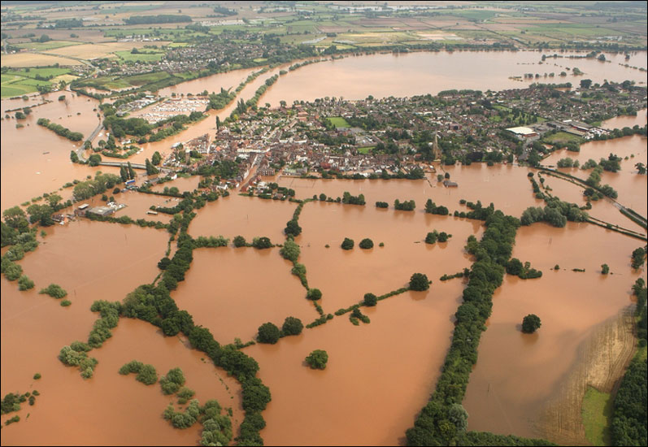
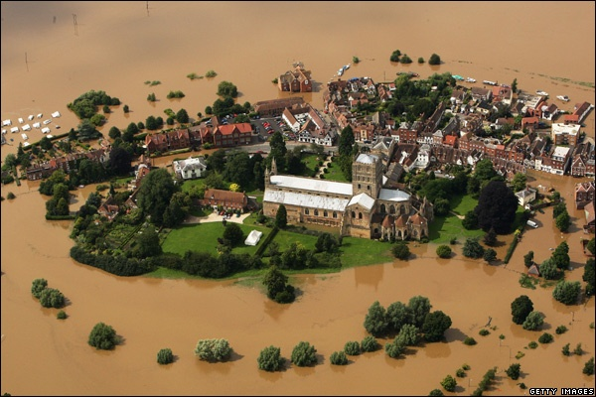
High impact weather
Dominated by flooding or wind damage
Summer 2007 flooding described as “largest peacetime emergency since World War II” (Sir Michael Pitt, 2008)
48,000 households flooded
350,000 people without fresh water supplies (Gloucestershire)
42,000 acres of agricultural land flooded
Total cost to UK economy ~ £3.2 billion (Environment Agency, Jan 2010)
SUMMER 2007 FLOODS
Notes:
3

Slide 4
Number of days per year with extreme England-Wales precipitation (EWP) total
Extremes here defined as wettest 2% of days on record.
Derived from EWP index – based on rain gauge network.

Slide 5
Number of extreme 5-day rainfall accumulation events per year
Indicates that persistence has been unusual in last decade or so
Autumn 2000, summer 2007 & 2008, summer+Dec 2012!
(De Leeuw, Methven & Blackburn, Int. J. Clim., 2015)

Slide 6
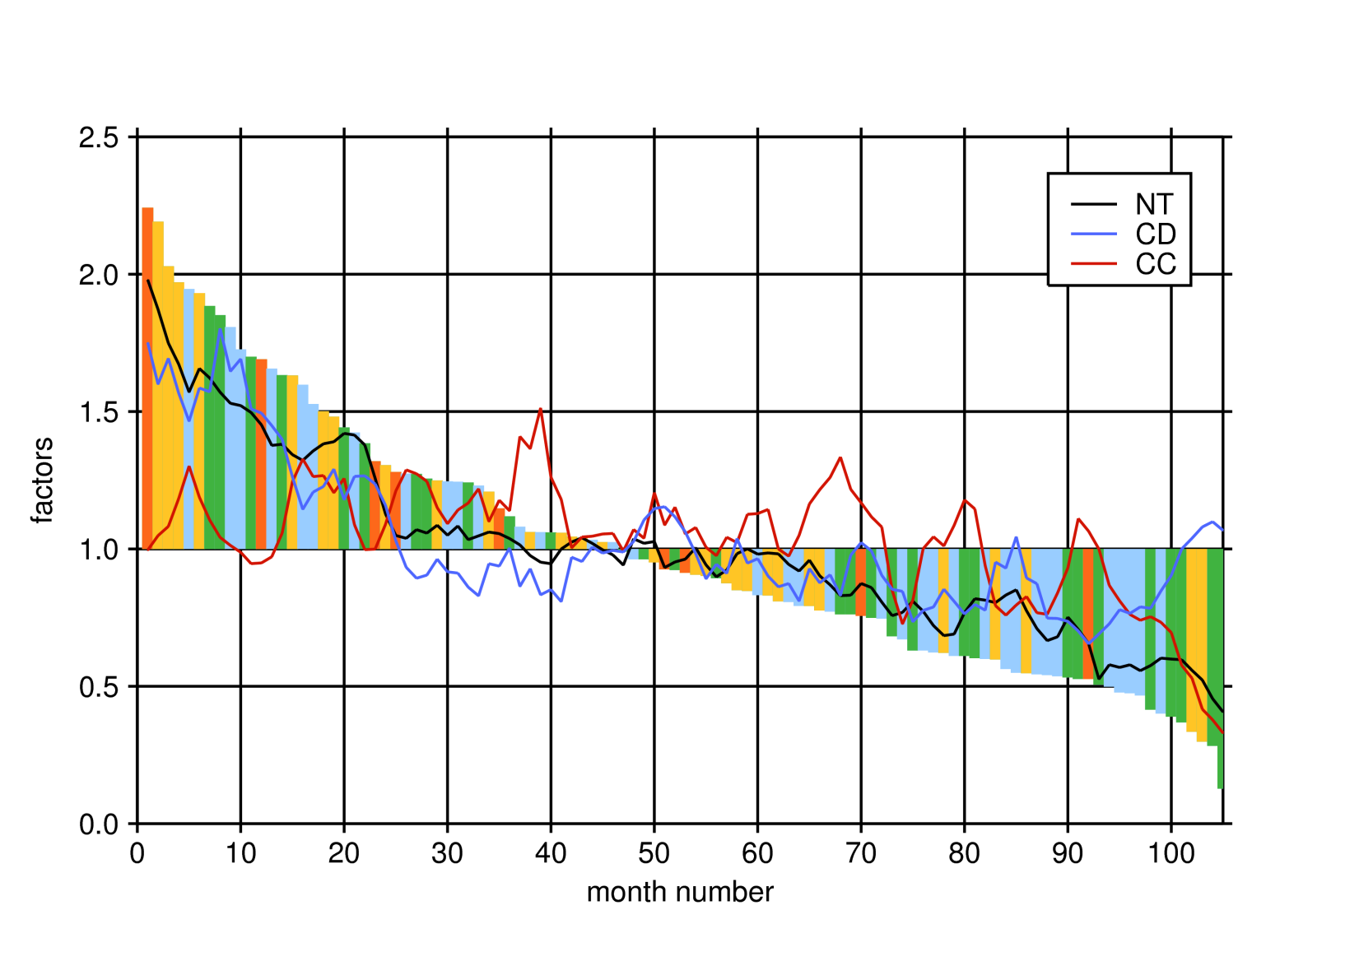
Ranked monthly precipitation (summer only) blue 1980s, green 1990s, yellow 2000s, orange 2010s
cyclone duration
cyclone count (relative to average)
Wettest summer months related to duration of cyclone rainfall events
SSTs anomalously cold at airmass origins in wettest months
(Hans de Leeuw, PhD thesis, 2015)

Slide 7
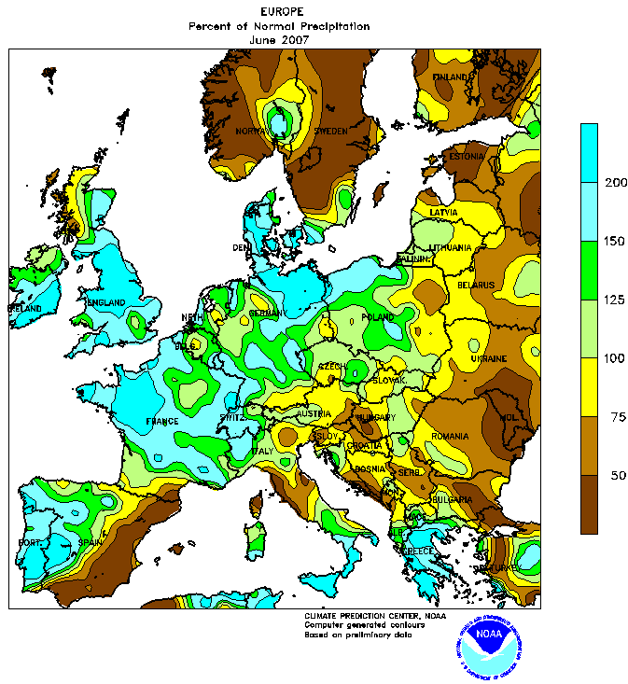
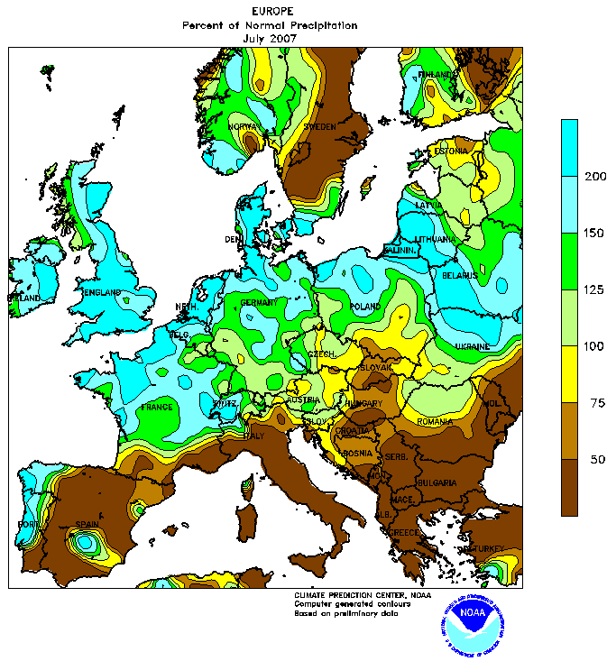
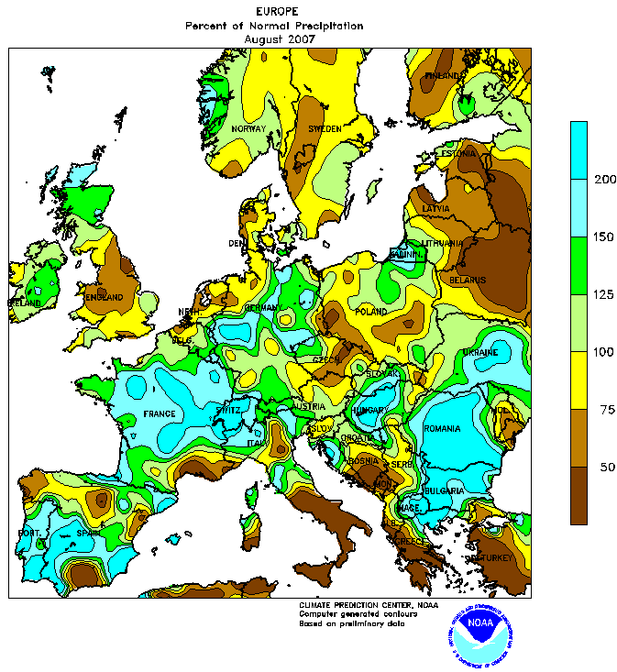
Summer 2007
European precipitation anomalies (% of 1961-1990 average)
Floods in NW Europe, wildfires in SE Europe
Both linked to stationary wave pattern on the jet stream
June
July
August
Blackburn, Methven and Roberts (2008), Weather

Slide 8
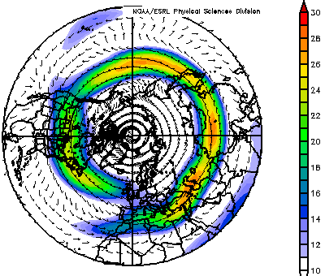
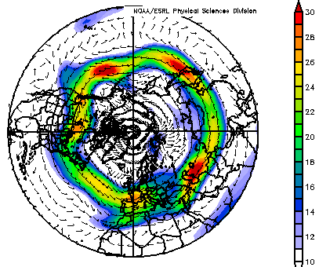
Jet stream in June and July
colours show average wind speed at the level of the jet stream (250 hPa)
(arrows show wind speed and direction)
Averages for 12 June to 25 July
Climatology for years 1968-1996
2007

Slide 9
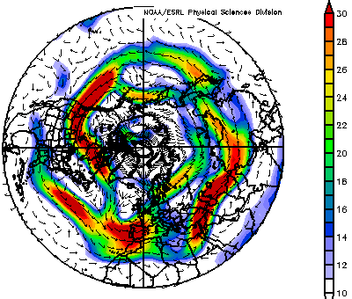
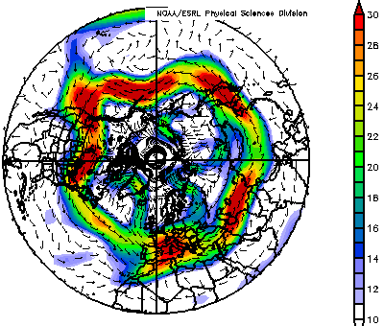
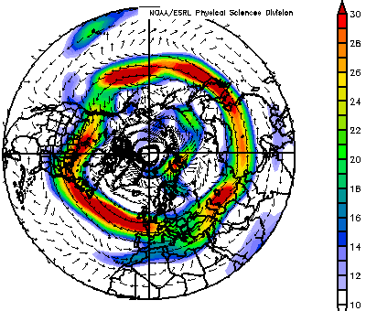
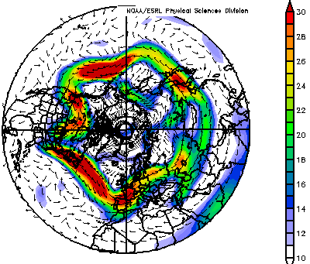
Jet stream in June-July 2007 – four intervals
12-20 June 2007
20-30 June 2007
m/s
m/s
01-15 July 2007
15-25 July 2007
m/s
m/s

Slide 10
Rossby waves on the jet stream
Rossby (1940), Q. J. Roy. Met. Soc.
Pattern deduced from consideration of potential vorticity structure in fairly weak westerly jet stream
ERA-Interim analysis produced by data assimilation blending global numerical model with global data (satellites, surface sites, sondes, …)

Slide 11
Rossby waves on the jet stream
Remarks on Rossby (1940)
The term “potential vorticity” was introduced, although the derivation of the conserved quantity for hydrostatic, shallow water equations is in Rossby (1936)
Extended to stratified flow in Rossby (1938)
Purpose of the 1940 paper is to explain quasi-stationary “centres of action” in the westerly flow
The motivation for illustrating wavenumber 6 in relatively weak westerly flow is not given
Rossby (1940), Q. J. Roy. Met. Soc.
Pattern deduced from consideration of potential vorticity structure in fairly weak westerly jet stream

Slide 12
Potential vorticity
Rossby (1940) considered evolution of vorticity (spin about a point) in a layer of fluid
Crucial aspect: stretching of vortex tubes, when layer depth (D) increases, spins up fluid such that a quantity P is conserved:
where $P=\frac{f+ξ}{D}$ (now called potential vorticity)
“…vorticity the air column would have if it were brought, isopycnically or isentropically, to a standard latitude ($f_{0})$ and stretched or shrunk vertically to a standard depth ($D_{0})$ or weight $\left(Δ_{0}\right).$”
Shallow water example in northern hemisphere ($f_{0}>0)$
D₀
ξ₀
D
ξ

Slide 13
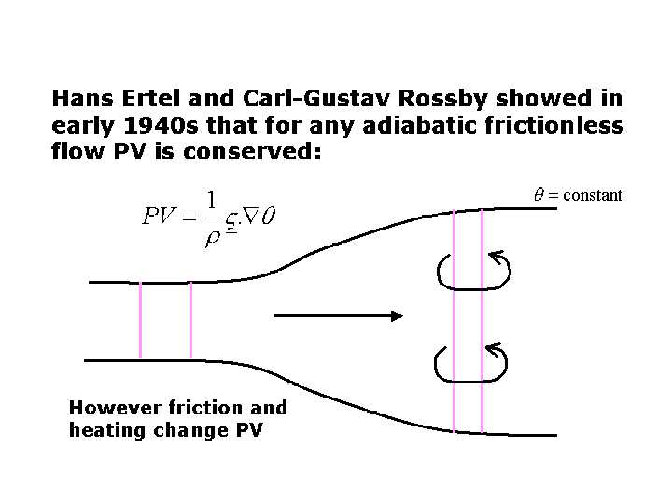
PV in stratified flow
Consider a fluid column of mass δM enclosed by the material contour of area δS within an isentropic layer of depth δθ
Rossby-Ertel PV,
Component of absolute vorticity normal to isentropic surfaces
Isentropic density, $σ=−\frac{1}{g}\frac{δp}{δθ}$
Conservation of PV following air masses stems from conservation of mass and circulation (C)
δθ
δS

Slide 14
Rossby Waves
Rossby waves propagate on horizontal potential vorticity gradients.
High PV
$$\frac{∂\overline{P}}{∂y}>0$$
Low PV
Air displaced to south carries high PV and forms +ve anomaly P’
⇒ P’ > 0 induces cyclonic circulation
⇒ advects air southwards on western flank
⇒ wave pattern propagates westwards
Phase speed: ${ c}_{p}=\overline{u}−\frac{1}{k^{2}}\frac{∂\overline{P}}{∂y}$
Fig: Hoskins, McIntyre and Robertson (1985), Q. J. Roy. Met. Soc.

Slide 15
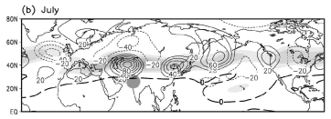
Dominant pattern of variability
Ding and Wang (2005), J. Climate
Leading pattern of variance (EOF) in geopotential height on 200 hPa surface for July.
6 +ve centres along jet stream (grey shading = zonal wind)
higher wavenumber than June or August (m=5)
NOTE: split jet in Atlantic in climatology disrupts pattern

Slide 16
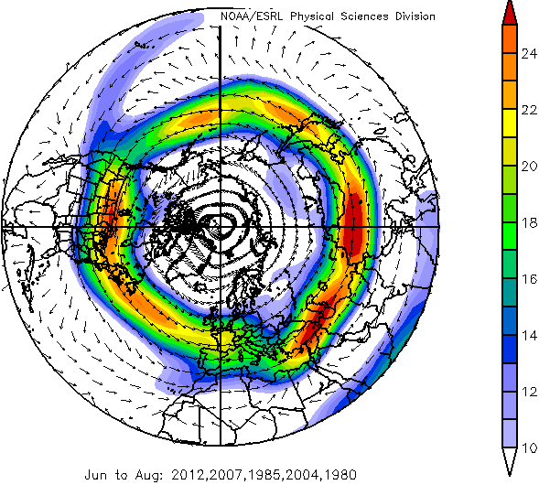
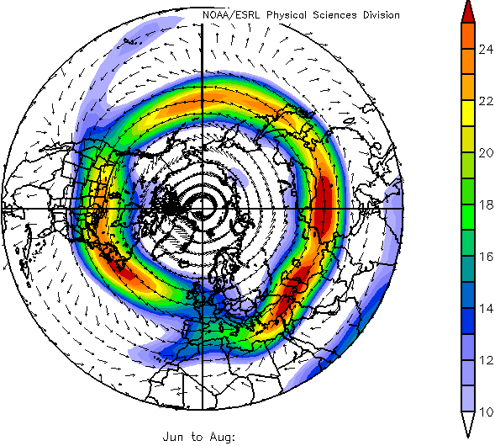
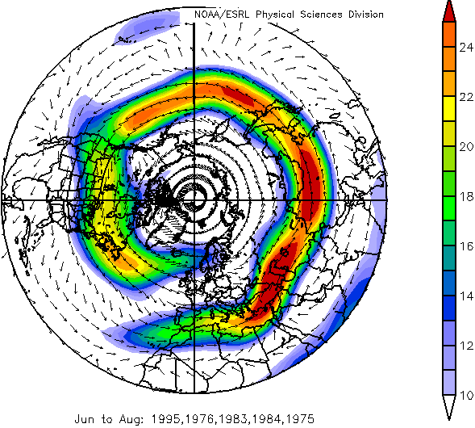
Relevance of jet states for summer precipitation anomalies
JJA seasonal composites: England-Wales Precipitation (EWP)
5 Wettest
Climatology
5 Driest
1981-2010
250hPa vector wind
NOAA ESRL
Notes:
NCEP Reanalysis Z500; Hadley Centre EWP: 1960/61-2013/14
5-year seasonal composites computed at NOAA’s Climate Diagnostics Centre, using their website www.cdc.noaa.gov

Slide 17
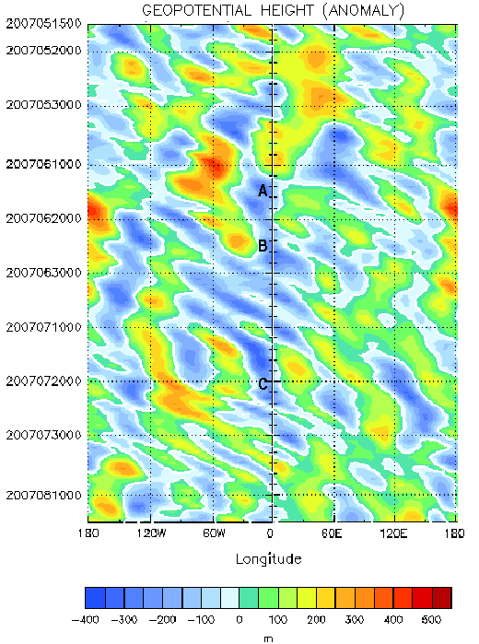
Large-scale evolution averaged 45-60N
Geopotential height anomaly on 250 hPa
15 June 2007
date
25 June 2007
20 July 2007

Slide 18
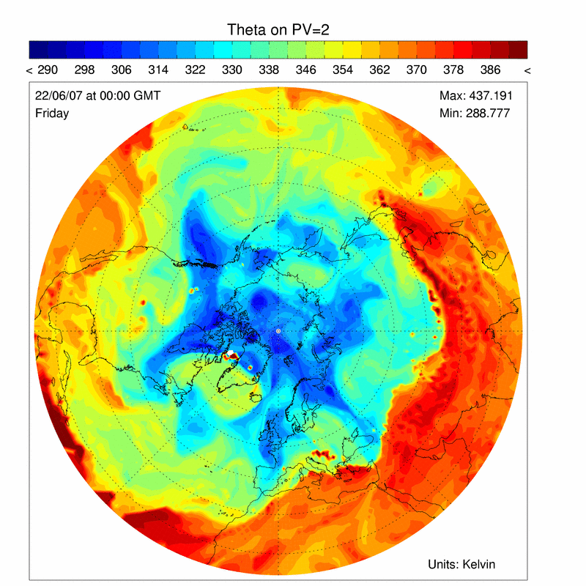
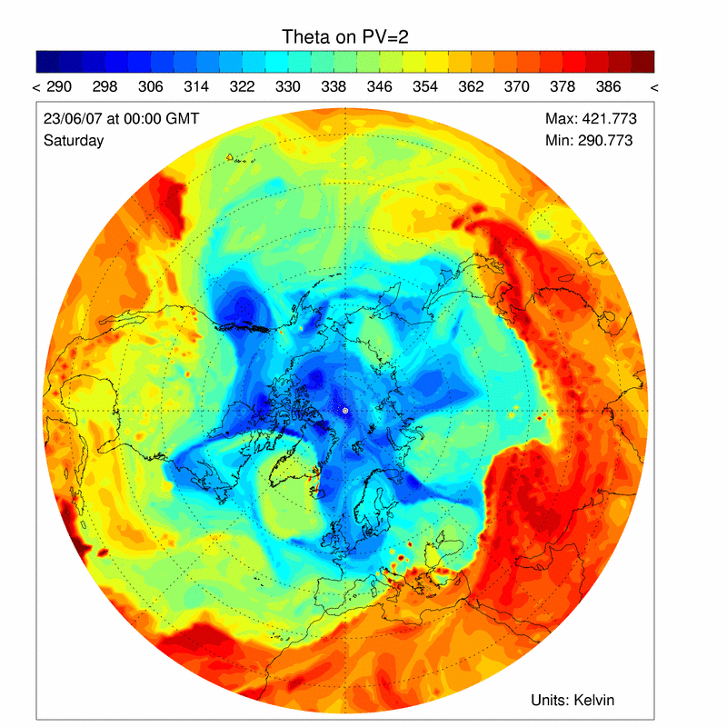
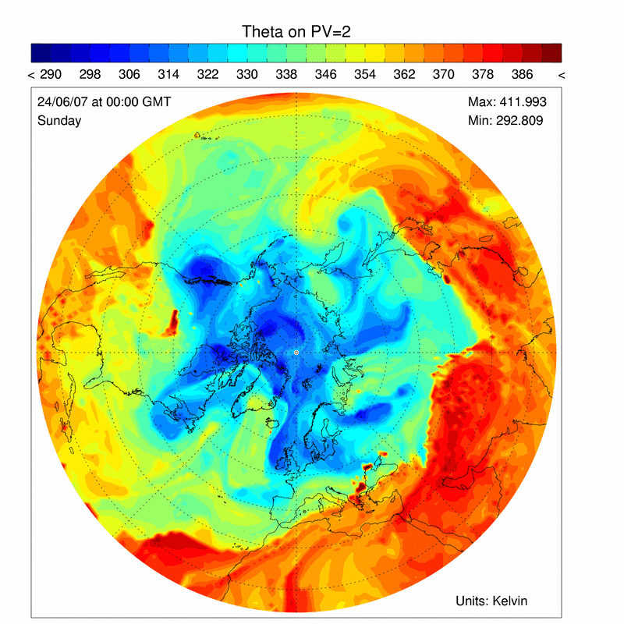
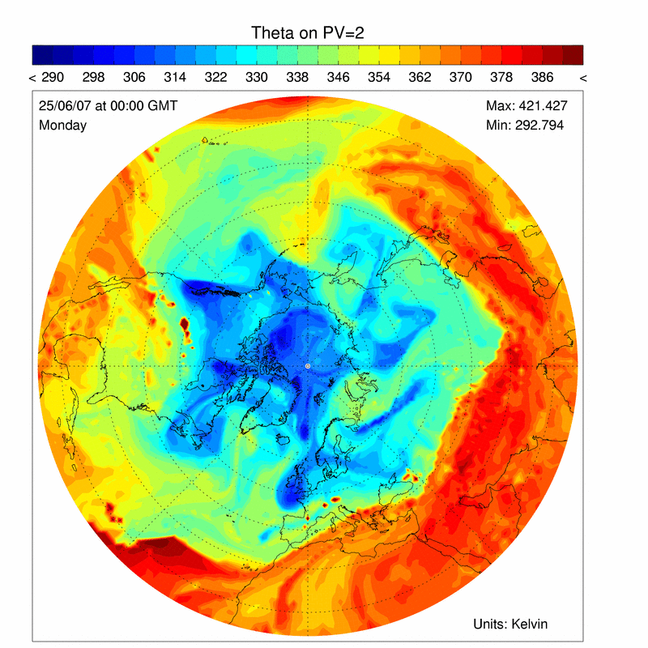
The second of 3 major UK rainfall events in summer 2007
₃
₃
₂
₂
₁
₁
Fri 22nd June 00 UTC
Sat 23rd 00 UTC
Rossby wave pattern on the tropopause
Trough “1” is stationary
₄
₅
₃
₃
₆
₂
₂
₇
₁
₁
Sun 24th 00 UTC
Mon 25th 00 UTC

Slide 19
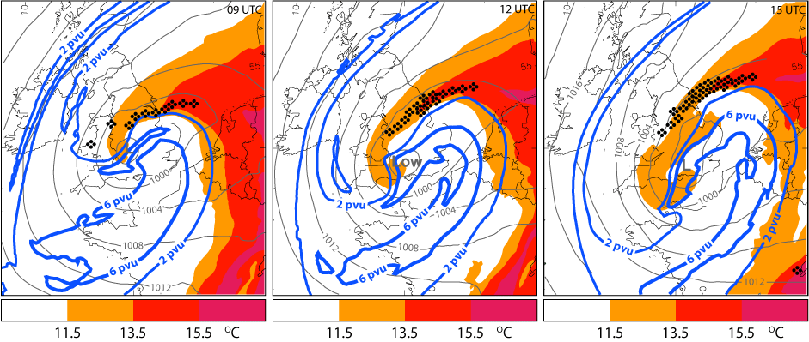
25th June rainfall event
Met Office forecast from 06UT (Nigel Roberts, MetOffice@reading)
PV on θ=315K
•
•
•
Heavy continuous rain
θ_{w} on 850hPa
•
msl pressure
∇
Heavy showers

Slide 20
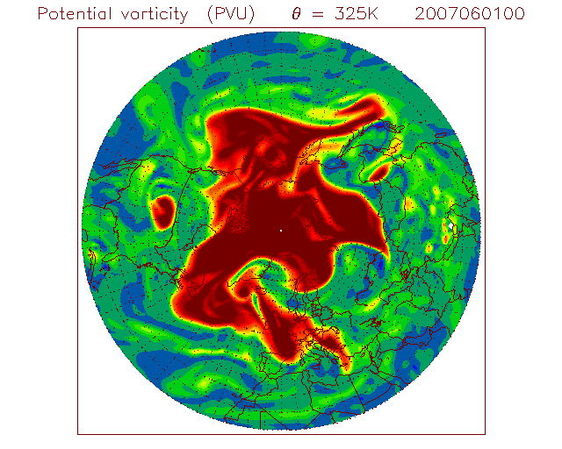
Rossby waves on the tropopause
Large amplitude “waves” are always present in the atmosphere.
Edge of the red patch represents undulations of the westerly jetstream.
Here movie shows frames every 6 hours for June and July 2007.
ERA-Interim re-analyses (T255, L60)

Slide 21
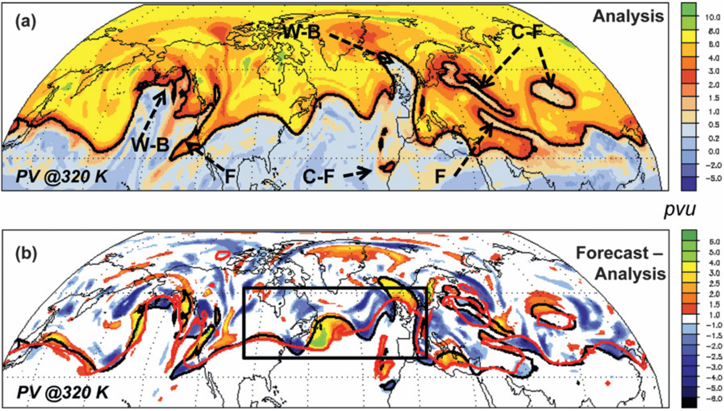
Rossby waves, forecast error and diabatic processes
Worst 100 forecast busts for Europe share a common pre-cursor Rossby wave pattern 6 days beforehand (Rodwell et al, BAMS, 2013)
Davies and Didone (2013)
PV forecast errors at 96 hr
Davies & Didone (2013, MWR) suggested that ridges are under-estimated. Rodwell hypothesis: Linked with mis-represented moist processes

Slide 22
Are there systematic forecast errors in tropopause structure?
Examine global forecasts from the TIGGE archive: ECMWF, Met Office and NCEP
PV on 320K potential temperature surface (forecasts compared with analyses from same centre)
Six winter seasons (December, January and February from 2006/7
Gray et al (2014), Geophys. Res. Lett.
Amplitude error
Location error
Notes:
THORPEX Interactive Grand Global Ensemble) archive
The TIGGE archive consists of global model ensemble forecast data from ten NWP centres, starting from October 2006: see http://tigge.ecmwf.int/

Slide 23
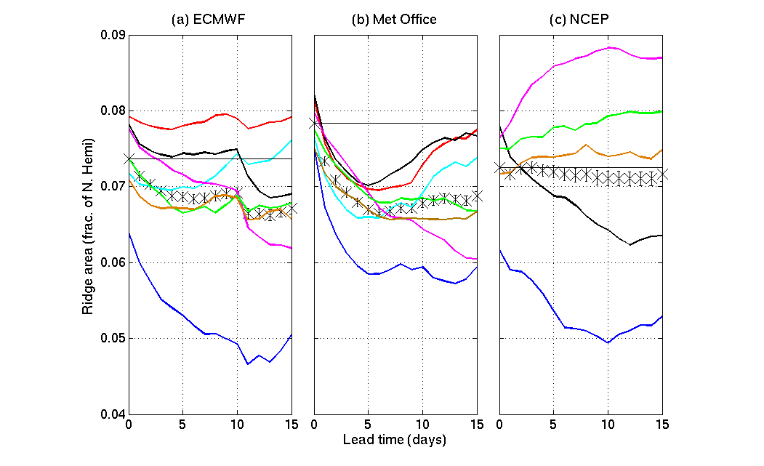
Forecasts of ridge area in Rossby waves
_{2.3x10}⁷ _{km}²
2006/7
2007/8
2008/9
2009/10
2010/11
2011/12
2012/13
Reduced forecast resolution after day 10
Gray, Dunning, Methven, Masato and Chagnon (2014), GRL

Slide 24
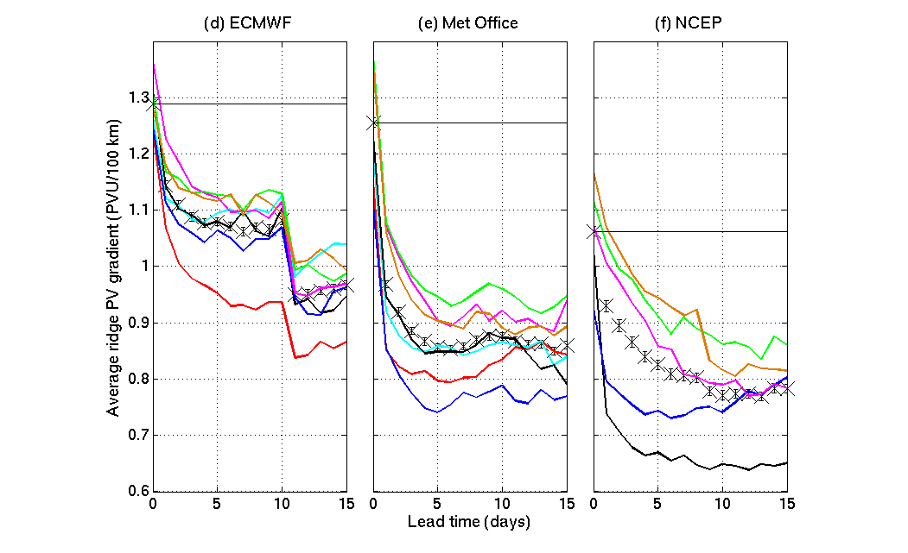
Forecast in horizontal PV gradient across the tropopause
2006/7
2007/8
2008/9
2009/10
2010/11
2011/12
2012/13

Slide 25
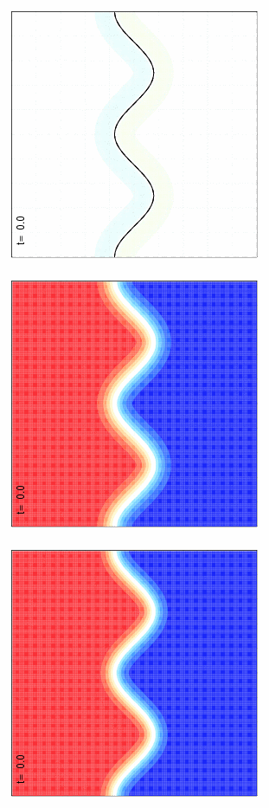
Does PV gradient sharpness matter?
QG shallow water (“equivalent barotropic”) equations:
$\frac{DP}{Dt}=0$ $P=f_{0}+∇^{2}ψ−ψ/L_{R}^{2}$
“analysis”
“forecast”
difference
high PV
high PV
low PV
low PV
$$r_{0}≈308 km$$
$$r_{0}≈381 km$$
Use: $L_{R}=700 km$

Slide 26
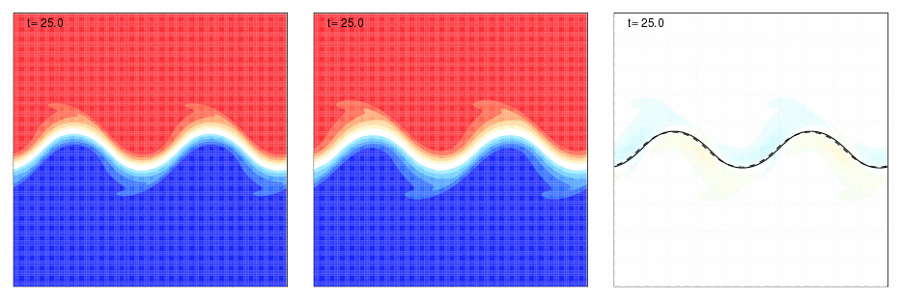
A simple simulation
QG shallow water (“equivalent barotropic”) equations:
$\frac{DP}{Dt}=0$ $P=f_{0}+∇^{2}ψ−ψ/L_{R}^{2}$
“analysis”
“forecast”
difference
high PV
high PV
low PV
low PV
$$r_{0}≈308 km$$
$$r_{0}≈381 km$$
Use: $L_{R}=700 km$

Slide 27
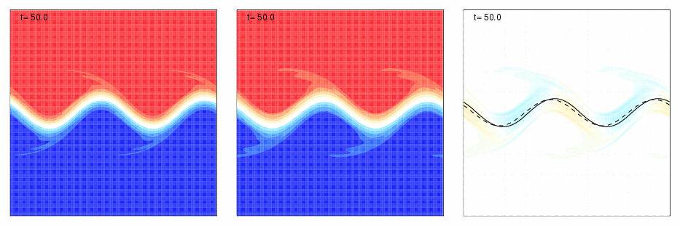
A simple simulation
QG shallow water (“equivalent barotropic”) equations:
$\frac{DP}{Dt}=0$ $P=f_{0}+∇^{2}ψ−ψ/L_{R}^{2}$
“analysis”
“forecast”
difference
high PV
high PV
low PV
low PV
$$r_{0}≈308 km$$
$$r_{0}≈381 km$$
Use: $L_{R}=700 km$

Slide 28
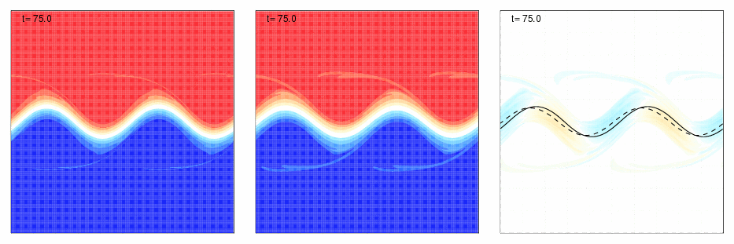
A simple simulation
QG shallow water (“equivalent barotropic”) equations:
$\frac{DP}{Dt}=0$ $P=f_{0}+∇^{2}ψ−ψ/L_{R}^{2}$
“analysis”
“forecast”
difference
high PV
high PV
low PV
low PV
$$r_{0}≈308 km$$
$$r_{0}≈381 km$$
Use: $L_{R}=700 km$

Slide 29
A simple simulation
QG shallow water (“equivalent barotropic”) equations:
$\frac{DP}{Dt}=0$ $P=f_{0}+∇^{2}ψ−ψ/L_{R}^{2}$
“analysis”
“forecast”
difference
high PV
high PV
Phase speed error
Amplitude error
low PV
low PV
$$r_{0}≈308 km$$
$$r_{0}≈381 km$$
Use: $L_{R}=700 km$

Slide 30
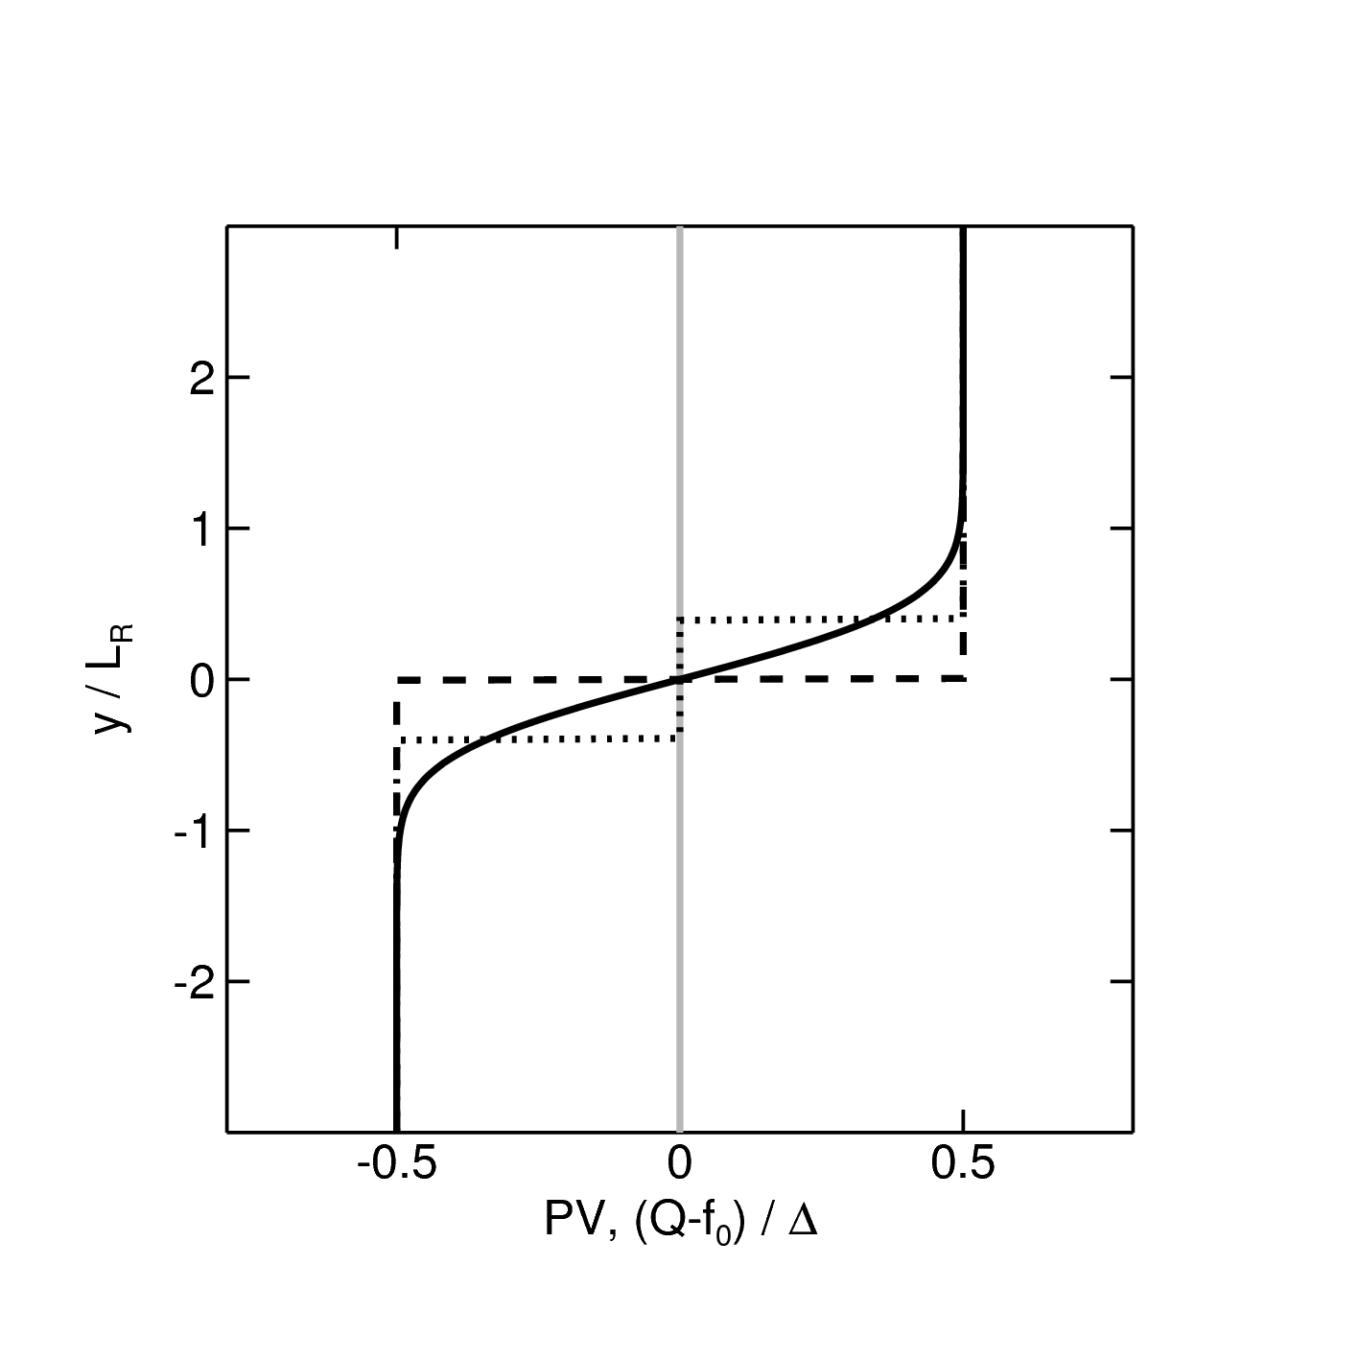
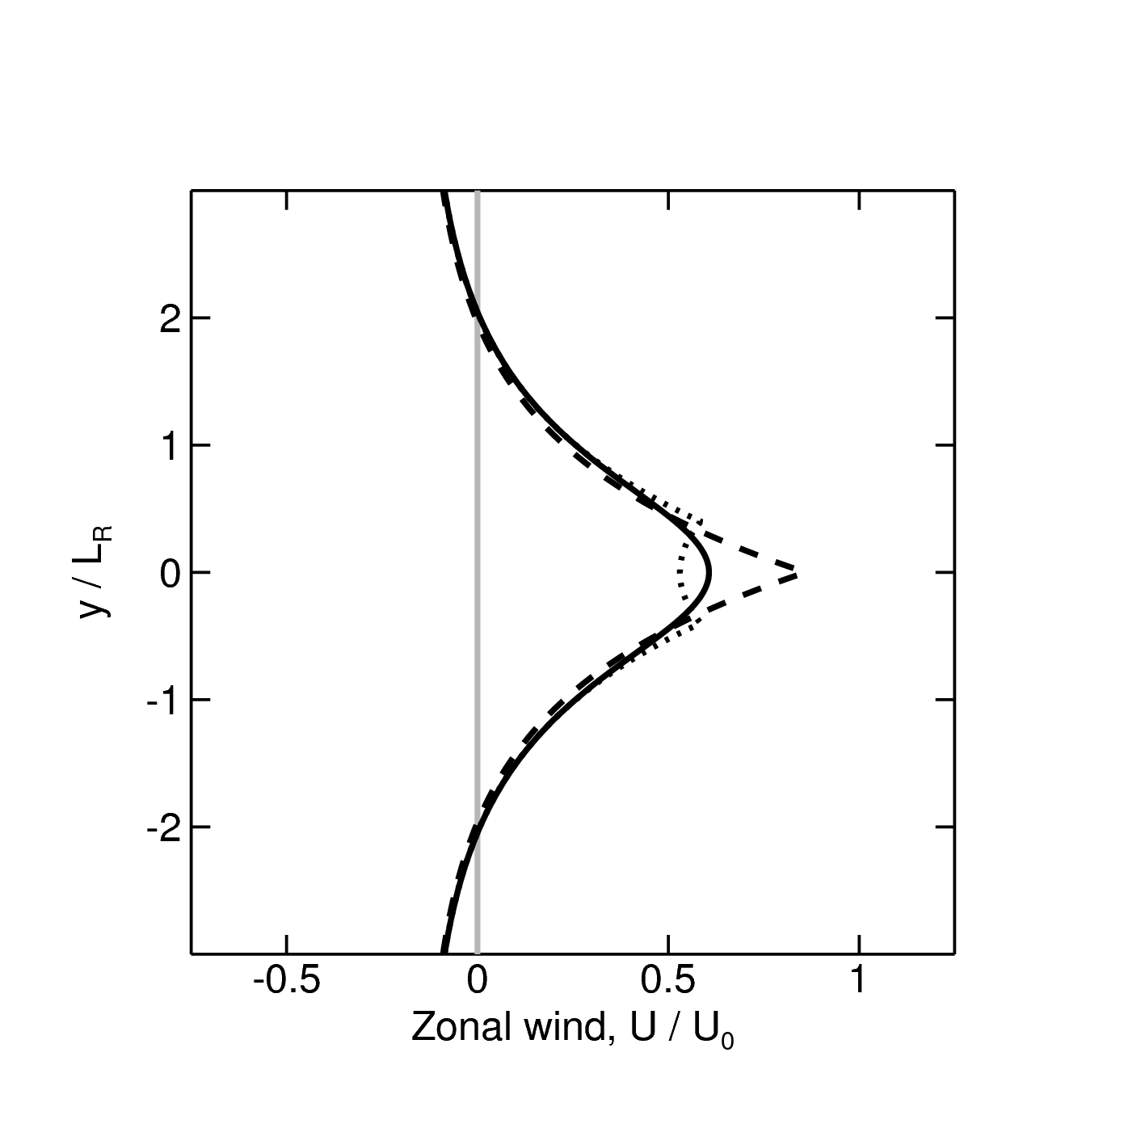
RW propagation on smooth PV step
Single step in PV is smoothed by convolution with a weight.
Solution obtained in limit where tropopause width is narrow compared with wavelength (${kr}_{0}≪1$)
General conclusion: smoothing PV gradient reduces both jet maximum and counter-propagation rate … but jet decrease is greater
phase speed reduces
affects shorter waves more, increasing dispersion
PV
U
latitude
latitude
$$r_{0}$$
Dots = numerical simulation
Speeds
$$c_{m}(k)$$
Jet speed
RW speed
Harvey (submitted to J. F. Mech.)
Smoothing width, $r_{0}/L_{R}$

Slide 31
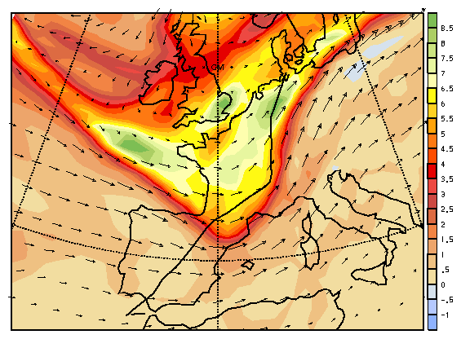
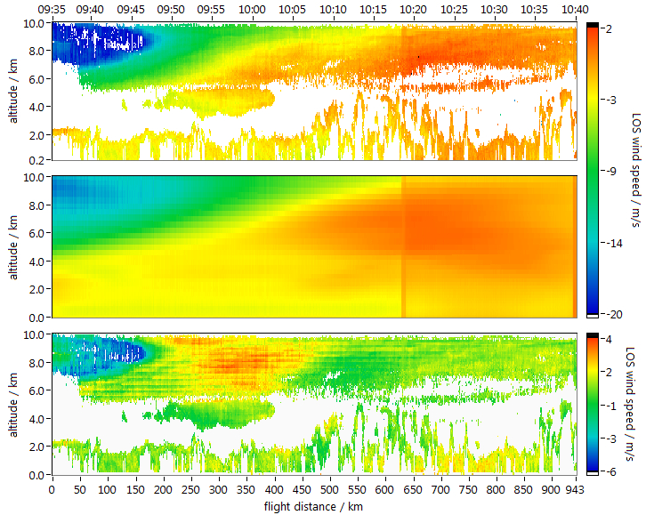
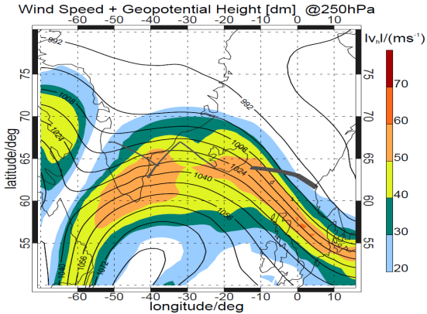
Aircraft observations of jet-level winds
Observed jet stream
Error > 15 m/s
Sharpness of tropopause PV gradient and jet maximum is not well observed.
In situ aircraft flights usually at one level.
Very few flights with high resolution vertical profiling to characterise jet stream structure.
Role of diabatic processes in sharpening tropopause has not been quantified.
Aircraft obs ECMWF analysis NCEP analysis
from Sandro Buss & Huw C. Davies
PhD Thesis, Uwe Marksteiner (DLR)
airborne wind lidar
ECMWF analysis

Slide 32
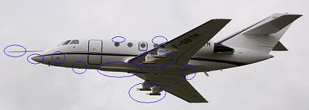
Airborne research facilities
DLR HALO
DLR Falcon
Meteorological fields to be measured/deduced:
wind components
humidity
liquid/ice water content
nature of hydrometeors
radiative fluxes
SAFIRE Falcon
In-situ sondes
Radar-Lidar platform
Drop sondes

Slide 33
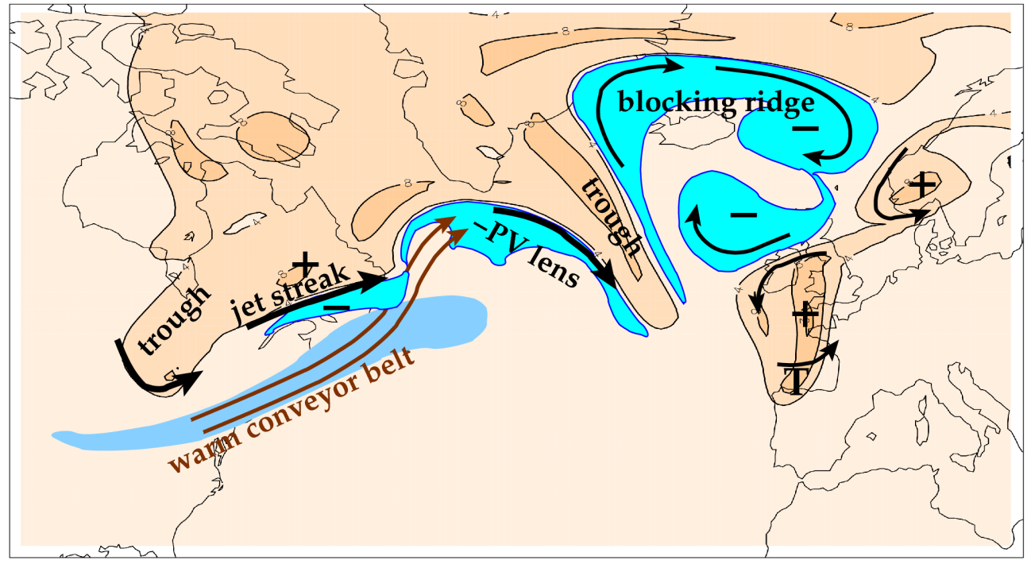
North Atlantic Waveguide and Downstream Impacts Experiment (NAWDEX)
Overarching scientific aim of NAWDEX: to increase the physical understanding and to quantify the effects of diabatic processes on disturbances to the jet stream near North America, their influence on downstream propagation across the North Atlantic, and consequences for high-impact weather in Europe.
NAWDEX (autumn 2016) http://www.nawdex.org

Slide 34
Conclusions
In the last decade England and Wales has experienced extreme monthly rainfall ↔ anomalous cyclone duration
Related to persistent patterns on the westerly jet stream with a trough over the British Isles
Identified with near-stationary Rossby waves (Rossby, 1940)
Systematic errors identified in Rossby wave forecasts
tropopause sharpness and strength of PV contrast
role of diabatic processes (both LHR and radiative effects of water vapour and cloud)
Addressed by NAWDEX, autumn 2016

Slide 35
Thankyou for your attention

Slide 36
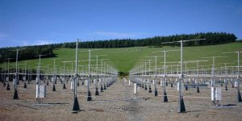
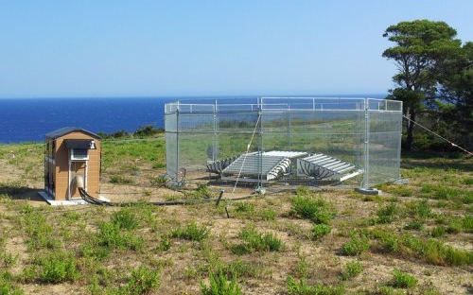
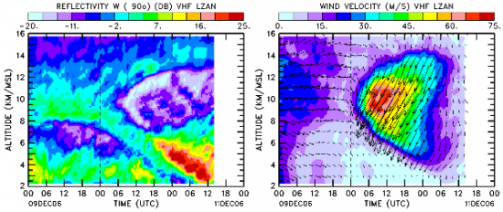
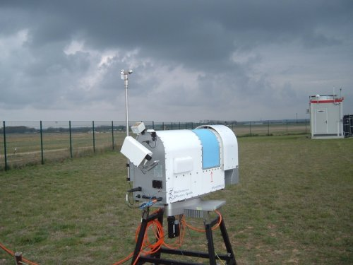
Ground-based observations
Deep wind profilers VHF (Stratosphere-troposphere radars)
Shallower wind profilers UHF
Microwave radiometers
Doppler radar network
Enhanced radiosonde obs

Slide 37
Diabatic PV near the tropopause
LW cooling max at tropopause (humidity step)
“diabatic PV dipole” but little direct PV change at tropopause
enhances tropopause PV gradient & jet strength
⇒ would be influenced by cirrus just under tropopause
Diabatic PV enhances PV anomaly pattern of Rossby wave
greater westward propagation and enhanced baroclinic interaction
influence on medium-range forecasts?
Chagnon, Gray and Methven (2013), QJRMetS

Slide 38
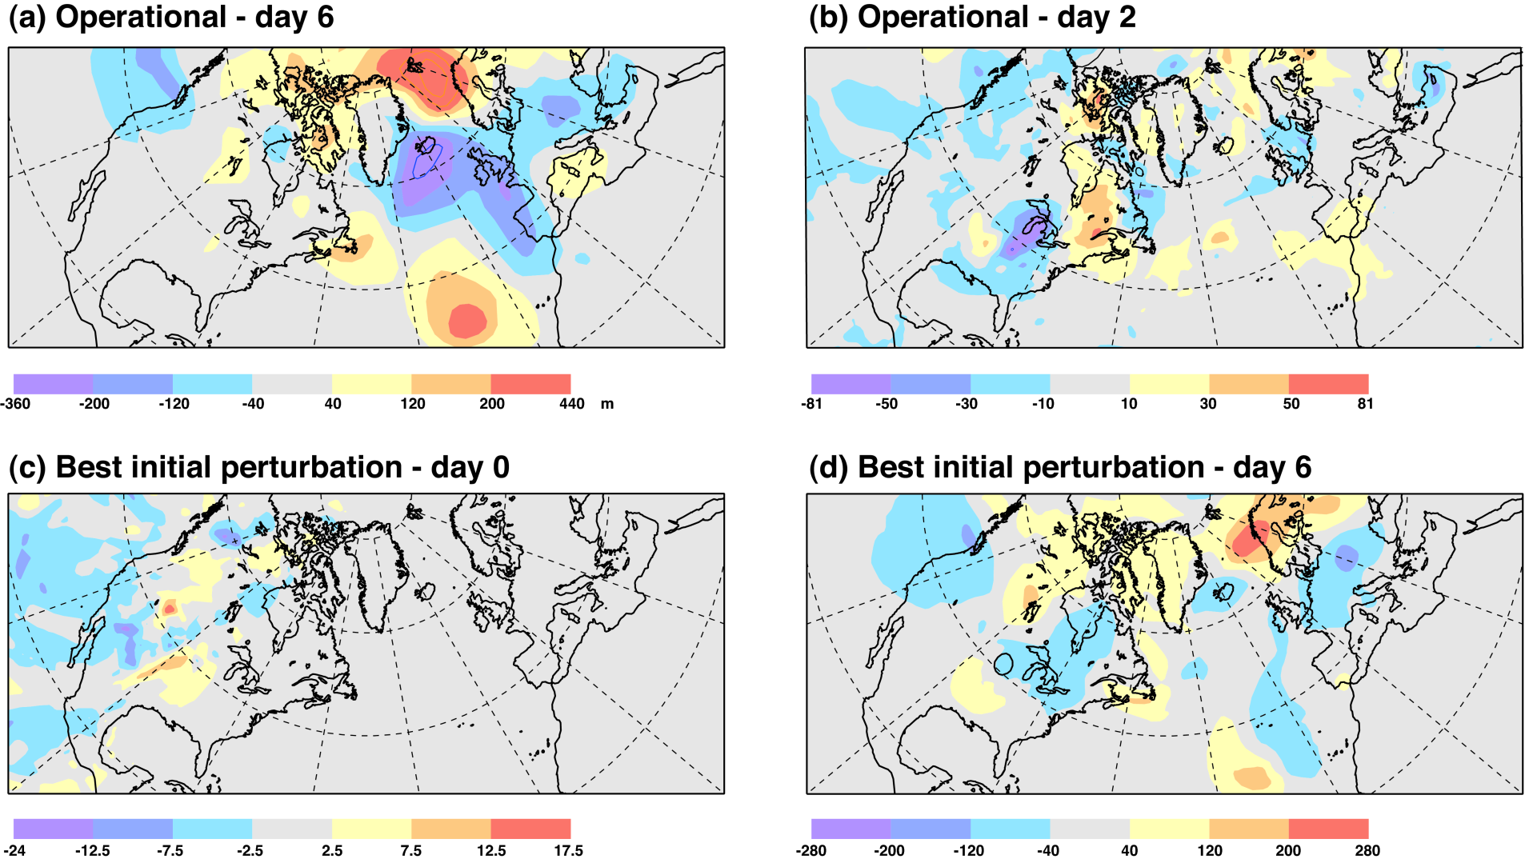
Tracing errors back to initial time
from Mark Rodwell
Z500 from forecasts started at 0000 UTC on 10 April 2011
Linus Magnusson
Can trace large European day 6 errors back to North America at day 2 of forecast.
‘best’ ensemble member results in smaller day 6 European error but similar structure.

Slide 39
10 April: Rockies trough with CAPE & MCS ahead
from Mark Rodwell
Z500 and CAPE anomaly
12-hr Radar-observed precipitation
Shade unit = 100Jkg⁻¹
30ms⁻¹
Unit = mm
Trough
CAPE
MCS
Contour Interval = 100m
Z500 at 0UTC, CAPE at 6UTC (T+6), 12hr ‘NEXRAD’ Radar precipitation accumulated to 9 UTC.
‘MCS’ is Mesoscale Convective System

Slide 40
Ensemble of data assimilations, EDA
from Mark Rodwell
10 April T200 mean & spread
First-guesses T+12hr
Analyses
MCS magnifies spread in first-guess
New data reduces spread
Rodwell et al. (2013)
Key question: Is the final analysis spread too large or too small to correctly reflect the predictability of the subsequent flow? Data: Temperature at 200 hPa from 10-member EDA, valid at 6UTC.

Slide 41
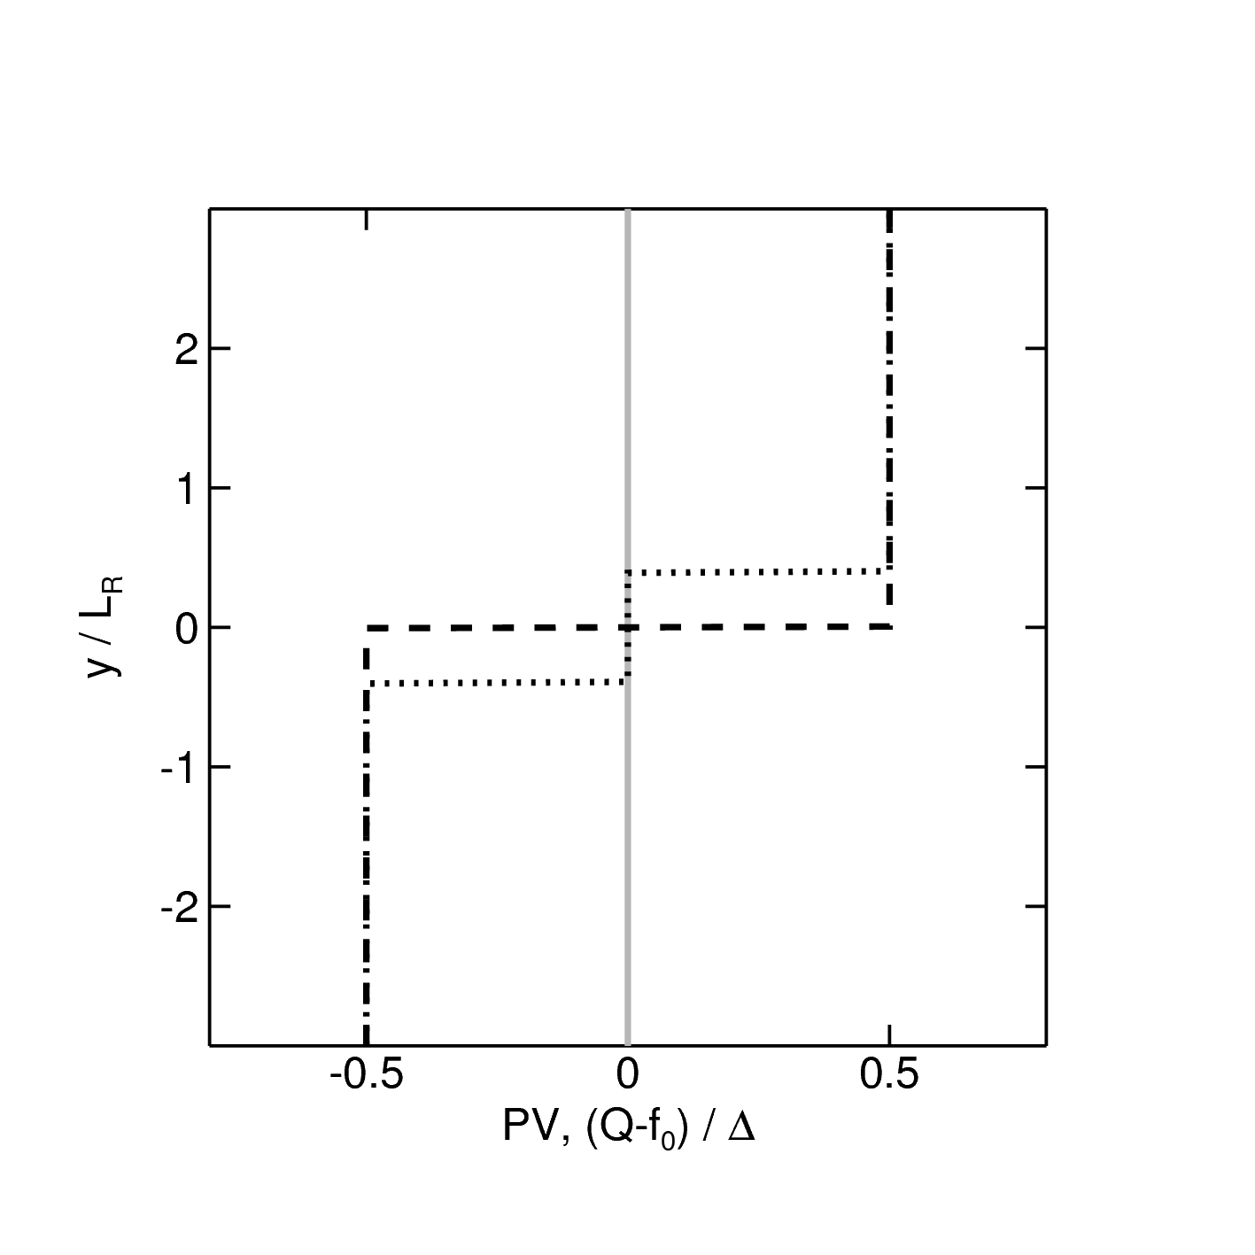
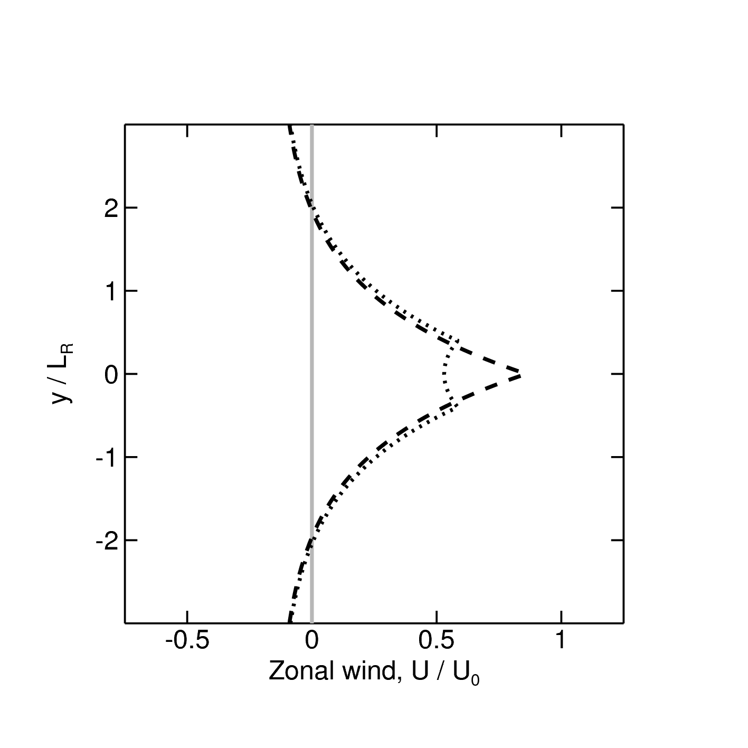
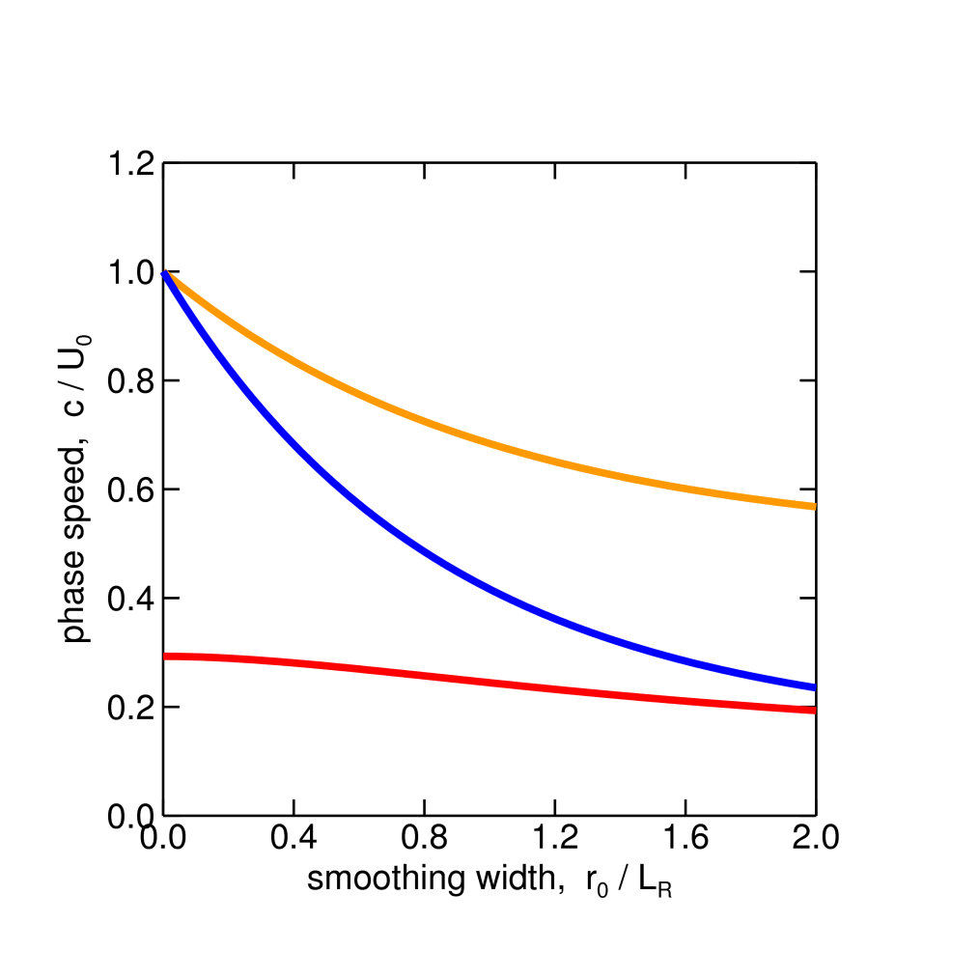
RW propagation – double PV step
Solution for double PV step:
$c_{}$ decreases as the front is smoothed
However, the effect is weak for meander mode:
there is a leading-order cancellation between reduction in advection and in counter-propagation:
$$c(k)=U_{adv}−c_{int}(k)$$
PV
U
latitude
latitude
$$r_{0}$$
Jet max
Jet streak or “Internal mode”
Speeds
$$c_{i}(k)$$
Meander mode
$$c_{m}(k)$$
Smoothing width, $r_{0}/L_{R}$

