Slide 1
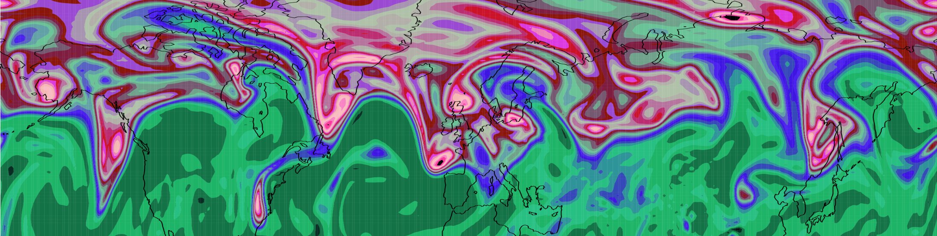
Mechanisms for Diabatic Influence on the Jet Stream and Obs Evidence
Department of Meteorology
John Methven, Ben Harvey, Leo Saffin, Jake Bland,
Sue Gray & Maarten Ambaum
Department of Meteorology, University of Reading
Andreas Schäfler, DLR
Claudio Sanchez, Met Office

Slide 2
Talk Outline
Fundamental dynamics of jet streams and Rossby waves
What is out there? Does the jet stream structure differ from its representation in models (and analyses)?
What are the ramifications for forecast errors?
What are the chief mechanisms enabling diabatic influence on the dynamics of jet streams and Rossby waves?

Slide 3
Jet Stream and Rossby Waves
Focus on jet streams at tropopause level
westerly on average around the extratropics
highly meandering and variable
often “split jet regions” with more than one
Why is there so much wave activity on the jet stream?
jet maximum = strong potential vorticity (PV) gradient
Rossby waves propagate on PV gradients
Shear instability grows through Rossby wave interaction
These unstable waves develop vortices at large amplitude
Origin of cyclones and anti-cyclones

Slide 4
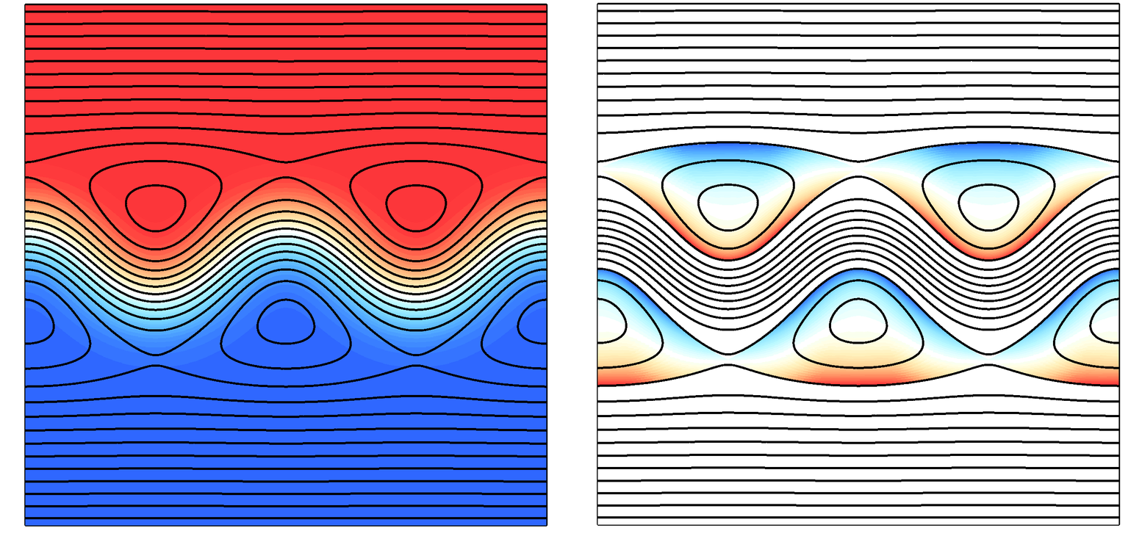
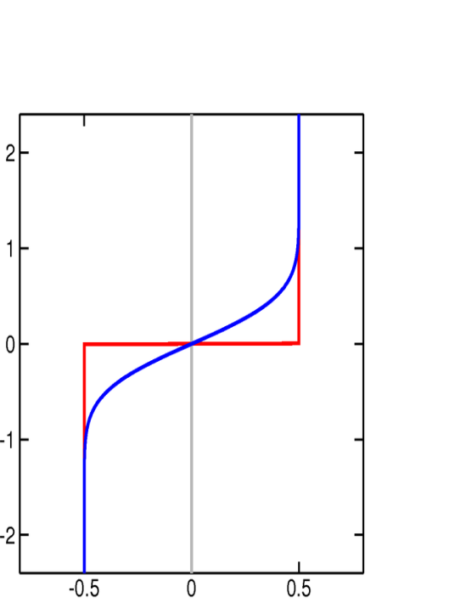
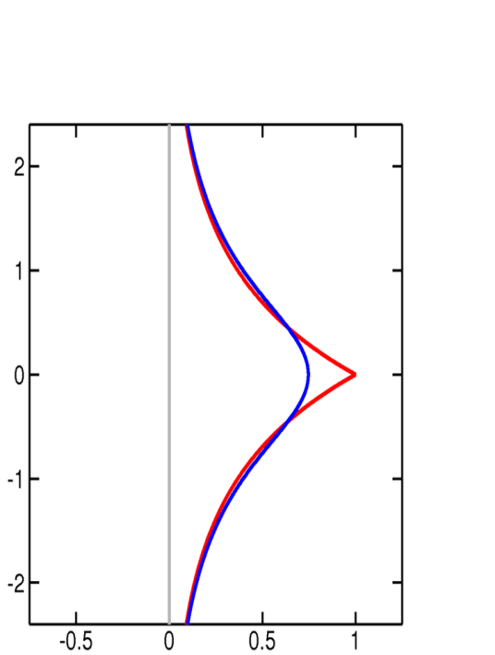
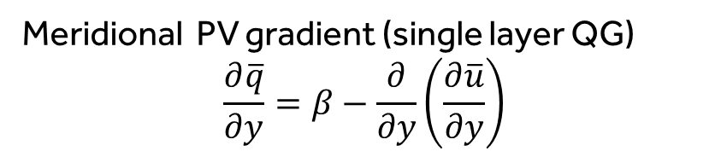
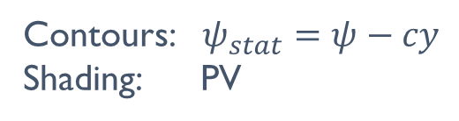


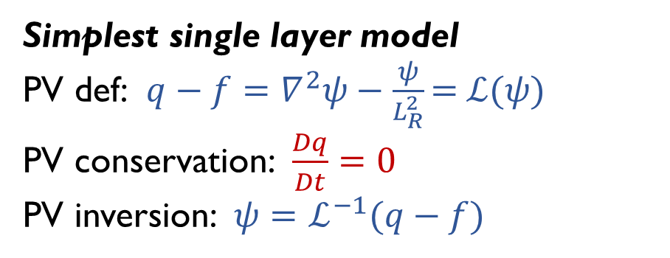
Jet maximum on PV gradient
Simplest single layer model
PV def: $q−f=∇^{2}ψ−\frac{ψ}{L_{R}^{2}}\text{=} ℒ(ψ\text{)}$
PV conservation:$\frac{Dq}{Dt}=0$
PV inversion: $ψ=ℒ^{−1}(q−f)$
Contours: $ψ_{stat}=ψ−cy$
Shading: PV
PV
u
+
+
$$r$$
Latitude
Latitude
-
-
-
$$Δq$$
Meridional PV gradient (single layer QG)
$$\frac{∂\overline{q}}{∂y}=β−\frac{∂}{∂y}\left(\frac{∂\overline{u}}{∂y}\right)$$
meandering jet

Slide 5
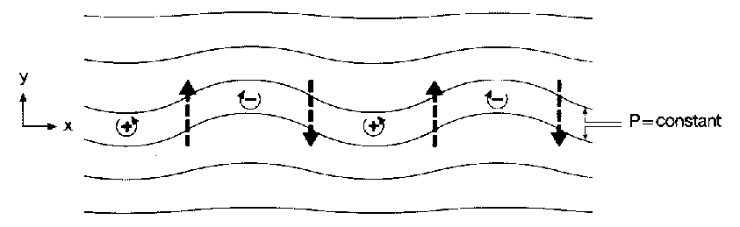
Rossby Wave Propagation
Rossby waves propagate on horizontal PV gradients.
High vorticity
Low vorticity
Air displaced to south carries high vorticity and forms +ve q’
⇒ q’>0 induces cyclonic circulation
⇒ advects air southwards on western flank
⇒ wave pattern propagates westwards
Phase speed:
Fig: Hoskins, McIntyre and Robertson (1985), Q. J. Royal Met. Soc.

Slide 6
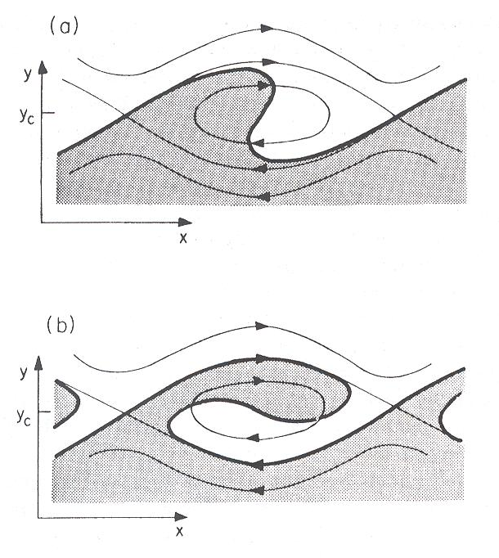
Rossby wave breaking
Theory so far for small amplitude waves (small wave slope).
At large amplitude PV waves are deformed irreversibly by shear.
A Rossby wave critical layer exhibits a wave breaking paradigm.
Viewed from frame moving with phase speed of wave:
Streamfunction has cat’s eye pattern.
Outside cat’s eye PV ≈ parallel to streamlines.
PV contours crossing hyperbolic points (by extra perturbation) are wrapped within cat’s eye.
From Andrews et al [1987] after Haynes [1985].

Slide 7
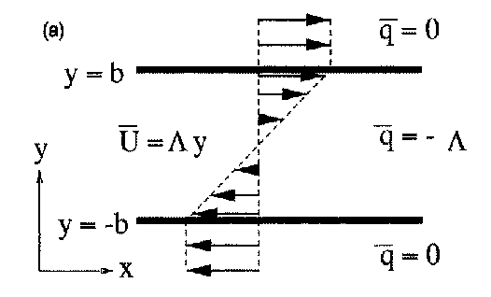
Shear Instability
Shear flows are often found to be unstable.
Small perturbations grow at exponential rate.
Lord Rayleigh considered the growth of waves as the transition to turbulence and explained growth for the simple flow below:
vorticity strip
Vorticity is piecewise constant ⇒ gradients are concentrated into two spikes: +ve at y=b and –ve at y=-b.

Slide 8

Roll-up of a vorticity strip.
Watch axi-symmetrisation happen as filamentation on edges of vortices progresses
Ben Harvey, University of Reading

Slide 9
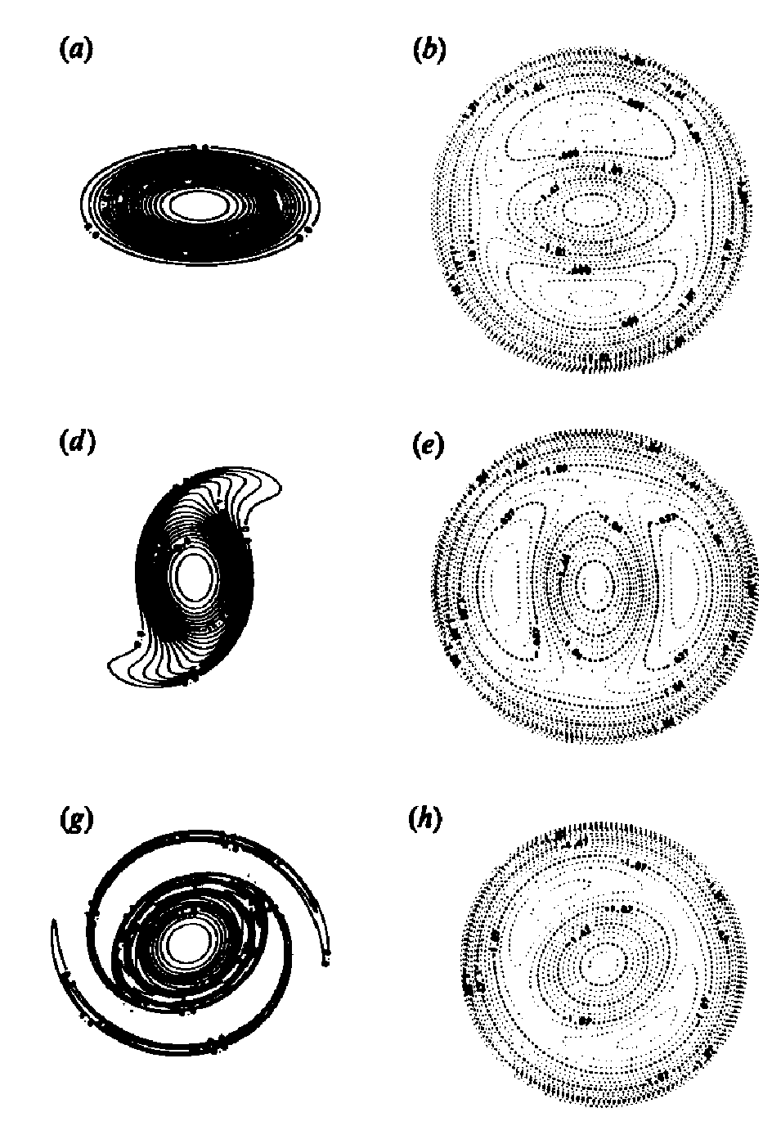
Vortex Stripping by Filamentation
Co-rotating streamfunction
vorticity
If vortex becomes too elliptical, vorticity contours can break
PV crosses hyperbolic points
formation of vorticity filaments
vortex area and circulation ends up smaller
vorticity gradients on vortex edge are sharper
Melander, McWilliams and Zabusky (1987)

Slide 10
Talk Outline
Fundamental dynamics of jet streams and Rossby waves
What is out there? Does the jet stream structure differ from its representation in models (and analyses)?
What are the ramifications for forecast errors?
What are the chief mechanisms enabling diabatic influence on the dynamics of jet streams and Rossby waves?

Slide 11
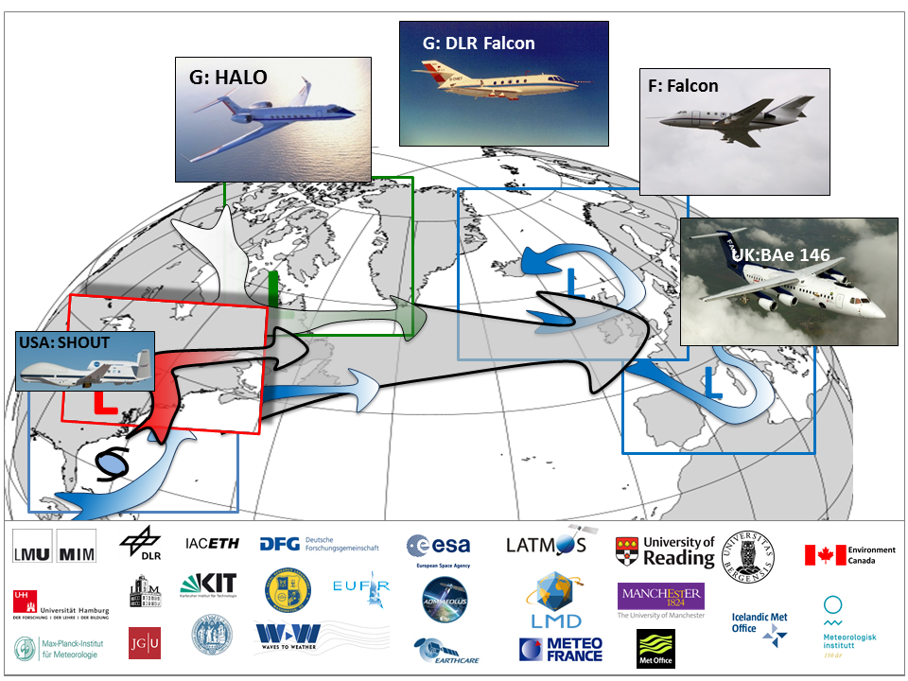
North Atlantic Waveguide and Downstream Impacts Experiment (NAWDEX)

Slide 12
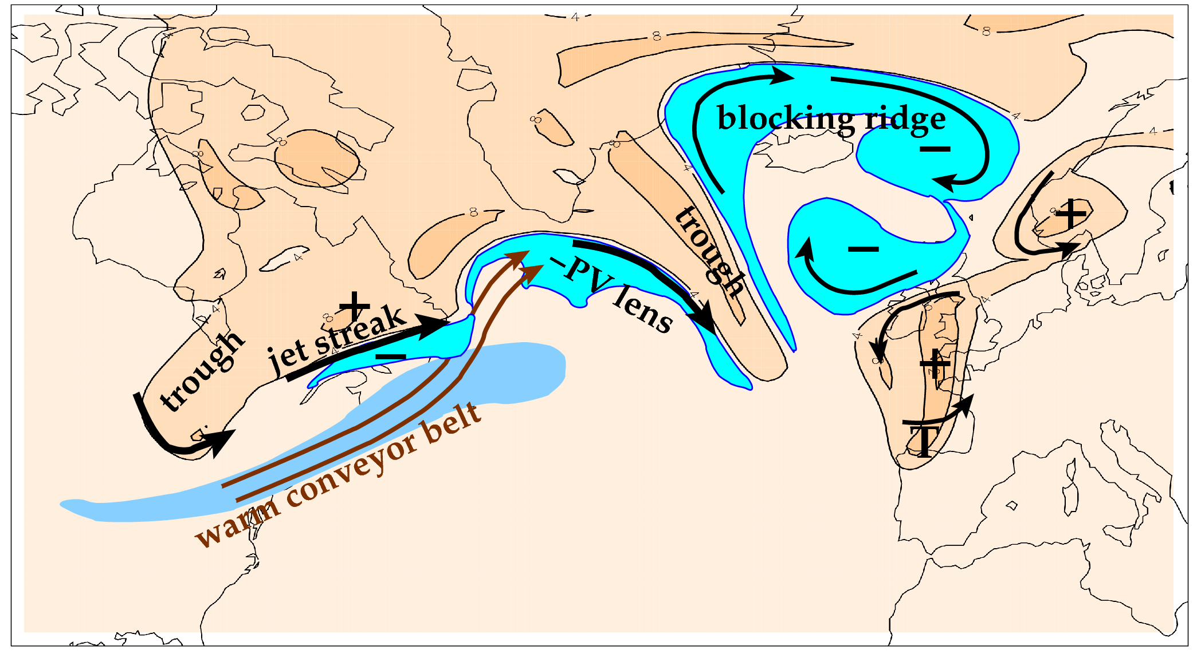
Overarching scientific aim of NAWDEX: to quantify the effects of diabatic processes on disturbances to the jet stream near North America, their influence on downstream propagation across the North Atlantic, and consequences for high-impact weather in Europe.
Features related to the meandering tropopause and jet stream (orange is stratospheric air; cyan marks upper tropospheric PV anomalies).

Slide 13
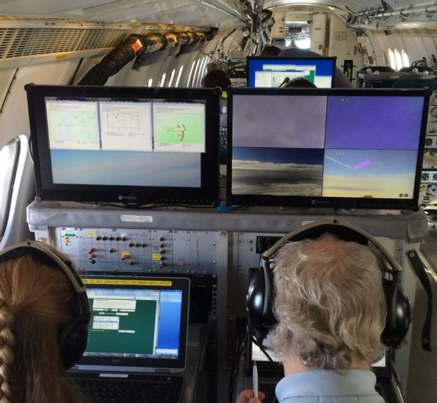
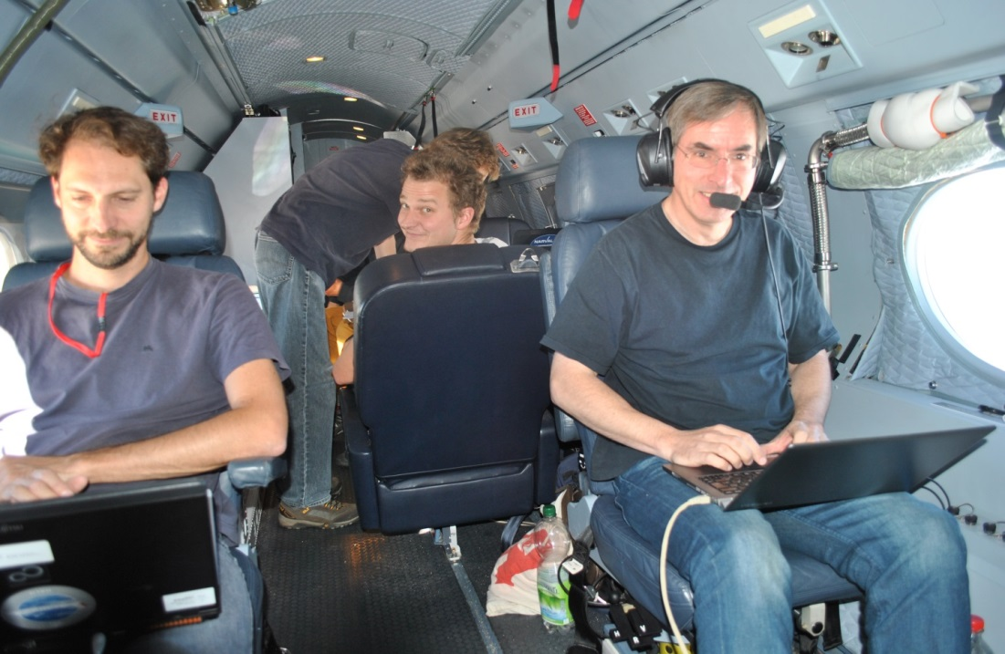
NAWDEX Research Aims
How sharp is the jet stream and what are the ramifications for Rossby wave propagation?
How much do cloud and radiative processes influence jet stream disturbances?
What are the situations with lowest predictability for Europe, and why?
Collaborators
Germany (Waves 2 Weather, DFG)
Switzerland (ETH, Bern)
UK (Reading, Manchester, Met Office)
France (Meteo France, LMD, CNRS)
Canada (ECCC)
USA (NRL)
Norway (Met Norway)

Slide 14
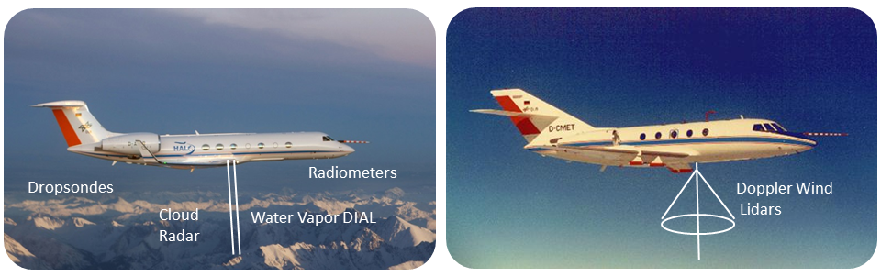
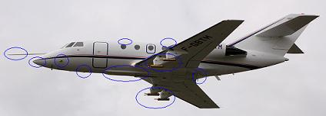
NAWDEX: 16/9/16-18/10/16
North Atlantic Waveguide and Downstream Impacts Expt
DLR HALO
DLR Falcon
Meteorological variables measured:
wind components
humidity
liquid/ice water paths
nature of hydrometeors
radiative fluxes
SAFIRE Falcon
In-situ sondes
Radar-Lidar
Dropsondes
Schäfler et al (2018), Bull. Am. Met. Soc.

Slide 15
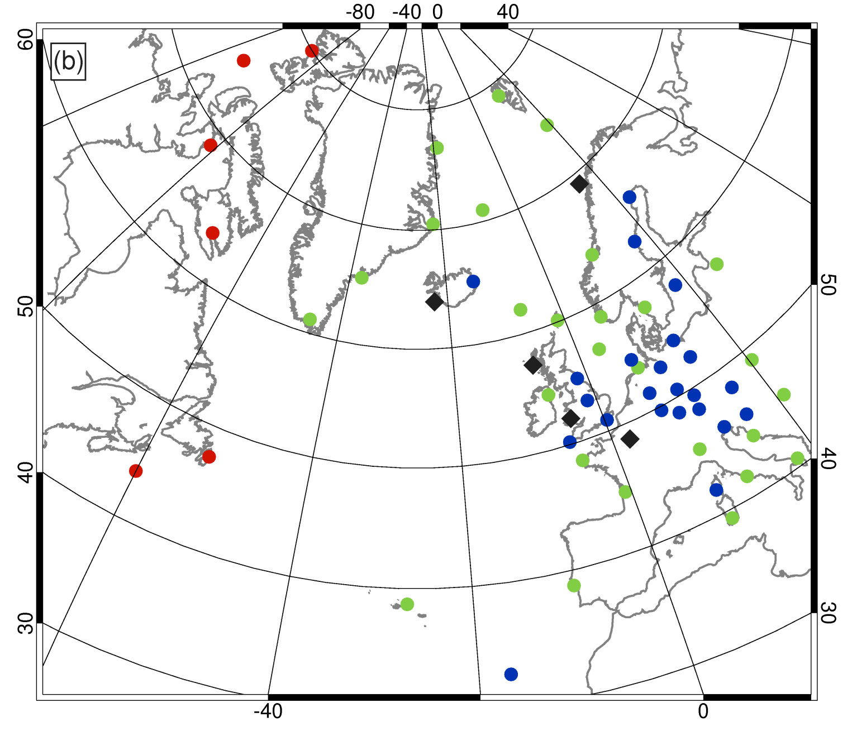
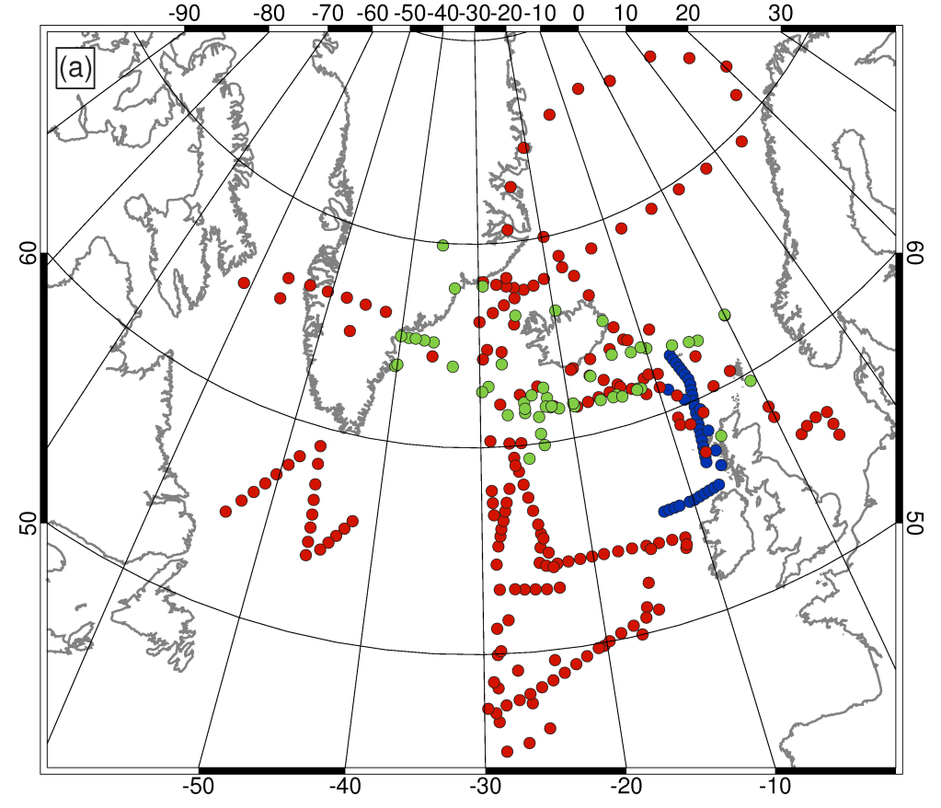
Sonde profiles during NAWDEX
16/9/16-18/10/16.
289 dropsondes
589 additional balloon launches from 14 countries
4 wind profilers across tropopause
Falling during 13 IOPs related to downstream development of weather and its impacts on Europe.

Slide 16
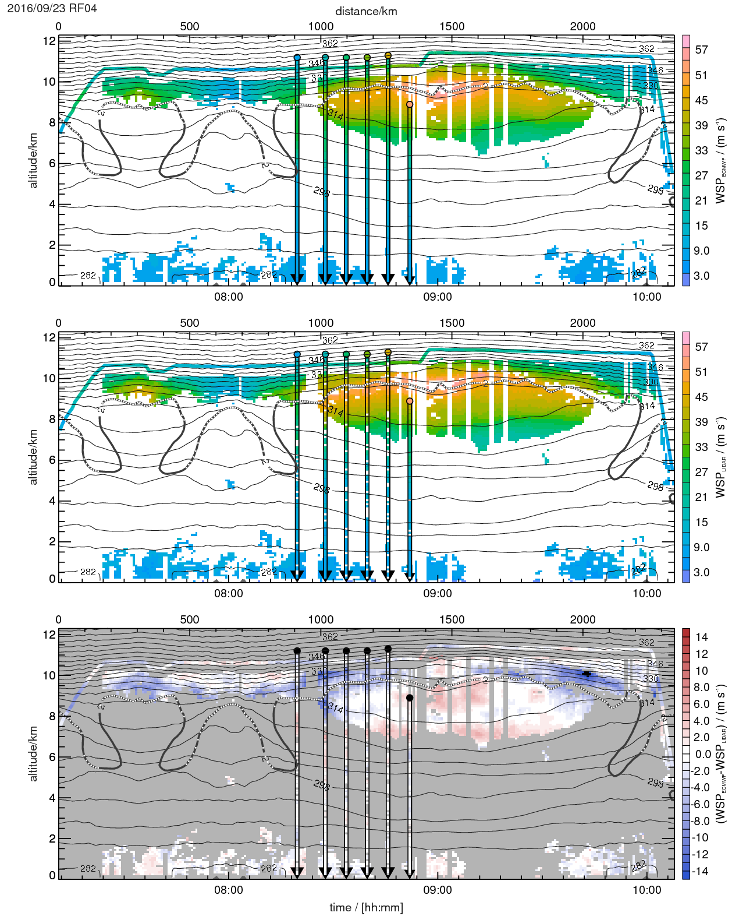
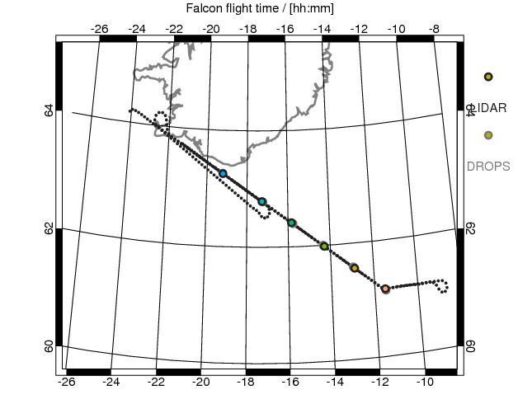
23 September 2016
Observations of jet structure
Lidar and dropsonde wind measurements are much closer to each other than analysis.
Structure of error similar in ECMWF and Met Office analyses
ECMWF
LIDAR &
SONDES
EC - LIDAR

Slide 17
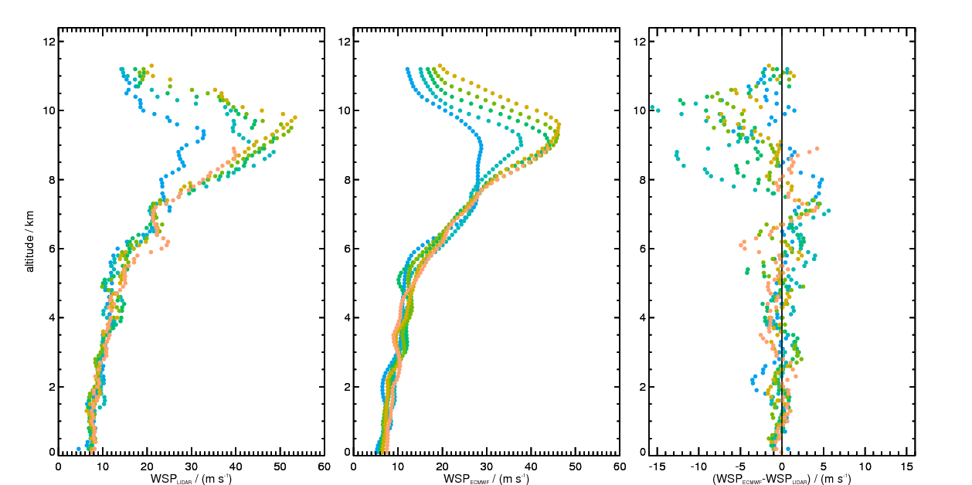
RF04: 23/9/16
Magnitude of analysis - obs wind
dropsondes
ECMWF
difference

Slide 18
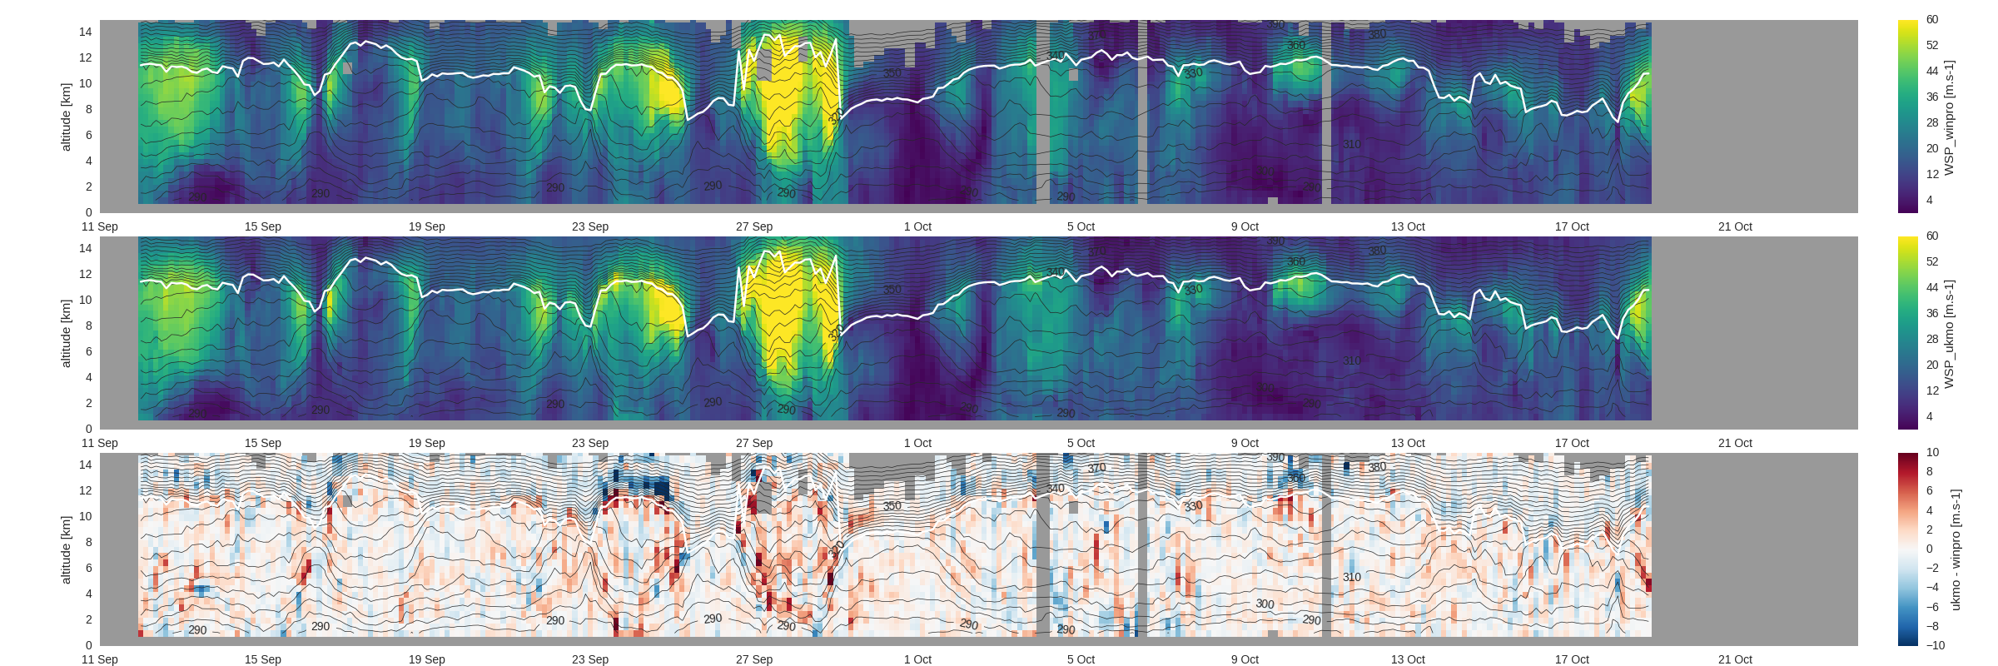
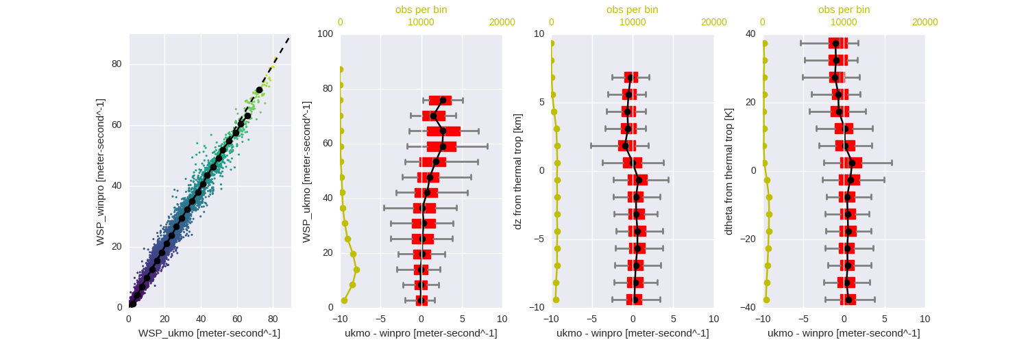
Obs vs model at T+0 Wind profiler @ South Uist
Obs
UKMO
Difference
Wind profiler (ST radar) and analyses compared.
Composite relative to height of the tropopause on each profile.
tropopause

Slide 19
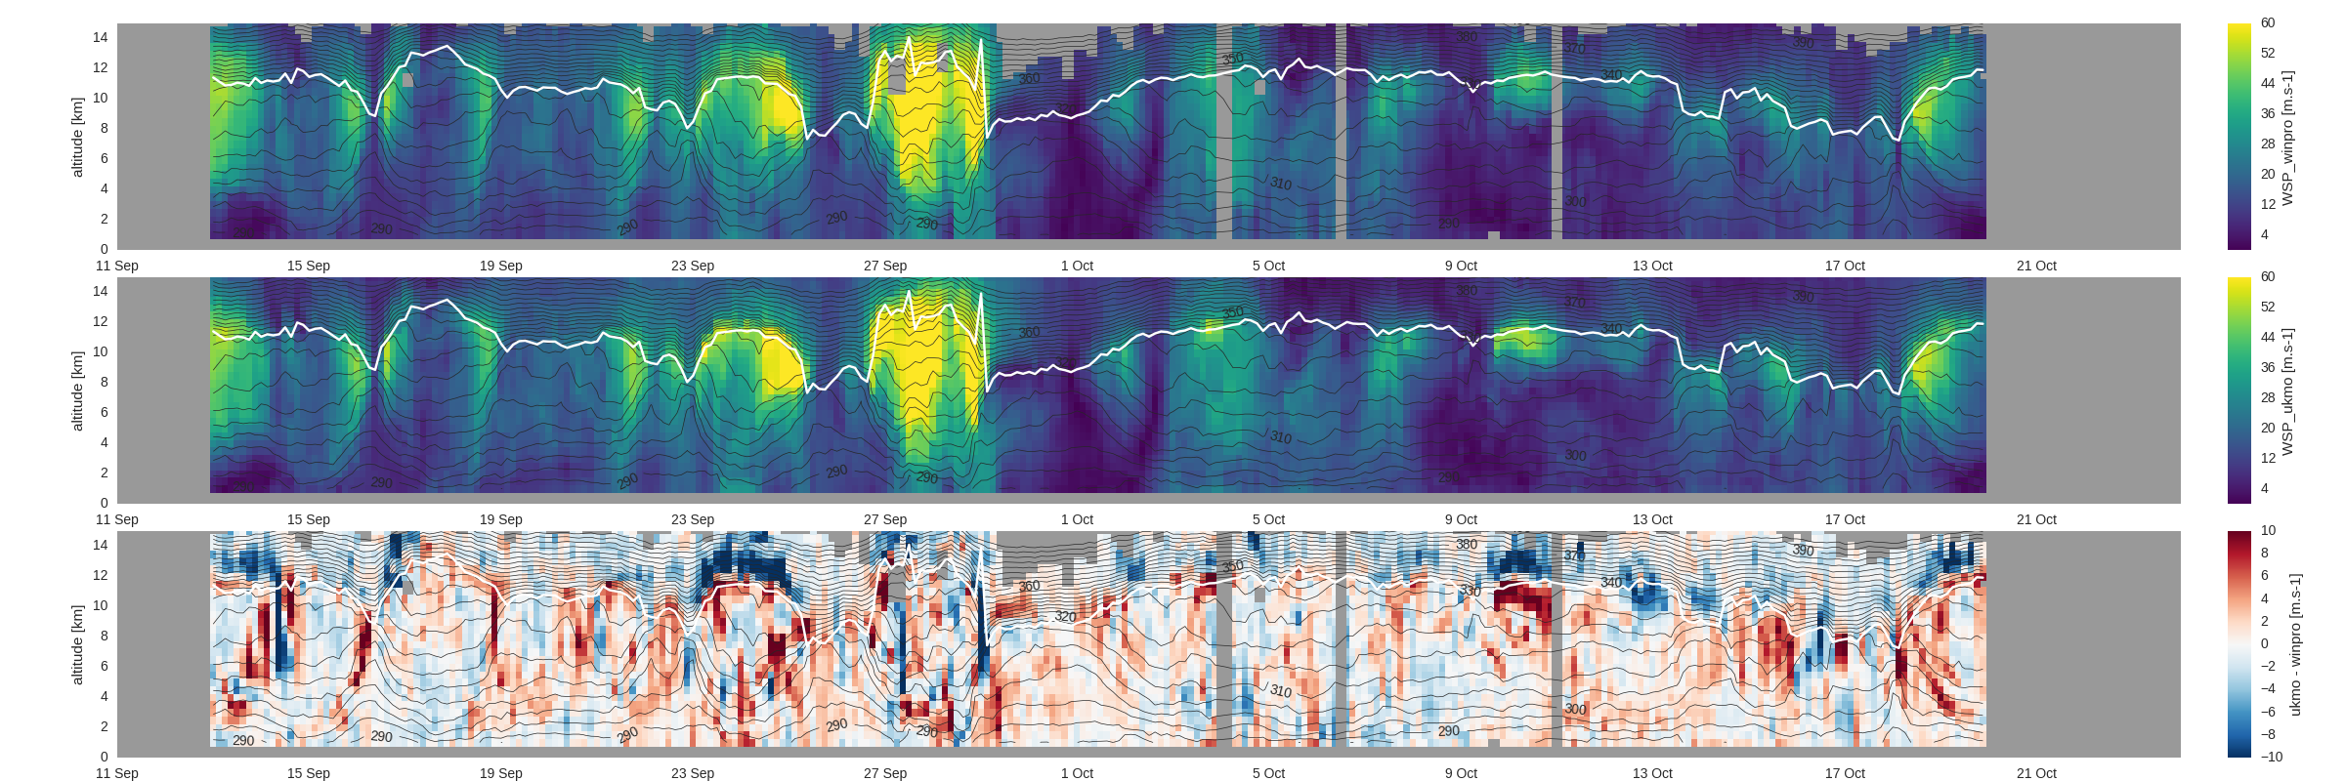
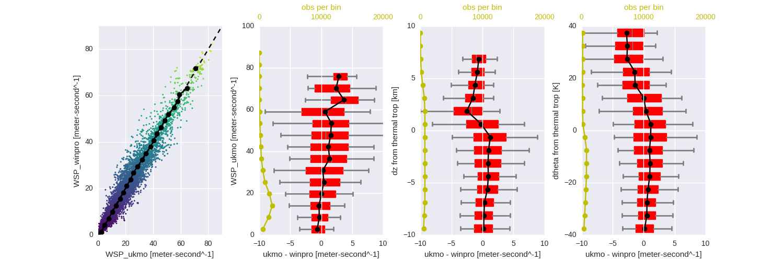
Obs vs model at T+24
Obs
UKMO
Difference
Wind profiler (ST radar) and analyses compared.
Composite relative to height of the tropopause on each profile.
tropopause

Slide 20
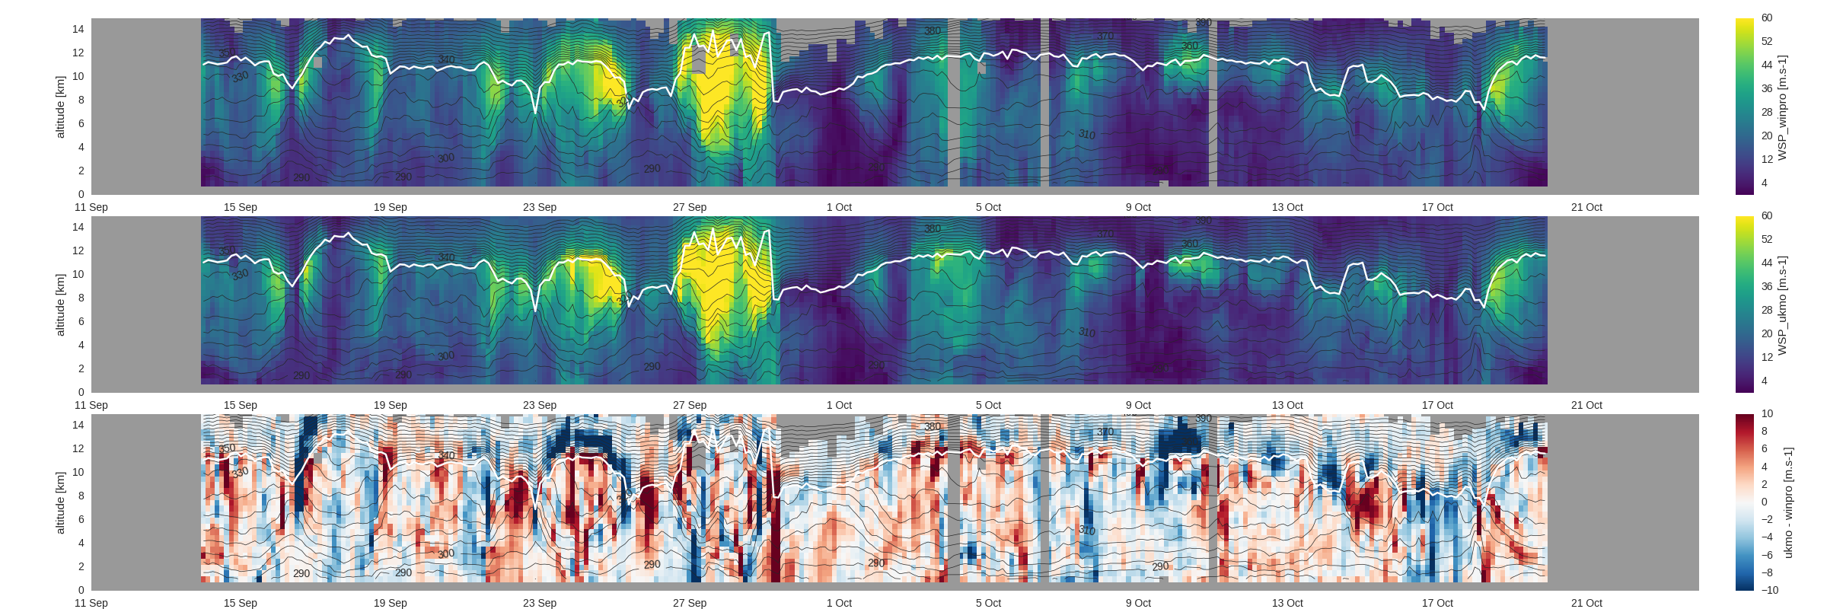
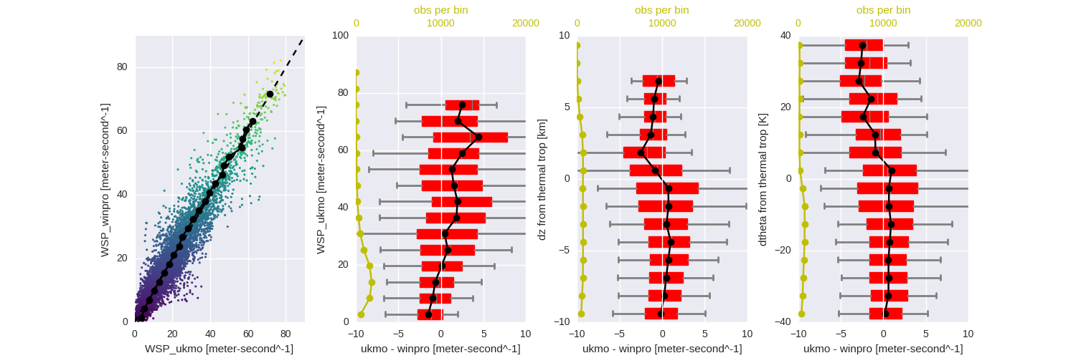
Obs vs model at T+48
Obs
UKMO
Difference
Wind profiler (ST radar) and analyses compared.
Composite relative to height of the tropopause on each profile.
tropopause

Slide 21
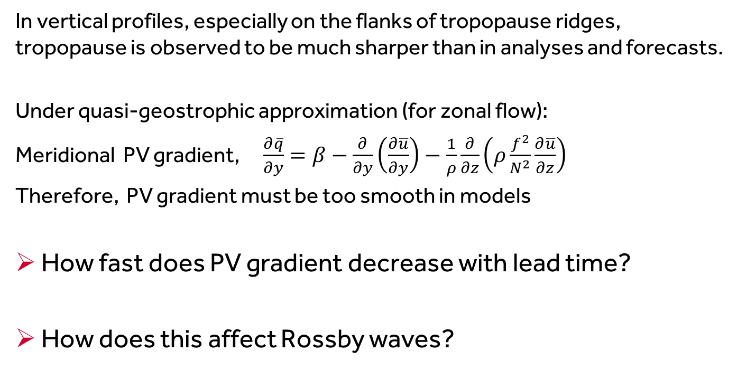
Observed jet stream is “sharper”
3. What are ramifications for forecast evolution?
In vertical profiles, especially on the flanks of tropopause ridges, tropopause is observed to be much sharper than in analyses and forecasts.
Under quasi-geostrophic approximation (for zonal flow):
Meridional PV gradient, $\frac{∂\overline{q}}{∂y}=β−\frac{∂}{∂y}\left(\frac{∂\overline{u}}{∂y}\right)−\frac{1}{ρ}\frac{∂}{∂z}\left(ρ\frac{f^{2}}{N^{2}}\frac{∂\overline{u}}{∂z}\right)$
Therefore, PV gradient must be too smooth in models
How fast does PV gradient decrease with lead time?
How does this affect Rossby waves?

Slide 22
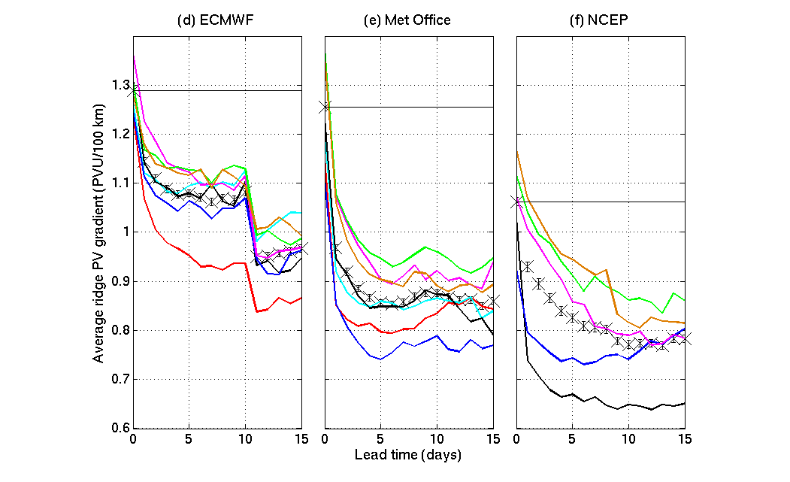
Forecast of horizontal PV gradient across the tropopause (from TIGGE)
2006/7
2007/8
2008/9
2009/10
2010/11
2011/12
2012/13
Gray, Dunning, Methven, Masato and Chagnon (2014), GRL

Slide 23
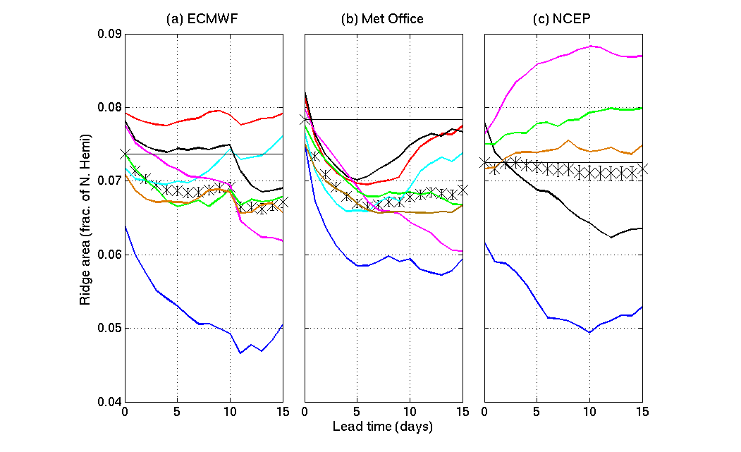
Forecasts of ridge area in Rossby waves
_{2.3x10}⁷ _{km}²
2006/7
2007/8
2008/9
2009/10
2010/11
2011/12
2012/13
Reduced forecast resolution after day 10
Gray, Dunning, Methven, Masato and Chagnon (2014), GRL

Slide 24
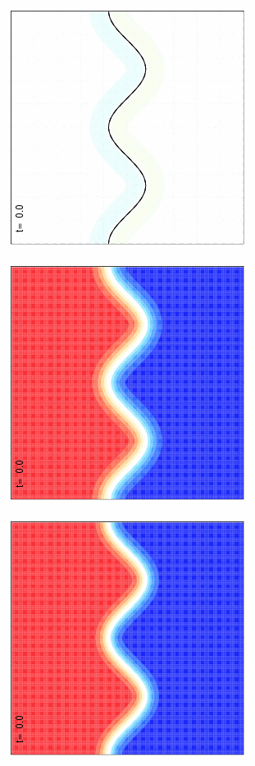




Why does PV gradient sharpness matter?
QG shallow water (“equivalent barotropic”) equations:
  $\frac{DP}{Dt}=0$ $P=f_{0}+∇^{2}ψ−ψ/L_{R}^{2}$
“analysis”
“forecast”
difference
high PV
high PV
low PV
low PV
$$r_{0}≈308 km$$
$$r_{0}≈381 km$$
Use: $L_{R}=700 km$

Slide 25
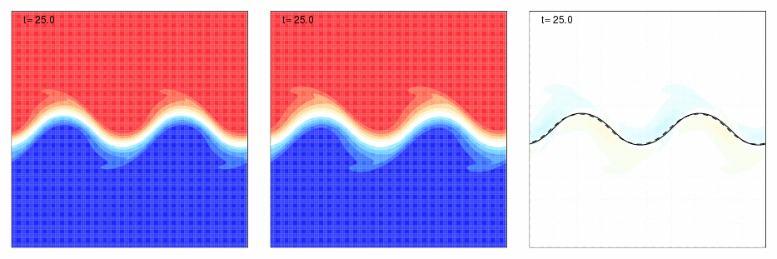
A simple simulation
QG shallow water (“equivalent barotropic”) equations:
  $\frac{DP}{Dt}=0$ $P=f_{0}+∇^{2}ψ−ψ/L_{R}^{2}$
“analysis”
“forecast”
difference
high PV
high PV
low PV
low PV
$$r_{0}≈308 km$$
$$r_{0}≈381 km$$
Use: $L_{R}=700 km$

Slide 26
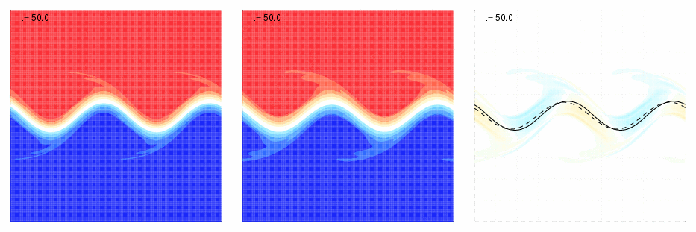


A simple simulation
QG shallow water (“equivalent barotropic”) equations:
  $\frac{DP}{Dt}=0$ $P=f_{0}+∇^{2}ψ−ψ/L_{R}^{2}$
“analysis”
“forecast”
difference
high PV
high PV
low PV
low PV
$$r_{0}≈308 km$$
$$r_{0}≈381 km$$
Use: $L_{R}=700 km$

Slide 27
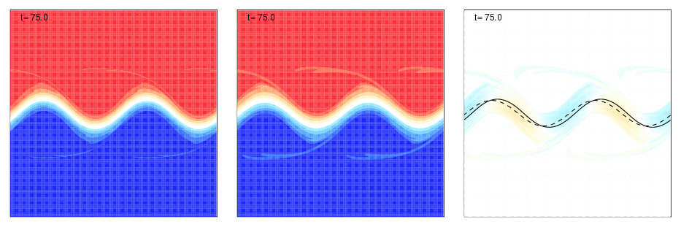
A simple simulation
QG shallow water (“equivalent barotropic”) equations:
  $\frac{DP}{Dt}=0$ $P=f_{0}+∇^{2}ψ−ψ/L_{R}^{2}$
“analysis”
“forecast”
difference
high PV
high PV
low PV
low PV
$$r_{0}≈308 km$$
$$r_{0}≈381 km$$
Use: $L_{R}=700 km$

Slide 28
A simple simulation
QG shallow water (“equivalent barotropic”) equations:
  $\frac{DP}{Dt}=0$ $P=f_{0}+∇^{2}ψ−ψ/L_{R}^{2}$
“analysis”
“forecast”
difference
high PV
high PV
Phase speed error
Amplitude error
low PV
low PV
$$r_{0}≈308 km$$
$$r_{0}≈381 km$$
Use: $L_{R}=700 km$

Slide 29
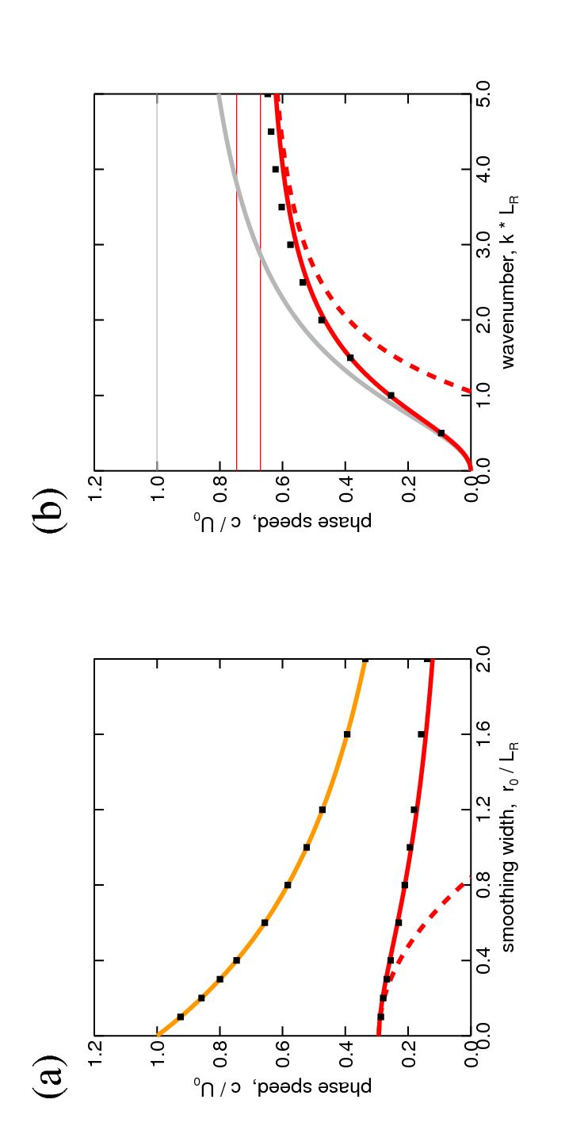


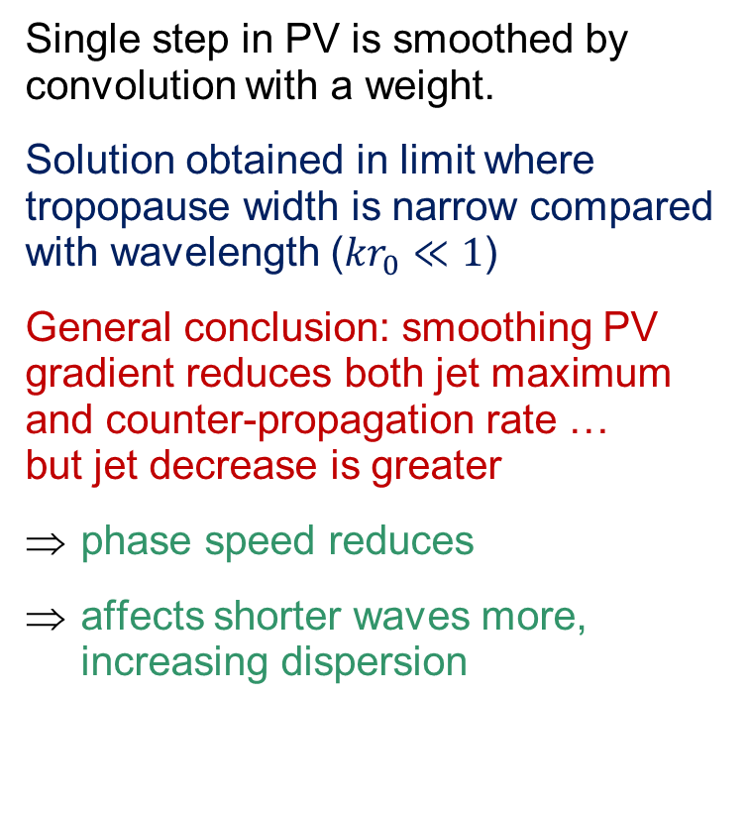



RW propagation on smooth PV step
PV
u
Single step in PV is smoothed by convolution with a weight.
Solution obtained in limit where tropopause width is narrow compared with wavelength (${kr}_{0}≪1$)
General conclusion: smoothing PV gradient reduces both jet maximum and counter-propagation rate … but jet decrease is greater
phase speed reduces
affects shorter waves more, increasing dispersion
$$r$$
Latitude
Latitude
$$Δq$$
Dots = numerical simulation
Speeds
$$c_{m}(k)$$
Jet speed
RW speed
Harvey et al, J. F. Mech. (2016)
Smoothing width, $r_{0}/L_{R}$

Slide 30
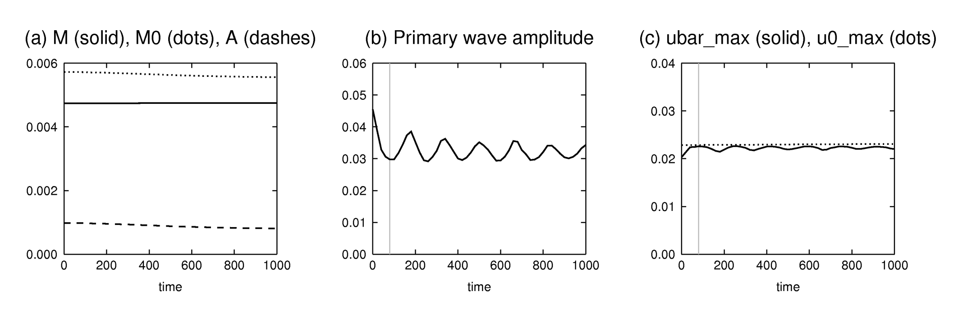
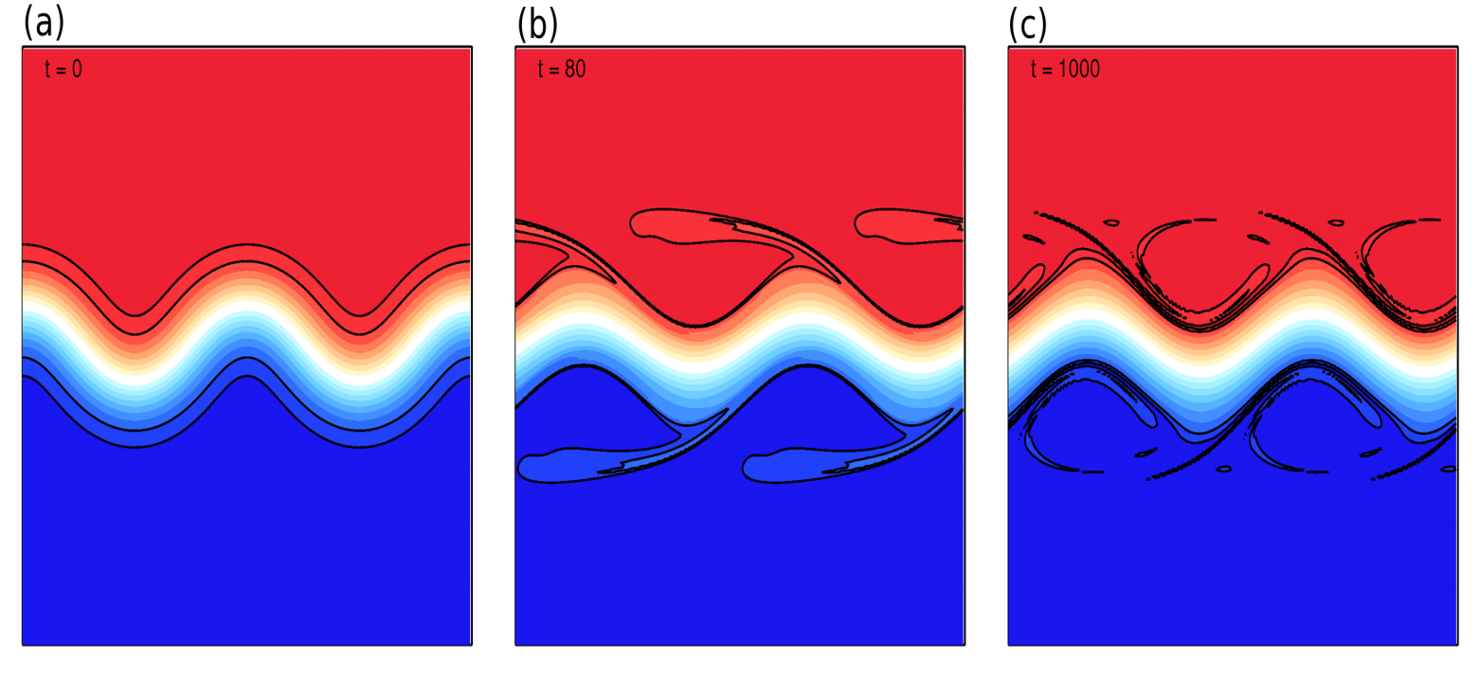
Decrease of jet meander amplitude
Fast oscillation:
  through advection of PV filaments around the cat’s eyes on jet flanks
Gradual decrease:
  mixing of PV within the critical layer
Wave activity fluxes into jet flanks, but global WA is conserved ⇒ WA of jet meander must decrease.
Primary wave amplitude
Harvey et al, J. Atmos. Sci. (2018)

Slide 31
4. Mechanisms for diabatic influence
Focus on the diabatic influences on Rossby waves at tropopause level (wave guide disturbances).
Radiative maintenance of PV contrast across the tropopause
Sharpening of jet stream PV gradient and max winds by “non-advective PV flux” (heating in vertical wind shear)
Amplification of baroclinic wave growth rate through lower “effective static stability”
Diabatic mass transport into cut-off anti-cyclones and importance for mid-latitude blocking

Slide 32
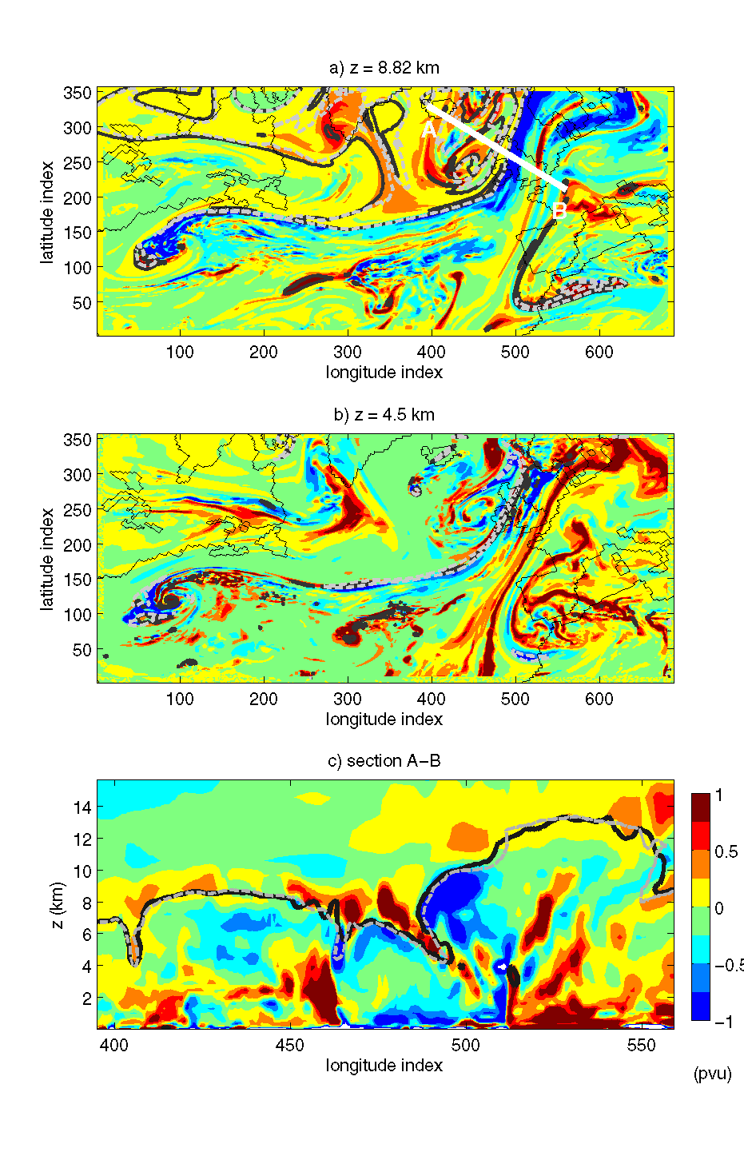
A. Radiative maintenance of PV contrast across tropopause
Positive diabatic PV above (on strat side) of tropopause
Negative diabatic PV beneath (on trop side) of tropopause
Tropopause elevation not significantly altered by direct diabatic PV modification
Chagnon, Gray and Methven (2013), Q J R Met S

Slide 33
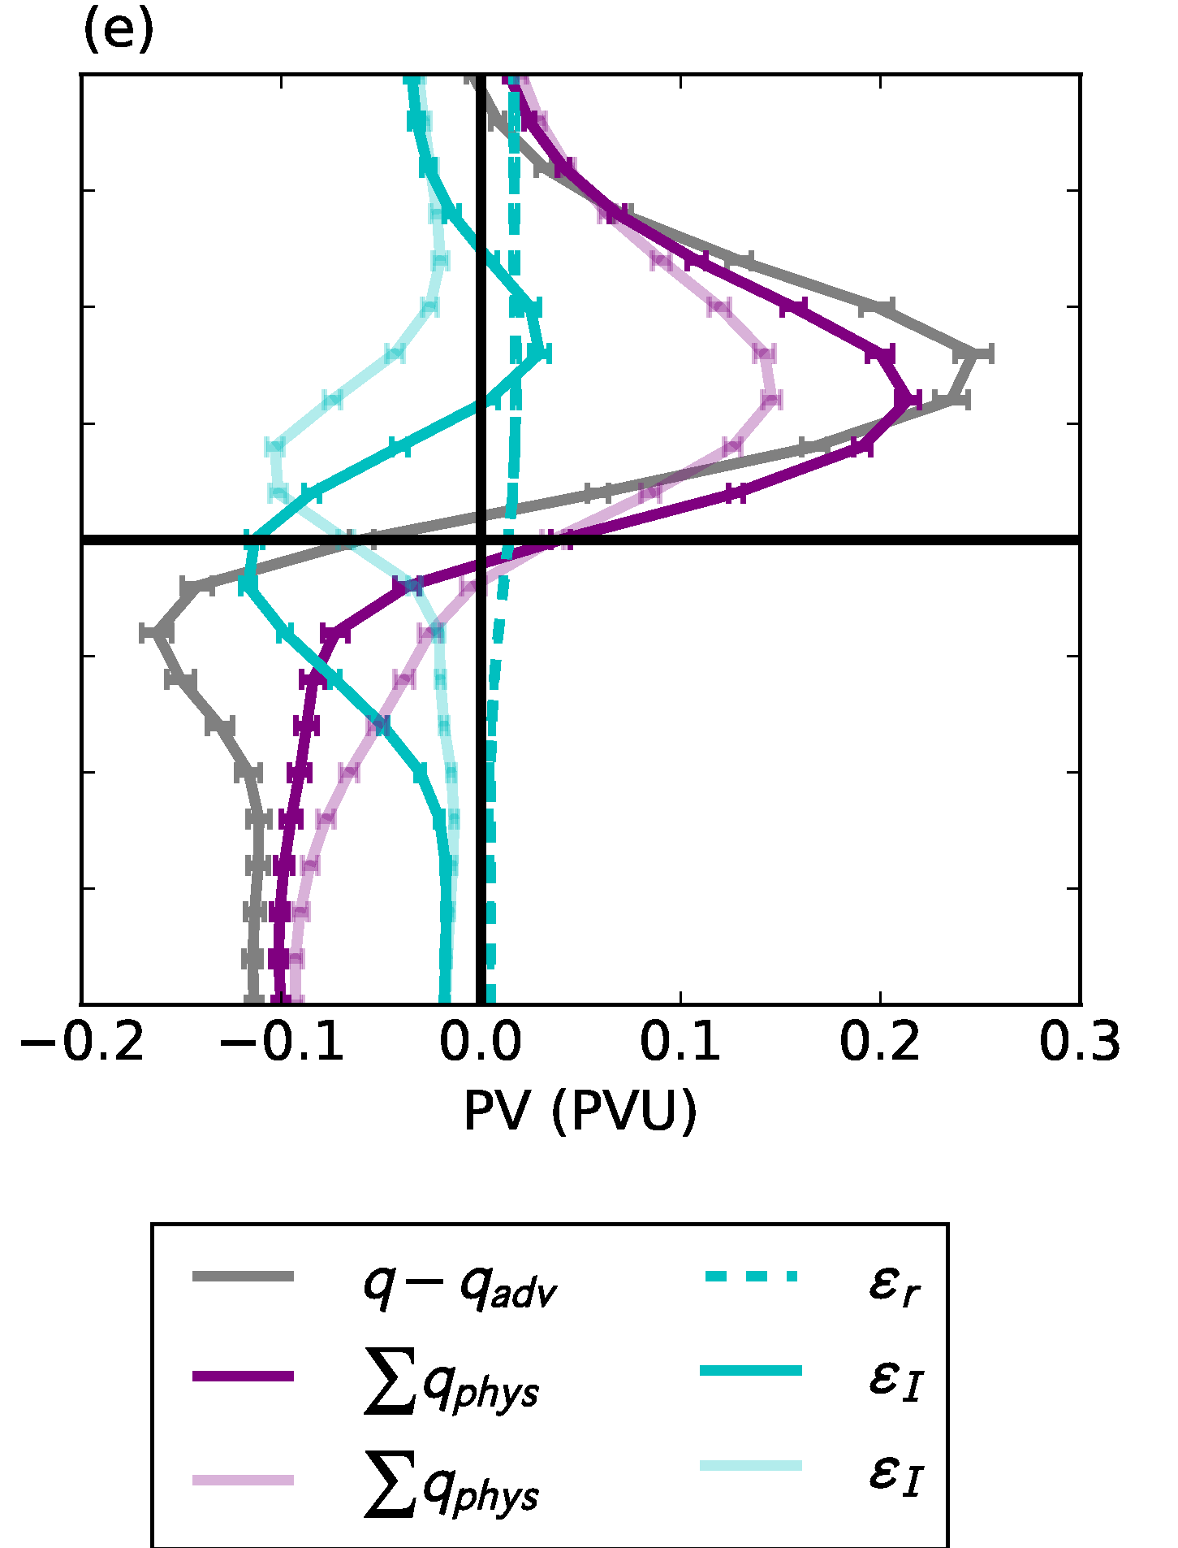
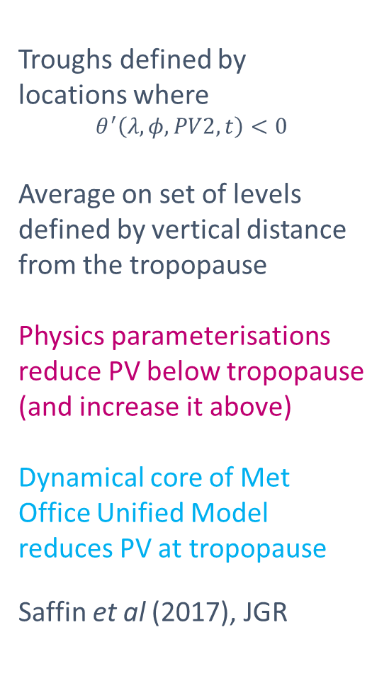
Composite of 92 forecasts
Relative to the tropopause in troughs
Troughs defined by
locations where
$$θ^{′}\left(λ,φ,PV2,t\right)<0$$
Average on set of levels defined by vertical distance from the tropopause
Physics parameterisations reduce PV below tropopause (and increase it above)
Dynamical core of Met Office Unified Model reduces PV at tropopause
Saffin et al (2017), JGR
2 km
z-z_{tpp}
0 km
-2 km

Slide 34
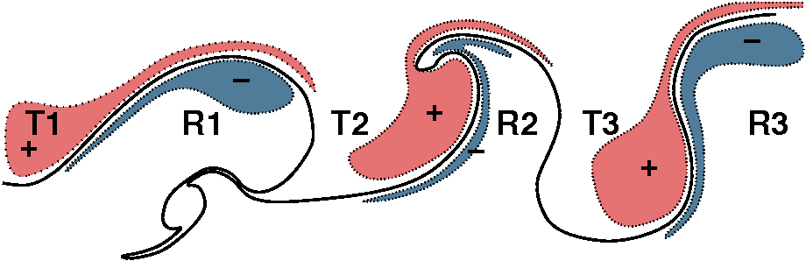
Diabatic influence on Rossby waves
LW cooling max at tropopause (humidity step)
  “diabatic PV dipole” but little direct PV change at tropopause
  enhances tropopause PV gradient
  ⇒ would be influenced by cirrus just under tropopause
Diabatic PV enhances PV anomaly pattern of Rossby wave
  greater westward propagation and enhanced baroclinic interaction
  But, also stronger jet associated with greater PV contrast
Chagnon, Gray and Methven (2013), QJRMetS

Slide 35


B. Jet sharpening by non-advective PV flux
Lagrangian form of Ertel PV equation:
PV increases below heating maximum (and decreases above it).
However, there is not an obvious constraint on PV values.
Now consider flux (or local conservation) form of PV equation:
J = “non-advective PV flux” arising from non-conservative processes
(Haynes & McIntyre, 1987, JAS)
$$=−∇.J$$

Slide 36
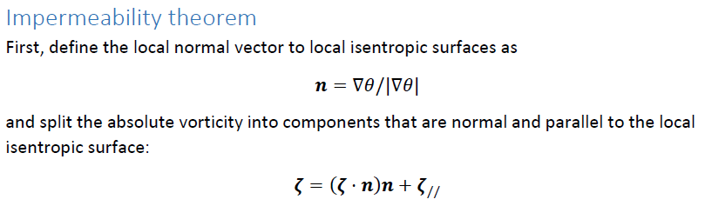




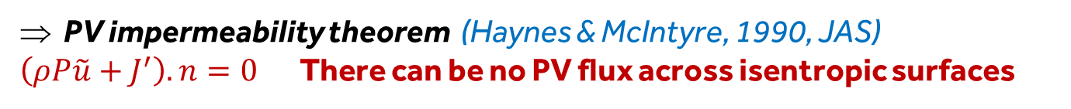
PV evolution equation (II)
We can write the flux form PV equation as:
Using and partitioning velocity into cross-isentropic and along-isentropic components :
$$=−∇.J′$$
PV impermeability theorem (Haynes & McIntyre, 1990, JAS)
$\left(ρP\tilde{u}+J^{′}\right).n=0$There can be no PV flux across isentropic surfaces

Slide 37



PV evolution equation (III)
Leads to an alternative Lagrangian form of PV equation.
Evolution following flow within an isentropic layer
Non-advective transport of
PV along $θ$ surfaces
Concentration/dilution of PV
above/below heating
Negative PV cannot arise through diabatic mass flux convergence
If P>0 initially, it must remain positive through the first term on right.

Slide 38
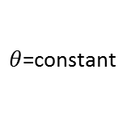
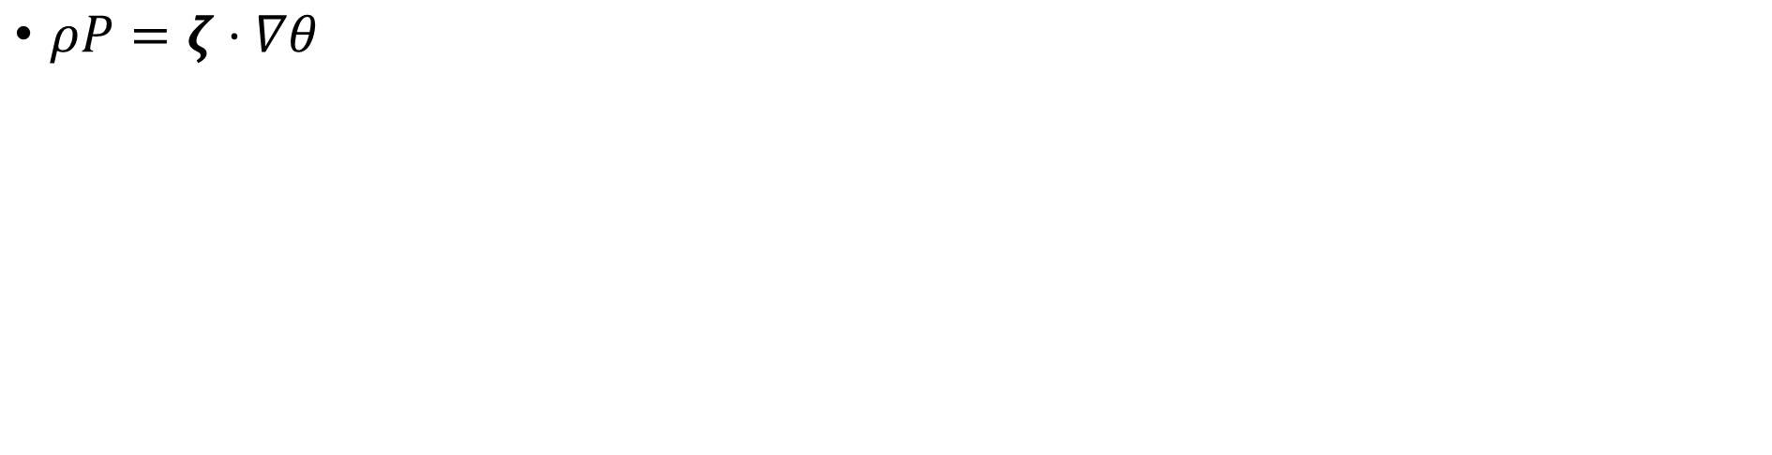
Thought experiment
$θ$=constant
Heating
(no motion)
Motion
(no heating)
J
z
x, y
$ρP=ζ⋅∇θ$
Vortex stretching induced by adjustment to heating → vertical PV dipole
But…negative PV cannot be produced (only a PV reduction/decay)

Slide 39
Thought experiment
$θ$=constant
Heating
(no motion)
Motion
(no heating)
z
x, y
Now include some horizontal vorticity
Vortex tilting induced by response to heating → horizontal PV dipole
Requires a horizontal component of absolute vorticity (= vertical wind shear)
No constraint on sign of PV values (negative PV can be produced)

Slide 40
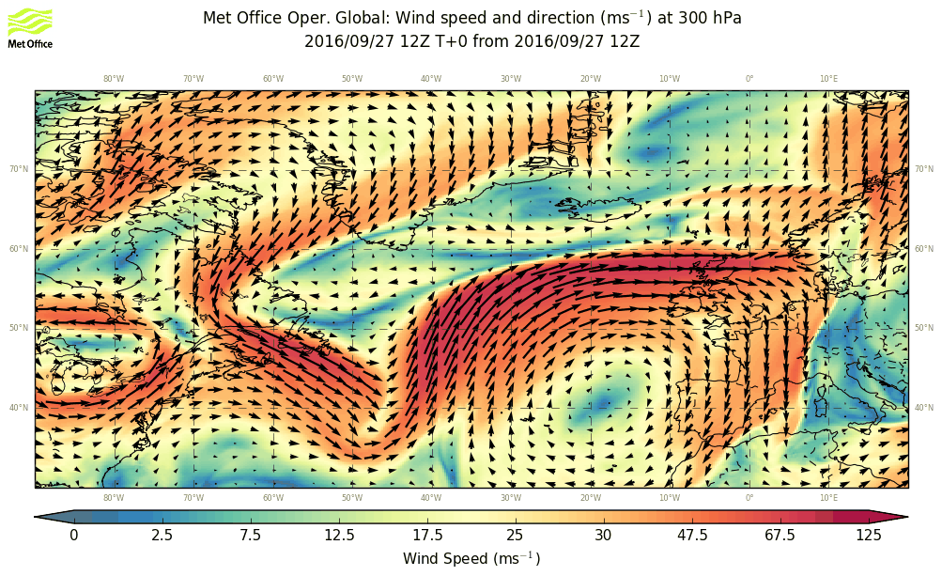
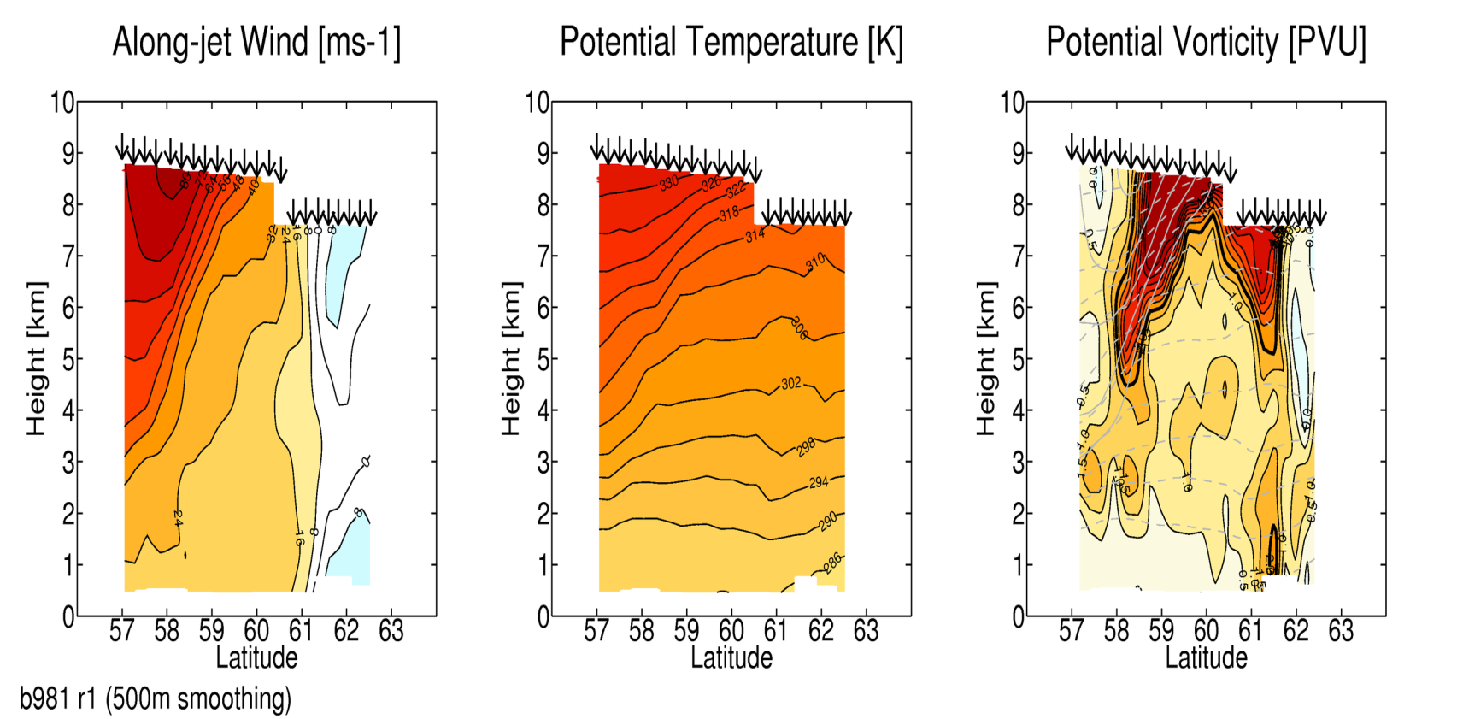

NAWDEX jet streak case
12Z: wind at 300 hPa
12Z: PV on 315 K
22 dropsondes on section crossing the jet stream

Slide 41

Negative PV observed with dropsondes
Signature of diabatic processes sharpening jet stream
$P=\frac{1}{ρ}ζ⋅∇θ=(ζ⋅n)\frac{|∇θ|}{ρ}$ where $n=\frac{∇θ}{|∇θ|}$

Slide 42


Response to “WCB” heating (imposed)
2-D semi-geostrophic model with heating:
$$\frac{Du_{g}}{Dt}−fv_{ag}=0$$
$$\frac{Dθ}{Dt}=H$$
$$\frac{D}{Dt}=\frac{∂}{∂t}+\left(u_{g}+u_{ag}\right)\frac{∂}{∂x}+v_{ag}\frac{∂}{∂y}+w\frac{∂}{∂z}$$
Define cross-frontal streamfunction, ψ
$v_{ag}=−\frac{∂ψ}{∂z}$ $w=\frac{∂ψ}{∂y}$
Meridional circulation acts to maintain TWB:
$$ψ_{yy}θ_{z}+ψ_{yz}\left(u_{z}−θ_{y}\right)+ψ_{zz}\left(f−u_{y}\right)=H_{y}$$
Height [km]
Distance [km]

Slide 43

Response to “WCB” heating (imposed)
2-D semi-geostrophic model with heating:
$$\frac{Du_{g}}{Dt}−fv_{ag}=0$$
$$\frac{Dθ}{Dt}=H$$
$$\frac{D}{Dt}=\frac{∂}{∂t}+\left(u_{g}+u_{ag}\right)\frac{∂}{∂x}+v_{ag}\frac{∂}{∂y}+w\frac{∂}{∂z}$$
Define cross-frontal streamfunction, ψ
$v_{ag}=−\frac{∂ψ}{∂z}$ $w=\frac{∂ψ}{∂y}$
Meridional circulation acts to maintain TWB:
$$ψ_{yy}θ_{z}+ψ_{yz}\left(u_{z}−θ_{y}\right)+ψ_{zz}\left(f−u_{y}\right)=H_{y}$$
Height [km]
Distance [km]

Slide 44

Response to “WCB” heating (imposed)
2-D semi-geostrophic model with heating:
$$\frac{Du_{g}}{Dt}−fv_{ag}=0$$
$$\frac{Dθ}{Dt}=H$$
$$\frac{D}{Dt}=\frac{∂}{∂t}+\left(u_{g}+u_{ag}\right)\frac{∂}{∂x}+v_{ag}\frac{∂}{∂y}+w\frac{∂}{∂z}$$
Define cross-frontal streamfunction, ψ
$v_{ag}=−\frac{∂ψ}{∂z}$ $w=\frac{∂ψ}{∂y}$
Meridional circulation acts to maintain TWB:
$$ψ_{yy}θ_{z}+ψ_{yz}\left(u_{z}−θ_{y}\right)+ψ_{zz}\left(f−u_{y}\right)=H_{y}$$
Height [km]
Distance [km]

Slide 45


Semi-geostrophic theory in 3-D (Hoskins, 1975)
Makes geostrophic momentum approximation (GMA)
  Advection by full flow including w and ageostrophic wind
Q. How is Rossby wave propagation affected compared with basic QG theory?
Amazingly, using the S-G coordinate transformation:
the S-G evolution in (X, Y, Z) is similar to Q-G evolution in (x, y, z)
Transformed into physical coords, +ve vorticity regions contract
Figure: Davies, Schar and Wernli, J. Atmos. Sci., 1991

Slide 46




C. Effects of heating on Rossby waves
Vertical velocity can be deduced using the S-G omega equation.
Its form in momentum coordinates (Hoskins & Draghici, 1977) is:
Geostrophic forcing
Diabatic forcing (H=heating)
“Large-scale rain” parametrization of heating:
⇒ Response of moist equations using effective static stability, $N_{\begin{aligned}eff \\ \end{aligned}}$
Predicted effects on baroclinic waves:
Amplified vertical and ageostrophic motion
Faster propagation of tropopause Rossby wave westwards (relative to jet)
Faster growth through baroclinic interaction between surface and tropopause

Slide 47

Amplification of ageostrophic flow by heating
Balanced ageostropic flow and w from S-G “omega” equation.
Without forcing from heating. Mike Cullen & Claudio Sanchez.

Slide 48

Amplification of ageostrophic flow by heating
Balanced ageostropic flow and w from S-G “omega” equation.
With forcing from full parametrized heating from MetUM.

Slide 49

Amplification of ageostrophic flow by heating
Balanced ageostropic flow and w from S-G “omega” equation.
Heating proportional to vertical velocity (“large-scale rain”).

Slide 50
4. Mechanisms for diabatic influence
Focus on the diabatic influences on Rossby waves at tropopause level (wave guide disturbances).
Radiative maintenance of PV contrast across the tropopause
Sharpening of jet stream PV gradient and max winds by “non-advective PV flux” (heating in vertical wind shear)
Amplification of vertical velocity and baroclinic wave growth rate through lower “effective static stability”
Diabatic mass transport into cut-off anti-cyclones and importance for mid-latitude blocking

Slide 51


Lagrangian coherent structures
Example of large amplitude Rossby wave.
Unstable (+ stable) manifolds. Locations from which neighbouring forward (+ backward) trajectories separate rapidly.
Generalisation of “cat’s eyes” for unsteady (aperiodic) flows.
C
C
AC
AC
C
C
AC
AC

Slide 52

Lagrangian coherent structures
Example of large amplitude Rossby wave.
Black = unstable (+ stable) manifolds. Locations from which forward (+ backward) trajectories separate rapidly.
Colour indicates sum of back and forward trajectory length from each point.
Highlights jet stream and eddy regions
C
C
AC
AC
C
C
AC
AC

Slide 53


Formation of “omega block”
Rossby wave reaches large amplitude.
Vortex roll-up forms new hyperbolic point, A,
and A/C cut-off.
Colour indicates sum of back and forward trajectory length from each point.
A
A

Slide 54

Diabatic mass transport into A/C cut-off volumes
Latent heating enables diabatic mass transport into cut-off volume.
Adiabatic flow would be constrained to isentropic surfaces and could not cross into cut-off, once formed.
Field is net heating along trajectories over 1.5 days
A
A

Slide 55


Diabatic mass transport into A/C cut-off volumes
Once hyperbolic point, A,
is formed, it can only be destroyed by non-conservative processes.
It moves with the flow.
Path of A =
“hyperbolic trajectory”
Field is net heating along trajectories over 1.5 days
A
A

Slide 56


Diabatic mass transport into A/C cut-off volumes
Once hyperbolic point, A,
is formed, it can only be destroyed by non-conservative processes.
It moves with the flow.
Path of A =
“hyperbolic trajectory”
Field is net heating along trajectories over 1.5 days
A
A

Slide 57


Diabatic mass transport into A/C cut-off volumes
Hyperbolic point B forms near tip of extended trough
Field is net heating along trajectories over 1.5 days
A
B
A
B

Slide 58


Diabatic mass transport into A/C cut-off volumes
Hyperbolic point C forms near tip of next trough
Diabatic mass transport into volume north of B
Field is net heating along trajectories over 1.5 days
A
C
B
A
C
B

Slide 59


Diabatic mass transport into A/C cut-off volumes
Field is net heating along trajectories over 1.5 days
C
A
B
C
A
B

Slide 60


Diabatic mass transport into A/C cut-off volumes
Hyperbolic point D forms near tip of next trough
Large diabatic mass transport into WCB outflow volume, northwest of C
Field is net heating along trajectories over 1.5 days
C
A
D
B
C
A
D
B

Slide 61


Diabatic mass transport into A/C cut-off volumes
Field is net heating along trajectories over 1.5 days
C
A
D
C
A
D

Slide 62


Diabatic mass transport into A/C cut-off volumes
Field is net heating along trajectories over 1.5 days
C
A
D
C
A
D

Slide 63


Diabatic mass transport into A/C cut-off volumes
Field is net heating along trajectories over 1.5 days
C
D
C
D

Slide 64


Diabatic mass transport into A/C cut-off volumes
C and D converge to form strengthen hyperbolic point in front of dipole block.
Vortex roll-up ⇒ emergence of new hyperbolic trajectories
Latent heating can double mass in A/C cut-off regions.
Crucial to blocking onset?
C
D
C
D

Slide 65






Circulation and mass of outflow
Large increase in mass of outflow volume (x2) by diabatic mass transport from below.
But, variation in circulation is small.
Consequence of PV impermeability theorem, Haynes and McIntyre (1987, 1990).
Circulation cannot be changed through diabatic mass flux.
Then, why is outflow size important to block?
As area increases, anticyclonic relative flow is stronger around the boundary.
$$τ_{1}$$
$$τ_{2}$$
$$τ_{1}$$
$$τ_{2}$$
$$= <f+ξ>S$$

Slide 66
Conclusions
PV gradient at tropopause is too weak in global forecasts and declines
  expect Rossby waves to move eastwards too slowly in forecasts
  Rossby wave amplitude declines (on average)
  Mixing too strong, or diabatic maintenance too weak?
Negative PV must be signature of diabatic “sharpening” of jet stream
  Via non-advective PV flux which requires heating in vertical wind shear
Effects of heating in cyclones diluting PV in tropopause ridges
  Vertical motion and divergent outflow are amplified, but both captured partly by reduced static stability effect in S-G balanced dynamics
  Faster baroclinic growth rate and Rossby wave counter-propagation
Diabatic mass transport into cut-off anti-cyclonic coherent structures
  ⇒ Critical to onset of blocking and maintenance?

Slide 67
Thankyou for your attention

Slide 68

The NAWDEX Storyline
Mesoscale triggers interact with the jet stream, modifying development and high impact weather downstream

Slide 69

Lowest predictability following trigger -
a precursor to a regime transition?
Time series of Z500 data projected onto 4 large-scale patterns of variability
+NAO
blocking
Anomaly correlations between members of forecast ensemble (T+120) and verifying analyses
A
B

Slide 70


Integral PV conservation (circulation)
Integrate PV equation over control volume (lateral boundary velocity V_{b} )
Circulation conservation
(if V_{b}=V & J’-integral=0)
Integrate mass continuity over control volume
Diabatic mass flux convergence “dilutes” average PV
Mass-weighted average PV or amount of PV substance divided by mass
(Haynes & McIntyre, 1990)

