Slide 1
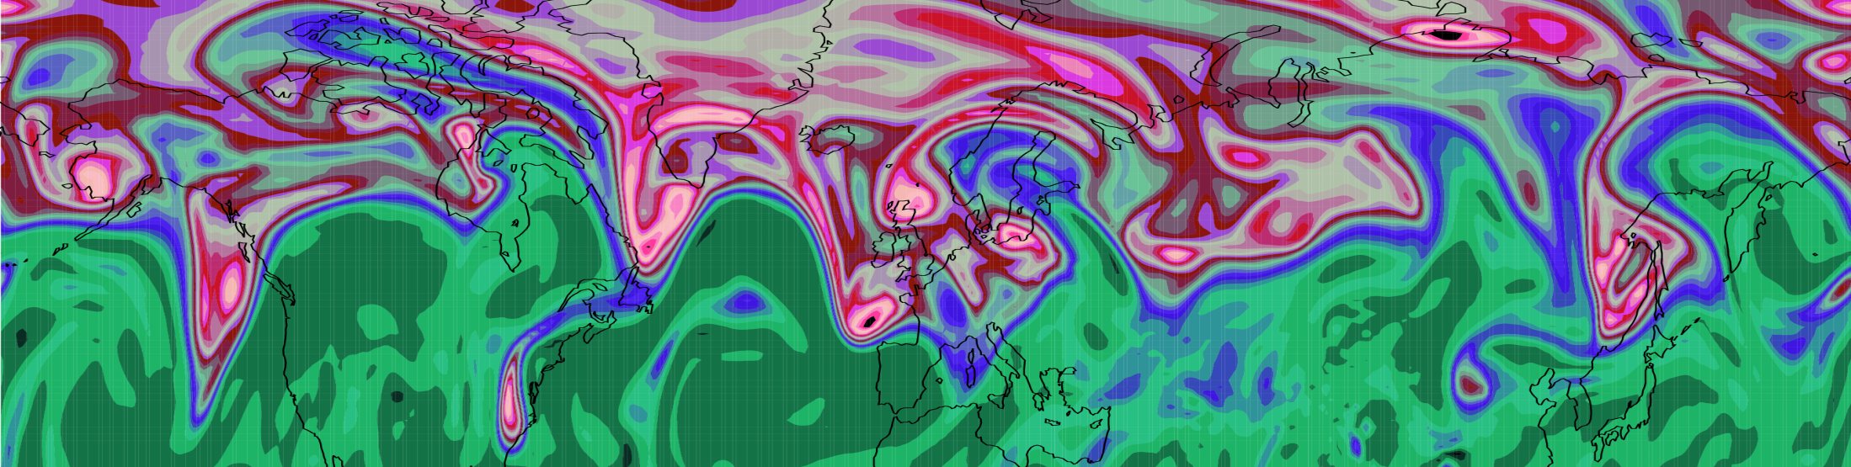
Mechanisms for Diabatic Influence on the Jet Stream and Obs Evidence
Department of Meteorology
John Methven, Ben Harvey, Leo Saffin, Jake Bland,
Sue Gray & Maarten Ambaum
Department of Meteorology, University of Reading
Andreas Schäfler, DLR
Claudio Sanchez, Met Office

Slide 2
Mechanisms for diabatic influence
Observations of North Atlantic jet stream structure.
Explore diabatic influences on Rossby waves at tropopause level.
Radiative maintenance of PV contrast across the tropopause
Sharpening of jet stream PV gradient and max winds by “non-advective PV flux” (heating in vertical wind shear)
Indirect influence of diabatic processes: Amplification of baroclinic wave growth rate via lower “effective static stability”
Diabatic mass transport into upper level ridges and importance for mid-latitude blocking

Slide 3
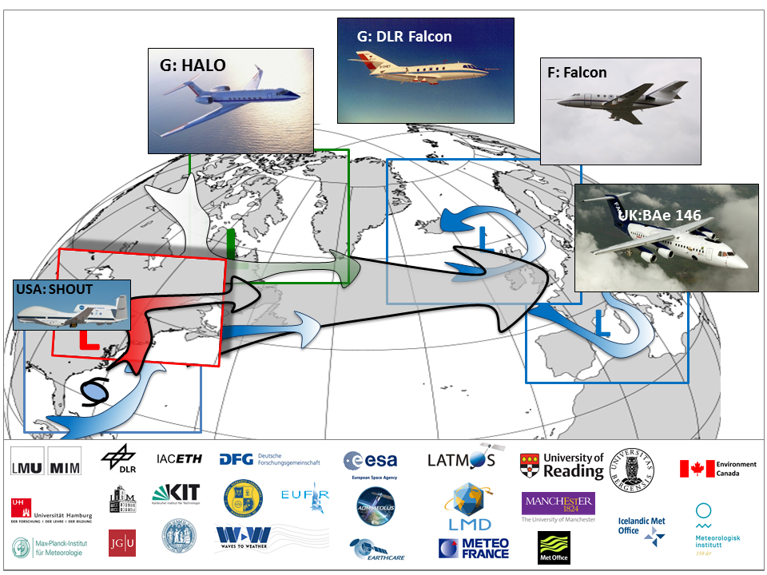
North Atlantic Waveguide and Downstream Impacts Experiment (NAWDEX)

Slide 4
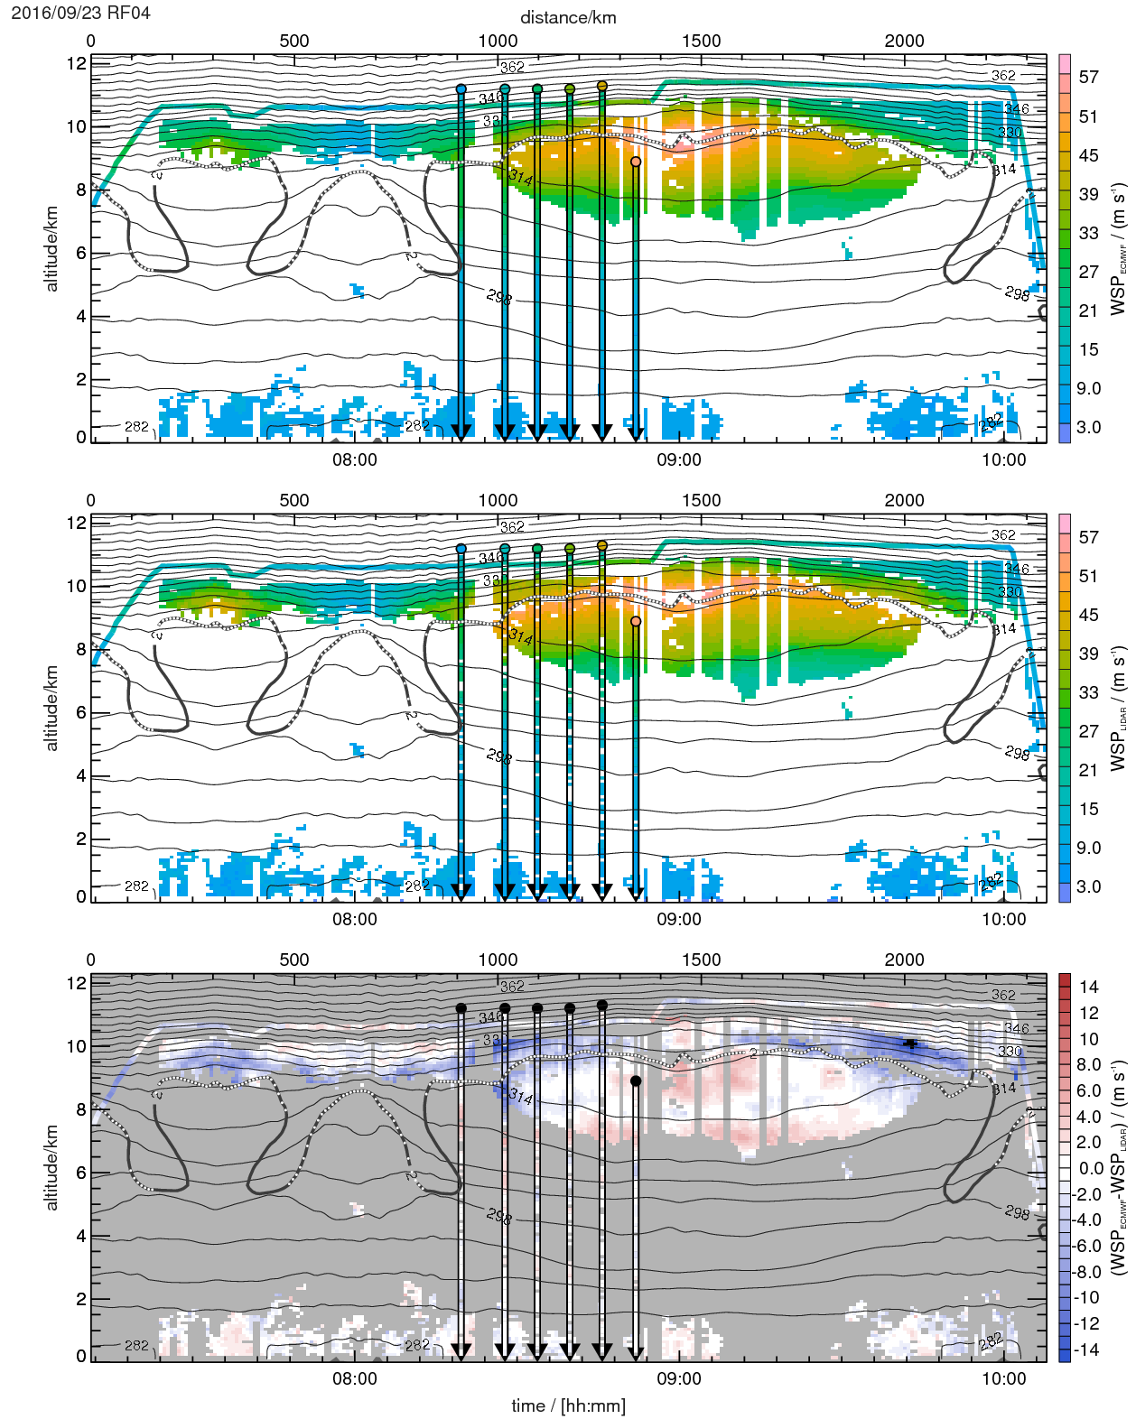
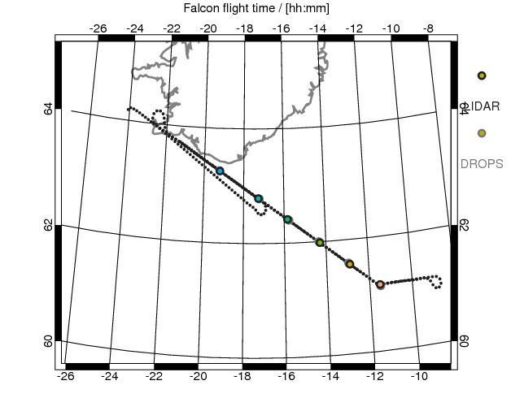
23 September 2016
Observations of jet structure
Lidar and dropsonde wind measurements are much closer to each other than analysis.
Structure of error similar in ECMWF and Met Office analyses
ECMWF
LIDAR &
SONDES
EC - LIDAR

Slide 5
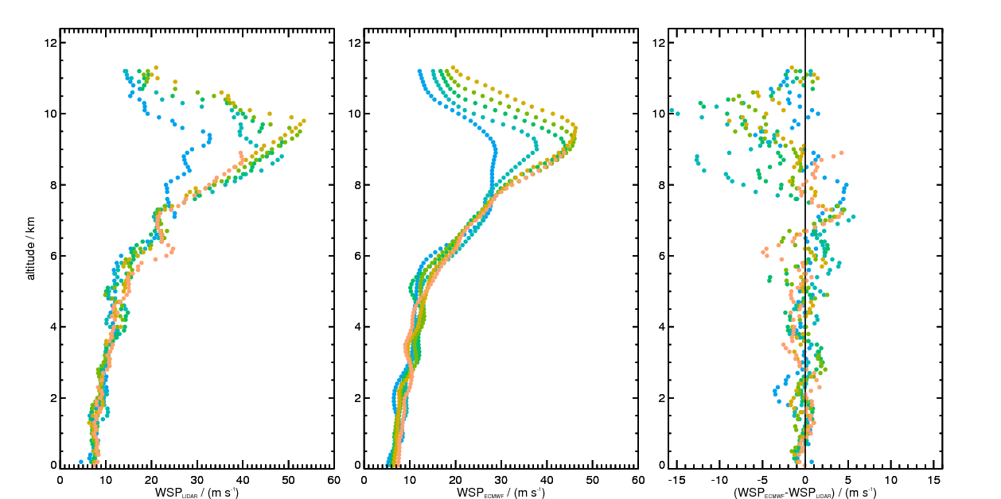
RF04: 23/9/16
Magnitude of analysis - obs wind
dropsondes
ECMWF
difference

Slide 6
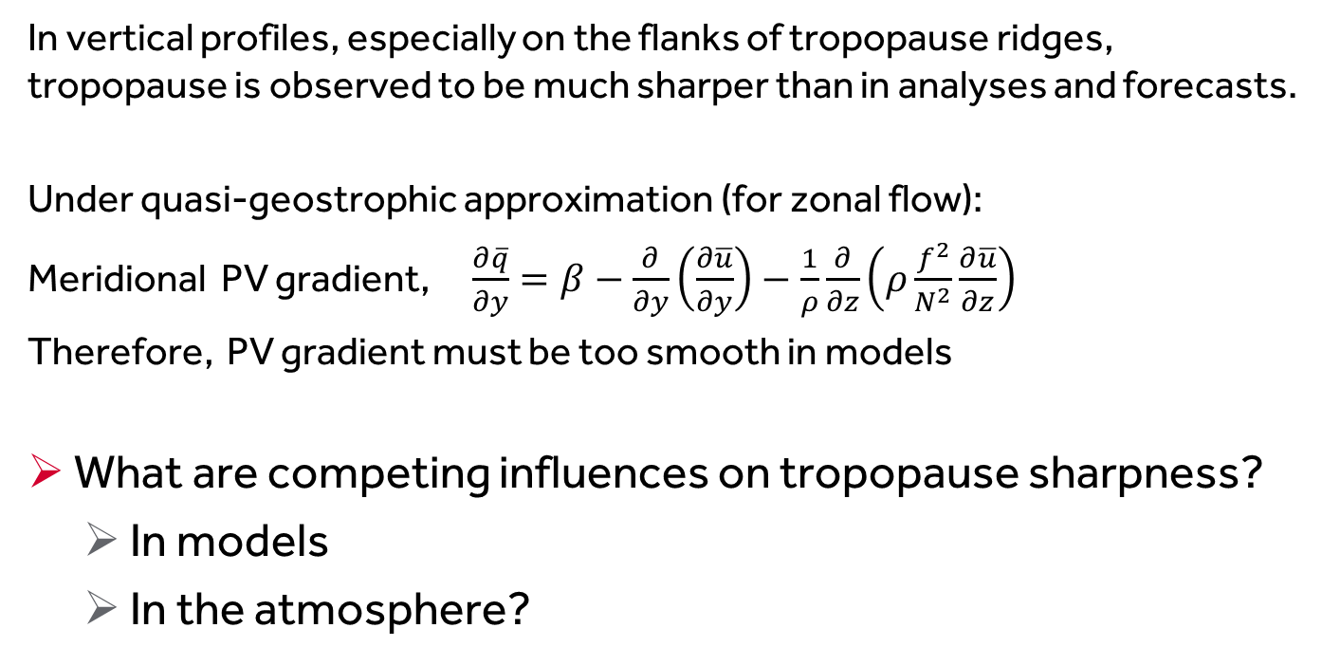
Observed jet stream is “sharper”
Tighter PV gradient and stronger max wind
In vertical profiles, especially on the flanks of tropopause ridges, tropopause is observed to be much sharper than in analyses and forecasts.
Under quasi-geostrophic approximation (for zonal flow):
Meridional PV gradient, $\frac{∂\overline{q}}{∂y}=β−\frac{∂}{∂y}\left(\frac{∂\overline{u}}{∂y}\right)−\frac{1}{ρ}\frac{∂}{∂z}\left(ρ\frac{f^{2}}{N^{2}}\frac{∂\overline{u}}{∂z}\right)$
Therefore, PV gradient must be too smooth in models
What are competing influences on tropopause sharpness?
  In models
  In the atmosphere?

Slide 7
“Diabatic PV tracers” - tracking
non-conservative changes in PV
PV tracer diagnostics are based on a Lagrangian decomposition of the PV field, q
Full PV conservation equation can be written:
where Si denotes the Lagrangian tendency resulting from one physical process in model
Diabatic tracers qi are initialised as zero but experience only one of the Si terms, and are advected by the semi-Lagrangian scheme.
⇒ each tracer shows accumulated contribution of one process to PV.
{

Slide 8
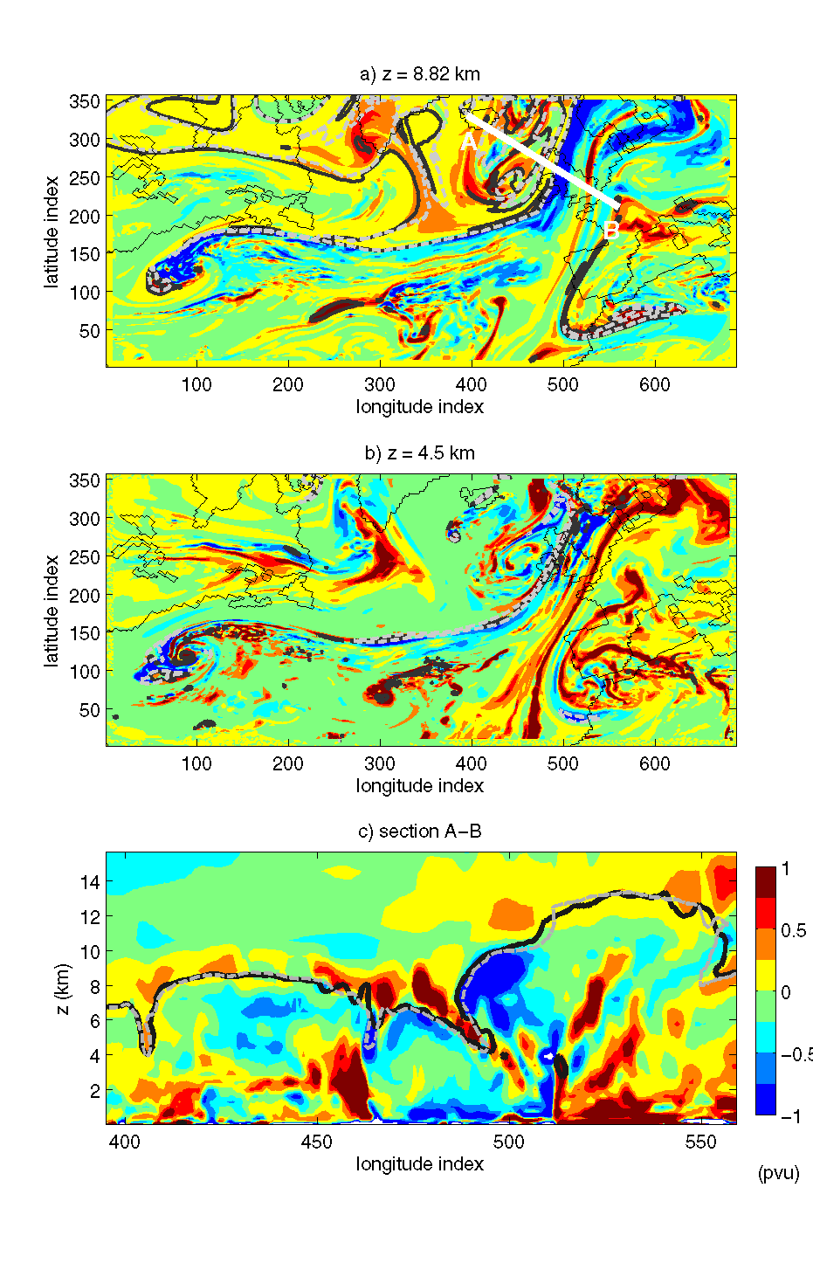
A. Radiative maintenance of PV contrast
Positive diabatic PV above (on strat side) of tropopause
Negative diabatic PV beneath (on trop side) of tropopause
Tropopause elevation not significantly altered by direct diabatic PV modification
Chagnon, Gray and Methven (2013), Q J R Met S

Slide 9
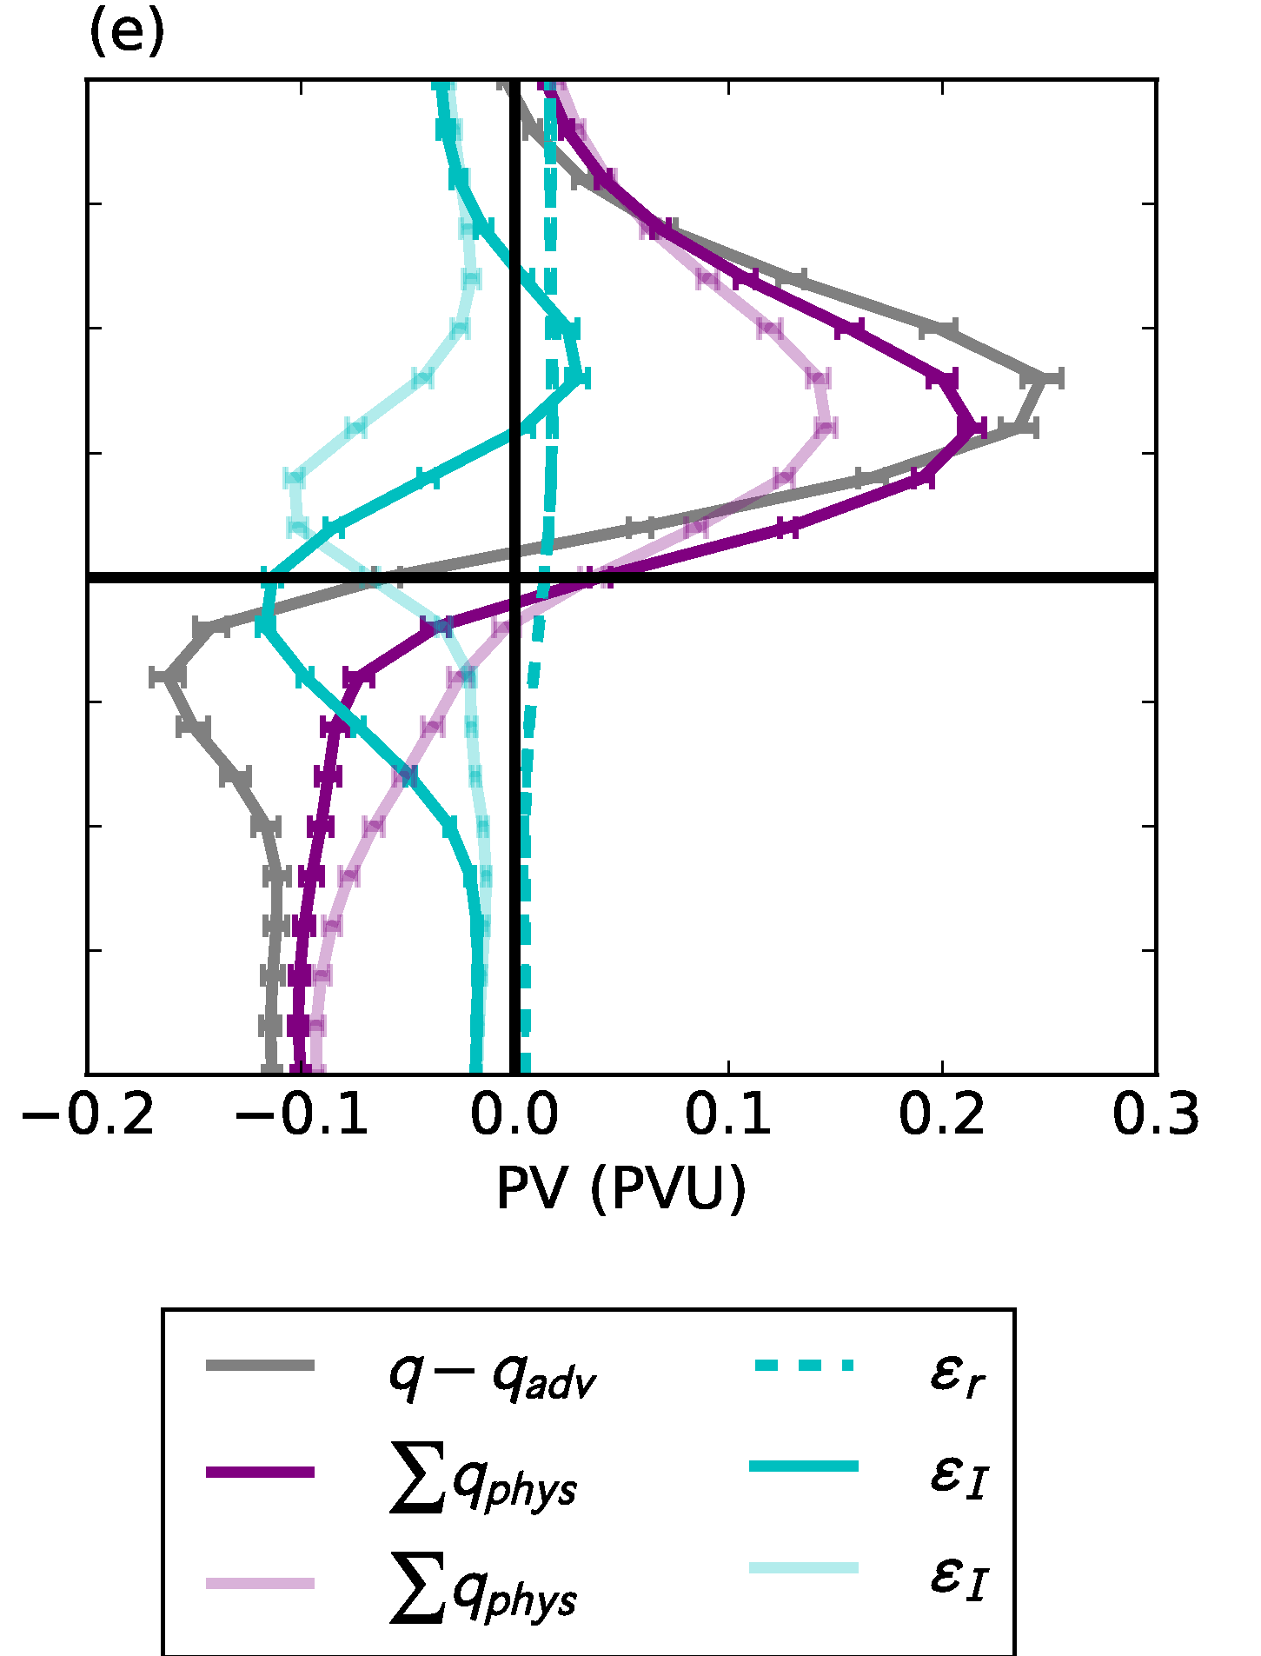
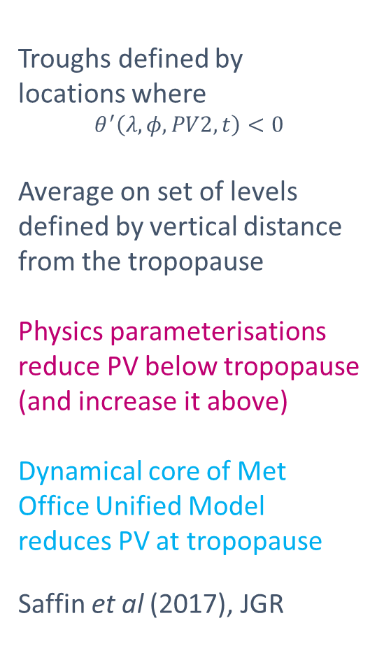
Composite of 92 winter forecasts
Relative to the tropopause in troughs
Troughs defined by
locations where
$$θ^{′}\left(λ,φ,PV2,t\right)<0$$
Average on set of levels defined by vertical distance from the tropopause
Physics parameterisations reduce PV below tropopause (and increase it above)
Dynamical core of Met Office Unified Model reduces PV at tropopause
Saffin et al (2017), JGR
2 km
z-z_{tpp}
0 km
-2 km

Slide 10
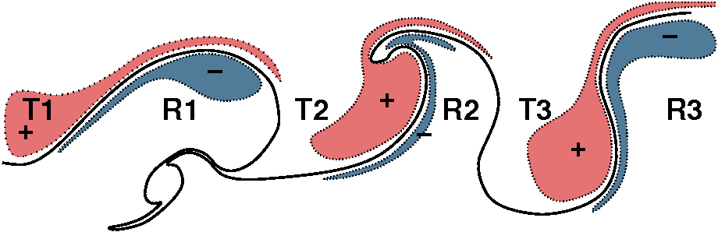
Diabatic influence on Rossby waves
LW cooling max at tropopause (humidity step)
  “diabatic PV dipole” but little direct PV change at tropopause
  enhances tropopause PV gradient
  ⇒ would be influenced by cirrus just under tropopause
Diabatic PV enhances PV anomaly pattern of Rossby wave
  greater westward propagation and enhanced baroclinic interaction
  But, also stronger jet associated with greater PV contrast
Chagnon, Gray and Methven (2013), QJRMetS

Slide 11


B. Jet sharpening by non-advective PV flux
Lagrangian form of Ertel PV equation:
PV increases below heating maximum (and decreases above it).
However, there is not an obvious constraint on PV values.
Now consider flux (or local conservation) form of PV equation:
J = “non-advective PV flux” arising from non-conservative processes
(Haynes & McIntyre, 1987, JAS)
$$=−∇.J$$

Slide 12
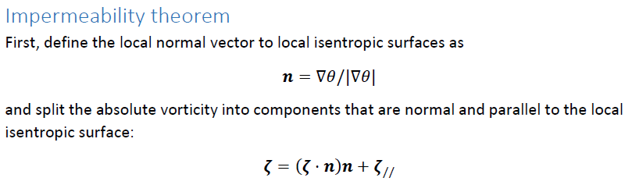




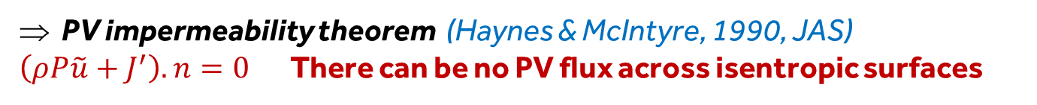
PV evolution equation (I)
We can write the flux form PV equation as:
Using and partitioning velocity into cross-isentropic and along-isentropic components :
$$=−∇.J′$$
PV impermeability theorem (Haynes & McIntyre, 1990, JAS)
$\left(ρP\tilde{u}+J^{′}\right).n=0$There can be no PV flux across isentropic surfaces

Slide 13



PV evolution equation (II)
An alternative Lagrangian form of PV equation.
Evolution following flow within an isentropic layer
Non-advective transport of
PV along $θ$ surfaces
Concentration/dilution of PV
above/below heating
Negative PV cannot arise through diabatic mass flux convergence
If P>0 initially, it must remain positive through the first term on right.

Slide 14
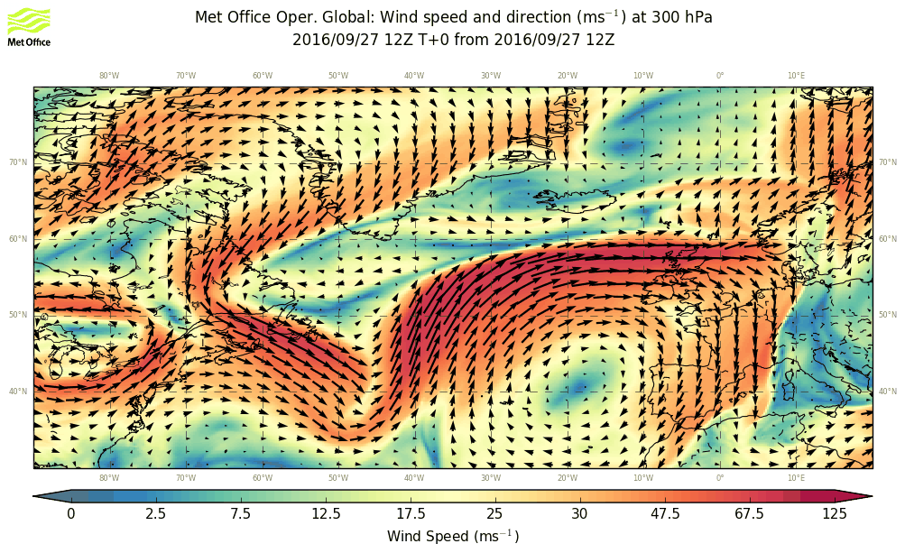
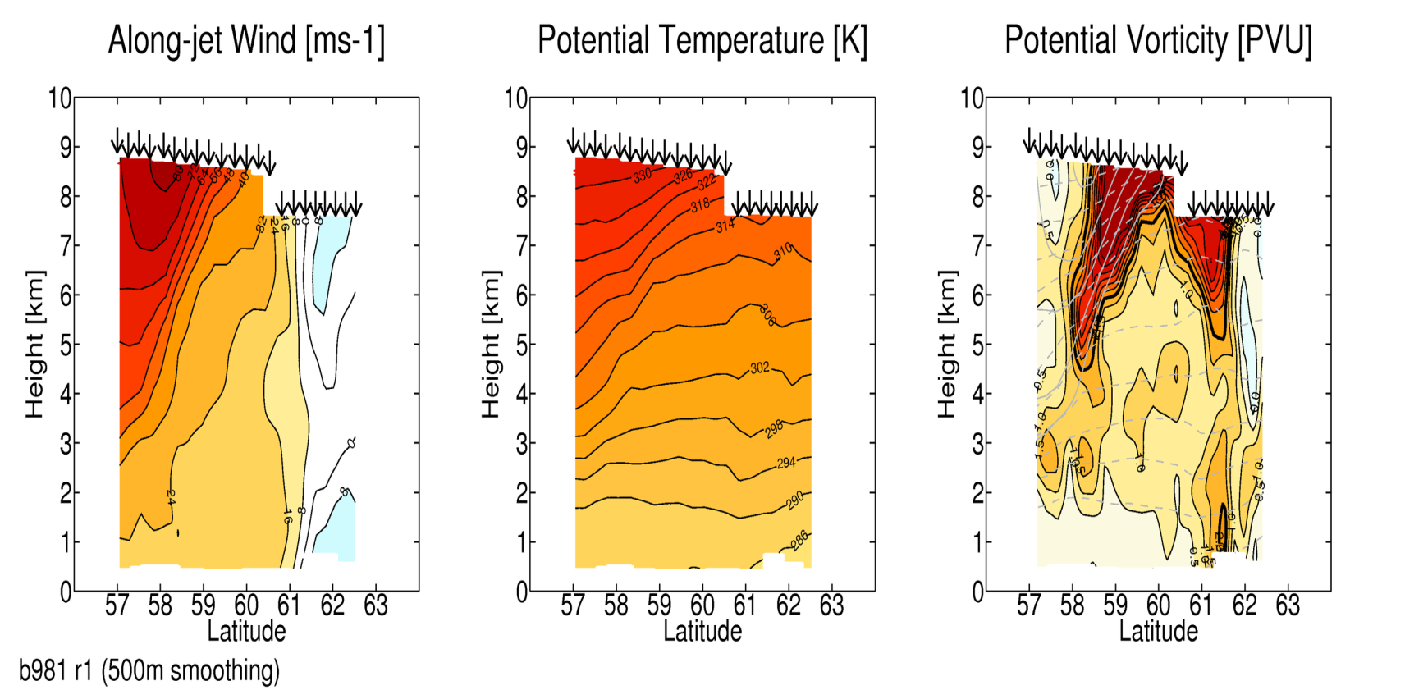
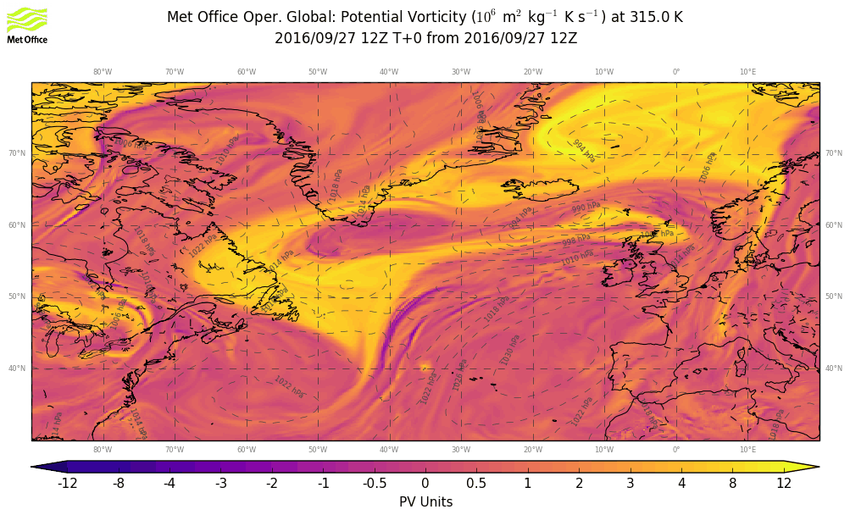
NAWDEX jet streak case
12Z: wind at 300 hPa
12Z: PV on 315 K
22 dropsondes on section crossing the jet stream
Harvey & Methven (2019, in prep.)

Slide 15
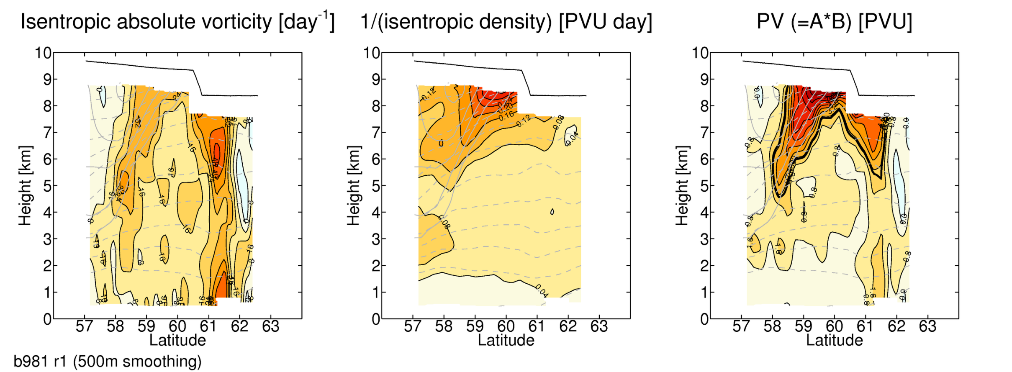
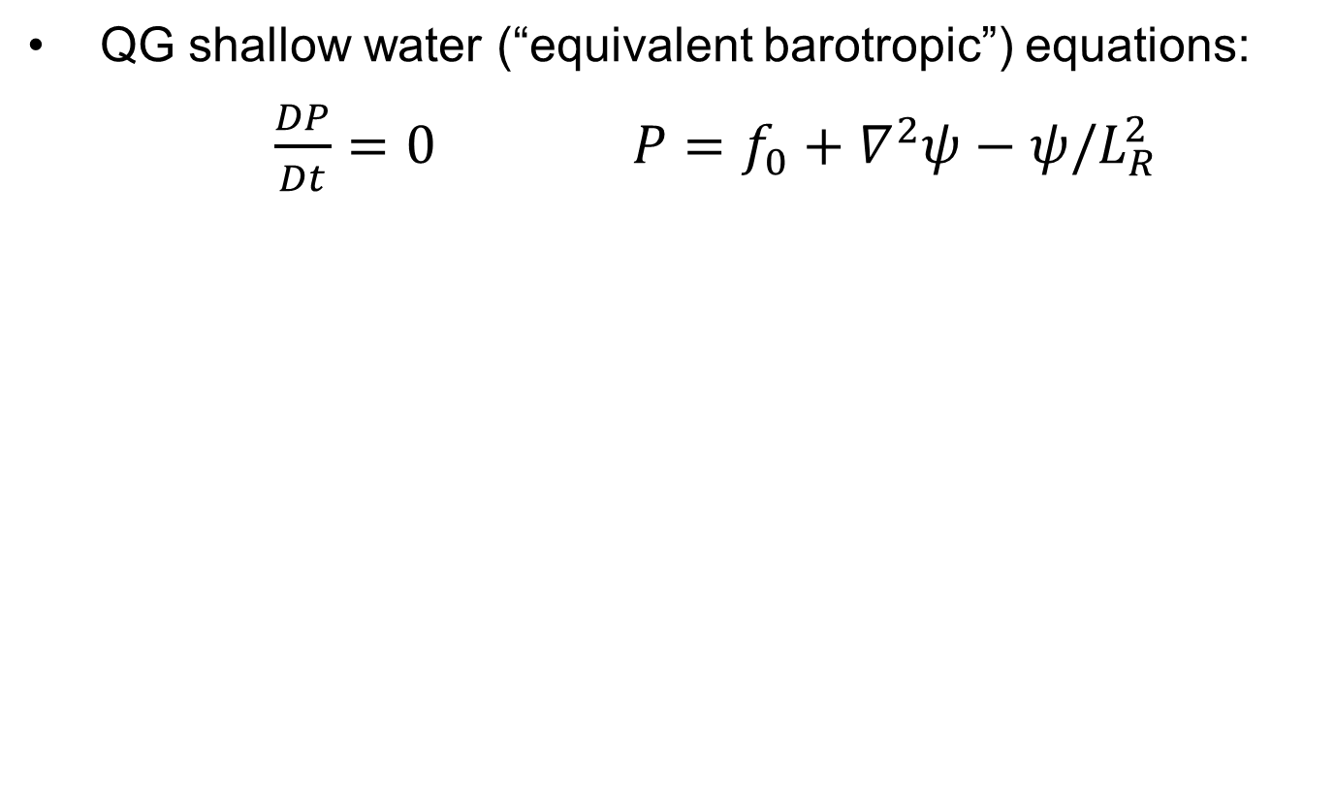
Negative PV observed with dropsondes
Signature of diabatic processes sharpening jet stream
$P=\frac{1}{ρ}ζ⋅∇θ=(ζ⋅n)\frac{|∇θ|}{ρ}$ where $n=\frac{∇θ}{|∇θ|}$

Slide 16
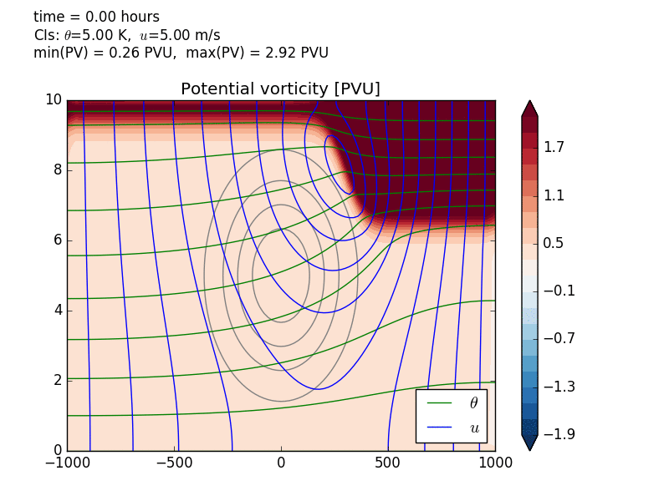
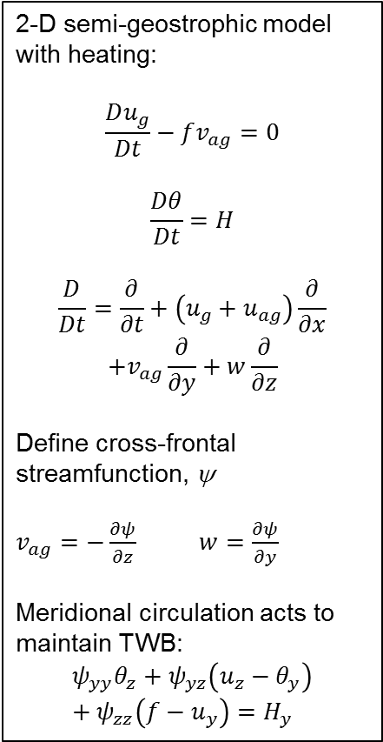
Response to “WCB” heating (imposed)
2-D semi-geostrophic model with heating:
$$\frac{Du_{g}}{Dt}−fv_{ag}=0$$
$$\frac{Dθ}{Dt}=H$$
$$\frac{D}{Dt}=\frac{∂}{∂t}+\left(u_{g}+u_{ag}\right)\frac{∂}{∂x}$$
$$+v_{ag}\frac{∂}{∂y}+w\frac{∂}{∂z}$$
Define cross-frontal streamfunction, ψ
$v_{ag}=−\frac{∂ψ}{∂z}$ $w=\frac{∂ψ}{∂y}$
Meridional circulation acts to maintain TWB:
$$ψ_{yy}θ_{z}+ψ_{yz}\left(u_{z}−θ_{y}\right)+ψ_{zz}\left(f−u_{y}\right)=H_{y}$$
Height [km]
Distance [km]

Slide 17
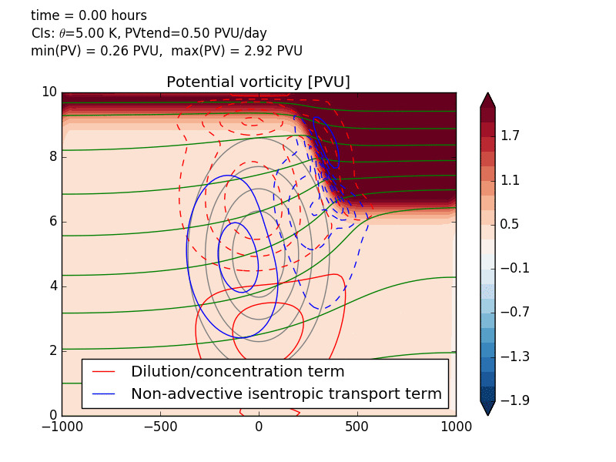
Response to “WCB” heating (imposed)
2-D semi-geostrophic model with heating:
$$\frac{Du_{g}}{Dt}−fv_{ag}=0$$
$$\frac{Dθ}{Dt}=H$$
$$\frac{D}{Dt}=\frac{∂}{∂t}+\left(u_{g}+u_{ag}\right)\frac{∂}{∂x}$$
$$+v_{ag}\frac{∂}{∂y}+w\frac{∂}{∂z}$$
Define cross-frontal streamfunction, ψ
$v_{ag}=−\frac{∂ψ}{∂z}$ $w=\frac{∂ψ}{∂y}$
Meridional circulation acts to maintain TWB:
$$ψ_{yy}θ_{z}+ψ_{yz}\left(u_{z}−θ_{y}\right)+ψ_{zz}\left(f−u_{y}\right)=H_{y}$$
Height [km]
Distance [km]

Slide 18
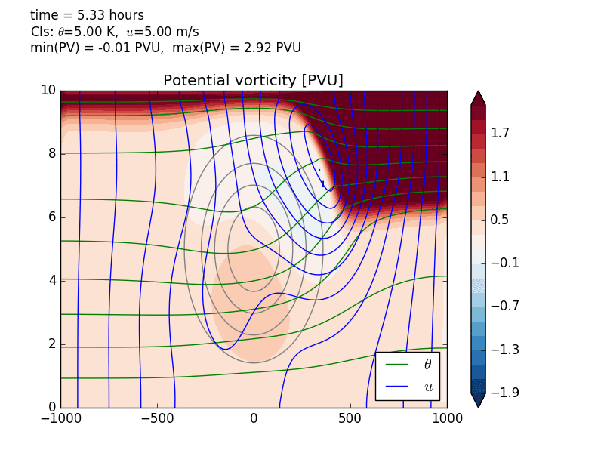
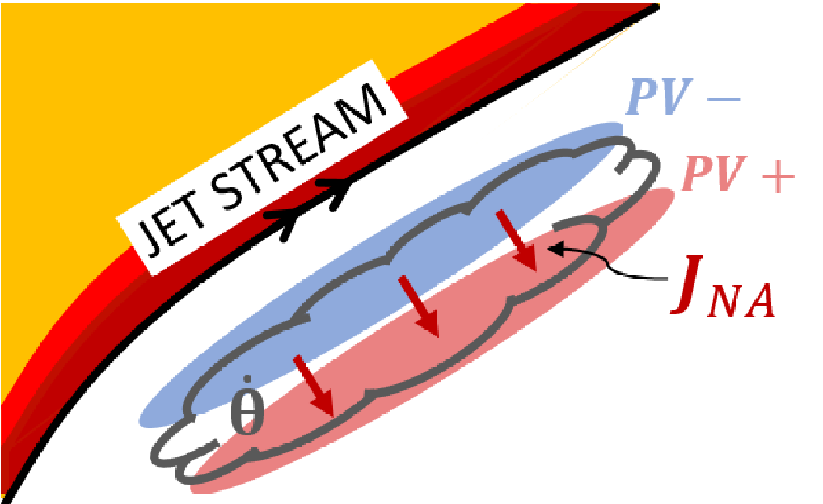
Response to “WCB” heating (imposed)
2-D semi-geostrophic model with heating:
$$\frac{Du_{g}}{Dt}−fv_{ag}=0$$
$$\frac{Dθ}{Dt}=H$$
$$\frac{D}{Dt}=\frac{∂}{∂t}+\left(u_{g}+u_{ag}\right)\frac{∂}{∂x}$$
$$+v_{ag}\frac{∂}{∂y}+w\frac{∂}{∂z}$$
Define cross-frontal streamfunction, ψ
$v_{ag}=−\frac{∂ψ}{∂z}$ $w=\frac{∂ψ}{∂y}$
Meridional circulation acts to maintain TWB:
$$ψ_{yy}θ_{z}+ψ_{yz}\left(u_{z}−θ_{y}\right)+ψ_{zz}\left(f−u_{y}\right)=H_{y}$$
Height [km]
Distance [km]

Slide 19
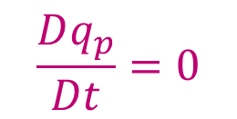

C. Indirect influence of diabatic processes
PV conservation equation ……….. and PV-tracer
$$\frac{Dq_{p}}{Dt}=0$$
$$q_{p}\left(0\right)=q(0)$$
Using observation of little direct diabatic PV modification at tropopause:
However, diabatic effects are felt mainly through induced wind, u_{i}
Indirect PV modification by diabatic processes via changes to winds.
Links directly with moist baroclinic wave theory (De Vries, 2010, JAS).
Cooperative coupling between diabatic PV in troposphere and Rossby waves along tropopause or lower boundary.

Slide 20
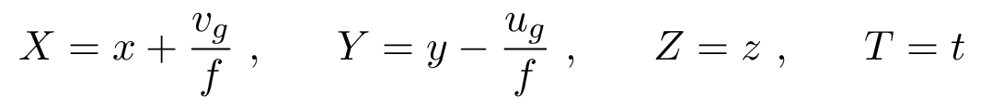
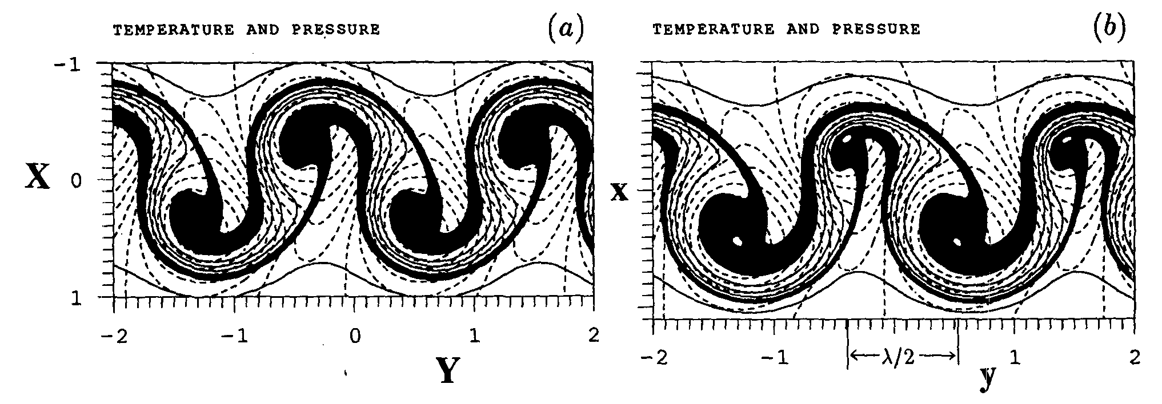
Semi-geostrophic theory in 3-D (Hoskins, 1975)
Makes geostrophic momentum approximation (GMA)
  Advection by full flow including w and ageostrophic wind
Q. How is Rossby wave propagation affected compared with basic QG theory?
Amazingly, using the S-G coordinate transformation:
the S-G evolution in (X, Y, Z) is similar to Q-G evolution in (x, y, z)
Transformed into physical coords, +ve vorticity regions contract
Figure: Davies, Schar and Wernli, J. Atmos. Sci., 1991

Slide 21
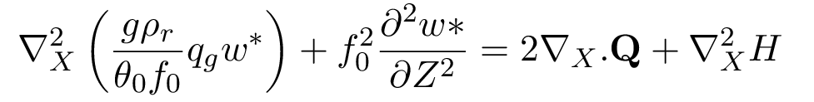
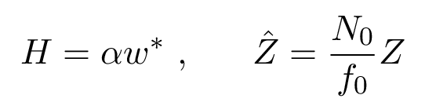
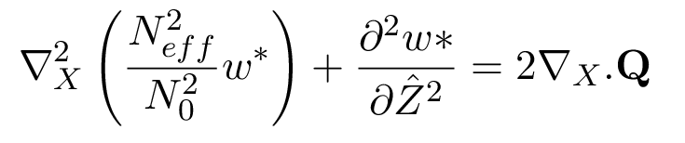
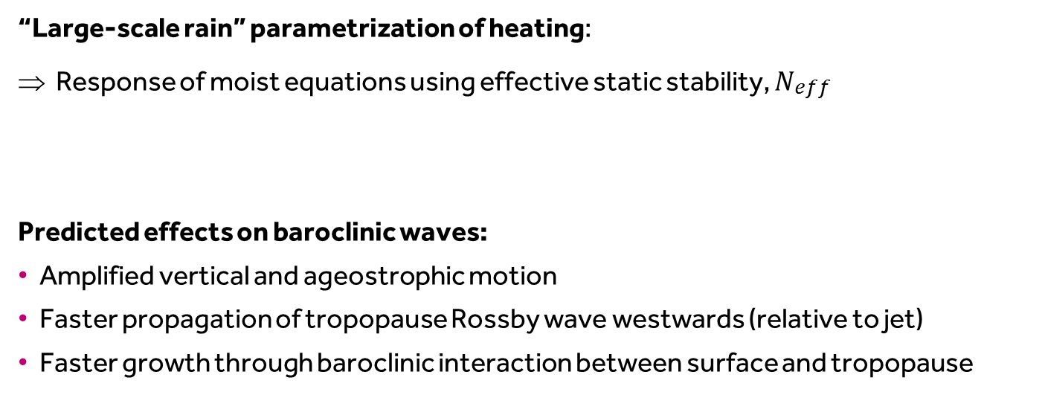
Effects of heating on Rossby waves
Vertical velocity can be deduced using the S-G omega equation.
Its form in momentum coordinates (Hoskins & Draghici, 1977 with heating) is:
Geostrophic forcing
Diabatic forcing (H=heating)
“Large-scale rain” parametrization of heating:
⇒ Response of moist equations using effective static stability, $N_{\begin{aligned}eff \\ \end{aligned}}$
Predicted effects on baroclinic waves:
Amplified vertical and ageostrophic motion
Faster propagation of tropopause Rossby wave westwards (relative to jet)
Faster growth through baroclinic interaction between surface and tropopause

Slide 22
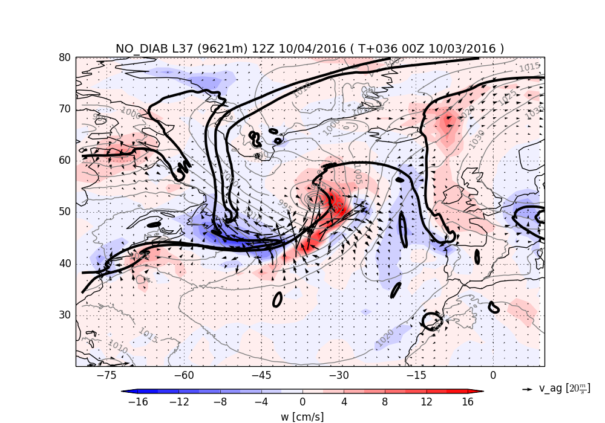
Amplification of ageostrophic flow by heating
Balanced ageostropic flow and w from S-G “omega” equation.
Without forcing from heating. Mike Cullen & Claudio Sanchez.

Slide 23
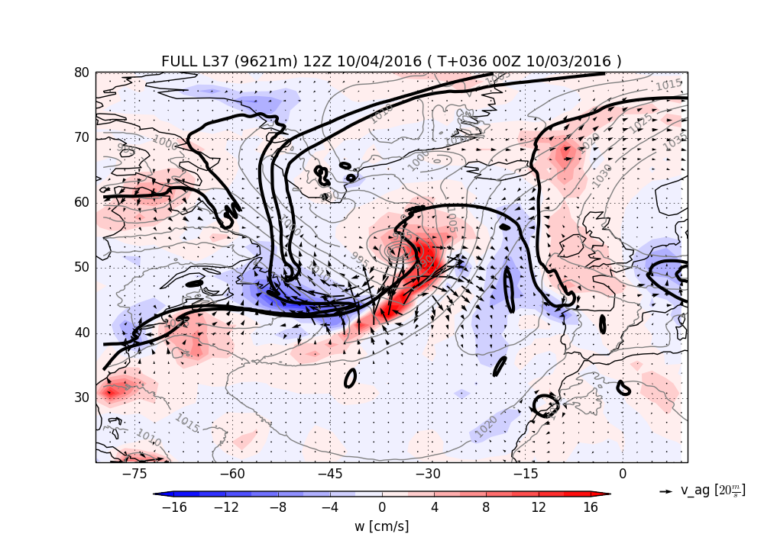
Amplification of ageostrophic flow by heating
Balanced ageostropic flow and w from S-G “omega” equation.
With forcing from full parametrized heating from MetUM.

Slide 24
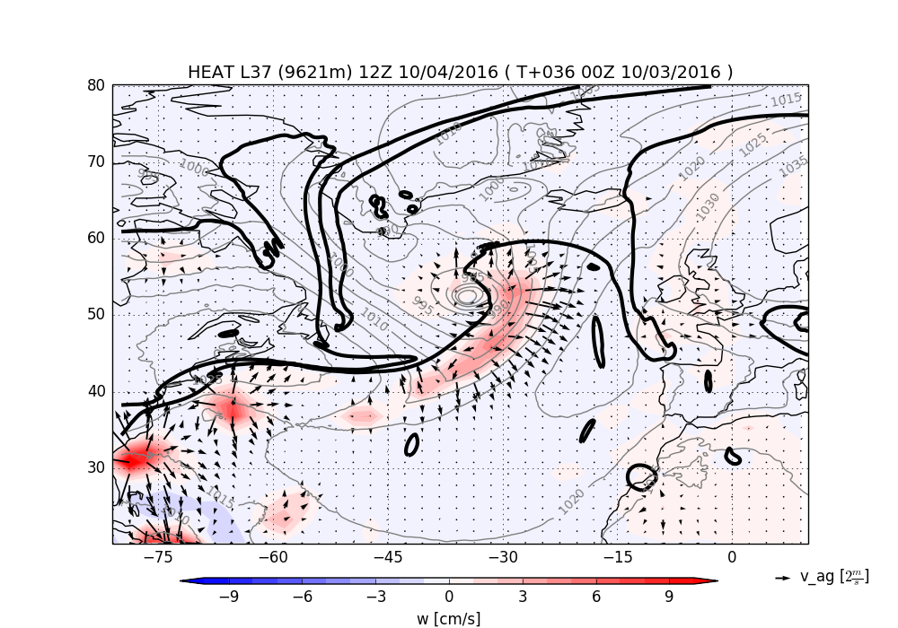
Amplification of ageostrophic flow by heating
Balanced ageostropic flow and w from S-G “omega” equation.
Only forcing from heating (no geostrophic forcing)

Slide 25
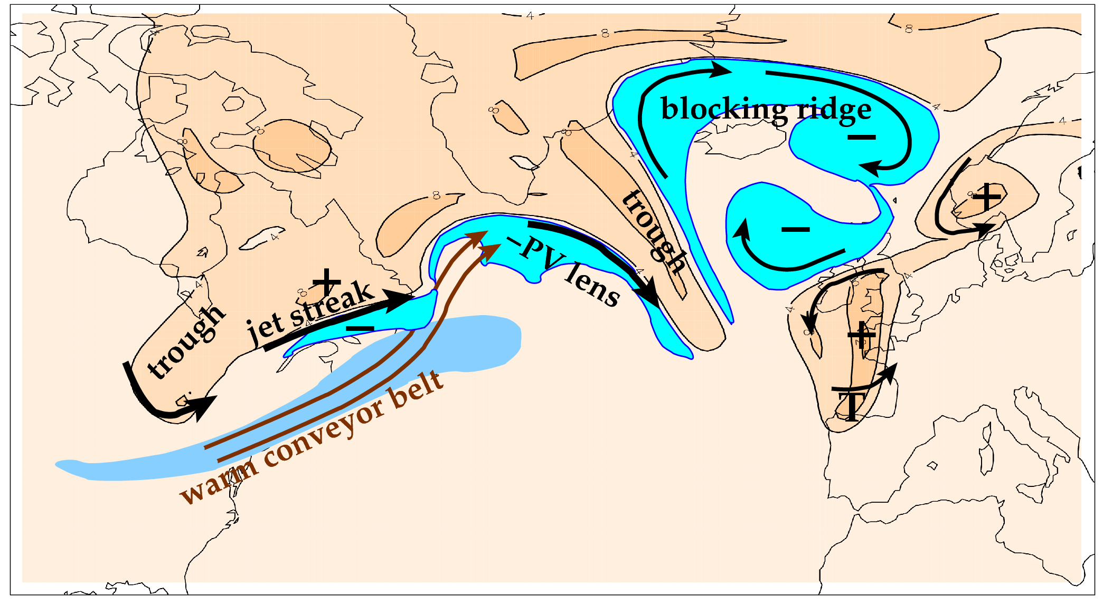
D. Diabatic mass transport into ridges
Features related to the meandering tropopause and jet stream (orange is stratospheric air; cyan marks upper tropospheric PV anomalies)

Slide 26
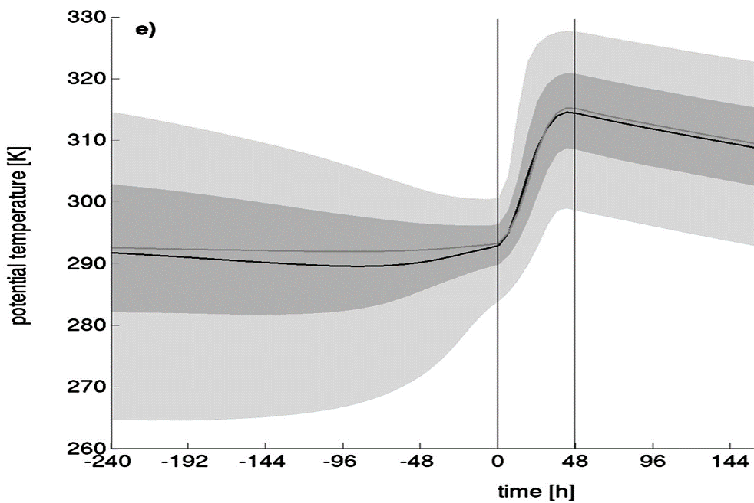
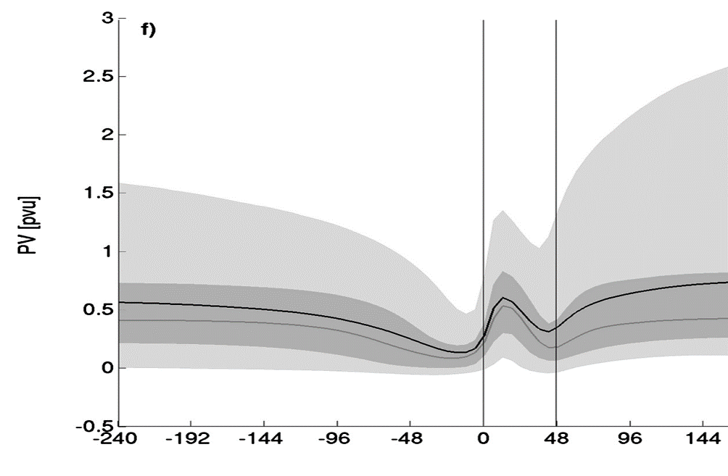
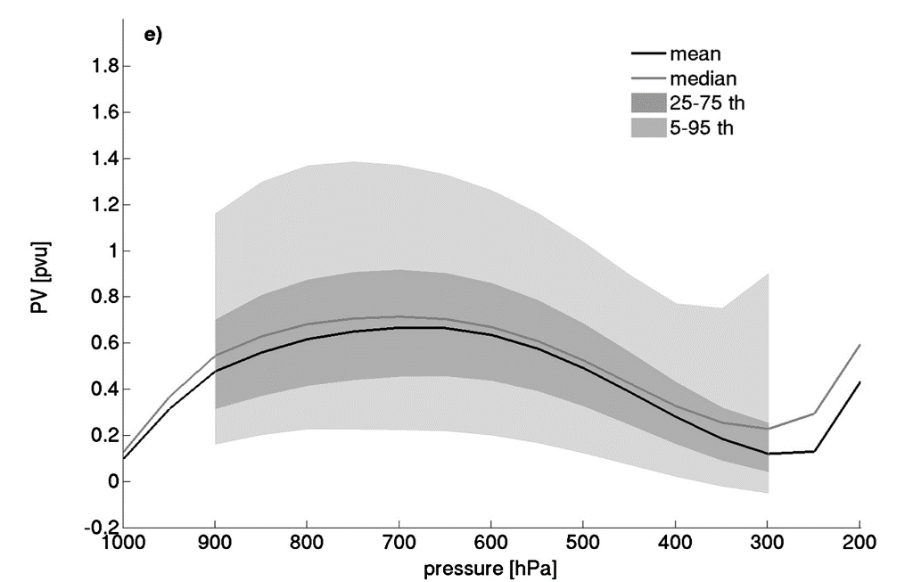
Air mass changes following WCB
WCB frequently defined as a coherent ensemble of trajectories (following the resolved flow)
Climatology from
Madonna et al, 2014, J. Climate
θ increases by greater than isentropic spread of the inflow or outflow layer of the CET
Although PV increases below heating maximum, it decreases again above. PV of outflow ≈ PV of inflow
Why is PV constrained in this way?
Implications for role of heating?

Slide 27
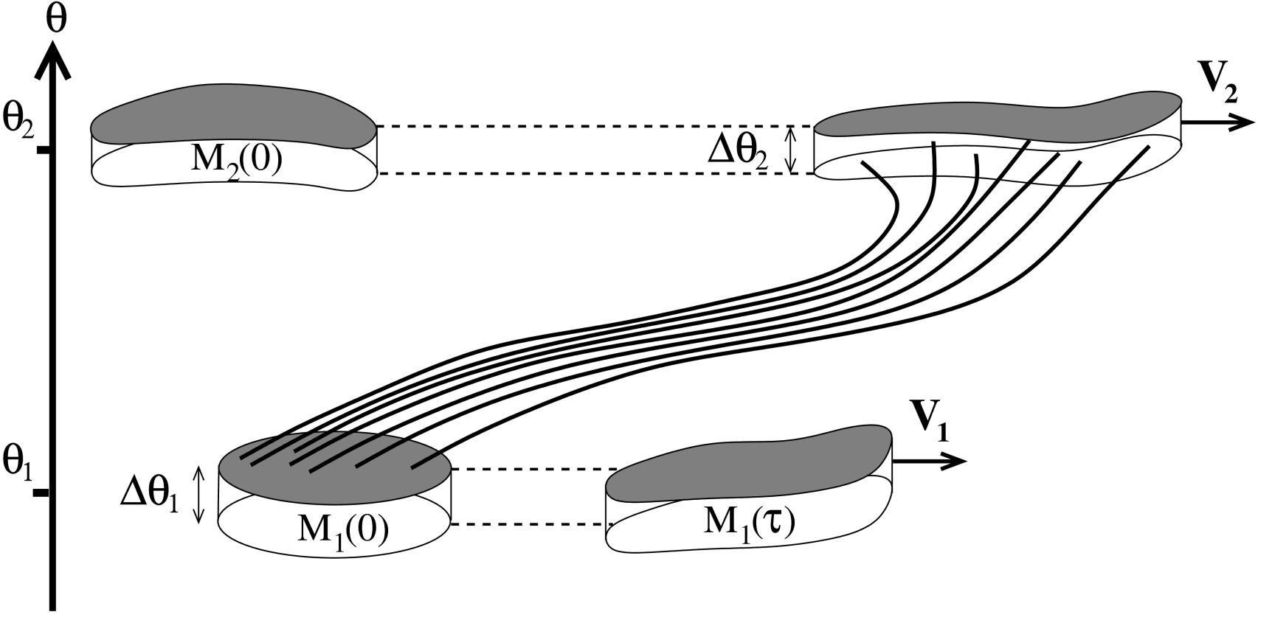

PV in warm conveyor belts
Consider two volumes, in isentropic layers representing the inflow and outflow of a warm conveyor belt.
Heating ⇒ diabatic mass transport from lower to upper volume
Concentrates PV substance of “inflow volume” and dilutes outflow PVS
$$\dot{θ}>0$$
Methven, Q. J. Royal Met. Soc. (2015)

Slide 28
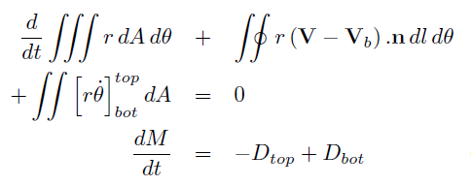

Integral PV conservation (circulation)
Integrate PV equation over control volume (lateral boundary velocity V_{b} )
Circulation conservation
(if V_{b}=V & J’-integral=0)
Integrate mass continuity over control volume
Diabatic mass flux convergence “dilutes” average PV
Mass-weighted average PV or amount of PV substance divided by mass
(Haynes & McIntyre, 1990)

Slide 29
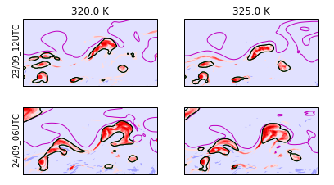

Defining outflow volume using net heating
Black contour = lateral boundary of “outflow volume” on θ-surface

Slide 30
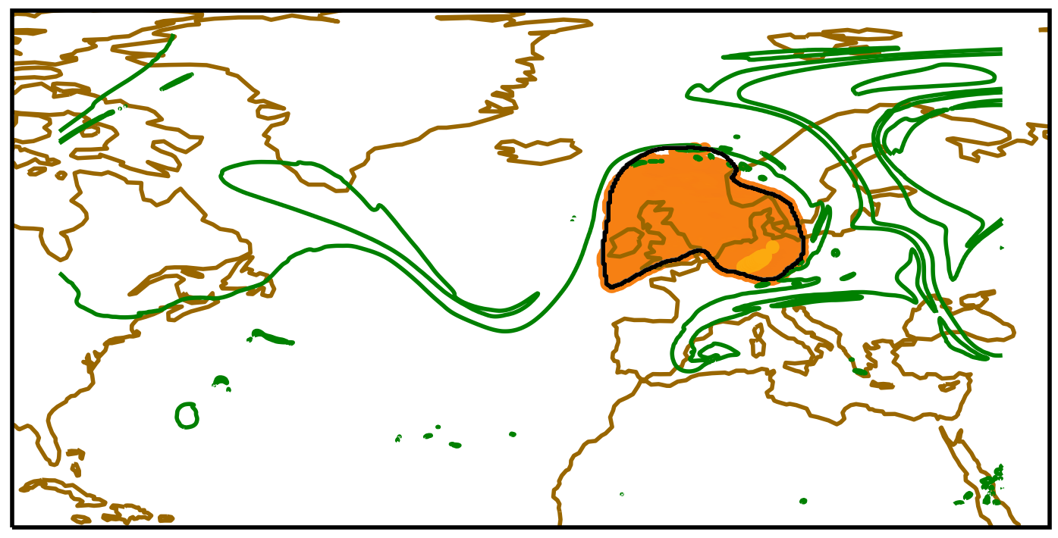
Outflow volume at outflow time
Black contour = lateral boundary of “outflow volume” on 325K surface
Yellow = release locations of 3D back trajectories from outflow volume
Green contour = tropopause on 325K

Slide 31
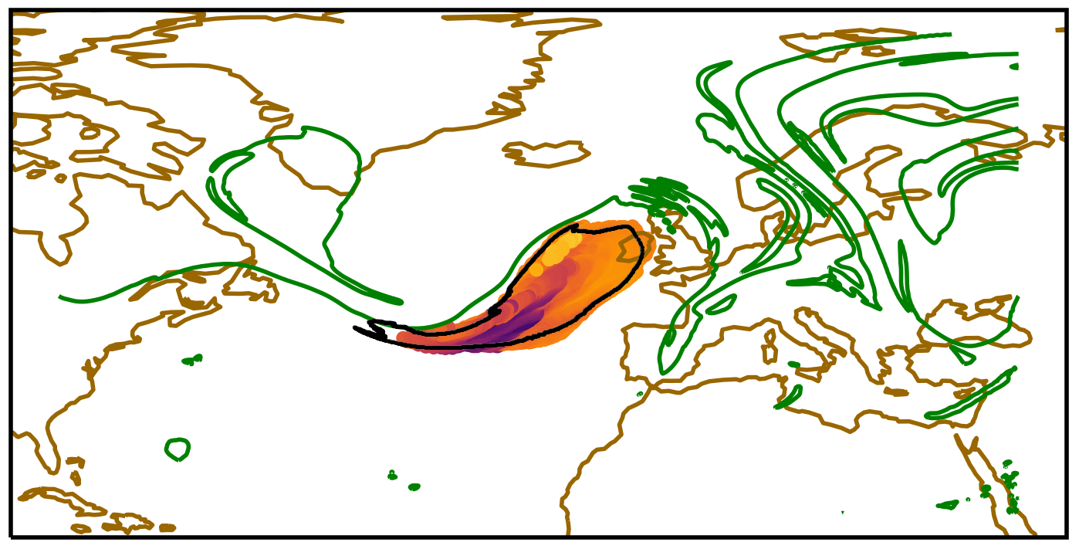
Following backwards (T-18)
Contour = lateral boundary of “outflow volume” on 325K surface
Colour dots = θ at locations of 3D back trajectories from outflow volume
Green contour = tropopause on 325K

Slide 32
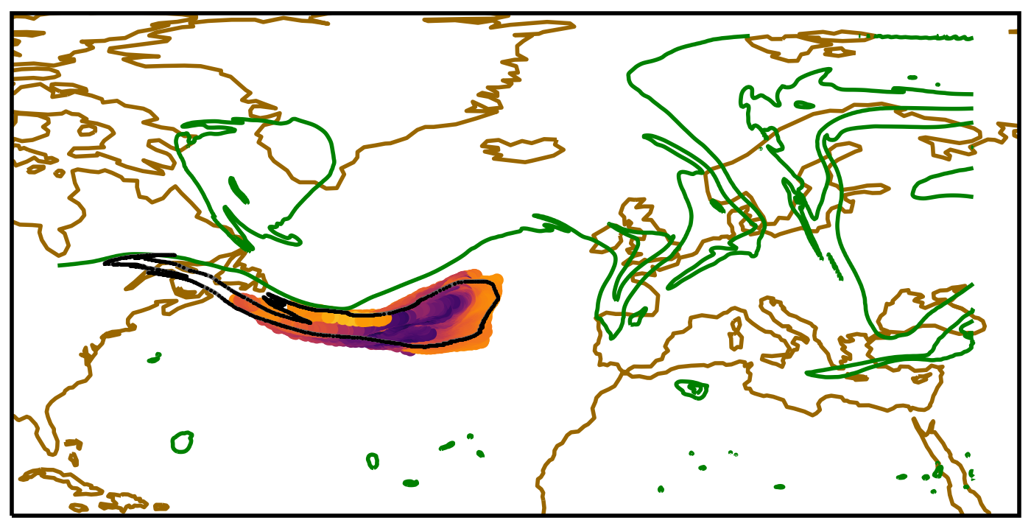
Following backwards (T-30)
Contour = lateral boundary of “outflow volume” on 325K surface
Colour dots = θ at locations of 3D back trajectories from outflow volume
Green contour = tropopause on 325K

Slide 33
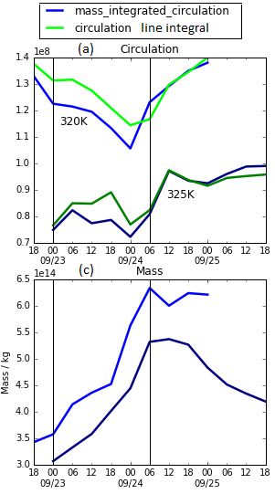





Circulation and mass of outflow
Large increase in mass of outflow volume (x2) by diabatic mass transport from below.
But, variation in circulation is small.
Consequence of PV impermeability theorem, Haynes and McIntyre (1987, 1990).
Circulation cannot be changed through diabatic mass flux.
Then, why is outflow size important to block formation?
As area increases, anticyclonic relative flow (ξ < 0) is stronger around the boundary.
$$τ_{1}$$
$$τ_{2}$$
$$τ_{1}$$
$$τ_{2}$$
$$= <f+ξ>S$$

Slide 34
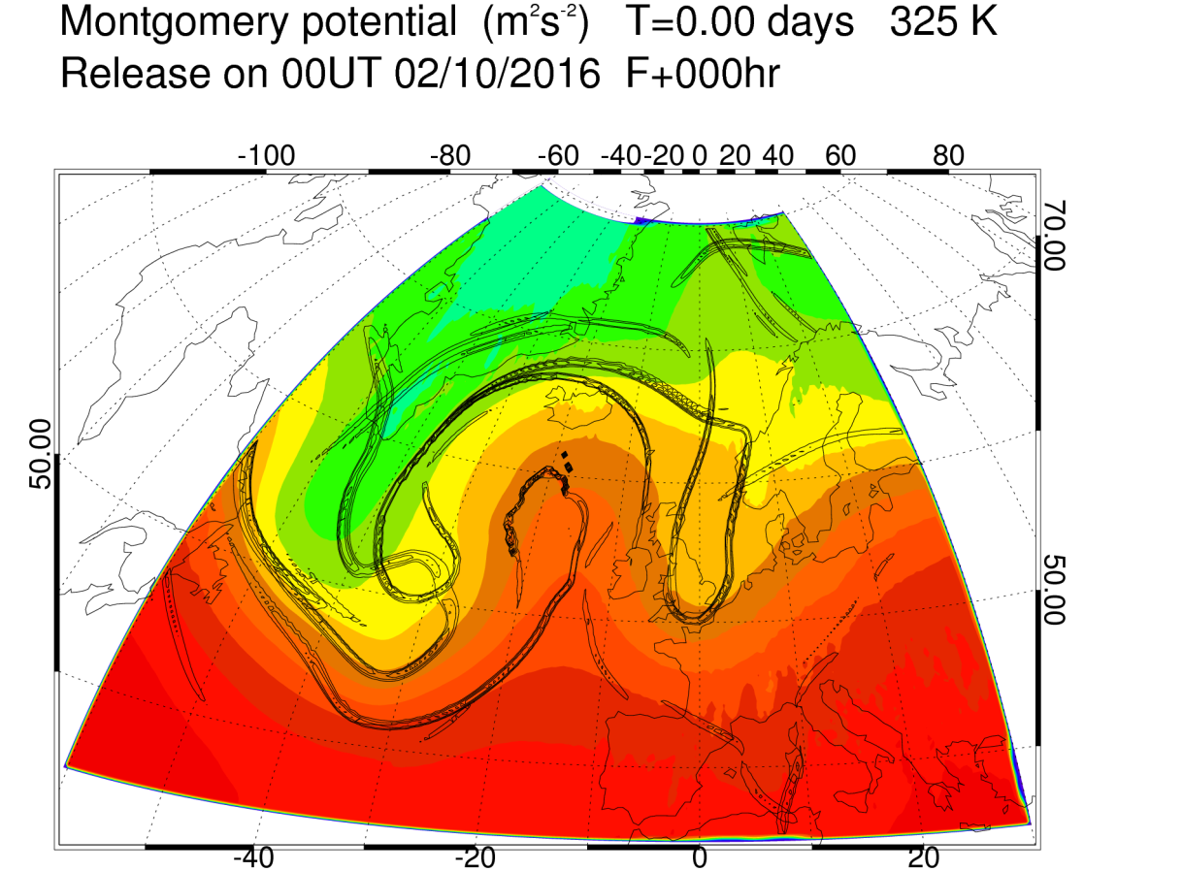
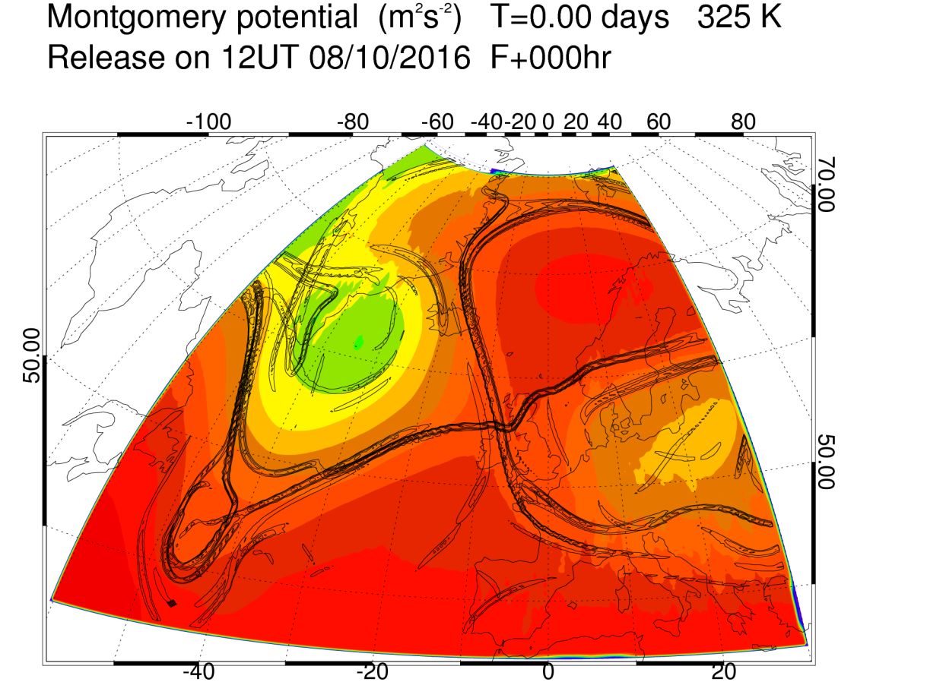
Transition from wave to block?
Block onset- transition from a large amplitude wave into dipole structure
Pfahl et al (2015).
Air masses in ridges making transition into block experience greater heating
How do diabatic processes influence this topological transition?

Slide 35
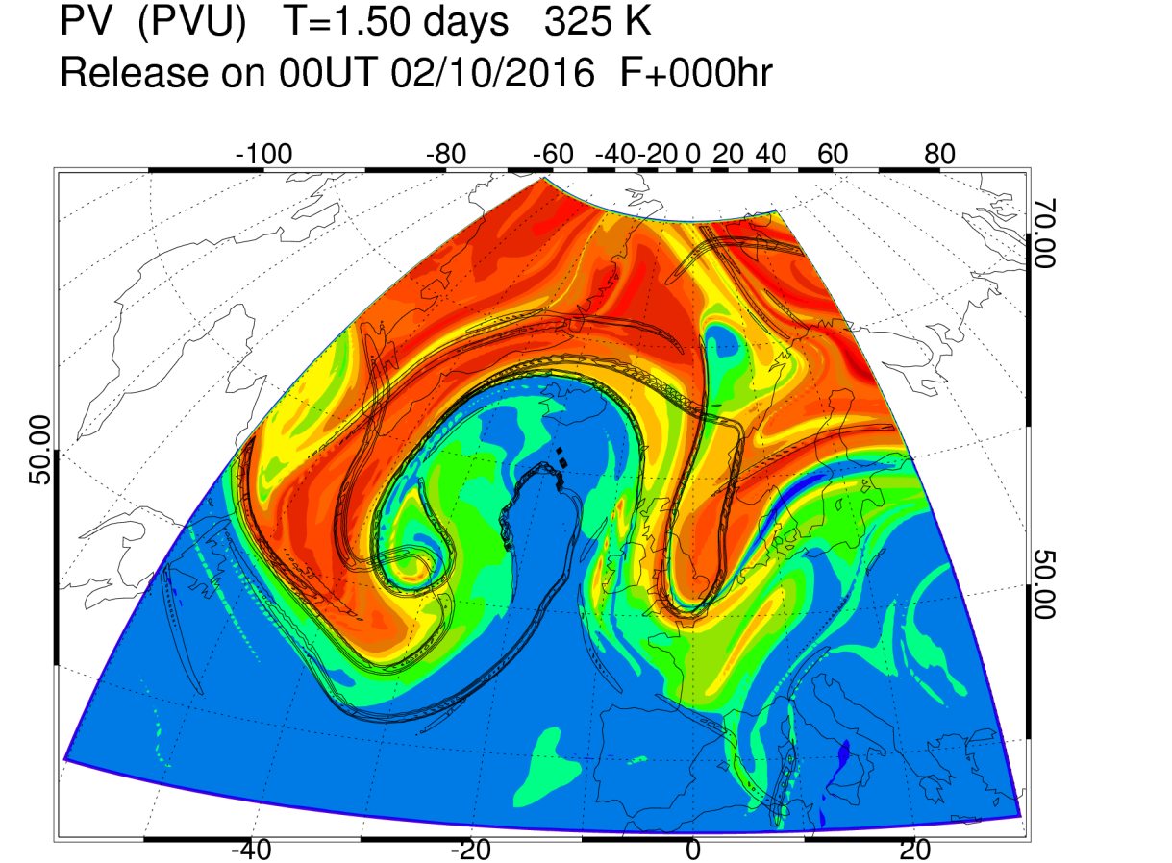
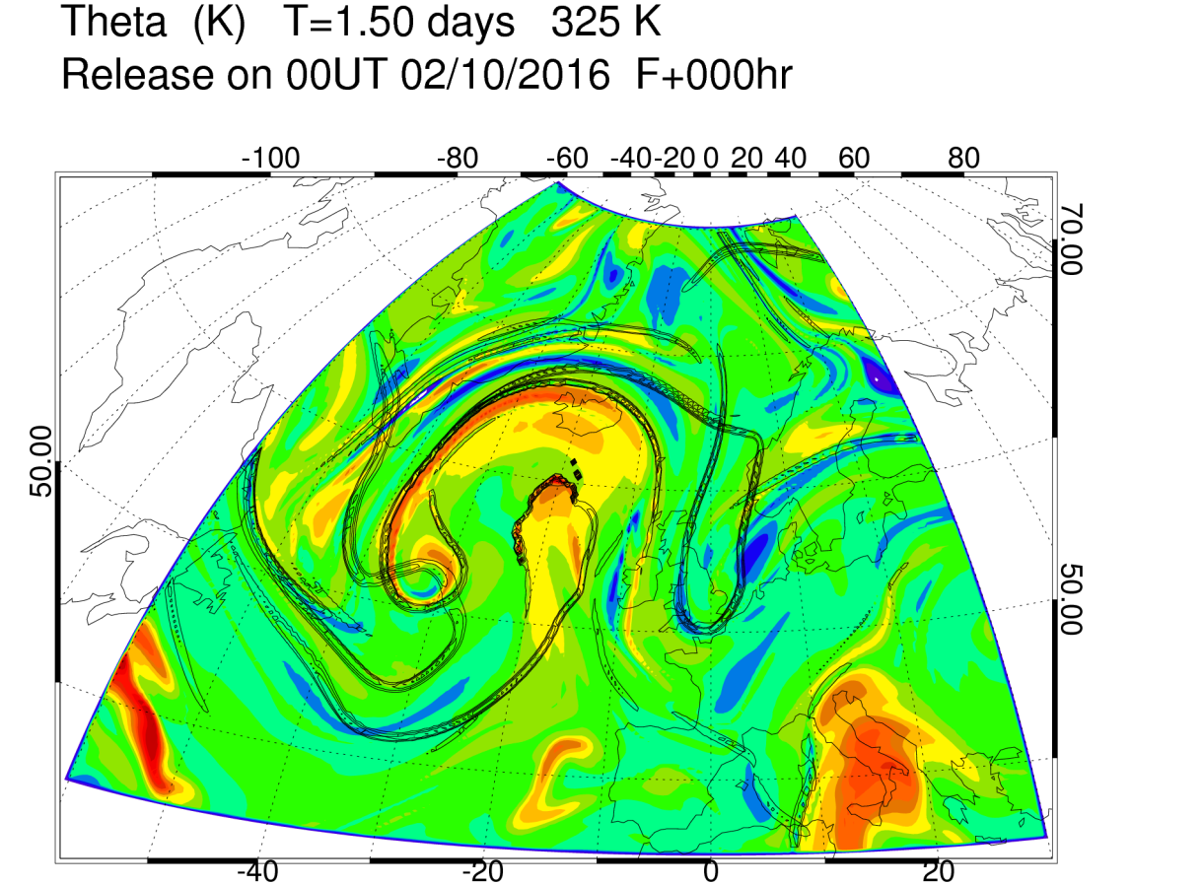
Diabatic mass transport into A/C cut-off volumes
Latent heating enables diabatic mass transport into cut-off volume.
Adiabatic flow would be constrained to isentropic surfaces and could not cross into cut-off, once formed.
Field is net heating along trajectories over 1.5 days
A
A

Slide 36
Conclusions
PV gradient at tropopause is too weak in global forecasts and declines
  expect Rossby waves to move eastwards too slowly in forecasts
  Rossby wave amplitude declines (on average)
  Mixing too strong, or diabatic maintenance too weak?
Negative PV must be signature of “diabatic sharpening” of jet stream
  Via non-advective PV flux which requires heating in vertical wind shear
Effects of heating in cyclones diluting PV in tropopause ridges
  Vertical motion and divergent outflow are amplified, but both captured partly by reduced static stability effect in S-G balanced dynamics
  Faster baroclinic growth rate and Rossby wave counter-propagation
Diabatic mass transport into cut-off anti-cyclonic coherent structures
  ⇒ Critical to onset of blocking and maintenance?

Slide 37
Thankyou for your attention

Slide 38
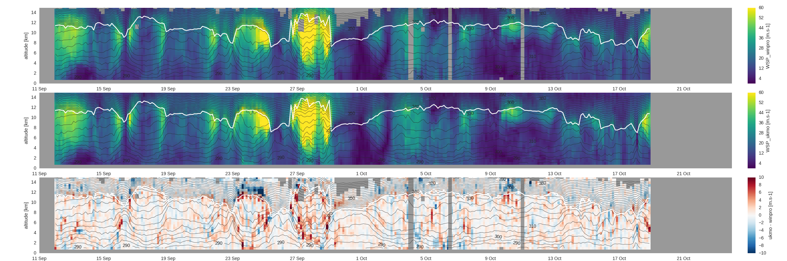
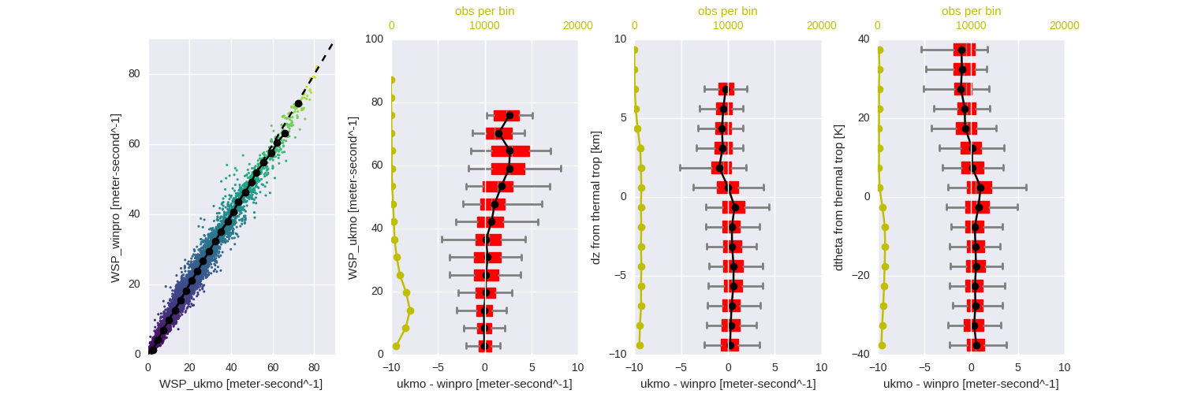
Obs vs model at T+0 Wind profiler @ South Uist
Obs
UKMO
Difference
Wind profiler (ST radar) and analyses compared.
Composite relative to height of the tropopause on each profile.
tropopause

Slide 39


Obs vs model at T+24
Obs
UKMO
Difference
Wind profiler (ST radar) and analyses compared.
Composite relative to height of the tropopause on each profile.
tropopause

Slide 40

The NAWDEX Storyline
Mesoscale triggers interact with the jet stream, modifying development and high impact weather downstream

Slide 41

Lowest predictability following trigger -
a precursor to a regime transition?
Time series of Z500 data projected onto 4 large-scale patterns of variability
+NAO
blocking
Anomaly correlations between members of forecast ensemble (T+120) and verifying analyses
A
B

