Slide 1
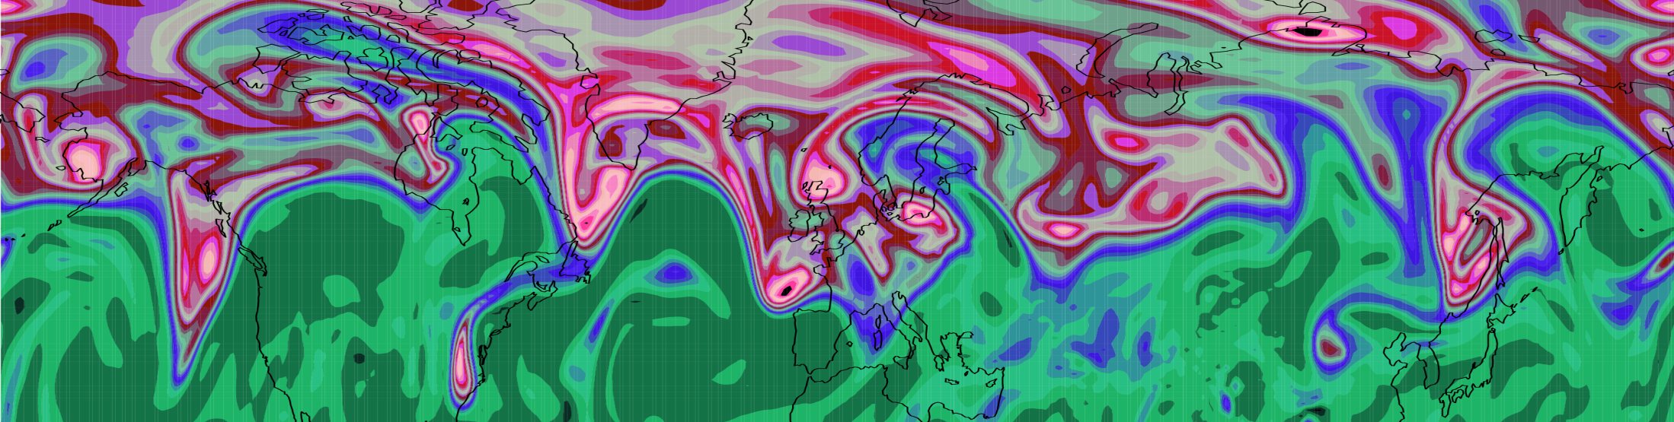
Mechanisms for Diabatic Influence on the Jet Stream and Block Onset
Department of Meteorology
John Methven, Ben Harvey, Leo Saffin, Jake Bland
Department of Meteorology, University of Reading
Claudio Sanchez, Met Office

Slide 2
Influences of latent heat release on development of weather systems
Diabatic heating intensifies ascent, vortex stretching and baroclinic growth rate
Majority of ascent occurs in “warm conveyor belt” (WCB) of cyclones (poleward moving, warm, moist air)
Heating enables ascent across surfaces of constant potential temperature (θ) - diabatic mass transport
Mass outflow of WCBs into the upper troposphere in the ridges of meandering jet stream
Q.1 What fraction of mass in a ridge arrives by diabatic transport?
Q.2 What influence does it have on Rossby wave behaviour?

Slide 3
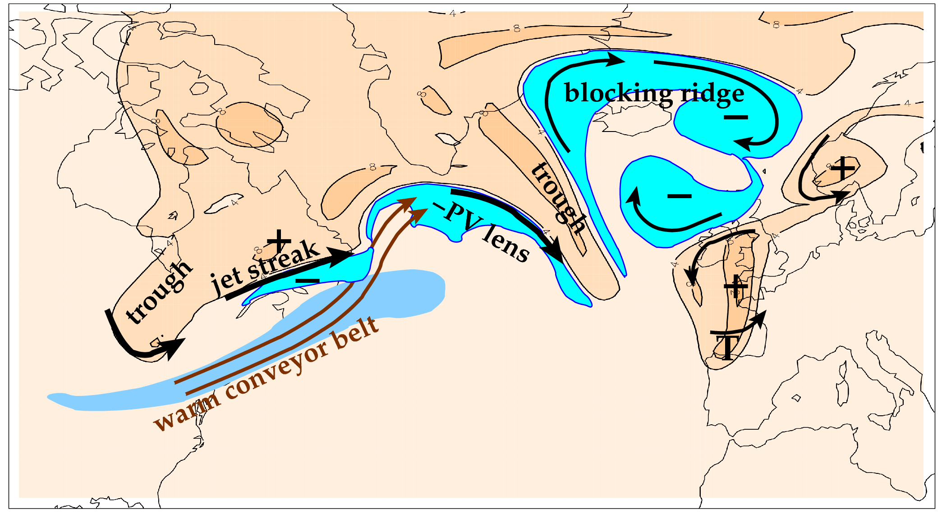
Overarching scientific aim of NAWDEX: to quantify the effects of diabatic processes on disturbances to the jet stream near North America, their influence on downstream propagation across the North Atlantic, and consequences for high-impact weather in Europe.
Features related to the meandering tropopause and jet stream (orange is stratospheric air; cyan marks upper tropospheric PV anomalies).

Slide 4
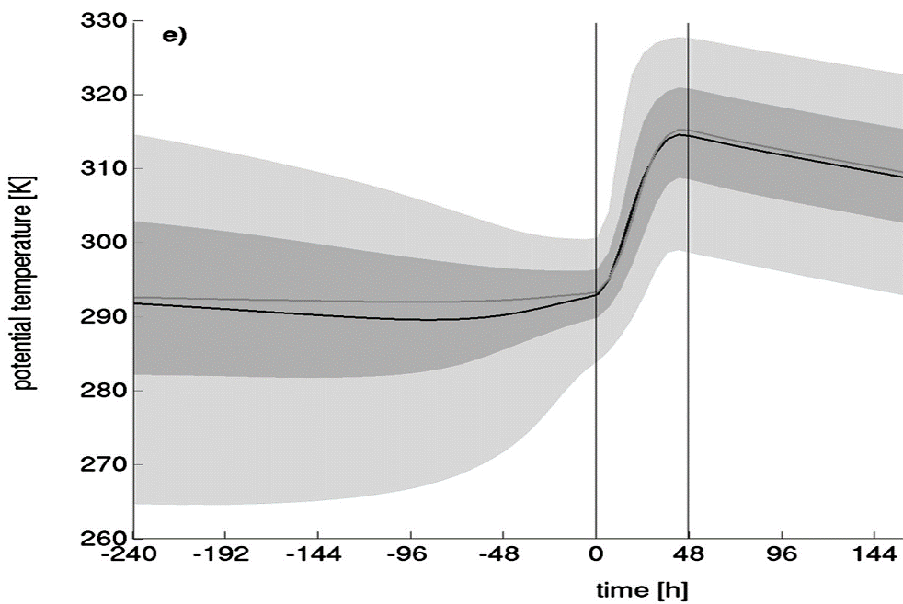
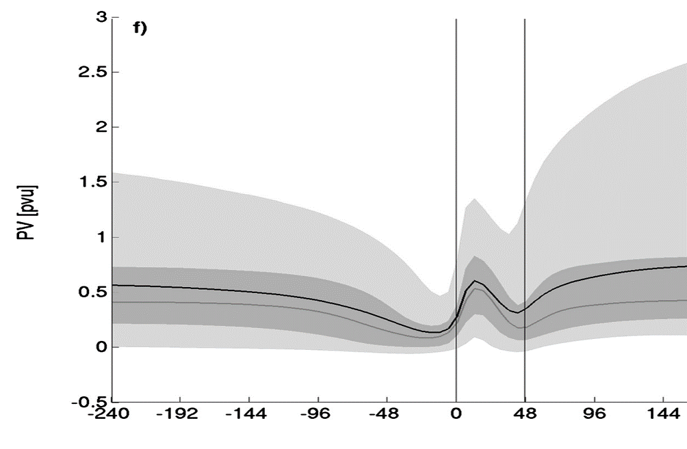
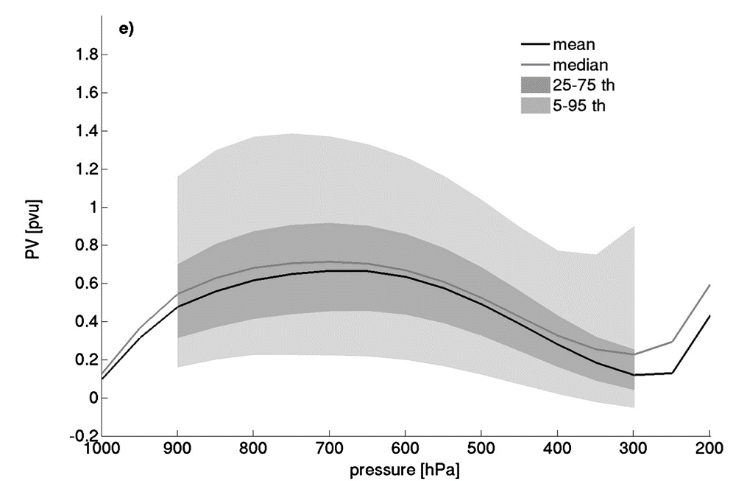
Air mass changes following WCB
WCB frequently defined as a coherent ensemble of trajectories (following the resolved flow)
Climatology from
Madonna et al, 2014, J. Climate
θ increases by greater than isentropic spread of the inflow or outflow layer of the CET
Although PV increases below heating maximum, it decreases again above. PV of outflow ≈ PV of inflow
Why is PV constrained in this way?
Implications for role of heating?

Slide 5


PV evolution equation (I)
Lagrangian form of Ertel PV equation:
PV increases below heating maximum (and decreases above it).
However, there is not an obvious constraint on PV values.
Now consider flux (or local conservation) form of PV equation:
J = “non-advective PV flux” arising from non-conservative processes
(Haynes & McIntyre, 1987, JAS)
$$=−∇.J$$

Slide 6
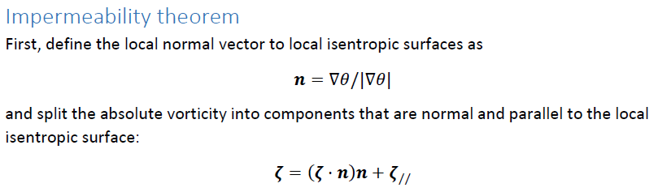




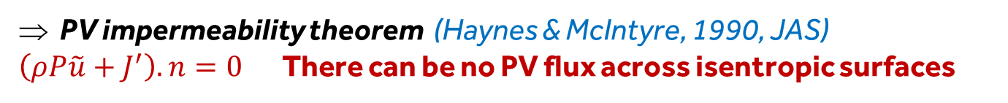
PV evolution equation (II)
We can write the flux form PV equation as:
Using and partitioning velocity into cross-isentropic and along-isentropic components :
$$=−∇.J′$$
PV impermeability theorem (Haynes & McIntyre, 1990, JAS)
$\left(ρP\tilde{u}+J^{′}\right).n=0$There can be no PV flux across isentropic surfaces

Slide 7



PV evolution equation (III)
Leads to an alternative Lagrangian form of PV equation.
Evolution following flow within an isentropic layer
Non-advective transport of
PV along $θ$ surfaces
Concentration/dilution of PV
below/above heating
Negative PV cannot arise through diabatic mass flux convergence
If P>0 initially, it must remain positive through the first term on right.

Slide 8
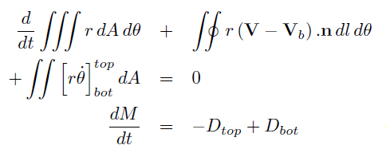

Integral PV conservation (circulation)
Integrate PV equation over control volume (lateral boundary velocity V_{b} )
Circulation conservation
(if V_{b}=V & J’-integral=0)
Integrate mass continuity over control volume
Diabatic mass flux convergence “dilutes” average PV
Mass-weighted average PV or amount of PV substance divided by mass
(Haynes & McIntyre, 1990)

Slide 9
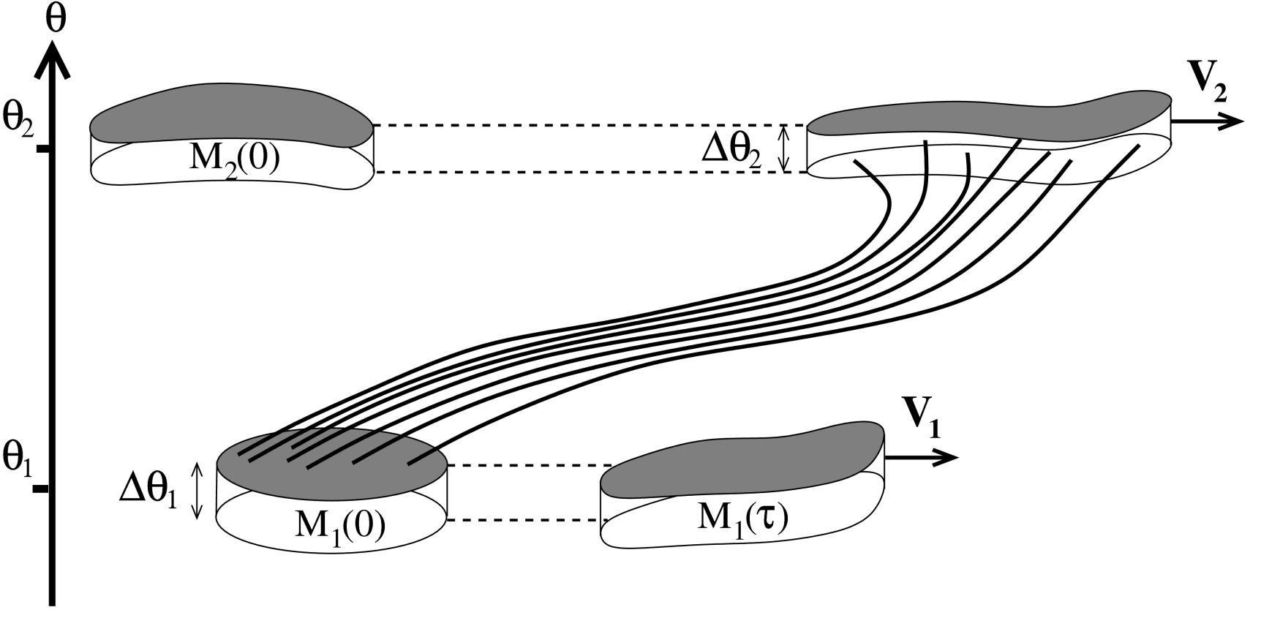

PV in warm conveyor belts
Consider two volumes, in isentropic layers representing the inflow and outflow of a warm conveyor belt.
Heating ⇒ diabatic mass transport from lower to upper volume
Concentrates PV substance of “inflow volume” and dilutes outflow PVS
$$\dot{θ}>0$$
Methven, Q. J. Royal Met. Soc. (2015)

Slide 10
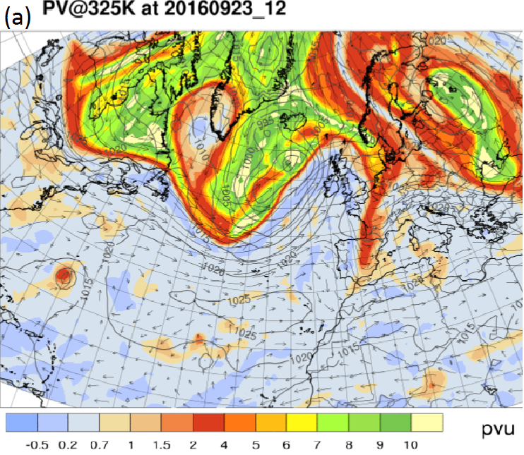
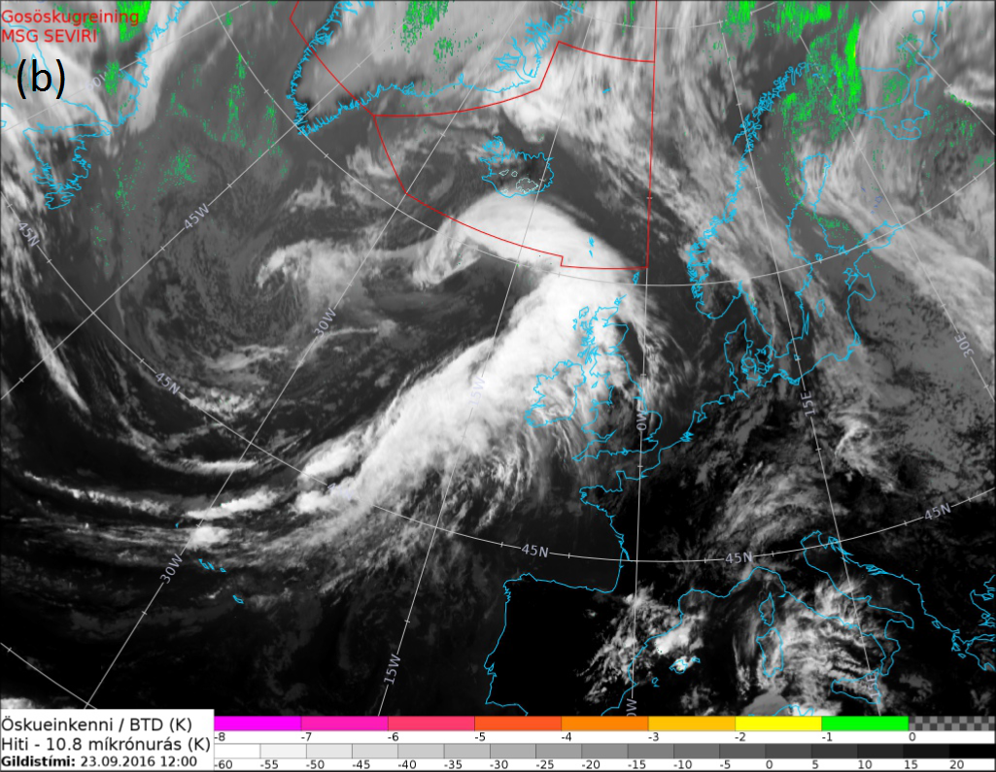
Is this conceptual picture realised?
Examine NAWDEX case 3 (Jake Bland, MSc)
IR satellite image and corresponding PV map: 12UT 23/9/2016

Slide 11
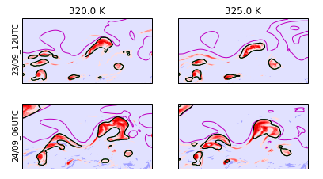

Defining outflow volume using net heating
Black contour = lateral boundary of “outflow volume” on θ-surface

Slide 12
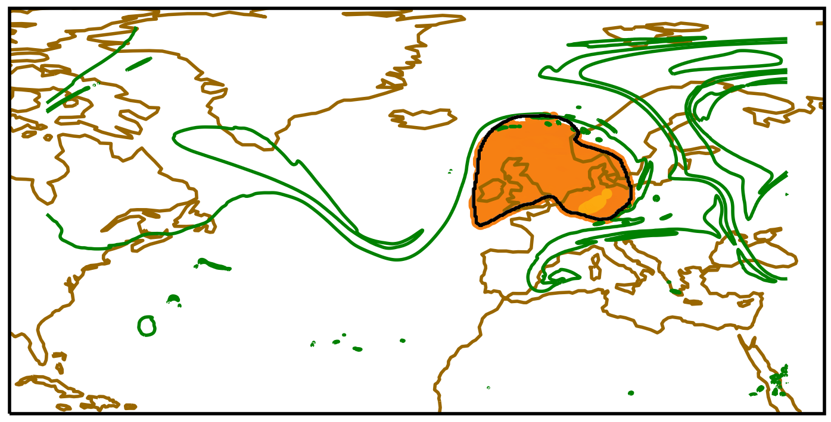
Outflow volume at outflow time
Black contour = lateral boundary of “outflow volume” on 325K surface
Yellow = release locations of 3D back trajectories from outflow volume
Green contour = tropopause on 325K

Slide 13
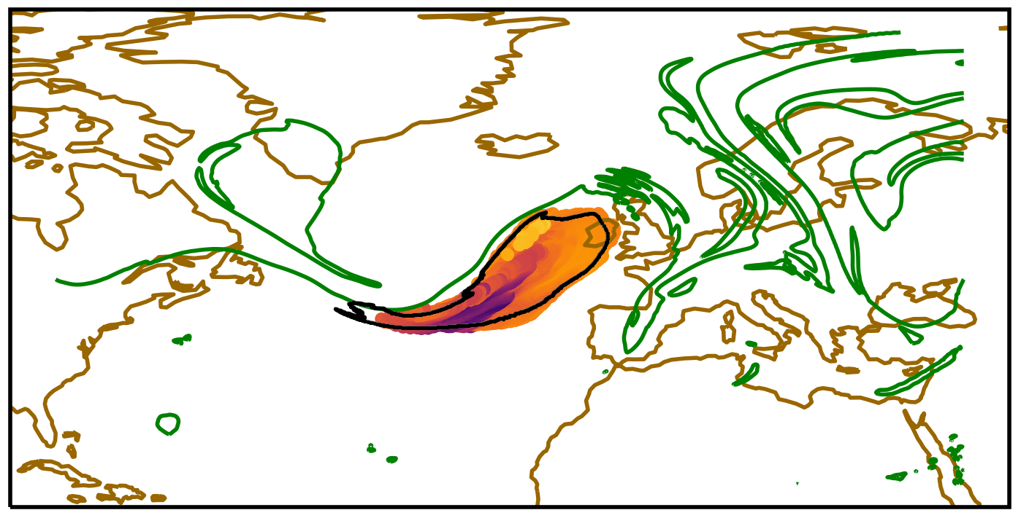
Following backwards (T-18)
Contour = lateral boundary of “outflow volume” on 325K surface
Colour dots = θ at locations of 3D back trajectories from outflow volume
Green contour = tropopause on 325K

Slide 14
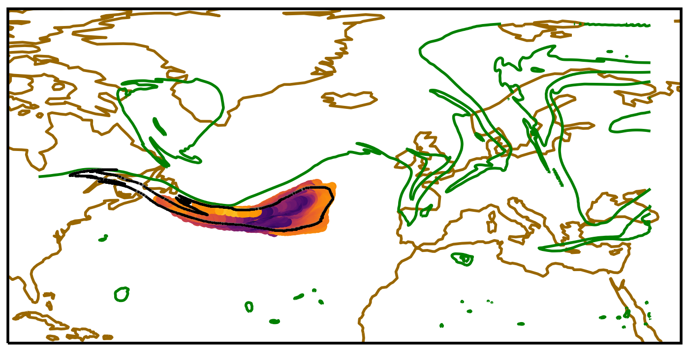
Following backwards (T-30)
Contour = lateral boundary of “outflow volume” on 325K surface
Colour dots = θ at locations of 3D back trajectories from outflow volume
Green contour = tropopause on 325K

Slide 15
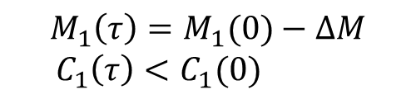

PV in warm conveyor belts
Consider two volumes, in isentropic layers representing the inflow and outflow of a warm conveyor belt.
Heating ⇒ diabatic mass transport from lower to upper volume
Concentrates PV substance of “inflow volume” and dilutes outflow PVS
$$M_{2}\left(τ\right)=M_{2}\left(0\right)+∆M$$
${ C}_{2}\left(τ\right)≈C_{2}(0)$
$$\dot{θ}>0$$
$$M_{1}\left(τ\right)=M_{1}(0)−∆M$$
$${ C}_{1}\left(τ\right)<C_{1}(0)$$
Methven, Q. J. Royal Met. Soc. (2015)

Slide 16
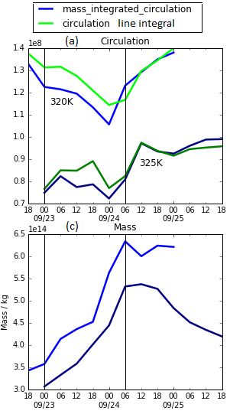

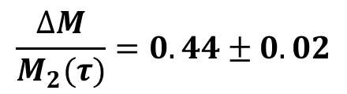



Circulation and mass of outflow
Fractional variation in circulation of outflow volume is small
Verifying that circulation is conserved even though diabatic processes are strong
within WCB
Large increase in mass of outflow volume (x2) by diabatic mass transport from below
$$τ_{1}$$
$$τ_{2}$$
$$τ_{1}$$
$$τ_{2}$$
$$\frac{∆M}{M_{2}(τ)}=0.44±0.02$$

Slide 17
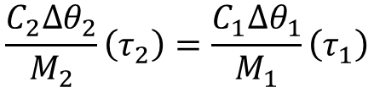



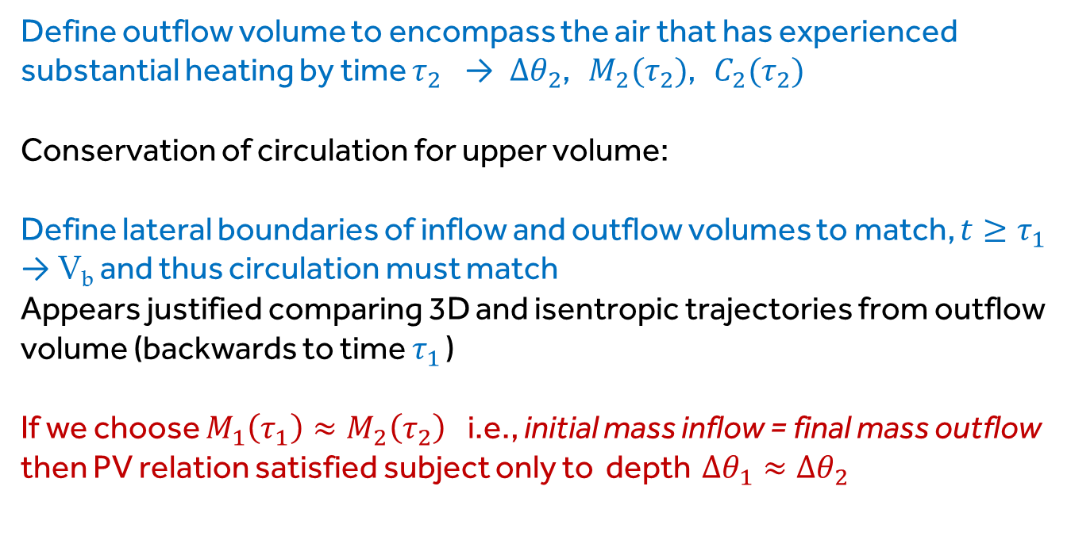
When does PV outflow = PV inflow?
Under what conditions does average PV of outflow = PV of inflow?
$${\left\langle q\right\rangle }_{2}\left(τ_{2}\right)={\left\langle q\right\rangle }_{1}\left(τ_{1}\right)$$
$$\frac{C_{2}∆θ_{2}}{M_{2}}\left(τ_{2}\right)=\frac{C_{1}∆θ_{1}}{M_{1}}\left(τ_{1}\right)$$
Define outflow volume to encompass the air that has experienced substantial heating by time $τ_{2}$ → $∆θ_{2}$, $M_{2}(τ_{2})$, $C_{2}(τ_{2})$
Conservation of circulation for upper volume:
Define lateral boundaries of inflow and outflow volumes to match, $t≥τ_{1}$
→ V_{b} and thus circulation must match
Appears justified comparing 3D and isentropic trajectories from outflow volume (backwards to time $τ_{1}$ )
If we choose $M_{1}\left(τ_{1}\right)≈M_{2}\left(τ_{2}\right)$i.e., initial mass inflow = final mass outflow then PV relation satisfied subject only to depth $∆θ_{1}≈∆θ_{2}$
$$C_{2}\left(τ_{1}\right)=C_{2}(τ_{2})$$
$$C_{1}\left(τ_{1}\right)=C_{2}\left(τ_{1}\right)=C_{2}(τ_{2})$$

Slide 18
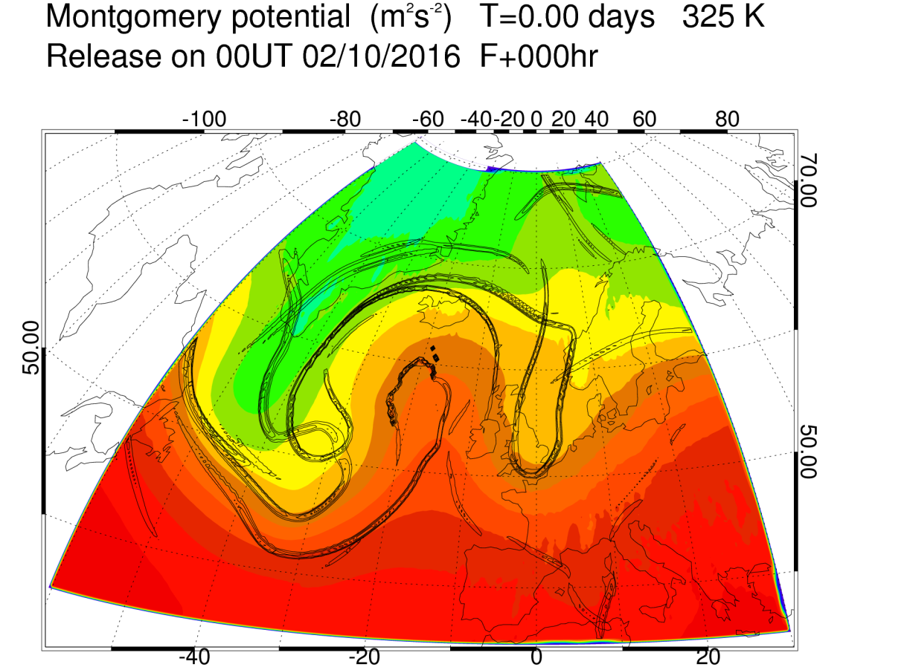
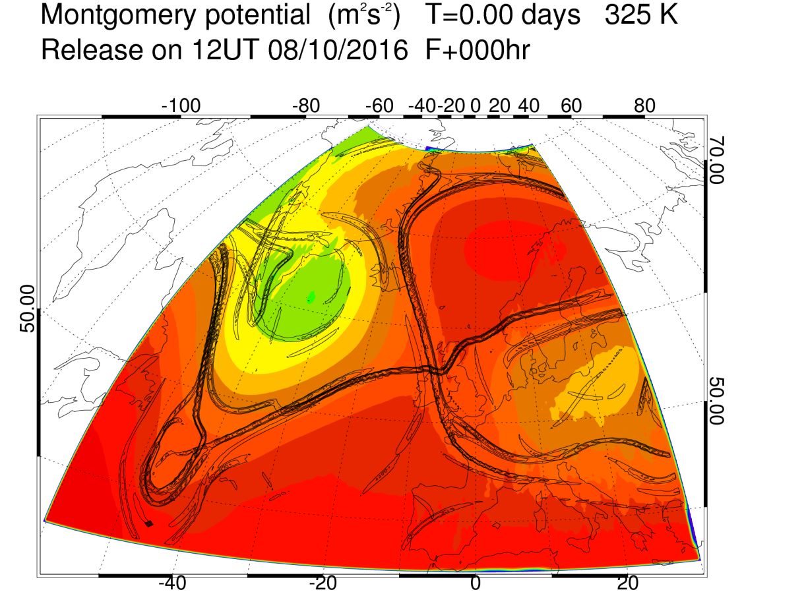
Transition from wave to block?
Block onset- transition from a large amplitude wave into dipole structure
Pfahl et al (2015).
Air masses in ridges making transition into block experience greater heating
How do diabatic processes influence this topological transition?

Slide 19
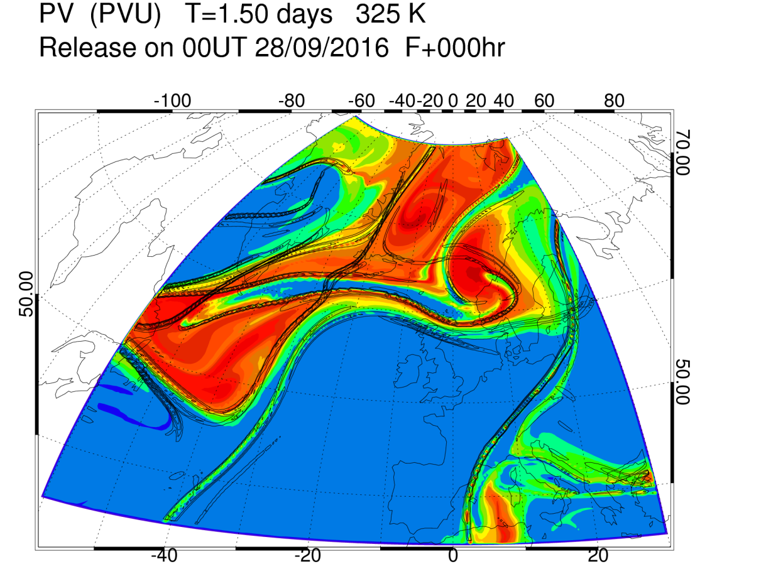
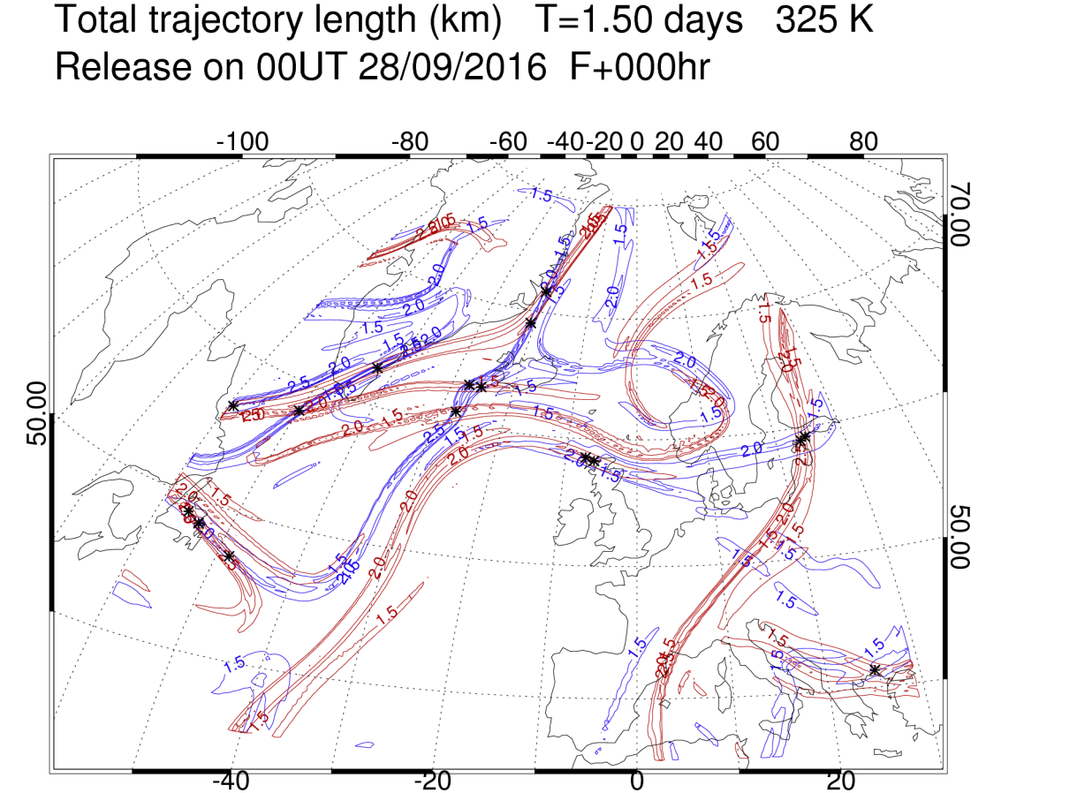
Lagrangian coherent structures
Example of large amplitude Rossby wave.
Unstable (+ stable) manifolds. Locations from which neighbouring forward (+ backward) trajectories separate rapidly.
Generalisation of “cat’s eyes” for unsteady (aperiodic) flows.
C
C
AC
AC
C
C
AC
AC

Slide 20
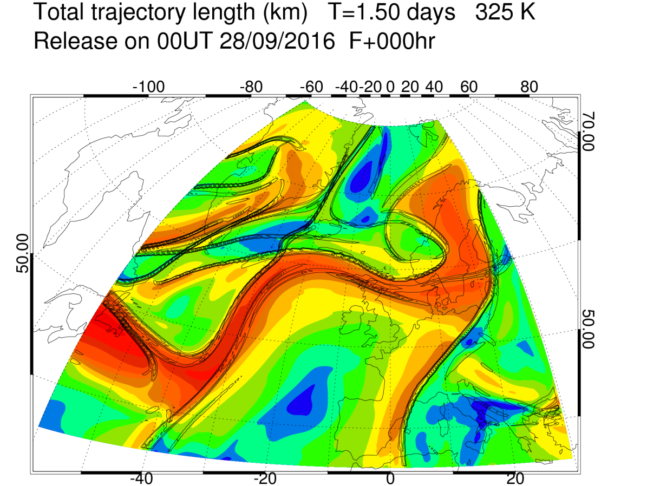
Lagrangian coherent structures
Example of large amplitude Rossby wave.
Black = unstable (+ stable) manifolds. Locations from which forward (+ backward) trajectories separate rapidly.
Colour indicates sum of back and forward trajectory length from each point.
Highlights jet stream and eddy regions
C
C
AC
AC
C
C
AC
AC

Slide 21
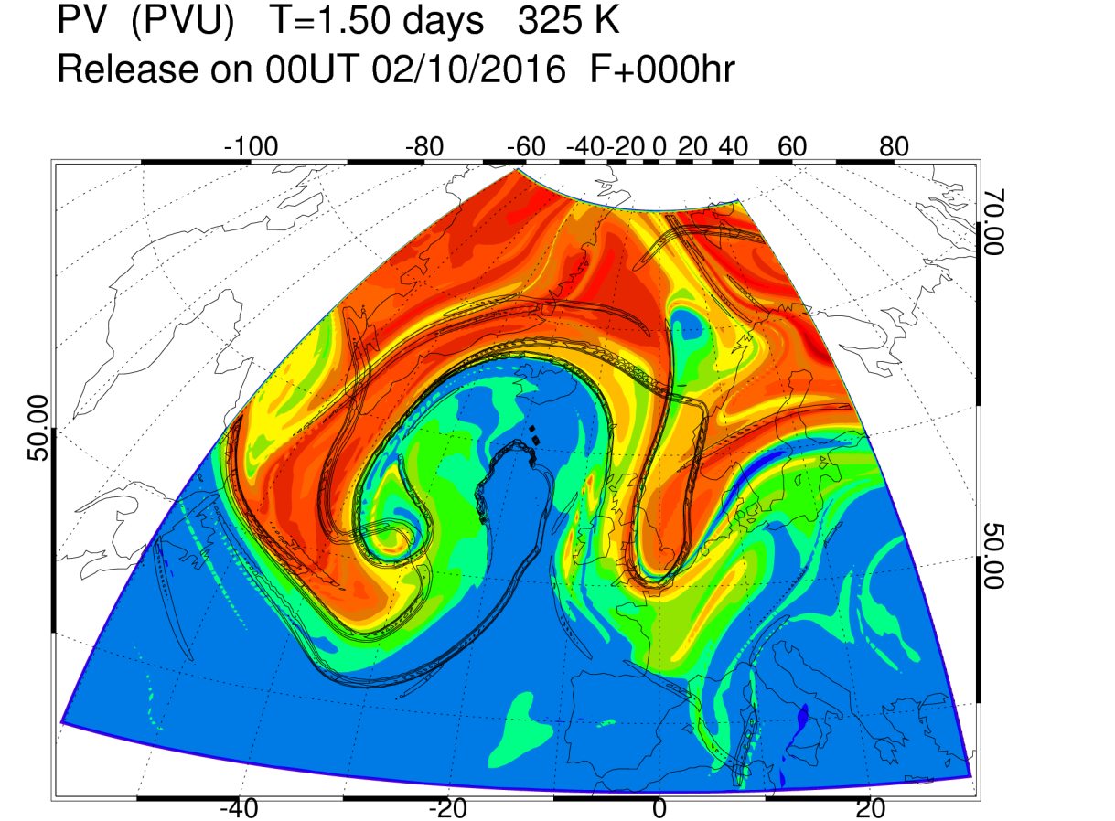
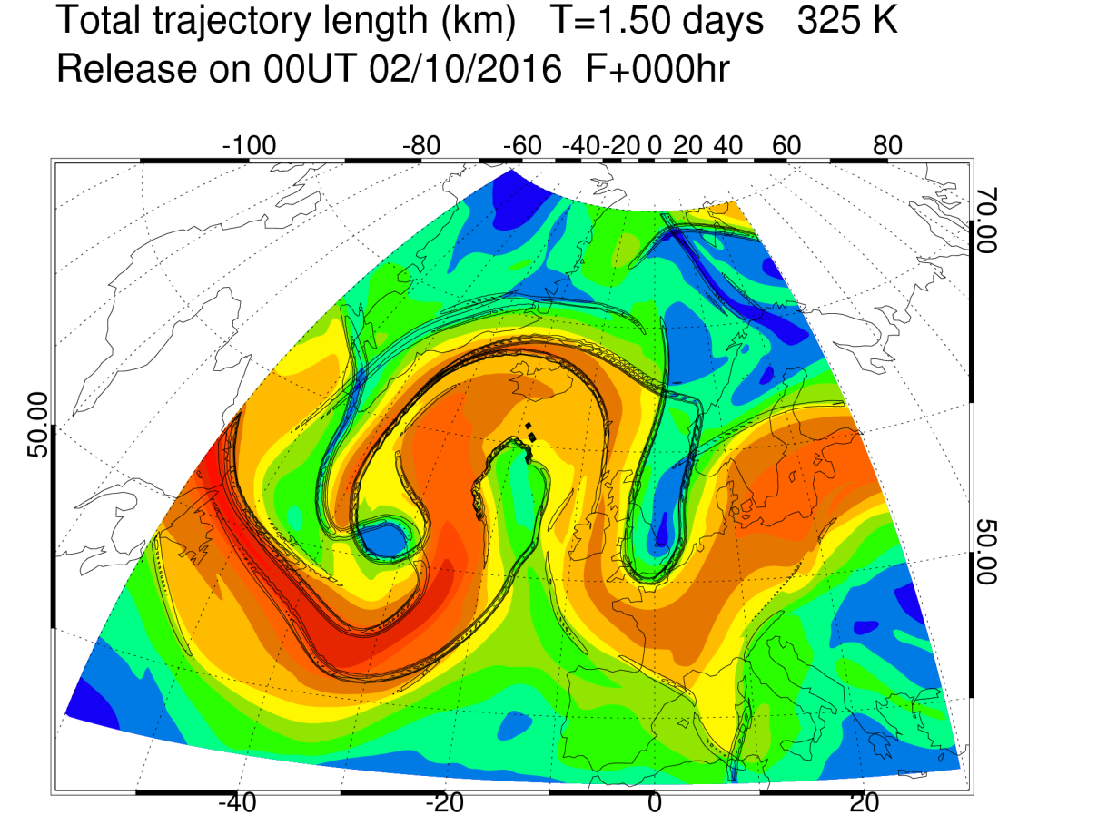
Formation of “omega block”
Rossby wave reaches large amplitude.
Vortex roll-up forms new hyperbolic point, A,
and A/C cut-off.
Colour indicates sum of back and forward trajectory length from each point.
A
A

Slide 22
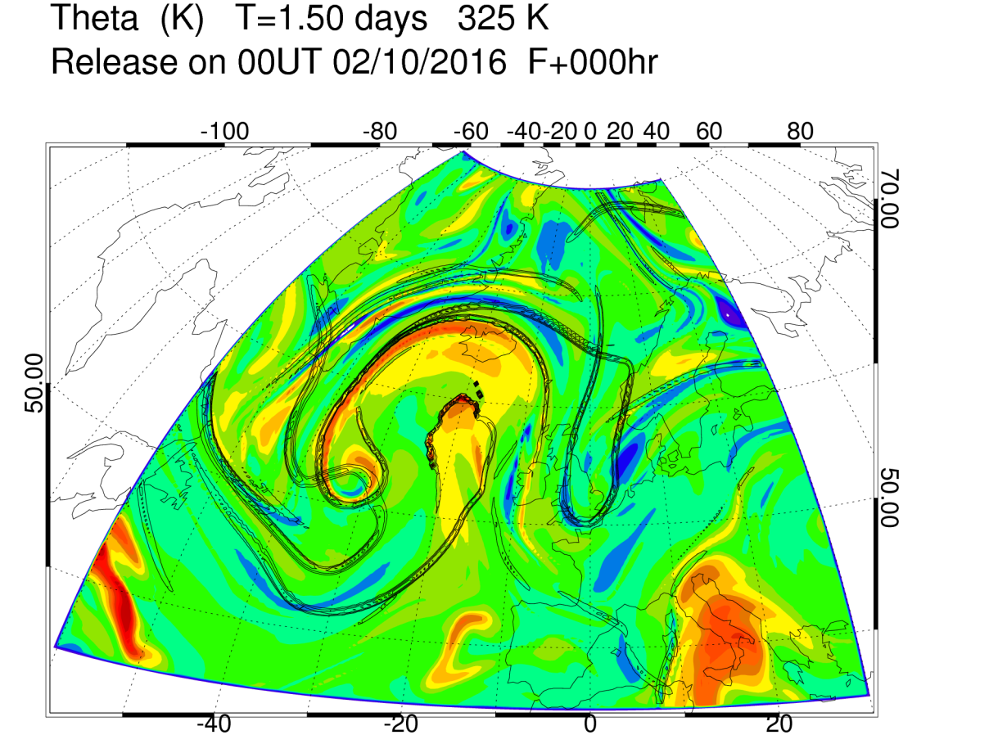
Diabatic mass transport into A/C cut-off volumes
Latent heating enables diabatic mass transport into cut-off volume.
Adiabatic flow would be constrained to isentropic surfaces and could not cross into cut-off, once formed.
Field is net heating along trajectories over 1.5 days
A
A

Slide 23
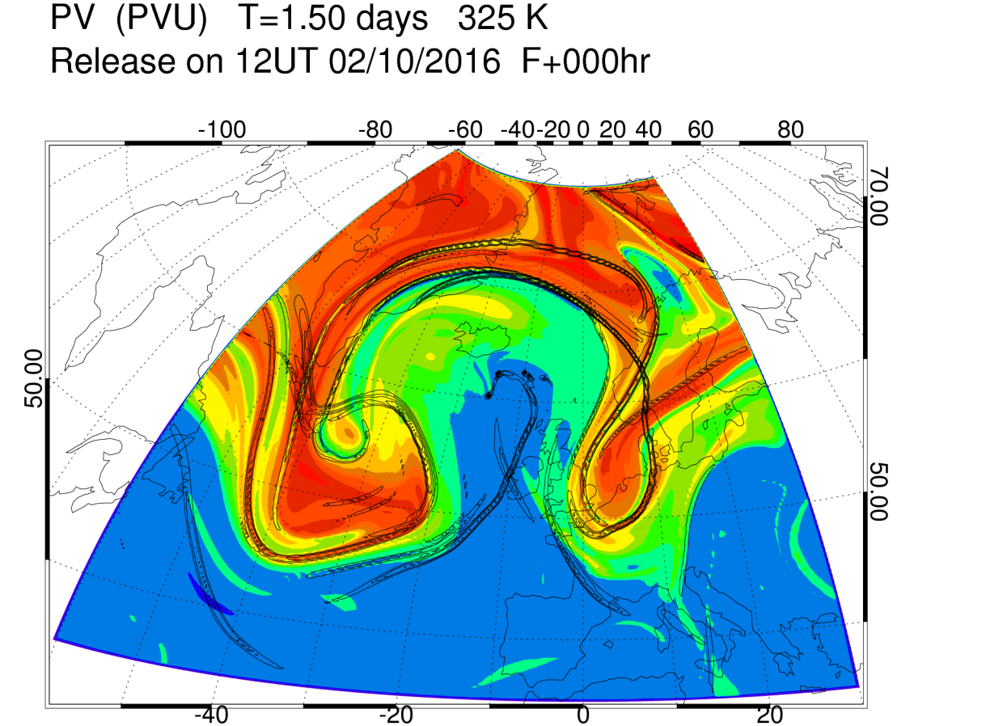
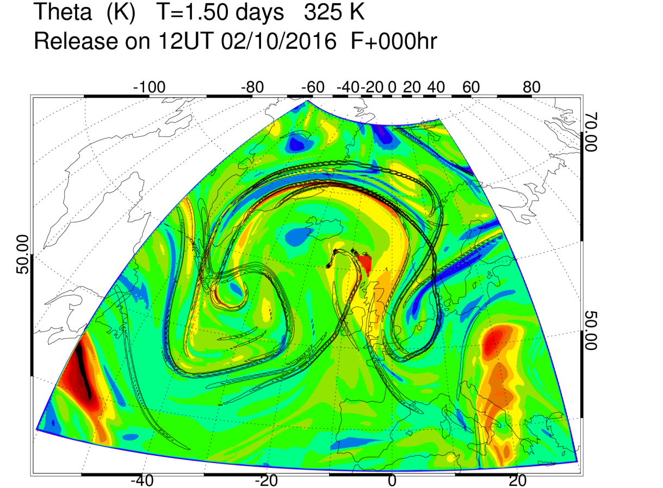
Diabatic mass transport into A/C cut-off volumes
Once hyperbolic point, A,
is formed, it can only be destroyed by non-conservative processes.
It moves with the flow.
Path of A =
“hyperbolic trajectory”
Field is net heating along trajectories over 1.5 days
A
A

Slide 24
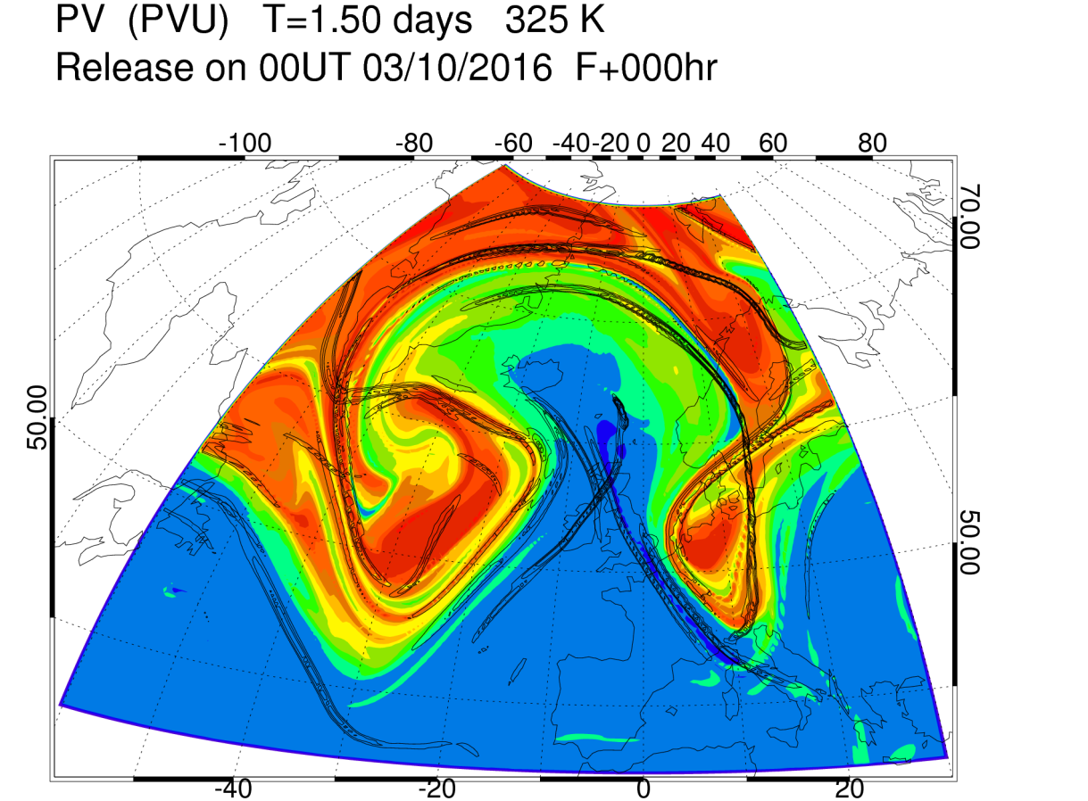
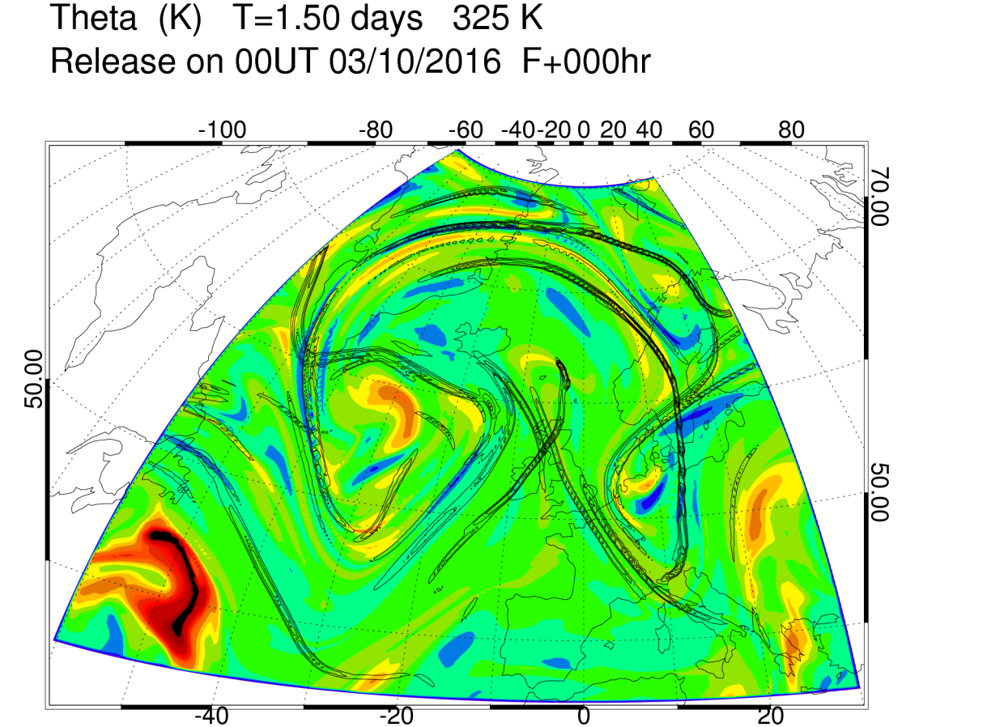
Diabatic mass transport into A/C cut-off volumes
Once hyperbolic point, A,
is formed, it can only be destroyed by non-conservative processes.
It moves with the flow.
Path of A =
“hyperbolic trajectory”
Field is net heating along trajectories over 1.5 days
A
A

Slide 25
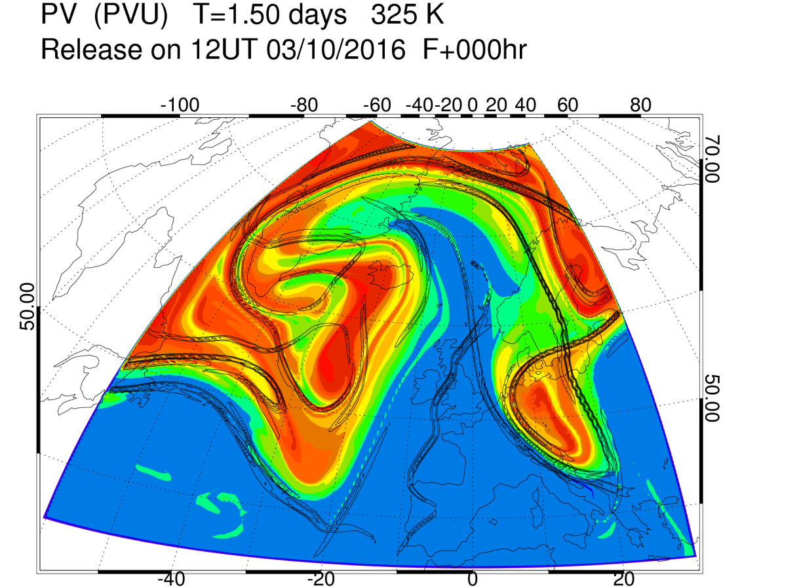
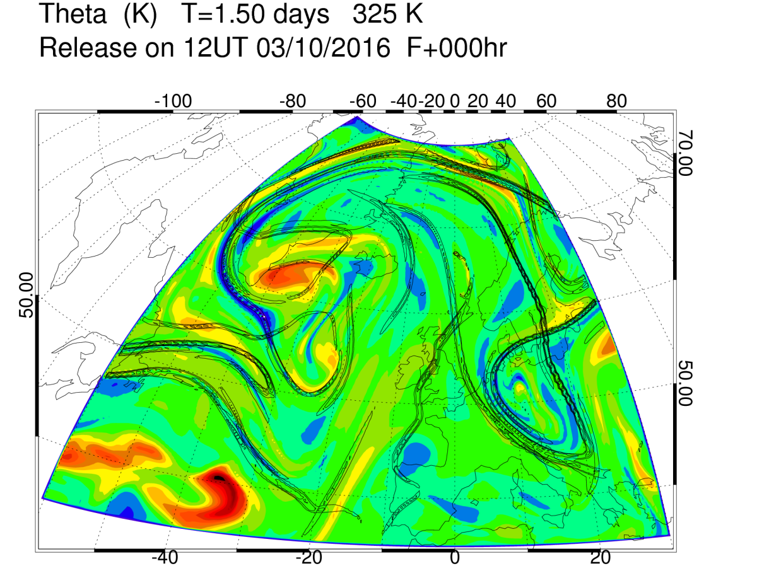
Diabatic mass transport into A/C cut-off volumes
Hyperbolic point B forms near tip of extended trough
Field is net heating along trajectories over 1.5 days
A
B
A
B

Slide 26
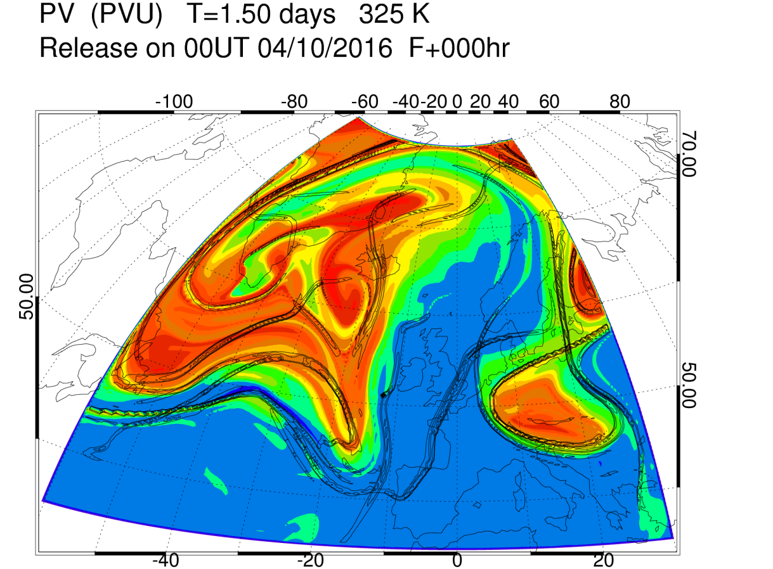
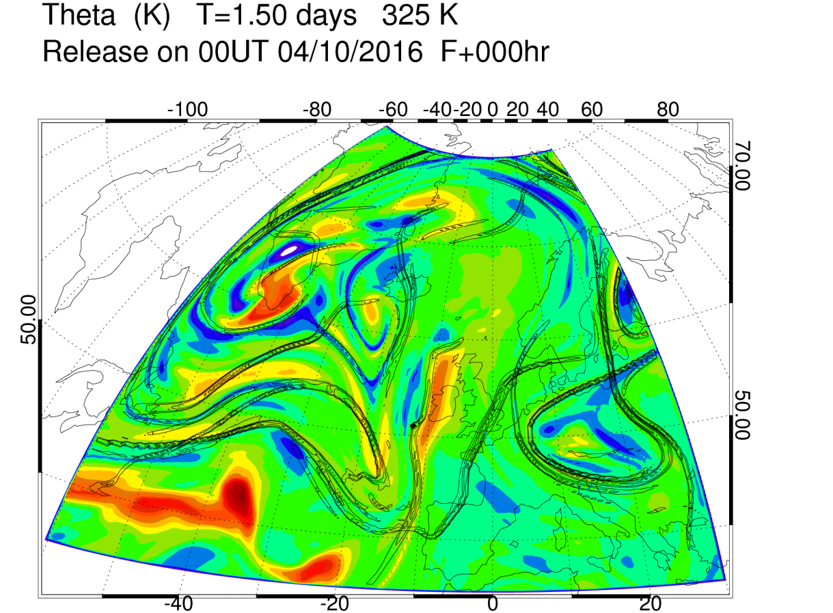
Diabatic mass transport into A/C cut-off volumes
Hyperbolic point C forms near tip of next trough
Diabatic mass transport into volume north of B
Field is net heating along trajectories over 1.5 days
A
C
B
A
C
B

Slide 27
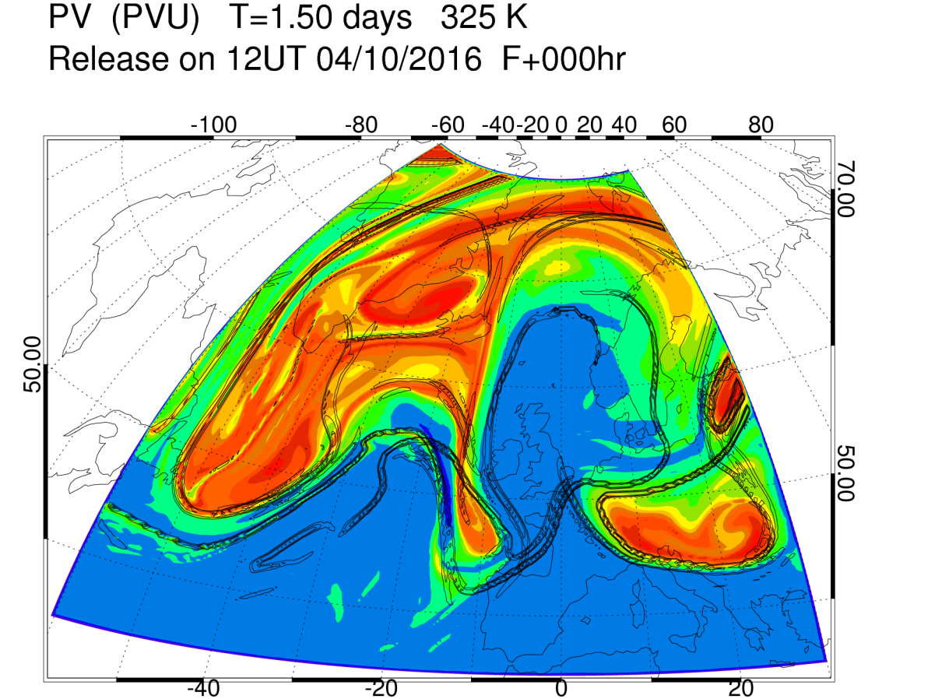
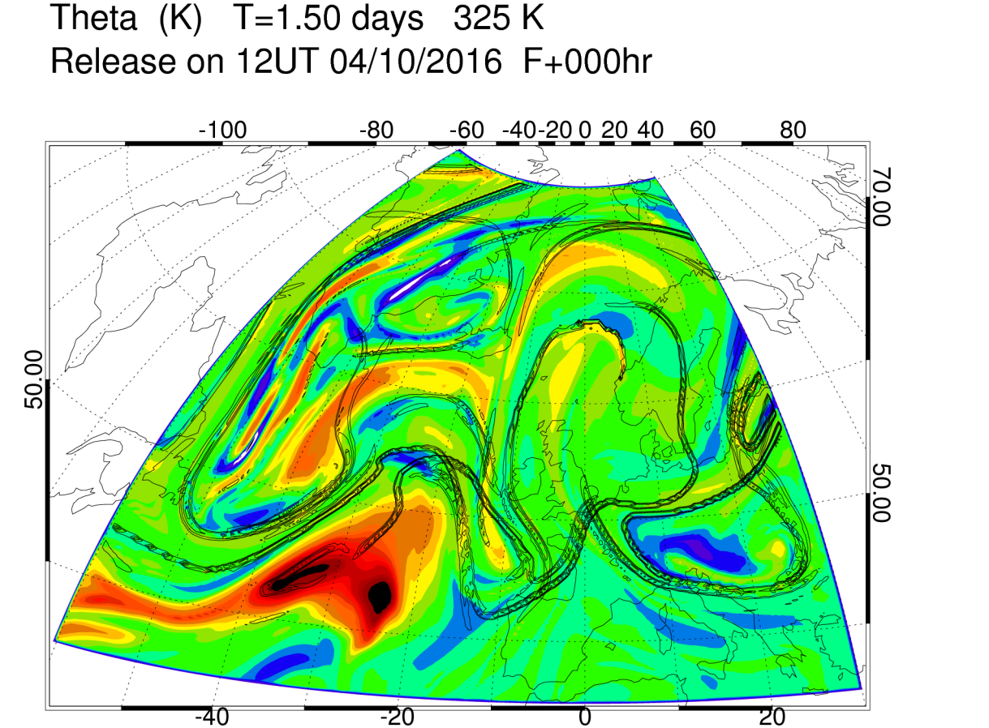
Diabatic mass transport into A/C cut-off volumes
Field is net heating along trajectories over 1.5 days
C
A
B
C
A
B

Slide 28
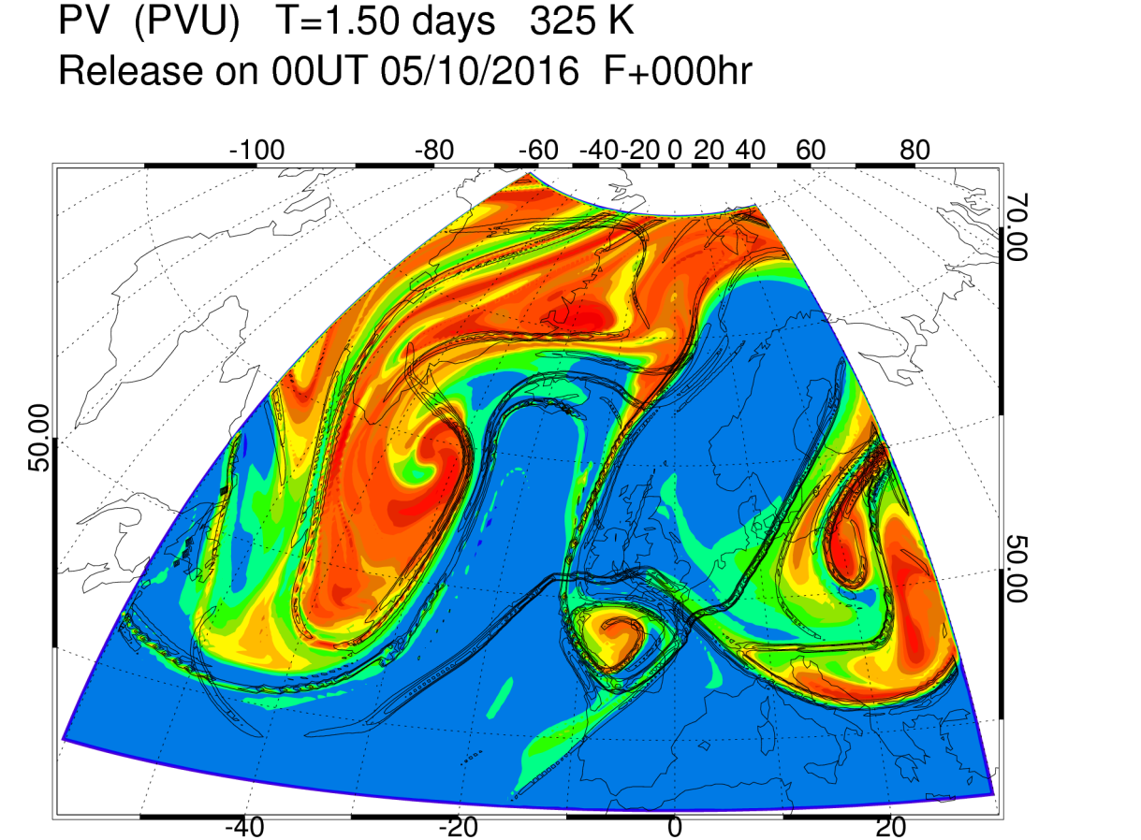
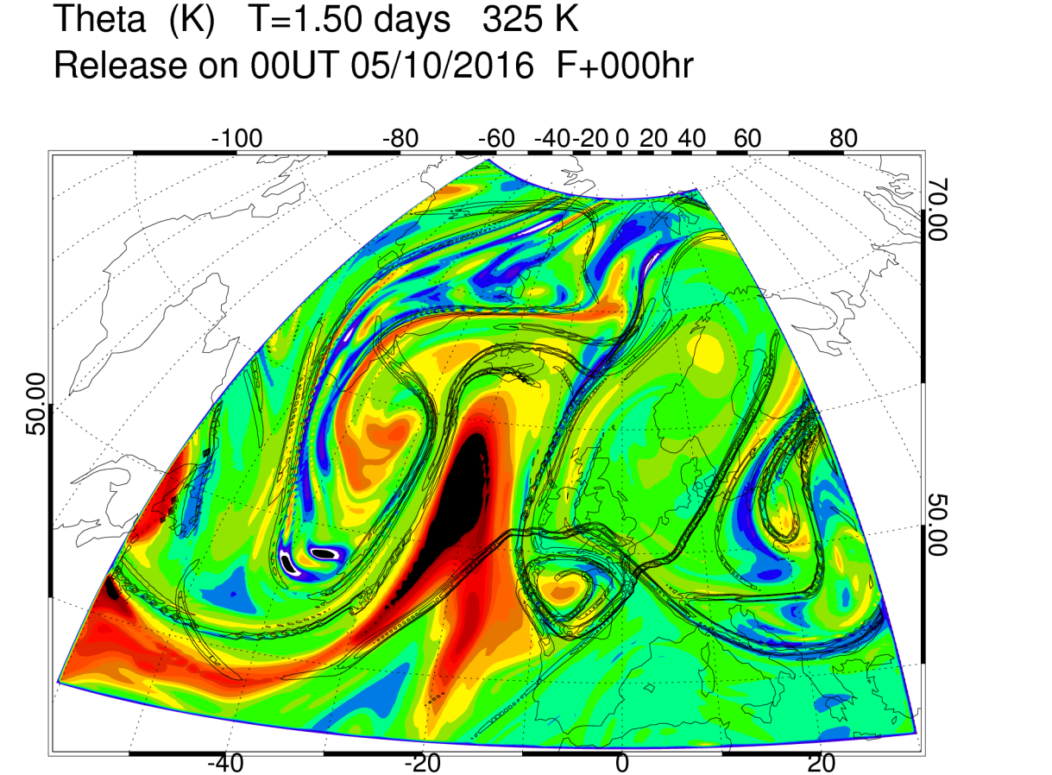
Diabatic mass transport into A/C cut-off volumes
Hyperbolic point D forms near tip of next trough
Large diabatic mass transport into WCB outflow volume, northwest of C
Field is net heating along trajectories over 1.5 days
C
A
D
B
C
A
D
B

Slide 29
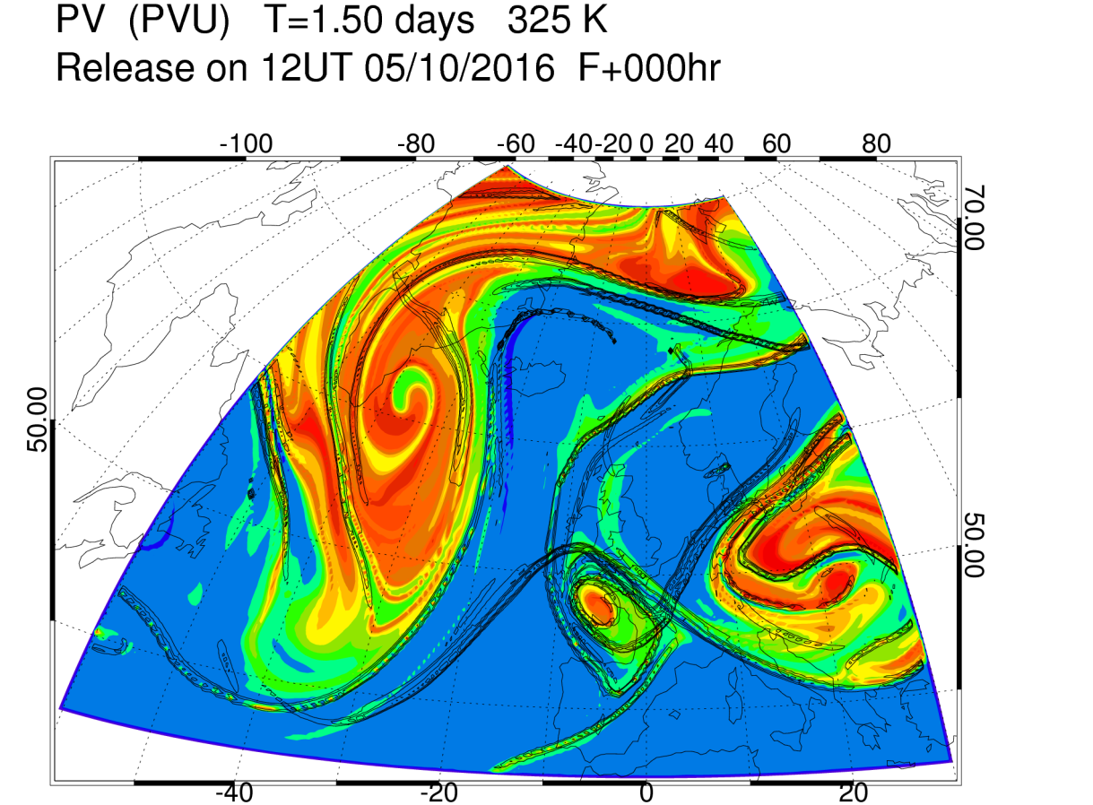
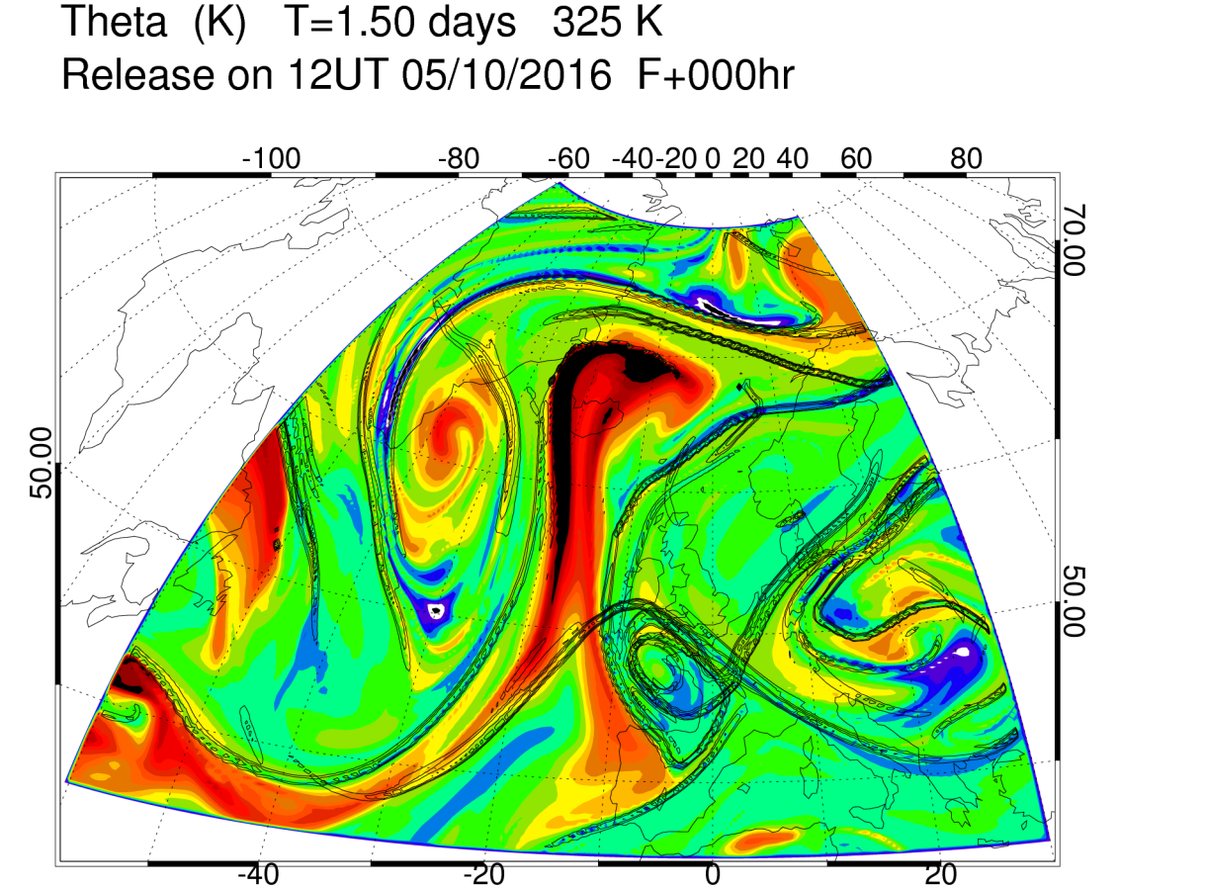
Diabatic mass transport into A/C cut-off volumes
Field is net heating along trajectories over 1.5 days
C
A
D
C
A
D

Slide 30
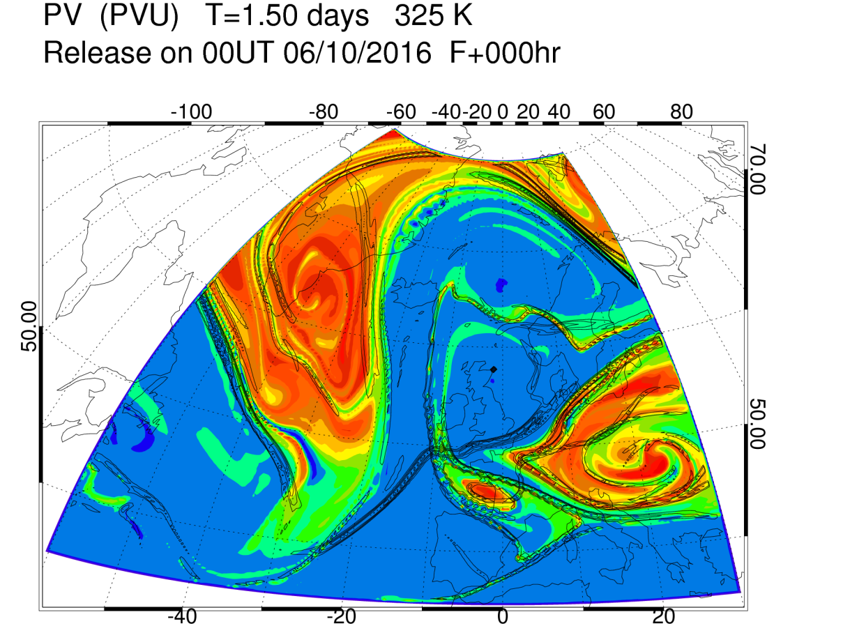
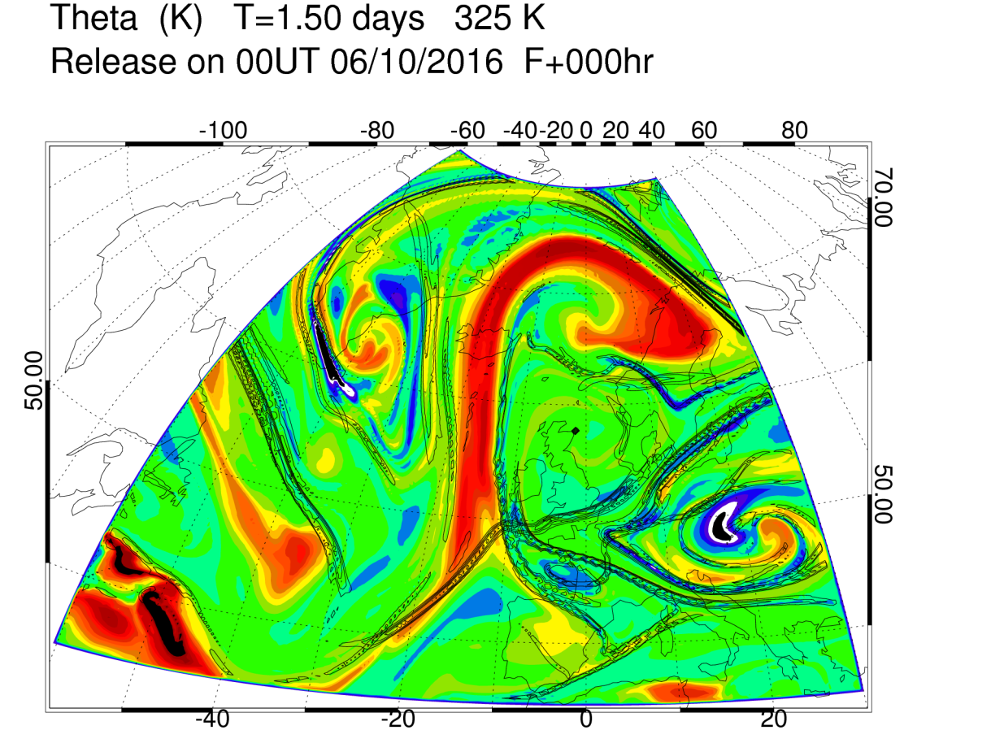
Diabatic mass transport into A/C cut-off volumes
Field is net heating along trajectories over 1.5 days
C
A
D
C
A
D

Slide 31
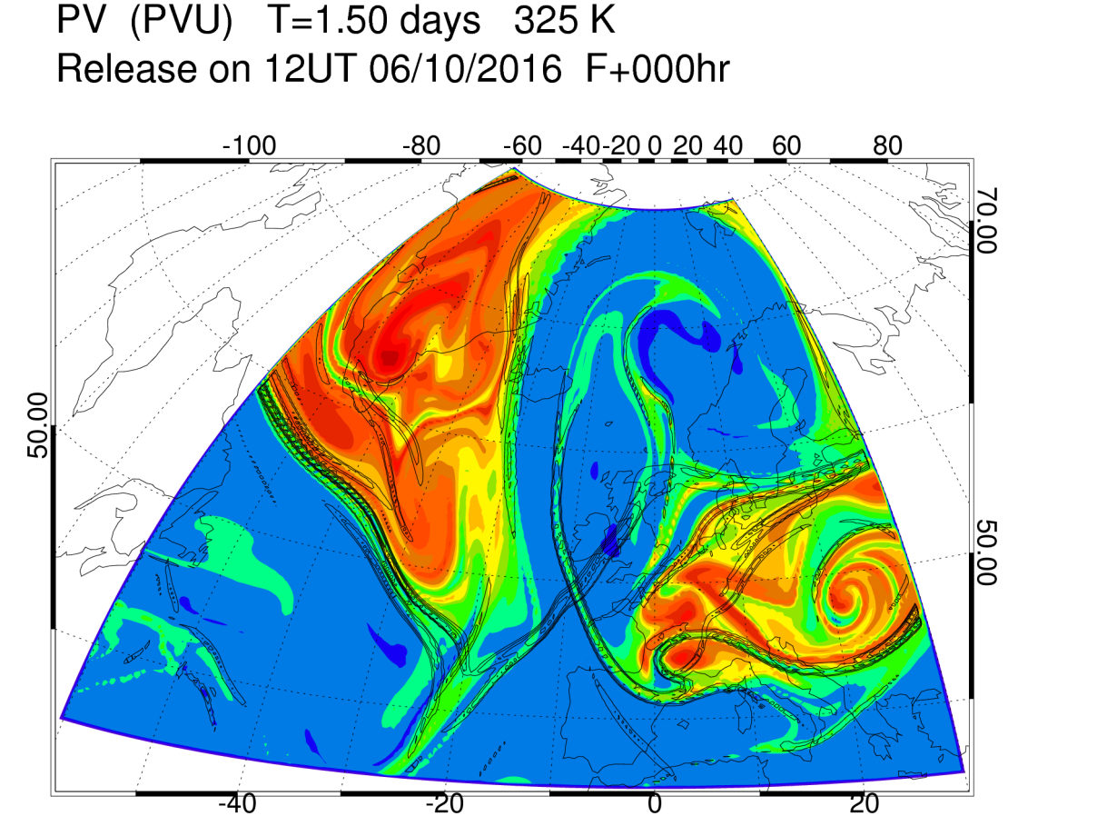
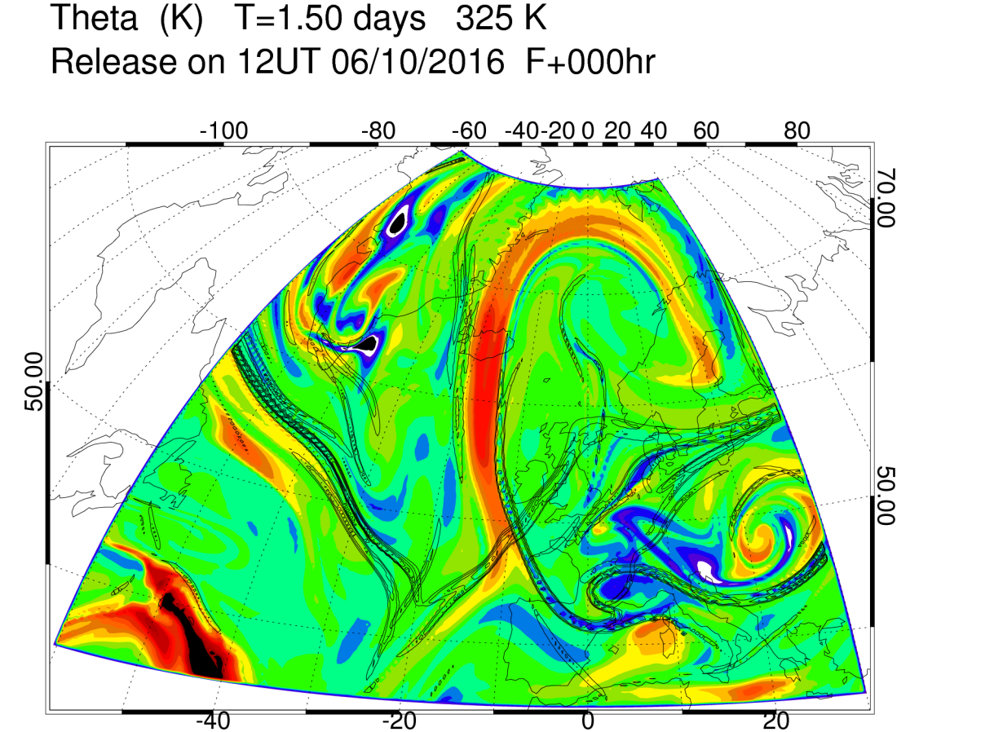
Diabatic mass transport into A/C cut-off volumes
Field is net heating along trajectories over 1.5 days
C
D
C
D

Slide 32
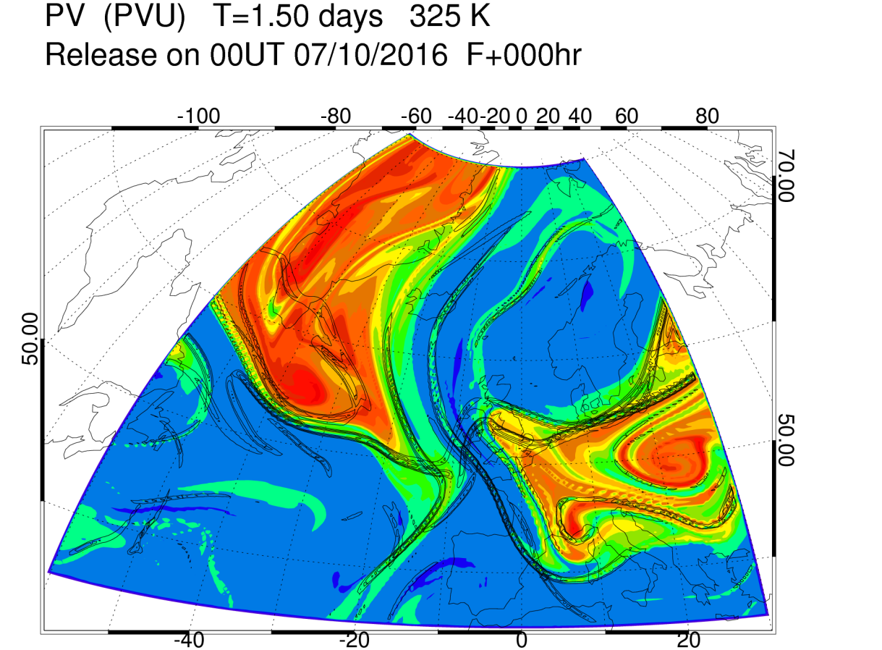
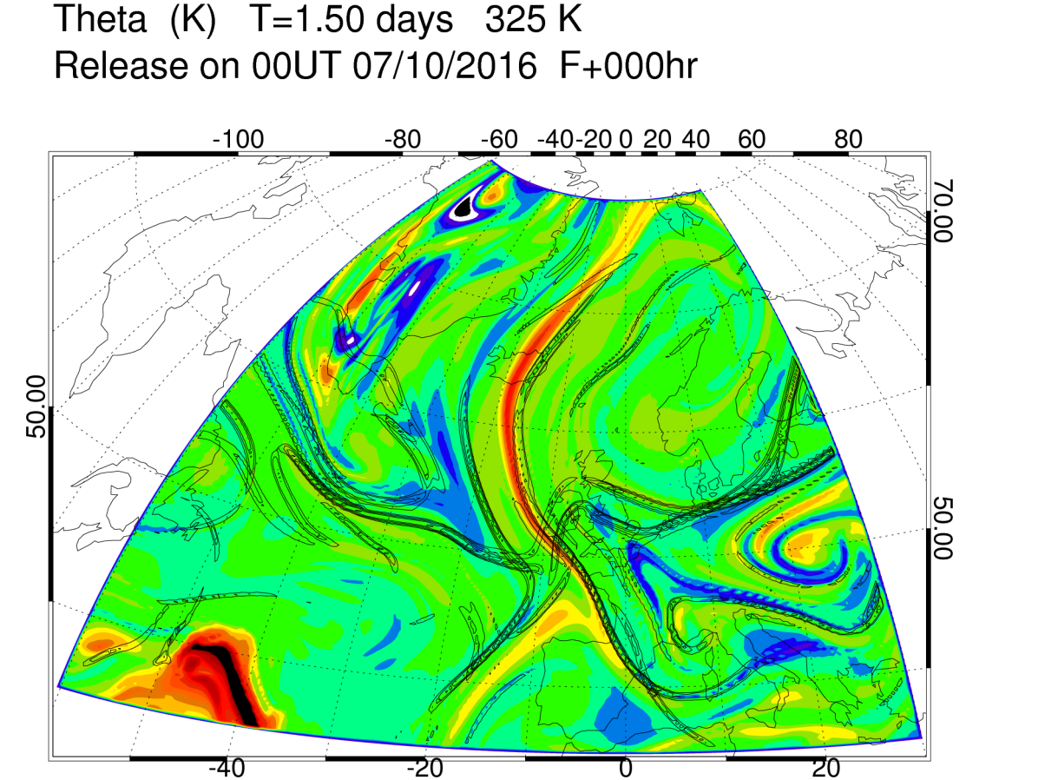
Diabatic mass transport into A/C cut-off volumes
C and D converge to form strengthen hyperbolic point in front of dipole block.
Vortex roll-up ⇒ emergence of new hyperbolic trajectories
Latent heating can double mass in A/C cut-off regions.
Crucial to blocking onset?
C
D
C
D

Slide 33

Circulation and mass of outflow
Large increase in mass of outflow volume (x2) by diabatic mass transport from below.
But, variation in circulation is small.
Consequence of PV impermeability theorem, Haynes and McIntyre (1987, 1990).
Circulation cannot be changed through diabatic mass flux.
Then, why is outflow size important to block?
As area, S, increases, anticyclonic relative flow is stronger around the boundary.
$$τ_{1}$$
$$τ_{2}$$
$$τ_{1}$$
$$τ_{2}$$
$$= \left\langle f+ξ\right\rangle S$$

Slide 34

Conclusions
Key ingredients to a WCB (even with embedded convection):
  Net heating (Δθ) is large cf range of θ in “inflow” and “outflow”
  Horizontal advection on each isentropic surface is dominated by the “balanced flow” (including ageostrophic motion)
Influence of latent heating on level and mass of WCB outflow
  Circulation in outflow layer is unchanged (by direct diabatic effects)
  Average PV of outflow = PV of the inflow (from PV impermeability)
Diabatic mass transport expands anti-cyclonic cut-offs
  Can double mass of outflow volume (prohibited for adiabatic flow)
  Fractional mass increase , $\frac{∆M}{M_{0}}≈\frac{∆A}{A_{0}}+\frac{∆r}{r_{0}}$
  Integrated anticyclonic vorticity = -(f- circulation/area)
  Blocks must be more likely as a consequence

Slide 35
Thankyou for your attention

Slide 36

The NAWDEX Storyline
Mesoscale triggers interact with the jet stream, modifying development and high impact weather downstream

Slide 37

Lowest predictability following trigger -
a precursor to a regime transition?
Time series of Z500 data projected onto 4 large-scale patterns of variability
+NAO
blocking
Anomaly correlations between members of forecast ensemble (T+120) and verifying analyses
A
B

Slide 38


Semi-geostrophic theory in 3-D (Hoskins, 1975)
Makes geostrophic momentum approximation (GMA)
  Advection by full flow including w and ageostrophic wind
Q. How is Rossby wave propagation affected compared with basic QG theory?
Amazingly, using the S-G coordinate transformation:
the S-G evolution in (X, Y, Z) is similar to Q-G evolution in (x, y, z)
Transformed into physical coords, +ve vorticity regions contract
Figure: Davies, Schar and Wernli, J. Atmos. Sci., 1991

Slide 39




C. Effects of heating on Rossby waves
Vertical velocity can be deduced using the S-G omega equation.
Its form in momentum coordinates (Hoskins & Draghici, 1977) is:
Geostrophic forcing
Diabatic forcing (H=heating)
“Large-scale rain” parametrization of heating:
⇒ Response of moist equations using effective static stability, $N_{\begin{aligned}eff \\ \end{aligned}}$
Predicted effects of reduced effective static stability on baroclinic waves:
Amplified vertical and ageostrophic motion
Faster propagation of tropopause Rossby wave westwards (relative to jet)
Faster growth through baroclinic interaction between surface and tropopause

Slide 40

Amplification of ageostrophic flow by heating
Balanced ageostropic flow and w from S-G “omega” equation.
Without forcing from heating. Mike Cullen & Claudio Sanchez.

Slide 41

Amplification of ageostrophic flow by heating
Balanced ageostropic flow and w from S-G “omega” equation.
In response to heating from physical parametrizations.

Slide 42

Amplification of ageostrophic flow by heating
Balanced ageostropic flow and w from S-G “omega” equation.
With forcing from full parametrized heating from MetUM.

Slide 43

Amplification of ageostrophic flow by heating
Balanced ageostropic flow and w from S-G “omega” equation.
Heating proportional to vertical velocity (“large-scale rain”).

