Slide 1
warm conveyor belts
Department of Meteorology
John Methven,
Department of Meteorology,
University of Reading

Slide 2
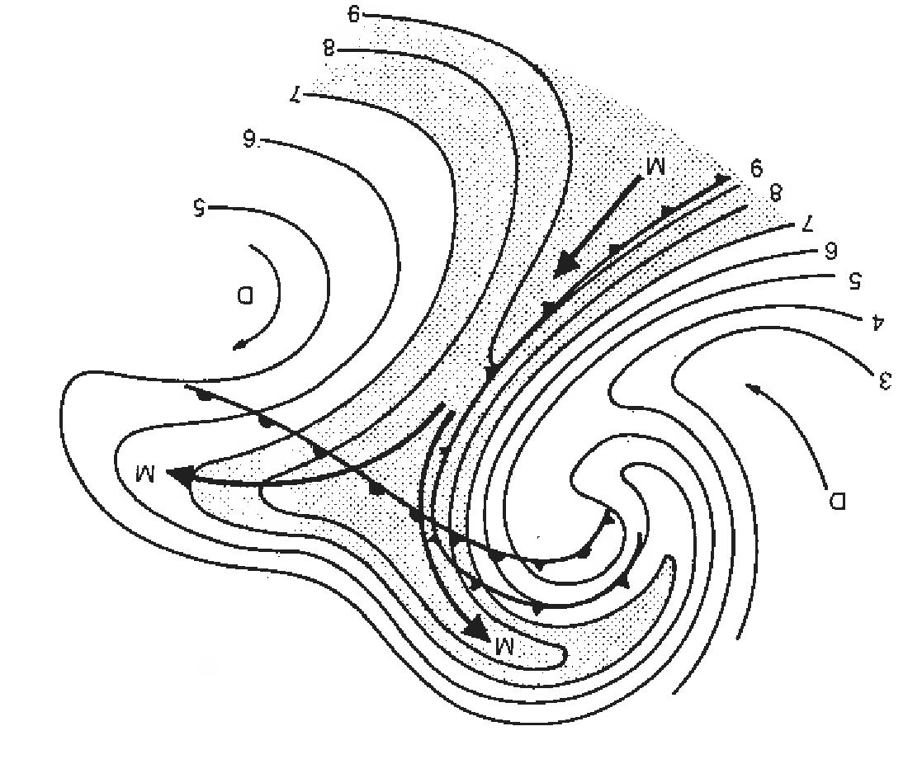
What is a warm conveyor belt?
An air mass concept. Warm, moist air moving rapidly polewards just ahead of a cold front and ascending.
Originally identified in isentropic relative-flow analysis
Namias (1939) as reproduced in Browning (1990).

Slide 3
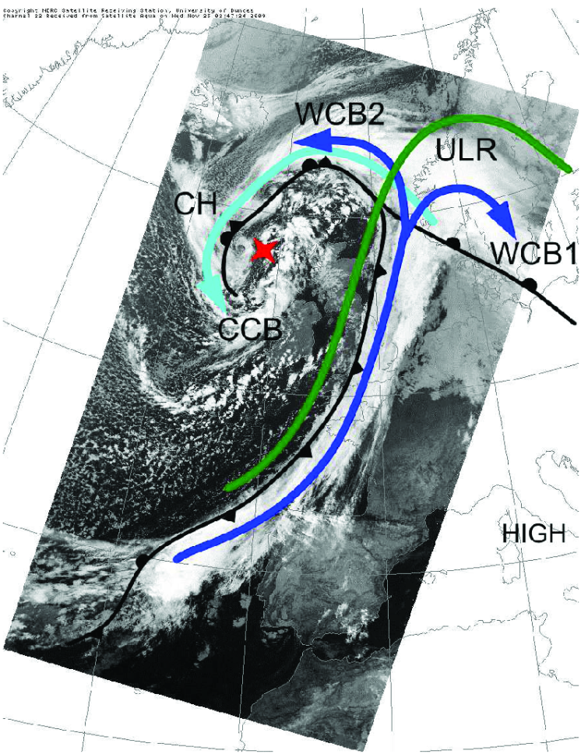
What is a warm conveyor belt?
WCB has two branches identified with precipitation and cloud features
Example from case 24/11/09
(Martínez-Alvarado et al, 2014)
T-NAWDEX Pilot flight (3)

Slide 4
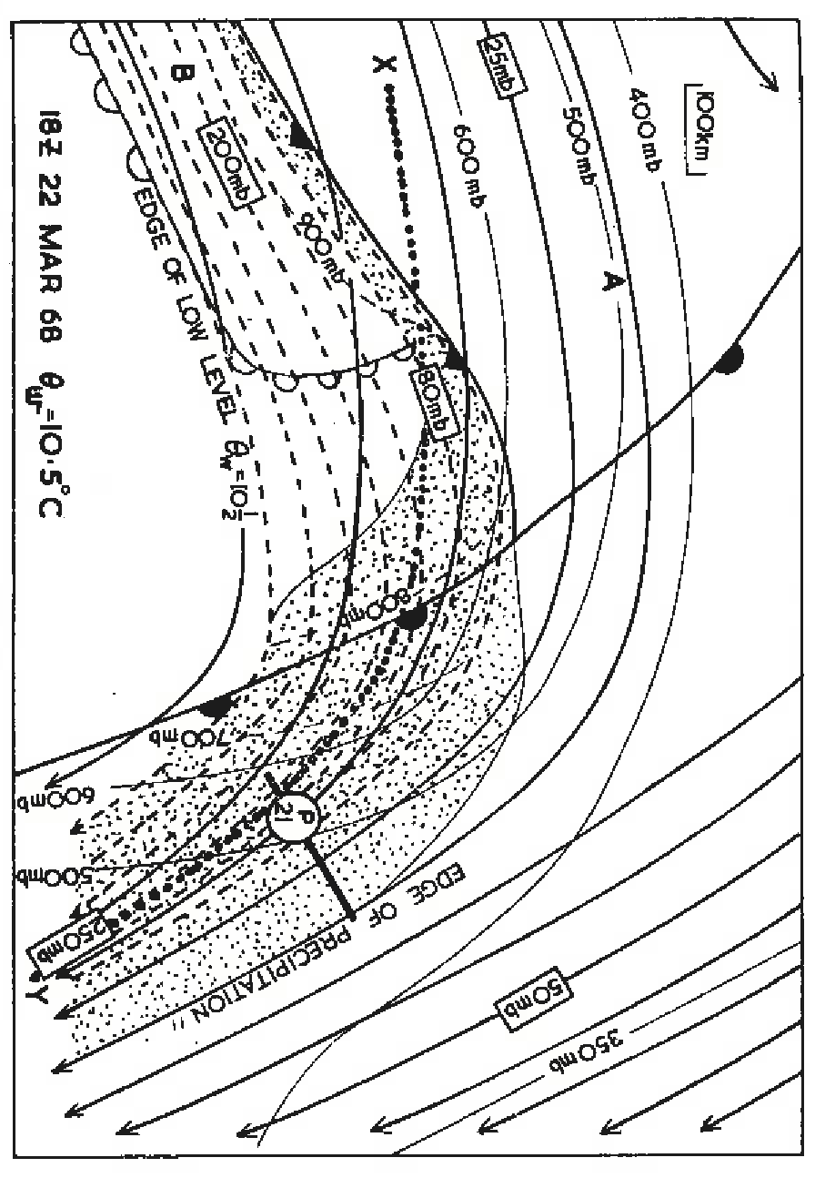
What is a warm conveyor belt?
Isentropic relative-flow analysis and the parcel theory
– Green, Ludlam & McIlveen (1966) QJ
Extended to wet bulb theta surfaces by Browning & Harrold
Harrold (1973) QJ
First use of term “warm conveyor belt”
Key tool was the new weather radar.
WCB identified with the major precipitation band of a cyclone.

Slide 5
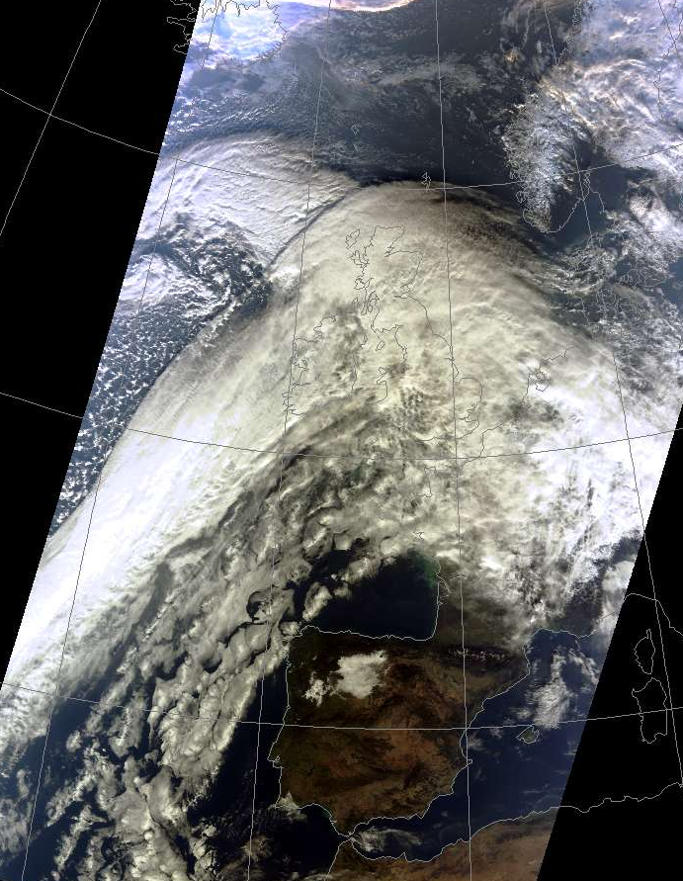
What is a warm conveyor belt?
WCB has two branches identified with precipitation and cloud features
Example from case 24/11/09
(Martínez-Alvarado et al, 2014)
T-NAWDEX Pilot flight (3)

Slide 6
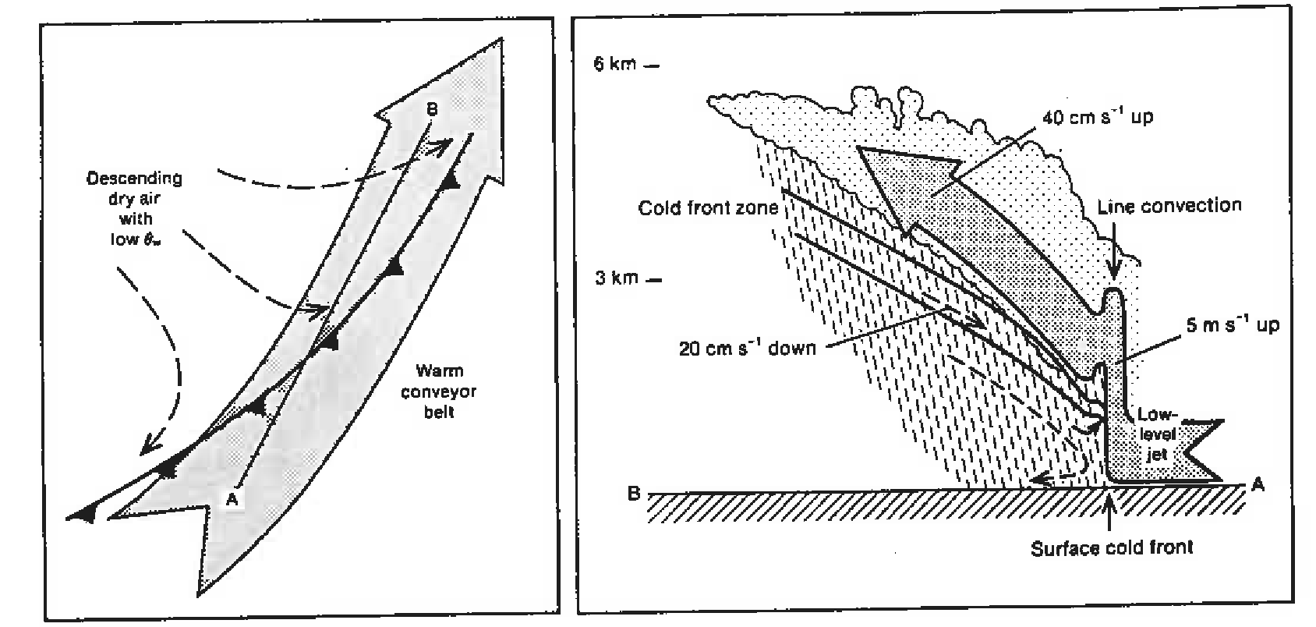
What is a warm conveyor belt?
Combination of isentropic relative flow analyses and radar sections yielded mesoscale structure associated with WCB (Browning and Harrold).

Slide 7
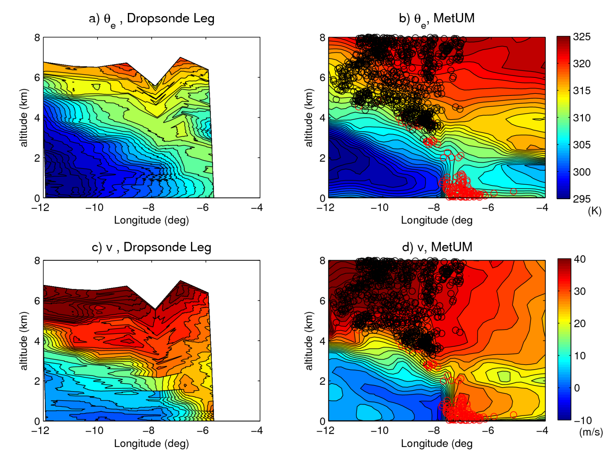
What is a warm conveyor belt?
Cross-section through cold front and WCB in T-NAWDEX Pilot 3 case.
Black dots – trajectories of WCB1 crossing section
Red dots – trajectories of WCB2 crossing section
Martínez-Alvarado et al, 2014, QJ

Slide 8
What is a warm conveyor belt?
With increase in objective analysis quality, became possible to identify WCB with Lagrangian structures using trajectories:
Letestu (PhD thesis 1994, with Browning)
Wernli & Davies (1997) QJ
introduce coherent ensemble of trajectories (CET)
e.g., identified WCB with CET where trajectories experience pressure decrease > 600 hPa.

Slide 9
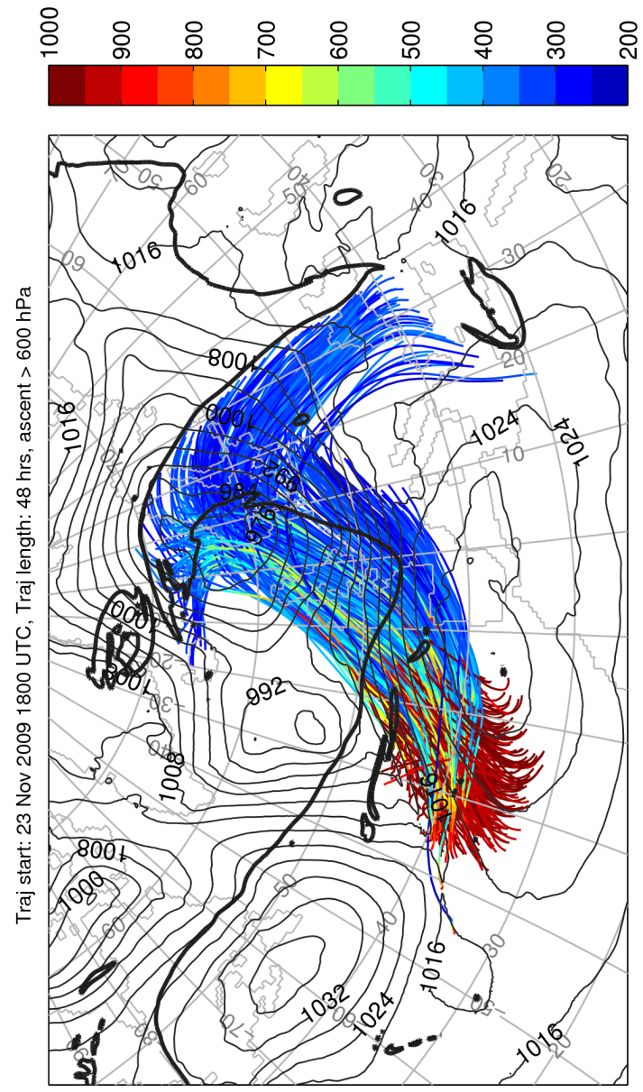
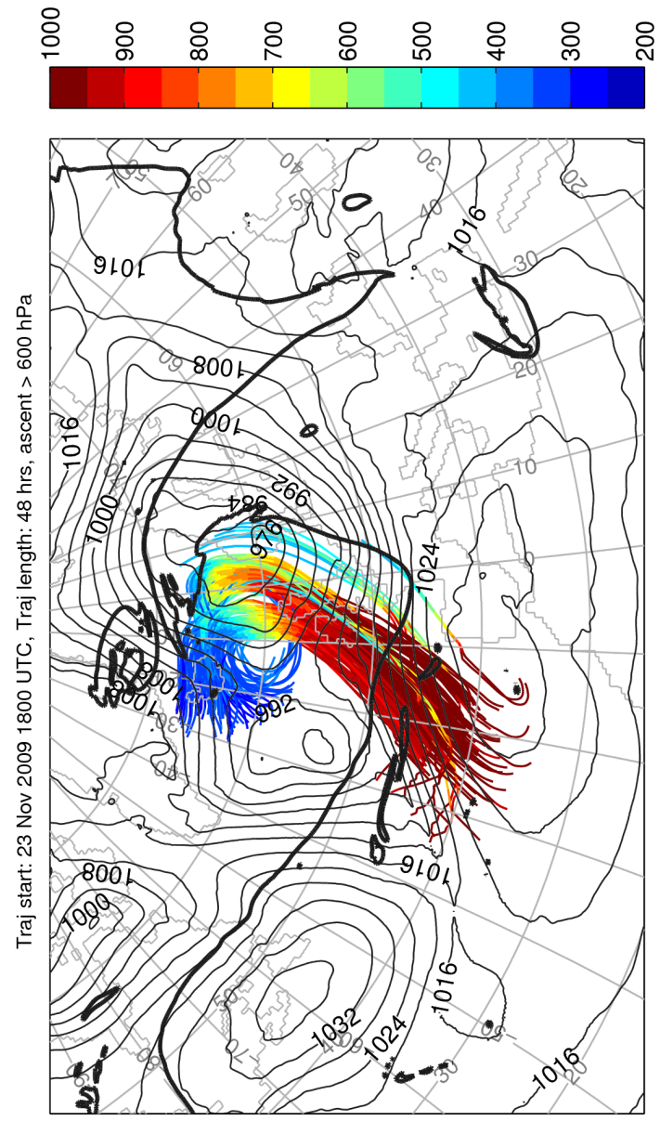
What is a warm conveyor belt?
Example from case 24/11/09
(Martínez-Alvarado et al, 2014)
Trajectories calculated following resolved flow in model (in this case 12km grid with parameterised convection)

Slide 10
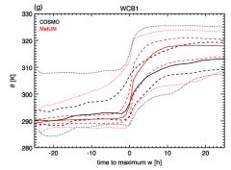
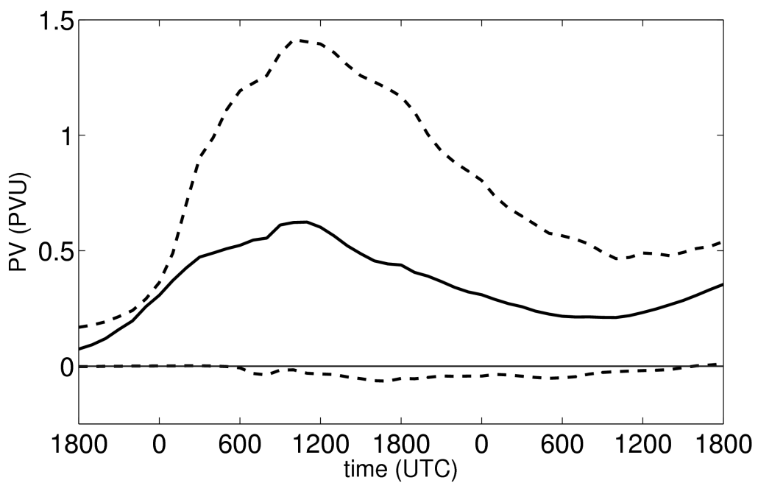
Air mass changes following WCB
Can follow trajectories of the resolved flow and see:
Theta increases by greater than isentropic spread of the inflow or outflow layer of the CET
Although PV increases below heating maximum, it decreases again above. PV of outflow ≈ PV of inflow
(also in Madonna et al, 2014, J. Clim.)
Two major questions:
Are trajectories following resolved flow relevant, given embedded convection in WCB?
Why is PV constrained in this way?

Slide 11
Trajectory ascent in convection-permitting simulations
Stephan Rasp, Tobias Selz, George Craig
Simulation setup:
COSMO-2.8km simulations (no convection scheme)
Online trajectory scheme by Miltenberger et al. (2013)

Slide 12
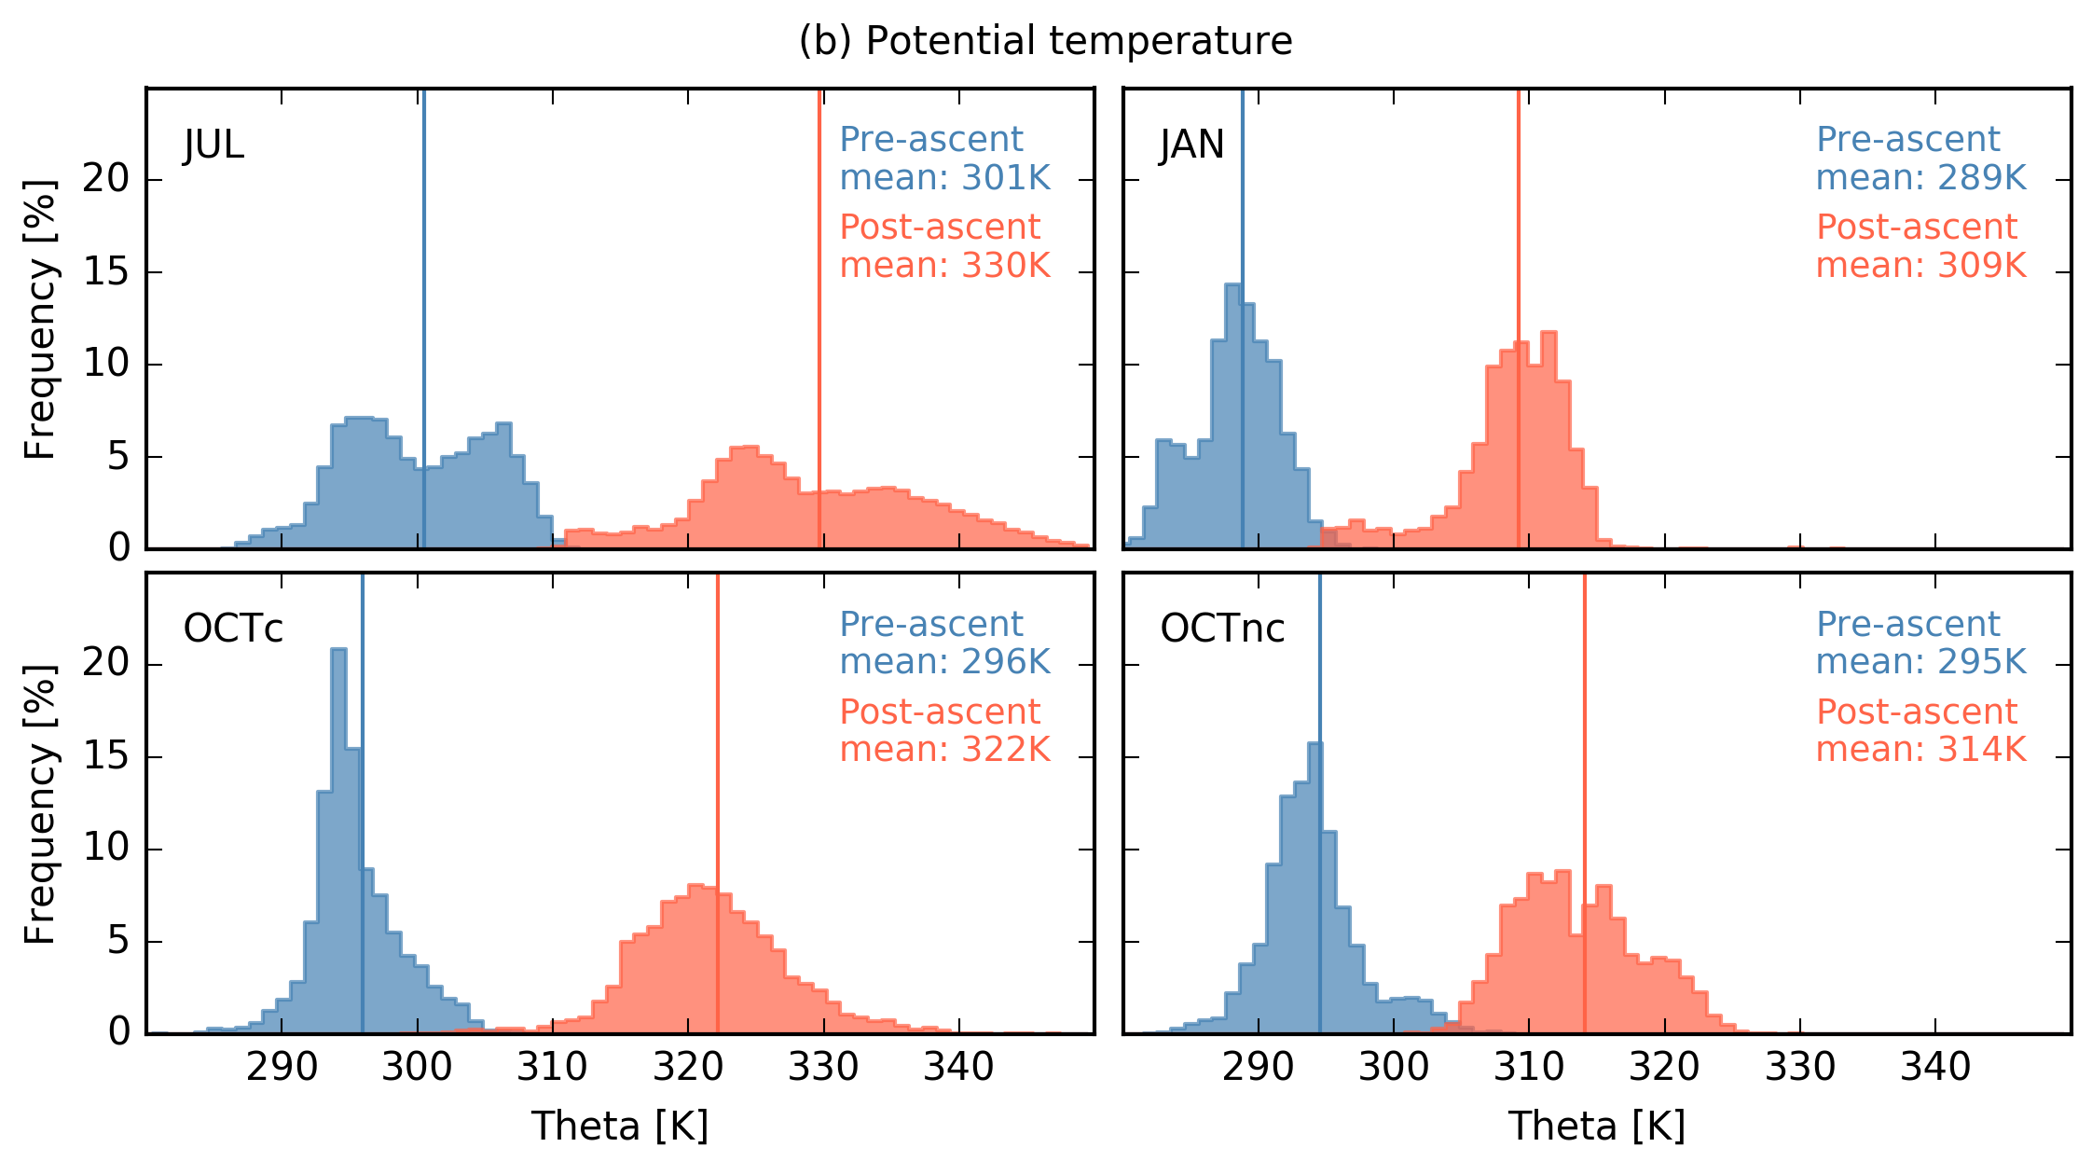
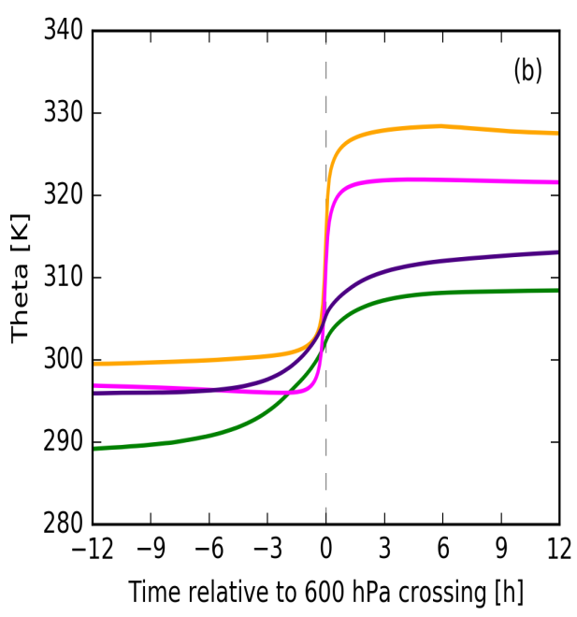
THETA evolution (in three WCB cases)
Temporal evolution of potential temperature (in K) for all three cases, where OCT is divided into convective and non-convective trajectories.
Histograms of potential temperature (in K) for all three cases, where OCT is devided into convective and non-convective trajectories.

Slide 13
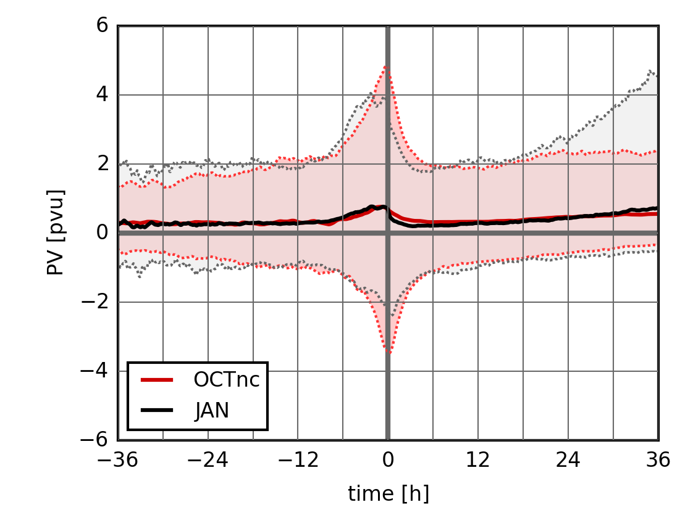
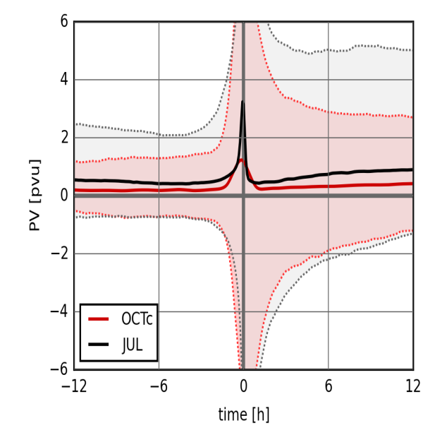
PV evolution
PV against time. Thick lines represent the average value, the shaded area represents the 5th – 95th percentile range.

Slide 14
Local PV Conservation Equation
Conservation of mass (in isentropic coordinates; r = density)
V = horizontal wind
$\dot{θ}$ = cross-isentropic motion
Conservation of tracer mass (χ = tracer mixing ratio)
S = tracer source/sink
Conservation of PV (q = PV)
No PV source/sink
Non-conservative PV flux (effect of diabatic and frictional processes)
Amazing result! No PV flux across isentropic surfaces
PV impermeability theorem (Haynes & McIntyre, 1987)

Slide 15
Conservation for 3D isentropic layers
Consider control volume bounded above and below by isentropic surfaces and laterally by surface moving with horizontal flow, V_{b}= V.
If flow were adiabatic and frictionless, the mass and circulation of the volume would be conserved.
density
PV
Potential temperature surface

Slide 16
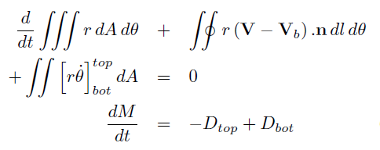
Integral PV conservation (circulation)
Integrate PV equation over control volume (boundary velocity V_{b} )
+J.n
Circulation conservation
Integrate mass continuity over control volume
Mass-weighted average PV or amount of PV substance divided by mass
(Haynes & McIntyre, 1990)

Slide 17
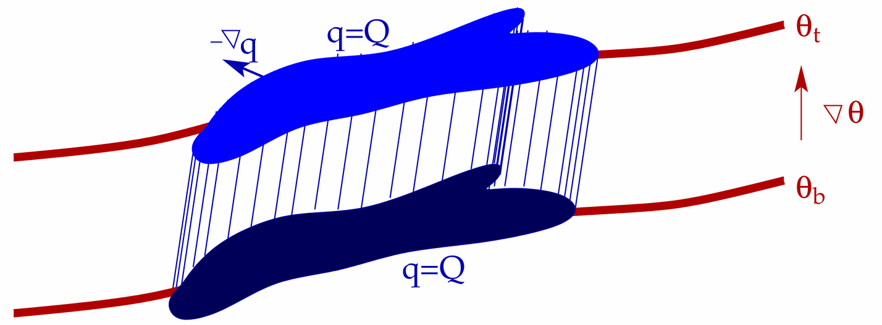
4. Integral effects of diabatic processes
Consider two such volumes, one above the other.
Cooling at θ_{i} ⇒ diabatic mass transport from upper to lower layer
Dilutes PV substance below and concentrates it above
θ_{i}
$$\dot{θ}<0$$
Potential temperature surface

Slide 18
Total diabatic PV in section across tropopause fold
Positive diabatic PV above (on strat side) of tropopause
Negative diabatic PV beneath (on trop side) of tropopause
Tropopause elevation not significantly altered by direct diabatic PV modification
Chagnon, Gray and Methven (2013), Q J R Met S

Slide 19
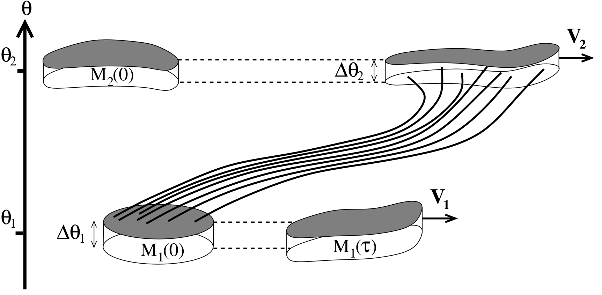
PV in warm conveyor belts
Consider two volumes, in isentropic layers representing the inflow and outflow of a warm conveyor belt.
Heating at θ_{i} ⇒ diabatic mass transport from lower to upper layer
Concentrates PV substance of “inflow volume” and dilutes outflow PVS
$$\dot{θ}>0$$
Methven, Q. J. Royal Met. Soc. (2015)

Slide 20
Conclusions
WCB can be described as coherent ensemble of trajectories (CET) even if following flow including convective motions
Key ingredients
Net heating (Δθ) is large cf range of θ in “inflow” and “outflow”
Horizontal advection on each isentropic surface is dominated by the “large-scale flow”
PV of outflow ≈ PV of inflow only when averaging over the CET
“observed” to apply whether or not resolving convective motions
A result of conservation of circulation within inflow and outflow isentropic layers (although not constrained to be an equality)
Detail of θ-history following each trajectory is unimportant as long as it leaves inflow layer and ends up in outflow layer (in time interval).
-ve PV anomaly at jet stream level is greater when net heating is greater because outflow layer is higher (rather than net PV decrease).

Slide 21
Thankyou for your attention

