Slide 1
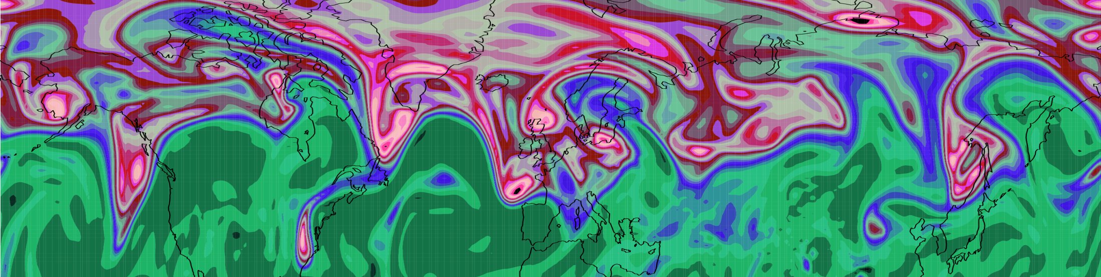
Diabatic Influence on Tropopause Rossby Waves
Department of Meteorology
John Methven, Ben Harvey, Leo Saffin and Jake Bland
Department of Meteorology,
University of Reading

Slide 2
Influences of latent heat release on development of weather systems
Diabatic heating intensifies ascent, vortex stretching and baroclinic growth rate
Majority of ascent occurs in “warm conveyor belt” (WCB) of cyclones (poleward moving, warm, moist air)
Heating enables ascent across surfaces of constant potential temperature (θ) - diabatic mass transport
Mass outflow of WCBs into the upper troposphere in the ridges of meandering jet stream
Q.1 What fraction of mass in a ridge arrives by diabatic transport?
Q.2 What influence does it have on Rossby wave activity?

Slide 3
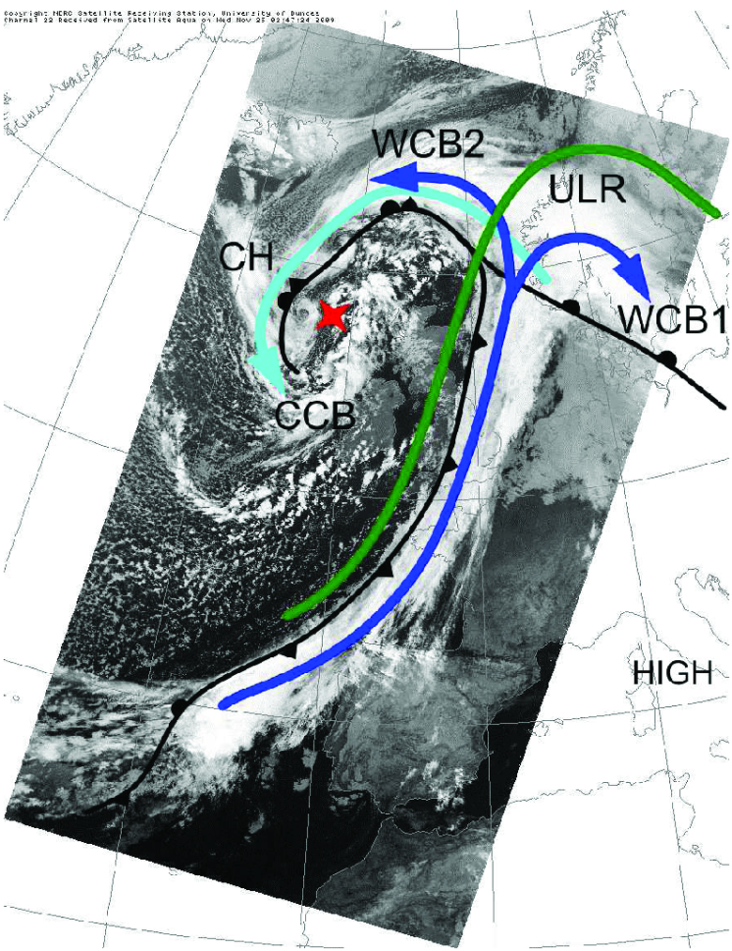
Observed warm conveyor belts
WCB has two branches identified with precipitation and cloud features
Example from case 24/11/09
Martínez-Alvarado et al, 2014, QJ
T-NAWDEX Pilot flight (3)

Slide 4
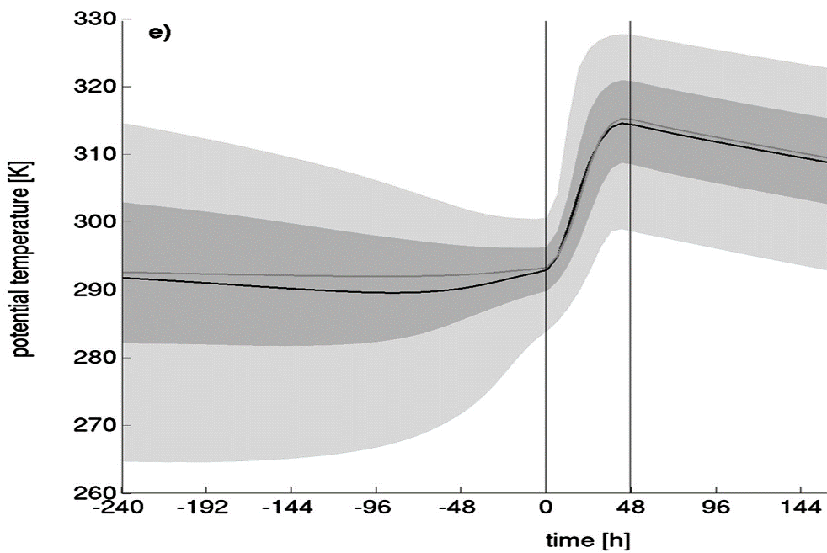
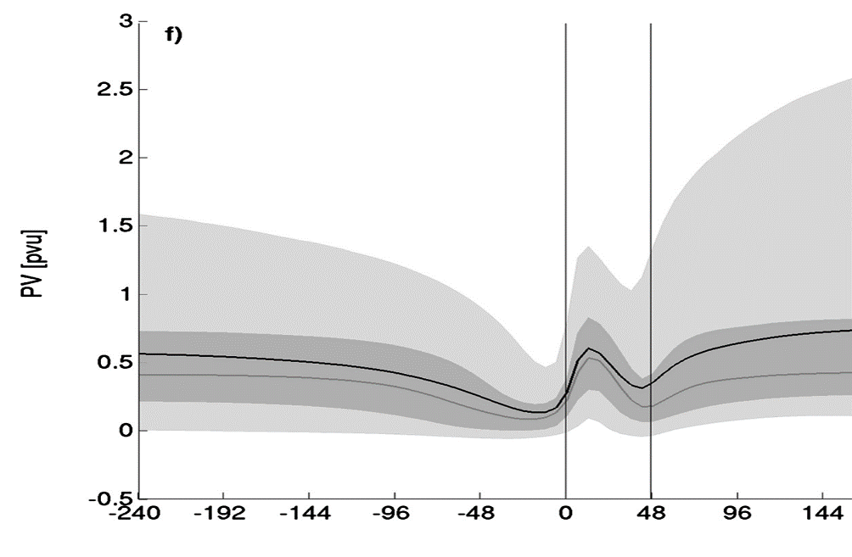
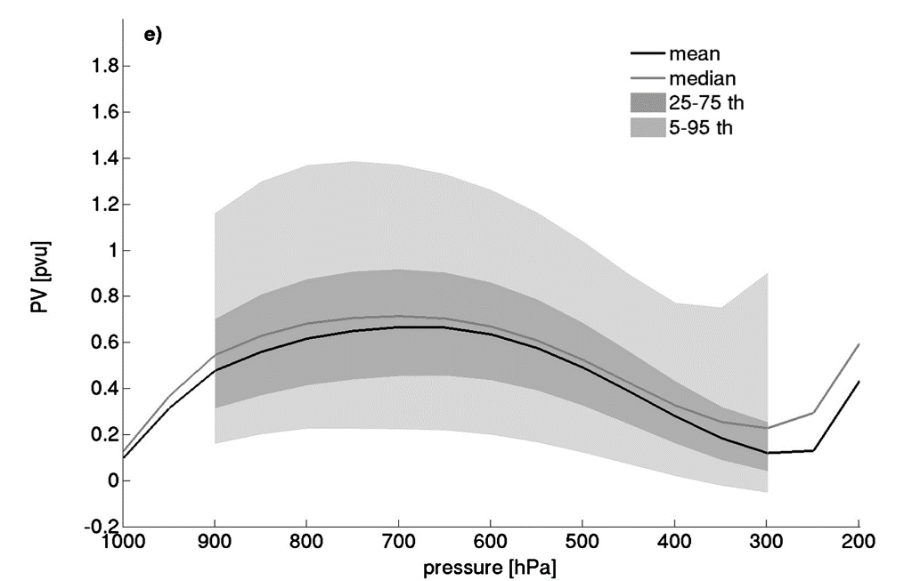
Air mass changes following WCB
WCB frequently defined as a coherent ensemble of trajectories (following the resolved flow)
Climatology from
Madonna et al, 2014, J. Climate
θ increases by greater than isentropic spread of the inflow or outflow layer of the CET
Although PV increases below heating maximum, it decreases again above. PV of outflow ≈ PV of inflow
Why is PV constrained in this way?
Implications for role of heating?

Slide 5
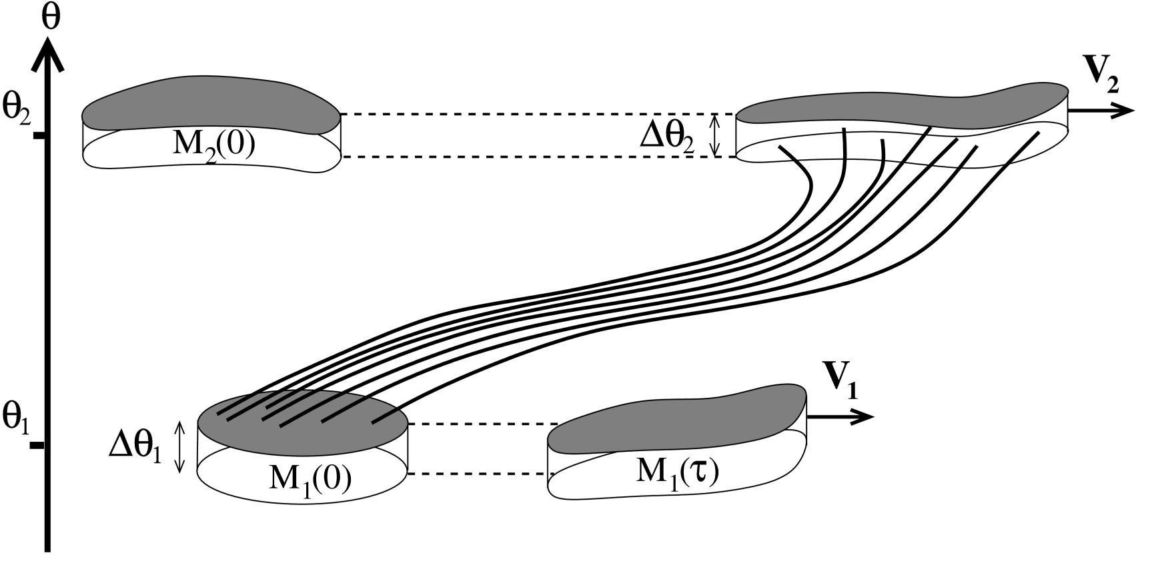

PV in warm conveyor belts
Consider two volumes, in isentropic layers representing the inflow and outflow of a warm conveyor belt.
Heating ⇒ diabatic mass transport from lower to upper volume
Concentrates PV substance of “inflow volume” and dilutes outflow PVS
$$\dot{θ}>0$$
Methven, Q. J. Royal Met. Soc. (2015)

Slide 6
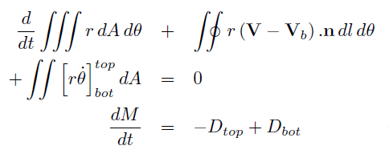

Integral PV conservation (circulation)
Integrate PV equation over control volume (lateral boundary velocity V_{b} )
Circulation conservation
(if V_{b}=V & J’-integral=0)
Integrate mass continuity over control volume
Diabatic mass flux convergence “dilutes” average PV
Mass-weighted average PV or amount of PV substance divided by mass
(Haynes & McIntyre, 1990)

Slide 7
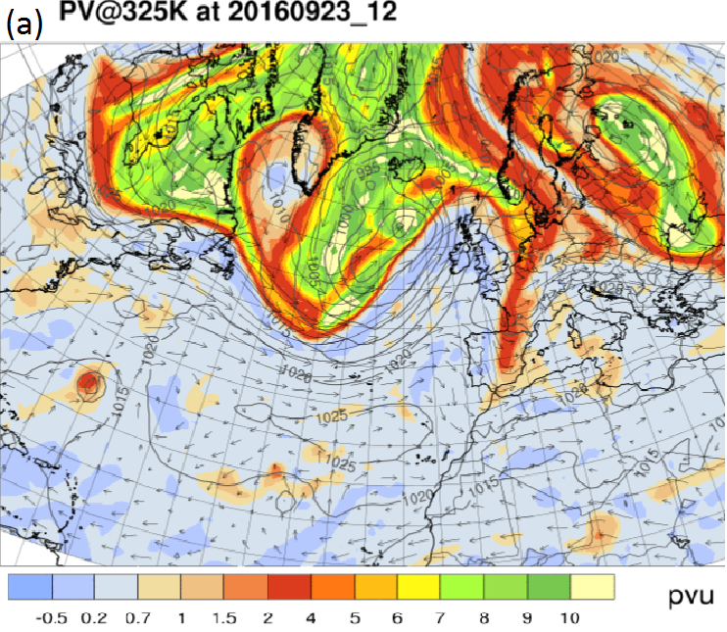
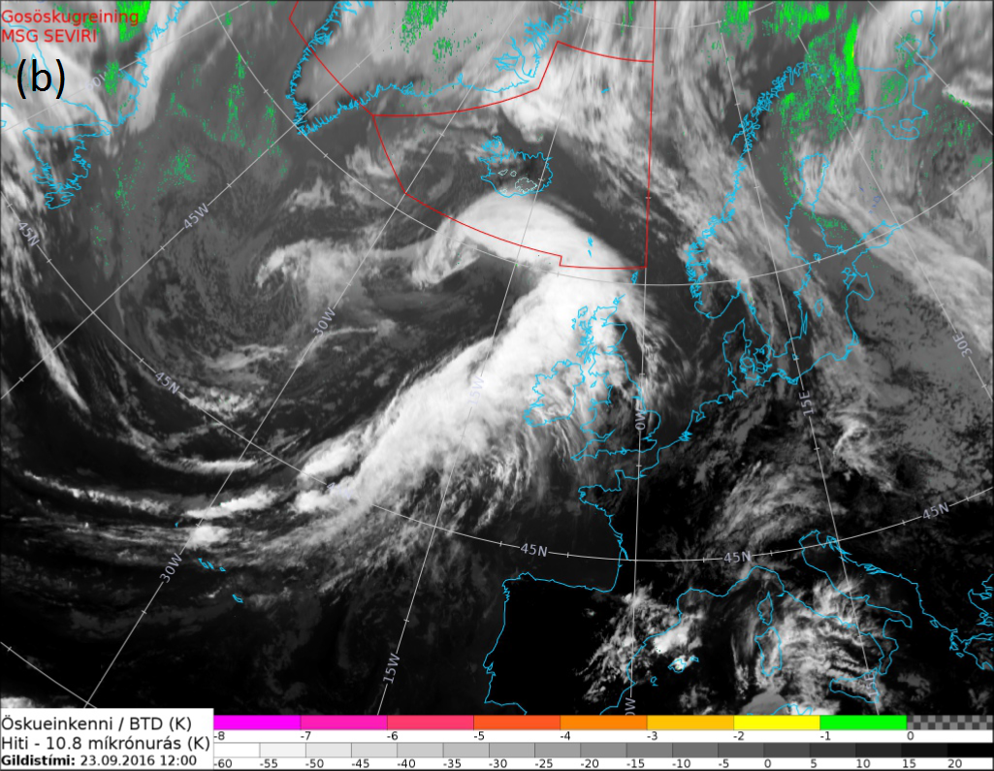
Is this conceptual picture realised?
Examine NAWDEX case 3
IR satellite image and corresponding PV map: 12UT 23/9/2016

Slide 8
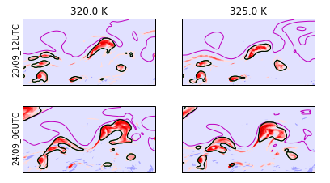

Defining outflow volume using net heating
Black contour = lateral boundary of “outflow volume” on θ-surface

Slide 9
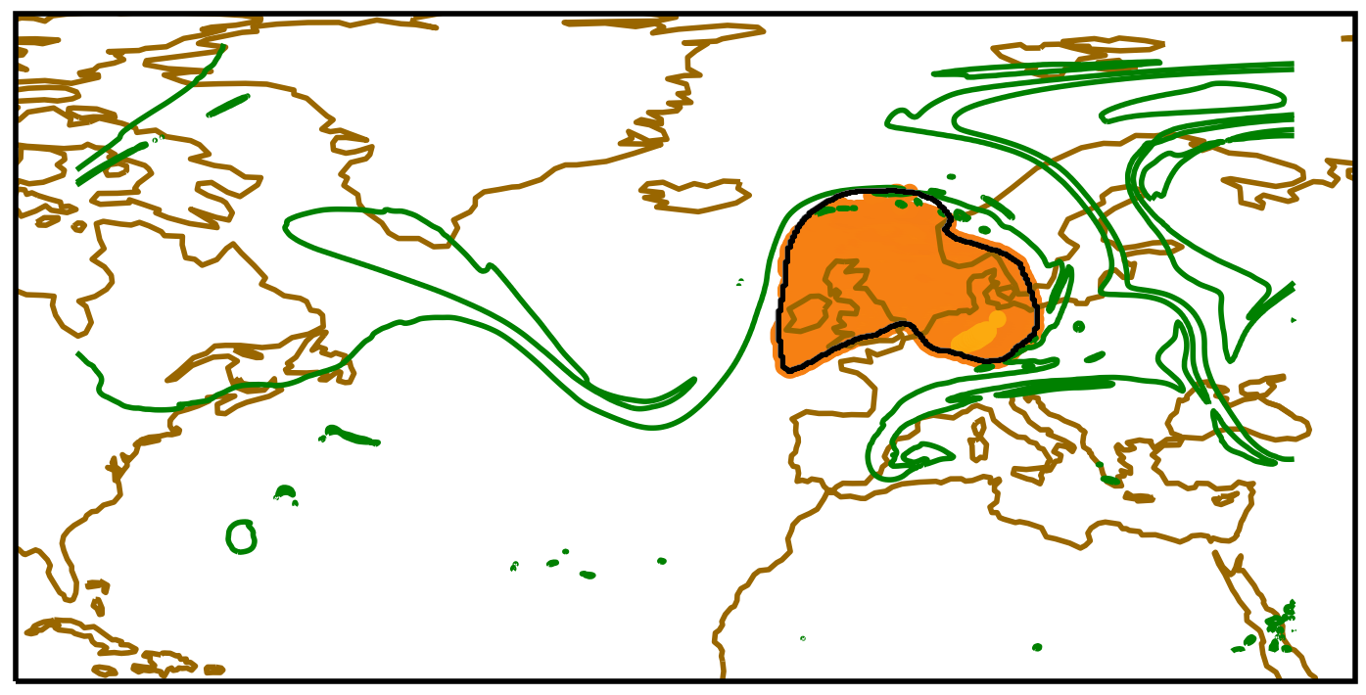
Outflow volume at outflow time
Black contour = lateral boundary of “outflow volume” on 325K surface
Yellow = release locations of 3D back trajectories from outflow volume
Green contour = tropopause on 325K

Slide 10
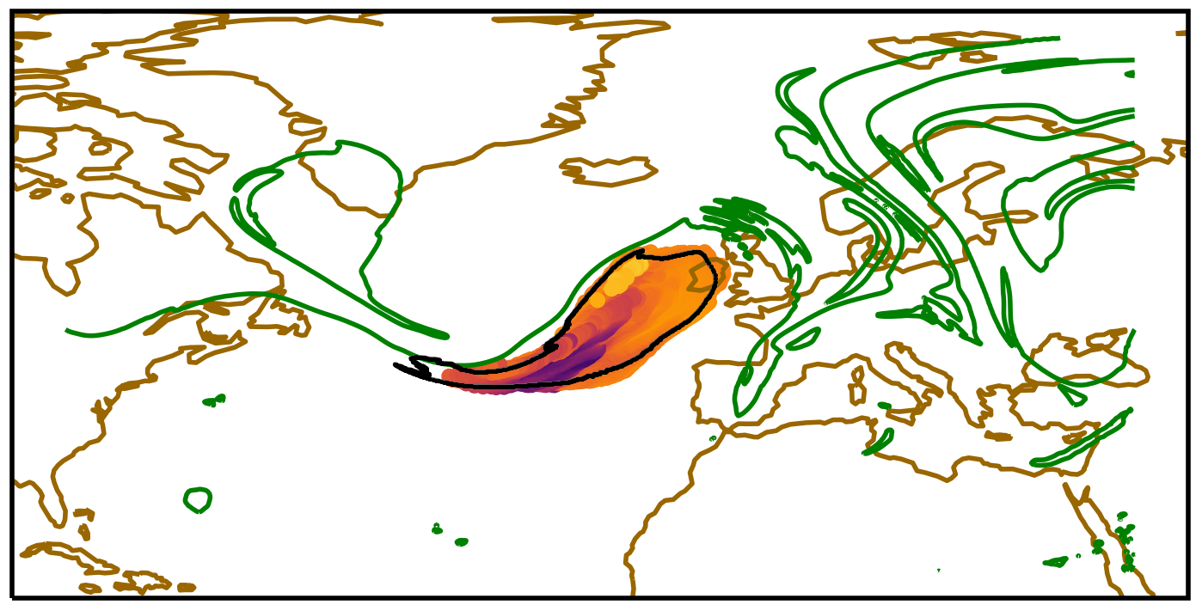
Following backwards (T-18)
Contour = lateral boundary of “outflow volume” on 325K surface
Colour dots = θ at locations of 3D back trajectories from outflow volume
Green contour = tropopause on 325K

Slide 11
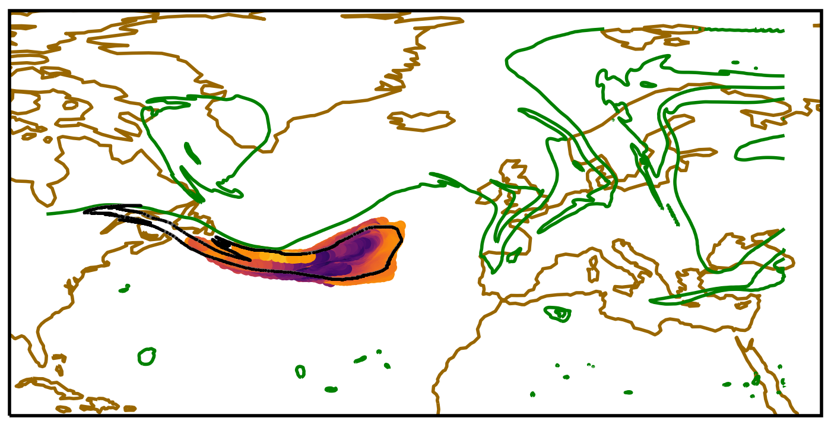
Following backwards (T-30)
Contour = lateral boundary of “outflow volume” on 325K surface
Colour dots = θ at locations of 3D back trajectories from outflow volume
Green contour = tropopause on 325K

Slide 12
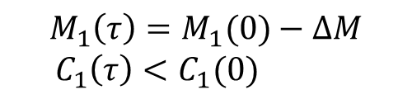

PV in warm conveyor belts
Consider two volumes, in isentropic layers representing the inflow and outflow of a warm conveyor belt.
Heating ⇒ diabatic mass transport from lower to upper volume
Concentrates PV substance of “inflow volume” and dilutes outflow PVS
$$M_{2}\left(τ\right)=M_{2}\left(0\right)+∆M$$
${ C}_{2}\left(τ\right)≈C_{2}(0)$
$$\dot{θ}>0$$
$$M_{1}\left(τ\right)=M_{1}(0)−∆M$$
$${ C}_{1}\left(τ\right)<C_{1}(0)$$
Methven, Q. J. Royal Met. Soc. (2015)

Slide 13
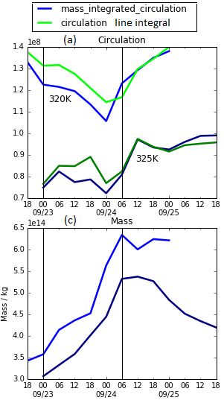

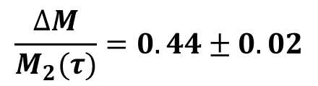



Circulation and mass of outflow
Fractional variation in circulation of outflow volume is small
Verifying that circulation is conserved even though diabatic processes are strong
within WCB
Large increase in mass of outflow volume (x2) by diabatic mass transport from below
$$τ_{1}$$
$$τ_{2}$$
$$τ_{1}$$
$$τ_{2}$$
$$\frac{∆M}{M_{2}(τ)}=0.44±0.02$$

Slide 14
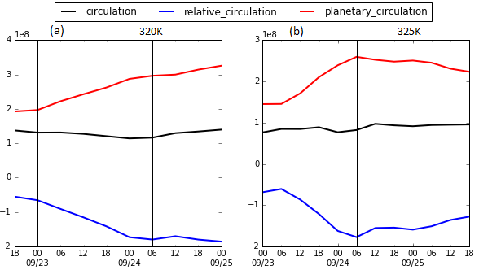
Circulation and mass of outflow
Fractional variation in circulation of outflow volume is small.
Integral of planetary vorticity increases (poleward motion of circuit)
Compensating decrease in integral of relative vorticity
As expected in Rossby wave – but here with strong diabatic transport

Slide 15
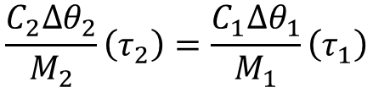



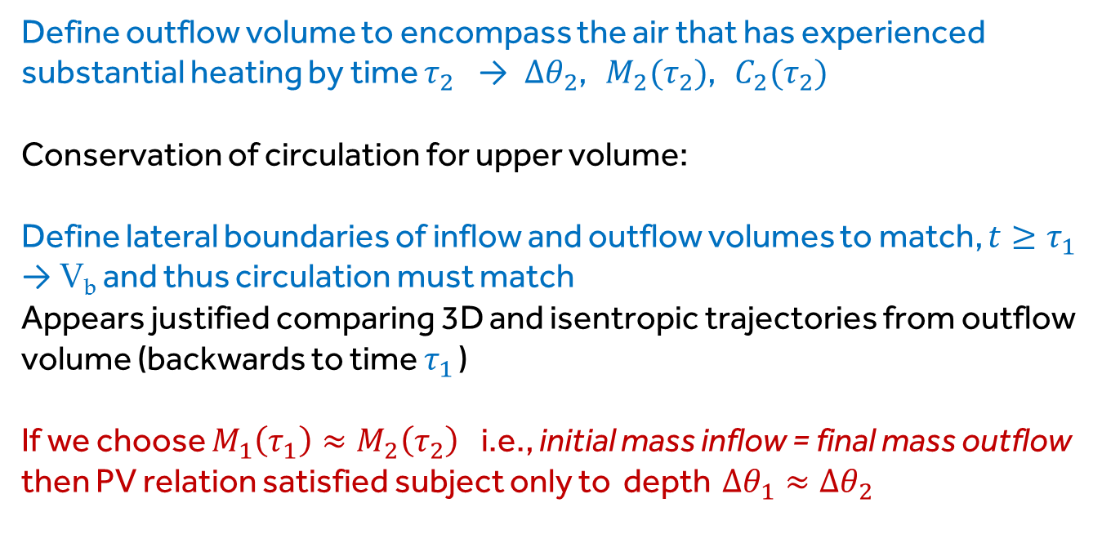
When does PV outflow = PV inflow?
Under what conditions does average PV of outflow = PV of inflow?
$${\left\langle q\right\rangle }_{2}\left(τ_{2}\right)={\left\langle q\right\rangle }_{1}\left(τ_{1}\right)$$
$$\frac{C_{2}∆θ_{2}}{M_{2}}\left(τ_{2}\right)=\frac{C_{1}∆θ_{1}}{M_{1}}\left(τ_{1}\right)$$
Define outflow volume to encompass the air that has experienced substantial heating by time $τ_{2}$ → $∆θ_{2}$, $M_{2}(τ_{2})$, $C_{2}(τ_{2})$
Conservation of circulation for upper volume:
Define lateral boundaries of inflow and outflow volumes to match, $t≥τ_{1}$
→ V_{b} and thus circulation must match
Appears justified comparing 3D and isentropic trajectories from outflow volume (backwards to time $τ_{1}$ )
If we choose $M_{1}\left(τ_{1}\right)≈M_{2}\left(τ_{2}\right)$i.e., initial mass inflow = final mass outflow then PV relation satisfied subject only to depth $∆θ_{1}≈∆θ_{2}$
$$C_{2}\left(τ_{1}\right)=C_{2}(τ_{2})$$
$$C_{1}\left(τ_{1}\right)=C_{2}\left(τ_{1}\right)=C_{2}(τ_{2})$$

Slide 16
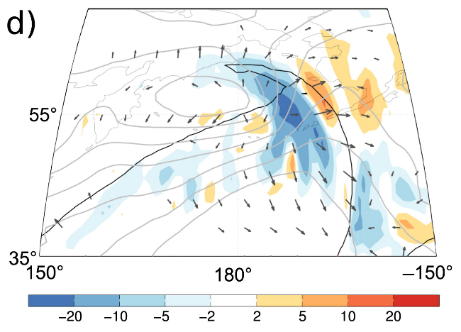
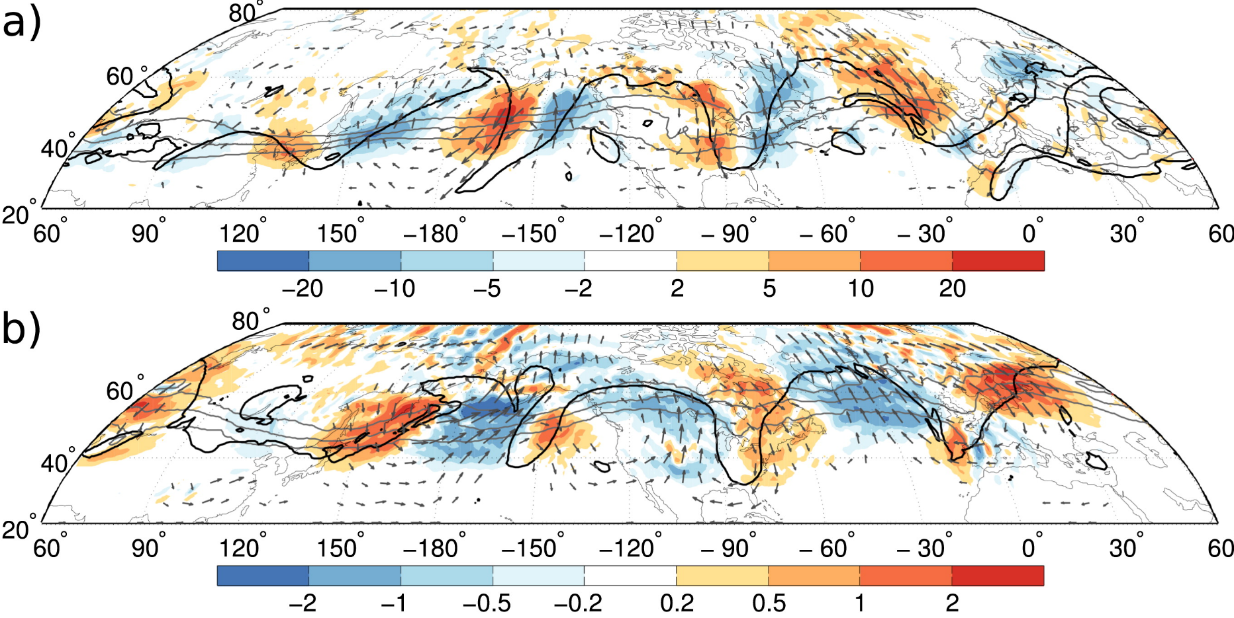
Advection by divergent outflow
Outflow circulation approximately unchanged by diabatic processes
But, divergence in outflow layer expands outflow area
Stronger net heating → higher outflow and stronger divergence
e.g., Teubler and Riemer (2016) JAS Divergent wind expanding ridge area and advecting tropopause
cf, advection by self-induced rotational wind obtained by inversion of upper level PV train

Slide 17
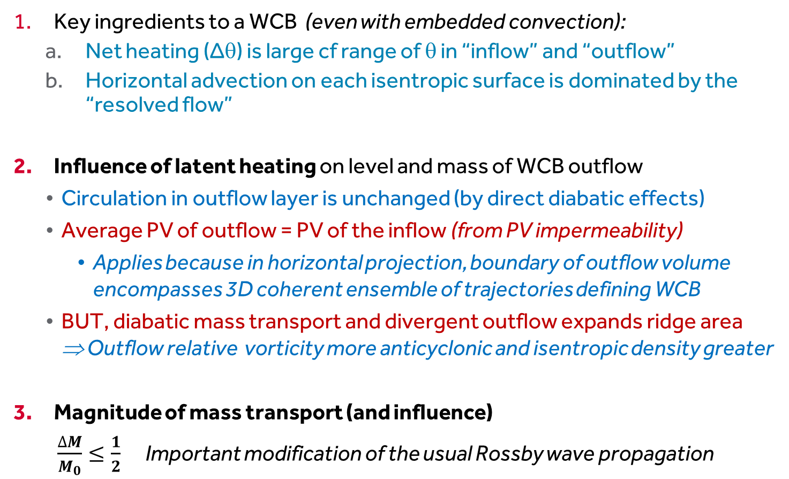
Conclusions
Key ingredients to a WCB (even with embedded convection):
  Net heating (Δθ) is large cf range of θ in “inflow” and “outflow”
  Horizontal advection on each isentropic surface is dominated by the “resolved flow”
Influence of latent heating on level and mass of WCB outflow
  Circulation in outflow layer is unchanged (by direct diabatic effects)
  Average PV of outflow = PV of the inflow (from PV impermeability)
    Applies because in horizontal projection, boundary of outflow volume encompasses 3D coherent ensemble of trajectories defining WCB
  BUT, diabatic mass transport and divergent outflow expands ridge area ⇒ Outflow relative vorticity more anticyclonic and isentropic density greater
Magnitude of mass transport (and influence)
  $\frac{∆M}{M_{0}}≤\frac{1}{2}$Important modification of the usual Rossby wave propagation

Slide 18
Thankyou for your attention

Slide 19
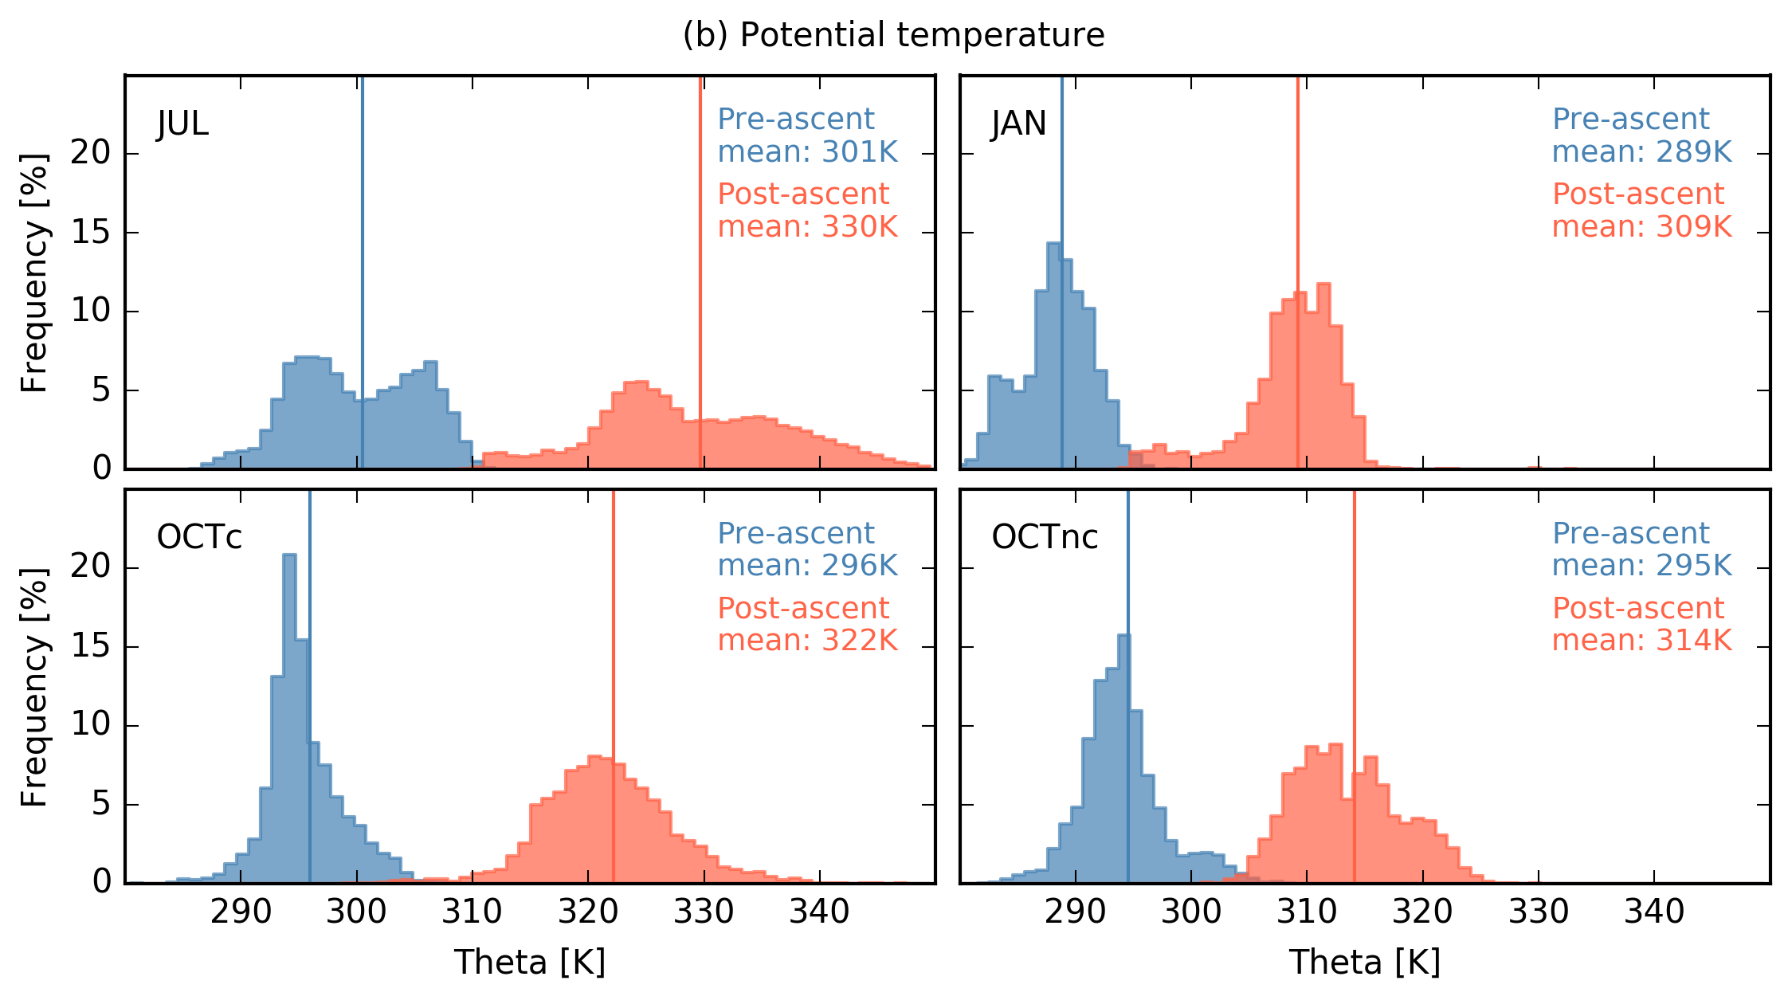
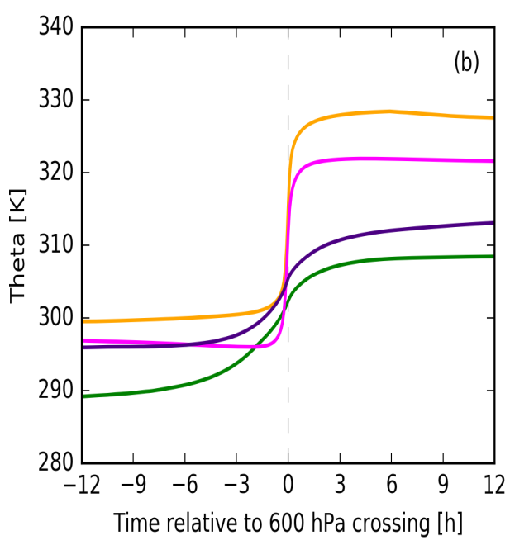
Trajectory ascent in convection-permitting COSMO simulations (2.8 km grid)
Rasp et al, MWR (2016)
Temporal evolution of potential temperature (in K) for all three cases, where OCT is divided into convective and non-convective trajectories.
Histograms of potential temperature (in K) for all three cases, where OCT is divided into convective and non-convective trajectories.

Slide 20
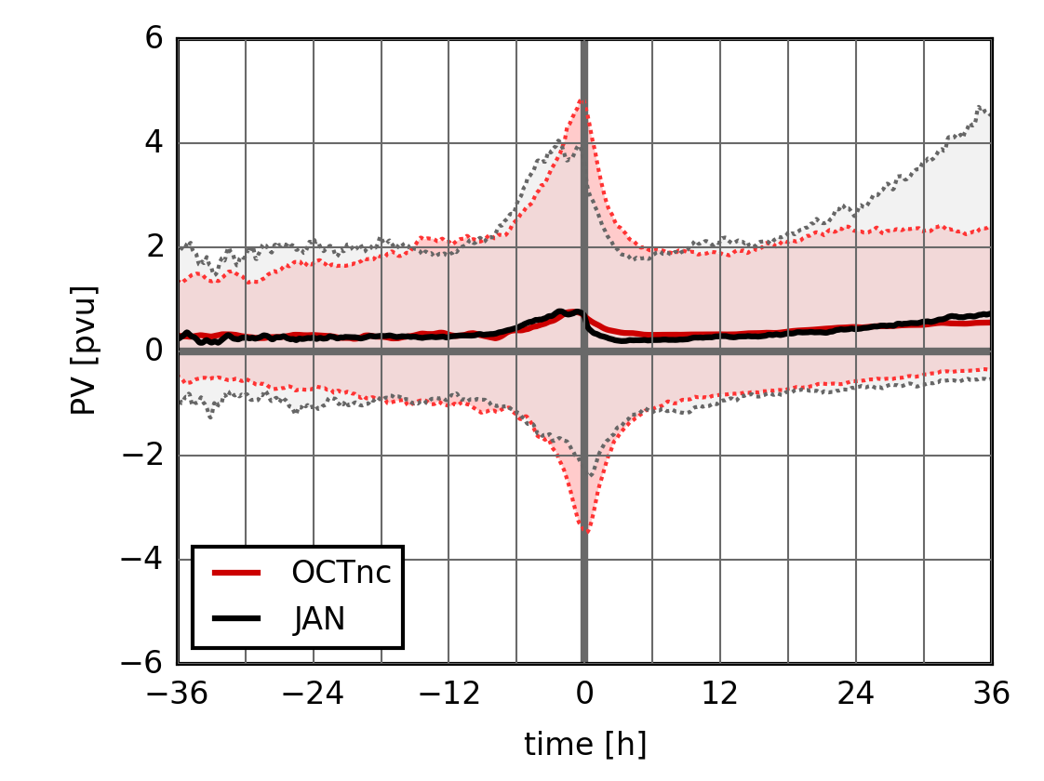
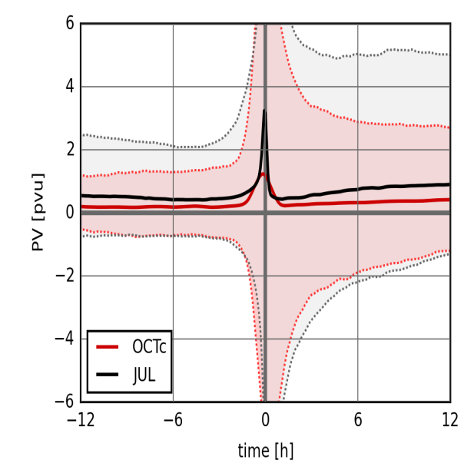
Evolution of PV for trajectory ensemble
PV against time. Thick lines represent the average value, the shaded area represents the 5th – 95th percentile range.

Slide 21


PV evolution equation (I)
Lagrangian form of Ertel PV equation:
PV increases below heating maximum (and decreases above it).
However, there is not an obvious constraint on PV values.
Now consider flux (or local conservation) form of PV equation:
J = “non-advective PV flux” arising from non-conservative processes
(Haynes & McIntyre, 1987, JAS)
$$=−∇.J$$

Slide 22
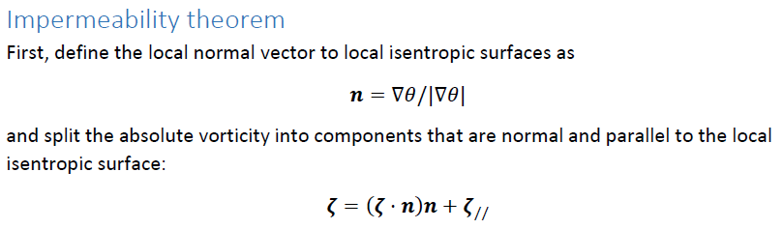




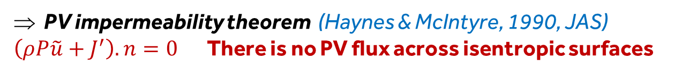
PV evolution equation (II)
We can write the flux form PV equation as:
Using and partitioning velocity into cross-isentropic and along-isentropic components :
$$=−∇.J′$$
PV impermeability theorem (Haynes & McIntyre, 1990, JAS)
$\left(ρP\tilde{u}+J^{′}\right).n=0$There is no PV flux across isentropic surfaces

Slide 23


PV evolution equation (III)
Back to an alternative Lagrangian form of PV equation
Evolution following flow within an isentropic layer
Non-advective transport of
PV along $θ$ surfaces
Concentration/dilution of PV
above/below heating
Negative PV cannot arise through diabatic mass flux convergence
If P>0 initially, it must remain positive through the first term on right.

Slide 24
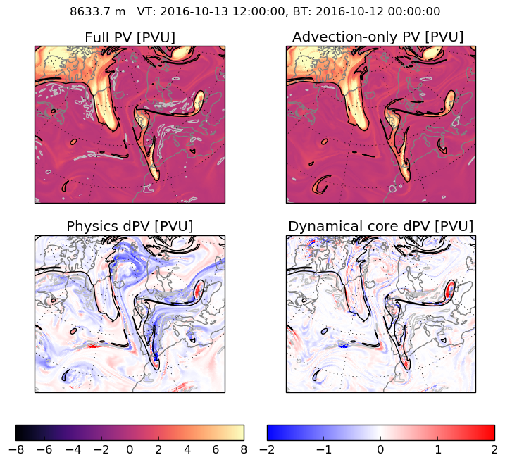
PV tracers for Thor ridge development
PV and PV tracers in NAWDEX Thor case
Calculated online in operational Met Office forecasts by Claudio Sanchez
Effects of non-conservation by dynamical core calculated explicitly
Saffin et al (2016), QJ
Net effect of diabatic physics processes ⇒ lower PV in ridge

Slide 25
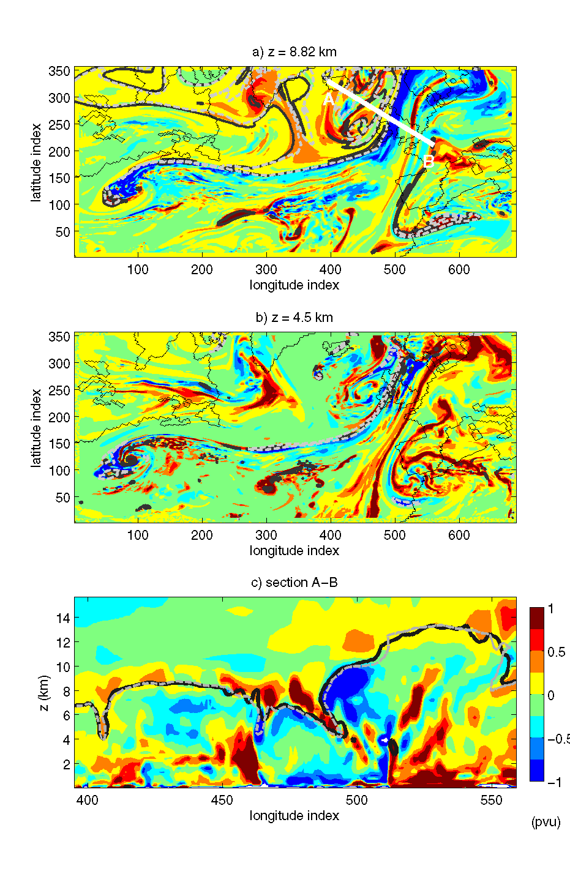
Total diabatic PV in section across tropopause fold
Positive diabatic PV above (on strat side) of tropopause
Negative diabatic PV beneath (on trop side) of tropopause
Tropopause elevation not significantly altered by direct diabatic PV modification
Chagnon, Gray and Methven (2013), Q J R Met S

