Slide 1
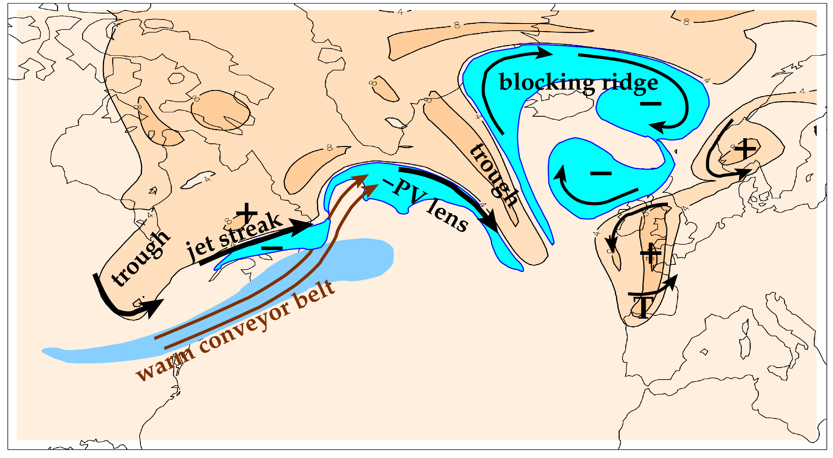
Overarching scientific aim of NAWDEX: to quantify the effects of diabatic processes on disturbances to the jet stream near North America, their influence on downstream propagation across the North Atlantic, and consequences for high-impact weather in Europe.
Features related to the meandering tropopause and jet stream (orange is stratospheric air; cyan marks upper tropospheric PV anomalies).

Slide 2
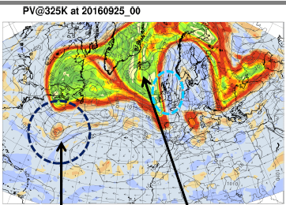
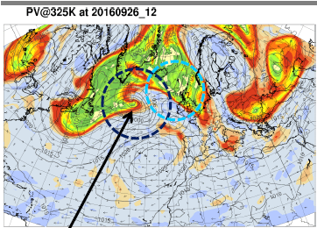
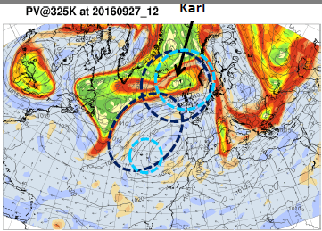
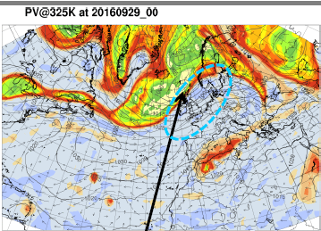
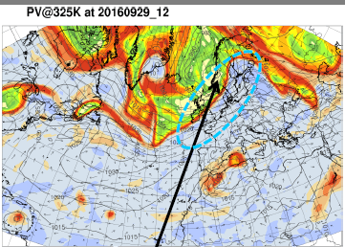
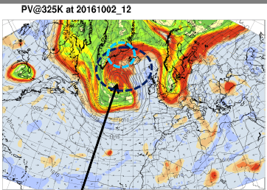
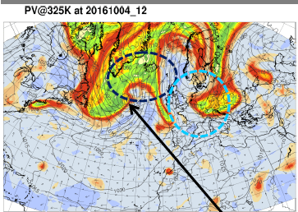
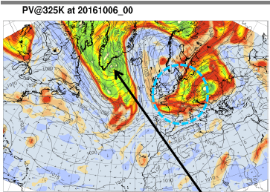
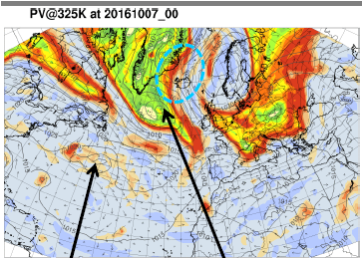
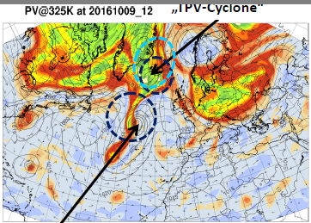
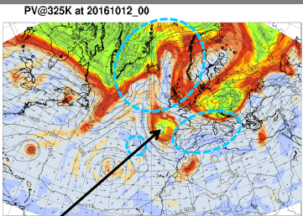
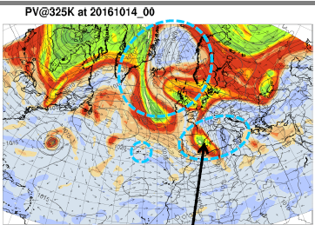
1) TRIGGER 2) INTERACTION 3) DEVELOPMENT 4) IMPACT
R1
C
R4
R1
R4
R1
R5
R4
R2
C
C
R3
R3
R2
R3
M
M
A: ex-TS Karl re-intensification downstream jet streak heavy rain on Norway
R3
R4
R3
R6
C
R5
R3
C
R5
R7
R5
R7
R6
C
R6
C
N
N
M
B: vortex roll-up strong cyclogenesis second cyclone European block forms
R7
R6
R6
T
R8
R6
T
S
R8
T
S
M
C
M
T
S
S
N
N
N
N
C: cyclone S TPV vortex roll-up meridional extension heavy rain in W. Med.

