Slide 1
Linking African Easterly Wave activity with equatorial waves and the influence of Rossby waves from the SH
Gui-Ying Yang, John Methven, Steve Woolnough,
Kevin Hodges and Brian Hoskins
HHH, 20 November 2017
Tropical Hour, 15 January 2018

Slide 2
Climatology of African Easterly Waves
Vorticity tracks at 600 hPa in JJAS 1979-2010
Number of positive vorticity centres
Amplitude ${(10}^{−5}s^{−1})$
Centre: 30W
15W
0E
15E
30E
The area where AEWs are most prevalent is divided into 5 regions:
Each spanning 15º in longitude, centred at 30W, 15W, 0E, 15E and 30E,
and 10º in latitude: 8-18ºN for two west regions and 5-15ºN for three east regions.

Slide 3
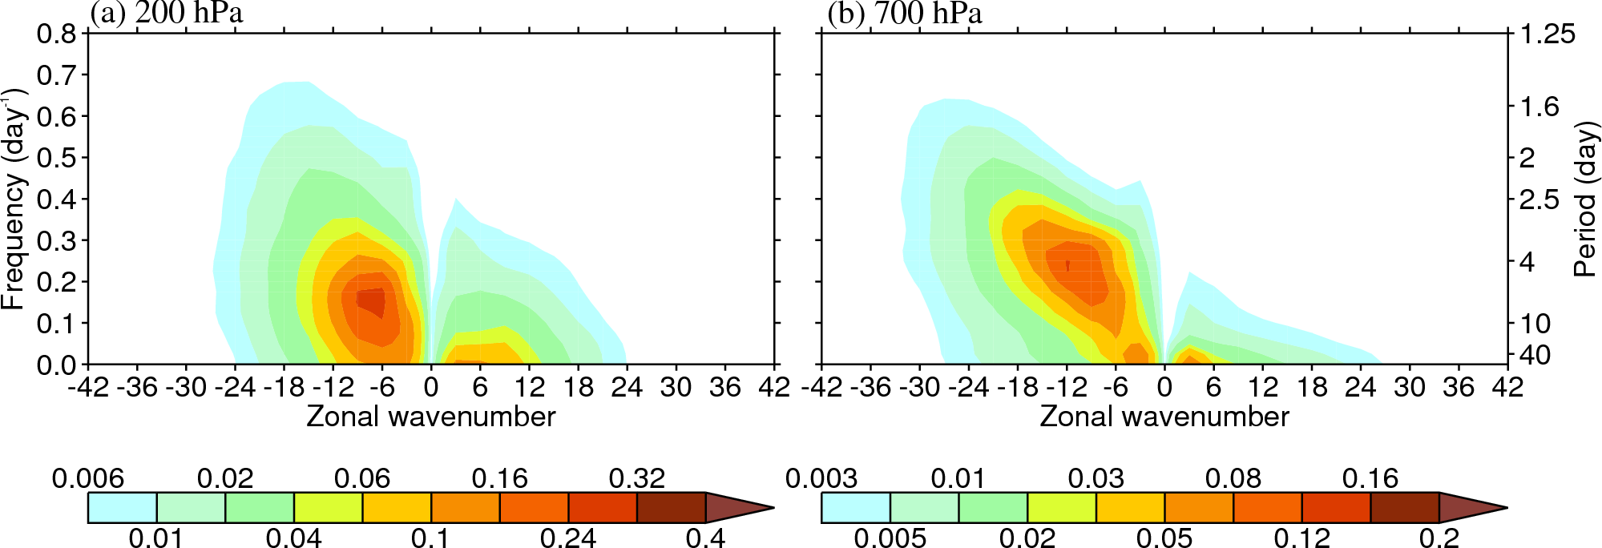
Power spectra for v at 5-18N, 75W-45E in JJAS 1979-2010
Filter box: k=3-40, τ=2.5-10 days
Westward-moving power dominates (k<0)
At 700 hPa peak at τ = 4 days and k = 9-12 (the AEWs)
Upper tropospheric peak slightly longer τ and wavelength

Slide 4
Interannual variability of African Easterly Waves
Amplitude anomaly of positive vorticity centres in all regions
6 strong and 6 weak years with amplitude anomaly exceeding one standard deviation

Slide 5
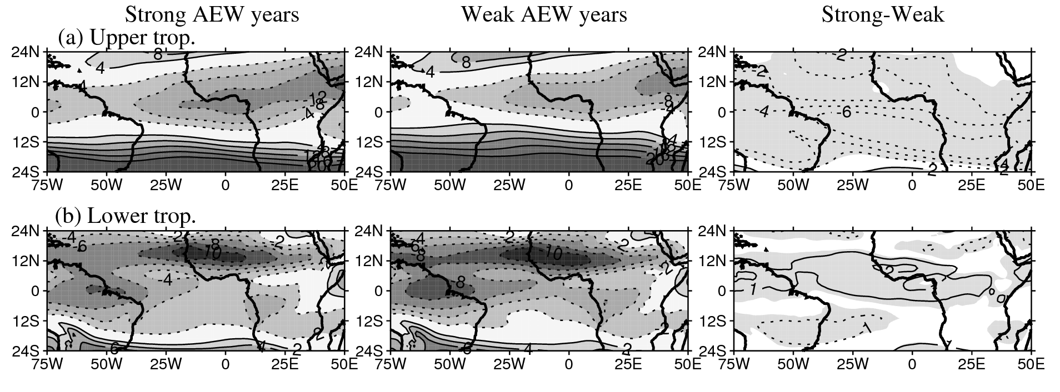
Seasonal-mean flow composited by strength of African Easterly Wave activity
What does equatorial and SH upper tropospheric flow have to do with AEWs?

Slide 6
Horizontal structures of three gravest westward-moving equatorial waves
n=0 westward mixed
Rossby-gravity wave
n=1 Rossby wave
n=2 Rossby wave
Div 10⁻⁷ s⁻¹
ERA-Interim data is broad-band filtered (3 < k < 40, 2.5 < τ < 10 days)
Data is projected onto orthogonal equatorial wave basis
Projected data is reconstructed by Fourier transform from k back to longitude
Done on each pressure level independently

Slide 7
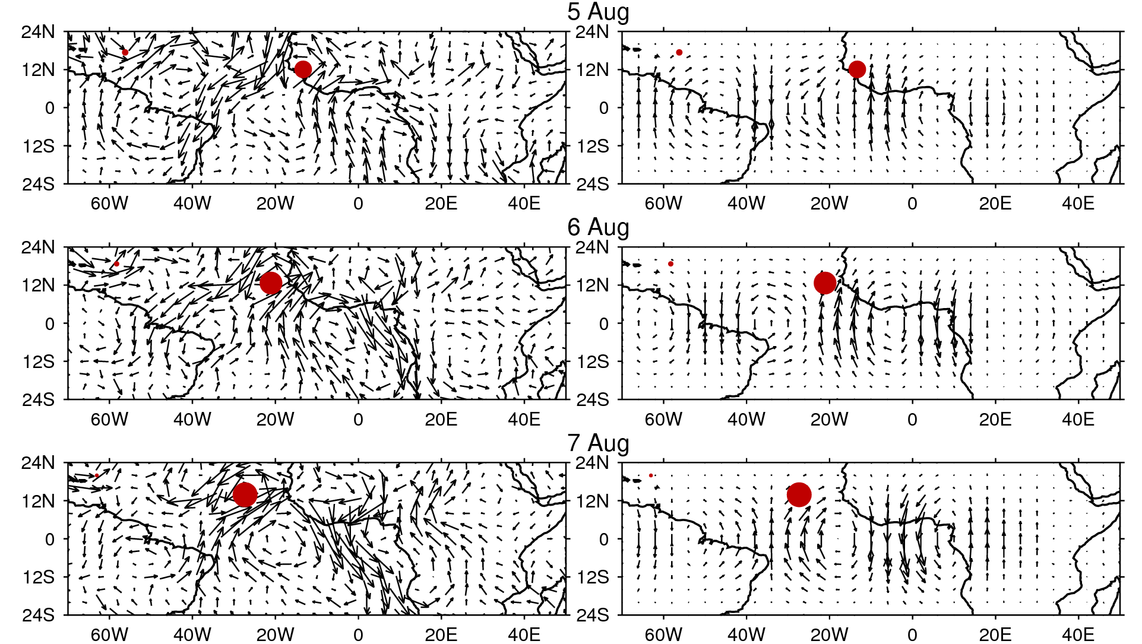
Case study, August 1995
Westward-filtered data at 700 hPa
Projection on to WMRG

Slide 8
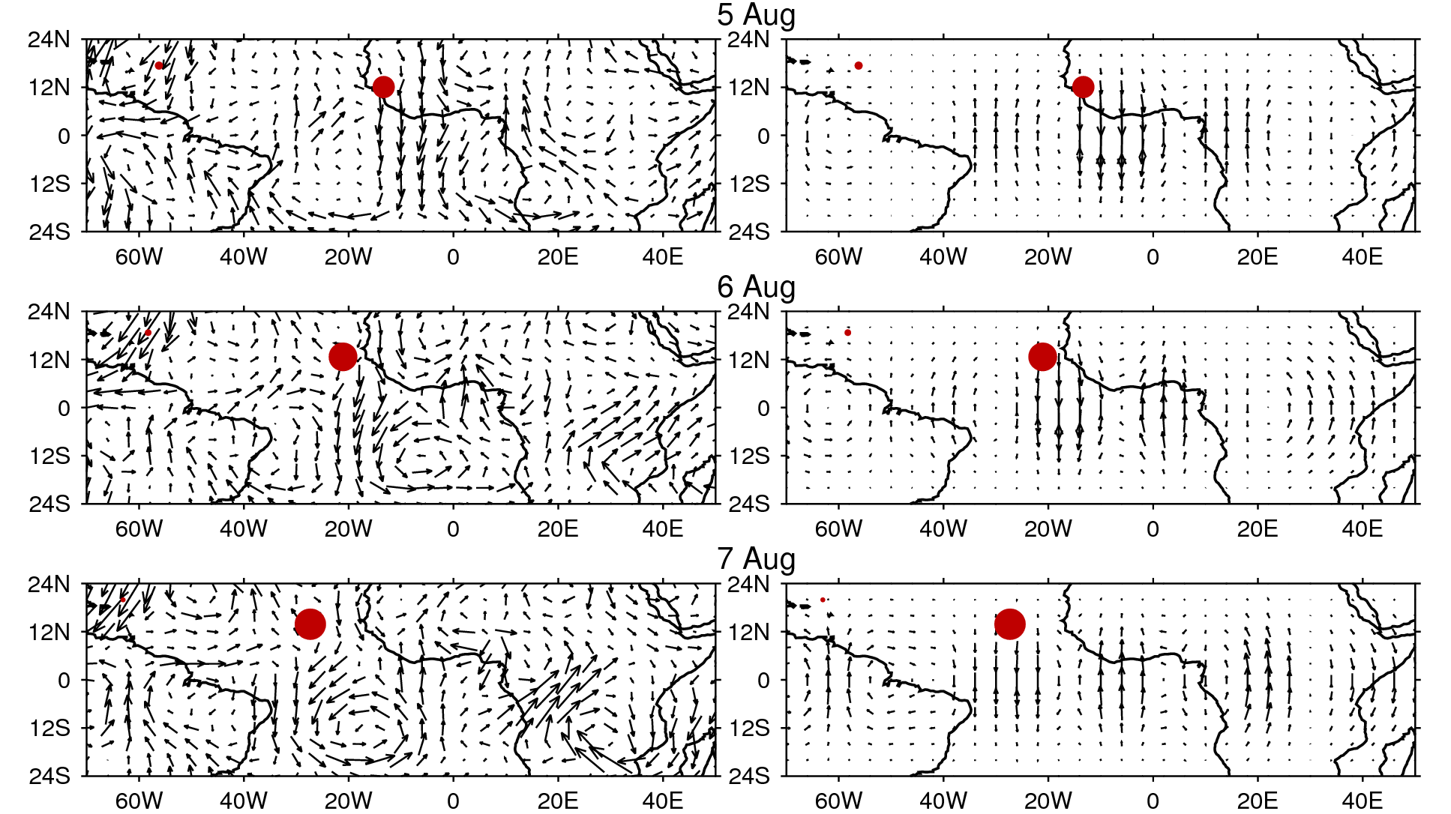
Case study, August 1995
Westward-filtered data at 200 hPa
Projection on to WMRG

Slide 9
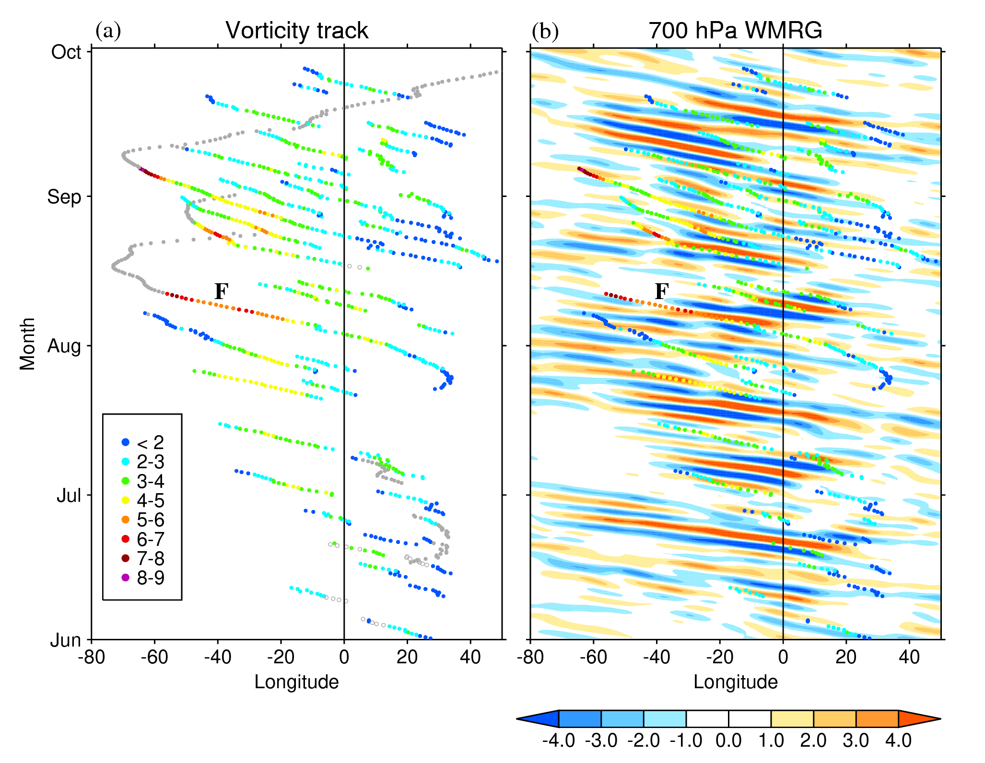

Slide 10
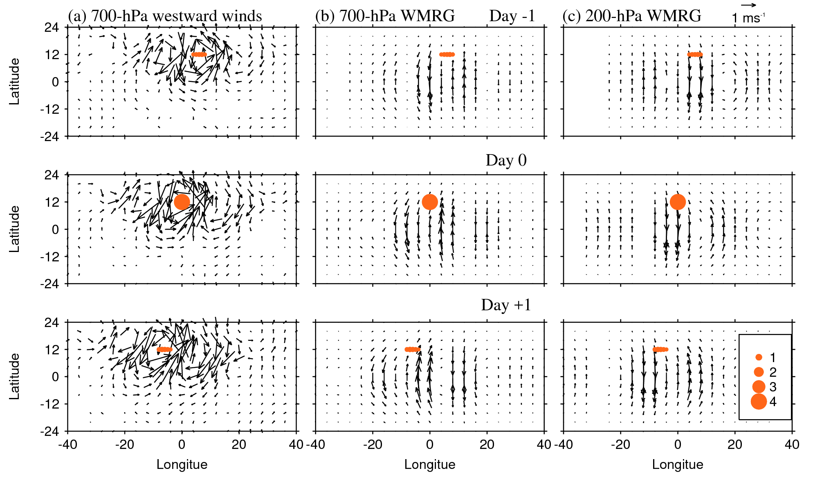
Regression onto amplitude of tracked vorticity centres (all JJAS seasons)

Slide 11
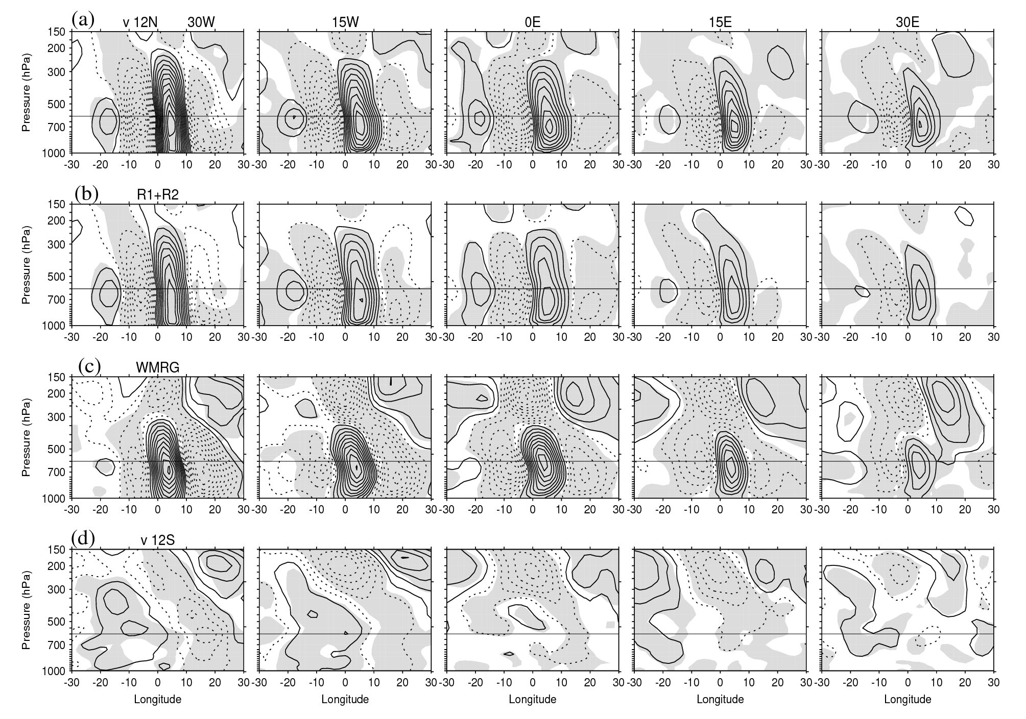
Vertical structure of projected data Broad-band filter → projection → regression onto vorticity centres (600 hPa, each sector)

Slide 12
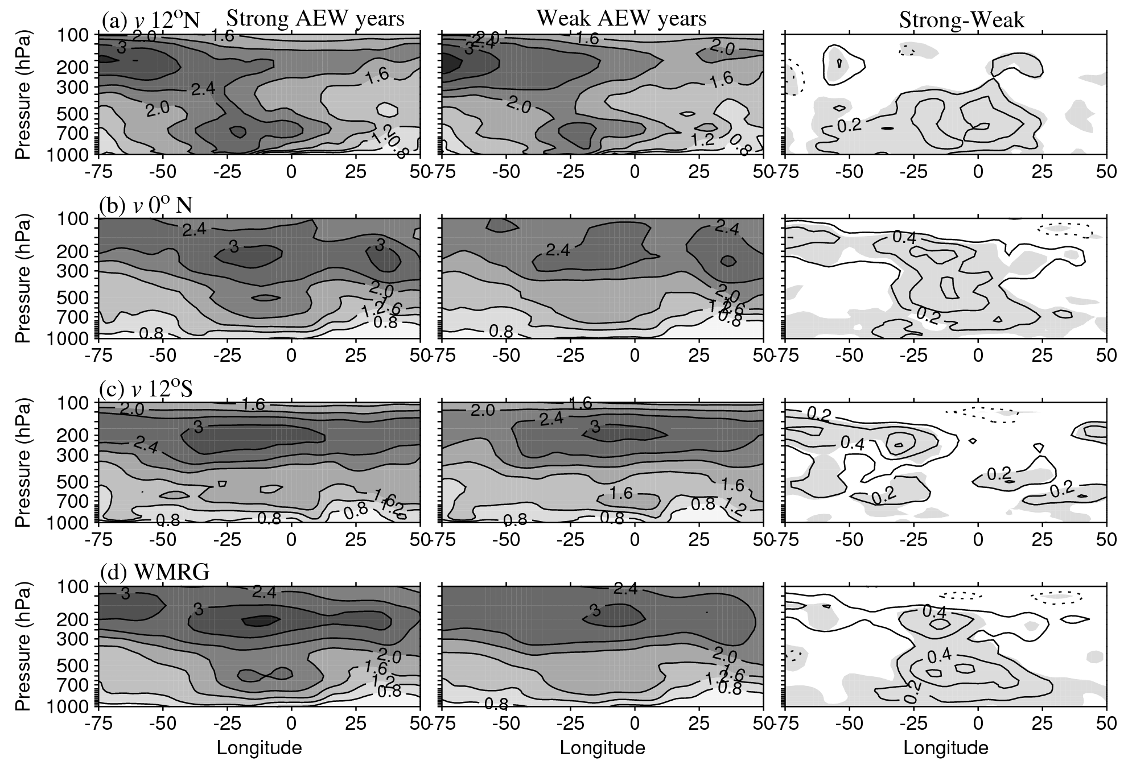
Variance (of v) in years of strong/weak AEW activity westward-filtered data

Slide 13
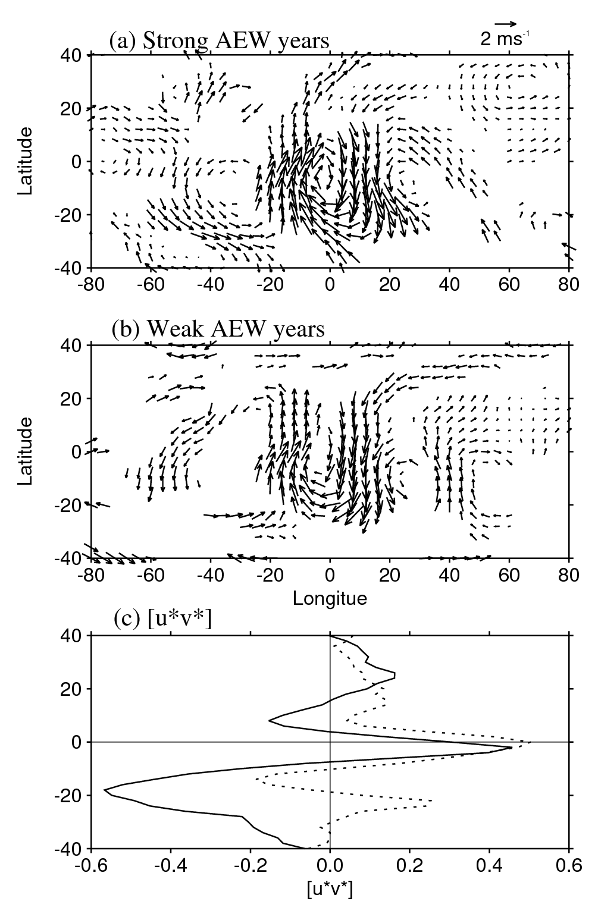
Mechanism I: Rossby waves in SH upper troposphere excite WMRG waves
Full winds are regressed onto max(-v) in WMRG component.
Here shown at lag -1 day.
NW-SE tilt implies [u* v* ] < 0
⇒ RW flux F_{y} > 0 (northwards)
and flux convergence acts to accelerate easterlies

Slide 14
Rossby wave propagation diagnostics
Following Hoskins and Karoly (1981), Rossby waves in the Mercator projection have the dispersion relation :
$ω=U_{m}k−\frac{β_{m}k}{k^{2}+l^{2}}$ (1) $k^{2}+l^{2}$=$\frac{β_{m}}{U_{m}−c }$
Following RW rays, ω and k are constants and only l varies.
Two behaviours can occur:
The ray approaches a turning latitude when l → 0, Eq.(1) reduces to the quadratic Uk²-ωk-β=0, which has two roots:
$k1,2=\frac{ω\text{∓}\sqrt{ω^{2}+4βU}}{2U}$ (2)
ii) The ray approaches a critical line where c=ω/k=U, l → ∞,
a critical wavenumber k_{c}= ω/U.

Slide 15
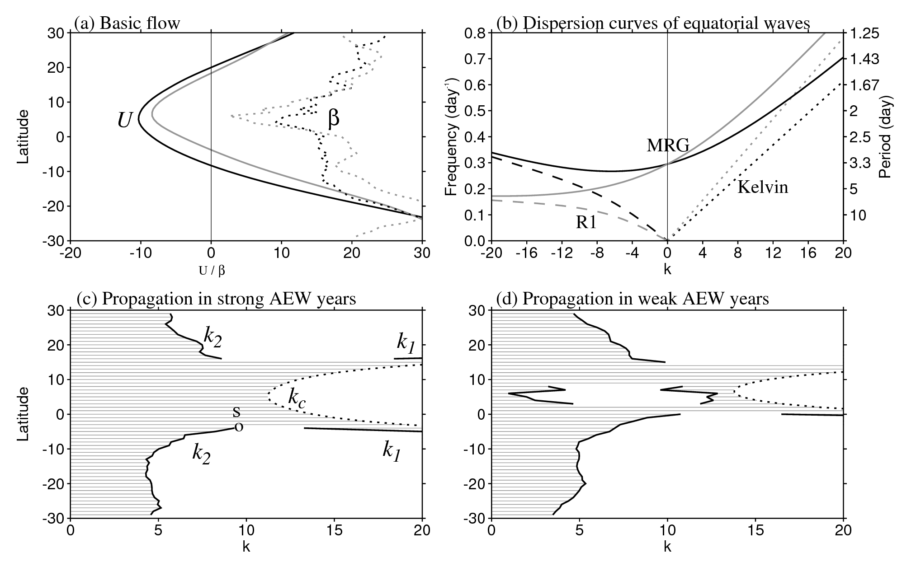
Wave dispersion (on flow 200-300 hPa, 75W-45E)
Basic flow 200-300hPa
Equatorial wave dispersion
weak
Strong AEWs
Period = -4 days

Slide 16
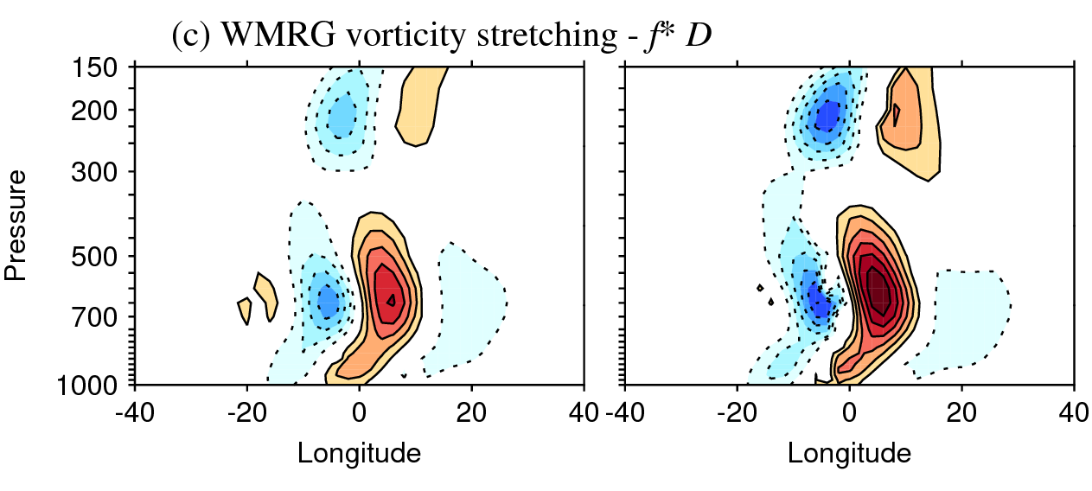
Mechanism II: WMRG wave component amplifies vorticity centres on the AEJ via vortex stretching

Slide 17
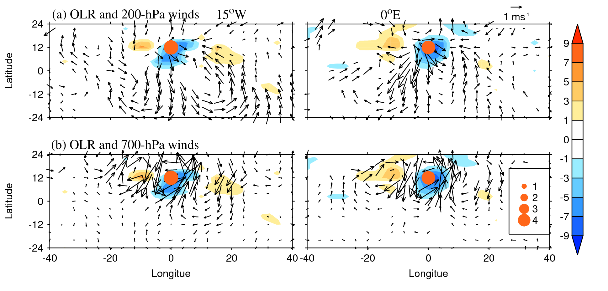
Mechanism III: WMRG wave component amplifies vorticity centres by meridional advection of moist air on eastern flank and latent heating in convection

Slide 18
Conclusions
Winds over W. Africa and Atlantic have strong projection on to WMRG structure and this evolves coherently and independently of AEWs
Faster westward phase speed & distinct group speed (depending on bg flow)
Interannual variability of AEWs is influenced non-locally by teleconnection from the southern Hemisphere involving propagating waves
Mechanisms:
When zonal flow is sufficiently easterly, RWs on flank of SH subtropical jet can propagate into tropical wave guide and excite WMRG via meridional advection of planetary vorticity (over Atlantic)
WMRG wave packets propagate eastwards with wave energy convergence over Africa (due to Doppler shifting)
WMRG waves can intensify vorticity within AEWs when in correct phase (stretching and/or LHR in moist flow)
RW flux convergence maintains easterlies

Slide 19
For $β>$0, RWs with ω<0 (westward moving) can propagate in both westerly and easterly.
i. For westerly, U > 0
propagation for any k < k₂ and no critical line
ii. For weak easterly, U_{e} < U < 0, U_{e} = -ω₂/4β
propagation for k < k₂ and k₁< k < k_{c}
iii. For strong easterly, U < U_{e}
propagation for any k < k_{c} and no reflection lines

