Slide 1

How can we represent the 3D interaction of radiation with clouds, cities and forests in global models?
Robin Hogan, ECMWF
Cloud collaborators: Mark Fielding, Howard Barker, Najda Villefranque, Sophia Schaefer
Urban collaborators: Sue Grimmond, Will Morrison, Meg Stretton
Vegetation collaborators: Tristan Quaife, Renato Braghiere

Slide 2
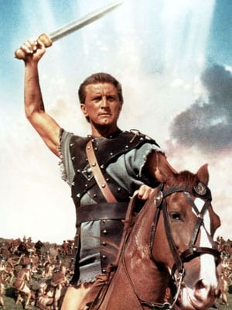
Overview
The new IFS radiation scheme “ecRad”
Efficient radiative transfer in the presence of 3D objects: “SPARTACUS”
Application to forests
  Weather forecasts sensitive to forest albedo; ESMs need photosynthesis rates
Application to cities
  Needed to compute urban heat island effect
  The exponential model of urban geometry
  How important is atmospheric absorption between buildings?
Application to clouds
  Climate simulations sensitive to representation of cloud structure
  The “entrapment” mechanism
  Towards an estimate of the global impact of 3D radiative transfer
Outlook
Speedy Algorithm for Radiative Transfer through Cloud Sides

Slide 3
2-m temperature biases in ECMWF forecasts
Tropics ~2 K too cold in the day
Boreal forests ~5 K too warm at night in winter
Europe ~0.5 K too cold,
except summer T_{min} too warm

Slide 4
What is the cause of near-surface temperature errors at individual sites?
Some locations more difficult than others!
  Sapporo is a large city, by the coast, surrounded by mountains, with large annual snowfall
Many processes involved, but there are obvious areas where radiation scheme could be improved, e.g. forests, urban areas and clouds
Far too little downwelling LW: not enough cloud?
Early evening error could also be signature of urban heat island (Oke 1982), not in model

Slide 5
From McRad to ecRad
Surface under development!
Solver
  McICA, Tripleclouds or SPARTACUS solvers
  SPARTACUS makes the IFS the only global model that can do 3D radiative effects
  Better solution to longwave equations improves tropopause & stratopause
  Longwave scattering optional
  Can configure cloud overlap, width and shape of PDF
Implemented in Meso-NH; ICON coming soon
Offline version available for non-commercial use under OpenIFS license
Gas optics
  RRTM-G (as before)
  Plan to develop new scheme with fewer spectral intervals
Aerosol optics
  Number of species and optical properties set at run time
  Supports prognostic & diagnostic aerosol
Cloud optics
  Liquid clouds: more accurate SOCRATES scheme
  Ice clouds: Fu by default, Baran and Yi available

Slide 6
Reduced noise
Shortwave Longwave
McICA scheme represents cloud heterogeneity by presenting a different cloud realization to each spectral interval
ecRad implementation of McICA samples partially cloudy scenes better than the older McRad scheme and uses fewer random numbers
Reduced noise compared to noise-free but more expensive Tripleclouds solver
Global IFS snapshot Single IFS profile

Slide 7
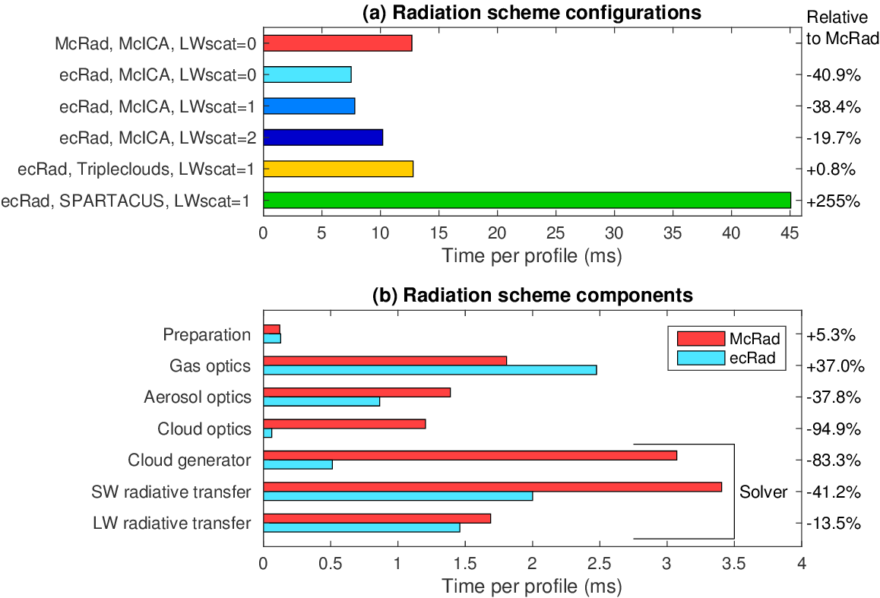
Improved efficiency
Much faster than original scheme in operational configuration
Longwave scattering by clouds but not aerosols only slightly more expensive (for 46R1)
3D radiation is more expensive, but feasible in research mode
Cloud treatment is much faster

Slide 8
Impact on forecast skill
Latest version of ecRad reduces temperature RMSE by ~0.5% compared to older McRad scheme
  Combination of longwave scattering, reduced biases and (possibly) reduced McICA noise
All forecast model configurations except HRES call radiation every 3 h
Reinvest 40% speed-up by calling radiation every 2 h?
  Temperature RMSE reduced by 1-2%, associated with better low clouds especially over tropical rainforests
Ensemble system will use 1 h radiation from operational cycle 46R1
  Temperature RMSE down by 3%
Hogan & Bozzo (JAMES 2018)

Slide 9
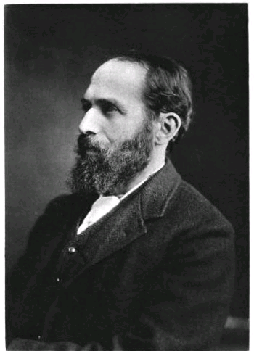
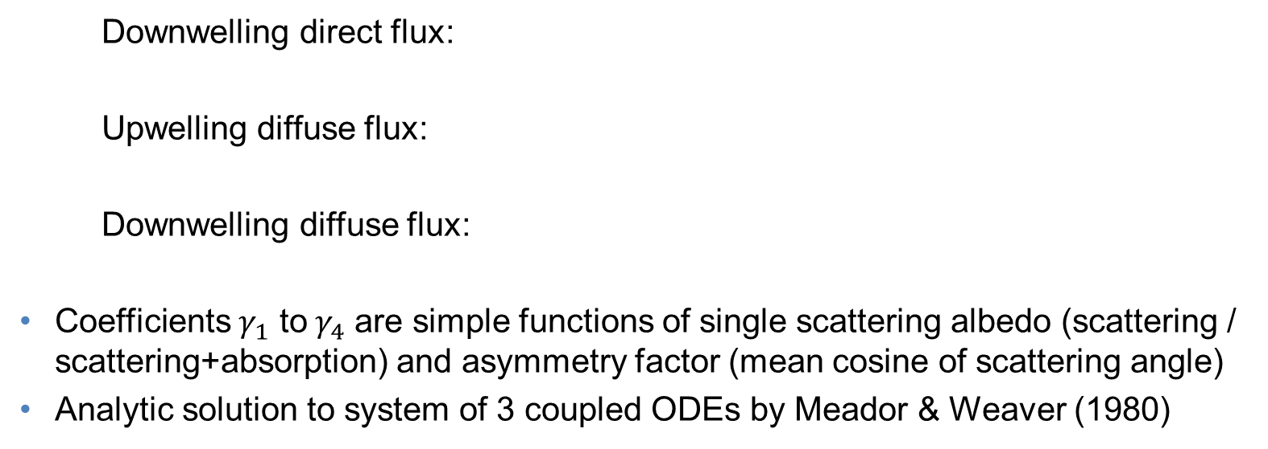
Beer-Lambert law for direct flux, two-stream equations for diffuse flux
Extinction coefficient (gas, aerosol & cloud optical depth per metre)
Gradient of flux with height
Loss of flux by scattering or absorption
Original idea from Schuster (1905)
Gain in flux by scattering from other direction
Downwelling direct flux:
Upwelling diffuse flux:
Downwelling diffuse flux:
Coefficients $γ_{1}$ to$γ_{4}$ are simple functions of single scattering albedo (scattering / scattering+absorption) and asymmetry factor (mean cosine of scattering angle)
Analytic solution to system of 3 coupled ODEs by Meador & Weaver (1980)
Gain from scattering of the direct solar beam

Slide 10
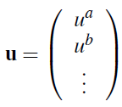
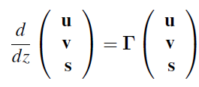
The SPARTACUS method applied to forests
SPARTACUS = Speedy Algorithm for Radiative Transfer through Cloud Sides (Hogan et al. 2016)
Idea: apply the two-stream equations in each of two or three regions a–c
New terms represent horizontal exchange of radiation between regions: if trees are randomly distributed then they are a function only of effective tree diameter
Define each flux component as a vector and solve system of nine ODEs
f^{ab}
uª
u^{b}

Slide 11
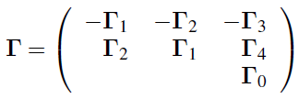
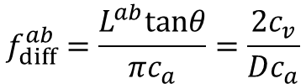
How do we relate exchange matrix to vegetation properties?
Write as:
Rate of change of diffuse radiation along its path is sum of old and new terms:
Assume that the rate of exchange (per unit height) is proportional to the length of the interface, L^{ab}, between regions a and b, valid if trees are randomly separated:
trees
$$f_{diff}^{ab}=\frac{L^{ab}tanθ}{{πc}_{a}}=\frac{2c_{v}}{Dc_{a}}$$
Vegetation cover fraction
Clear-air fraction
Effective tree diameter
Hogan et al. (GMD 2018)

Slide 12
Exact solution
Solve coupled ODEs in each layer using matrix-exponential or eigendecomposition methods to obtain reflectance and transmittance matrices R and T:
Use matrix version of Adding Method to step up through canopy computing albedo matrix of entire scene beneath each half level, then step down computing flux profile:
Layer i–1
A_{i – 1/2} = R_{i} + T_{i} A_{i+1/2}T_{i} + T_{i} A_{i+1/2}R_{i}A_{i+1/2}T_{i} +… = R_{i} + T_{i} (I – A_{i+1/2}R_{i})^{–1}A_{i+1/2}T_{i}
Geometric series of matrices
Layer i
Diffuse albedo matrix A_{i+1/2}
Layer i+1

Slide 13
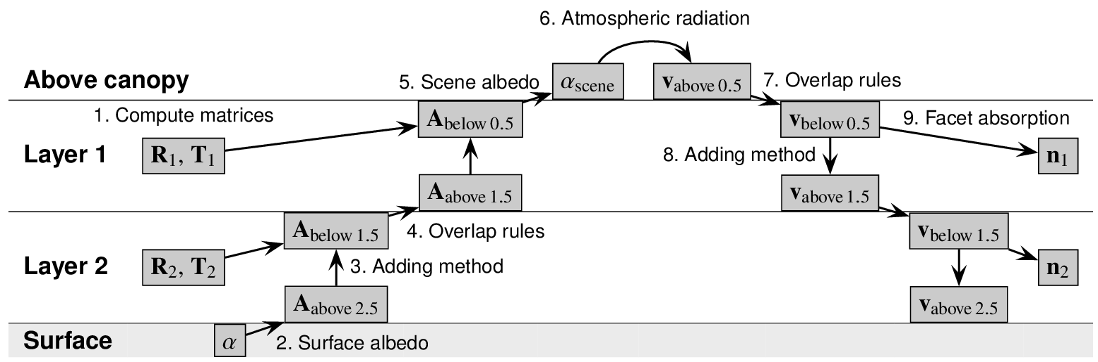
Flowchart of SPARTACUS algorithm for surface problems
Define fluxes as vectors, e.g. upwelling diffuse in 4 stream case has two terms, and in this example two regions: air and vegetation
Write differential equation relating fluxes in a single layer, where matrix Γ describes absorption, exchange between regions etc.
Thermal emission
Shortwave: Longwave:
Solve in each layer

Slide 14
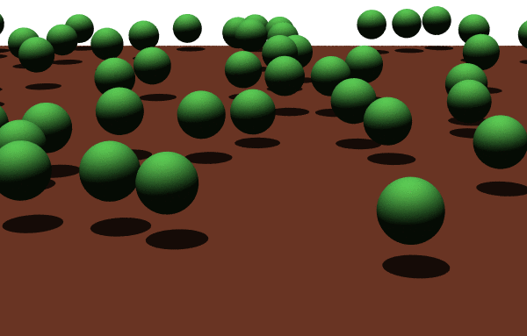
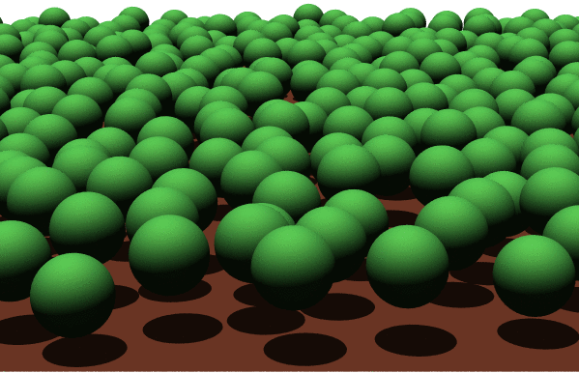
RAMI4PILPS evaluation
Compare to Monte Carlo calculations for idealized representations of forests
Most vegetation models assume homogeneous canopies (Sellers 1985): photosynthesis rates overestimated
SPARTACUS with 2 or 3 regions: agrees much better with Monte Carlo
10% tree cover
50% tree cover
Snow surface Bare-soil surface
Reflectance of forests over snow in IFS (Dutra et al. 2010)
Scope for improvement
Hogan et al. (GMD 2018)

Slide 15
Beyond two streams
2 stream
4 stream
Two-stream approximation limited by assumption that diffuse radiation all travels at same zenith angle (60° or μ₁=0.5)
Discrete Ordinate method generalizes to 2N streams and underpins DISORT (Stamnes et al. 1988) and many other accurate radiative transfer solvers
Choose angles using Gaussian Quadrature in each hemisphere (Sykes 1951)
When SPARTACUS is generalized in this way it predicts the reflectance and absorptance of trees over snow more accurately
Four streams appears to be sufficient
Upward diffuse radiation

Slide 16
Radiative transfer in complex urban areas
Masson (2000),
Harman et al. (2004)
etc...
H
We want to efficiently represent:
  Street trees
  Variable building height
  Realistic building layout
  Atmospheric absorption and emission
  Spectral coupling to the atmosphere above
  Contrasting neighbourhoods that interact radiatively
  Pitched roofs
Typically we simplify the geometry and solve analytically, but can then only do 1 and 2 above
  Complex models with vegetation still assume infinitely long street canyons
  Some can only incorporate more complex features by partial use of Monte Carlo techniques, too slow for most operational applications
W
Kanda et al. (2005)
Krayenhoff et al. (2013)
Redon et al. (2017)

Slide 17
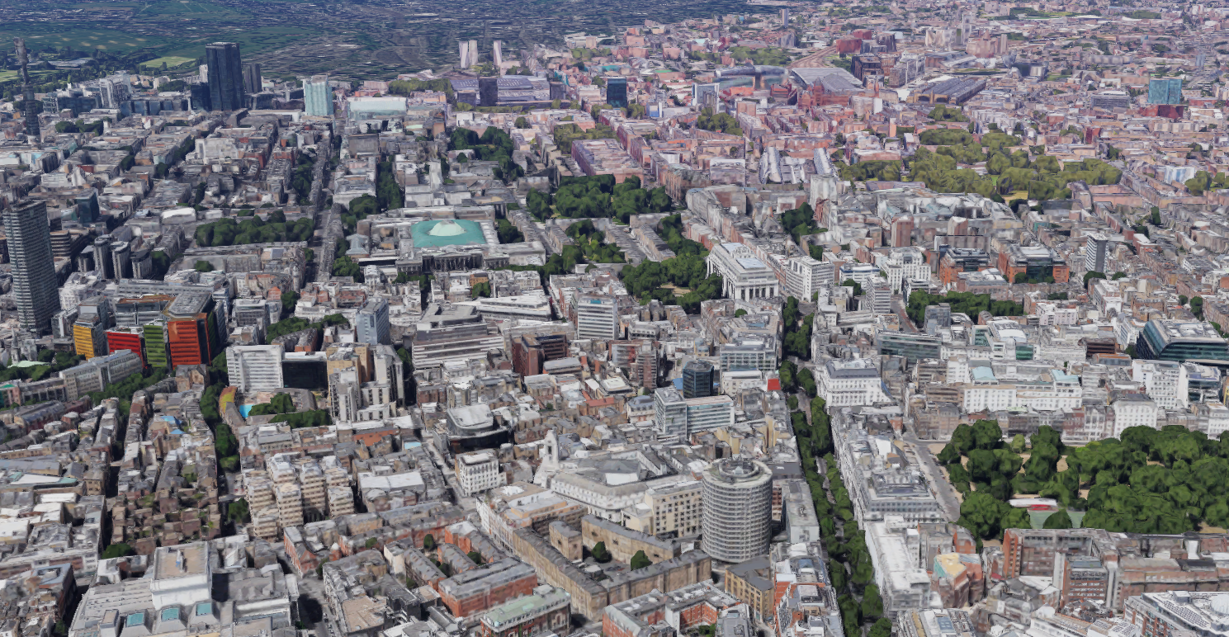
Towards “SPARTACUS-Urban”
Discrete-ordinate method uses one stream for direct solar radiation and 2N streams for the diffuse radiation field
Rate of radiation interception by buildings uses same geometry arguments as with trees (is this valid?) with some being specularly reflected, some isotropically reflected and some absorbed
We want net radiative fluxes into ground, walls roofs, vegetation and air, to be used in energy-balance calculations together with turbulent fluxes
Russell Square area of London

Slide 18
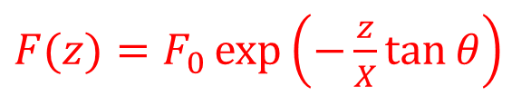

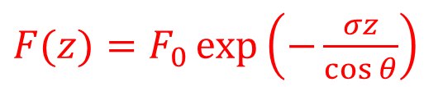
Atmospheric layer
Urban canopy layer
Rate of change of radiation passing through a layer in a discrete direction is governed by dF/dz = −σ/cosθ, where σ is the height-independent volume-extinction coefficient
The Beer-Lambert law
The same behaviour will be observed if the probability distribution of wall-to-wall separations is exponential: p_{ww}(x) = exp(−x/X)/X, where X is the e-folding (or mean) building separation distance
Need to compute p_{ww}(x) in real cities
$$F_{0}$$
θ
z
x
$F(z)=F_{0}\exp\left(−\frac{σz}{\cos{θ}}\right)$
$F(z)=F_{0}\exp\left(−\frac{z}{X}\tan{θ}\right)$
Hogan (BLM 2018, in press)

Slide 19
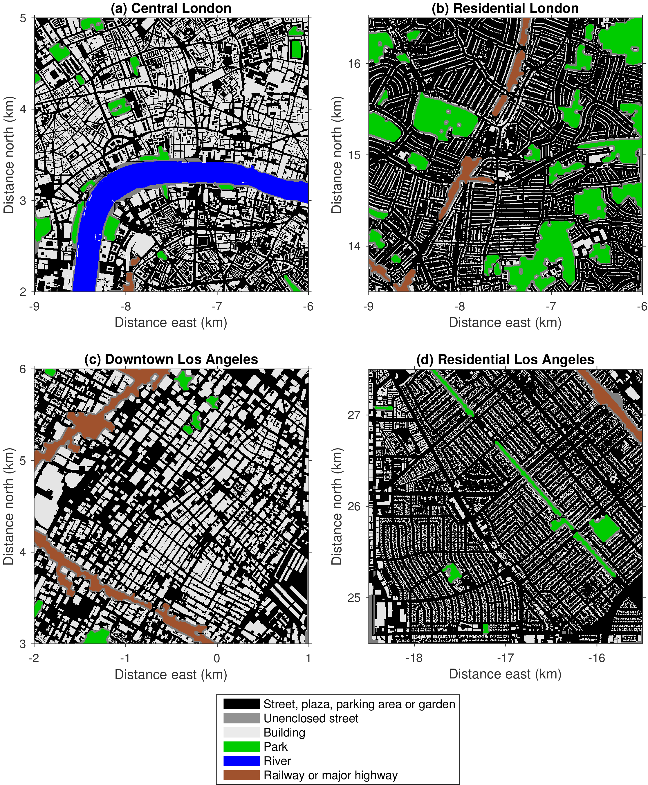
Geometry of real cities
Compute p_{ww}(x) from “strips” in four directions

Slide 20
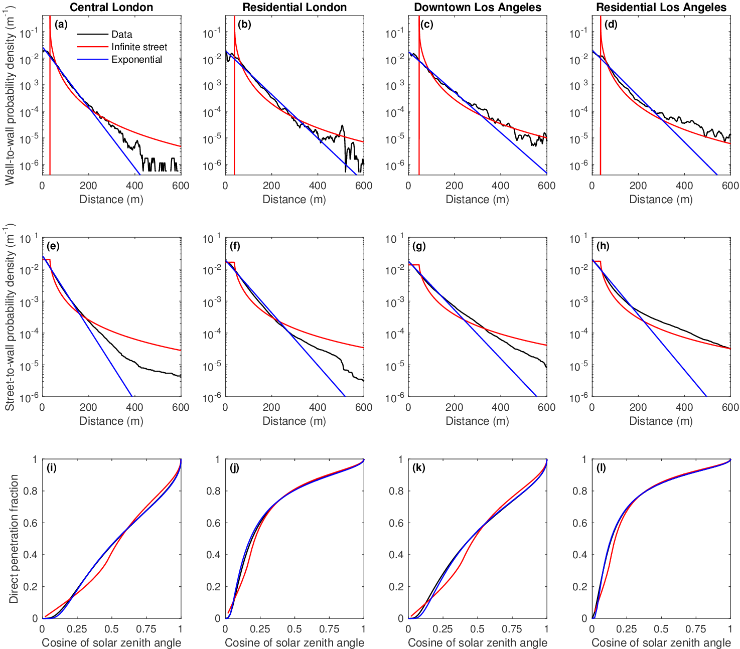
Real urban areas are very well fitted by the exponential model!
The infinite-street model is a poor fit
p_{ww}(x)
X=38 m
X=53 m
X=57 m
X=50 m
Fraction of direct beam reaching street
Exponential model predicts direct-beam much better
Hogan (BLM 2018, in press)

Slide 21
Diffuse radiative exchange factors
Does difference between infinite-street and exponential models matter? Can’t we simply adjust H/W ratio to get F_{gs} exactly?
Yes but then F_{ww} will be overestimated; only exponential model gets both accurately
F_{gs}
F_{ww}
F_{gs}
F_{ww}
Wall
H
Ground

Slide 22
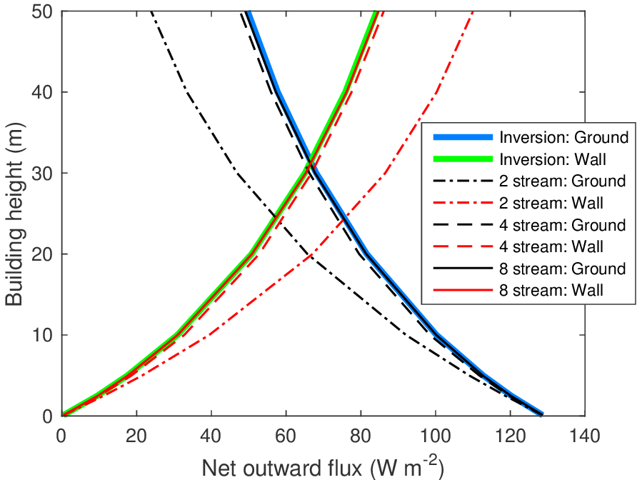
Longwave evaluation: constant-height buildings in vacuum
From H and mean building separation X we can compute fraction of radiation emitted from each facet (sky, walls and ground) that intercepts each other facet
Harman et al. (2004) described matrix inversion method to obtain net flux out of each facet (only works in vacuum with very simple geometry):
Sky
X=50 m
F_{sw}
F_{gs}
F_{ws}
F_{sg}
F_{ww}
Wall
H
F_{wg}
Test with ground and walls 10 K warmer than air above, and use mid-latitude summer “sky” flux
SPARTACUS agrees well with matrix-inversion method for 4 or more streams
F_{gs}
Ground

Slide 23
Space between buildings is not a vacuum in longwave!
RRTM-G 140-pt gas optics model
All (?) current urban radiation schemes to ignore gas absorption and emission between the buildings
Consider the gas concentrations and temperature of the typical “Mid-Latitude Summer” (MLS) standard atmosphere
Over a third of the emitted energy is associated with a mean-free-path less than the typical building separation of 50 m!
37%
50 m

Slide 24
Longwave effect of gases in the urban canopy under MLS standard atmosphere
T_{above}
Lowest atmospheric layer (20 m)
Consider ground and walls to be 10 K warmer than overlying air
Strong dependence on temperature of the air in the canopy
Urban canopy
+10 K
T_{air}
T_{above} T_{air} T_{wall}
+10 K
Air temperature

Slide 25
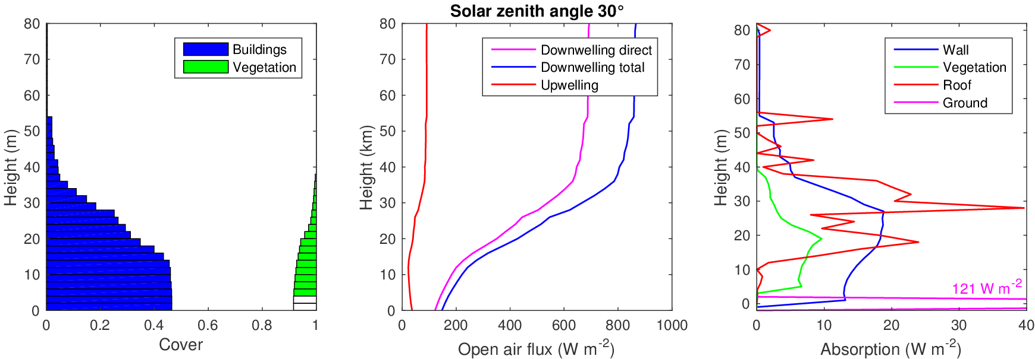
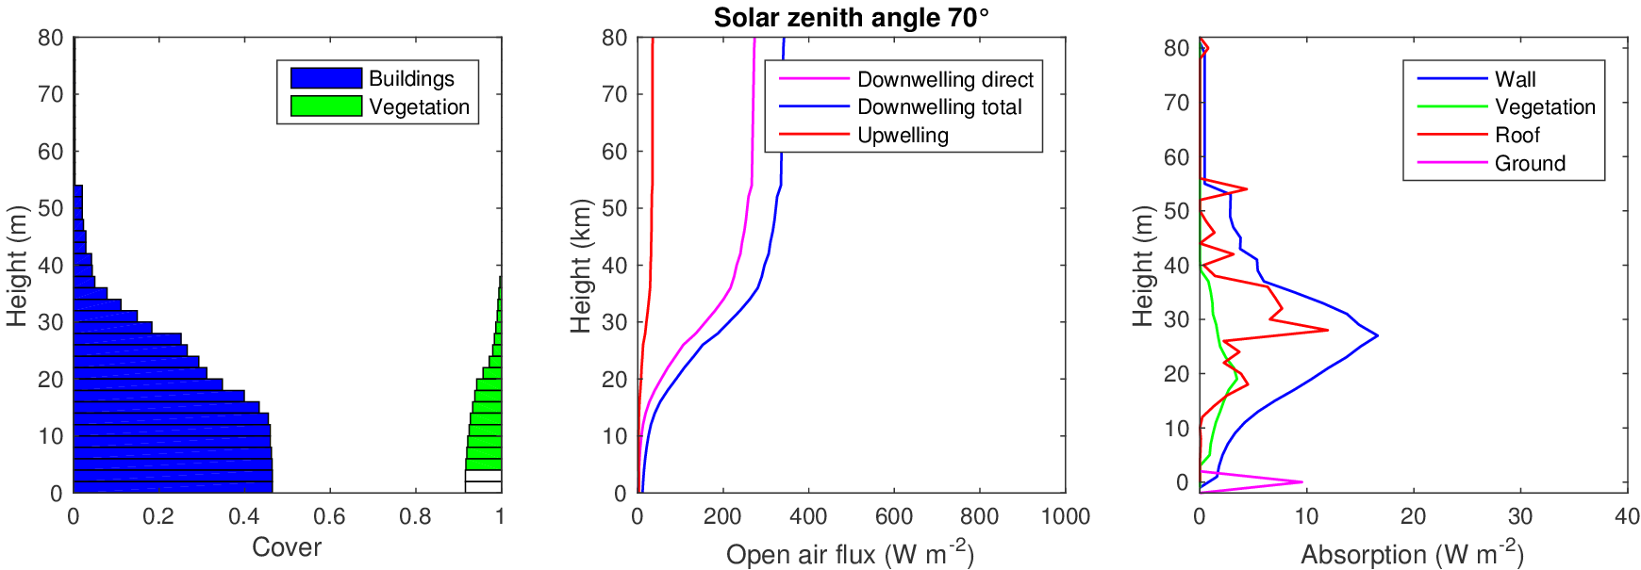
Example profiles of flux and net absorption
Meg Stretton’s PhD project: compare profiles to explicit calculations using DART model
Which details of an urban scene really matter which can be safely ignored? What level of detail can be justified in a weather or climate model?
2-m vertical resolution
25

Slide 26
How could we represent pitched roofs?
Isotropic emission from a facet is proportional to cosine of wall normal
Used to weight streams for emission or reflection from walls and flat roofs (4 streams shown here)
Pitched roofs: probability of being scattered into another stream simply depends on roof angle
More complex and costly because symmetry broken: upward and downward reflection matrix no longer equal, similarly for transmittance etc.
Town Hall Square, Reading

Slide 27
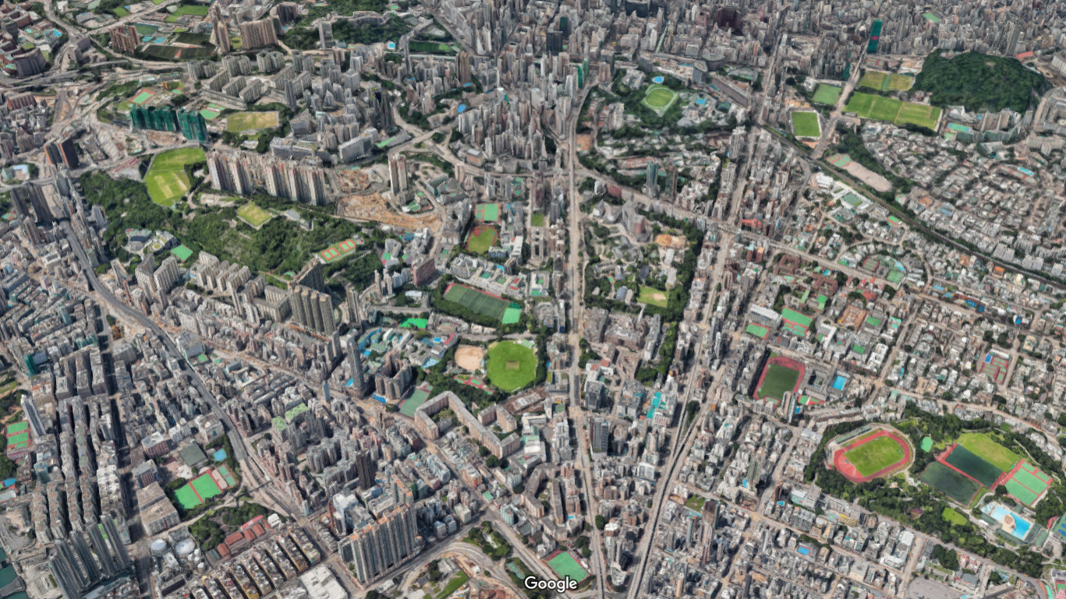
3x3 km view of Hong Kong
High-rise area
Low-rise area: 2-3 storeys
Parks
Can we use SPARTACUS regions to represent radiative interactions between neighbourhoods as well as between buildings and trees?

Slide 28
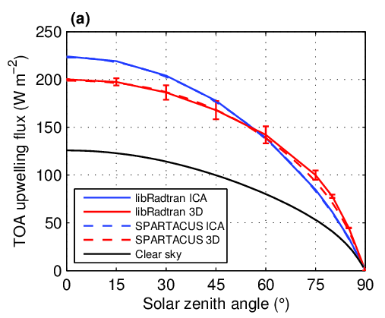
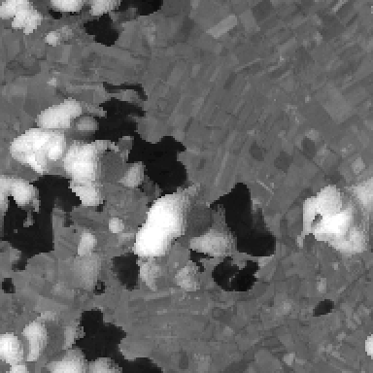
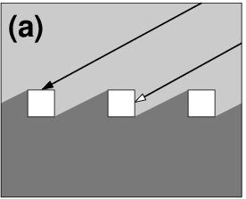
What is the global impact of 3D cloud-radiation interactions?
3D radiative effects ignored in all current weather and climate models
Quantify in individual scenes by comparing independent column approximation with fully 3D Monte Carlo (too slow for a climate model)
SPARTACUS solver in ecRad agrees well with (far slower) Monte Carlo for simple cumulus scene
Lower reflectance… why?
?
Higher reflectance due to cloud edges
Hogan et al. (JGR 2016)

Slide 29
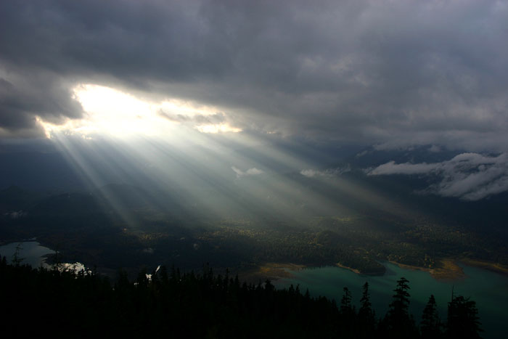
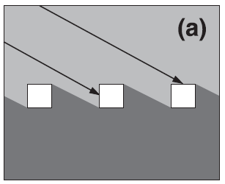
Main mechanisms for 3D radiation
Shortwave side illumination
  Strongest when sun near horizon
  Increases chance of sunlight intercepting cloud
Shortwave entrapment (new!)
  Horizontal transport beneath clouds makes reflection to space less likely
Longwave side emission
  Radiation can now be emitted from the side of a cloud
  3D effects can increase surface cloud radiative effect

Slide 30



Representing three extremes of “entrapment” in SPARTACUS
We need albedo matrix A at layer interfaces
$$α_{ba}$$
Region b
Region a
No 3D effects requires matrix to be diagonal
Better approach: compute RMS horizontal migration distance of light paths beneath cloud
2016 SPARTACUS: full horizontal homogenization of radiation under clouds
$$A=\left(\begin{matrix}α_{aa} & α_{ba} \\ α_{ab} & α_{bb}\end{matrix}\right)=\left(\begin{matrix}α & 0 \\ 0 & α\end{matrix}\right)$$
$$A=\left(\begin{matrix}α/2 & α/2 \\ α/2 & α/2\end{matrix}\right)$$

Slide 31
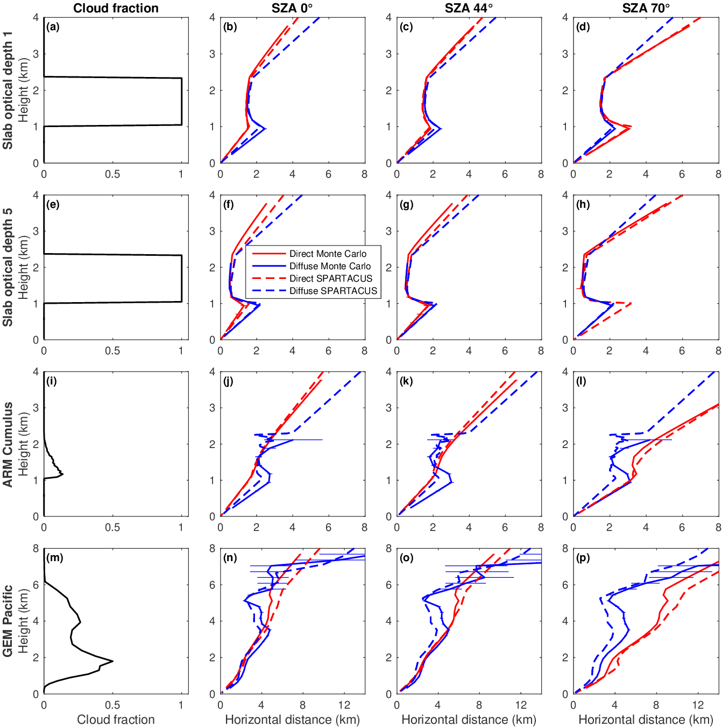
Computing horizontal migration distances within SPARTACUS
At each height z, estimate mean horizontal distance travelled by reflected light x_{diff}(z) and x_{dir}(z)
By comparing to cloud effective size, estimate fraction of radiation reflected into base of another region, i.e. the off-diagonal elements of albedo matrix A(z)
x_{diff}(z)
_{direct}
_{diffuse}
z
x_{dir}(z)
Monte Carlo calculations by Najda Villefranque

Slide 32
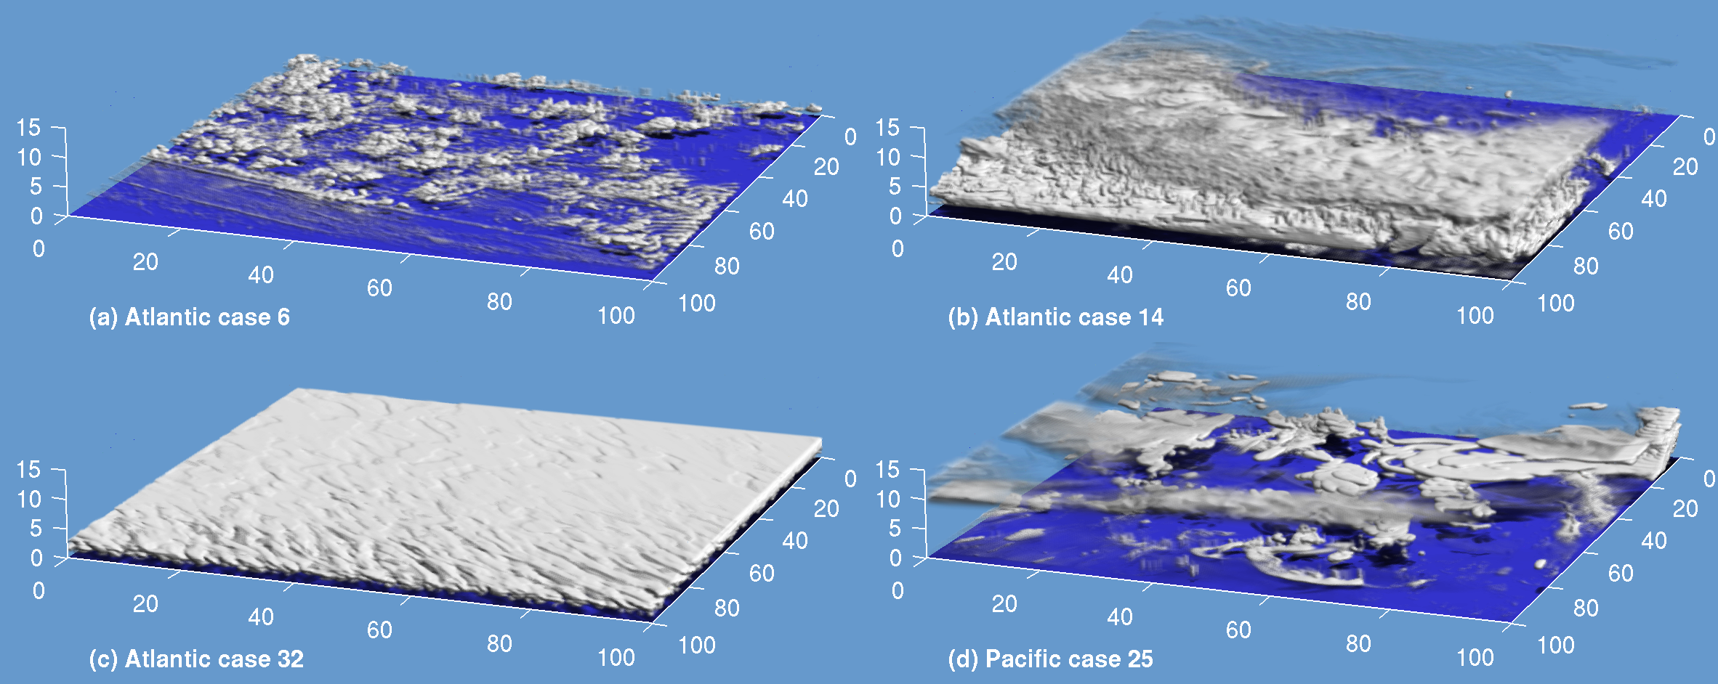
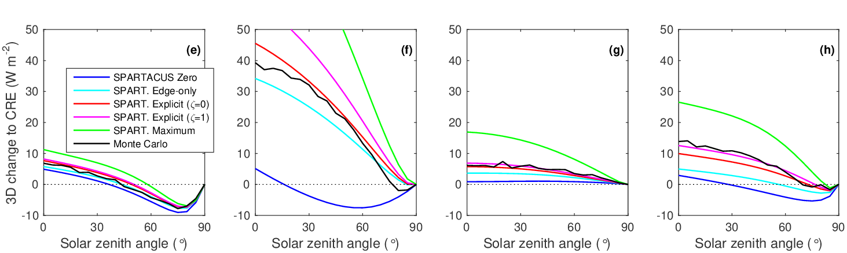
Evaluating fluxes using Monte Carlo calculations on 100x100km scenes
Monte Carlo calculations by Howard Barker
SPARTACUS with explicit entrapment matches Monte Carlo well, on average
Huge difference between maximum entrapment and zero entrapment
Cumulus Frontal cloud Stratocumulus Decaying Cb
Best explicit entrapment
Monte Carlo
Maximum entrapment
Zero entrapment

Slide 33
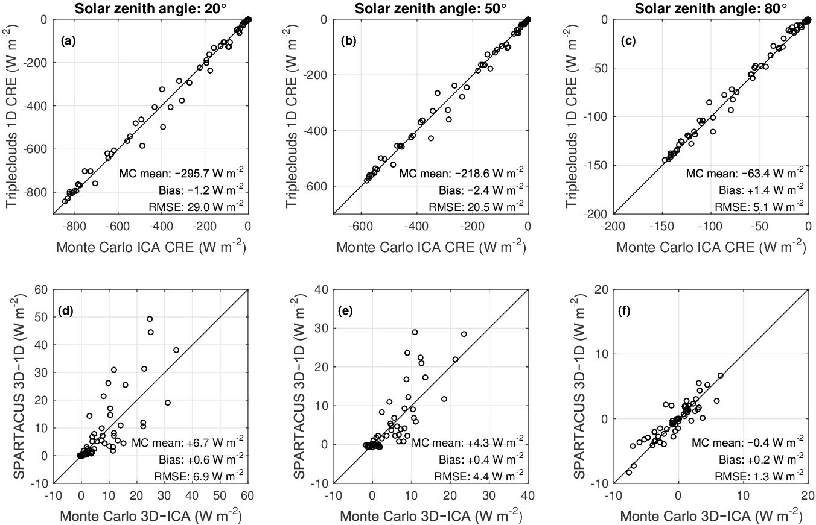
Evaluating fluxes using all 65 scenes
3D radiative effect predicted by SPARTACUS agrees quite well with Monte Carlo
The entrapment mechanism appears to win over side-illumination, implying shortwave 3D effects warm the climate system
Very dependent on cloud size, which might not be realistic for these CRM scenes but needs to be parameterized in any global simulation
Entrapment wins
Side-illumination wins

Slide 34
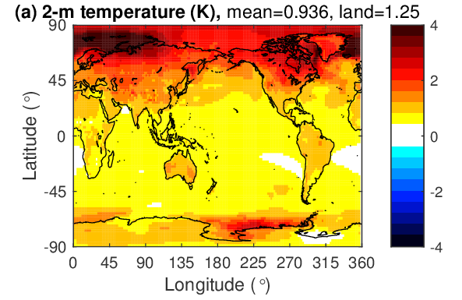
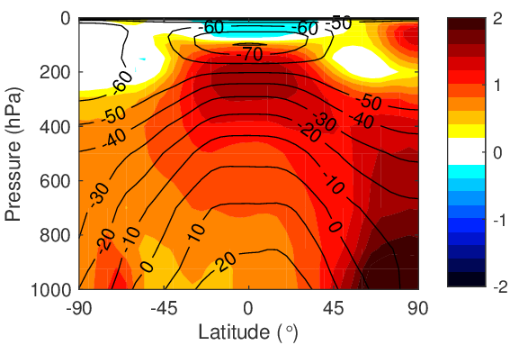
Global impact of the specification of cloud structure and 3D effects
Shonk and Hogan (2010) estimated the instantaneous change to cloud radiative effect of sub-grid cloud structure and overlap (W m⁻²)
Best estimate from SPARTACUS suggests 3D effects have similar net impact to overlap decorrelation, but opposite sign
Impact of turning on 3D effects in a free-running coupled simulation of the ECMWF model (5 member 20 years, average final 5 years): warm the surface by around 1 K, improve Arctic sea-ice bias
Mechanism | Shortwave surface | Longwave surface | Net surface
Add horizontal structure | +6.7 | -2.9 | +3.8 (±2)
Add overlap decorrelation (EXP-RAN minus MAX-RAN) | -4.1 | +2.2 | -1.9 (±0.2)
Add 3D effects | +0.9 | +1.2 | +2.1
(b) Atmospheric temperature (°C)

Slide 35
Summary
ecRad: fast and flexible new radiation scheme for the IFS has improved weather forecasts
SPARTACUS is a general technique for radiative transfer in the presence of 3D obstacles
SPARTACUS-Vegetation: much better than state-of-the-art for radiative transfer in forests
Exponential model fits building separations very well in cities of very different character, and should replace the infinite street canyon model; need to characterise the e-folding wall-to-wall separation distance X for difference cities around the world
SPARTACUS-Urban can represent realistic buildings geometry, vegetation, specular reflection, atmospheric effects between buildings and potentially more; next step is detailed evaluation on complex scenes, and implementation into ecRad
Longwave atmospheric effects between buildings cannot be ignored
Entrapment is a key mechanism for interaction of clouds with shortwave radiation
Global impact of 3D radiation appears to be in the sense of warming the Earth system, but need to be able to parameterize cloud size in order to predict whether entrapment or side illumination win on a global scale

Slide 37
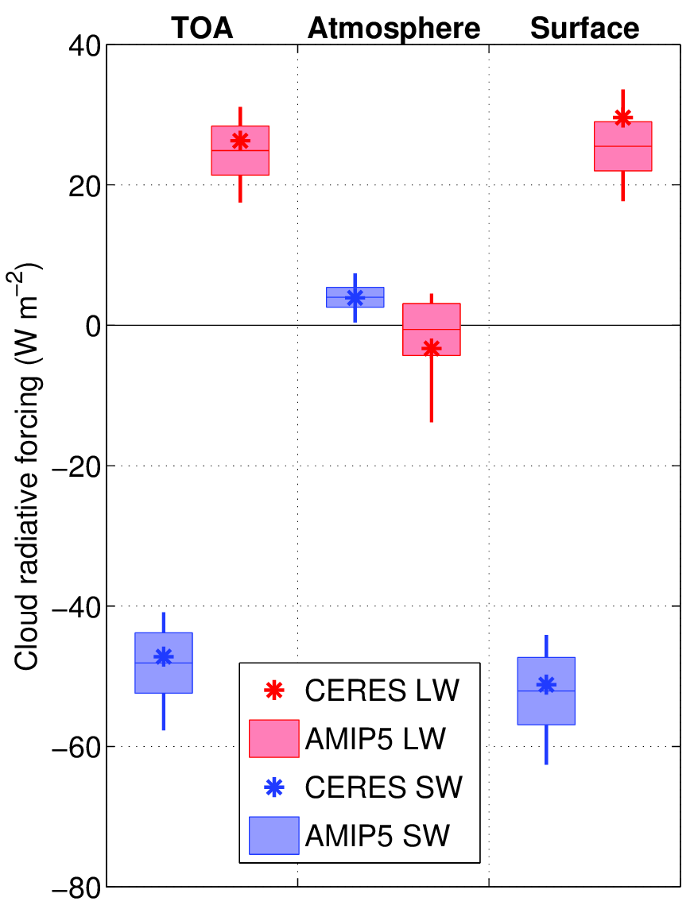
How reliable are cloud radiative effects in climate models?
Some outliers but global agreement is reasonable
Data from Wang et al. (2014)
Massive differences in cloud water content
Lauer and Hamilton (2013)

Slide 38
Middle atmosphere warm bias
Historically, IFS has had a huge warm bias in upper stratosphere and above
Improved in recent cycles (better longwave in ecRad, CAMS ozone, better solar zenith averaging)
Remaining bias could be removed in stratosphere by updating solar UV which is 7-8% too high in IFS
Lower mesosphere could be improved with a diurnal cycle of ozone (even if approximate)
But resolution-dependence of lower stratosphere temperature (due to waves) needs to be addressed
IFS Cycle 41R1
Hogan & Hirahara (2016)
IFS Cycle 43R3

Slide 40
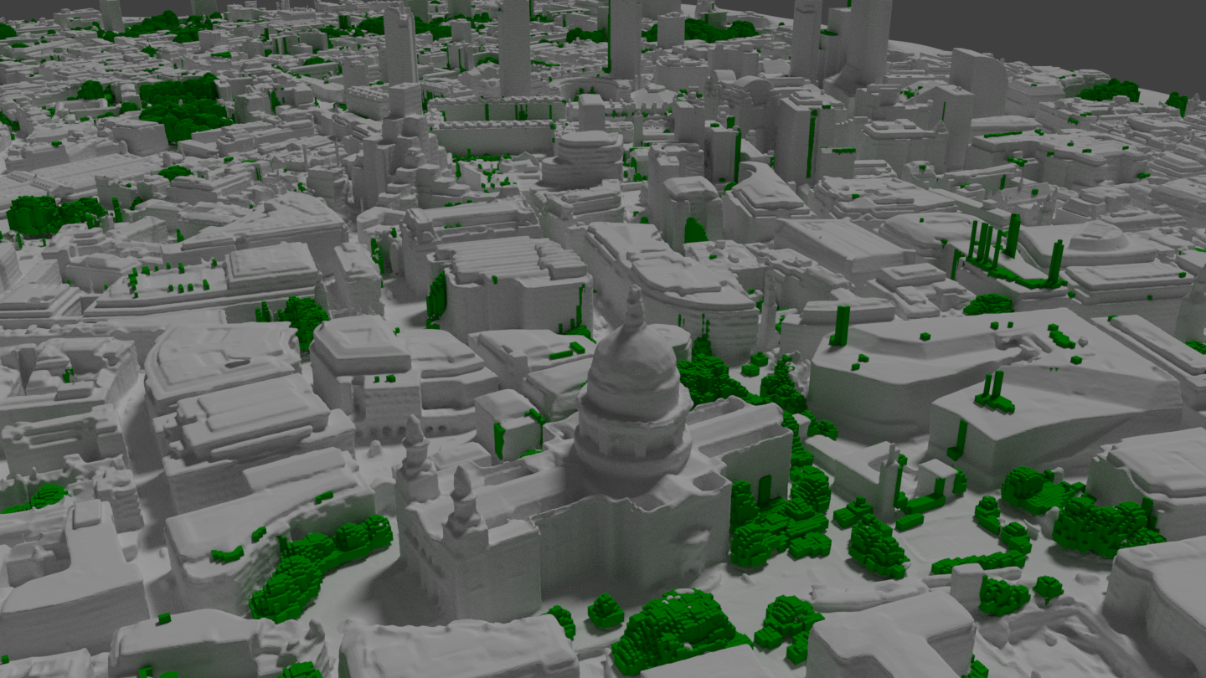
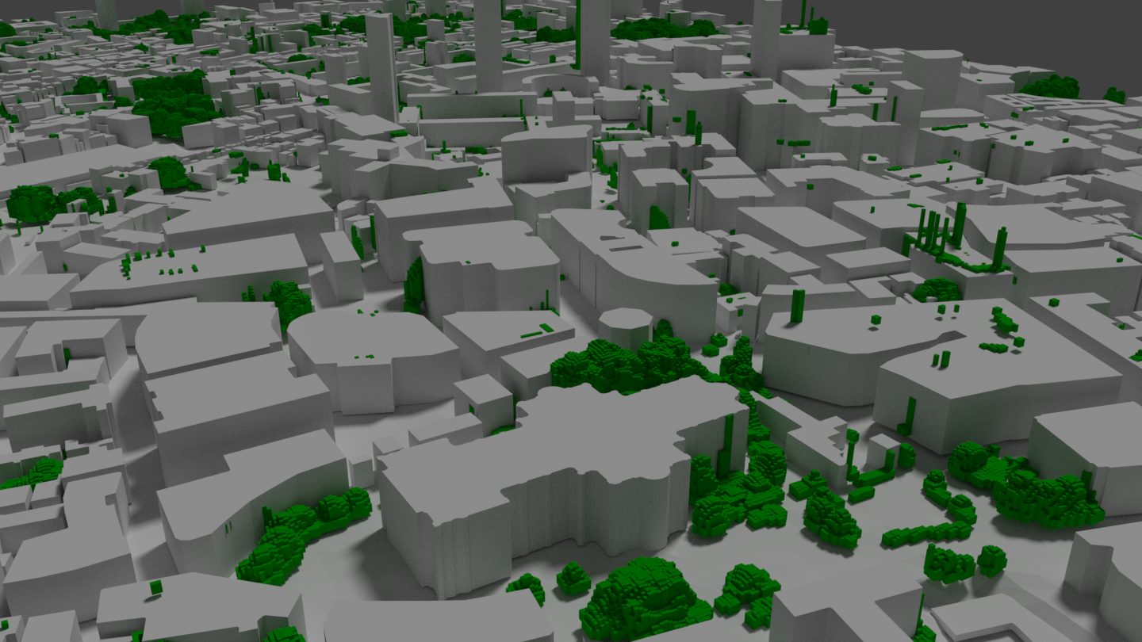
Meg Stretton’s PhD project
Compare multi-layer multi-region multi-stream SPARTACUS-Urban with explicit calculations by “DART” model for a 2x2 km London scene at various levels of detail
What improvements are needed to SPARTACUS-Urban?
Which details of an urban scene really matter which can be safely ignored?
What level of detail can be justified in a weather or climate model?
Image courtesy of Will Morrison

Slide 41
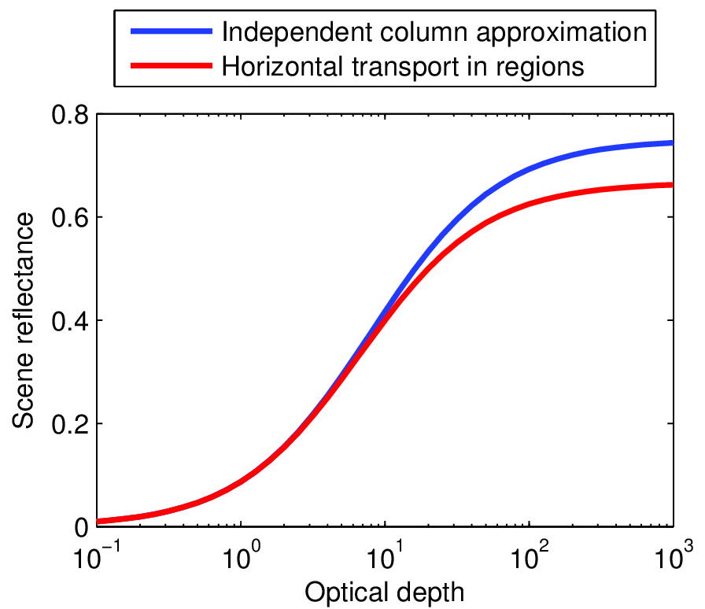
Idealized calculation: what is the albedo of this scene?
Surface albedo = 0
Reflectance of each cloud: R
No absorption so transmittance T = 1 – R
R R* R 0
R/2
R/2
Independent column approximation
Reflectance of 2 non-absorbing clouds
  Adding method with R* = 2R/(1+R)
Reflectance of scene
  Weighted average R_{scene} = R/2 + R*/4 = R(1+R/2)/(1+R)
Optically thick limit: R_{scene} = 3/4
Horizontal transport in regions
Mean reflectance of layer = R/2
Reflectance of scene
  Random overlap so apply adding method to mean reflectances: R_{scene} = 2(R/2)/(1+R/2) = 2R/(2+R)
Optically thick limit: R_{scene} = 2/3

Slide 42
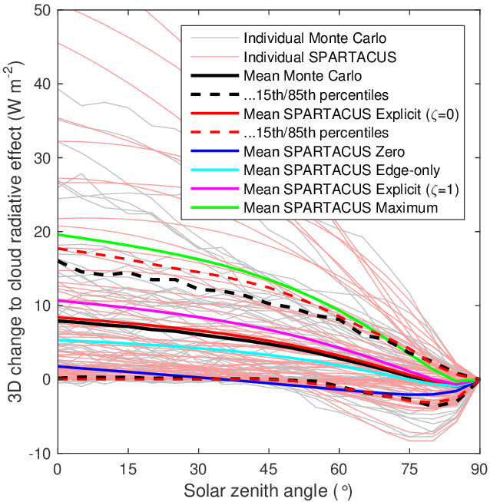

Slide 44
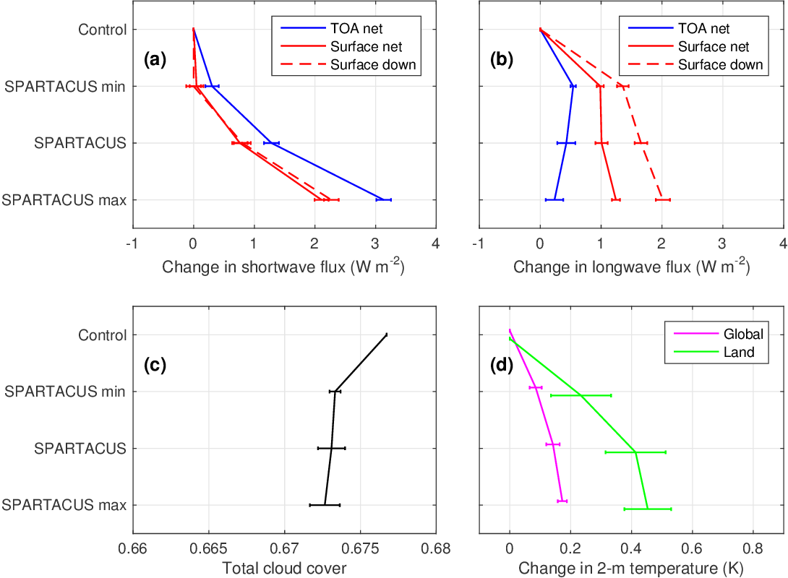
Impact in 4x 1-year 80-km uncoupled simulations

