Slide 1
What is the impact of 3D radiative effects on the global radiation budget?
Robin Hogan
ECMWF and the University of Reading
Contributions from
Sophia Schäfer and Christine Chiu (University of Reading, UK)
Carolin Klinger and Bernhard Mayer (LMU, Germany)
Maike Ahlgrimm, Richard Forbes and Alessio Bozzo (ECMWF)

Slide 2
Overview
A puzzling bias
Representing cloud structure in radiation schemes
Conceptual models for 3D cloud-radiation effects
The SPARTACUS solver
How big is a cloud?
An estimate of the global impact of 3D radiation

Slide 3
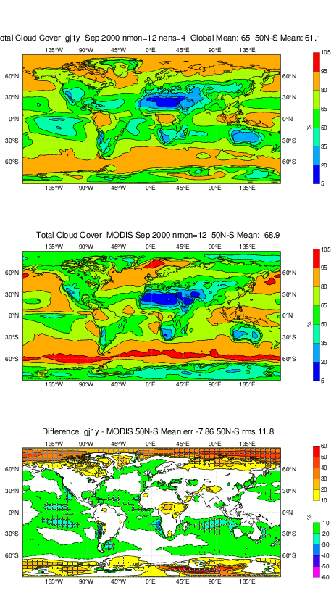
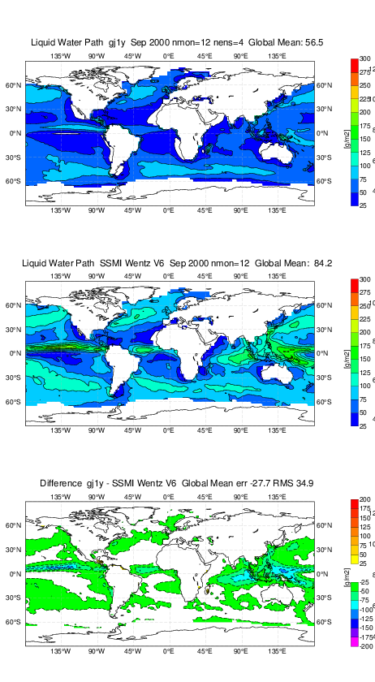
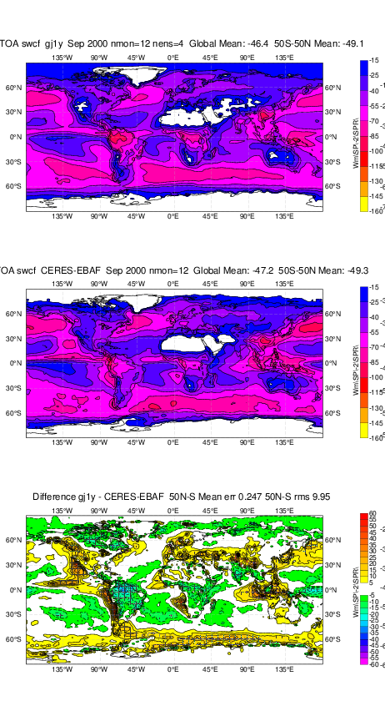
ECMWF cycle 43R1: clouds in uncoupled model climate
Cloud cover: model
LWP: model
SW CRE: model
Cloud cover: MODIS
LWP: SSMI
SW CRE: CERES-EBAF
Cloud cover: difference
LWP: difference
SW CRE: difference (mean 0.2 W m⁻²)
Cloud cover and LWP are too low, yet clouds are too reflective

Slide 4
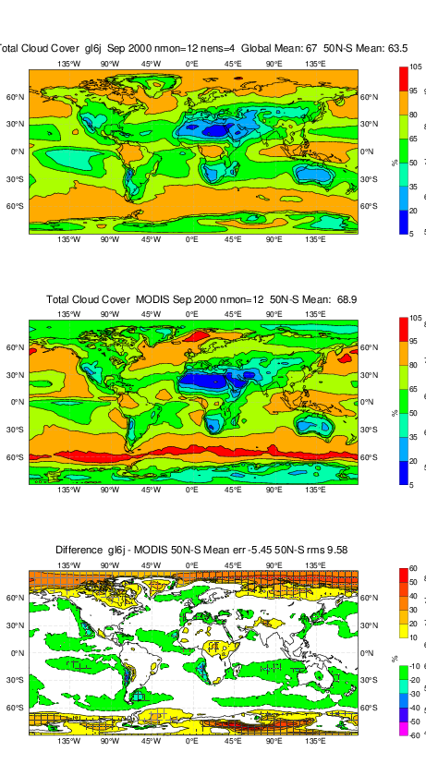

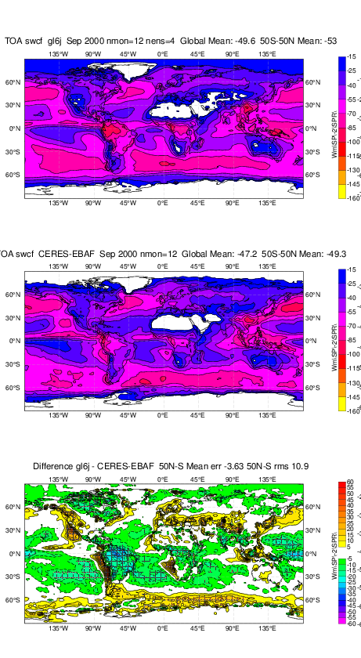
“Improvements”: less cloud overlap and less heterogeneity
Cloud cover: model
LWP: model
SW CRE: model
Cloud cover: MODIS
LWP: SSMI
SW CRE: CERES-EBAF
Cloud cover: difference
LWP: difference
SW CRE: difference (mean -3.6 W m⁻²)
Cloud cover is better, SW CRE is worse

Slide 5
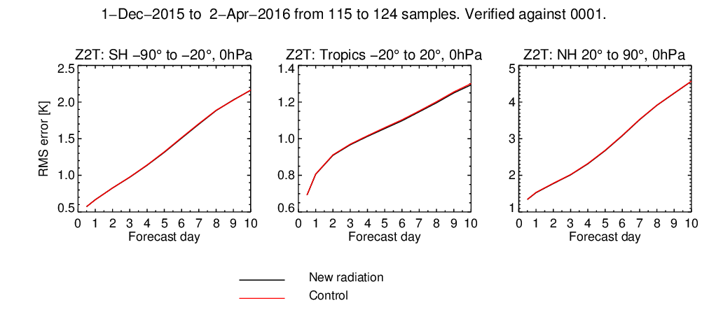
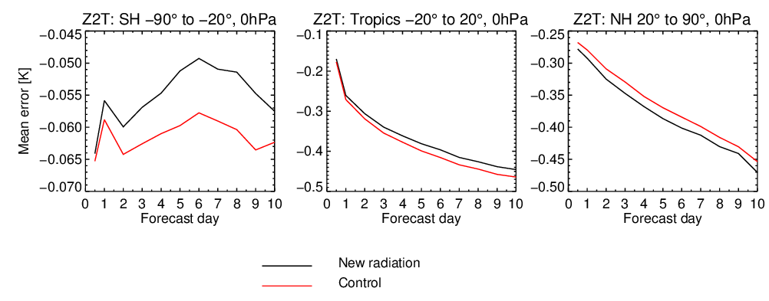
2-m temperature bias (winter example)
RMS errors are one way to judge whether a new model version improves forecasts
Mean errors are small but negative and grow during the forecast towards the climatic biases
A related puzzle: global-mean shortwave cloud radiative effect is about right but temperatures are a little low

Slide 6
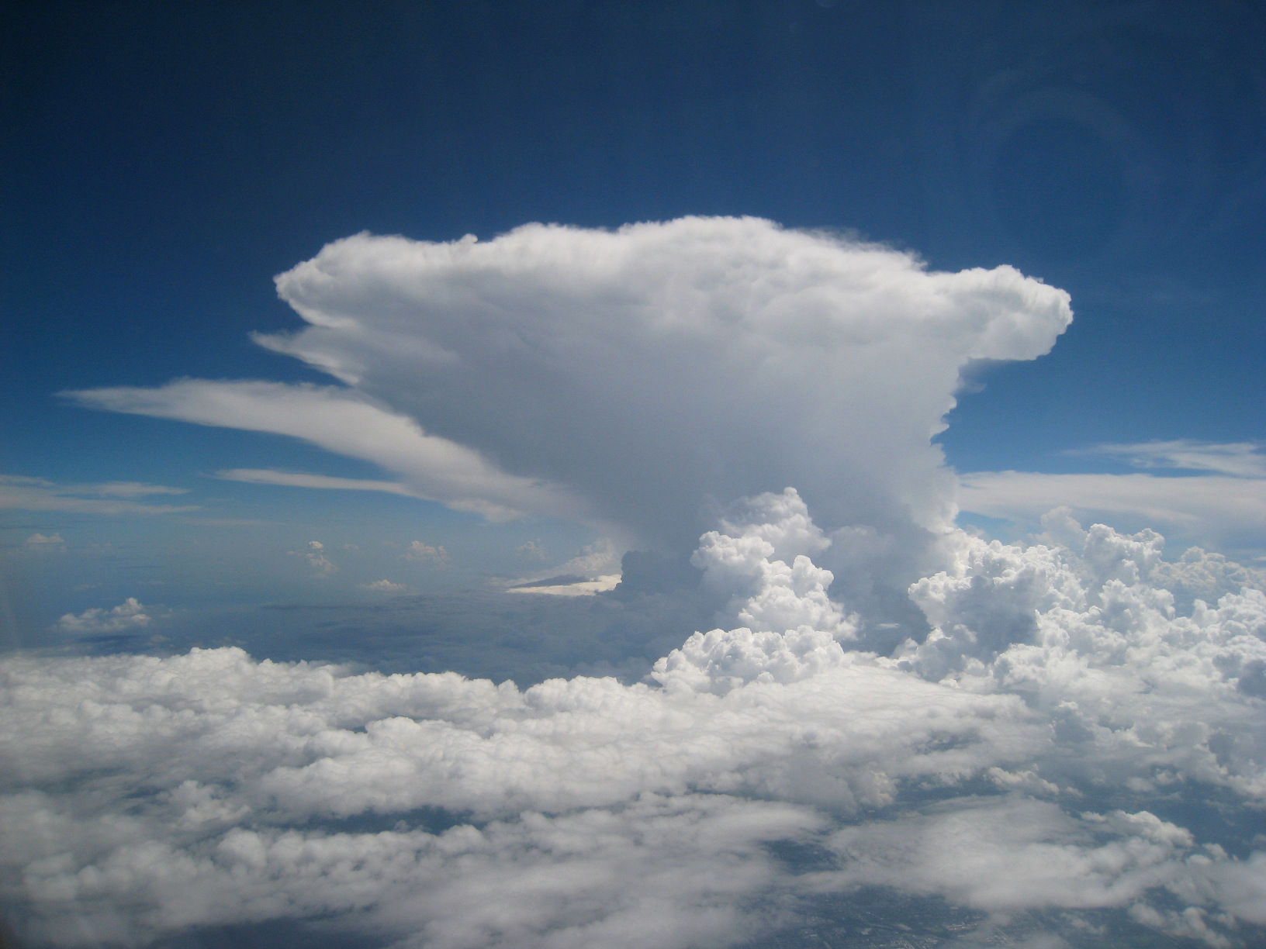
How do we compute how this interacts with radiation?

Slide 7
Plane-parallel, maximum-random overlap
Most models circa 2000
Model variables needed: cloud fraction, water content
Reflection & transmission computed for clear & cloudy regions separately
Fluxes merged at layer interfaces according to cloud fraction

Slide 8
Realistic overlap
Increases cloud cover and hence magnitude of cloud radiative effect
Net impact –1.9 W m⁻² at surface and TOA (Shonk & Hogan 2010)
Extra input: overlap decorrelation length from cloud radar ~2 km
  Ground-based (Hogan & Illingworth 2000, Mace & Benson-Troth 2002)
  CloudSat (Barker 2008, Shonk et al. 2010)

Slide 9
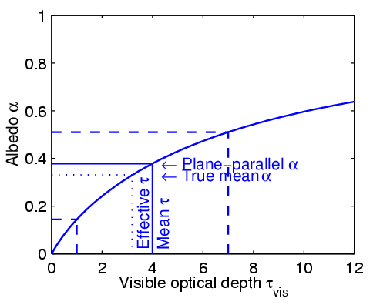
Tripleclouds (Shonk & Hogan 2008)
Cloud structure reduces cloud reflectance
Net impact 4.1 W m⁻² (TOA), 3.8 W m⁻² (surf)
Cloud water fractional standard deviation ~0.75
  Satellite & cloud radar (Barker, Shonk, Cahalan, Oreopoulos, Rossow…)
Cloud water overlap decorrelation length ~1 km
  Ground-based cloud radar (e.g. Hogan & Illingworth 2003)

Slide 10
Monte-Carlo Independent Column Approximation (McICA) – Pincus et al. (2005)
Info required similar to Tripleclouds but computationally faster
Use of stochastic cloud generator leads to some noise in fluxes
Now used in many (most?) global weather and climate models

Slide 11
Full Monte Carlo (being investigated by Barker et al.)
“It’s better to solve the right problem approximately than the wrong problem exactly,” or “random errors are better than biases.” (for climate!)
Use 3D cloud distribution generated by a stochastic model in each gridbox
How many light rays are needed for random errors to be tolerable? 500?
  NWP models tolerate random errors much less than climate models
Monte Carlo at least provides good benchmark for approximate schemes

Slide 12
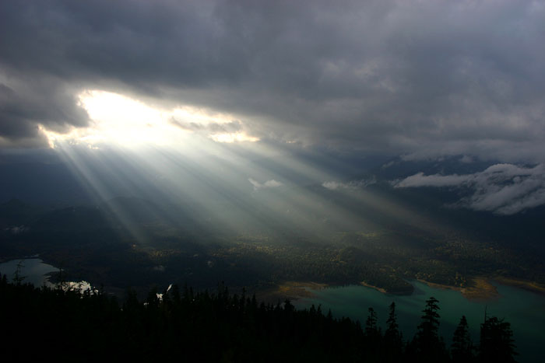
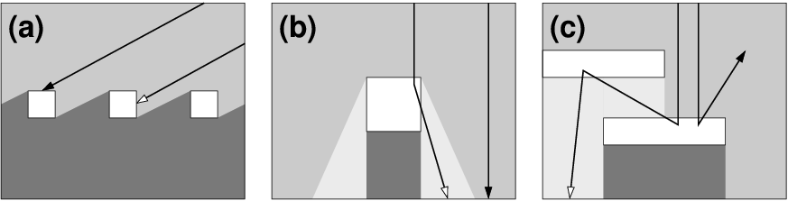
Mechanisms for shortwave 3D effects
Side illumination
  Strongest when sun near horizon
  Increases chance of sunlight intercepting cloud
Side escape
  Strongest for overhead sun
  Forward scattering leads to more sunlight penetration
  Second-order importance
In-region transport
  Systematically reduces reflectance for all solar zenith angles

Slide 13
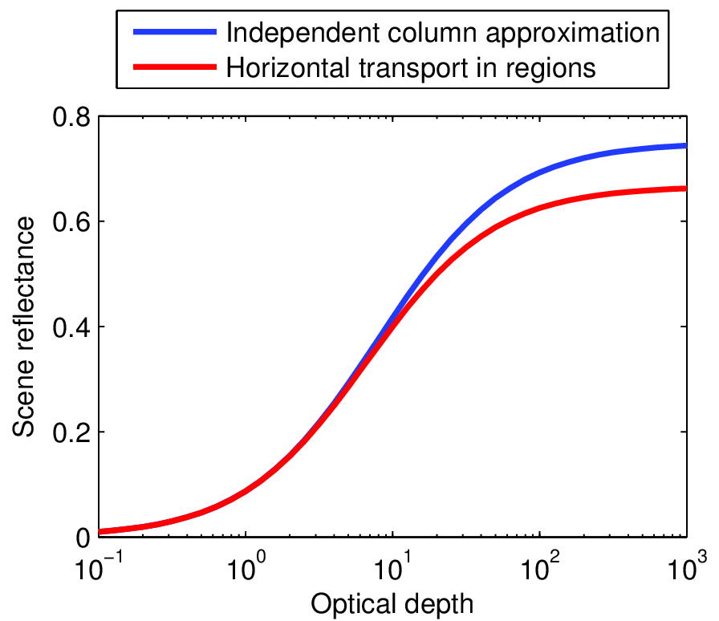
Idealized calculation: what is the albedo of this scene?
R R* R 0
Surface albedo = 0
Reflectance of each cloud: R
No absorption so transmittance T = 1 – R
R/2
R/2
Independent column approximation
Reflectance of 2 non-absorbing clouds
  Adding method with R* = 2R/(1+R)
Reflectance of scene
  Weighted average R_{scene} = R/2 + R*/4 = R(1+R/2)/(1+R)
Optically thick limit: R_{scene} = 3/4
Horizontal transport in regions
Mean reflectance of layer = R/2
Reflectance of scene
  Random overlap so apply adding method to mean reflectances: R_{scene} = 2(R/2)/(1+R/2) = 2R/(2+R)
Optically thick limit: R_{scene} = 2/3

Slide 14
Conceptual model for longwave 3D effects
Radiation can now be emitted from the side of a cloud, increasing downwelling at the surface
A useful benchmark: for an isolated, optically thick, cubic cloud in vacuum, 3D effects increase downwelling flux at the surface by a factor of 3
Clouds are not cubes, the atmosphere is not a vacuum to longwave radiation: many radiation people assume 3D effects are negligible in the longwave… are they right?

Slide 15
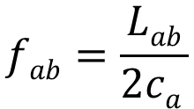
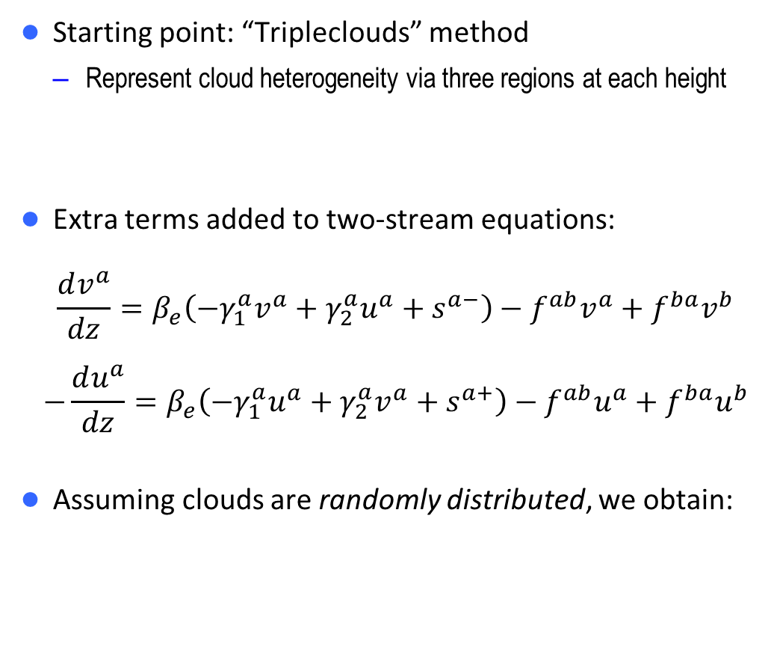
SPARTACUS “Speedy Algorithm for Radiative Transfer through Cloud Sides”
a
Starting point: “Tripleclouds” method
  Represent cloud heterogeneity via three regions at each height
Extra terms added to two-stream equations:
$$\frac{dv^{a}}{dz}=β_{e}\left(−γ_{1}^{a}v^{a}+γ_{2}^{a}u^{a}+s^{a−}\right)−f^{ab}v^{a}+f^{ba}v^{b}$$
$$−\frac{du^{a}}{dz}=β_{e}\left(−γ_{1}^{a}u^{a}+γ_{2}^{a}v^{a}+s^{a+}\right)−f^{ab}u^{a}+f^{ba}u^{b}$$
Assuming clouds are randomly distributed, we obtain:
vª
uª
a
b
c
v^{b}
u^{b}
a
b
c
a
New terms representing exchange between regions
$$fab=\frac{Lab}{2ca }$$
Length of cloud perimeter per unit gridbox area
Fraction of gridbox occupied by clear skies (region a)

Slide 16
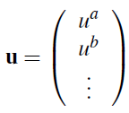
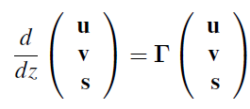
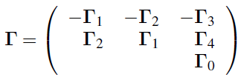
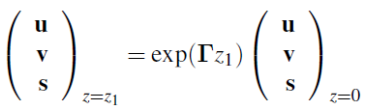
Matrix solution in a single layer (shortwave)
Define diffuse upwelling, diffuse downwelling and direct downwelling as vectors u, v and s:
Write two-stream equations as: where 9x9 matrix is composed of known terms analogous to γ₁-γ₄ in the standard two-stream equations:
Solution for layer of thickness z₁:
Matrix exponential
Waterman (1981), Flatau & Stephens (1998)
Can compute using Padé approximant plus scaling & squaring method (Higham 2005)

Slide 17


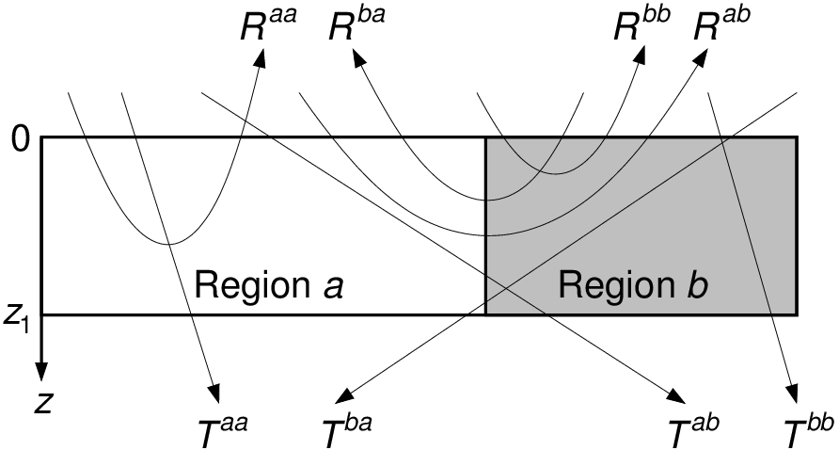
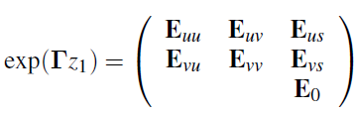

Reflection and transmission matrices
s(0)
v(0)
u(0)
We want relationships between fluxes of the form:
Transmission matrix for 2 regions given by:
and likewise for R and S±
If matrix exponential is decomposed as:
then reflection and transmission matrices given by:
For scalars, get same answer as traditional Meador & Weaver (1980) formulas
For speed, only use matrix exponential for partially cloudy layers
u(z₁)

Slide 18
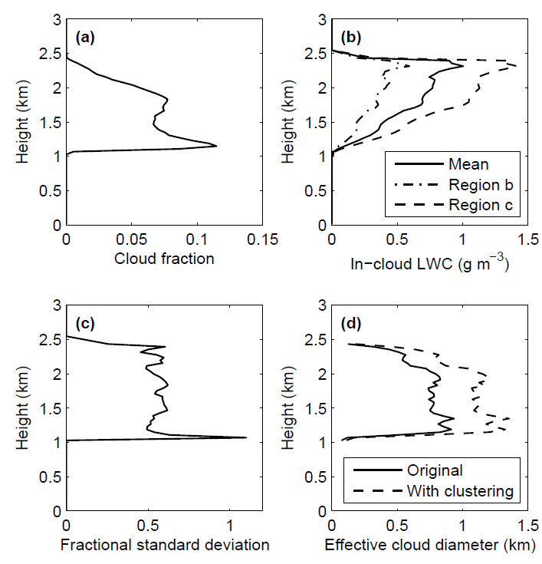
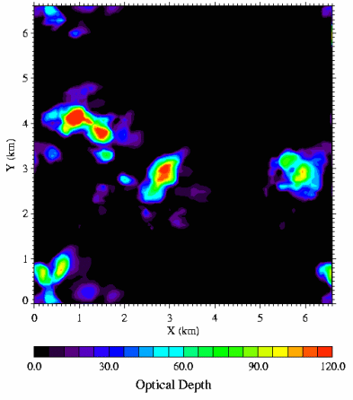
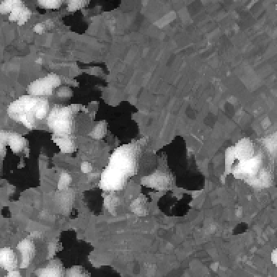
Test with I3RC cumulus cloud
Fully 3D simulations with MYSTIC
Inputs needed by SPARTACUS
  Thanks to Carolin Klinger & Bernhard Mayer, LMU Munich

Slide 19
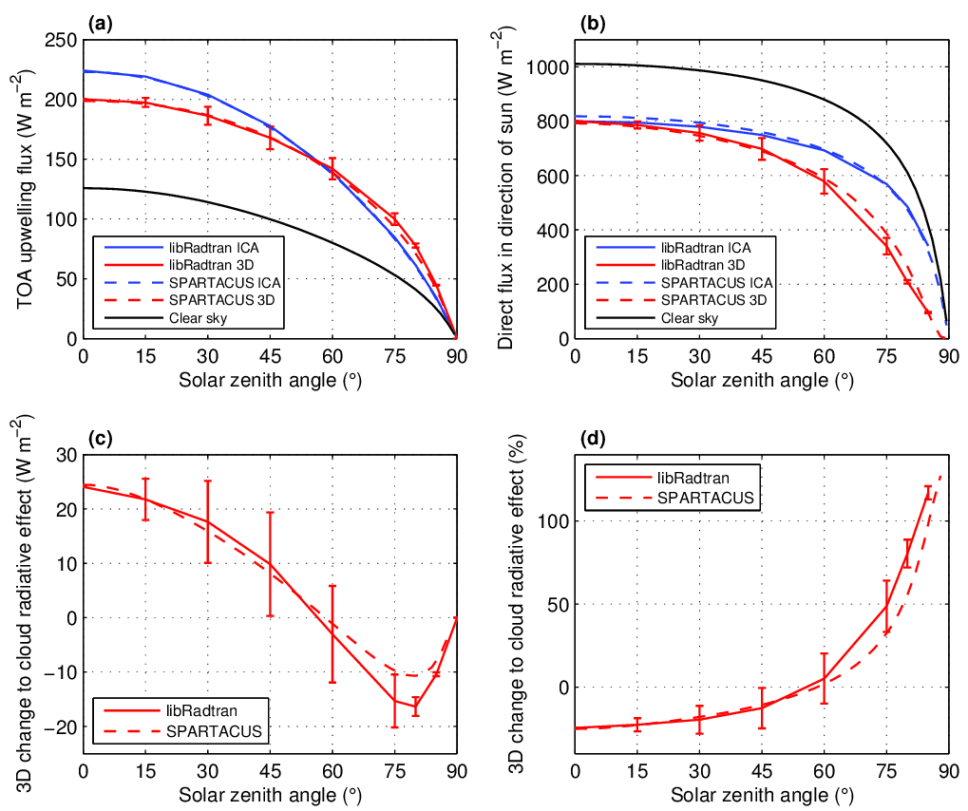
Broadband shortwave SPARTACUS vs MYSTIC (Monte Carlo)
Good match!
Big difference in direct surface flux when sun low in the sky
Hogan et al. (JGR 2016)

Slide 20
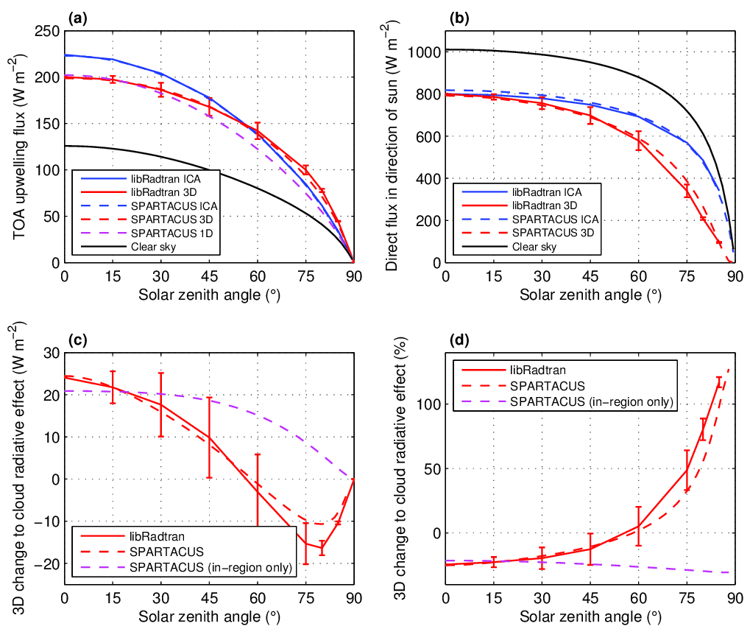
Broadband shortwave SPARTACUS vs MYSTIC (Monte Carlo)
Good match!
Big difference in direct surface flux when sun low in the sky
Change due to in-region horizontal transport
Change due to cloud edge effects
Hogan et al. (JGR 2016)

Slide 21
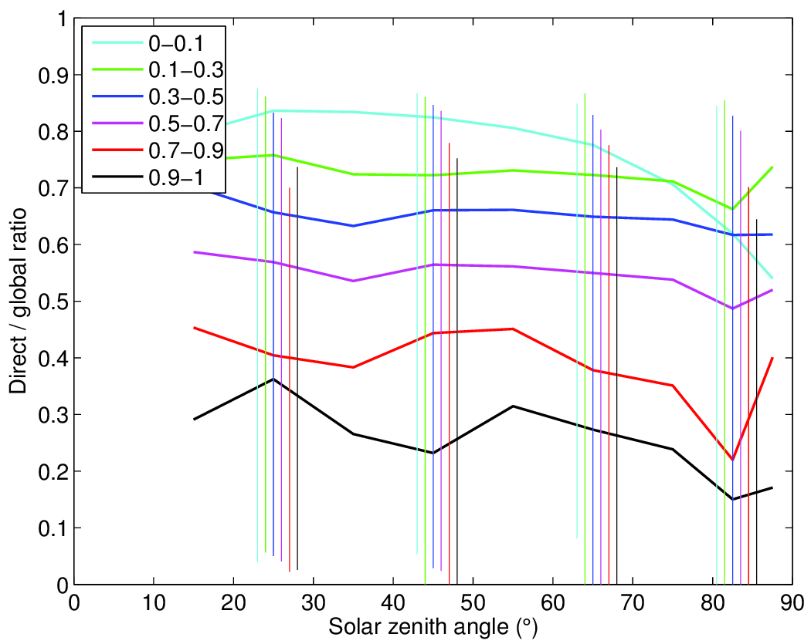
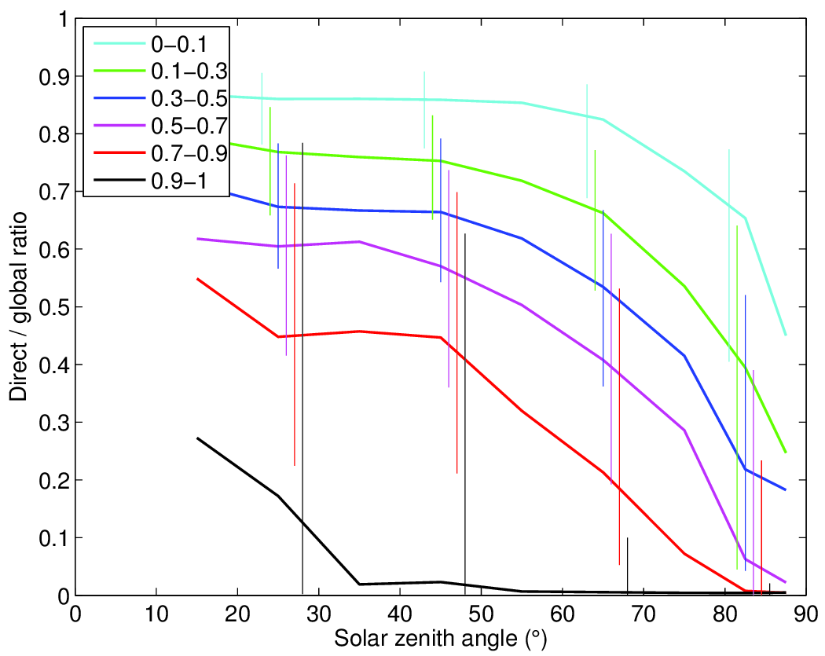
3D effects in observations of direct/total downwelling flux
Troccoli & Morcrette (2014) reported biases in ECMWF direct solar radiation from, important for solar energy industry
Bin observations and model by solar zenith angle and cloud fraction, considering only cases of boundary-layer clouds (thanks to Maike Ahlgrimm):
Next step: apply new 3D radiation scheme to the ECMWF cloud fields to verify that differences are due to 3D effects
ECMWF model
ARM SGP (13 yrs)

Slide 22
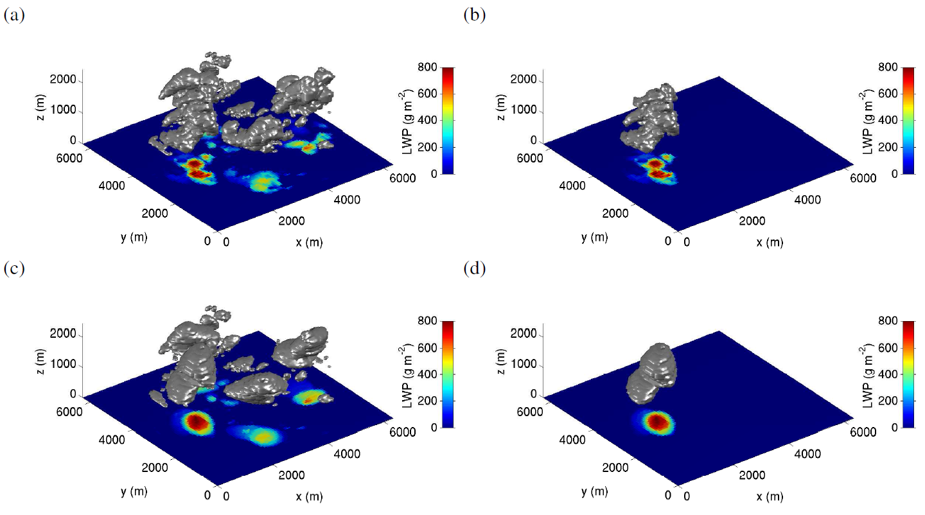
Longwave…
Good 1D agreement
MYSTIC 3D effect: 30% (the same in broadband)
Too big in SPARTACUS?
Use radiatively effective cloud edge length: contour of a fitted ellipse
Consider full cloud field
Effective edge length not sufficient: clustering is also important
We know how to estimate the radiatively relevant edge length; clustering can only be represented approximately (multiply by 0.7 in this case)

Slide 23
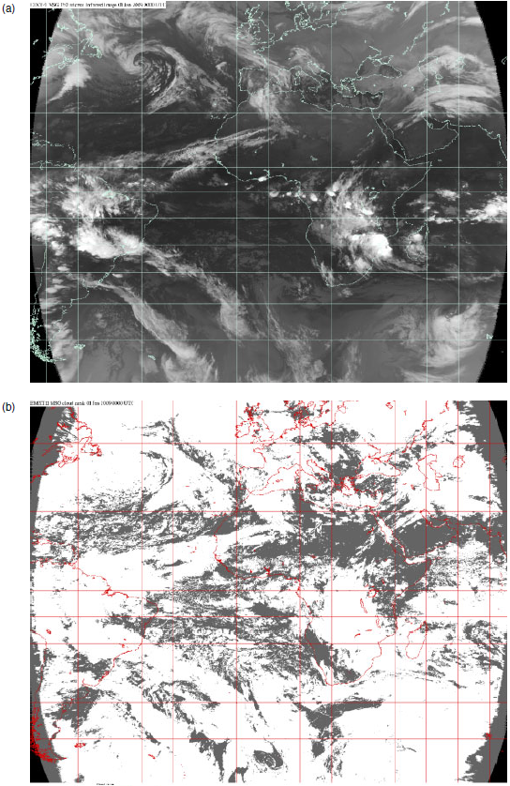
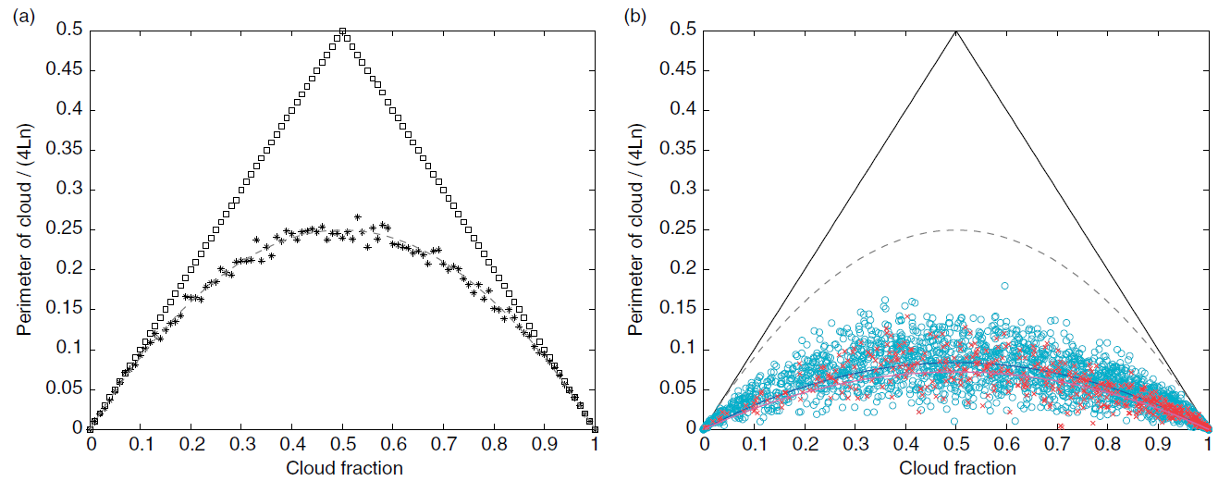
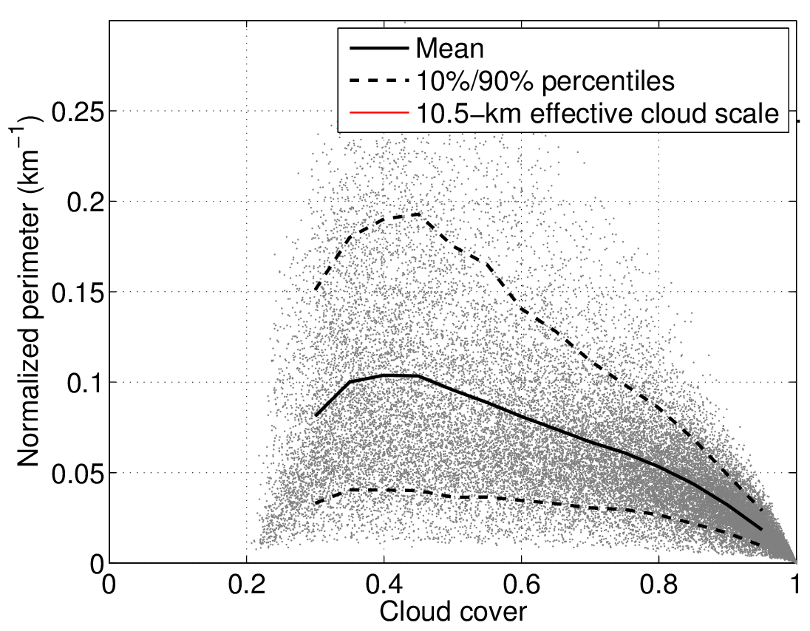
How can we characterize cloud edge length in a model?
Morcrette (2012): MSG
MSG infrared
Jensen et al. (2006) data: MODIS stratocumulus
Cloud mask

Slide 24
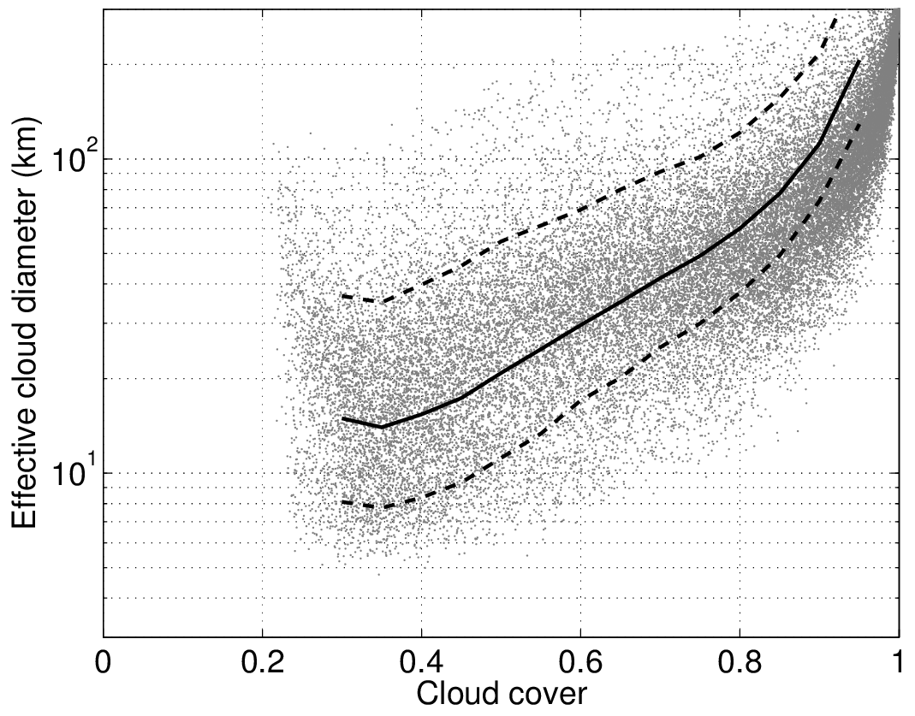
Characterizing cloud perimeter vs. cloud fraction
Jensen et al. (2006) proposed effective cloud diameter D: diameter of identical circular clouds that have the same perimeter and area as the actual cloud field
  If cloud area A = π(D/2)² and perimeter P = πD then
  Effective cloud diameter D = 4A/P = 4 x cloud cover / normalized perimeter
Problem with this concept is that effective cloud diameter computed from real cloud fields is strongly dependent on cloud cover
We seek an effective cloud scale S that is independent of cloud cover, and can be parameterized in GCMs
Jensen et al. (2006) data: MODIS stratocumulus

Slide 25
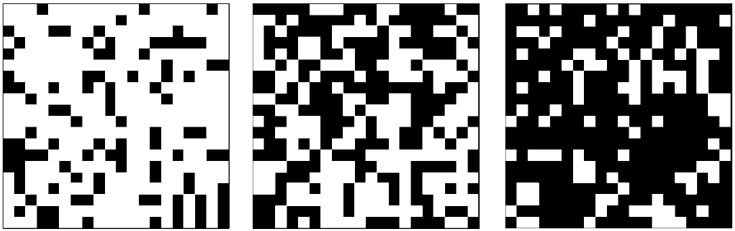
Morcrette (2012)
Conceptual model: fill a checkerboard randomly with squares of size S:
Morcrette (2012) found that perimeter simulated in this way behaves the same as in observations:
P = 4A(1-A)/S
His MSG data for all clouds yields S of around 10 km
Simulations MSG data

Slide 26
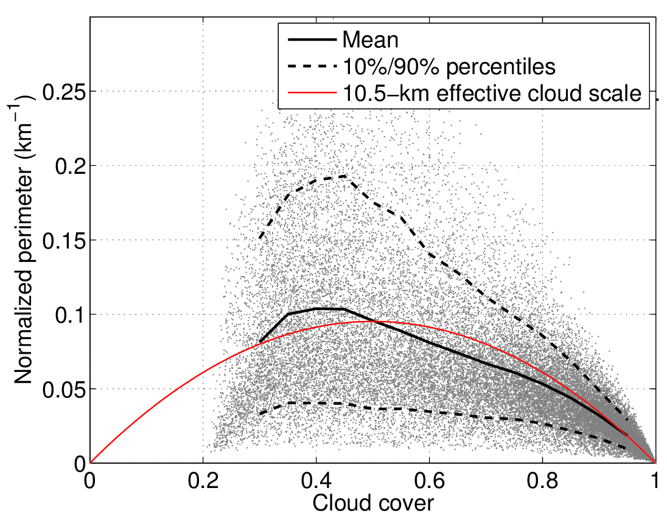
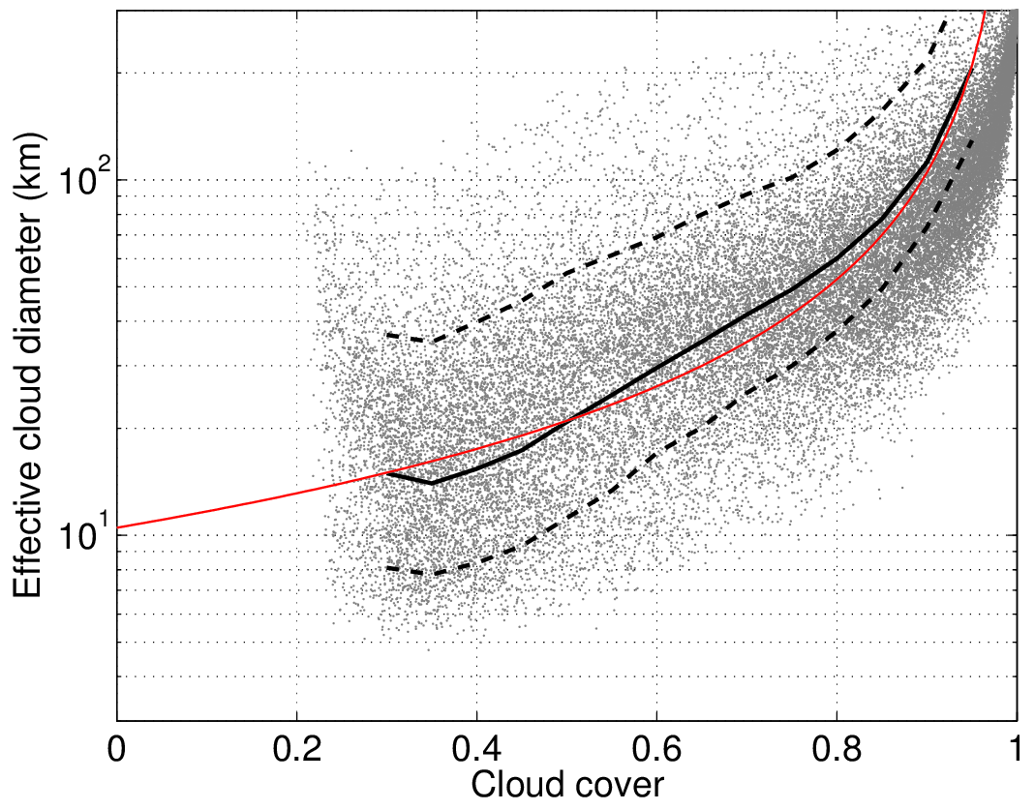
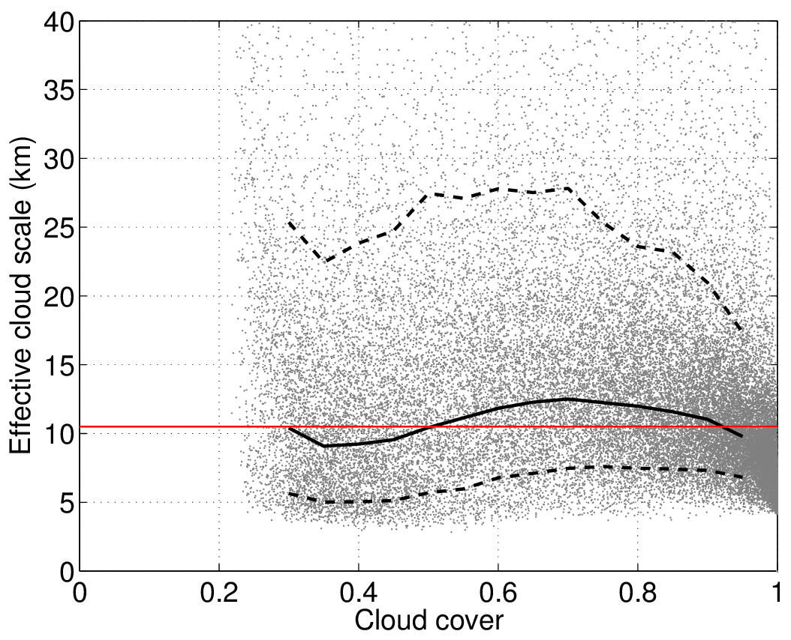
Apply concept to MODIS data
1-km MODIS is higher resolution than MSG
Application to Jensen et al. stratocumulus data suggests effective cloud scale of around 10 km

Slide 27
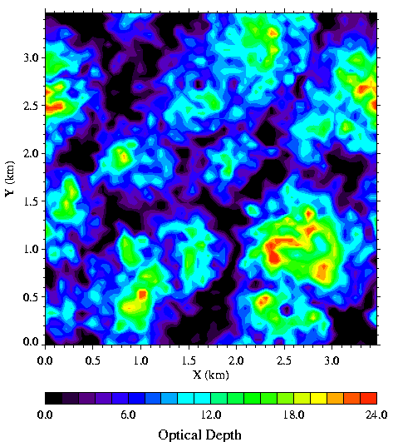
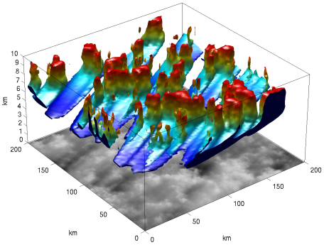
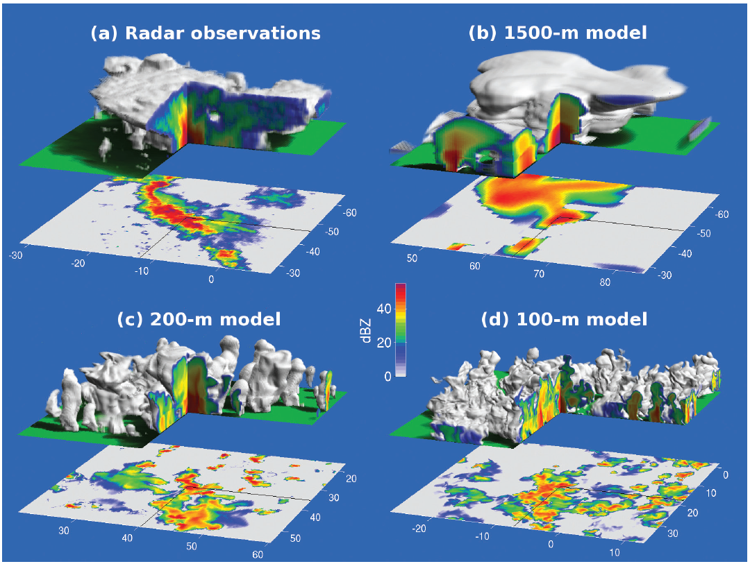
Estimates of effective cloud scale (Schäfer 2016, PhD thesis)
Cu: Fielding et al. (2014)
Sc: I3RC
Ci: Hogan & Kew (2005)
Cb: Stein et al. (2015)
Type | Source | Res (m) | Cloud scale (km)
Cu | I3RC CRM | 67 | 0.8±0.2
Cu | Azores radar | 50 | 0.9±0.2
Sc | I3RC CRM | 55 | 0.7±0.2
Sc | MODIS | 1000 | 10±2
Ci | Stochastic model | 49 | 4±1.5
Cb | Radar | 333 | 14±6
Cb | CRM | 250-350 | 5-30
Cu & Sc: 1 km (0.7–1.4 range)
  Approximate account for clustering
  MODIS too coarse
Non-BL clouds: 10 km (5–20 range)
Obviously further refinement is needed!

Slide 28
What is the global impact of 3D radiative transfer?
Offline calculations 1 yr of ERA-Interim clouds
Compare McICA to SPARTACUS 3D solver (Hogan et al. 2016)
SW & LW effects both act to warm the surface
Similar order to effect of cloud heterogeneity or doubling CO₂
Sophia Schäfer (PhD thesis, 2016)
Top of atmosphere Surface
Mean
+3.0 W m⁻²
+2.3
Total Longwave Shortwave
+0.9
+2.1
+3.9
+4.4

Slide 29
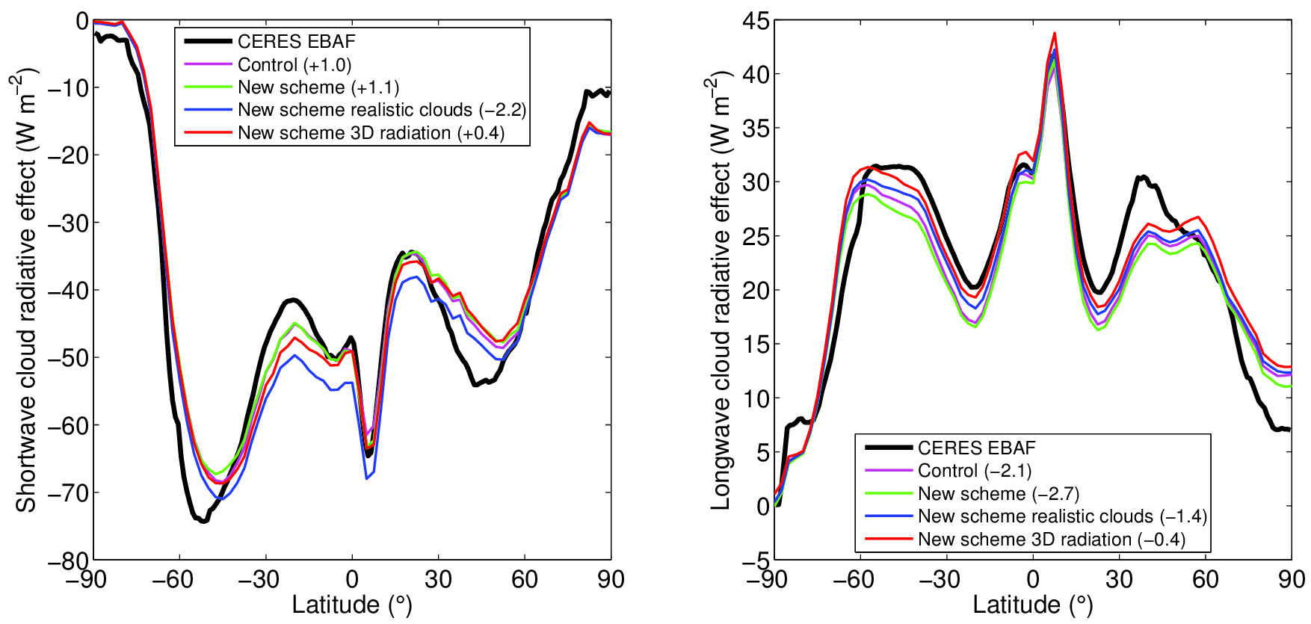
Comparison of ECMWF model to CERES CRE
Introduction of 3D effects improves agreement with CERES in SW and LW
  Is CERES longwave biased compared to model estimates (Allan and Ringer 2003)?

Slide 30
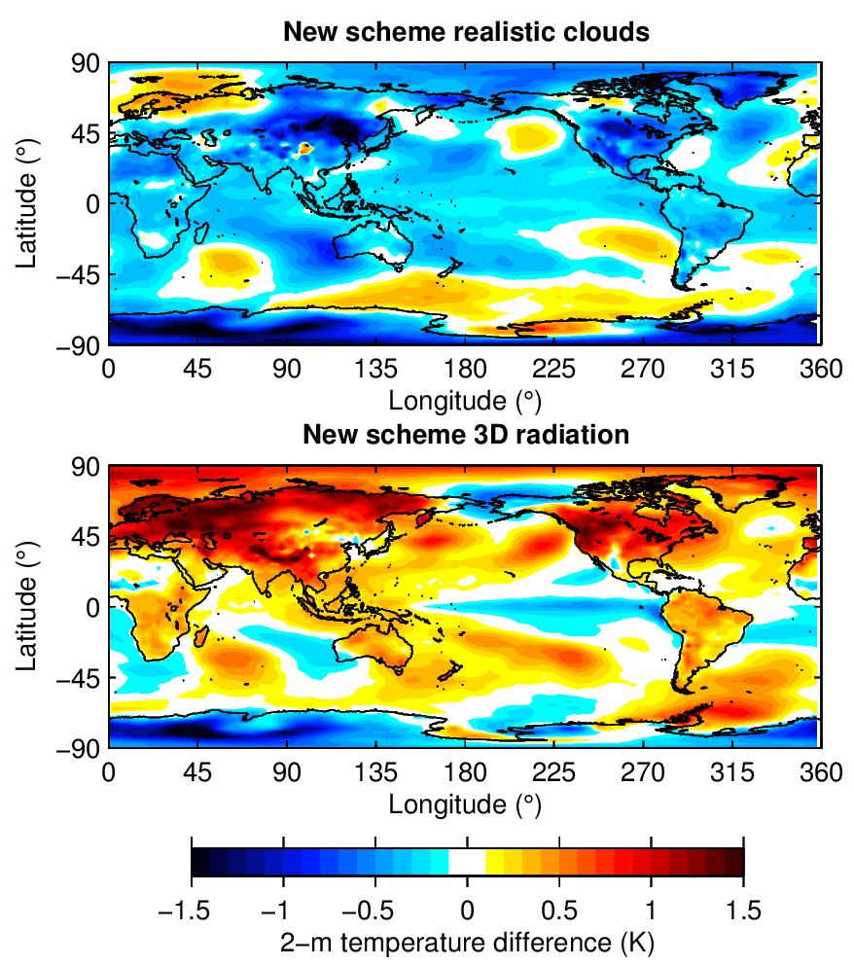
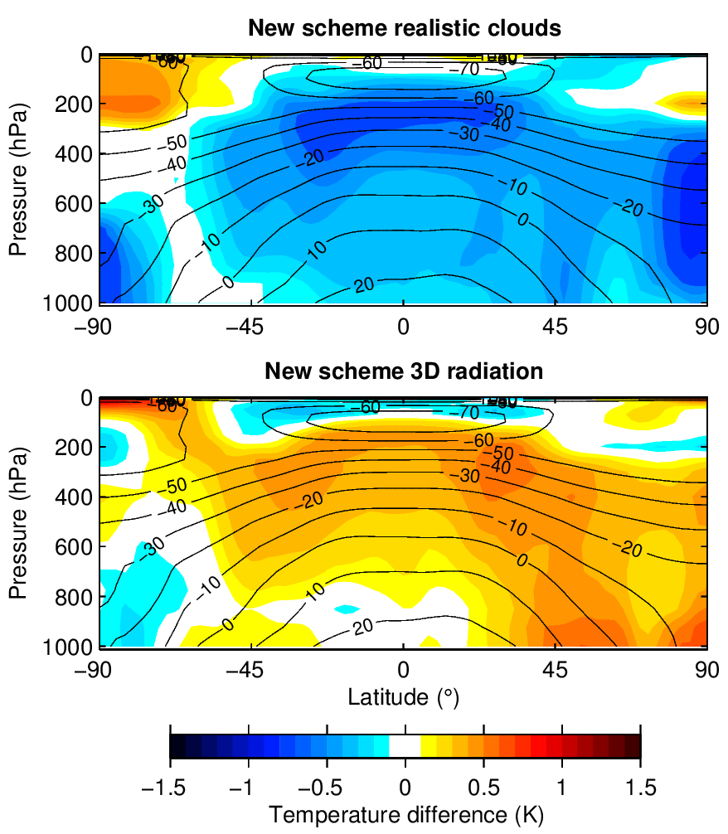
Impact on temperature (8x coupled 1-yr simulations)
Impact on 2-m temperature over land compared to ECMWF IFS control:
  Introducing realistic cloud overlap & inhomogeneity: – 0.3 K
  Introducing 3D radiation: + 0.4 K (so + 0.7 K due to 3D radiation) – is this the missing physics?

Slide 31
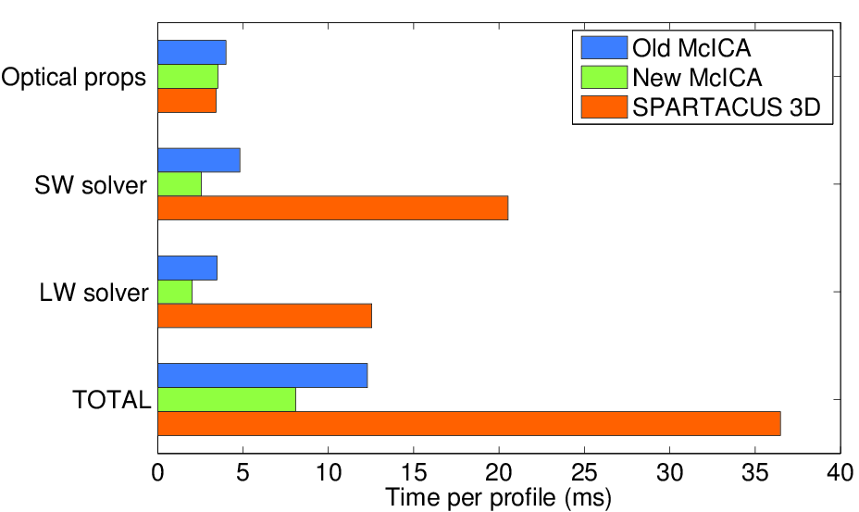
Computational cost inside ECMWF model
New ECRAD radiation scheme with McICA solver is 30-35% faster
ECRAD with SPARTACUS solver: matrix exponential and other matrix operations are the main cost so further optimization needed

Slide 32
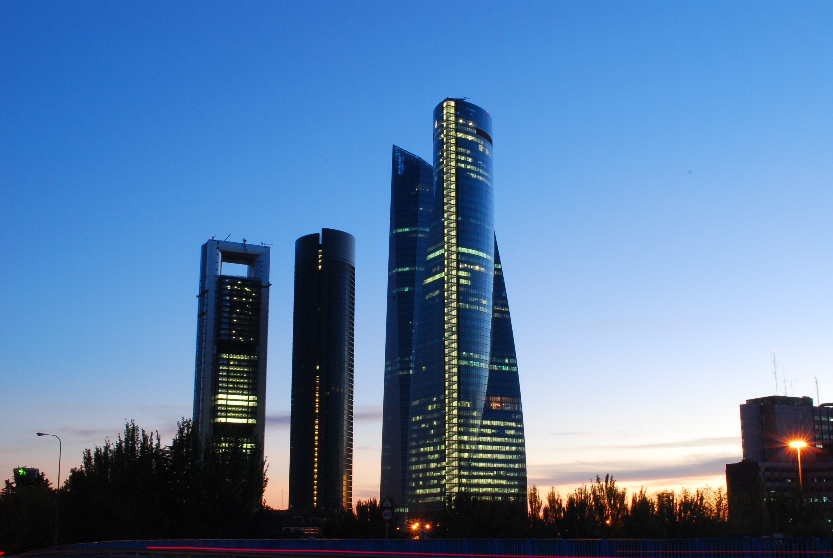
Summary and outlook
New capability to represent 3D radiative effects in a global model
First estimates suggest 4 W m⁻² global impact on net fluxes at surface and TOA
  Similar to the impact of cloud inhomogeneity and overlap
  Longwave effects are significant
  Could help explain the cold bias in the ECMWF model? …but many other factors need constraining too!
Further work required:
  More analysis of high resolution cloud observations and CRMs to characterize “effective cloud scale”
  Comparison of SPARTACUS with full Monte Carlo calculations in a wide variety of scenes
  Optimize SPARTACUS: perhaps treat it as a benchmark for more approximate schemes to represent 3D effects, e.g. perturbing cloud overlap (Tompkins & DiGuiseppe)
SPARTACUS is an option in new ECMWF radiation scheme “ECRAD”
  Offline version to be released under the OpenIFS license
SPARTACUS idea will also be used to compute 3D effects in urban and vegetation canopies

Slide 34
Do subtle radiative effects really matter for an NWP centre?
Short to medium term
  Surface temperature forecasts are of first-order importance
  Solar energy industry increasingly using radiation diagnostics from NWP
Monthly to seasonal (both coupled)
  Predictability on this timescale from stratosphere, MJO, ocean memory – all require accurate radiation
  Difficult to get statistical significance when evaluating different seasonal forecast systems – but a pre-requisite for a skilful system is a model with a good climate
Overview
A puzzling bias
Representing cloud structure in radiation schemes
Conceptual models for 3D cloud-radiation effects
The SPARTACUS solver
How big is a cloud?
An estimate of the global impact of 3D radiation

Slide 35
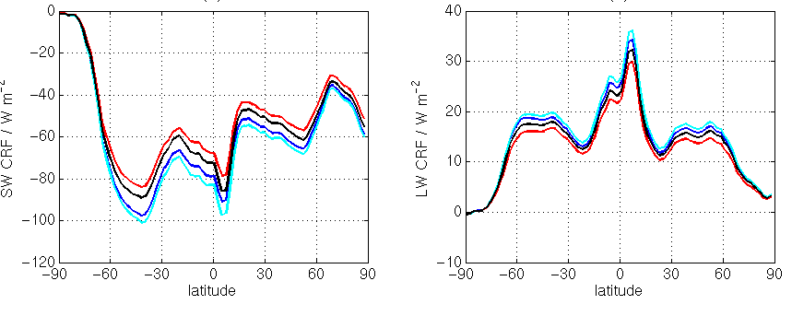
Global impact of cloud inhomogeneity and overlap
Plane-parallel, maximum-random
Top-of-atmosphere cloud radiative forcing
Shortwave
Longwave
Fix only overlap
Fix only inhomogeneity
Fixing just horizontal structure (blue to red) would overcompensate the error
Fixing just overlap (blue to cyan) would increase the error
Need to fix both overlap and horizontal structure
Fix overlap and inhomogeneity
Shonk & Hogan (2010)

Slide 36

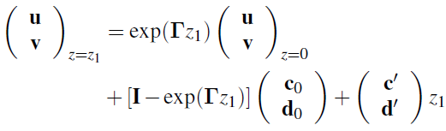
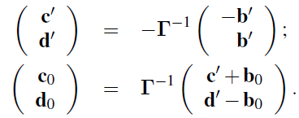
Longwave equivalent
Two-stream equations now look like this:
(No solar beam and Planck function assumed to vary linearly in optical depth via inhomogeneous terms)
Solution is a bit more complex:
where:

Slide 37
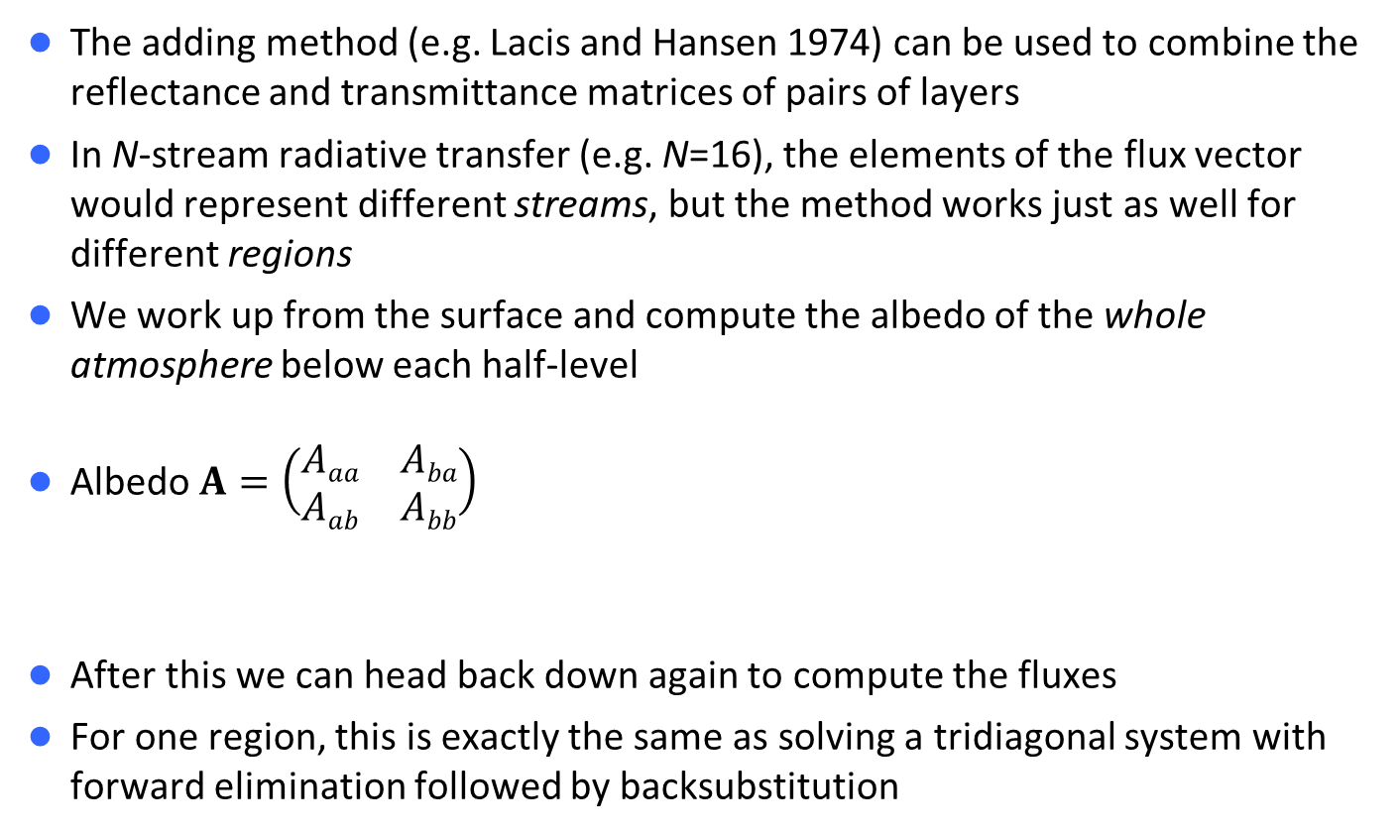
Extension to multiple layers: the adding method
The adding method (e.g. Lacis and Hansen 1974) can be used to combine the reflectance and transmittance matrices of pairs of layers
In N-stream radiative transfer (e.g. N=16), the elements of the flux vector would represent different streams, but the method works just as well for different regions
We work up from the surface and compute the albedo of the whole atmosphere below each half-level
Albedo $A=\left(\begin{matrix}Aaa & Aba \\ Aab & Abb\end{matrix}\right)$
After this we can head back down again to compute the fluxes
For one region, this is exactly the same as solving a tridiagonal system with forward elimination followed by backsubstitution
A_{aa}
A_{ab}
A_{ba}
A_{bb}

Slide 38
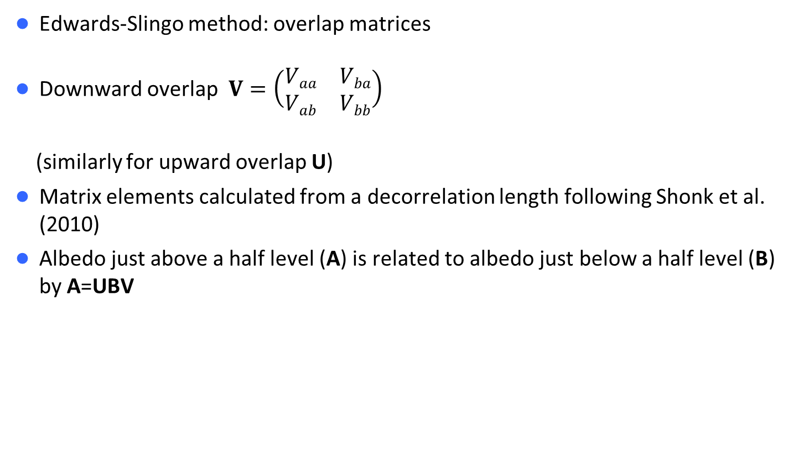
How do we deal with cloud overlap?
Edwards-Slingo method: overlap matrices
Downward overlap $V=\left(\begin{matrix}Vaa & Vba \\ Vab & Vbb\end{matrix}\right)$
(similarly for upward overlap U)
Matrix elements calculated from a decorrelation length following Shonk et al. (2010)
Albedo just above a half level (A) is related to albedo just below a half level (B) by A=UBV
V_{aa}
V_{ab}
V_{bb}
V_{ba}
Half-level

Slide 39
What is LW radiatively effective cloud edge length?
Schäfer et al. (JGR 2016)
Single cloud Full cloud field
MYSTIC: solid lines
SPARTACUS: dashed lines
Ellipses remove radiatively irrelevant small-scale structure
Clustering reduces effective edge length (nearest-neighbour spacing is 280 m vs. random value of 430 m)
“Ellipsified” clouds Original clouds

Slide 40
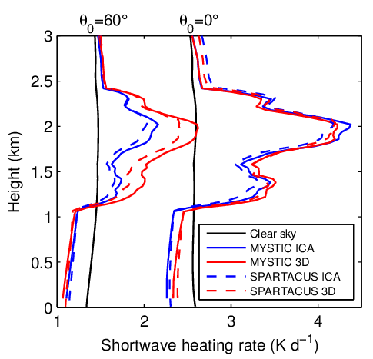

Heating-rate comparisons with MYSTIC
Shortwave
Longwave
Clustering has a fairly small effect on atmospheric heating rates
3D effects increase longwave CRF at surface by 30% in both MYSTIC and SPARTACUS (42% in SPARTACUS if clustering effect not represented)

Slide 41


What is the effective size of typical cumulus clouds?
This study: between 0.5 and 1 km
Neggers et al. (2003): cloud resolving model applied to a range of cumulus experiments

Slide 42



Towards a global estimate of the impact of 3D effects
Instantaneous cloud radiative forcing applying SPARTACUS to one ERA-Interim clouds
To get cloud edge length, assume cumulus horizontal length scale is 750-m, all other clouds 10 km
Solar zenith angle
Night-time: positive LW effect
Low sun:
negative SW effect
High sun:
positive SW effect

Slide 43

Effective size of deep convection (Stein et al., BAMS 2015)
Radar observations suggest cores of UK storms around 10 km wide
Don’t trust size of storms in models with grid spacing larger than around 1 km (Met Office model in this case)

