Slide 1



Water in the Climate System –
The Hydrological Cycle
Richard Allan - University of Reading 18th Sep 9am
Thanks to Julia Slingo, Adrian Tomkins, Peter Bechtold, Pier Luigi Vidale

Slide 2
Water in the climate system
Fundamental to Earth System, supporting plant, animal and marine life.
Water in both liquid & frozen forms cover ~75% of Earth’s surface
Water vapour is Earth’s most abundant and important greenhouse gas
Water in its various forms (vapour, liquid, solid) determines the characteristics and spatio-temporal evolution of the Earth System
  Latent heat release from precipitation is a major driver of the global circulation, which acts to transport heat, moisture and momentum around the climate system.
  Natural ecosystems depend on precipitation, and so water has a fundamental role to play in other cycles of the earth system, such as the carbon and nitrogen cycles.

Slide 3
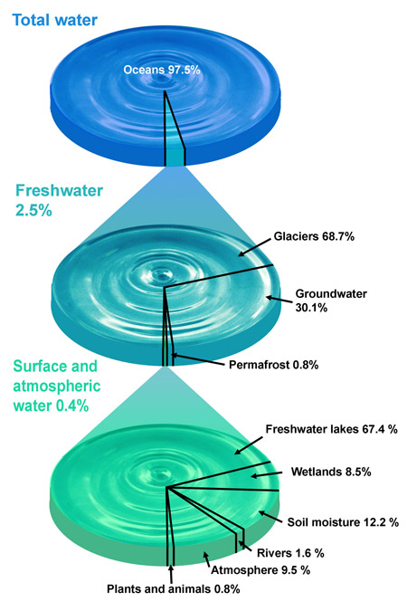
Water, water everywhere…
Most water on Earth is salty
Most fresh water is locked away in glaciers or deep in ground
Atmosphere contains a minute amount of water ~ 0.001% (~ 2.5cm of water globally)
BUT every year atmosphere cycles ~ 40 times that amount (~ 1m of water globally)
Usable water depends strongly on water cycle
Notes:
Total mass of oceans ~1.4x10^21 kg
Mean column water vapour ~24 kg/m^2
Global area=5.1x10^14 m^2

Slide 4
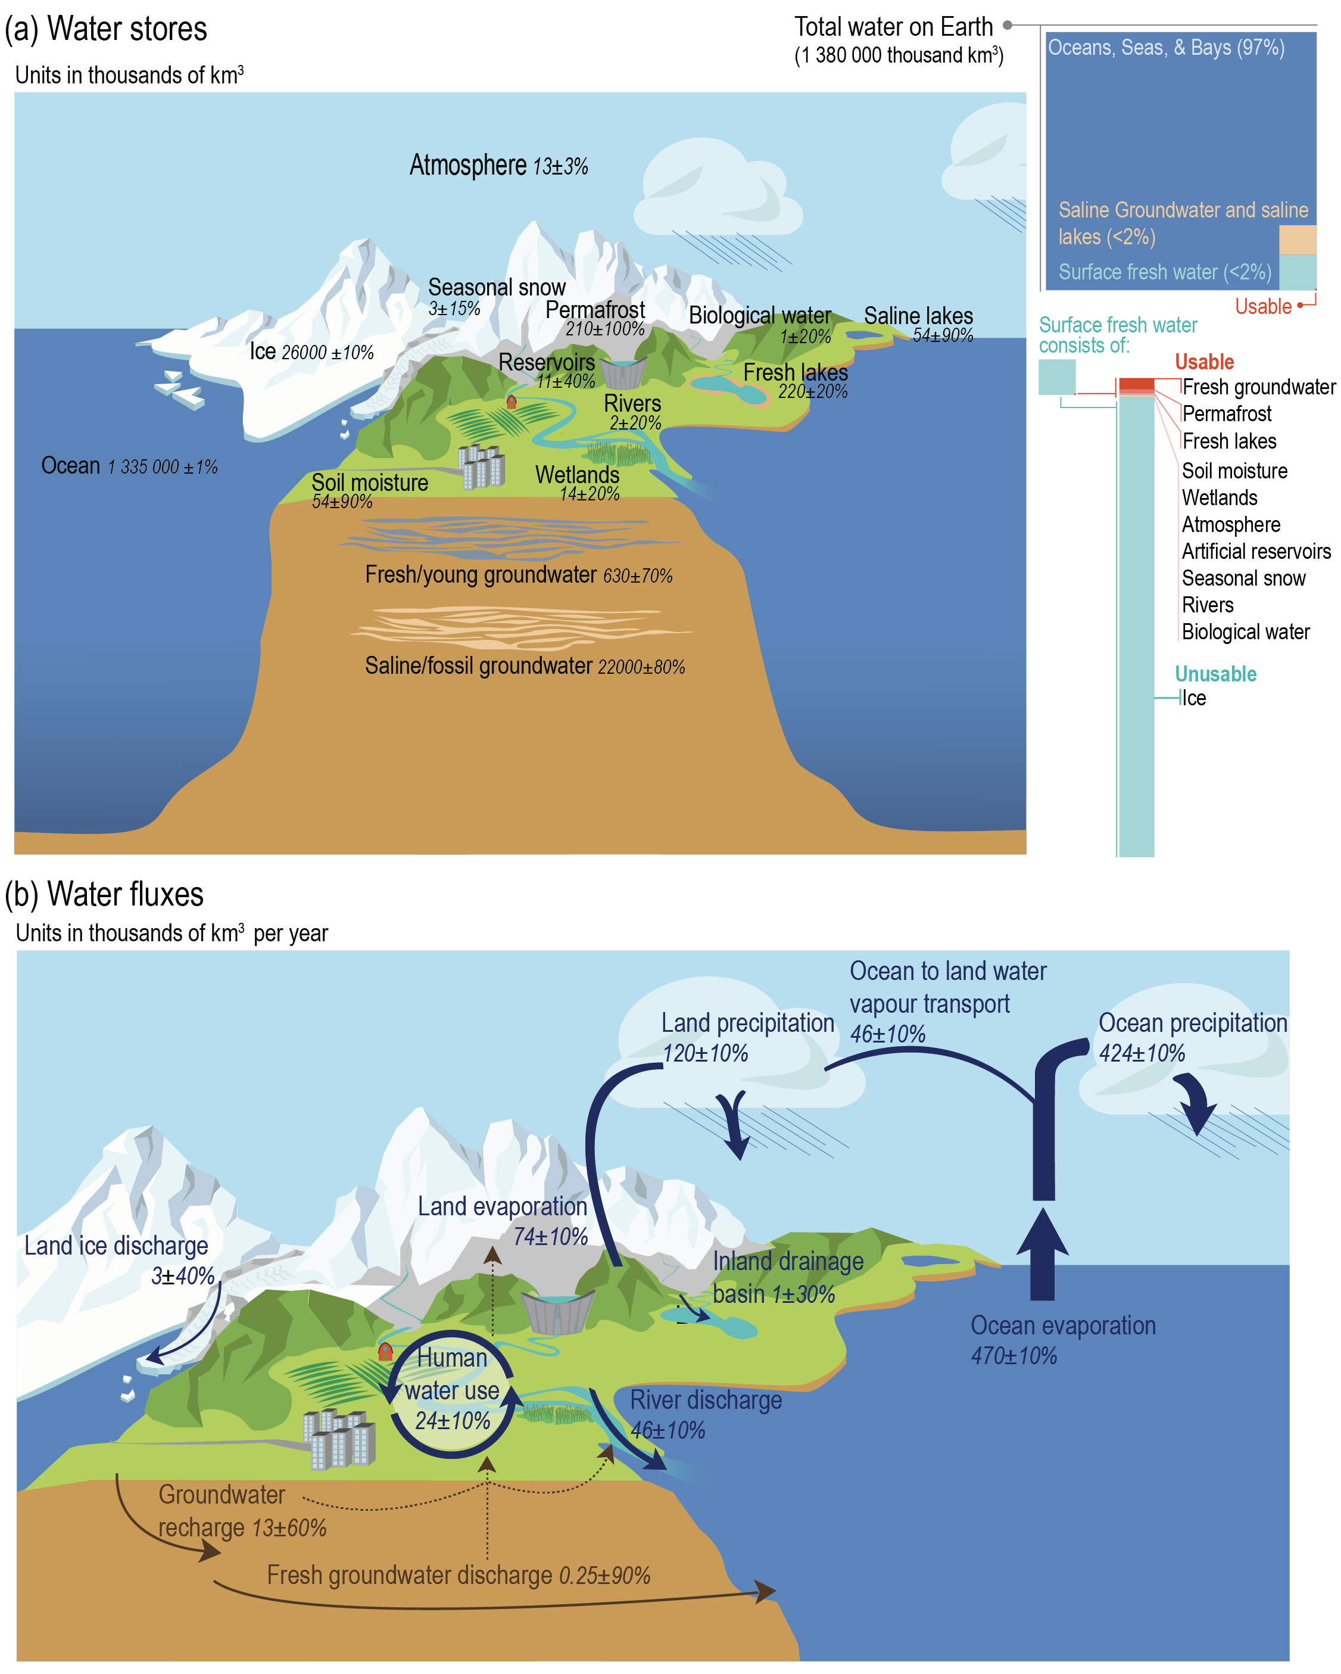
Water Stores in thousands of km³
Allan et al. (2020) NYAS
See also Abbott et al. (2018) Nature Geosci; Douville et al. (2021) IPCC, Ch 8 (Fig. 8.1a)

Slide 5
Water Fluxes in thousands of km³ per year
Douville et al. (2021) IPCC, Chapter 8 (Fig. 8.1a)
See Allan et al. (2020) NYAS; Abbott et al. (2018) Nature Geosci

Slide 6
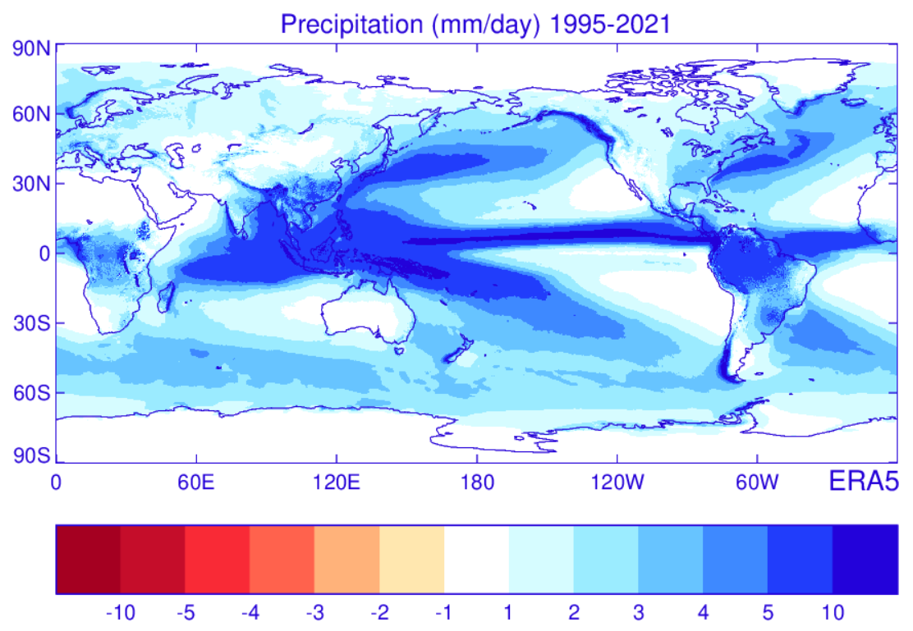
Precipitation = Surface Evaporation + Atmospheric Transport

Slide 7
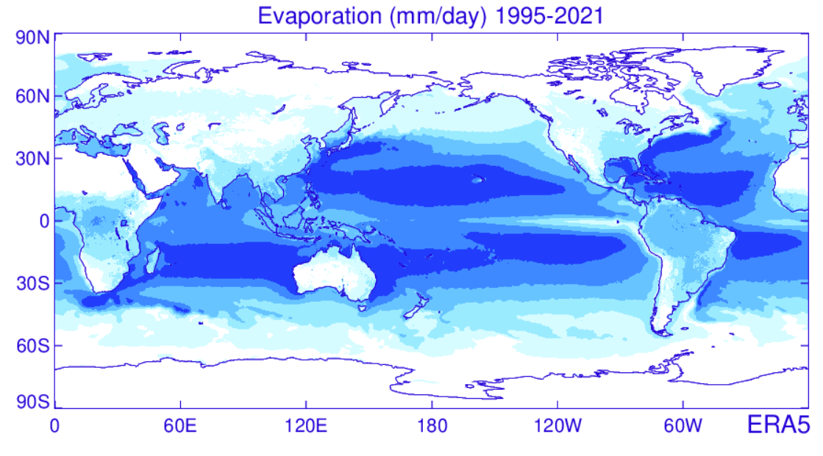
Precipitation = Surface Evaporation + Atmospheric Transport
1 mm/day
= 28.9 Wm⁻²
Notes:
CHECK CAN CONVERT 28.9 Wm-2 to 1mm/day (and also 561,000 km³/yr).
3 mm/day=0.003 m/day=1.1m/yr=3.47x10⁻⁸ m/s
Volume=1.1 m/yr x 5.1x1014 m² = 5.6x10¹⁴ m³/yr = 561,000 km³/yr.
Energy equivalent per m²=3.47x10⁻⁸ m/s x 2.5x10⁶ J/kg x 1000 kg/m³ = 86.7 J/s/m² = 86.7 Wm⁻²
Residence time of water vapour=25mm/3mm/day = 8 days.
Global atmospheric moisture store=25x10⁻³m x 5.1x10¹⁴ m² = 12.7x10¹² m³ = 12,750 km³ ~ 13 thousand cubic km or water.
What about snow? If 0.3 mm/day ~ 10% Lf=3.3x10⁶ J/kg. Psn=0.1*3.47x10⁻⁸ m/s x 3.3x10⁶ J/kg x 1000 kg/m³ )= 11.5 Wm-2
So 90%x86.7 +11.5 = 89.5 Wm-2
Note Stephens estimates about 4Wm-2 which would correspond with around 0.15 mm/day

Slide 8
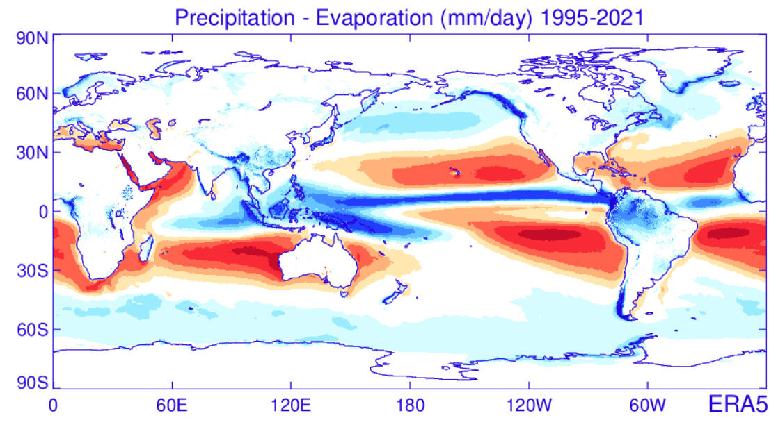
Precipitation = Surface Evaporation + Atmospheric Transport

Slide 9
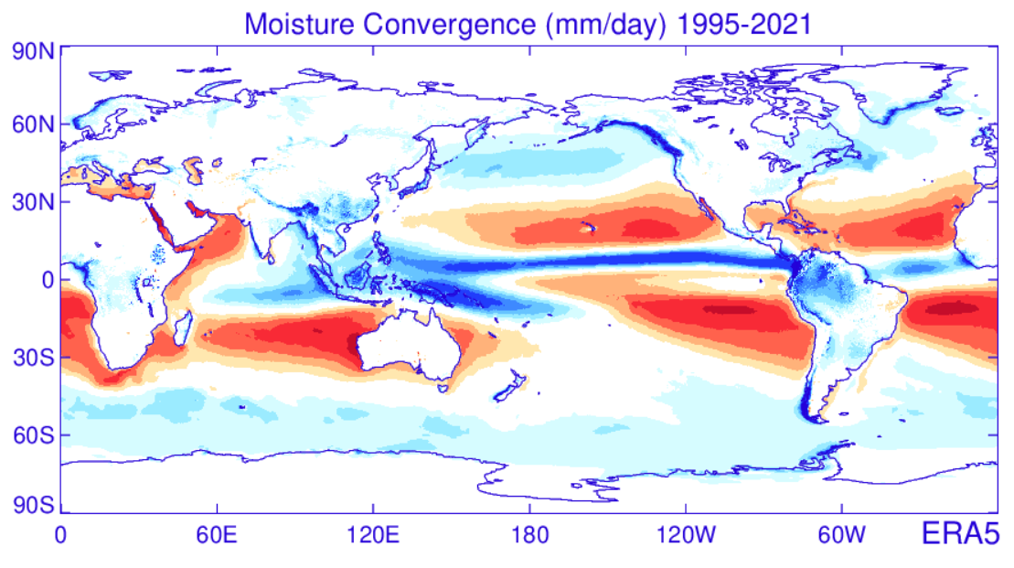
Precipitation = Surface Evaporation + Atmospheric Transport

Slide 10
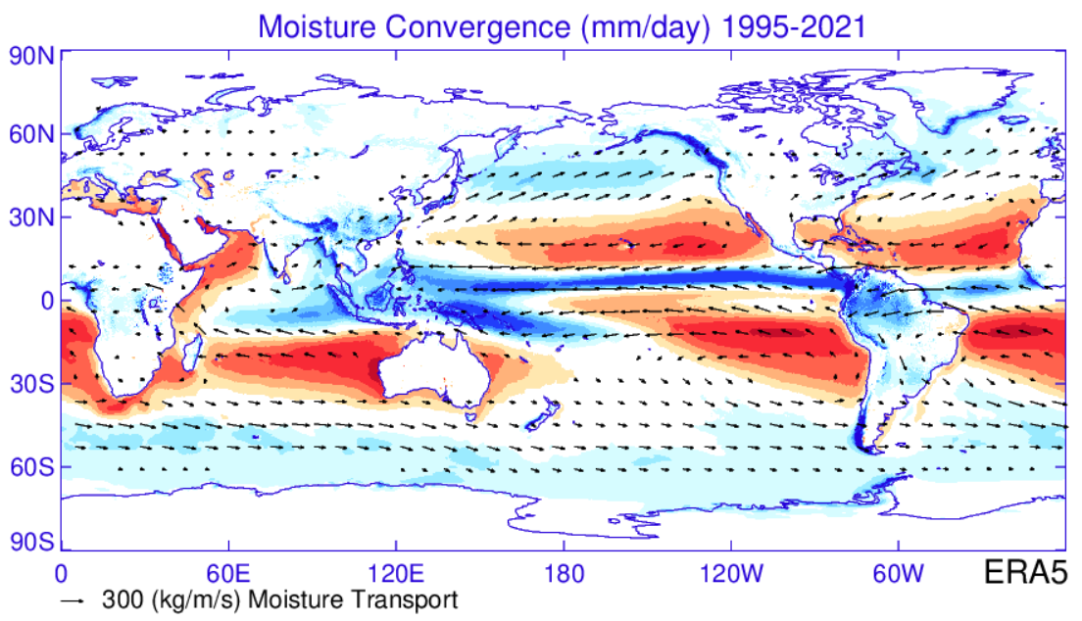
Mid-latitudes: transient eddies
Tropics: Hadley Cell
Tropics: mean meridional circulation provides major equatorward transport (Hadley Cell)

Slide 11
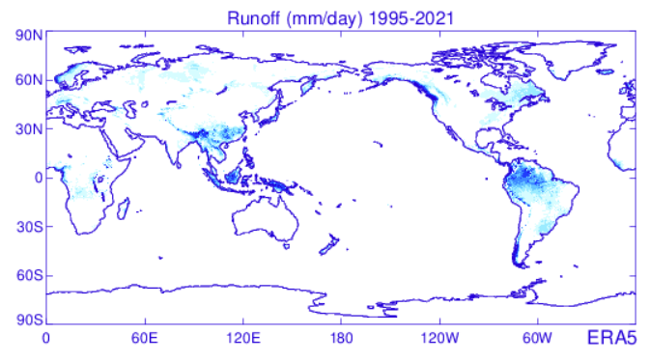
Runoff ~ Precipitation minus Evaporation

Slide 12
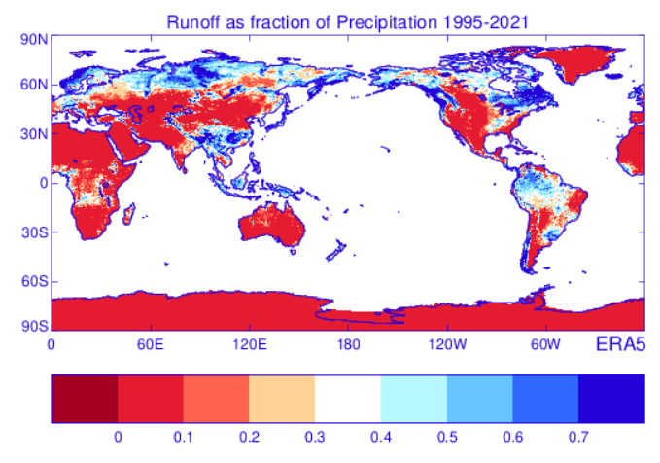
Runoff ~ Precipitation minus Evaporation

Slide 13
Units and conversions
Continuity of mass and energy: dS/dt = P(t) – E(t) – Q(t)
P = precipitation; E = evaporation; Q = runoff; dS/dt = change in storage (S) with time (t)
If global precipitation is 3 mm/day on average, what is the equivalent in km³/yr or in Wm⁻²?
  Assume latent heat of vapourization, L=2.5x10⁶ J/kg; density of water, ρ=1000 kg/m³; global surface area, A=5.1x10¹⁴ m².
  Show that 1 Wm⁻² latent heating is equivalent to about 29 x mm/day
  If global average total column water vapour is 25mm:
    What is the global moisture content in thousands of km³?
    Calculate the theoretical time for complete depletion by global precipitation (residence time) in days?
Notes:
3 mm.day → 1m/yr → 5x10^14 m3/yr → 500,000 km3/yr
3 mm/day=0.003 m/day=1.1m/yr=3.47x10⁻⁸ m/s
Volume=1.1 m/yr x 5.1x1014 m² = 5.6x10¹⁴ m³/yr = 561,000 km³/yr.
Energy equivalent per m²=3.47x10⁻⁸ m/s x 2.5x10⁶ J/kg x 1000 kg/m³ = 86.7 J/s/m² = 86.7 Wm⁻²
Residence time of water vapour=25mm/3mm/day = 8 days.
Global atmospheric moisture store=25x10⁻³m x 5.1x10¹⁴ m² = 12.7x10¹² m³ = 12,750 km³ ~ 13 thousand cubic km or water.
What about snow? If 0.3 mm/day ~ 10% Lf=3.3x10⁶ J/kg. Psn=0.1*3.47x10⁻⁸ m/s x 3.3x10⁶ J/kg x 1000 kg/m³ )= 11.5 Wm-2
So 90%x86.7 +11.5 = 89.5 Wm-2
Note Stephens estimates about 4Wm-2 which would correspond with around 0.15 mm/day

Slide 14
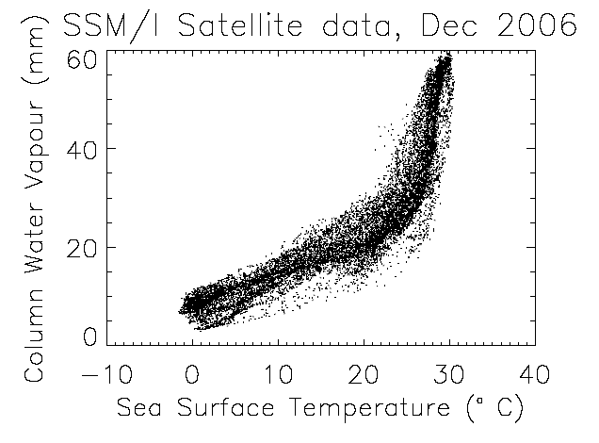
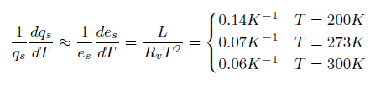
The role of water vapour
Physics: Clausius-Clapeyron
  Relates saturated water vapour pressure (e_{s}) to temperature (T)
  Fundamental control on the atmospheric hydrological cycle
Low-level saturation vapour pressure increases with atmospheric warming at about 6-7%/K
See Allan (2012) Surv. Geophys
Notes:
R _{v} is the gas constant for water vapour (461 J K⁻¹ kg⁻¹)
Most of the water in the air is invisible gaseous vapour. This water vapour produces a strong greenhouse effect and is also the fuel for precipitation. Simple physics dictates that the capacity for the atmosphere to carry water vapour rises rapidly with temperature. This causes a changes in climate to be larger (an amplifying or positive feedback) and also explains why we expect heavy rainfall events to become more intense as the planet warms.

Slide 15
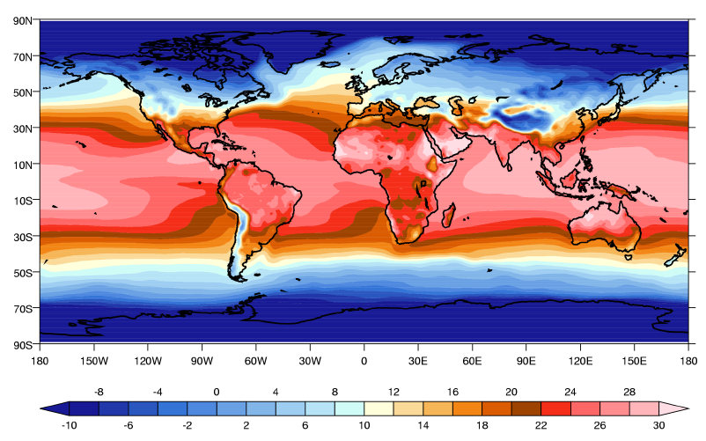
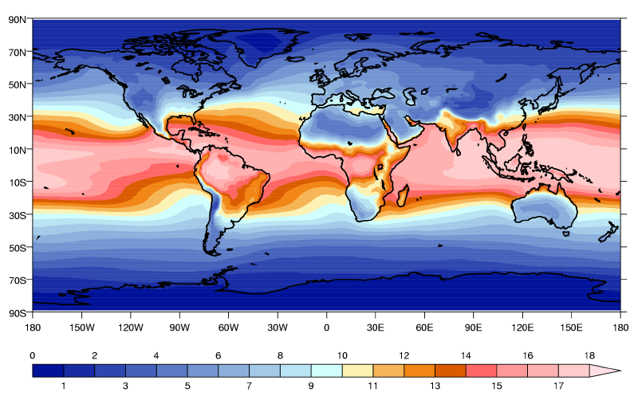
The role of water vapour
Over oceans (where water is freely available) surface humidity closely follows surface temperature
Over arid land*, surface humidity is strongly controlled by soil moisture availability.
Surface Temperature ⁰C
Near Surface specific humidity (g/kg)
*
*

Slide 16
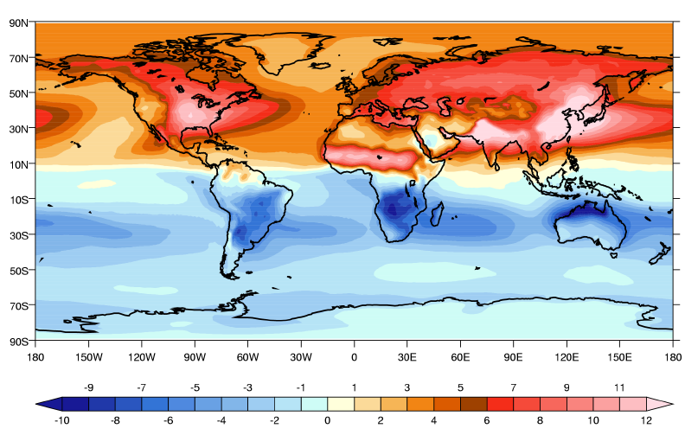
Seasonal variation in surface humidity
July minus January
Why are variations larger over land than ocean ?
Why are largest variations* over India/China and Sahel?
*
*
*

Slide 17
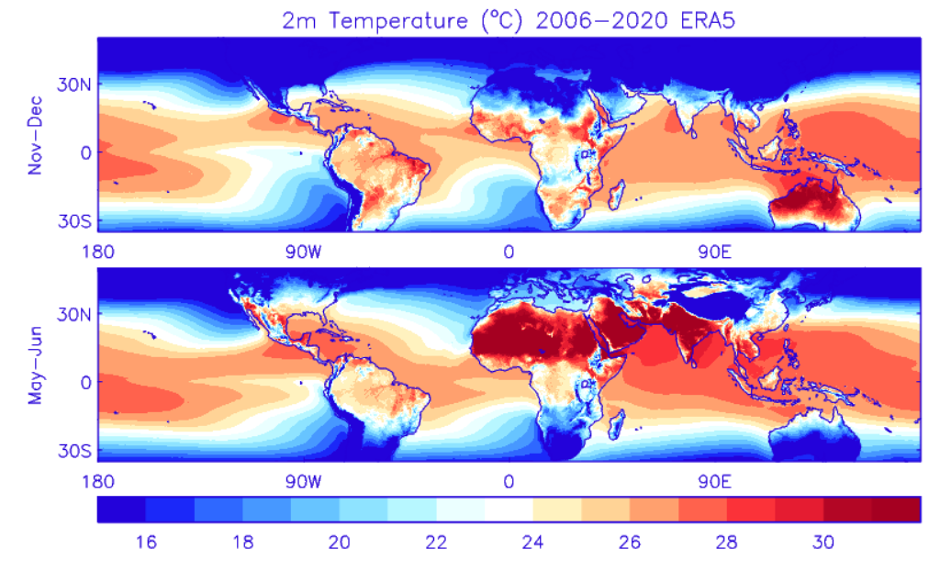
Monsoons: Land/Sea Temperature contrasts, 1979-2020: ERA5 T_{2m} (ºC)
Australian and Maritime Continent Monsoon
South Asian Monsoon
West African Monsoon
Note: other monsoons are available, see Douville et al. (2021) IPCC, Figure 8.11

Slide 18
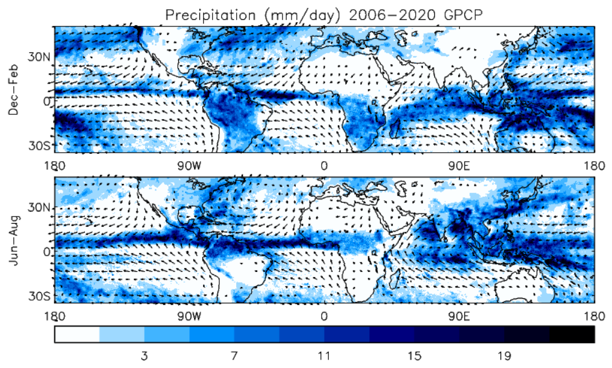
Monsoons: precipitation (mm/day) & 10m Winds, 2006-2020: ERA5
Australian and Maritime Continent Monsoon
South Asian Monsoon
West African Monsoon
‘Monsoon’ means ‘season’ and describes complete reversal of wind regimes during the seasonal cycle

Slide 19
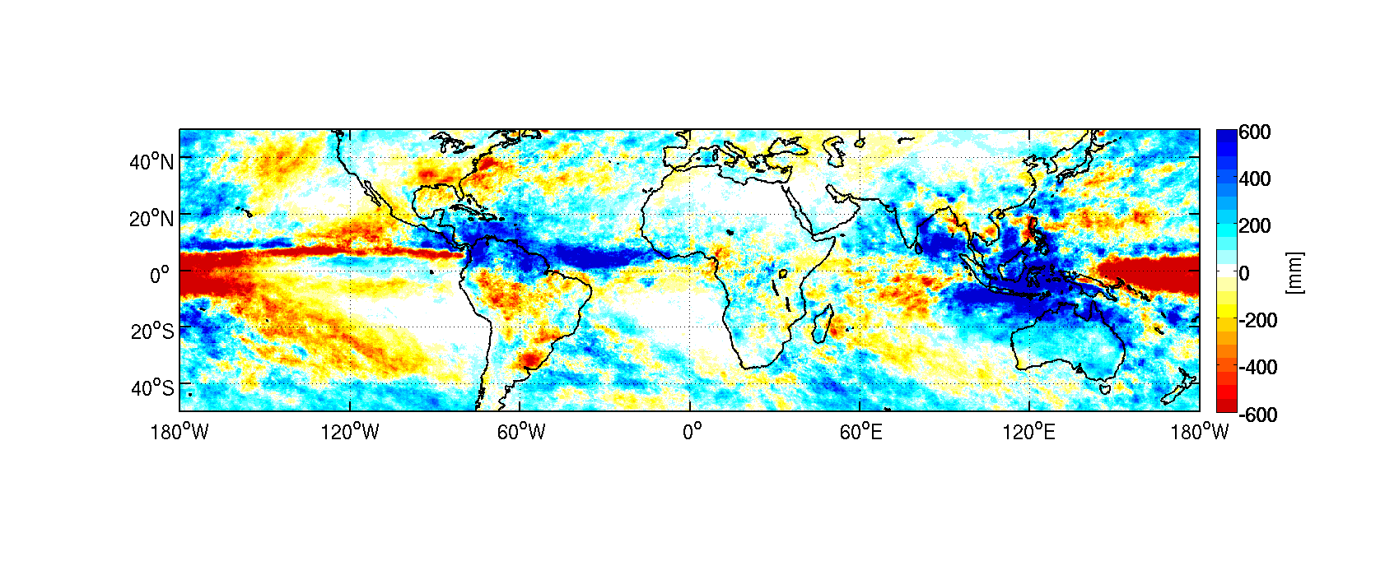
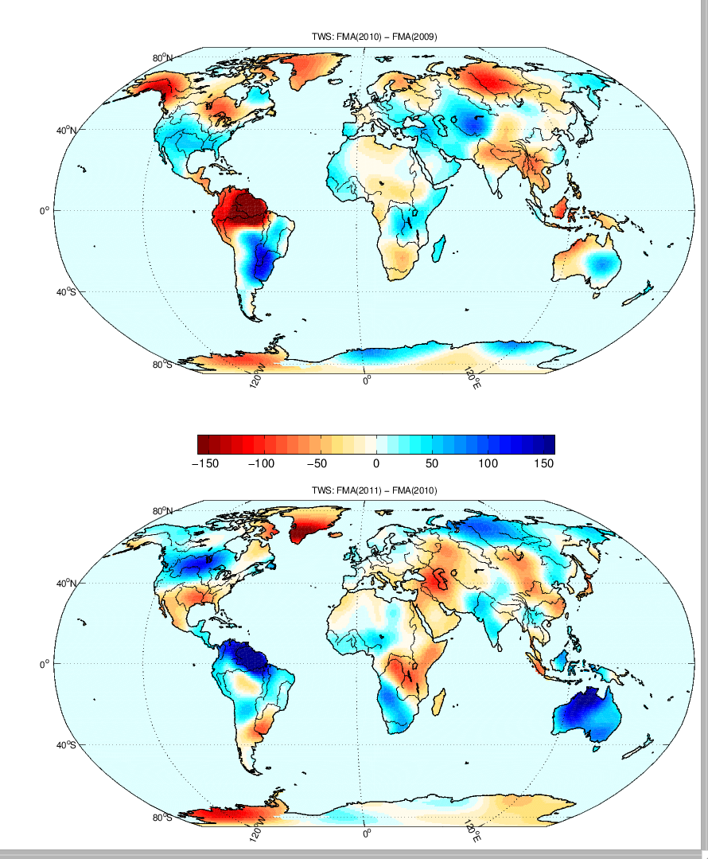
Year to year changes in water
March 2010 to
March 2011
TRMM Precipitation from March 2010 to March 2011 relative to the previous year
Extra Rain in 2011 compared to 2010
Boening et al., 2012 GRL
Extra Water
GRACE measured changes of mass in mm of water thickness MAM 2011 minus JFM 2010
For 2015/16 see also Rodell et al. (2024) Surv. Geophys
Notes:
GRACE measure changes in gravity from space, and most of its signals are caused by the movement of water on the surface of the planet. GRACE data was used to track the movement of water from the ocean onto the land. The biggest signals were in the northern parts of S. America and Australia. In fact, the amount of gained by these regions accounts for most of the water lost from the ocean. Extra rain in these regions caused the mass increases.

Slide 20
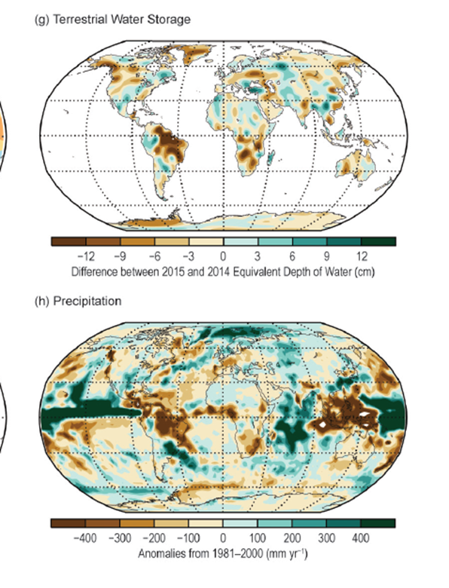
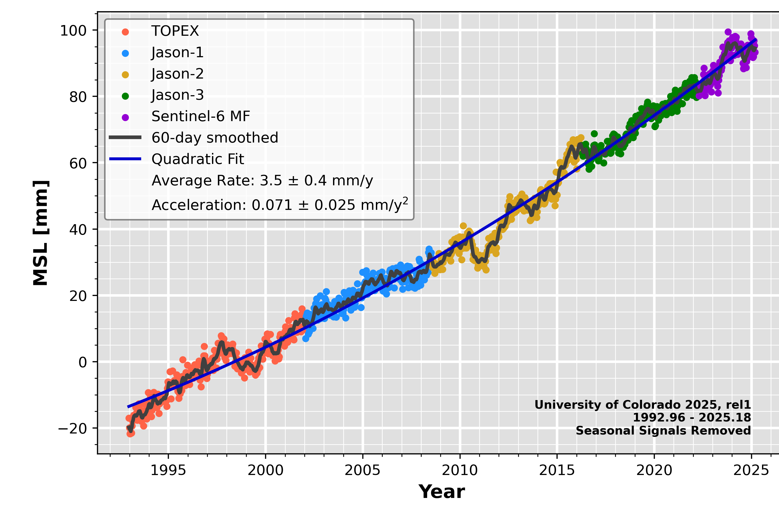
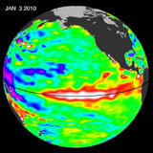
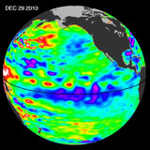
So much rain the sea dropped
Global Sea Level Drops 5 mm in 2010
El Nino ← La Nina
state of the climate 2015
El Nino → La Nina
Latest data: http://sealevel.colorado.edu/
See: Boening et al. (2012) GRL: The 2011 La Niña so strong, the oceans fell and Rodell et al. (2024) Surv. Geophys.
Notes:
Satellite altimeters detected a significant drop in global mean sea level, beginning in the spring of 2010 and falling by about half a centimeter by spring or summer of 2011. The drop corresponded to the fast transition from the 09/10 El Nino to the 10/11 La Nina. The La Nina was one of the strongest in recent decades. This drop happened despite the background rate of global mean sea level rise, which has been fairly steady at 3.2 mm/yr since the early 1990s. GRACE data showed that most of the drop was due to a decrease of the amount of water in the ocean

Slide 21
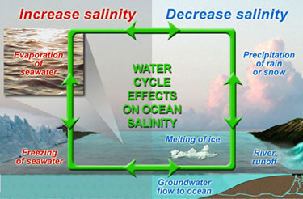
Ocean Water Cycle
Controls Surface Salinity and Temperature, hence water density.
Changes in water density drive ocean mixing and deep circulations

Slide 22
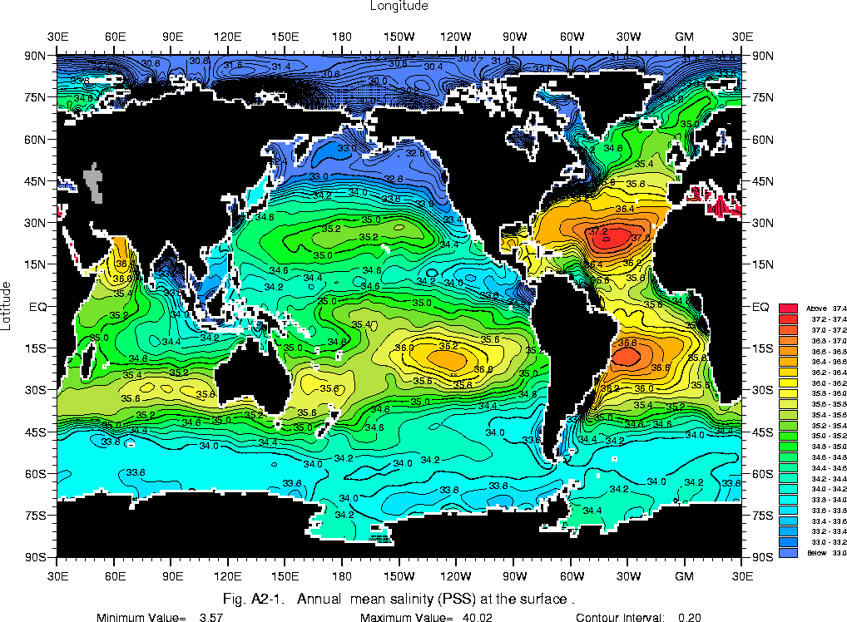
Annual Mean Sea Surface Salinity
Strongly reflects Precipitation minus Evaporation
Note much higher salinity in Atlantic
e.g. Craig et al. (2023) JGR
PSS = practical salinity scale
33-37g salt per kg or water

Slide 23
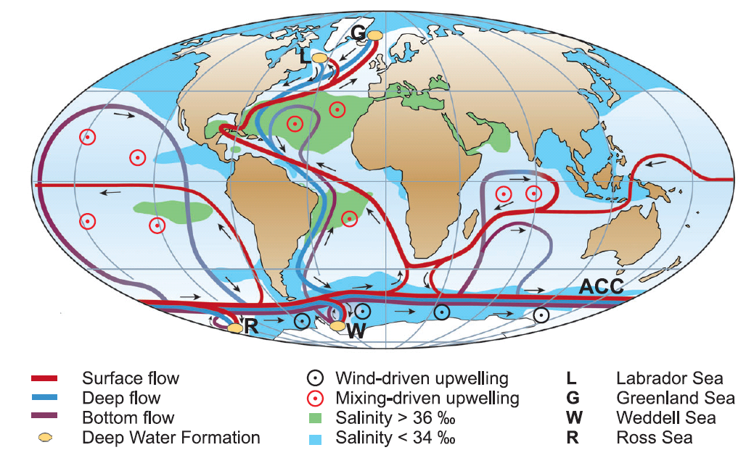
Global Thermohaline Circulation
From S. Rahmstorf: Thermohaline Ocean Circulation. In: Encyclopedia of QuaternarySciences, Edited by S. A. Elias. Elsevier, Amsterdam 2006 (see www.pik-potsdam.de/~stefan/thc_fact_sheet.html)

Slide 24
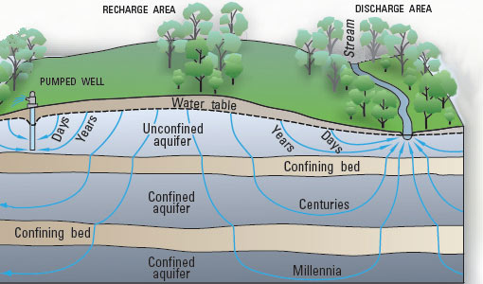
Terrestrial Water Cycle
Storage = P – E – R_{o}(Surface run-off) – R_{u}(Subterranean run-off)
Operates on a vast range of timescales and space scales
Terrestrial biosphere interacts with water cycle by:
Extracting water from soils
Returning water to the atmosphere through evapotranspiration
Water extraction is significantly altering the terrestrial water balance e.g. Abbott et al. (2018) Nature Geosci

Slide 25

Soil Moisture & Surface Energy Budget
Soil water availability strongly influences the surface energy budget by determining the partitioning between surface sensible (H) and latent (LE) heat fluxes.
Surface Energy Budget:
where T_{s} is surface temperature, S_{net} is net solar radiation, L_{net} is net longwave radiation and G is ground heat flux, C is heat capacity
Bowen Ratio (β) is widely used to describe the influence of soil moisture on surface fluxes and hence temperature:
$$β=\frac{H}{LE}$$

Slide 26
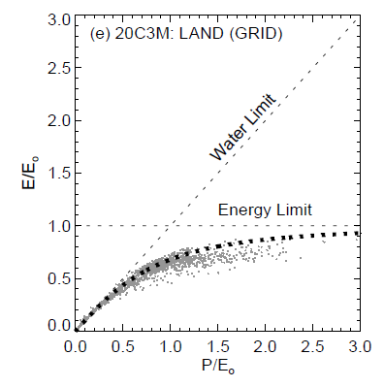
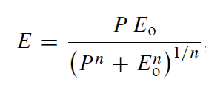
Constraints on evaporation
Energy & precipitation (P) constraints on evaporation (E)
Budyko Framework
E_{o} is maximum theoretical evaporation (E is energy limited)
E is also limited by water availability (determined by P)
n is a catchment-specific parameter
If P>>E_{o}, E→E_{o} (energy limited)
If E_{o}>>P, E→P (precipitation limited)
E_{o}>>P
P>>E_{o}
Roderick et al. (2014) HESS;
see also Lambert et al. (2025) Wires
Notes:
As P→big, E

Slide 27
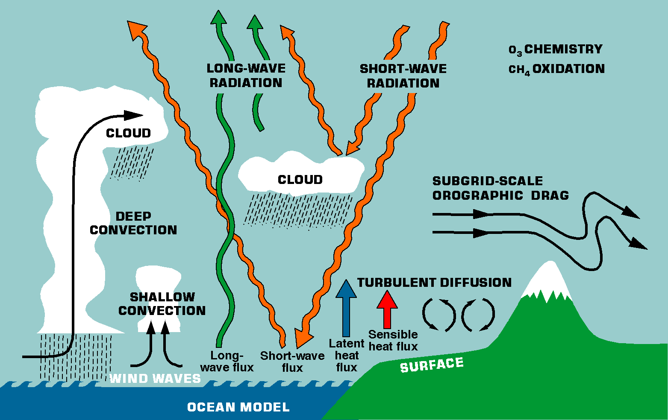
Representing Water Cycle in Models
Phase changes of water (evaporation, condensation, freezing and sublimation) all operate at the sub-gridscale and hence need to be parametrized.

Slide 28

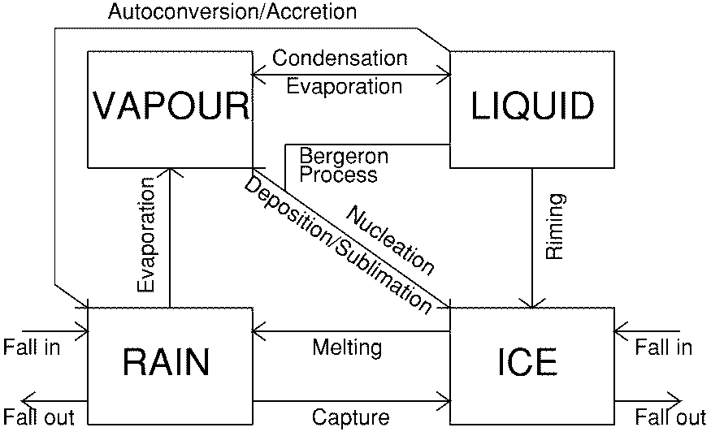
Cloud and Precipitation Processes
We need to include in models:
  Formation of clouds
  Release of precipitation
  Evaporation of both clouds and precipitation
Therefore we need to describe:
  change of phase from water vapour to water droplets and ice crystals
  transformation of small cloud droplets/ice crystals to larger rain drops/ice particles
  advection and sedimentation/falling of these species
  evaporation/sublimation of cloud and precipitation size particles
See lectures on Convection & Parametrizations (Bob Plant) and Aerosol, Clouds & Radiation (James Weber)

Slide 29
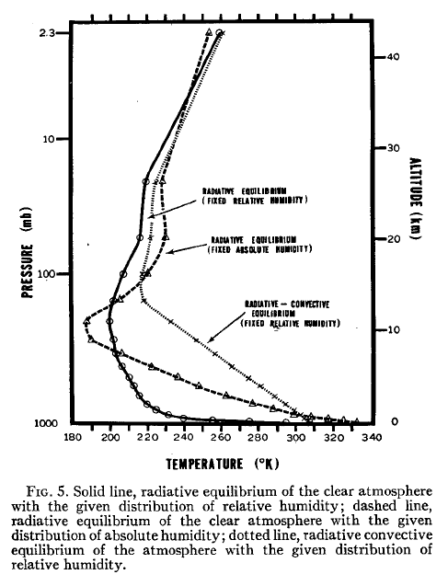
Radiative-convective equilibrium
If we assume that only radiative processes are operating, the equilibrium surface temperature is very high, tropospheric temperatures very low and the profile is strongly superadiabatic*.
In reality, convection removes heat from the surface, warms the atmosphere and adjusts the lapse-rate towards that observed#.
From the classic paper by Manabe and Wetherald, JAS, 1967 →
#
*

Slide 30
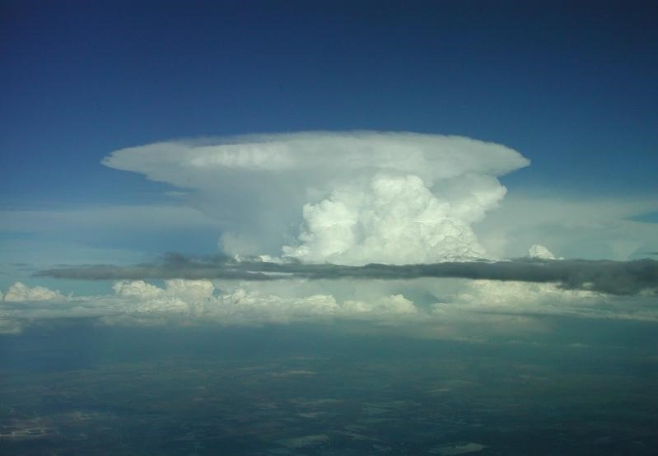
convection
Convection transports heat, water vapour, momentum … and chemical constituents… upwards. Water vapour then condenses and falls out → net convective heating/drying
Deep Convection (precipitating convection) stabilizes the environment; shallow convection redistributes the surface fluxes
Tropical atmosphere in radiative(cooling)/convective(heating) equilibrium: 2K/day cooling in lowest 15 km corresponds to about 5 mm/day precipitation (c_{p}=1000 J/kg/K, lowest 15km ~200-1000 hPa).
For lower resolution models (e.g. >4km) convective parametrization is necessary to calculate collective effects of ensemble of convective clouds in a model column as a function of grid-scale variables.
Hence parameterization needs to describe Condensation/ Evaporation and Transport of T, q and (often) momentum
→ Physics-guided machine learning
See lecture by Bob Plant
From Bechtold, ECMWF Training Course
Notes:
Rossby radius of deformation is the length scale at which rotational effects become as important as buoyancy or gravity wave effects in the evolution of the flow about some disturbance
In mid-latitudes, coriolis effect will constrain perturbation to certain space scale. In tropics where f is weak, this space scale is large and spread out globally via gravity waves.
2K/day, Cp=1000 J/kg/K →
Mass of troposphere/m^2 ~ 100000 Pa / 10 m/s^2 = 10,000 kgm-2
Mass of lowest 15km (200-1000 hPa) ~ 80000 Pa / 10 m/s^2 = 8,000 kg/m^2
Energy lost= 2 K/day x 1000 J/kg/K x 8,000 kgm-2 = 1.6x10^7 J/day/m2
L=2.5x10^6 J/kg so need 1.6x10^7 / 2.5x10^6 = 6.4 kg/m2/day of precipitation = 6.4 mm/day
If lowest 15km is about 80% mass of atmosphere

Slide 31
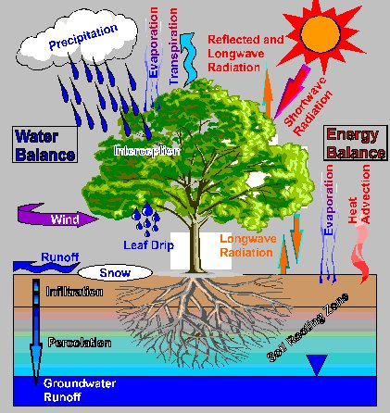
Representing Surface processes
Surface schemes are needed to:
1. Calculate the fluxes of heat, moisture and momentum between the surface and atmosphere
2. Calculate surface temperature and other variables
Over the oceans, the schemes are quite simple
Over land, models now contain quite detailed representations of evaporation, interception and vertical transfers of heat and moisture in the soil

Slide 33
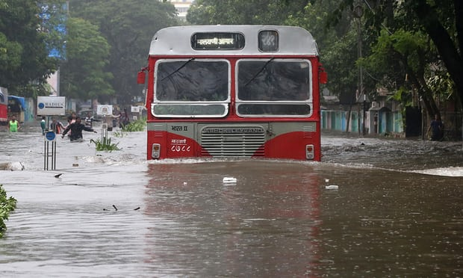
PART II: THE Water Cycle
AND climate change
Intensification of the hydrological cycle has implications for the incidence of wet and dry extreme events.
Regional changes in mean precipitation patterns with atmospheric circulation changes have implications for flooding and drought.
Changes in the partitioning between fresh and salty water (e.g. melting ice-caps, river water extraction, intensified hydrological cycle from global warming) could have major consequences for the Earth System.
Impacts of climate variability and change on natural ecosystems directly involve precipitation.
The impacts of climate variability and change on the quality of human life occur primarily through changes in the water cycle.
Water availability and water quality are fundamental issues for the 21st century.

Slide 34
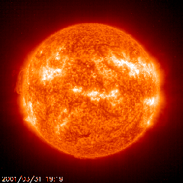
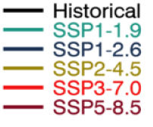
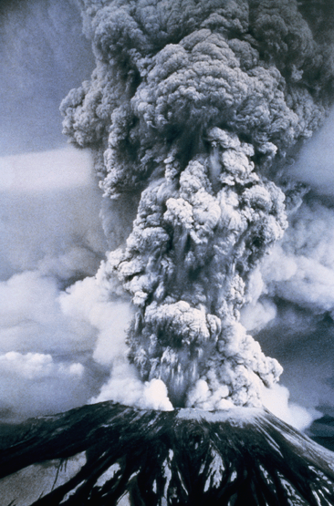
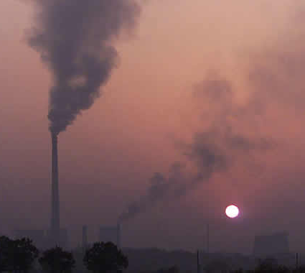
How will THE WATER CYCLE respond to climate change?
SSP5-8.5
SSP3-7.0
SSP2-4.5
SSP1-2.6
SSP1-1.9
IPCC (2021) Chapter 4 (Figure 4.2b)
Near term
Mid term
Long term
Notes:
We know that the total global precipitation (including rain, hail and snow) will increase as the planet warms. The amount of warming and consequent increases in precipitation depend mostly on future emissions of greenhouse gases. The forcing factors that are currently heating (and cooling) the planet influence the details of how precipitation are currently changing.

Slide 35
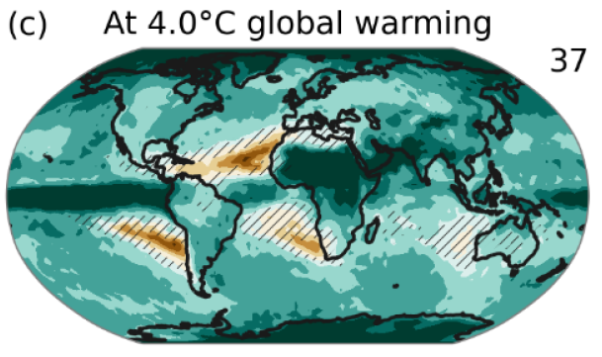

water cycle CHANGES AT 4ºC warming
Precipitation intensity (Rx1day)
Increases in global precipitation
More Intense rainfall, more severe droughts
Wet events wetter, dry events drier
Increased variation (day to day; year to year)
Circulation changes & regional projections?
% change
Total Column Soil Moisture
Mean Precipitation
IPCC WG1 (2021) Ch 11 and SPM
Notes:
Although we know global precipitation will increase with warming, more local changes are less coherent (bottom right). The moist tropics and higher latitude regions will indeed experience increased rainfall but many subtropical regions will experience diminishing precipitation and reduced soil moisture content (bottom right). Despite this mixed signal for annual and seasonal average precipitation, most land regions will experience an intensification of the heaviest rainfall events (top right).
PRECIPITATION: [Tech Summ Fig. 2]
RCP8.5 ANN: Multi-model CMIP5 average mm/day change.
Hatching: multi-model mean change is small (<1SD of internal variability)
Stippling: multi-model mean change is big (>2SD of internal variability and 90% of models agree on sign)
P INTENSITY:
Percent change in annual maximum 5-day precipitation 2081-2100 relative to 1981-2000 for RCP8.5 CMIP5 ensemble.
Fig. 12.26, Chapter 12.
Stippling → significant change
SOIL MOISTURE: [Tech Summ, Fig. 2]
RCP8.5 ANN change in %, Upper 10cm
Hatching: multi-model mean change is small (<1SD of internal variability)
Stippling: multi-model mean change is big (>2SD of internal variability and 90% of models agree on sign)

Slide 36
Earth’s Energy Budget & the Global Water Cycle
IPCC WG1 (2021) Fig. 7.2a (also: Trenberth et al. (2009) BAMS; Wild (2020) Clim. Dyn.)

Slide 37
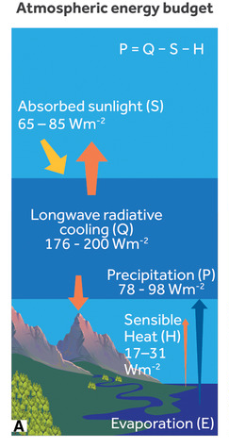
Radiative energy budget of the atmosphere and hydrological response
Latent heat flux is a component of the surface and atmospheric energy budget
There is an approximate balance between latent heating LP (precipitation) and net radiative cooling (Q)
Stronger atmospheric radiative cooling is primarily balanced by increased precipitation
Increased greenhouse gases (and absorbing aerosol) initially reduce Q (rapid P reduction)
Global atmospheric warming increases Q and therefore P
Overall global response ~ dP/dT=1-3 %/ºC
Allan et al. (2020) NYAS →
Also O’Gorman et al. (2012) Surv. Geophys; Manabe & Wetherald (1975) JAS

Slide 38
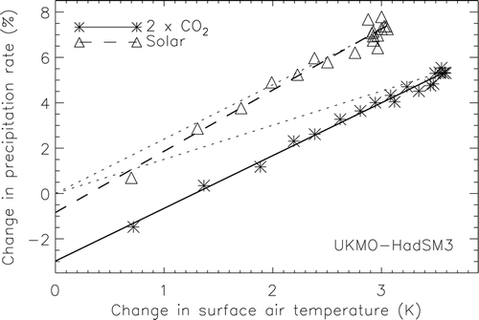
Earth’s Energy budget & global precipitation response
Global evaporation and precipitation increase with warming due to stronger radiative cooling of a warmer atmosphere but this is partly offset by direct atmospheric heating from increasing greenhouse gases and absorbing aerosols
k=2.5%/K
Andrews et al. (2009) J Climate
LΔP ≈ kΔT – f_{F}ΔF
Further reading: Allen and Ingram (2002) Nature ; O’Gorman et al. (2012) Surv. Geophys ; Allan et al. (2020) NYAS

Slide 39
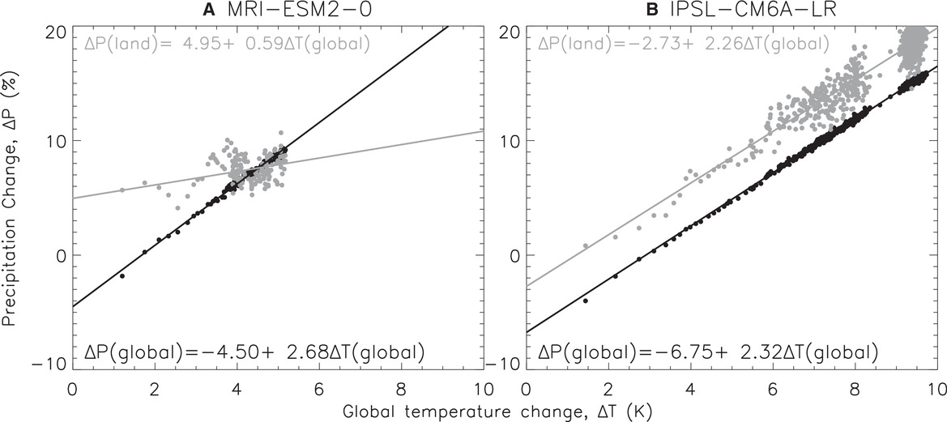
Fast & slow global precipitation
responses to INSTANTANEOUS 4xCO₂
Allan et al. (2020) NYAS
Global: rapid decline, consistent slow increase with warming (2-3%/ºC)
Land: model-dependent rapid response & suppressed increase with warming
See also: Allen and Ingram (2002) Nature ; O’Gorman et al. (2012) Surv. Geophys ; Pendergrass & Hartmann (2012) GRL; IPCC WGI (2021) Section 8.2
39

Slide 40
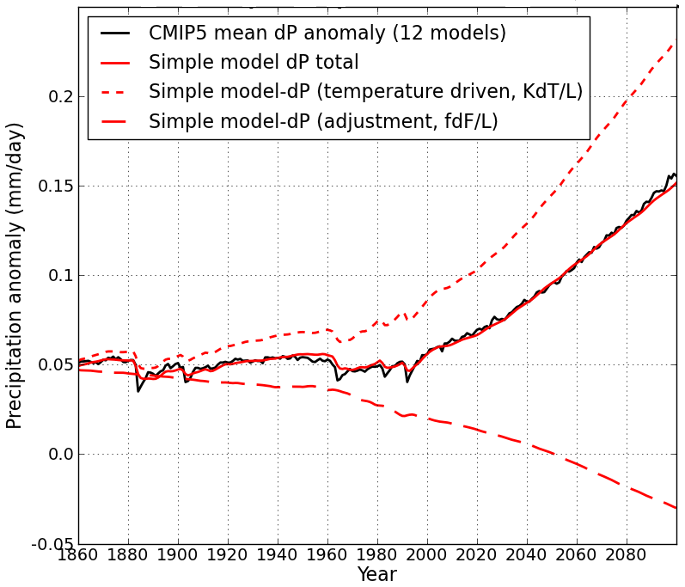
Simple model to understand global precipitation responses
Using simple model:
LΔP = kΔT – f_{F}ΔF
Precipitation change (mm/day)
N=ΔF – YΔT
CMIP5 historical/RCP8.5
ΔT
D
Z. Mousavi PhD thesis
After Allan et al. (2014) Surv. Geophys and Thorpe and Andrews (2014) ERL
Notes:
40
There is huge uncertainty in global precipitation projections, relating both to climate sensitivity and mitigation pathways.
In PAGODA we are understanding the precipitation changes at the largest scales relating both to the warming (in response to radiative forcings) and and also the direct effect of the radiative forcings themselves on precipitation.

Slide 41
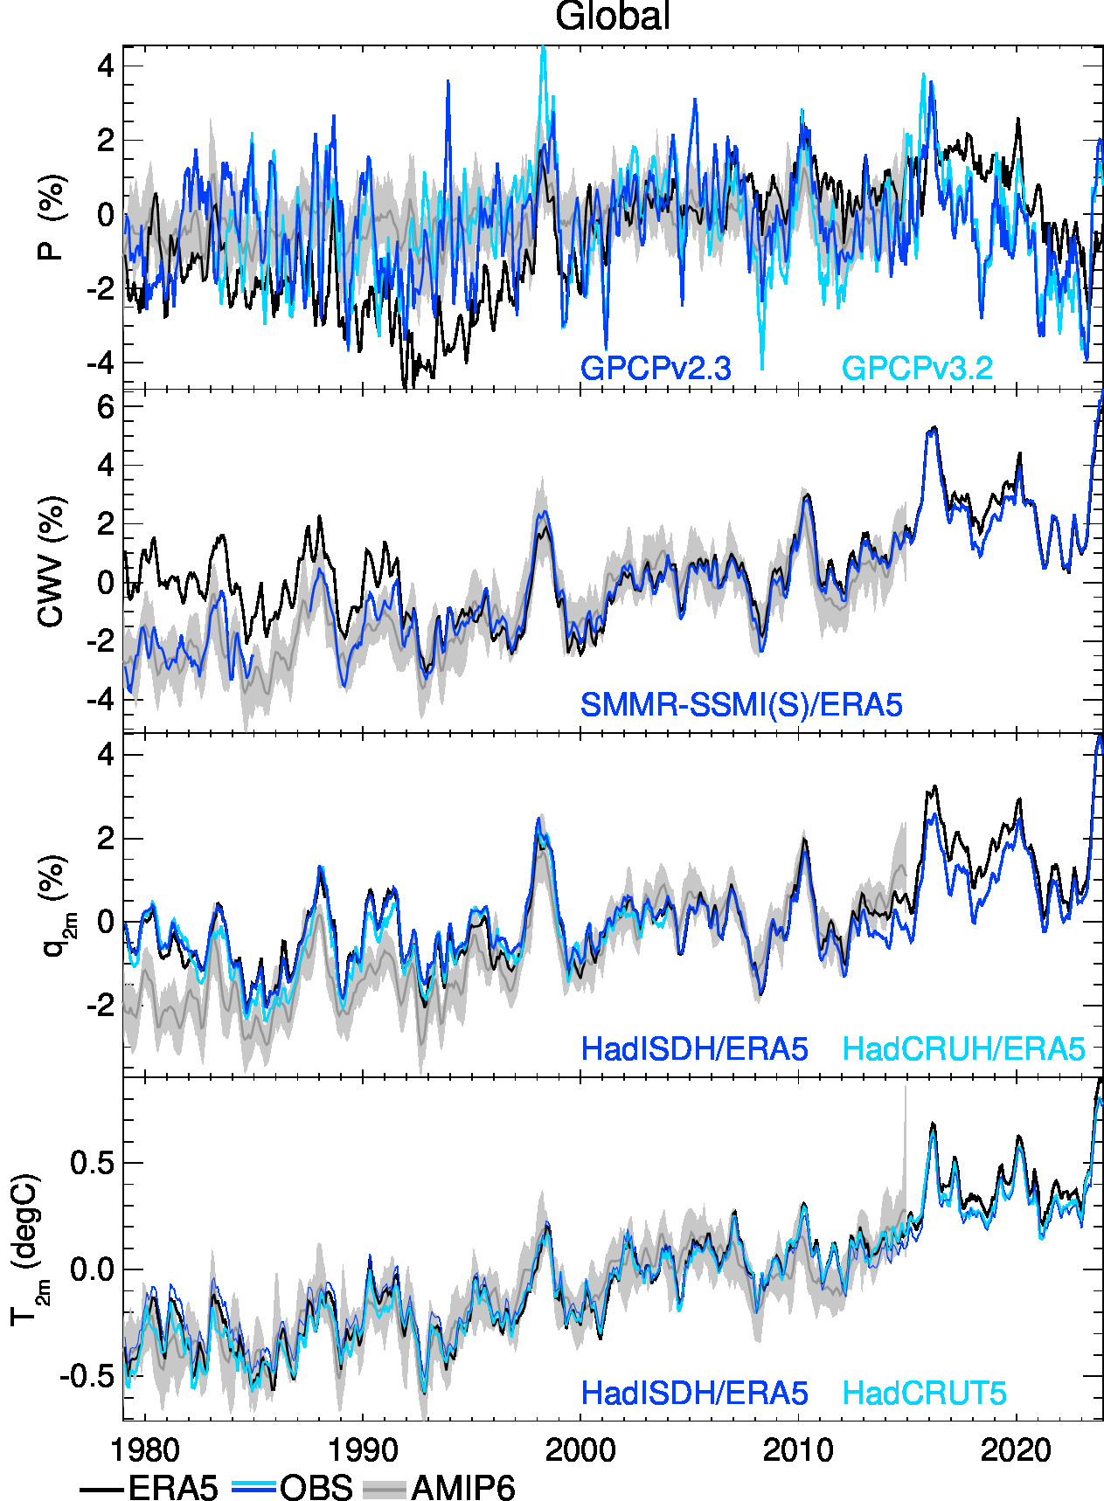
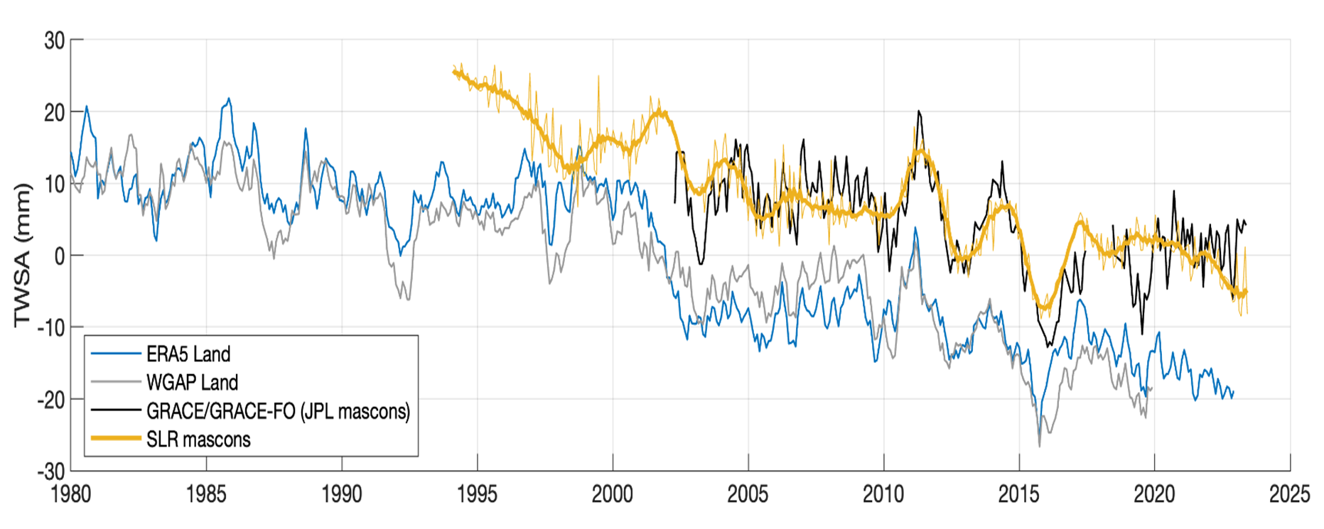
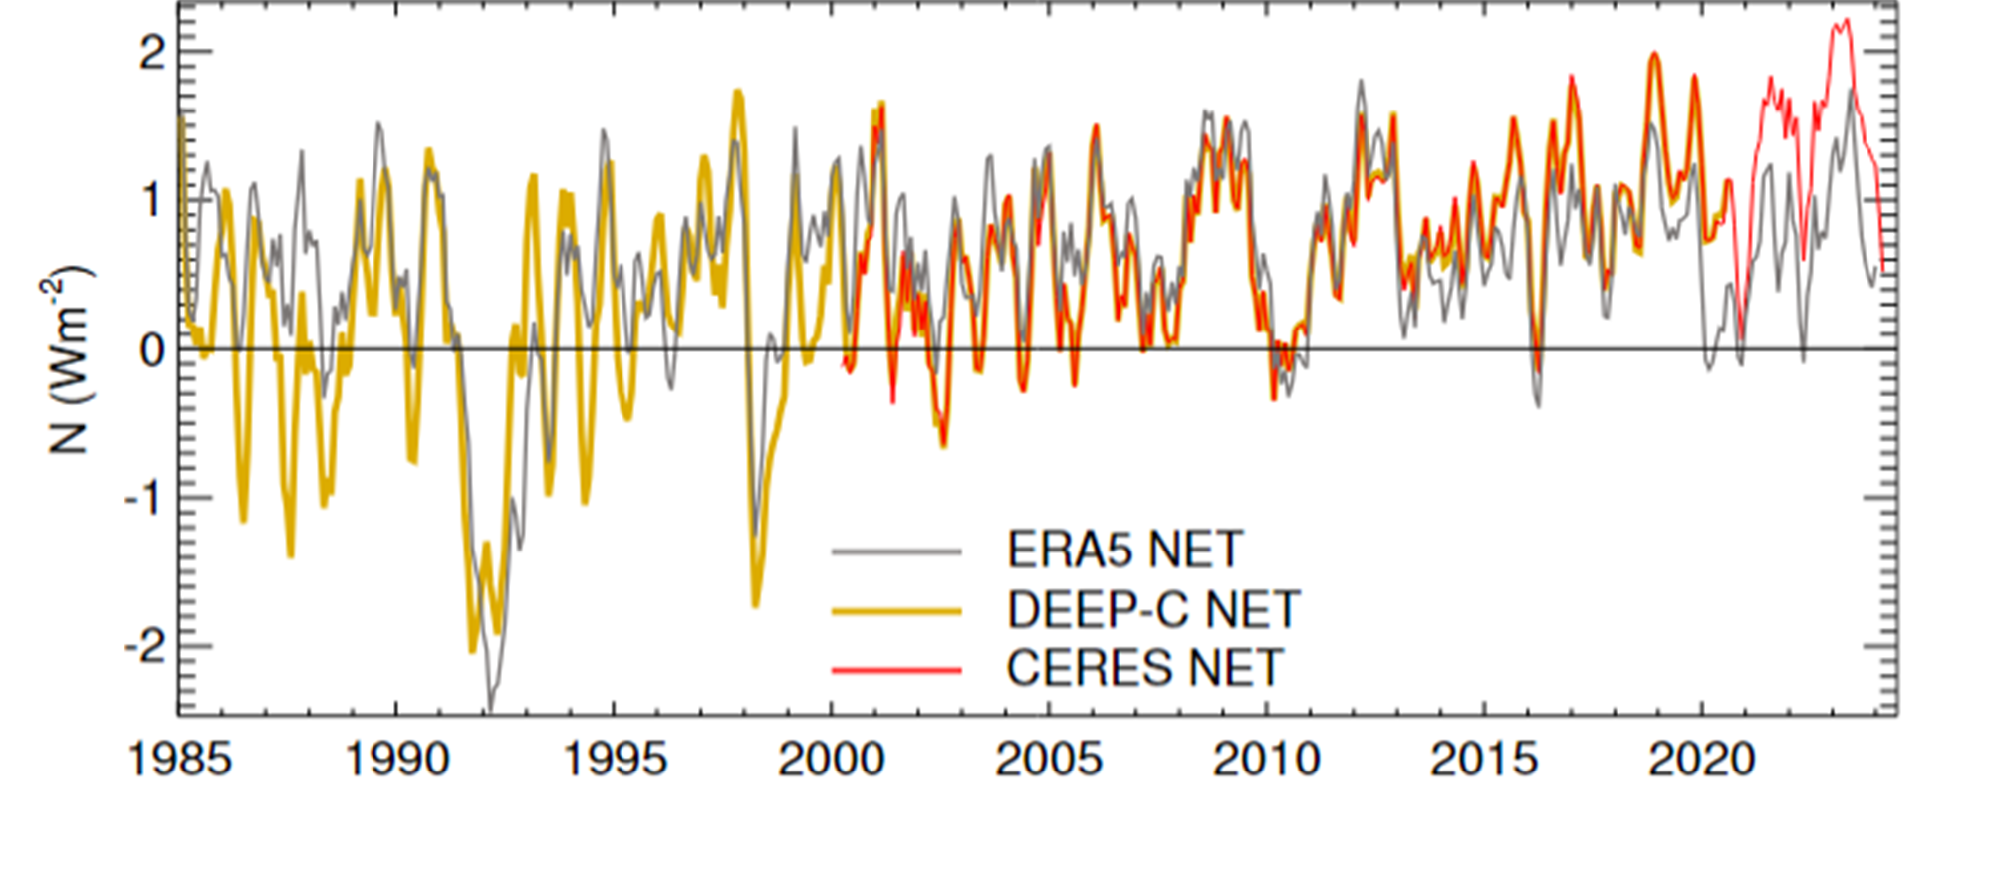
Monitoring water cycle changes
Temperature Moisture Precipitation
Terrestrial Water Storage
Earth Energy
Imbalance
Allan et al. (2022) JGR ; Allan et al. (2020) NYAS; (see CLIVAR note); Allan & Merchant (2025) ERL; Rodell et al. 2024 Surv. Geophys.

Slide 42
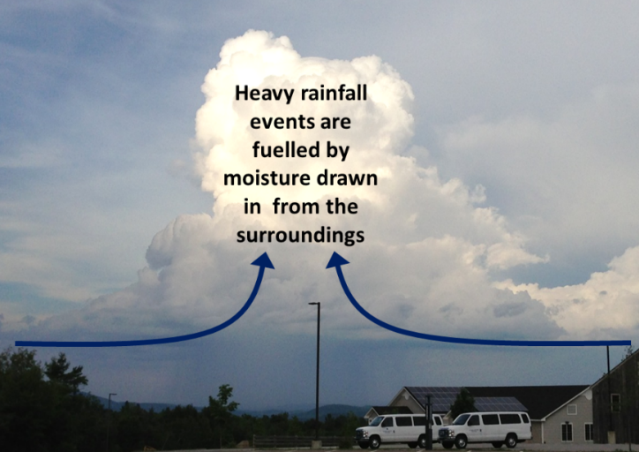

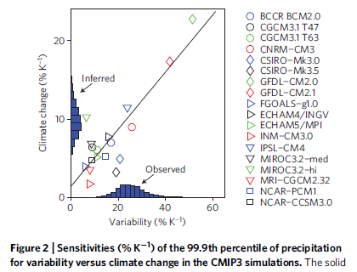
Precipitation ExtremeS
Moisture convergence fuels large-scale rainfall events
e.g. Trenberth et al. (2003) BAMS
Intensification of rainfall with warming ~Clausius Clapeyron 7%/K?
e.g. Allan & Soden (2008) Science
Amplifying latent heat feedbacks?
e.g. Berg et al. (2013) Nature Geo
Time/space scale important
Observational constraints? →
e.g. O’Gorman (2012) Nature Geosci
Stronger increase for short duration rainfall?
e.g. Fowler et al. (2021) Nature Rev

Slide 43
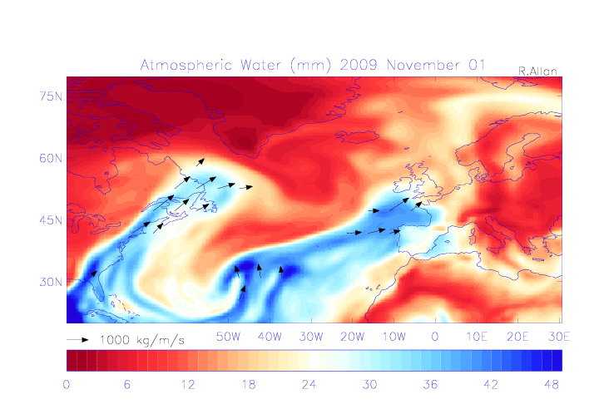
Water vapour & mid-latitude flooding
Strong, sustained moisture transport linked with mid-latitude flooding (e.g. Lavers et al. 2011 GRL)
Intensification of moisture flux with warming implies more severe flooding events (e.g. Lavers et al. (2013) ERL)
Models can represent large-scale fronts, but not sub-grid-scale extremes

Slide 44

Changes in heavy precipitation AND flood hazard
Allan et al. (2020) NYAS; Fowler et al. (2021) Nature Rev

Slide 45
Contrasting regional precipitation responses
Basic physics dictates that precipitation changes won’t be uniform in space.
If increases in heavy rain 7%/K but global changes 3%/K, some regions must have less frequent or less intense precipitation
Some regions will experience increases and others decreases
Regional changes dominated by thermodynamics and shifts in large-scale circulation
e.g. Allen and Ingram (2002) Nature; Allan (2011) Nature

Slide 46





Moisture budget & Precipitation − Evaporation
$$\frac{∂S}{dt}\sim 0$$
Moisture flux (F) is mass weighted integral of moisture times wind:
F = $−\frac{1}{g}\int_{ps}^{0}{q}u dp$ (kg/m/s)
F increases with q at Clausius Clapeyron rate (~7%/ºC for low altitudes) if wind (u) is unchanged:
$$−∇. F$$
E P
$$\frac{\text{Δ}F}{F}\sim \frac{\text{Δ}qs}{qs}\sim \frac{\text{Δ}es}{es}\sim \text{0.07}\text{Δ}\text{T}\text{, } \text{Δ}\text{F} \sim \text{0.07}\text{Δ}\text{T}\text{.}\text{F}$$
Precipitation $−$ Evaporation = moisture convergence ($−$ storage, S)
$\text{Δ}\left(P−E\right)\text{ = }\text{Δ}\left(−∇.F\right) \sim −∇.\text{Δ}F=−∇.\text{(0.07}\text{Δ}\text{T}\text{.}\text{F}\text{)}$
$\text{Δ}\left(P−E\right) \sim 0.07\text{Δ}T\text{(}−∇.F) \sim 0.07\text{Δ}T(P−E)$
P – E scales with temperature at the Clausius Clapeyron rate (but see Byrne & O'Gorman 2015)
$$\text{P}\text{ − }\text{E} \text{\sim }−∇. F$$
assume P − E meridional structure more than δT

Slide 47

Thermodynamic driver of regional water cycle change
Δ(P-E) ~ 0.07(P-E) ΔT
Enhanced moisture transport leads to amplification of patterns in:
(1) P–E Held & Soden (2006) J Climate →
(2) ocean salinity (fresh gets fresher, salty gets saltier) Durack et al. (2012) Science
ΔP ~ 0.07(P-E) ΔT + 0.02E
See also Mitchell et al. (1987) QJRMS

Slide 48

Wet wetter, dry drier?
Ocean: amplification of existing P-E pattern
Wet wetter, dry drier (or salty saltier)
Captured by Held & Soden (2006) scaling
Land: P-E is positive (or rivers would run backwards!)
P-E should get more positive with warming?
But there are additional drying factors…
See IPCC Chapter 8, Douville et al. (2021) Section 8.2.2.1/Figure 8.5
P−E ΔP − E

Slide 49

Changes in "aridity "
‘…the “emerald city” of Seattle… receives ~ 950 mm/yr of precipitation on average. Yet the environment of Dallas, Texas, which also averages ~ 950 mm/yr of precipitation seems much drier….’ [Scheff & Frierson 2015 J. Clim]
“Dryness” also determined by potential for evaporation that is limited by energy
Assume potential evaporation, ΔE_{P} ~ Δ(R_{n}/L)
…though also depends on lateral transports of water Miguez-Macho & Fan (2025) Nature
~ Δ(P- E_{P} )
~ Δ E_{P}
Greve & Seneviratne (2015) GRL

Slide 50



Aridity Change: Amplification of wet/dry seasons?
Aridity index: $P−Eo \sim P−Rn/λ$
(E_{o} is potential evaporation, R_{n} is net radiation, λ is latent heat of vapourization). Top right: $Δ(P−Rn/λ$)
Greve & Seneviratne (2015) GRL
See also: Roderick et al. (2014) HESS
Trends in wetness and dryness:
  Affected by shifts in atmospheric circulation
  Constrained by P > E & land water limitation
  But: P-E < 0 after wet season
Amplification of wet/dry seasons over land
  Kumar et al. 2016 GRL ; Allan (2023) ERL →
~ Δ(P- E_{P} )
Greve & Seneviratne (2015) GRL
MAX
ΔP-E
MIN
RCP8.5: Dry land, dry season
dry drier
dry wetter
Wet land, wet season
wet wetter
wet drier

Slide 51

Moisture transport and intensification of wet/dry seasonS
Tropical Land
Increased moisture with warming implies amplified P-E (e.g. Held & Soden 2006)
Multi-annual P-E > 0 over land: implies increased P-E (e.g. Greve et al. 2014)
T/RH gradients change (Byrne & O’Gorman 2015) & land surface feedbacks (Berg et al. 2013)
And P-E < 0 in dry season over land: more intense dry and wet seasons? Schurer et al 2020; Liu & Allan 2013; Kumar et al 2015; Allan (2023) ERL
Aridity metrics more relevant (Scheff & Frierson 2015; Greve & Seneviratne 2015; Roderick et al. 2014 ; Milly & Dunne 2016 )
Plus changes in circulation dominate locally Scheff & Frierson 2012; Chadwick et al. 2013; Muller & O’Gorman 2011; Allan 2014
6
4
2
0
-2
-4
GPCC GPCP
Precipitation Change (%)
WET
1900 1950 2000 2050 2100
5
0
-5
-10
-15
DRY
CMIP5 Simulations
Liu & Allan 2013 ERL →
1900 1950 2000 2050 2100

Slide 52

Circulation response
ω = Q/σ
1) P ~ Mq
If P constrained to rise more slowly than q, this implies reduced M:
Bony et al. (2013) Nature Geosci ; Chadwick et al. (2012) J Clim
2) ω = Q/σ
Subsidence (ω) induced by radiative cooling (Q) but the magnitude of ω depends on static stability (σ = Г_{d} - Г).*
If Г follows MALR → increased σ.
This offsets Q effect on ω. See Held & Soden (2006) ; Zelinka & Hartmann (2010) JGR
But see Williams & Jeevanjee (2024) JAMES
P ~ Mq
Q
ω
P
M
q
Schematic from Gabriel Vecchi
*Г is lapse rate (here gradient of potential temperature with atmospheric pressure, K/Pa)
Q is radiative cooling in K/s (converted from Wm⁻² using specific heat of air c_{p}/g)
Notes:
Radiative cooling Q makes air subside, and how much (w) is determined by lapse rate Г. If Г follows moist adiabat, this reduces lapse rate with surface warming (more warming aloft) and so air needs to sink less to reach neutral buoyancy.
Entrainment/detrainment and sub-cloud relative humidity complicates these conceptual relationships and reduced subsidence can manifest as changes in area of upward motion as well as velocity.

Slide 53


earth’s energy budget & regional changes in the water cycle
Enhanced energy transport
Regional precipitation biases/changes sensitive to asymmetries in Earth’s energy budget e.g. Loeb et al. (2015) Clim. Dyn; Haywood et al. (2016) GRL
N. Hemisphere cooling: less heat transport out of hemisphere; see Frierson et al. (2013) Nature Geosci
Reduced Sahel rainfall from:
Anthropogenic aerosol cooling 1950s-1980s Hwang et al. (2013) GRL; Douville et al. (2021) Box 8.1
Asymmetric volcanic forcing e.g. Haywood et al. (2013) Nature Climate
cooling
Anomalous heat fluxes
Sulphate aerosol effects on Asian monsoon e.g. Bollasina et al. 2011 Science (left) & links to drought in Horn of Africa? Park et al. (2011) Clim Dyn
GHGs & Sahel rainfall recovery? Dong & Sutton (2015) Nature Clim; Dunning et al. (2018) J. Clim; Rugenstein & Hakuba (2023) GRL
Also paleoclimate response of ITCZ Donahoe et al. (2013) J. Clim ; RA-MIP modelling Wilcox et al. (2025) GMD

Slide 54


Challenge: Regional projections
Changes in circulation systems are crucial to regional changes in water resources and risk yet predictability is poor.
How will catchment-scale runoff & crucial local impacts & risk respond to warming?
Aerosol particle pollution can strongly influence spatial pattern/characteristics of rainfall e.g. Douville et al. (2021) Box 8.1

Slide 55

Circulation changes
Annual P-E change at 3ºC global warming vs 1850-1900
Uncertain role of Arctic amplification on high latitude weather systems e.g. Henderson et al. 2018; Tang et al. 2014
Poleward migration of sub-tropical belt over ocean, complex effects over land Grise & Davis 2020; Byrne & O’Gorman 2015
Slowing tropical circulation supresses thermodynamic intensification of monsoons
Contraction and intensification of ITCZ e.g. Byrne & Schneider, 2016; Su et al., 2020
Region dependent shifts in ITCZ Dong & Sutton 2015; Dunning et al. 2018; Mamalakis et al. 2021
Poleward, complex migration of storm tracks/contrasting hemispheric forcing Watt‐Meyer et al., 2019; Zhao et al., 2020
P-E=0 over oceans to illustrate ITCZ (solid) and sub-tropical boundaries (dotted)
See IPCC WG1 (2021) Chapter 8, Fig. 8.21

Slide 56
Some additional Local-scale factors affecting water cycle change
Increases in atmospheric evaporative demand intensify dry spells
  Land-ocean warming contrast important in explaining declining continental relative humidity and change in regional precipitation patterns
  Vegetation-soil-atmosphere feedbacks important in amplifying drying
Direct CO₂ effect on plant growth and water use efficiency
  low confidence in how these combine regionally Peters et al. 2018; Lemordant et al. 2018
Earlier but possibly slower spring snow melt: Musselman et al. 2017
  altitude/latitude/catchment dependent Pall et al 2019; Musselman et al 2018
  Some rivers increase then decrease flow as glaciers melt then disappear (IPCC SROCC)
Direct human effects on water extraction, irrigation and deforestation
  Irrigation increases local precipitation, large-scale deforestation decreases local precipitation
  Urbanisation can delay/intensify precipitation (heat island & aerosol effects)
  See Allan et al. (2020) NYAS; Abbott et al. (2018) Nature Geosci
Many other factors but circulation change critical

Slide 57

Summary
Water cycle fundamental to climate system
Crucial to transport of heat and moisture
Changes in the water cycle represent, arguably, the most profound impacts of climate change, but remain some the most uncertain parts of the predictions
When atmospheric ingredients produce extreme rainfall, additional moisture in a warmer atmosphere will increase the event severity including associated flooding
A warmer atmosphere is a thirstier atmosphere and this can amplify dry extremes
Changes in atmospheric circulation determine regional water cycle change but predictive capability limited
Surface soil-vegetation feedbacks and direct human factors can modulate regional water cycle changes
Some additional recent water cycle references (click for link)

Slide 59
Background Reading
Douville et al. (2021) IPCC report (Chapter 8):
  Sections 8.1.1.1-8.1.1.2 in Chapter 8*
  Section 8.2.3.4 and FAQ 8.1, 8.2, 8.3*
  SPM (Sections A3*, B3*); TS (Box TS.6 on water cycle*); see also Chapter 2 (observations) Section 2.3.1.3, Chapter 11 (extremes)
Human water use: Abbott et al. (2019) Nature Geosci.
Energy & Moisture Balance constraints: Allan et al. (2020) NYAS; O’Gorman et al. (2012) Surv. Geophys; Andrews et al. (2009) J Clim ; Held & Soden (2006) J Clim. ; Allen and Ingram (2002) Nature ; Mitchell et al. (1987) QJRMS ; Manabe & Wetherald (1975) J Atmos. Sci.
Rainfall Extremes: Trenberth et al. (2003) BAMS* ; Allan & Soden (2008) Science ; Allan (2011) Nature ; Berg et al. (2013) Nature Geosci. ; O’Gorman (2012) Nature Geosci. ; Fowler et al. (2021) Nature Rev.
Regional Response & Aridity: Scheff & Frierson 2015 J. Clim Byrne & O'Gorman 2015 ; Durack et al. (2012) Science ;Greve & Seneviratne (2015) GRL
* Essential reading

Slide 60

Monsoons: Winds at 925hPa
DJF
West African Monsoon
Asian Monsoon
Austral Monsoon
JJA
‘Monsoon’ means ‘season’ and describes complete reversal of wind regimes during the seasonal cycle

Slide 61

Aerosol & Global
Monsoon Changes
Aerosol emissions determine local-scale and regional scale circulation changes
Changes in northern hemisphere anthropogenic aerosol emission altered interhemispheric heating & ITCZ location
Southward ITCZ shift 1950s-1980s & Sahel drought linked with aerosol emissions
Recovery linked to decline in northern hemisphere emissions & GHG forcing
IPCC WGI (2021) Box 8.1

Slide 62


Cross-Equatorial heat transport linked to model precipitation bias
Link between bias in cross-equatorial heat transport by atmosphere and inter-hemispheric precipitation asymmetry Loeb et al. (2015) Clim. Dyn; see also:
Haywood et al. (2016) GRL
Hawcroft et al. (2016) Clim. Dyn.

