Slide 1
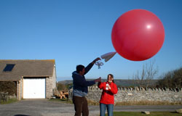
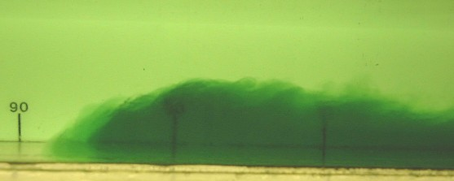
Today’s Activities
Instruments
Radiosonde Launch
Richardson’s Forecast
Fluids Labroatory

Slide 2
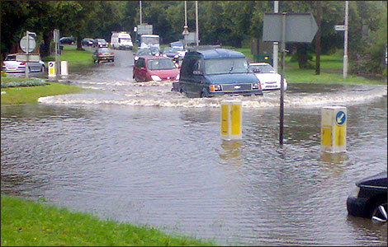
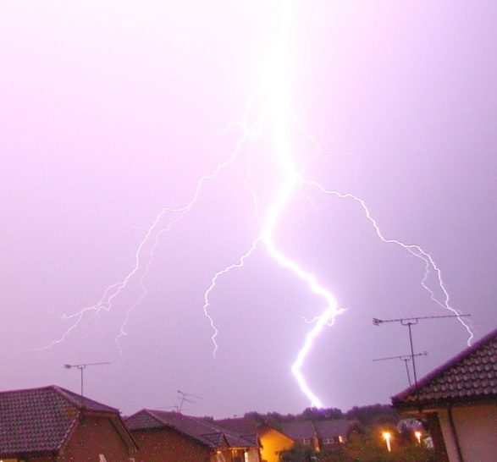
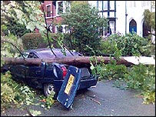
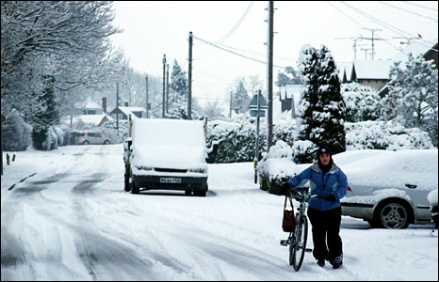
Research – Hazardous Weather
Flooding (Oxford Road, Reading)
Lightning (Woodley)
Wind (Birmingham tornado)
Snow (Reading)
Notes:
Our research is tackling some of the most critical environmental issues facing society today. In particular we aim to understand and improve predictions of climate change, hazardous weather and air pollution.

Slide 3
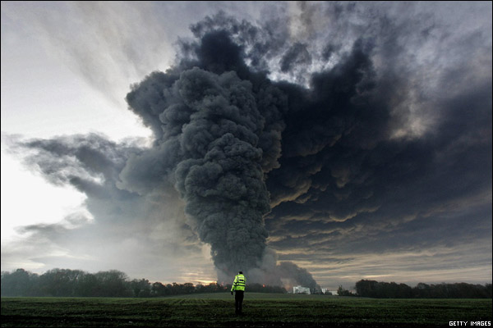
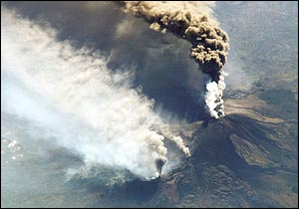
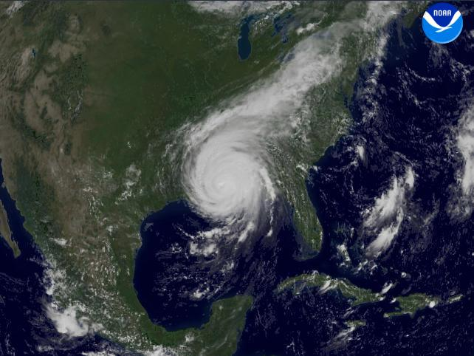
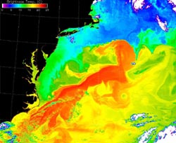
Research – Air Pollution & Simulation
Air Pollution (Buncefield Fire)
Aerosols (Etna)
Tropical Cyclones (Katrina)
Ocean Circulation (Gulf Stream)
Notes:
Our research is tackling some of the most critical environmental issues facing society today. In particular we aim to understand and improve predictions of climate change, hazardous weather and air pollution.

Slide 4
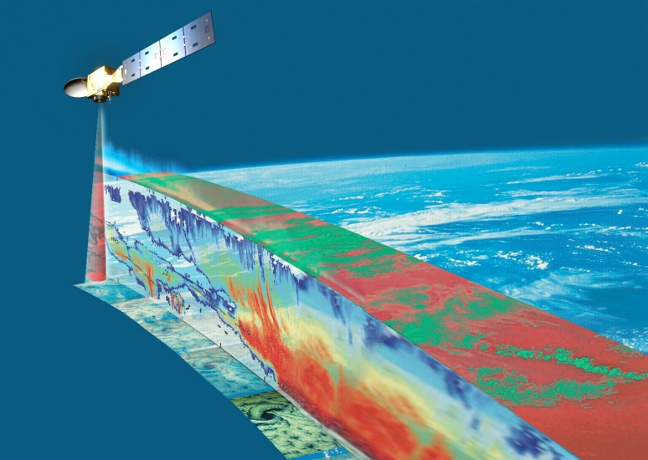
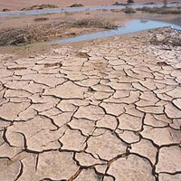
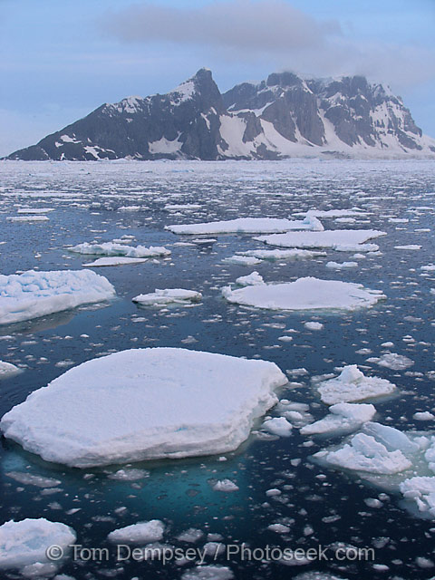
Research – Climate Change
Earth Observation
Rainfall
Sea Ice
Notes:
Our research is tackling some of the most critical environmental issues facing society today. In particular we aim to understand and improve predictions of climate change, hazardous weather and air pollution.

Slide 5
Meteorology Courses
We offer the following undergraduate courses:
BSc Meteorology and Climate (BB physics and maths)
MMet Meteorology and Climate with a year in Oklahoma (AA physics and maths)
BSc Mathematics and Meteorology
MMath Mathematics and Meteorology
New: BSc Environmental Physics (ABB incl. Maths & Physics)
More information at www.met.rdg.ac.uk/ug/ugcourses.html

