Slide 1

Sunshine or RAIN:
How do we predict the weather?
Department of Meteorology
Welcome to the Department of Meteorology Weather & Climate Day 2015!

Slide 2
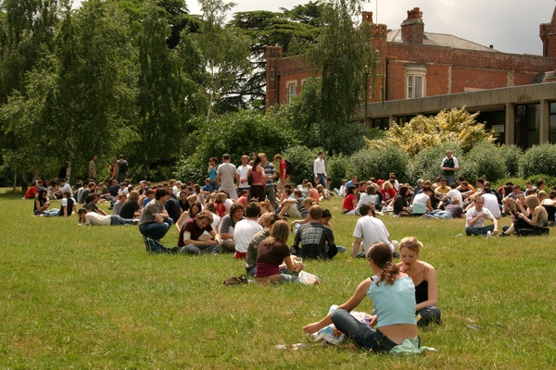
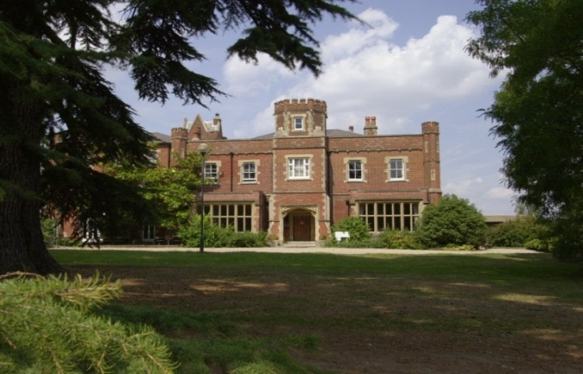
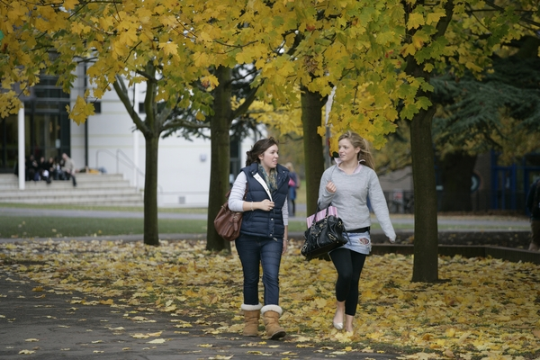
Established in 1892, Received Royal Charter in 1926.
Around 19,000 full and part-time students
20% International Students from over 150 countries.
Over 4,000 staff across all departments
Approx 250 different subjects and combinations of subjects ranging from Sciences, Arts, Humanities, Social Sciences
Science subjects are very popular and include biological sciences, chemistry, food science, microbiology, electronic engineering, meteorology, cybernetics
Masters and PhD programmes are available
Notes:
Introduce staff and student ambassadors
Fire alarm
Toilets

Slide 3


Emergencies
On hearing the fire alarm make your way to the nearest available safe exit route and leave the building without delay.
The fire assembly point is located in the car park in front of the Department.

Slide 4
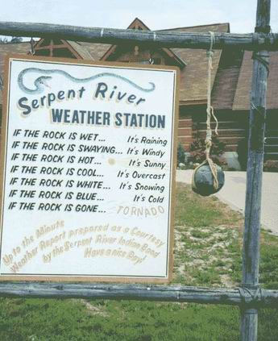
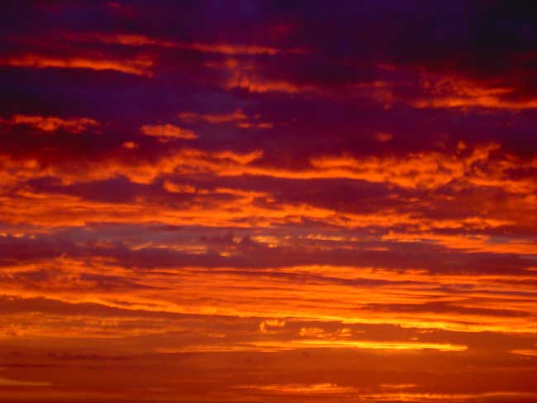

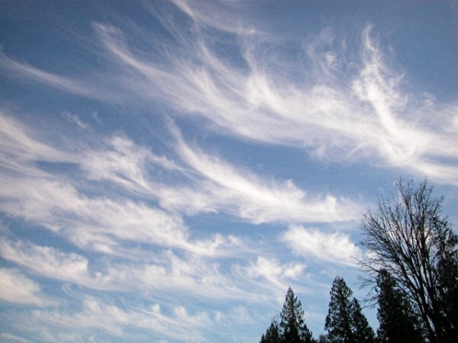
How do we predict the weather and climate?
Notes:
The difference between weather and climate is a measure of time. Weather is what conditions of the atmosphere are over a short period of time, and climate is how the atmosphere "behaves" over relatively long periods of time.
Does anyone know how we predict the weather and climate?

Slide 5
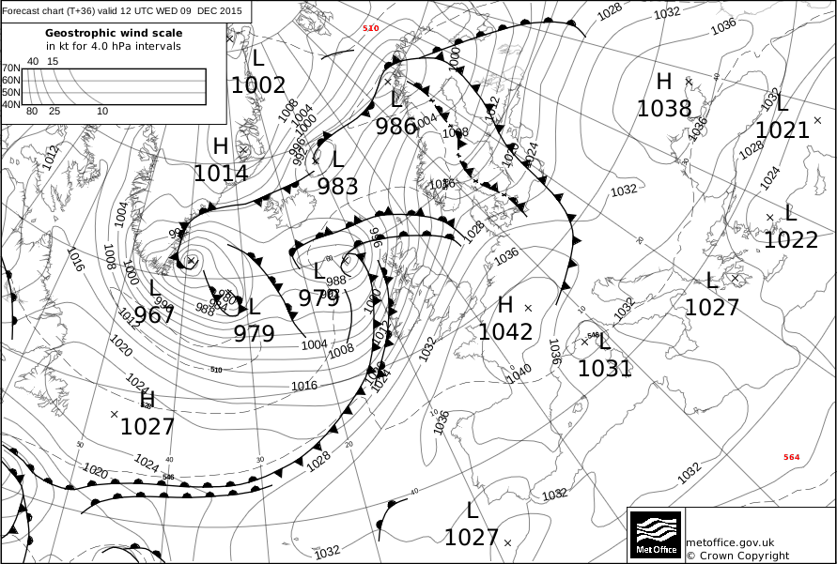
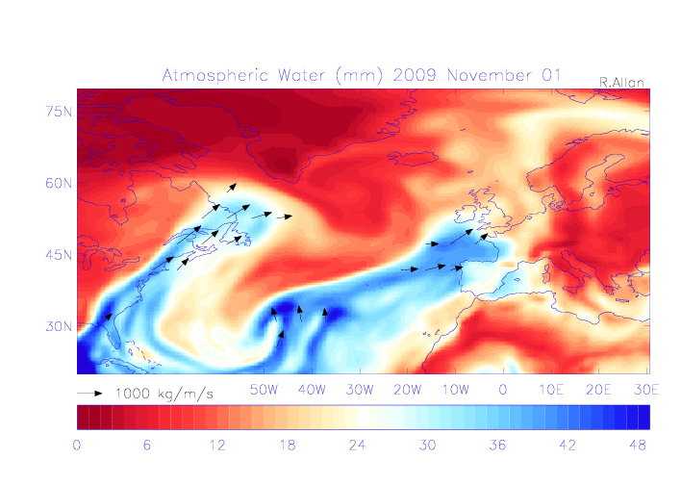
How do we predict the weather and climate?
What is a prediction?
What is the difference between weather and climate?
Notes:
The difference between weather and climate is a measure of time. Weather is what conditions of the atmosphere are over a short period of time, and climate is how the atmosphere "behaves" over relatively long periods of time.
Does anyone know how we predict the weather and climate?

Slide 6

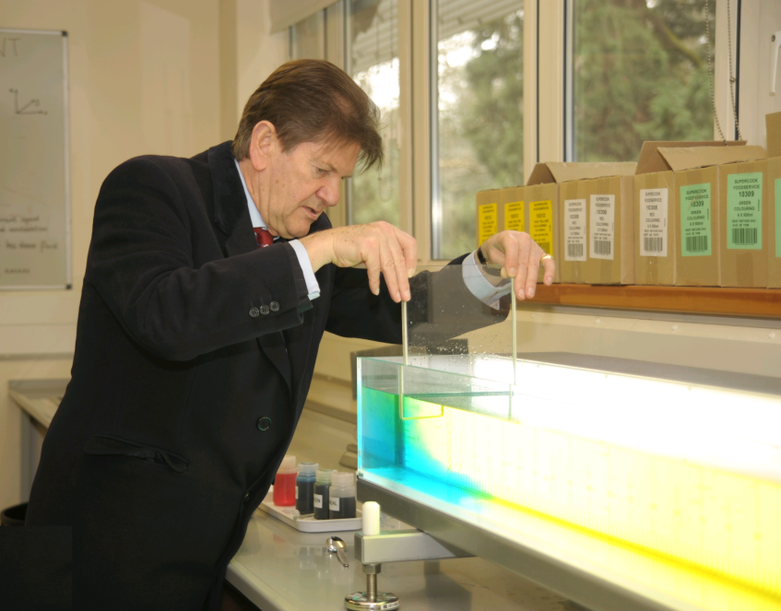
Step 1: Find out how the atmosphere works
Fluids Experiment
Notes:
The atmosphere is a fluid (just like water!)
We can do experiments with water (easier to move around than air) to find out how air moves around.
We can use the results of the experiments to find physical laws which we can use to make predictions

Slide 7
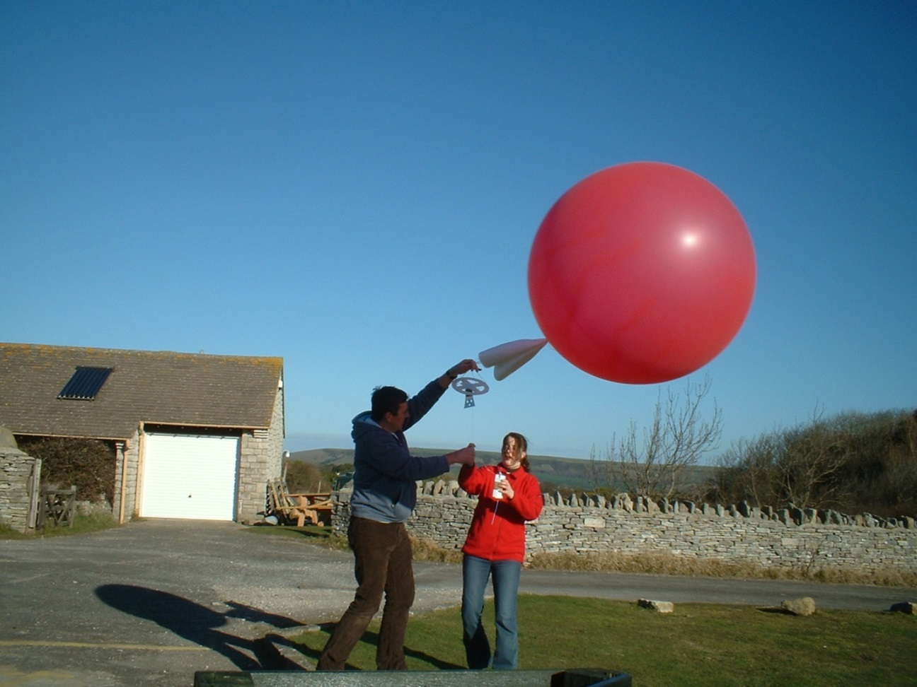
Step 2: Make observations of the atmosphere
Notes:
If we can find out what the temperatures and winds in the atmosphere are like today it will help us make predictions.
We need to observe the atmosphere at different heights and in different locations.
Observations of the weather are made 24 hours a day, all over the world. The main observations are from weather satellites, balloons, land based instruments, ships, buoys and aircraft.
Each day, the MetOffice uses around half a million observations of temperature, pressure, wind speed and direction, humidity and many other properties to provide the starting conditions of our weather forecast model. We continually update our knowledge of the current state of the

Slide 8

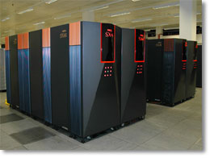
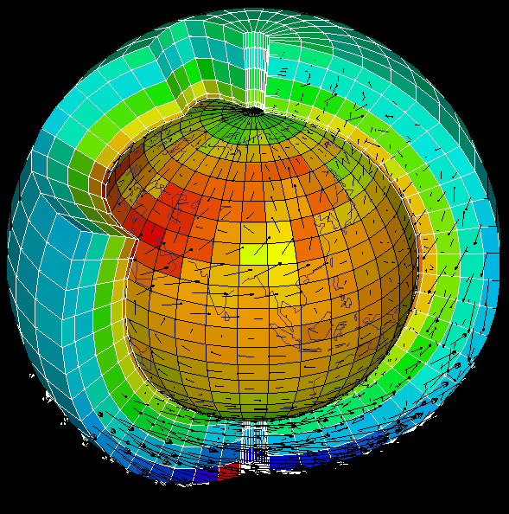
Step 3: Make some predictions
Notes:
If we know what the atmosphere looks like now (observations) and we know how it normally behaves (physical laws) we can make predictions
To do this we need to make lots of calculations which show how the atmosphere will change over time
Our numerical model starts with the current atmospheric conditions in the area of interest from the surface to the upper atmosphere at points on a three dimensional grid.
The atmosphere is a thin shell of turbulent gas on a rotating Earth. Numerical Weather Prediction (NWP) models replicate the behaviour of this gas with mathematical equations.
Details of the wind speed and direction, temperature, pressure, moisture and cloud in each grid box are then stored in a computer.

Slide 9
Timetable
Forecast Factory: - Synoptic Lab (up stairs, turn left)
Experiment: Fluid lab (downstairs)
Observations: Outside (straight out the window)
Lunch and Weather Forecast - Synoptic Lab
Radiosonde balloon launch (Field Site, 10:30am)

Slide 11
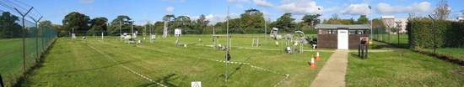
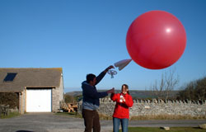
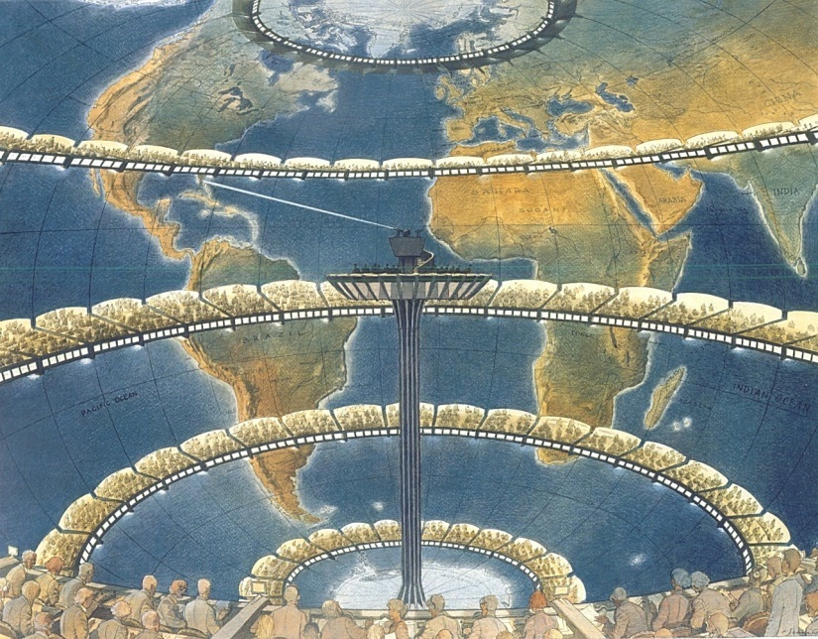
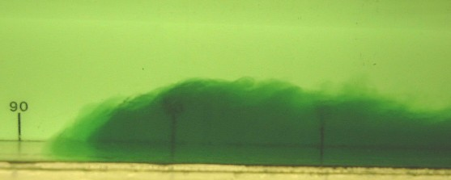
Today’s Activities
Instruments
Radiosonde Launch
Richardson’s Forecast
Fluids Labroatory

Slide 12
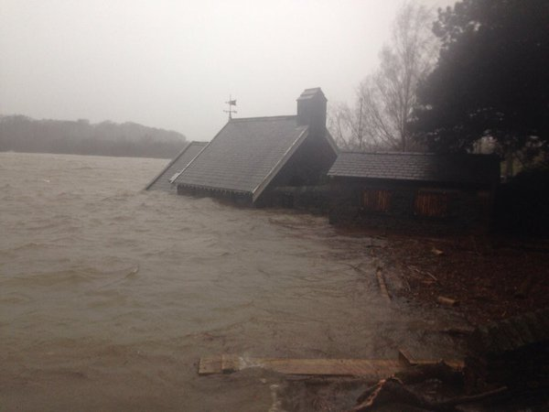
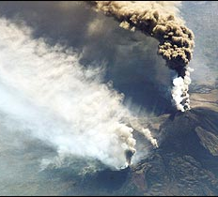
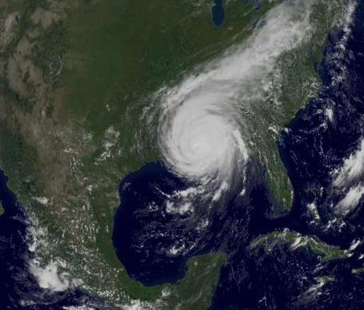
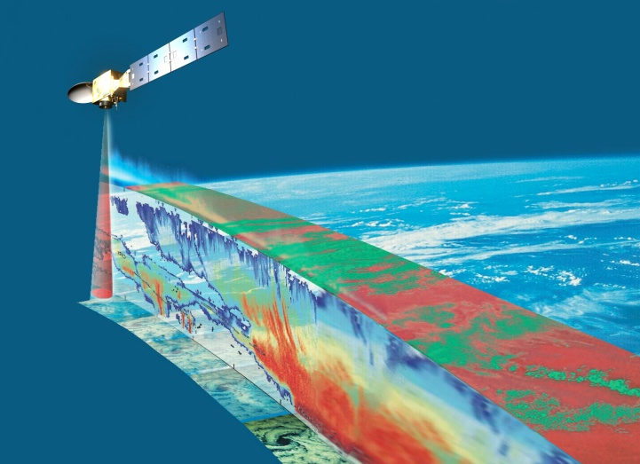
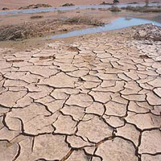
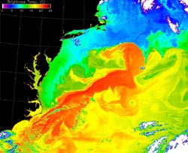
Research – Weather & Climate
Flooding (Cumbria)
Aerosols (Etna)
Tropical Cyclones
Observations
African Rainfall
Ocean circulation

Slide 13
Meteorology Courses
We offer the following undergraduate courses:
  BSc Meteorology and Climate (BB physics and maths)
  MMet Meteorology and Climate with a year in Oklahoma (AA physics and maths)
  BSc Mathematics and Meteorology
  MMath Mathematics and Meteorology
  NEW: Environmental Physics BSc (ABB from three A levels including Mathematics and Physics, one of which must be at a grade A)
More information at www.met.rdg.ac.uk/ug/ugcourses.html

