Slide 1





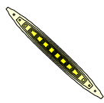


On the interaction of observation and a-priori error correlations in Variational data assimilation
Alison Fowler, Sarah Dance, Jo Waller

Slide 2
Motivation
Background (a-priori) error correlations (BECs) known to be important in DA.
Until recently observation error correlations (OECs) have been neglected in NWP. To account for this the data has either been thinned, ‘super-obbed’ or the error variance have been inflated.
  Therefore, accounting for OECs correctly could allow for denser observations to be assimilated which could be important for high-resolution/high-impact weather forecasting.
Accounting for inter-channel error correlations in IASI (which previously relied on variance inflation) have led to an improvement in the skill of the analysis and forecast (Weston et al., 2014, QJRMS, Bormann et al., 2016, QJRMS).
This has motivated the OECs to be estimated for a range of other observations, for example using innovation ‘Desroziers’ diagnostics.
Can we expect to see benefit to including OECs in all observation types? Are their cases when thinning the data is still desirable?

Slide 3
Origin of OECs
OECs generally result from errors in comparing the observations to the state variables rather than instrument error (Janjic and Cohn, 2006, MWR)
Can be state and model dependent (Waller et al. 2014, Tellus A)
Found predominately in observations
  with complex observation operators,
  that measure different scales to those modeled
  that have gone through a lot of preprocessing (e.g. high level SST products from satellite measurements, quality control)

Slide 4
Quick literature review
Effect of suboptimal R i.e not accounting for OECs
Rainwater et al. 2015, QJRMS
Miyoshi et al. 2013, Inverse Problems in Science and Engineering
Stewart et al. 2008, International J. for Numerical Methods in Fluids
Stewart et al. 2013, Tellus A
Liu and Rabier 2002, QJRMS – also suboptimal H
In this talk I will be assuming that the correct B, R and H are known and used in the assimilation.
Impact of OECs on different scales
Seaman 1977, MWR
Rainwater et al. 2015, QJRMS

Slide 5
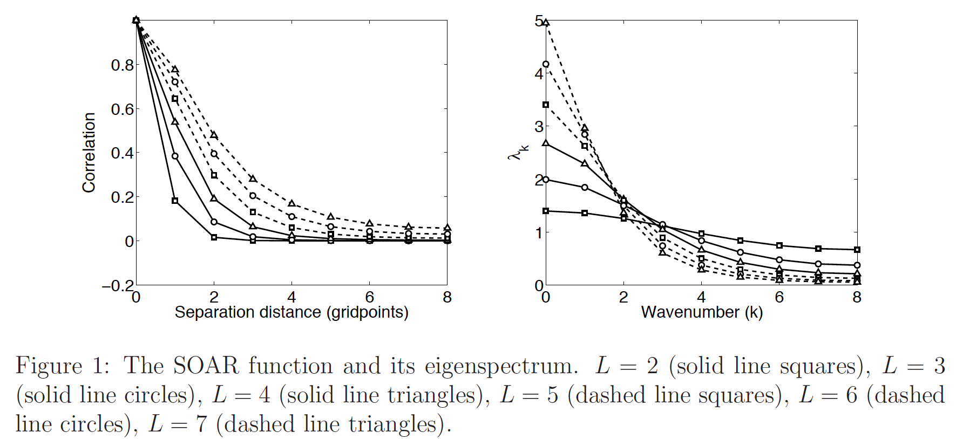
Quick literature review
Impact of OECs on different scales
Positive error correlations
Taken from Waller et al. 2016, QJRMS

Slide 6
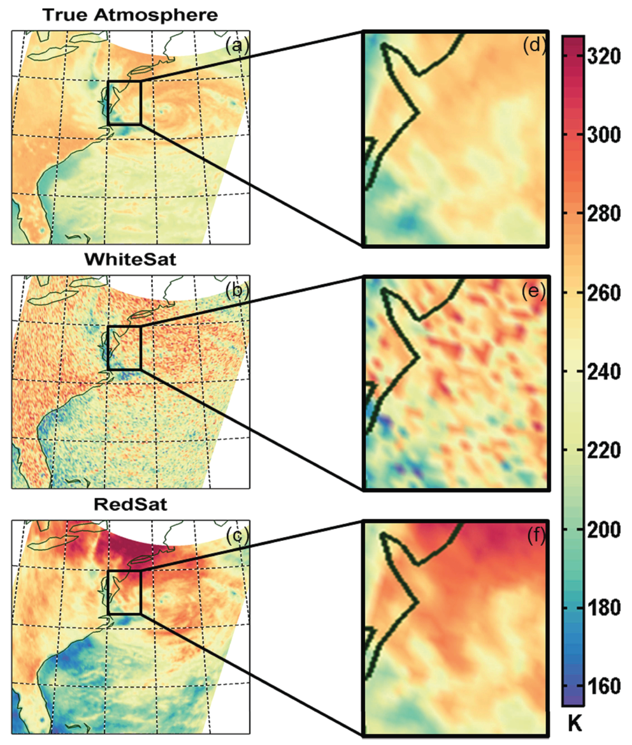
(a) A microwave satellite image of Hurricane Sandy on 24 October 2012, which is treated as truth. (b) Panel (a) plus white (uncorrelated) noise; (c) panel
(a) plus red (spatially correlated) noise.

Slide 7
Quick literature review
Impact of OECs in relation to the observation operator
Miyoshi et al. 2013, Inverse Problems in Science and Engineering
Terasaki and Miyoshi 2014, SOLA
Liu and Rabier 2002, QJRMS
Optimal thinning when OECs present
Liu and Rabier 2002, QJRMS
Bergman and Bonner 1976, MWR
Few of these papers mentioned, look at how these aspects of the impact of OECs depend upon the background error statistics, beyond noting that there is a sensitivity.
Many have only studied the impact of OECs in terms of one metric, such as analysis rmse.

Slide 8
Aim of this work
To show how the impact of observations with correlated errors depends on the specification of the background error statistics (B) and the observation operator (H).
Three different metrics studied
  The analysis error covariance
  The sensitivity of the analysis to the observations
  Mutual information

Slide 9
Structure of remainder of talk
Introduce measures
Illustrate the interaction of R, B and H in terms of Bayes’ theorem
Numerical experiments for a two variable case
Effect of OECs on the optimal density of observations

Slide 10








Measure I: The analysis error covariance matrix
Recall the analysis, xª, in the case of Gaussian near-linear system is given by (using standard notation)
Where is the background, is the observation vector, K is the Kalman gain and h is the (near-linear) observation operator
The analysis error covariance matrix is
Where and are the background and observation error covariance matrices
is the linearised observation operator

Slide 11
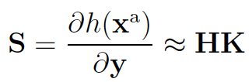

Measure II: The sensitivity matrix
This quantifies the sensitivity of the analysis (in observation space) to the observations
The diagonal elements are known as the self-sensitivities
The off-diagonal elements are known as the cross-sensitivities, measure the spread in information.
dfs=trace(S) i.e. a sum of the self-sensitivities.
The sensitivity matrix can be related to the analysis error covariance matrix:

Slide 12
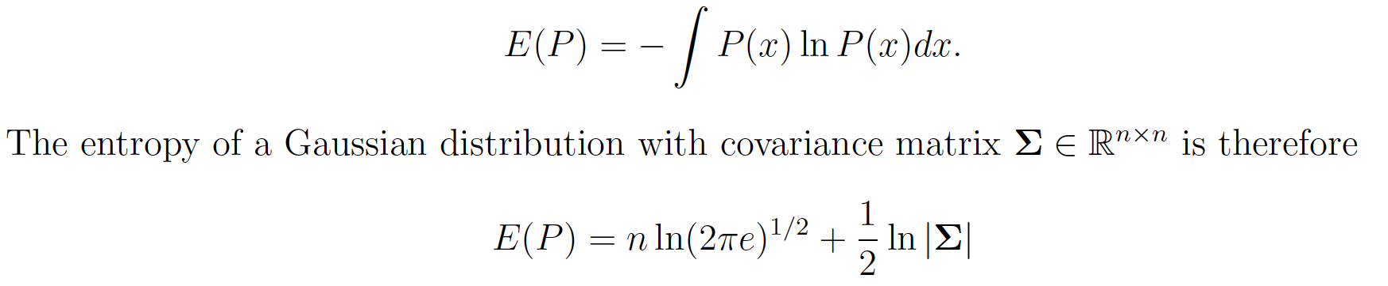
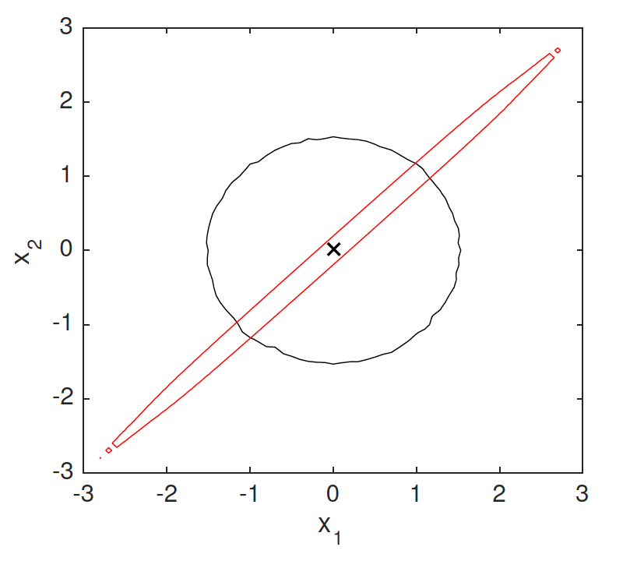
Measure III: Mutual information
Mutual information measures the reduction in entropy due to the assimilation of observations
Entropy (uncertainty) is defined as
The entropy of a Gaussian distribution with covariance matrix is therefore
Illustration of the 95th percentile of the region of uncertainty given
by Gaussian distribution when the errors in x₁ and x₂ are uncorrelated (black)and correlated with a coefficient of 0.999 (red).
In the first case the entropy is 3.3692 and in the second case the entropy is 0.2616.

Slide 13

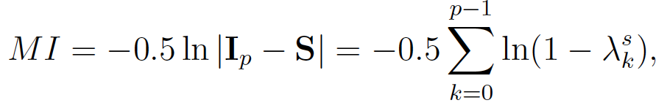
Measure III: Mutual information
Mutual information is the prior entropy minus the posterior entropy
This can also be written in terms of the sensitivity matrix as
Unlike dfs, MI is a function of both the self and cross sensitivities.

Slide 14
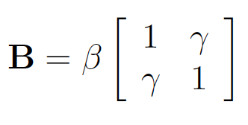
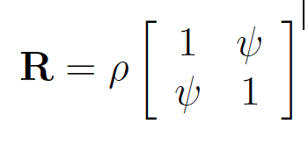


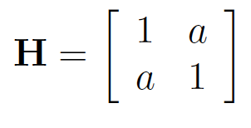

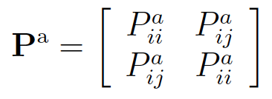
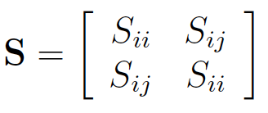
2 variable experimental design
In the following experiments, the background and observation error variances are defined as:
The observation operator is given by:
This setup results in circulant analysis error covariance and sensitivity matrices.
e.g. a=0.5 =>
y₁=x₁+0.5x₂, y₂=x₂+0.5x₁
(obs themselves are +vely corr in state space.)
a=-0.5 =>
y₁=x₁-0.5x₂, y₂=x₂-0.5x₁
(obs themselves are -vely corr in state space.)

Slide 15


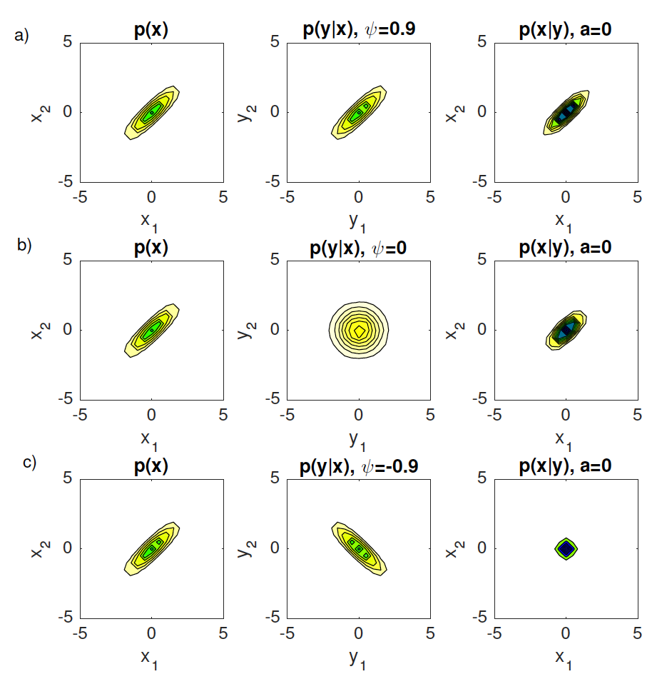
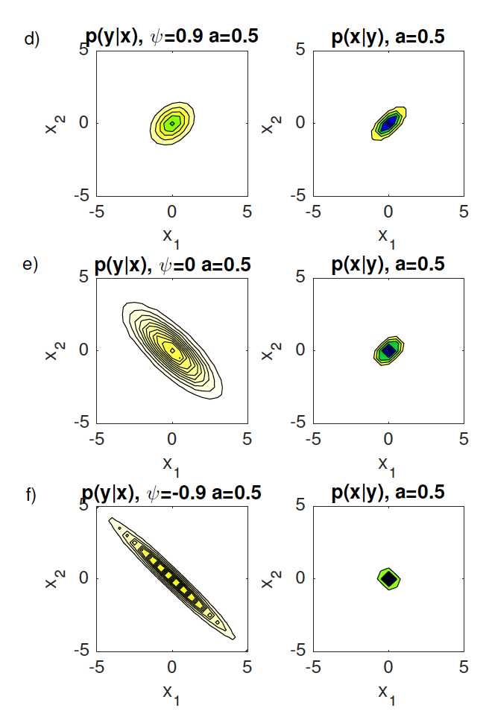
Bayes’ illustration
β=ρ=1, γ=0.9
H=I

Slide 16
Bayes’ illustration
Key findings
The analysis error variance is smallest when the prior and likelihood provide information about different regions of state space (i.e. their correlation structures are very different).
The effect of a positive observation operator coefficient (i.e. observations themselves are positively correlated) is to reduce the information coming from the observations about the small scales and increase the amount of information about the large scales.
  This has a beneficial impact on the analysis uncertainty when the background errors are positively correlated.

Slide 17
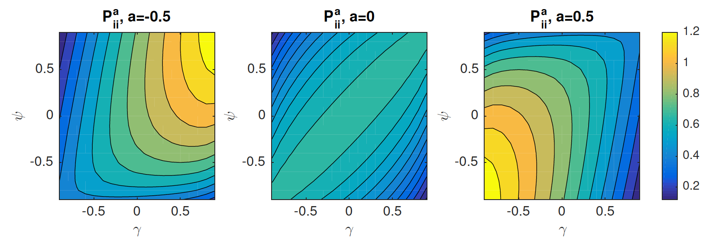
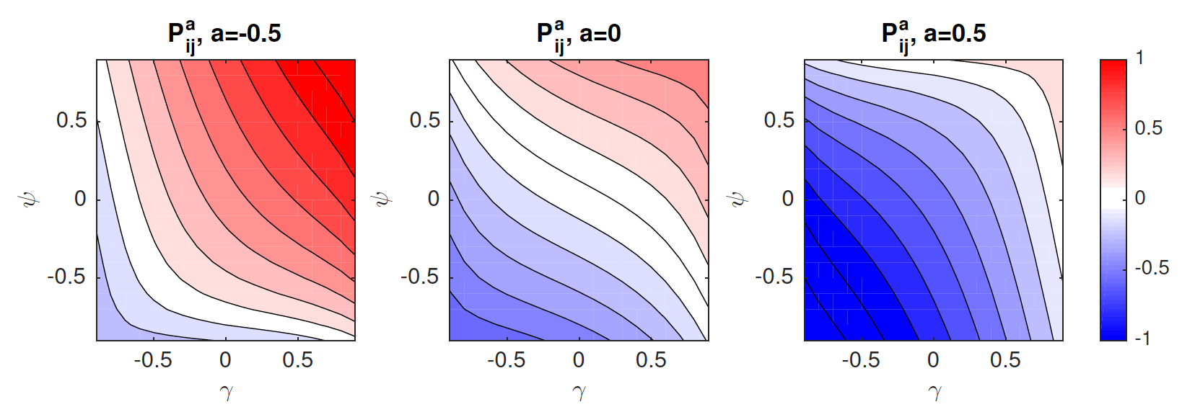
Analysis error covariance, β=2,ρ=1
Analysis more accurate at small scales
---------------
Analysis more accurate at large scales

Slide 18
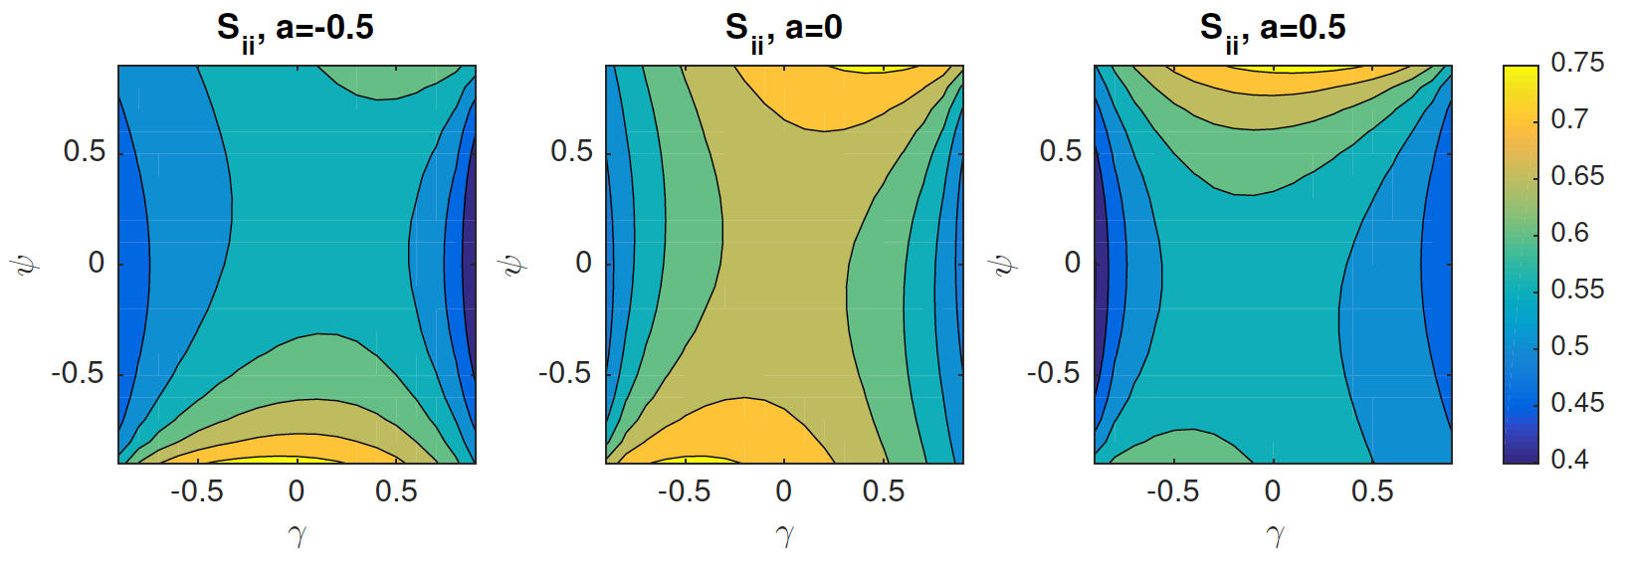
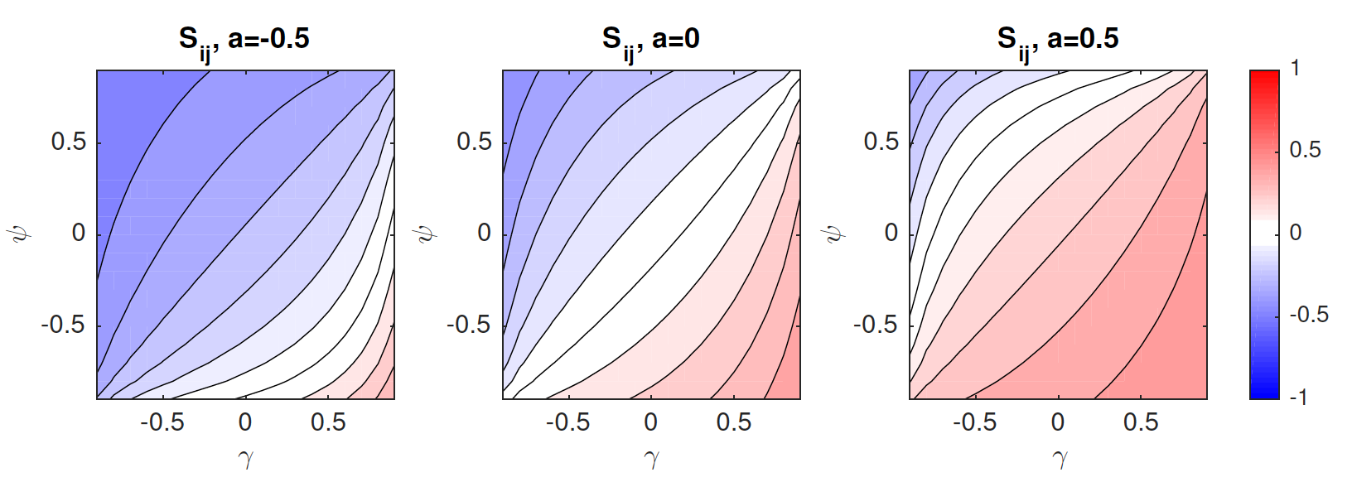
Analysis sensitivity, β=2,ρ=1
Analysis at large scales more sensitive to observations
-----------------
Analysis at small scales more sensitive to observations

Slide 19
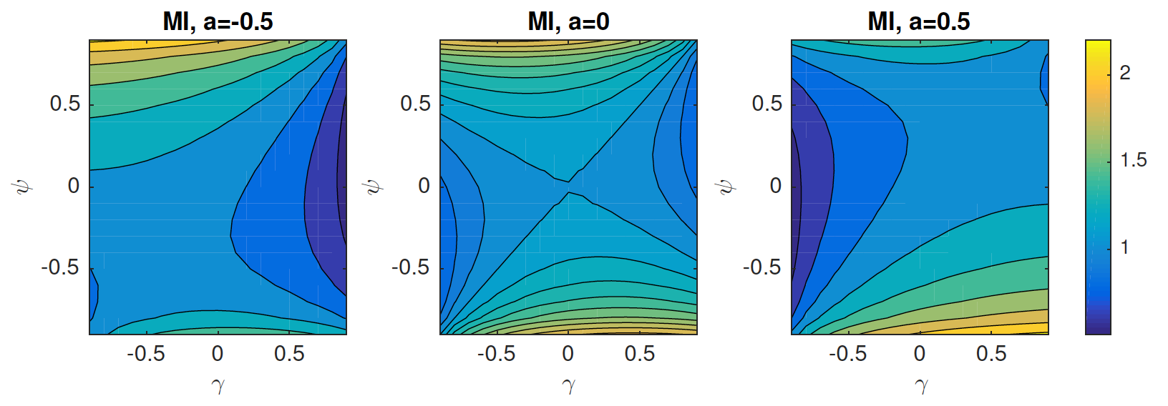
Mutual information, β=2,ρ=1
Note: this looks very different to the pattern seen for the self-sensitivities => using dfs as a measure of information content would lead to different conclusions

Slide 20
Summary of results so far
In general as the magnitude of the OECs increase, the dfs (self-sensitivities) and MI increase.
However, the impact of the OECs on the other metrics cannot be understood in isolation of the background error statistics and the observation operator.
When the prior and likelihood provide information about different regions of the state space.
  The analysis error variances are smallest
  There is the greatest spread in information (e.g. cross-sensitivities are largest).
  Observations have the greatest mutual information.

Slide 21
Data thinning
It was suggested by Miyoshi et al. 2013, who noted the dependence of the observation impact on both the OECs and H, that this could be used in the design of instruments.
However, in practice this may not be feasible as often the OECs and H are related.
An easier way to exploit these results is in the choice of the density of the observations.

Slide 22

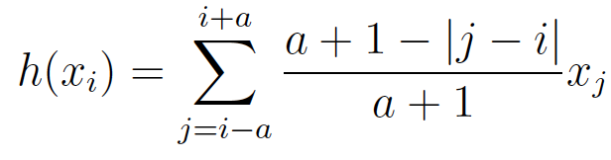
Data thinning
Results shown assume circular domain discretized into 32 gridpoints.
R and B are given by circulant matrices with correlations given by the SOAR function
The background error correlation lengthscale is given by L_{b}=5. The observation error correlation lengthscale L_{o} is allowed to vary.
The observation and background error variances are both set to 1.
H assumes observations are made regularly and are a weighted combination of the state variables

Slide 23
Data thinning
L_{b}=5

Slide 24
Data thinning
Key findings
When the correlation lengthscales in the likelihood and prior are similar there is less benefit, in terms of the analysis error, in increasing the density of the observations compared to if the lengthscales are very different.
If OECs are correctly included in the DA systems then denser observations are beneficial (in terms of MI/p) only if the lengthscales in R are much larger than B.
If the observations have overlapping weighting functions then this dominates the effect of the OECs.

Slide 25
Conclusions
The impact of observations with correlated errors cannot be considered in isolation of the background error correlations or the observation operator.
  This is particularly true if interested in the impact on analysis errors or the spread in information
These results could be used in the design of new instruments and observing networks.
  Thank you for listening

