Slide 1
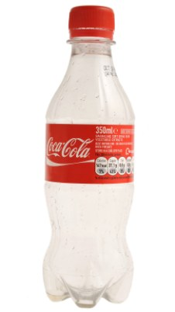

Slide 2
THE ADVENTURES OF
THE MR METS

Slide 3
Episode 8:
PROF CLARK’S
MIRACLE PANTO CURE

Slide 4
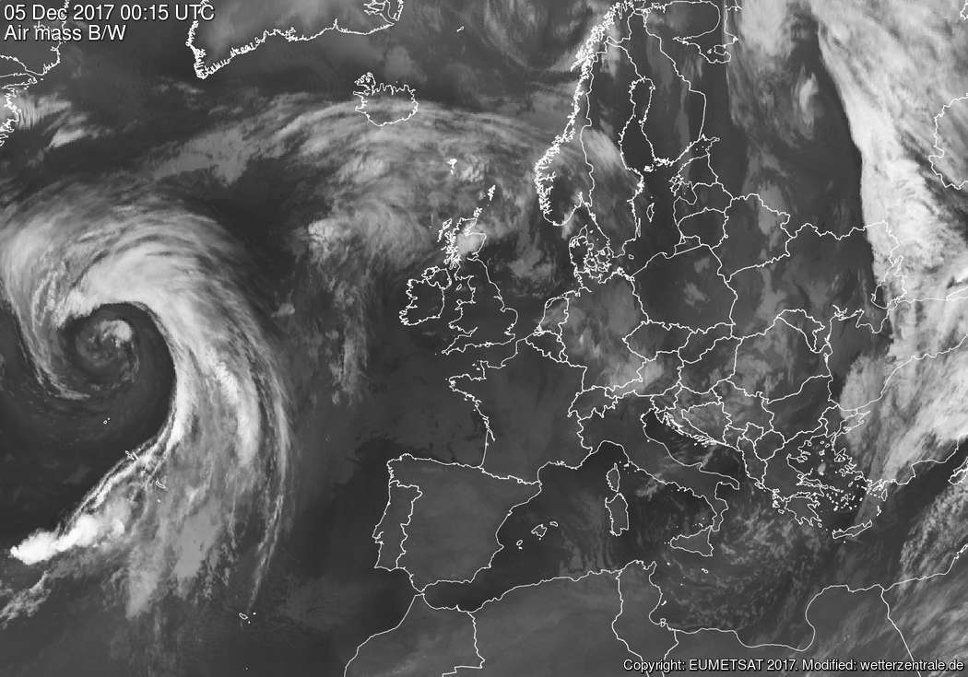
HAPPY MET LAND
Recipient of
HAPPY MET LAND
Recipient of

Slide 6
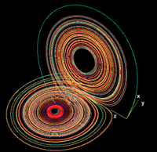
DECEMBER 2016
 |  |  |  | 1 | 2 | 3
4 | 5 | 6 | 7 | 8 | 9 | 10
11 | 12 | 13 | 14 | 15 | 16 | 17
18 | 19 | 20 | 21 | 22 | 23 | 24
25 | 26 | 27 | 28 | 29 | 30 | 31

Slide 7
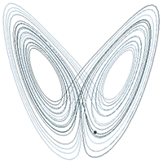

Slide 8
DECEMBER 2016
 |  |  |  | 1 | 2 | 3
4 | 5 | 6 | 7 | 8 | 9 | 10
11 | 12 | 13 | 14 | 15 | 16 | 17
18 | 19 | 20 | 21 | 22 | 23 | 24
25 | 26 | 27 | 28 | 29 | 30 | 31

Slide 10
DECEMBER 2016
 |  |  |  | 1 | 2 | 3
4 | 5 | 6 | 7 | 8 | 9 | 10
11 | 12 | 13 | 14 | 15 | 16 | 17
18 | 19 | 20 | 21 | 22 | 23 | 24
25 | 26 | 27 | 28 | 29 | 30 | 31

Slide 11
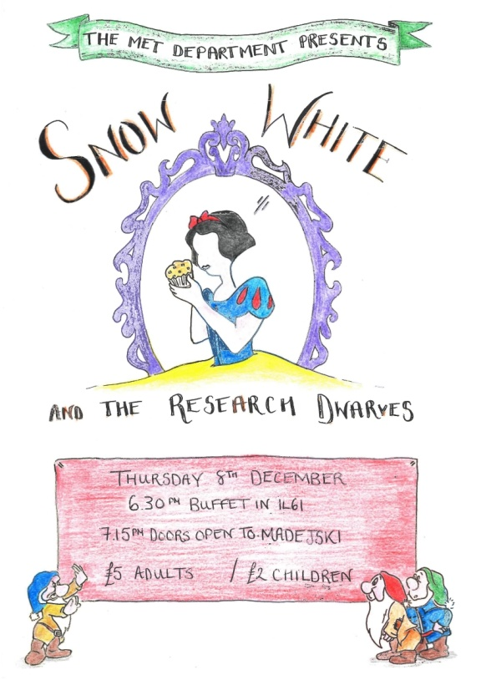
DECEMBER 2016
 |  |  |  | 1 | 2 | 3
4 | 5 | 6 | 7 | 8 | 9 | 10
11 | 12 | 13 | 14 | 15 | 16 | 17
18 | 19 | 20 | 21 | 22 | 23 | 24
25 | 26 | 27 | 28 | 29 | 30 | 31

Slide 13
DECEMBER 2016
 |  |  |  | 1 | 2 | 3
4 | 5 | 6 | 7 | 8 | 9 | 10
11 | 12 | 13 | 14 | 15 | 16 | 17
18 | 19 | 20 | 21 | 22 | 23 | 24
25 | 26 | 27 | 28 | 29 | 30 | 31

Slide 15
DECEMBER 2016
 |  |  |  | 1 | 2 | 3
4 | 5 | 6 | 7 | 8 | 9 | 10
11 | 12 | 13 | 14 | 15 | 16 | 17
18 | 19 | 20 | 21 | 22 | 23 | 24
25 | 26 | 27 | 28 | 29 | 30 | 31

Slide 18
QUO
VADIS
2017
Wednesday 1 February
Starting 09:00
1L61
TODAY!!
David Grimes Synoptic Laboratory

Slide 20
ROB
PETER-JAN
MAARTEN
RÉMI

Slide 23
ROB
PETER-JAN
MAARTEN
RÉMI
The role of the Asian Summer Monsoon in English Cricket Performances
by Mr J Beverley

Slide 25
ROB
PETER-JAN
MAARTEN
RÉMI
The role of the Asian Summer Monsoon in English Cricket Performances
by Mr J Beverley

Slide 26
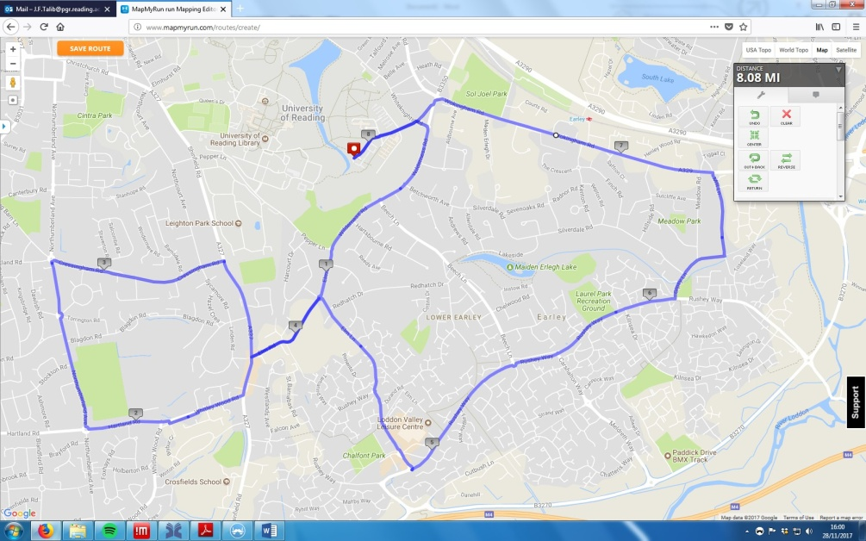
ROB
PETER-JAN
MAARTEN
RÉMI
The impact of marathon running on the ITCZ
Mr J Talib

Slide 28
ROB
PETER-JAN
MAARTEN
RÉMI
The impact of marathon running on the ITCZ
Mr J Talib

Slide 29
ROB
PETER-JAN
MAARTEN
RÉMI
IT’S BEHIND YOU!!!
The Effect of Panto
on the Madden-Julian Oscillation
Miss B Harris & Mr M Johnston

Slide 34
THE END

Slide 35
THE END

