Slide 1
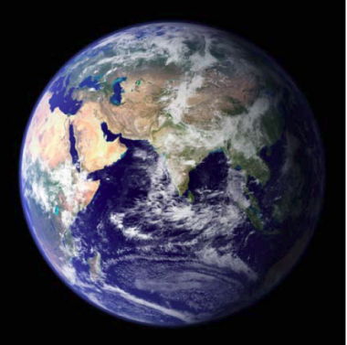
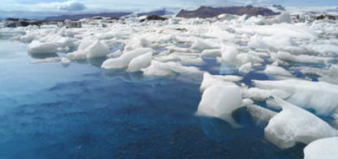
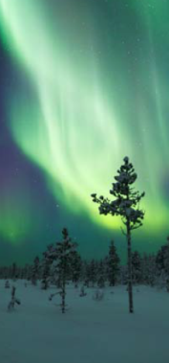
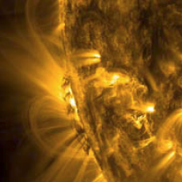
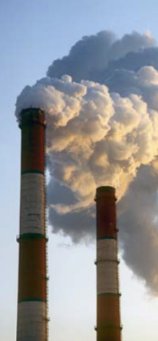
Environmental Physics The physics of the Sun-Earth system
Department of Meteorology
Dr Mathew Owens
Undergraduate course director, Environmental Physics BSc

Slide 2
Undergraduate degrees AT READING
3 year BSc in Meteorology and Climate
(BBB including maths and physics)
4 year MMet in Meteorology and Climate with a year in Oklahoma
(AAB including maths and physics, plus interview)
3 or 4 year Maths and Meteorology (BSc or MMath)
(ABB or AAB including maths)
3 year BSc in Environmental Physics
(ABB including maths and physics)

Slide 3
A university physics degree
Maths for physicists
Mechanics and relativity
Quantum
Condensed matter
Oscillations and waves
Electromagnetism
Optics
Thermodynamics and statistical physics

Slide 4
THE Natural world: A physics laboratory
The Sun and Earth are a complex, coupled system…
There are a range of interactions between solar radiation, atmospheric pollution, ocean dynamics, the solar/terrestrial magnetic fields, etc.
But these complex interactions and processes are governed by relatively few fundamental physical laws.
Studying the underlying physics is the only way to tackle current and future environmental and space issues

Slide 5
Context-based learning
Physics taught through contemporary examples
Learn physics and analytical skills through your interest in environment/climate space issues
Learn specifics of current environmental issues

Slide 6
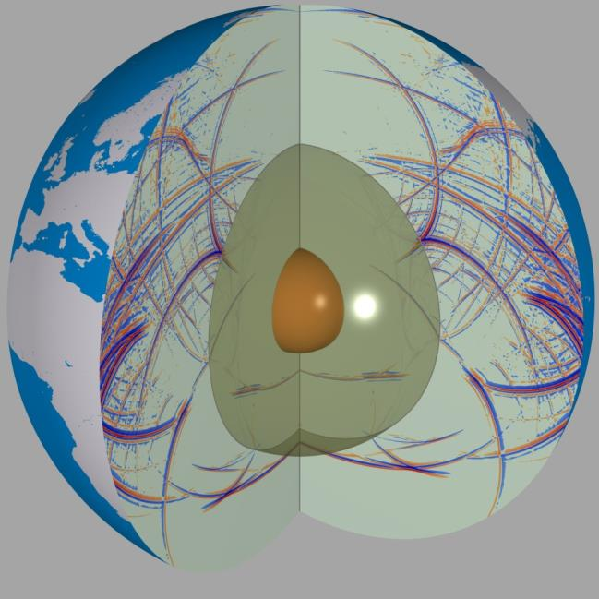
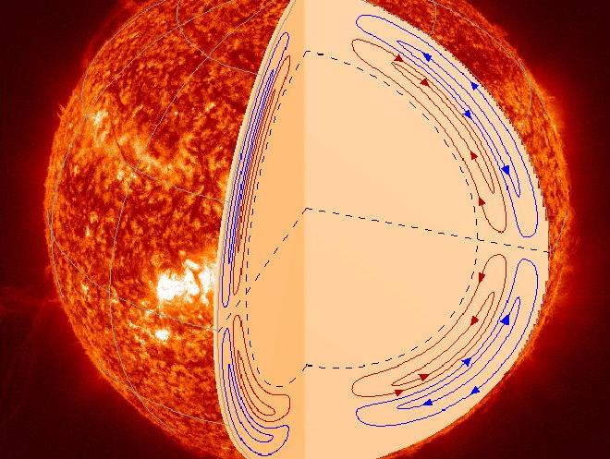
Fundamental physics: Sound waves

Slide 7
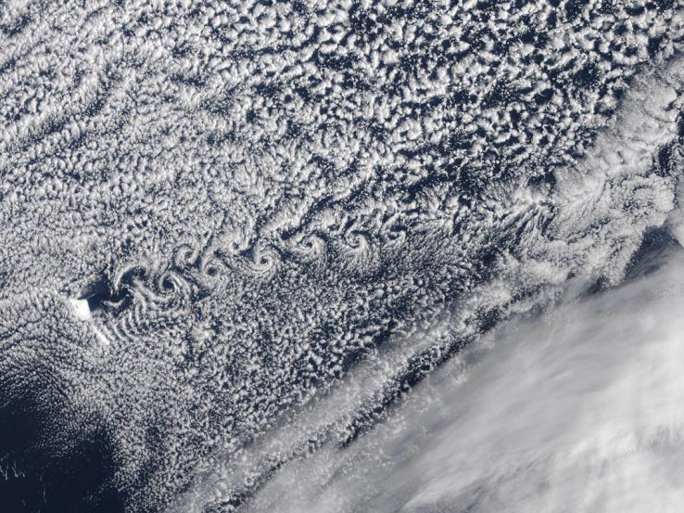
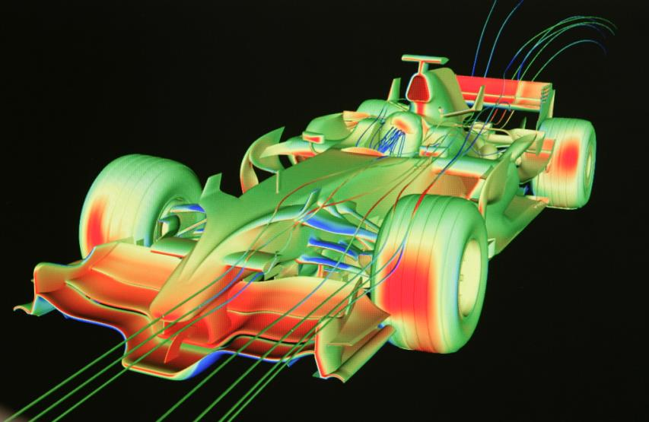
Fundamental physics: Fluid dynamics

Slide 8
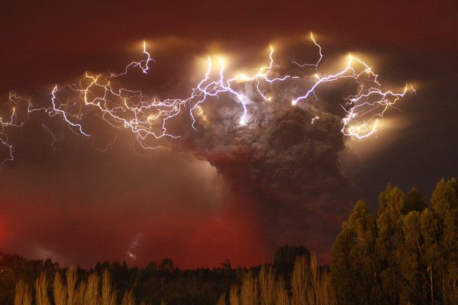
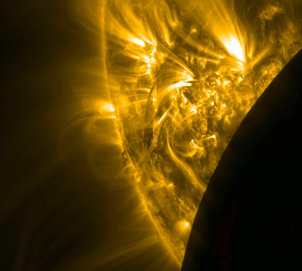
Fundamental physics: Electromagnetism

Slide 9
Modules year-by-year
Part 1 | Part 2 | Part 3
Calculus | Vector Calculus | General Studies
Linear algebra | Statistics for Weather and Climate Science | Dissertation project
Weather and Climate Fundamentals | Surface Energy Exchange
Global Environmental Chemistry | Atmospheric chemistry and transport
Skills for Environmental Science | Numerical Methods for Environmental Science
Atomic and Nuclear Physics | Instrumentation for Env Measurements
Physics of the Natural World | Mathematical physics
 | Skills for Graduates
Maths
Physics
Env Phys
Env Lab
General

Slide 10
Modules year-by-year
Part 2 | Part 3
Geophysics | Climate Change
Atmosphere and Ocean Dynamics | Soil, Atmos and Vegetation Modelling
Transport Processes in the Environment | Environmental Modelling
Global Quaternary Climate Change | Remote Sensing Methods/Apps
Monitoring the Earth from Space | Space Weather
Weather Case Studies and Forecasting | Atmospheric Spectroscopy
Practise of Entrepreneurship | Hydrology and Global Env Change
History and Philosophy of Science | Oceanography
Sustainable Resource Management | Boundary Layer Meteorology
French/ German/ Italian/ Spanish | Atmospheric Electricity
 | Atmospheric Science Field Course

Slide 11
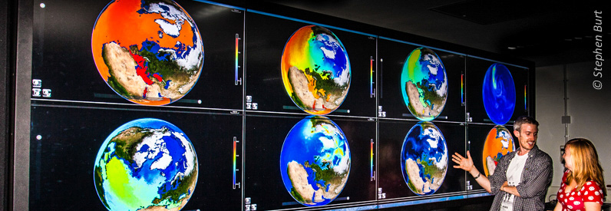
The Meteorology department
We teach the next generation of weather, climate and space scientists and forecasters
Teaching staff: 45
Research staff:180
Research students: 80
Undergraduate students: 70

Slide 12
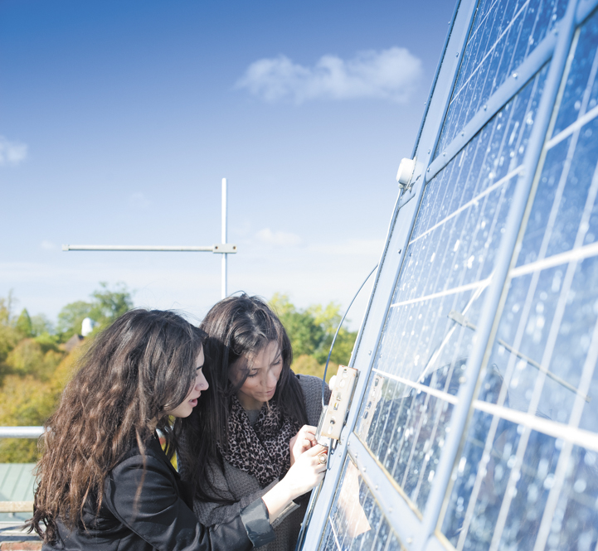
The Meteorology department
Small student numbers means we have a very high staff/student ratio of about 1:2
This means we know our students very well
Each member of teaching staff has 2-3 tutees
In some optional modules you will be taught in groups of 5-10.
These numbers are unmatched pretty well anywhere else in the UK for pretty much any subject

Slide 13
National Student survey
100% overall student satisfaction
100% agreed 'Staff are good at explaining things'
100% agreed 'Staff are enthusiastic about what they are teaching'
100% agreed 'The course is intellectually stimulating' 100% agreed 'The course has helped me to present myself with confidence'

Slide 14
Academic/industrial placements
Placement year
Open to All students
Earn from £15,000 to £26,000
Improves motivation to study and academic performance
Develops technical & non technical skills graduate employers require
Secure graduate job earlier with higher starting salary.
Think of it as your 1st graduate job
Also offer summer placements
e.g., Space Internship Network (SpIN)

Slide 15
Academic/industrial placements
Dedicated, in-house placements officer
This year, three summer placements:
Civil aviation authority
Dept of Meteorology (through Royal Astro Soc)
UK Met Office
Previous years:
Huge range of transport, power, health, insurance, forecasting, instrumentation, etc. companies
Both private and public sector

Slide 16
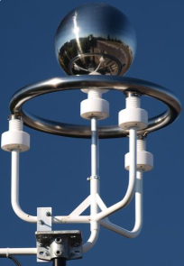
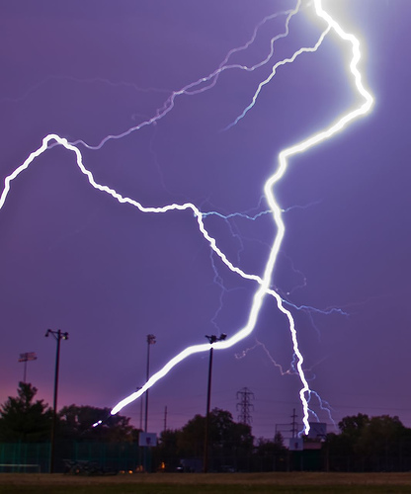
Career prospects
Graduates will gain excellent analytical, technical, and personal skills
- Governmental institutions (e.g., British Antarctic Survey, British Geological Survery, Centre for Ecology and Hydrology, Environment Agency, Met Office)
Environmental and space research and consultancy
Industry (aviation, transport, energy)
Other general applications of physics and maths, (e.g., teaching, the scientific civil service, media, emergency services)
Numerate professions (finance, risk management, insurance, etc).
Notes:
wide range of physical science-based careers or environmental research and consultancy in private companies as well as

Slide 17
Latest employment data
2014 graduation group, 6 months on
Full time work 70%
Further study 27%
“Other” 3%
Unemployed 0%
These figures are fairly typical of our student destinations over the past 3 years

Slide 18
Environmental physics AT READING
The Meteorology Department is at the forefront of Weather, Climate and Space research, with strong links throughout the industry
We run courses with small student numbers
Our courses cover all aspects of Weather, Climate and Space science and include a wide range of practical activities
Our graduates go onto a wide range of scientific careers

Slide 19
Environmental physics AT READING
ANY QUESTIONS?

Slide 20
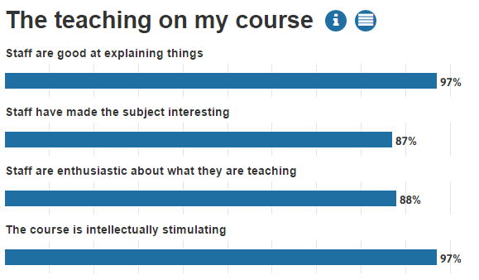
UNIstats survey data 96% overall satisfaction

