Slide 1

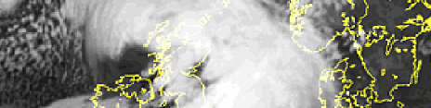
Predictability and variability of sting jets in extreme windstorms
Department of Meteorology
Suzanne Gray,
Neil Hart and Peter Clark

Slide 2
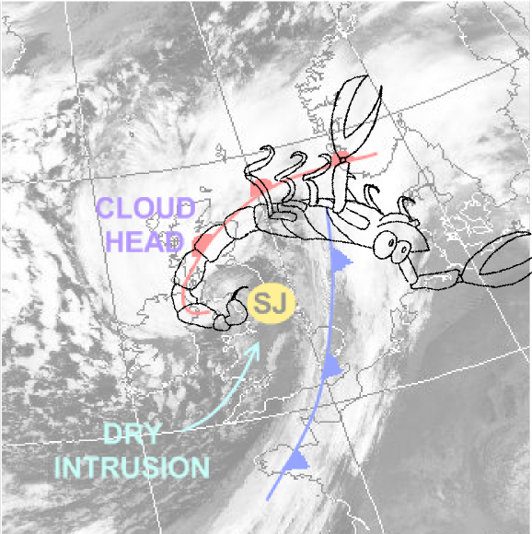
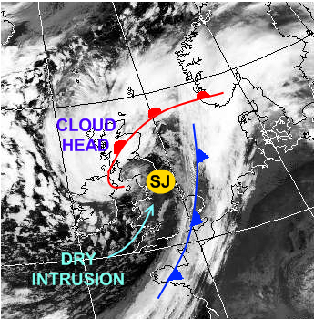
Sting jets
Transient (few hours), mesoscale (~50km spread) jets of air descending from the tip of the hooked cloud head in the frontal fracture regions of some extratropical storms.
Can cause damaging winds (and especially gusts).
Coined ‘the sting at the end of the tail by Browning (2004)’ in his study of the Great October storm of 1987.
Since then large body of work performed on modelling, mechanisms and climatologies.
First research aircraft flight into a sting jet storm led by Reading scientists within DIAMET project: Windstorm Friedhelm (2011).
Term has now entered common usage(?)
Adapted from Laura Baker by Neil Hart.

Slide 3
Questions
What is the variability in and predictive capability of
  (i) cyclones containing sting jets?
  (ii) the characteristics (surface wind speed, descent rate, horizontal extent) of the sting jets in a cyclone?
What mechanisms can lead to the descent of the sting jet?

Slide 4
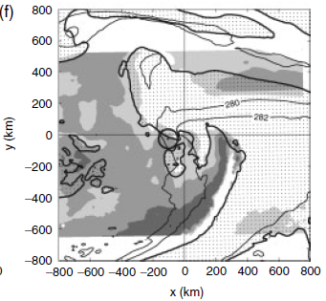
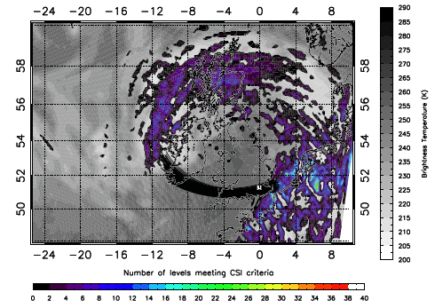
Mechanisms: atmospheric instability
Martínez-Alvarado et al. (2014). Instability diagnosis along sting jet trajectories in windstorm Friedhelm.
Gray et al. (2011). DSCAPE in windstorm Anna., Light grey – 100-300 Jkg⁻¹, Dark grey – 500-700 Jkg⁻¹.
Parton et al. (2009). # levels meeting CSI criteria in windstorm Jeanette (2005), back trajectories and psuedo-IR imagery.

Slide 5
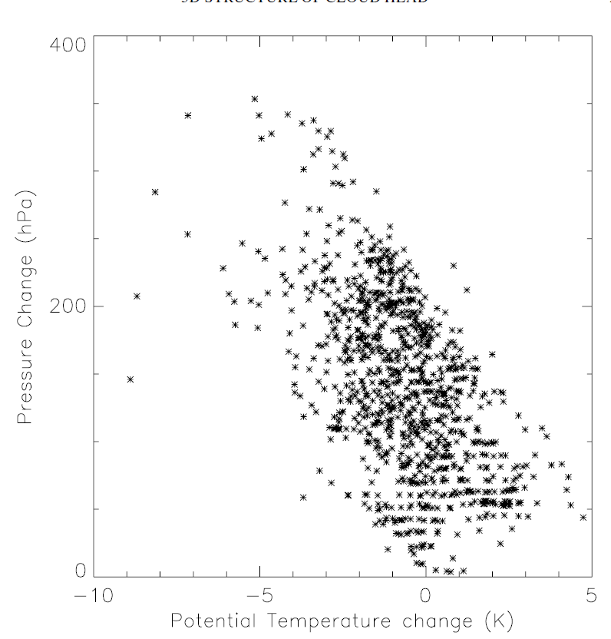
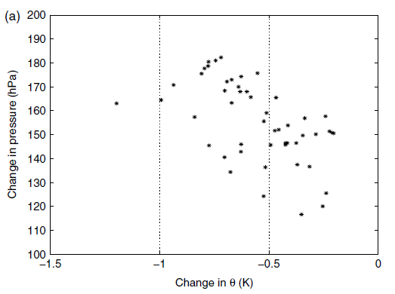
Mechanisms: evaporative cooling
But, simulation with evaporation of melting snow and rain turned off 2 hrs prior to sting jet descent showed no change in sting jet behaviour.
Baker et al. (2014), sting jet trajectories in an idealised cyclone.
Clark et al. (2005), sting jet trajectories in the Great October storm (1987)

Slide 6
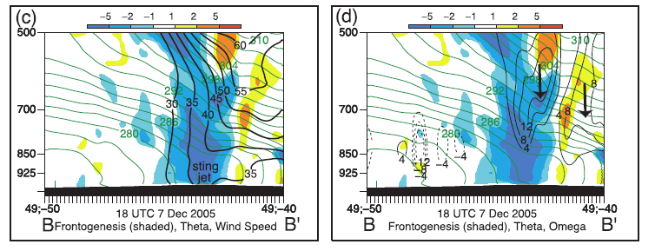
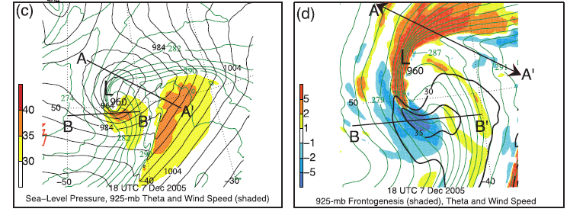
Mechanisms: frontolysis
?
Zoomed c.f. (c)
Schultz and Sienkiewicz (2013)

Slide 7
Method: Ensemble model configuration
Potential for sting jets in cyclones identified using precursor diagnostic (Martínez-Alvarado et. al 2013) applied to ERA-Interim data.
24 member ensemble simulations of three recent windstorms with evidence of sting jets: windstorms Friedhelm (8 Dec 2011), Robert (27 Dec 2011) and Ulli (3 Jan 2012).
Initial condition perturbations from operational MOGREPS (The Met Office Global and regional Ensemble Prediction System). Designed to generate model spread appropriate for forecast uncertainty at 1-2 days lead time.
Recently operational limited area (North Atlantic and European domain) configuration of the Met Office Unified Model (~12 km grid spacing and 70 vertical levels up to 38 km).
Notes:
Threshold 40ms-1 wind region connected to contour at 850 hPa (950-650 hPa). Theta-e threshold used to restrict analysis to cold sector strong winds. Forward and backward trajectories calculated and clustered using their lat/long/pressure/theta_e for the 5 hours preceding arrival in the low-level jet region.
Simulations all initialised 21Z previous day.

Slide 8
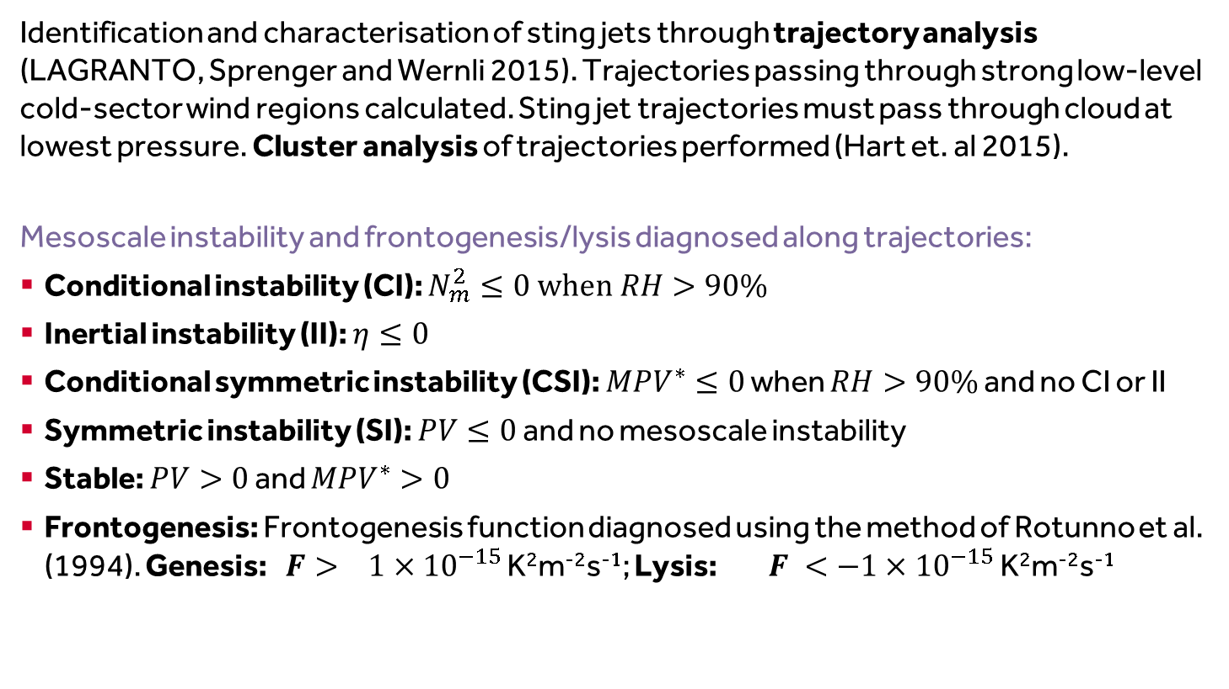
Method: Analysis of dynamical forcing and instabilities
Identification and characterisation of sting jets through trajectory analysis (LAGRANTO, Sprenger and Wernli 2015). Trajectories passing through strong low-level cold-sector wind regions calculated. Sting jet trajectories must pass through cloud at lowest pressure. Cluster analysis of trajectories performed (Hart et. al 2015).
Mesoscale instability and frontogenesis/lysis diagnosed along trajectories:
Conditional instability (CI): $N_{m}^{2}≤0 when RH>90\%$
Inertial instability (II): $η≤0$
Conditional symmetric instability (CSI): ${MPV}^{∗}≤0$ when $RH>90\%$ and no CI or II
Symmetric instability (SI): $PV≤0$ and no mesoscale instability
Stable: $PV>0$ and ${MPV}^{∗}>0$
Frontogenesis: Frontogenesis function diagnosed using the method of Rotunno et al. (1994). Genesis: $F> 1×{10}^{−15}$ K²m⁻²s⁻¹; Lysis: $F <−1×{10}^{−15}$ K²m⁻²s⁻¹
Notes:
Check this!

Slide 9
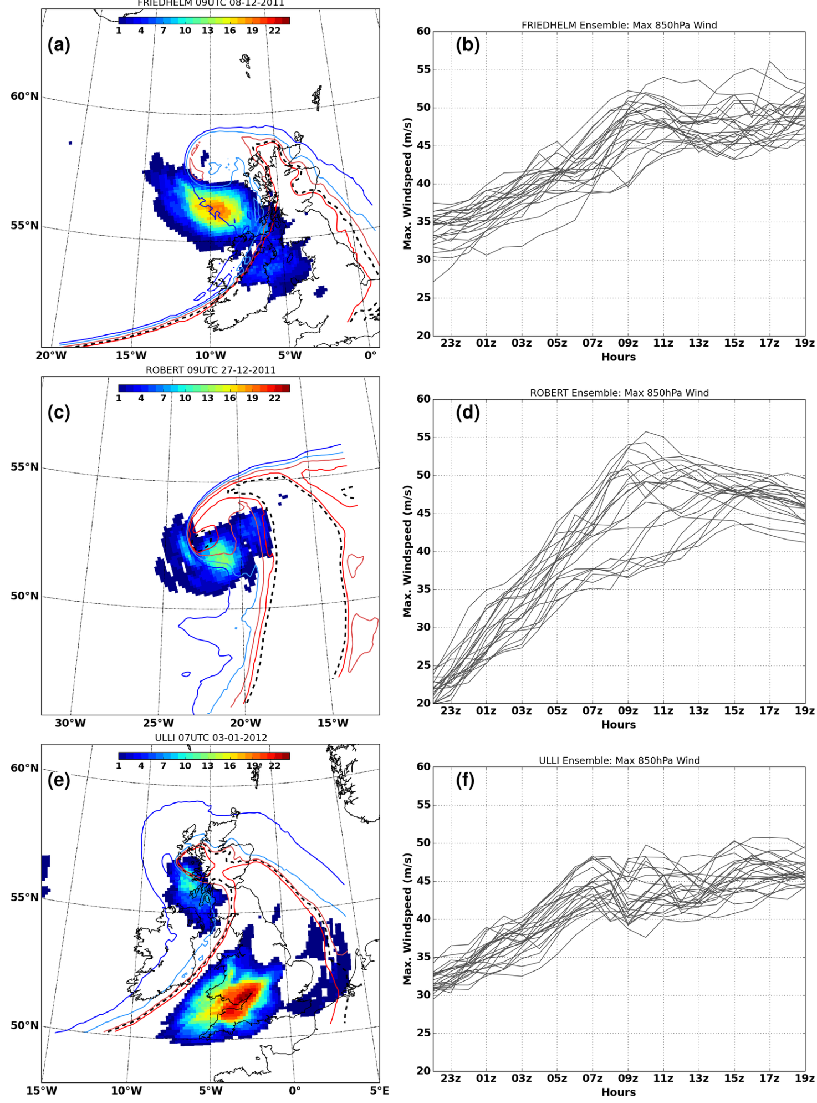
Scale-dependent variability
# members with |v|_{850hPa} > 40 ms⁻¹
Ensemble evolution of 850 hPa |v|_{max}
Friedhelm
Robert
Ulli
Analysis of trajectories entering the cool-sector low-level jet regions shows cold conveyor belt flows.
Strongly descending trajectories arrive ahead or on the southeastern flank of the conveyor belt flow.
We now focus on these descending trajectories…
Notes:
Figure 3: (a) Friedhelm grid-point count of ensemble members with windspeeds >40 ms􀀀1 (shaded)
0900 UTC 8 December 2011. (b) Ensemble evolution of maximum windspeed at 850hPa from
2200 UTC 7 December 2011. (c) as (a) for Robert at 0900 UTC 27 December 2011 and (d) as
(b) starting from 2200 UTC 26 December 2011. (e) as (a) for Ulli at 0700 UTC 3 January 2012
and (f) as (b) starting from 2200 UTC 2 January 2012. Control ensemble member e-contours are
overlaid and coloured from blue to red: (a) 293, 296, 299, 302K; (b) 294, 297, 300, 303K; (c) 293,
296, 299, 302K. Black dotted contour is cool-sector e-threshold at 850hPa: (a) Friedhelm 301K,
(b) Robert 305K, and (c) Ulli 300K.

Slide 10
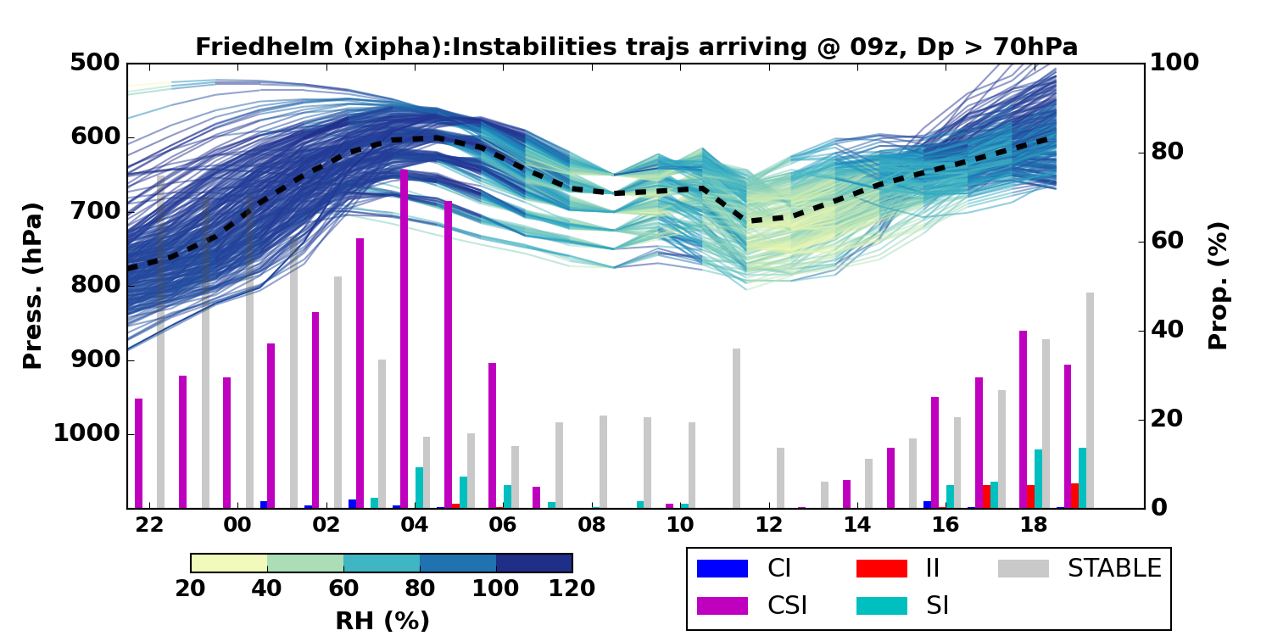
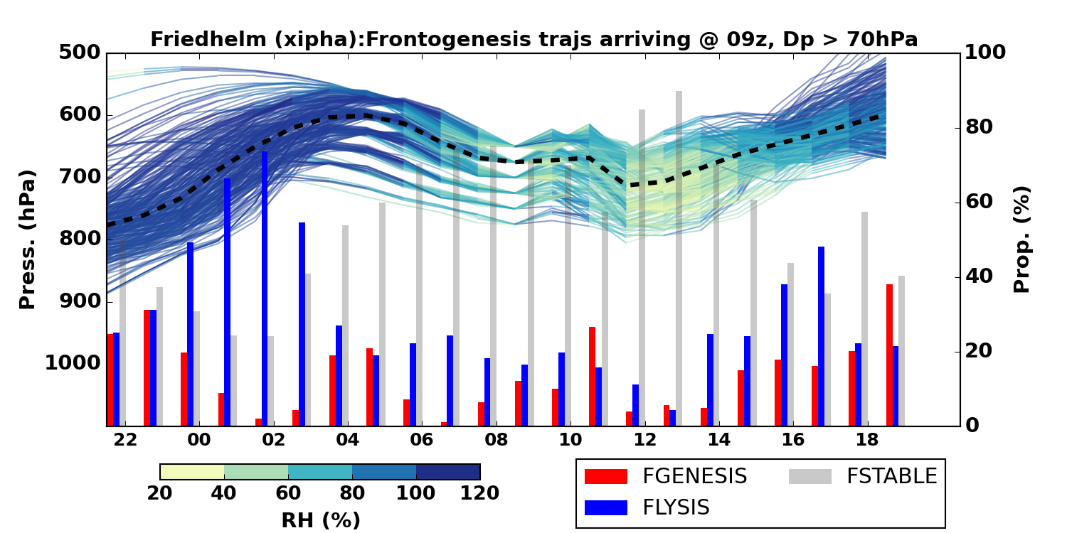
Windstorm Friedhelm
Identified as a sting jet cyclone by precursor diagnostic and Martínez-Alvarado et. al (2014). Deepened 44 hPa/ 24 h.
Most (22/24) ensemble members have sting jet trajectories arriving at 9Z and other arrival times.
Ensemble member trajectories characteristically have CSI prior to descent which then diminishes during descent. CI present prior to descent and II present during descent in some members.
Ensemble member trajectories generally pass through regions that are more frontolytic than frontogenetic but there is no consistent behaviour relative to the timing of the descent.
Suggestion: Example trajectories from Control (A) at 9am for DP>70
Notes:
Sting jet trajectories descent at least 50 hPa, and are saturated at start of descent.

Slide 11
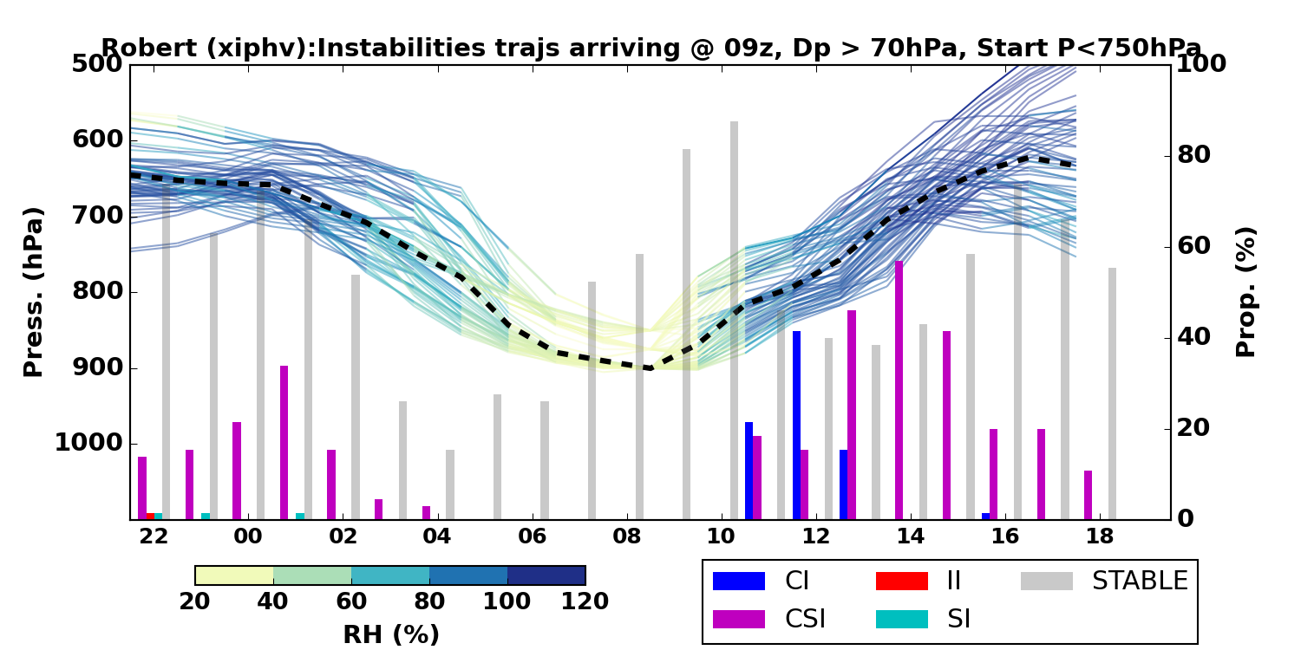
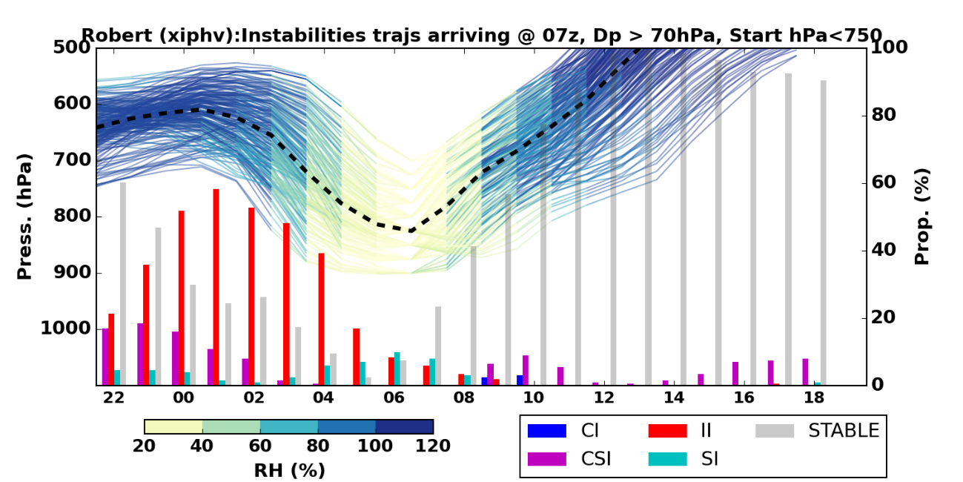
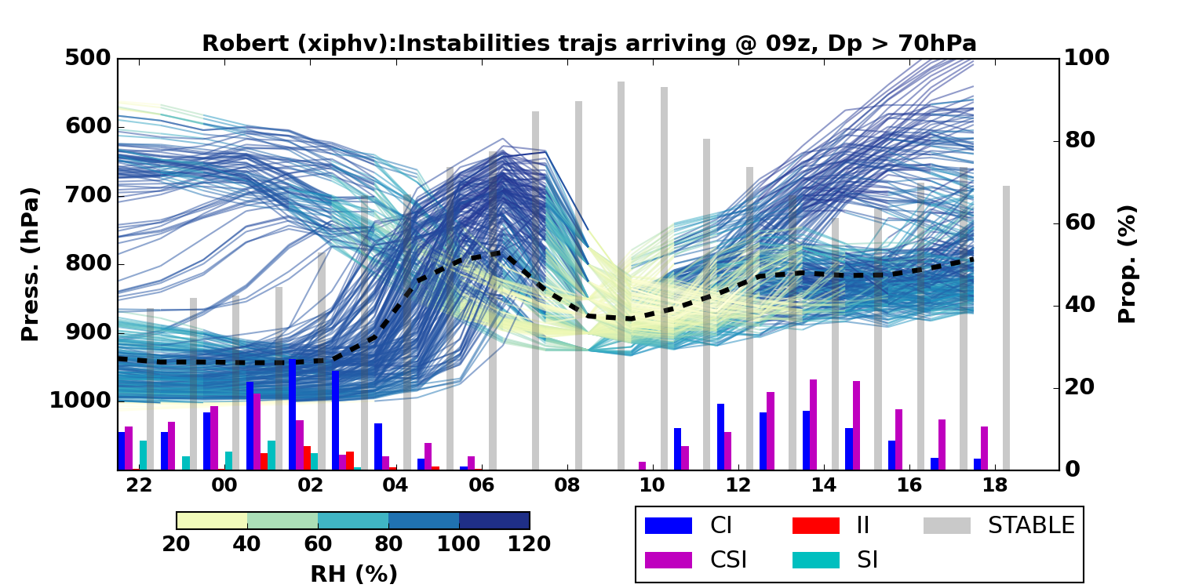
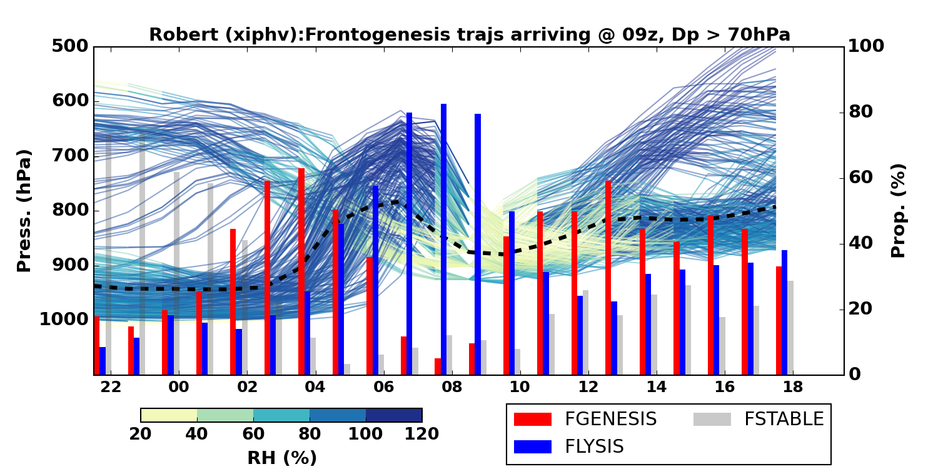
Windstorm Robert
Identified as a potential sting jet storm by precursor diagnostic though CSI points not in main cloud head. Deepened 36 hPa/24 h.
15/22 ensemble members have sting jet trajectories arriving at 9Z (similar at other times). Some ensemble members have no sting jet.
Two descending branches: 1. descent from 700 hPa over ~ 7 h; 2. ascent from 950 hPa to 800 hPa then descent over ~4 h.
Typically passage through frontogenetic regions during ascent then frontolytic regions during descent.
One ensemble member shows strong descent from 700hPa associated with II, at early times in storm.
Suggestion: Example trajectories from V at 7am (II) and 9am (Fronto)
For DP>70

Slide 12
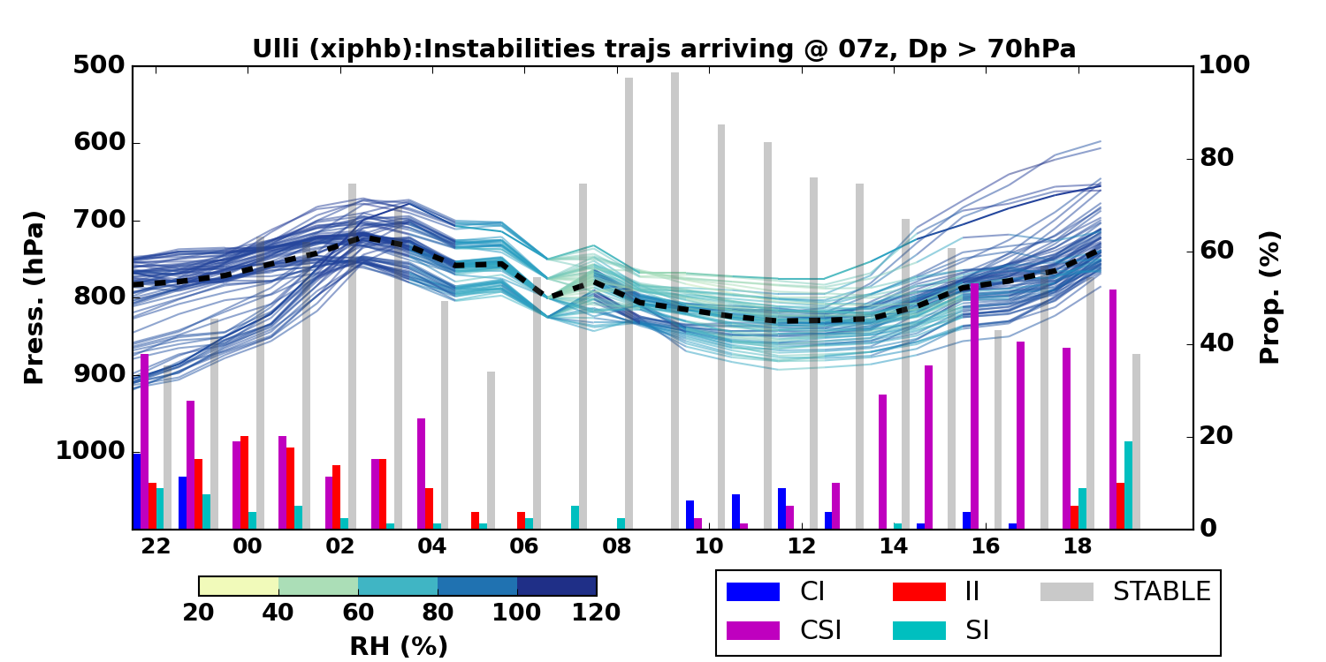
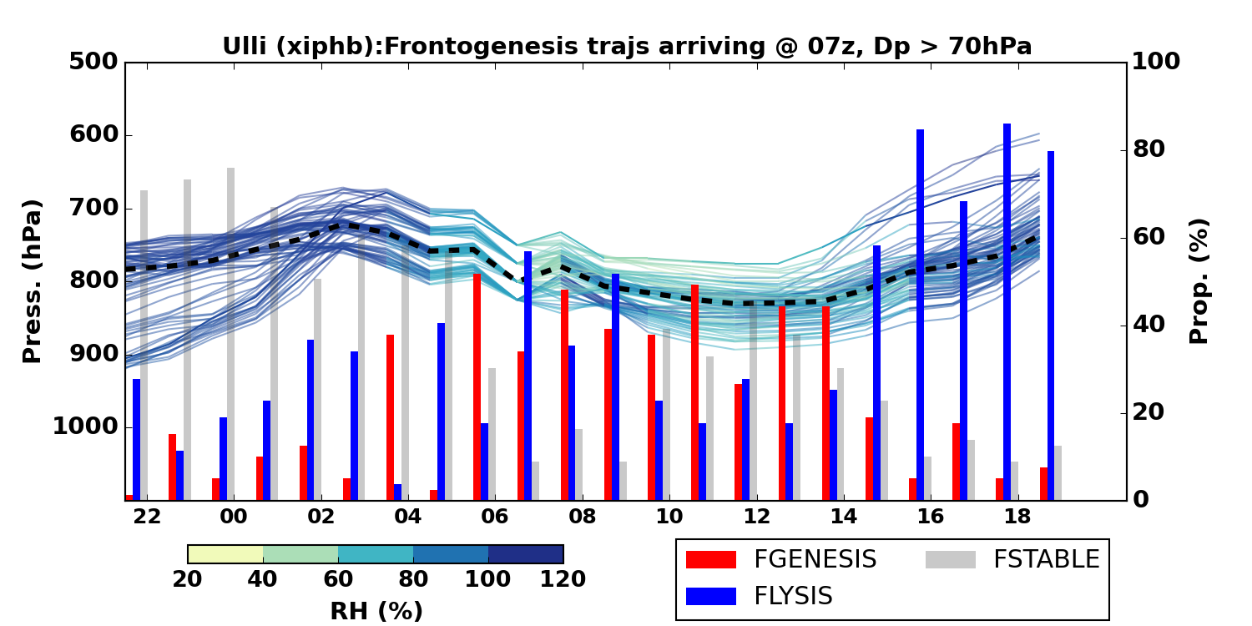
Windstorm Ulli
Not identified by precursor diagnostic as too few CSI points. Sting jet diagnosed by Smart and Browning (2013) arriving at about 4 Z but not associated with CSI. Deepened 33 hPa/ 24 h.
Although 20/24 ensemble had string jet trajectories arriving at 7Z the typical number of trajectories in each jet was far fewer than for Friedhelm and Robert. Weak descent magnitudes including in control member.
Some association of mesoscale instability during descent; no clear association with passage through frontogentic/frontolytic regions.
Notes:
Suggestion: Example trajectories from B at 7am (some II,CSI,SI), 9am nothing much and 11am (CSI) For DP>70
Note that the control has very little descent even of only 50hPa

Slide 13
Ensemble variability
Mesoscale
instability
Frontogenesis/lysis
X
V
CNTL
W
CNTL
B
FRIEDHELM
ROBERT
I
N
Q
D
O
F
P
H
W
L
B
U
X
CNTL
ULLI

Slide 14
Conclusions
Sting-jet-resolving short-range ensemble forecasts of three windstorms argued to contain sting jets have been presented.
Within a given storm, the ensemble members exhibit close synoptic-scale agreement but the characteristics of the sting jets vary widely in terms of the number of trajectories comprising them and their associated mesoscale instabilities and/or passage through frontogenetic/lytic regions. This suggests relatively weak predictability exists in sting jet strength.
Comparing storms, different the mechanisms associated with sting jet descent emerge despite the ensemble variability.
CSI release is characteristically associated with drying sting jets descending from the cloud head in the most intense windstorms. But other mesoscale instabilities (CI and II) and passage through the frontolytic regions typically found at the hooked tip of the bent-back front can also be associated with descent.
Mesoscale instabilities and strongly frontolytic regions are both typical characteristics of intense and explosively developing extratropical cyclones.

Slide 15
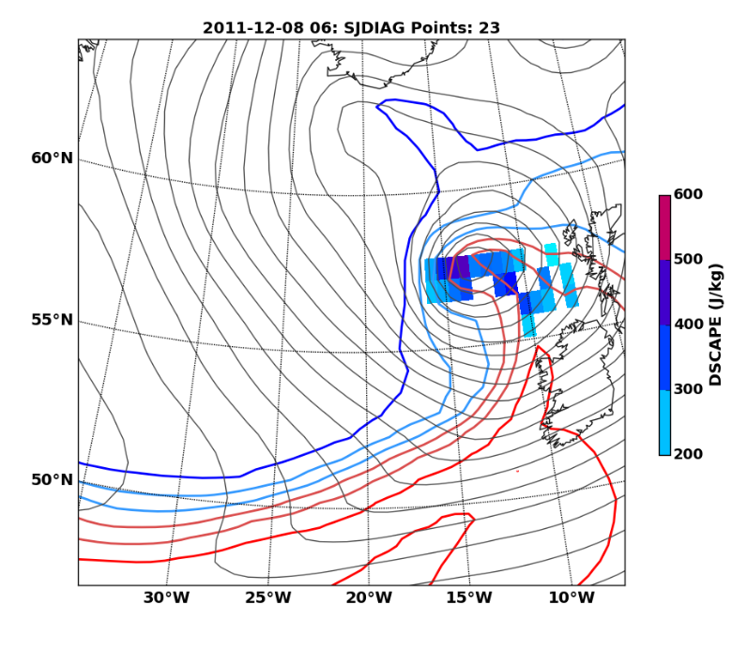
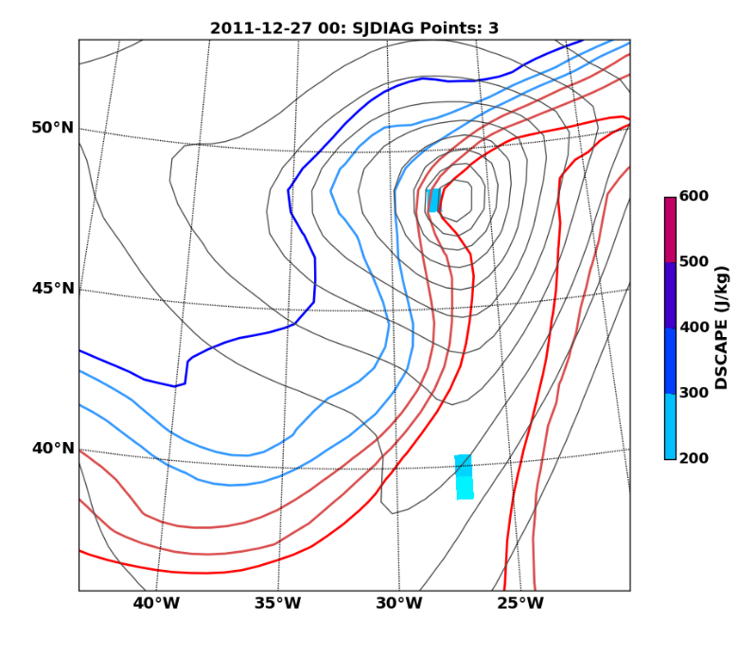
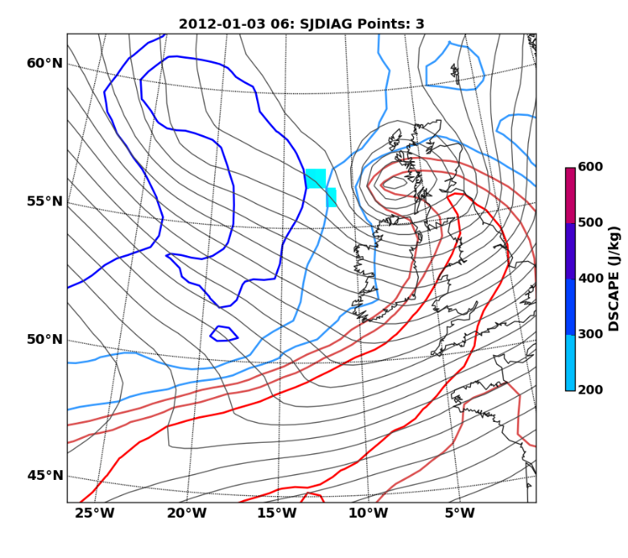
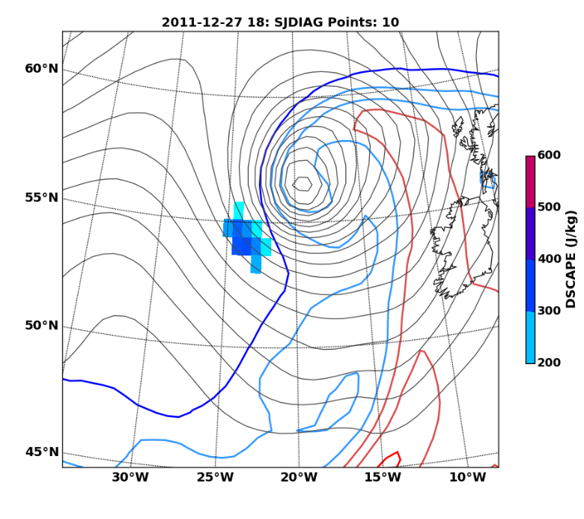
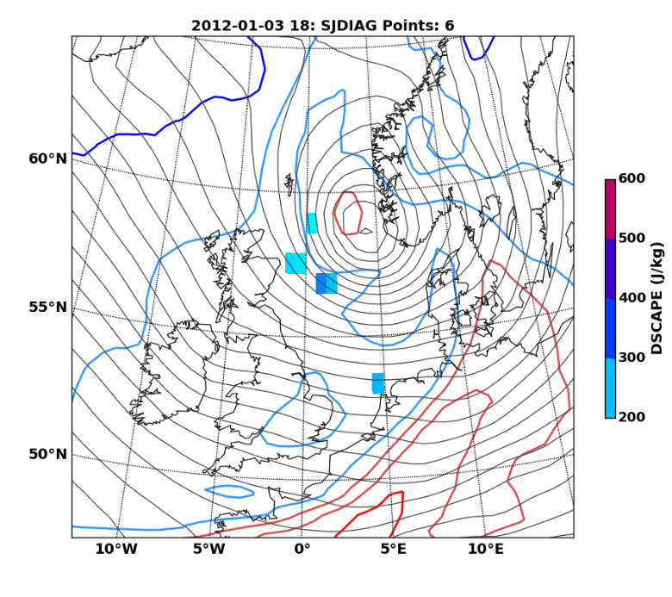
Precursor diagnostics
Friedhelm
Robert
Ulli

Slide 16
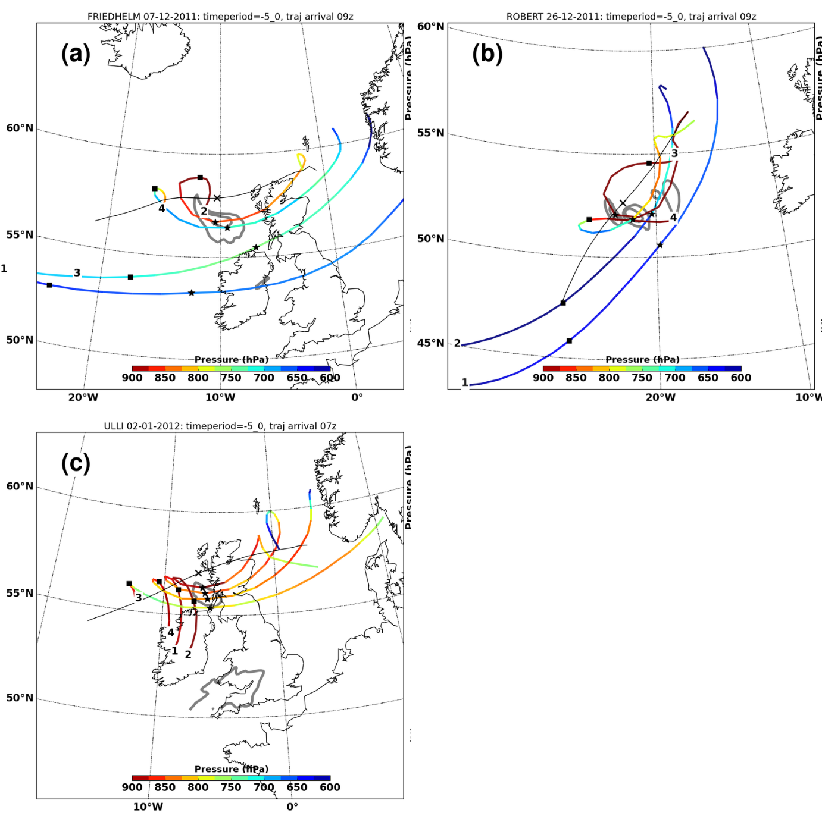
Cluster diagnostics
Notes:
Figure 4: Trajectory cluster class-medians summarising all trajectories entering cool-sector lowlevel
jet (grey contours at 850 hPa of 40 ms􀀀1 and 45 ms􀀀1) in: (a) Friedhelm at 0900 UTC 8
December 2011, (b) Robert at 0900 UTC 27 December 2011, and (c) Ulli at 0700 UTC 3 January
2012. Shading indicates height in hPa. Class medians are labelled by class number, with stars
and squares denoting position at tinitial and tinitial-5hours, respectively. Trajectories are plotted for
full time period 2200 UTC to 1800 UTC next day, however clustering was only performed using
period tinitial to tinitial-5hours. Classes with some descent are presented in Fig.5 for Friedhelm (a,
clas s#4), Robert (b, class #4), and Ulli (c, class #3).
19

