Slide 1
A first look at a contingency table for sting jets
Mesoscale group weekly meeting
01 November 2010
Oscar Martinez-Alvarado
Sue Gray
Peter Clark
Department of Meteorology
University of Reading

Slide 2
Sting Jets
Jet descending from mid-troposphere from the tip of the hooked cloud head
Located in the frontal fracture region
Mesoscale (~100 km) region of strong surface winds (that can reach more than 100 km/h) occurring in rapidly deepening extratropical cyclones
Transient (~ few hours), possibly composed of multiple circulations
Clark et al. (2005)

Slide 3
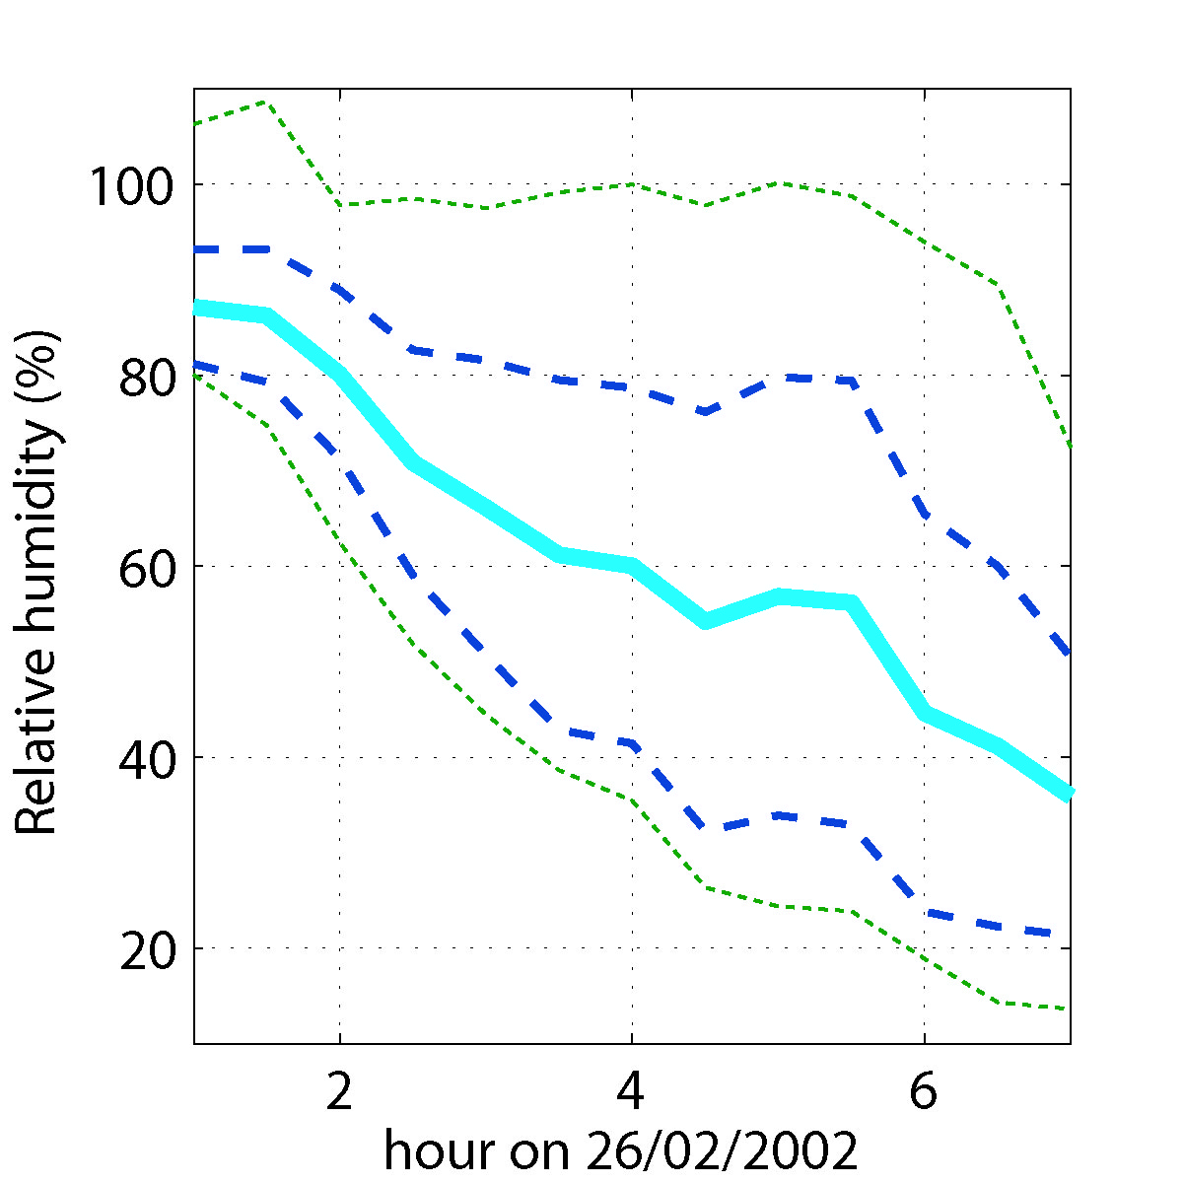
Storm Anna: Sting jet history along trajectories
A
B
Time series along Lagrangian trajectories following the sting jet showing the ensemble–mean (solid), ensemble-mean plus/minus one standard deviation (dashed) and instantaneous maxima and minima (dotted) of (A) pressure and (B) relative humidity.

Slide 4
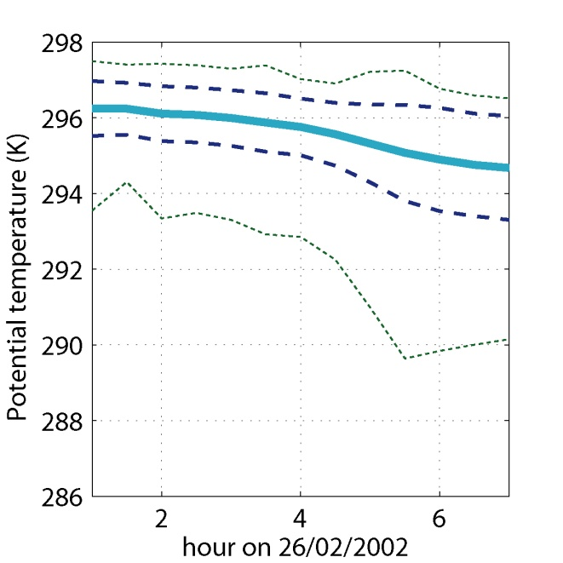
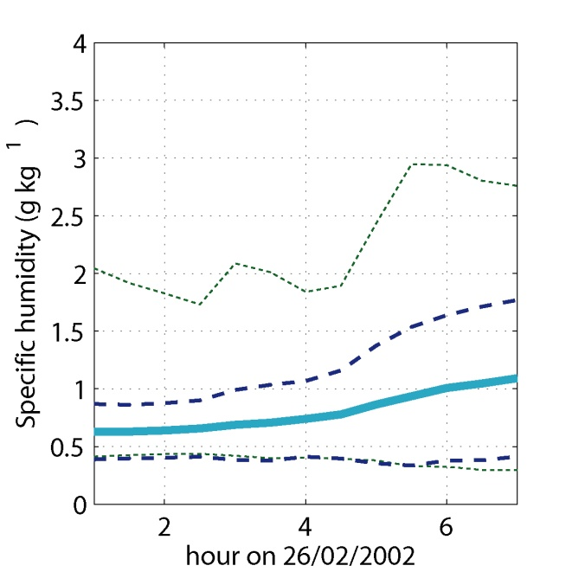
Storm Anna: Sting jet history along trajectories
C
A
B
Time series along trajectories following the sting jet showing the ensemble–mean (solid), ensemble-mean plus/minus one standard deviation (dashed) and instantaneous maxima and minima (dotted) of (A) wet-bulb potential temperature, (B) potential temperature, and (C) specific humidity.

Slide 5
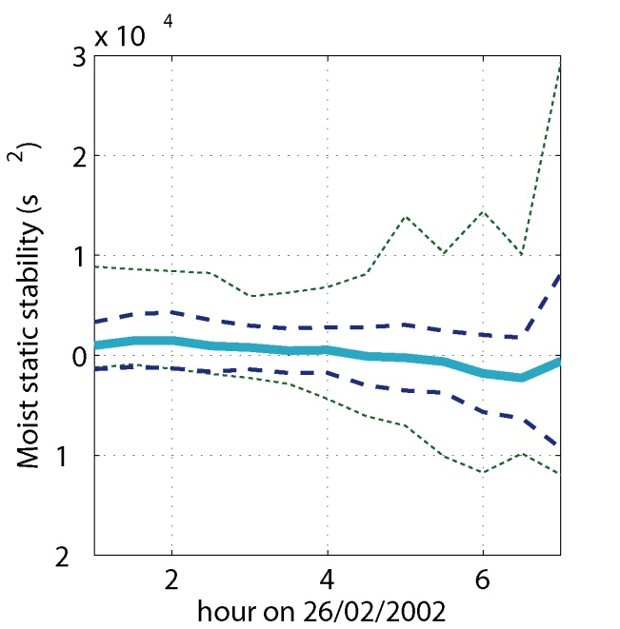
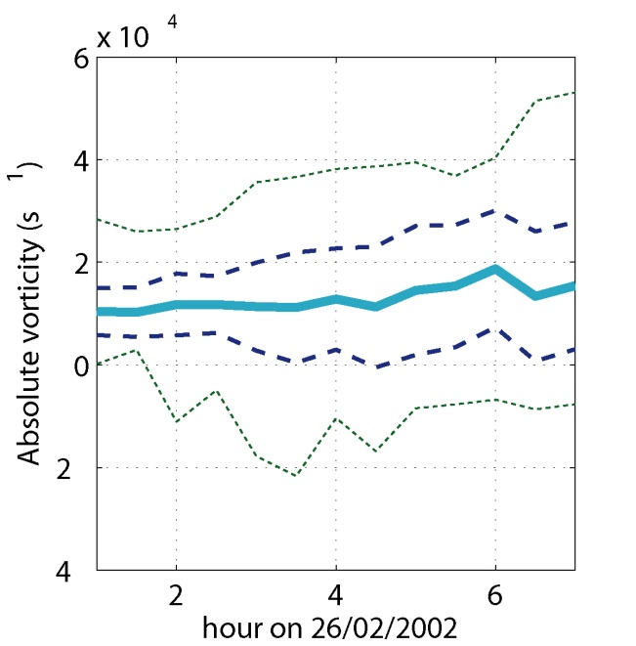
Storm Anna: Sting jet history along trajectories
C
A
B
Time series along trajectories following the sting jet showing the ensemble–mean (solid), ensemble-mean plus/minus one standard deviation (dashed) and instantaneous maxima and minima (dotted) of (A) moist potential vorticity, (B) moist static stability, and (C) absolute vorticity.

Slide 6
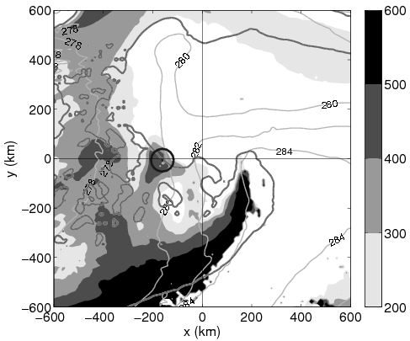
Storm Anna: Downdraught SCAPE
A
B
Downdraught SCAPE (DSCAPE, in J/kg) at (A) 0100 UTC and (B) 0300 UTC on 26 February 2002. The bold dark line represents the edge of the cloud head; the grey lines are lines of constant wet-bulb potential temperature (in K). The black circle marks the position of the sting jet at each time.

Slide 7
A climatology of sting jets
Minimum DSCAPE descending from the mid-troposphere
DSCAPE > E_{min} J kg⁻¹
Search restricted to upper levels
p_{start} < P_{max} hPa
Moisture needed to precipitate over unstable areas with large DSCAPE
RH > RH_{max} %
Location within a fractured cold front

Slide 8
Method output
Sting Jet case:
Track 35

Slide 9
Method output
Non-sting Jet case:
Track 31

Slide 10
Method output
Non-sting Jet case:
Track 59

Slide 11
Results from ERA-Interim
100 most intense cyclones (classified by absolute vorticity) in winter months (DJF) in ERA-Interim (1989—2009).
23 cyclones present instability in the proximity of the cyclone centre.
This instability is not always located in optimal locations to generate to sting jets

Slide 12
Verification
No available surface wind dataset with appropriate temporal and spatial resolution
Verification method relies on high-resolution LAM simulations (12 km)
The techniques are the same used in previous case studies
Identification of regions of dry, strong winds close to the surface, and in the frontal fracture region
Backward trajectories starting from (ending up at) those regions
Very computationally expensive

Slide 13
Verification
Extensive exploration of LAM output
Between two and three days of hourly data for each case
Two criteria to choose suitable regions
Penetration
Size (volume) of strong wind region
Trajectories classified according to two parameters
Period of descent
Minimum descent
The combination of these two parameters leads to a mean descent rate

Slide 14
Verification output
Sting Jet case:
Track 35

Slide 15
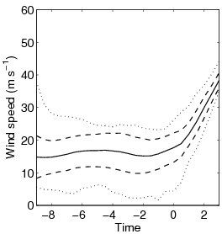
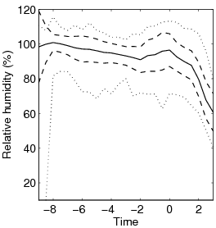
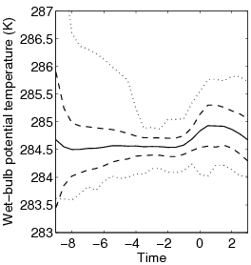
Verification output
Sting Jet case: Track 35

Slide 16
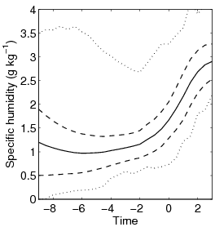
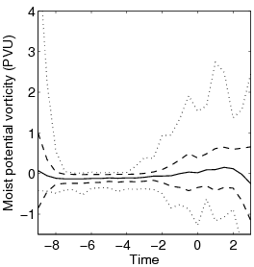
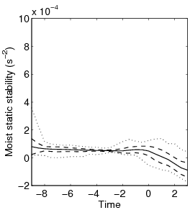
Verification output
Sting Jet case: Track 35

Slide 17
Contingency tables (At last!)
A table in which each observation is classified in two or more ways (DeGroot and Schervish, 2002) .
Most basic analysis: Testing independence between causes (presence of instability as the method’s basis) and effects (presence of strong surface winds related to descending jets)
 | Obs SJ | Non-obs SJ
0 | a | b | r = a + b
1 | c | d | s = c + d
 | m = a + c | n = b + d | N

Slide 18
Contingency tables
Ideal contingency table.
 | Obs SJ | Non-obs SJ
0 | 0 | b | r = b
1 | c | 0 | s = c
 | m = c | n = b | N

Slide 19
Contingency tables
Independent classifications.
 | Obs SJ | Non-obs SJ
0 | rm/N | rn/N | r
1 | sm/N | sn/N | s
 | m | n | N

Slide 20
Contingency tables
The contingency table after 9 (!) verified cases
Including 100-hPa and 50-hPa minimum descent cases
Only including 100-hPa minimum descent cases
 | Obs SJ | Non-obs SJ
0 | 0 | 3 | 3
1 | 5 | 1 | 6
 | 5 | 4 | 9
p-value = 0.048 (using exact Fisher test)
 | Obs SJ | Non-obs SJ
0 | 0 | 3 | 3
1 | 4 | 2 | 6
 | 4 | 5 | 9
p-value = 0.119 (using exact Fisher test)

Slide 21
Final remarks
Even with very few results the method to find instability associated with sting jets is giving satisfactory results.
Many more verified cases are also necessary to properly characterise a contingency table.
The amount of data can be useful for more extensive sting-jet (and extra-tropical cyclone) studies.

Slide 22
References
Clark, P. A., K. A. Browning, and C. Wang, 2005: The sting at the end of the tail: Model diagnostics of fine-scale three-dimensional structure of the cloud head. Quart. J. Roy. Meteor. Soc., 131, 2263-2292.
DeGroot, M.H. and M. J. Schervish, 2002: Probability and statistics. (3rd ed.). Addison-Wesley.

