Slide 1

Eclipse-induced wind changes over the British Isles on the 20 march 2015
Department of Meteorology
Suzanne Gray and Giles Harrison

Slide 2
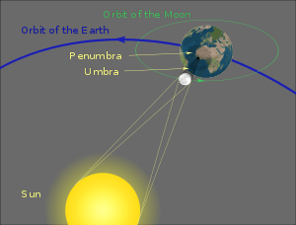
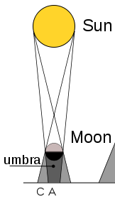
What is a solar eclipse?

Slide 3
Predicted meteorological effects of a solar eclipse?
Cold anomaly due to loss of solar irradiance; peak anomaly lags eclipse maximum by ~15min (well established).
Reduction in surface windspeed due to thermal stablization of the cooled boundary layer (well established).
Wind direction changes have been attributed to eclipses but little agreement.
Eclipse cyclone, postulated by Clayton (1901) but not well established: cold outflow of air from the umbra leading to negative surface pressure anomaly (positive MSLP anomaly) with outer ring of positive pressure anomaly. Anticyclonic circulation associated with the cold core.
Other authors have attributed changes to synoptic evolution, see breezes or mountain slope flows.
Anecdotal reports of surface wind effects have led to the suggestion of an ‘eclipse wind’. Possibly, mythical – caused by increased subjectivity of observers to small wind fluctuations when average wind speed is reduced?
Notes:
note pressure reduction only evident in surface pressure, not in mean sea level pressure which
may rise due to the cooling.

Slide 4
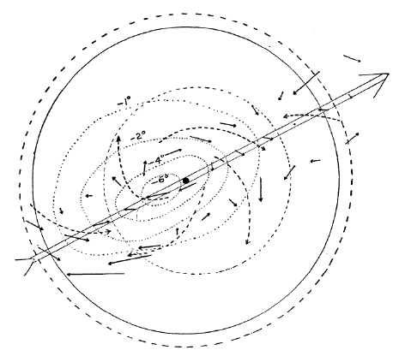
Clayton’s (1901) eclipse cyclone model
2500 miles
Totality path
Lunar shadow relative recorded values of temperature, windspeed and wind direction (15-min data from 6 met stations).
1500 miles
28 May 1900 eclipse
penumbra
Low pressure limit
High pressure limit
Notes:
Anticyclonic circulation of wind around the centre of the eclipse, extending outward to a distance of about 1500 miles from the umbra. Beyond this (broken line) cyclonic circulation about 1000 miles in width extending to the edge of the penumbra. Beyond this are indications of more outflowing winds.

Slide 5
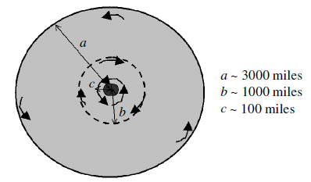
Clayton’s (1901) eclipse cyclone model
Limit of cold core
Simplified and revised version of Clayton’s model based on observations at Reading and Camborne during August 1999 eclipse.
Penumbra
Umbra
Aplin and Harrison (2003)

Slide 6
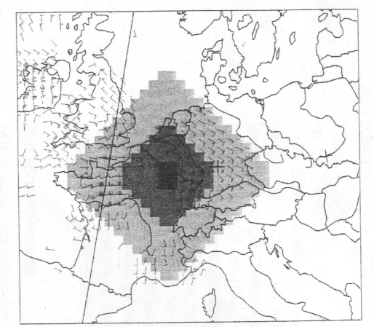
Previous studies
Prenosil (2000) found a slight cyclonic circulation attributable to the eclipse by comparison of model simulations with and without an eclipse (63.5 km gridspacing).
10-m wind forecast at 1030 UTC 11 August 1999 (with – without eclipse)

Slide 7
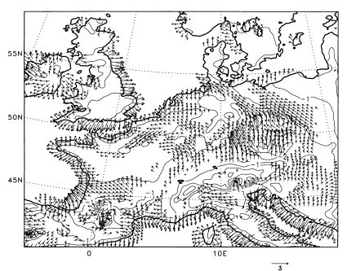
Previous studies
Gross and Hense (1999) predicted outflow from cold continental areas - similar to a large-scale land-sea circulation modified by orography (14 km gridspacing).
Wind vectors with – without eclipse at 20 m at 1240 UTC for an eclipse on 11 August 1999 under optimal weather conditions

Slide 8
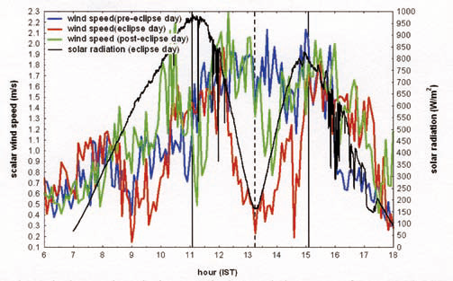
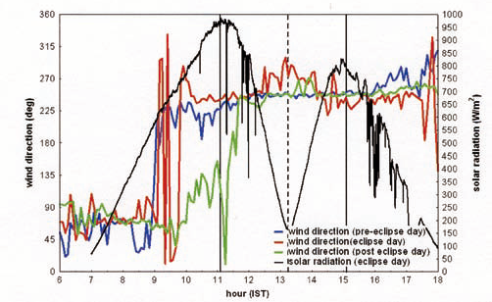
Previous studies
Wind speed
Wind direction
Windspeed decrease during eclipse
Veering, then backing, during eclipse attributed to sea-breeze changes
Namboodiri et al. (2011): Annular solar eclipse of 15 January 2010 over Thumba, India

Slide 9
Previous studies
MIDAS data
UKV output
Cooling of ~1ºC.
Mean regional wind decrease of ~0.7ms⁻¹ and backing in wind direction (anticlockwise turning in the direction the wind is going towards) of ~17º
Gray and Harrison (2013). 11 August 1999 eclipse

Slide 10
Aim
To determine eclipse-induced effects on wind direction and speed in the 20 March 2015 eclipse (the most recent eclipse to have affected the UK).

Slide 11
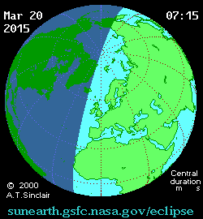
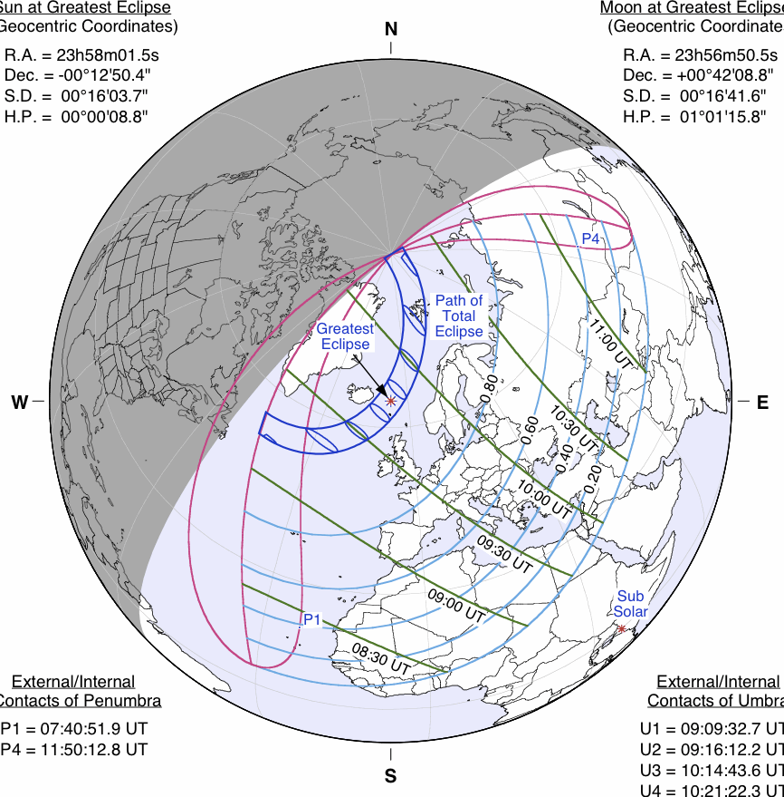
The eclipse path
The eclipse path through Europe on 20 March 2015 (Figure courtesy of NASA)
Notes:
Exceptional in path over densely populated land masses and in occurring near midday in summer.

Slide 12
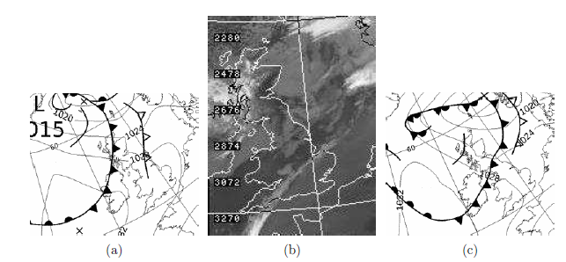
Synoptic situation
06 UTC
0922 UTC
12 UTC
Notes:
Figure 1. (a) Met Office surface analysis at 06 UTC, (b) Infra-red satellite image at 0922 UTC, and (c) Met Office surface
analysis at 12 UTC. All for 20 March 2015. Surface analyses are c Crown copyright. Satellite image is courtesy of
Dundee Satellite Receiving Station.

Slide 13
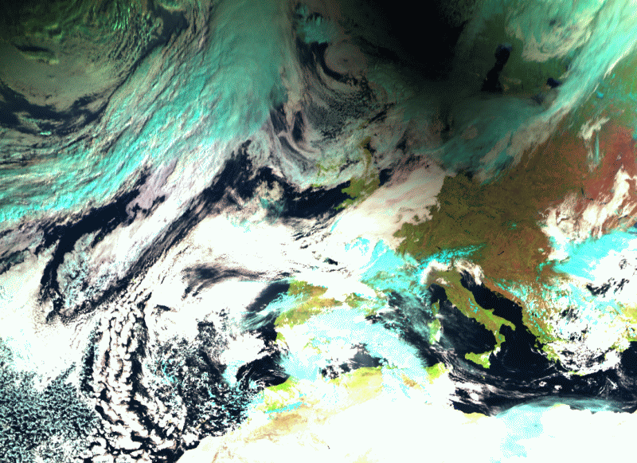
The observed eclipse
copyright © 2015 EUMETSAT

Slide 14
Methodology
Compare hourly meteorological measurements from two dense station networks with a high spatial and temporal resolution model forecast ignorant of the eclipse.
Specifically, compare the UK MIDAS Land Surface Stations dataset and Vaisala roadside network with a operational MetUM UKV model forecast i.e. determine synoptic-evolution relative changes.
Demonstrate that the eclipse induced changes in meteorological variables are significant relative to values estimated from times before and after the eclipse.
Use the model forecast to demonstrate that a similar signal would not have been expected in the absence of the eclipse.

Slide 15
Vaisala Road Weather Station (RSW200)

Slide 16
Observation sites
Notes:
Figure 2. Locations of observational stations where temperature data are available at 12 UTC on 20 March 2015 from (a)
the MIDAS dataset and (b) the Vaisala roadside dataset. Magenta, black, green and red boxes in both panels mark the
’Central southern England’, ’Wales’, ’Midlands1’ and ’Midlands2’ regions respectively, as specified in Table 1.

Slide 17
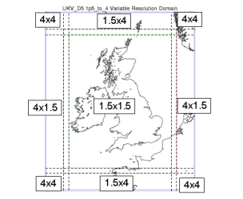
Met Office model
Operational weather forecast model, the Unified Model.
1.5 km horizontal grid spacing across most of UK, increasing to 4 km in the rim. 70 vertical levels with lid at 40 km height.
Runs 4 times every day for 36 hours, starting at 03, 09, 15, 21 UTC.
Assimilates latest observations using 3D variational assimilation.
Nested within global model, ~17 km horizontal gridspacing.
Uses suites of parametrizations to represent subgridscale processes.
But, no operational `eclipse parametrization’.

Slide 18
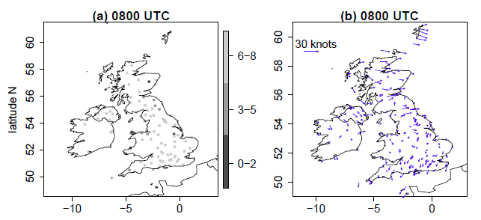
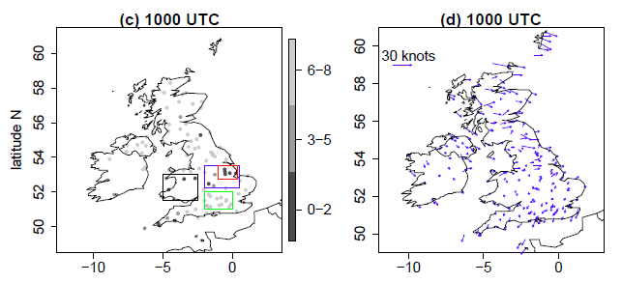
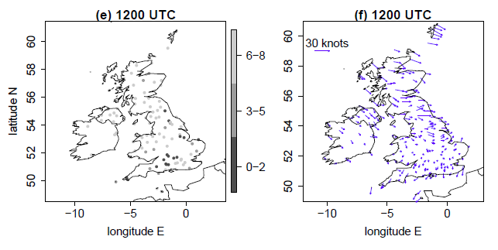
MIDAS observations
10-m wind
Cloud cover
Notes:
Figure 3. (left column) Total cloud cover amount at MIDAS stations (oktas) and (right column) 10-m wind vectors at
MIDAS stations (with scale indicated by representative length in the upper-left of each plot) at (top row) 08, (middle row)
10 and (bottom row) 12 UTC. Note that an okta is a unit of measurement indicating the proportion of sky covered by cloud
ranging from 0 (completely clear sky) to 8 (completely overcast) with a station value of 9 indicating that the sky is totally
obscured.

Slide 19
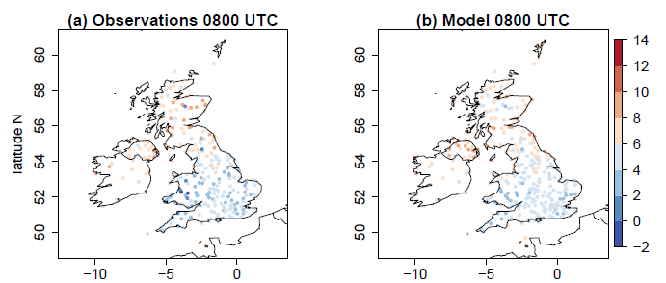
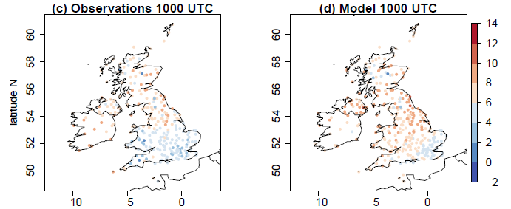
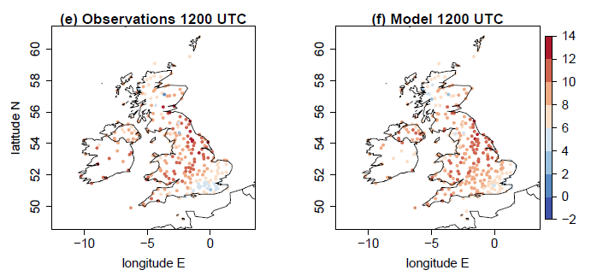
MIDAS observations vs model
2-m temperature
Notes:
Figure 4. 2-m temperature (◦C) from (left column) MIDAS stations and (right column) model temperatures interpolated to
MIDAS station locations at (top row) 08, (middle row) 10, and (bottom row) 12 UTC.

Slide 20
MIDAS observations vs model
Positive RH change implies obs. RH increasing faster than model RH
Positive T change implies obs. warming faster than model
Notes:
Figure 5. (top row) MIDAS observations minus model difference for (a) 2-m temperature (◦C) and (b) 2-m relative
humidity (%) at 0900 UTC. (middle row) Change in (observation - model) difference between 1000 and 0900 UTC for
(c) temperature and (d) relative humidity. (bottom row) As for middle row but for change in difference between 1100 and
1000 UTC. A positive value for temperature difference or change in difference indicates either warmer observed relative
to modelled temperature (top row) or a warming with time of the observed relative to the modelled temperature (middle
and bottom rows). A positive value for relative humidity difference or change in difference indicates either increased
observed relative to modelled relative humidity (top row) or an increase with time of the observed relative to the modelled
relative humidity (middle and bottom row). Station values are averaged over 1◦ longitude by 0.5◦ latitude regions. Small
magnitude values are shaded light grey (-0.2 to 0.2◦C; -1 to 1%).

Slide 21
MIDAS observations vs model
Positive direction change implies obs. wind backing relative to model wind
Positive speed change implies obs. wind strengthening relative to model wind
Notes:
Figure 6. (top row) MIDAS observations minus model (interpolated to station locations) difference for (a) 10-m speed
(knots) and (b) 10-m direction (◦) at 0900 UTC. (middle row) Change in (observation - model) difference between 1000
and 0900 UTC for (c) speed and (d) direction. (bottom row) As for middle row but for change in difference between 1100
and 1000 UTC. A positive value for speed difference or change in difference indicates either stronger observed relative
to modelled wind (top row) or a strengthening with time of the observed relative to the modelled wind (middle and bottom
rows). A positive value for direction difference or change in difference indicates either a backed observed relative to
modelled wind (top row) or a backing with time of the observed relative to the modelled wind (middle and bottom rows).
Station values are averaged over 1◦ longitude by 0.5◦ latitude regions. Small magnitude values are shaded light grey
(-0.2 to 0.2 knots; -4 to 4◦). Note that in panel (a) there is one data value of -14 knots; this is shaded in the colour indicted
as the -10 to -4 knot range.

Slide 22
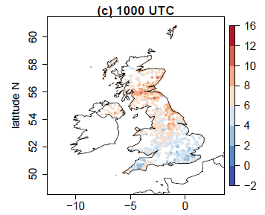
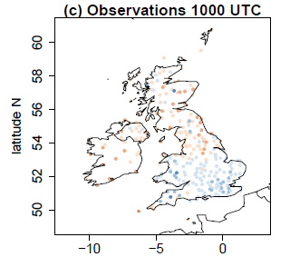

Roadside observations
Roadside temperature
MIDAS temperature

Slide 23
Roadside observations vs model
Positive direction change implies obs. wind backing relative to model wind
Positive speed change implies obs. wind strengthening relative to model wind
Notes:
Figure 8. As for Fig. 6 but for comparison of the roadside observations with the model. All data values are within ranges
indicated on the colour bars.

Slide 24
1-min MIDAS timeseries: wind speed
Notes:
Figure 9. One-minute temporal resolution MIDAS 10-m wind speed data (knots) as a function of time for sets of stations
in four regions: (a) central southern England; (b) Wales, (c) the Midlands, and (d) a reduced area Midlands. Stations
are selected within the latitude and longitude limits at which one-minute wind speed data is available at all times and
the speed is non-zero at all times. Vertical dashed line marks the approximate time of the maximum partial eclipse
(0930 UTC). Thick red line shows the mean value with error bars given by ―

Slide 25
1-min MIDAS timeseries: wind direction
Notes:
Figure 10. As Fig. 9 but for wind direction. Wind directions are described conventionally as the angle clockwise from
North that the wind is coming from (e.g. an angle on 90◦ is an easterly wind). Stations are selected within the latitude
and longitude limits at which one-minute wind speed data and direction data are available at all times and the speed is
non-zero at all times. Model forecast values interpolated to station locations are overplotted in orange diamonds (rather
than as box and whiskers as in Fig. 9); black diamond denotes mean values. Number of stations plotted is the same as in
Fig. 9. Note y-axis varies between panels.

Slide 26
20-min roadside timeseries: wind speed
Notes:
Figure 11. As Fig. 9 but for 20-minute temporal resolution roadside wind speed data. Number of stations plotted is (a) 26,
(b) 19, (c) 44 and (d) 12.

Slide 27
20-min roadside timeseries: wind direction
Notes:
Figure 12. As Fig. 11 but for wind direction. Number of stations plotted is the same as in Fig. 11.

Slide 28
20-min roadside timeseries: temperature and RH
Notes:
Figure 13. 20-minute temporal resolution roadside observations as a function of time for (a) temperature and (b) RH in
the Midlands1 region only. Stations are selected within the latitude and longitude limits at which 20-minute (a) temperature
and (b) RH data are available at all times. Vertical dashed line marks the approximate time of the maximum partial eclipse
(0930 UTC). Thick red line shows the mean value with error bars given by ―

Slide 29
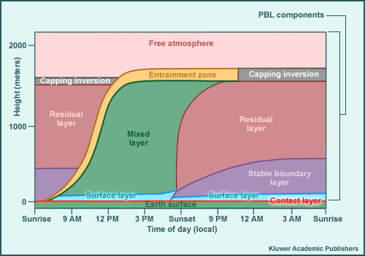
Typical boundary layer evolution
Comet MetEd

Slide 30
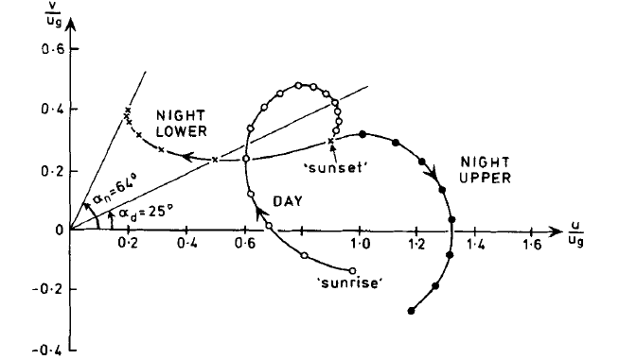
Theory for eclipse wind backing?
During an eclipse the boundary layer stablises – as occurs at sunset.
Wind in a stable layer near the ground could be undergoing a damped inertial oscillation, and be backed w.r.t. the geostrophic windspeed (and the residual layer above the stable layer, where the undamped oscillation occurs).
Hodograph of model results for a three-layer model (lower and upper boundary layer and free atmosphere) and linear stress parametrisation. Thorpe and Guymer (1977): ‘The nocturnal jet’.
Notes:
Figure 3. Hodograph of model results (appropriate to northern hemisphere mid-latitudes) for linear stress
law. Labels 'night lower', 'night upper', and 'day' refer to the layers h < h_n h > h_n and h < h_d respectively.
Points are at hourly intervals and the length of day is 16 hours. The following values have been used:
K_s =0.04ms-', h_n=200m, and h_d = 1OOOm.
K_s = C_D u
After sunset the wind
in the lower layer is rapidly modified by friction and decreases in magnitude to a steady
value of about 0.4 of the geostrophic speed. The cross-isobar flow increases and alpha_n reaches
a steady value of approx 64 degrees. It is interesting to note that, due to the increase in k_s the winds in
Fig. 4 have a larger cross-isobar flow angle of approx 70° and a lower wind speed

Slide 31
Theoretical model results
upper level
lower level
Notes:
Figure 14. Illustrative calculations of the variation in wind direction for atmospheric boundary layer heights of 1000 m
(dashed lines) and 200 m (solid lines), using the theoretical model of ref. [26]. (a) Hodograph showing the wind vectors
at hourly intervals, beginning from initial wind vector components u and v of 3 ms−1 (at t = 0). The values of u and v
have been normalised by an assumed geostrophic wind speed ug of 10 ms−1. (b) Time series of the calculated wind
directions for the two boundary layer heights. (Drag coefficient CD = 8 × 10−3, and Coriolis parameter calculated for
50◦N.)

Slide 32
Conclusions
In addition to the well-documented cooling, increase in RH and slackening of the near-surface wind speed, wind direction changes can also be attributed to an eclipse.
While confidence in wind speed changes (~2 knots weakening in clear skies) is similar to that in temperature and RH changes, these far exceed confidence in the wind direction changes.
The wind direction changes (backing of ~20º in clear skies) have been found to be robust across the two eclipse events in 1999 and 2015, with the latter analysis here using two independent observation networks.
Some theoretical support for the wind direction changes identified in the clear sky inland regions is provided by considering the rapid eclipse-induced cooling as analogous to sunset, leading to the formation of nocturnal wind structures.
This may provide a more parsimonious explanation for the surface wind direction changes observed than the substantial mesoscale structure postulated by Clayton.

Slide 33
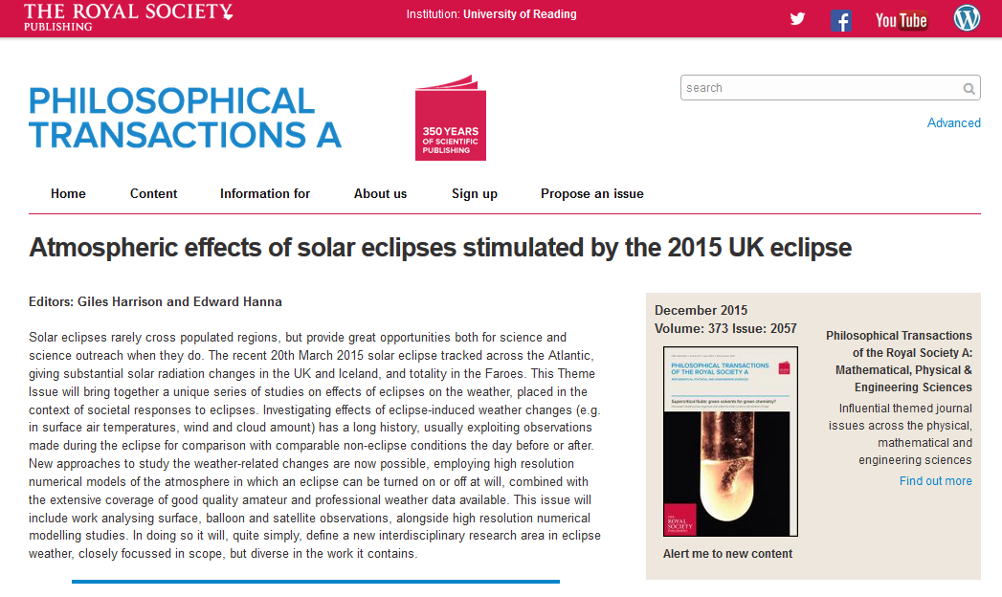
All the results are being gathered in the same place as those of Edmund Halley in 1714:
to be published on 22nd August 2016

Slide 34
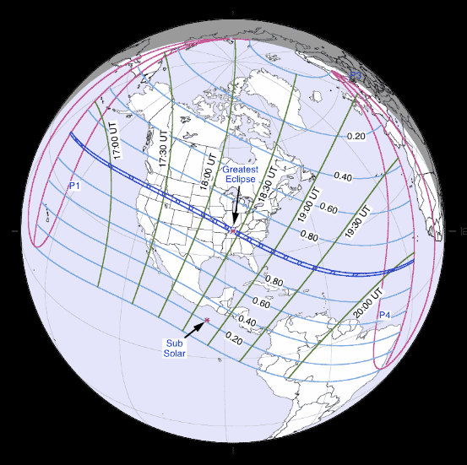
Total solar eclipse:
21 August 2017
Next total eclipse: visible over the USA.
The eclipse path (courtesy of NASA)

Slide 35
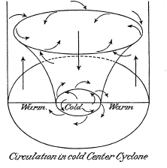
Clayton’s (1901) eclipse cyclone model
Cyclonic circulation associated with cold-core cyclone based on Ferrel (1877).
From Bigelow (1901) in his critique of Clayton’s model. Concluded that Clayton’s observations did not show a cold-core cyclone.

Slide 36
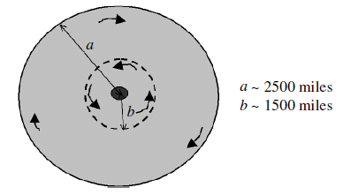
Clayton’s (1901) eclipse cyclone model
Limit of cold core
Simplified version of Clayton’s model
Penumbra
Umbra
Aplin and Harrison (2003)

