Slide 1
Potential vorticity structures in extratropical cyclones and their relationship to forecast evolution and surface winds
Department of Meteorology
Suzanne Gray

Slide 2
Conceptual cyclones
Martínez-Alvarado et al. (2014)
Notes:
FIG. 1. The structure of a Northern Hemisphere Shapiro–Keyser cyclone in development
stage 3: surface cold front (SCF); surface warm front (SWF); bent-back front (BBF); cold
conveyor belt (CCB); sting jet airstream (SJ); dry intrusion (DI); warm conveyor belt (WCB);
WCB anticyclonic branch (WCB1); WCBcyclonic branch (WCB2); and the large3 represents
the cyclone center at the surface, and the gray shading represents cloud top (see also Fig. 2).

Slide 3
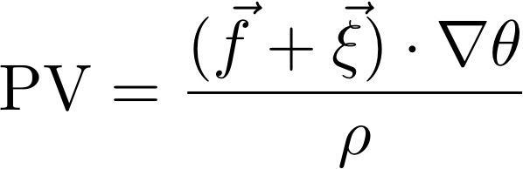
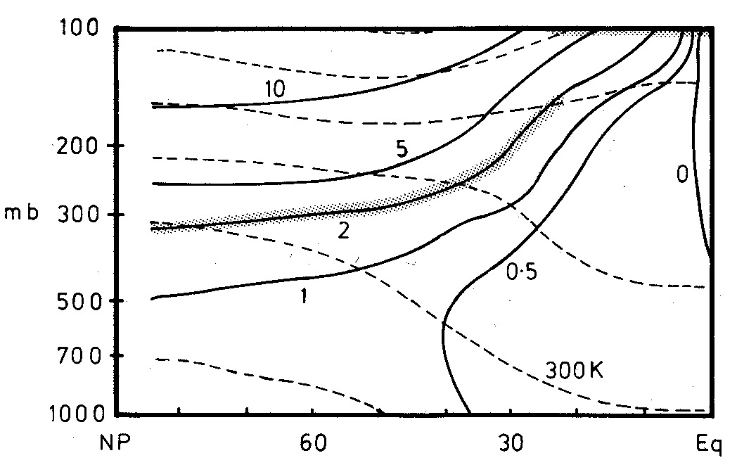
Potential vorticity (PV)
tropopause
Potential vorticity is conserved following fluid parcels for adiabatic frictionless flow.
This makes it a good tracer for upper-tropospheric air over several days.
330K
270K
Climatology of PV (in PVU) and q in NH winter (Hoskins, 1990)
Notes:
A summary of the climatological PV and theta distribution below 100mb in the NH winter. PV in PVU, theta every 30K

Slide 4
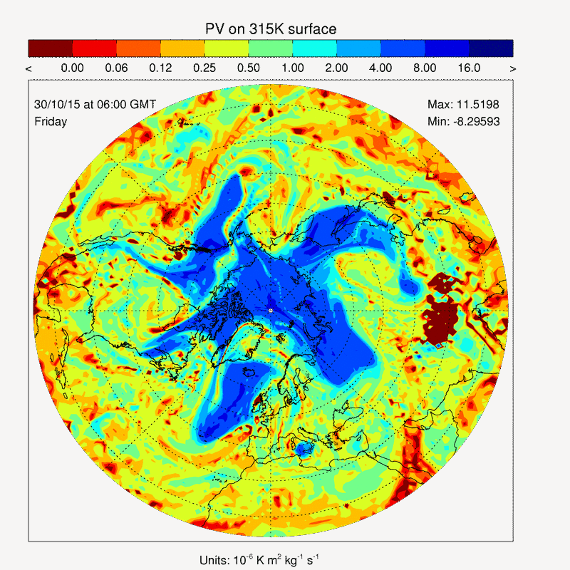
Potential vorticity (PV)
Potential vorticity is conserved following fluid parcels for adiabatic frictionless flow.
This makes it a good tracer for upper-tropospheric air over several days.
ECMWF analyses of PV on 315K isentrope.
Notes:
A summary of the climatological PV and theta distribution below 100mb in the NH winter. PV in PVU

Slide 5
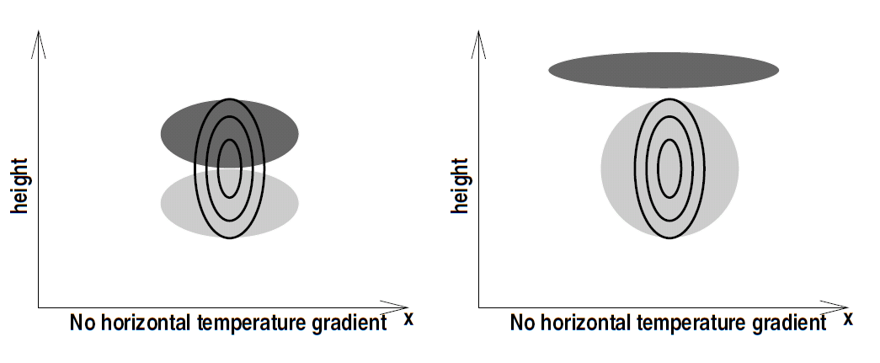
Diabatic PV modification
where H is the heating rate
Instantaneous heating
Steady heating
PV dipole arising from heating applied in a barotropic environment
Notes:
Figure 1. Schematic diagram depicting the orientation of the PV dipole arising from heating applied against (a) a barotropic environment having
a background vertical (planetary) vorticity, and (b) a baroclinic environment containing vertical wind shear (directed into the page). Positive
(negative) PV anomaly is indicated by light (dark) shading.

Slide 6
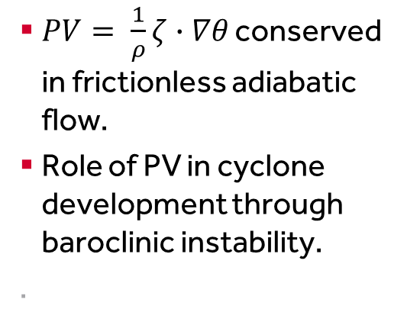
PV structure of dry cyclones
+ve PV anomaly
$PV= \frac{1}{ρ}ζ∙∇θ$ conserved in frictionless adiabatic flow.
Role of PV in cyclone development through baroclinic instability.
.
Hoskins et al. (1985)
Heifetz et al. (2004)
Notes:
Quart. J. R. Met. Soc. (1985), 111, pp. 877-946 551.509.3:551.511.2:551.511.32
On the use and significance of isentropic potential vorticity maps
By B. J. HOSKINS’, M. E. McINTYRE’ and A. W. ROBERTSON3
Figure 21. A schematic picture of cyclogenesis associated with the arrival of an upper air IPV anomaly over
a low-level baroclinic region. In (a) the upper air cyclonic IPV anomaly, indicated by a solid plus sign and
associated with the low tropopause shown, has just arrived over a region of significant low-level baroclinicity .
The circulation induced by the anomaly is indicated by solid arrows, and potential temperature contours are
shown on the ground. The low-level circulation is shown above the ground for clarity. The advection by this
circulation leads to a warm temperature anomaly somewhat ahead of the upper IPV anomaly as indicated in
(b), and marked with an open plus sign. This warm anomaly induces the cyclonic circulation indicated by the
open arrows in (b). If the equatorward motion at upper levels advects high-PV polar lower-stratospheric air,
and the poleward motion advects low-PV subtropical upper-tropospheric air, then the action of the upper-level
circulation induced by the surface potential temperature anomaly will, in effect, reinforce the upper air IPV
anomaly and slow down its eastward progression. (To this extent the situation is similar to the small-amplitude
instability situation represented by Fig. 18 and described in section 6(b).)
Q. J. R. Meteorol. Soc. (2004), 130, pp. 211–231 doi: 10.1256/qj.02.184
The counter-propagating Rossby-wave perspective on baroclinic instability.
I: Mathematical basis
By E. HEIFETZ1, C. H. BISHOP2, B. J. HOSKINS3 and J. METHVEN3¤
Figure 1. Schematic illustration of the upper and lower counter-propagating Rossby waves (CRWs) on a
baroclinic basic state where qy is the mean potential-vorticity (PV) gradient and the mean wind, U.z/, relative to
its average is indicated by the blank arrows. The phase of each CRWis indicated by its PV anomalies, q0, and each
wavy line indicates the corresponding meridional displacements of a PV contour. The solid zonal arrows indicate
the propagation direction of each CRW (counter to the relative zonal  ow). The other solid arrows indicate the
meridional wind associated with each CRW at its own level and the dashed arrows indicate the wind induced at
the level of the other CRW. In (a) the PV anomalies of the upper CRW are shifted to the west of the lower CRW’s
PV anomalies by a phase between 0 and ¼=2. Consequently, the CRWs ‘help’ each other to counter-propagate
and to grow.

Slide 7
PV structure of moist cyclones
Plant et al. (2003)
Notes:
Figure 2. Schematic diagram to illustrate the impact of latent-heat release on the low-level circulation of the
Fronts and Atlantic Storm-Track EXperiment Intensive Observing Period 18. (a) Shows the situation at early
times, before latent-heat release occurs. The upper line illustrates a tropopause fold, with associated positive
potential vorticity (PV) anomaly. A low-level, cyclonic circulation is induced. (b) Illustrates the dominant effects
of latent heating within the mature system. A positive low-level anomaly is formed which intensi. es the lowlevel
circulation. A local sink of PV is located above, which weakens the upper-level feature. A surface thermal
anomaly remains weak throughout. (After Ahmadi-Givi et al. 2002.)
Q. J. R. Meteorol. Soc. (2003), 129, pp. 2989–3012 doi: 10.1256/qj.02.174
On a threefold classi. cation of extratropical cyclogenesis
By R. S. PLANT¤, G. C. CRAIG and S. L. GRAY

Slide 8
PV structure of moist cyclones
PV east-west vertical section through Lothar (1999)
PV anomaly composite (200 km radius) NH DJF intense cyclones
Câmpa and Wernli (2012)
Notes:
A PV Perspective on the Vertical Structure of Mature Midlatitude Cyclones
in the Northern Hemisphere
JANA C ˇ AMPA
HEINI WERNLI
DOI: 10.1175/JAS-D-11-050.1FIG. 1.
West–east-oriented vertical sections of PV (PVU) across the
center of three mature extratropical cyclones for (a) the Superstorm of
1993 at 398Nat 0000UTC 14 Mar 1993, (b) Lothar at 498Nat 0600UTC
26 Dec 1999, and (c) Xynthia at 468N at 0000 UTC 28 Feb 2010.
FIG. 3. Composite PV anomaly profiles of Northern Hemisphere (NH) winter (DJF) cyclones with minimum SLP
in the range of (a) 930–970 and (b) 990–1010 hPa. The black line connects the mean values of DPV on each level
(every 25 hPa) and the shaded area marks the interval between the 10th and 90th percentiles on each level.

Slide 9
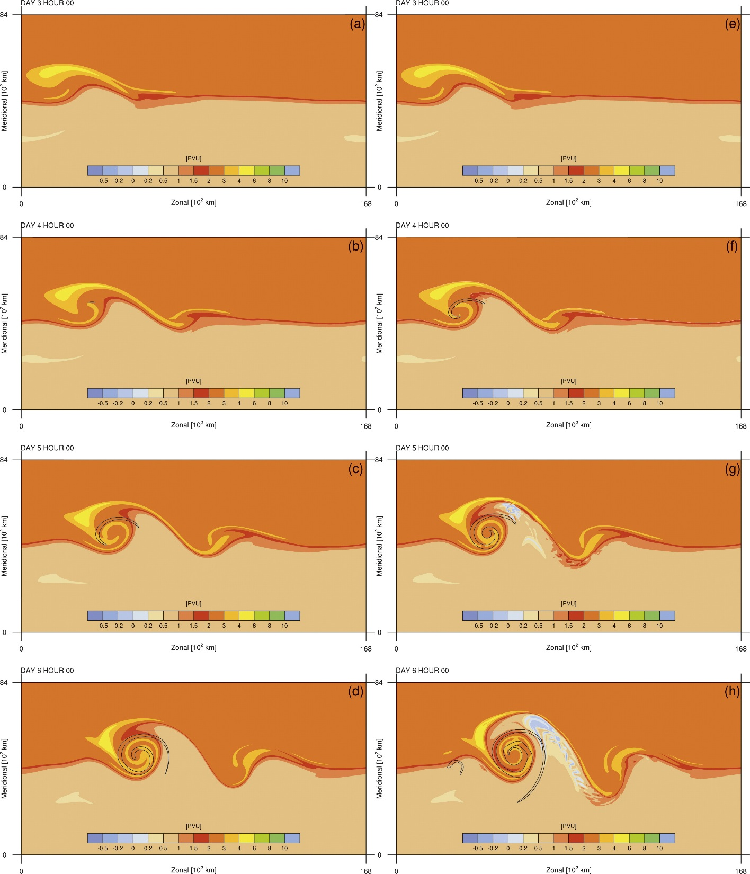
PV structure of moist cyclones
DRY
MOIST
Idealised baroclinic wave simulations.
PV on 316K (coloured); PV at 950 hPa (black contour for 1 PVU)
Schemm et al. (2013)
Notes:
Sebastian Schemm, Heini Wernli, and Lukas Papritz, 2013: Warm Conveyor Belts in Idealized Moist Baroclinic Wave Simulations*. J. Atmos. Sci., 70, 627–652.
doi: http://dx.doi.org/10.1175/JAS-D-12-0147.1
Fig. 4. Time evolution from days 3 to 6 of PV on 316 K (colored, PVU) and low-level PV at 950 hPa (black contour for 1 PVU). (a)–(d) Dry simulation, and (e)–(h) moist simulation m60.

Slide 10
PV tracers tool
Based on a Lagrangian decomposition of the PV field.
Full PV conservation equation:
where S_{i} denotes the Lagrangian tendency resulting from one physical process in model
~ 20 tracers PV_{i} each initialised as zero, receive S_{i} from one physical process and advected by the semi-Lagrangian scheme ⇒ each tracer shows accumulated contribution of one process to PV.

Slide 11
PV tracers tool
Diagnosis of diabatically-generated PV, its attribution to modelled physical processes and influence on forecast evolution.
Diabatically-generated PV
Chagnon et al. (2013)
Notes:
Citation: Chagnon JM, Gray SL,Methven J. 2013. Diabatic processesmodifying potential vorticity in a North
Atlantic cyclone. Q. J. R. Meteorol. Soc. 139: 1270–1282. DOI:10.1002/qj.2037
Figure 5. The net diabatic PV (computed as the difference between the full
PV and the advection-only PV tracer) on model levels corresponding to
altitudes of (a) 8.4 km and (b) 4.4 km, valid at 1200 UTC 20 October 2008.
(c) Net diabatic PV in the vertical section indicated in panel (a). The
solid black and grey lines depict the 2 PVU contour in the full PV and
advection-only PV tracer, respectively.

Slide 12
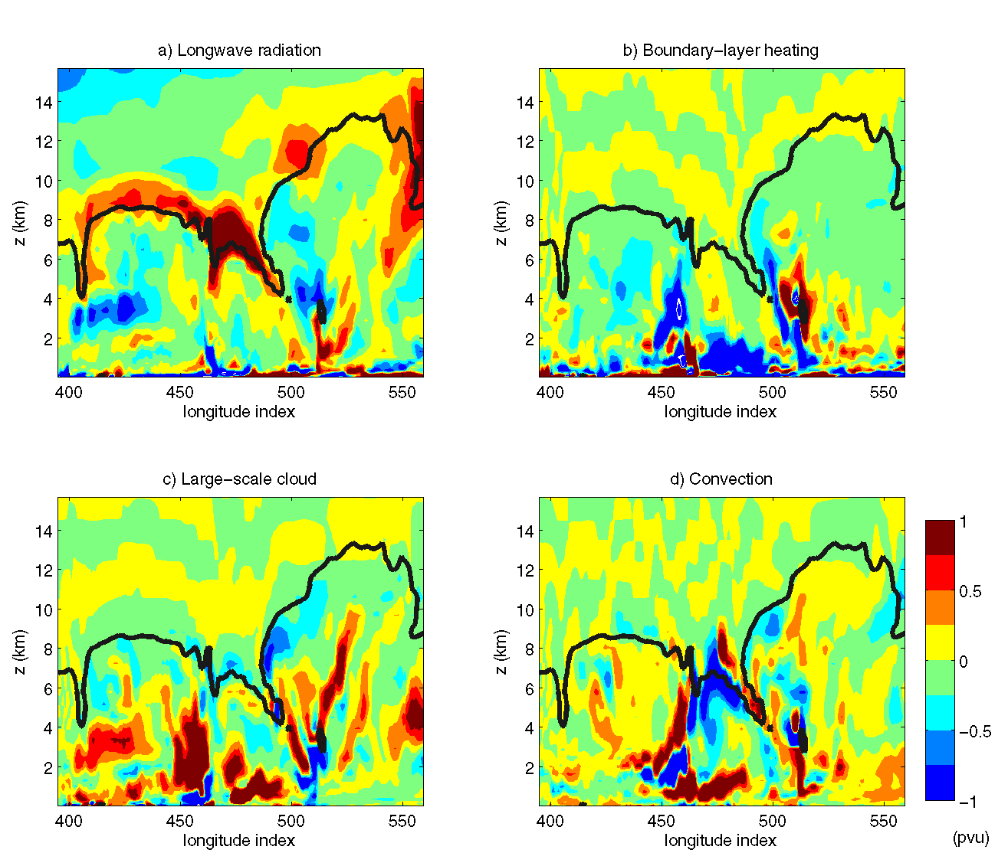
LW radiation
Boundary-layer heating
Large-scale cloud
Convection
Chagnon et al. (2013)

Slide 13
PV tracers tool
Vertical cross-sections of diabatically-generated PV accumulated over 36 hours for 3 cyclones
Chagnon and Gray (2015)
Notes:
Jeffrey M. Chagnon and Suzanne L. Gray, 2015: A Diabatically Generated Potential Vorticity Structure near the Extratropical Tropopause in Three Simulated Extratropical Cyclones. Mon. Wea. Rev., 143, 2337–2347.
doi: http://dx.doi.org/10.1175/MWR-D-14-00092.1
Fig. 3. Vertical cross sections of net accumulated diabatic PV (colored lled contours) valid
36 hours into each simulation in a) Case I, b) Case II, and c) Case III. The 2 PVU contour
of the full PV field is depicted by the red line, and the 2 PVU contour of the conservative
PV tracer is depicted by the black line. The locations of the cross sections are indicated in
Fig. 2. The dashed circle in panel (b) depicts the location of the dipole referred to in the
text.

Slide 14
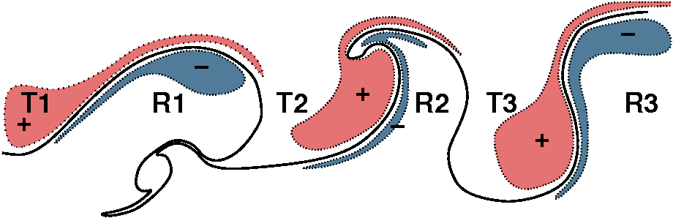
Forecast errors in upper-
level PV
Rossby wave growth
Schematic illustration of the diabatic PV dipole relative to the tropopause in an evolving wave – based on extratropical cyclone case study
Chagnon et al. (2013)
Notes:
Figure 10. A schematic representation of the net diabatic PV (shaded) relative to large-amplitude waves on the tropopause (solid line). Positive diabatic
PV associated with longwave cooling is greatest in the troughs T1, T2, T3, enhancing the PV anomalies associated with equatorward advection of
stratospheric air. The negative diabatic PV enhances the ridges R1, R2 and R3. The net diabatic effect is greater amplitude in the Rossby wave along the
tropopause.

Slide 15
Forecast errors in upper- level PV
ECMWF forecast and analysis
Martínez-Alvarado et al. (in press)
Notes:
Are there errors?
Figure 2. Forecast error (PVU, colour shading) and 2 PVU contours in the analysis (black) and in the forecast with initialisation time 1200 UTC 19 January
2011 (green) valid at 1200 UTC on (a) 20 January 2011 (D + 1), (b) 22 January 2011 (D + 3) and (c) 24 January 2011 (D + 5). All the fields are plotted on the
320 K isentropic surface. The right panels show zoomed-in details inside the grey boxes (30◦N–80◦N, 90◦W–0◦W) marked in the left panels. They also show WCB
intersection points with the 320 K isentropic surface at the given time in the analysis (black crosses) and the forecast (green circles), independent of when they started
to ascend.

Slide 16
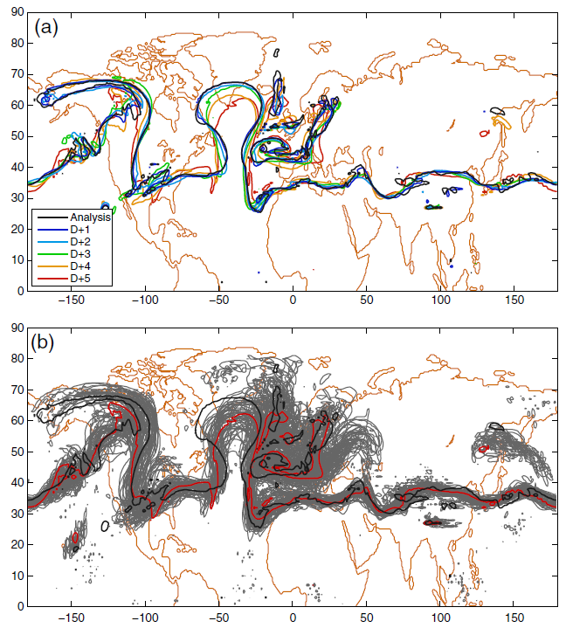
Forecast errors in upper- level PV
Error appears in last 2 days of forecast
Error in all ensemble members
Martínez-Alvarado et al. (in press)
Notes:
Figure 4. Contours of 2 PVU on the 320 K isentropic surface valid at 1200 UTC on 24 January 2011 in the ECMWF EPS showing (a) control members for forecasts
with different lead times and (b) analysis (black), control member (red) and ensemble members (grey) for the D + 5 forecast.

Slide 17
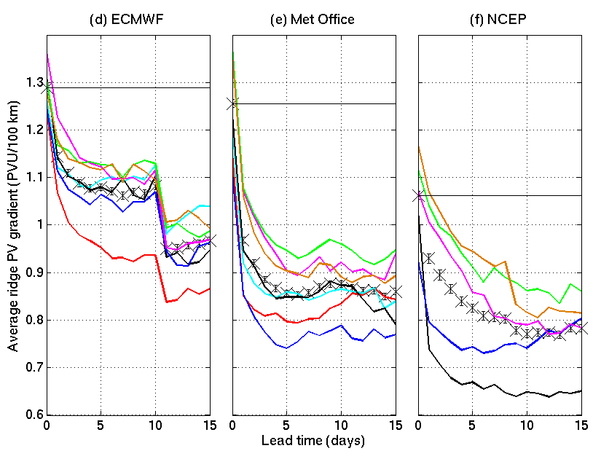
Ridge PV gradient forecast
Forecast errors in upper-
level PV
2006/7
2007/8
2008/9
2009/10
2010/11
2011/12
2012/13
Gray et al. (2014)

Slide 18
Forecast busts
Composites of bust initial conditions
6-day forecast busts associated with mesoscale convective systems over US Great Lakes.
Rodwell et al. (2013)
Notes:
define a “forecast bust” to be an occasion when the
day-6 high-resolution forecast of European Z500
has an RMSE greater than 60 m and an ACC less
than 40%. These two conditions ensure that a bust
is associated with errors of a sufficient magnitude
and also involve a pattern or phase discrepancy
DOI:10.1175/BAMS-D-12-00099.1
Fig. 2. The number of European forecast busts at day 6 from the ECMWF operational high-resolution
forecast and forecasts made within the ERA-Interim project, for 1989–2011. (a) Time series of annual totals. Results are based on forecasts started at 1200 UTC since operational high-resolution forecasts were not made at 0000 UTC before 2001. In addition to improvements to the forecast model and improvements in the processes used to derive its initial conditions, the resolution of ECMWF’s high resolution forecast increased steadily over the period, from 190 km in 1989 to 16 km in 2011. ERA-Interim is based on a fixed IFS cycle that was operational in 2006 and has a fixed resolution of 80 km.
The two curves in (a) should not necessarily intersect in 2006 since the high-resolution forecast had a resolution of 25 km at that time.
Fig. 4. The mean initial condition anomalies of (a) Z500 and (b) CAPE leading to the same forecast busts used in Fig. 3. Anomalies are relative to the ERA-Interim climatology for 1989–2008. Statistical significance at the 5% level is indicated with bold colors. Throughout this article, the analyzed CAPE is actually a 6-h forecast, since this is what is archived. CAPE is computed for several parcel ascents, from the surface and higher up, and the maximum value is taken.

Slide 19
Mesoscale PV structure of cyclones
moist
Link between negative moist PV at fronts, conditional symmetric instability and frontal rainbands.
Slantwise convection at a front
-ve PV_{e}
Delta M adjustment
~zero PV
Linear CSI
Nonlinear CSI
Holt and Thorpe (1991)
Browning et al. (2001)
Morcrette and Browning (2006)
Notes:
Q. J. R. Meteorol. Soc. (2006), 132, pp. 1073–1089 doi: 10.1256/qj.04.108
Formation and release of symmetric instability following
Delta-M adjustment
By C. J. MORCRETTE∗ and K. A. BROWNING
Figure 1. A thought experiment linking line convection, M adjustment and CSI in the development of
slantwise convection. These sketches show a time series (a)–(i) of vertical cross-sections through a baroclinic
zone, normal to the thermal wind. The vertical cross-sections represent an area around 5 km deep and several
hundreds of kilometres wide. Areas of negative equivalent potential vorticity are shaded. The first, second and
third row of panels represent three distinct stages which are dominated by M adjustment, linear CSI and nonlinear
Q. J. R. Meteoml. SOC. (2001). 127, pp. 2513-2536
Stacked slantwise convective circulations
By K. A. BROWNING*, D. CHAPMAN and R. S. DIXON
CSI respectively. Further details are given in the text in section 2.

Slide 20
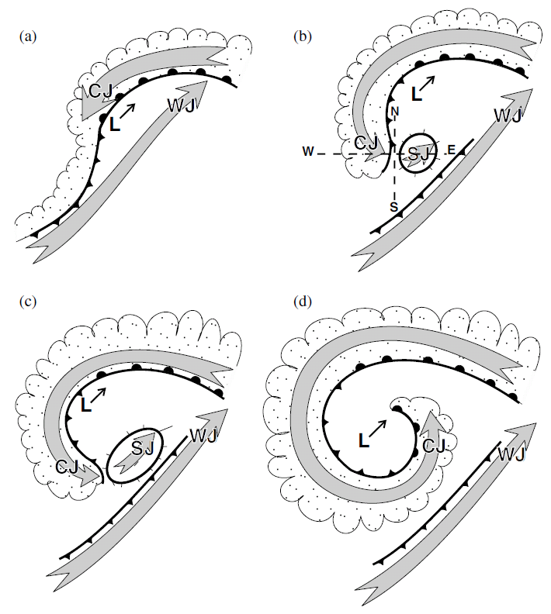
Low-level wind jets
Shapiro-Keyser conceptual model
Clark et al. (2005)
Notes:
Figure 17. Conceptual model of the near-surface flows in an extratropical cyclone. (a) Early stage of frontal wave
cyclone development. L denotes low-pressure centre with direction of movement shown by thin arrow. Grey
arrows show the system-relative low-level jets; WJ is the warm-conveyor-belt jet (WCB in text) and CJ the cold conveyor-
belt jet (CCB in text). (b) Frontal fracture phase, when the sting jet (SJ) first appears at the surface.
(c) As the cloud head wraps round further the SJ region extends. (d) Eventually the distinct SJ disappears and
the dominant low-level wind in this region is due to the CJ. Positions of cross-sections shown in Fig. 18 are
marked in (b).
Frontal analysis based on the Shapiro and Keyser (1990) lifecycle model in which the surface cold front fractures from the surface warm front so as to leave behind a bent-back warm front (part of which is analysed here as a cold front. Secondary WCB omitted for clarity.

Slide 21
Low-level wind jets
Hewson and Neu (2015)
Notes:
HEWSON, Tim D.; NEU, Urs. Cyclones, windstorms and the IMILAST project. Tellus A, [S.l.], sep. 2015. ISSN 1600-0870. Available at: <http://www.tellusa.net/index.php/tellusa/article/view/27128>. Date accessed: 05 Nov. 2015. doi:http://dx.doi.org/10.3402/tellusa.v%v.27128.
Fig. 1. Conceptual model of an extra-tropical cyclonic windstorm. Panel (a) shows the cyclone track (black), with spots denoting
positions equally separated in time, and numbered according to the cyclone life-cycle phases in panel (b). Spot colour relates to the
identification method and objective typing used in Hewson and Titley (2010), green being a diminutive frontal wave, orange a frontal
wave cyclone, and black a barotropic low. Shading denotes the footprints, or nominal damage swathes, attributable to the warm jet/
warm conveyor (yellow), the cold jet/cold conveyor (orange) and the sting jet (red). Panel (b) shows the synoptic-scale evolution
of fronts and isobars around the cyclone, after Hewson and Titley (2010) and Shapiro and Keyser (1990), with added letters denoting
relative locations of the strong wind features, and brackets indicating marginal existence. Panel (c) denotes the temporal evolution of
gust strength for each jet zone, with numbers cross-referencing phases on panel (b). On each panel, a dashed blue line denotes the
period of most rapid deepening, whilst the solid blue arrow shows the time of maximum depth. This conceptual model should
be considered to be very malleable; for example most intense cyclones will have only one or two of the three strong wind footprints
associated.

Slide 22
Cold conveyor belt jet
Windstorm Friedhelm
09 UTC
12 UTC
Air ahead of and beneath the warm front which,
relative to the advancing system, flows rapidly rearwards around the poleward side of
the low centre (Carlson 1980)
15 UTC
18 UTC
Ground-relative windspeed
Martínez-Alvarado et al. (2014)
Notes:
DOI: 10.1175/MWR-D-13-00348.1
Distinguishing the Cold Conveyor Belt and Sting Jet Airstreams
in an Intense Extratropical Cyclone
OSCAR MARTI´NEZ-ALVARADO, LAURA H. BAKER, SUZANNE L. GRAY,
JOHN METHVEN, AND ROBERT S. PLANT
FIG. 3. Ground-relative wind speed (m s21) on the 850-hPa isobaric surface at (a) 0900, (b) 1200, (c) 1500, and (d) 1800 UTC. Gray
contours show ue every 5K. Panels (b)–(d) show the track followed by the FAAM research aircraft, highlighting the hour centered at the
time shown (purple line). Crosses indicate the position of the cyclone center. End points of vertical sections discussed in later figures are
indicated by dots and labeled by letters (except for A, which coincides with the cyclone center).

Slide 23
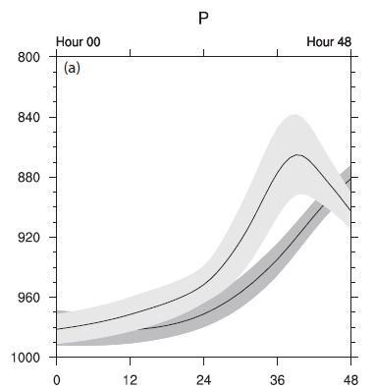
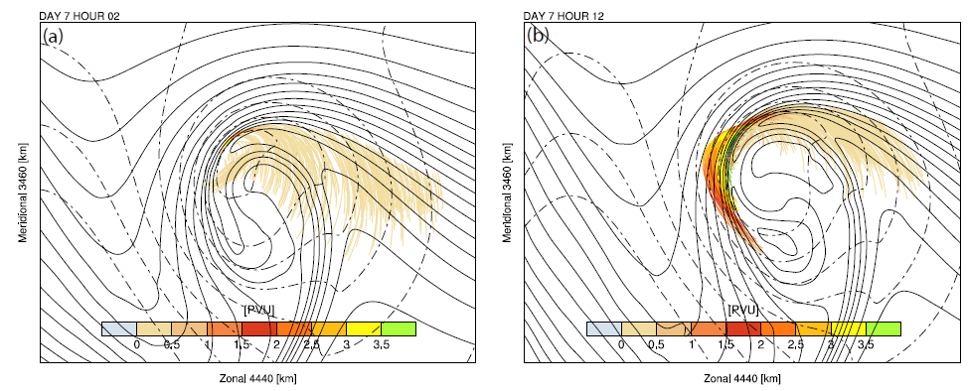
Cold conveyor belt jet: idealised
Control – simple moist physics
Extended physics
Schemm and Wernli (2014). Surface pressure (dashed contours), θ at 850 Pa (solid contours), trajectories during previous 10 hours coloured by PV.

Slide 24
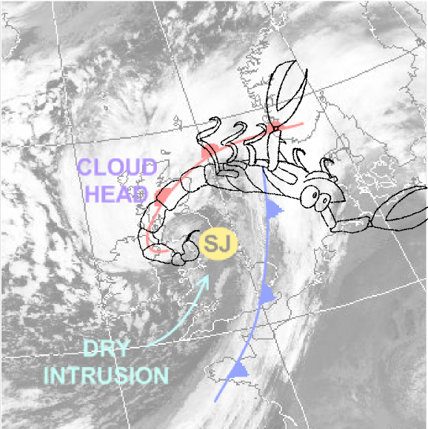
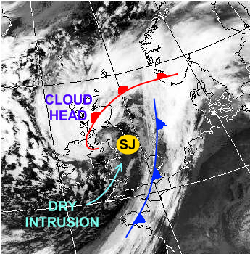
Sting jets
Transient (few hours), mesoscale (~50km spread) jets of air descending from the tip of the hooked cloud head in the frontal fracture regions of some extratropical storms.
Can cause damaging winds (and especially gusts).
Coined ‘the sting at the end of the tail by Browning (2004)’ in his study of the Great October storm of 1987.
Since then large body of work performed on modelling, mechanisms and climatologies.
First research aircraft flight into a sting jet storm led by Reading scientists within DIAMET project: Windstorm Friedhelm (2011).
Term has now entered common usage(?)
Adapted from Laura Baker by Neil Hart.

Slide 25
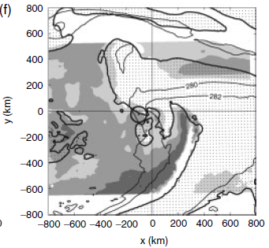
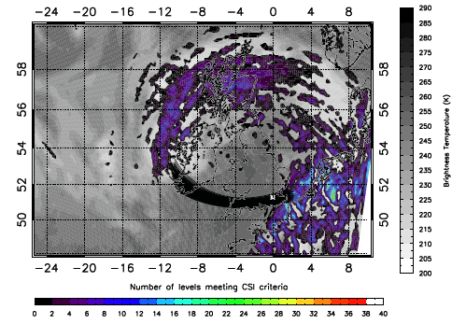
Mechanisms: atmospheric instability
Martínez-Alvarado et al. (2014). Instability diagnosis along sting jet trajectories in windstorm Friedhelm.
Parton et al. (2009). # levels meeting CSI criteria in windstorm Jeanette (2005), back trajectories and psuedo-IR imagery.
Gray et al. (2011). DSCAPE in windstorm Anna., Light grey – 100-300 Jkg⁻¹, Dark grey – 500-700 Jkg⁻¹.

Slide 26
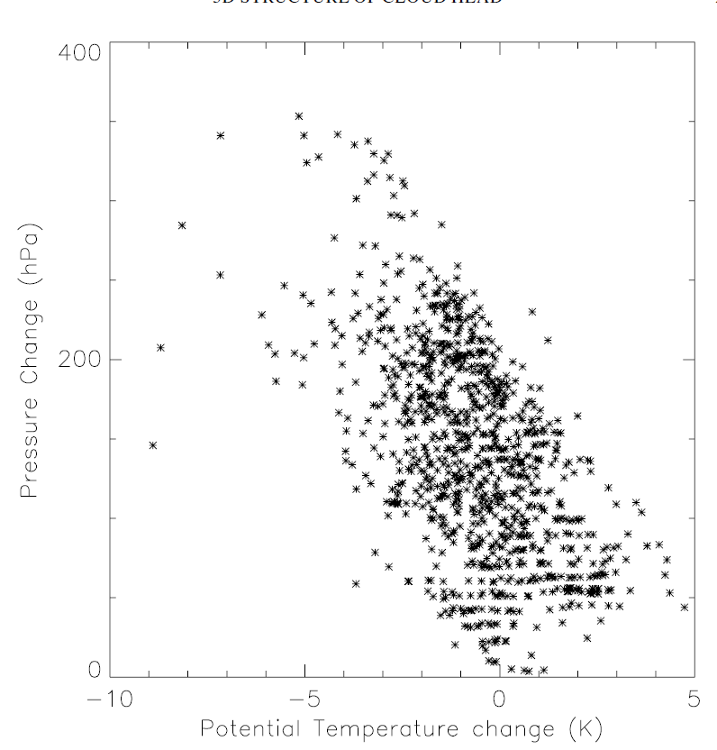
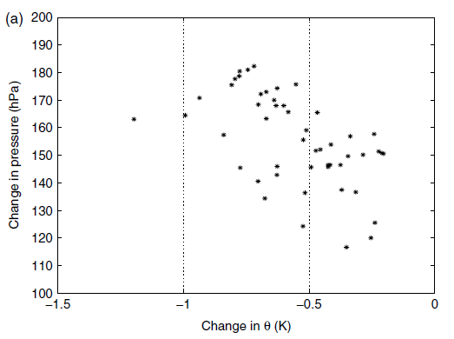
Mechanisms: evaporative cooling
Baker et al. (2014), sting jet trajectories in an idealised cyclone.
But, simulation with evaporation of melting snow and rain turned off 2 hrs prior to sting jet descent showed no change in sting jet behaviour.
Clark et al. (2005), sting jet trajectories in the Great October storm (1987)

Slide 27
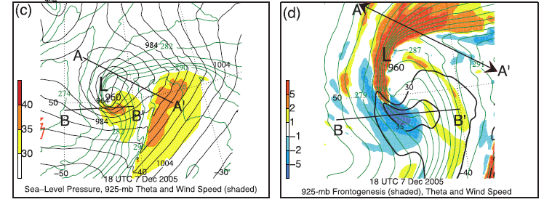
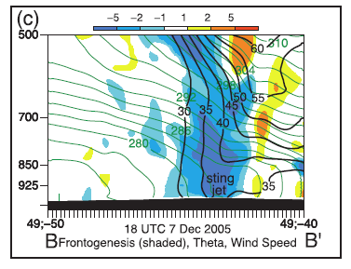
Mechanisms: frontolysis
Zoomed c.f. (c)
Schultz and Sienkiewicz (2013)

Slide 28
Questions
What is the variability in and predictive capability of
  (i) cyclones containing sting jets?
  (ii) the characteristics (surface wind speed, descent rate, horizontal extent) of the sting jets in a cyclone?
What mechanisms can lead to the descent of the sting jet?
Hart, Gray and Clark (in prep.)

Slide 29
Method: Ensemble model configuration
Potential for sting jets in cyclones identified using precursor diagnostic (Martínez-Alvarado et. al 2013) applied to ERA-Interim data.
24 member ensemble simulations of three recent windstorms with evidence of sting jets: windstorms Friedhelm (8 Dec 2011), Robert (27 Dec 2011) and Ulli (3 Jan 2012).
Initial condition perturbations from operational MOGREPS (The Met Office Global and regional Ensemble Prediction System). Designed to generate model spread appropriate for forecast uncertainty at 1-2 days lead time.
Recently operational limited area (North Atlantic and European domain) configuration of the Met Office Unified Model (~12 km grid spacing and 70 vertical levels up to 38 km).
Notes:
Threshold 40ms-1 wind region connected to contour at 850 hPa (950-650 hPa). Theta-e threshold used to restrict analysis to cold sector strong winds. Forward and backward trajectories calculated and clustered using their lat/long/pressure/theta_e for the 5 hours preceding arrival in the low-level jet region.
Simulations all initialised 21Z previous day.

Slide 30
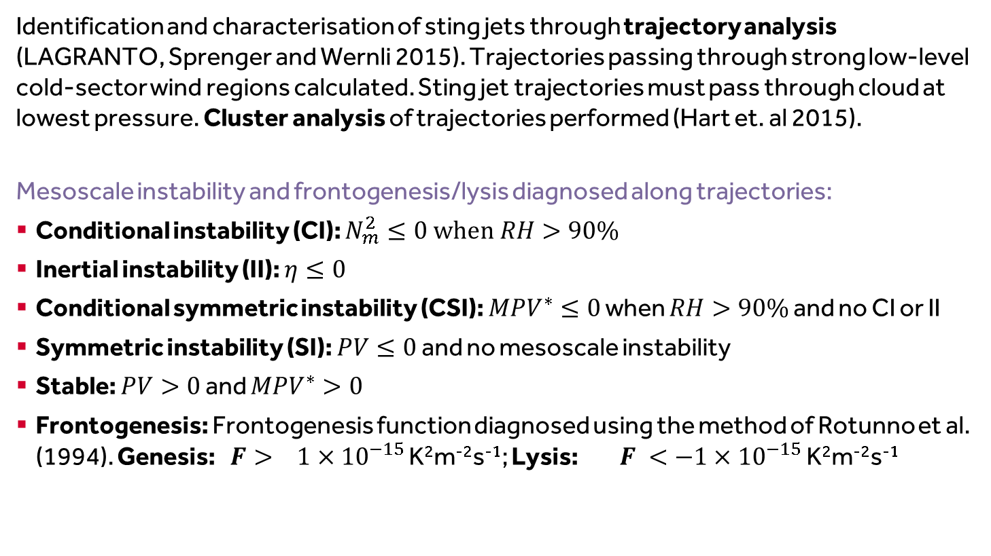
Method: Analysis of dynamical forcing and instabilities
Identification and characterisation of sting jets through trajectory analysis (LAGRANTO, Sprenger and Wernli 2015). Trajectories passing through strong low-level cold-sector wind regions calculated. Sting jet trajectories must pass through cloud at lowest pressure. Cluster analysis of trajectories performed (Hart et. al 2015).
Mesoscale instability and frontogenesis/lysis diagnosed along trajectories:
Conditional instability (CI): $N_{m}^{2}≤0 when RH>90\%$
Inertial instability (II): $η≤0$
Conditional symmetric instability (CSI): ${MPV}^{∗}≤0$ when $RH>90\%$ and no CI or II
Symmetric instability (SI): $PV≤0$ and no mesoscale instability
Stable: $PV>0$ and ${MPV}^{∗}>0$
Frontogenesis: Frontogenesis function diagnosed using the method of Rotunno et al. (1994). Genesis: $F> 1×{10}^{−15}$ K²m⁻²s⁻¹; Lysis: $F <−1×{10}^{−15}$ K²m⁻²s⁻¹
Notes:
Check this!

Slide 31
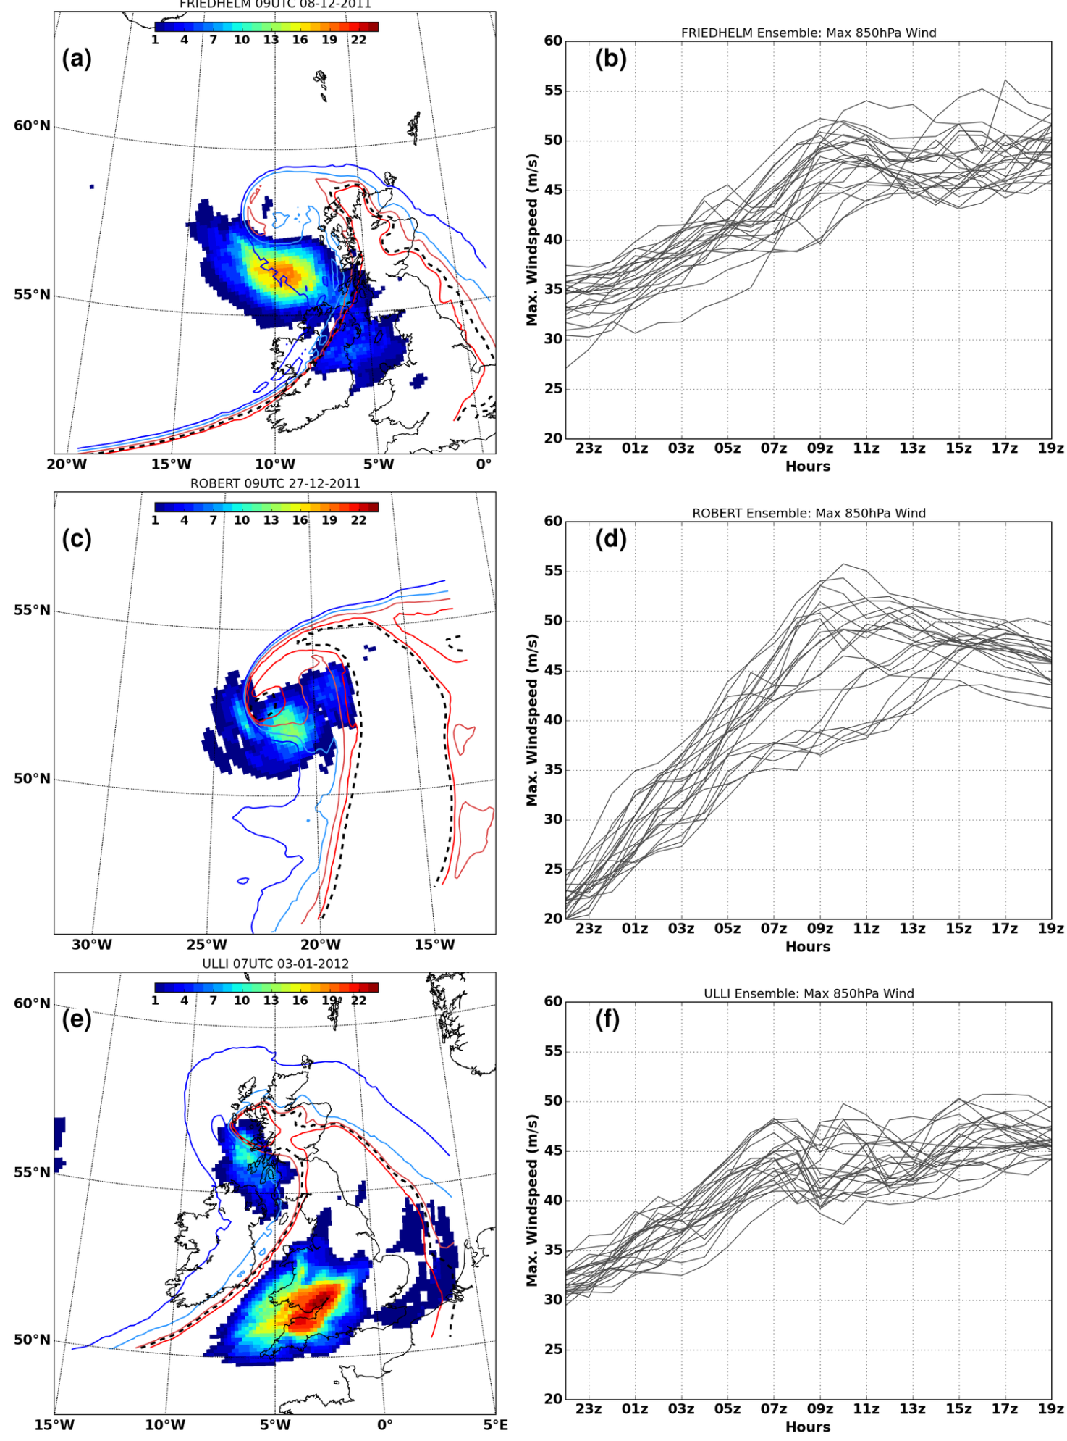
Predictability of low-level jets
# members with |v|_{850hPa} > 40 ms⁻¹
Ensemble evolution of cool sector850 hPa |v|_{max}
Friedhelm
Hart, Gray and Clark (in prep.)
Ulli
Robert
24 member regional forecast ensembles; initial condition perturbations
Notes:
Figure 3: (a) Friedhelm grid-point count of ensemble members with windspeeds >40 ms􀀀1 (shaded)
0900 UTC 8 December 2011. (b) Ensemble evolution of maximum windspeed at 850hPa from
2200 UTC 7 December 2011. (c) as (a) for Robert at 0900 UTC 27 December 2011 and (d) as
(b) starting from 2200 UTC 26 December 2011. (e) as (a) for Ulli at 0700 UTC 3 January 2012
and (f) as (b) starting from 2200 UTC 2 January 2012. Control ensemble member e-contours are
overlaid and coloured from blue to red: (a) 293, 296, 299, 302K; (b) 294, 297, 300, 303K; (c) 293,
296, 299, 302K. Black dotted contour is cool-sector e-threshold at 850hPa: (a) Friedhelm 301K,
(b) Robert 305K, and (c) Ulli 300K.
Analysis of trajectories entering the cool-sector low-level jet regions shows cold conveyor belt flows.
Strongly descending trajectories arrive ahead or on the southeastern flank of the conveyor belt flow.
We now focus on these descending trajectories…

Slide 32
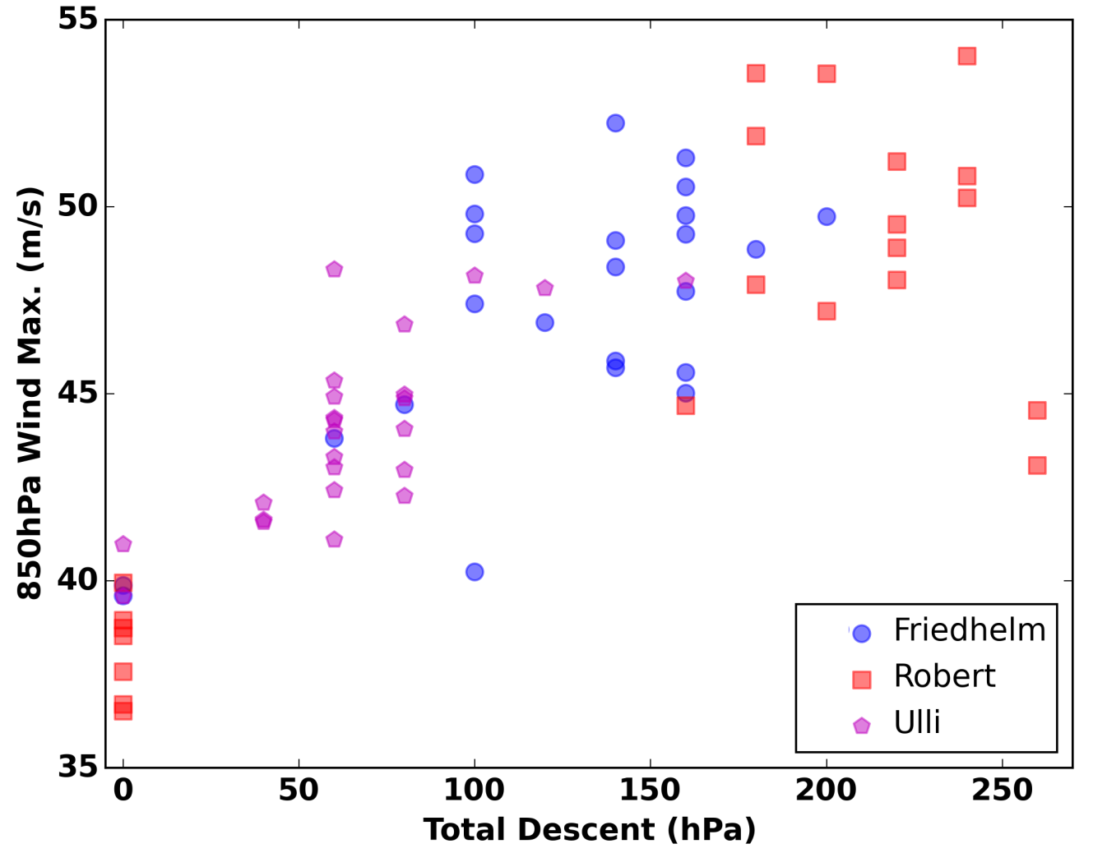
Sting jet descent rates
Greatest total airstream descent versus maximum cool-sector 850hPa windspeed
Notes:
Greatest total airstream descent versus maximum cool-sector 850hPa windspeed for each
ensemble member of each storm at time ensembles rst reach strongest windspeeds: 0900 UTC in
Friedhelm and Robert and 0700 UTC in Ulli

Slide 33
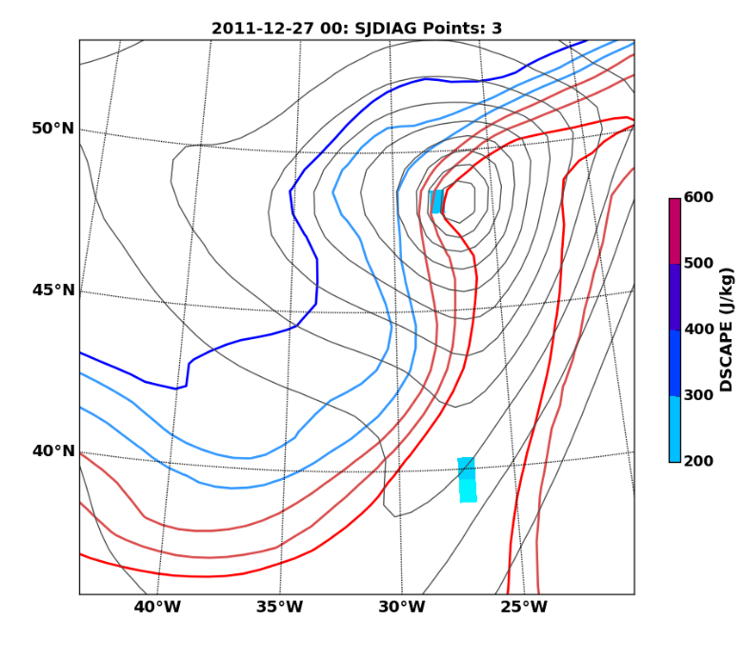
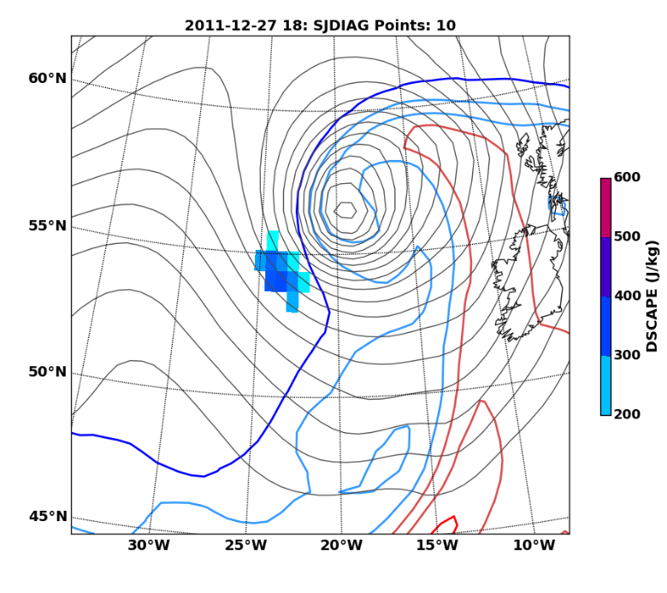
Examples of low-level jets:
Windstorm Robert
00 UTC
Identified as a potential sting jet storm by precursor diagnostic though CSI points not in main cloud head. Deepened 36 hPa/24 h.
18 UTC
Sting jet precursor diagnostic based on DSCAPE (Downdraught Slantwise Convective Available Potential Energy) applied to ERA-I data
Notes:
Two descending branches: 1. descent from 700 hPa over ~ 7 h; 2. ascent from 950 hPa to 800 hPa then descent over ~4 h.
Typically passage through frontogenetic regions during ascent then frontolytic regions during descent.
One ensemble member shows strong descent from 700hPa associated with II, at early times in storm.

Slide 34
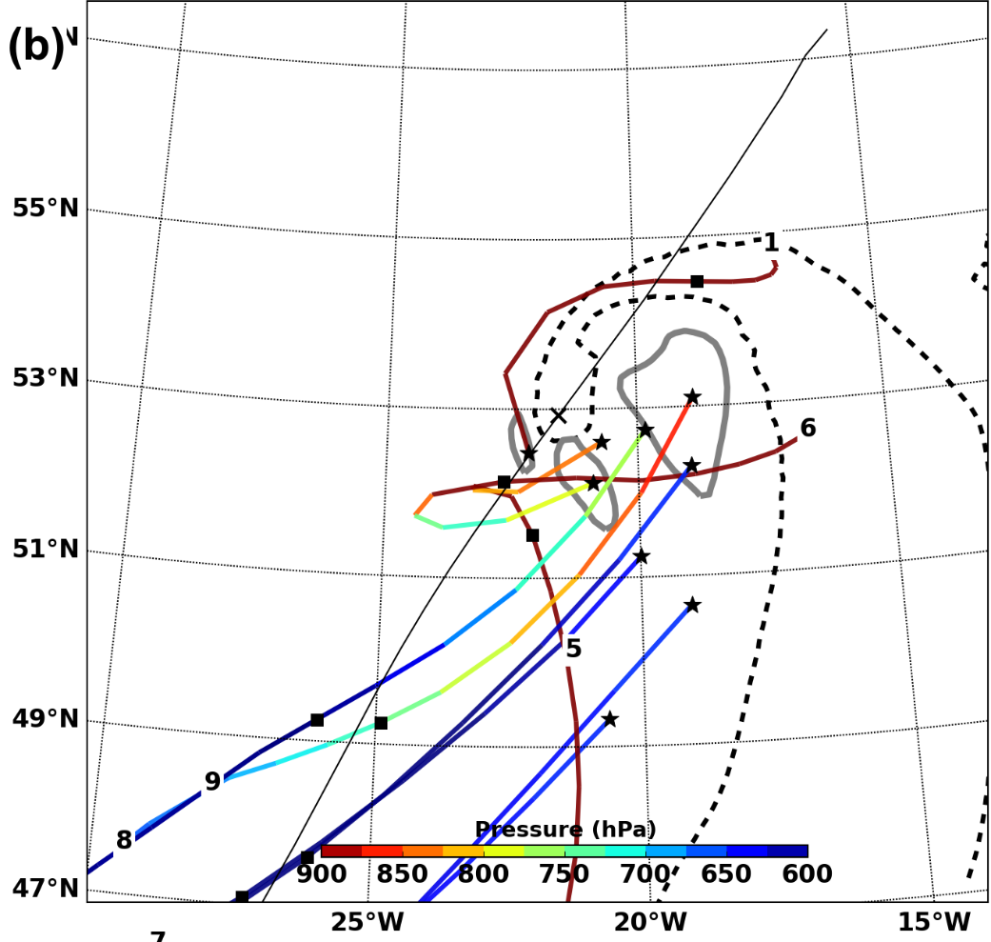
Examples of low-level jets:
Windstorm Robert
Representative ensemble member
15/22 ensemble members have sting jet trajectories arriving at 9Z (similar at other times). Some ensemble members have no sting jet.
Classes 8&9 descend into strongest low-level jet region from aloft: SJ
Classes 5&6 wrap round cyclone centre ascending and then descending rapidly into low-level jet: ?
Class 1stays close to the surface and wraps around the cyclone into the rearmost region of the low-level jet: CCB
Winds>40ms⁻¹
Cluster class medians of back trajectories arriving in cool-sector low-level jet (earth relative). Method from Hart et al. (2015).
Notes:
Cluster class medians (shaded by pressure) summarising airstreams arriving in cool-sector low-level jet of Robert ensemble member \textbf{\emph{v}} at 0700~UTC and 0900~UTC 27 December 2011 (a and b, respectively) with 850hPa windspeed (grey contours at 40 m.s$^{-1}$), smoothed storm track (black line) and centre (``$\mathbf{\times}$'').}
Hierarchical clustering using Ward’s variance minimisation for the algorithm (lon, lt, p and theta_e) for observation variable.
Neil C. G. Hart, Suzanne L. Gray, and Peter A. Clark, 2015: Detection of Coherent Airstreams Using Cluster Analysis: Application to an Extratropical Cyclone. Mon. Wea. Rev., 143, 3518–3531.
doi: http://dx.doi.org/10.1175/MWR-D-14-00382.1
Two descending branches: 1. descent from 700 hPa over ~ 7 h; 2. ascent from 950 hPa to 800 hPa then descent over ~4 h.
Typically passage through frontogenetic regions during ascent then frontolytic regions during descent.
One ensemble member shows strong descent from 700hPa associated with II, at early times in storm.

Slide 35
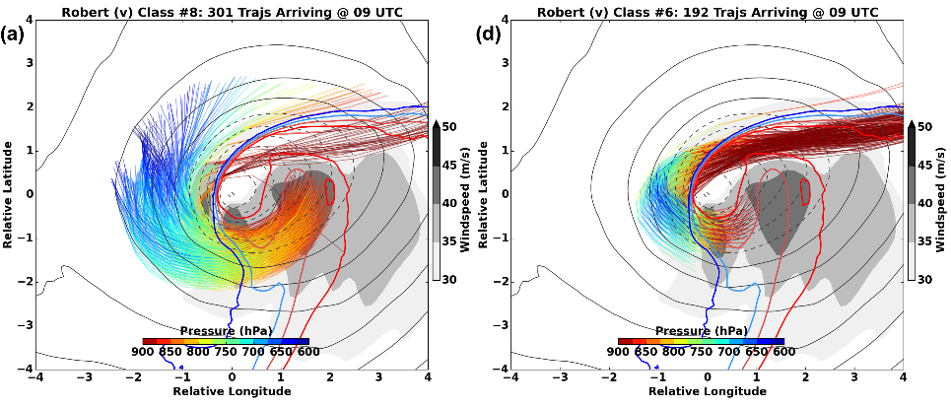
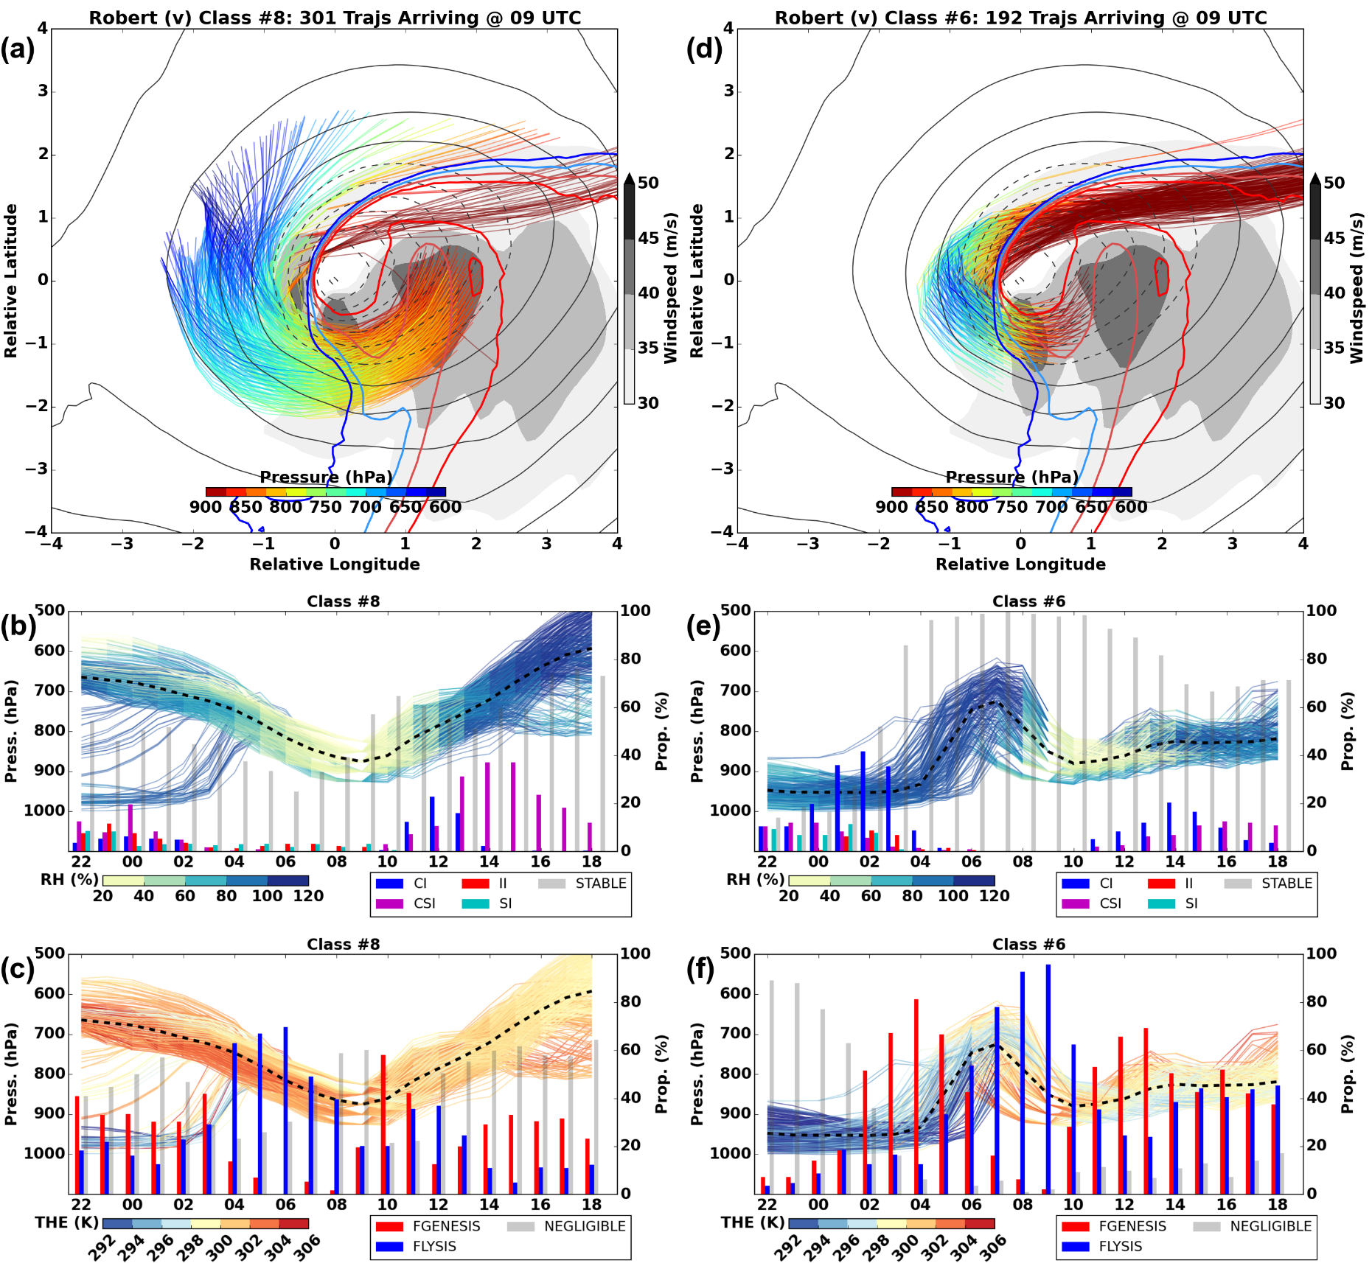
Windstorm Robert: sting jet
Storm-relative trajectories
Not physically reasonable?
Notes:
Trajectories are plotted system-relative over atmospheric fields at arrival time: 850~hPa windspeed (shaded), 1000~mb geopotential (contoured every 3~gpm), and 850~hPa $\theta_e$ (blue to red contours from 293K, every 3K). (b) The pressure evolution of these trajectories until 0900~UTC and beyond is shaded by relative humidity with height of bars showing proportion (\%) of trajectories exhibiting mesoscale instabilities as in chart legend. In (c), pressure evolution is shaded $\theta_e$ and the bars denote proportion of trajectories within regions of substantial frontogenesis or lysis (threshold of $\pm$100~K.km$^{-2}$.10$^5$s$^{-1}$).
Storm relative trajectories (a), mesoscale instability
proportions (b), and frontogenesis proportions (c), as in Fig. \ref{f6},
for sting-jet class \#3 at 0700~UTC in Robert ensemble member \textbf{\emph{v}}
and class \#6 (e-g) which experience rapid ascent and descent associated
with frontogenesis and lysis. In (a and e), 850hPa $\theta_e$ contours
are shown blue to red from 294K, every 3K.}
Two descending branches: 1. descent from 700 hPa over ~ 7 h; 2. ascent from 950 hPa to 800 hPa then descent over ~4 h.
Typically passage through frontogenetic regions during ascent then frontolytic regions during descent.
One ensemble member shows strong descent from 700hPa associated with II, at early times in storm.

Slide 36
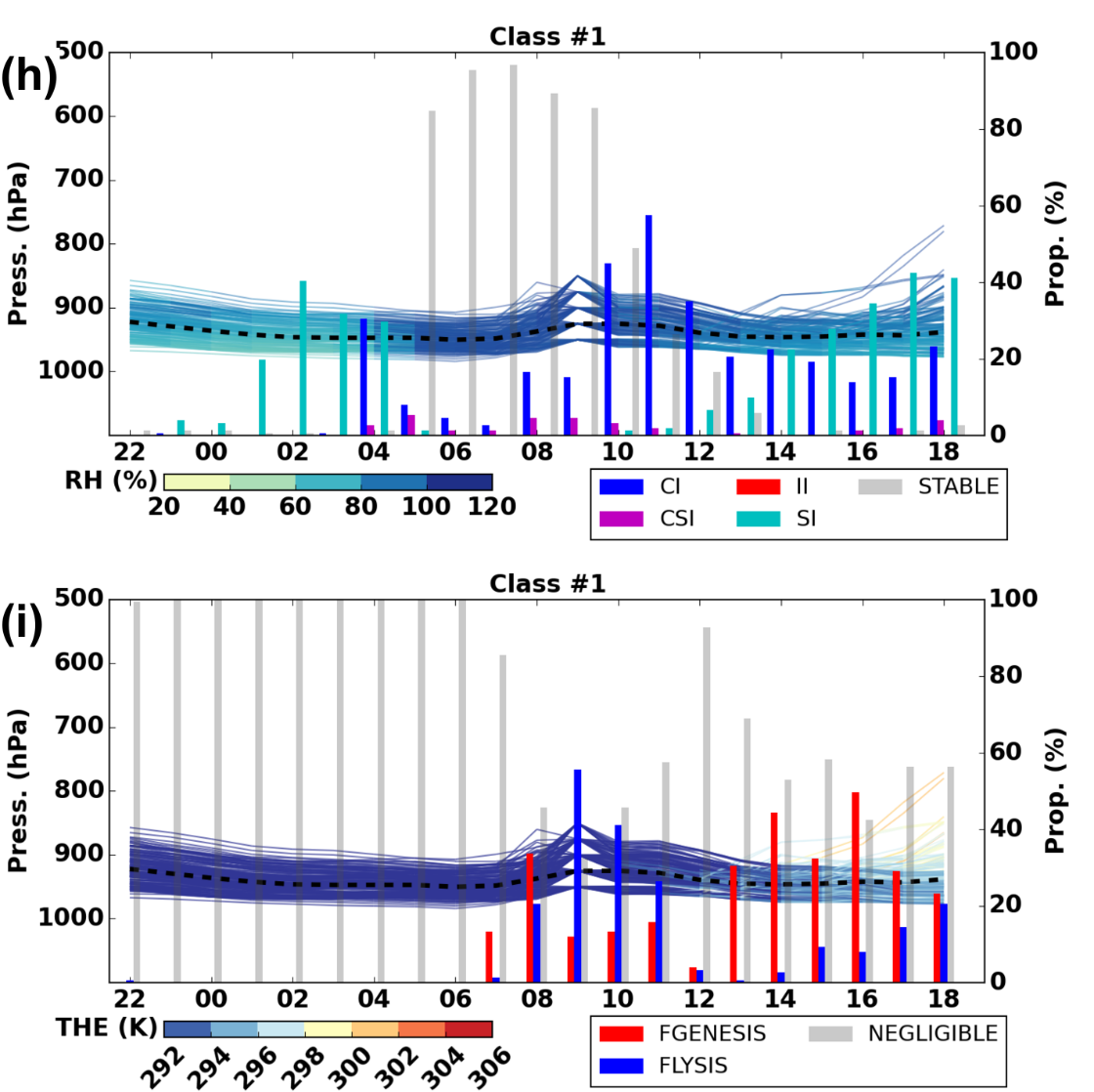

Windstorm Robert: cold conveyor belt jet

Slide 37
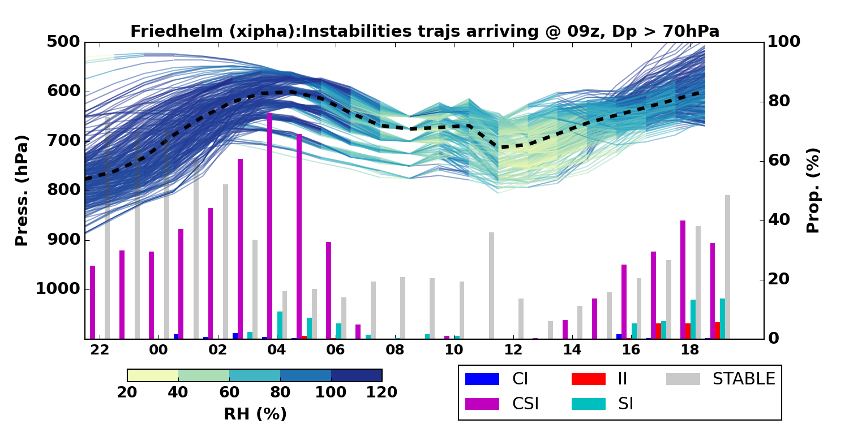
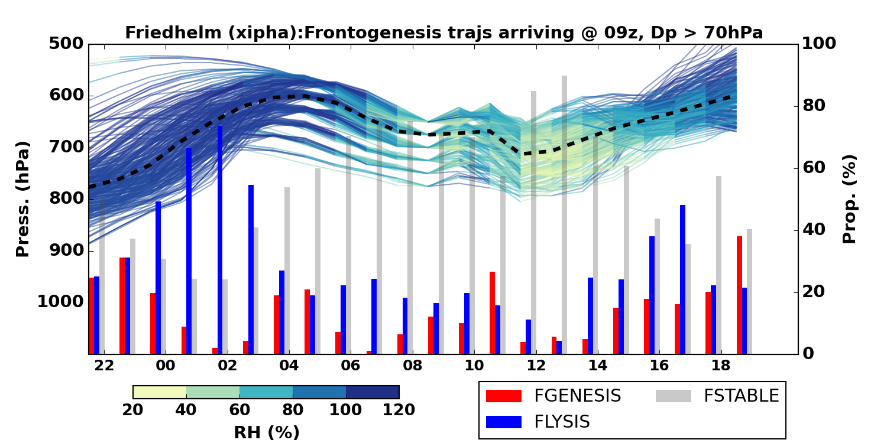
Windstorm Friedhelm
Identified as a sting jet cyclone by precursor diagnostic and Martínez-Alvarado et. al (2014). Deepened 44 hPa/ 24 h.
Most (22/24) ensemble members have sting jet trajectories arriving at 9Z and other arrival times.
Ensemble member trajectories characteristically have CSI prior to descent which then diminishes during descent. CI present prior to descent and II present during descent in some members.
Ensemble member trajectories generally pass through regions that are more frontolytic than frontogenetic but there is no consistent behaviour relative to the timing of the descent.
Suggestion: Example trajectories from Control (A) at 9am for DP>70
Notes:
Sting jet trajectories descent at least 50 hPa, and are saturated at start of descent.

Slide 38
Ensemble variability
Mesoscale
instability
Frontogenesis/lysis
X
V
CNTL
W
CNTL
B
FRIEDHELM
ROBERT
I
N
Q
D
O
F
P
H
W
L
B
U
X
CNTL
ULLI

Slide 39
Summary
Diabatic processes in the warm conveyor belt can lead to dipoles of
  enhanced mid-tropospheric level PV with reduced PV below the tropopause and
  diabatic PV across the tropopause with positive diabatically-generated PV in the lower stratosphere (from LW cooling) and negative diabatic-generated PV in the upper troposphere .
This is consistent with the paradigm of an indirect effect of diabatic PV modification on cyclones through the induced winds and subsequent advection.
Within the cyclone diabatic processes lead to
  enhanced intensification rates and intensity
  mesoscale instabilities associated with sting jets
Consideration of sting-jet-resolving short-range ensemble forecasts of three windstorms argued to contain sting jets shows
  CSI release is characteristically associated with drying sting jets descending from the cloud head in the most intense windstorms but….
  other mesoscale instabilities (CI and II) and passage through the frontolytic regions typically found at the hooked tip of the bent-back front can also be associated with descent.

Slide 40
PV structures in extratropical cyclones: open questions
What are the systematic effects of diabatic processes on the development of extratropical cyclones and downstream evolution?
Are limitations in our ability to represent diabatic processes in weather and climate forecast models (given these processes are typically parameterized) limiting our forecasting abilities?
How can we make better use of aircraft and remote sensing observations to constrain diabatic processes in models and the impact on the large-scale dynamics?
What is the global distribution of sting jet cyclones?
What is the relative importance and predictability of different flow settings leading to extreme surface winds (e.g., sting jets, stratospheric intrusions, orographic flow channelling)?
What are the environmental controls on the development of sting jet storms?
How do sting jets lead to strong surface gusts (boundary layer control)?
Adapted from WWOSC white paper (2015)

Slide 41
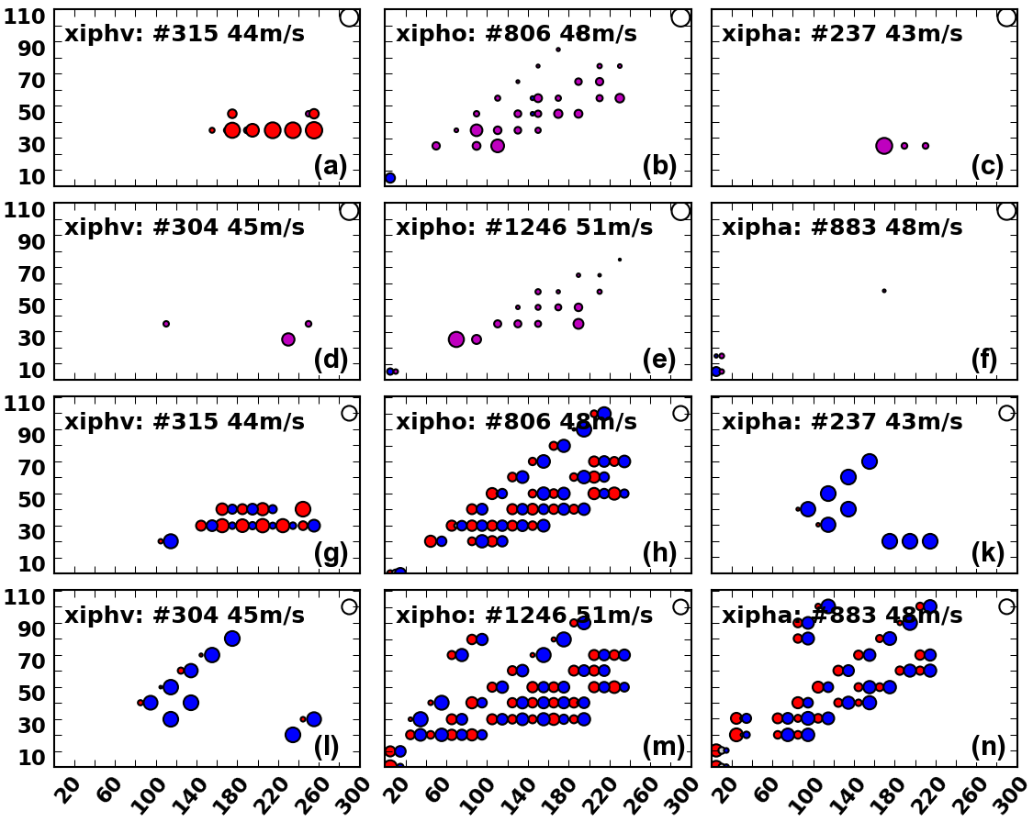
Descent mechanisms
07UTC
Mesoscale instability
Descent rate (hPah⁻¹)
09UTC
Frontogenesis/lysis
07UTC
09UTC
Total descent (hPa)
Notes:
Figure 15: As in Fig. 14 for Robert at 0700 UTC and 0900 UTC 27 December 2011. Ensemble
members v, o, and the control (a) are shown in left, middle and right columns, respectively
Figure 14: (a) Trajectories which descended (>0 hPa) into strong wind region at 0900 UTC 8
December in Friedhelm control ensemble member are binned by total descent (hPa, x-axis) and
descent rate ( dp
dt , hPa.hr−1). Only trajectories which were saturated (>90% RH) before descent
are considered. Dot size denotes proportion (100% dot size plotted top right) of trajectories in
a given bin which had mesoscale instability (to include legend ) at start of descent. (b) and (c)
are for ensemble members e and q. (d-f) shows same for trajectories arriving at 1100 UTC.
(g-n) is analogous to (a-f) but displaying proportion of trajectories that experienced substantial
(±100 K.km−2.105s−1) frontogenesis or lysis during descent.

Slide 42
Role of the boundary layer
Example atmospheric soundings
Low-level stable layer due to surface cooling inhibits downwards momentum transfer
Transfer of momentum in moist and dry air from 920 hPa to surface unimpeded
Shallow stable layer inhibits downwards momentum transfer
Hewson and Neu (2015)
Notes:
Fig. 2. Example UK-area lower tropospheric soundings for the WJ, SJ and CJ phenomena, in (a), (b) and (c), respectively, with winds in
alphanumeric format (speeds in kts). Pressure in hPa is shown on the left, whilst temperature in 8C is shown below. (a) is for Camborne at
00 UTC on 30 October 2000 (Oratia), whilst (c) is for Crawley at 18 UTC on 25 January 1990 (Daria). To denote the SJ (b) shows two
soundings from ECMWF HRES 6-hour forecast fields valid at 06 UTC on 3 January 2012 (Ulli). These nominally straddle the SJ surface
impact zone at this time; mauve is to the west, blue to the east. Sounding locations are shown (by coloured rings) on Fig. 4b for the WJ in
(a), on Fig. 10b for the SJ in (b), and on Fig. 4a for the CJ in (c).

Slide 43
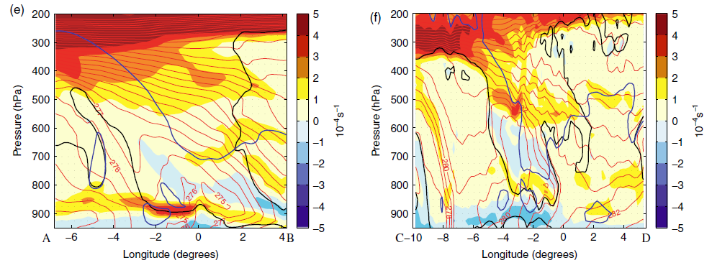
Role of the boundary layer
Idealised cyclone
Windstorm Gudrun
Enhanced static stability layer inhibits descent?
Sting jet?
CCB
Sting jet
Moist static stability (shading), θ_{w} (red contours), 80% RH (black contours)
Baker at al. (2014).

Slide 44
Conclusions
Sting-jet-resolving short-range ensemble forecasts of three windstorms argued to contain sting jets have been presented.
Within a given storm, the ensemble members exhibit close synoptic-scale agreement but the characteristics of the sting jets vary widely in terms of the number of trajectories comprising them and their associated mesoscale instabilities and/or passage through frontogenetic/lytic regions. This suggests relatively weak predictability exists in sting jet strength.
Comparing storms, different the mechanisms associated with sting jet descent emerge despite the ensemble variability.
CSI release is characteristically associated with drying sting jets descending from the cloud head in the most intense windstorms. But other mesoscale instabilities (CI and II) and passage through the frontolytic regions typically found at the hooked tip of the bent-back front can also be associated with descent.
Mesoscale instabilities and strongly frontolytic regions are both typical characteristics of intense and explosively developing extratropical cyclones.

Slide 45
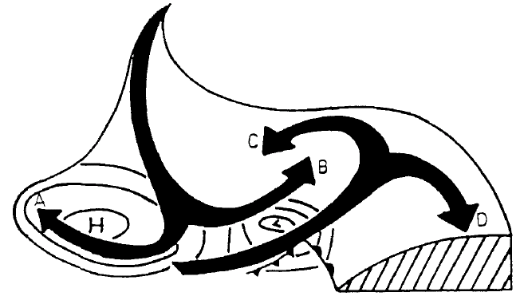
Conceptual cyclones
Isentropic relative flow in a baroclinic wave
Dry intrusion
Warm conveyor belt
Thorncroft et al., (1993)
Notes:
Figure 1 shows the general nature of isentropic motion in a mature cyclonic system
and its surroundings, looking northwards in the northern hemisphere. This schematic
picture draws on the work of several authors (e.g. Danielsen 1964, 1980; Green et al.
1966; Carlson 1980; Heckley and Hoskins 1982; Golding 1984). The descending air west
of the surface pressure low, on reaching middle levels, splits into two branches A and B
turning anticyclonically and cyclonically. Air originating at lower levels in the warm
sector equatorward of the surface low rises and splits into two branches C and D. To the
extent that condensation occurs in the moist warm-sector branch as it rises, there will be
enhanced ascent involving cross-isentropic motion. This pattern of air motion may then
result in a cloud pattern with a hammer-head appearance. Note also that since the
descending air is certain to be unsaturated, and indeed likely to be very dry, its cyclonic
branch B may cut in behind the rising moister air to form a ‘dry slot’, a feature often
observed in strong systems (e.g. Reed and Albright 1986; Young er al. 1987).
When considering such systems it is useful to distinguish two extreme types of
behaviour. In the first type, most of the flow is in branches A and D, whereas in the
second type, most is in B and C. For brevity we refer to these respectively as ‘anticyclonic’
and ‘cyclonic’. Other aspects of the contrast between them will emerge later. Real
systems often combine both types of behaviour, as do model baroclinic-wave life-cycle
simulations. The purpose of this paper is to show how the distinction is useful for
understanding both the real systems and the simulations. In particular, it throws new
light on the dynamics underlying the strikingly different energetic behaviours found by
Simmons and Hoskins (1980) (hereafter SH) in the two wavenumber-6 cases they denoted
as ‘basic’ and ‘anomalous’, of which the initial mean flows differ only as regards the
horizontal shear.

Slide 46
Windstorm Friedhelm
Identified as a sting jet cyclone by precursor diagnostic and Martínez-Alvarado et. al (2014). Deepened 44 hPa/ 24 h.
Most (22/24) ensemble members have sting jet trajectories arriving at 9Z and other arrival times.
Ensemble member trajectories characteristically have CSI prior to descent which then diminishes during descent. CI present prior to descent and II present during descent in some members.
Ensemble member trajectories generally pass through regions that are more frontolytic than frontogenetic but there is no consistent behaviour relative to the timing of the descent.
Suggestion: Example trajectories from Control (A) at 9am for DP>70
Notes:
Sting jet trajectories descent at least 50 hPa, and are saturated at start of descent.

Slide 47
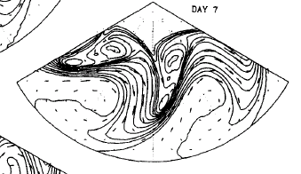
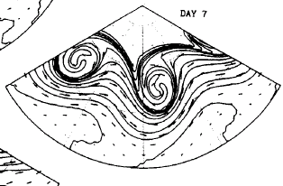
PV structure of dry cyclones
Idealised baroclinic waves
LC2: with added cyclonic shear
LC1
Potential temperature, Ɵ, on the PV = 2PVU surface (tropopause)
Thorncroft et al., (1993)
Notes:
LC2 – added cyclonic shear.
Potential temperature on the PV = 2 PVU surface in LC1 between days 4 and 9. Contours are
drawn every 5 K from 290 K to 350 K going equatorward. Wind vectors are included; for days 4 to 7 these have
had the phase speed of the normal mode removed to give the relative flow.
here designated
‘anticyclonic’ and ‘cyclonic’, and epitomized by strongly contrasting upper-air trough behaviour. ‘Anticyclonic’
behaviour dominates the late stages of LCl and is characterized by backward-tilted, thinning troughs being
advected anticyclonically and equatorward, as in the commoner cases of planetary-scale mid-stratospheric
‘Rossby-wave breaking’. ‘Cyclonic’ behaviour dominates LC2 and is characterized by forward-tilted, broadening
troughs wrapping themselves up cyclonically and poleward, producing major cut-off cyclones in high latitudes.

Slide 48
PV structure of dry cyclones
Modification of tropopause-level PV to improve short-range weather forecasts.
Satellite and PV
Original
Modified
Demirtas and Thorpe (1999)
Notes:
922 M O N T H L Y W E A T H E R R E V I E W VOLUME 127
q 1999 American Meteorological Society
Sensitivity of Short-Range Weather Forecasts to Local Potential Vorticity Modifications
MERAL DEMIRTAS* AND ALAN J. THORPE
FIG. 2. Initial conditions for FA160295 and FA160295/R1. The Meteosat water vapor imagery in gray shades and the 315 K isentropic
surface PV in white contours at initial analysis time for 0000 UTC 16 Feb 1995. Dark shades represent dry air, light shades represent moist
air. (a) The original forecast (FA160295), (b) the FA160295/R1 forecast. Contour interval is 0.5 pvu.

Slide 49
PV structure of dry cyclones
Attribution of frictional generation of PV to Ekman and Baroclinic mechanisms.
Frictional generation of PV through baroclinic mechanism in a growing wave
Positive baroclinic PV generation
Adamson et al (2006)
Notes:
Q. J. R. Meteorol. Soc. (2006), 132, pp. 101–124 doi: 10.1256/qj.04.145
Boundary-layer friction in midlatitude cyclones
By D. S. ADAMSON, S. E. BELCHER, B. J. HOSKINS and R. S. PLANT∗
Figure 11. Schematic describing the frictional generation of potential vorticity by the baroclinic mechanism in
the linear phase of a baroclinic wave. (a) and (b) illustrate the baroclinic mechanism in a neutral wave associated
with the meridional and zonal potential temperature gradients, respectively. (c) illustrates the impact of frictional
turning of the wind in a growing wave, with both components of baroclinicity taken into account. L and H denote
the surface low and high pressure centres, the arrowheads denote low-level winds and the long arrows denote
the thermal wind that is associated with the relevant component(s) of baroclinicity. Shading indicates regions
where vs · vT is large, with darker shading being used for negative values (corresponding to positive baroclinic
PV generation). See text for further explanation.

Slide 50
Conceptual cyclones
Browning (1997), after Young (1994)
Notes:
Meteorol. Appl. 4, 317–324 (1997)
The dry intrusion perspective of extra-tropical
cyclone development
Figure 5. Conceptual model showing system-relative airflow
associated with the diffluent-flow type of cyclogenesis. The
arrows labelled W1 and W2 are the primary and secondary
warm conveyor belts. The dashed arrow labelled CCB is a
cold conveyor belt. The dry intrusion is seen to overrun W2
over a broad region to produce an upper cold front at its leading
edge. (After Young, 1994.)

