Slide 1
The contribution of sting-jet windstorms to extreme wind risk in the North Atlantic
Department of Meteorology
Suzanne Gray
Neil Hart (now at Univ Oxford), and Peter Clark

Slide 2
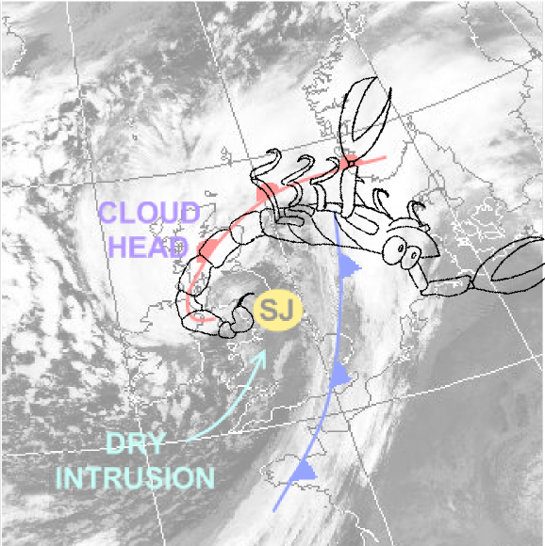
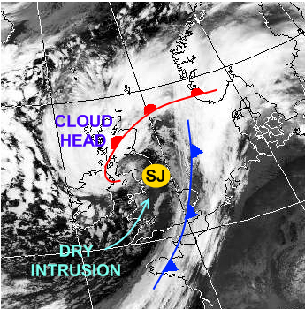
What is a sting jet?
Transient (few hours), mesoscale (~50km spread) jets of air descending from the tip of the hooked cloud head in the frontal fracture regions of some extratropical storms.
Can cause damaging winds (and especially gusts).
Coined ‘the sting at the end of the tail’ by Browning (2004) in his study of the Great October storm of 1987.
Since then large body of work performed on modelling, mechanisms and climatologies.
First research aircraft flight into a sting jet storm led by Reading scientists within DIAMET project: Windstorm Friedhelm (Martínez-Alvarado et al., 2014).
Term has now entered common usage(?)
Adapted from Laura Baker by Neil Hart.

Slide 3
Conceptual model
Clark et al. (2005). Adapted from Shapiro and Keyser (1990).
Notes:
part a of Fig. 18 is a key part of the conceptual model in this paper, which I think needs a bit more emphasis in a talk on 'jets'. The key message is that the SJ exists as a distinct flow within and descending out of the cloud head above the CCB in the CH and descending in front of the CCB in the frontal fracture.

Slide 4
Questions
What is the prevalence of sting-jet cyclones in the North Atlantic?
Are the characteristics of sting-jet cyclones different to those of non sting-jet cyclones:
  storm track?
  deepening rate?
  low-level wind speed?
  seasonal cycle?
What is the relative contribution of sting-jet cyclones to strong wind events in Europe or the UK?

Slide 5
Identification method
ERA-Interim data (1979-2011): 6 hourly, Sept. to May inclusive.
Extratropical cyclone tracks diagnosed using TRACK algorithm (e.g. Hodges and Hoskins, 2002) using ξ₈₅₀ smoothed to T42 resolution.
Cyclones reaching their ξ_{max} within a specified North Atlantic domain analysed.
Sting-jet precursors diagnosed assuming release of atmospheric instability generates or strengthens sting jets (Gray et al., 2011).
Midtropospheric atmospheric instability to slantwise descent diagnosed using downdraught slantwise CAPE (DSCAPE).
Cyclones considered to have the potential to produce sting jets have a sufficiently large contiguous region of DSCAPE exceeding 200 Jkg⁻¹ in their cloud head.
Identification of cloud head and ‘sufficient’ DSCAPE is threshold dependant, but previous work (Martínez-Alvarado et al., 2011) has demonstrated skill in identification of cyclones that generated sting jets in weather forecasts.

Slide 6
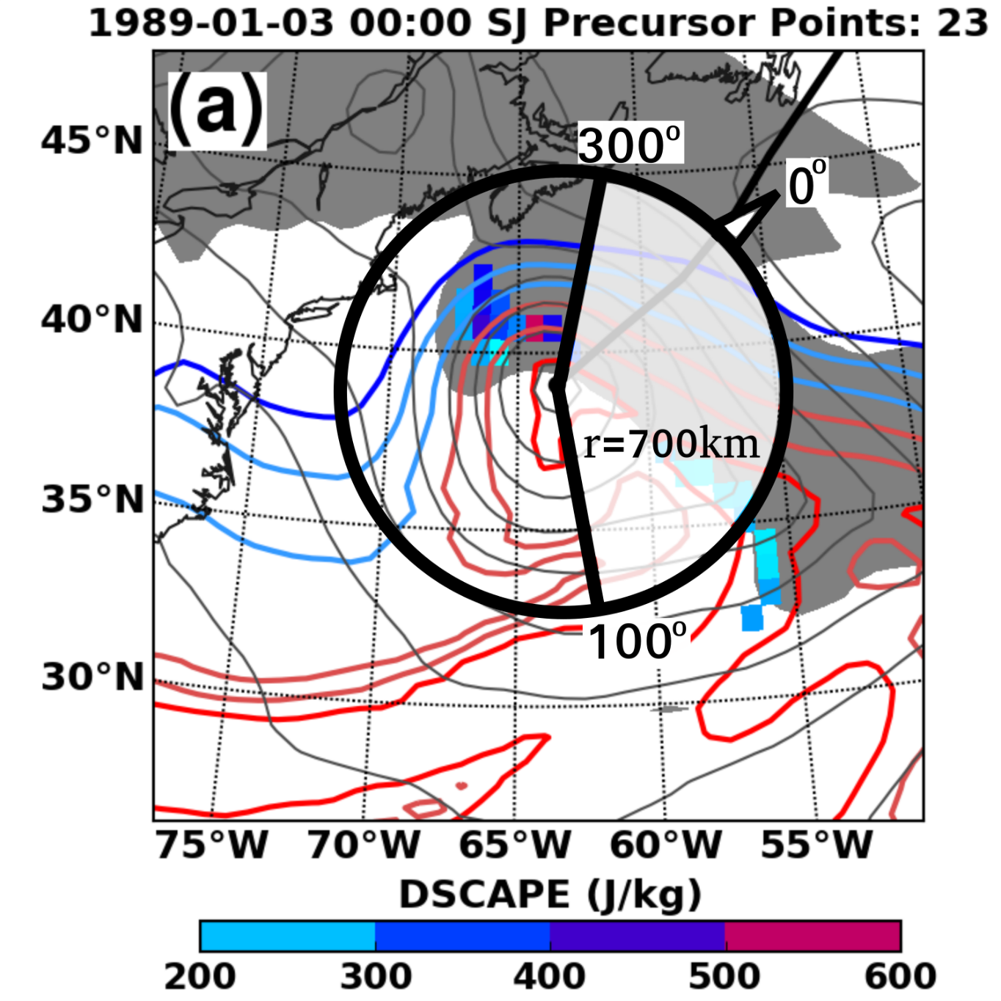
Example: ERICA IOP4
Notes:
Figure 1: Methodology example ERICA IOP4 as represented in ERA-Interim: (a) Sting Jet
DSCAPE precursor (color shading), w-contours (coloured, every 2K starting at 277K in blue)
and MSLP (gray contours) with RH>90% in lower troposphere in gray shading to approximate
cloud head. Northeastward movement indicated by system track (thick black line). Criteria for
location of DSCAPE values valid to precursor are proximity to cyclone centre (circle, r=700km)
and within rearward-developing cloud head (clear sector in circle bounded by 100 0 to 3000 when 00
dened as direction of cyclone movement). (b) demonstrates separation of cool sector and warm
sector winds (blue, red shading) by a w-threshold (black line) identied by the mean w-value
obtained from grid-points above 99th-percentile rw (gray shaded areas) within a 1000-km radius
of the cyclone centre.

Slide 7
Diagnostic skill
Martínez-Alvarado et al. (2012) demonstrated that the diagnostic showed skill when 15 cases were simulated at ‘sting jet resolving’ resolution (12 km horizontal grid spacing)
Up to 1/3 of 100 North Atlantic winter windstorms selected from the last two decades were found to have had sting jet precursors

Slide 8
Classification of cyclones
 | Non explosive | Explosive (Δp (24h)< -20 hPa) | Totals
No SJ precursor | 3020 | 676 | 3696
SJ precursor | 1252 | 499 | 1751
Totals | 4272 | 1175 | 5447
22% of tracked cyclones are explosive.
32% of tracked cyclones have a SJ precursor.
29% of non-explosive cyclones have a SJ precursor.
42% of explosive cyclones have a SJ precursor.
Notes:
Same % of tracked cyclones with SJ precursor for 2 years in N Pacific

Slide 9
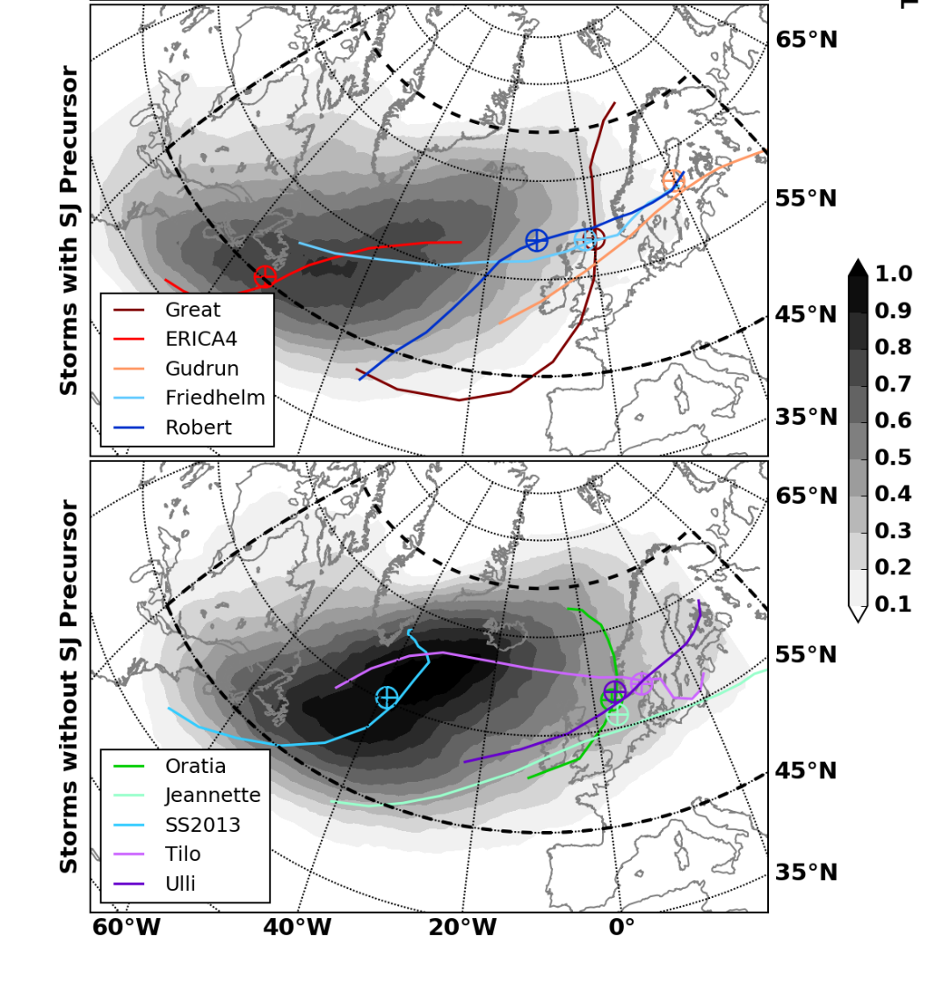
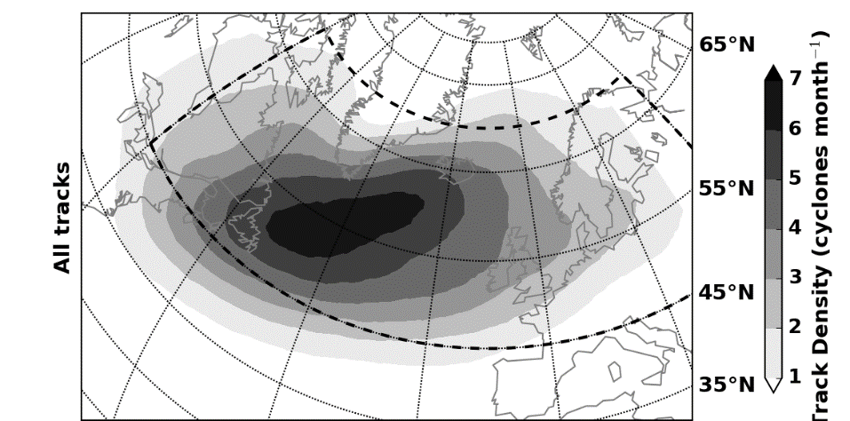
Track density maps
Precursor
All cyclones
No precursor
Cyclones with sting-jet precursors follow a more southerly storm track compared to those without these precursors.
Notes:
/home/rb904381/stingjets/precursorfigs/erain/TrackDensitySJnoSJmap100_dp-20.png
Figure 2: Extratropical cyclone track density (month􀀀1) for all systems occurring during Sept-May
seasons through 1979-2012 with vorticity maxima within dashed black curve (a). Track density
(month-1) for explosively-developing (MSLPmin >20hPa/24h) systems without (b) and with (c)
sting-jet producing potential. Select 850hPa tracks from systems with published case studies are
shown in coloured lines with legend.

Slide 10
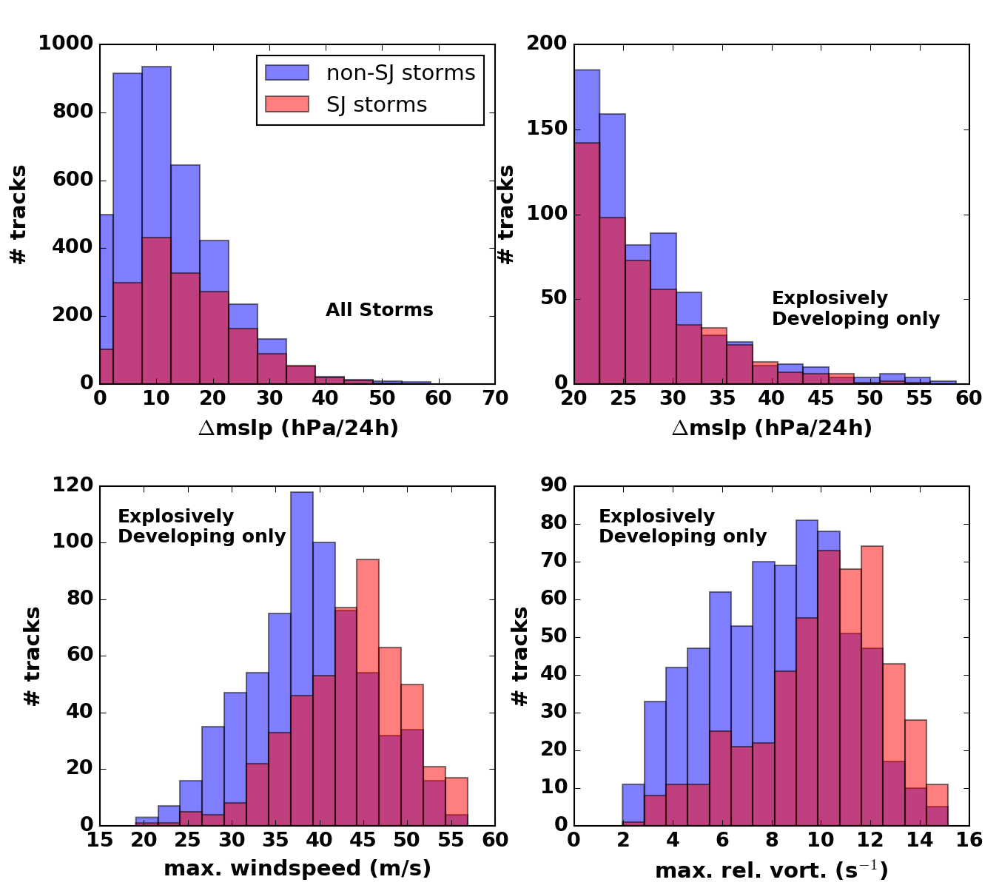
Cyclone metrics
But, ERA-Interim is too coarse to resolve SJs.
Interpretation: precursor identifies those cyclones with atmospheric instability in the cloud head (more substantial cloud head?) that is released by the model dynamics (not necessarily physically) and/or cyclones where potential temperature & momentum surfaces are close to parallel (indicator of a rapidly developing fronts); these factors intensify the cold conveyor belt.
Explosive cyclones with SJ precursor do not deepen obviously faster in MSLP than those without.
But, cyclones with SJ precursors have faster windspeeds and greater ξ.
Notes:
Figure 3: (a) The maximum drop in MSLP associated with all North Atlantic systems that are
agged with the sting-jet precursor diagnostic (red) and those without the diagnostic (blue). (b)
as in (a), but only for explosively-developing (MSLPmin >20hPa/24h) storms. (c) and (d) show
the maximum windspeed and relative vorticity, respectively, for the explosively-developing subset
of storms as shown in (b).
7

Slide 11
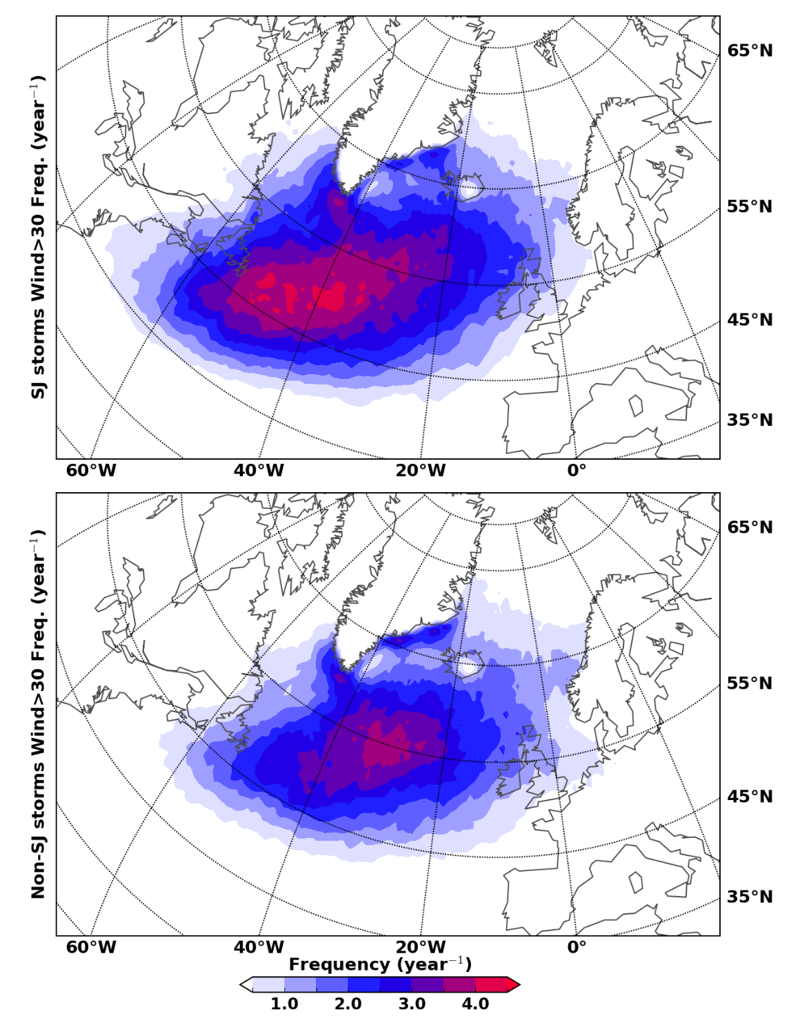
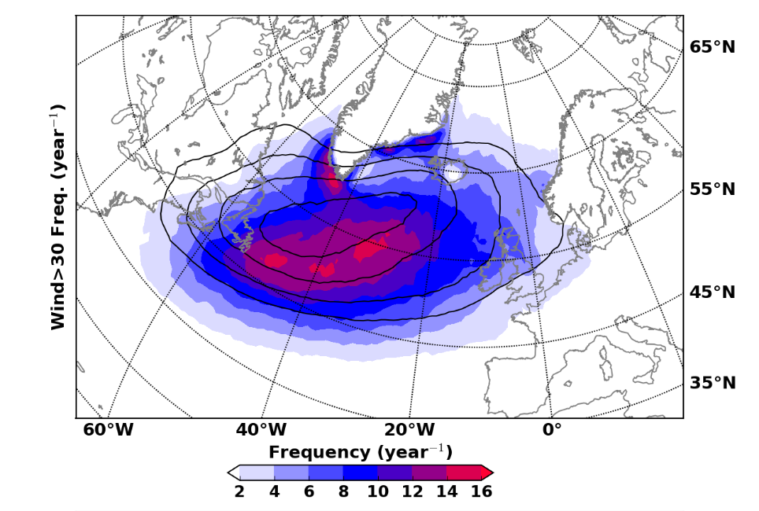
850 hPa windspeed
Explosive cyclones only
Precursor
All cyclones
No precursor
N.B. Explosive cyclones contribute just over half of these strong wind events
Cyclones with SJ precursors are more likely to be associated with strong low-level winds, particularly in the SW of the North Atlantic.
Notes:
Figure 5: (a) The annual frequency of 850hPa wind speeds >30 m.s-1 computed from all storms.
(b) Shows the proportion of this frequency due to the explosively-developing systems.
Figure 6: Considering only explosively-developing storms (a) shows annual frequency of 850hPa
wind speeds >30 m.s-1 for cyclones that have been diagnosed with sting-jet potential and in (b),
non-stingjet storms.

Slide 12
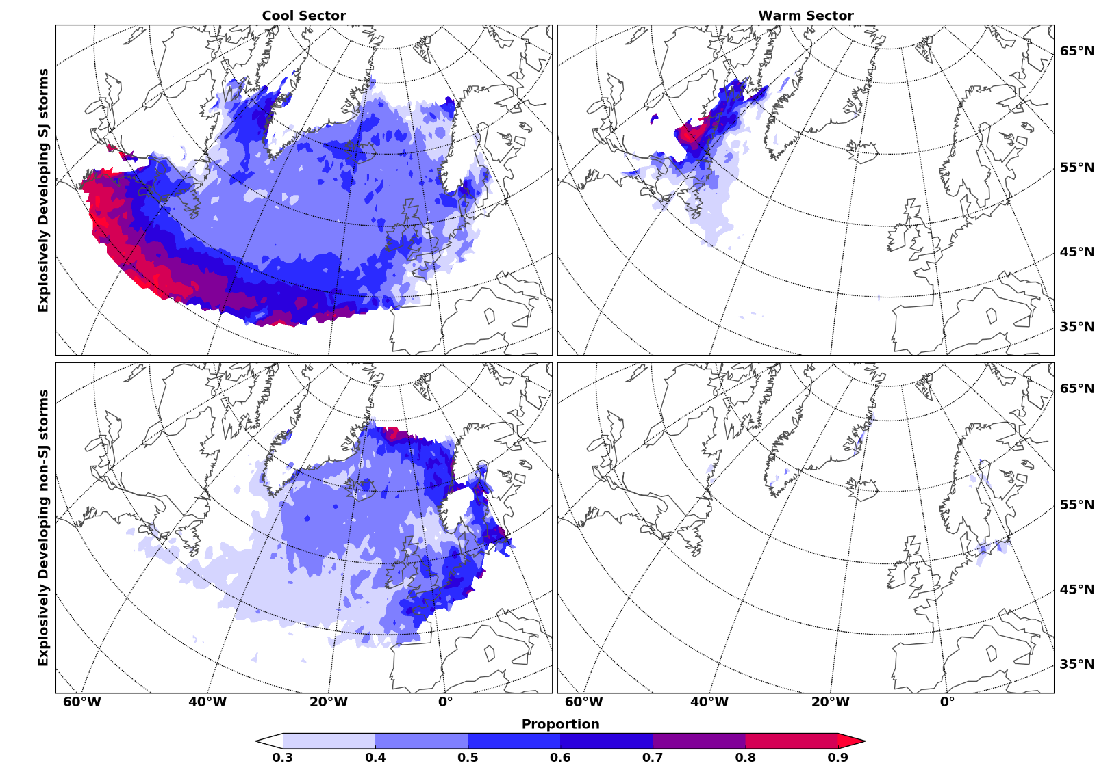
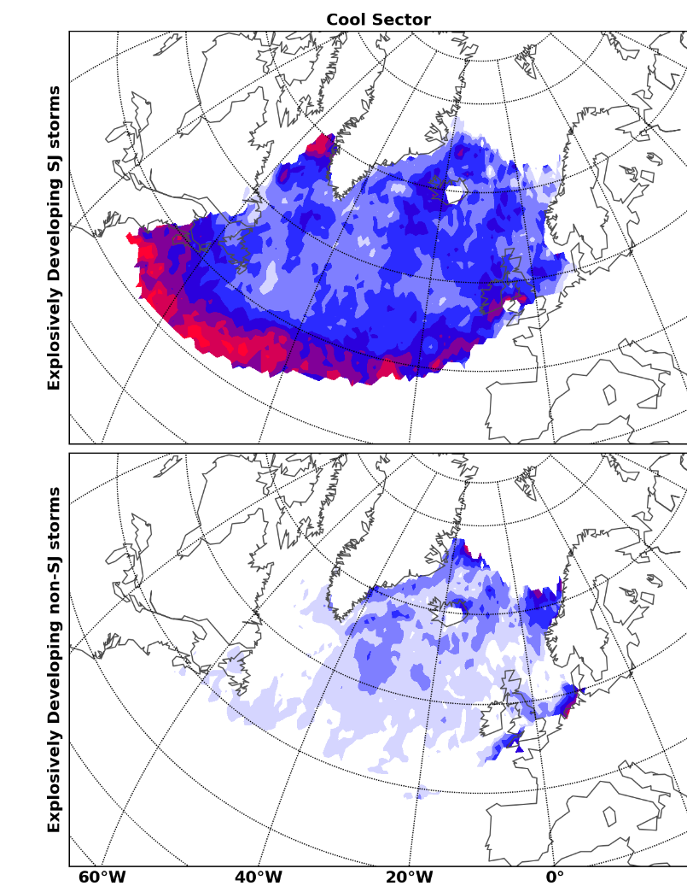
Cool- vs. warm-sector winds
Cool sector dominates contribution to strong (>30 ms⁻¹) low-level winds
Cyclones with SJ precursors contribute more in the SW of the N. Atl.
Cyclones without SJ precursors contribute more in the NE of the N. Atl.
The contribution from cyclones with SJ precursors increases with the windspeed threshold.
Explosive cyclones only
Precursor
Precursor
30 ms⁻¹
35 ms⁻¹
No precursor
No precursor
Cool -sector
Warm -sector
Notes:
Figure 7: Proportional contribution to total (combination of frequencies shown in Fig. 6 a and b)
explosively-developing cyclone high-wind risk by stingjet (top panels) and non-stingjet cyclones
(bottom panels) separated into respective cool sector winds (left panels) and warm sector winds
(right panels).

Slide 13
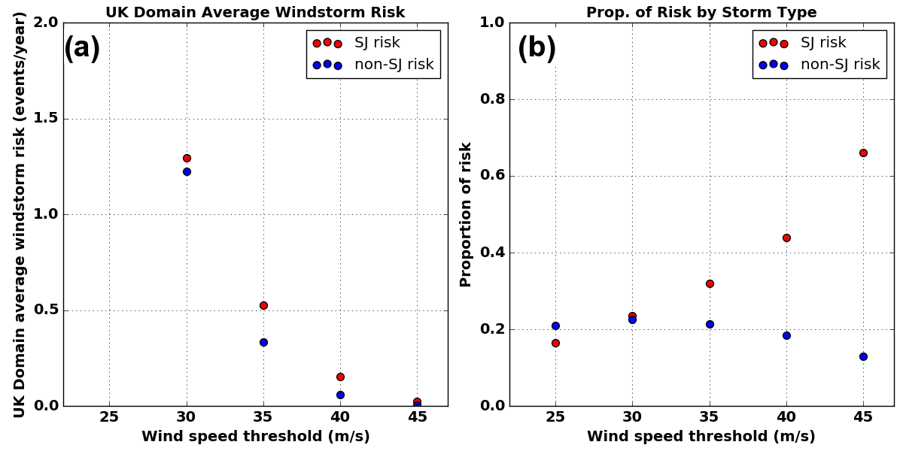
UK windstorm risk
Explosively-deepening cyclones

Slide 14
Conclusions
A diagnostic for sting jet precursors has been applied to tracked North Atlantic cyclones in the ERA-Interim reanalysis (1979-2011).
32% of all cyclones have SJ precursors; 42% of explosively developing cyclones have SJ precursors.
For explosively developing cyclones the low-level maximum windspeed and ξ is distributed towards much higher values for those cyclones with SJ precursors.
For explosive cyclones, those with SJ precursors dominate the contribution to strong low-level winds events, particularly in the SW North Atlantic; these winds are generally in the cool sector of the cyclone.
These cyclones with SJ precursors become more dominant as the windspeed threshold is increased. Of all cyclones leading to winds exceeding 45ms⁻¹ over the UK, nearly 70% of them are explosively-deepening cyclones with SJ precursors.
The precursor diagnostic thus identifies systems that develop stronger cold conveyor belts. In real systems (or sting-jet resolving weather forecasts) the sting jet is likely to be an additional cause of strong cold-sector winds, either directly or through enhancement of the cold conveyor belt.

Slide 15
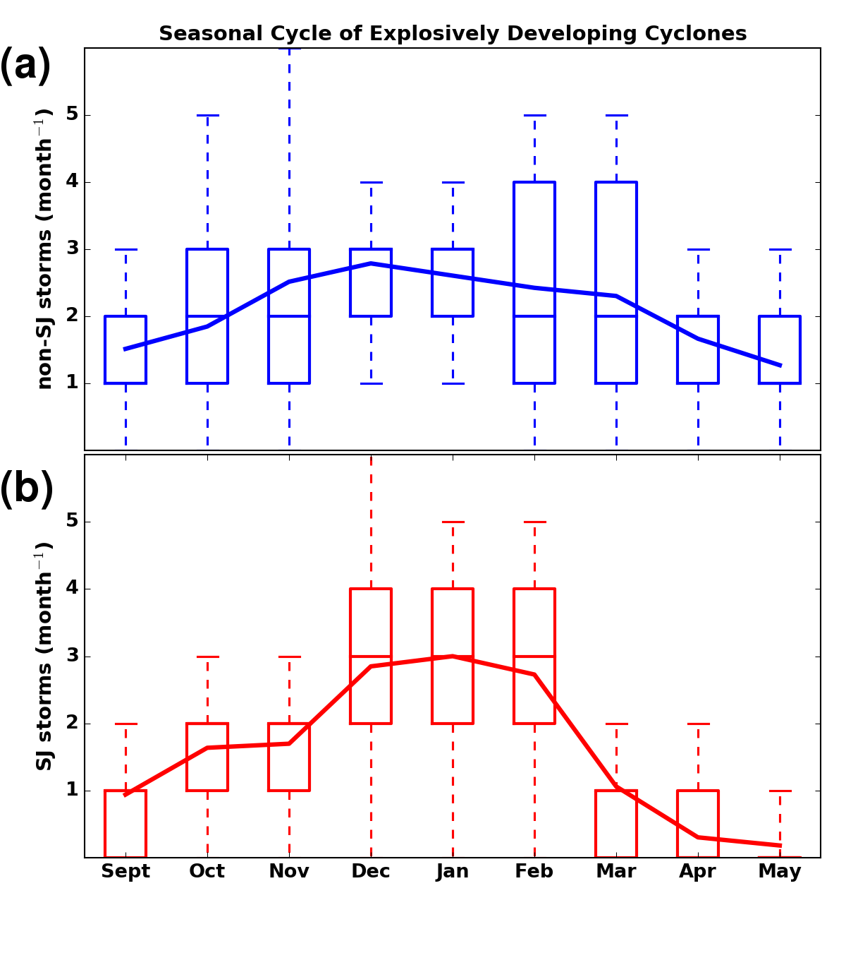
Seasonal distribution
Explosive cyclones only
No precursor
Explosive cyclones with SJ precursors have a stronger seasonal cycle than those without, with greatest numbers in winter (DJF).
Precursor

Slide 16
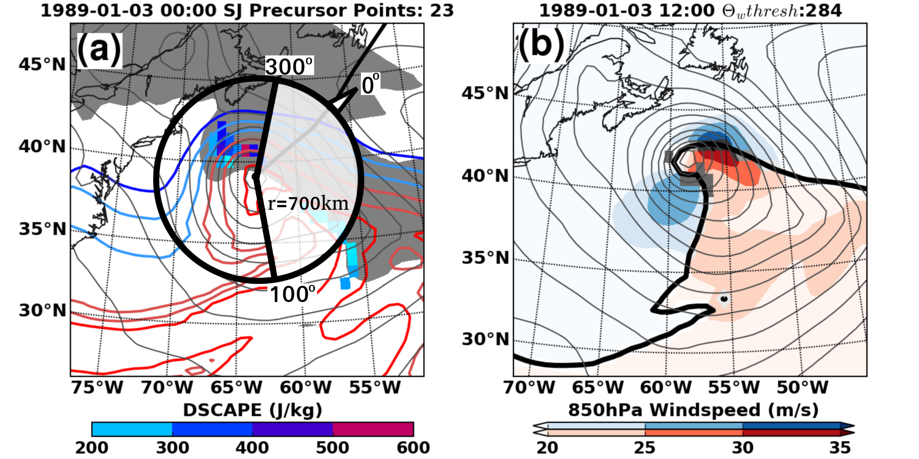
Example: ERICA IOP4
Cool sector winds
Warm sector winds
Notes:
Figure 1: Methodology example ERICA IOP4 as represented in ERA-Interim: (a) Sting Jet
DSCAPE precursor (color shading), w-contours (coloured, every 2K starting at 277K in blue)
and MSLP (gray contours) with RH>90% in lower troposphere in gray shading to approximate
cloud head. Northeastward movement indicated by system track (thick black line). Criteria for
location of DSCAPE values valid to precursor are proximity to cyclone centre (circle, r=700km)
and within rearward-developing cloud head (clear sector in circle bounded by 100 0 to 3000 when 00
dened as direction of cyclone movement). (b) demonstrates separation of cool sector and warm
sector winds (blue, red shading) by a w-threshold (black line) identied by the mean w-value
obtained from grid-points above 99th-percentile rw (gray shaded areas) within a 1000-km radius
of the cyclone centre.

Slide 17
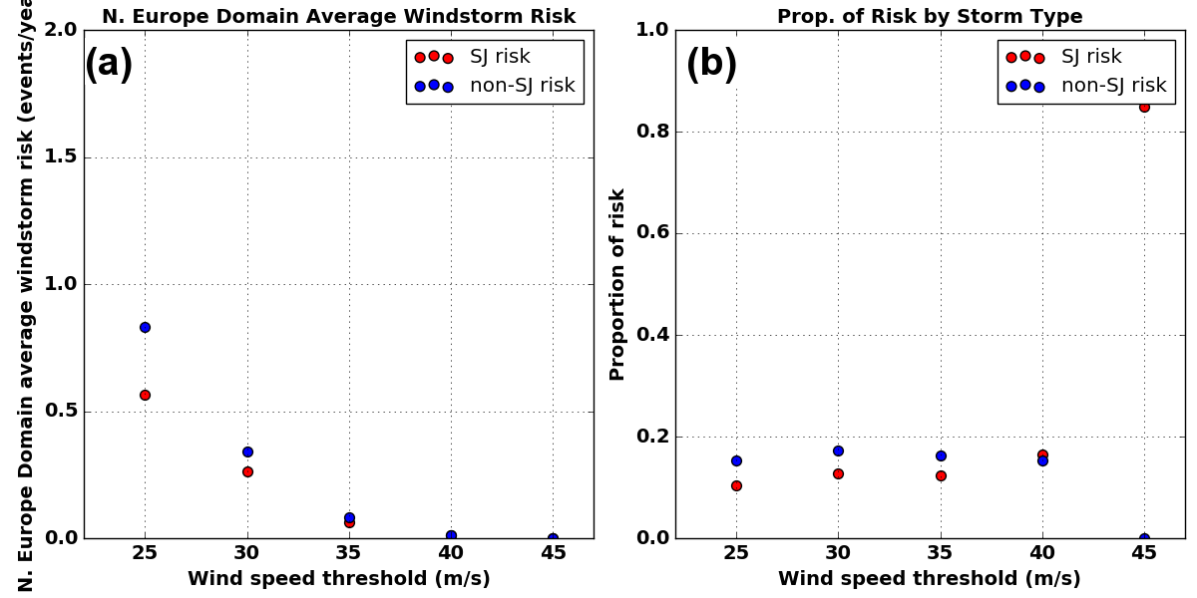
Northern Europe windstorm risk

