Slide 1
The sting at the end of the tail: causes, importance and prevalence of the sting jet in extratropical cyclones
Department of Meteorology
Suzanne Gray

Slide 2
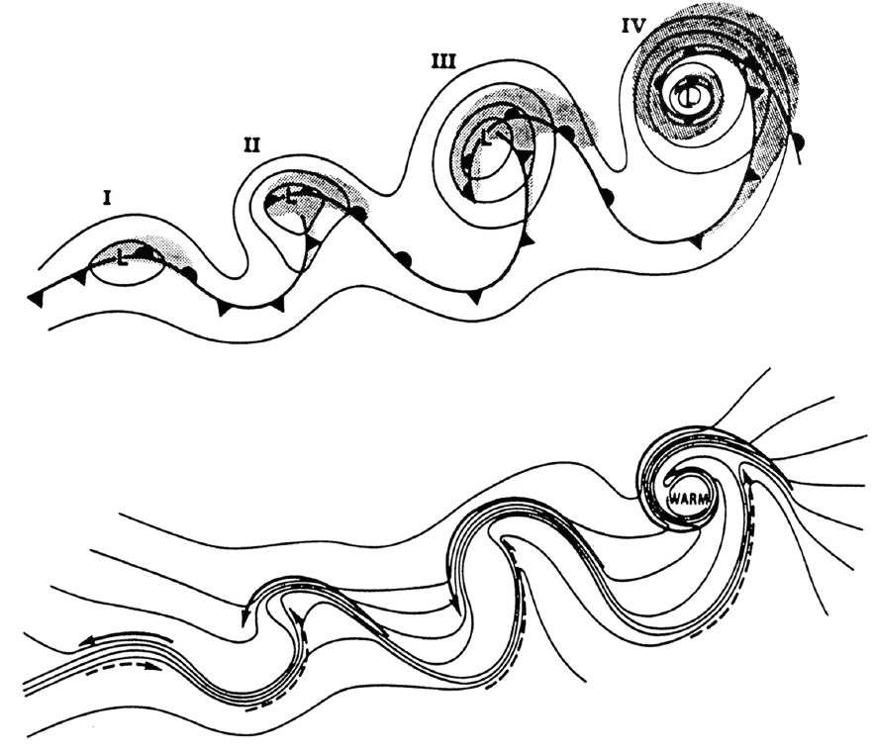
Structure of intense cyclones
Shapiro and Keyser (1990)

Slide 3
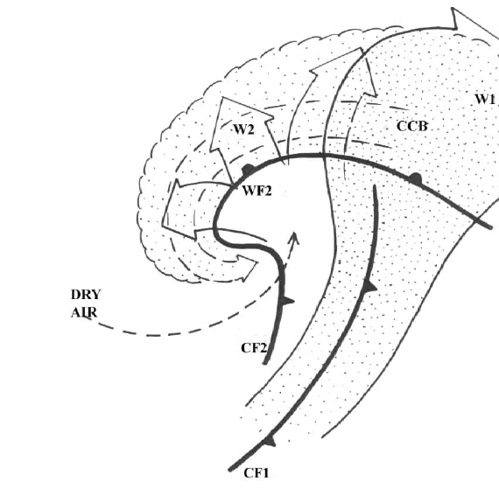
Structure of intense cyclones
Browning (2004) redrafted from Bader et al. (1995)

Slide 4

The start of the ‘sting jet’ era

Slide 5
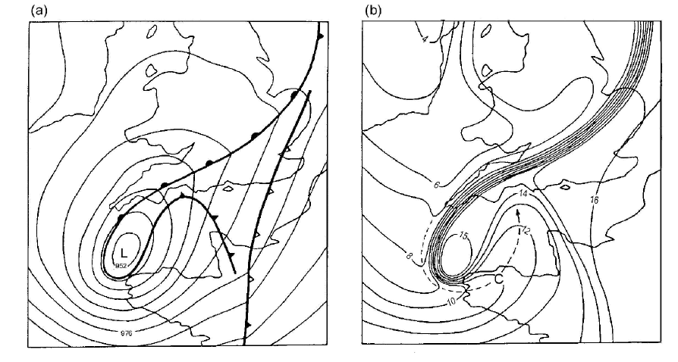
The Great October storm (1987)
Meso-analyses at 0000 UTC 16 October
MSLP
Surface wet-bulb temperature
Notes:
Might be worth saying that the 87 storm work was motivated by the 30 October 2000 storm, which shows up the banded structure very clearly in radar as well as imagery, did damage on the NE coast (and the SE, associated with the cold front) and only avoided worse as the max winds were off the coast. As a result of this + lack of manual anemographs, Keith went back to 87 storm as they'd all been kept as part of the investigation at the time. (We're only just beginning to have high time res. data again).

Slide 6
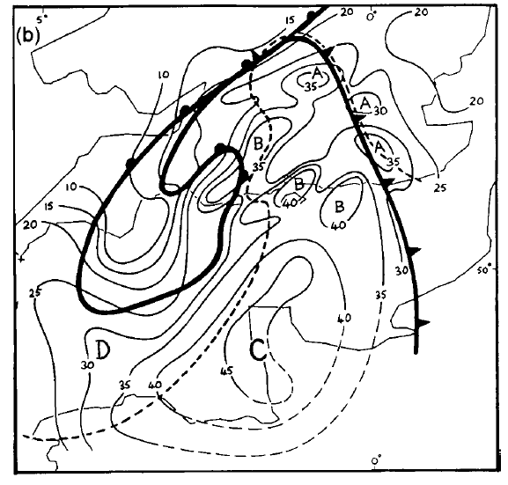
The Great October storm (1987)
0000 UTC
0130 UTC
MSLP
peak surface wind gusts (ms⁻¹)

Slide 7
The Great October storm (1987)
A: Localised strong gust regions (up to 35ms⁻¹) associated with cumulonimbus clouds ahead of CF2.
B: Localised strong gust regions (up to 40ms⁻¹ associated with shallow, non-precipitating cloud in dry slot.
C: Larger stronger wind region (40-50ms⁻¹ gusts) close to the tip of the hooked cloud head with shallow or no cloud.
D: Extension of region C behind the bent-back front and associated with moister air under the tip of the cloud head.
Notes:
Keith's gust analysis is based on his time-honoured technique of 'system relative displacement' - Fig 9a. Probably a 'classic technique' for identifying conveyor belts and jets with spatially sparse data.

Slide 8
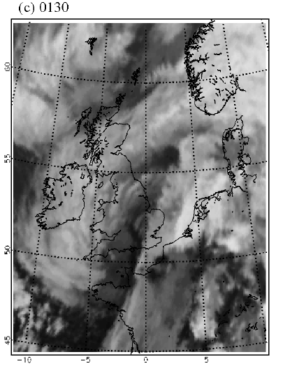
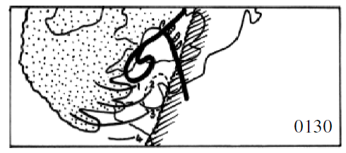
The Great October storm (1987)
Meteosat infrared imagery
Evidence for cloud banding in the cloud head attributed to multiple slantwise circulations.

Slide 9
The Great October storm (1987)
Shallow cumulonimbus clouds related to enhanced surface gusts
Main region of strong gusts
Axes of mesoscale cloud bands 1,2,3&4

Slide 10
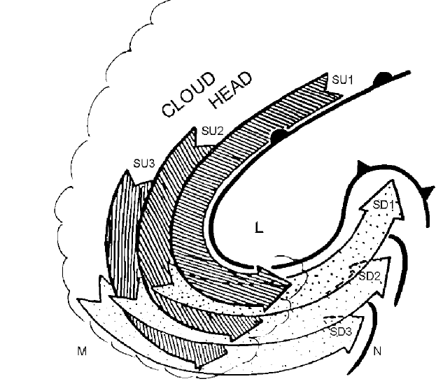
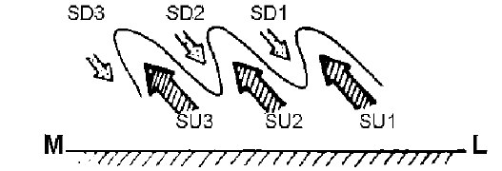
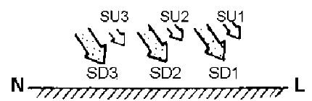
The Great October storm (1987)
Conceptual model of stacked slantwise circulations

Slide 11
Summary of Browning (2004)
Strong winds can occur close to the cyclone centre in the dry slot that are distinct from the strong winds that occur along the warm conveyor belt (and also the cold conveyor belt jet).
Associated with strongly intensifying cyclones following the conceptual Shapiro-Keyser evolution that includes frontal fracture.
These strong winds occur where descending air exits the cloud head at its tip and enters the dry slot – the sting jet.
Balanced dynamics account for a large part of the strength of the surface winds but evaporative cooling may enhance the dry slot wind maximum.
Multiple banded structure in cloud head suggests mesoscale slantwise circulations, possibly associated with the release of conditional symmetric instability.
Strong surface gusts occur because evaporative cooling reduces static stability in the dry slot contributing to upright convection due to potential instability release and/or strong turbulence and so mixing of momentum down to the ground.

Slide 12
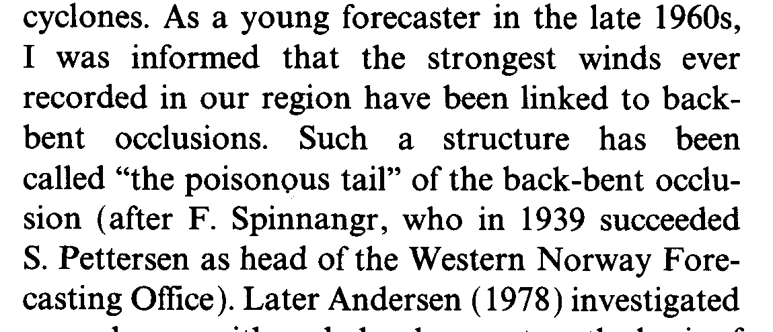
Sting jet?
Grønås (1995)
Browning (2004) “In the present paper the damaging winds in this region will be referred to as the sting at the end of the tail”

Slide 13
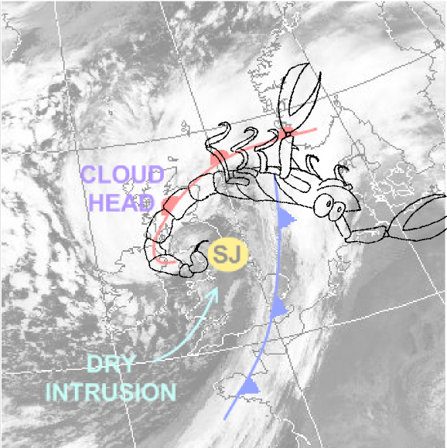
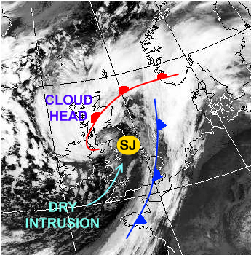
Sting jet?
Adapted from Laura Baker by Neil Hart.

Slide 14
Model support for the sting jet
Notes:
Boscastle event caused implementation of Met Office convection-permitting model to be accelerated – hence no 3rd paper. Research showed though that removing evaporative-cooling from the start of the run caused the descent to become weaker and broader (weakly descending slab of air). Hence evaporative cooling was not the cause of the sting jet descent but did seem to amplify it.

Slide 15
Model support for the sting jet
Conceptual model; adapted from Shapiro and Keyser (1990)

Slide 16
Model support for the sting jet
Conceptual model
Notes:
part a of Fig. 18 is a key part of the conceptual model in this paper, which I think needs a bit more emphasis in a talk on 'jets'. The key message is that the SJ exists as a distinct flow within and descending out of the cloud head above the CCB in the CH and descending in front of the CCB in the frontal fracture.

Slide 17
Model support for the sting jet
Model evidence for the conceptual model

Slide 18
Model support for the sting jet
System-relative winds at 850 hPa exceeding 30ms⁻¹
Model evidence for the conceptual model
Earth-relative winds at 850 hPa exceeding 30ms⁻¹
Notes:
Importance of diagnosis through trajectories.
Triangles in bottom right panel are group 2 trajectories shown in left hand panels.

Slide 19
Key issues from Clark et al.
To confirm that SJs exist similarly in other extratropical cyclones (consistent with the conceptual model)
To confirm the existence and importance of conditional symmetric instability.
To confirm the importance of evaporation in the production of strong surface gusts. Does the evaporation merely lower the static stability and enhance the vertical transport of momentum through the boundary layer, or does it also significantly increase the strength of the overall SJ?
To improve the understanding of the vertical transport of mass and momentum from the SJ through the boundary layer to the surface.
Notes:
To confirm that SJs exist and play a similar role in other damaging extratropical
cyclones, and confirm that the conceptual model presented here is representative of most
storms that deepen explosively and/or undergo frontal fracture.
• To confirm the existence and importance of CSI. In particular to determine
whether CSI plays a role in initiating the development of the SJ.
• To confirm the importance of evaporation in the production of strong surface
gusts. It is clear that the larger-scale dynamics and the release of latent heat of condensation
play the key roles in producing the rapid deepening and the strong gradient
winds, but the dependence of wind damage on wind speed is highly nonlinear, and
further relatively small increments in the strength of wind gusts due to evaporative heat
sinks can make a big difference. Does the evaporation merely lower the static stability
and enhance the vertical transport of momentum through the boundary layer, or does it
also significantly increase the strength of the overall SJ?
• To improve the understanding of the vertical transport of mass and momentum
from the SJ through the boundary layer to the surface. What are the physical characteristics
of the entities (kilometre-scale eddies?) responsible for the peak gusts at the
surface?

Slide 20
What happened next?

Slide 21
What have we learnt?
Observations
Mechanisms
  atmospheric instability
  evaporative cooling
  synoptic-scale forcing including frontogenesis/lysis
Role of the boundary layer
Predictability
Conceptual model development

Slide 22
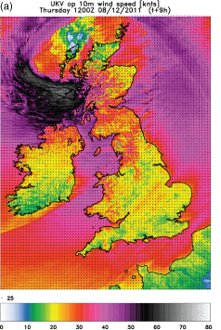
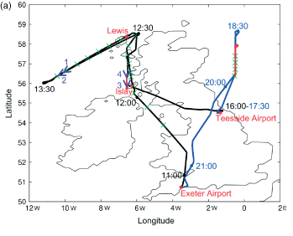
1. Observations
Wind profiler observations of windstorm Jeanette (2002)
First detailed analysis of a sting jet using measurements from a research aircraft flight into a sting jet storm during the DIAMET project: Windstorm Friedhelm (2011).
Parton et al. (2009)
Martínez-Alvarado et al. (2014)
Baker et al. (2013)
Notes:
Figure 16. MST radar wind speeds (colour) with corresponding values
from the operational UM fields overlaid as contours. Note that below
the main jet stream the operational UM depicted two separate features
between 0700 UTC and 0900 UTC: a wind maximum at 4–5 km and
the CCB below 2 km. Unreliable MST radar winds have been blanked
as described in the text. This figure is available in colour online at
www.interscience.wiley.com/journal/qj
Distinguishing the Cold Conveyor Belt and Sting Jet Airstreams
in an Intense Extratropical Cyclone
OSCAR MARTI´NEZ-ALVARADO, LAURA H. BAKER, SUZANNE L. GRAY,
JOHN METHVEN, AND ROBERT S. PLANT
Churned up sea off the west coast of Scotland as photographed from the FAAM research aircraft at about 450 m (1,480 ft) above sea level.
FIG. 8. Model-derived horizontal wind speed at 1500 UTC on a vertical section between F and G in Fig. 3c. Also
shown are equivalent potential temperature (thin contours, interval 1K) and the 80% and 90%RHice contours (black
solid and dashed, respectively). The pipes represent the flight track on the section. (a) Colors inside the pipe show
observed horizontal wind speed (according to color scale) and observed RHice (inner color, gray is RHice , 80%,
black is RHice . 80%). (b) Pipe color shows observed CO concentration (,115 ppb, black; between 115 ppb and
120 ppb, gray; and .20 ppb, white). The dots represent air parcels close to the section at 1500 UTC from airstreams
S1 (white), S2 (light gray), and S3 (dark gray). Each parcel is linked to a back trajectory from strong wind regions at
1600 UTC. Points R, T1, and T2 are as defined in the caption to Fig. 7.

Slide 23
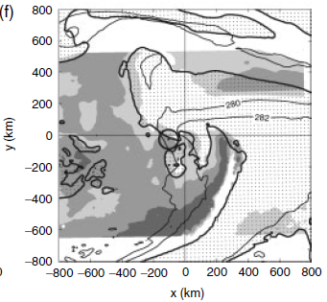
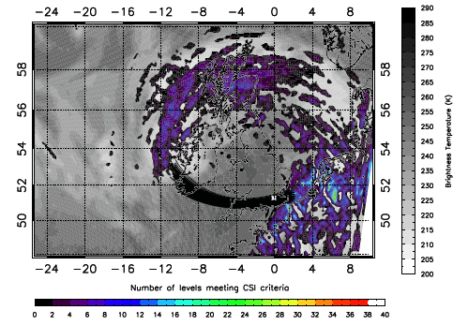
2.i. Mechanisms: atmospheric instability
Martínez-Alvarado et al. (2014). Instability diagnosis along sting jet trajectories in windstorm Friedhelm.
Parton et al. (2009). # levels meeting CSI criteria in windstorm Jeanette (2005), back trajectories and psuedo-IR imagery.
Gray et al. (2011). DSCAPE in windstorm Anna., Light grey – 100-300 Jkg⁻¹, Dark grey – 500-700 Jkg⁻¹.

Slide 24
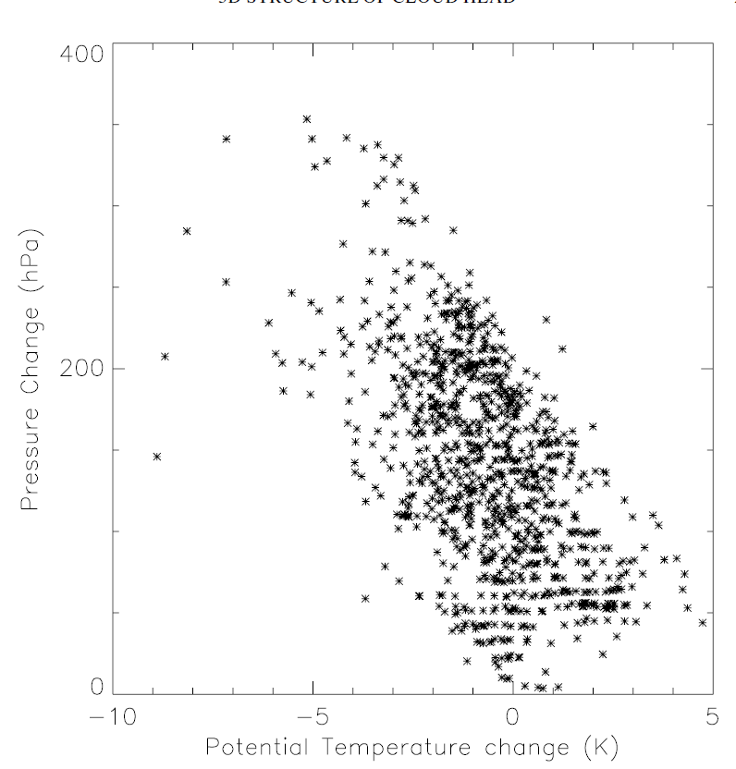
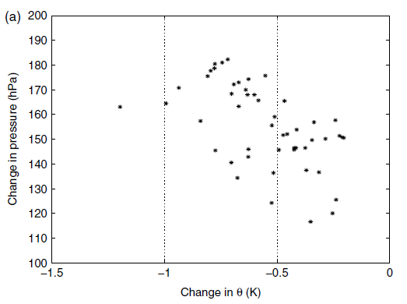
2.ii. Mechanisms: evaporative cooling
Baker et al. (2014), sting jet trajectories in an idealised cyclone.
But, simulation with evaporation of melting snow and rain turned off 2 hrs prior to sting jet descent showed no change in sting jet behaviour.
Clark et al. (2005), sting jet trajectories in the Great October storm (1987)
Notes:
SJ starts saturated and evaporation does, of course, occur, but it is dry for most of its descent. However, it's also the case that the potential cooling in the SJ trajectories in this case is, I think, very large compared with other examples. Of course, if one is looking at CSI in descending air, one is also looking implicitly at evaporative cooling. The issue is whether it's in-situ cloud or precip. falling from above. As you know, turning off evaporative cooling of precip does change the SJ in the 87 storm; this has been presented in talks but not published.

Slide 25
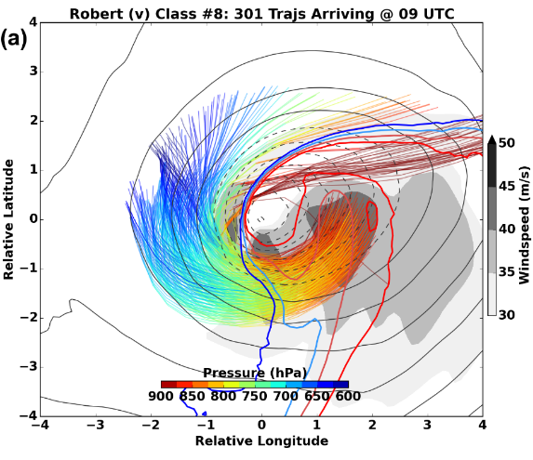
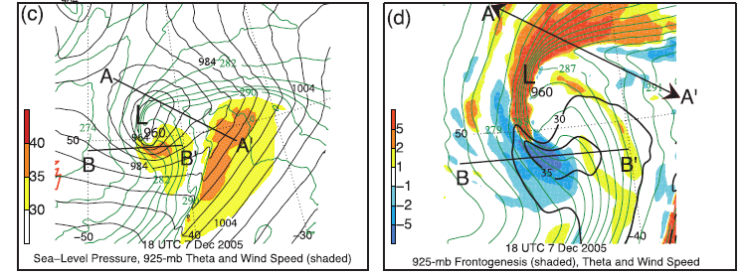

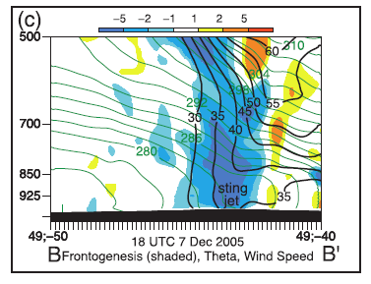
2.iii. Mechanisms: frontolysis
Schultz and Sienkiewicz (2013)
Hart, Gray, Clark (in prep.)

Slide 26
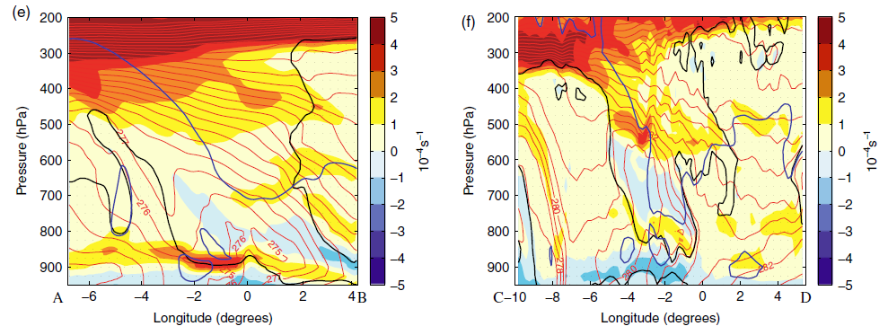
3. Role of the boundary layer
Idealised cyclone
Windstorm Gudrun
Enhanced static stability layer inhibits descent?
Sting jet?
CCB
Sting jet
Moist static stability (shading), θ_{w} (red contours), 80% RH (black contours)
Baker at al. (2014).

Slide 27
4. Predictability
Short-range ensemble forecasts
Up to 1/3 of North Atlantic winter storms may contain sting jets but these sting jets may not always lead to strong surface wind gusts.
Contingency table for instability based precursor diagnostic applied to global model forecast.
Hart, Gray, Clark (in prep.)
Martínez-Alvarado et al. (2012)
Notes:
Figure 4: Greatest total airstream descent versus maximum cool-sector 850hPa windspeed for each
ensemble member of each storm at time ensembles rst reach strongest windspeeds: 0900 UTC in
Friedhelm and Robert and 0700 UTC in Ulli.
Table 1. 2 2 contingency table after fifteen cases. Minimum size
of region is 5–8 grid columns inclusive. The p-value, p D 0:035,
was calculated using the Fisher exact probability test.

Slide 28
5. Conceptual model development
Hewson and Neu (2015)
Notes:
HEWSON, Tim D.; NEU, Urs. Cyclones, windstorms and the IMILAST project. Tellus A, [S.l.], sep. 2015. ISSN 1600-0870. Available at: <http://www.tellusa.net/index.php/tellusa/article/view/27128>. Date accessed: 05 Nov. 2015. doi:http://dx.doi.org/10.3402/tellusa.v%v.27128.
Fig. 1. Conceptual model of an extra-tropical cyclonic windstorm. Panel (a) shows the cyclone track (black), with spots denoting
positions equally separated in time, and numbered according to the cyclone life-cycle phases in panel (b). Spot colour relates to the
identification method and objective typing used in Hewson and Titley (2010), green being a diminutive frontal wave, orange a frontal
wave cyclone, and black a barotropic low. Shading denotes the footprints, or nominal damage swathes, attributable to the warm jet/
warm conveyor (yellow), the cold jet/cold conveyor (orange) and the sting jet (red). Panel (b) shows the synoptic-scale evolution
of fronts and isobars around the cyclone, after Hewson and Titley (2010) and Shapiro and Keyser (1990), with added letters denoting
relative locations of the strong wind features, and brackets indicating marginal existence. Panel (c) denotes the temporal evolution of
gust strength for each jet zone, with numbers cross-referencing phases on panel (b). On each panel, a dashed blue line denotes the
period of most rapid deepening, whilst the solid blue arrow shows the time of maximum depth. This conceptual model should
be considered to be very malleable; for example most intense cyclones will have only one or two of the three strong wind footprints
associated.

Slide 29
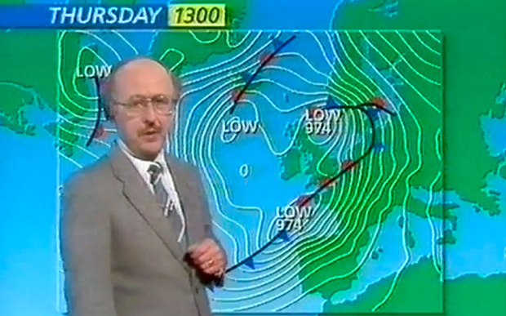
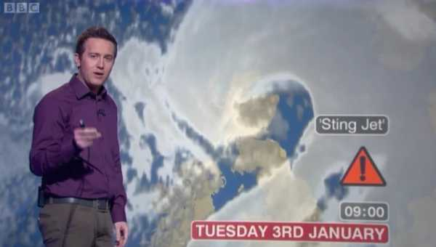
Summary
The detailed retrospective observational and model analyses of the Great October storm of 1987 by Browning (2004) and Clark et al. (2005) ignited interest in the mesoscale transient wind jet Browning christened the `sting jet’.
Terminology has gained wide-scale acceptance within the research and operational forecasting community (particularly within Europe) and public recognition.
Questions remain regarding the preferential environments for these storms, the conditions in which they lead to strong surface wind gusts, the importance of the different proposed descent mechanisms, and the effect of climate change
Notes:
"Michael Fish 1987 storm forecast" by Source (WP:NFCC#4). Licensed under Fair use via Wikipedia - https://en.wikipedia.org/wiki/File:Michael_Fish_1987_storm_forecast.jpg#/media/File:Michael_Fish_1987_storm_forecast.jpg

Slide 30
2.iii. Mechanisms: frontolysis
Zoomed c.f. (c)
Schultz and Sienkiewicz (2013)

Slide 31
Mesoscale PV structure of cyclones
moist
Link between negative moist PV at fronts, conditional symmetric instability and frontal rainbands.
Slantwise convection at a front
-ve PV_{e}
Delta M adjustment
~zero PV
Linear CSI
Nonlinear CSI
Holt and Thorpe (1991)
Browning et al. (2001)
Morcrette and Browning (2006)
Notes:
Q. J. R. Meteorol. Soc. (2006), 132, pp. 1073–1089 doi: 10.1256/qj.04.108
Formation and release of symmetric instability following
Delta-M adjustment
By C. J. MORCRETTE∗ and K. A. BROWNING
Figure 1. A thought experiment linking line convection, M adjustment and CSI in the development of
slantwise convection. These sketches show a time series (a)–(i) of vertical cross-sections through a baroclinic
zone, normal to the thermal wind. The vertical cross-sections represent an area around 5 km deep and several
hundreds of kilometres wide. Areas of negative equivalent potential vorticity are shaded. The first, second and
third row of panels represent three distinct stages which are dominated by M adjustment, linear CSI and nonlinear
Q. J. R. Meteoml. SOC. (2001). 127, pp. 2513-2536
Stacked slantwise convective circulations
By K. A. BROWNING*, D. CHAPMAN and R. S. DIXON
CSI respectively. Further details are given in the text in section 2.

Slide 32
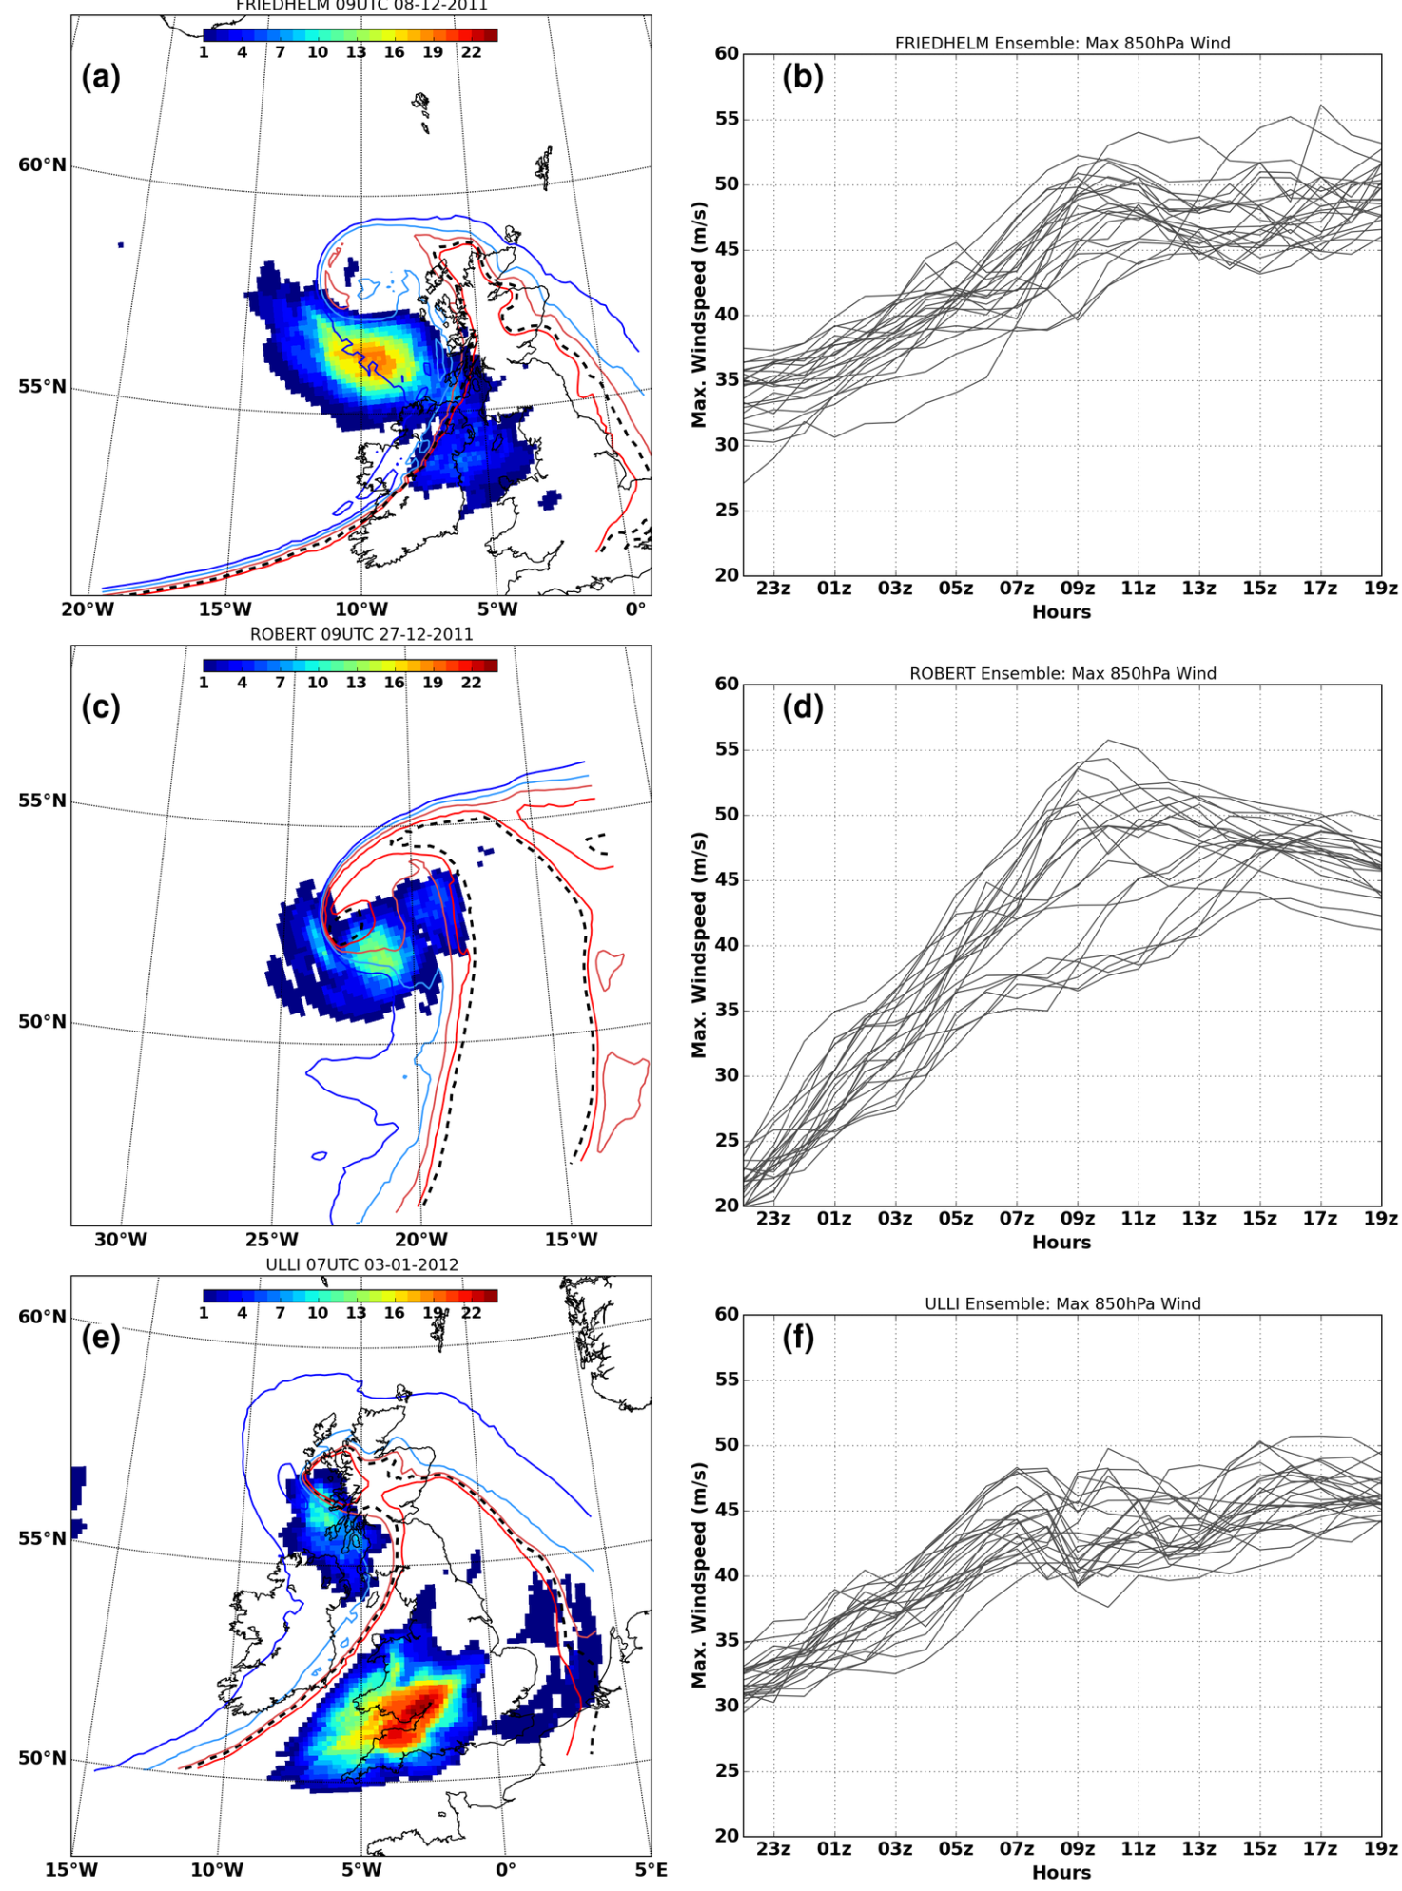
Predictability of low-level jets
# members with |v|_{850hPa} > 40 ms⁻¹
Ensemble evolution of cool sector850 hPa |v|_{max}
Friedhelm
Hart, Gray and Clark (in prep.)
Ulli
Robert
24 member regional forecast ensembles; initial condition perturbations
Notes:
Figure 3: (a) Friedhelm grid-point count of ensemble members with windspeeds >40 ms􀀀1 (shaded)
0900 UTC 8 December 2011. (b) Ensemble evolution of maximum windspeed at 850hPa from
2200 UTC 7 December 2011. (c) as (a) for Robert at 0900 UTC 27 December 2011 and (d) as
(b) starting from 2200 UTC 26 December 2011. (e) as (a) for Ulli at 0700 UTC 3 January 2012
and (f) as (b) starting from 2200 UTC 2 January 2012. Control ensemble member e-contours are
overlaid and coloured from blue to red: (a) 293, 296, 299, 302K; (b) 294, 297, 300, 303K; (c) 293,
296, 299, 302K. Black dotted contour is cool-sector e-threshold at 850hPa: (a) Friedhelm 301K,
(b) Robert 305K, and (c) Ulli 300K.
Analysis of trajectories entering the cool-sector low-level jet regions shows cold conveyor belt flows.
Strongly descending trajectories arrive ahead or on the southeastern flank of the conveyor belt flow.
We now focus on these descending trajectories…

Slide 33
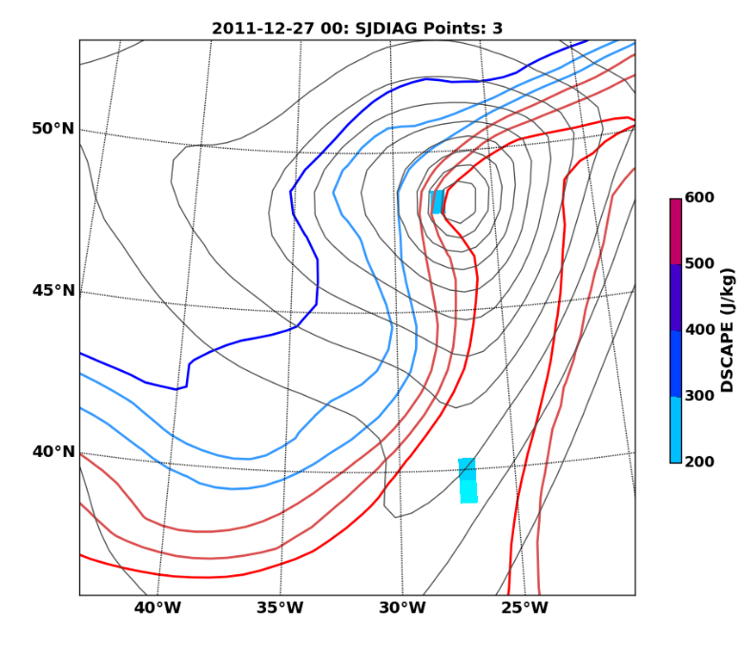
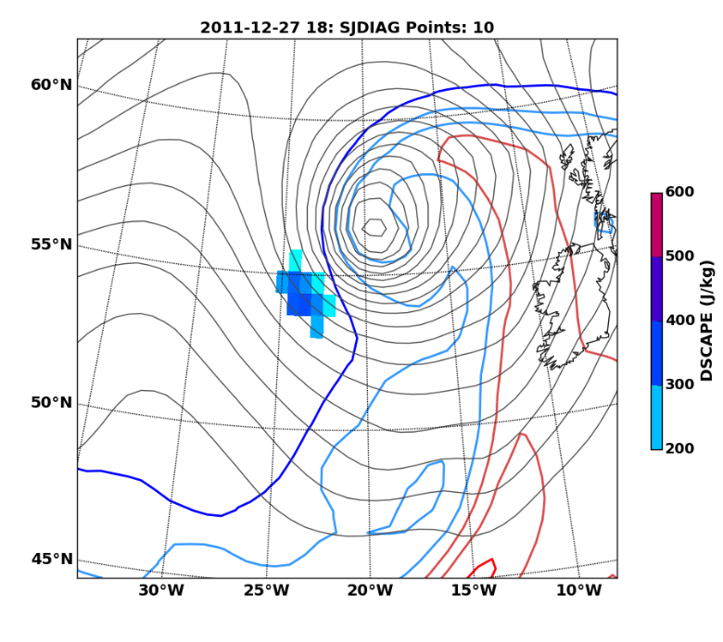
Examples of low-level jets:
Windstorm Robert
00 UTC
Identified as a potential sting jet storm by precursor diagnostic though CSI points not in main cloud head. Deepened 36 hPa/24 h.
18 UTC
Sting jet precursor diagnostic based on DSCAPE (Downdraught Slantwise Convective Available Potential Energy) applied to ERA-I data
Notes:
Two descending branches: 1. descent from 700 hPa over ~ 7 h; 2. ascent from 950 hPa to 800 hPa then descent over ~4 h.
Typically passage through frontogenetic regions during ascent then frontolytic regions during descent.
One ensemble member shows strong descent from 700hPa associated with II, at early times in storm.

Slide 34
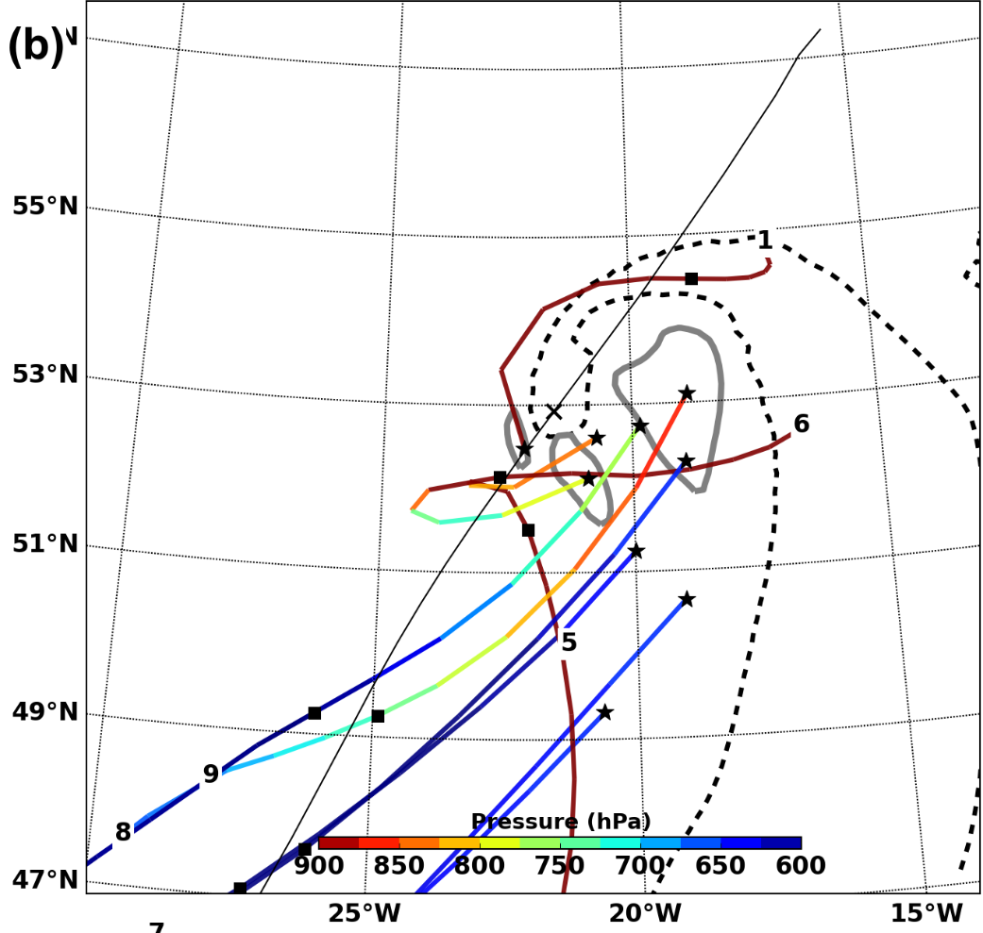
Examples of low-level jets:
Windstorm Robert
Representative ensemble member
15/22 ensemble members have sting jet trajectories arriving at 9Z (similar at other times). Some ensemble members have no sting jet.
Classes 8&9 descend into strongest low-level jet region from aloft: SJ
Classes 5&6 wrap round cyclone centre ascending and then descending rapidly into low-level jet: ?
Class 1stays close to the surface and wraps around the cyclone into the rearmost region of the low-level jet: CCB
Winds>40ms⁻¹
Cluster class medians of back trajectories arriving in cool-sector low-level jet (earth relative). Method from Hart et al. (2015).
Notes:
Cluster class medians (shaded by pressure) summarising airstreams arriving in cool-sector low-level jet of Robert ensemble member \textbf{\emph{v}} at 0700~UTC and 0900~UTC 27 December 2011 (a and b, respectively) with 850hPa windspeed (grey contours at 40 m.s$^{-1}$), smoothed storm track (black line) and centre (``$\mathbf{\times}$'').}
Hierarchical clustering using Ward’s variance minimisation for the algorithm (lon, lt, p and theta_e) for observation variable.
Neil C. G. Hart, Suzanne L. Gray, and Peter A. Clark, 2015: Detection of Coherent Airstreams Using Cluster Analysis: Application to an Extratropical Cyclone. Mon. Wea. Rev., 143, 3518–3531.
doi: http://dx.doi.org/10.1175/MWR-D-14-00382.1
Two descending branches: 1. descent from 700 hPa over ~ 7 h; 2. ascent from 950 hPa to 800 hPa then descent over ~4 h.
Typically passage through frontogenetic regions during ascent then frontolytic regions during descent.
One ensemble member shows strong descent from 700hPa associated with II, at early times in storm.

Slide 35
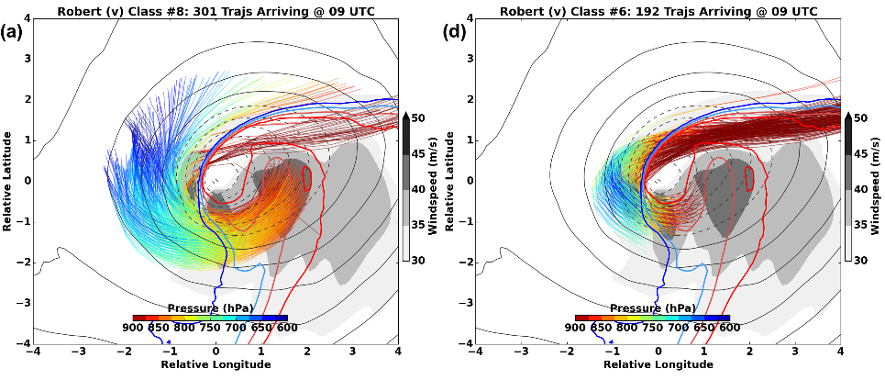
Windstorm Robert: sting jet
Storm-relative trajectories
Not physically reasonable?
Notes:
Trajectories are plotted system-relative over atmospheric fields at arrival time: 850~hPa windspeed (shaded), 1000~mb geopotential (contoured every 3~gpm), and 850~hPa $\theta_e$ (blue to red contours from 293K, every 3K). (b) The pressure evolution of these trajectories until 0900~UTC and beyond is shaded by relative humidity with height of bars showing proportion (\%) of trajectories exhibiting mesoscale instabilities as in chart legend. In (c), pressure evolution is shaded $\theta_e$ and the bars denote proportion of trajectories within regions of substantial frontogenesis or lysis (threshold of $\pm$100~K.km$^{-2}$.10$^5$s$^{-1}$).
Storm relative trajectories (a), mesoscale instability
proportions (b), and frontogenesis proportions (c), as in Fig. \ref{f6},
for sting-jet class \#3 at 0700~UTC in Robert ensemble member \textbf{\emph{v}}
and class \#6 (e-g) which experience rapid ascent and descent associated
with frontogenesis and lysis. In (a and e), 850hPa $\theta_e$ contours
are shown blue to red from 294K, every 3K.}
Two descending branches: 1. descent from 700 hPa over ~ 7 h; 2. ascent from 950 hPa to 800 hPa then descent over ~4 h.
Typically passage through frontogenetic regions during ascent then frontolytic regions during descent.
One ensemble member shows strong descent from 700hPa associated with II, at early times in storm.

Slide 36
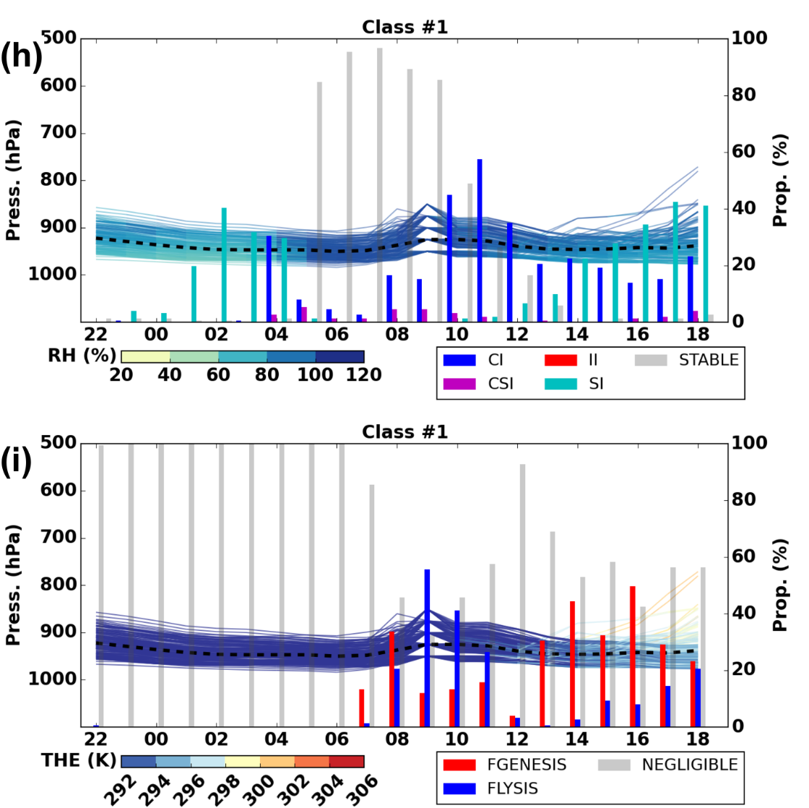

Windstorm Robert: cold conveyor belt jet

Slide 37
Role of the boundary layer
Example atmospheric soundings
Low-level stable layer due to surface cooling inhibits downwards momentum transfer
Transfer of momentum in moist and dry air from 920 hPa to surface unimpeded
Shallow stable layer inhibits downwards momentum transfer
Hewson and Neu (2015)
Notes:
Fig. 2. Example UK-area lower tropospheric soundings for the WJ, SJ and CJ phenomena, in (a), (b) and (c), respectively, with winds in
alphanumeric format (speeds in kts). Pressure in hPa is shown on the left, whilst temperature in 8C is shown below. (a) is for Camborne at
00 UTC on 30 October 2000 (Oratia), whilst (c) is for Crawley at 18 UTC on 25 January 1990 (Daria). To denote the SJ (b) shows two
soundings from ECMWF HRES 6-hour forecast fields valid at 06 UTC on 3 January 2012 (Ulli). These nominally straddle the SJ surface
impact zone at this time; mauve is to the west, blue to the east. Sounding locations are shown (by coloured rings) on Fig. 4b for the WJ in
(a), on Fig. 10b for the SJ in (b), and on Fig. 4a for the CJ in (c).

Slide 38
Conceptual cyclones
Martínez-Alvarado et al. (2014)
Notes:
FIG. 1. The structure of a Northern Hemisphere Shapiro–Keyser cyclone in development
stage 3: surface cold front (SCF); surface warm front (SWF); bent-back front (BBF); cold
conveyor belt (CCB); sting jet airstream (SJ); dry intrusion (DI); warm conveyor belt (WCB);
WCB anticyclonic branch (WCB1); WCBcyclonic branch (WCB2); and the large3 represents
the cyclone center at the surface, and the gray shading represents cloud top (see also Fig. 2).

Slide 39
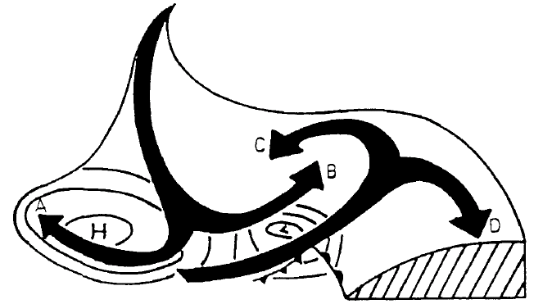
Conceptual cyclones
Isentropic relative flow in a baroclinic wave
Dry intrusion
Warm conveyor belt
Thorncroft et al., (1993)
Notes:
Figure 1 shows the general nature of isentropic motion in a mature cyclonic system
and its surroundings, looking northwards in the northern hemisphere. This schematic
picture draws on the work of several authors (e.g. Danielsen 1964, 1980; Green et al.
1966; Carlson 1980; Heckley and Hoskins 1982; Golding 1984). The descending air west
of the surface pressure low, on reaching middle levels, splits into two branches A and B
turning anticyclonically and cyclonically. Air originating at lower levels in the warm
sector equatorward of the surface low rises and splits into two branches C and D. To the
extent that condensation occurs in the moist warm-sector branch as it rises, there will be
enhanced ascent involving cross-isentropic motion. This pattern of air motion may then
result in a cloud pattern with a hammer-head appearance. Note also that since the
descending air is certain to be unsaturated, and indeed likely to be very dry, its cyclonic
branch B may cut in behind the rising moister air to form a ‘dry slot’, a feature often
observed in strong systems (e.g. Reed and Albright 1986; Young er al. 1987).
When considering such systems it is useful to distinguish two extreme types of
behaviour. In the first type, most of the flow is in branches A and D, whereas in the
second type, most is in B and C. For brevity we refer to these respectively as ‘anticyclonic’
and ‘cyclonic’. Other aspects of the contrast between them will emerge later. Real
systems often combine both types of behaviour, as do model baroclinic-wave life-cycle
simulations. The purpose of this paper is to show how the distinction is useful for
understanding both the real systems and the simulations. In particular, it throws new
light on the dynamics underlying the strikingly different energetic behaviours found by
Simmons and Hoskins (1980) (hereafter SH) in the two wavenumber-6 cases they denoted
as ‘basic’ and ‘anomalous’, of which the initial mean flows differ only as regards the
horizontal shear.

Slide 40
Conclusions
Sting-jet-resolving short-range ensemble forecasts of three windstorms argued to contain sting jets have been presented.
Within a given storm, the ensemble members exhibit close synoptic-scale agreement but the characteristics of the sting jets vary widely in terms of the number of trajectories comprising them and their associated mesoscale instabilities and/or passage through frontogenetic/lytic regions. This suggests relatively weak predictability exists in sting jet strength.
Comparing storms, different the mechanisms associated with sting jet descent emerge despite the ensemble variability.
CSI release is characteristically associated with drying sting jets descending from the cloud head in the most intense windstorms. But other mesoscale instabilities (CI and II) and passage through the frontolytic regions typically found at the hooked tip of the bent-back front can also be associated with descent.
Mesoscale instabilities and strongly frontolytic regions are both typical characteristics of intense and explosively developing extratropical cyclones.

Slide 41
Method: Ensemble model configuration
Potential for sting jets in cyclones identified using precursor diagnostic (Martínez-Alvarado et. al 2013) applied to ERA-Interim data.
24 member ensemble simulations of three recent windstorms with evidence of sting jets: windstorms Friedhelm (8 Dec 2011), Robert (27 Dec 2011) and Ulli (3 Jan 2012).
Initial condition perturbations from operational MOGREPS (The Met Office Global and regional Ensemble Prediction System). Designed to generate model spread appropriate for forecast uncertainty at 1-2 days lead time.
Recently operational limited area (North Atlantic and European domain) configuration of the Met Office Unified Model (~12 km grid spacing and 70 vertical levels up to 38 km).
Notes:
Threshold 40ms-1 wind region connected to contour at 850 hPa (950-650 hPa). Theta-e threshold used to restrict analysis to cold sector strong winds. Forward and backward trajectories calculated and clustered using their lat/long/pressure/theta_e for the 5 hours preceding arrival in the low-level jet region.
Simulations all initialised 21Z previous day.

Slide 42
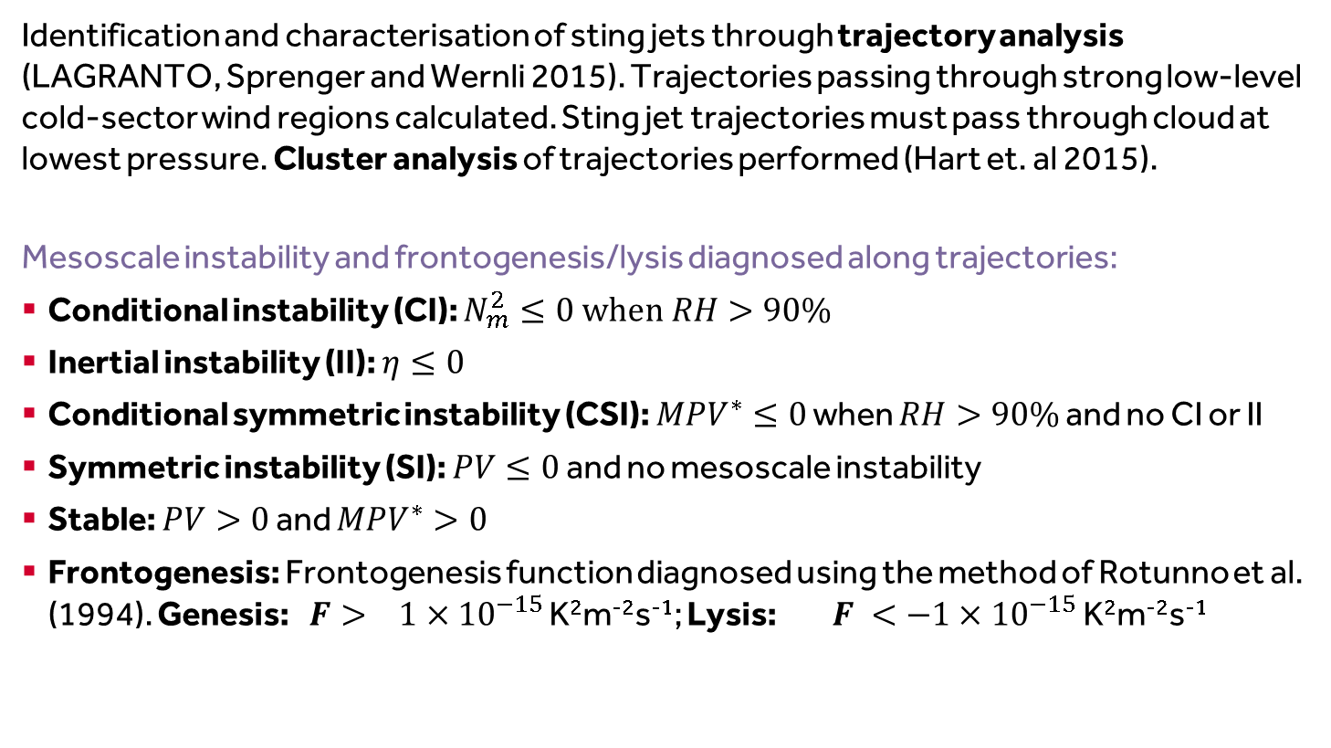
Method: Analysis of dynamical forcing and instabilities
Identification and characterisation of sting jets through trajectory analysis (LAGRANTO, Sprenger and Wernli 2015). Trajectories passing through strong low-level cold-sector wind regions calculated. Sting jet trajectories must pass through cloud at lowest pressure. Cluster analysis of trajectories performed (Hart et. al 2015).
Mesoscale instability and frontogenesis/lysis diagnosed along trajectories:
Conditional instability (CI): $N_{m}^{2}≤0 when RH>90\%$
Inertial instability (II): $η≤0$
Conditional symmetric instability (CSI): ${MPV}^{∗}≤0$ when $RH>90\%$ and no CI or II
Symmetric instability (SI): $PV≤0$ and no mesoscale instability
Stable: $PV>0$ and ${MPV}^{∗}>0$
Frontogenesis: Frontogenesis function diagnosed using the method of Rotunno et al. (1994). Genesis: $F> 1×{10}^{−15}$ K²m⁻²s⁻¹; Lysis: $F <−1×{10}^{−15}$ K²m⁻²s⁻¹
Notes:
Check this!

Slide 43
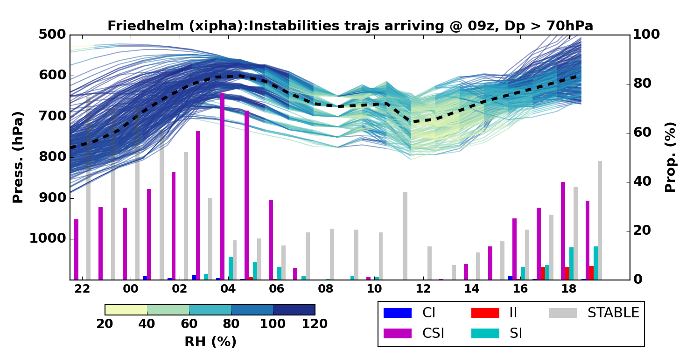
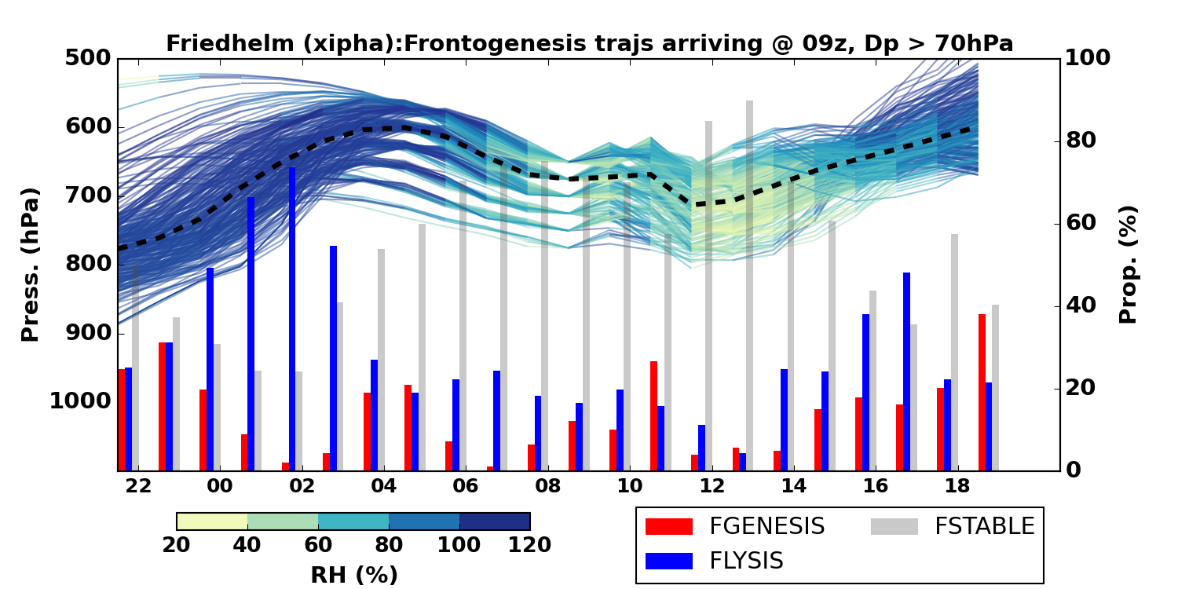
Windstorm Friedhelm
Identified as a sting jet cyclone by precursor diagnostic and Martínez-Alvarado et. al (2014). Deepened 44 hPa/ 24 h.
Most (22/24) ensemble members have sting jet trajectories arriving at 9Z and other arrival times.
Ensemble member trajectories characteristically have CSI prior to descent which then diminishes during descent. CI present prior to descent and II present during descent in some members.
Ensemble member trajectories generally pass through regions that are more frontolytic than frontogenetic but there is no consistent behaviour relative to the timing of the descent.
Suggestion: Example trajectories from Control (A) at 9am for DP>70
Notes:
Sting jet trajectories descent at least 50 hPa, and are saturated at start of descent.

