Slide 1
Diabatic Processes in extratropical cyclones:
A general overview and a detailed example of two heavily precipitating slow-moving summer cyclones
Department of Meteorology
Suzanne Gray

Slide 2
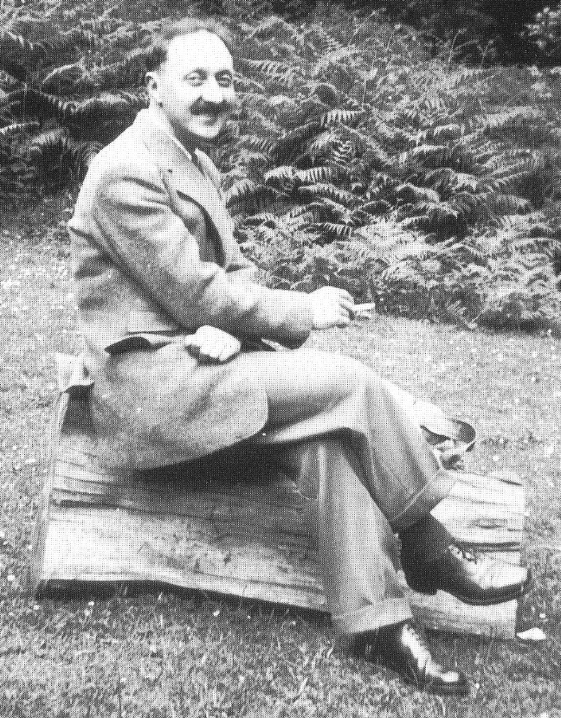

Why diabatic processes?
The development of extratropical cyclones through baroclinic instability has been known about for more than 60 years (Eady, 1949, Charney, 1948).
Eric Eady (1915-1966)
Jule Charney (1917-1981)
Notes:
Charney gave the first convincing physical explanation for the development of mid-latitude cyclones known as the Baroclinic instability theory. He is considered the father of modern dynamical meteorology.
Eric Eady (1915-1966) – author of the eady model of baroclinic instability.

Slide 3
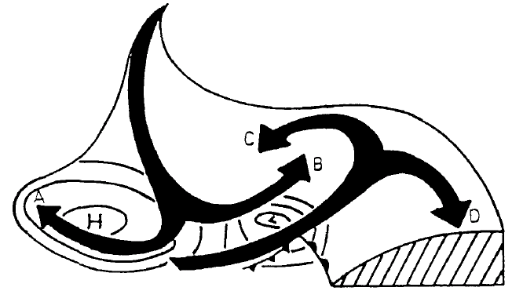
Idealised baroclinic lifecycles
Isentropic relative flow in a baroclinic wave
Dry intrusion
Warm conveyor belt
Thorncroft et al., (1993)
Notes:
Figure 1 shows the general nature of isentropic motion in a mature cyclonic system
and its surroundings, looking northwards in the northern hemisphere. This schematic
picture draws on the work of several authors (e.g. Danielsen 1964, 1980; Green et al.
1966; Carlson 1980; Heckley and Hoskins 1982; Golding 1984). The descending air west
of the surface pressure low, on reaching middle levels, splits into two branches A and B
turning anticyclonically and cyclonically. Air originating at lower levels in the warm
sector equatorward of the surface low rises and splits into two branches C and D. To the
extent that condensation occurs in the moist warm-sector branch as it rises, there will be
enhanced ascent involving cross-isentropic motion. This pattern of air motion may then
result in a cloud pattern with a hammer-head appearance. Note also that since the
descending air is certain to be unsaturated, and indeed likely to be very dry, its cyclonic
branch B may cut in behind the rising moister air to form a ‘dry slot’, a feature often
observed in strong systems (e.g. Reed and Albright 1986; Young er al. 1987).
When considering such systems it is useful to distinguish two extreme types of
behaviour. In the first type, most of the flow is in branches A and D, whereas in the
second type, most is in B and C. For brevity we refer to these respectively as ‘anticyclonic’
and ‘cyclonic’. Other aspects of the contrast between them will emerge later. Real
systems often combine both types of behaviour, as do model baroclinic-wave life-cycle
simulations. The purpose of this paper is to show how the distinction is useful for
understanding both the real systems and the simulations. In particular, it throws new
light on the dynamics underlying the strikingly different energetic behaviours found by
Simmons and Hoskins (1980) (hereafter SH) in the two wavenumber-6 cases they denoted
as ‘basic’ and ‘anomalous’, of which the initial mean flows differ only as regards the
horizontal shear.

Slide 4
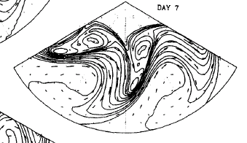
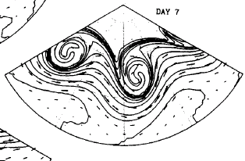
Idealised baroclinic lifecycles
LC2: with added cyclonic shear
LC1
Potential temperature, Ɵ, on the PV = 2PVU surface (tropopause)
Thorncroft et al., (1993)
Notes:
LC2 – added cyclonic shear.
Potential temperature on the PV = 2 PVU surface in LC1 between days 4 and 9. Contours are
drawn every 5 K from 290 K to 350 K going equatorward. Wind vectors are included; for days 4 to 7 these have
had the phase speed of the normal mode removed to give the relative flow.
here designated
‘anticyclonic’ and ‘cyclonic’, and epitomized by strongly contrasting upper-air trough behaviour. ‘Anticyclonic’
behaviour dominates the late stages of LCl and is characterized by backward-tilted, thinning troughs being
advected anticyclonically and equatorward, as in the commoner cases of planetary-scale mid-stratospheric
‘Rossby-wave breaking’. ‘Cyclonic’ behaviour dominates LC2 and is characterized by forward-tilted, broadening
troughs wrapping themselves up cyclonically and poleward, producing major cut-off cyclones in high latitudes.

Slide 5
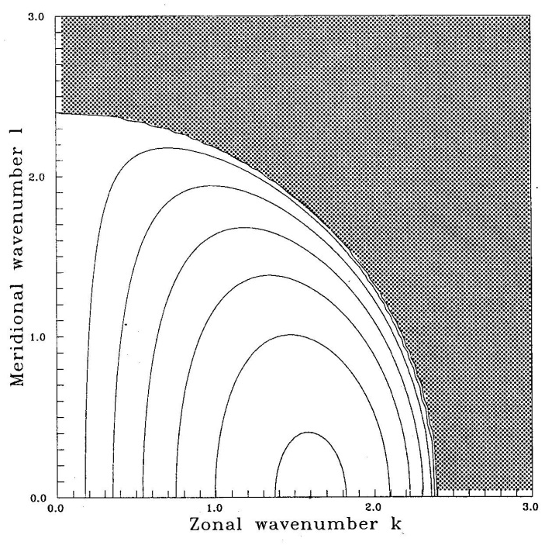
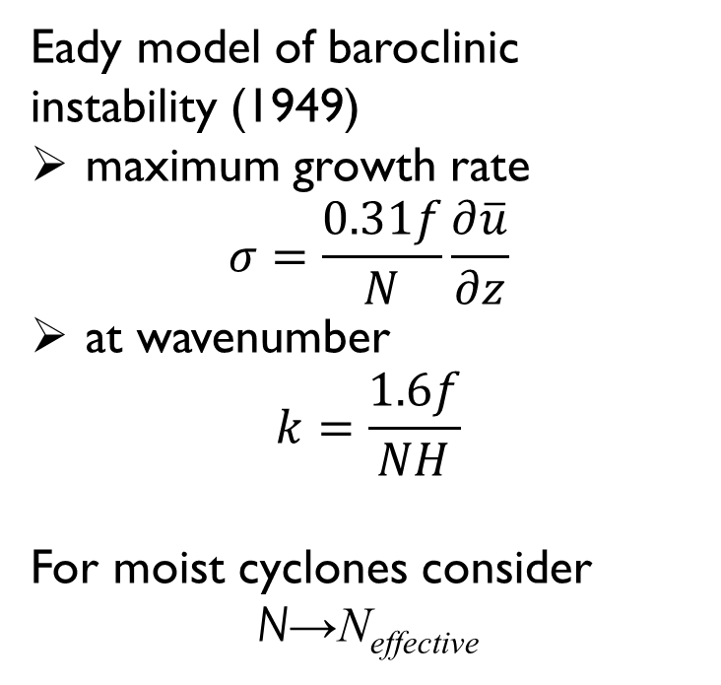
Eady model
0.1
0.2
0.3
James (1994)
Notes:
Reduced static stability enhances communication between PV-conserving waves (Rossby waves) on the surface and tropopause
Craig, George C., Han-Ru Cho, 1992: A Study of Two Cases of Comma-Cloud Cyclogenesis Using a Semigeostrophic Model. Mon. Wea. Rev., 120, 2942–2961.
doi: http://dx.doi.org/10.1175/1520-0493(1992)120<2942:ASOTCO>2.0.CO;2
Heating results in a shorter wavelength due to a reduced vertical scale as the midtropospheric PV anomaly associated with the upper part of the heating region becomes stronger than the anomaly produced at the PV gradient at the tropopause.
Large-scale barotropic mode essentially unmodified by diabatic effects but large destabilization of more baroclinic branch at short wavelengths. Heating rates almost exactly at the threshold from a transition between long-wave and short-wave instabilities. See growth-rate curves with heating parameter increased/decreased by 20%.

Slide 6
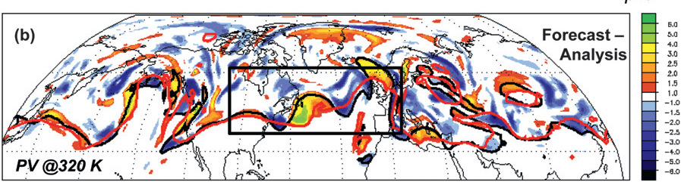
Forecast errors in upper- level PV
PV on 320 K isentrope (analysis and 96h forecast): 1200 UTC 16 Jan 2002 (Davies and Didone 2013)
Notes:
Are there errors?

Slide 7
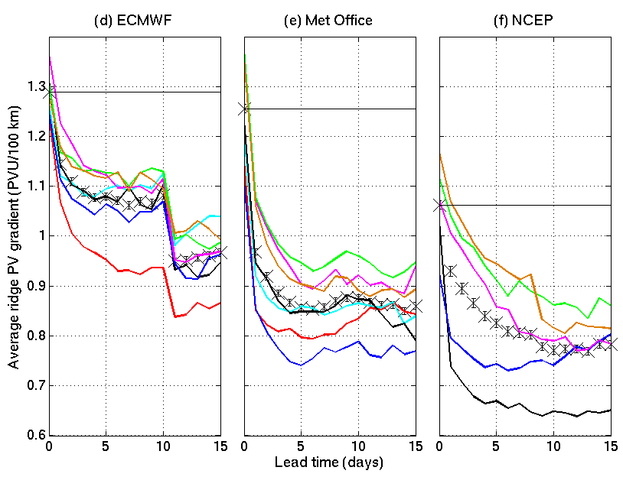
Ridge PV gradient forecast
2006/7
2007/8
2008/9
2009/10
2010/11
2011/12
2012/13
Gray et al. (2014)

Slide 8
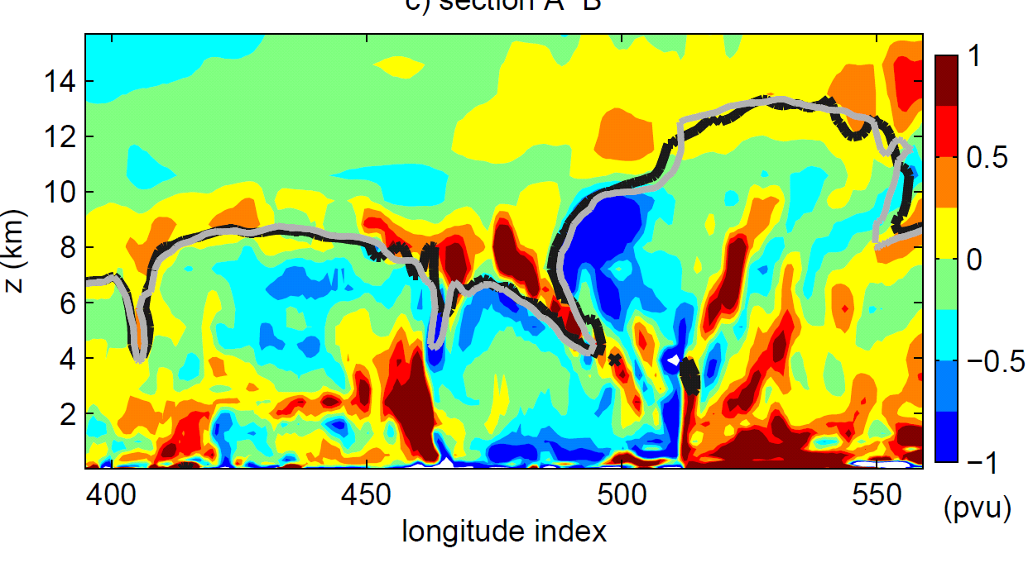
Net diabatic PV generation
NW
3.5 days
SE
WCB
Cold front
Chagnon et al. (2013)

Slide 9
Forecast busts
Composites of bust initial conditions
6-day forecast busts associated with mesoscale convective systems over US Great Lakes.
Rodwell et al. 2013
Notes:
define a “forecast bust” to be an occasion when the
day-6 high-resolution forecast of European Z500
has an RMSE greater than 60 m and an ACC less
than 40%. These two conditions ensure that a bust
is associated with errors of a sufficient magnitude
and also involve a pattern or phase discrepancy
DOI:10.1175/BAMS-D-12-00099.1
Fig. 2. The number of European forecast busts at day 6 from the ECMWF operational high-resolution
forecast and forecasts made within the ERA-Interim project, for 1989–2011. (a) Time series of annual totals. Results are based on forecasts started at 1200 UTC since operational high-resolution forecasts were not made at 0000 UTC before 2001. In addition to improvements to the forecast model and improvements in the processes used to derive its initial conditions, the resolution of ECMWF’s high resolution forecast increased steadily over the period, from 190 km in 1989 to 16 km in 2011. ERA-Interim is based on a fixed IFS cycle that was operational in 2006 and has a fixed resolution of 80 km.
The two curves in (a) should not necessarily intersect in 2006 since the high-resolution forecast had a resolution of 25 km at that time.
Fig. 4. The mean initial condition anomalies of (a) Z500 and (b) CAPE leading to the same forecast busts used in Fig. 3. Anomalies are relative to the ERA-Interim climatology for 1989–2008. Statistical significance at the 5% level is indicated with bold colors. Throughout this article, the analyzed CAPE is actually a 6-h forecast, since this is what is archived. CAPE is computed for several parcel ascents, from the surface and higher up, and the maximum value is taken.

Slide 10
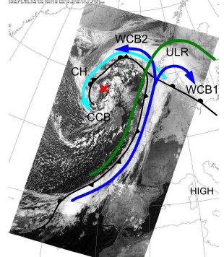
Diabatic phenomena
Sting
jets
Warm
Conveyor
belts
Extratropical transition
Martínez-Alvarado et al (2014); Parker and Thorpe (1995); Vaughan et al. (2015);
Jones et al. (2003)
Diabatic Rossby Waves
Notes:
Figure 3. (b) Rain rate (mm hr–1) at 1300 UTC estimated by the Met Office radar 702 network (1-km grid
spacing). At 1234 UTC, the FAAM aircraft reached the storm center (pink dot). A–D indicate
704 rainbands moving to the east-southeast.
Figure 12. The rain rate (mm h–1, colored according to scale at bottom) 792 from the first four
members of the MOGREPS-UK trial forecast at 1600 UTC 8 December 2011, 7 h into the forecast.
794 Red lines indicate the axes of the wind maxima identified in Fig. 11.
FIG. 1. Tracks of all tropical cyclones that underwent extratropical
transition during 1970–99. (a) Western North Pacific. Tracks of tropical
cyclones defined to be extratropical in JTWC best-track data. (b)
Southwest Pacific [data as in (a)] and southeast Indian Ocean [tracks
of tropical cyclones that accelerated toward the southeast under the
influence of a midlatitude frontal system and maintained gales into
midlatitudes, the so-called captured cyclones in Foley and Hanstrum
(1994); best-track data taken from http://www.australiasevereweather.
com/cyclones/history.htm]. (c) North Atlantic. Tracks of tropical cyclones
defined to be extratropical in National Hurricane Center besttrack
data.
Douglas J. Parker and Alan J. Thorpe, 1995: Conditional Convective Heating in a Baroclinic Atmosphere: A Model of Convective Frontogenesis. J. Atmos. Sci., 52, 1699–1711.
doi: http://dx.doi.org/10.1175/1520-0469(1995)052<1699:CCHIAB>2.0.CO;2
G. Vaughan, J. Methven, D. Anderson, B. Antonescu, L. Baker, T. P. Baker, S. P. Ballard, K. N. Bower, P. R. A. Brown, J. Chagnon, T. W. Choularton, J. Chylik, P. J. Connolly, P. A. Cook, R. J. Cotton, J. Crosier, C. Dearden, J. R. Dorsey, T. H. A. Frame, M. W. Gallagher, M. Goodliff, S. L. Gray, B. J. Harvey, P. Knippertz, H. W. Lean, D. Li, G. Lloyd, O. Martínez–Alvarado, J. Nicol, J. Norris, E. Öström, J. Owen, D. J. Parker, R. S. Plant, I. A. Renfrew, N. M. Roberts, P. Rosenberg, A. C. Rudd, D. M. Schultz, J. P. Taylor, T. Trzeciak, R. Tubbs, A. K. Vance, P. J. van Leeuwen, A. Wellpott, and A. Woolley, 2015: Cloud Banding and Winds in Intense European Cyclones: Results from the DIAMET Project. Bull. Amer. Meteor. Soc., 96, 249–265.
doi: http://dx.doi.org/10.1175/BAMS-D-13-00238.1
Jones S.C. et al., 2003: The extratropical transition of tropical cyclones: Forecast challenges, current understanding, and future directions. Weather and Forecasting, 18:1052-1092, doi: 10.1175/1520-0434(2003)018<1052:TETOTC>2.0.CO;2

Slide 11
Tools: pressure tendency eq.
Windstorm Xynthia (Feb. 2010)
Diagnose terms in a vertical column that moves with the storm
Fink et al. (2013)
Notes:
ITT – vertically integrated virtual temperature tendency
TADV – horizontal temperature advection
VMT – vertical motions
DIAB – diabatic processes inc. radiation, LH due to phase changes, dissipation and diffusion
E-P – evaporation - precipitation
Figure 1. Schematic illustration of the methodology (see Section 2 for details and definition of terms). The bold arrow in the x-y plane indicates the motion of the center of a surface cyclone between two analysis times t0 and t6h (arrow length not true to the scale). The surface pressure tendency equation is evaluated for the 3 3 latitude-longitude box extending from the surface to 100 hPa centered on the position of the storm at t0. The terms of equation (2), TADV (horizontal advection; red arrows) and VMT (vertical advection; dark blue vectors), are computed by integrating over the box volume and then averaging
over t0 and t6h as schematically indicated in the two graphs in the top right corner. The computation of the terms Df, Dp, DIAB (diabatic processes; curled orange vectors), and EP (evaporation minus precipitation; curled blue vectors and dashed blue lines) is illustrated in the lower four graphs on the right-hand side. Note that while Df and Dp are simple differences between instantaneous values at t0 and t6h, EP is the difference between two parameters accumulated between t0 and t6h. DIABRES is the residuum of equation (2).
Figure 3. Results of the PTE analysis. Terms of (left) equation (1) and (right) equation (2) for the storms (a, f ) Lothar, (b, g)Martin, (c, h) Kyrill I and II, (d, i) Klaus, and (e, j) Xynthia. For an explanation of the different terms, see section 2. In the right panels, DIABptend (gray bars in %, scale on right y-axis) is defined as in equation (3). Note the different pressure scales in the left and right panels. The vertical bold lines delineate the interval of explosive deepening as in Table S1 in Text S1. The periods correspond to those in the captions of Figure 2 (see also Figure S3 in Text S1).
Fink, A. H., S. Pohle, J. G. Pinto, and
P. Knippertz (2012), Diagnosing the influence of diabatic processes
on the explosive deepening of extratropical cyclones, Geophys.
Res. Lett., 39, L07803, doi:10.1029/2012GL051025.

Slide 12
Tools: piecewise PV inversion
Identify PV anomalies using thresholds for pressure, relative humidity etc.: typically upper-level, surface thermal anomaly) and diabatically generated.
Apply PV inversion to each anomaly using a balance assumption such as Charney (1955) nonlinear balance to determine the contributions to the instantaneous cyclone intensity. Pioneered by Davis and Emanuel (1991).
Other work has gone beyond this to diagnose the contributions from interactions between the different PV anomalies using a factor separation approach (Romero, 2008).
Ahmadi-Givi et al. (2004)
Romero (2008)
Notes:
Figure 7. The maximum geopotential-height perturbations at 850 mb from the upper-level PV anomaly (UPV),
the diabatically produced PV anomaly (LPV), the surface thermal anomaly (μB), and the upper-level PV anomaly
in experiment L02, without latent heating (UPV(L02)).
Q. J. R. Meteorol. Soc. (2004), 130, pp. 295–323 doi: 10.1256/qj.02.226
The dynamics of a midlatitude cyclone with very strong latent-heat release
By F. AHMADI-GIVI, G. C. GRAIG and R. S. PLANT
QUARTERLY JOURNAL OF THE ROYAL METEOROLOGICAL SOCIETY
Q. J. R. Meteorol. Soc. 134: 385–402 (2008)
Published online 2 April 2008 in Wiley InterScience
(www.interscience.wiley.com) DOI: 10.1002/qj.219
A method for quantifying the impacts and interactions
of potential-vorticity anomalies in extratropical cyclones
R. Romero
Figure 9. Factor-separation results on the geopotential-height tendency at 925 hPa, corresponding to the mature phase of the cyclone (11 November at 00 UTC). The contributions from (a) Mean, (b) ULev, (c) LLev and (d) Diab are shown as shaded for positive height tendency, and shaded within thick-line-highlighted regions for negative height tendency, starting at −5 gpm/12 h and 5 gpm/12 h respectively, with a contour interval of 10 gpm/12 h. The total height-tendency field at 925 hPa is also shown, with dashed lines representing negative values starting at −10 gpm/12 h and continuous lines representing positive values starting at 10 gpm/12 h, with a contour interval of 20 gpm/12 h. The black circle located in the southern Mediterranean indicates the central position of the cyclone (see Figure 1(d)).

Slide 13
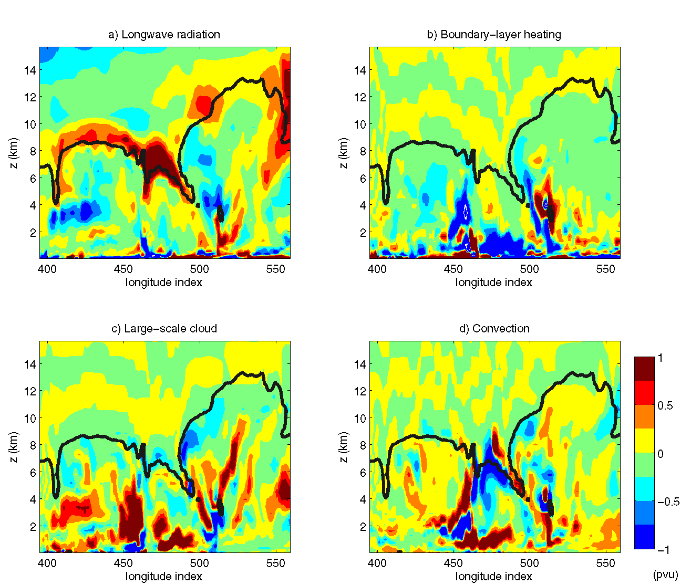
Tools: PV tracers
Based on a Lagrangian decomposition of the PV field.
Full PV conservation equation:
LW radiation
Boundary-layer heating
where S_{i} denotes the Lagrangian tendency resulting from one physical process in model
Large-scale cloud
Convection
~ 20 tracers PV_{i} each initialised as zero, receive S_{i} from one physical process and advected by the semi-Lagrangian scheme ⇒ each tracer shows accumulated contribution of one process to PV.
{
Chagnon et al. (2013)

Slide 14
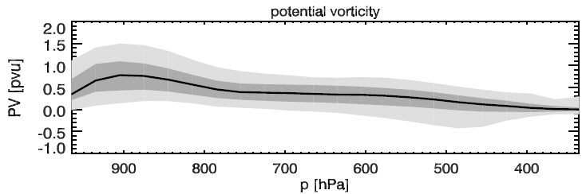

Tools: trajectories
Heating rates associated with different diabatic processes diagnosed along trajectories.
Associated diabatically-generated PV calculated using
Diabatic heating contributions from different microphysical processes strongly modulated by local vorticity to yield contributions to PV.
$$DPVR= \frac{DPV}{Dt}=\frac{1}{ρ}η⋅∇\left(DHR\right)$$
$$≈\frac{1}{ρ}η_{z}\frac{∂}{∂z}(DHR)$$
Total
Condensation/evaporation
Depositional growth of snow
Joos and Wernli (2012)
Notes:
Citation: Joos H, WernliH. 2012. Influence of microphysical processes on the potential vorticity development
in a warm conveyor belt: a case-study with the limited-area model COSMO. Q. J. R. Meteorol. Soc. 138:
407–418. DOI:10.1002/qj.934
Figure 10. Evolution of the mean over all WCB trajectories of (a) hydrometeor mass, (b) DHR and (c) DPVR. In (b, c), the black lines show the DHR
and the corresponding total DPVR (TLH), and coloured lines show the contributions from the different microphysical processes to the total DHR
(DPVR): condensation/evaporation (TCE), depositional growth of snow (TSDEP), melting of snow (TSMELT), and evaporation of rain (TEV).
Figure 4. Evolution along trajectories of potential temperature θ, PV,
z-component of the absolute vorticity ηz , and total latent heating. Grey
shaded areas denote the 5–95% and 25–75% percentiles, and black lines
show the median over all trajectories.
exists

Slide 15
Diabatic processes in extratropical cyclones:
Open questions
What are the systematic effects of diabatic processes on the development of extratropical cyclones and downstream evolution?
Are limitations in our ability to represent diabatic processes in weather and climate forecast models (given these processes are typically parameterized) limiting our forecasting abilities?
How can we make better use of aircraft and remote sensing observations to constrain diabatic processes in models and the impact on the large-scale dynamics?
WWOSC white paper (2015)

Slide 16

Contrasting two heavily precipitating slow-moving summer cyclones using potential vorticity
Oscar Martínez-Alvarado
NCAS-Atmospheric Physics
Suzanne Gray, John Methven
Department of Meteorology, University of Reading

Slide 17
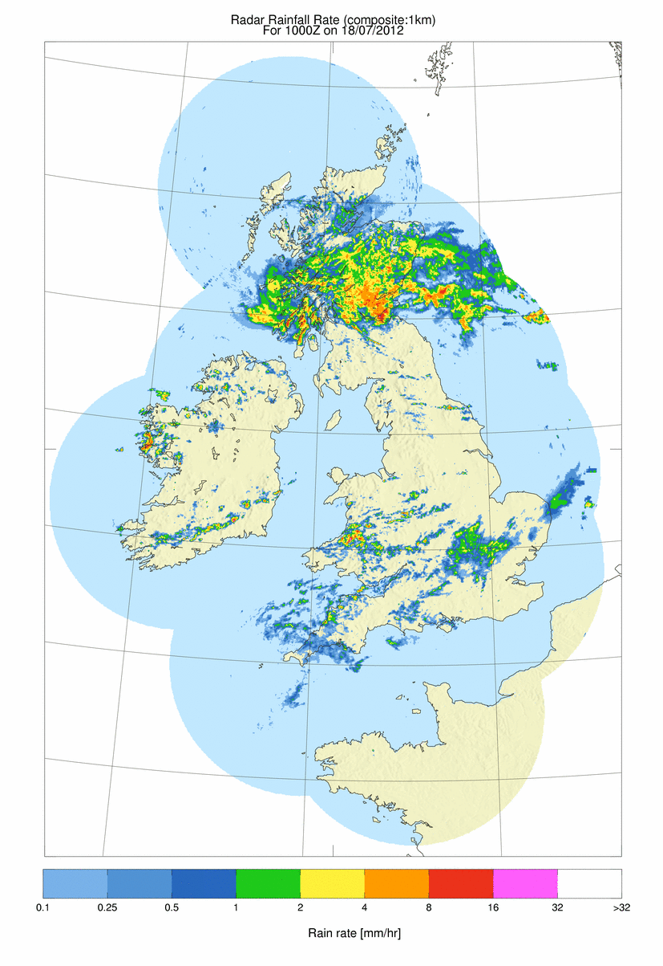
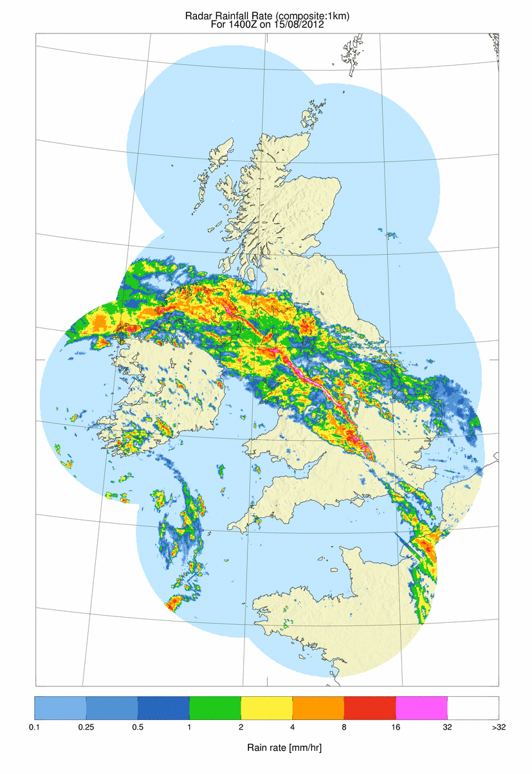
Radar rainfall rate
1000 UTC 18 July 2012
1400 UTC 15 August 2012
Both cyclones produced heavy prolonged frontal precipitation, implying strong diabatic processes
0.1 0.25 0.5 1 2 4 8 16 32 >32
Rain rate (mm hr⁻¹)

Slide 18
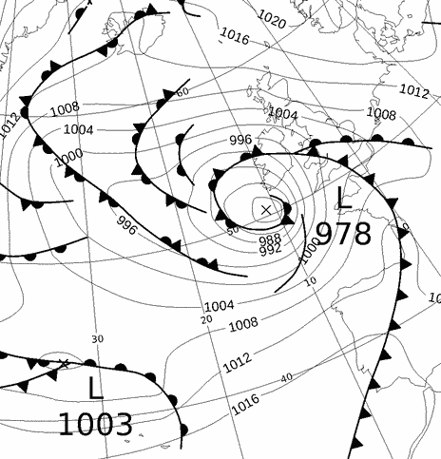
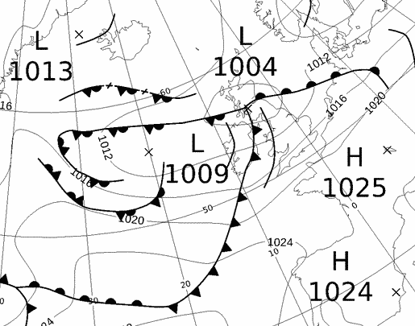
Synoptic conditions
1200 UTC 15 August 2012
0600 UTC 18 July 2012
MSLP | Summer | Winter
930 – 970 hPa | 1 | 33
970 – 990 hPa | 16 | 74
990 – 1010 hPa | 99 | 65
1010 – 1030 hPa | 15 | 10
Yet their synoptic structure and development were very different
Adapted from Čampa and Wernli (2012)

Slide 19
Objective
To compare the evolution of these two contrasting summer cyclones in terms of
Vertical motion due to heating
Changes in circulation and vorticity

Slide 20
Method
Tracers of potential temperature and potential vorticity
Both variables are conserved under adiabatic frictionless flow
POTENTIAL TEMPERATURE is an excellent marker of cross-isentropic motion and air mass origin.
POTENTIAL VORTICITY provides information about the wind and potential temperature fields.
All results shown at 21-h lead time using the Met Office Unified Model (MetUM)

Slide 21
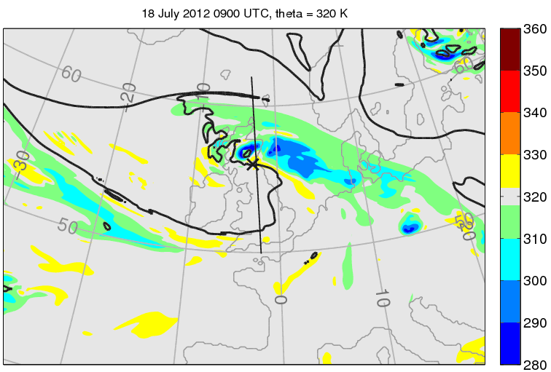
Upper-level (320-K)
structure: θ₀
18 July 2012
K
B
θ0
Potential temperature that the air had at the start of the simulation
stratospheric
stratospheric
warm conveyor belt outflow
A
tropospheric
BLACK: 2-PVU contour (tropopause)
Notes:
0900 UTC 21hr lead time

Slide 22
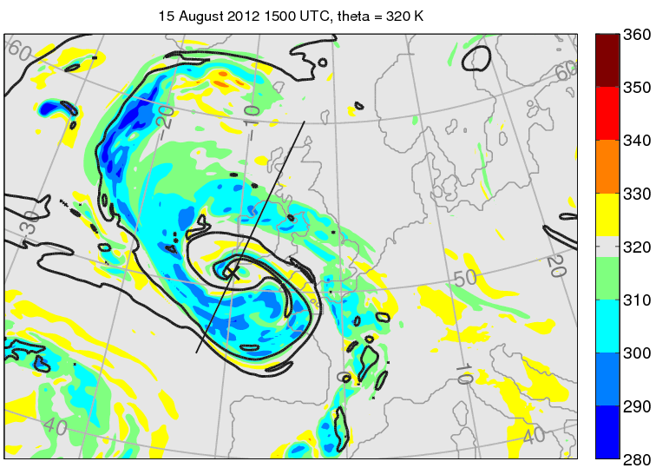
Upper-level (320-K)
structure: θ₀
15 August 2012
K
D
θ0
Potential temperature that the air had at the start of the simulation
warm conveyor belt flow
stratospheric
C
tropospheric
BLACK: 2-PVU contour (tropopause)
Notes:
1500 UTC 21h lead time

Slide 23
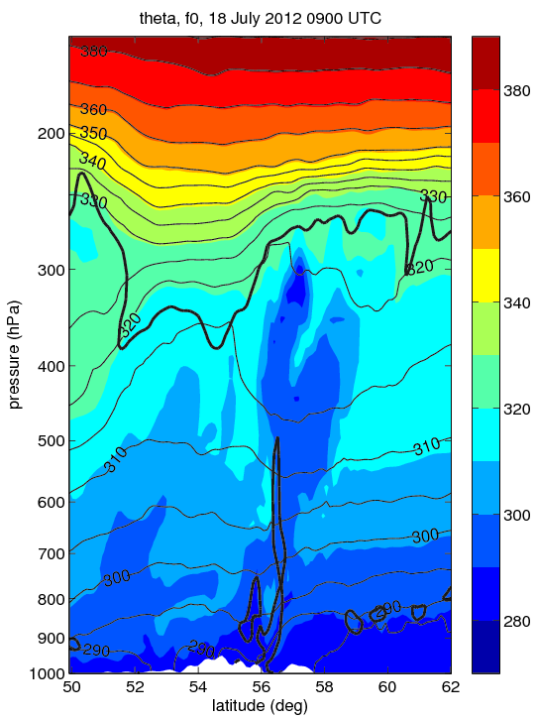
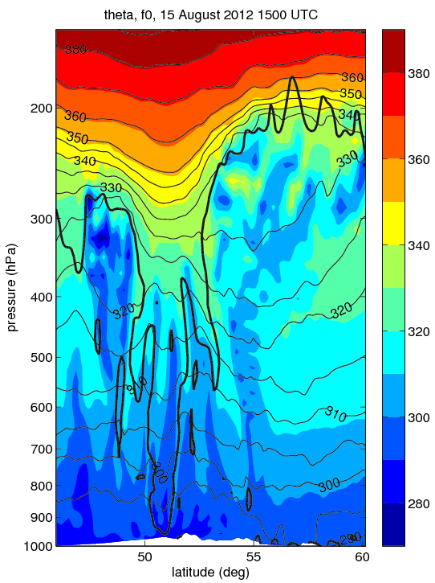
Vertical structure: θ₀
18 July 2012
15 August 2012
380
K
360
340
320
300
280
380
K
360
340
320
300
280
K
K
warm conveyor belt flow
warm conveyor belt flow
A
B
C
D
Low-pressure centre
Low-pressure centre
BOLD BLACK: 2-PVU
THIN BLACK: θ

Slide 24
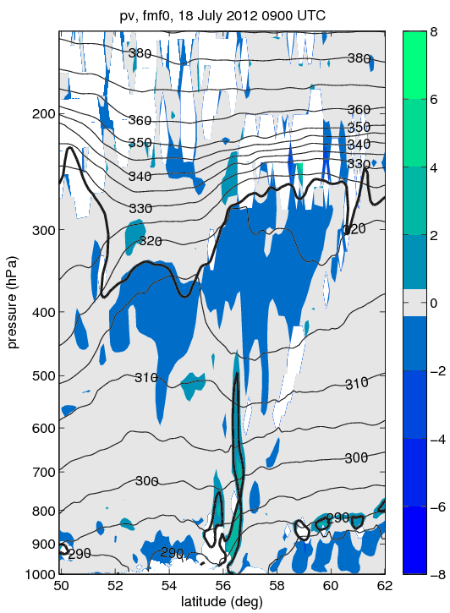
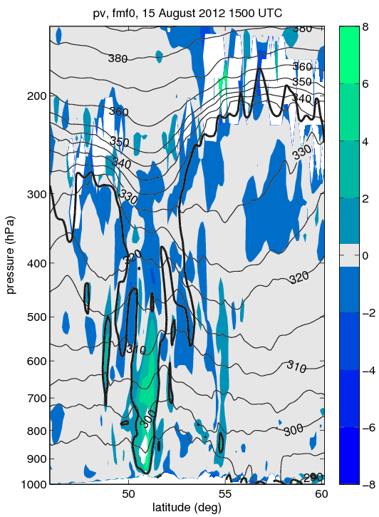
Vertical structure: diabatic PV
18 July 2012
15 August 2012
warm conveyor belt flow
warm conveyor belt flow
A
B
C
D
Low-pressure centre
Low-pressure centre
BOLD BLACK: 2-PVU
THIN BLACK: θ

Slide 25
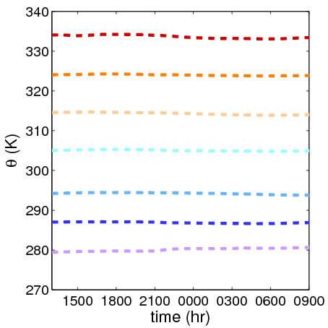
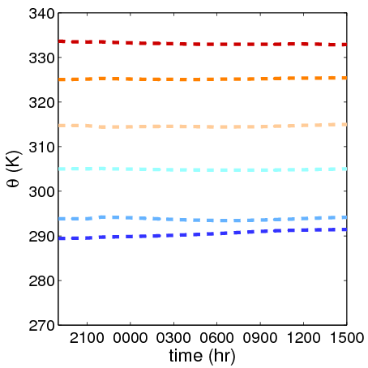
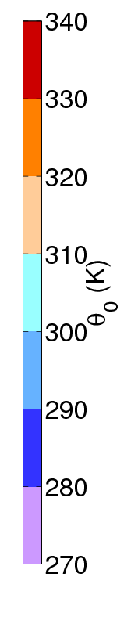
Mass redistribution
18 July 2012
15 August 2012
Median
98th percentile
In each θ₀ bracket
Averaged over a 1000-km radius circle

Slide 26
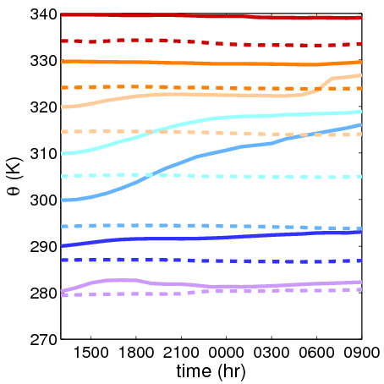
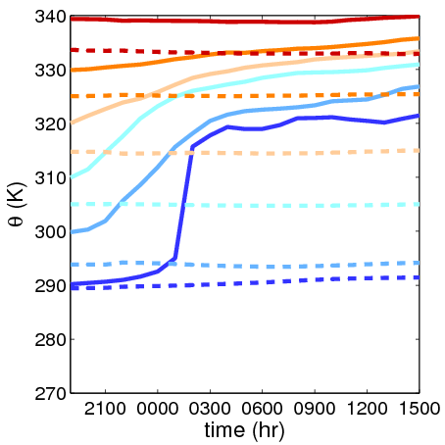
Mass redistribution
18 July 2012
15 August 2012
Median
98th percentile
In each θ₀ bracket
Averaged over a 1000-km radius circle

Slide 27
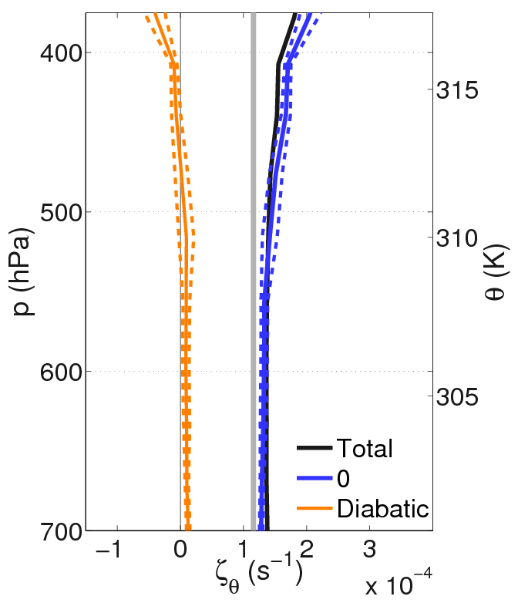
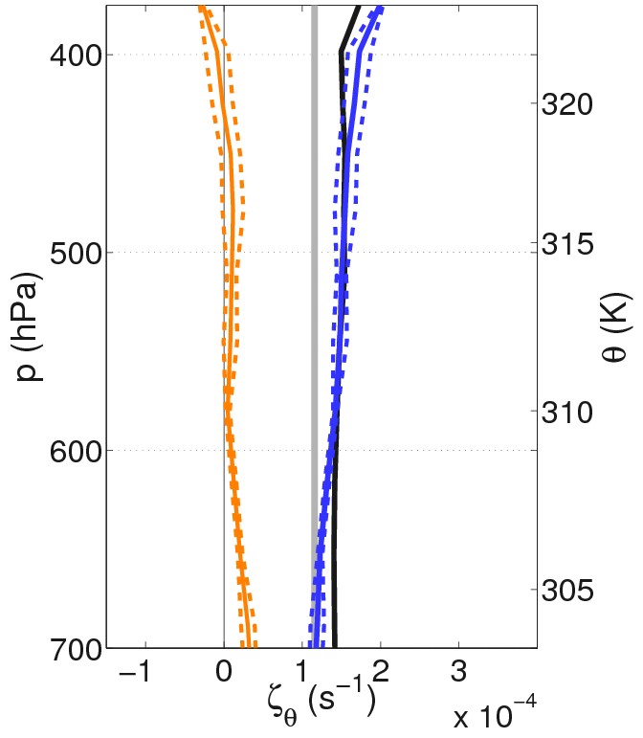

Isentropic absolute vorticity
$$ζ_{θ}=\frac{\iint_{A}{{σPV}_{θ}dA}}{A}$$
18 July 2012
15 August 2012
f
f
Averaged over a 1000-km radius circle

Slide 28
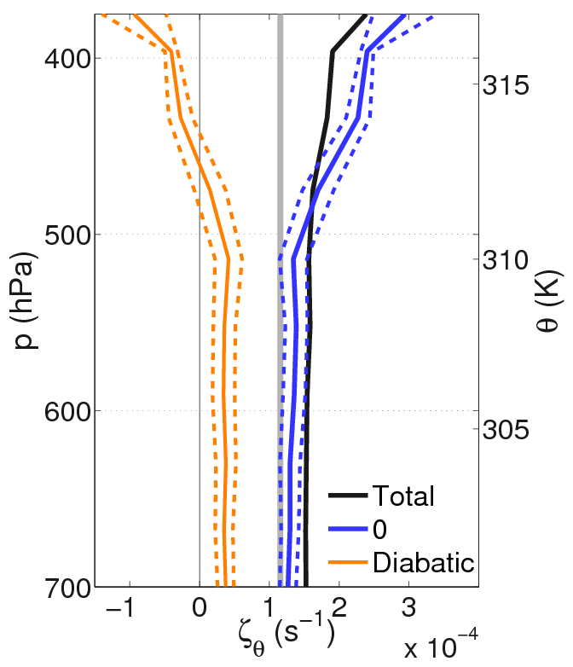
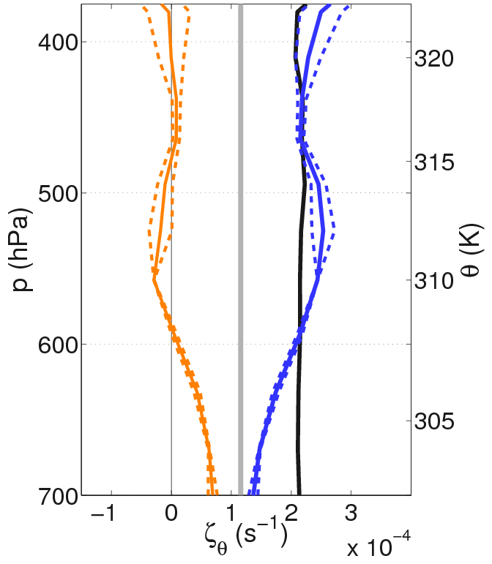
Isentropic absolute vorticity
$$ζ_{θ}=\frac{\iint_{A}{{σPV}_{θ}dA}}{A}$$
18 July 2012
15 August 2012
f
f
Averaged over a 500-km radius circle

Slide 29
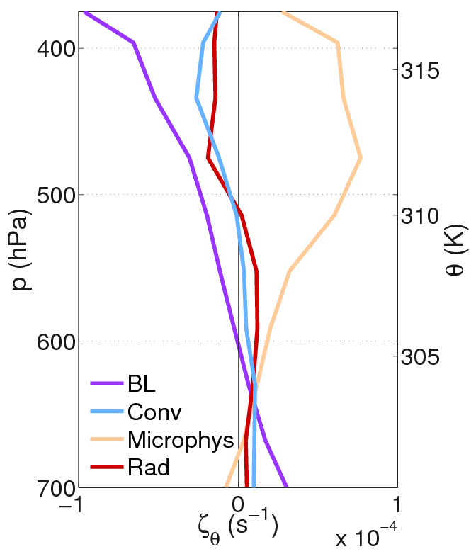
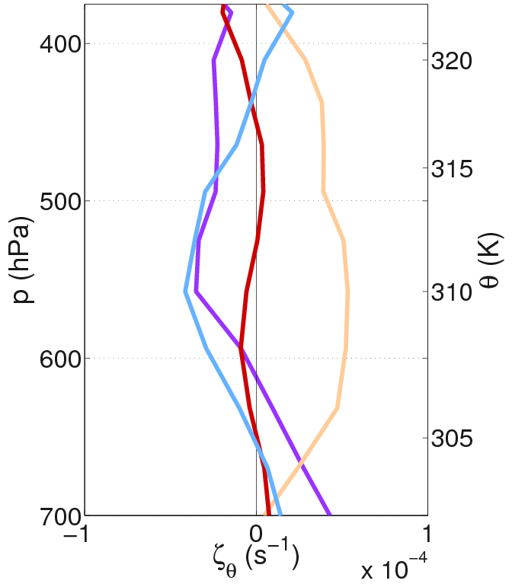
Isentropic absolute vorticity
$$ζ_{θ}=\frac{\iint_{A}{{σPV}_{θ}dA}}{A}$$
18 July 2012
15 August 2012
Averaged over a 500-km radius circle

Slide 30
Conclusions
The evolution of diabatically-generated PV in two contrasting summer extratropical cyclones has been characterised.
One cyclone exhibited relatively shallow lower- and upper- level PV anomalies
In contrast, the second cyclone exhibited very strong and well-developed PV anomalies leading to a strong PV tower
Diabatic tracers have been used to show that
the convection scheme was much more active in the case with a strong PV tower; its effects are present in the heating production, cross-isentropic vertical motion and the changes in vorticity within the cyclone
The boundary layer and the cloud microphysics schemes were important in producing low-level anomalies in both cyclones

Slide 31
Diabatic processes in extratropical cyclones:
Open questions
What are the systematic effects of diabatic processes on the development of extratropical cyclones and downstream evolution?
Are limitations in our ability to represent diabatic processes in weather and climate forecast models (given these processes are typically parameterized) limiting our forecasting abilities?
How can we make better use of aircraft and remote sensing observations to constrain diabatic processes in models and the impact on the large-scale dynamics?
WWOSC white paper (2015)

Slide 32
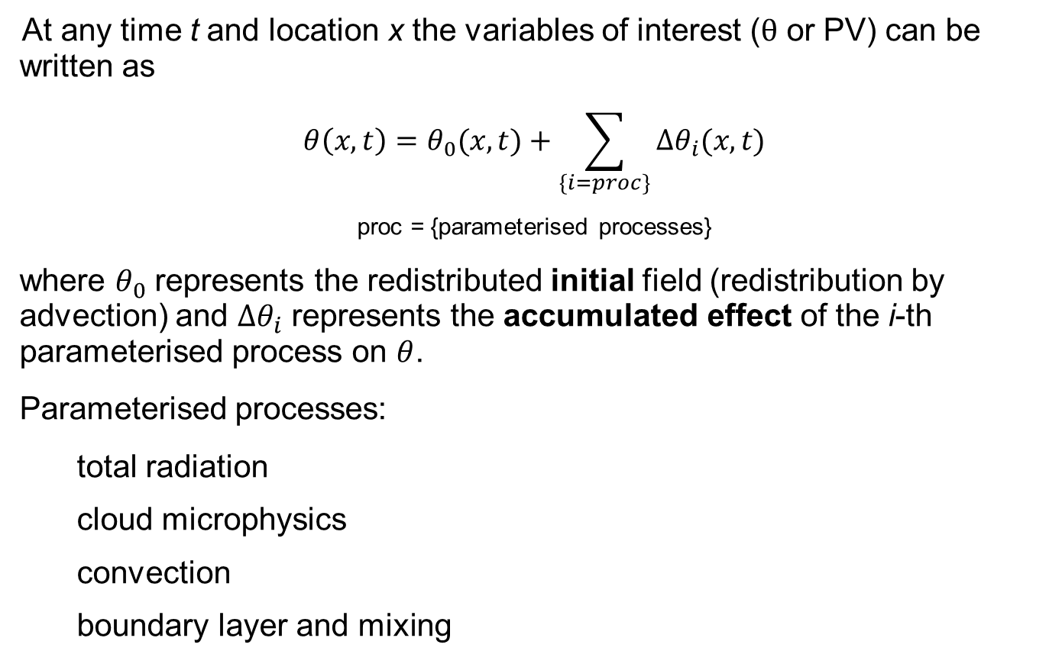
Description of tracers
At any time t and location x the variables of interest ($θ$ or PV) can be written as
$$θ\left(x,t\right)=θ_{0}(x,t)+\sum_{\left\{i=proc\right\}}{Δθ_{i}(x,t)}$$
proc = {parameterised processes}
where $θ_{0}$ represents the redistributed initial field (redistribution by advection) and $∆θ_{i}$ represents the accumulated effect of the i-th parameterised process on $θ$.
Parameterised processes:
  total radiation
  cloud microphysics
  convection
  boundary layer and mixing
(1)
These tracers tell us how important different processes are for the formation of structures in cyclones

Slide 33
Closing remarks
The analysis of these two summer extratropical cyclones was done using diabatic tracers; they allowed us to investigate
    Cross-isentropic vertical motion linked to heating and
    Changes in vorticity and circulation.
They are a powerful tool for atmospheric science, either for weather or climate research
Alternative to other methods such as trajectory analysis
Run on-line; therefore more consistent with model dynamics
Averaging over regions at different spatial scales provides a consistent means for the comparison of weather features at different resolutions

Slide 34


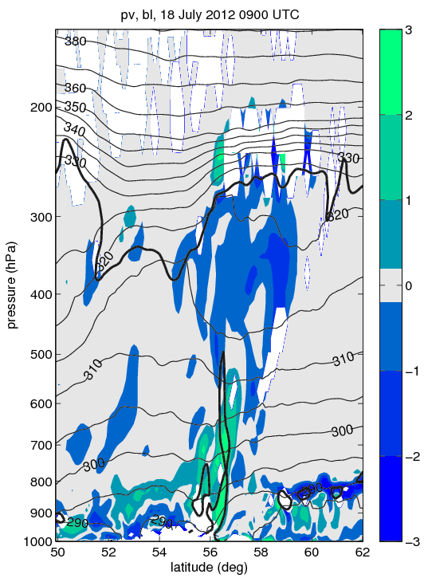
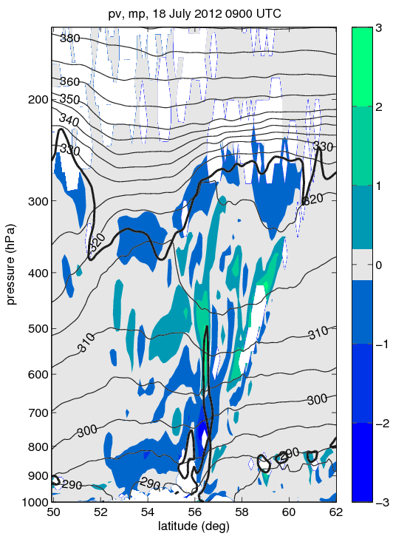
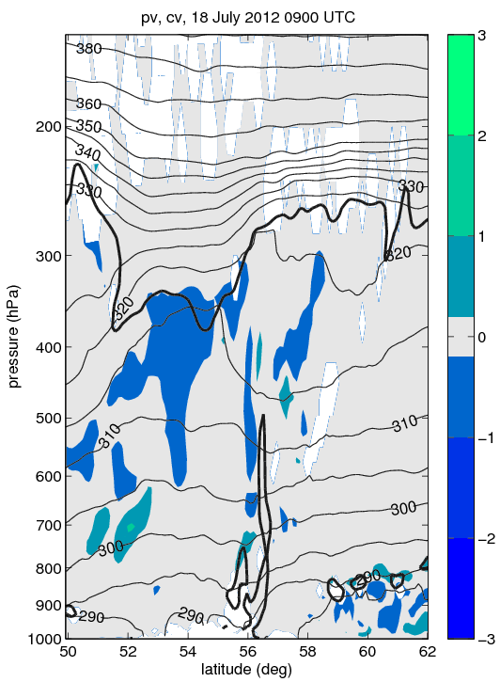
Diabatic PV from parameterized processes
Boundary layer
Cloud microphysics
Convection
3
PVU
2
1
0
-1
-2
-3
A
B
A
B
A
B
BOLD BLACK: 2-PVU
THIN BLACK: θ

Slide 35
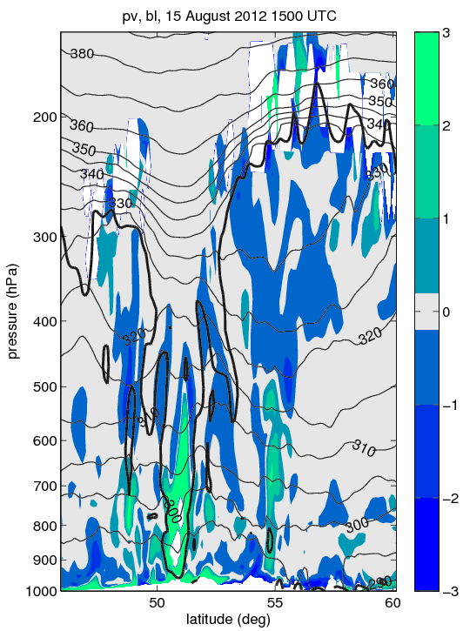
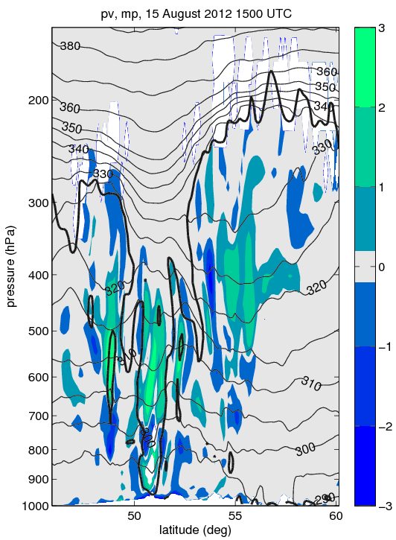
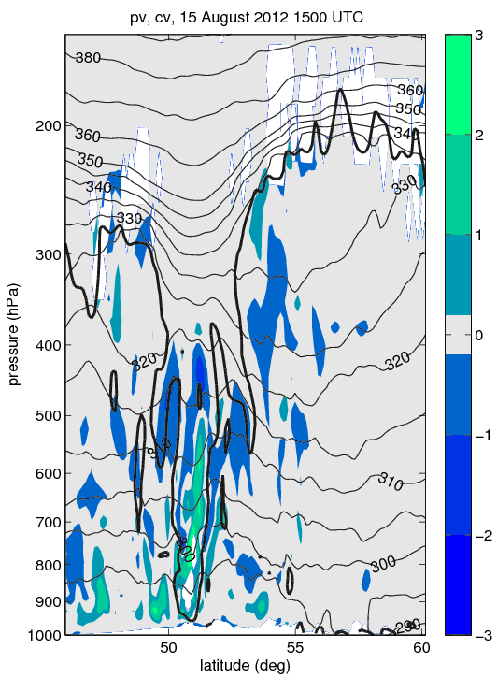
Diabatic PV from parameterized processes
Boundary layer
Cloud microphysics
Convection
3
PVU
2
1
0
-1
-2
-3
warm conveyor belt flow
warm conveyor belt flow
warm conveyor belt flow
C
D
C
D
C
D
Low-pressure centre
Low-pressure centre
Low-pressure centre
BOLD BLACK: 2-PVU
THIN BLACK: θ

