Slide 1
Dynamics of extratropical windstorms
Department of Meteorology
Suzanne Gray

Slide 2
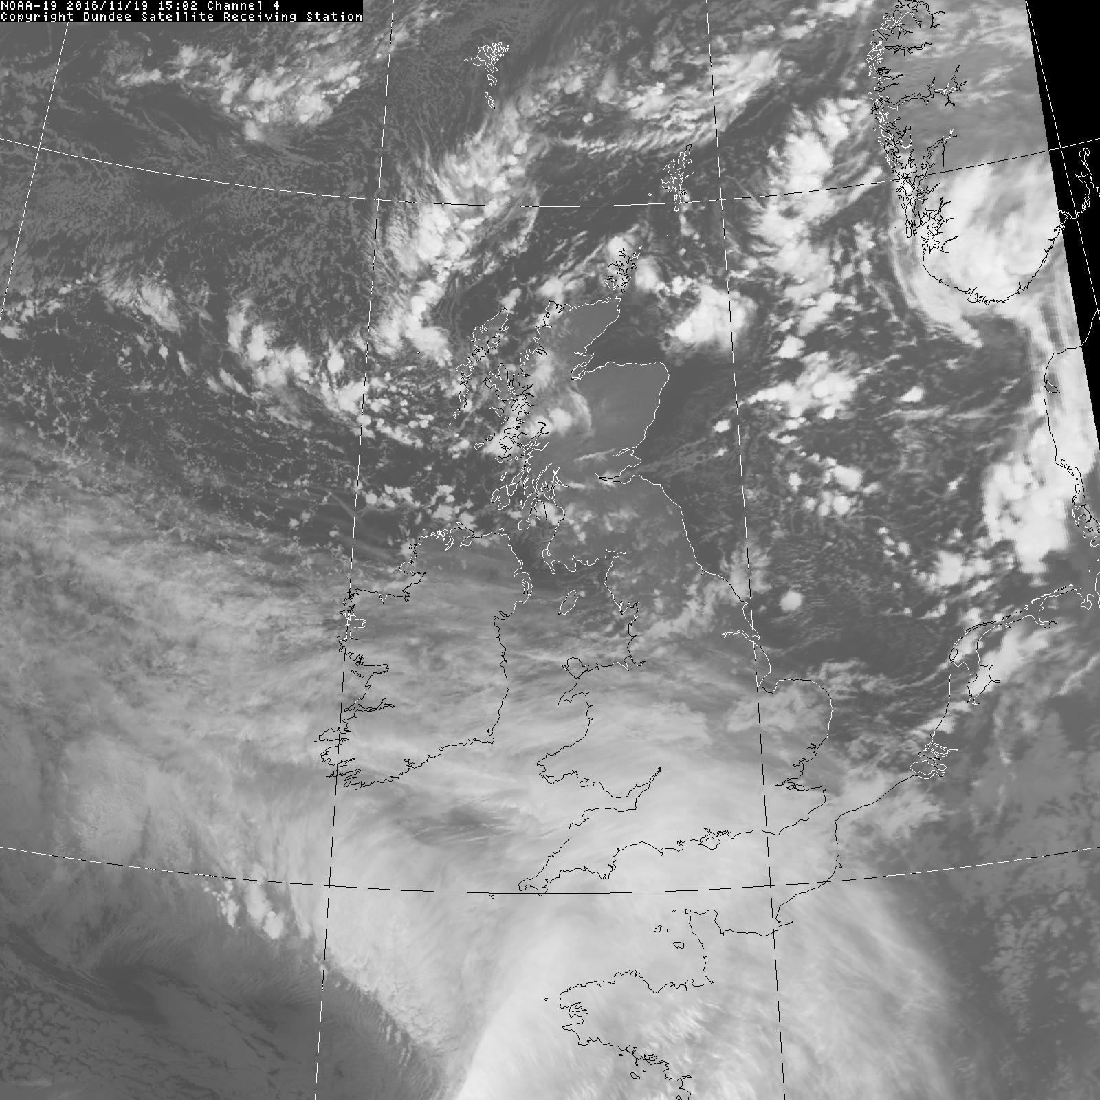
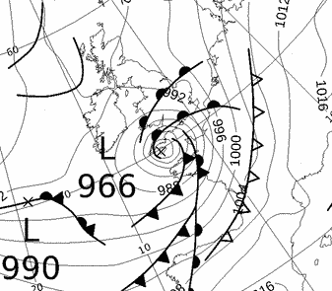
Storm
Angus
20 Nov 2016
AVHRR
imagery
00 UTC Met Office synoptic chart

Slide 3
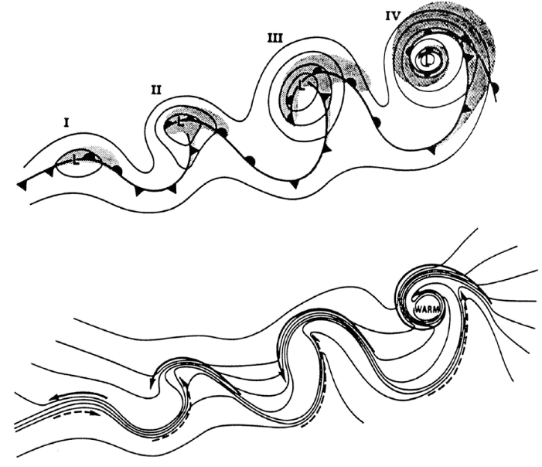
Structure of intense cyclones
Warm-core frontal seclusion
Frontal fracture
Bent-back front and T-bone
Incipient frontal cyclone
Shapiro and Keyser (1990)
Notes:
Figure 1. Conceptual model of the life cycle of an extratropical cyclone: (I) incipient frontal cyclone, (II) frontal
fracture, (III) bent-back front and frontal T-bone, and (IV) warm-core frontal seclusion. Upper diagram: sea-level
pressure, full lines; fronts, bold lines; cloud signature, shaded. Lower diagram: temperature, full lines; and cold
and warm air currents, full and dashed arrows, respectively. (From Shapiro and Keyser 1990.)

Slide 4
Structure of intense cyclones
Martínez-Alvarado et al. (2014)

Slide 5
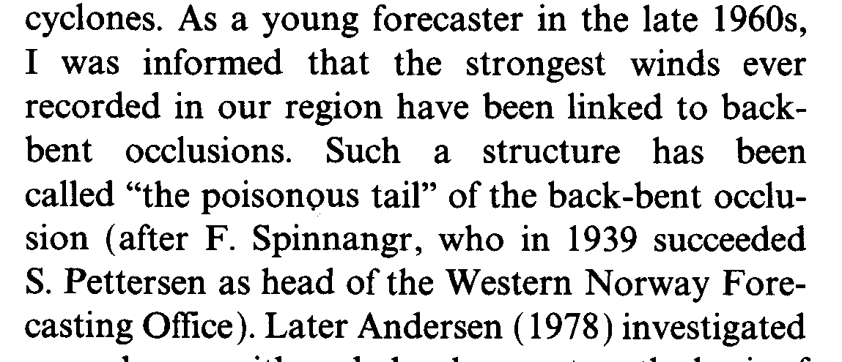
Sting jet?
Grønås (1995)
Browning (2004) “In the present paper the damaging winds in this region will be referred to as the sting at the end of the tail”

Slide 6
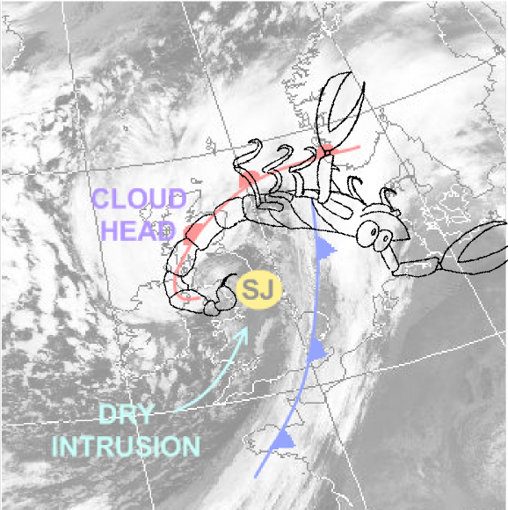
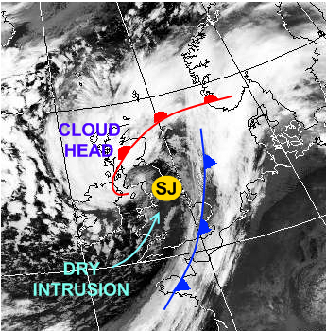
Sting jet?
The strongest winds in extratropical cyclones are normally associated with low-level jets along the warm and cold fronts.
Some cyclones form an additional region of very strong surface winds and gusts, known as a sting jet.
The sting jet is a transient mesoscale air stream that descends from the cloud head into the frontal fracture region.
Examples: October 1987 storm; St. Jude’s Day (28 Oct 2013); windstorm Tini (12 Feb 2014)
Adapted from Laura Baker by Neil Hart.

Slide 7


DIAbatic influence on Mesoscale structures in ExTratropical storms
Field programme: Autumn 2011, Spring and Summer 2012
Detachment: Exeter during Autumn 2011

Slide 8
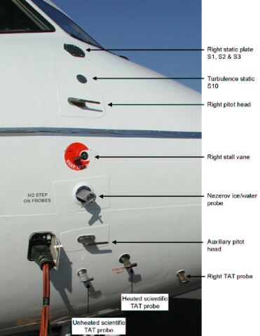
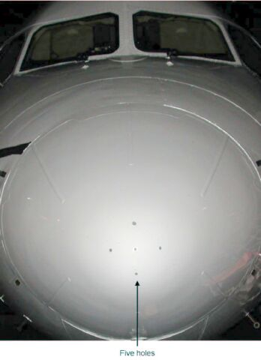
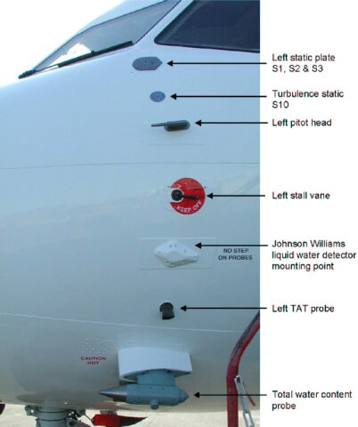
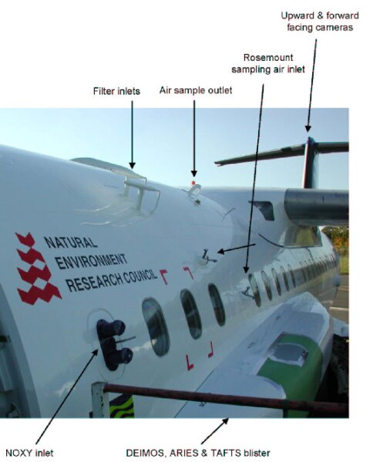
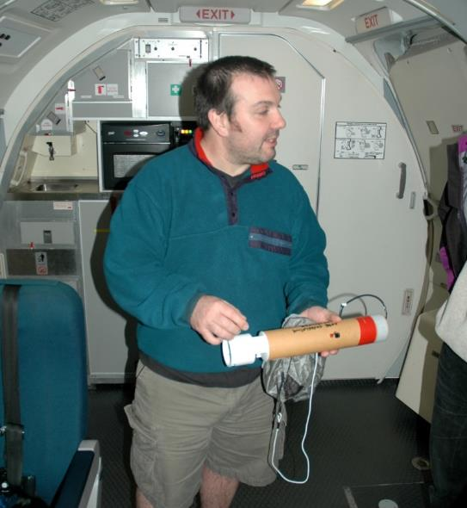

Slide 9
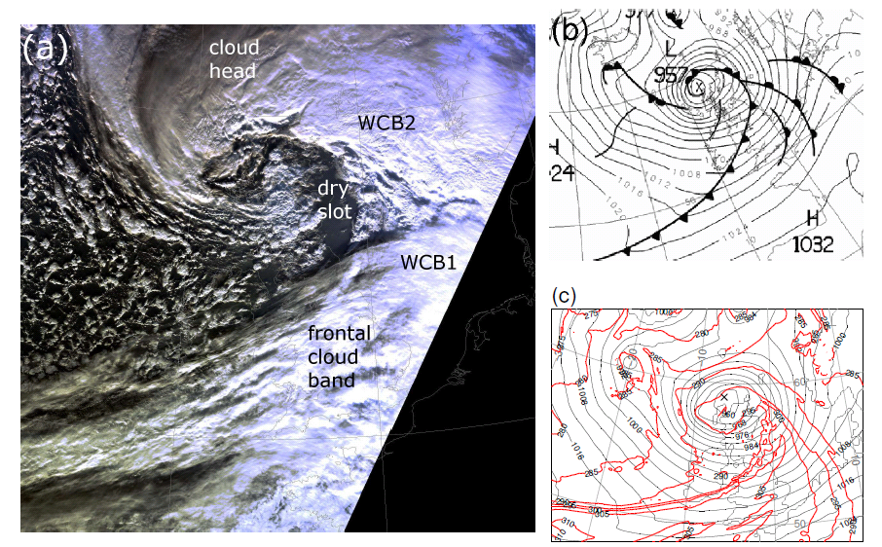
Windstorm Friedhelm
(hurricane Bawbag): 8 December 2011

Slide 10
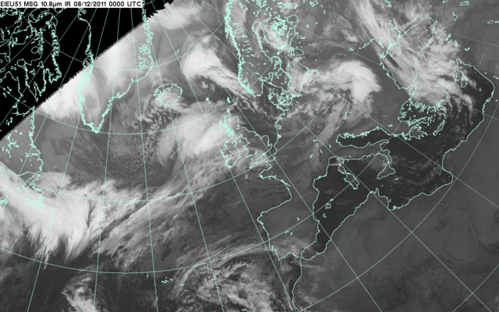

Slide 11
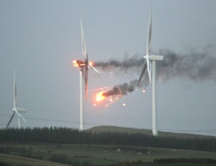
Windstorm Friedhelm
Rapid development (deepening 40hPa in 24 hours)
Fast system speed (wave slowing as it matures)
Shapiro-Keyser structure at low levels
All ingredients for severe surface winds
  165mph (gust) on Cairngorm
  Considerable damage and disruption
Science Questions
  Were the low-level winds well forecast (structure + strength)?
  What caused the damaging winds near the cyclone centre?
  What was the nature of cloud banding around the cyclone centre?
  Role of ice evaporation ⇒ diabatic cooling ⇒ enhanced descent and stronger winds at boundary layer top?
  Implications for predictability?
Ardrossan windfarm, Scotland

Slide 12
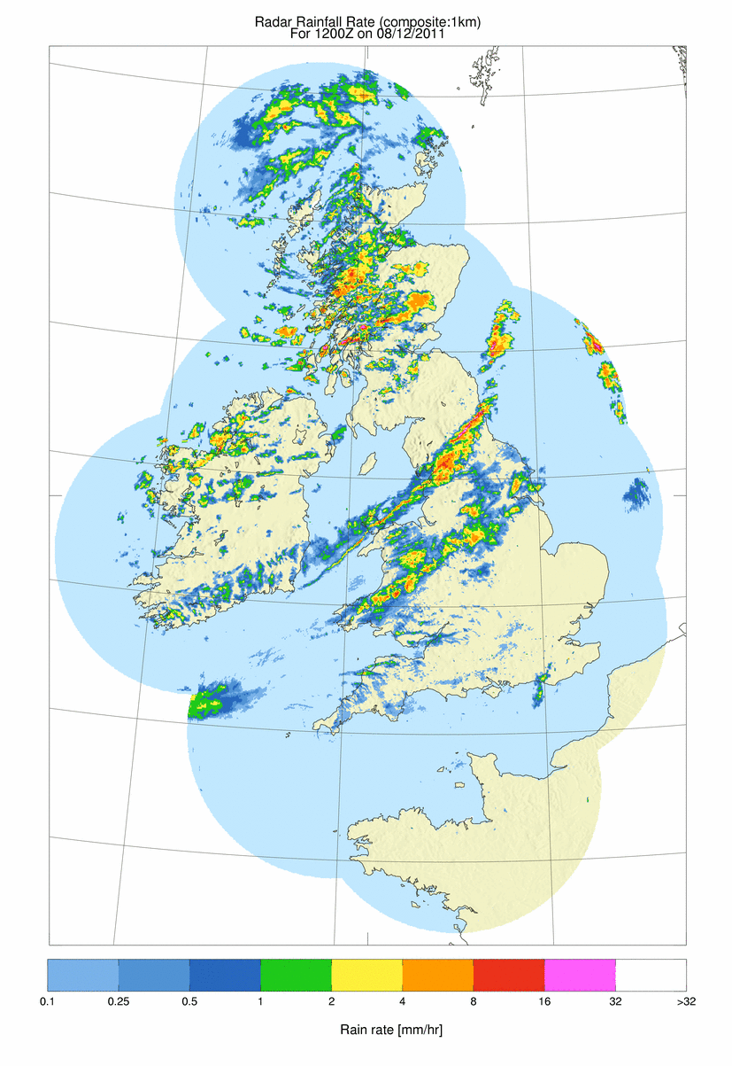
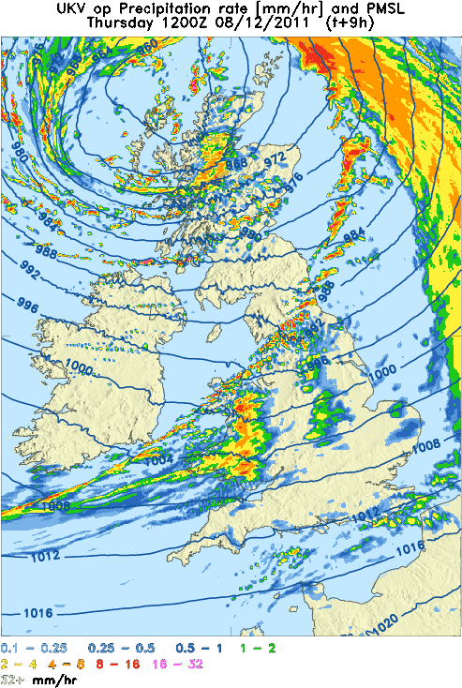
12 UTC
UKV T+9 forecast Radar image

Slide 13
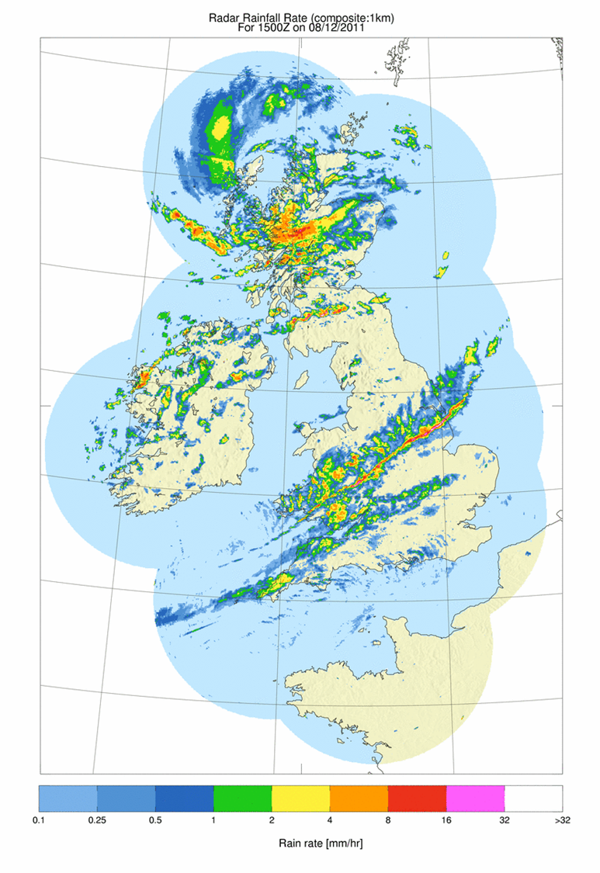
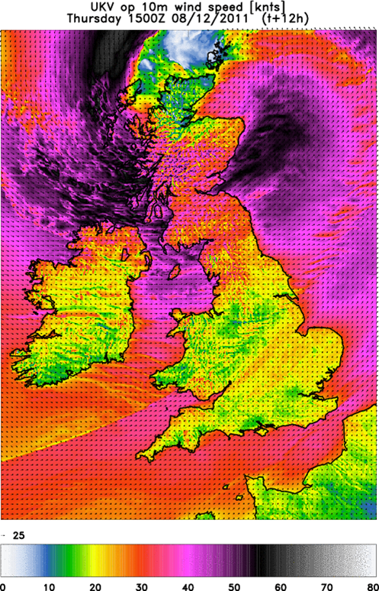
15 UTC
10m wind speed (knots)
Met Office 12hr forecast (1.5km model) Radar obs

Slide 14
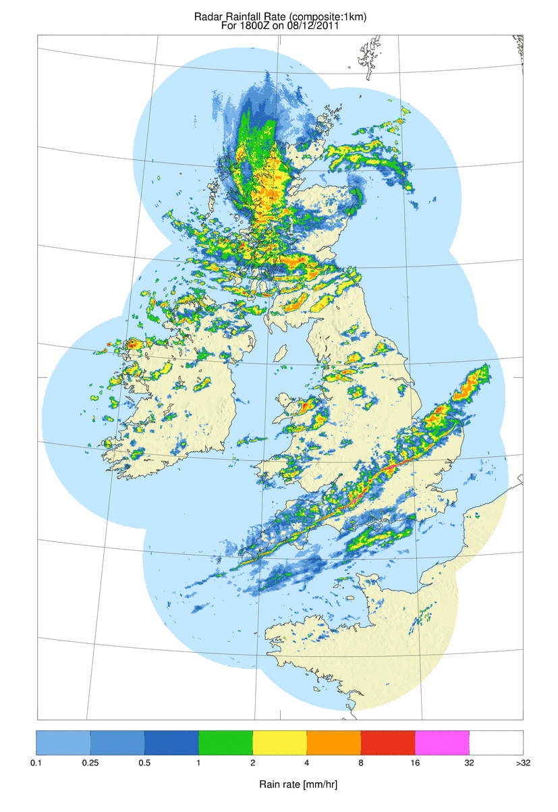
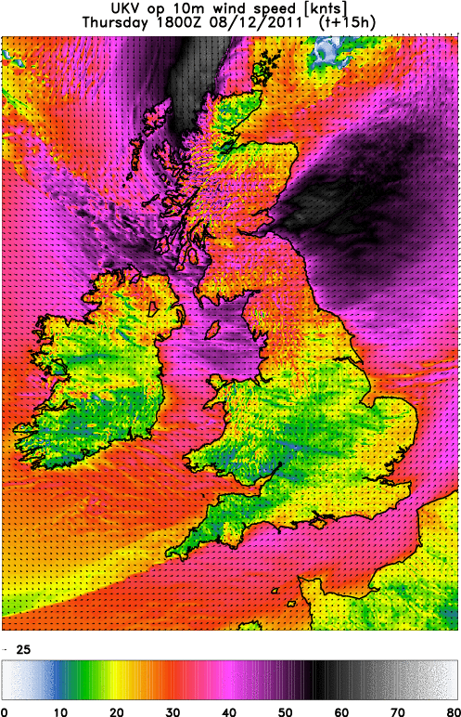
18 UTC
10m wind speed (knots)
Met Office 15hr forecast (1.5km model) Radar obs

Slide 15

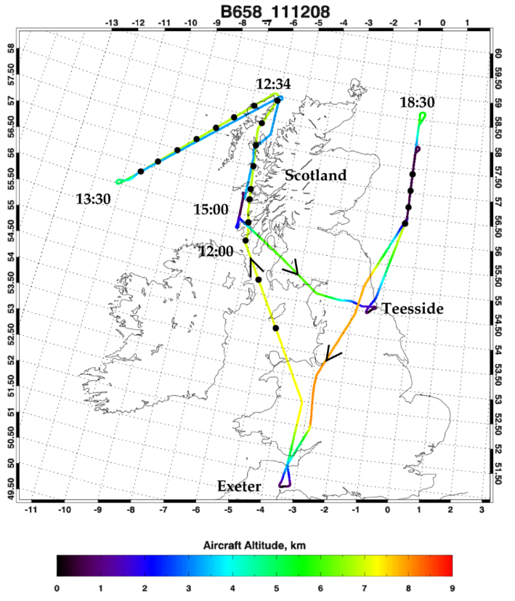
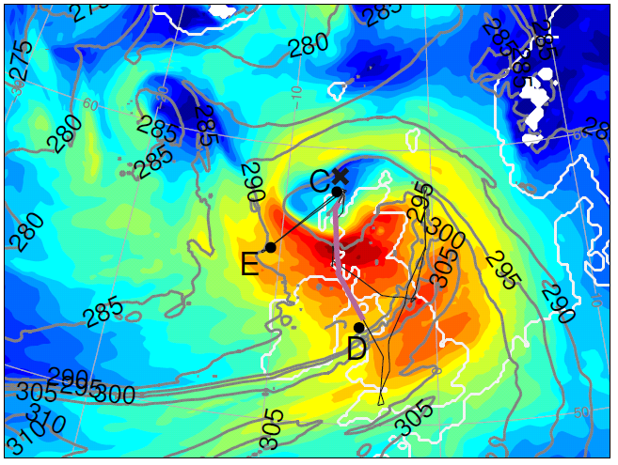
Flight into the eye of the cyclone
Met Office model simulation: 12 UTC
Colour shading: ground-relative wind speed @ 850 hPa; thin contours: equivalent potential temperature @ 850 hPa.

Slide 16
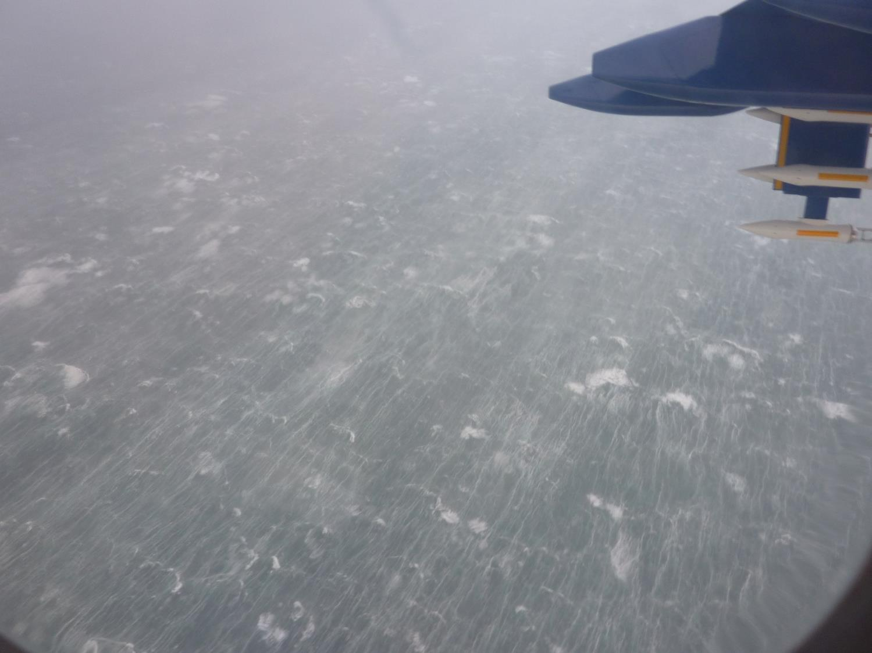
Churned up sea off the west coast of Scotland as photographed from the FAAM research aircraft at about 450 m (1,480 ft) above sea level.

Slide 17
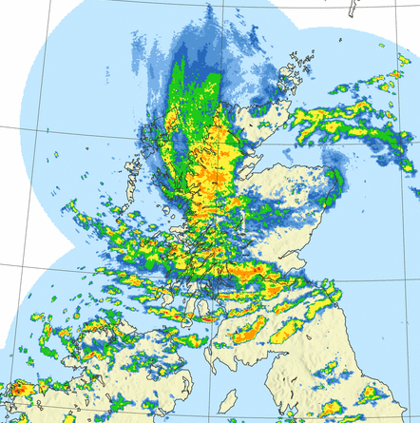
Observations of mesoscale banding
Most pronounced at 18 UTC
Distinctive precipitation banding observed on south side of this intense cyclone.
Vaughan et al. (2015)

Slide 18
Importance of sting jet storms
UK windstorms
Windspeed threshold (m s⁻¹)
Hart et al. (submitted)
Notes:
FIG. 10. (a) Frequency (events/year) of strong resolved wind events in storms with (red shading) and without
(blue shading) sting-jet precursors averaged over the UK domain (marked in Fig. 9) for resolved windspeed
thresholds from 25–45 ms􀀀1 (increment 5 ms􀀀1). Distinction is made between storms that did (dark shading)
and did not (light shading) develop explosively. (b) Same data as in (a), but plotted as proportion of total
frequencies for each resolved windspeed threshold. (c, d) are as in (a,b) but for the northern European domain
(marked in Fig. 9). Some of the points in panels (b) and (d) are displaced slightly from the resolved windspeed
threshold lines for clarity)

Slide 19
The North Atlantic storm track

Slide 20
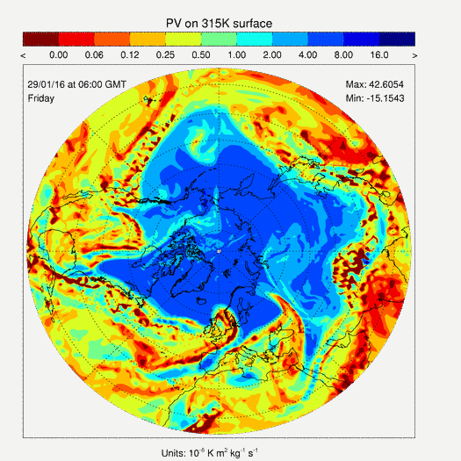
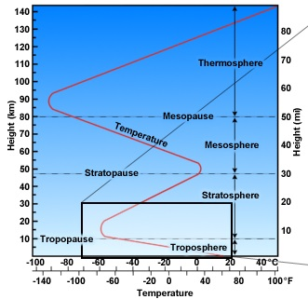
Rossby (planetary) waves
Giant meanders of high-altitude winds
Have a major effect on the development of weather systems and surface weather

Slide 21
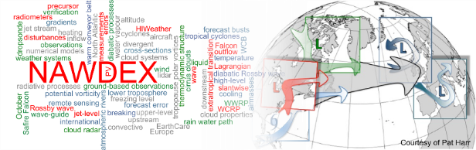
North Atlantic Waveguide and
Downstream Impact Experiment
AIM: to increase the physical understanding and to quantify the effects of diabatic processes on disturbances to the jet stream near North America, their influence on downstream propagation across the North Atlantic, and consequences for high-impact weather in Europe.

Slide 22
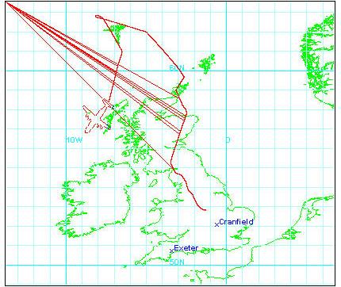
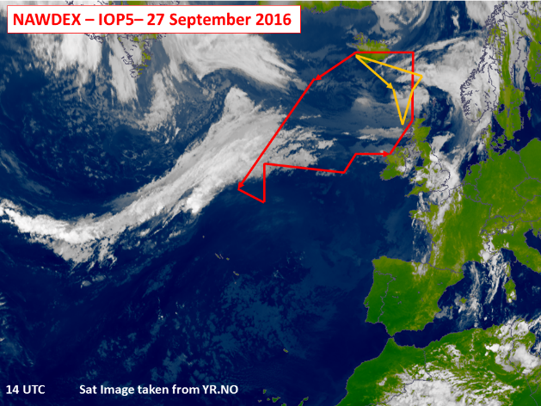
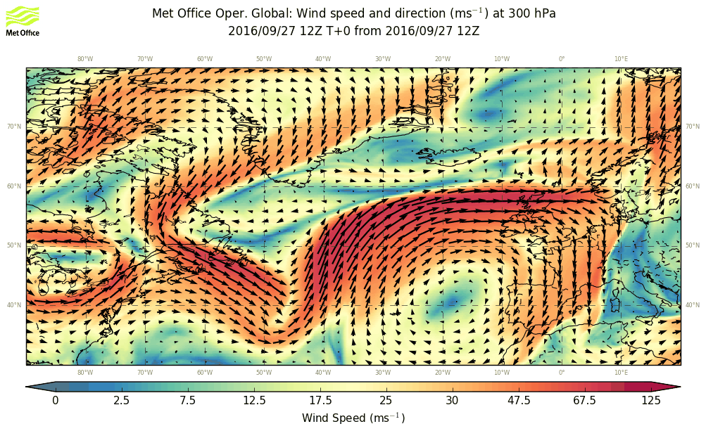
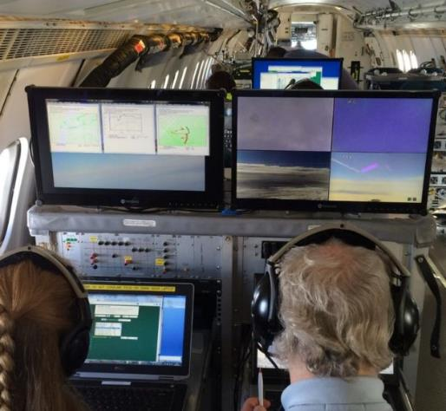
NAWDEX
15 Intensive observing periods from 17 Sept. to 18 Oct. 2016
Observations from 4 planes: German Halo, German Falcon, French Falcon and UK FAAM BAE 146 (in-situ, remote sensing and dropsonde observations) plus additional ground-based observations.
International effort: Germany, France, Switzerland, US, Canada, UK, Norway.

Slide 23
NAWDEX: (some) questions
What are the climatological characteristics of the sharpness of the tropopause and jet speed?
What is the role of diabatic (moist and frictional) processes in determining the sharpness of the tropopause and the evolution of large-scale Rossby waves around the globe?
How does upper-level humidity affect Rossby waves?
How does model resolution near the tropopause affect Rossby waves?
How predictable is high impact weather and how important are small (mesoscale)-scale moisture and wind features in determining predictability?

