Slide 1
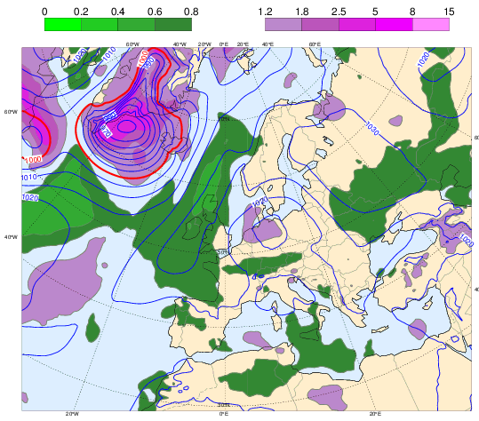
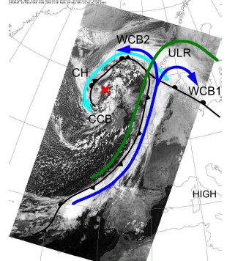
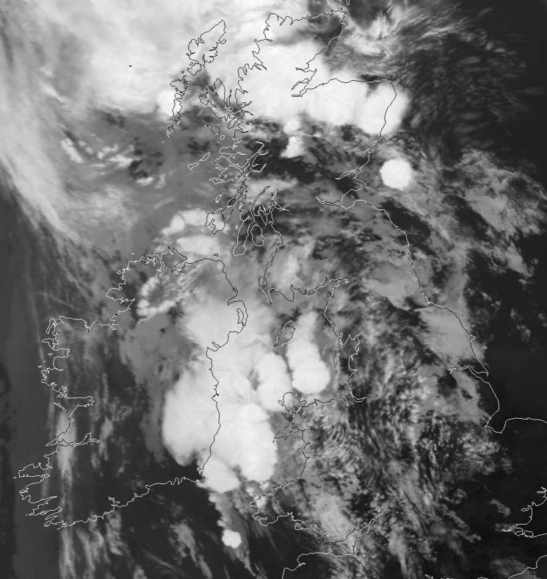
Weather processes and predictability: Sue Gray
Extratropical cyclones;
Convection;
Polar lows;
Mesoscale convective systems;
Transitioning tropical cyclones.
Extratropical transition
Ensemble forecasting
Sting
jets
Warm
Conveyor
belts
Thunderstorms
Notes:
British Isles thunderstorms 20 July 2016
ECMWF ensemble forecast for oZ 20 Oct T+48, MSLP ensemble mean plus normalised std dev (colours)
Figure 3. (b) Rain rate (mm hr–1) at 1300 UTC estimated by the Met Office radar 702 network (1-km grid
spacing). At 1234 UTC, the FAAM aircraft reached the storm center (pink dot). A–D indicate
704 rainbands moving to the east-southeast.
Figure 12. The rain rate (mm h–1, colored according to scale at bottom) 792 from the first four
members of the MOGREPS-UK trial forecast at 1600 UTC 8 December 2011, 7 h into the forecast.
794 Red lines indicate the axes of the wind maxima identified in Fig. 11.
FIG. 1. Tracks of all tropical cyclones that underwent extratropical
transition during 1970–99. (a) Western North Pacific. Tracks of tropical
cyclones defined to be extratropical in JTWC best-track data. (b)
Southwest Pacific [data as in (a)] and southeast Indian Ocean [tracks
of tropical cyclones that accelerated toward the southeast under the
influence of a midlatitude frontal system and maintained gales into
midlatitudes, the so-called captured cyclones in Foley and Hanstrum
(1994); best-track data taken from http://www.australiasevereweather.
com/cyclones/history.htm]. (c) North Atlantic. Tracks of tropical cyclones
defined to be extratropical in National Hurricane Center besttrack
data.
Douglas J. Parker and Alan J. Thorpe, 1995: Conditional Convective Heating in a Baroclinic Atmosphere: A Model of Convective Frontogenesis. J. Atmos. Sci., 52, 1699–1711.
doi: http://dx.doi.org/10.1175/1520-0469(1995)052<1699:CCHIAB>2.0.CO;2
G. Vaughan, J. Methven, D. Anderson, B. Antonescu, L. Baker, T. P. Baker, S. P. Ballard, K. N. Bower, P. R. A. Brown, J. Chagnon, T. W. Choularton, J. Chylik, P. J. Connolly, P. A. Cook, R. J. Cotton, J. Crosier, C. Dearden, J. R. Dorsey, T. H. A. Frame, M. W. Gallagher, M. Goodliff, S. L. Gray, B. J. Harvey, P. Knippertz, H. W. Lean, D. Li, G. Lloyd, O. Martínez–Alvarado, J. Nicol, J. Norris, E. Öström, J. Owen, D. J. Parker, R. S. Plant, I. A. Renfrew, N. M. Roberts, P. Rosenberg, A. C. Rudd, D. M. Schultz, J. P. Taylor, T. Trzeciak, R. Tubbs, A. K. Vance, P. J. van Leeuwen, A. Wellpott, and A. Woolley, 2015: Cloud Banding and Winds in Intense European Cyclones: Results from the DIAMET Project. Bull. Amer. Meteor. Soc., 96, 249–265.
doi: http://dx.doi.org/10.1175/BAMS-D-13-00238.1
Jones S.C. et al., 2003: The extratropical transition of tropical cyclones: Forecast challenges, current understanding, and future directions. Weather and Forecasting, 18:1052-1092, doi: 10.1175/1520-0434(2003)018<1052:TETOTC>2.0.CO;2

