Slide 1

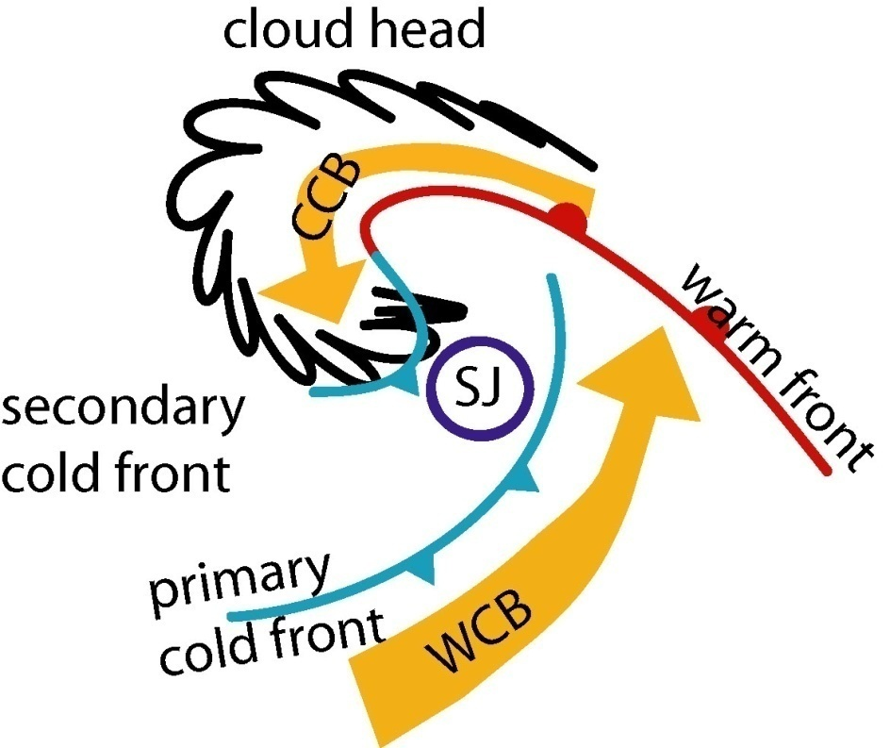
Sting jets in intense Winter North Atlantic windstorms
Abstract
Extratropical cyclones dominate autumn and winter weather over western Europe. The strongest cyclones, often termed windstorms, have a large socio-economic impact due to the strong surface winds and associated storm surges in coastal areas. Here we show that sting jets are a common feature of windstorms [1]; up to a third of the 100 most intense North Atlantic winter windstorms over the last two decades (identified from ERA-Interim data) satisfy conditions for sting jets.
The sting jet is a mesoscale descending airstream that can cause strong near-surface winds in the dry slot of the cyclone, a region not usually associated with strong winds. Despite their localised transient nature these sting jets can cause significant damage, a prominent example being the storm that devastated southeast England on 16 October 1987. We present the first regional climatology of windstorms with sting jets. Previously analysed sting-jet cases appear to have been exceptional in that they tracked over northwest Europe rather than in their strength.
Figure 1
Relative position of a sting jet (SJ) with respect to the cloud head, the bent-back front and the two main air streams (the warm (WCB) and cold (CCB) conveyor belts) according to the conceptual model in [2,3]. This configuration occurs during stage III of the Shapiro-Keyser model of cyclogenesis.
Results
Sting-jet cyclone characteristics
Six of the fifteen cyclones simulated at high resolution had sting jets. After optimization of a minimum size threshold range for the precursor region in ERA-Interim five of the six sting-jet cases had precursor regions and seven of the nine cases without sting jets did not have any precursor regions (Table 1). For this size threshold range between 23 and 32 of the 100 cyclones examined had sting-jet precursors.
Precursor regions occur within cyclones all along the storm track but sting-jet cyclones form at lower latitudes than cyclones without sting jets (Fig. 2 shows that all the sting-jet cyclones were south of 50ºN at the start of the day before their time of maximum intensity). This is consistent with the need for warm moist air to fuel the sting jet. Consistent with previous case studies, precursors preferentially occur prior to the time when the cyclone reaches its maximum intensity (Fig. 4).
Sting jet characteristics
Air parcel following trajectories calculated along the sting jets in the high-resolution simulations demonstrate the expected rapid descent and drying of air parcels within a few hours of leaving the cloud head of the cyclone (Fig. 5). The sting-jet descent rates and peak horizontal wind speeds at the top of the boundary layer compare well with previously analysed cases although they do not quite reach the values attained by the Great October storm of 1987. These results suggest that sting jets are a relatively generic feature of North Atlantic cyclones and that previously analyzed cases are more exceptional in their path over Europe, which led to their identification as sting-jet cases, than in the strength of their sting jets.
Table 1
Contingency table (p = 0.035)
 | Sting jet | No Sting Jet
Sting jet precursor | 5 | 2 | 7
No precursor | 1 | 7 | 8
 | 6 | 9 | 15
Introduction
Sting jets are transient, highly localized low-level jets occurring in some rapidly deepening Shapiro-Keyser type extratropical cyclones. They are different from other air streams, such as the warm and cold conveyor belts (Fig. 1). Until now knowledge of sting-jet cyclones has been mainly gained from case studies of exceptional events, their climatology has been unknown.
Figure 2
Track section plotted every 6 hrs from 0000 UTC the day before to 1800 UTC the day after the day of maximum intensity (defined by 850 hPa relative vorticity) for sting-jet cyclones. The start of the tracks and points at which precursors were identified are marked by + and respectively.
Method
It is not possible to directly search for sting jets in climatological datasets such as reanalyses because their resolution is not high enough to resolve sting jets. We have developed a method to diagnose the precursors of sting jets rather than the sting jets themselves [4]. We search for conditional symmetric instability in cloudy air near the cold fronts of cyclones [5]. Insufficient resolution does not prevent the accumulation of this instability, only its release to produce a sting jet. We applied this diagnostic to the 100 most intense North-Atlantic cyclones during 20 winter seasons of the ECMWF reanalysis, ERA-Interim. The predicted presence, or absence, of a sting jet was verified by performing high-resolution, sting-jet resolving, simulations with an operational weather forecast model.
Figure 4
Time distribution of all cyclones (grey) and those with sting-jet precursors (black).
Summary
  About a third of the 100 most intense North Atlantic cyclones that occurred during the past 20 winters are likely to have had sting jets.
  Despite the small number of cyclones simulated at high resolution, the results show the reliability of the sting-jet identification method.
  These results constitute the first regional climatological study of sting jets.
  Future research will associate metrics for sting jet existence (such as the magnitude of the atmospheric instability in the precursor diagnostic discussed here) to the strength of surface winds and gusts.
  Future research will also determine the changes expected in sting-jet cyclone frequency and tracks, and in the strength of sting jets, as the climate warms.
Figure 3
Distribution of sting-jet precursors with respect to time of maximum relative vorticity ( t = 0).
Figure 5
Fields along sting jet trajectories for six cases simulated at high resolution. (a) Pressure and (b) Relative humidity with respect to ice. Black solid lines represent ensemble-mean; dashed lines represent ensemble-mean +/- one standard deviation, colour shading represents the ensemble spread, vertical lines mark the onset of the sting-jet descent.
Pressure (hPa)
Relative humidity (%)
References
The work presented here has been submitted to Environ. Res. Lett.: Martínez-Alvarado, O., S. L. Gray, J. L.Catto, P. A. Clark, Sting jets in intense winter North-Atlantic windstorms.
Browning, K. A., 2004: The sting at the end of the tail: damaging winds associated with extratropical cyclones. Q. J. R. Meteorol. Soc., 130, 375-399.
Clark, P. A., K. A. Browning and C. Wang, 2005: The sting at the end of the tail: model diagnostics of fine-scale three-dimensional structure of the cloud head. Q. J. R. Meteorol. Soc., 131, 2263-2292.
Martínez-Alvarado, O., S. L. Gray, P. A. Clark and L. H. Baker: Objective detection of sting jets in low-resolution datasets. In press Met. Apps.
Gray, S. L., O. Martínez-Alvarado, L. H. Baker and P. A. Clark, 2011: Conditional symmetric instability in sting jet storms, Q.J.R. Meteorol. Soc., 137, 1482-1500.
Acknowledgements
This work was funded by Natural Environment Research Council (NERC) grant NE/E004415/1. We thank the ECMWF for providing ERA-Interim, the Met Office for making the MetUM available and NCAS (National Centre for Atmospheric Science) CMS (Computational Modelling Services) for providing computing and technical support.
Affiliations
Department of Meteorology, University of Reading
School of Geography and Environmental Science, Monash University
Departments of Mathematics and Civil, Chemical and Environmental Engineering, University of Surrey

