Slide 1
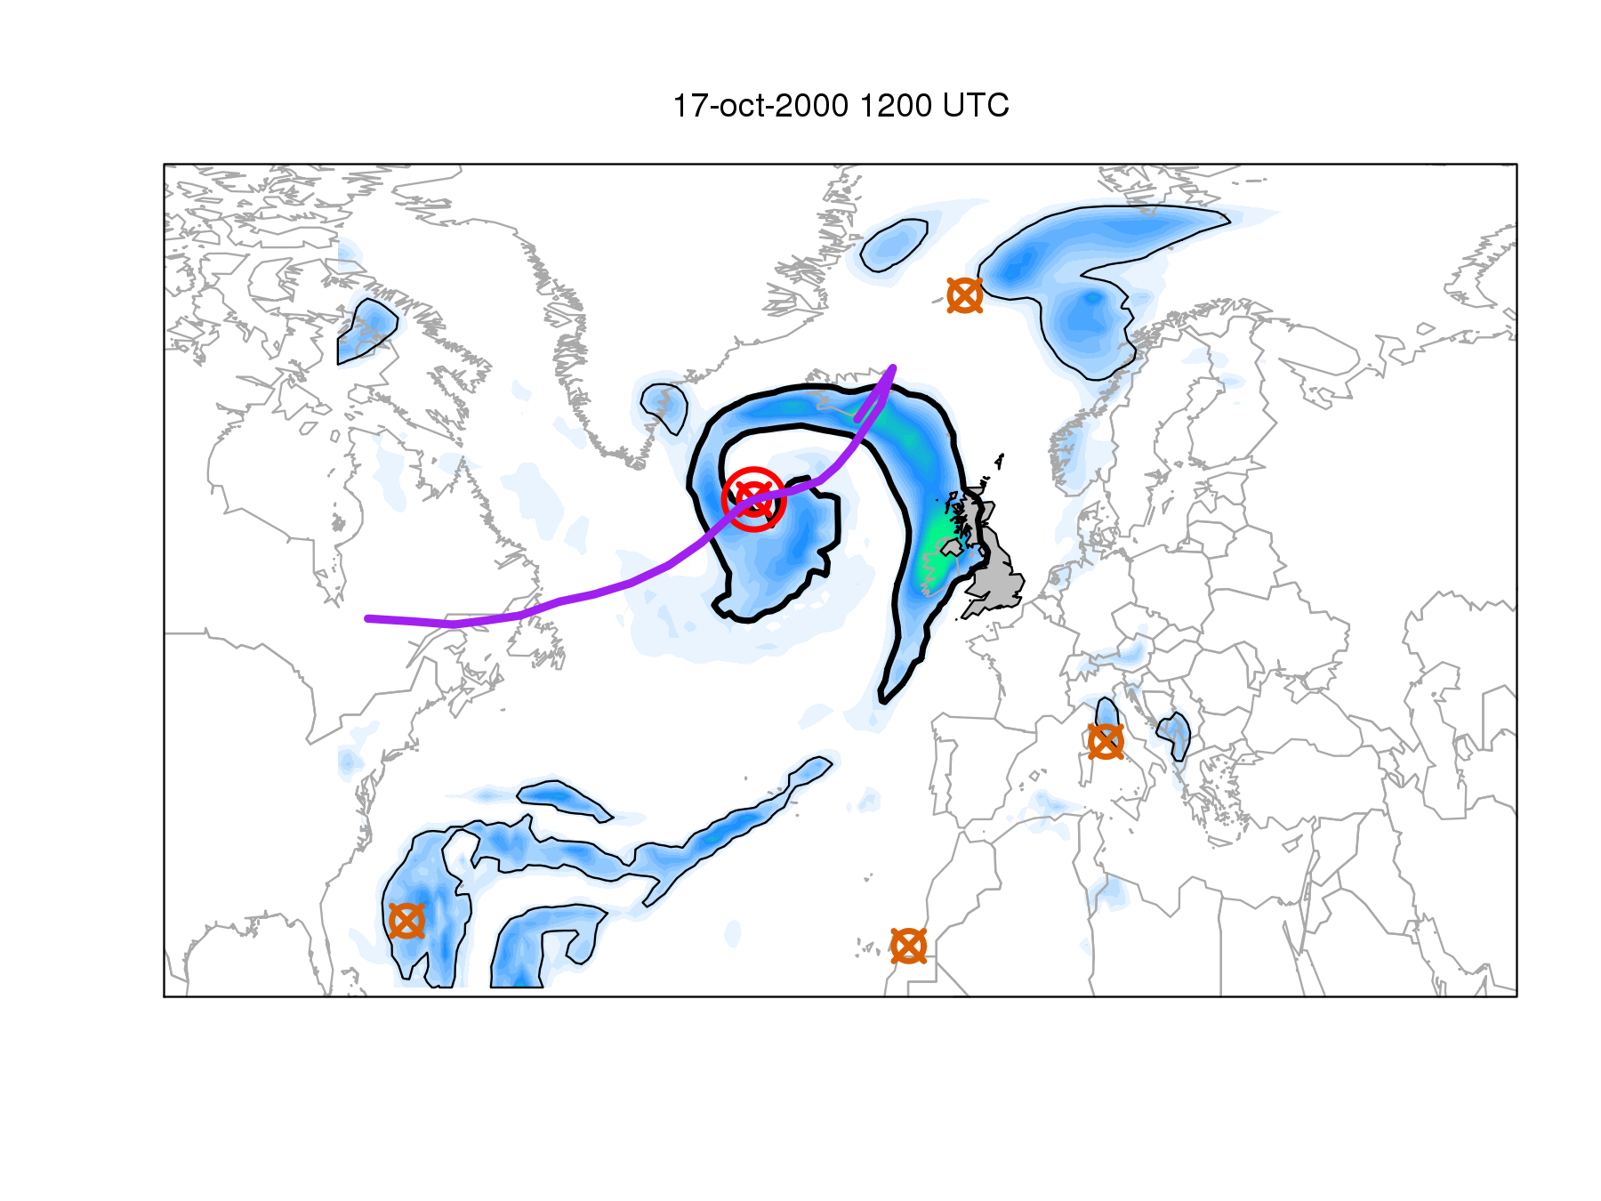
Clustering and stalling of extratropical cyclones: their influence on extreme precipitation events in the UK
Suzanne Gray
Ruari Rhodes, Len Shaffrey
Jointly sponsored by University of Reading and Lloyds Banking Group

Slide 2
Precipitation in the midlatitudes
Climatological precipitation
(mm/day)
Storm contribution (%)
Hawcroft et al. (2012)
Notes:
How much Northern Hemisphere precipitation is associated
with extratropical cyclones?
M. K. Hawcroft,1 L. C. Shaffrey,2 K. I. Hodges,3 and H. F. Dacre1
GEOPHYSICAL RESEARCH LETTERS, VOL. 39, L24809, doi:10.1029/2012GL053866, 2012
Figure 1. Climatological precipitation (mm/day) from ERAI and GPCP for DJF and JJA.
Figure 3. Contribution of storm associated precipitation to the total precipitation (%) from ERAI and GPCP derived from
the data in Figures 1 and 2. The masked and stippled areas are where the total climatological precipitation (Figure 1) is less
than 1 mm/day. The GPCP data is smoothed over 3-degrees to reduce noise.

Slide 3
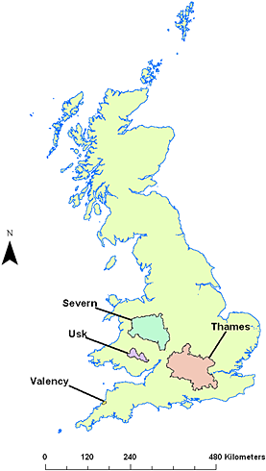
What is extreme precipitation?
Absolute threshold, local percentile, period of accumulation, flooding potential?
Smith et al. 2014
Notes:
Hydrological Processes
Volume 28, Issue 5, pages 2810-2823, 7 MAY 2013 DOI: 10.1002/hyp.9815
http://onlinelibrary.wiley.com/doi/10.1002/hyp.9815/full#hyp9815-fig-0001
D-day vulnerability - Flooding events were defined as all days when discharge exceeded the bank full estimate at each of the gauging stations. The selected flooding events were then compared against the length of the causing rainfall event. To ensure that the selected rainfall days were representative of flood-causing rainfall, rainfall days were defined as all days that exceeded 5% quantile of total storm accumulation. n-Day vulnerabilities could then be calculated by taking the mean length of flood-causing rainfall events. Calculated n-day vulnerabilities were 4.8, 3.6 and 3, for the Severn, Thames and Usk, respectively.

Slide 4
Extratropical cyclones and extreme precipitation
Proportion of ERA-I extreme precipitation events (99th percentile for 6-hourly accumulations at gridpoints) associated with….
Both a front and a cyclone
Neither a front nor a cyclone
Catto and Pfahl (2013)
Notes:
Figure 7. The proportion of 6-hourly ERA-Interim extreme precipitation EVENTS associated with
(a) both a front and a cyclone, (b) only a cyclone, (c) only a front, and (d) no front or cyclone. High
orography is blanked out in grey.
Citation: Catto, J. L., and S. Pfahl (2013), The importance of fronts for extreme precipitation, J. Geophys. Res. Atmos.,
118, 10,791–10,801, doi:10.1002/jgrd.50852.

Slide 5
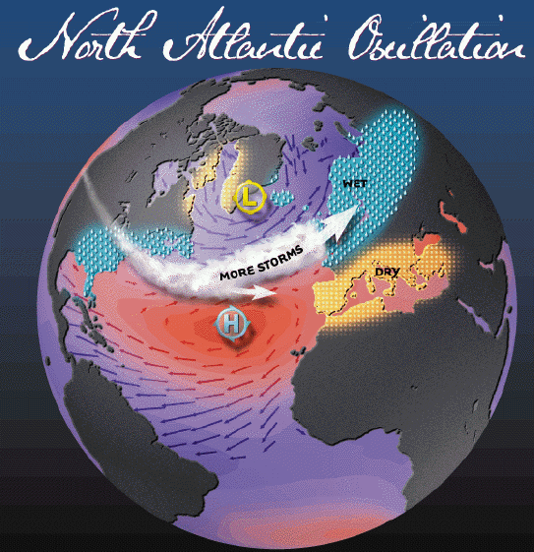
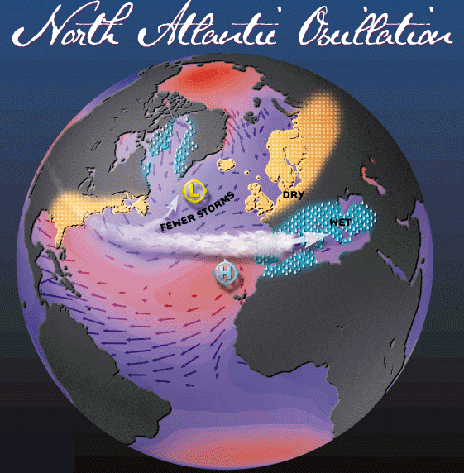
Clustering and stalling causes
http://www.ldeo.columbia.edu/res/pi/NAO/
Notes:
For this reason,
the NAO has traditionally been regarded as the principal
large-scale pattern that explains the variation in
the rate of cyclones arriving in western Europe (Rogers
1997). However, little attention has been devoted to
the possible contribution of other large-scale factors
besides the NAO.

Slide 6
Clustering and stalling causes
Secondary cyclogenesis
Bjerknes and Solberg (1922)
Notes:
Formation of the secondary cyclone as a wave on the cold front of the “mother” cyclone
J. Bjerknes and H. Solberg, " Life Cycle of Cyclones and the Polar Front Theory of Atmospheric Circulation", Geofysiker Publikationer, vol. iii., No. 1, 1922, p. 14.

Slide 7
Clustering example
January 2007
12 clustering days for p98 intensity cyclones (9–20 January, red line) identified, with a total of nine cyclones including Kyrill (15-19 January).
Pinto et al. (2014)
Notes:
Figure 1. (a) Trajectories of all (black lines), p95 (blue lines), and p98 (red lines)
cyclones crossing the circle detection area ((55°N, 5°W), r = 700 km) during
January 2007. (b) All, p95, and p98 cyclone counts in January 2007 per
calendar day (stems, see legend). Solid lines: 7 day running sums of cyclone
counts. Dashed red line: threshold defined for clustering detection
(four cyclones within 7 days).
MSLP percentile
Pinto, J.G., I. Gómara,G.Masato, H. F. Dacre,
T. Woollings, and R. Caballero (2014),
Large-scale dynamics associated with
clustering of extratropical cyclones
affecting Western Europe, J. Geophys. Res.
Atmos., 119, 13,704–13,719, doi:10.1002/
2014JD022305.

Slide 8
Stalling example
Summer 2007
Blackburn et al. (2008)
Notes:
Figure 1. European precipitation anomalies during 2007 as a percentage of the climatological average. (a) June, (b) July. (Courtesy, National Oceanic and
Atmospheric Administration, not subject to copyright protection.)
Figure 2. Time versus longitude diagram showing the evolution from 15 May to 15 August 2007 of
geopotential height anomalies, in metres, averaged over 45 °–60 °N near the tropopause (250 hPa).
Dates of the three UK rainfall events are labelled A–C along the Greenwich meridian. Data are from
NCEP operational analyses.
Blackburn, M., Methven, J. and Roberts, N. (2008), Large-scale context for the UK floods in summer 2007. Weather, 63: 280–288. doi: 10.1002/wea.322

Slide 9
Clustering metrics
Mean monthly counts of cyclone transits (past 20º meridional section – barrier – at each gridpoint)
Estimated dispersion statistic
Mailier et al. (2006)
Notes:
FIG. 3. Sample mean n of the monthly counts of cyclone transits.
Contours start at 1 month1, contour intervals of 2 month1. Regions
where n 5 month1, are shaded to highlight the storm
tracks.
FIG. 5. Estimated dispersion statistic ˆ (%) of the monthly number
of cyclone transits. Solid (dashed) lines indicate positive
(negative) values. Contours start at 10%, contour intervals of
20%. Areas where ˆ 10% are shaded. Thick dark lines representing
the boundaries of the regions where n 5 month1
(shaded areas in Fig. 3) have been added for easy reference to the
storm tracks. For annotations A, B, A, B see text.

Slide 10
Clustering metrics
< 0 underdispersed (regular)
dispersion statistic: = 0 random
>0 overdispersed (clustered)
Dispersion statistic =
(sample variance/sample mean) -1
for the monthly mean cyclone transit counts
Estimated dispersion statistic
Mailier et al. (2006)
Notes:
FIG. 3. Sample mean n of the monthly counts of cyclone transits.
Contours start at 1 month1, contour intervals of 2 month1. Regions
where n 5 month1, are shaded to highlight the storm
tracks.
FIG. 5. Estimated dispersion statistic ˆ (%) of the monthly number
of cyclone transits. Solid (dashed) lines indicate positive
(negative) values. Contours start at 10%, contour intervals of
20%. Areas where ˆ 10% are shaded. Thick dark lines representing
the boundaries of the regions where n 5 month1
(shaded areas in Fig. 3) have been added for easy reference to the
storm tracks. For annotations A, B, A, B see text.
FIG. 6. Point processes describing the transits of cyclones at the entrance (location A) and at
the exit (location B) of the North Atlantic storm track from December 1990 to March 1991.
A long cyclone-track database
was constructed for extended October–March winters from 1950 to 2003 using 6-h analyses of 850-mb
relative vorticity derived from the NCEP–NCAR reanalysis.
Serial clustering of extratropical cyclones
By:Mailier, PJ (Mailier, Pascal J.); Stephenson, DB (Stephenson, David B.); Ferro, CAT (Ferro, Christopher A. T.); Hodges, KI (Hodges, Kevin I.)
MONTHLY WEATHER REVIEW
Volume: 134
Issue: 8
Pages: 2224-2240
DOI: 10.1175/MWR3160.1

Slide 11
Clustering metrics
3-monthly cyclone counts
All cyclones
Clustering determined across a 20º meridional barrier centred on Berlin
Vitolo et al. (2009)
Notes:
Figure 6: Dispersion statistic (solid line) and 90 % bootstrap confidence
interval (dashed) of the 3-monthly cyclone counts at the approximate
location of Berlin (12.5◦E,52◦N) as a function of the 850
hPa relative vorticity threshold used to select the most intense cyclones.
Thick dots: values of φ which are significant according to
a Katz test at the 10 % confidence level (see Appendix). The relation
between vorticity and equivalent windspeeds is (2.1), compare
Fig. 3.
Figure 7: Dispersion statistic ψ (points) of the cyclone transit counts
versus aggregation period Δt, at the approximate location of Berlin
(12.5E,52N). Logarithmic scale is used in the horizontal axis. 90 %
confidence intervals (solid lines) are computed as quantiles of a
bootstrap sample for each Δt. A linear regression fit of ψ versus
log(Δt) is added (dashed line; the point with Δt = 182 was not
included in the regression).
Serial clustering of intense European storms
By:Vitolo, R (Vitolo, Renato)[ 1 ] ; Stephenson, DB (Stephenson, David B.)[ 1 ] ; Cook, IM (Cook, Ian M.)[ 2 ] ; Mitchell-Wallace, K (Mitchell-Wallace, Kirsten)[ 2 ]
METEOROLOGISCHE ZEITSCHRIFT
Volume: 18
Issue: 4
Pages: 411-424
DOI: 10.1127/0941-2948/2009/0393
Published: 2009

Slide 12
Clustering metrics
Clustering defined according to a radius of influence.
Consistent across reanalysis datasets. Clustering increases for intense cyclones.
Pinto et al. (2013)
Notes:
Figure 3. (a) Estimated dispersion statistic (Ψ) for NCEP for the winter cyclone transits (December–
February) for all cyclones and the period 1948–2012. (b) Same as Figure 3a but for cyclones with minimum
core pressure exceeding the 95th percentile. (c) Same as Figure 3a but for ERA-40 for the period
1958–2002. (d) Same as Figure 3c but for cyclones with minimum core pressure exceeding the 95th
percentile. (e) Same as Figure 3a but for ERAI for the period 1979–2011. (f) Same as Figure 3e but for
cyclones with minimum core pressure exceeding the 95th percentile. ERA40 and ERAI data were spectrally
degraded to T62 to enable direct comparison. Values in areas with orography above 1500m are
suppressed. Blue values correspond to an underdispersive process (Ψ<0; regular), white values to a
random process (Ψ= 0), and red values to an overdispersive process (Ψ>0; clustering).
Under future climate conditions (A1B scenario), the GCM ensemble indicates that serial
clustering may decrease over the North Atlantic storm track area and parts of western Europe.
This decrease is associated with an extension of the polar jet toward Europe, which implies a
tendency to a more regular occurrence of cyclones over parts of the North Atlantic Basin
poleward of 50°N and western Europe. An increase of clustering of cyclones is projected
south of Newfoundland. The detected shifts imply a change in the risk of occurrence of
cumulative events over Europe under future climate conditions.
Citation: Pinto, J. G., N. Bellenbaum, M. K. Karremann, and P. M. Della-Marta (2013), Serial clustering of extratropical
cyclones over the North Atlantic and Europe under recent and future climate conditions, J. Geophys. Res. Atmos., 118,
12,476–12,485, doi:10.1002/2013JD020564.

Slide 13
hypotheses
Observed extreme precipitation accumulations at several-week timescales are associated with more storm track passages (more clustered) than lower accumulations on the same timescales.
Observed extreme several-day precipitation accumulations are associated with storms with a longer residence period (stalled / slow moving storms) than lower accumulations on the same timescales.
Climate change in the 21st Century will cause changes in the patterns of clustering and stalling in North Atlantic cyclones, which will lead to changes in precipitation over England and Wales

Slide 14
hypotheses
Observed extreme precipitation accumulations at several-week timescales are associated with more storm track passages (more clustered) than lower accumulations on the same timescales.
Observed extreme several-day precipitation accumulations are associated with storms with a longer residence period (stalled / slow moving storms) than lower accumulations on the same timescales.
Climate change in the 21st Century will cause changes in the patterns of clustering and stalling in North Atlantic cyclones, which will lead to changes in precipitation over England and Wales

Slide 15
Can reanalyses represent
extreme precipitation?
Rhodes, R. I., Shaffrey, L. C. and Gray, S. L. (2014) Can reanalyses represent extreme precipitation over England and Wales? Quarterly Journal of the Royal Meteorological Society. Early view
doi: 10.1002/qj.2418

Slide 16
Data
Reanalysis datasets:
  ERA-Interim (1979-2011) 4D-Var data assimilation, gridded output at T255 resolution (~0.7º in lat/lon)
  Twentieth Century Reanalysis (20CR) (1871-2012). Only surface pressure and monthly SST assimilated (using ensemble Kalman filter). T62 resolution (~2.0º in lat/lon). 56 member ensemble forecast.
Observations
  England Wales precipitation dataset (EWP) derived from station rain gauge measurements (1931-present).
  Global precipitation climatology project (GPCP). Satellite and gauge-derived dataset available on 1º grid (1996-present).
Notes:
Lead time for ERA-I precipitation (daily data produced using sub-daily forecast data at lead times of 18-30h from the 0Z and 12Z analyses – constant rate of precipitation assumed between 6 and 9Z to obtain daily accumulations starting at 9Z).
ERA-I used for analysis due to concerns over high historical variability in 20CR ensemble – published in Q. J. Roy. Meteorol. Soc.: Rhodes, Shaffrey and Gray 2014: Can reanalyses represent extreme precipitation over England and Wales?

Slide 17
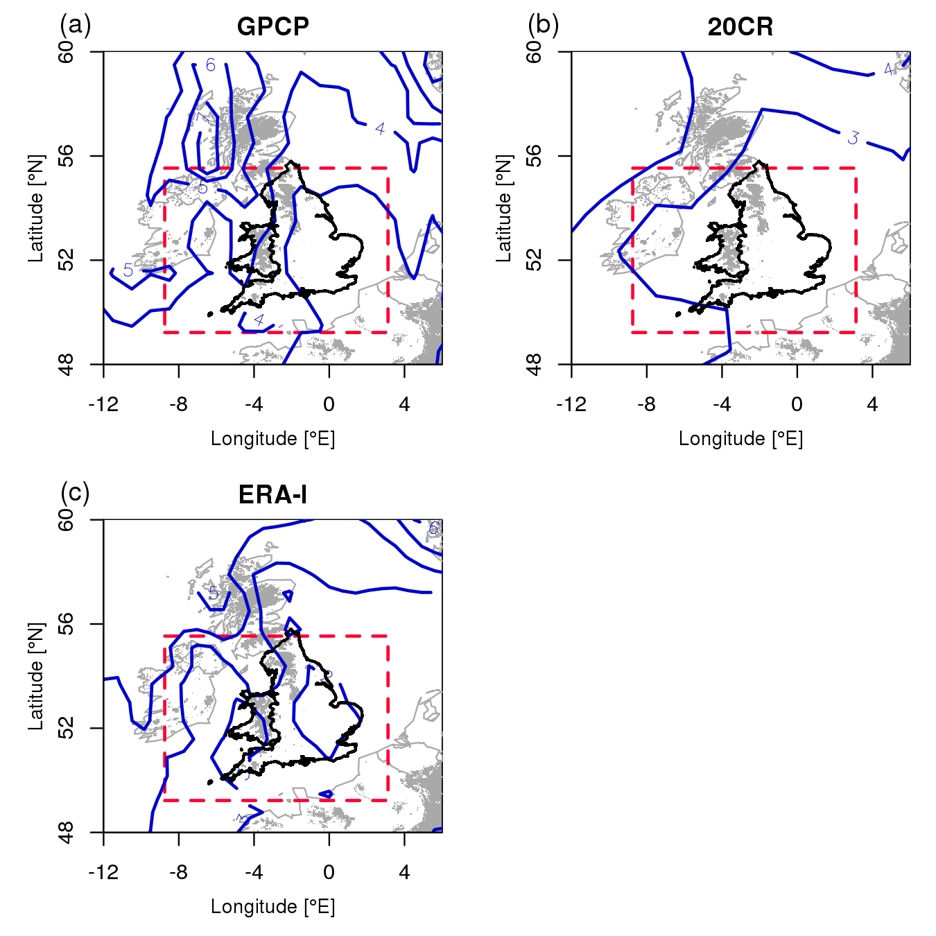
Spatial comparison
1996-2009 DJF mean daily precipitation accumulation contours (1mm intervals)
Notes:
Figure 1: 1996-2009 DJF mean daily precipitation accumulation contours for (a) GPCP, (b) 20CR, (c) ERA-I. Dashed box indicates spatial extent of data extracted from ERA-I and 20CR. England and Wales are shown with bold coastlines in all figures. Contours in 1mm intervals. Land with elevation over 200m is shaded grey.

Slide 18
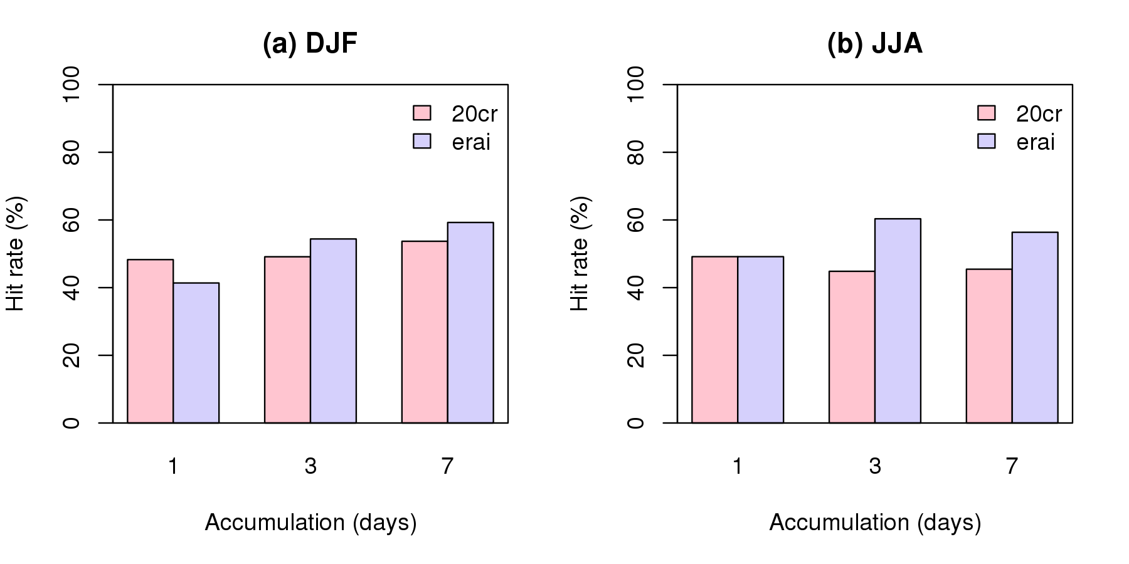
Hit rates
Hit rates against EWP for extreme (98th percentile) precipitation in ERA-I and 20CR (1979-2010)
Notes:
Figure 3: Hit rates for ERA-I and 20CR against EWP for extreme precipitation as defined as the 98th percentile of precipitation in each data set, for one-, three- and seven-day accumulations

Slide 19
Can reanalyses represent extreme precipitation?
Both ERA-I and 20CR represent large-scale features of climatological DJF precipitation though ERA-I generates more detail of localised features.
Hit rates for extreme precipitation events (98th percentile) are ~40-50% for daily precipitation.
Hit rate improves for longer accumulation timescales, implying timing errors exist, but do not exceed 60%.
Even at the 90th percentile of precipitation hit rates are <65% for daily accumulations (and <75% for 7-day accumulations) in both analyses and in summer and winter.
Conclusion: these reanalyses may be unsuitable for investigating long-term variability of extreme rainfall over England/Wales if timing of events is important.

Slide 20
When do cyclone clustering and stalling cause extreme precipitation?

Slide 21
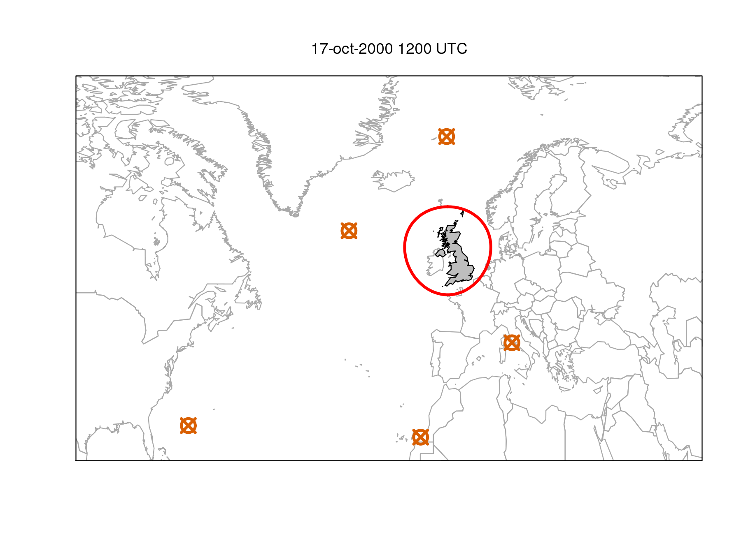
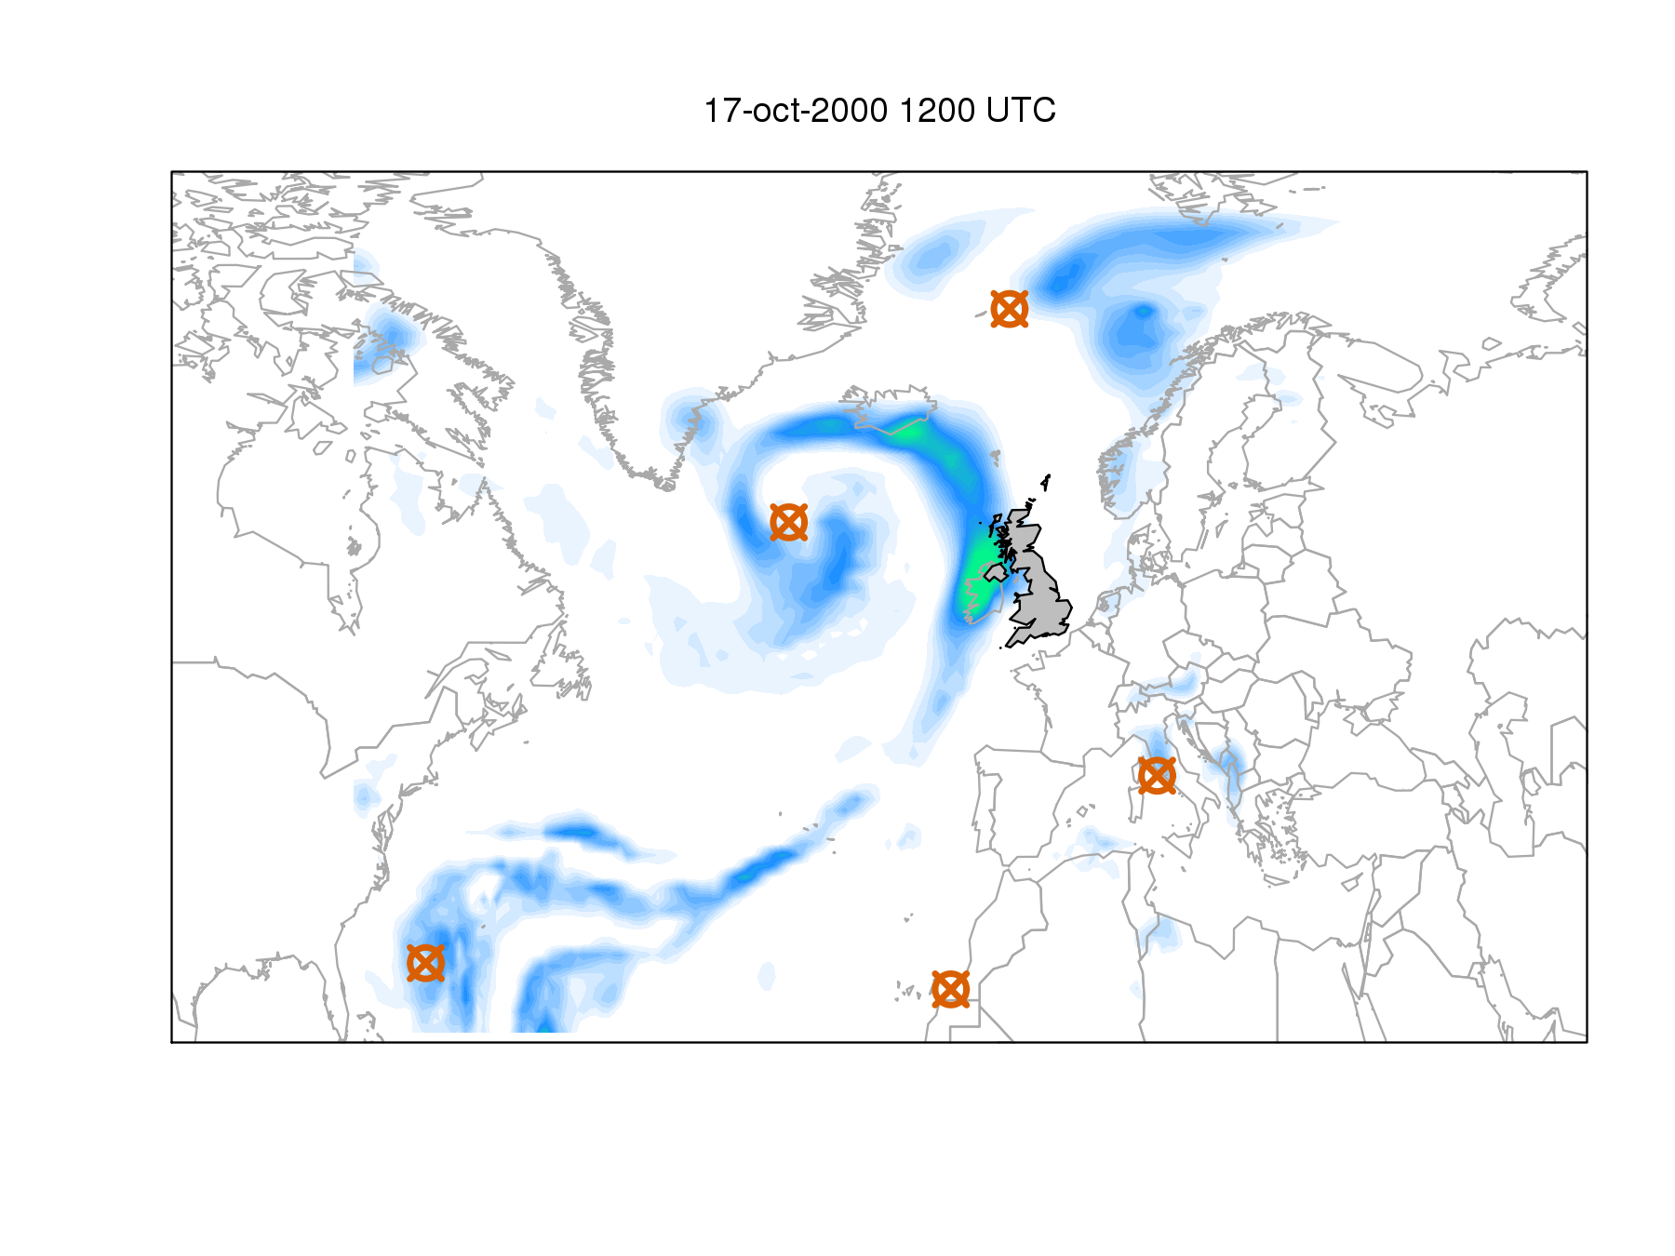
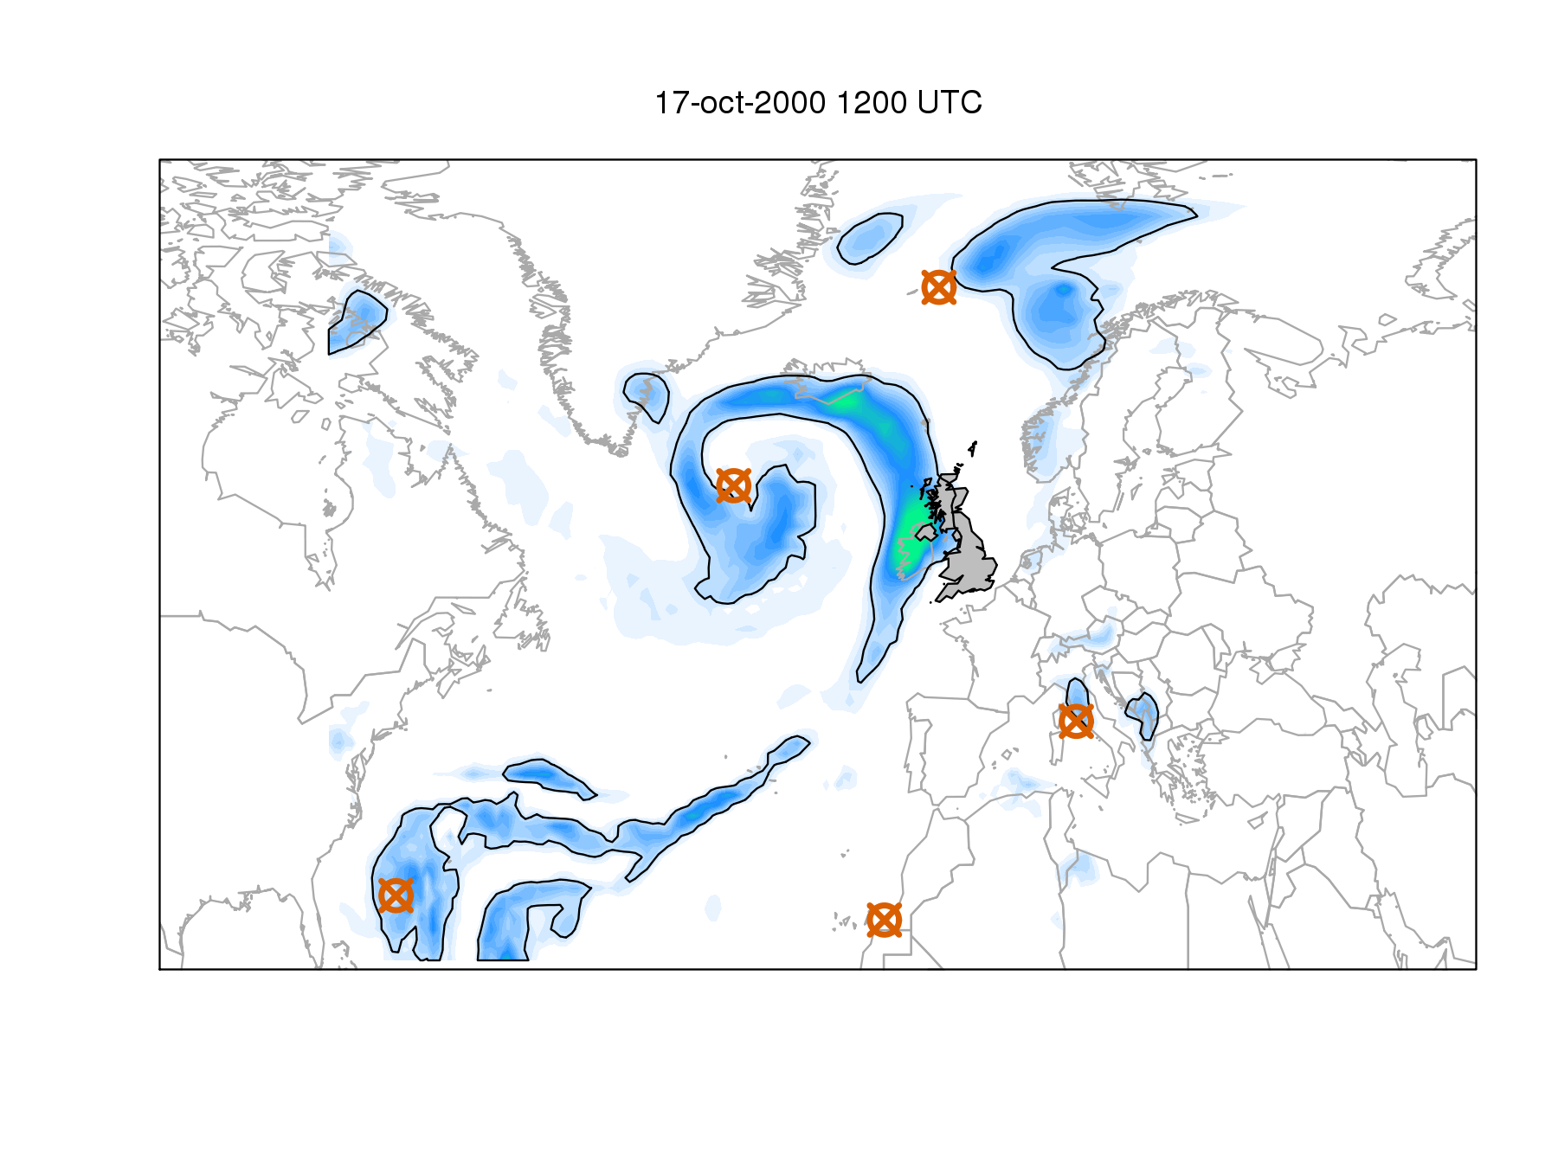
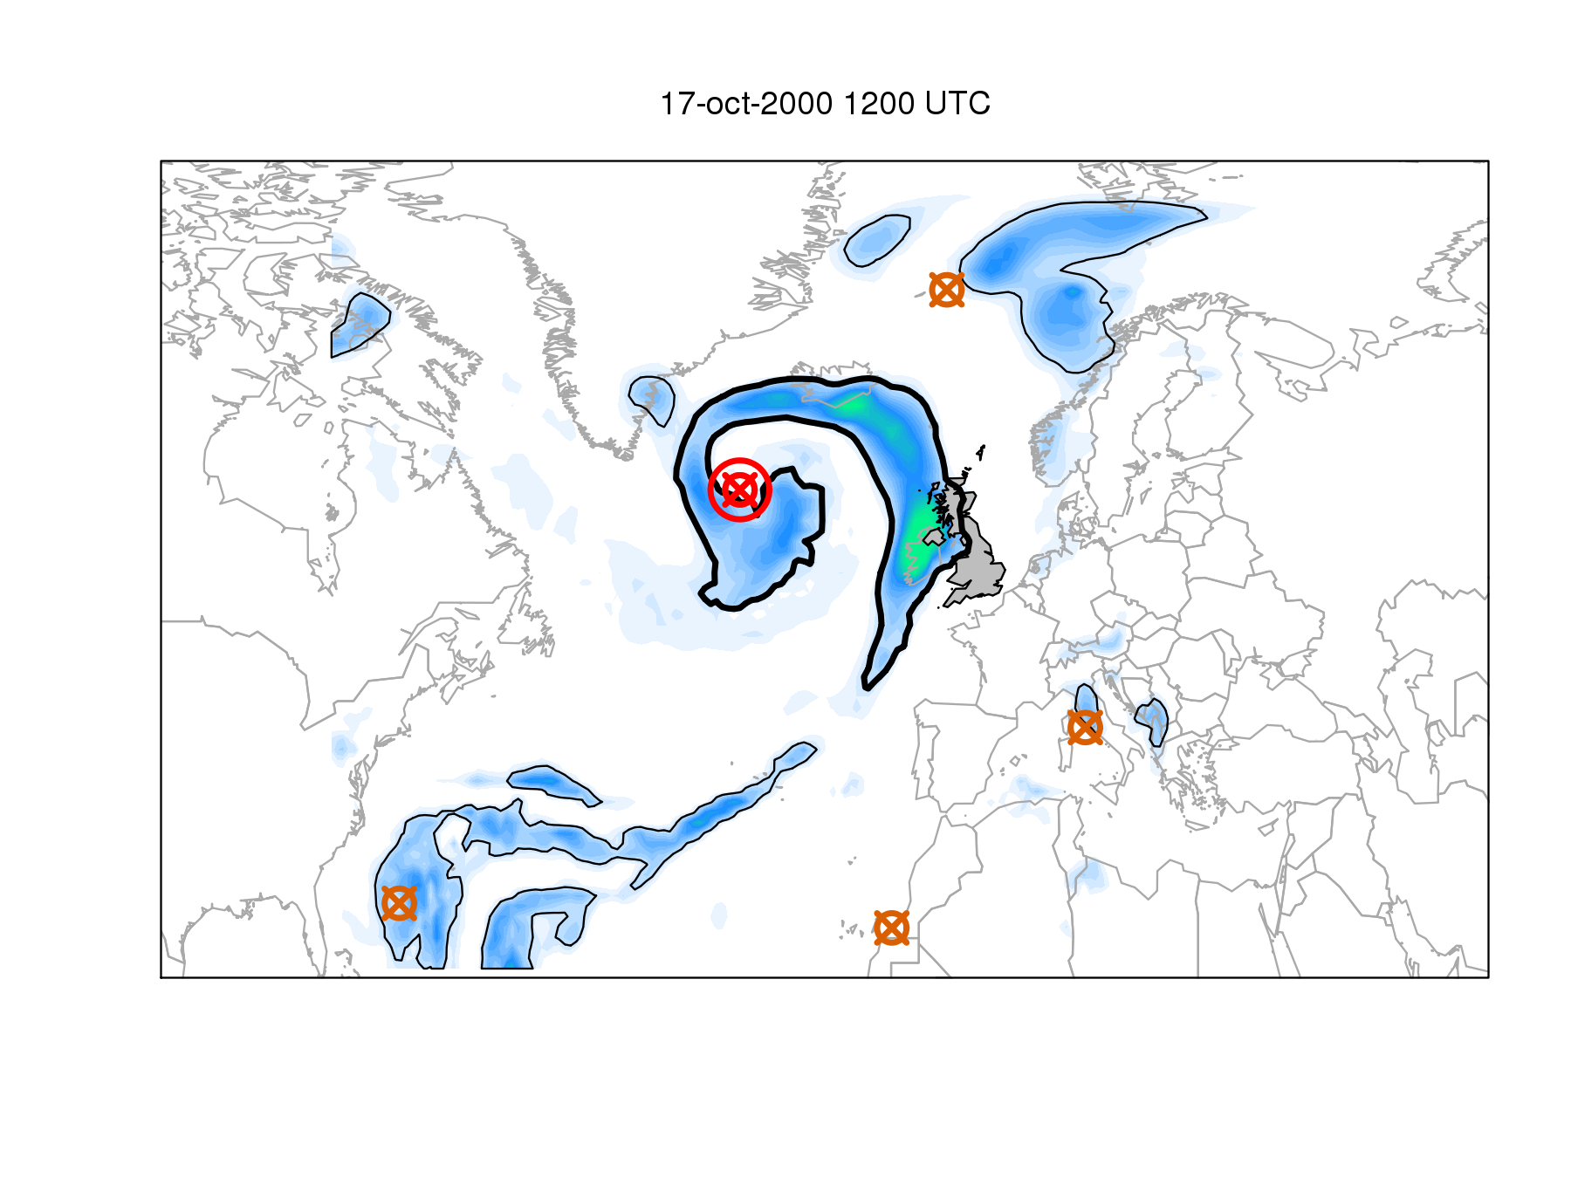
Method
1.5 mm/day precipitation threshold

Slide 22
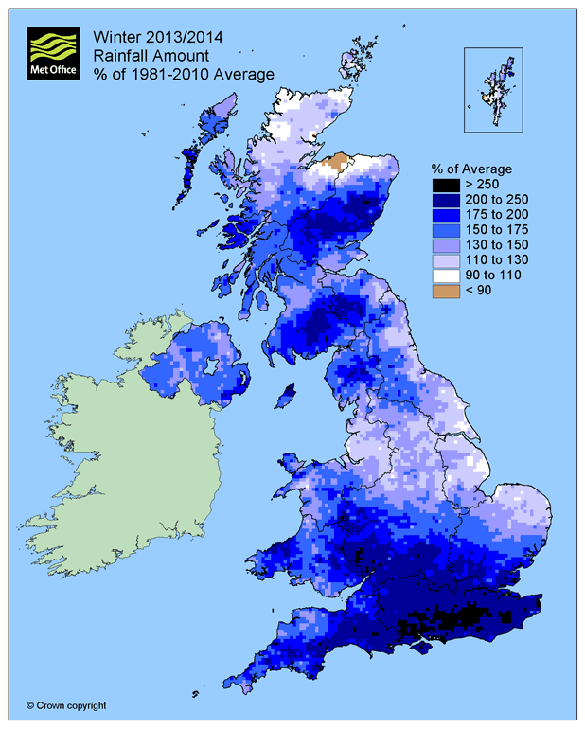
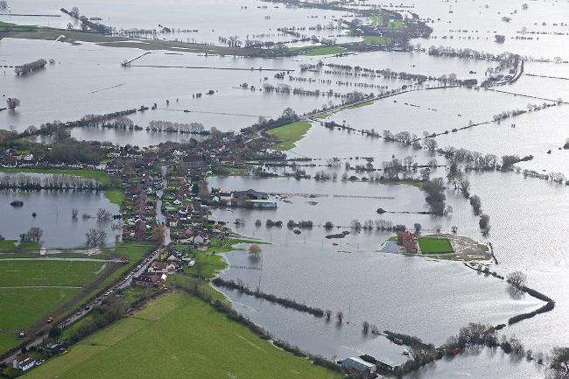
Clustering
Influence of large number of cyclone passages on a single accumulated precipitation event (e.g. DJF 2013-14)
Notes:
Images: DJF 2013-14 precip anomaly, UKMO
Somerset levels flooding

Slide 23
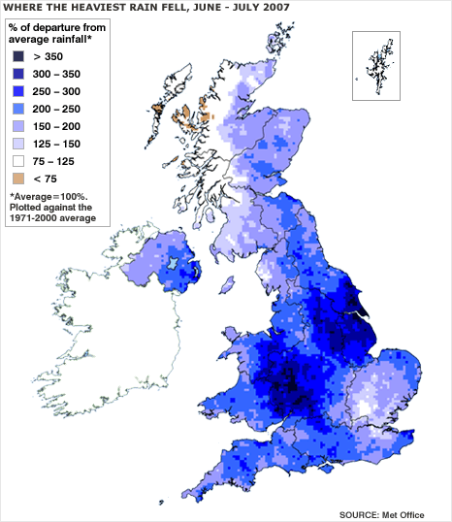
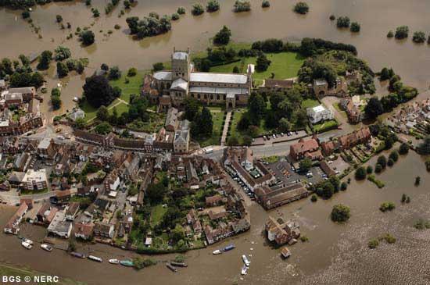
Stalling
Influence of slow-moving cyclones producing extreme precipitation over a region (e.g. July 2007)
Notes:
Images: July 2007 precip anomaly, UKMO (via BBC news)
Tewkesbury, July 2007

Slide 24
Definitions
“Wet”
  > 25th percentile of 1980-2011 rainfall value by season
“Extreme wet”
  > 98th percentile of 1980-2011 rainfall value by season
“Long residence time” or “Stalled”
  Cyclone associated with an event for >75th percentile of residence time values by season
“High track count” or “Clustered”
  Number of cyclones associated with event >75th percentile of track counts by season

Slide 25
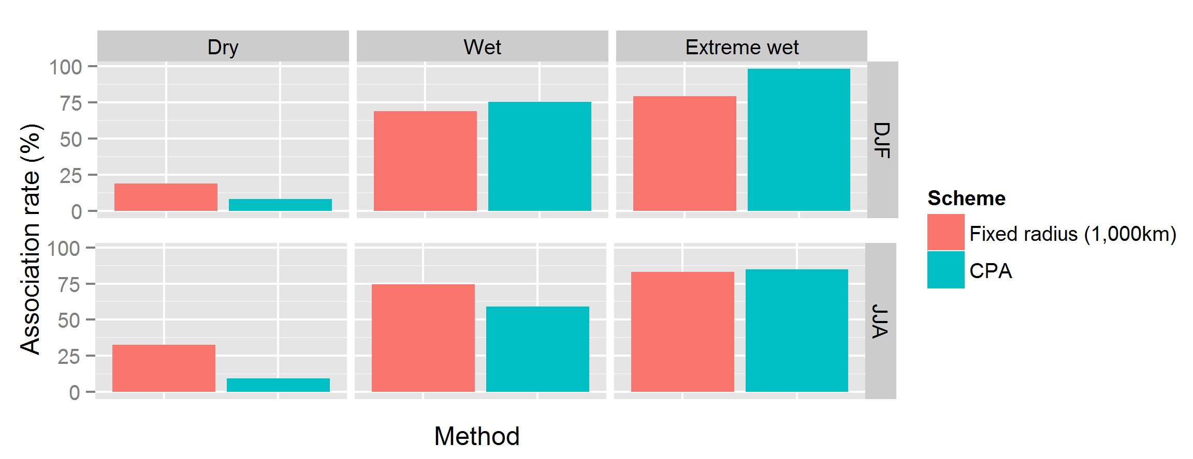
Comparison with fixed radius method
Notes:
Improved association rates for tracks with extreme events, fewer “false alarms” during dry events when the CPA method is used compared with the fixed radius method at 1,000km radius

Slide 26
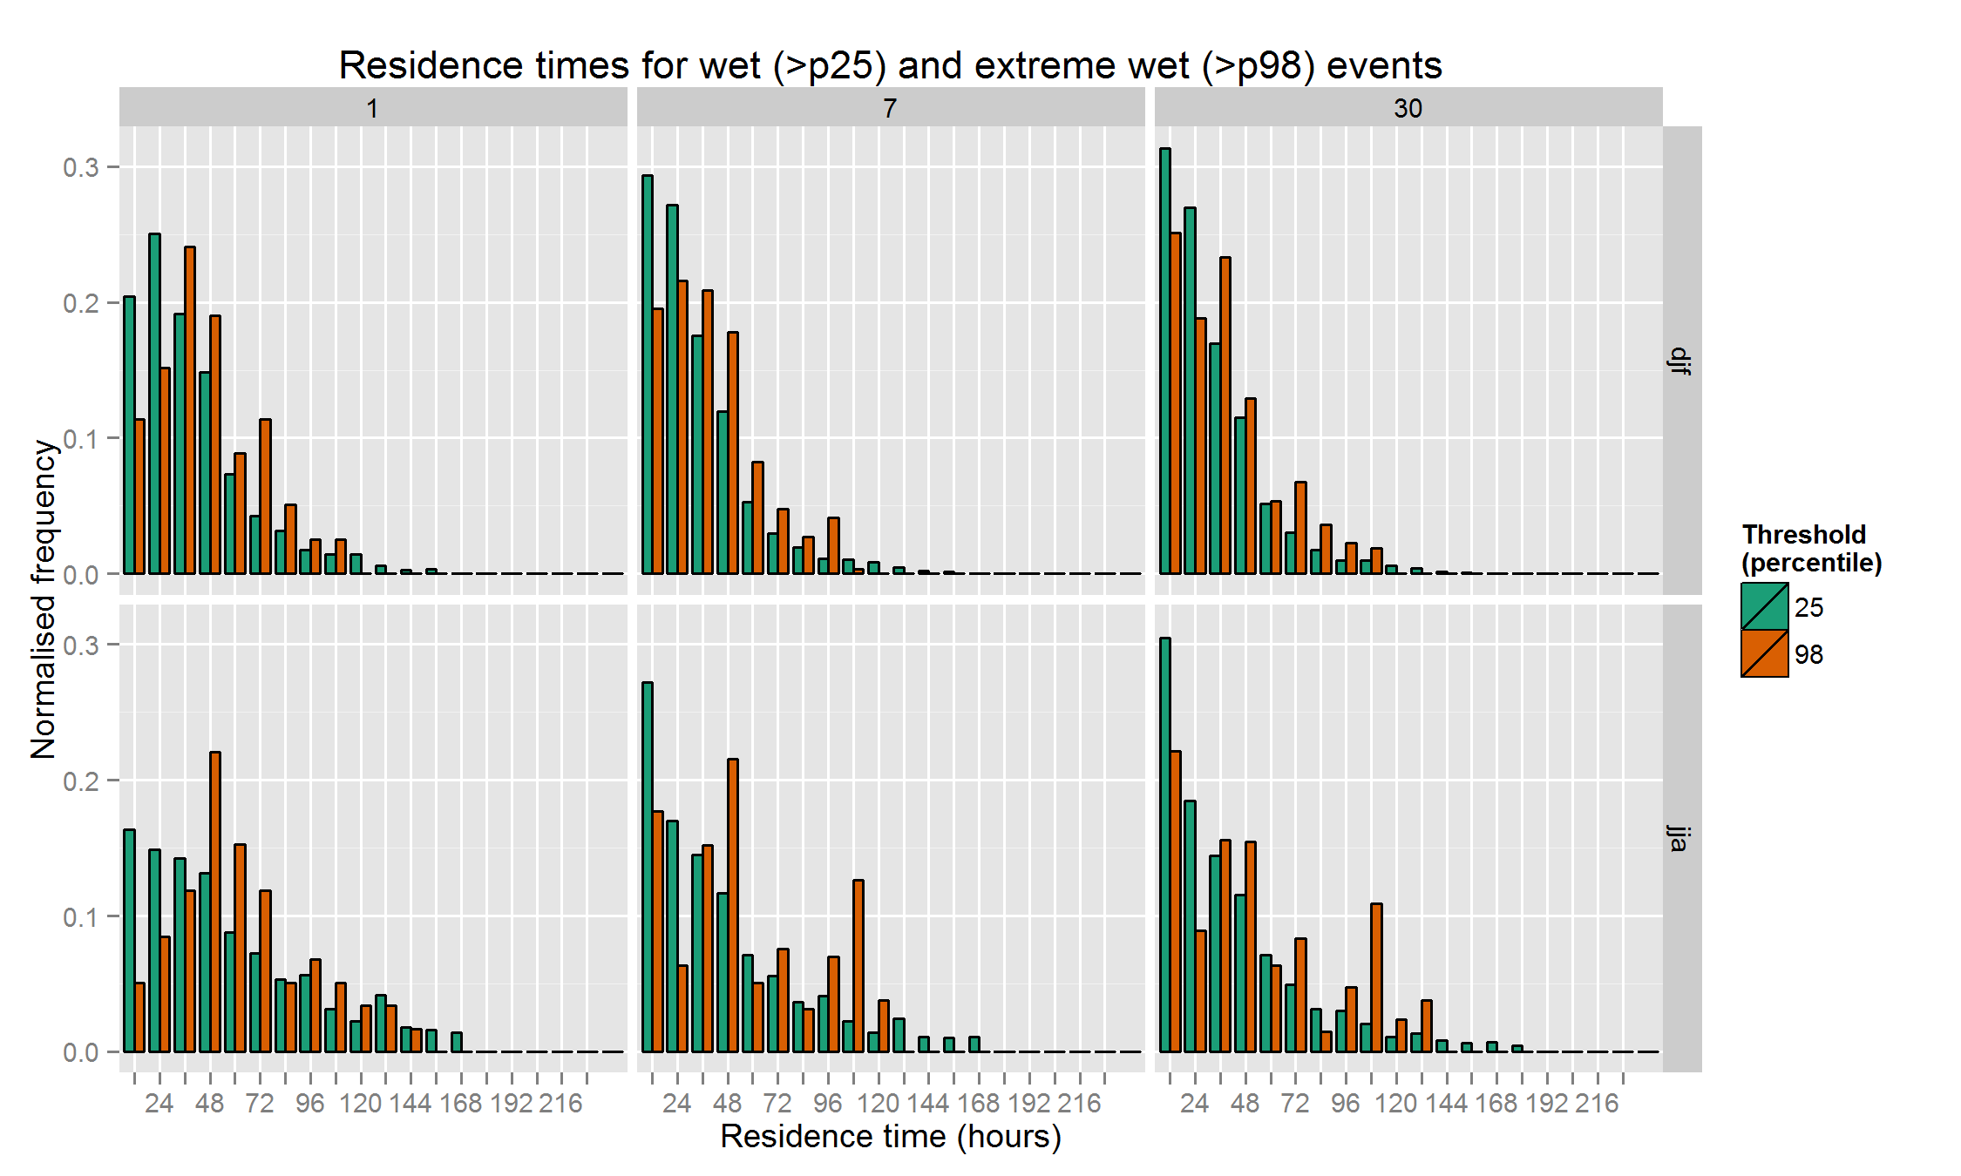
Residence times
Notes:
Residence times for p98 extreme (orange) and p25 wet (blue) events, binned to 12 hour intervals and normalised. Total for each set adds to 1. Increase in residence times for short accumulation events, particularly in JJA. Less difference for long accumulation events.

Slide 27
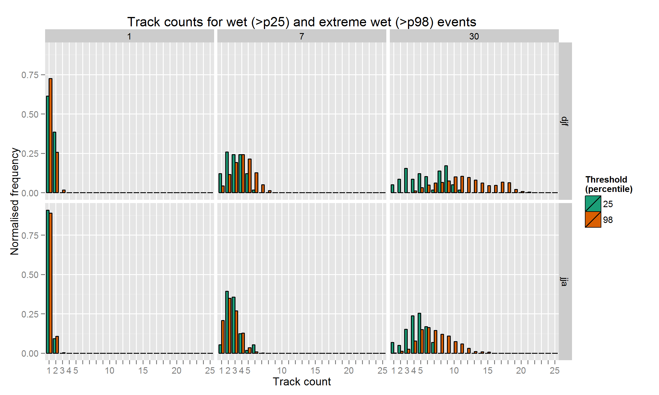
Track counts
Notes:
Track counts associated with p98 extreme (orange) and p25 wet (blue) events. Little difference in short accumulation events, but much higher track counts for 30 day accumulations.

Slide 28
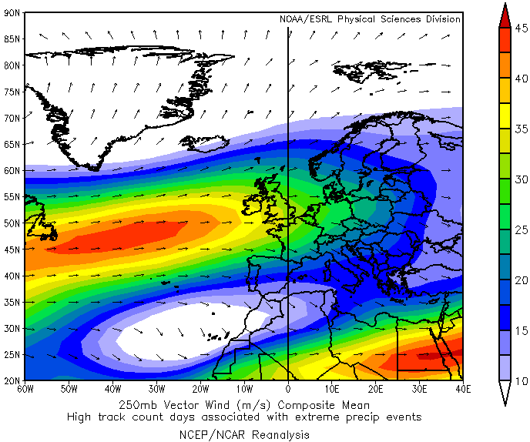
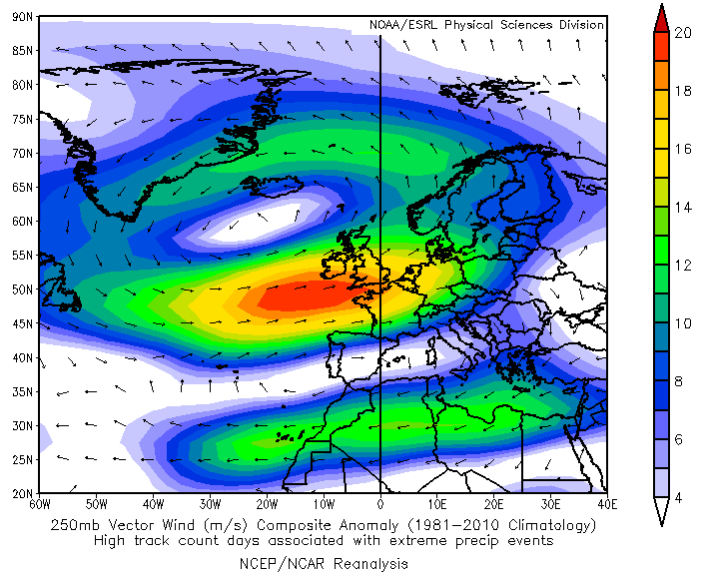
Upper-level wind anomaly
DJF high track count days associated with 30 day extreme precipitation events
Composite mean
Composite anomaly
Notes:
250hpa vector winds on days with high track counts associated with a 30d extreme precip accumulation.
Mean left, anomaly right
Showing enhanced upper level zonal flow across southern UK – extension / intensification of jet stream?

Slide 29
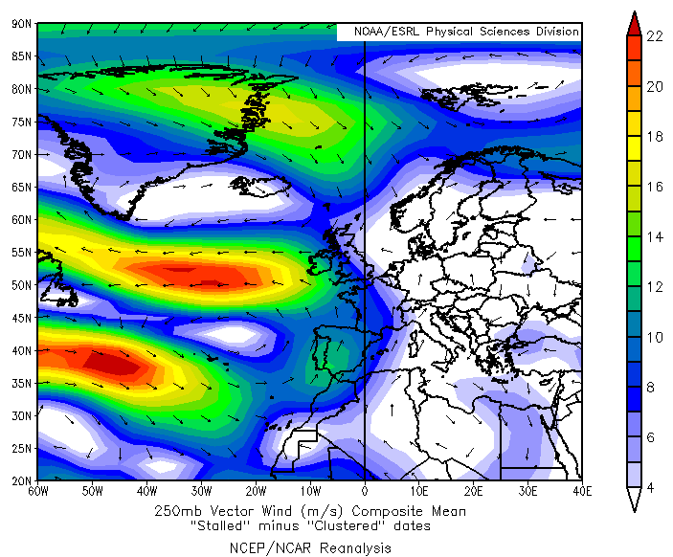
Upper-level wind anomaly
Extreme 7-day England/Wales precipitation events
High residence time dates – high track count dates
Notes:
250hpa vector winds: Extreme 7-day precip accumulation events, stalled days minus clustered days
Weakening of zonal flow towards UK, convergence of flows from north / south over UK

Slide 30
Conclusions
Reanalyses (ERA-I, 20CR) have poor hit rates against UK precipitation observations.
Using the spatial distribution of precipitation improves the association of cyclones with extreme precipitation events compared to a fixed radius method.
Short (1-day) accumulation period extremes associated with cyclones with long residence periods (“stalled”)
Long (30-day) accumulation period extremes associated with high cyclone counts (“clustered”)
Nature of “clustering” and “stalling” episodes strongly associated with upper-level wind speed
Future work:
  Further investigate the influence of synoptic-scale conditions on extreme precipitation events
  Apply method to climate model projection

Slide 31
References
Mailier, P., D.B. Stephenson, C.A.T. Ferro, K.I. Hodges, 2006: Serial clustering of extra-tropical cyclones. Mon. Wea. Rev., 134 2224-2240
Vitolo, R., D.B. Stephenson, I.M. Cook, K. Mitchell-Wallace, 2009: Serial clustering of intense European storms. Meteorol. Zeitschrift 18 411-424Pfahl, S., H. Wernli, 2012: Quantifying the relevance of cyclones for precipitation extremes. J. Climat. 25
Hawcroft, M.K., L.C. Shaffrey, K.I. Hodges, H.F. Dacre, 2012: How much Northern Hemisphere precipitation is associated with extra-tropical cyclones? Geophys. Res. Let. 39
Catto, J.L., S. Pfahl, 2013: The importance of fronts for extreme precipitation. J. Geophys. Res. Atmos. 118 10-791
Pinto, J.G., N. Bellenbaum, M.K. Karremann, P.M. Della-Marta, 2013: Serial clustering of extratropical cyclones over the North Atlantic and Europe under recent and future climate conditions. J. Geophys. Res. Atmos. 118 12-476
Rhodes, R.I., L.C. Shaffrey, S.L. Gray, 2014: Can reanalyses represent extreme precipitation accumulations over England and Wales? Quart. J. Roy. Meteorol. Soc.

