Slide 1
Weather systems
Sue Gray (Univ. of Reading)

Slide 2
1. Verification and interpretation of high resolution ensemble weather forecasts

Slide 3
Stationary convective bands
PRESTO project: Andrew Barrett, David Schultz, Jonathan Fairman
An elongated band of rain fixed above orography
Persistent for an hour or more
High rain accumulated amounts can lead to flooding

Slide 4
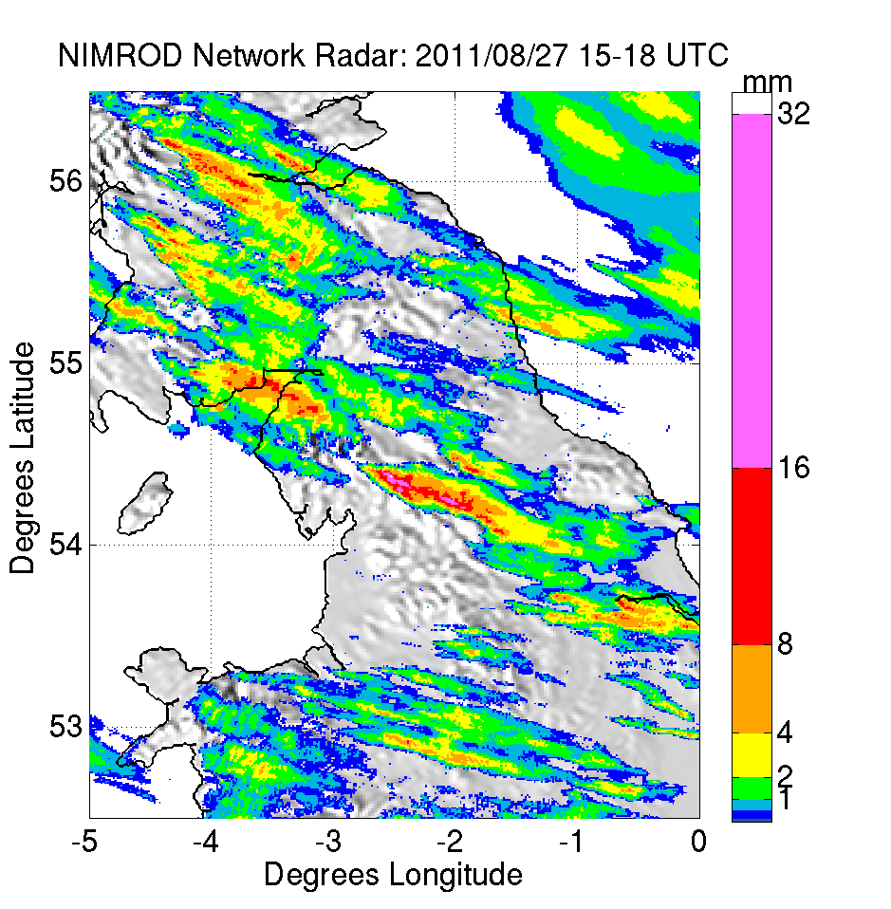
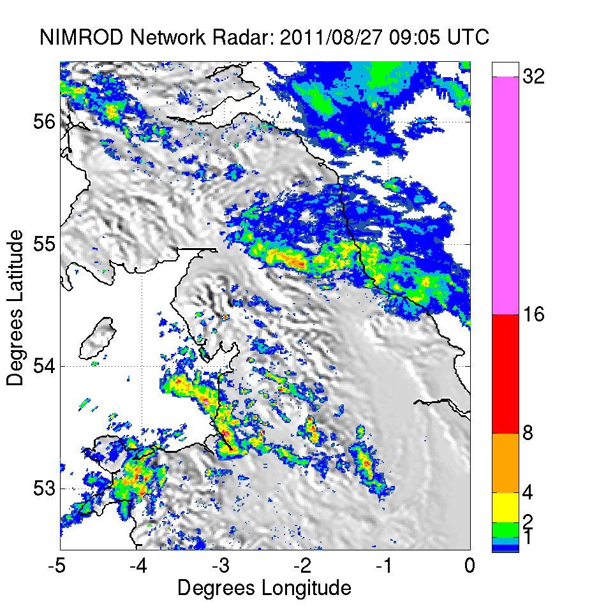
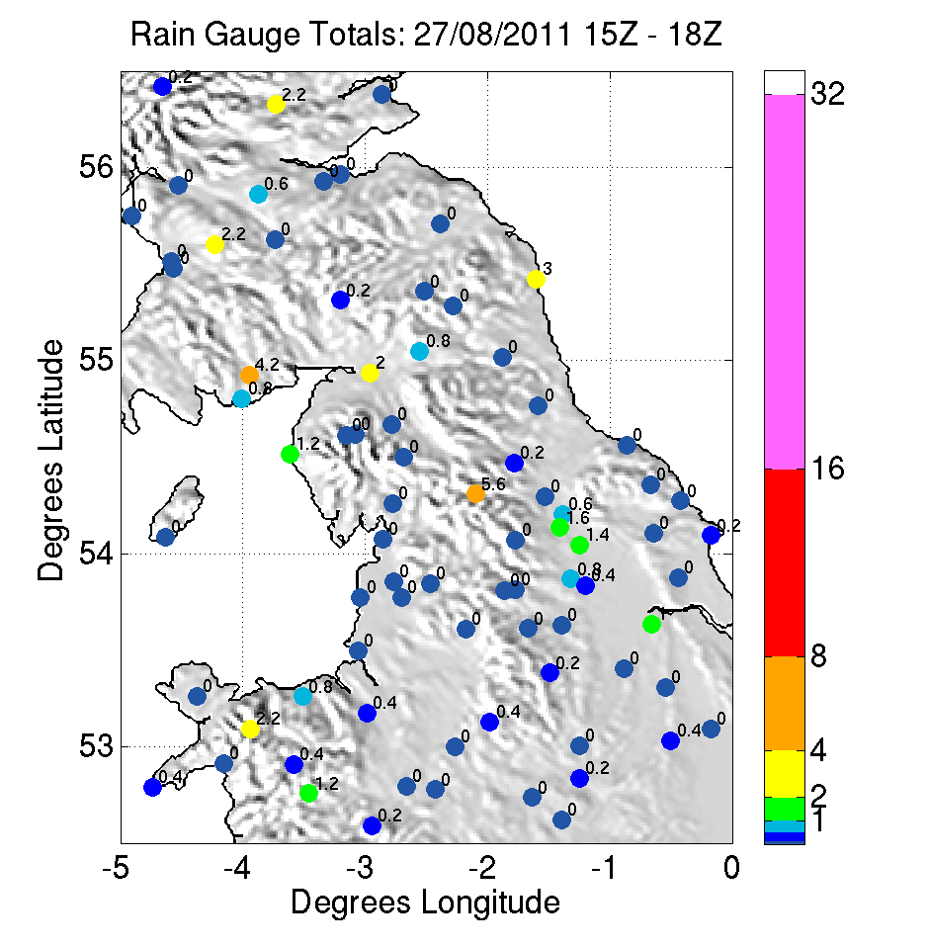
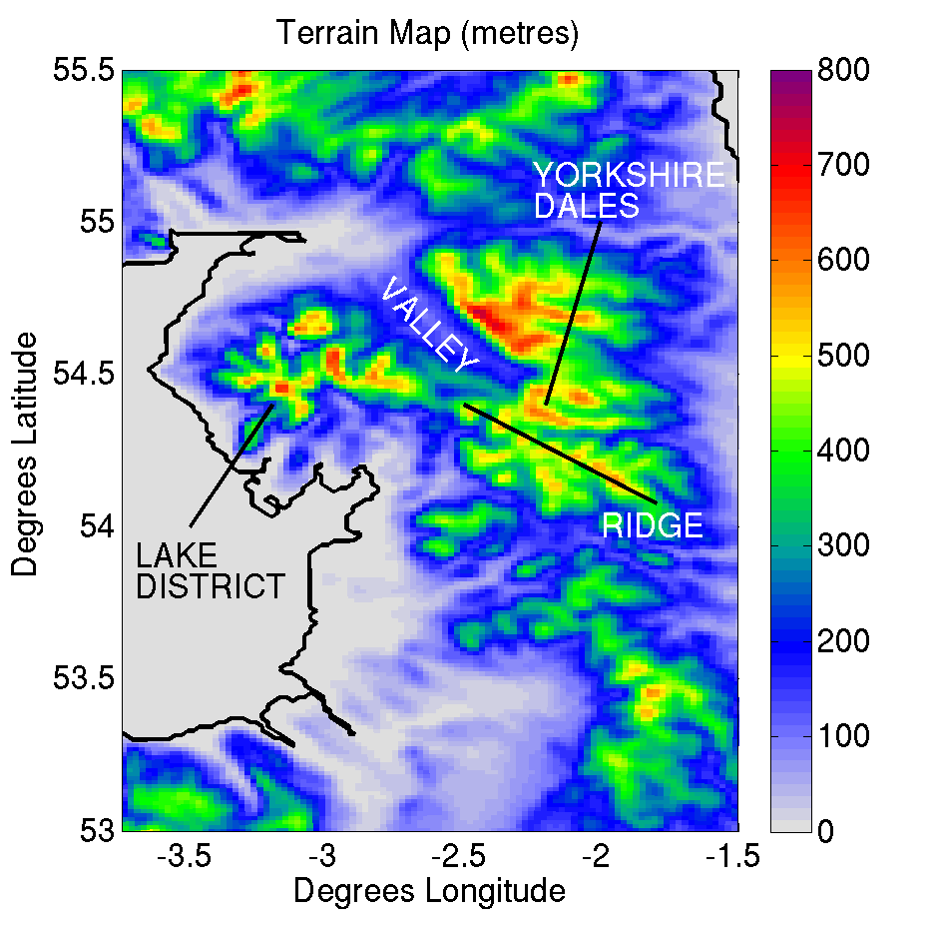
27 August 2011

Slide 5
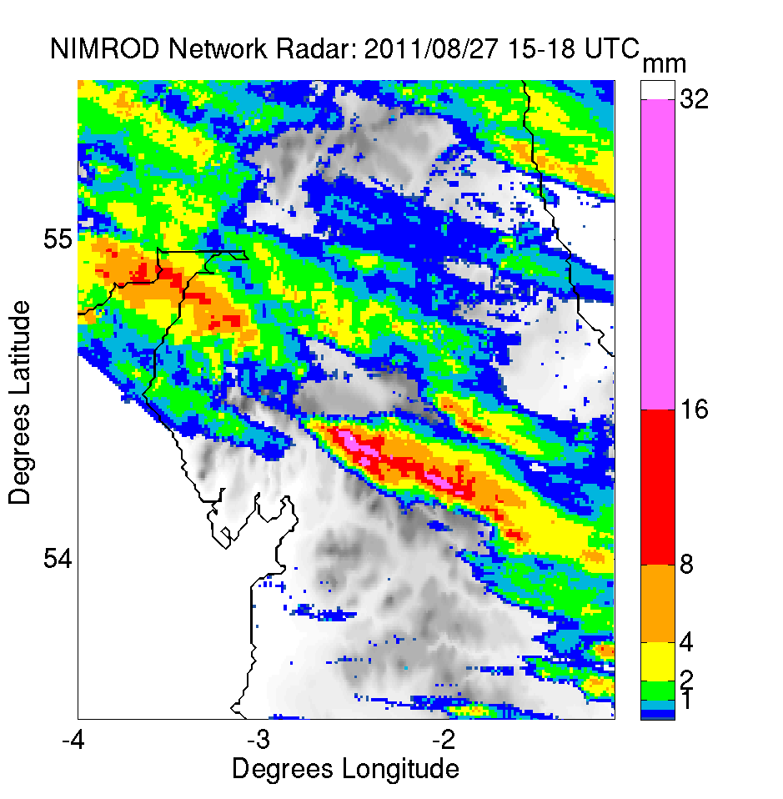
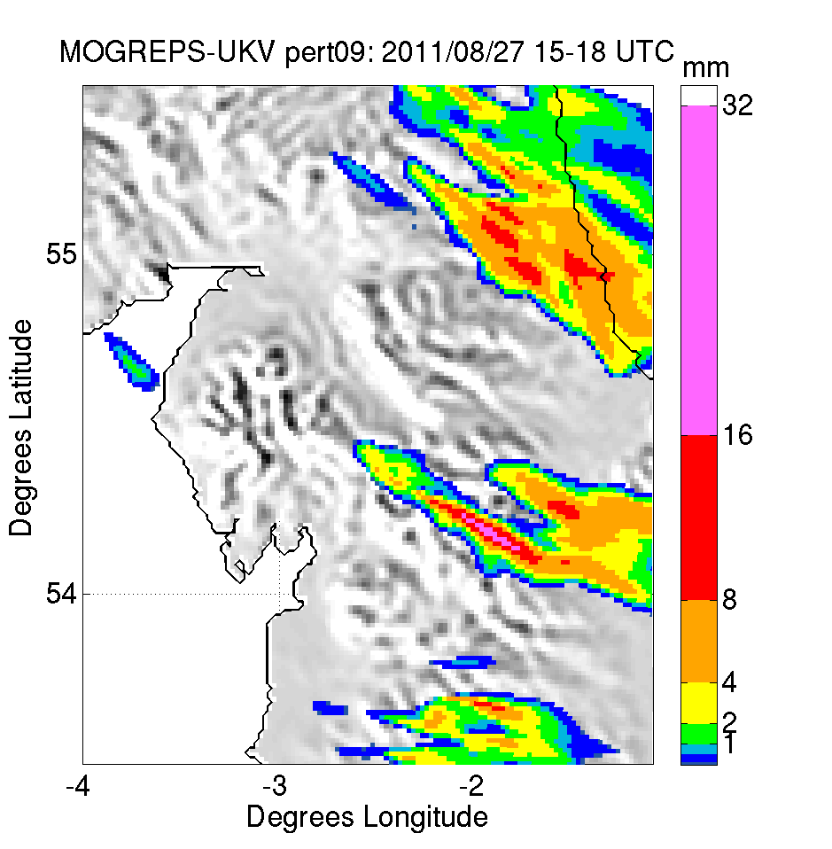
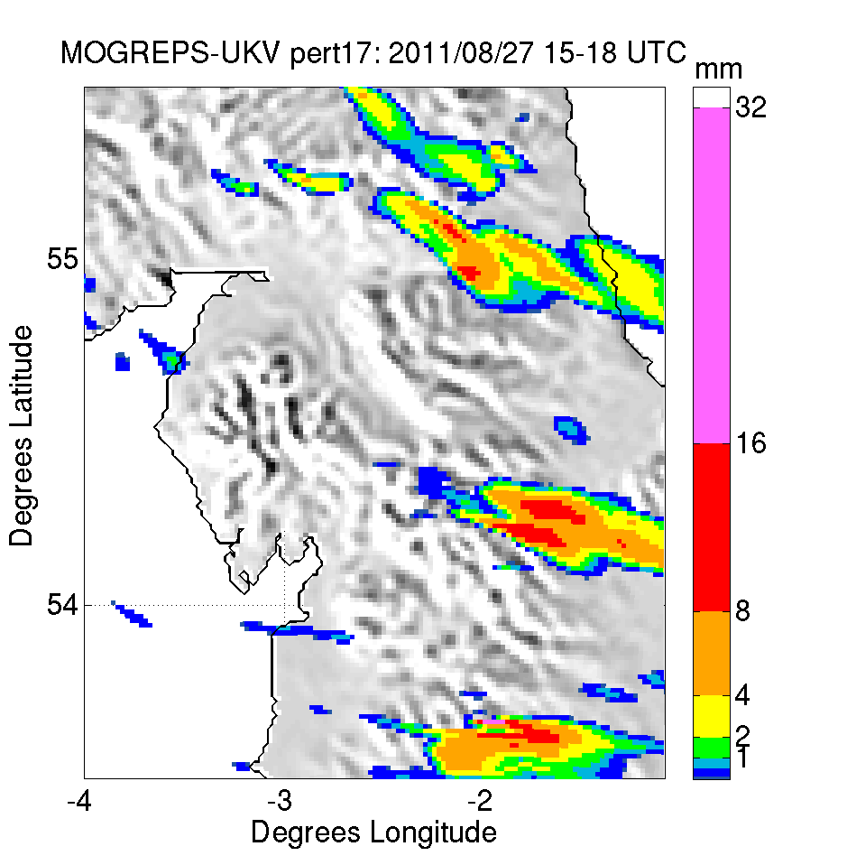
Best ensemble members
22 member ensemble forecast with 1.5 km gridspacing
Banded convection in observed location
Some degree of stationarity

Slide 6
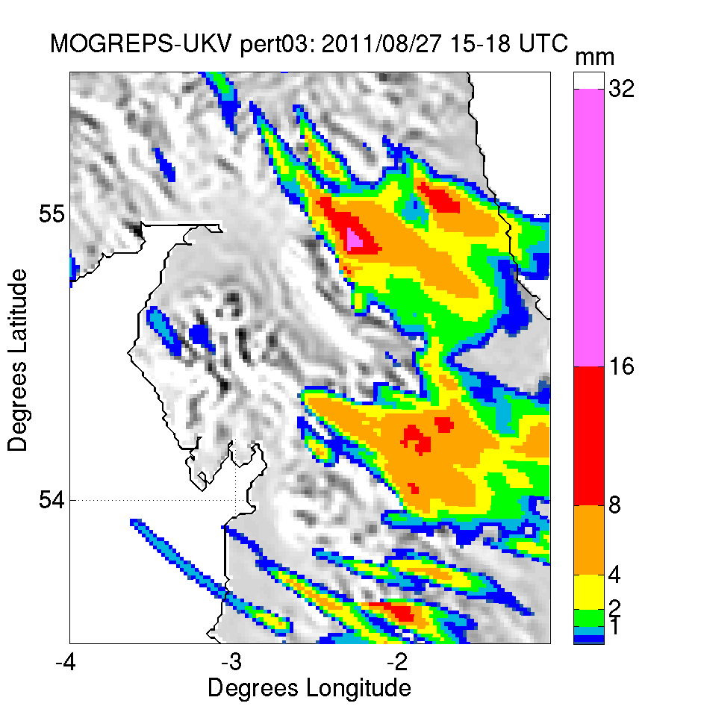
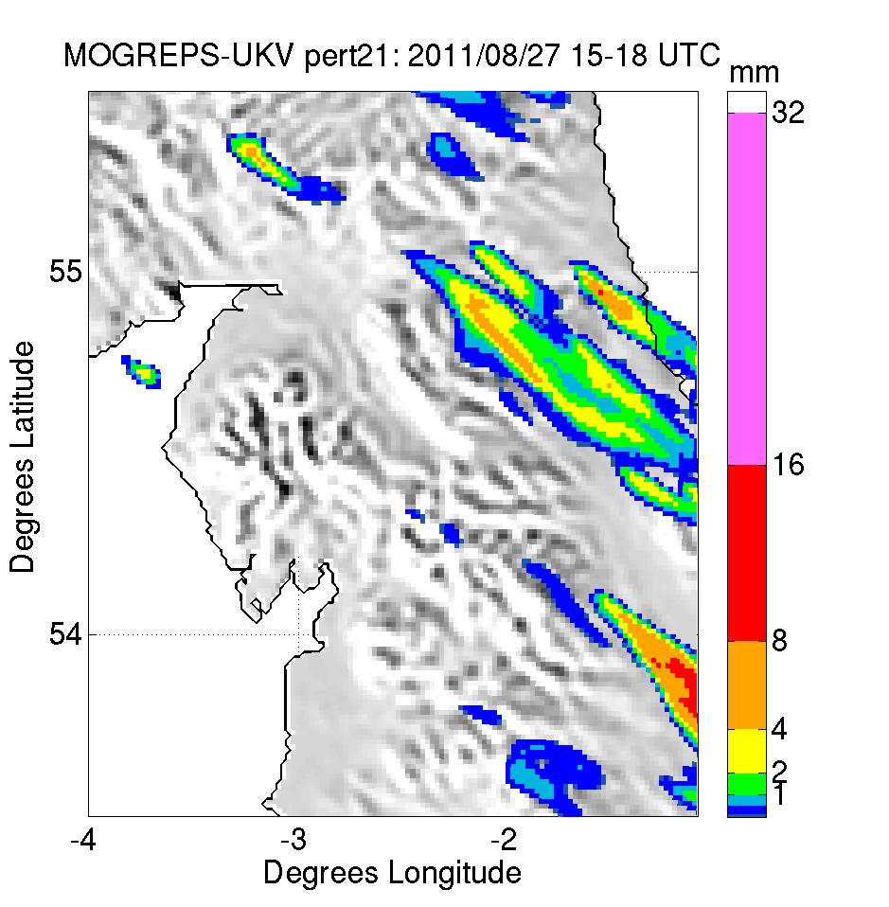
Worst ensemble members
Convective initiation in wrong location or not at all

Slide 7
Environmental control on rainfall
Favourable large-scale (synoptic) conditions:
Deeper low pressure centre
Low centre further east
Lower pressure in Irish Sea

Slide 8
2. Climatological distributions of strong wind events

Slide 9
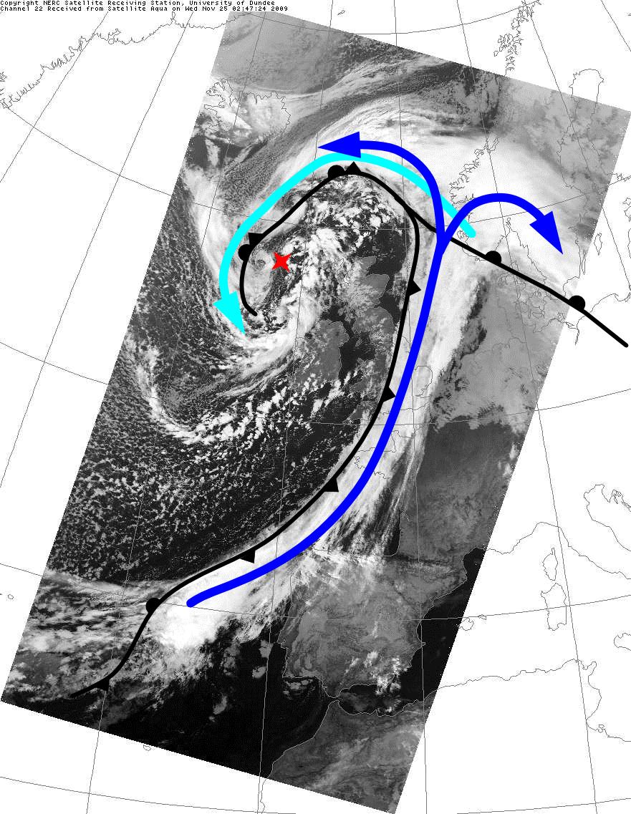
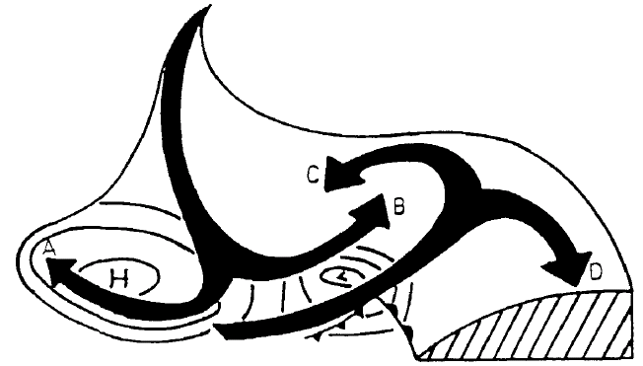
Cyclone structure
Dry intrusion
Cold conveyor belt
Warm conveyor belt
Cyclone’s low pressure centre
Warm conveyor belt

Slide 10
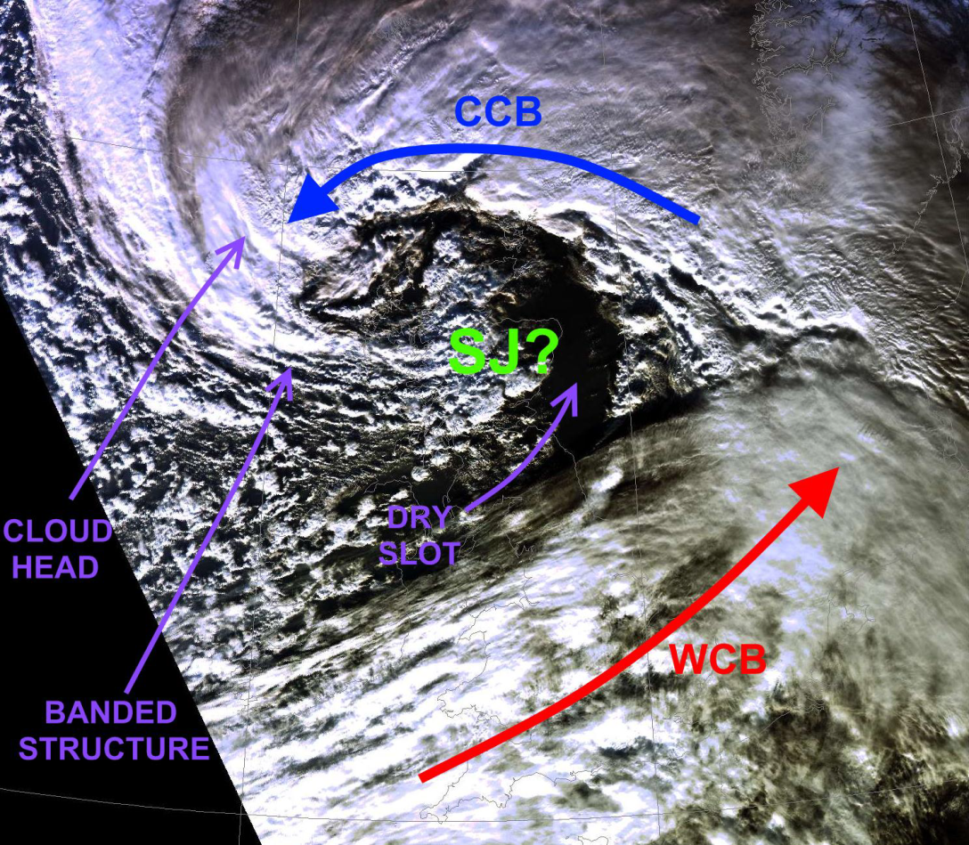
Sting jet case example
The strongest winds in extratropical cyclones are normally associated with low-level jets along the warm and cold fronts.
Some cyclones form an additional region of very strong surface winds and gusts, known as a sting jet.
Cyclone Friedhelm (8 December 2011) brought sustained winds of up to 80 mph across populous parts of Scotland.
Visible satellite image 1226 UTC
(courtesy Dundee Satellite Receiving station)

Slide 11
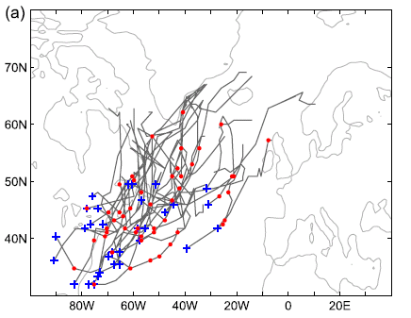
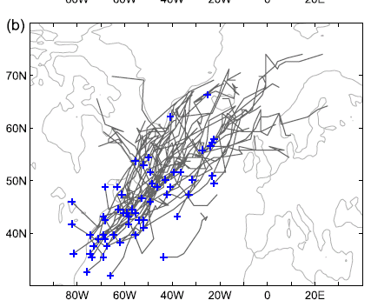
Climatology of sting jet storms
Development of diagnostics to identify likely sting jet storms in climate resolution model simulations
32 storms with sting jet precursor.
68 storms without sting jet precursor.

Slide 12
Sting jets in future climates
Sting jet windstorms in current and future climates
(AXA Research Fund): Neil Hart, Aga Mega, Peter Clark.
Distributions of sting jet strength in current and future climates
Predictability and variability of sting jets
Relationships between sting jet strength and driving mechanisms
Climatologies of sting jet storms in current and future climates

