Slide 1
Atmospheric Dynamics
Suzanne Gray (University of Reading)
With thanks to Alan Gadian and Geraint Vaughan.
Basic dynamical concepts for understanding the (extratropical) atmosphere

Slide 2
Outline
Equations of motion
Balance: geostrophic
Balance: hydrostatic
Vorticity
Balance: thermal wind balance
Potential vorticity
Planetary Rossby waves
Baroclinic instability

Slide 3
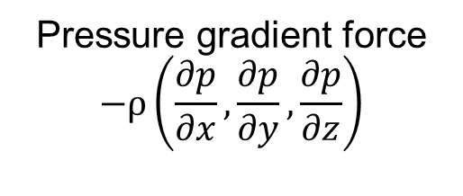
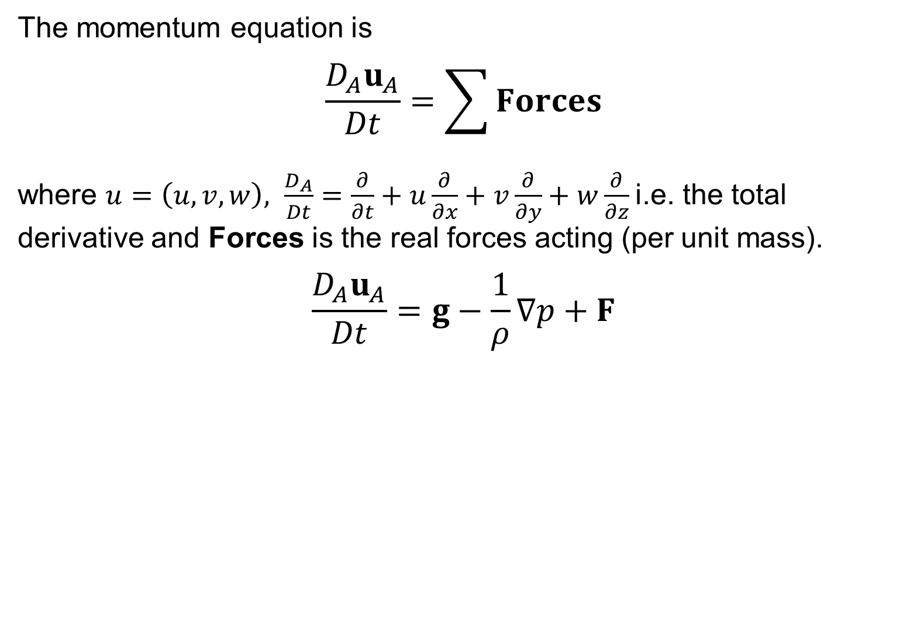
Equations of motion: rotating frame
The momentum equation is
$$\frac{D_{A}u_{A}}{Dt}=\sum{Forces}$$
where $u=\left(u,v,w\right), \frac{D_{A}}{Dt}=\frac{∂}{∂t}+u\frac{∂}{∂x}+v\frac{∂}{∂y}+w\frac{∂}{∂z}$i.e. the total derivative and Forces is the real forces acting (per unit mass).
$$\frac{D_{A}u_{A}}{Dt}=g−\frac{1}{ρ}∇p+F$$
Acceleration due to gravity
Friction
Pressure gradient force
$$−ρ\left(\frac{∂p}{∂x},\frac{∂p}{∂y},\frac{∂p}{∂z}\right)$$

Slide 4
Equations of motion: rotating frame
In a rotating frame of reference this becomes
which incorporating the centrifugal force into the definition of apparent gravity and neglecting friction (inviscid flow) becomes the Euler momentum equation:
Friction

Slide 5
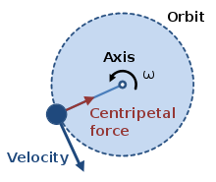
Equations of motion: rotating frame
In a rotating frame of reference this becomes
which incorporating the centrifugal force into the definition of apparent gravity and neglecting friction (inviscid flow) becomes the Euler momentum equation:
Friction
i.e. The acceleration following the relative motion in a rotating frame equals the sum of the Coriolis force, the pressure gradient force, effective gravity (and friction).
Notes:
A body experiencing uniform circular motion requires a centripetal force, towards the axis as shown, to maintain its circular path. (from Wikipedia)

Slide 6

Equations of motion: Primitive Equations in Cartesian coordinates
$$\frac{Du}{Dt}−fv=−\frac{1}{ρ}\frac{∂p}{∂x}+F_{x}$$
$$\frac{Dv}{Dt}+fu=−\frac{1}{ρ}\frac{∂p}{∂y}+F_{y}$$
$$\frac{Dw}{Dt}=g−\frac{1}{ρ}\frac{∂p}{∂z}+F_{z}$$
$$\frac{Dρ}{Dt}+ρ∇∙u=0$$
$$\frac{Dθ}{Dt}=0$$
Momentum equations
Mass conservation equation
Thermodynamic equation (adiabatic flow)
Friction components

Slide 7
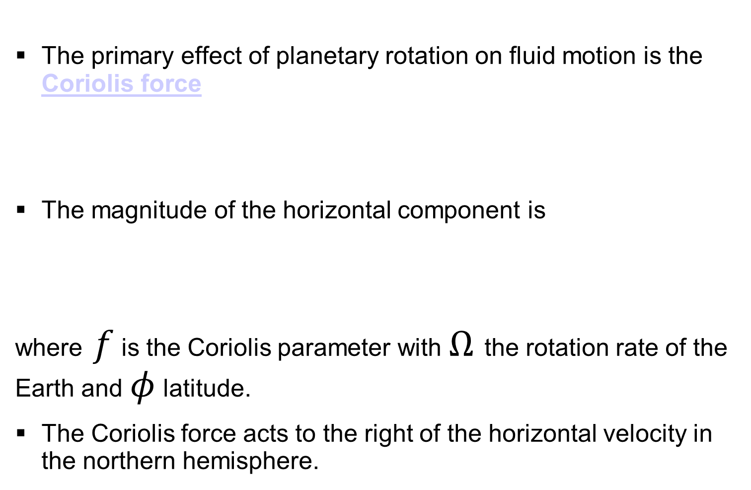
Equations of motion: Coriolis Force
The primary effect of planetary rotation on fluid motion is the Coriolis force
The magnitude of the horizontal component is
where $f$ is the Coriolis parameter with $Ω$ the rotation rate of the Earth and $φ$ latitude.
The Coriolis force acts to the right of the horizontal velocity in the northern hemisphere.

Slide 8
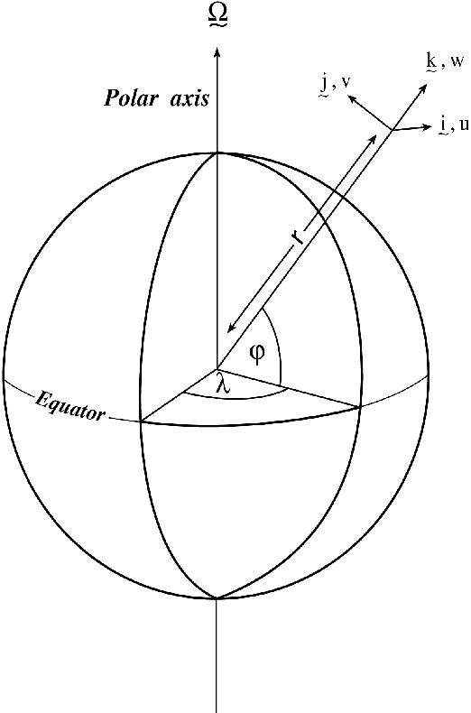
Equations of motion: Euler equations in spherical polar coordinates

Slide 9
Equations of motion: Primitive equations
Widely used as the basis of numerical weather prediction, ocean and climate models.
Centrifugal effects incorporated in gravity.
Shallow atmosphere approximation made and small terms neglected.
Equations conserve zonal angular momentum and kinetic energy.

Slide 10

Balance: geostrophic
Geostrophic balance: Coriolis force approximately balances pressure gradient force if the Rossby number (U/fL) is small (appropriate for ‘weather system’/synoptic scales)
Geostrophic winds:
.
In natural coordinates with n normal to the horizontal velocity
i.e. winds tend to follow isobars (constant pressure contours)
$$fv_{g}=\frac{1}{ρ}\frac{∂p}{∂x}$$
$$fu_{g}=−\frac{1}{ρ}\frac{∂p}{∂y}$$

Slide 11
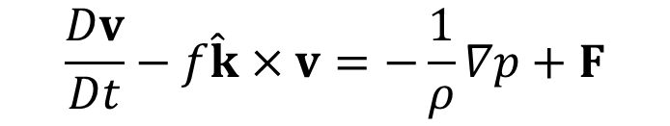
Balance: geostrophic
Balance
Balance with friction
Pressure
Pressure
Low
Low
U
U
Pressure gradient force
Pressure gradient force
Coriolis
F
Coriolis
Pressure gradient force is directed towards low pressure
Coriolis force is directed to the right of the wind in the Northern Hemisphere.
Surface wind rotated cyclonically from geostrophic in the presence of friction
Recall: Acceleration =
pressure gradient force
+ Coriolis force + Friction
$$\frac{Dv}{Dt}−f\hat{k}×v=−\frac{1}{ρ}∇p+F$$

Slide 12
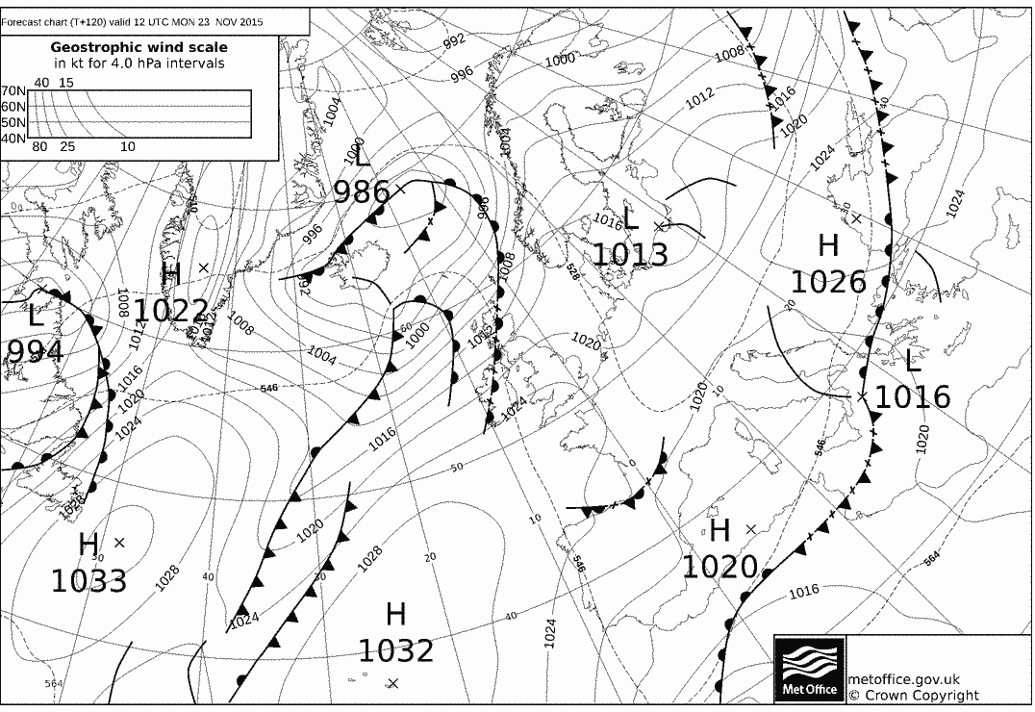
Example: surface chart with isobars (lines of constant pressure)
Met Office forecast for 12 UTC today

Slide 13
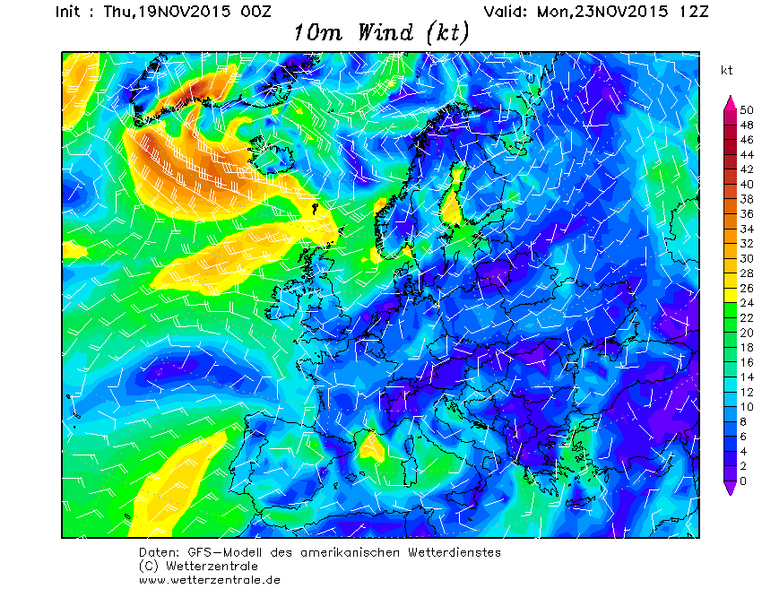
Example: surface wind chart
12 UTC forecast for today

Slide 14
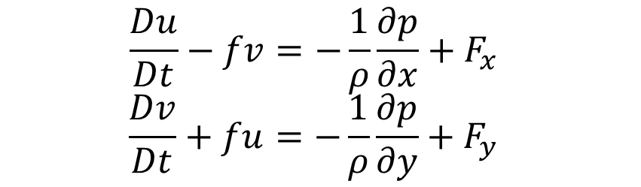
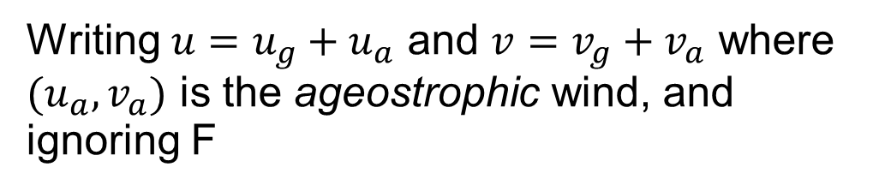
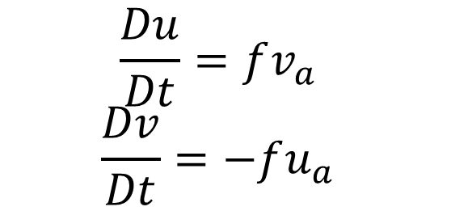
Balance: geostrophic. Why is geostrophy important?
The large-scale flow of the atmosphere is close to geostrophic balance
Geostrophy takes the place of a ‘state of rest’ in the fluid
Atmospheric dynamics is formulated as departures from geostrophy.
$$\frac{Du}{Dt}−fv=−\frac{1}{ρ}\frac{∂p}{∂x}+F_{x}$$
$$\frac{Dv}{Dt}+fu=−\frac{1}{ρ}\frac{∂p}{∂y}+F_{y}$$
Writing $u=u_{g}+u_{a}$ and $v=v_{g}+v_{a}$ where $(u_{a},v_{a})$ is the ageostrophic wind, and ignoring F
$$\frac{Du}{Dt}=fv_{a}$$
$$\frac{Dv}{Dt}=−fu_{a}$$
Acceleration is directly related to departure from geostrophy

Slide 15
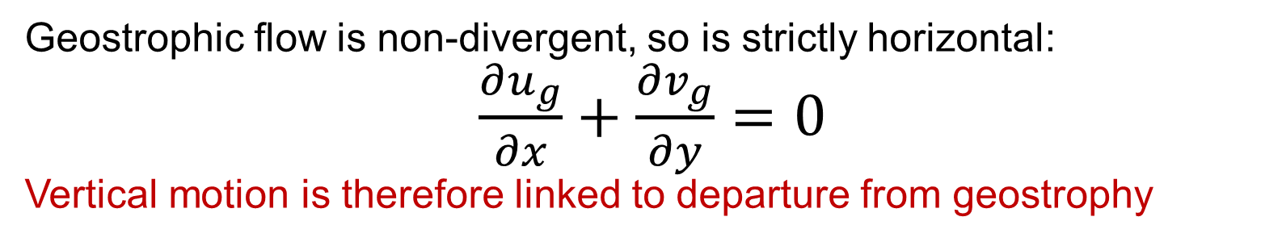
Balance: geostrophic. Divergence
When using pressure coordinates, air acts as if incompressible!
Mass = ρΔxΔyΔz
= -(ΔxΔyΔp)/g
=-(volume in p co-ords)/g
Δz
Δy
Δx
So large-scale vertical motion requires large-scale convergence or divergence
Geostrophic flow is non-divergent, so is strictly horizontal:
$\frac{∂u_{g}}{∂x}+\frac{∂v_{g}}{∂y}=0$
Vertical motion is therefore linked to departure from geostrophy

Slide 16
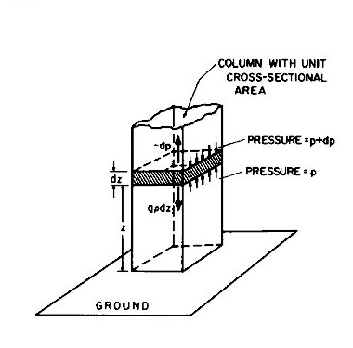
Balance: hydrostatic
To a good approximation the weight of air above an air parcel associated with the gravitational force is balanced by the vertical pressure gradient force:
This is known as hydrostatic
balance and is a good approximation if
i.e. for wide shallow systems.
Holton (2004)
Notes:
dz
p
p+dp
F_{p}
F_{g}
(11)
z
x

Slide 17
Balance: hydrostatic
This equation is followed closely in the atmosphere and pressure is often preferred as a measure of height.
Height, km approx. pressure, mb
0 1000
1 900
3 700
5 500
9 300
16 100
Pressure decreases almost exponentially with height

Slide 18
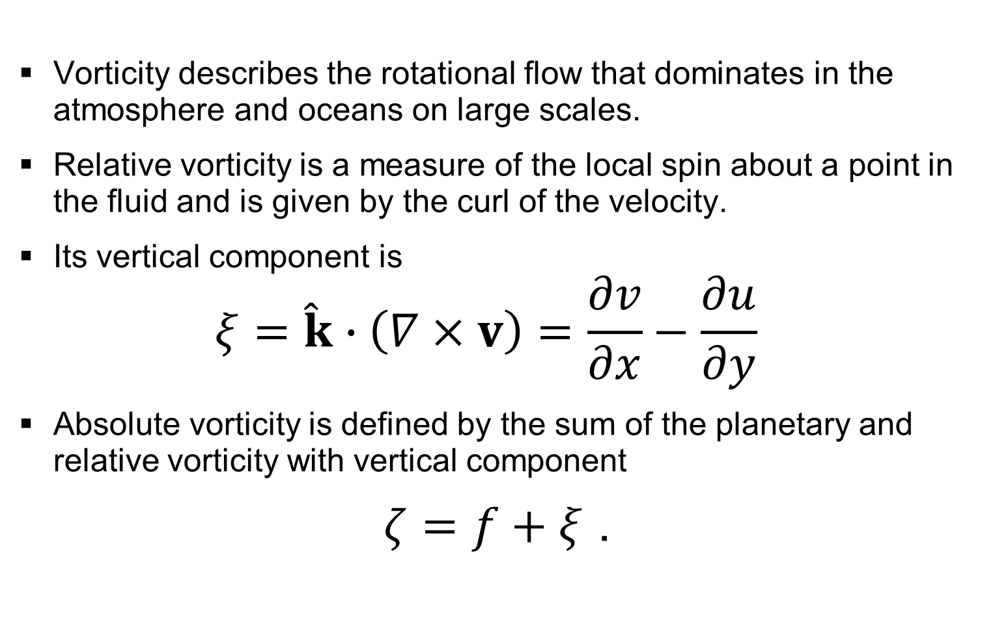
Vorticity
Vorticity describes the rotational flow that dominates in the atmosphere and oceans on large scales.
Relative vorticity is a measure of the local spin about a point in the fluid and is given by the curl of the velocity.
Its vertical component is
$$ξ=\hat{k}∙\left(∇×v\right)=\frac{∂v}{∂x}−\frac{∂u}{∂y}$$
Absolute vorticity is defined by the sum of the planetary and relative vorticity with vertical component
$ζ=f+ξ$ .

Slide 19
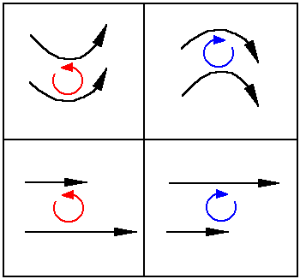
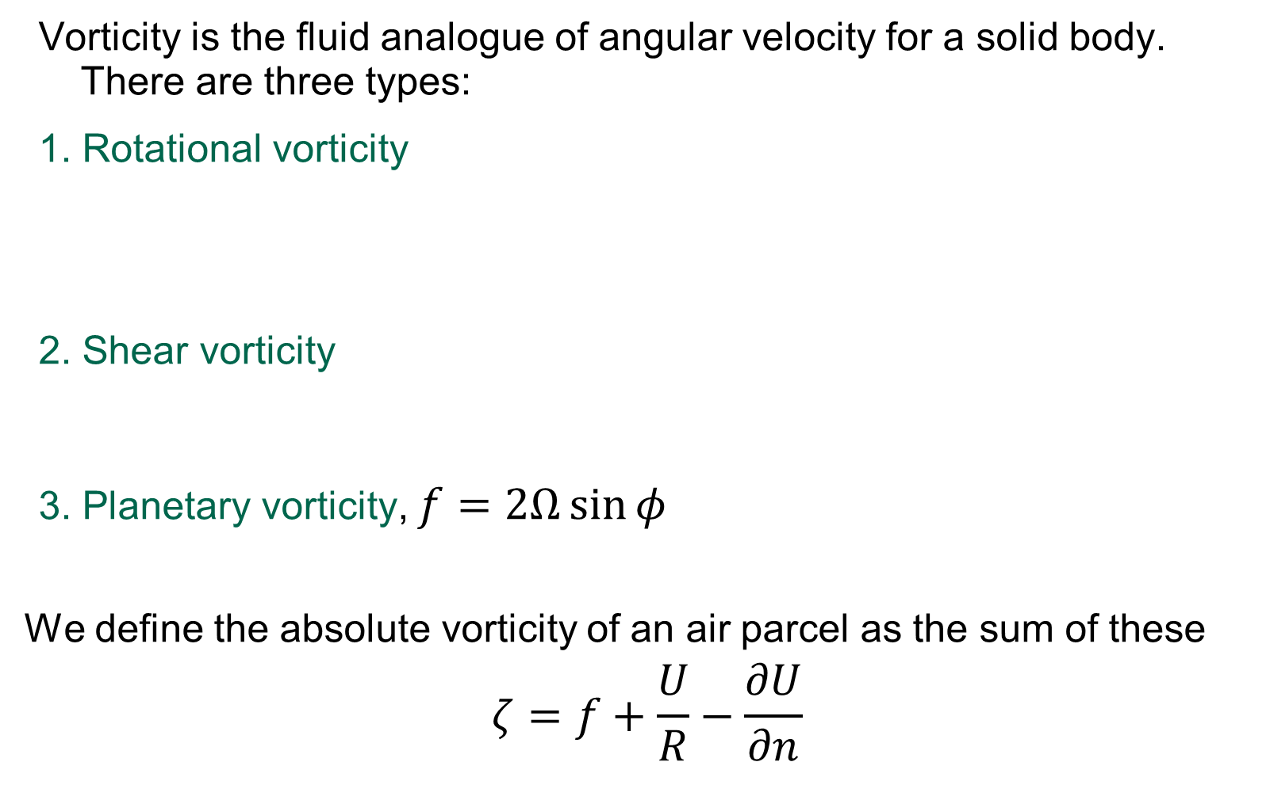
Vorticity in natural coordinates
Vorticity is the fluid analogue of angular velocity for a solid body. There are three types:
1. Rotational vorticity
2. Shear vorticity
3. Planetary vorticity, $f=2Ω\sin{φ}$
We define the absolute vorticity of an air parcel as the sum of these
$$ζ=f+\frac{U}{R}−\frac{∂U}{∂n}$$

Slide 20
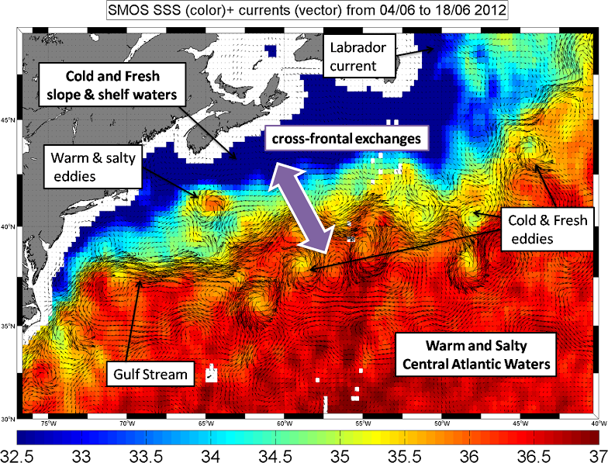
Sea surface salinity and wind vectors: http://www.salinityremotesensing.ifremer.fr/news/cross-frontalexchangesofsaltdetectedbysmosinthegulfstream
Notes:
Sketch explaining the ocean circulation features in this area. A SMOS 10-days averaged SSS map is shown in the background with vectors representing surface currents derived from altimer and surface wind products (OSCAR).

Slide 21
Balance: thermal wind balance
Combining geostrophic and hydrostatic balance gives “thermal wind balance” – horizontal gradients in buoyancy (or potential temperature) are related to vertical wind shear.
Notes:
dz
p
p+dp
F_{p}
F_{g}
(11)
z
x

Slide 22
Balance: example thermal wind balance
Cut-off low
5 km
Low pressure (p’<0) <-> ξ> 0 (cyclonic)
Cold core <-> ξ increases with height
Cold core
0 km

Slide 23
Hurricane
Warm-cored blocking high
5 km
5 km
Low pressure (p’<0) <-> ξ> 0 (cyclonic)
High pressure (p’>0) <-> ξ< 0 (anticyclonic)
Warm core <-> ξ decreases with height
Warm core <-> ξ decreases with height i.e. becomes more negative
Warm core
Warm core
0 km
0 km
Cut-off low
Siberian winter anticyclone
5 km
5 km
Low pressure (p’<0) <-> ξ> 0 (cyclonic)
High pressure (p’>0) <-> ξ< 0 (anticyclonic)
Cold core <-> ξ increases with height
Cold core <-> ξ increases with height (i.e. becomes less negative)
Cold core
Cold core
0 km
0 km

Slide 24
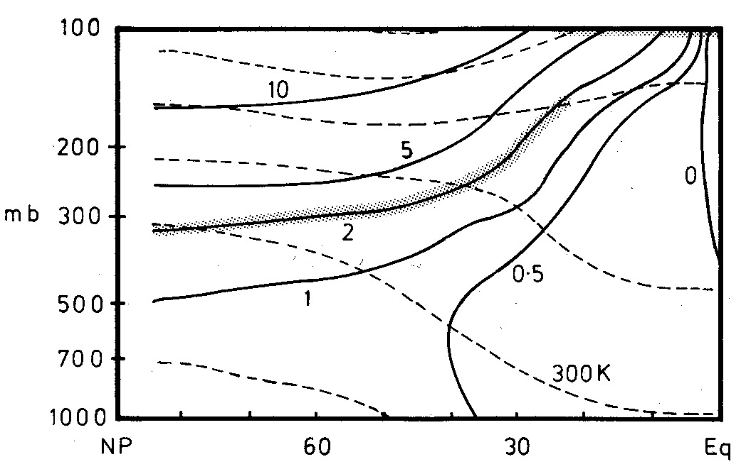
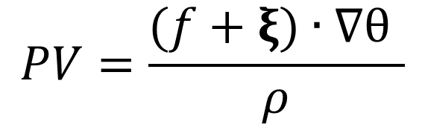
Potential vorticity
$$PV=\frac{(f+ξ)∙∇θ }{ρ}$$
tropopause
Potential vorticity is conserved following fluid parcels for adiabatic frictionless flow.
This makes it a good tracer for upper-tropospheric air over several days.
330K
270K
Climatology of PV (in PVU) and θ in NH winter (Hoskins, 1990)
Notes:
A summary of the climatological PV and theta distribution below 100mb in the NH winter. PV in PVU, theta every 30K

Slide 25
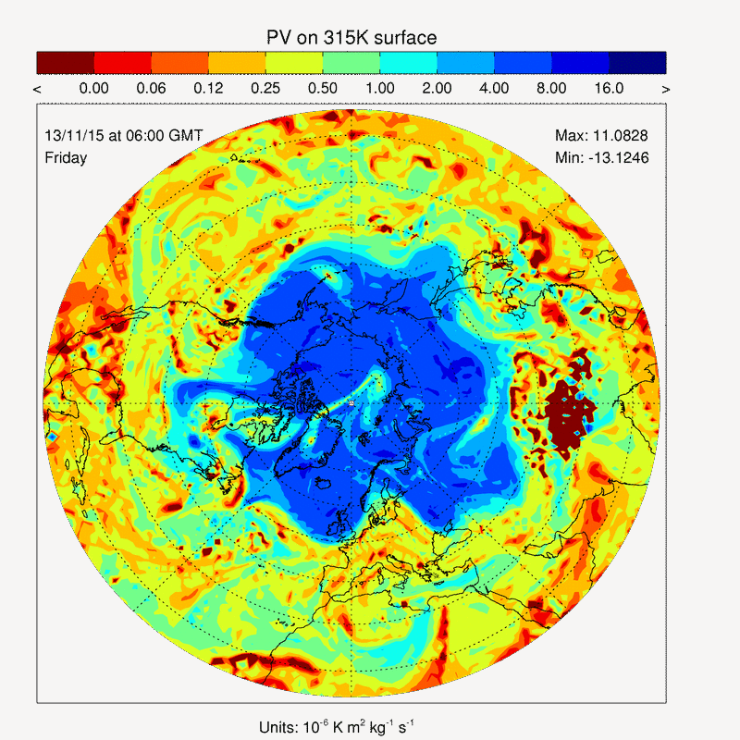
Planetary Rossby waves
Large amplitude waves are always present in the atmosphere.
Dispersive waves propaging westwards relative to the mean flow.
They conserve ‘potential vorticity’
Exhibit stirring, stretching and folding properties including vortex roll up.
ECMWF PV on 315 K isentrope animation

Slide 26
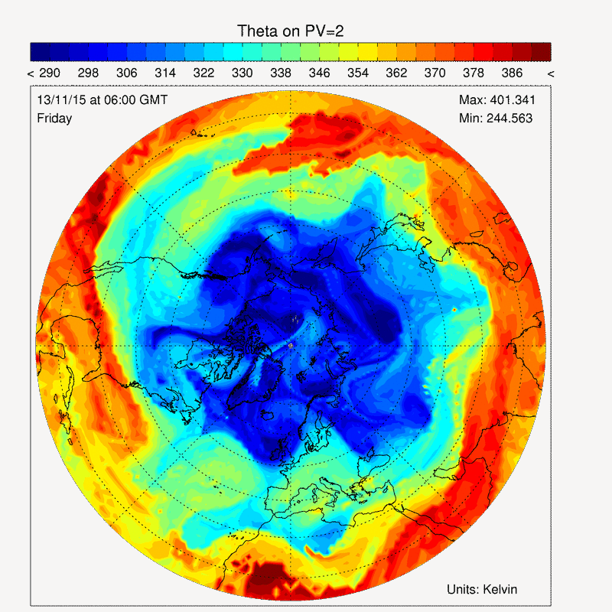
Planetary Rossby waves
Large amplitude waves are always present in the atmosphere.
Dispersive waves propaging westwards relative to the mean flow.
They conserve ‘potential vorticity’
Exhibit stirring, stretching and folding properties including vortex roll up.
ECMWF θ on PV2 animation

Slide 27
Baroclinic instability
A hydrodynamic instability associated with the vertical shear of the mean flow.
Can be considered as arising from the vertical interaction of two Rossby waves.
Converts potential energy from the mean meridional temperature gradient (associated with the vertical shear of horizontal wind through thermal wind balance) to kinetic energy.
Hoskins (1985)

Slide 28
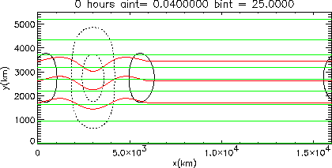
Baroclinic instability: Idealised (quasi-geostrophic) model simulation
Red: tropopause potential temperature (contour interval 25 K);
Green: surface potential temperature (contour interval 10 K);
Black: surface pressure anomaly (anticyclonic circulation, high pressure - solid, cyclonic circulation, low pressure dotted, contour interval 4 mb).

Slide 29
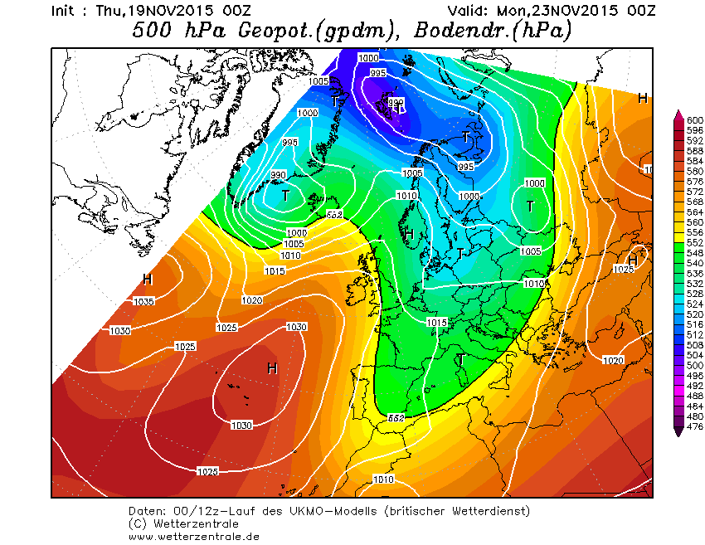
Baroclinic instability. Upper and lower air charts
500 hPa geopotential height (decametres, shading),
surface pressure (hPa, white contours)
Met Office forecast for 00 UTC today

Slide 30
Summary
Geostrophic wind follows the isobars, with speed proportional to gradient in height or pressure.
Divergence and convergence determine vertical velocity and changes in vorticity.
Acceleration, divergence and convergence require departures from geostrophy.
Pressure is the weight of the air above you.
Rossby waves are large amplitude waves – potential vorticity conserving motions that owe their existence to the gradient of PV along isentropes
Cyclones grow by baroclinic instability, converting potential energy from the background meridional temperature gradient into kinetic energy.
Consequently, cyclones have a characteristic vertical structure.

Slide 31
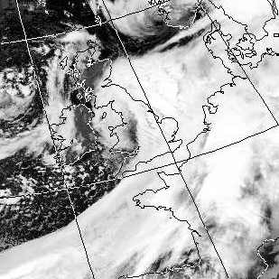
Practical assignment
Analysis of the extratropical cyclone of 30 October 2000 (storm Oratia).
Deepened explosively (60 hPa in 24 hrs) attaining depth of 941 hPa in the North Sea with sustained hurricane force winds.
Multiple cloud bands terminating at the tip of the satellite image suggest this was a possible sting jet event.
Infra-red satellite image 0619 UTC,
30 October 2014

Slide 32
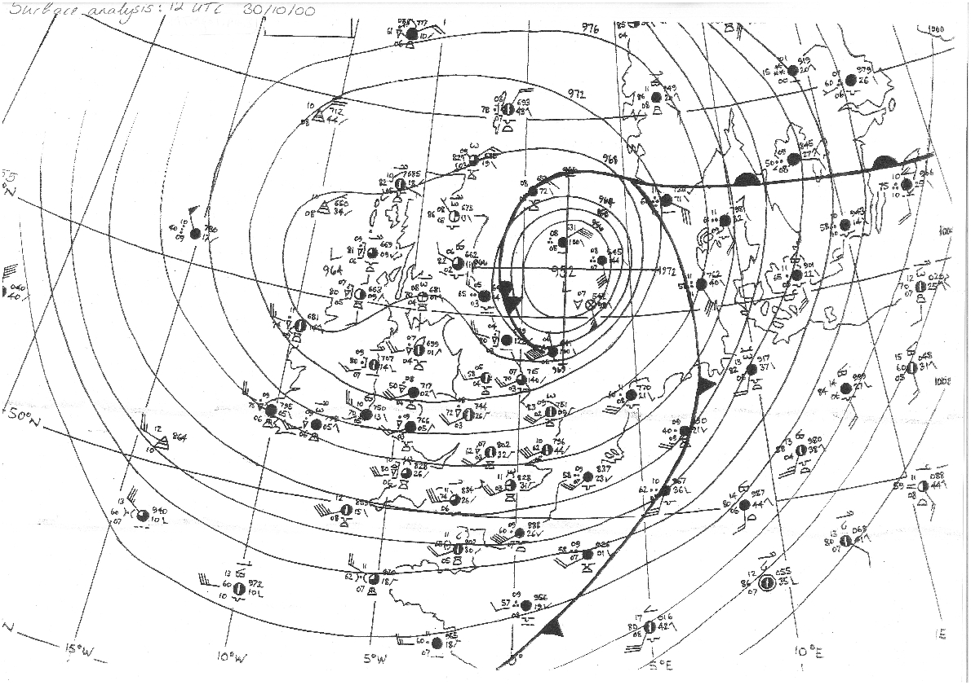
Practical assignment: surface analysis

Slide 33
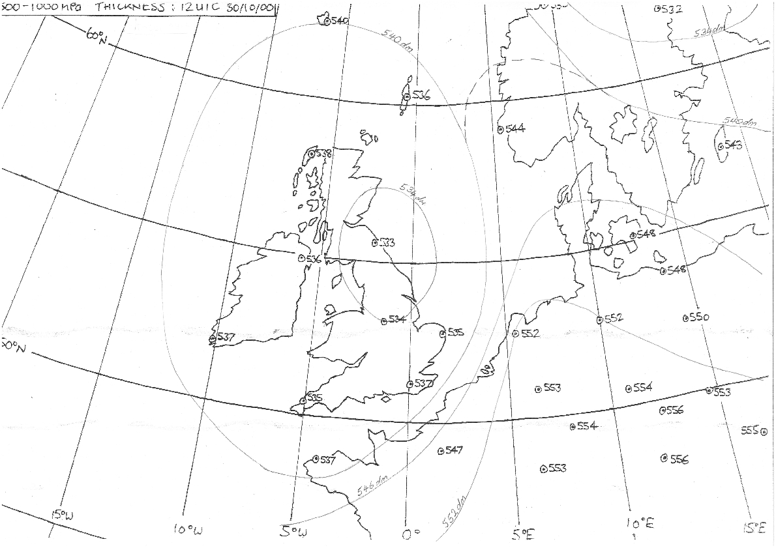
Practical assignment: thickness analysis

Slide 34
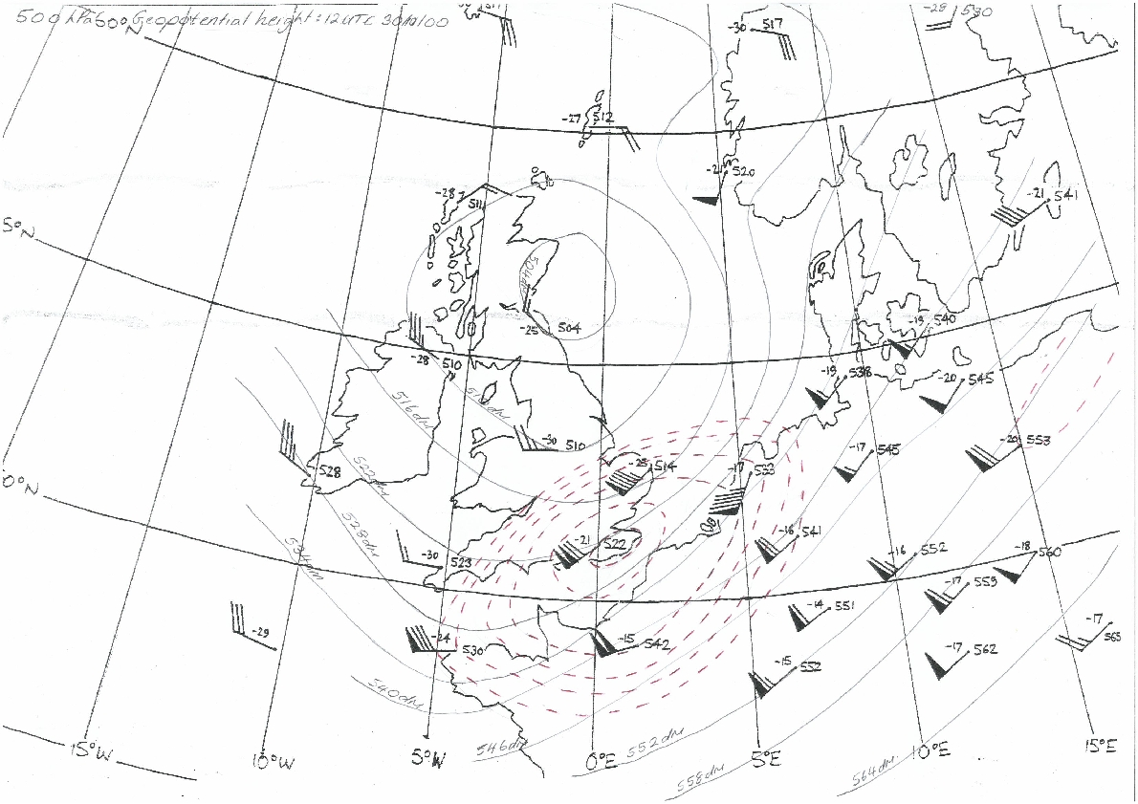
Practical assignment: 300 hPa geopotential height analysis

Slide 35
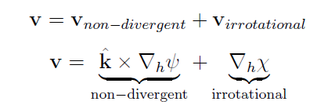

Streamfunction and velocity potential
Any horizontal flow can be split into two terms (called Helmholtz decomposition):
Streamfunction velocity potential
where in cartesian coordinates
Thus…

Slide 36
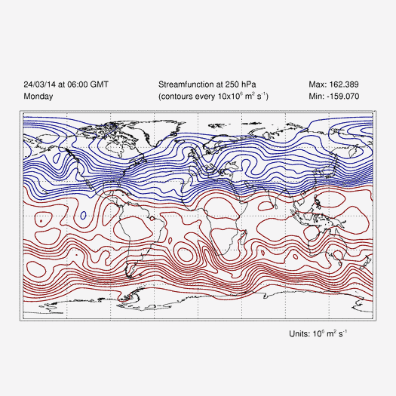
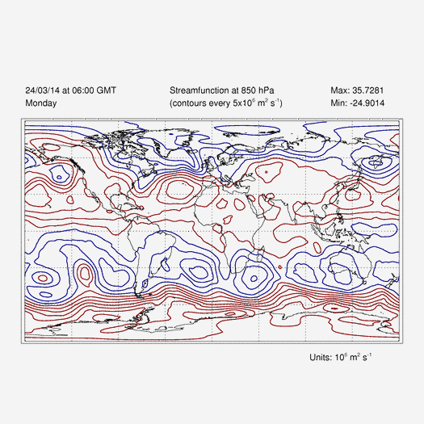
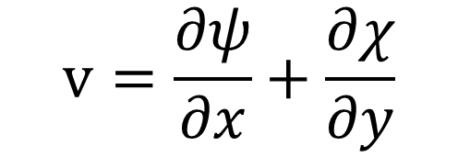
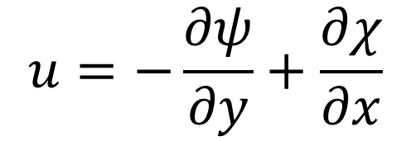
Streamfunction and velocity potential
$$u=−\frac{∂ψ}{∂y}+\frac{∂χ}{∂x}$$
$$v=\frac{∂ψ}{∂x}+\frac{∂χ}{∂y}$$
250 hPa
ECMWF streamfunction animations
850 hPa

