Slide 1
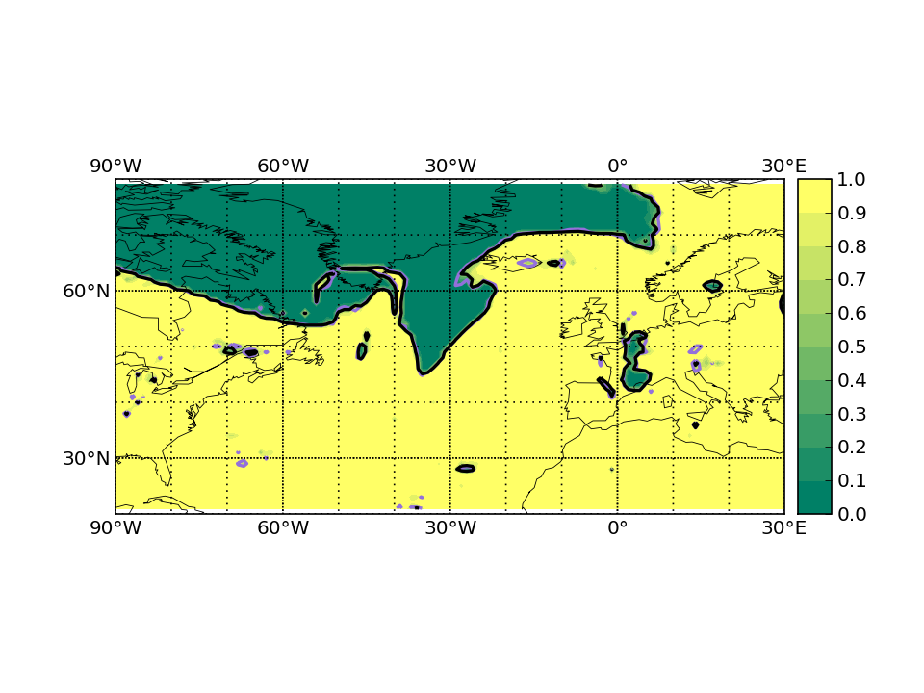
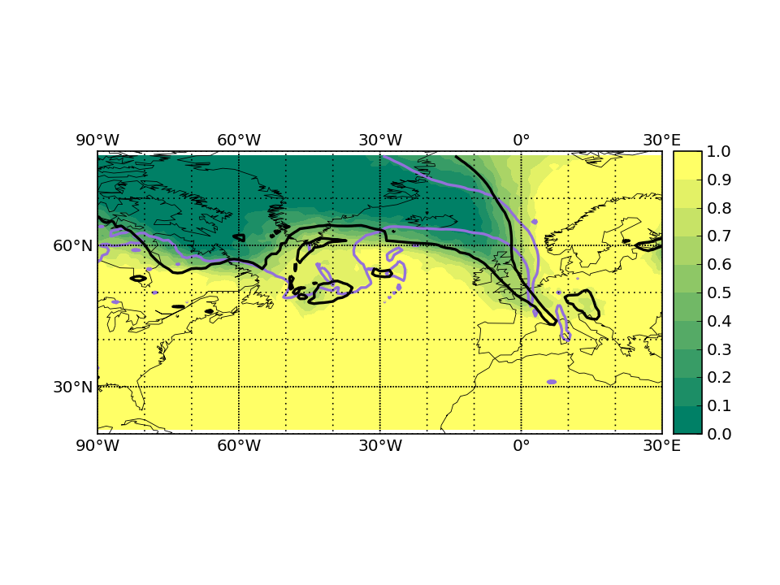
IOP1 1200 UTC 17 September 2016
Troposphere probability
T+0
T+120
✓
Very bad forecast

Slide 2
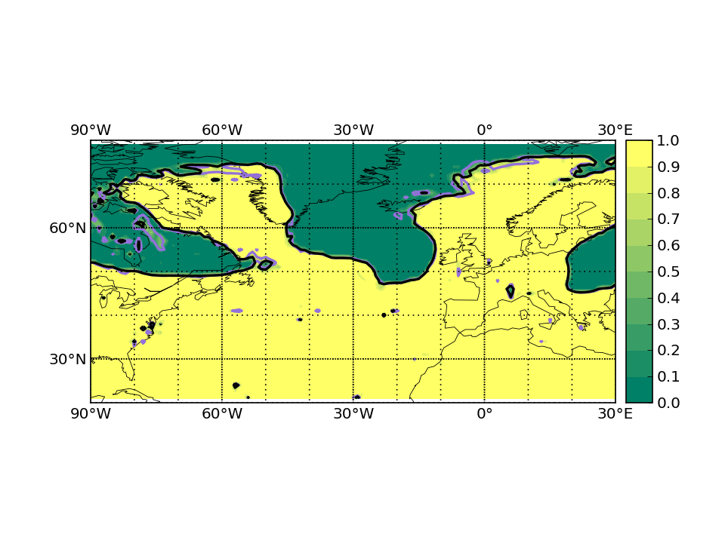
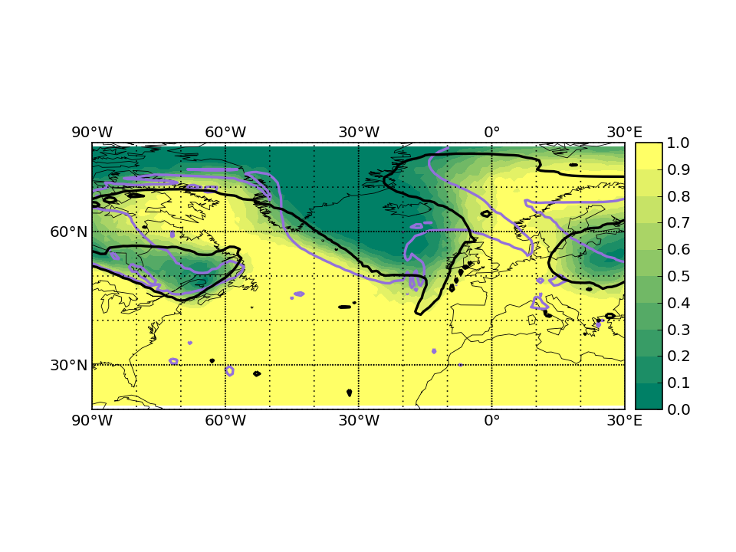
IOP2 1200 UTC 21 September 2016
Troposphere probability
T+0
T+120
✓
Good ensemble forecast

Slide 3
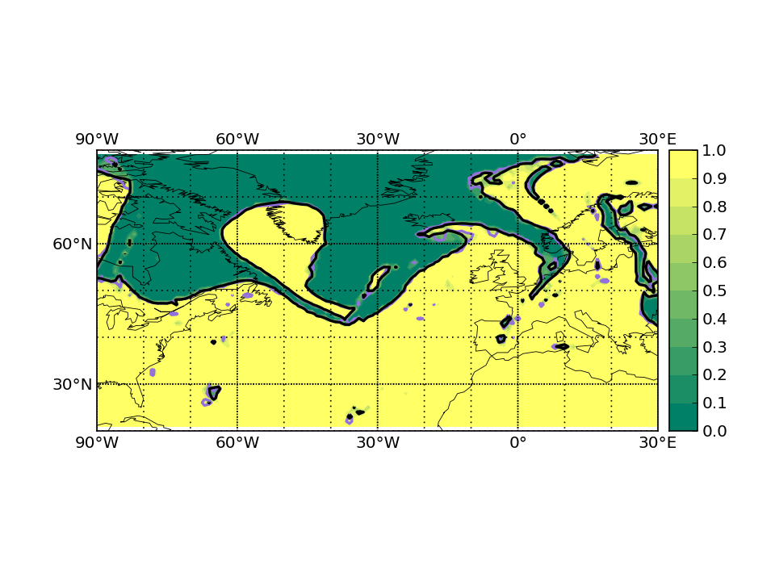
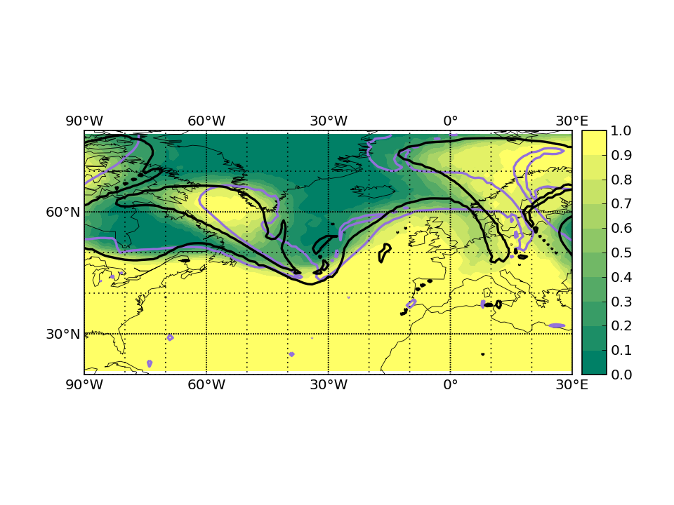
IOP3 1200 UTC 23 September 2016
Troposphere probability
T+0
T+120

Slide 4
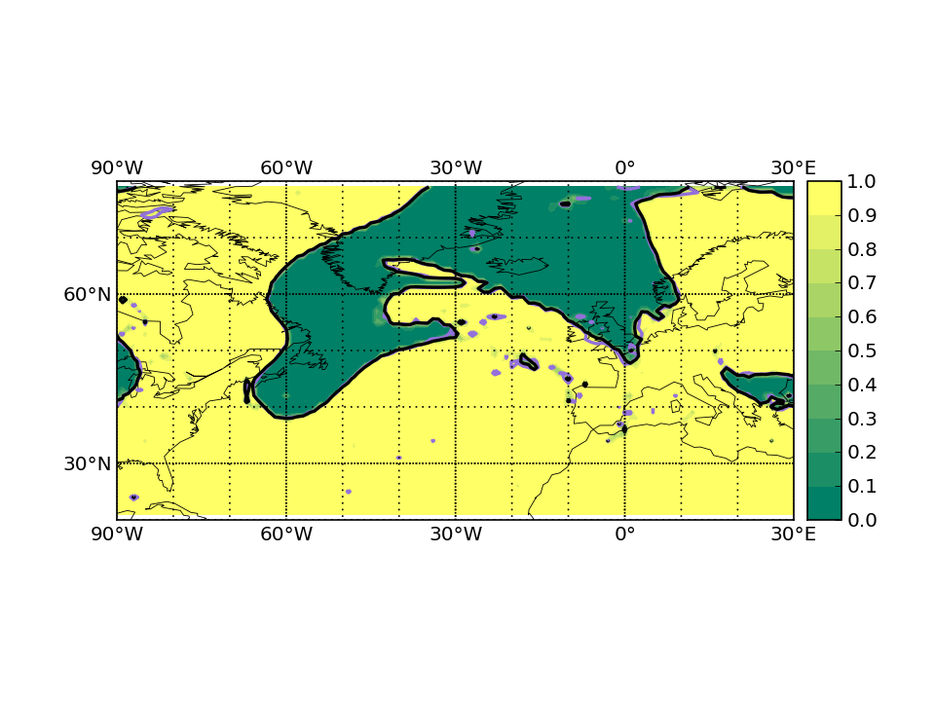
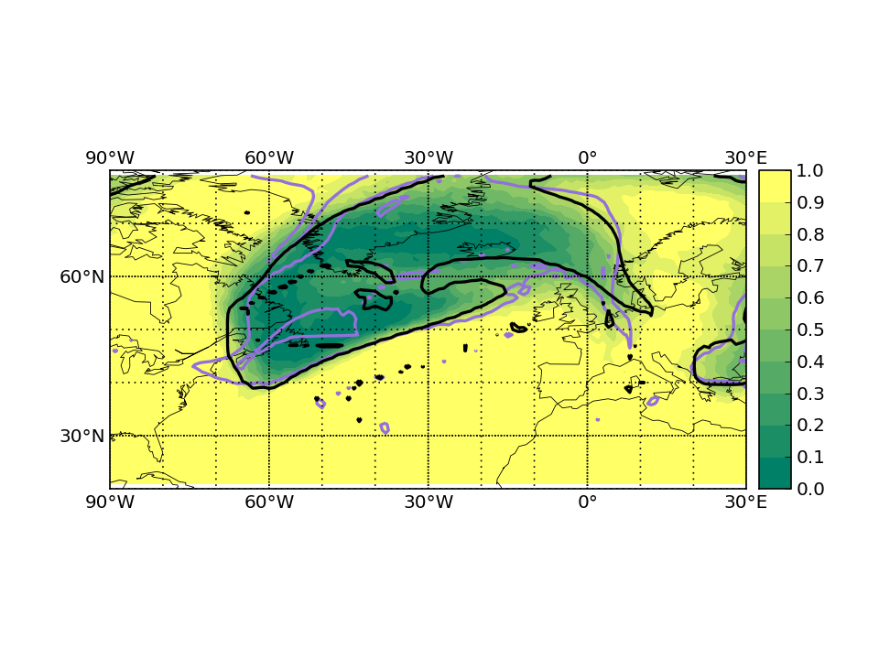
IOP4 1200 UTC 26 September 2016
Troposphere probability
T+0
T+120

Slide 5
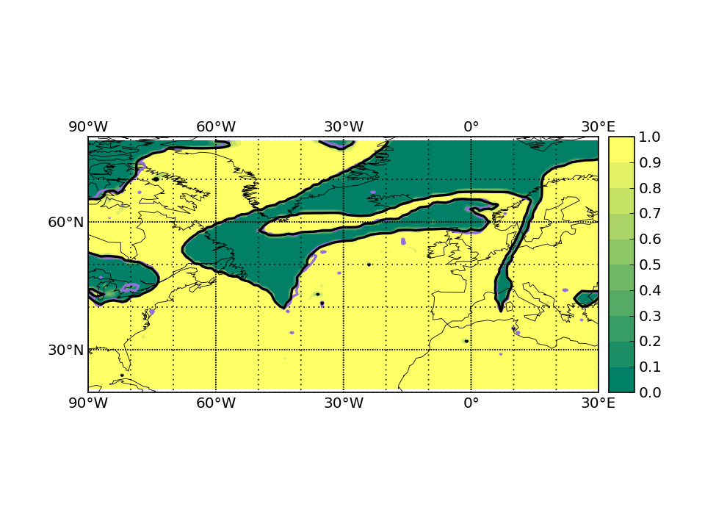
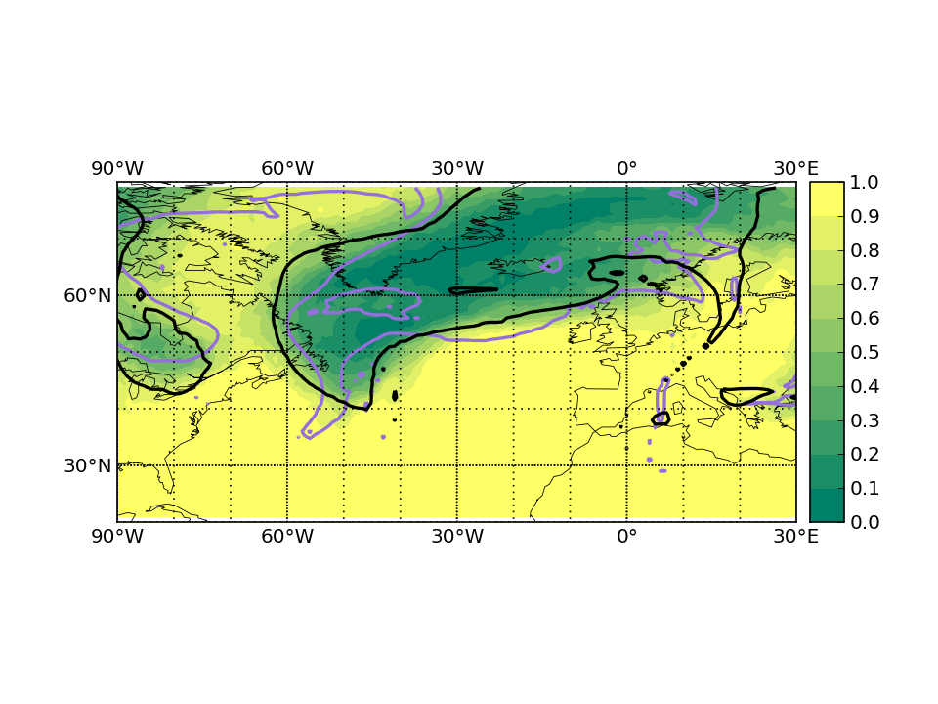
IOP5 1200 UTC 27 September 2016
Troposphere probability
T+0
T+120

Slide 6
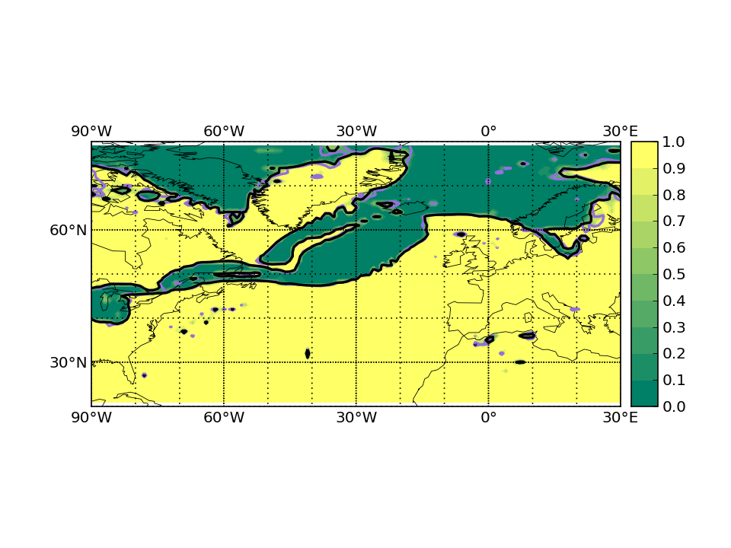
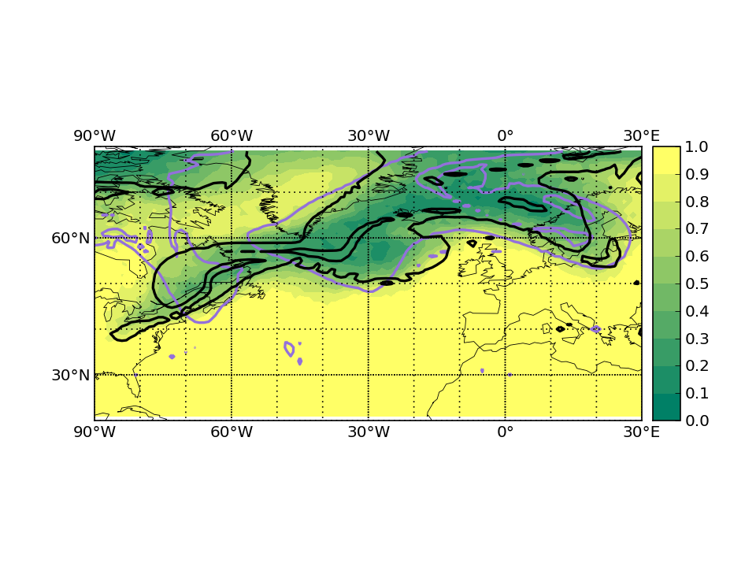
Falcon calibration flight 1200 UTC 28 September 2016
Troposphere probability
T+0
T+120
✓
Very large uncertainty

Slide 7
IOP6 1200 UTC 01 October 2016
Flight cancelled

Slide 8
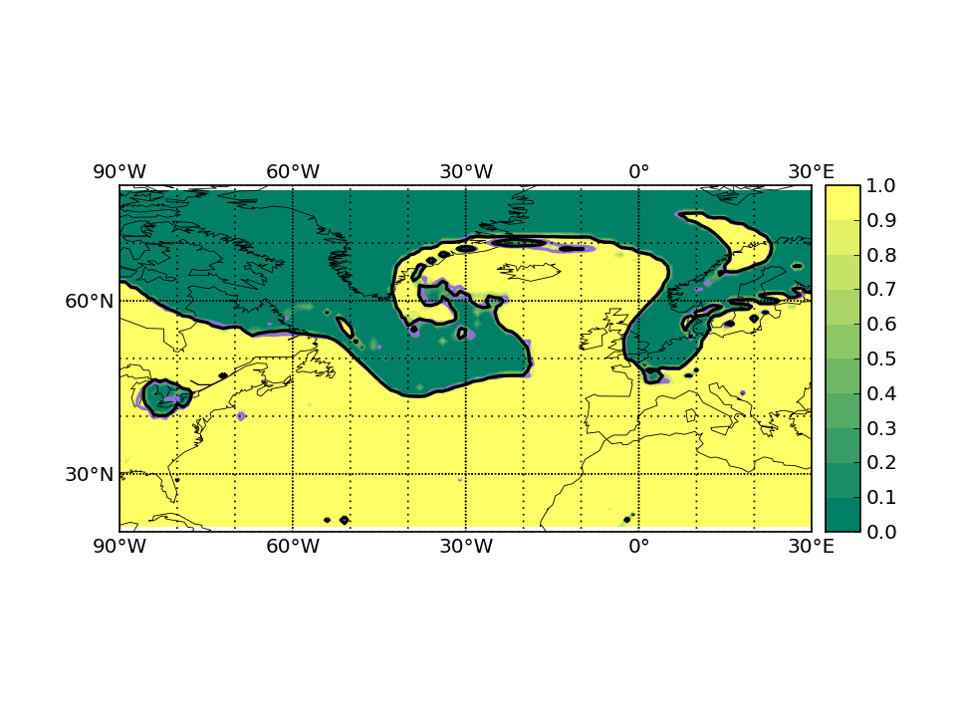
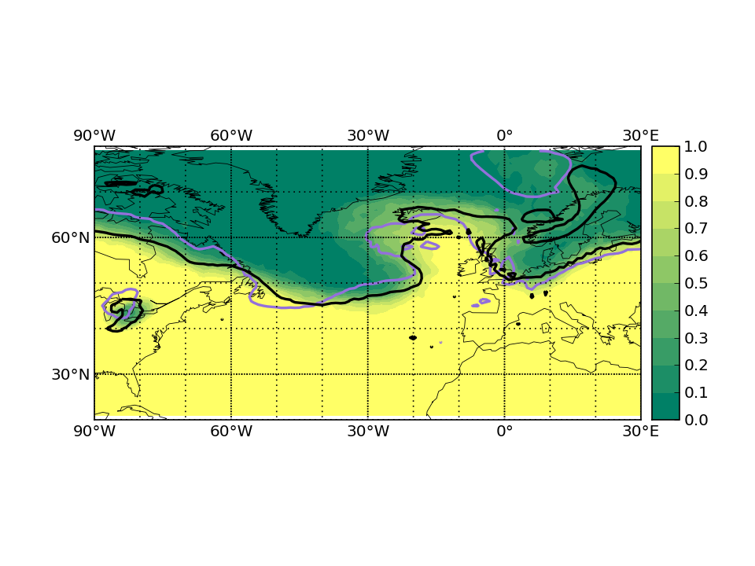
IOP7 1200 UTC 02 October 2016
Troposphere probability
T+0
T+120
✓
Bad forecast

Slide 9
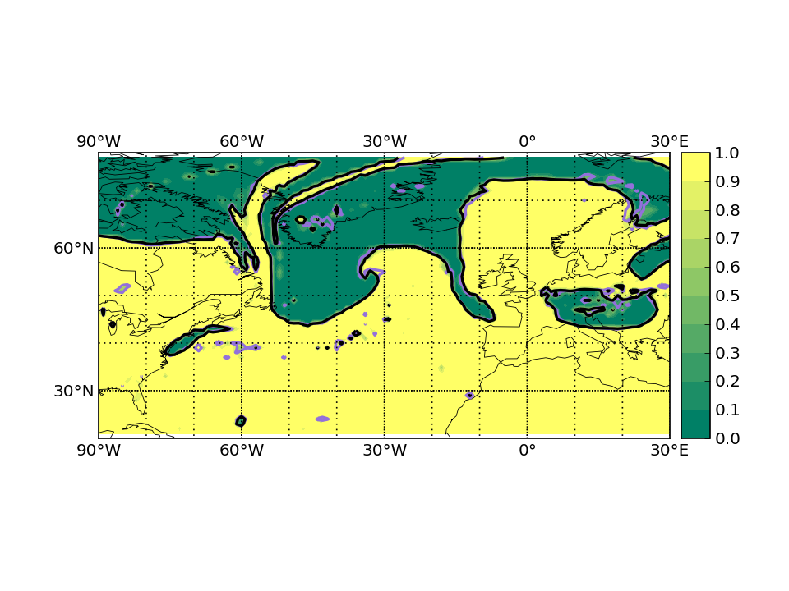
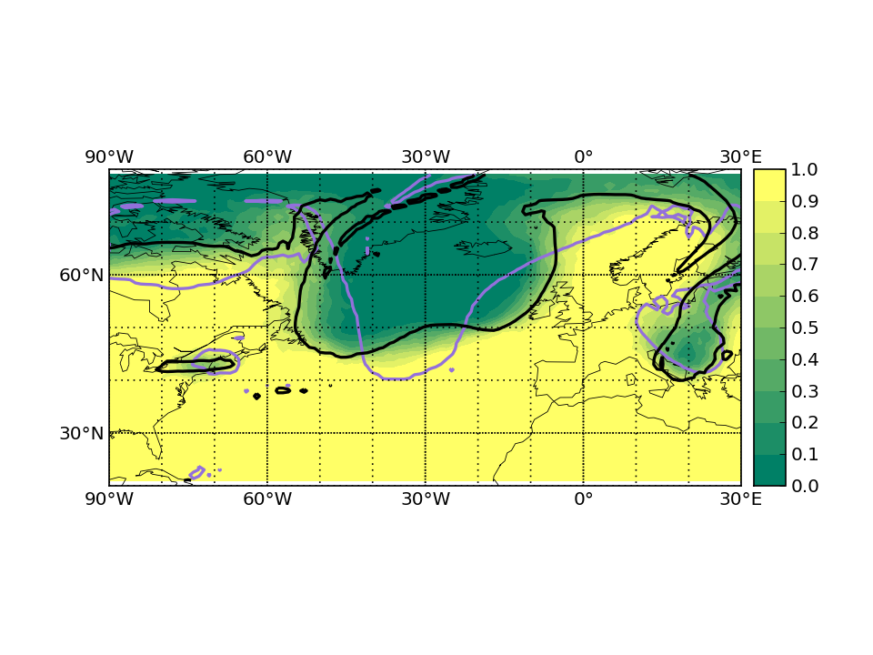
IOP8 1200 UTC 04 October 2016
Troposphere probability
T+0
T+120
✓
Bad forecast

Slide 10
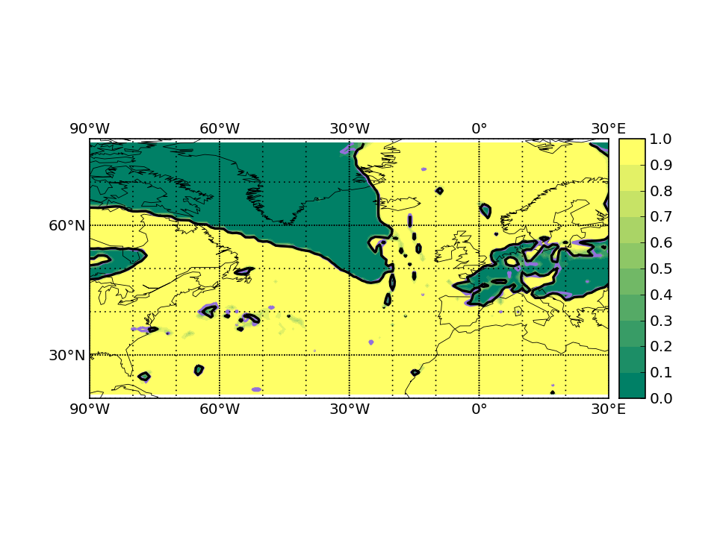
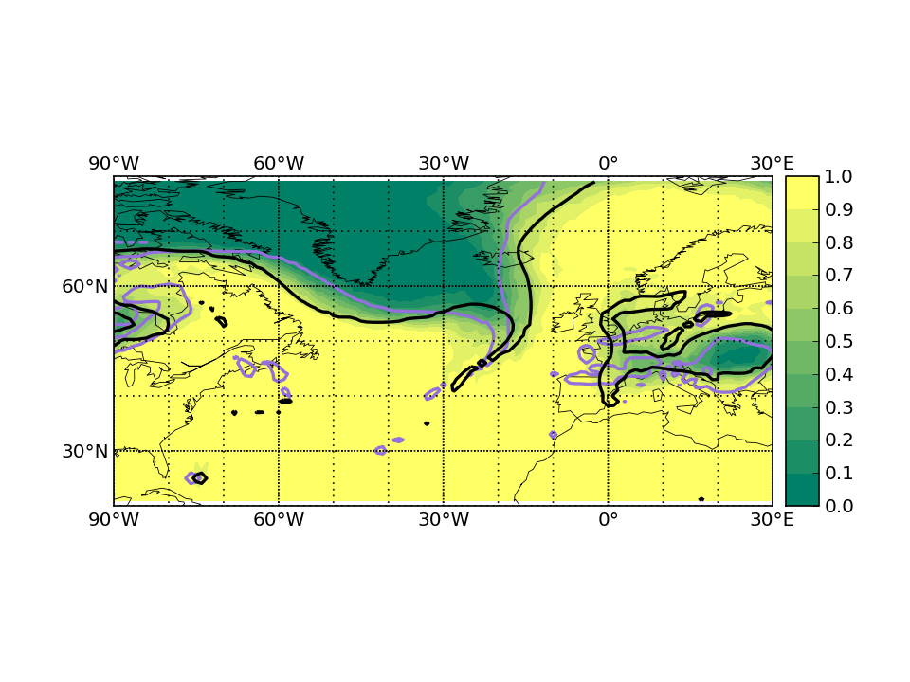
IOP9 1200 UTC 06 October 2016
Troposphere probability
T+0
T+120

Slide 11
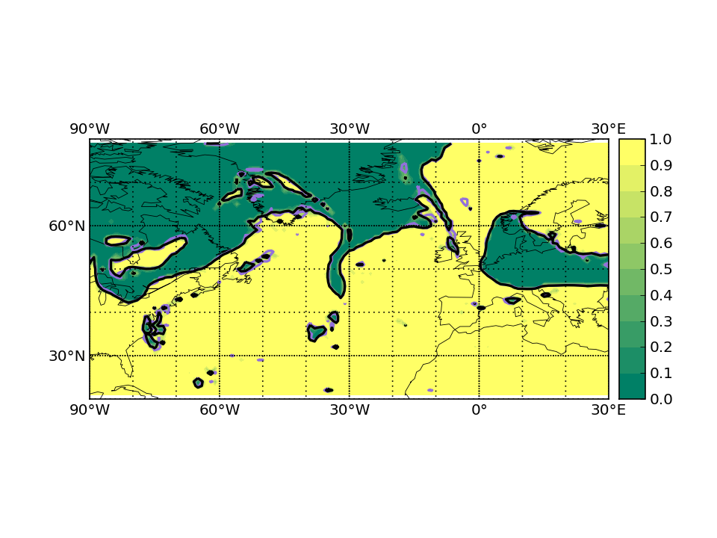
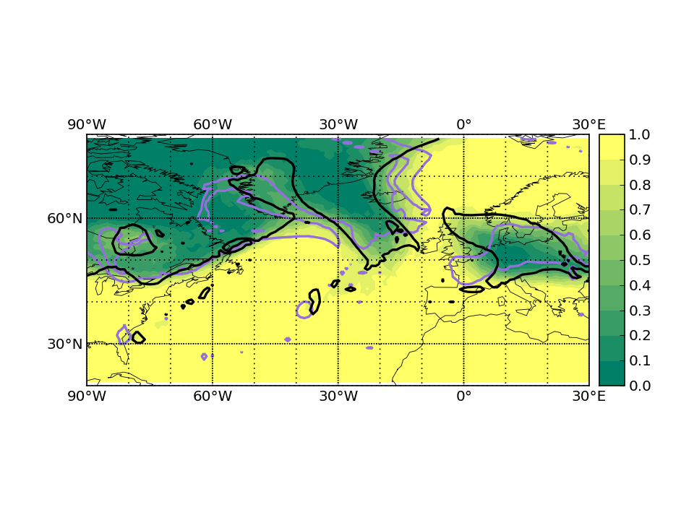
IOP10 1200 UTC 09 October 2016
Troposphere probability
T+0
T+120

Slide 12
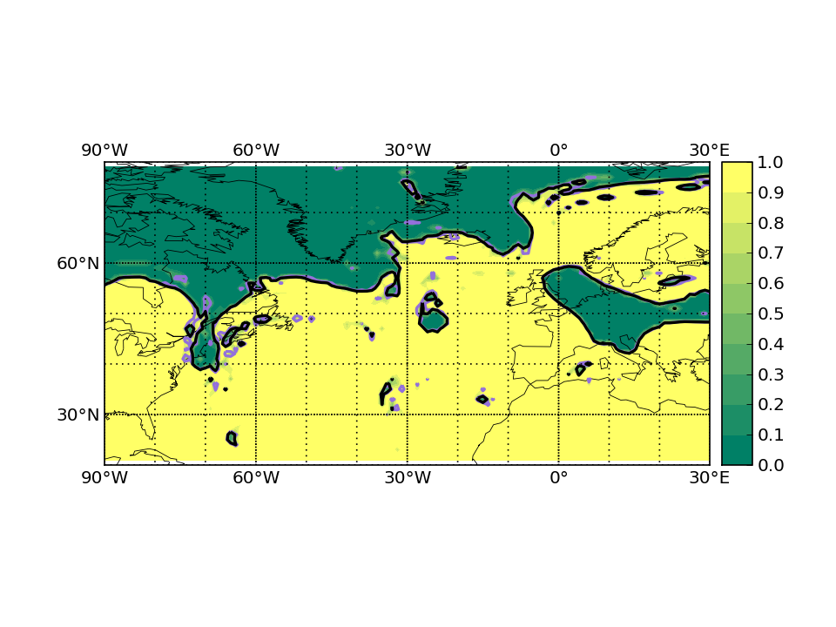
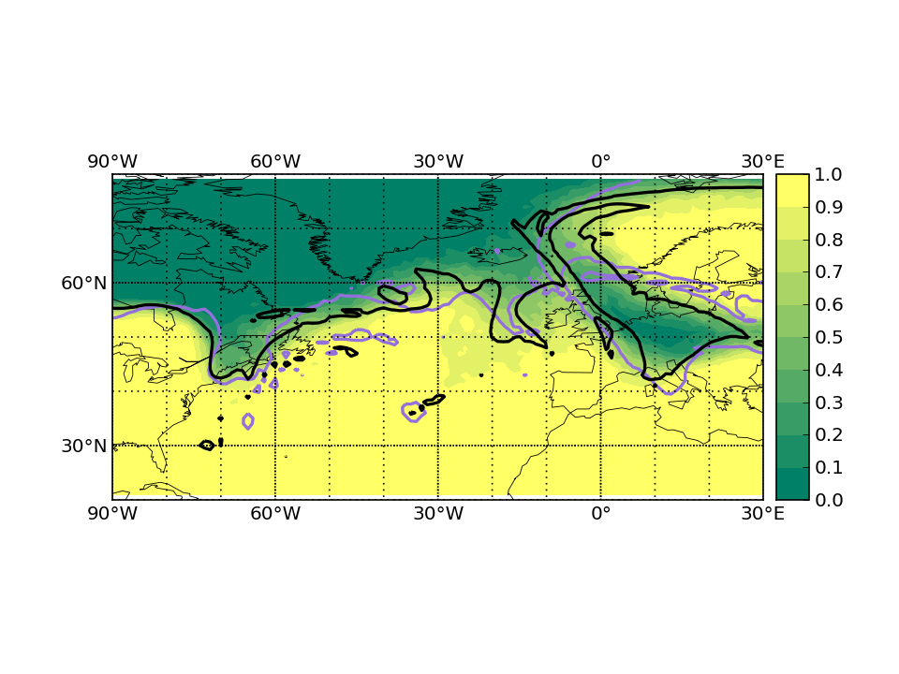
IOP11 1200 UTC 10 October 2016
Troposphere probability
T+0
T+120

Slide 13
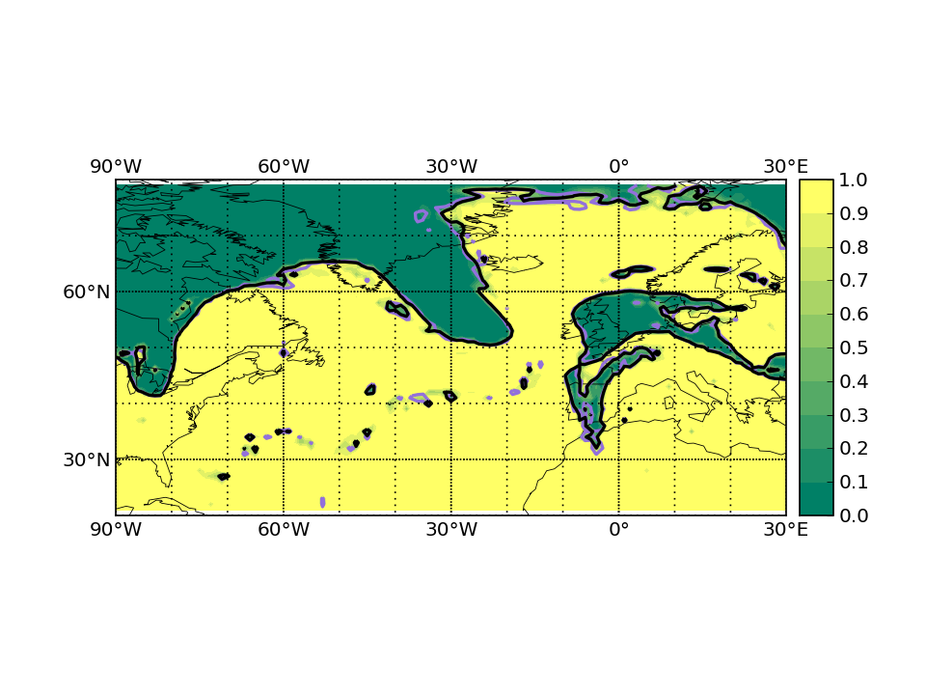
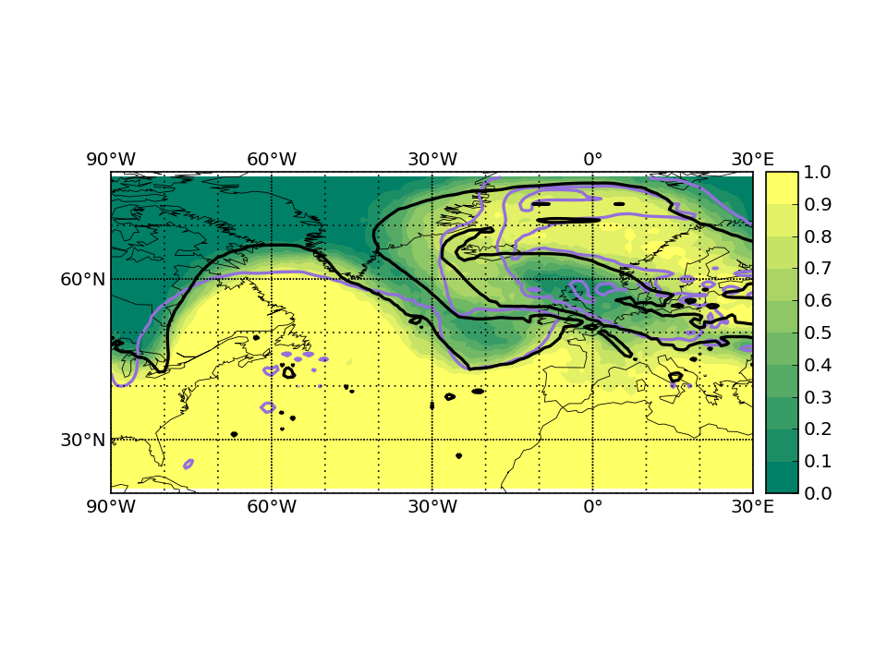
IOP12 1200 UTC 13 October 2016
Troposphere probability
T+0
T+120

Slide 14
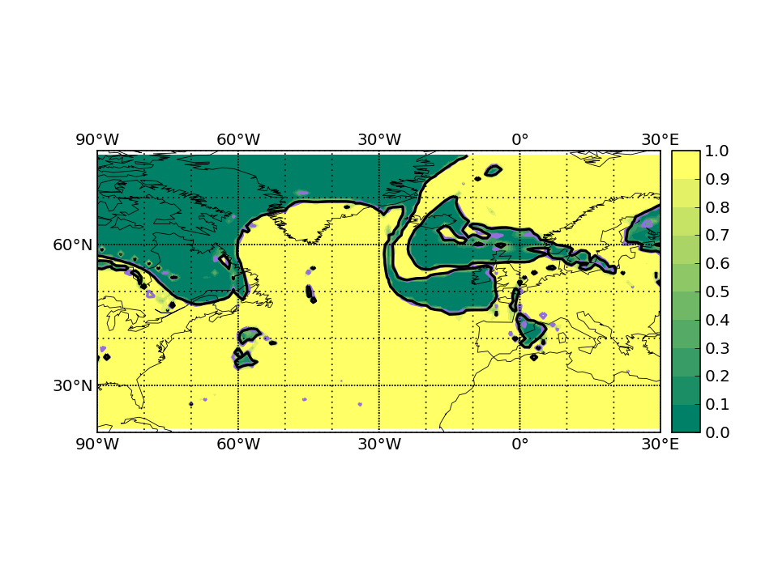
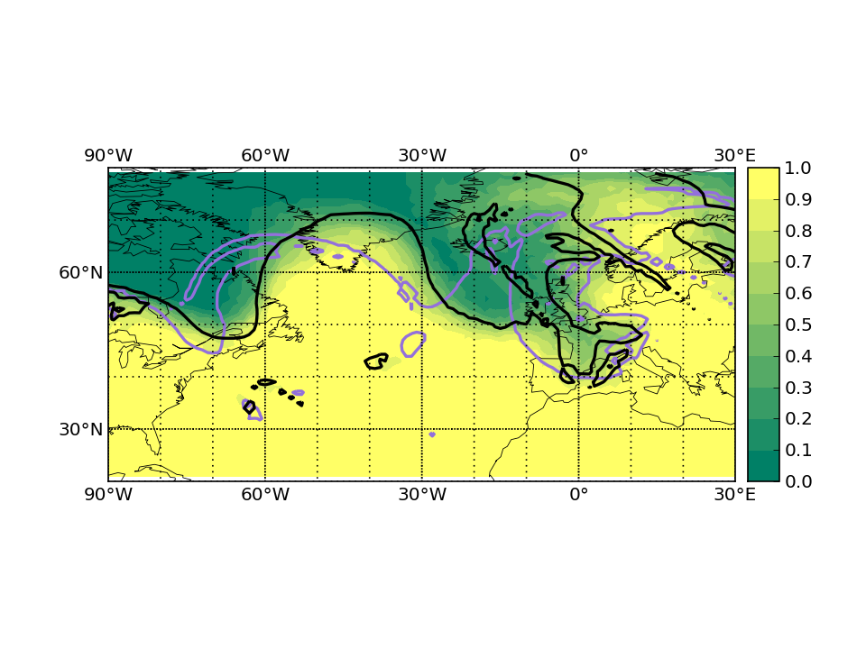
IOP13 1200 UTC 14 October 2016
Troposphere probability
T+0
T+120

Slide 15
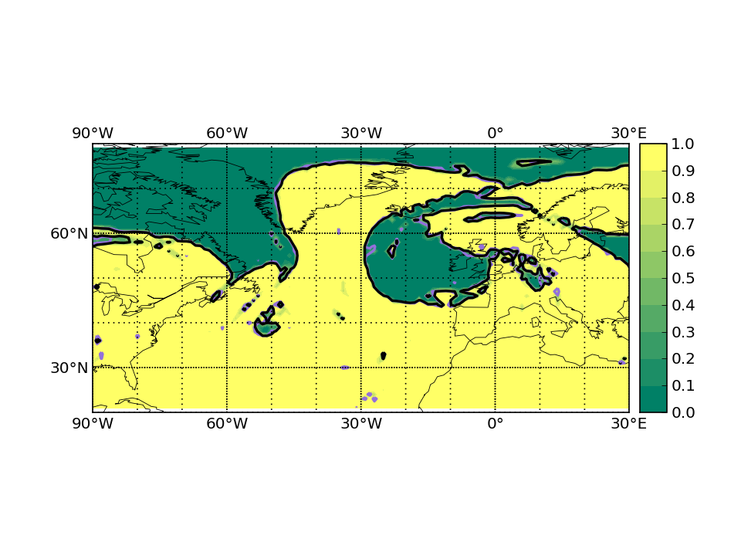
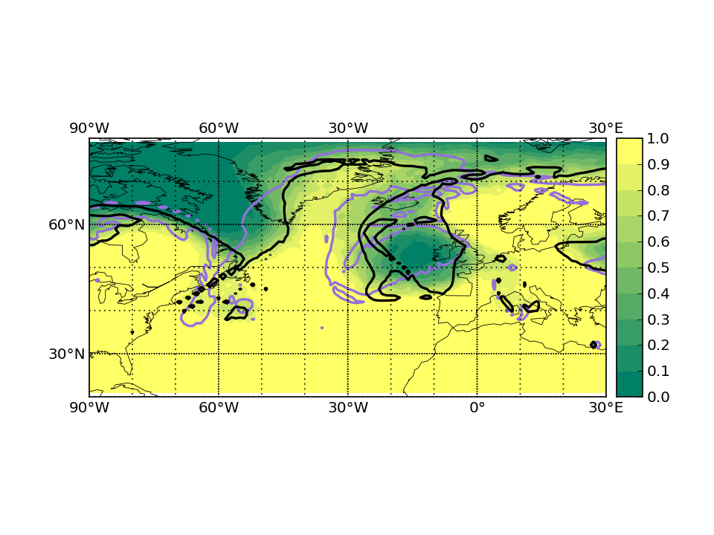
IOP14 1200 UTC 15 October 2016
Troposphere probability
T+0
T+120

Slide 16
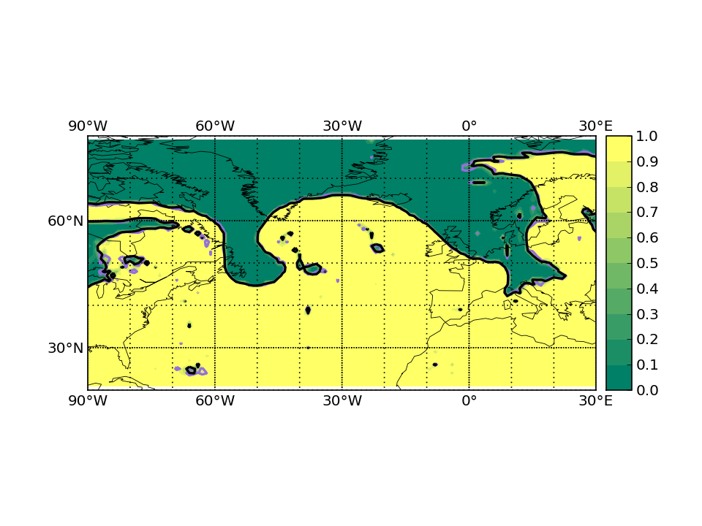
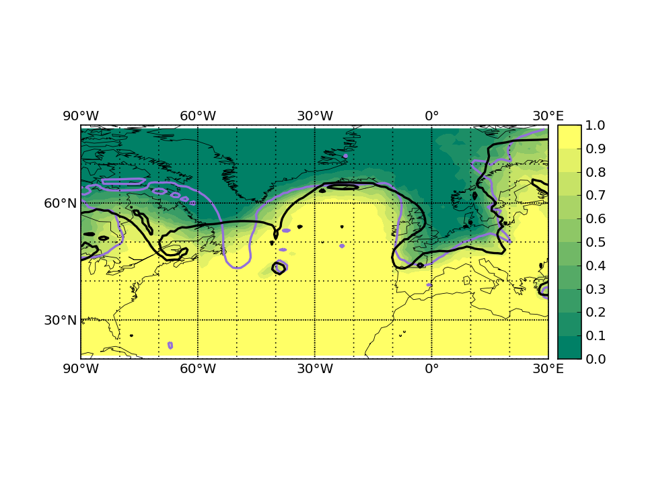
IOP15 1200 UTC 18 October 2016
Troposphere probability
T+0
T+120
✓
Cyclonic (ANA) v anti-cyclonic (FCT)

Slide 17
IOP7
02 October 2016

Slide 18
IOP7 1200 UTC 02 October 2016
Troposphere probability
T+0
T+120
RF Falcon 07 WCB outflow near Iceland: Box flight with tropopause jet stream crossing
Coordination: German Falcon and French falcon (3/4 of the box + dropsondes)
✓

Slide 19
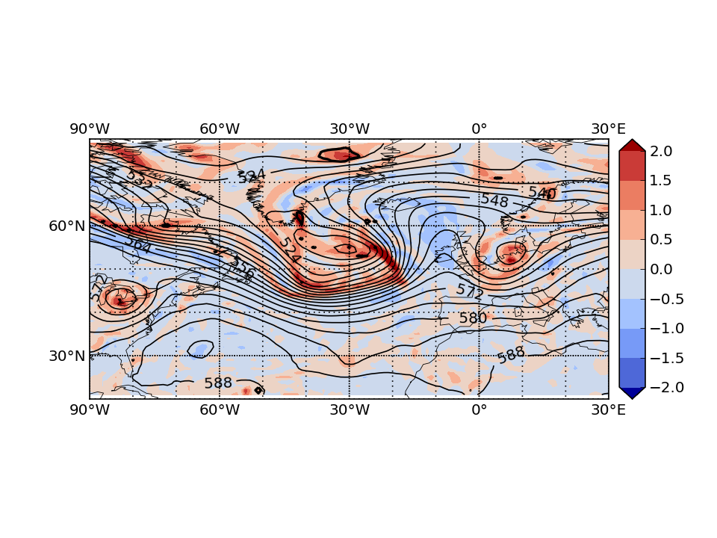
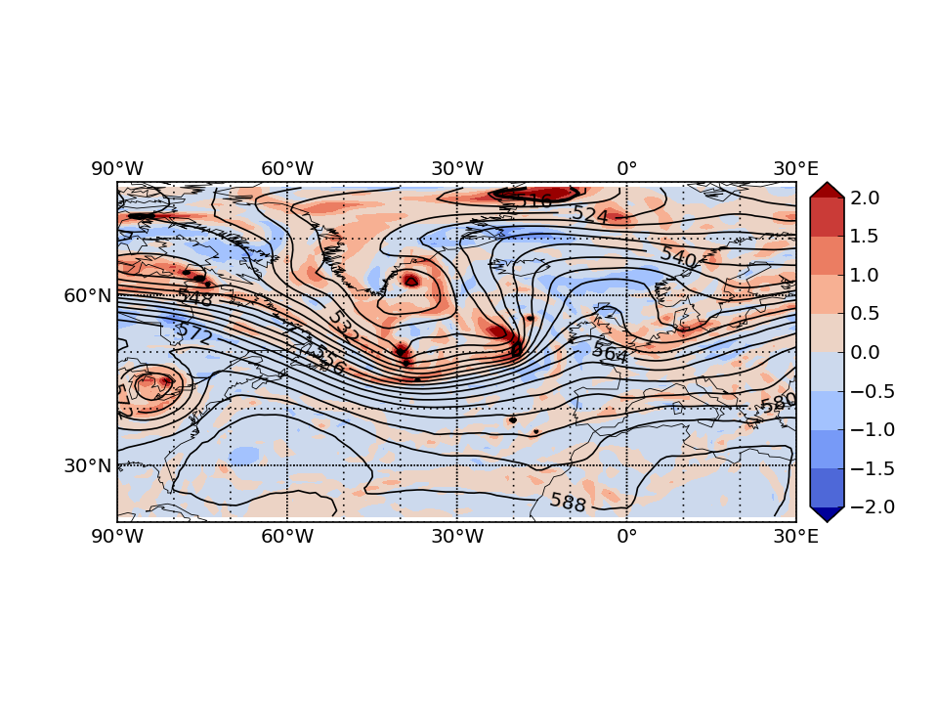
IOP7 1200 UTC 02 October 2016
500-hPa relative vorticity
T+0
T+120
✓

Slide 20
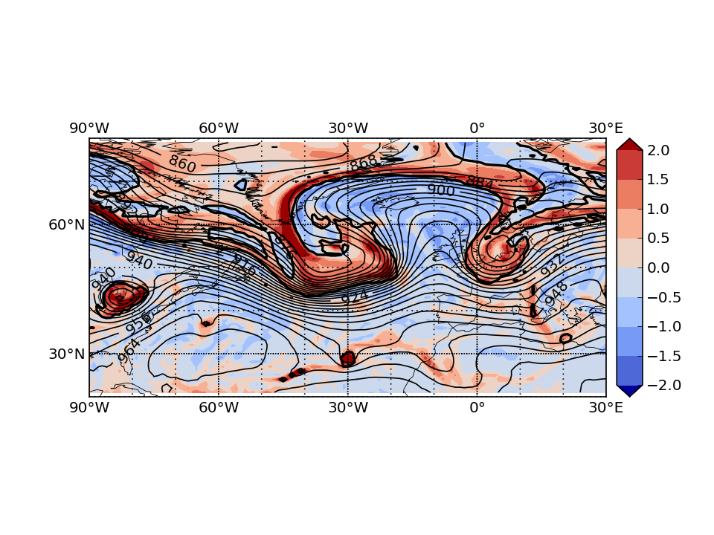
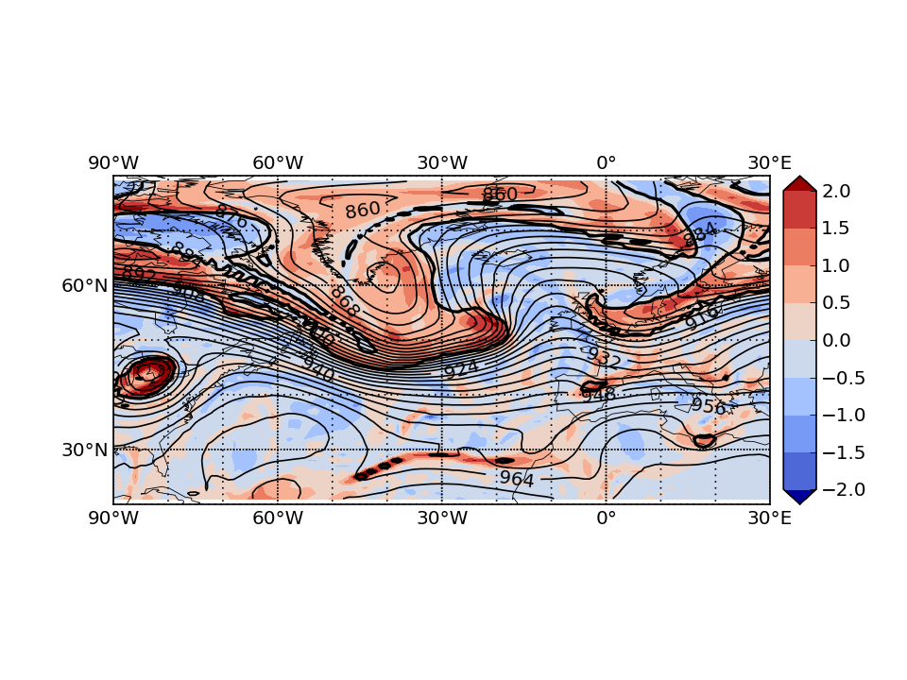
IOP7 1200 UTC 02 October 2016
300-hPa relative vorticity
T+0
T+120
✓
Stronger relative vorticity at the tropopause in analysis

Slide 21
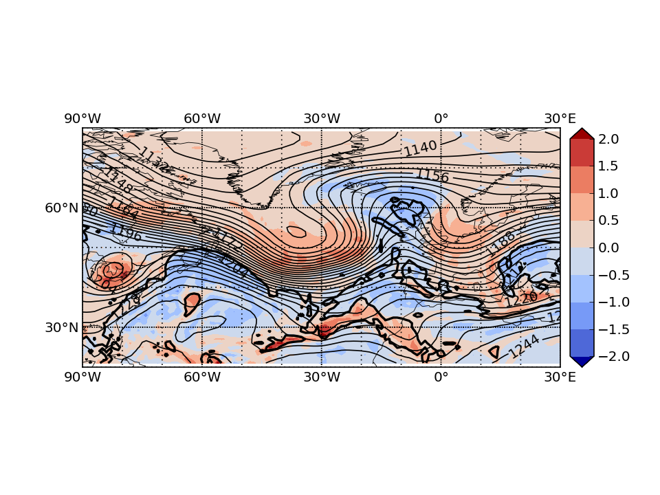
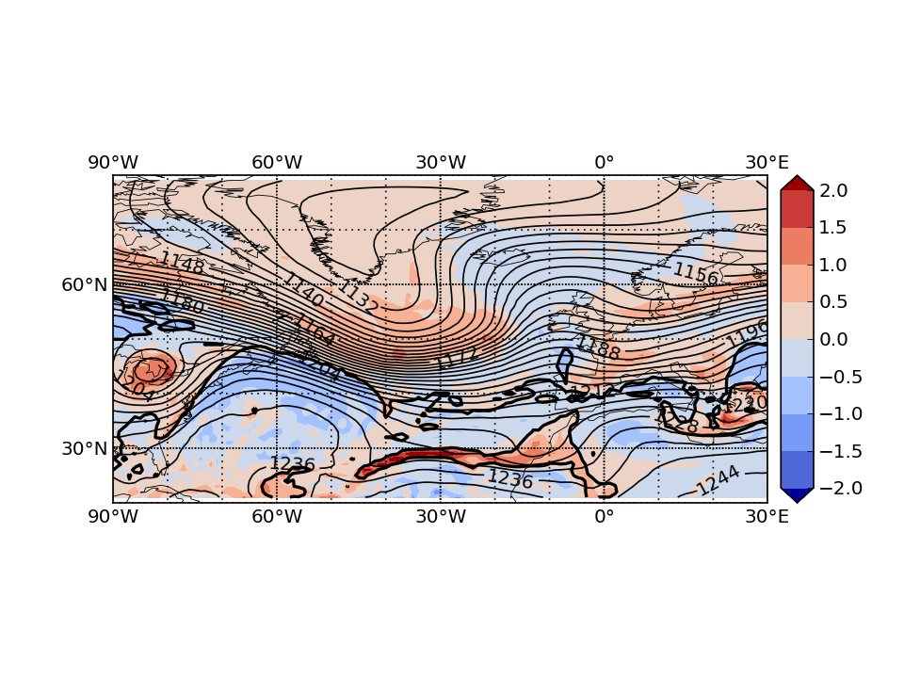
IOP7 1200 UTC 02 October 2016
200-hPa relative vorticity
T+0
T+120
✓

Slide 22
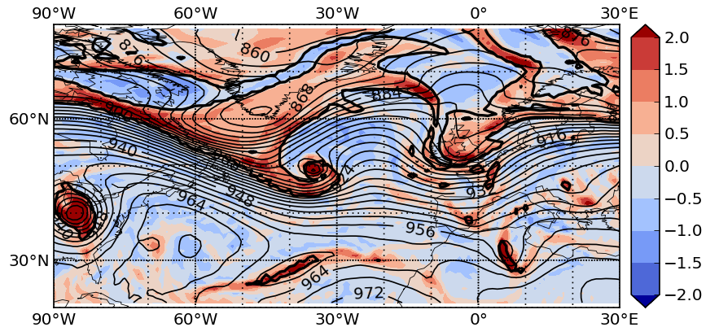
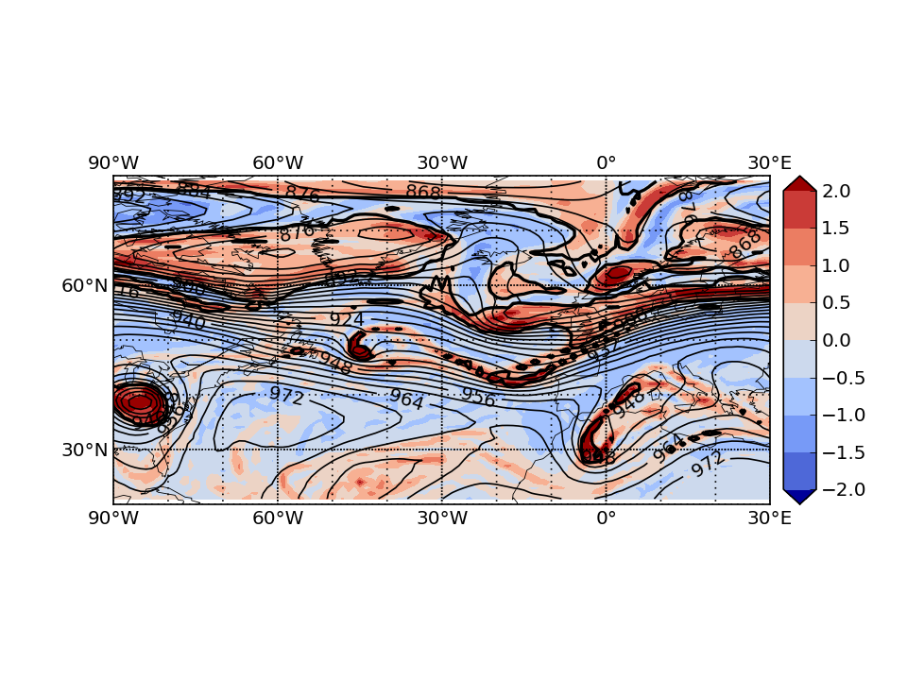
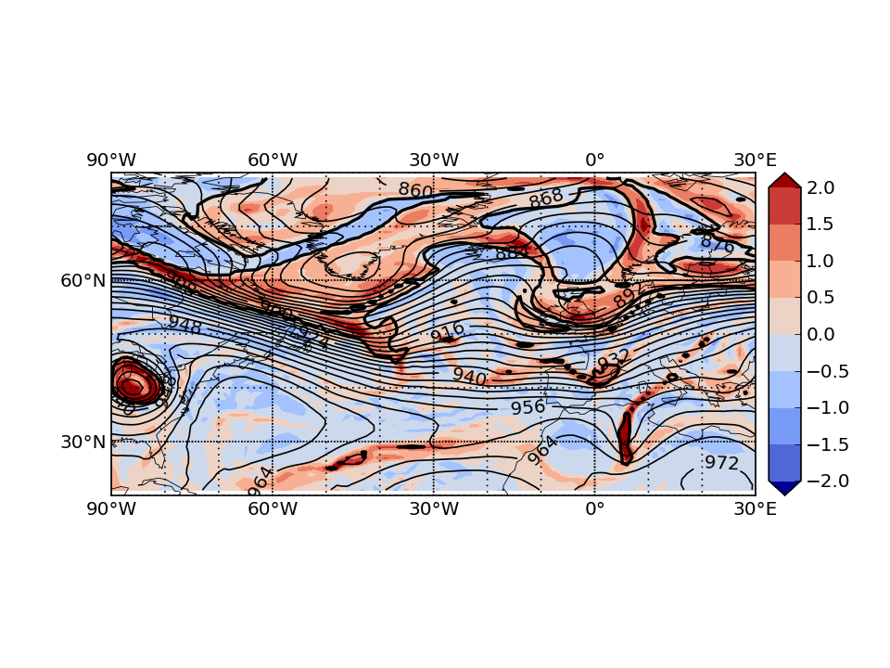
IOP7 1200 UTC 02 October 2016
300-hPa relative vorticity evolution
29 September
01 October
ANA
FCT

Slide 23
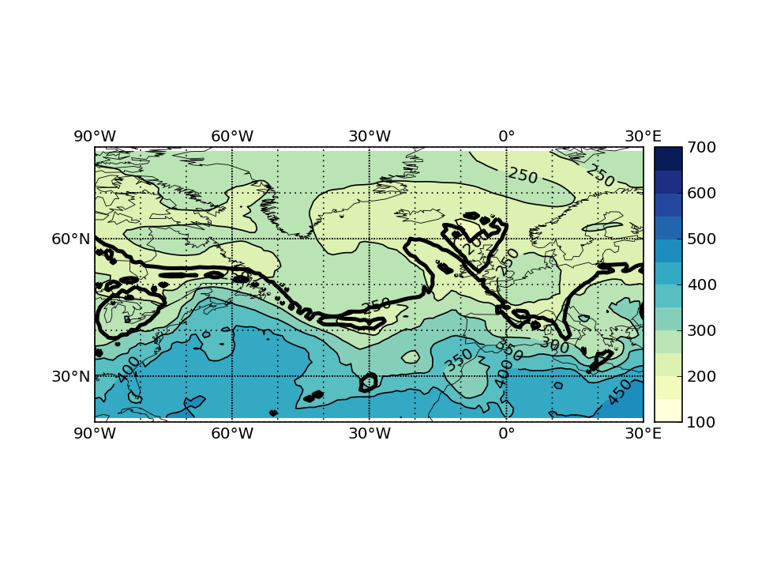
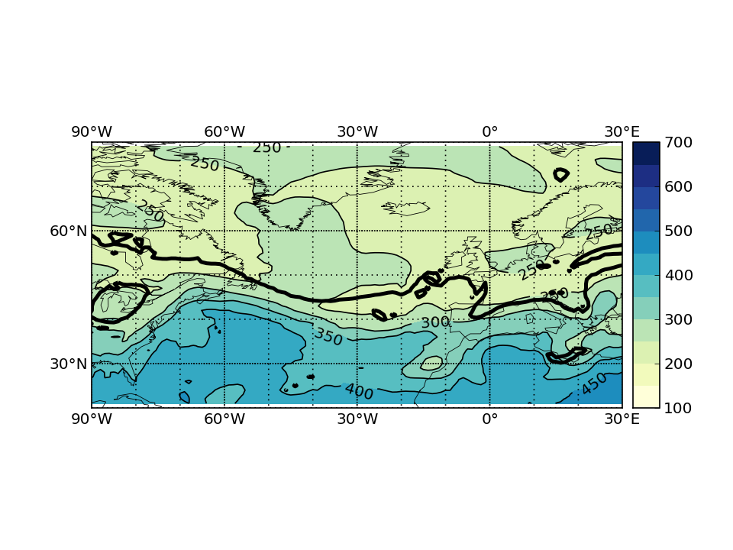
IOP7 1200 UTC 02 October 2016
330-K pressure
T+0
T+120
✓
Different geometry of 330-K isentropic surface

Slide 24
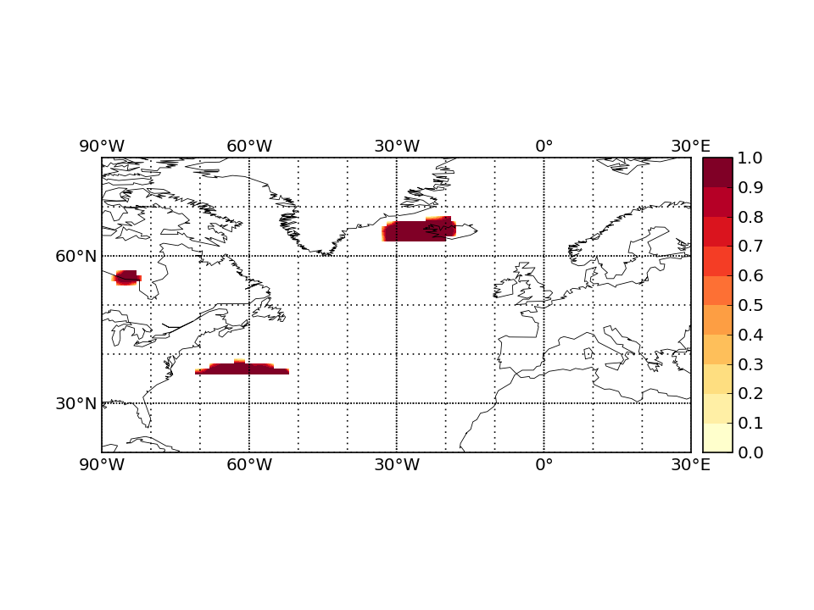
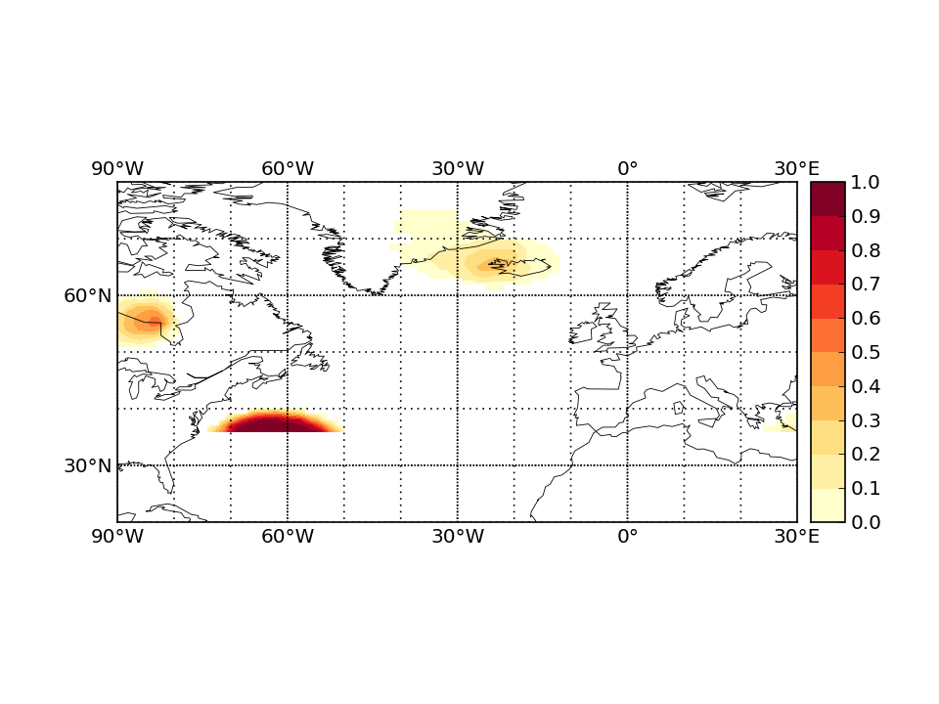
IOP7 1200 UTC 02 October 2016
Blocking probability
T+0
T+120
✓
No impact on blocking

Slide 25
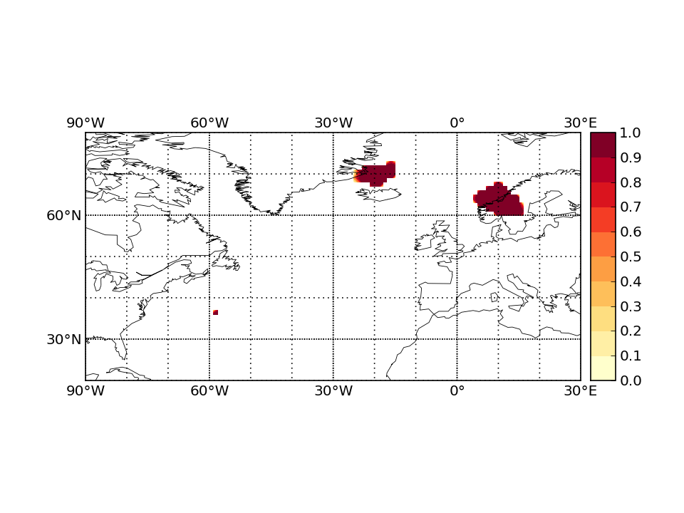
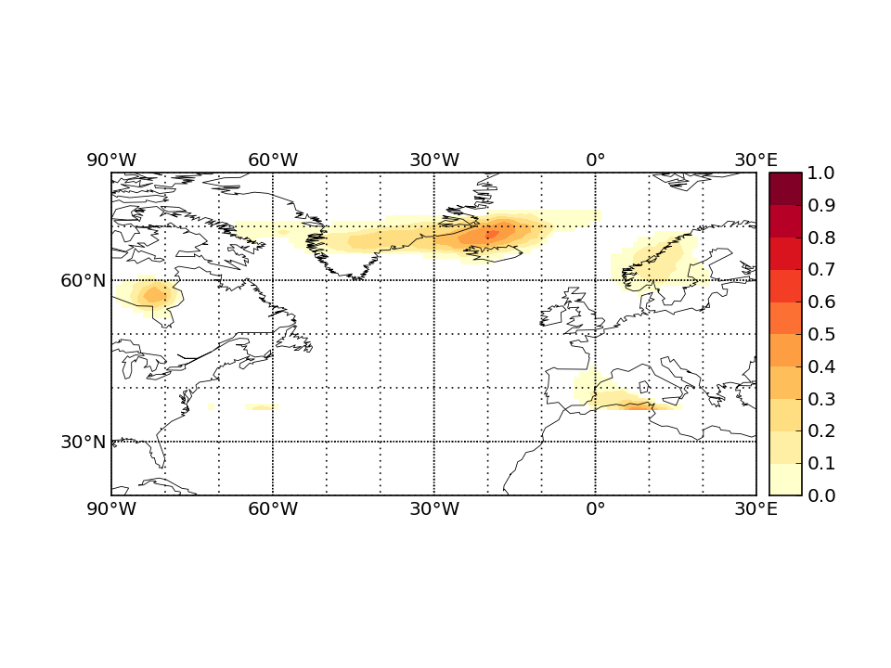
IOP7 1200 UTC 02 October 2016
Blocking probability a day later
T+0
T+144
✓
No impact on blocking

