Slide 1
Diabatic processes and the structure of extratropical cyclones
Mesoscale group meeting
Reading, 8 November 2012
Oscar Martínez-Alvarado
R. Plant, J. Chagnon, S. Gray, J. Methven
Department of Meteorology
University of Reading
H. Joos, M. Bötcher, H. Wernli
ETH Zurich

Slide 2
Objectives
Evaluate the accuracy of numerical models in simulating atmospheric diabatic processes in extratropical cyclones
What diabatic processes are important?
What effect do these processes have on the cyclone’s development?
What are the consequences for the subsequent development of the upper-level atmospheric structure?

Slide 3
Methods
Tracers tracking changes in potential vorticity (PV) and potential temperature ($θ$)
Trajectory analysis - computation of Lagrangian trajectories following air parcels subject to the model-resolved velocity field

Slide 4
Tracers (I)
The variables of interest (PV, $θ$) are decomposed as
proc = {parameterised processes}
where $φ_{0}$ represents a conserved field (redistribution by advection of the initial field) and $∆φ_{i}$ represents the accumulated tendency of $φ$ due to a parameterised process.
Parameterised processes:
short- and long-wave radiation
large-scale cloud formation
convection
boundary layer

Slide 5
Tracers (II)
Thus, there are evolution equations for $φ_{0}$ and for each $∆φ_{i}$
The evolution equation for the relevant variables can then be written as
The conserved field is affected by advection only
Each accumulated tendency is affected by advection and by a particular source of $φ$ given by $S_{φ_{i}}$
Total rate of change
Sources
Advection of conserved field
Advection of accumulated tendencies

Slide 6
Consistency between tracers and trajectories
Theoretically, $θ_{0}$ is conserved along trajectories. In practice, this is not true mainly because we simply cannot expect a perfect match between the advection in the model and the offline computation of trajectories.
We select those trajectories that do not depart too much from their initial $θ_{0}$ value.
The trajectories that are rejected largely correspond to trajectories that end up in the far right-end of the theta distribution in a long trailing tail beyond the value of $θ$ = 340 K.

Slide 7
Case-Study I:
An extratropical cyclone on
25 November 2009
(T-NAWDEX III)
Work in collaboration with Dr Hanna Joos and Dr Maxi Böttcher
ETH Zürich

Slide 8
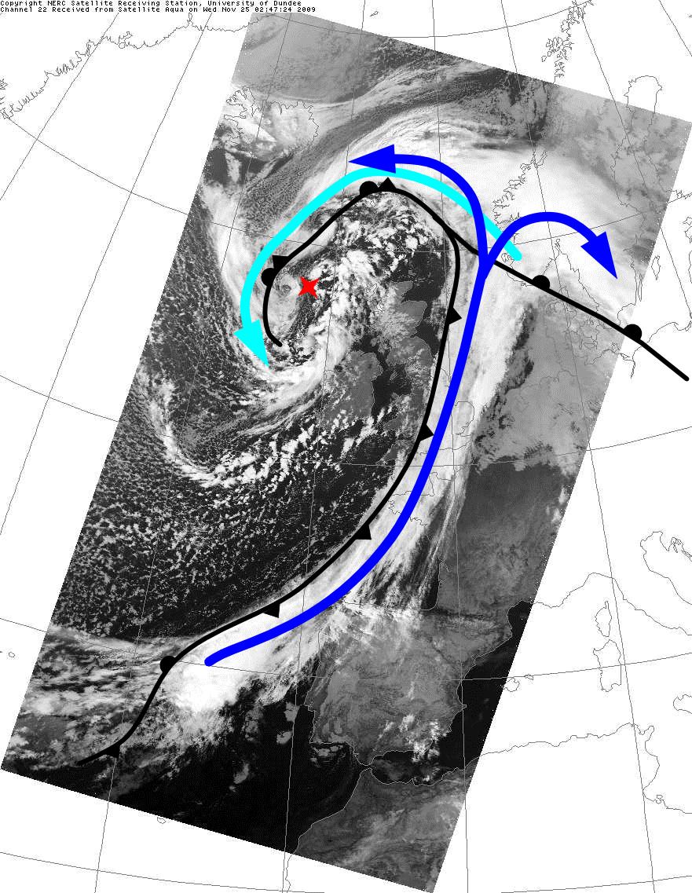
Case-Study II: Synoptic-scale context
Channel 22, satellite Aqua
0247 UTC 25 Nov 2009
The surface low formed in the North Atlantic on 23 November 2009 along an east-west oriented baroclinic zone
The low deepened from 0000 UTC 23 November to 0000 UTC 25 November 2009 and moved eastward.
By 0000 UTC 25 November, the system was occluded and had undergone “frontal fracture”.
Precipitation was heavy and continuous along the length of the cold front during the period 23-25 November 2009. As such, this is an ideal case for examining diabatic heating in a WCB.
The upper-level trough associated with the primary low amplified in concert with the surface low.
The downstream ridge and downstream trough also amplified during this period.
Cold conveyor belt
Cyclone’s low pressure centre
Warm conveyor belt
Satellite image courtesy of NERC Satellite Receiving Station, Dundee University, Scotland http://www.sat.dundee.ac.uk
Surface fronts based on the Met Office analysis at 00 UTC 25 Nov 2009 (archived by http://www.wetter3.de/fax)

Slide 9
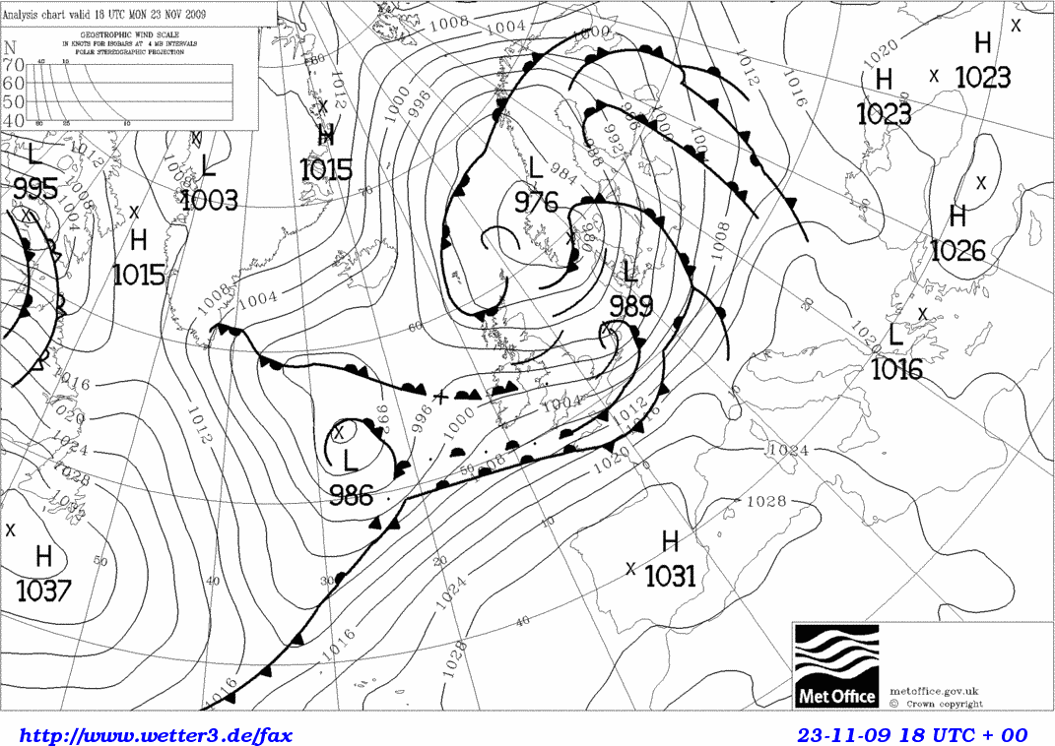
Trajectory selection
WCB trajectories
Ascent $Δp>500$ hPa in 48 hours (starting at 1800 UTC on 23 November 2009)
Wide starting region to capture every ascending trajectory related to the system

Slide 10
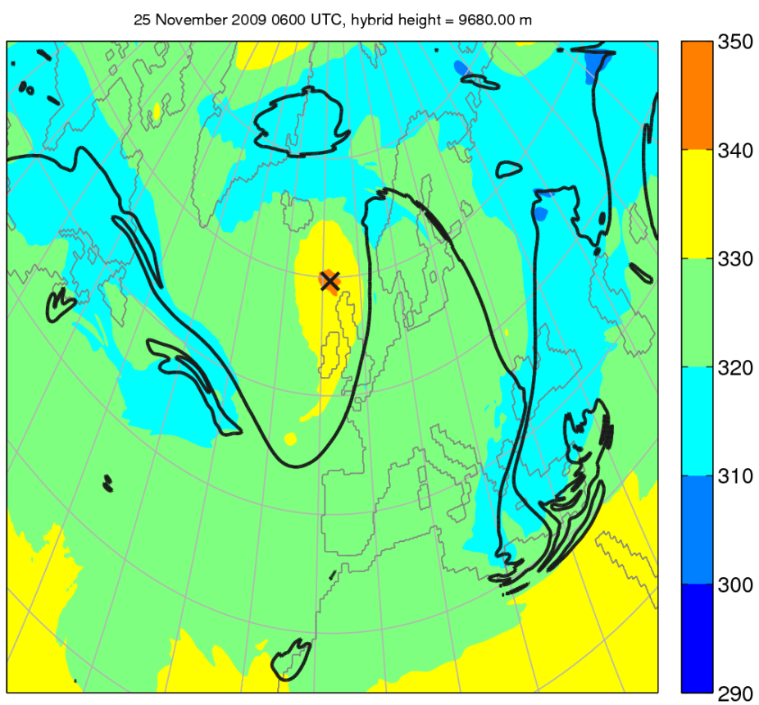
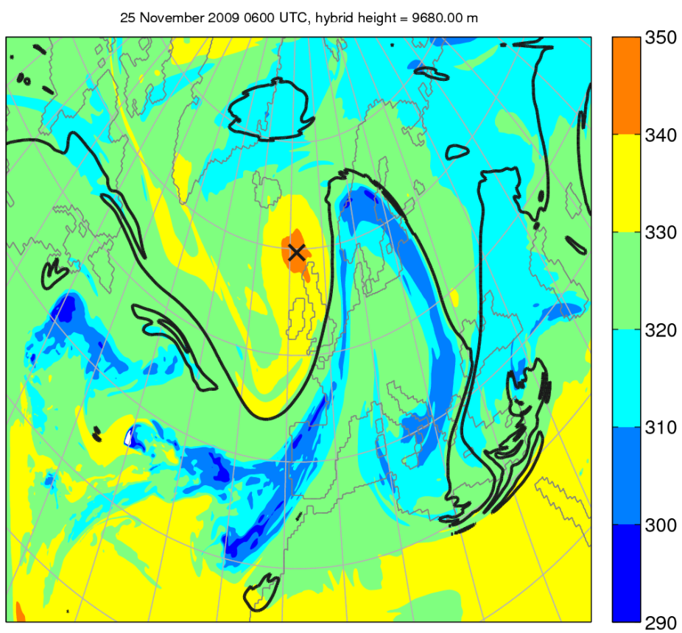
Upper-level structure (I)
Potential temperature conserved component (K)
Potential temperature (K)
Model level at 9.68 km

Slide 11
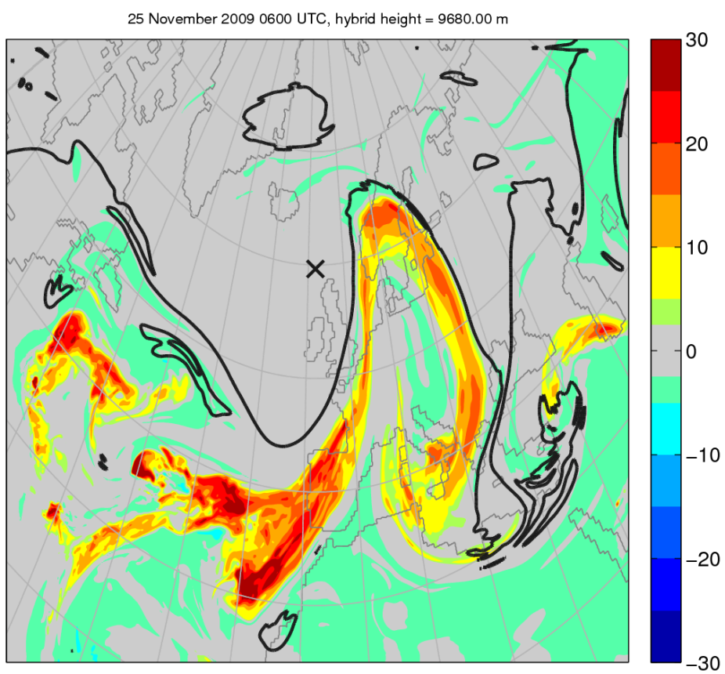
Upper-level structure (II)
Diabatic potential temperature (K)
Diabatic potential vorticity (PVU)
1
0.5
0
-0.5
2
Model level at 9.68 km

Slide 12
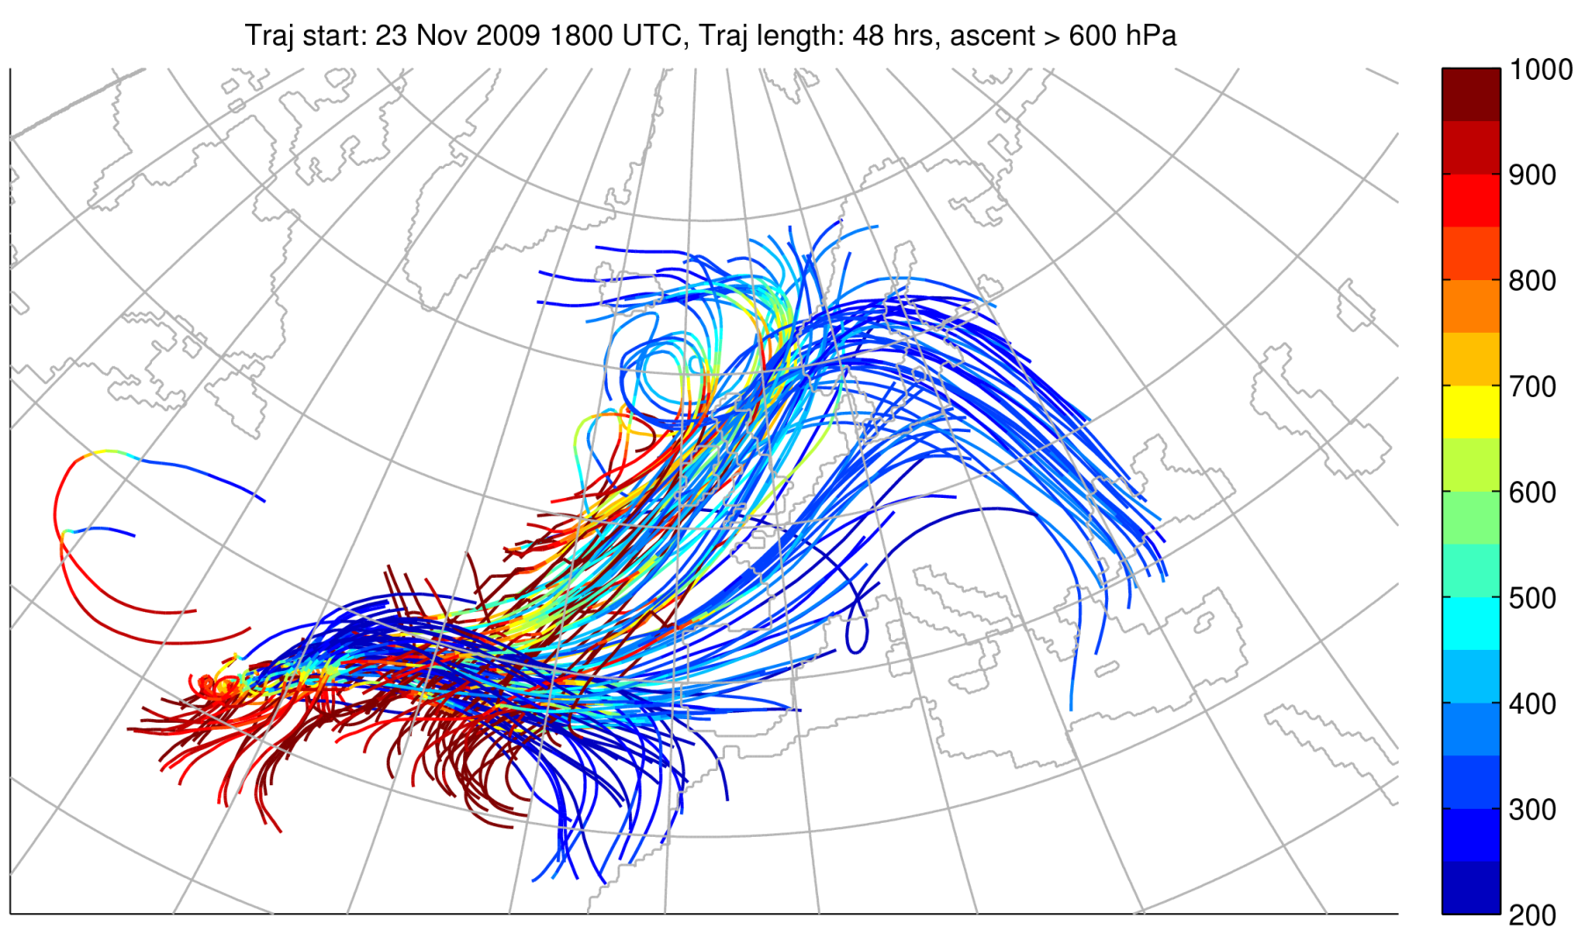
Trajectory bundle
A
B
C

Slide 13
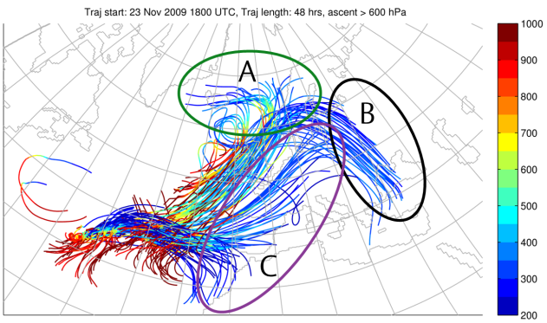
Identification of sub-streams
A
B + C
All trajectories
θ < 307.5 K
θ > 307.5 K
Y grid point
X grid point
X grid point
X grid point
Lower branch
Upper branch

Slide 14
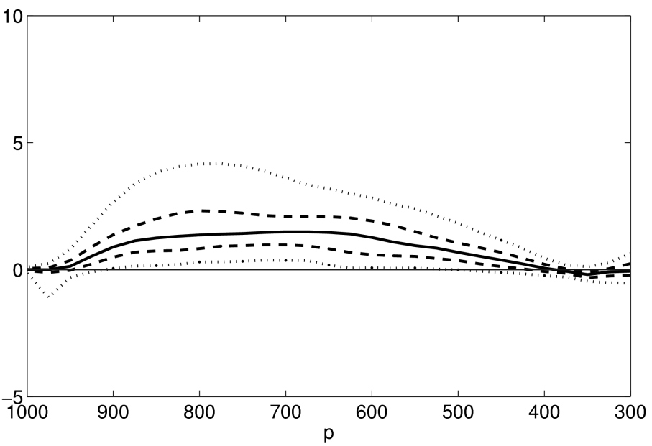
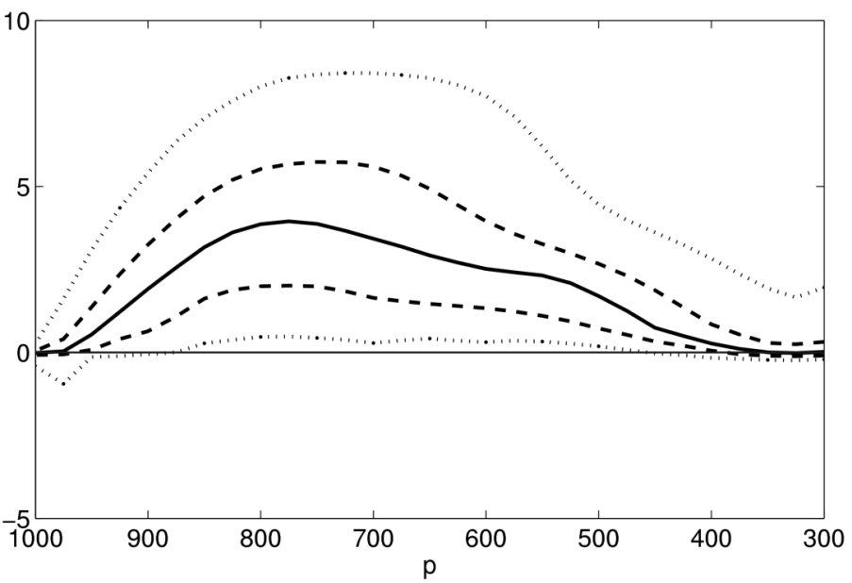
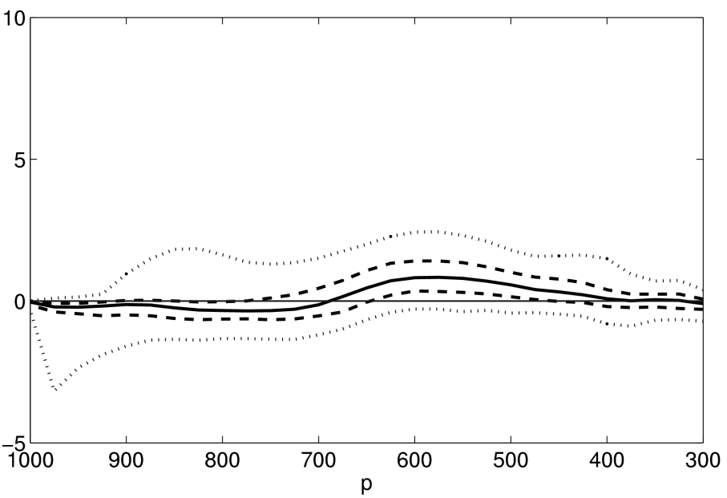
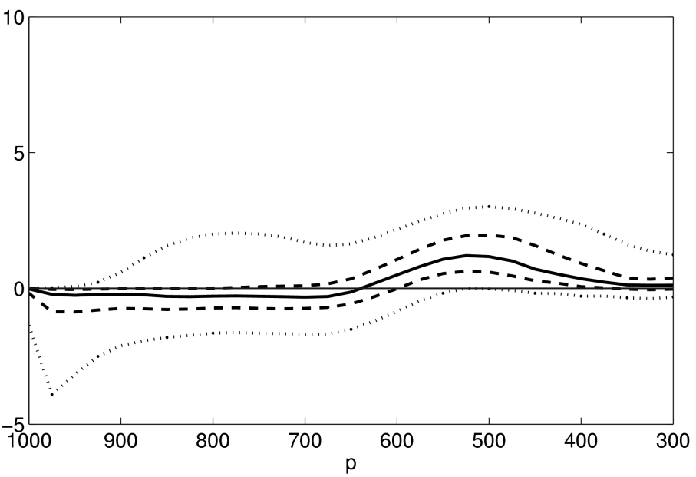
Heating rates – MetUM (I)
A
B + C
Total heating
Total heating
(K h⁻¹)
Large-scale cloud
Large-scale cloud
(K h⁻¹)
Pressure (hPa)
Pressure (hPa)

Slide 15
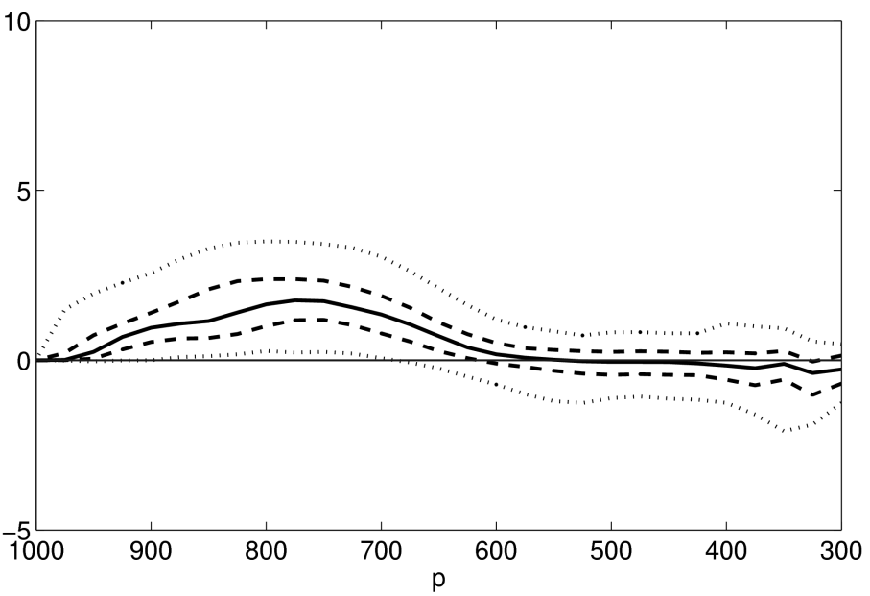
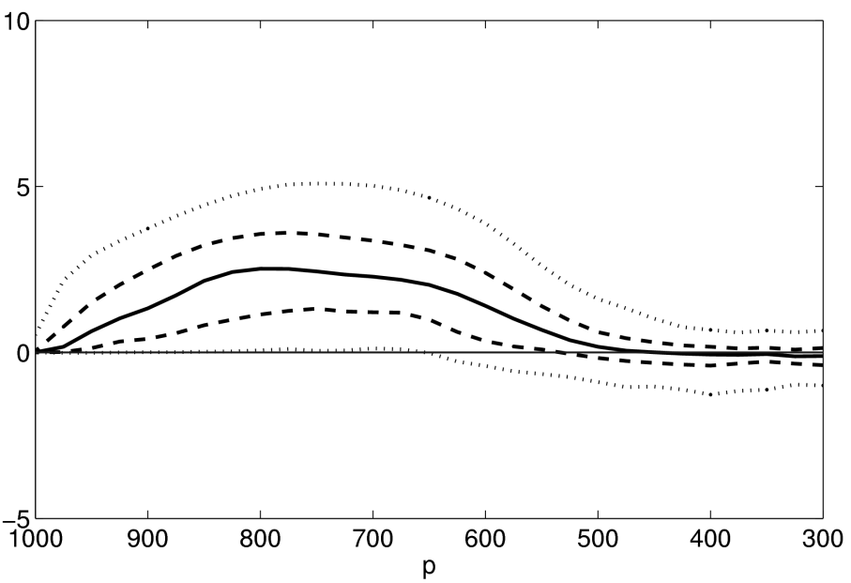
Heating rates – MetUM (II)
A
B + C
Total heating
Total heating
(K h⁻¹)
Boundary layer
Boundary layer
(K h⁻¹)
Pressure (hPa)
Pressure (hPa)

Slide 16
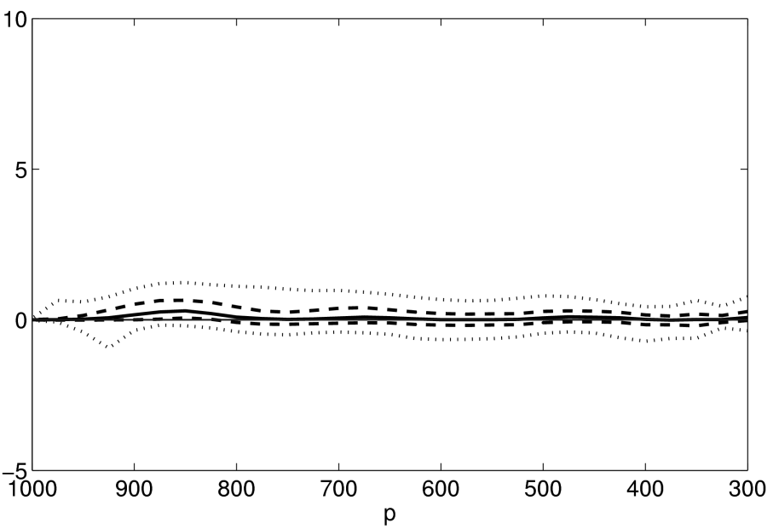
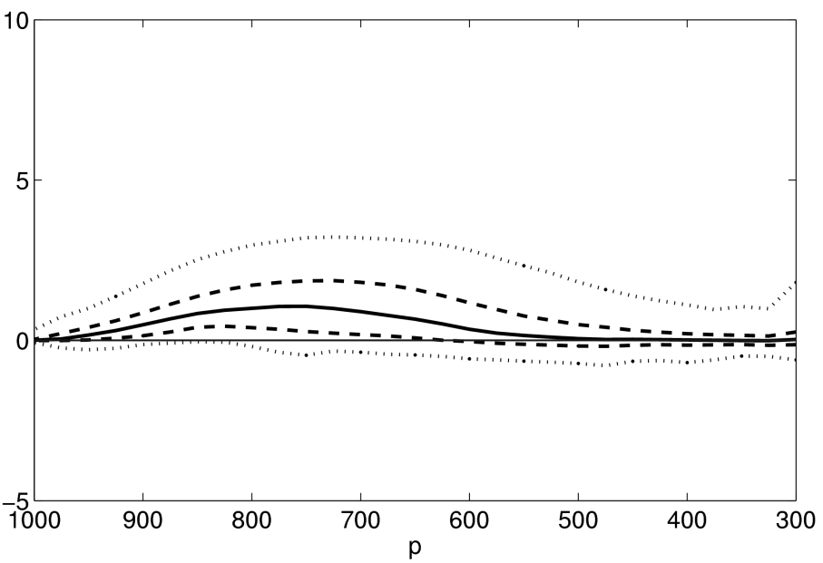
Heating rates – MetUM (III)
A
B + C
Total heating
Total heating
(K h⁻¹)
Convection
Convection
(K h⁻¹)
Pressure (hPa)
Pressure (hPa)

Slide 17
Summary and conclusions from Case-Study I
The convection, boundary layer latent heat and large-scale cloud parameterisations were the most active numerical diabatic sources in this case
These parameterisations contributed differently to each WCB branch
The most noticeable difference was found in the action of parameterised convection
Did it provide the extra heating necessary to lift those parcels to upper-levels and into the downstream ridge?

Slide 18
Case-Study II:
An extratropical cyclone on
30 September 2011

Slide 19
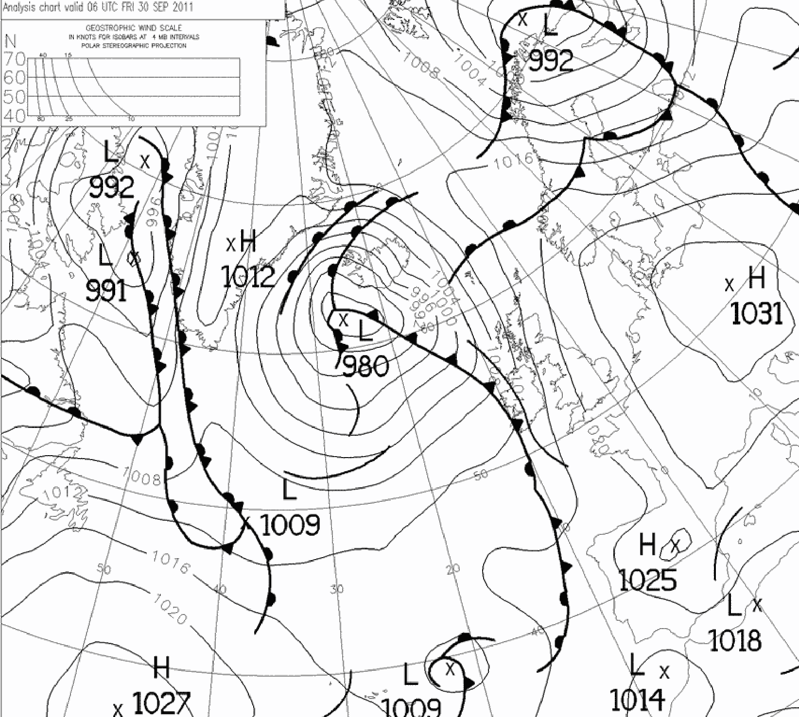
Case-Study I: 30 September 2011
Low-pressure system centred to the southwest of Iceland with a long-trailing cold front.
Development began 0600 UTC 28 September 2011 at 43°N 28°W.
From there it travelled northwards to be located around 62°N 25°W at 1200 UTC 30 September 2011, deepening from 997 hPa to 973 hPa in 54 hours.
Precipitation over the United Kingdom on 30 September 2011.
Met Office operational analysis chart at 06 UTC 30 Sep 2011
(archived by http://www.wetter3.de/fax)

Slide 20
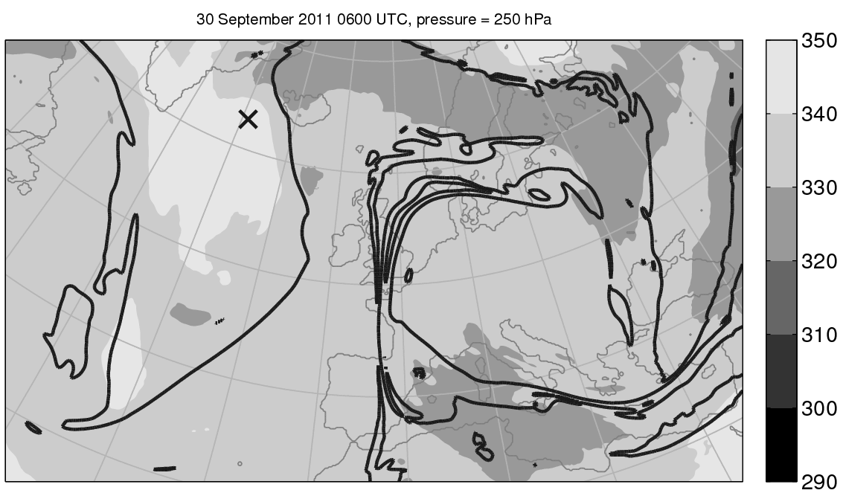
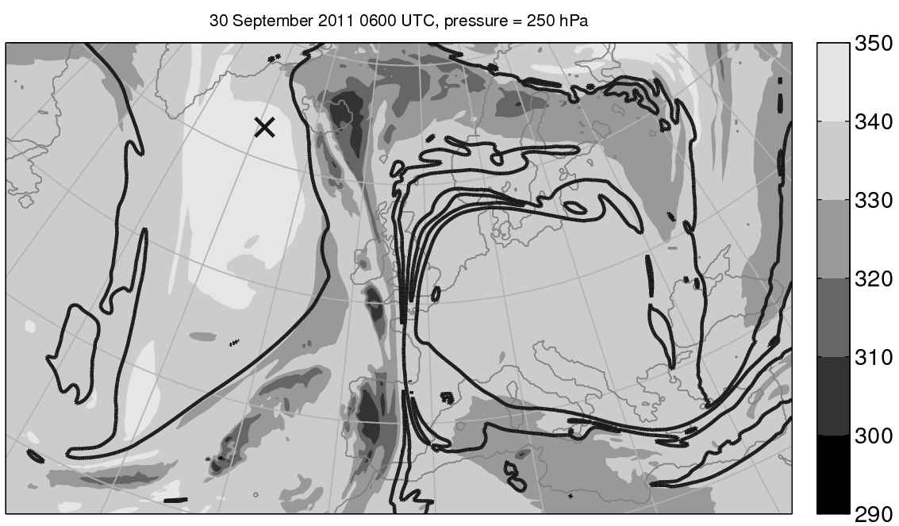
Diabatic potential temperature at 250 hPa
θ
θ₀
(K)
θ decomposition at 250 hPa on 06 UTC 30 Sep 2011.
Bold black lines represent the 2-PVU contour.
Black crosses (X) indicate the position of the mean sea-level low-pressure centre.

Slide 21
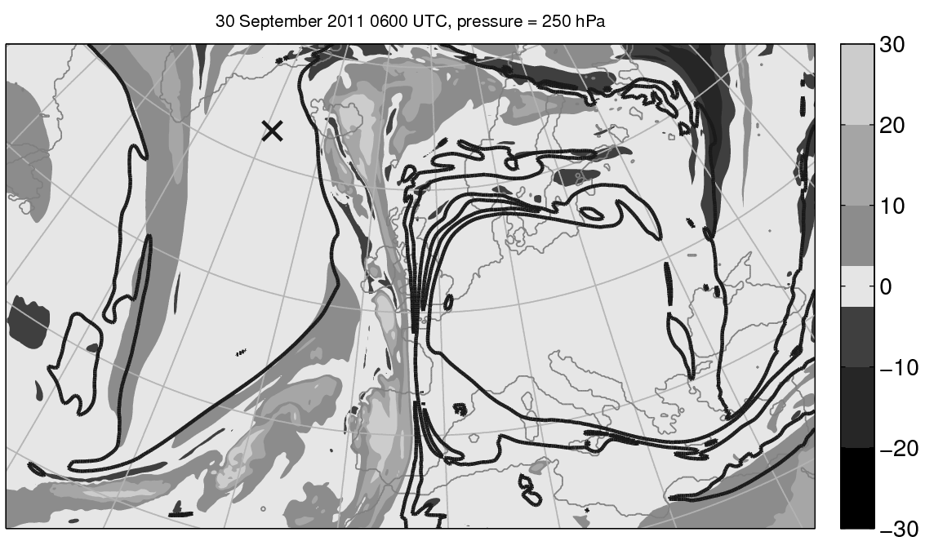
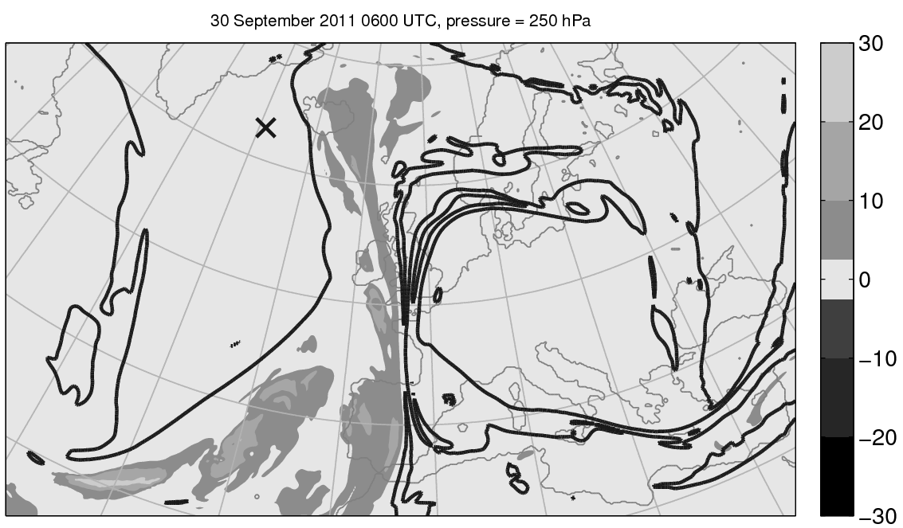
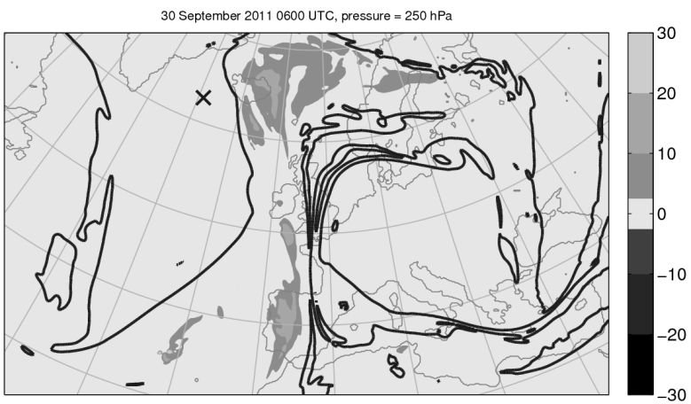
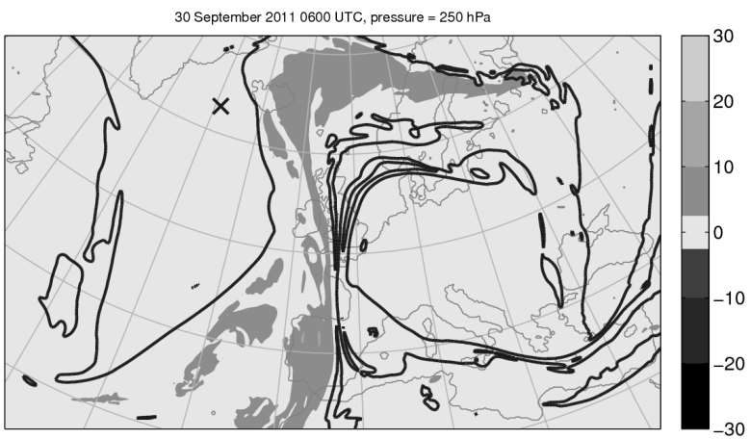
Diabatic potential temperature at 250 hPa
Total heating
Convection
(K)
Boundary layer
Large-scale cloud
(K)
θ decomposition at 250 hPa on 06 UTC 30 Sep 2011.
Bold black lines represent the 2-PVU contour.
Black crosses (X) indicate the position of the mean sea-level low-pressure centre.
The green line represents the position of the section in the next frames.

Slide 22
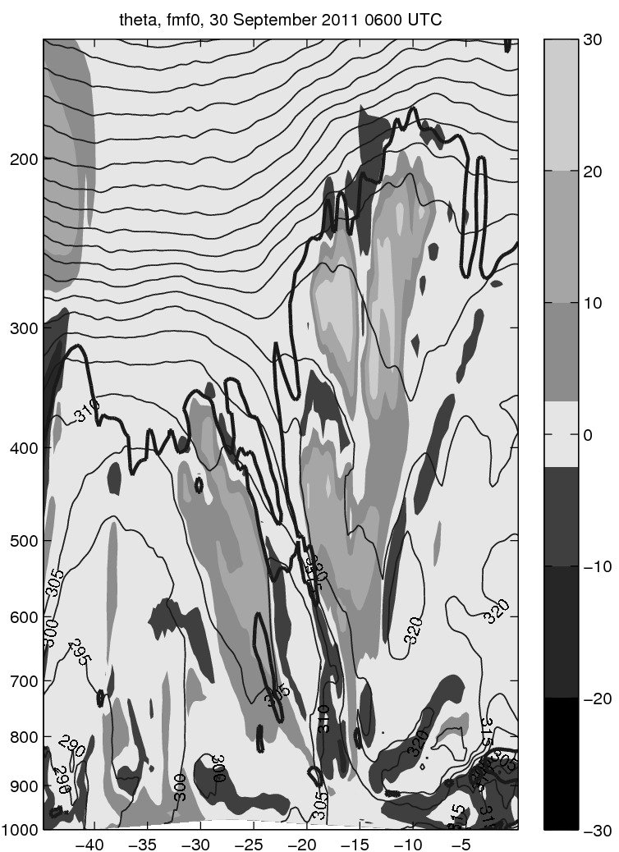
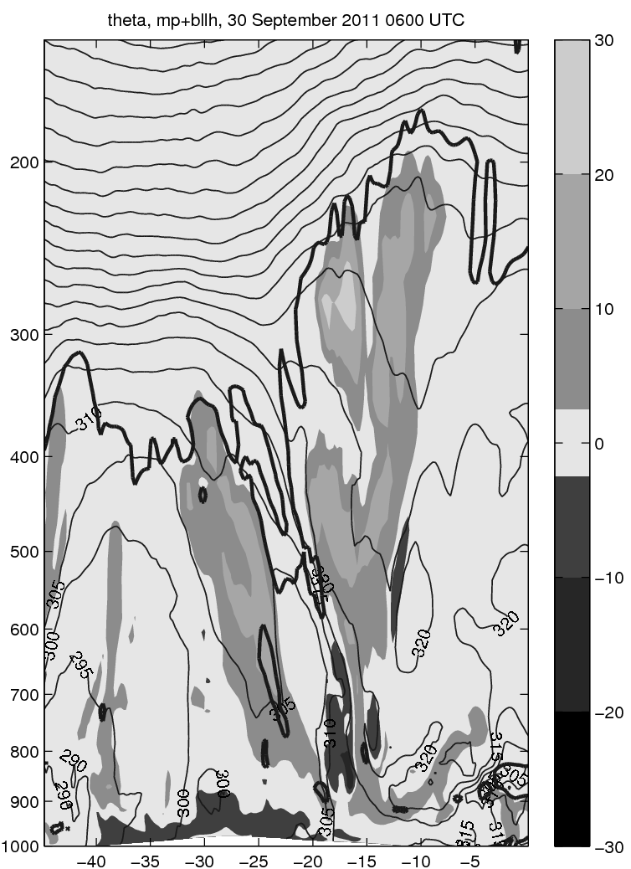
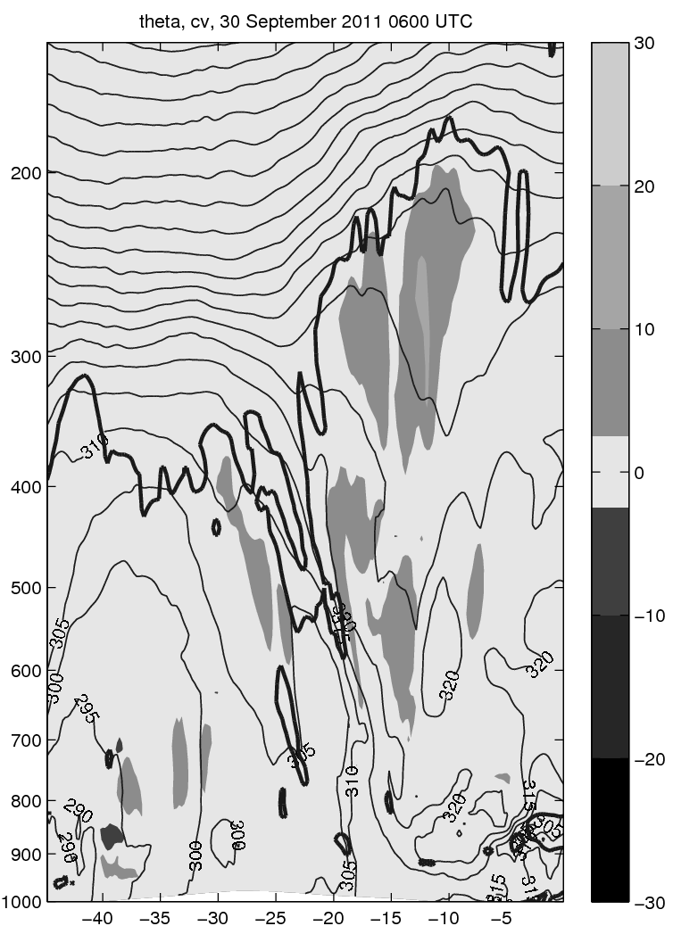
Diabatic potential temperature (Vertical structure)
Boundary layer
$∆θ$ (CONTROL)
(K)
+ Large-scale cloud
(K)
Convection
(K)
Bold black lines represent the 2-PVU contour.
Thin black lines represent equivalent potential temperature contours with a 5-K separation.

Slide 23
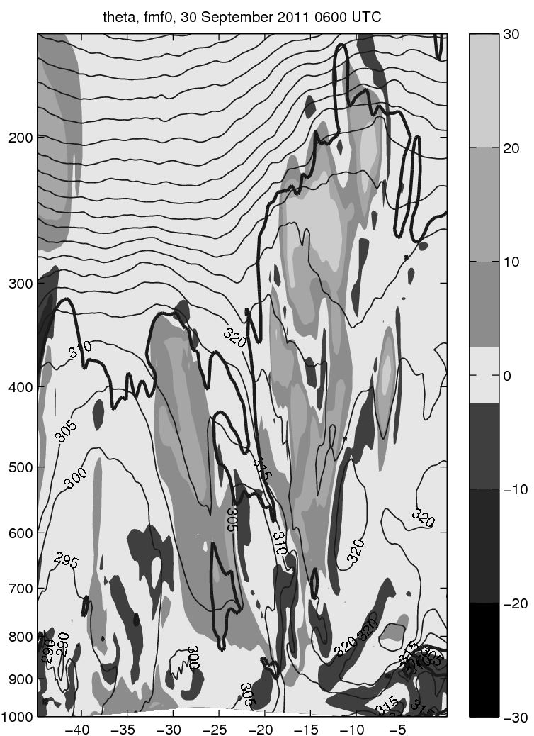
Diabatic potential temperature (Vertical structure)
$∆θ$ (CONTROL)
(K)
$∆θ$ (REDUCED Conv)
(K)
Bold black lines represent the 2-PVU contour.
Thin black lines represent equivalent potential temperature contours with a 5-K separation.

Slide 24
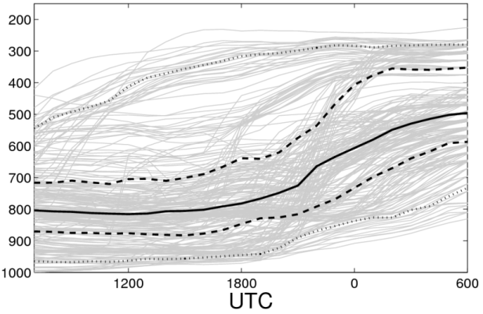
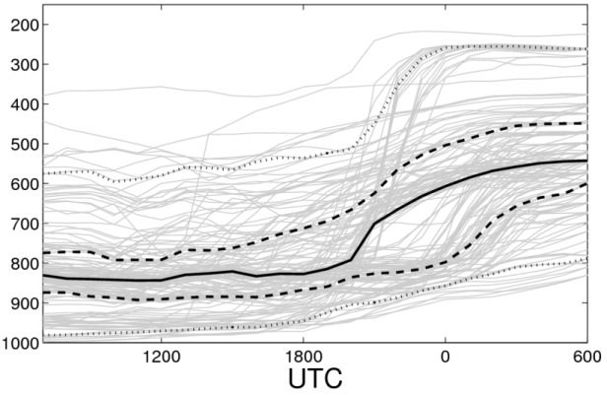
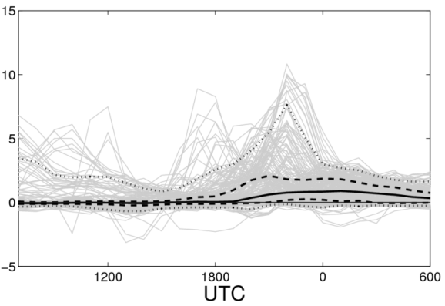
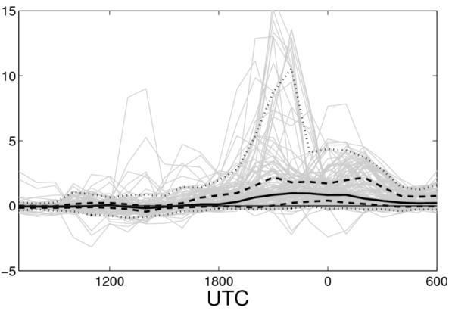
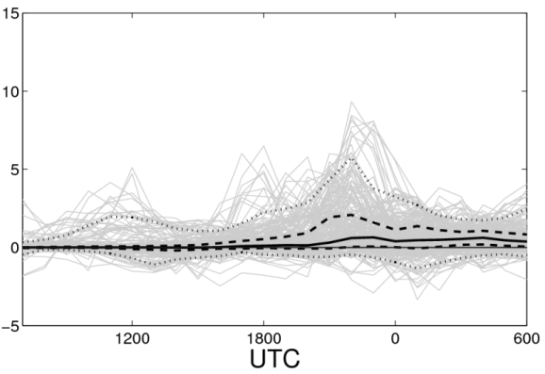
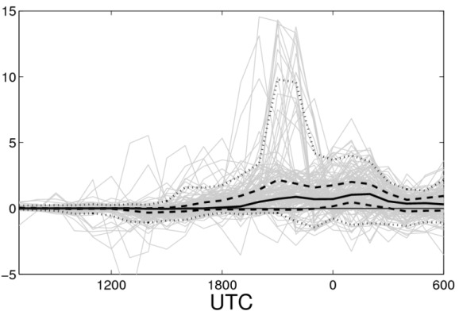
Trajectory analysis
CONTROL
REDUCED Conv
Evolution along trajectories that have strong accumulated heating.
Solid lines represent the median
Dashed lines represent the 25th and 75th percentiles
Dotted lines represent the 5th and 95th percentiles of the trajectory ensemble
Grey lines represent individual trajectories.
200
300
400
500
600
700
800
900
1000
200
300
400
500
600
700
800
900
1000
Pressure (hPa)
Pressure (hPa)
1200 1800 0 0600
1200 1800 0 0600
15
10
5
0
-5
15
10
5
0
-5
DΔθ/Dt (K)
DΔθ/Dt (K)
1200 1800 0 0600
1200 1800 0 0600
15
10
5
0
-5
15
10
5
0
-5
DΔθ_{bllh+lsc} /Dt (K)
DΔθ_{bllh+lsc} /Dt (K)
1200 1800 0 0600
1200 1800 0 0600

Slide 25
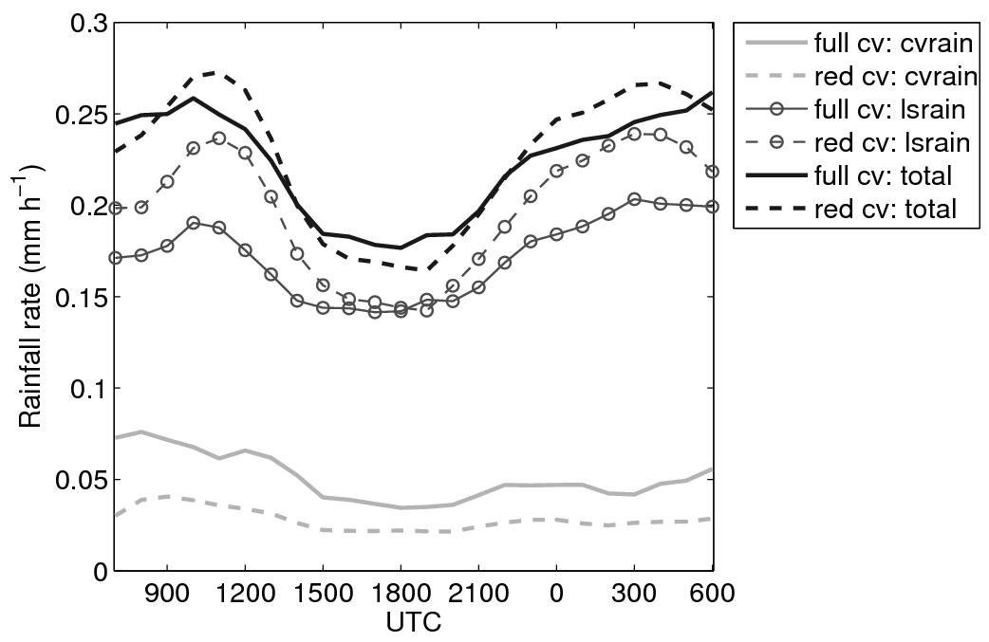
Convective–large-scale precipitation split
Rain rate averaged over an area of 1500-km radius centred on the low pressure centre, showing the contributions from convective (cvrain) and large-scale rain (lsrain) to the total precipitation (total) for CONTROL and REDUCED Conv.

Slide 26
Summary and conclusions from Case-Study II
The convection and large-scale cloud parameterisations were the most active numerical diabatic sources in this case
Two simulations, one with standard parameterised convection and one with reduced parameterised convection were contrasted
The upper-level PV structure was sensitive to the details of the parameterisation schemes and their interaction
Although, the convective – large-scale precipitation split was different, both simulations produced a similar amount of total precipitation
The most important diabatic modifications to potential temperature appeared along the warm conveyor belt

Slide 27
Conclusions
The upper-level PV structure reflects the WCB split and is affected by it
The action of diabatic processes is different for each branch
The upper-level PV structure is modified by these diabatic processes (through the WCB split)
The modifications to the upper-level PV structure depend on the details of the parameterisation of sub-grid scale processes and the interaction between parameterisation schemes

Slide 28
Conclusions
Are these modifications important for the subsequent evolution of the cyclone?
If they are then the details of the treatment of sub-grid scale processes is crucial for free-running simulations (climate projections)
Reanalyses benefit from data assimilation which maintains the model evolution close to reality
Climate projections are unable to benefit from these techniques

Slide 29
Future work
Complete a systematic comparison between two models
Met Office Unified Model (MetUM) at Reading
COnsortuim for Small-scale MOdelling (COSMO) model at Zürich
Two complementary diabatic decomposition techniques
Perform high-resolution (convection-permitting) simulations of parts of the WCB
Systematic comparison against observations (and reanalyses)

