Slide 1
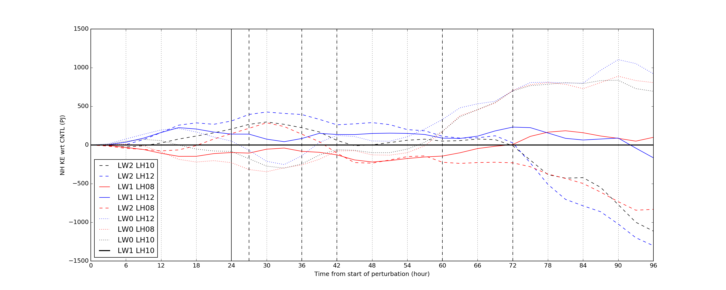
Total kinetic energy over Northern Hemisphere mid-latitudes (20⁰N - 80⁰N)

Slide 2
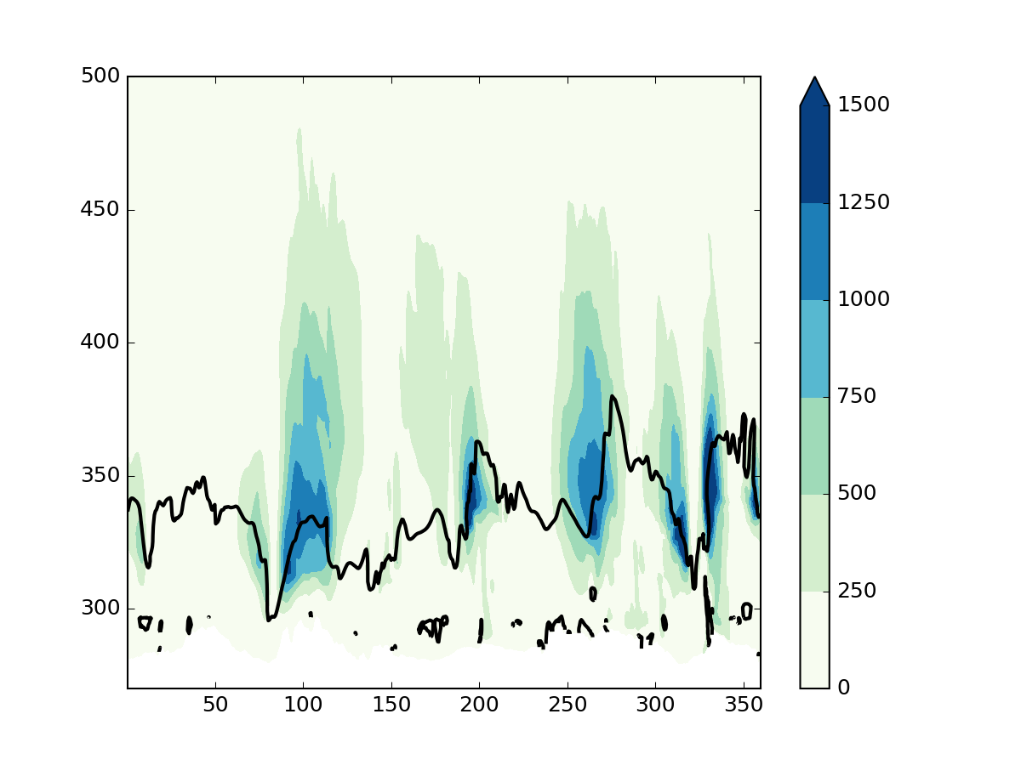
Time into simulation: 30 hours
LW0 LH10
LW1 LH10
LW2 LH10
Potential temperature (K)
Colour: Kinetic energy per unit mass (m² s⁻²) at 50ºN
Black line: 2-PVU contour at 50ºN

Slide 3
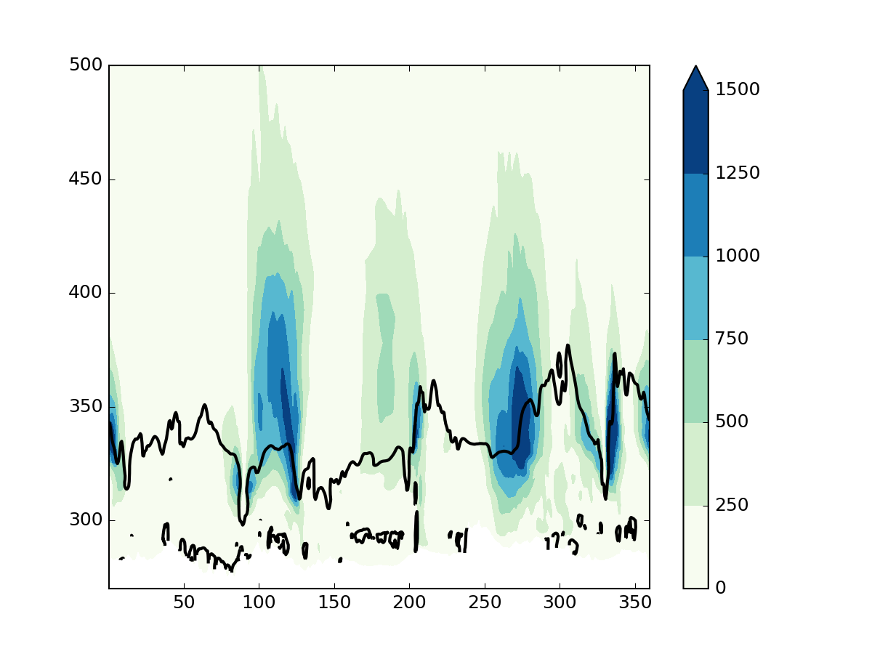
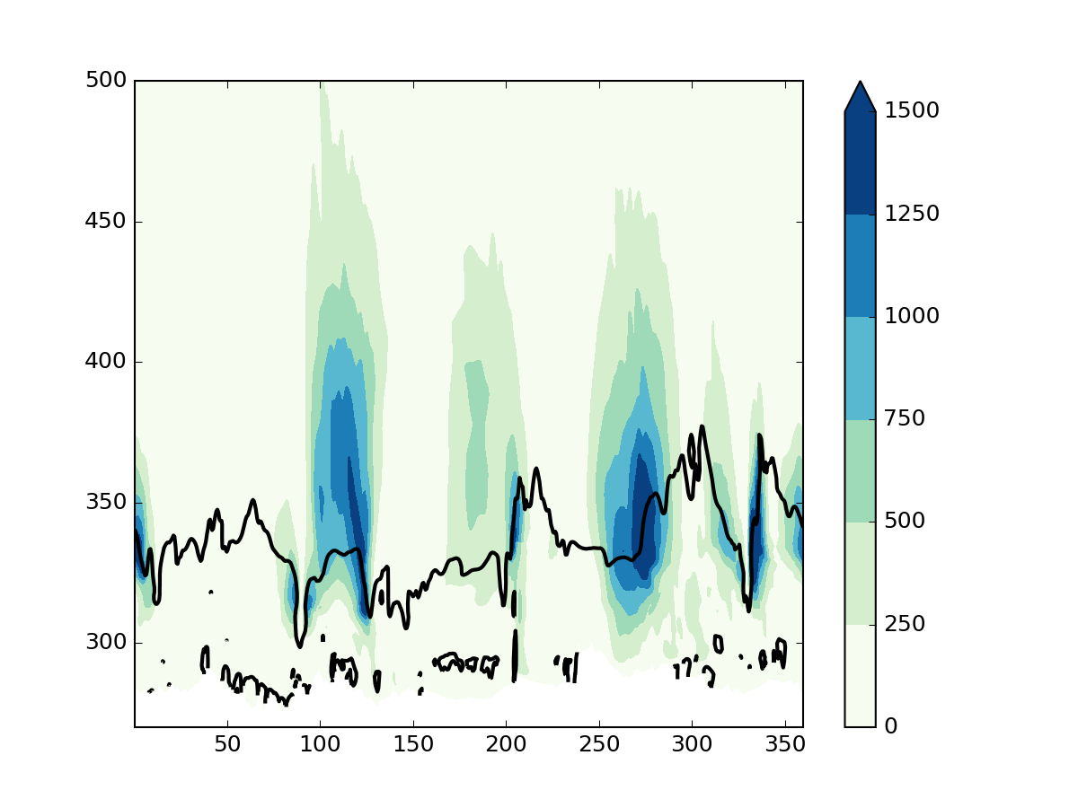
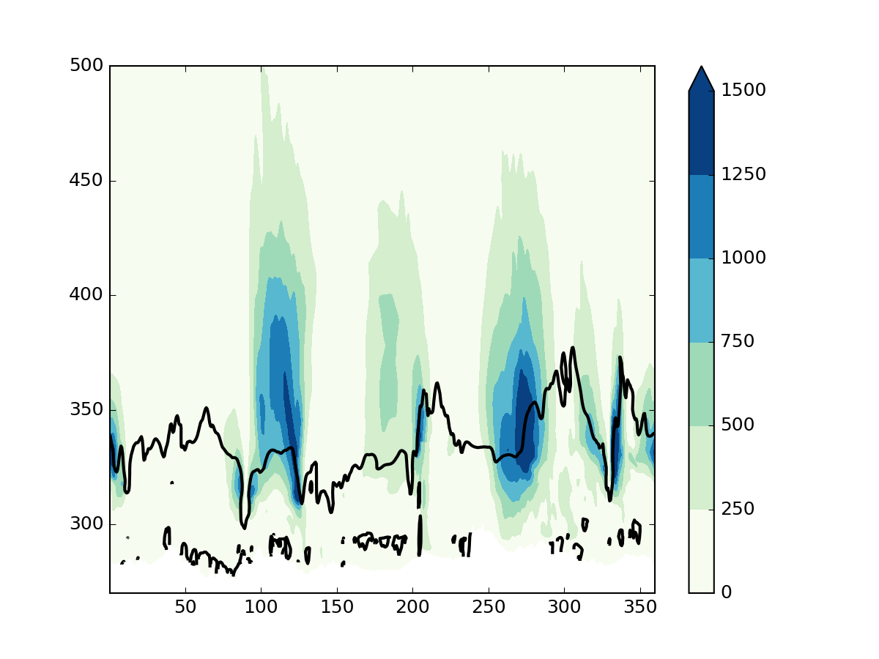
Time into simulation: 48 hours
LW0 LH10
LW1 LH10
LW2 LH10
Potential temperature (K)
Colour: Kinetic energy per unit mass (m² s⁻²) at 50ºN
Black line: 2-PVU contour at 50ºN

Slide 4
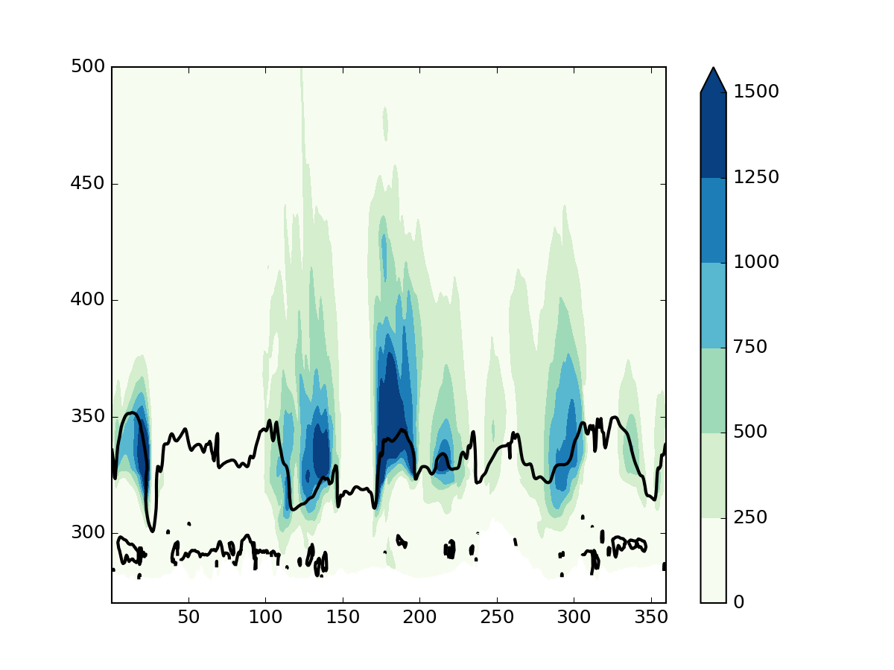
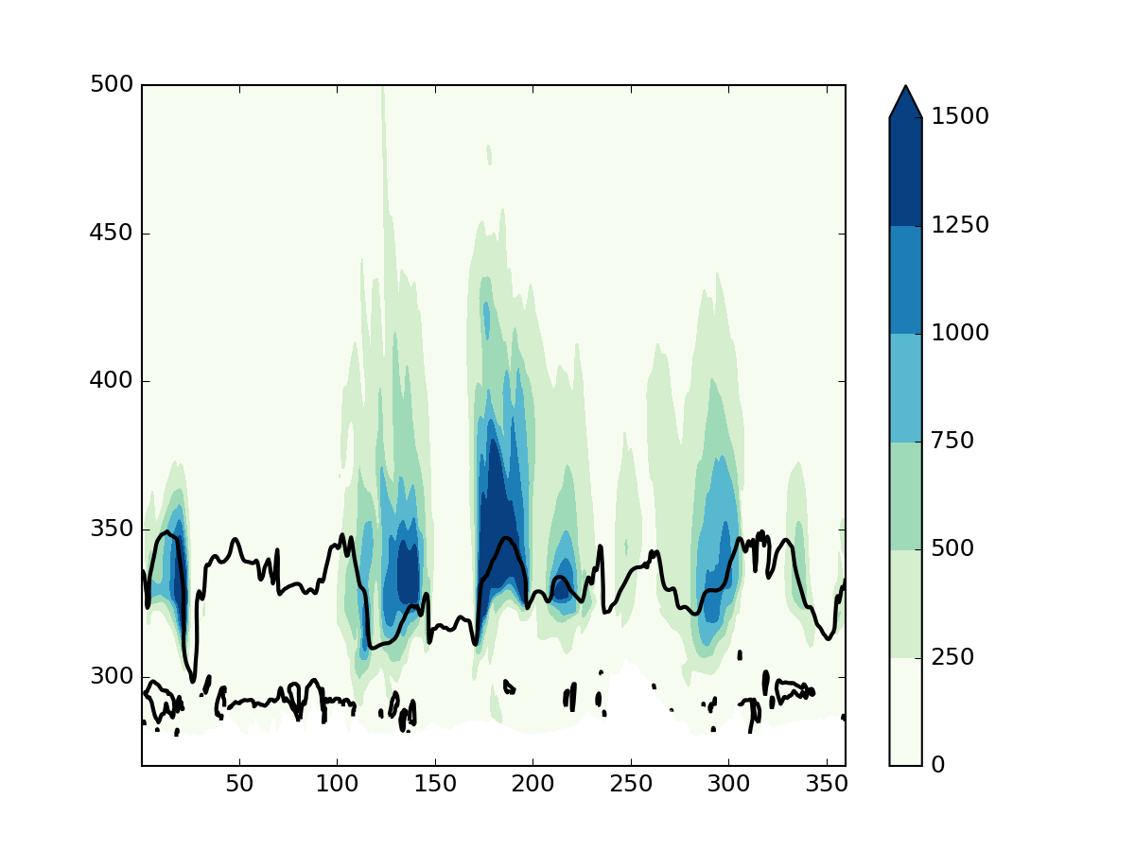
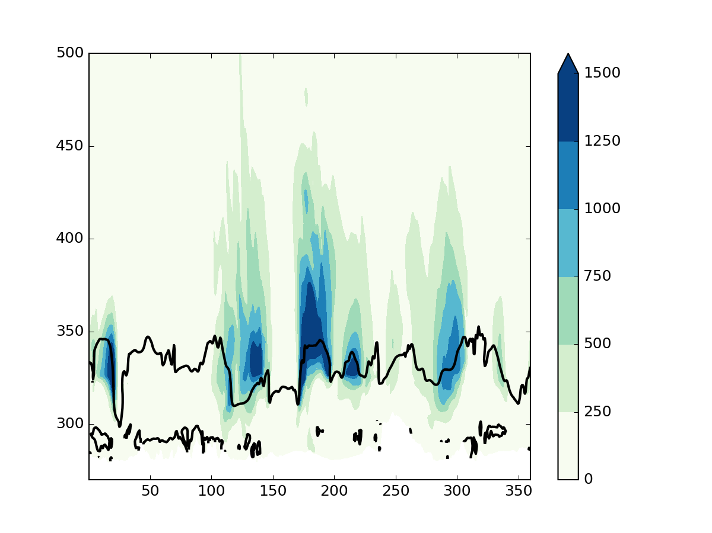
Time into simulation: 96 hours
LW0 LH10
LW1 LH10
LW2 LH10
Potential temperature (K)
Colour: Kinetic energy per unit mass (m² s⁻²) at 50ºN
Black line: 2-PVU contour at 50ºN

Slide 5
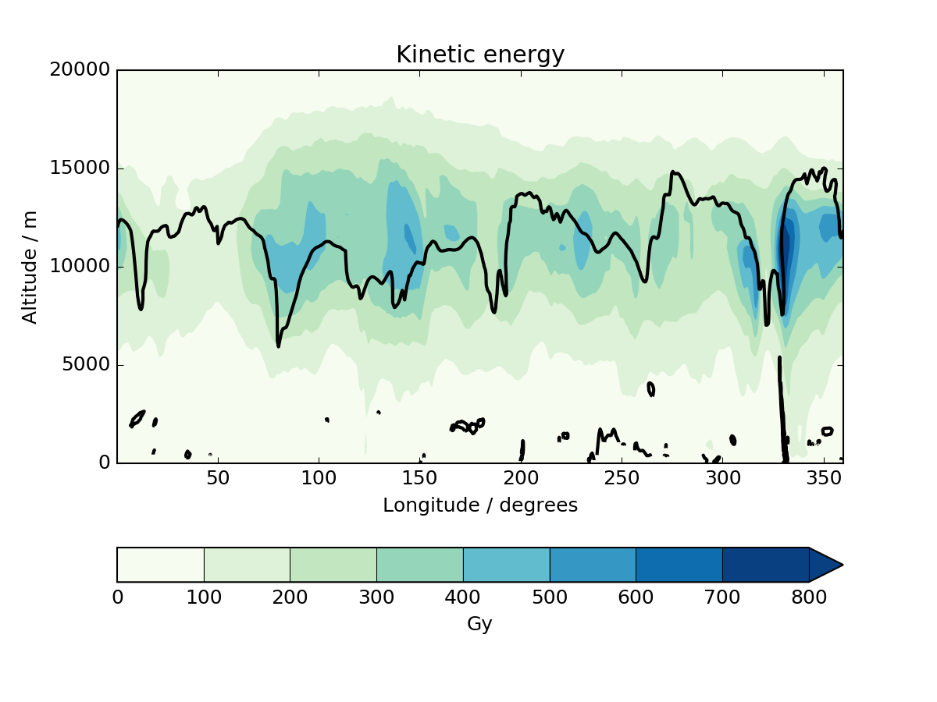
Time into simulation: 30 hours
LW0 LH10
LW1 LH10
LW2 LH10
Colour: Average kinetic energy per unit mass (m² s⁻²) in a mid-latitude band (20⁰N - 80⁰N)
Black line: 2-PVU contour at 50ºN

Slide 6
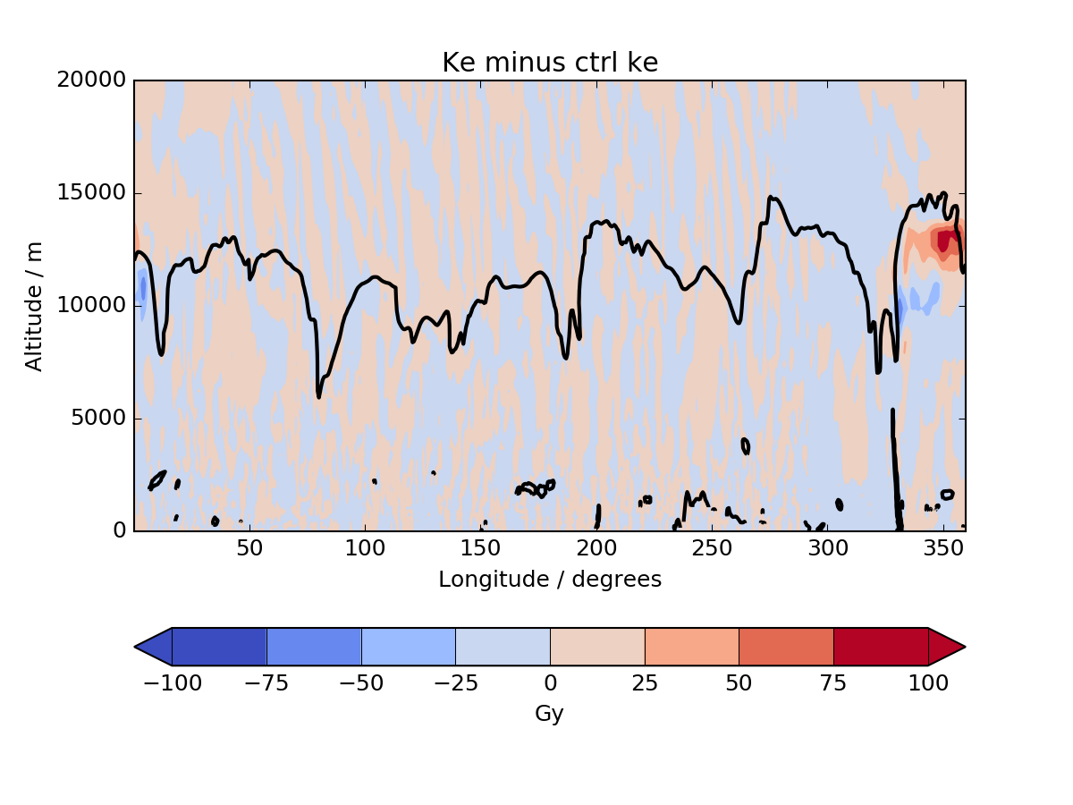
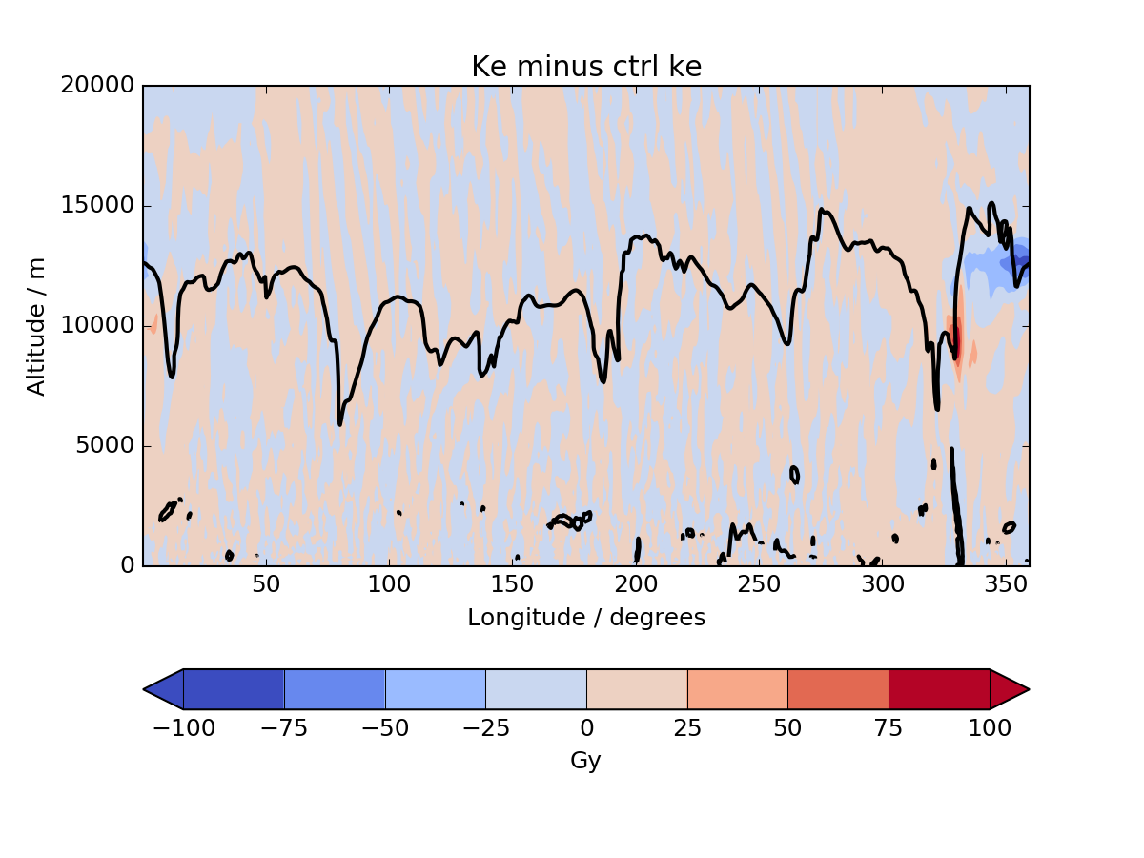
Time into simulation: 30 hours
LW0 LH10
LW1 LH10
LW2 LH10
All: Black line: 2-PVU contour at 50ºN
Centre: Colour: Average kinetic energy per unit mass (m² s⁻²) in a mid-latitude band (20⁰N - 80⁰N)
Sides: Colour: Difference modified physics minus control (m² s⁻²)

Slide 7
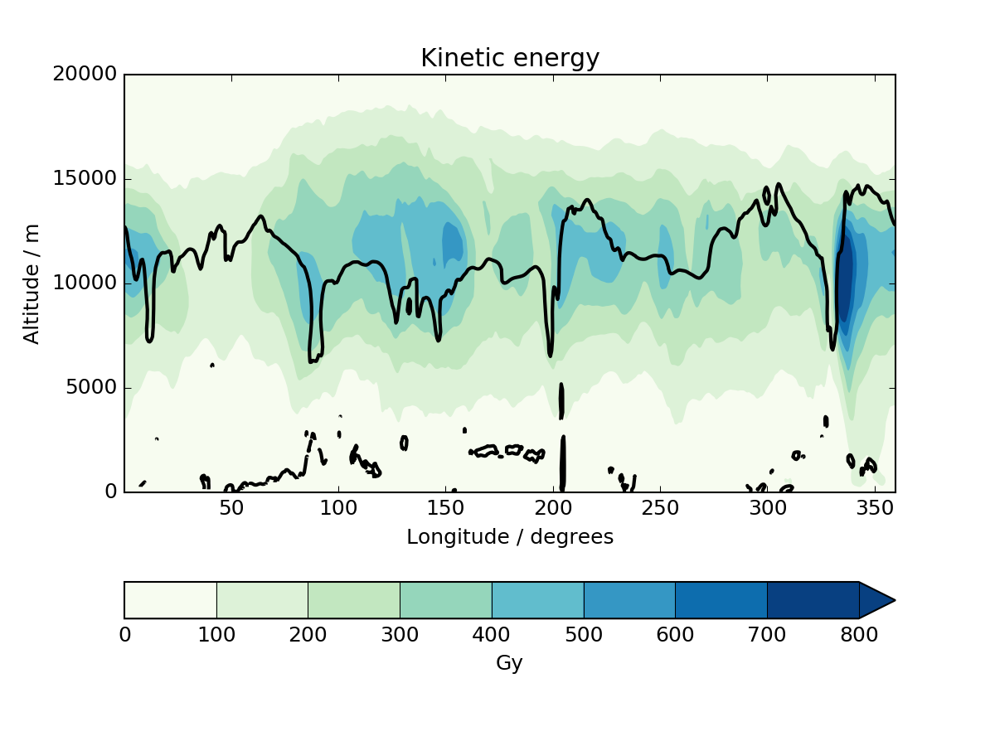
Time into simulation: 48 hours
LW0 LH10
LW1 LH10
LW2 LH10
Colour: Average kinetic energy per unit mass (m² s⁻²) in a mid-latitude band (20⁰N - 80⁰N)
Black line: 2-PVU contour at 50ºN

Slide 8
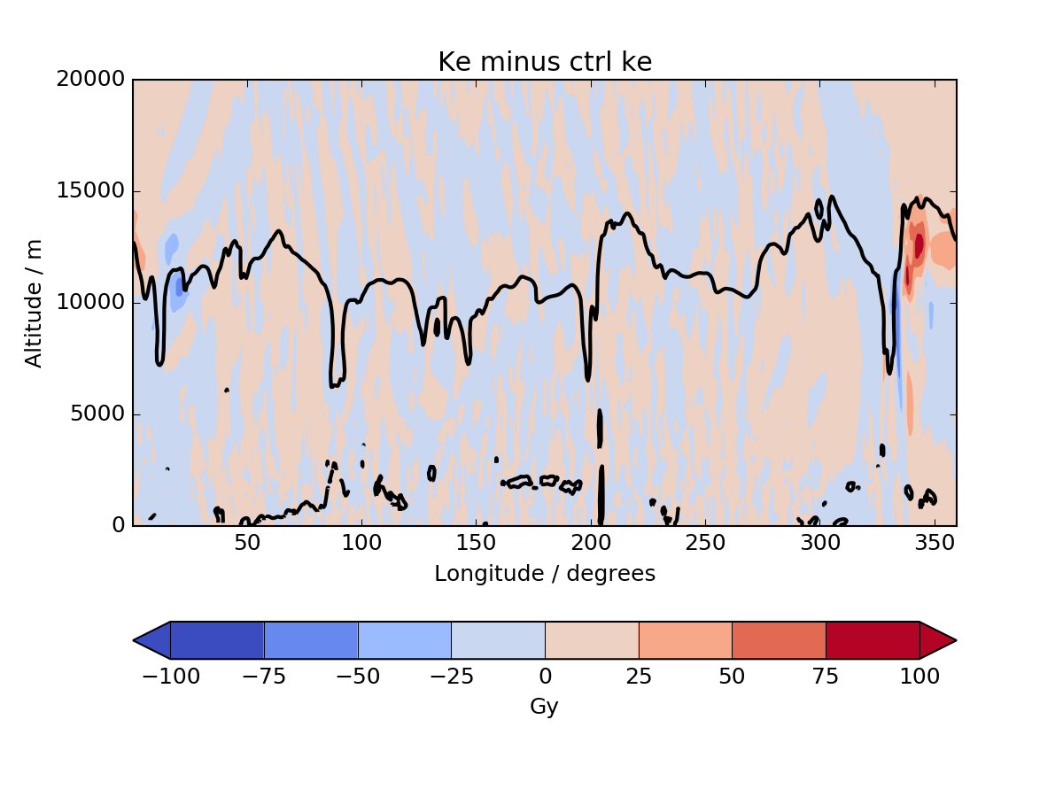
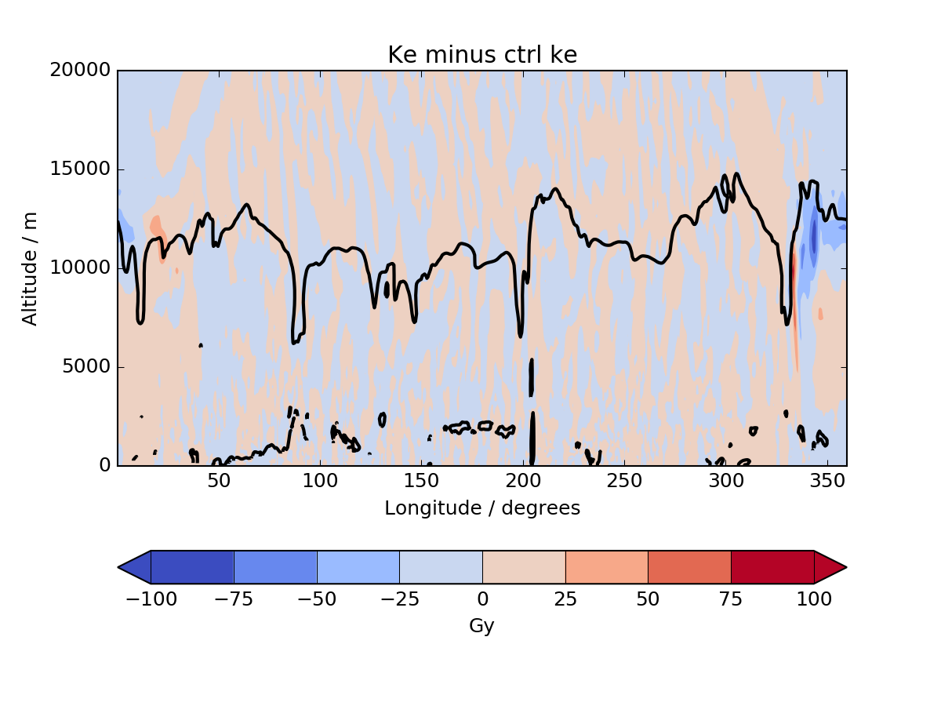
Time into simulation: 48 hours
LW0 LH10
LW1 LH10
LW2 LH10
All: Black line: 2-PVU contour at 50ºN
Centre: Colour: Average kinetic energy per unit mass (m² s⁻²) in a mid-latitude band (20⁰N - 80⁰N)
Sides: Colour: Difference modified physics minus control (m² s⁻²)

Slide 9
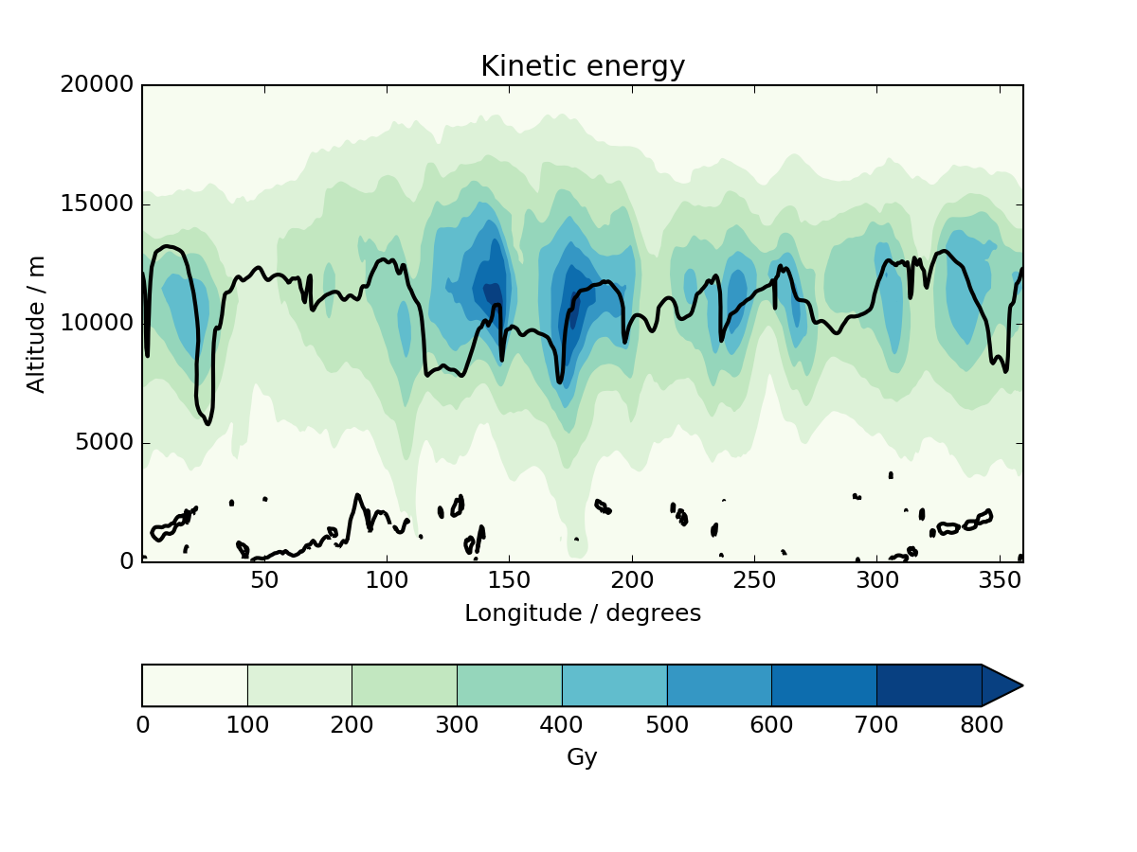
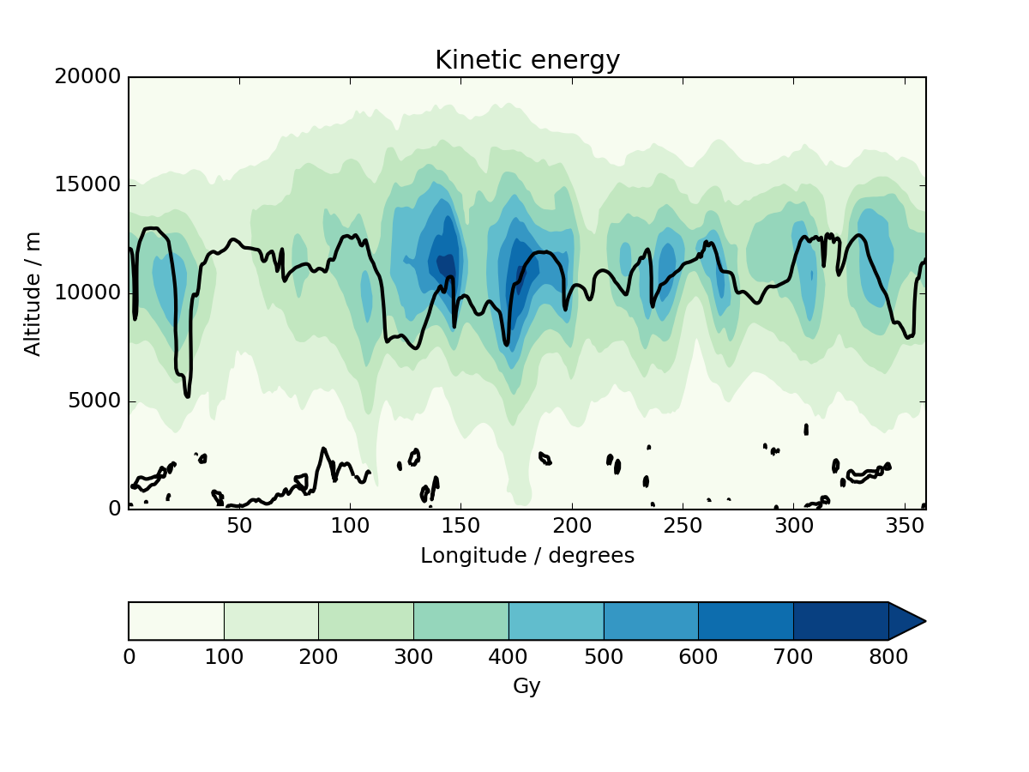
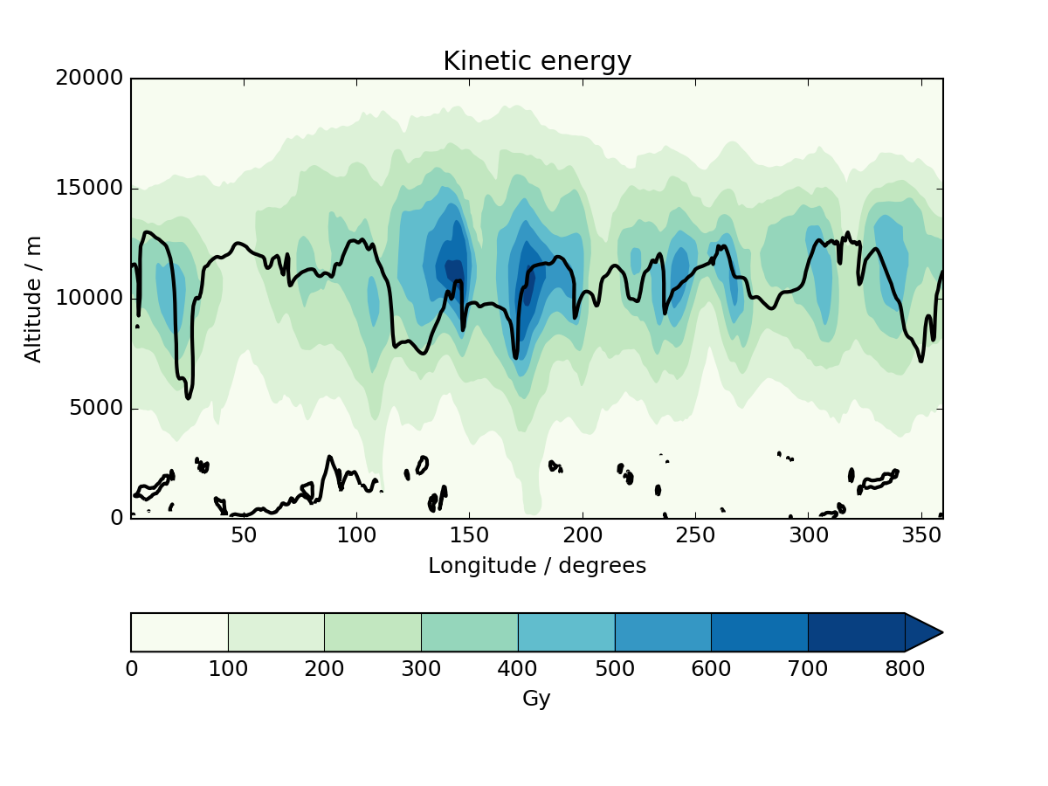
Time into simulation: 96 hours
LW0 LH10
LW1 LH10
LW2 LH10
Colour: Average kinetic energy per unit mass (m² s⁻²) in a mid-latitude band (20⁰N - 80⁰N)
Black line: 2-PVU contour at 50ºN

Slide 10
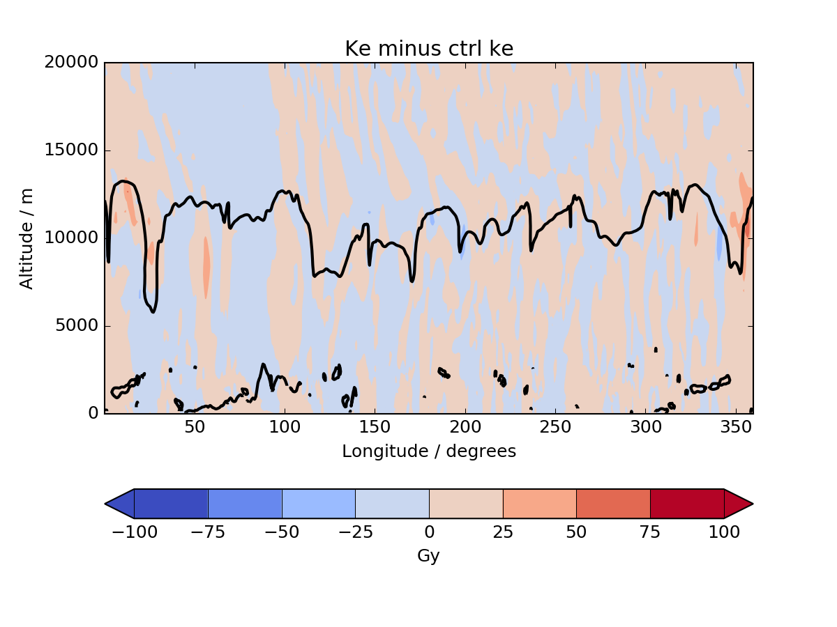
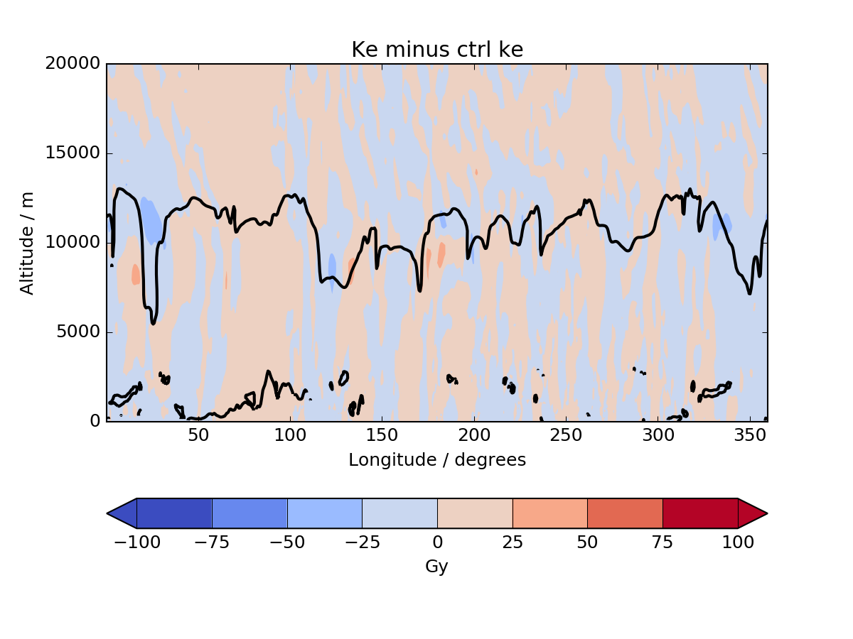
Time into simulation: 96 hours
LW0 LH10
LW1 LH10
LW2 LH10
All: Black line: 2-PVU contour at 50ºN
Centre: Colour: Average kinetic energy per unit mass (m² s⁻²) in a mid-latitude band (20⁰N - 80⁰N)
Sides: Colour: Difference modified physics minus control (m² s⁻²)

Slide 11
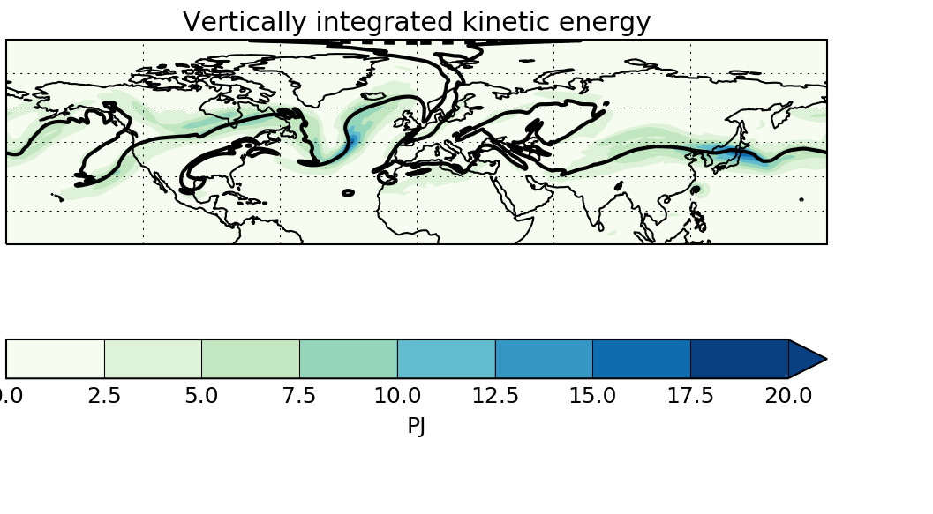
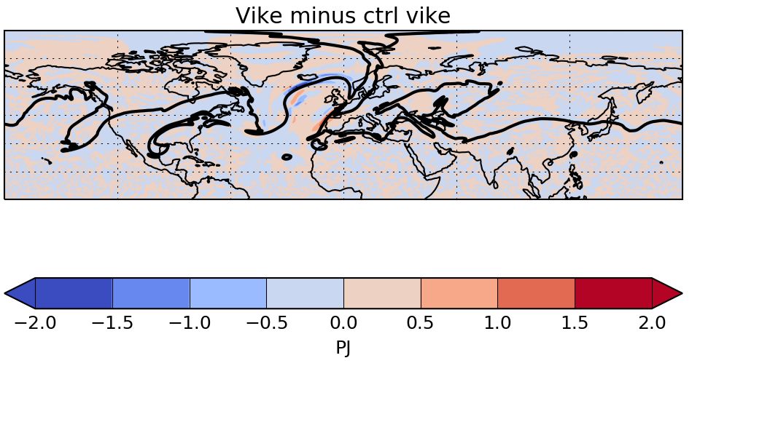
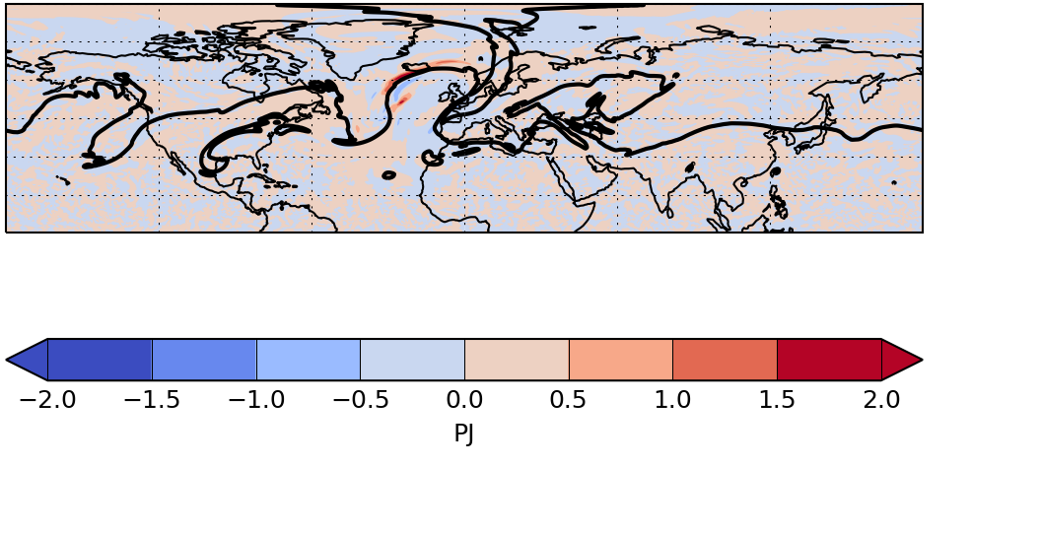
Time into simulation: 30 hours

Slide 12
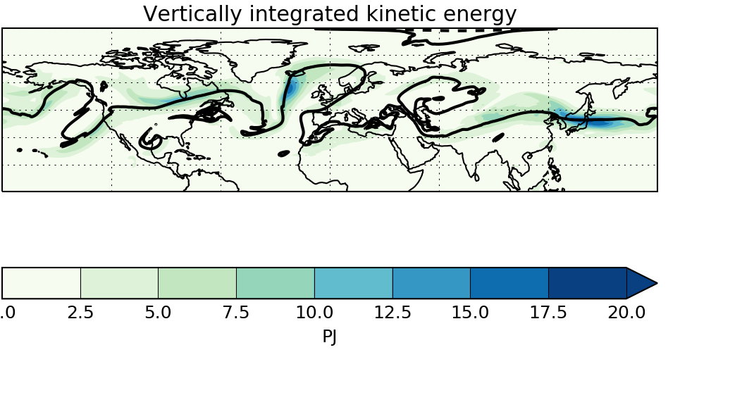
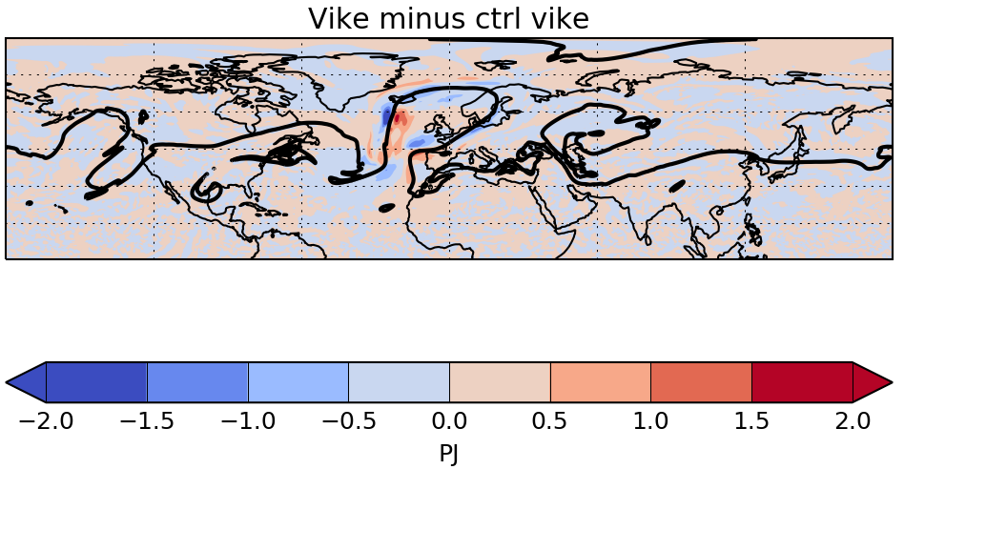
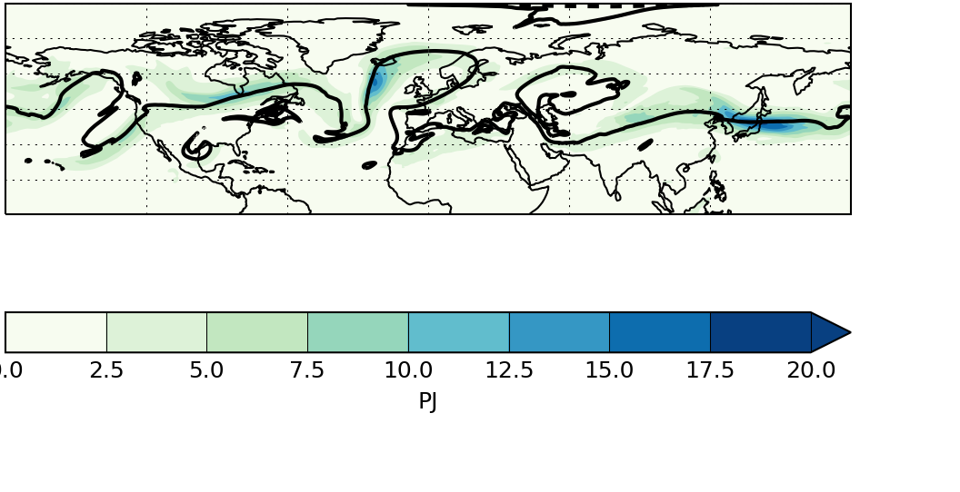
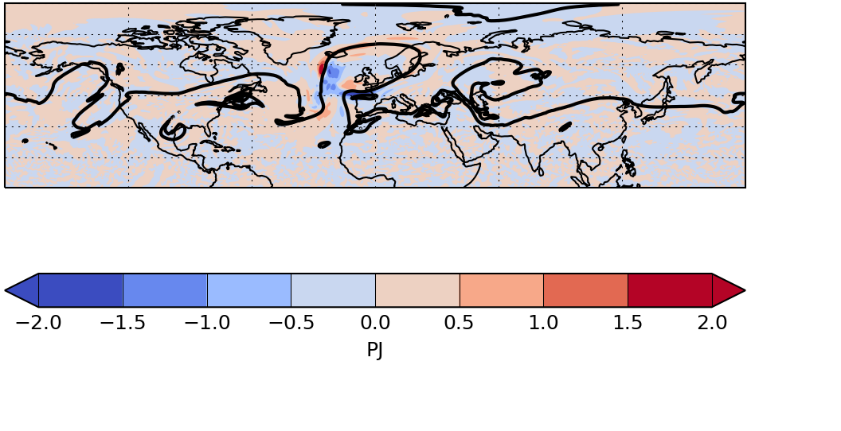
Time into simulation: 48 hours

Slide 13
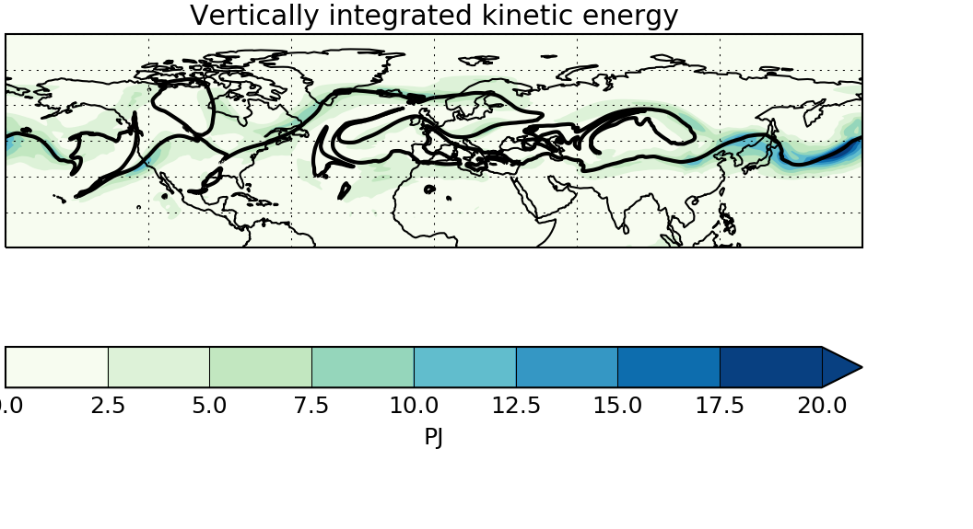
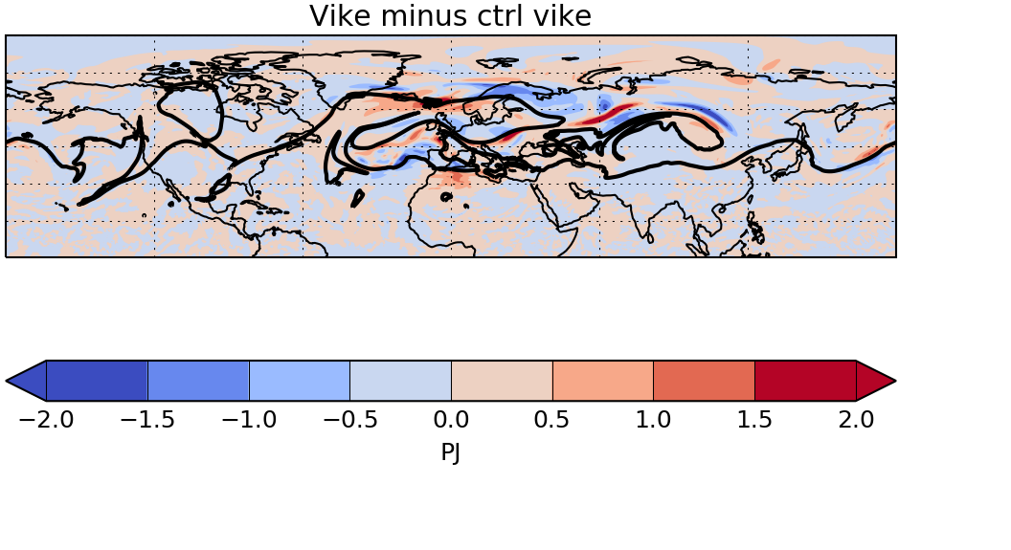
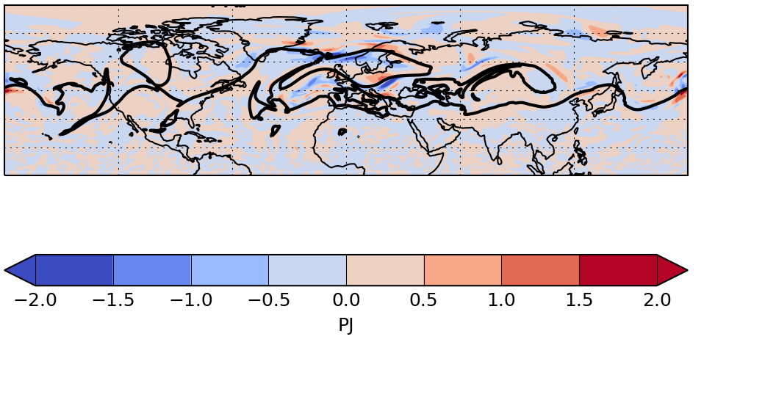
Time into simulation: 96 hours

