Slide 1
Climate information
Hour
Day
Week
Month
Year
Decade
Century
Nowcasting
Traditional weather forecasting
Extended range weather forecast
Seasonal forecast
Decadal forecast
Climate projection
Observation-based records and datasets

Slide 2
Climate information
E.g., a rainfall estimate or forecast for a country
+
Sectoral information
E.g., knowledge of the agricultural sector in a region, including crop types and their weather sensitivities
Actionable information
E.g., a tailored climate advisory service to farmers, overlaying relevant climate information with relevant sector-specific properties, operating on a timescale relevant to the decisions the region’s farmers need to make

Slide 3
Multiple meteorological inputs (wind, temp, precip) in time & space
Data, $M$
Complex impacted system (e.g., water reservoir management)
Model, $Φ=𝔉(M;$ $𝔉_{0}$)
Actionable information (multiple outputs)
Data, $Φ$
Complex impacts
Single meteorological input (at a location in time and space)
Data, $μ$
Simple impacted system (e.g., heatwave early warning system)
Model, $φ=f(μ)$
Actionable information (single output)
Data, $φ$
Simple impacts

Slide 4
(a)
(b)
(c)

Slide 5
(a)
(b)
Hurrell 2003 in Hurrell 2003

Slide 6
https://www.cpc.ncep.noaa.gov/products/precip/CWlink/ENSO/regressions/geplr.shtml

Slide 7
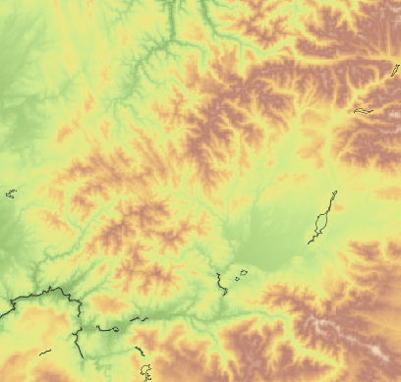
NW Spain, from global wind atlas

Slide 8
(a)
(b)

Slide 9
Infrastructure capacity
Infrastructure use
Fixed scenario (known number of ice-cream vans)
Determine optimal deployment and usage pattern of ice-cream vans
Operational
Interactions?
Determine optimal number of ice-cream vans required
Fixed assumptions of how ice-cream vans are deployed and used
Strategic

