Slide 1

Deep convection in models: parameterized modelling
Bob Plant, with thanks to many others!
Summer School on Atmospheric Convection
Nanjing University
21-25 July 2025

Slide 2
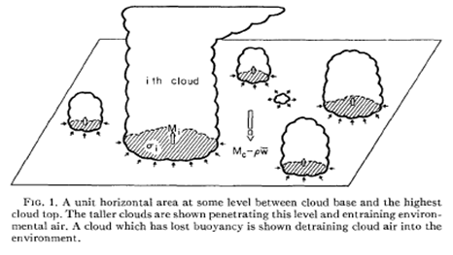
Scales of modelling
Parameterized
Δx ~ 100km or larger
Many clouds in a grid cell
Discuss today
Explicit (large-eddy modelling)
Δx ~ 100m or smaller
Many cells for each cloud
Discussed yesterday
Grey zone
Δx ~ 1-10 km
Not enough clouds in a cell for parameterization
Not enough cells to resolve individual clouds

Slide 3
Mass flux approach
There are many convection parameterizations used
The large majority take a mass flux approach (at least for “deep” precipitating convection)
I am not describing any particular scheme but will discuss the typical structure of a mass flux scheme

Slide 4
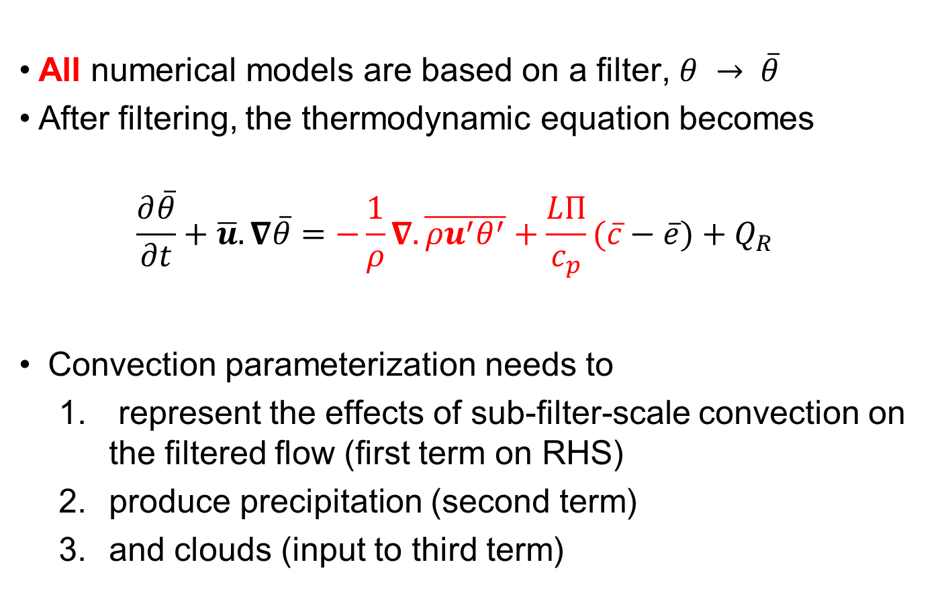
How parameterization enters the equations
All numerical models are based on a filter, $θ → \overline{θ}$
After filtering, the thermodynamic equation becomes
  $$\frac{∂\overline{θ}}{∂t}+\overline{u}.∇\overline{θ}=−\frac{1}{ρ}∇.\overline{{ρu}^{′}θ^{′}}+\frac{LΠ}{c_{p}}(\overline{c}−\overline{e})+Q_{R}$$
Convection parameterization needs to
  represent the effects of sub-filter-scale convection on the filtered flow (first term on RHS)
  produce precipitation (second term)
  and clouds (input to third term)

Slide 5
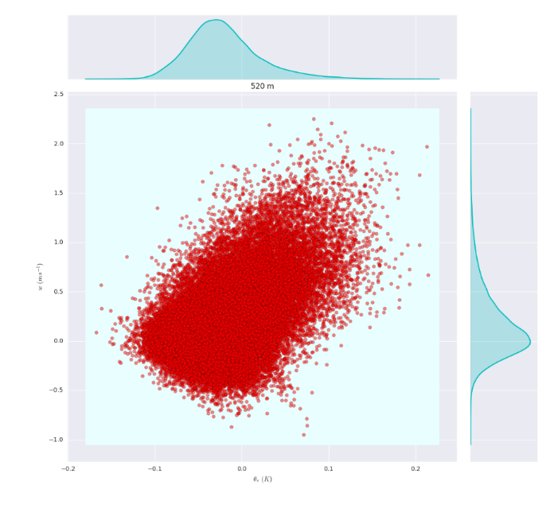
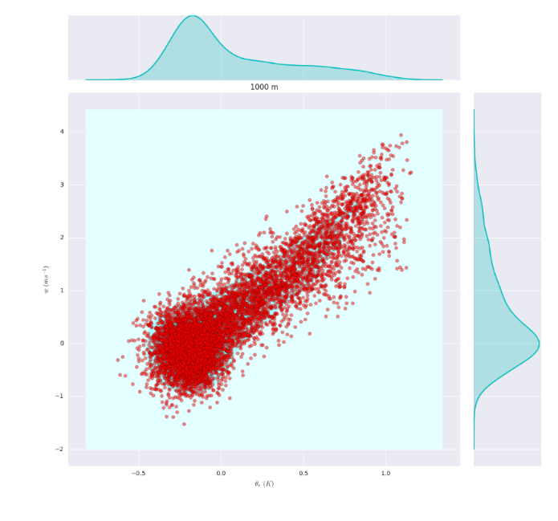
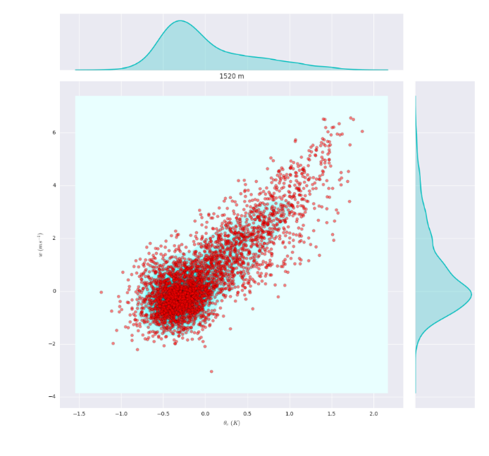
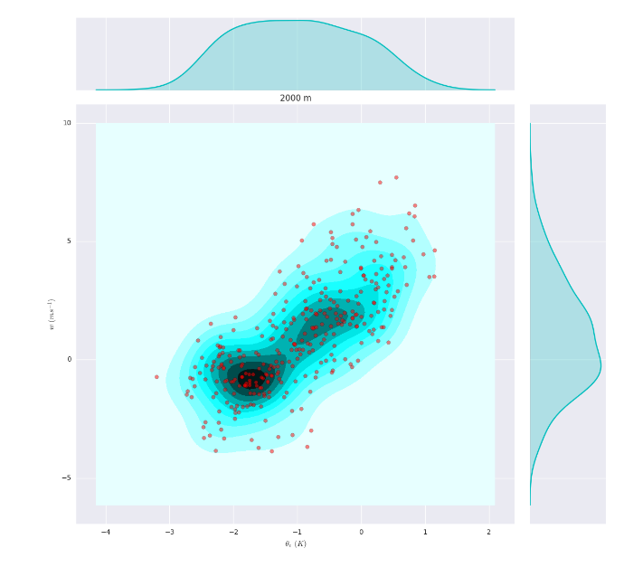


Fluxes in LES of maritime clouds
$$w′$$
In cloud layer, 1000m
Cloud base, 500m
$$θ_{v}′$$
Cloud top, 2000m
In cloud layer, 1500m
Useful to have a physical picture of cloud development to describe how changes with height

Slide 6
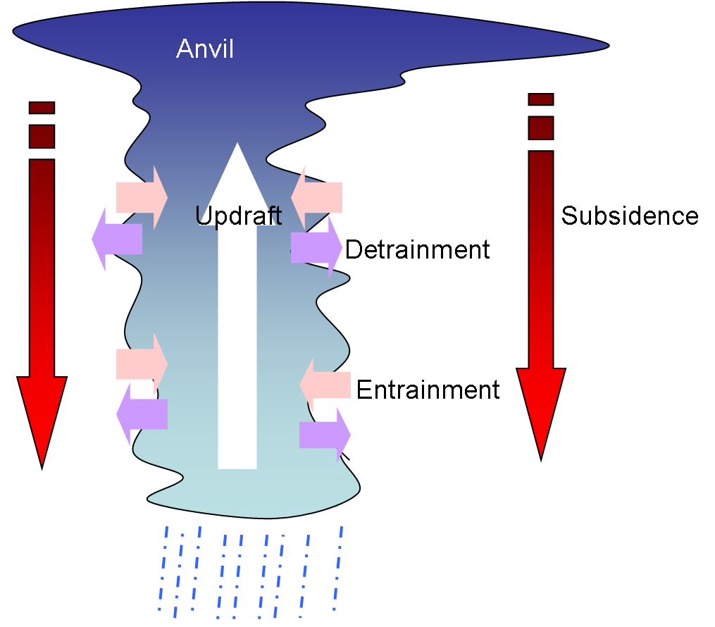
Convection Parameterization
Purpose is to feedback the effects of the unresolved flow on the resolved flow
Based on a simplified physical picture of multiple convective clouds within each grid cell
Real atmospheric convection is 3+1 dimensional (space + time varying)
Parameterization thinking claims that there is an important regime with sufficient horizontal and time filtering to render the problem 1+0 dimensional (vertical + diagnostic)

Slide 7
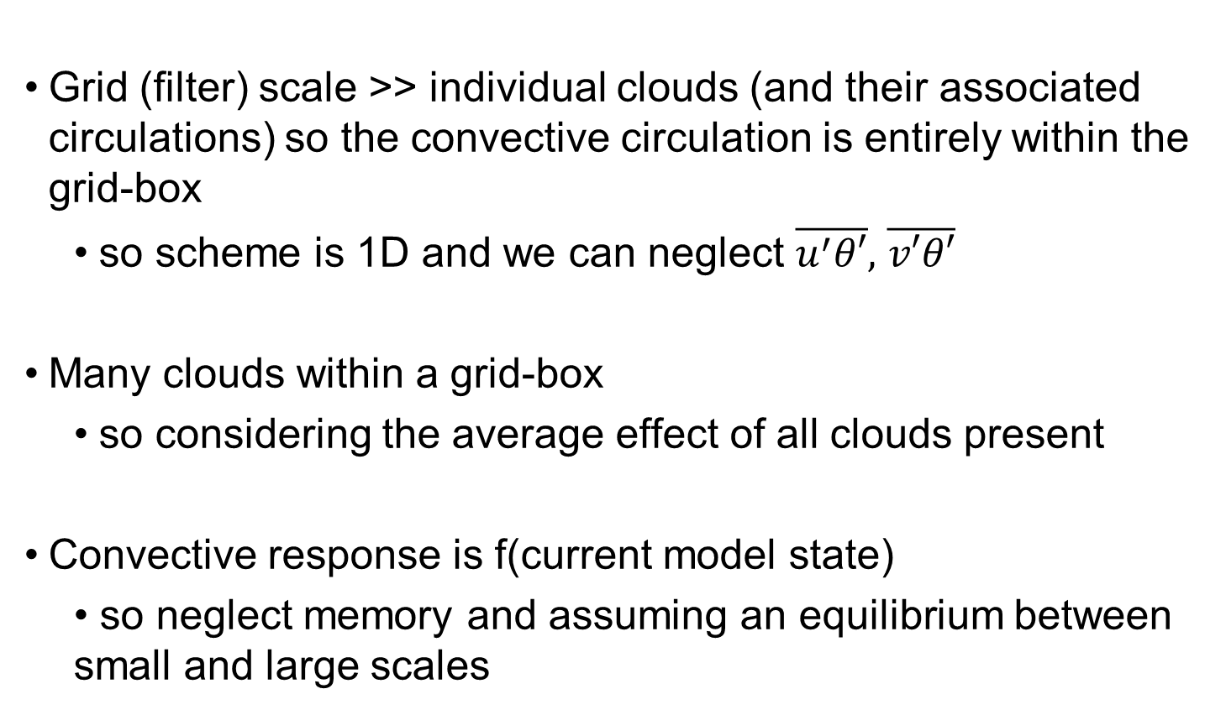
Traditional assumptions
Grid (filter) scale >> individual clouds (and their associated circulations) so the convective circulation is entirely within the grid-box
  so scheme is 1D and we can neglect $\overline{u^{′}θ′},$ $\overline{v′θ′}$
Many clouds within a grid-box
  so considering the average effect of all clouds present
Convective response is f(current model state)
  • so neglect memory and assuming an equilibrium between small and large scales

Slide 8
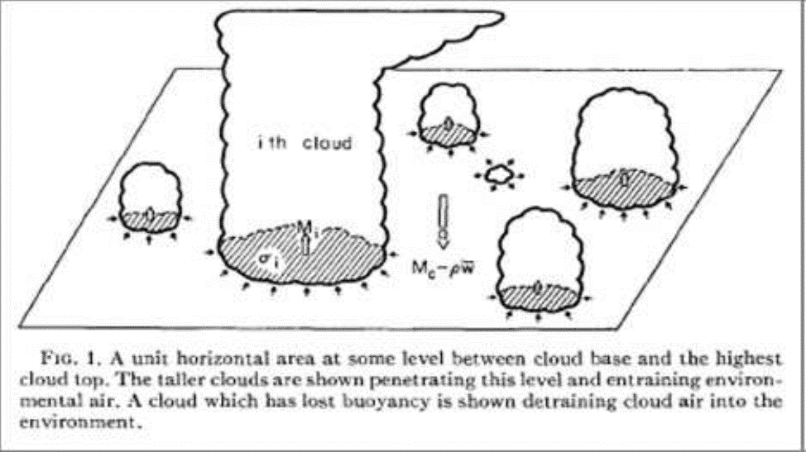
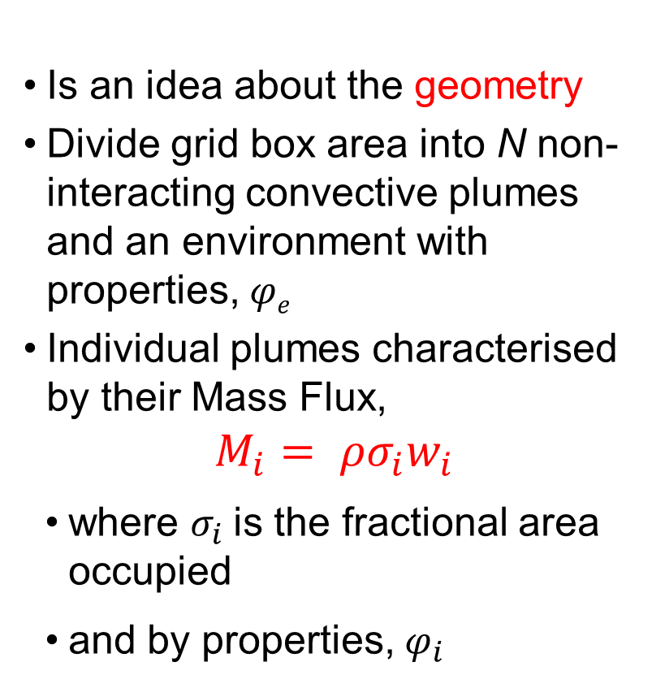
The mass flux idea
Is an idea about the geometry
Divide grid box area into N non-interacting convective plumes and an environment with properties, 𝜑_{𝑒}
Individual plumes characterised by their Mass Flux,
$$M_{i}= ρσ_{i}w_{i}$$
where $σ_{i}$is the fractional area occupied
and by properties, $φ_{i}$
e.g. Arakawa and Schubert, 1974

Slide 9
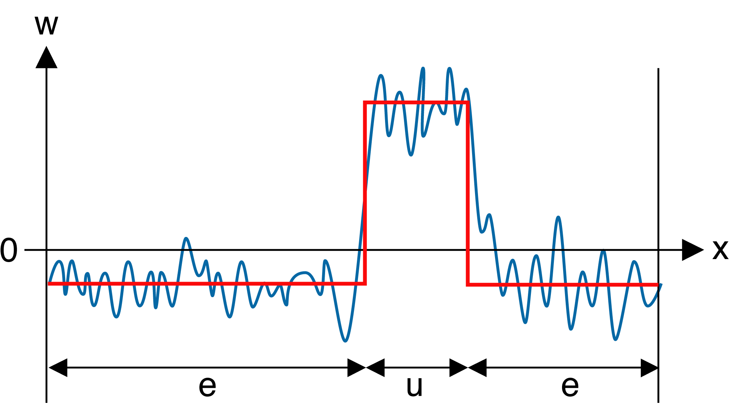




Example, using one element only
$$φ_{u}=\overline{φ_{u}}+φ_{u}^{′}$$
$$φ_{e}=\overline{φ_{e}}+φ_{e}^{′}$$
$$\overline{φ}=σ\overline{φ_{u}}+(1−σ)\overline{φ_{e}}$$
$$\overline{w}=σ\overline{w_{u}}+\left(1−σ\right)\overline{w_{e}}=0$$
Partition the flow into an updraught and its environment
After algebra (try it!) total flux is:
$ρ\overline{w^{′}φ^{′}}=ρσ\overline{w_{u}^{′}φ_{u}^{′}}+ρ\left(1−σ\right)\overline{w_{e}^{′}φ_{e}^{′}}+ρσ\overline{w_{u}}(\overline{φ_{u}}−\overline{φ_{e}}$)
First 2 terms due to variability within updraught and environment – ignore!

Slide 10
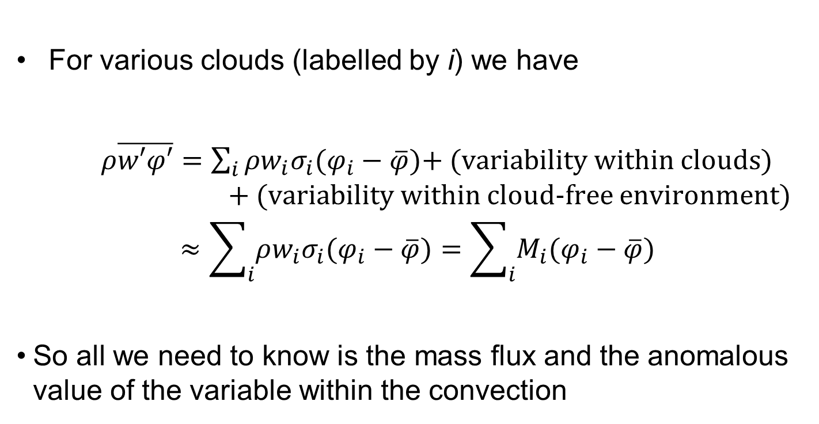
More generally
For various clouds (labelled by i) we have
  $ρ\overline{w′φ′}=$ $\sum_{i}{ρ{w_{i}σ}_{i}(φ_{i}−\overline{φ})}$+ (variability within clouds) + (variability within cloud-free environment)
$$≈\sum_{i}{ρ{w_{i}σ}_{i}(φ_{i}−\overline{φ})}=\sum_{i}{M_{i}(φ_{i}−\overline{φ})}$$
So all we need to know is the mass flux and the anomalous value of the variable within the convection

Slide 11
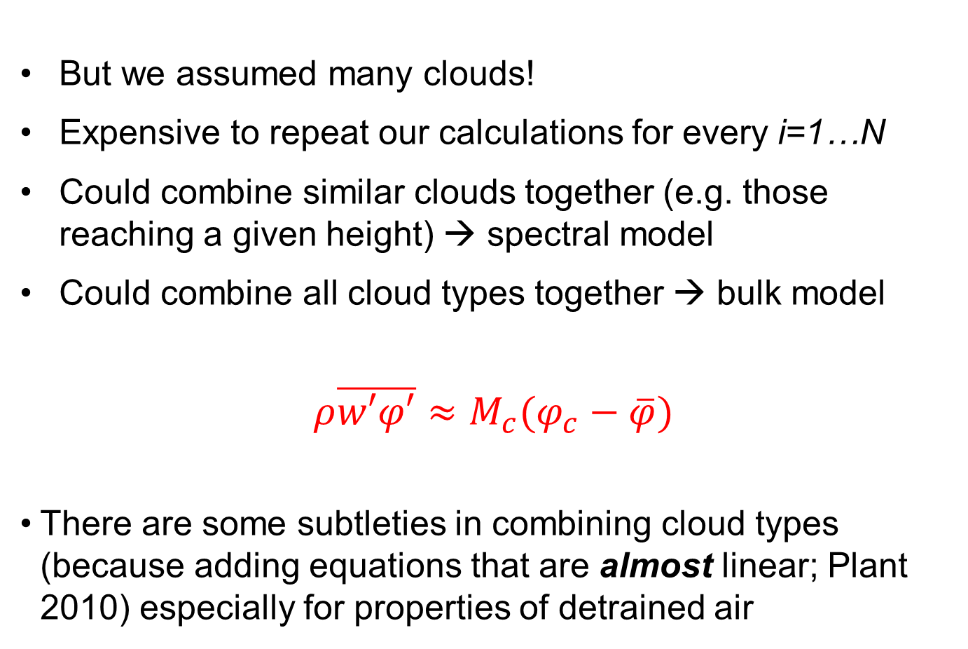
The composite “bulk” plume
But we assumed many clouds!
Expensive to repeat our calculations for every i=1…N
Could combine similar clouds together (e.g. those reaching a given height) → spectral model
Could combine all cloud types together → bulk model
$$ρ\overline{w′φ′}≈M_{c}(φ_{c}−\overline{φ})$$
There are some subtleties in combining cloud types (because adding equations that are almost linear; Plant 2010) especially for properties of detrained air

Slide 12
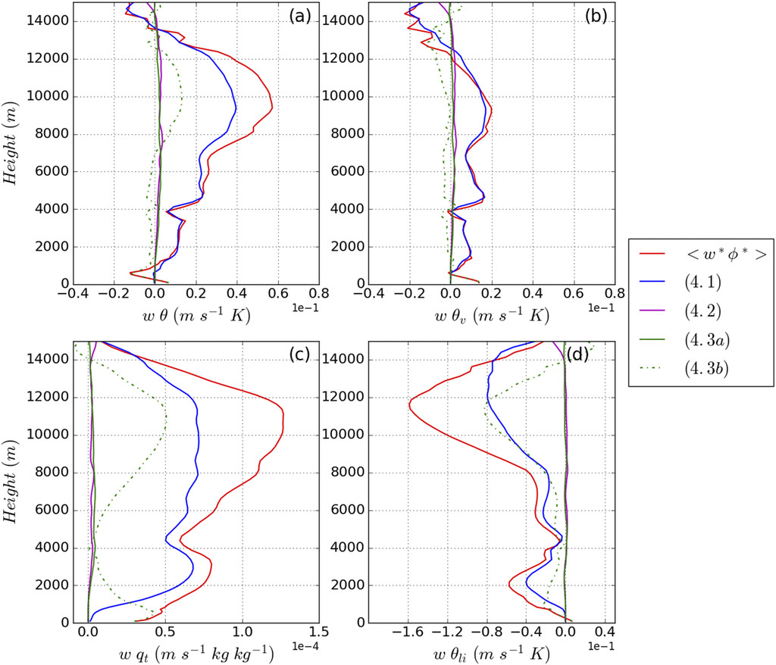
How well does it work?
Applying mass flux decomposition to LES data
Red = total flux
Blue = bulk approximation
Green dashed = environmental variability
Green solid = within-cloud variability
Purple = between cloud variability
2 convection types better than 1
3+ types not much better
Gu et al 2020

Slide 13
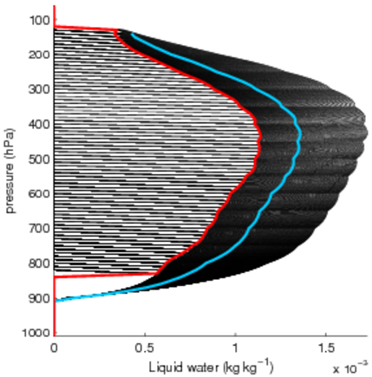
Overestimation of liquid water
Bulk parameterization scheme ansatz
The liquid water detrained from each individual plume is given by the bulk value:
N = 350 plumes
Ensemble detrained liquid water
Bulk liquid water
(typical tropical sounding)

Slide 14
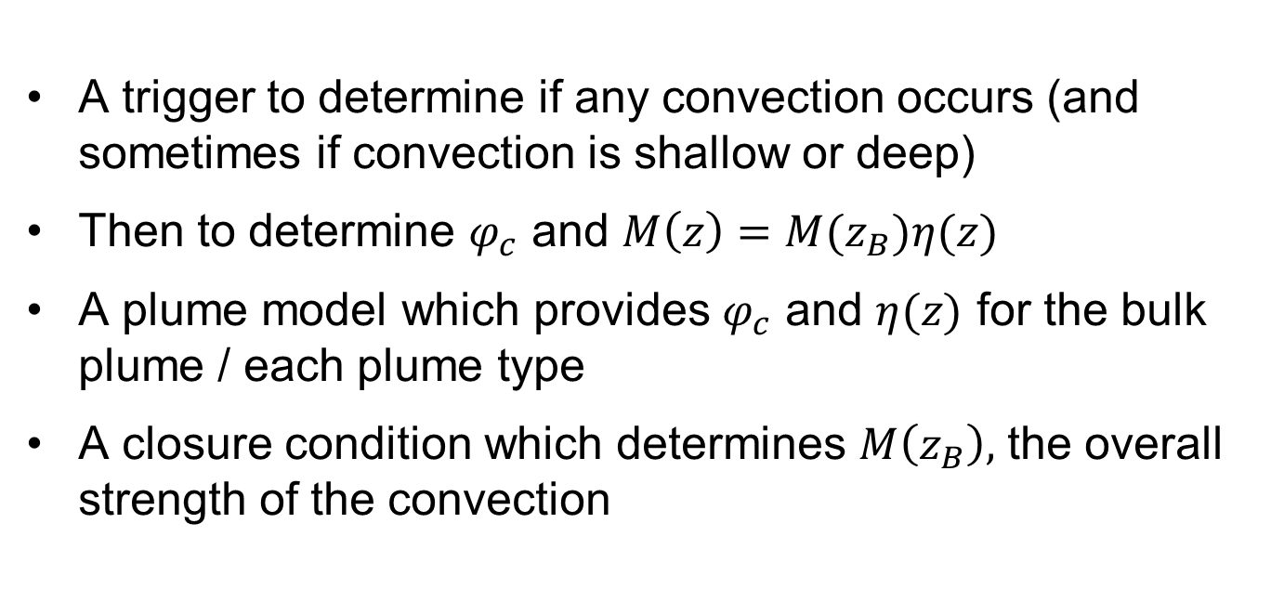
Components of mass flux scheme
A trigger to determine if any convection occurs (and sometimes if convection is shallow or deep)
Then to determine $φ_{c}$ and $M\left(z\right)=M(z_{B})η(z)$
A plume model which provides $φ_{c}$ and $η(z)$ for the bulk plume / each plume type
A closure condition which determines $M\left(z_{B}\right),$ the overall strength of the convection

Slide 15
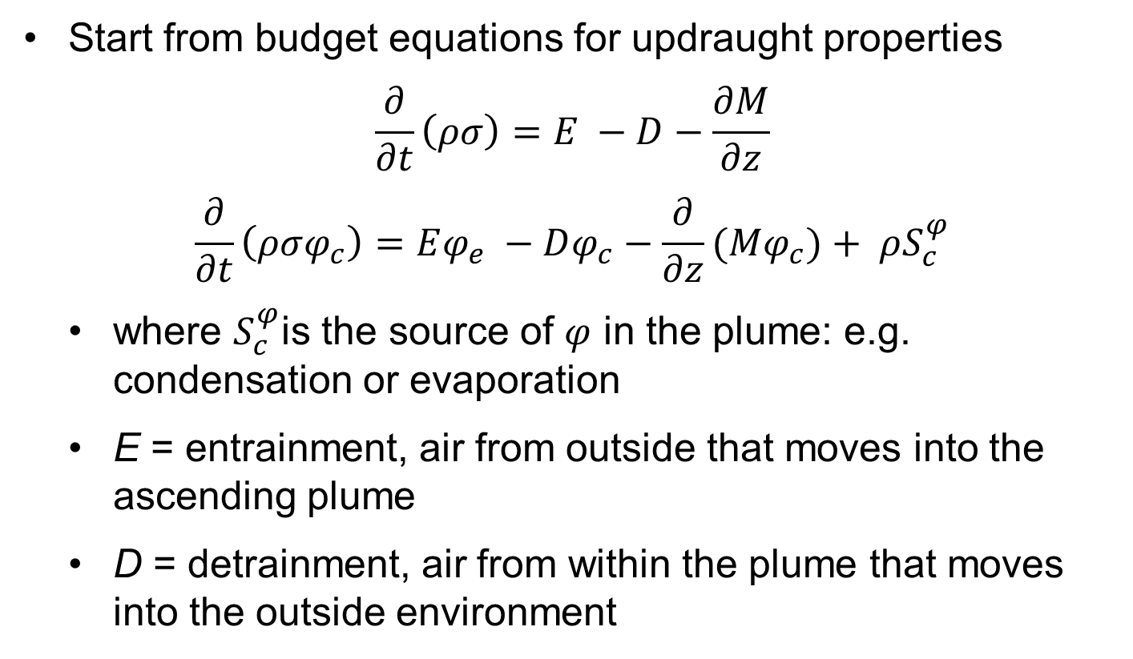
The Plume Model
Start from budget equations for updraught properties
$$\frac{∂}{∂t}\left(ρσ\right)=E −D−\frac{∂M}{∂z}$$
$$\frac{∂}{∂t}\left(ρσφ_{c}\right)=Eφ_{e} −Dφ_{c}−\frac{∂}{∂z}(Mφ_{c})+ ρS_{c}^{φ}$$
where $S_{c}^{φ}$is the source of $φ$ in the plume: e.g. condensation or evaporation
E = entrainment, air from outside that moves into the ascending plume
D = detrainment, air from within the plume that moves into the outside environment

Slide 16


The Plume Model
Average over lifetime
where $q,l$ are the water vapour and liquid water and $C_{u}$, $R_{u}$ are condensation and conversion of liquid water to rain in the updraft (can extend to other water species)
$$\frac{∂M}{∂z}=E −D$$
$$\frac{∂}{∂z}(Mθ_{c})=E\overline{θ} −Dθ_{c}+ ρ\frac{LΠ}{c_{p}}C_{u}$$
$$\frac{∂}{∂z}(Mq_{c})=E\overline{q} −Dq_{c}−C_{u}$$
$$\frac{∂}{∂z}\left(Ml_{c}\right)=−Dl_{c}+C_{u}−R_{u}$$

Slide 17
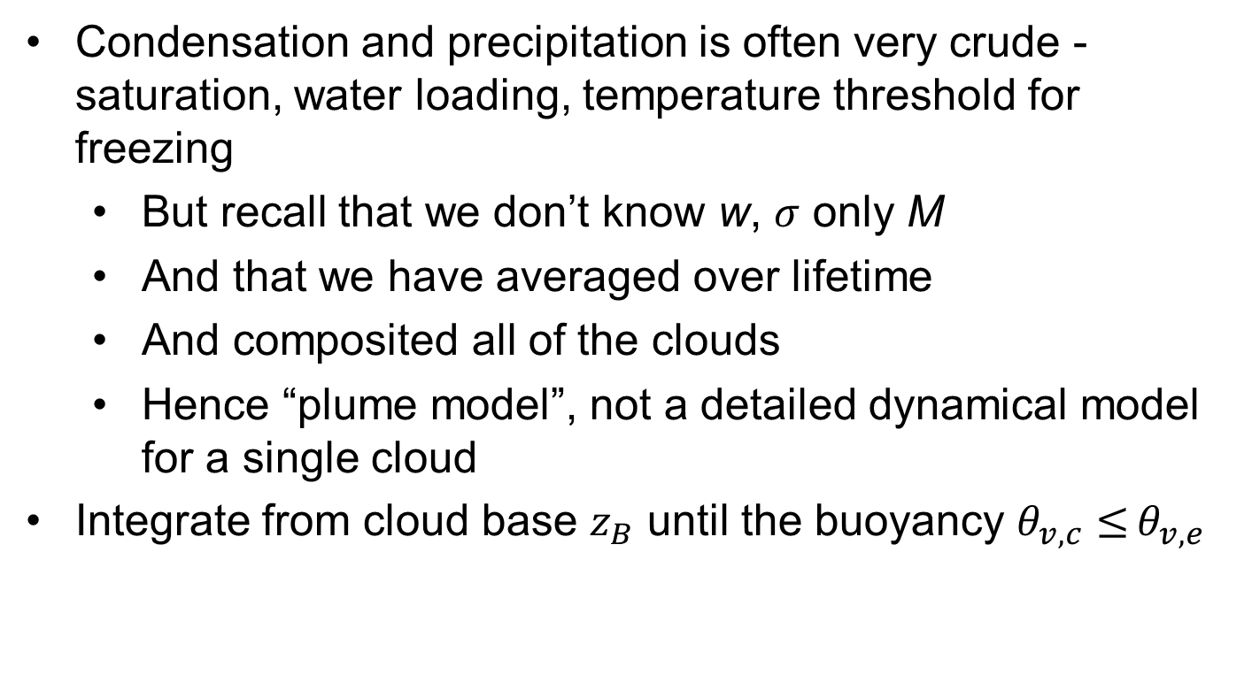
The Plume Model
Condensation and precipitation is often very crude - saturation, water loading, temperature threshold for freezing
  But recall that we don’t know w, $σ$ only M
  And that we have averaged over lifetime
  And composited all of the clouds
  Hence “plume model”, not a detailed dynamical model for a single cloud
Integrate from cloud base $z_{B}$ until the buoyancy $θ_{v,c}≤$ $θ_{v,e}$

Slide 18
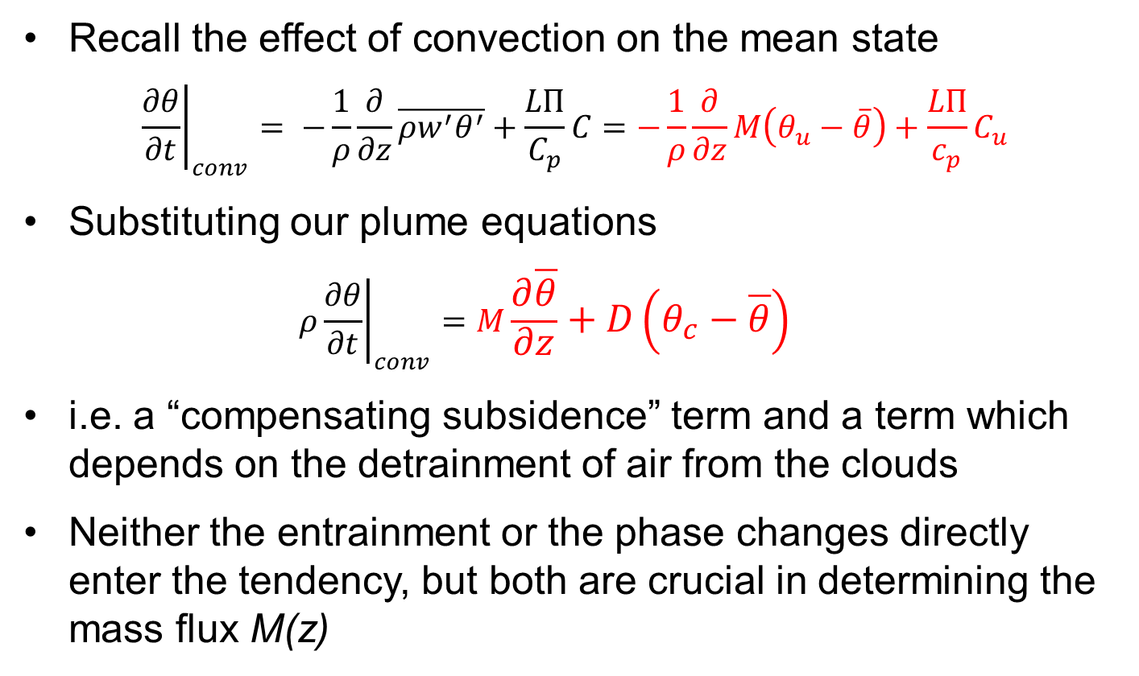
Impact on Environment: Interpretation
Recall the effect of convection on the mean state
$${\left.\frac{∂θ}{∂t}\right|}_{conv}= −\frac{1}{ρ}\frac{∂}{∂z}\overline{ρw^{′}θ^{′}}+\frac{LΠ}{C_{p}}C=−\frac{1}{ρ}\frac{∂}{∂z}M\left(θ_{u}−\overline{θ}\right)+\frac{LΠ}{c_{p}}C_{u}$$
Substituting our plume equations
  $$ρ{\left.\frac{∂θ}{∂t}\right|}_{conv}=M\frac{∂\overline{θ}}{∂z}+D\left(θ_{c}−\overline{θ}\right)$$
i.e. a “compensating subsidence” term and a term which depends on the detrainment of air from the clouds
Neither the entrainment or the phase changes directly enter the tendency, but both are crucial in determining the mass flux M(z)

Slide 19
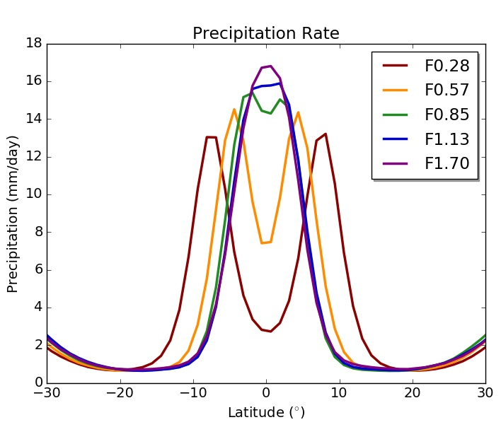
Sensitivity to Entrainment I
Climate models are very sensitive to choices of E and D
ITCZ sensitivity in an aquaplanet UM (Talib et al 2018)
Sensitivities of MJO (Klingaman and Woolnough, 2014), equatorial waves (Peatman et al, 2018) and monsoons (Bush et al, 2015)
Often there is a conflict between mean state (low E) and variability (high E)
Factor F applied to default E

Slide 20
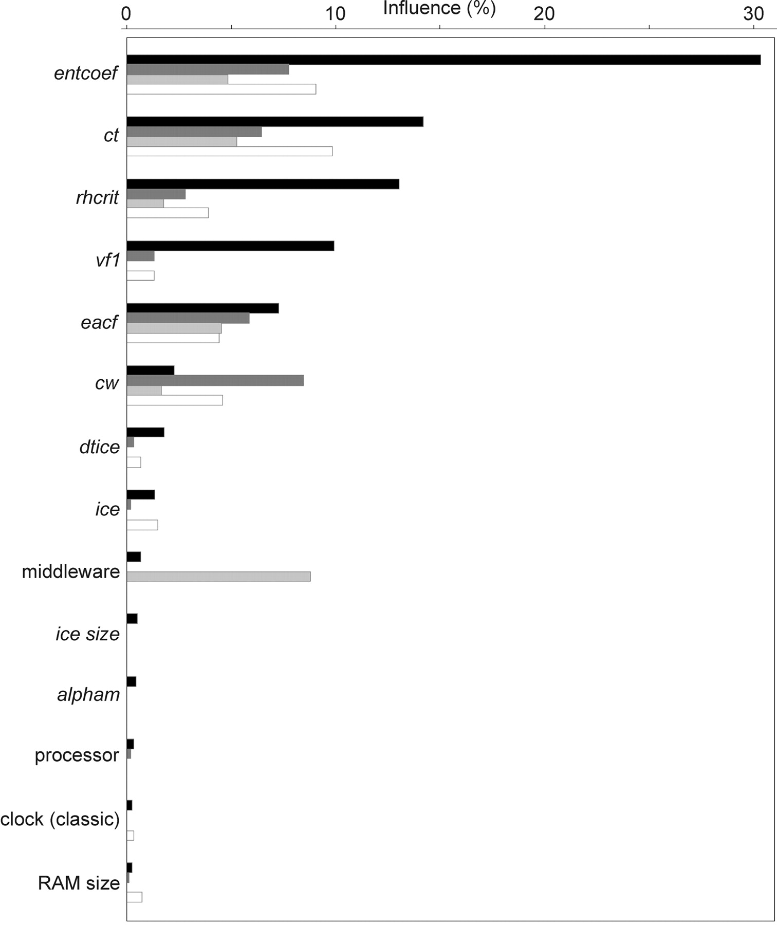
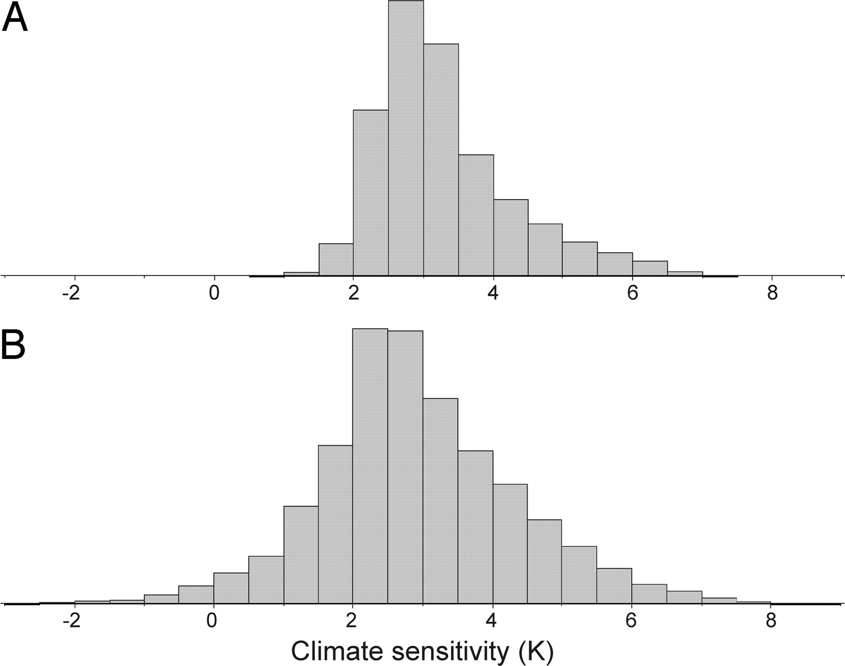
Sensitivity to Entrainment II
Large multi-parameter experiment, 30% of variation in climate sensitivity to 2xCO₂ attributed to E
But both high and low E can give high sensitivity
Knight et al, 2007

Slide 21
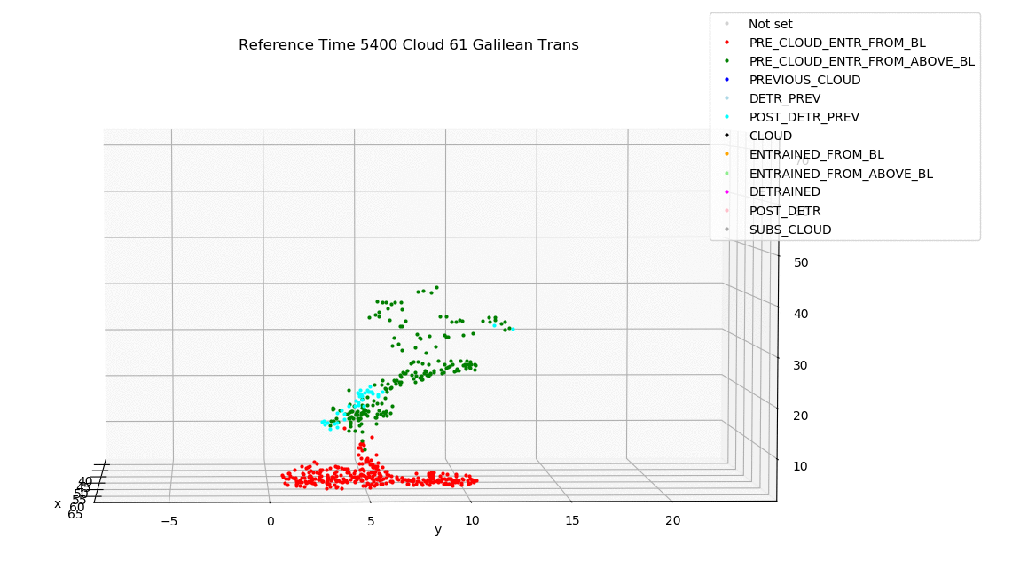
Entrainment and detrainment
For a single cloud, E and D encapsulate the exchange between updraft and the surrounding air
In a bulk model, they also encapuslate the cloud spectrum
e.g. the detrainment must capture the loss of updraft air at cloud top
Can be estimated (with difficulty) from LES
Here with parcel trajectories for shallow convection simulation with 10m grid length
Clark et al, submitted

Slide 22
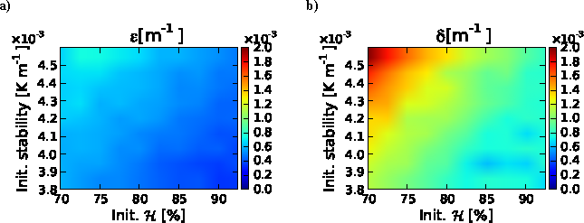
Entrainment and detrainment
• Entrainment often expressed as E/M ~ 1/r (smaller clouds as they have higher surface area to volume ratio)
• Not enough sensitivity to environmental RH (Derbyshire et al 2004, Bechtold et al 2008)
• More variation in detrainment than entrainment rates
This is linked to different cloud reaching different heights
• e.g. adaptive detrainment scheme of Derbyshire et al 2011
E/M and D/M dependence on RH and stability
Boing et al 2012

Slide 23
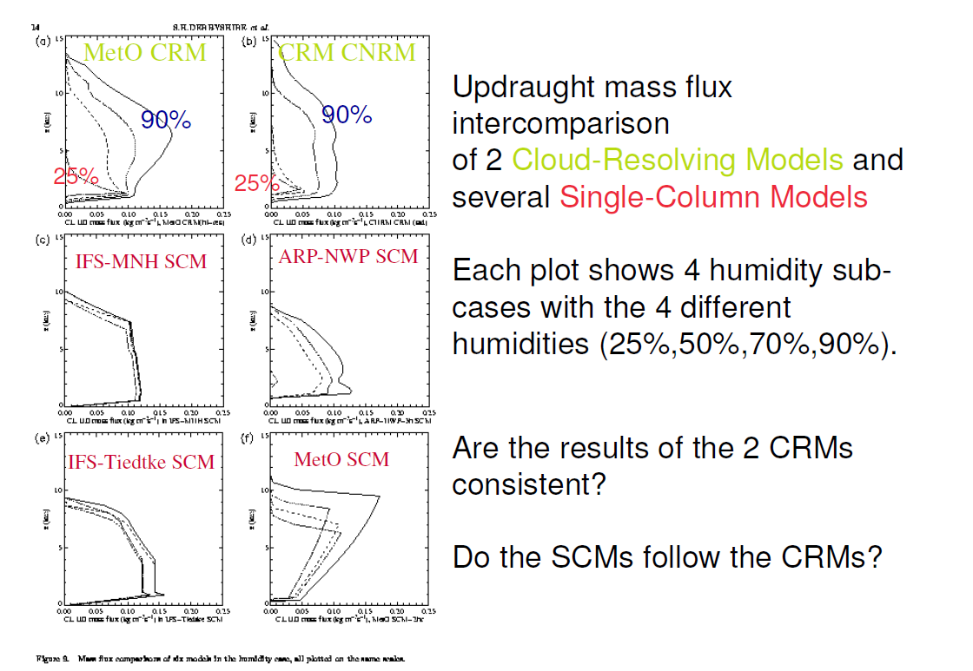

Slide 24
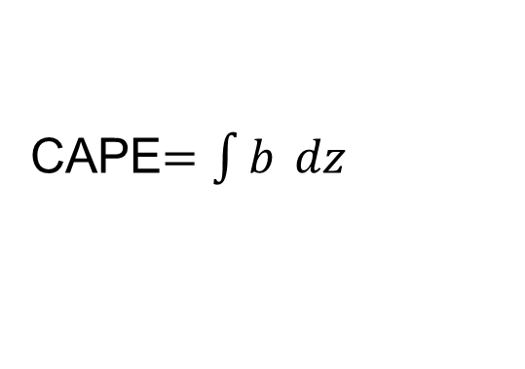
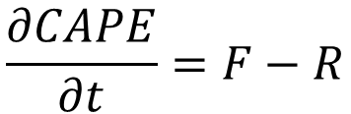
Closure
• The CAPE is the buoyancy of a parcel ascent integrated from LFC to LNB
Now take time derivative and use plume model equations for b. After some (lots of!) algebra (Arakawa and Schubert, 1974;Yano and Plant, 2016)….
F = large-scale generation or “forcing,” terms independent of M(z_{B})
R = response of convection: terms depending on M(z_{B}) (proportional for entraining plumes with simple microphysics)
CAPE$=\int{b }dz$
$$\frac{∂CAPE}{∂t}=F−R$$

Slide 25

Equilibrium Closures
Quasi-equilibrium (Arakawa and Schubert, 1974) is the assumption that $∂CAPE$/$∂t ≈0$ so F = R
$f=ρq$ Moisture convergence balanced by precip (Kuo, 1974)
$f=b$ CAPE closure with b for non-entraining parcel
$f=b$ dilute CAPE closure with b for entraining plume
$f=b$ Parcel-environment closure with BL excluded from integral (Zhang, 2003)
$f=b$ CIN closure with troposphere excluded from integral (Mapes, 2000)
$f=ρb$ PCAPE closure used at ECMWF (Bechtold 2015)
$f=ηb$ Cloud work function closure (Arakawa and Schubert, 1974)
In practice, many schemes do not impose a strict equilibrium, but relax towards it on a timescale of ~1-3h

Slide 26
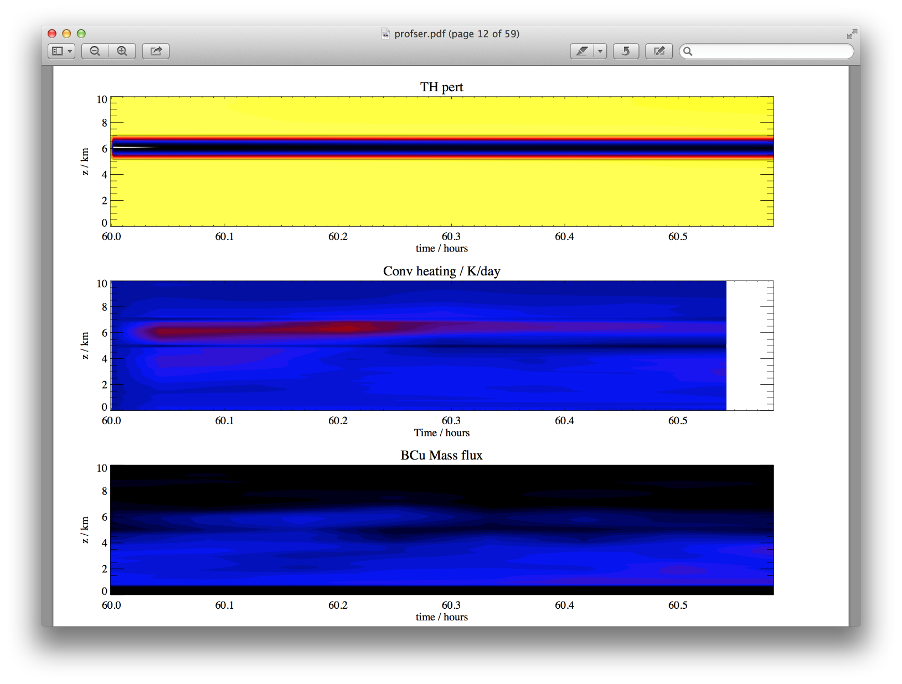
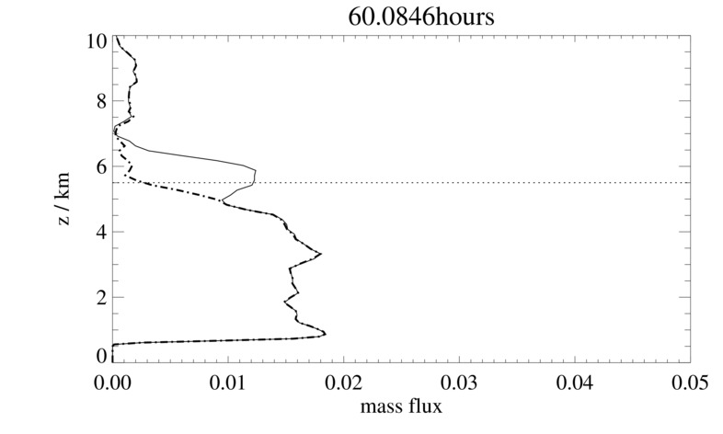
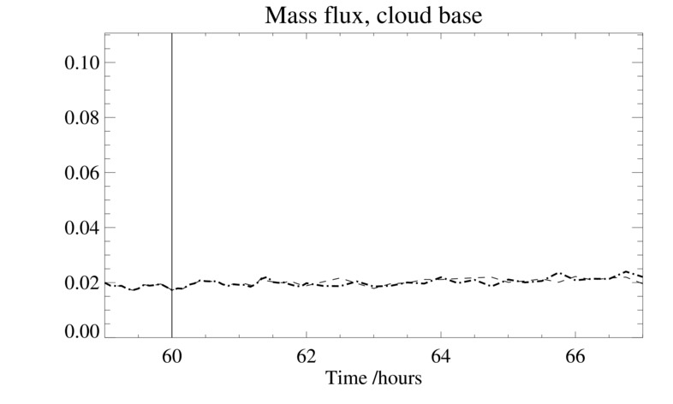
Limitations
Run an LES to equilibrium and then apply an extra jolt of upper level cooling
There is a response at that level, but mass flux at cloud base not affected
Adjustment to equilibrium can be slow, especially at upper levels
Mass flux more directly set by boundary-layer processes

Slide 27
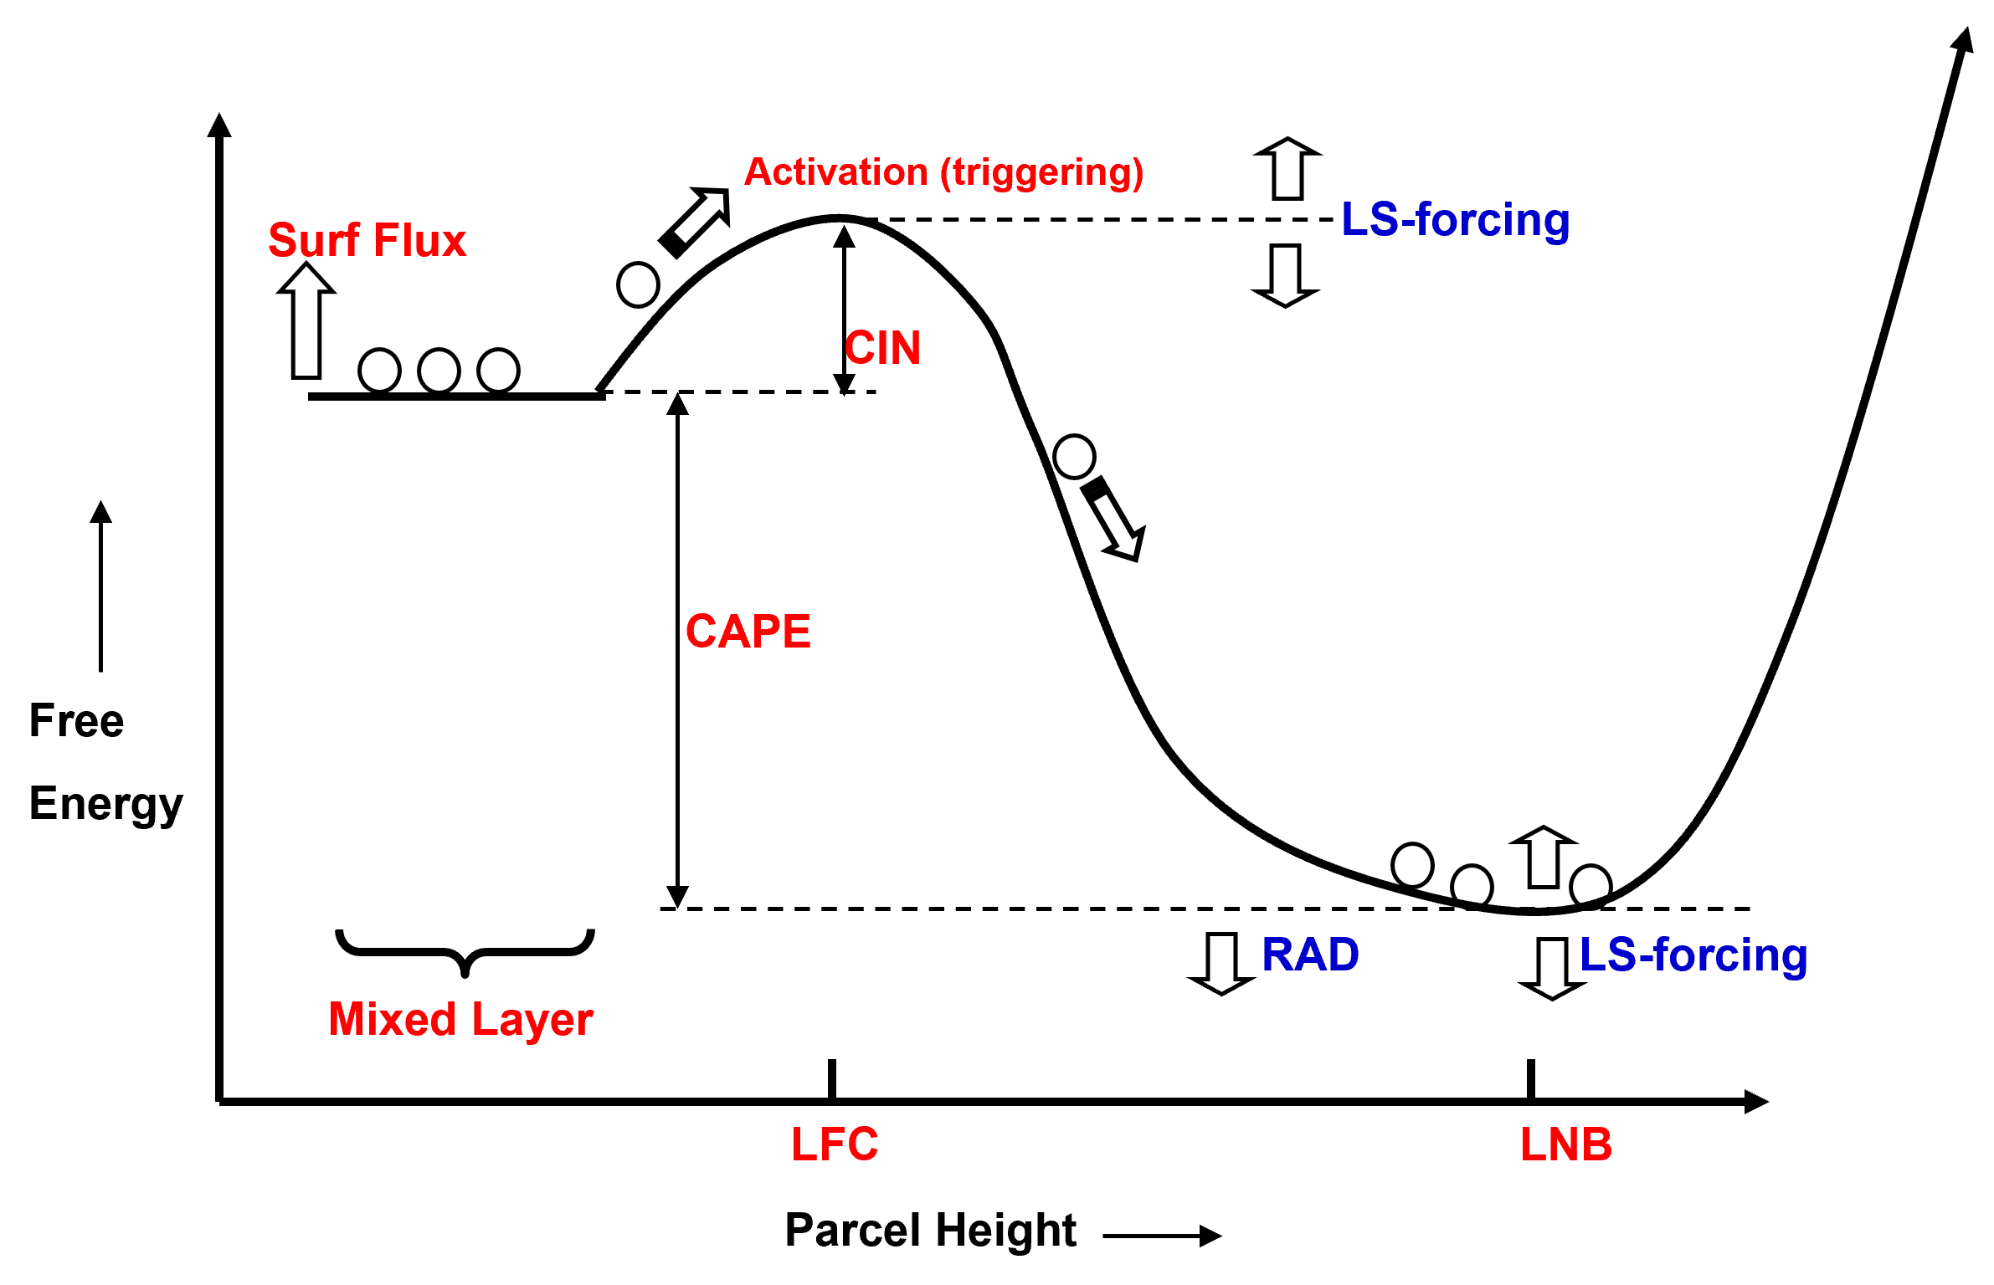
Closure
• Alternative perspective – can we overcome the CIN?
Mapes, 1997

Slide 28
CoMorph-A Convection Scheme
New mass flux scheme for the Unified Model
Beneficial (Lock et al 2024) but not yet operational
Initiated at any level, proportional to buoyant instability
No distinction between shallow, deep and mid-level
Entrainment rate depends on the turbulent mixing-length in the parcel’s source layer, and on precipitation in recent timesteps (i.e., simple memory effect)
Separate consideration of cloud-mean and cloud-core properties in detrainment calculations
Implicit detrainment calculation prevent artificial on/off noise
Developed through large Met Office / university partnership, ParaCon, but especially by Mike Whitall

Slide 29
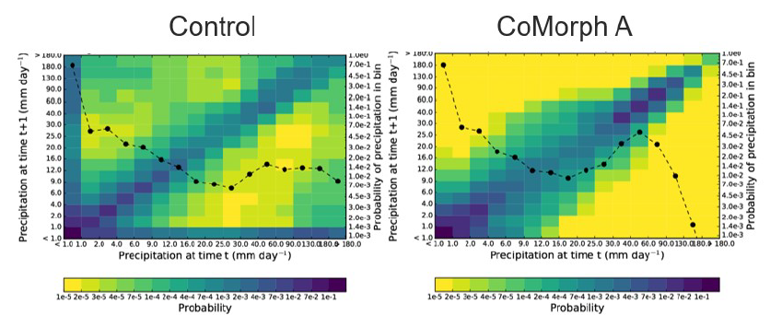
Autocorrelations
P(precip rate at t+Δt | precip rate at t) in N96 AMIP
High values along axes show 2 Δt noise
Lock et al, 2024
Notes:
The dashed lines show the one-dimensional histogram of the binned precipitation, using the right-hand vertical axis.

Slide 30
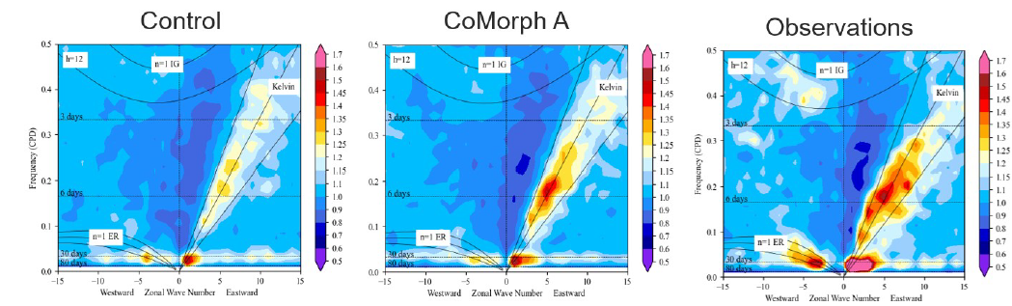
CoMorph-A Tropical Waves
Slightly stronger MJO
Improved Kelvin wave strength
N96, atmosphere only.
Improved coupling to lower tropospheric moisture has led to improvements in tropical waves and MJO
Observations (left), current UM (centre), with CoMorph (right).
Notes:
N96, atmosphere only. Tropical wavenumber-frequency spectrum for precipitation

Slide 31
More CoMorph
Under development:
  CoMorph-B, 2 convection types, improved diurnal cycle, nearing completion
  CoMorph-C, adaptations for grey-zone including stochastic aspects

Slide 32
A few words on the grey zone
Assumptions for parameterization break down
But explicit convection is not well resolved
Scheme-off and scheme-on are both problematic

Slide 33
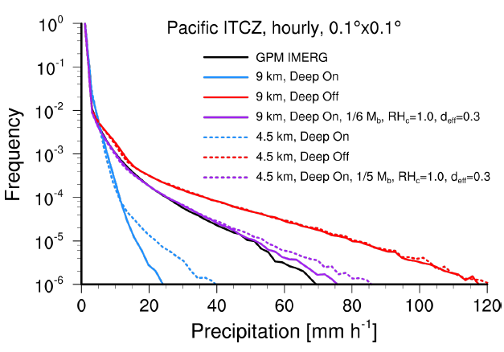
Retain modified parameterization?
Example from ECMWF
Convection scheme ON or OFF problematic at km scales
Goldilocks solution with it partially active
We propose to damp CoMorph depending on cloud spacing / Δx and cloud size / Δx
Plot courtesy Becker, 2022, WGNE workshop on systematic errors
Notes:
Illustrate problems with an all-parameterized or all not-parameterized approach
Scheme off is better for mesoscale organization and (usually) diurnal cycle. But often generates excessive precip locally and overall

Slide 34
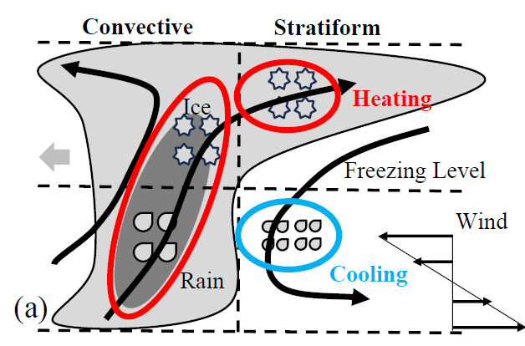
MCS
Stratiform component has heating aloft (deposition of vapour onto ice)
And cooling in lower troposphere, where melting and evaporation occur
Net effect is a top-heavy heating profile
Notes:
Deposition facilitated by ice hydrometeors transported from convective regions (Han et al., 2019).

Slide 35
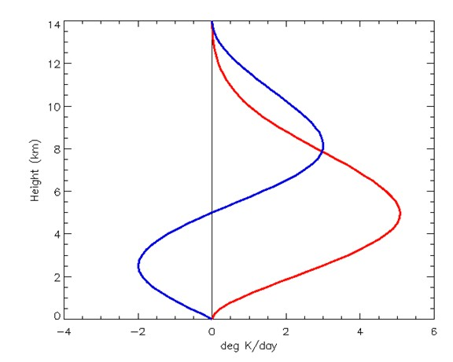
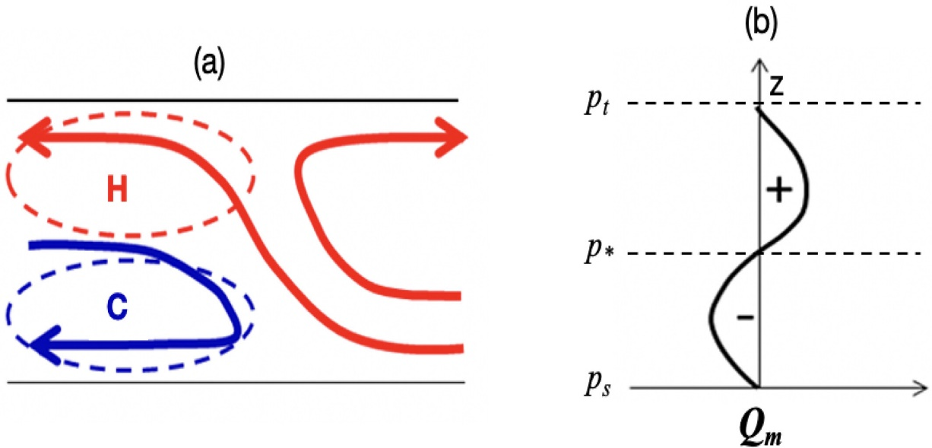
MCSP scheme
Multiscale Coherent Structure Parameterization (Moncrieff et al 2017) makes heating profile more top-heavy and provides additional momentum transports
Idealization of slantwise overturning MCS model
Scaled by integrated heating from convection scheme
Stratiform
Height
Convective
Houze (2004)
Heating
Notes:
The slantwise ascending layer in the center aligns with the convective region, where condensational heating is driven by updrafts loaded with raindrops below and ice condensates starting above the freezing level. The updrafts that curve horizontally to the right carry ice condensates aloft, aiding in the horizontal growth of the stratiform region. In the stratiform region, the ice condensates undergo depositional growth, which releases latent heat in the upper atmosphere. As these particles fall below the freezing level, they melt into raindrops. This melting process, followed by evaporation, induces cooling in the stratiform region’s lower levels

Slide 36
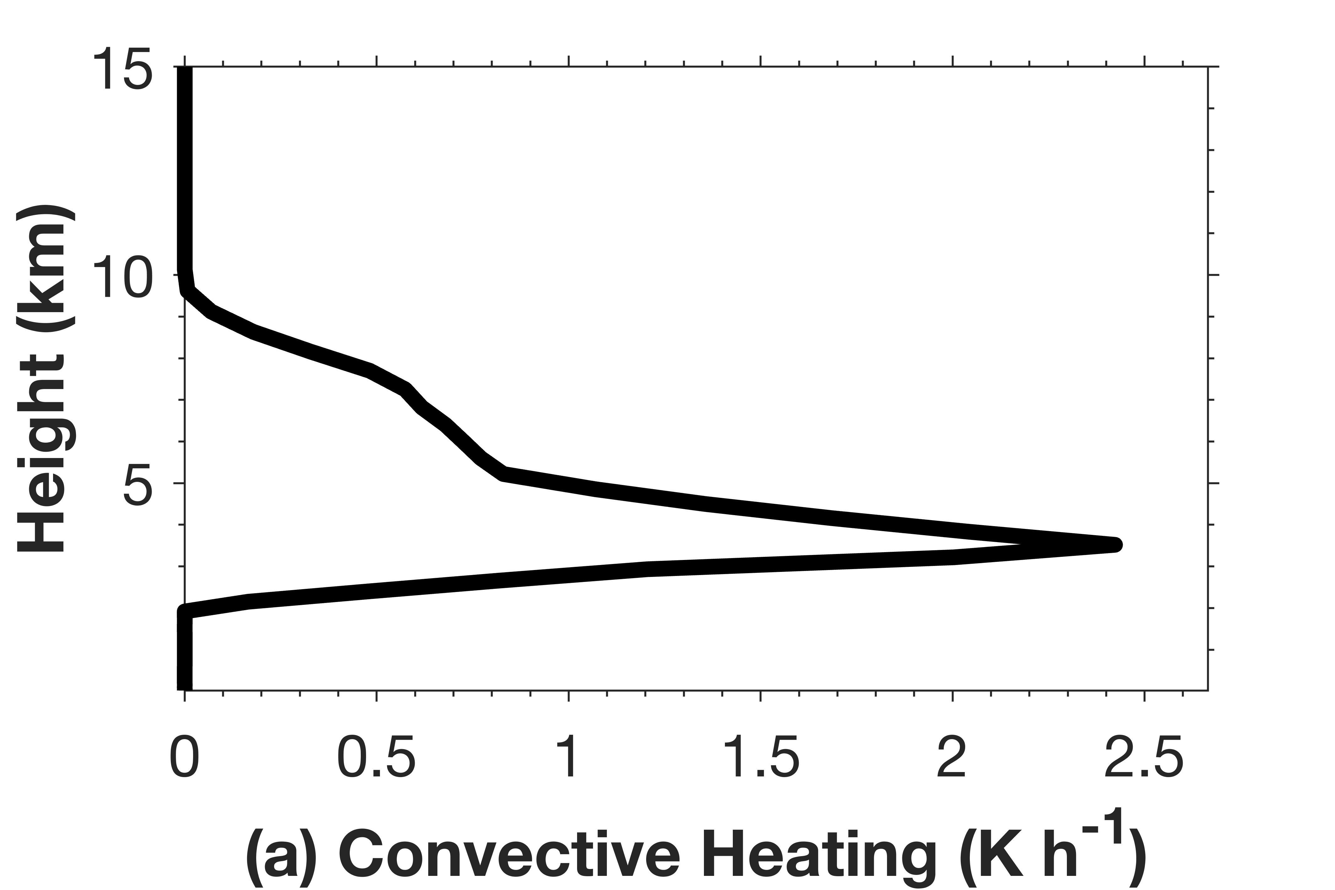
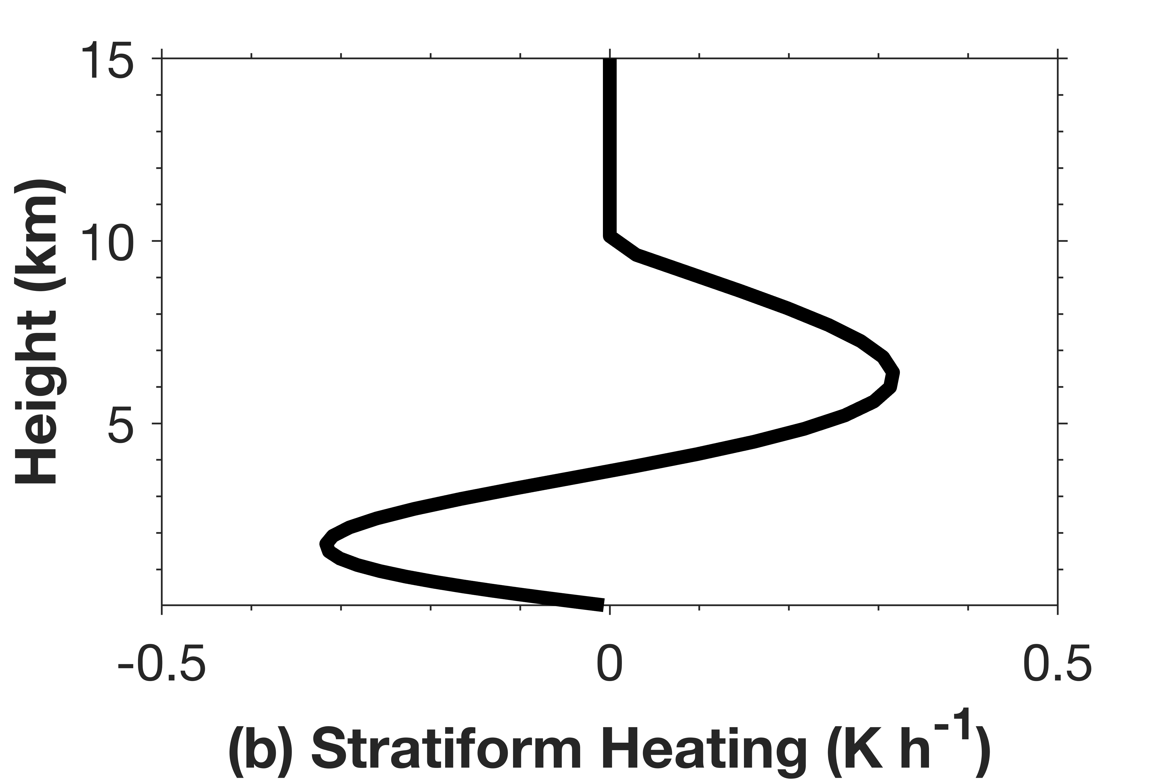

Additional stratiform tendency
Example convection scheme output
Emulated stratiform
$$Q_{strat}(p)=α\overline{Q_{conv}}\sin\left(2π\frac{p_{top}−p}{p_{top}−p_{surf}}\right)$$
where $\overline{Q_{conv}}$ is vertically integrated heating, $α$=0.5 or f(T_{top})
Notes:
Alpha =0.3 to 0.5 is estimated by Chen et al (2021) based on some high-res WRF simulations

Slide 37
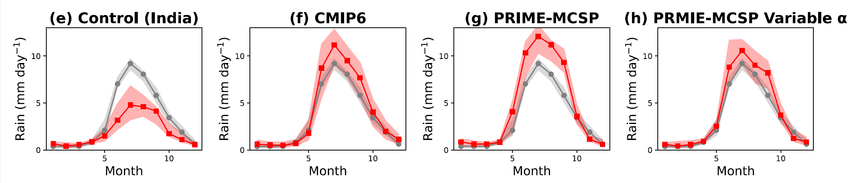
Indian monsoon
In the UM climate model, CoMorph with extra MCS-like tendencies
Grey = GPCP obs
Red = model
Enhanced monsoon amplitude (a longstanding UM issue)
And improved MJO
But West Pacific was worse!
Notes:
The bands and lines indicate the IQR ranges and median values respectively.
For cmip, variability is due to 20 years of data AND 26 different models
For control and prime, variation over the 20 years of this monthly area-averaged rainfall data

Slide 38
MCS scheme developed
Call existing convection parameterization
No convection
New part, informed by observational
dataset
Convection
Test for conducive environmental conditions
No MCS
Modified, informed by DA system
MCS
Call MCS scheme
Final convection tendency sum of output from convection scheme and MCS scheme

Slide 39
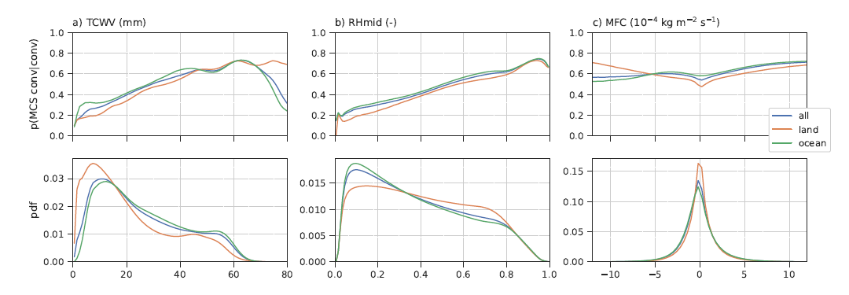
P (MCS | deep convection, variable)
  Analysis of large observational MCS database (Feng et al 2021)
  Top: the conditional probability
  Bottom: the pdf of the variable
  TCWV and RHmid were the most promising at distinguishing MCS from non-MCS deep convection
  Use for stochastic trigger of the MCS parametrization

Slide 40
What MCS tendencies?
The missing heating anomalies associated with MCS are available in the operational archive of analysis increments
How do such increments compare with MCSP?
Can we improve on the characterization of systematic errors and/or introduce probabilistic dependency of the MCS-associated tendencies on e.g. wind shear, TCWV?

Slide 41
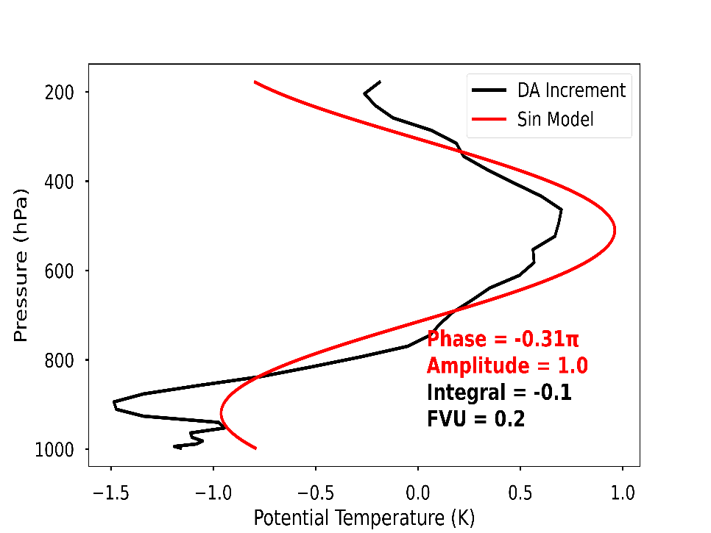
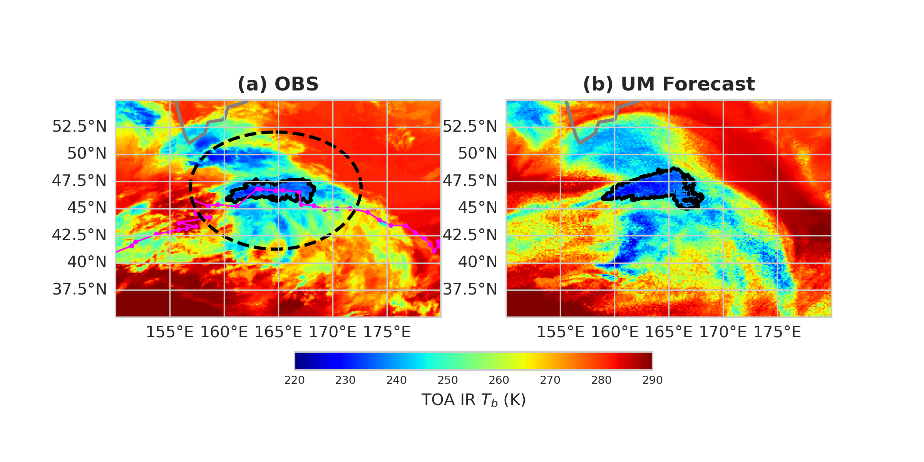

Select MCS Analysis Increments
(a) Operational Forecasts
Forecast
Next forecast
Analysis Increment
Observation
3Z
9Z
15Z
(b) Example of storm captured by the forecast
(c) Selected $θ$vertical profile
Observation
Forecast
$$∆θ(p)=Asin(kp+∅)$$
Overlap ratio > 50%

Slide 42
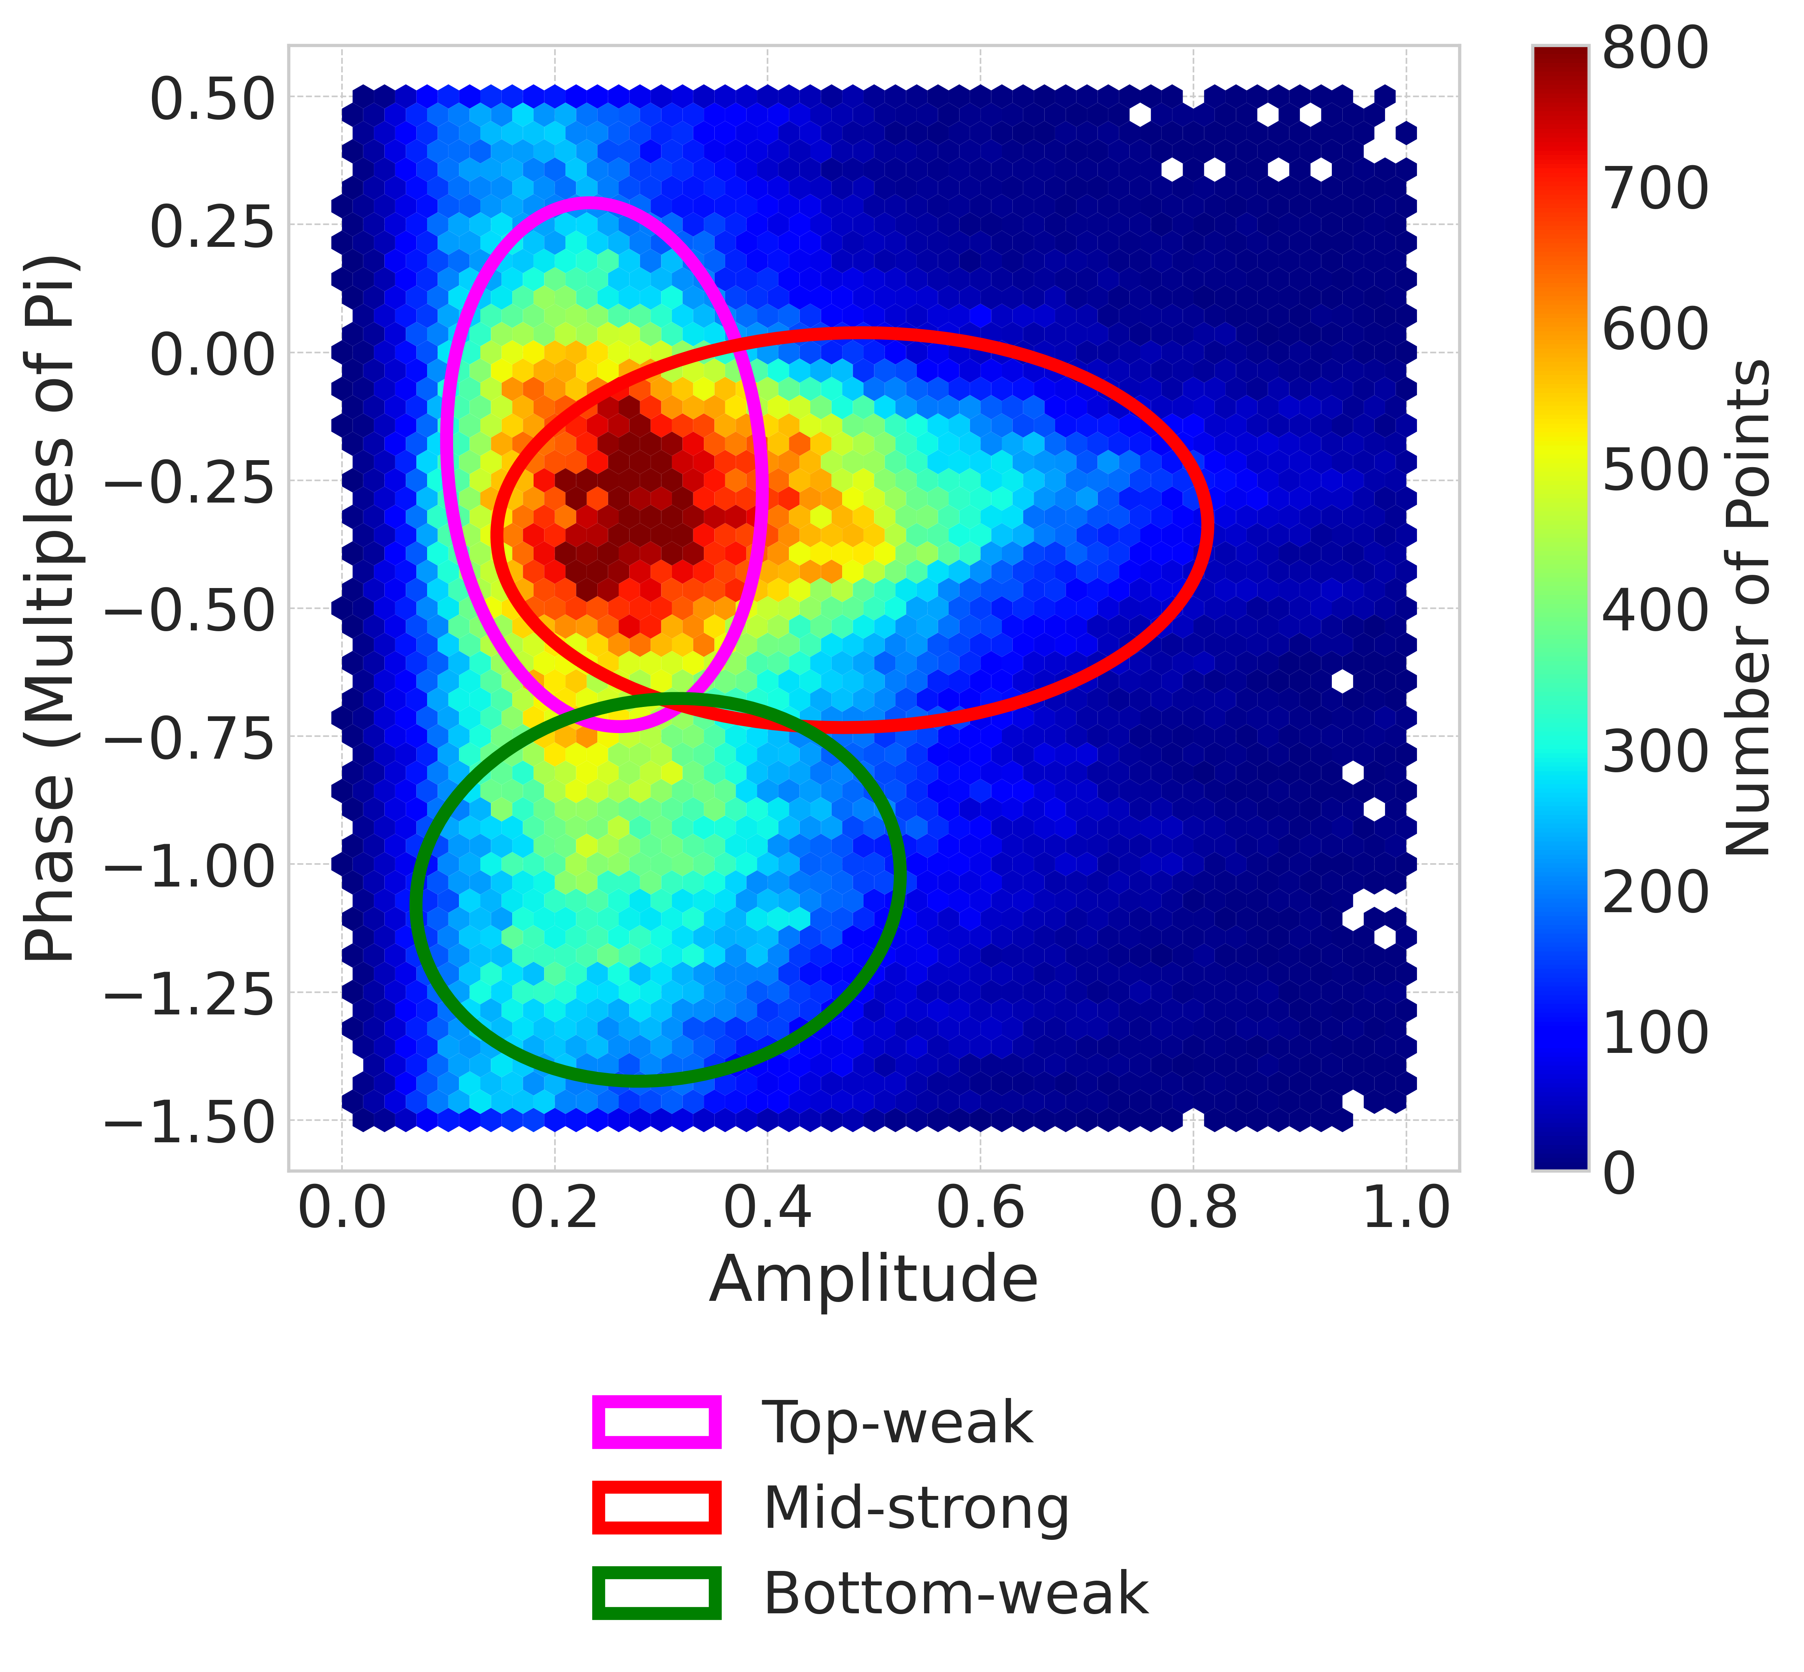
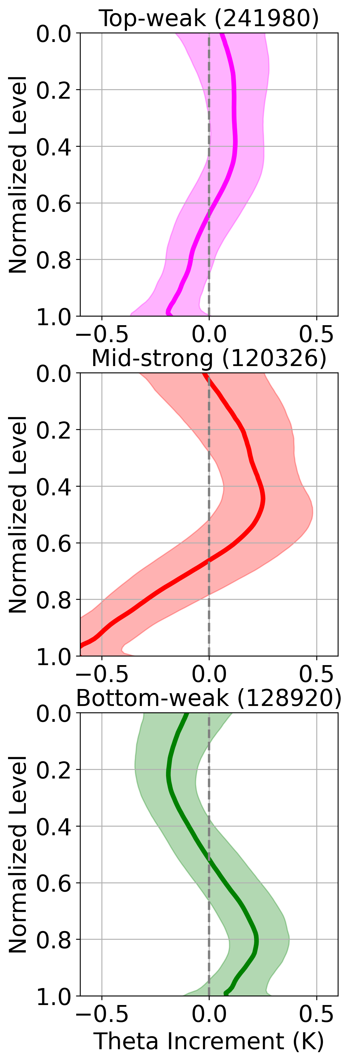
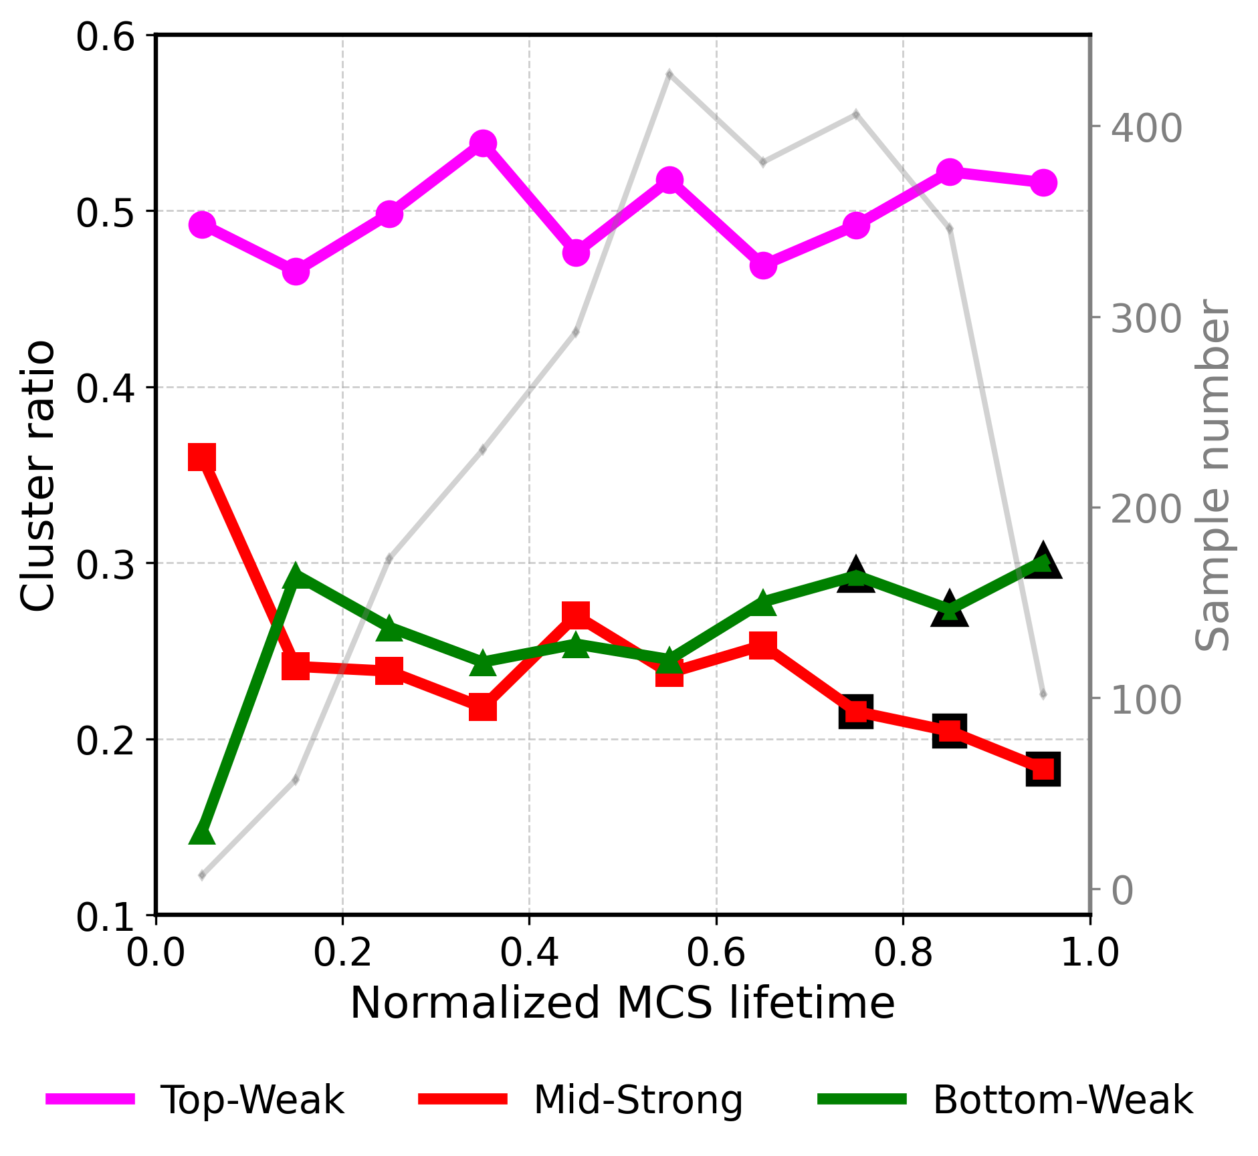
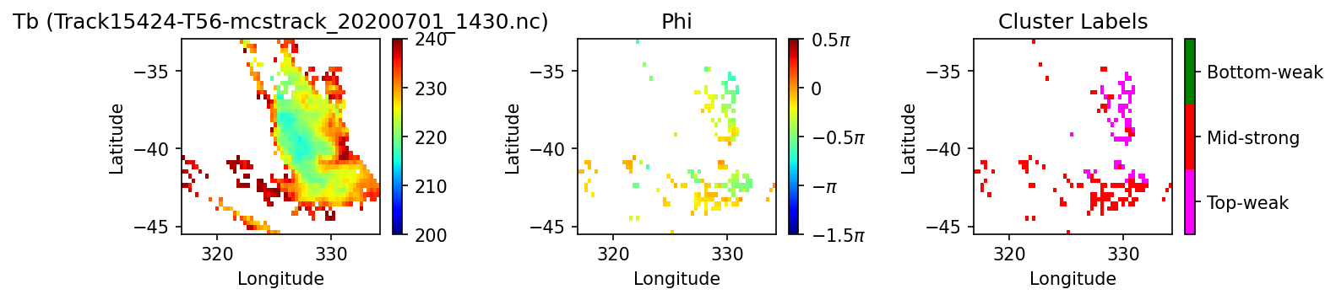


Clustering MCS Analysis Increments
(a)
(b)
(a)
(b)
0701 15Z
(c)
(c)
0702 3Z
(d)
0702 9Z
(d)

Slide 43

MCS scheme developed
Does it work?
We have just completed a 3 month trial of it with the global ensemble system
Keen to analyse the results…

Slide 44

An early hint
Error (solid) and spread (dashed) of tropical rainfall
Control, original MCSP, stochastic trigger
New trigger improves spread without degrading error
It treats 1/3 of convection as MCS-like

Slide 45
Summary
Most convection parameterizations are based on mass flux, assuming a representative plume ascent
Setting the entrainment is a key issue, as this controls the depth of convection and shape of the heating profile
Climate models are sensitive to this
The framework has some major limitations but progress can still be made within it
Challenges include:
  Grey zone
  Organized convection
  Microphysics (consistency with other parts of the model)
  Momentum transports….

