Slide 1

Some fundamentals of convection
Bob Plant, with thanks to many others!
Summer School on Atmospheric Convection
Nanjing University
21-25 July 2025

Slide 2
This session
  What is convection?
  Convective structures
  Importance of moisture / microphysics
  Why is convection important?
    Interactions with dynamics
  Types of atmospheric convection
    Dry, shallow, deep, organization on meso and large scales
  Simulations of convection

Slide 3
What is convection?
  In the geophysical sciences…
  A flow that is driven by the action of buoyancy
  Okay, but then….

Slide 4
What is buoyancy?

Slide 5

Buoyancy
  The Navier-Stokes equations are…
  $$\frac{Du}{Dt}=−g − \frac{1}{ρ}∇p +ν ∇^{2}u$$
  Consider a fluid parcel with a slightly different density $ρ=\overline{ρ}+ρ′$ in comparison to its surroundings
  In the vertical and neglecting molecular diffusion
  $$\frac{Dw}{Dt}=−g− \frac{1}{\overline{ρ}+ρ′}\frac{∂p}{∂z}$$

Slide 6

Buoyancy
  Make a Taylor expansion in $ρ^{′}/ρ$:
  $\frac{Dw}{Dt}=−g− \frac{1}{\overline{ρ}}\frac{∂p}{∂z}+\frac{ρ^{′}}{{\overline{ρ}}^{2} }\frac{∂p}{∂z}+…$
  The first two terms vanish if the surrounding air is in hydrostatic balance
  $$\frac{Dw}{Dt}≈\frac{ρ′}{\overline{ρ}}\frac{1}{\overline{ρ}}\frac{∂p}{∂z}=−\frac{ρ′}{\overline{ρ}}g$$
  Less dense fluid accelerates upwards relative to its surroundings

Slide 7

Buoyancy
  Using the ideal gas equation and neglecting pressure fluctuations then the buoyancy may be rewritten as
  $$B=−g\frac{ρ^{′}}{\overline{ρ}}=g\frac{T^{′}}{\overline{T}}=g\frac{θ′}{\overline{θ}}$$
  i.e., warm air rises.
  To neglect pressure fluctuations, we need $w≪c_{s}$ the speed of sound

Slide 8
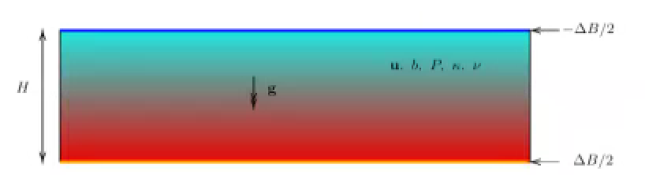
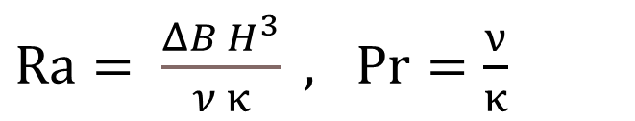
Rayleigh-Bernard convection
  Two plates held at fixed temperatures
Flow is described by two dimensionless numbers
$Ra= \frac{ΔB H^{3}}{ν κ} ,$ $Pr=\frac{ν}{κ}$

Slide 9
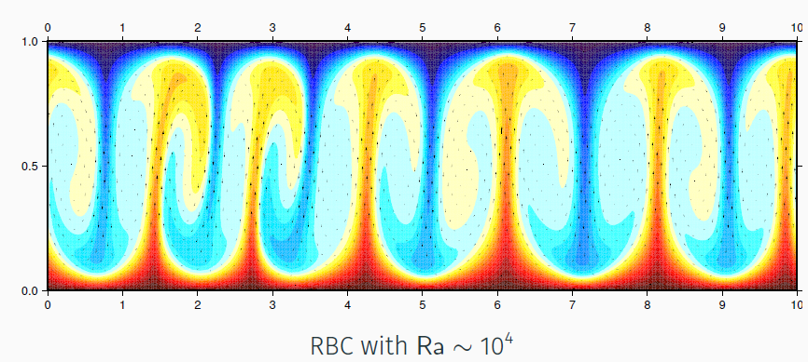
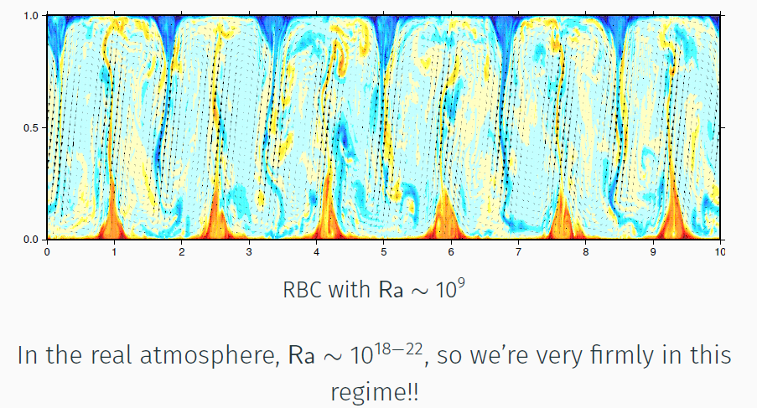












Rayleigh-Bernard
  For low Ra, heat diffuses, with no motions
  Above critical Ra = 27π⁴/4 convection occurs
  As Ra increases, steady rolls → intermittent → turbulent
$$b_{t}$$
$$H$$
$$ν,κ$$
$$b_{b}$$

Slide 10
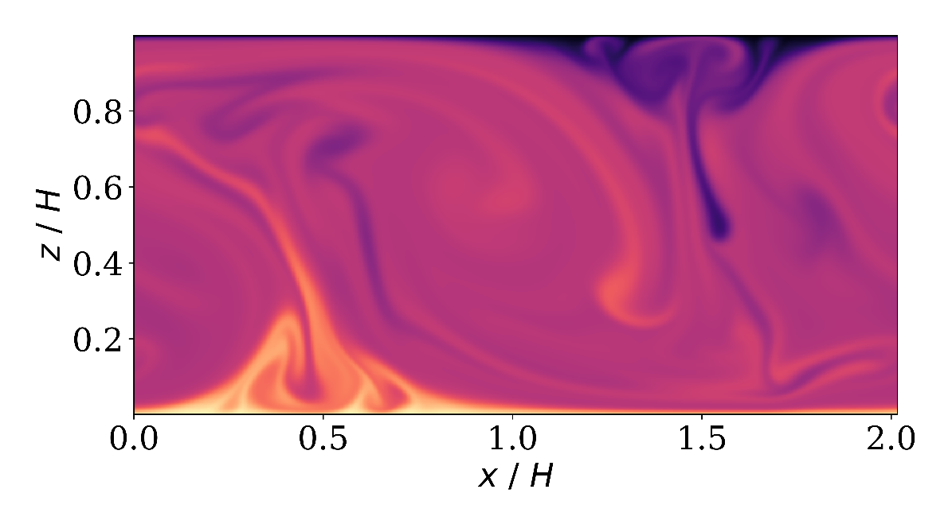
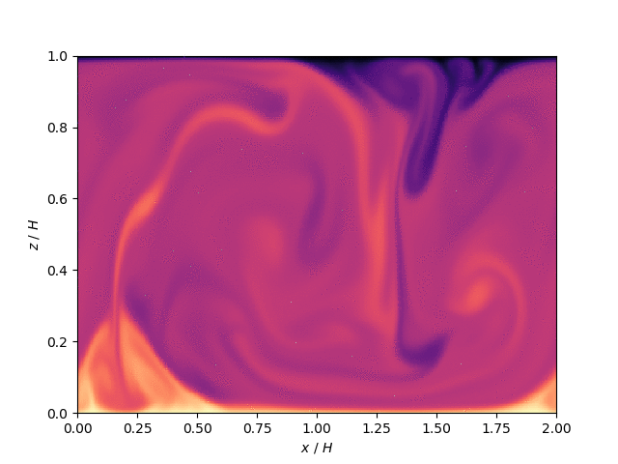
Rayleigh-Bernard
  For low Ra, heat diffuses, with no motions
  Above critical Ra = 27π⁴/4 convection occurs
  As Ra increases, steady rolls → intermittent → turbulent

Slide 11
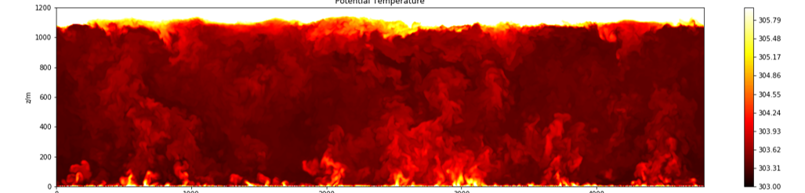
Dry convective boundary layer
  Daytime boundary layer over land is somewhat similar
  Main differences:
    Surface temperature not constant!
    But t = h/w* is around 10 min
    Top of BL is not fixed
    Though it may have a strong inversion layer

Slide 12
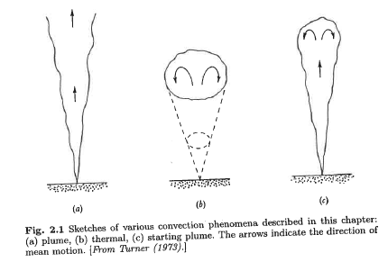
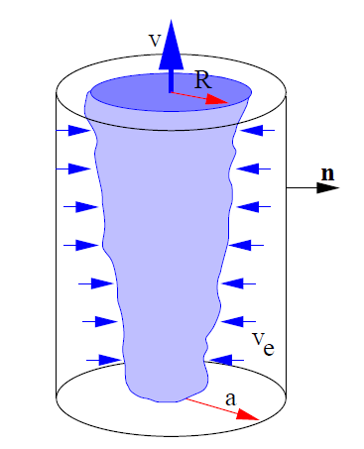
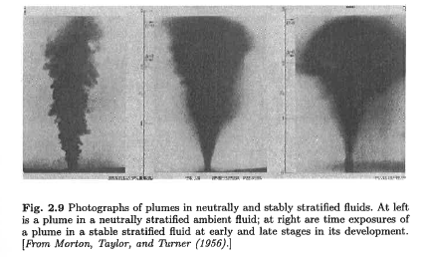
Convective structures: plumes
Plume Thermal Starting plume
  Buoyant, ascending air may form a “plume” structure
  Simple atmospheric models often formulated this way
  But may not be the best idea…
Laboratory plumes

Slide 13
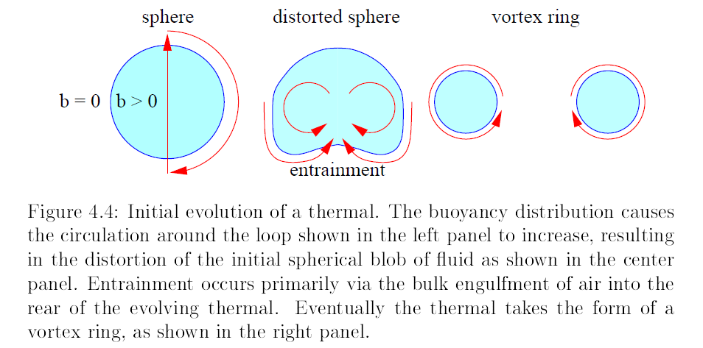
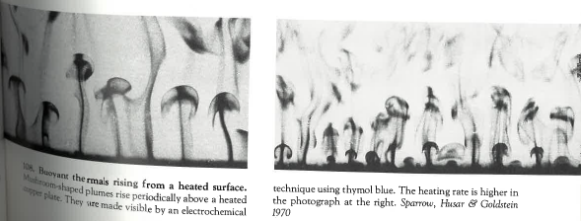
Convective structures: thermals
Plume Thermal Starting plume

Slide 14
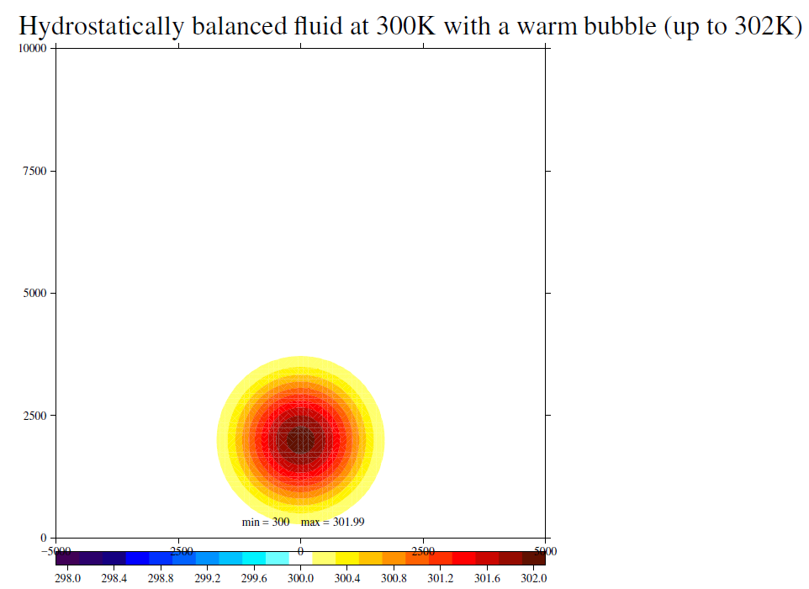
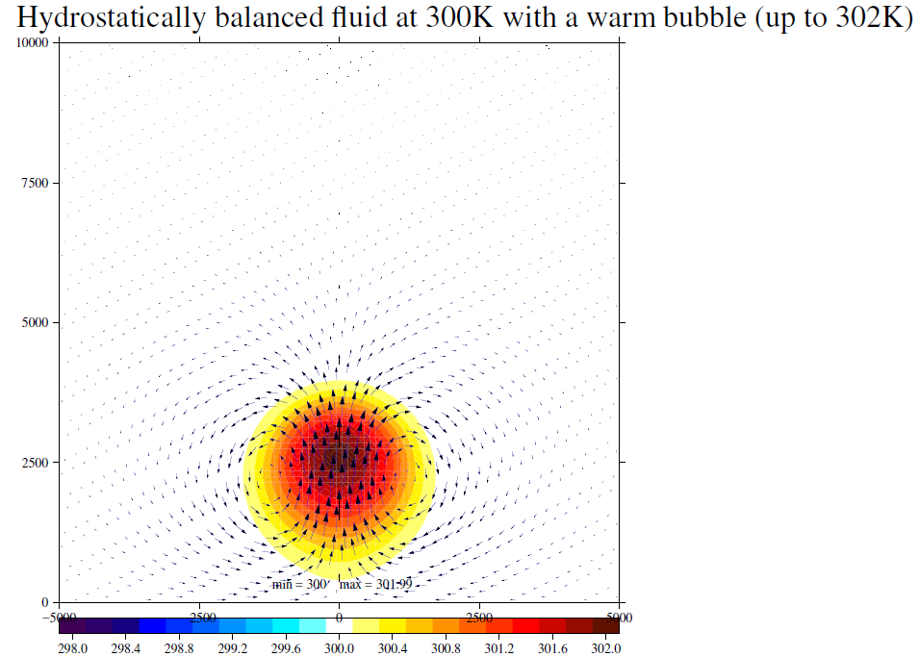
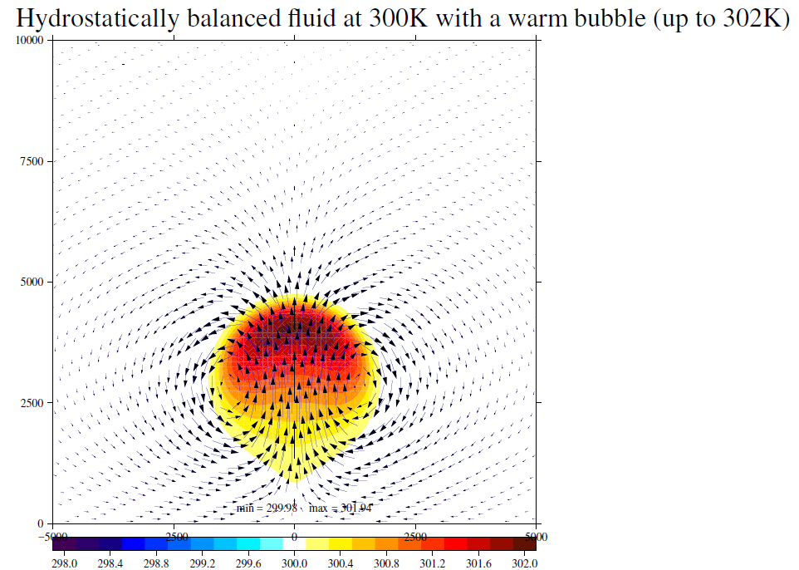
Rising warm bubble: a thermal

Slide 15
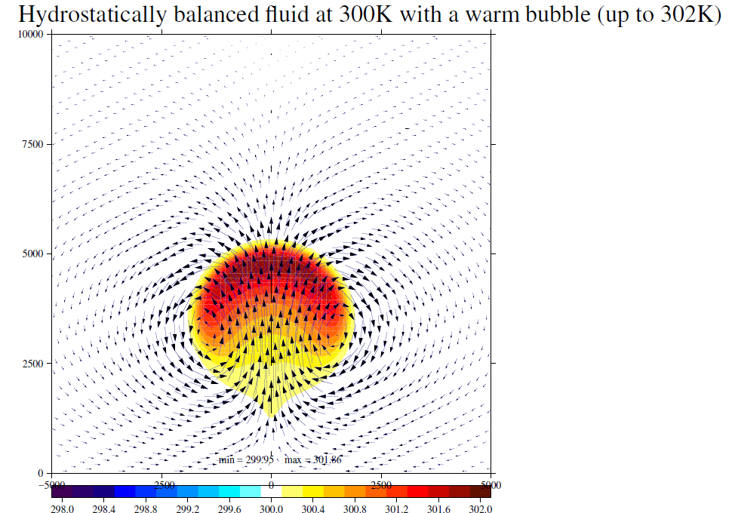
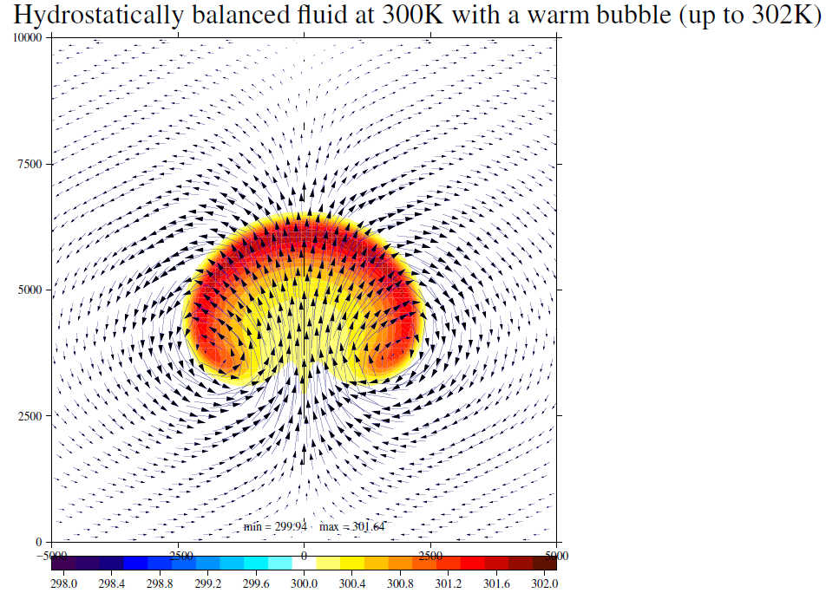
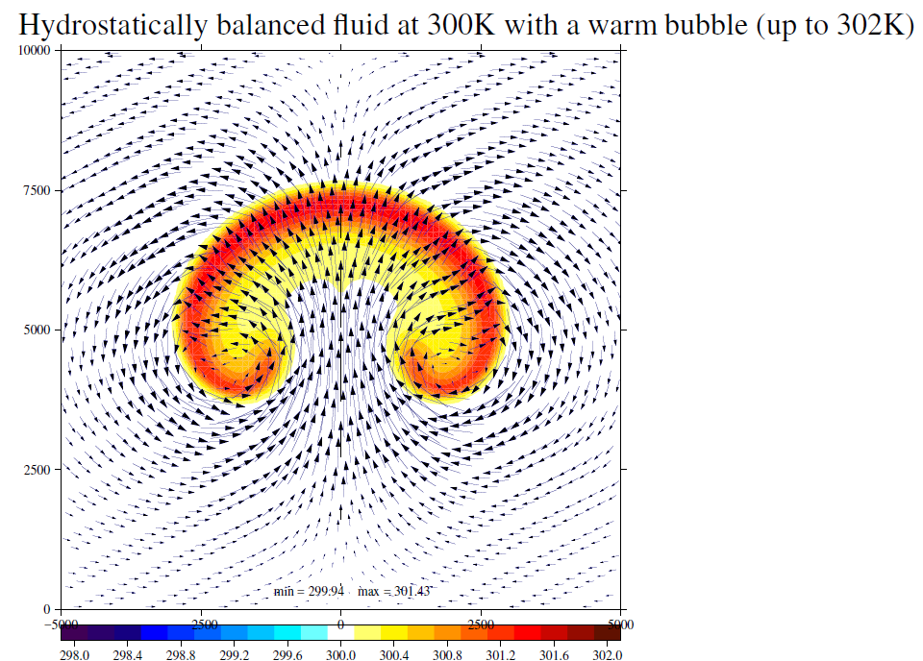
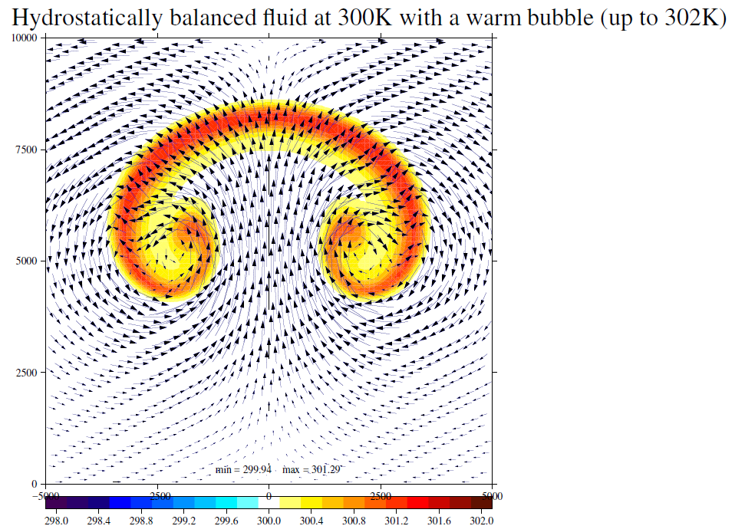
Rising warm bubble: a thermal

Slide 16
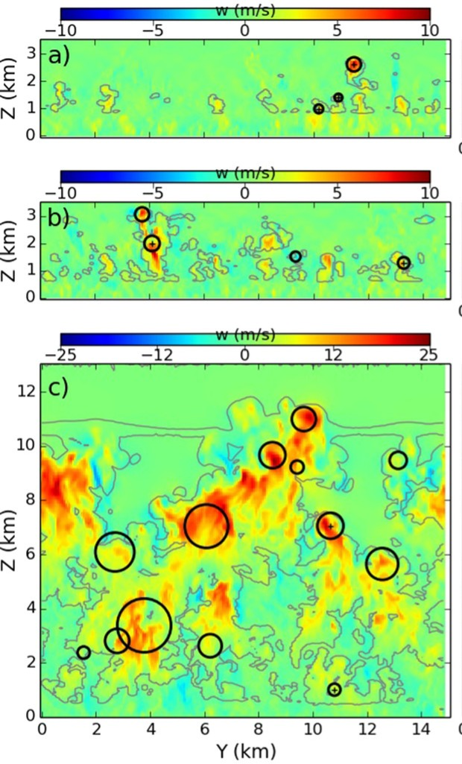
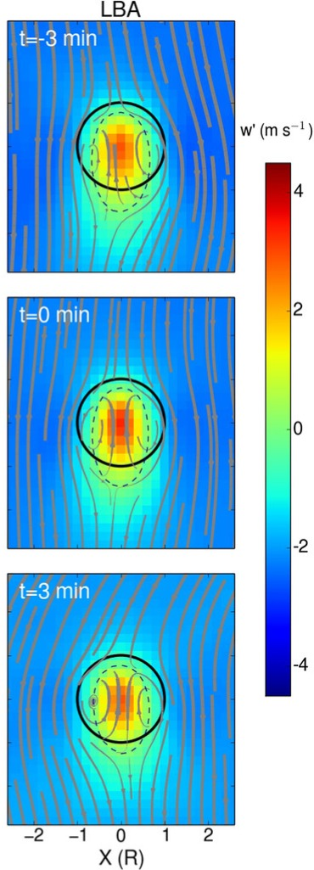
Thermals within atmospheric convection
Identify thermals in simulations of developing convection
Mean composite in thermal-relative frame on the right
Hernandez-Deckers and Sherwood, JAS, 2016

Slide 17

Moist Buoyancy
  The buoyancy needs to be generalized to a virtual temperature perturbation with
  $$T_{v}≈T(1+δr_{v} −r_{w})$$
  $δ=\frac{R_{v}}{R_{d}}−1≈0.608$ depends on the gas constants for dry and moist air, $r_{v}$ is the mixing ratio ($ρ_{v}/ρ_{d}$) for water vapour and $r_{w}$ for water
  The water (or ice) part of the buoyancy is known as the condensate loading

Slide 18
Moist Buoyancy
  Which of these produces the largest buoyancy effect?
  A difference of 0.5 K in temperature
  A difference of 5 g/kg in water vapour
  A difference of 2 g/kg in liquid water

Slide 19
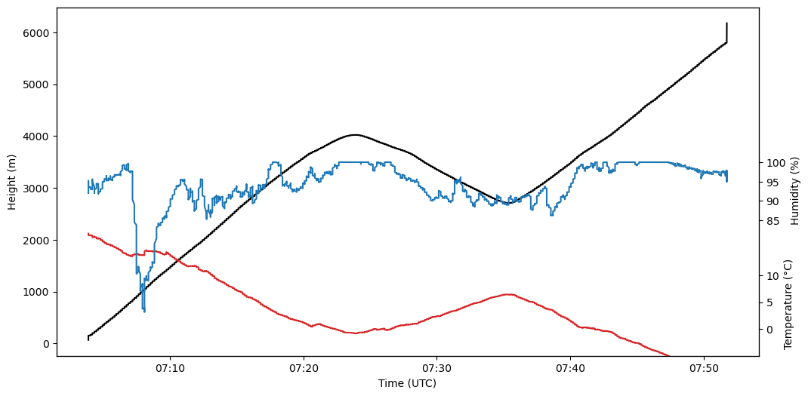
Radiosonde launch, 07Z summer day in Reading
Balloon descending
Black = height Blue = RH Temperature = red

Slide 20
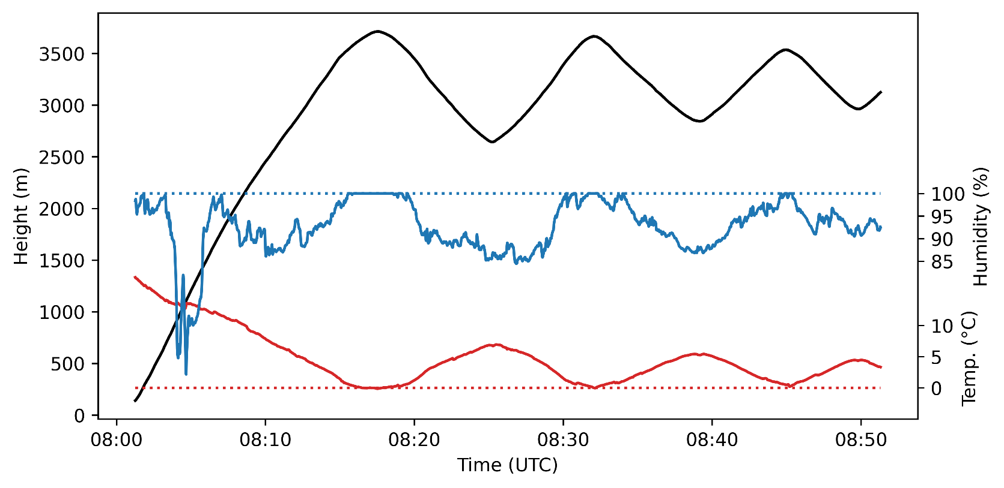
Oscillations continue…
Black = height Blue = RH Temperature = red

Slide 21
Condensate loading
Radar imagery shows balloon passing through cloud
Snow and ice settle on balloon
= loss of buoyancy
RH 100%
T 0°C
Melting snow/ice
= regain buoyancy

Slide 22
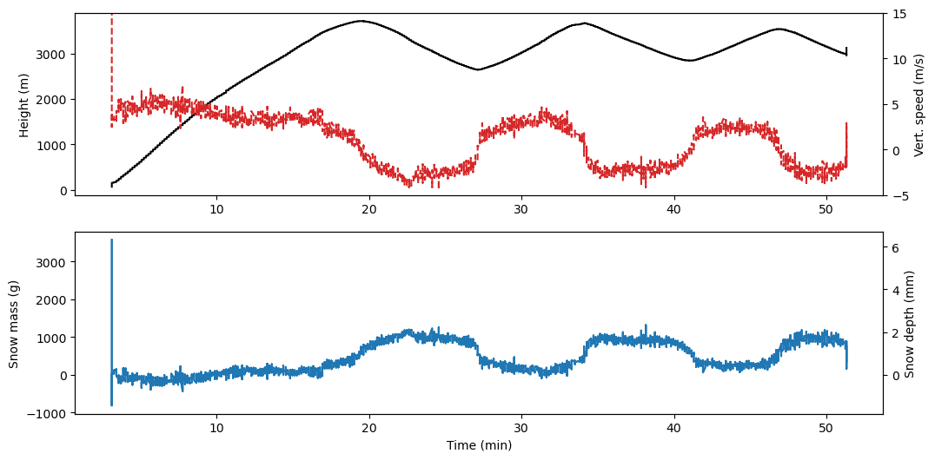
Condensate loading
Estimated ascent/descent rate and mass of snow/ice required
Liu et al (2023) MWR ~ 0.2% of soundings do this

Slide 23
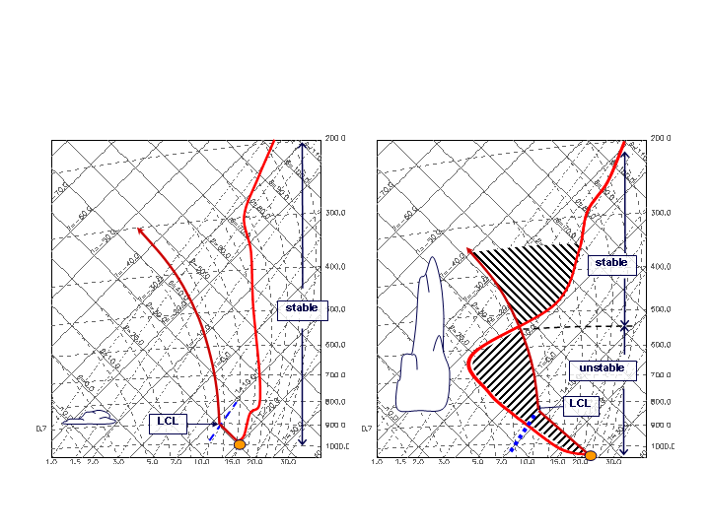
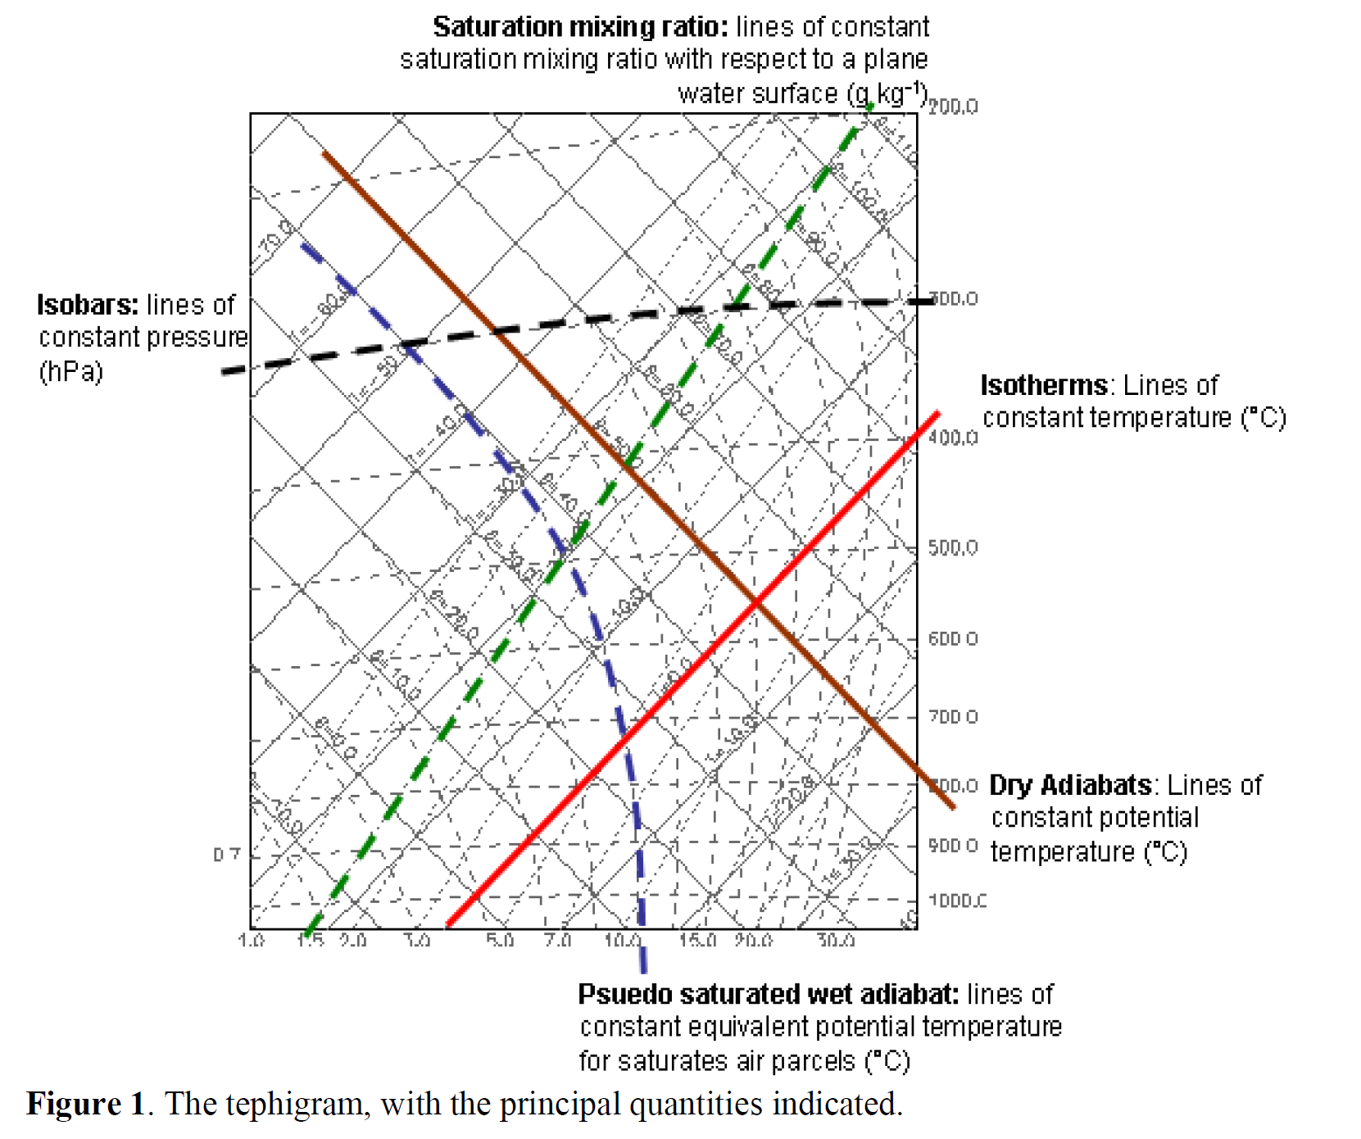
Assessment of vertical structure
Pseudo-adiabatic ascent indicates buoyancy available if it lies to the right of the atmospheric sounding

Slide 24
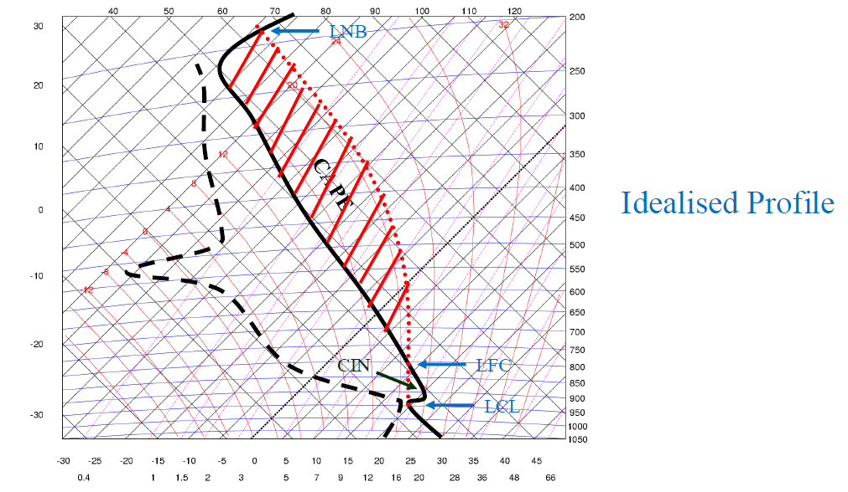
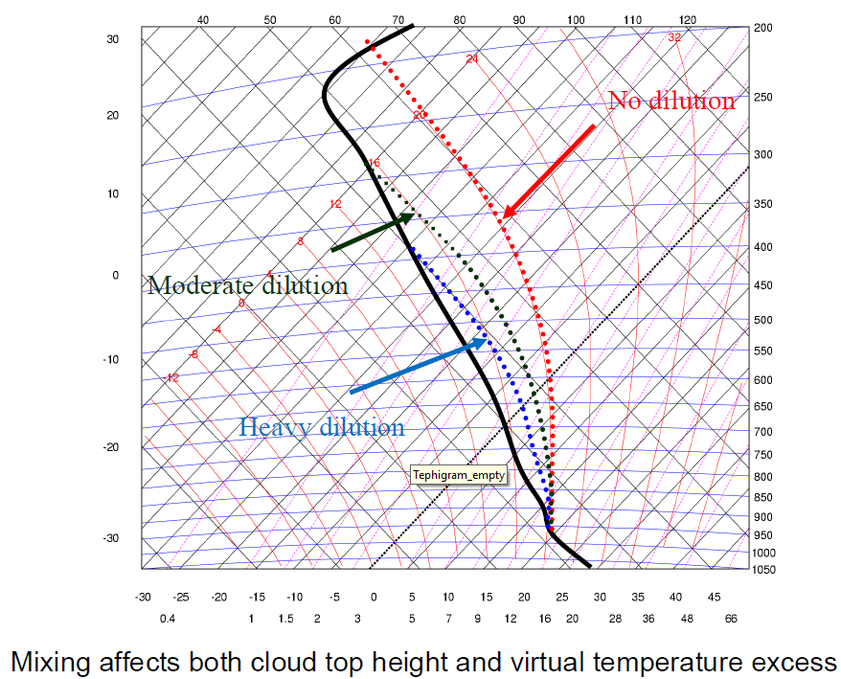
Assessment of vertical structure
If parcel ascends to reach LFC it will be accelerated
Buoyancy reduced by mixing with environment (and loading)
“Entrainment” and “microphysics” are important!

Slide 25
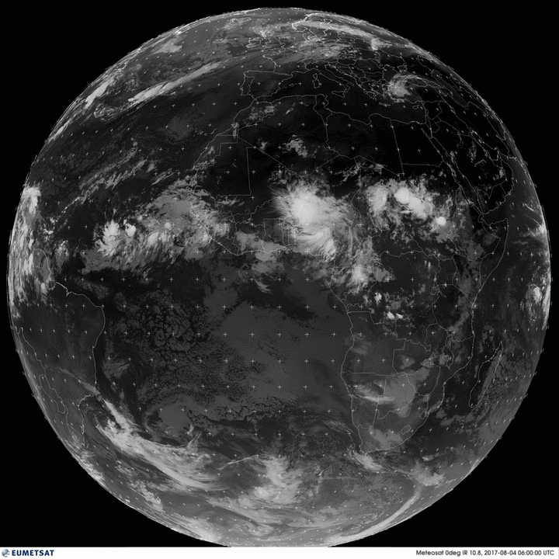
Convection in the atmosphere
Convection is important
It plays a leading role in planetary budgets of heat, moisture and momentum
Associated warming patterns drive tropical circulations:
  e.g., monsoons, the Walker circulation
  synoptic features, e.g. tropical cyclones
Production of extreme events, e.g. floods
Full-disk infrared METEOSAT Zero-Degree images from EUMETSAT http://oiswww.eumetsat.org/IPPS/html/MSG/IMAGERY/UMETSAT

Slide 26
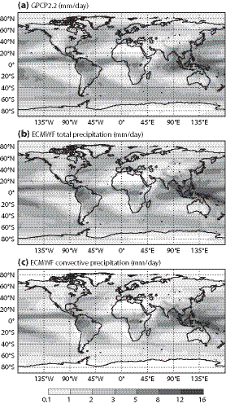
Global rainfall
Around 2.8mm/day globally, but higher in tropics
60% of global precip from convection parameterization
75% in tropics (and much of the rest from associated anvil cloud)
Observations
ECMWF,
total precip
ECMWF, convective precip
Bechtold, 2015

Slide 27
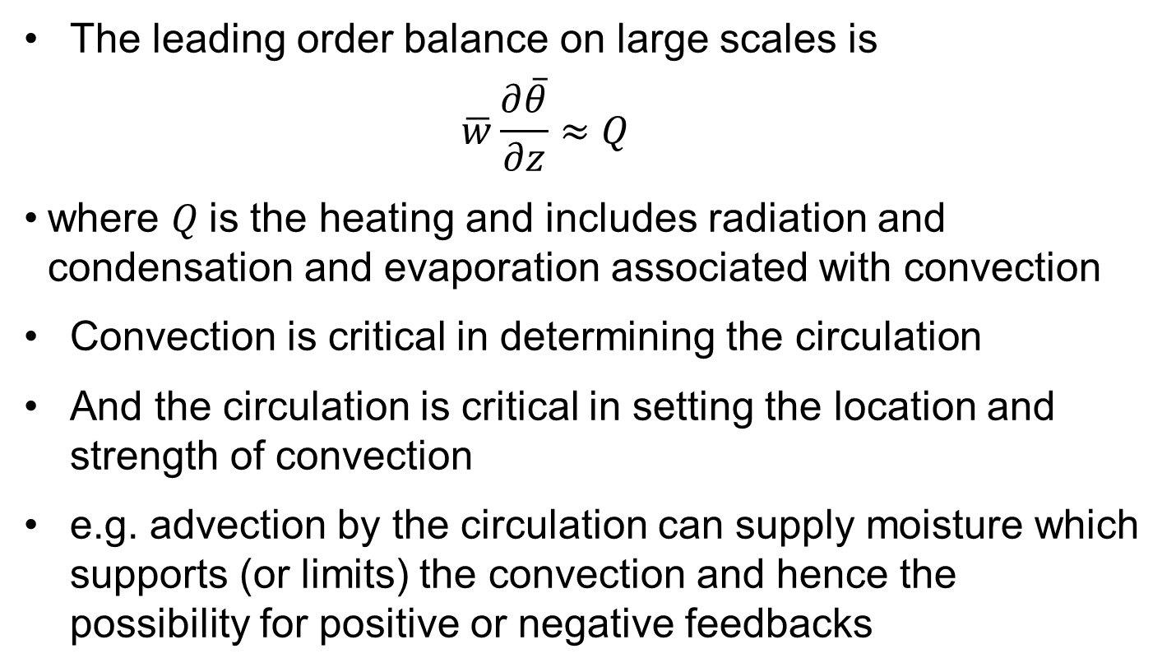
Tropical heat and moisture budgets
The leading order balance on large scales is
  $$\overline{w}\frac{∂\overline{θ}}{∂z}≈Q$$
where $Q$is the heating and includes radiation and condensation and evaporation associated with convection
Convection is critical in determining the circulation
And the circulation is critical in setting the location and strength of convection
e.g. advection by the circulation can supply moisture which supports (or limits) the convection and hence the possibility for positive or negative feedbacks

Slide 28
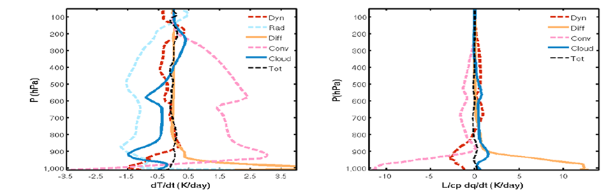
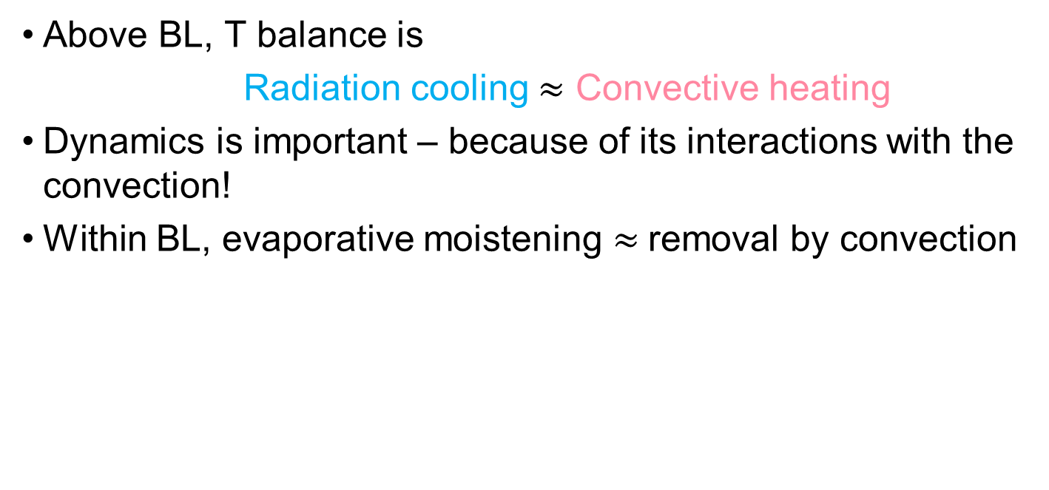
Tropical heat and moisture budgets
Above BL, T balance is
  Radiation cooling $≈$ Convective heating
Dynamics is important – because of its interactions with the convection!
Within BL, evaporative moistening $≈$removal by convection

Slide 29
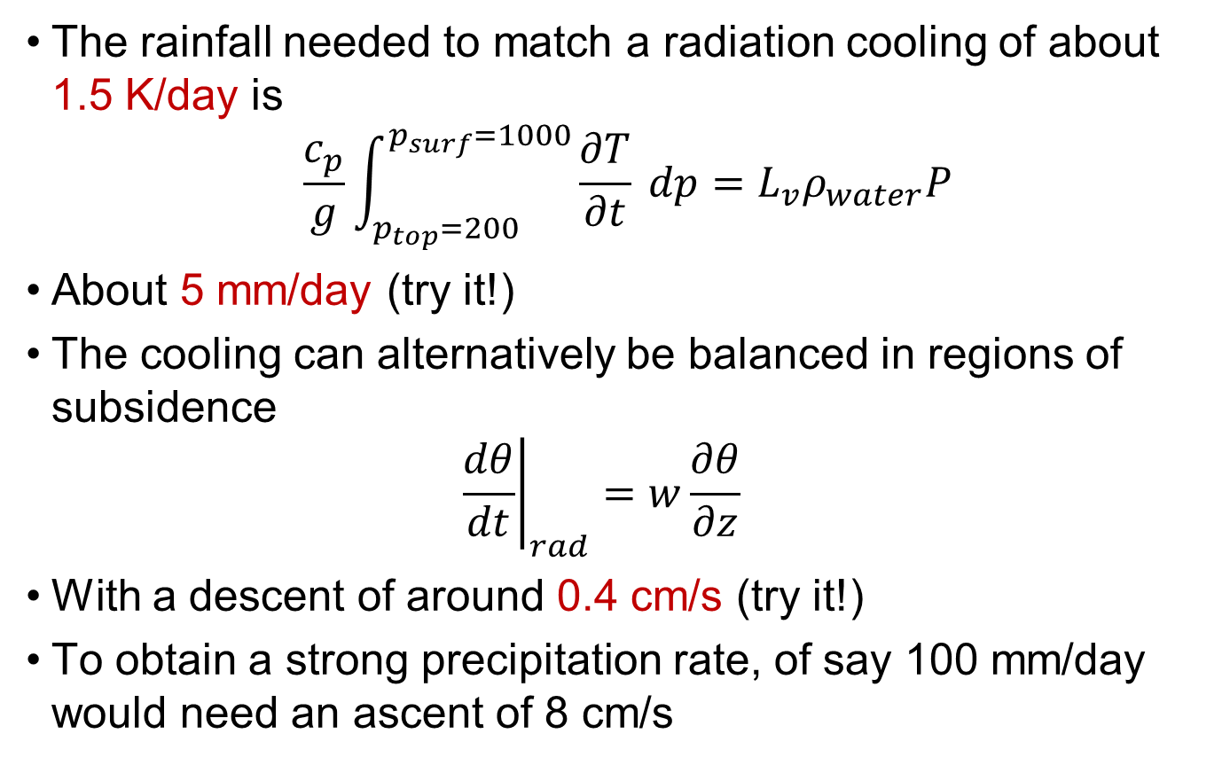
Simple heating estimates
The rainfall needed to match a radiation cooling of about 1.5 K/day is
$$\frac{c_{p}}{g}\int_{p_{top}=200}^{p_{surf}=1000}{\frac{∂T}{∂t} dp}=L_{v}ρ_{water}P$$
About 5 mm/day (try it!)
The cooling can alternatively be balanced in regions of subsidence
  $${\left.\frac{dθ}{dt}\right|}_{rad}=w\frac{∂θ}{∂z}$$
With a descent of around 0.4 cm/s (try it!)
To obtain a strong precipitation rate, of say 100 mm/day would need an ascent of 8 cm/s

Slide 30
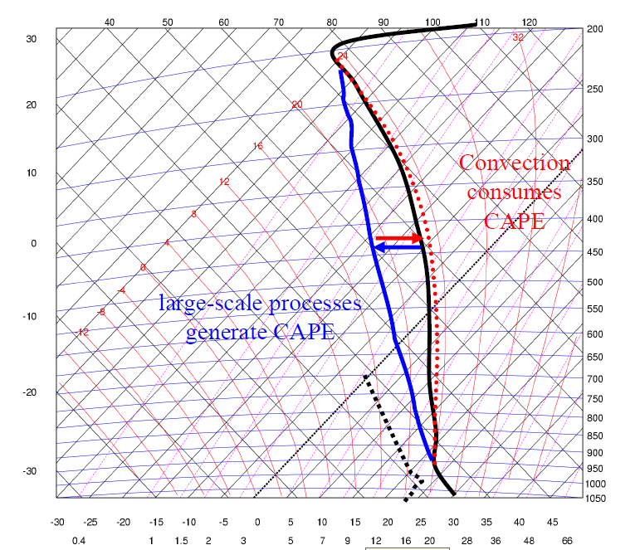
Convective Equilibrium
In equilibrium, convection balances large-scale forcing
  A good approximation over large areas / long times
  May work on smaller scales too
In other cases, a CAPE build up may be hard to release
  A key factor is to overcome CIN (possibly large uncertainty in occurrence)
Notes:
Black is the environmental sounding. Red shows warning caused by convection, which would drive the sounding towards a parcel ascent (not shown). So the CAPE is reduced. Blue shows the large-scale cooling the surroundings, driving the sounding towards the left of the tephigram and so increasing the CAPE.

Slide 31
Measuring Equilibrium
Use the timescale,
    T = CAPE / (dCAPE/dt due to convection)
An estimate of time needed for convection to adjust the atmosphere towards a neutral profile
Expected to be small in equilibrium conditions
Over Europe it is < 3 h for around 70% of convective events (Zimmer et al 2010; Flack et al 2016)

Slide 32
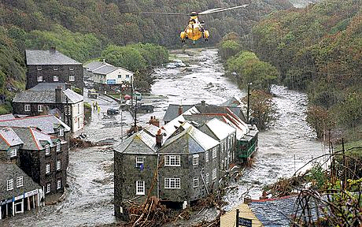
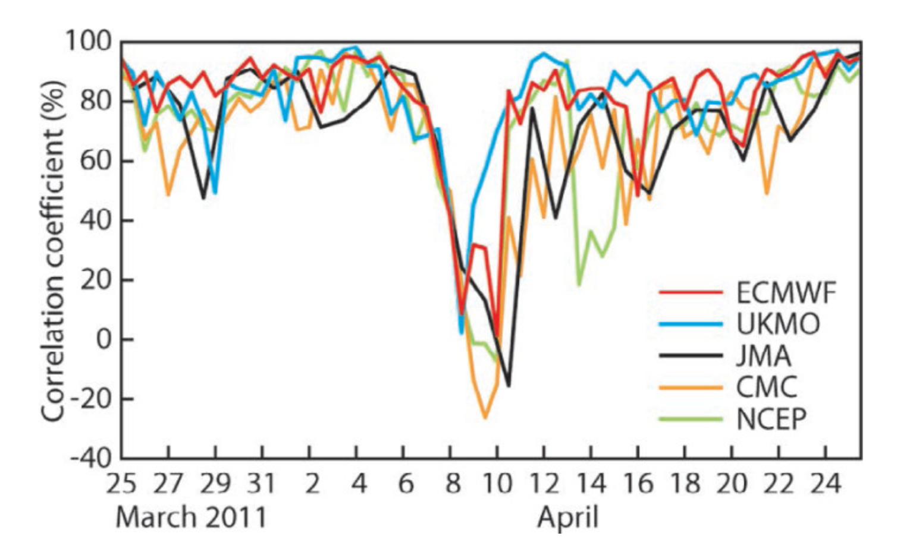
Numerical weather prediction
Localized flash floods
Flooding from organized systems dominated by convection: MCS, tropical cyclones
  Ding et al 2024, 90% of Asian monsoon floods related to MCS
Downstream effects: misrepresentation of US MCS can lead to “forecast busts” over Europe in 5-6 day forecasts

Slide 33
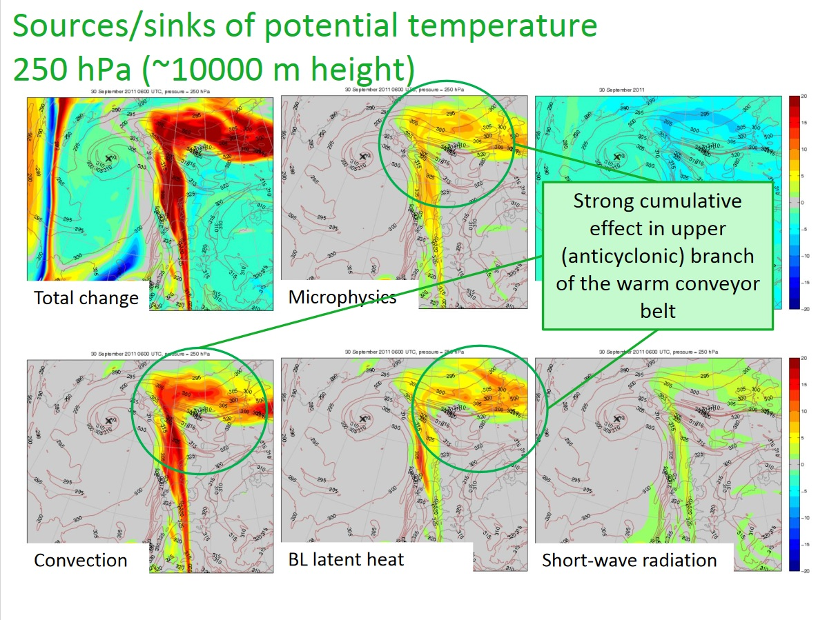
Downstream effects
Accumulate heating terms in model over 42h and advect these along with the flow
Notes:
NAWDEX, 30/09/11
Martinez-Alvarado and Plant, 2014

Slide 34
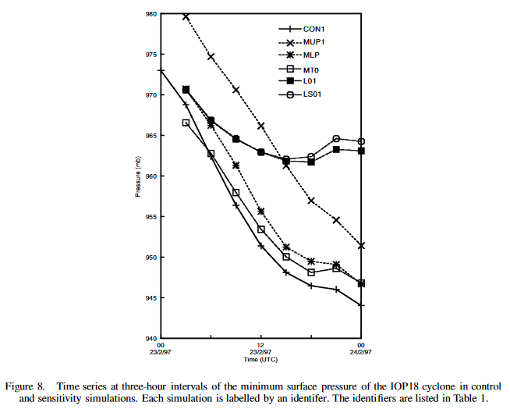
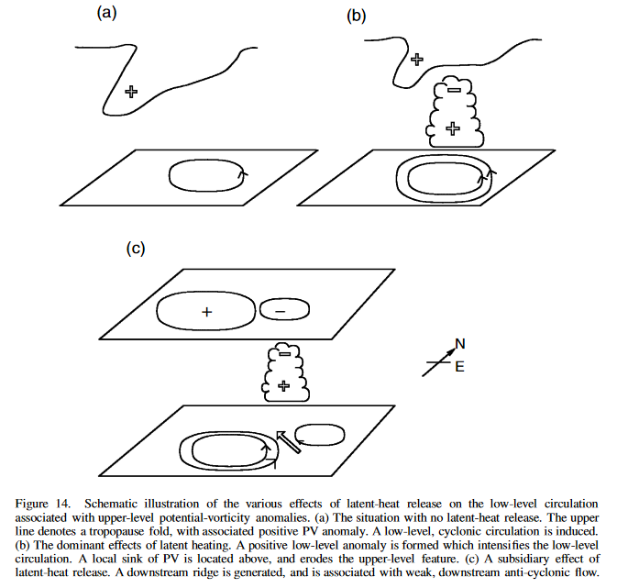
Explosive extratropical cyclone
Disable convection, 10mb in 24h
Control simulation, 30mb in 24h
Upper level feature → ascent → convection
Convection → mid-level PV structure that interacts to drive explosive cyclognesis
Notes:
FASTEX IOP18, 22/02/97
Ahmadi-Givi et al, 2004

Slide 35

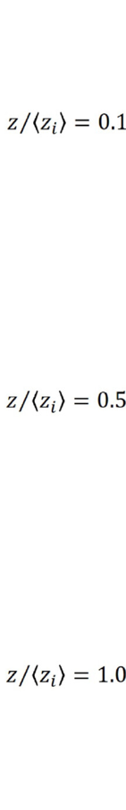
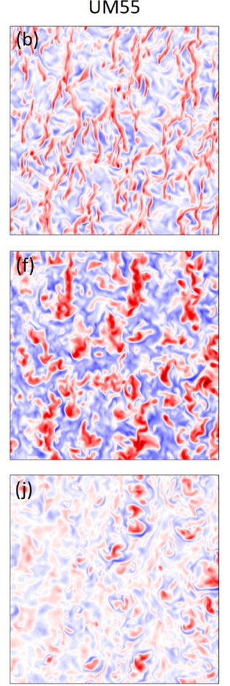
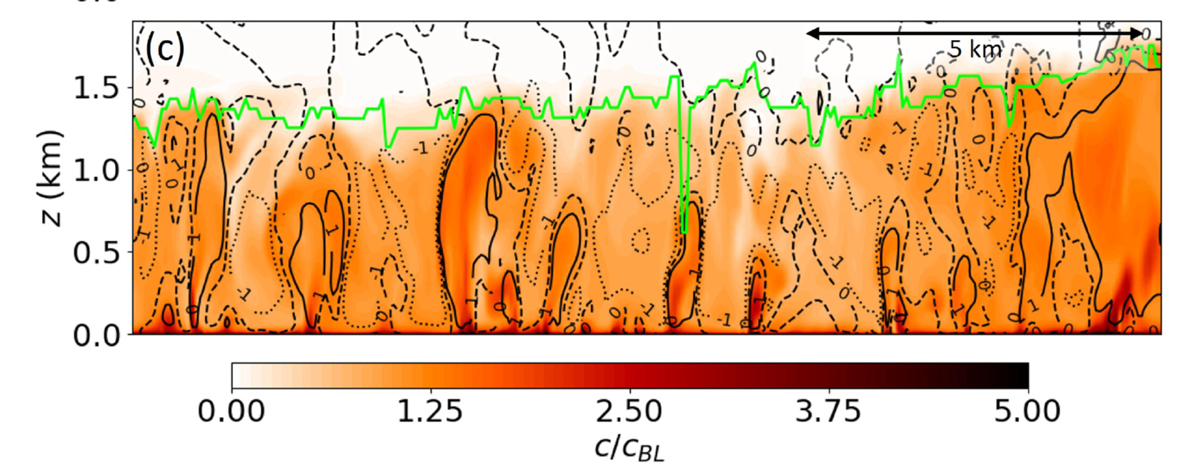
Types of atmospheric convection
  “Dry” i.e. no condensation
  Atmosphere heated from below
  Warm air rises to top of BL without reaching LCL
Notes:
Blunn et al 2021

Slide 36

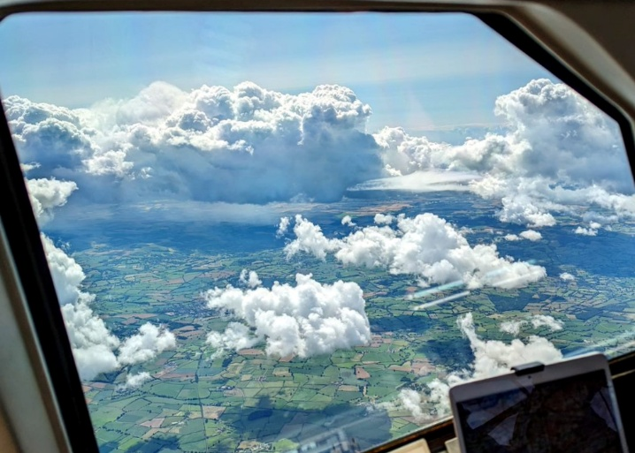

Shallow cumulus
  Convection reaches LCL but limited by a low-level inversion
  Typically no ice formation, so no or weak rainfall

Slide 37
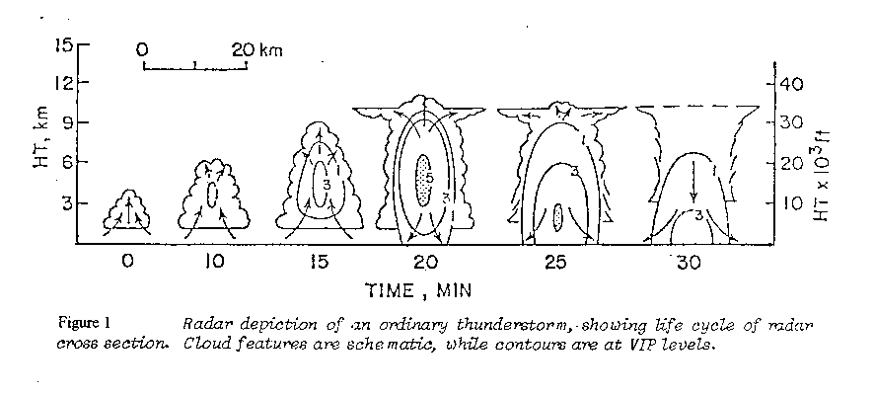
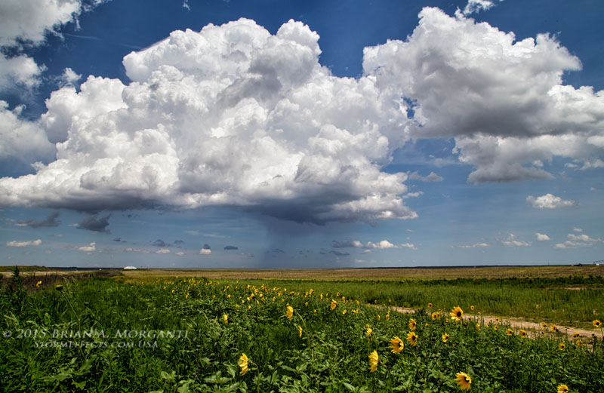
Deep cumulus – initial stage
Key point is not the depth per se but that rainfall feeds back on the dynamics
Notes:
Image credit: Brian Morganti www.stormeffects.com
Schematic from The kinematics of multicell and supercell Alberta hailstorms, Chisholm and Renick, Alberta Hail Studies, 1972.
Latent heat release warms air in cloud – it rises moist adiabatically.
Cloud edges sharp and distinct (because water droplets, no ice yet)
No lightning or thunder.

Slide 38

Deep cumulus - mature stage
Evaporation at edges and within precipitation area causes cooling and descent – cold pools
Notes:
Stronger updraft allows more mass (moisture) to enter the cloud, which can convert into more cloud drops, forming into larger rain drops.
Along the cloud edges, but also in the precipitation region, droplets can evaporate leading to cooling.
Colder air sinks and a downdraft is established, sometimes spreading out at the surface as a “cold pool”.
Rising air will reach tropopause and stop rising, must spread out into anvil.
Deepening of cloud means larger residence time for hydrometeors, and ice processes become important: hydrometeors grow in size, riming and melting, possibly leading to hail.

Slide 39

Deep cumulus - dissipating stage
Anvil at tropopause – may be orphaned from updraft and can continue to affect radiation
Notes:
. Low-level inflow may be disrupted through interference with nearby clouds and storms.
Alternatively, the downdraft can interfere with its own updraft and disrupt the flow.
Storm will stop if inflow is air is interrupted.
Cloud becomes largely glaciated, no further latent heat release.
Light precipitation falls from the cloud and the lower level cloud particles evaporate rapidly
Sometimes leaves a “ghost” of a cloud in mid or upper troposphere.

Slide 40

Squall lines
Some wind-shear environments can lead to convection forming in a linear arrangement
Common in the tropics but also in mid-latitude summer
Characterised by a strong wind-gust (squall) followed by brief heavy downpour then lighter rain for several hours
These are one type of Mesoscale Convective System (MCS)

Slide 41
Squall lines
~100 km
Front-to-rear updraft
Descending rear inflow
Storm motion
Stratiform rain
Intense convective showers

Slide 42


Simulations with different wind shear profiles
10 different background wind profiles from clustering
Simulations identical apart from the winds

Slide 43

Heating Profile in MCS
  MCS associated with large stratiform area as well as the strong convective updrafts
  The ice grows by deposition releasing latent heat
  And falls out, melt into rain drops and evaporating to give lower tropospheric cooling
  Heating profile becomes relatively “top heavy”
Yanai and Johnson, 1997

Slide 44

Contributions of MCS to precipitation
Satellite data shows:
MCS provide > 50% of tropical precipitation
> 70% some places
Notes:
Tao and Moncrieff 2009

Slide 45


Slide 46
A look ahead
  What is convection?
  Buoyancy
  Convective structures (Fu)
  Importance of moisture / microphysics (Satoh, Romps)
  Why convection is important?
    Interactions with dynamics (Sherwood)
  Types of convection
    Dry, shallow (de Roode), deep (Plant), organization on meso and large scales (Holloway, Tompkins, Haerter)
  Simulations of convection

Slide 47
Summary
Convection is a flow driven by buoyancy
  Vertical motions caused by horizontal density differences
Moisture and clouds are important in producing the density differences
It is a key component of the Earth’s atmosphere for both weather and climate
It is a major challenge to understand due to the large range of scales involved
And the close interactions with dynamics, microphysics and radiation
These produce a rich morphology of turbulent systems, from the individual thermal or plume to MCS to the MJO

