Slide 1
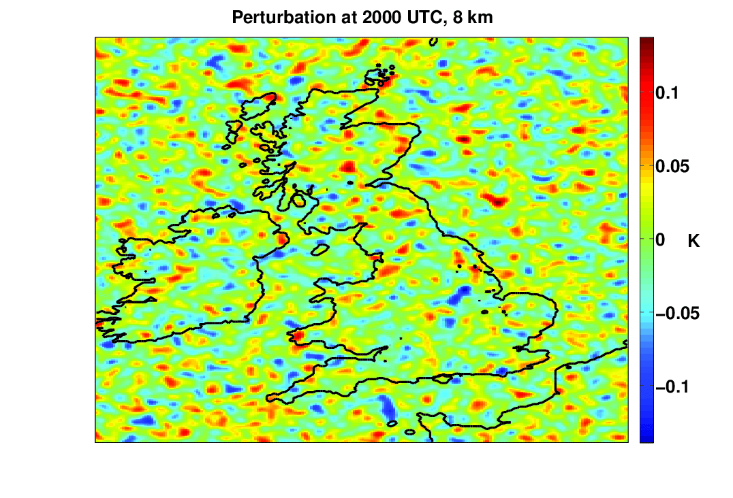
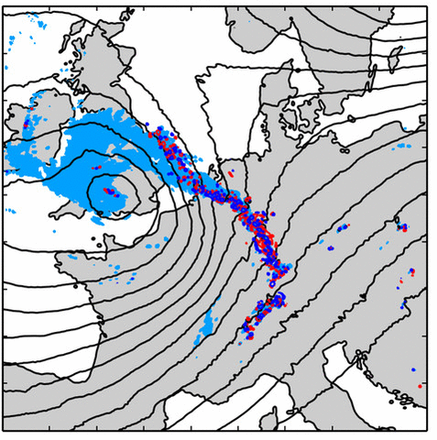

Error growth and parameterization assessment
Bob Plant
Department of Meteorology, University of Reading
ParaChute Mini-Workshop on Predictability
18 September 2025

Slide 2
Predictability vs systematic impact
Predictability literature looks at response to small perturbations through direct changes to model state
    initial state or periodic ( ~ h/w*) or continuous
    may be very small, e.g. 0.01K
    different levels tried
    different variables tried
    but BL buoyancy is what matters
How does a model respond?
If we change/add a parameterization, does it have systematic impact larger than the impact of small random perturbations?
  Impossible to answer unless we have measured the latter!

Slide 3
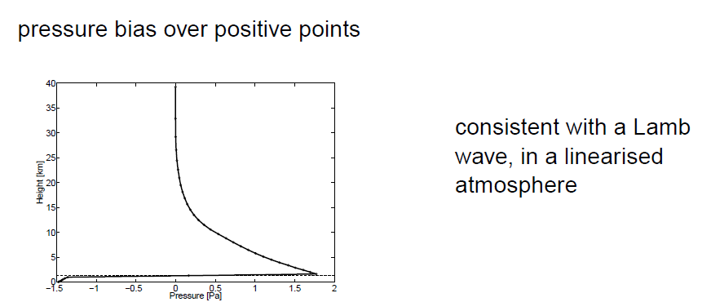
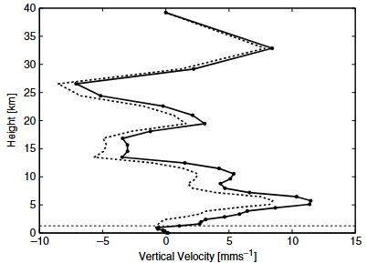
The immediate response (stage 0)
After one UM timestep
For BL θ perturbations of ~ 0.1K (Leoncini et al, 2010)
Can affect local CAPE by up to 1 J/kg, mainly by affecting LNB
Lock BL classification changes at up to 1% of points
Lamb (acoustic) wave responses in w and p, here the averaged response over points with Δθ >0

Slide 4
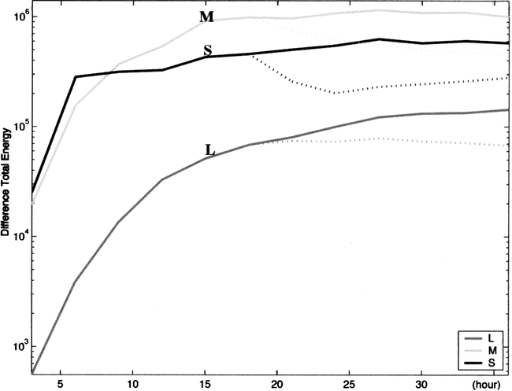
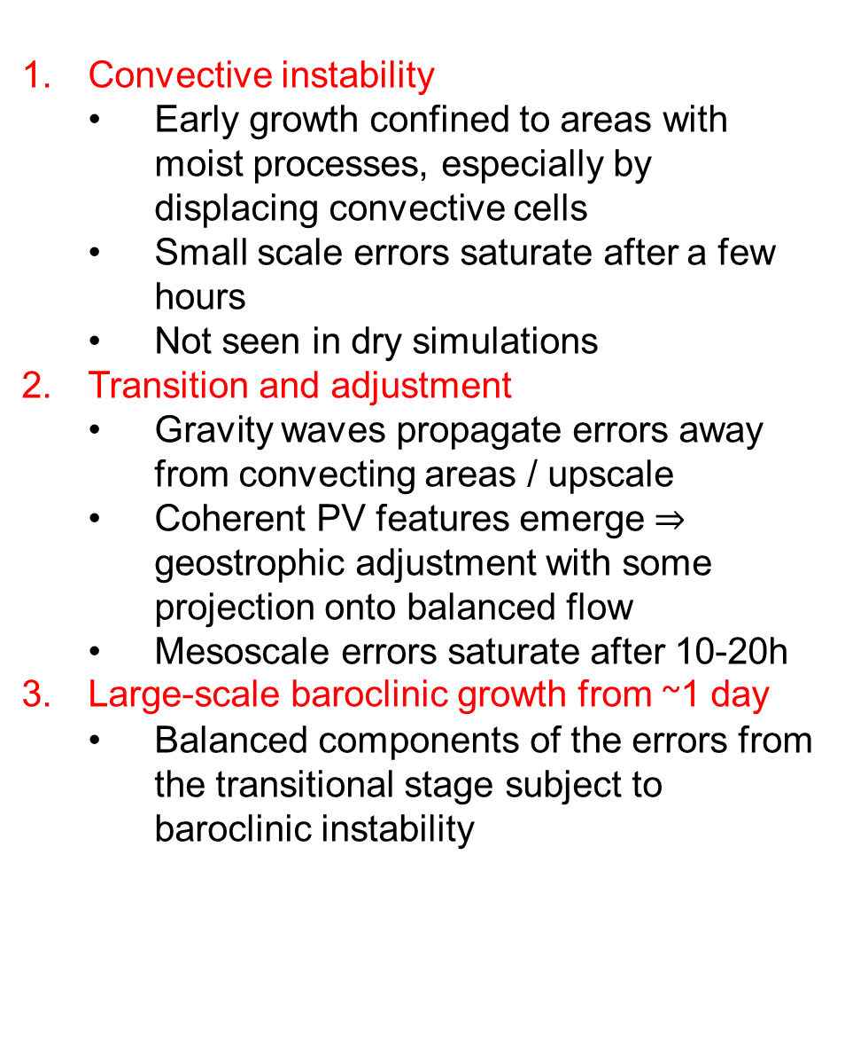
Picture of 3 (Overlapping) Stages
Convective instability
  Early growth confined to areas with moist processes, especially by displacing convective cells
  Small scale errors saturate after a few hours
  Not seen in dry simulations
Transition and adjustment
  Gravity waves propagate errors away from convecting areas / upscale
  Coherent PV features emerge $⇒$ geostrophic adjustment with some projection onto balanced flow
  Mesoscale errors saturate after 10-20h
Large-scale baroclinic growth from ~1 day
  Balanced components of the errors from the transitional stage subject to baroclinic instability
Zhang et al, 2007 and others
Notes:
3.3km convection permitting
Evolution of the domain-integrated DTE (m2 s−2) at three different characteristics scales (S: smaller-scale L < 200 km; M: intermediate-scale 200 < L < 1000 km; and L: larger-scale L > 1000 km), between CNTL-D3 and CNTL-D3P (solid curves) and between CNTLfd-D3 and CNTLfd-D3P (dotted curves)

Slide 5
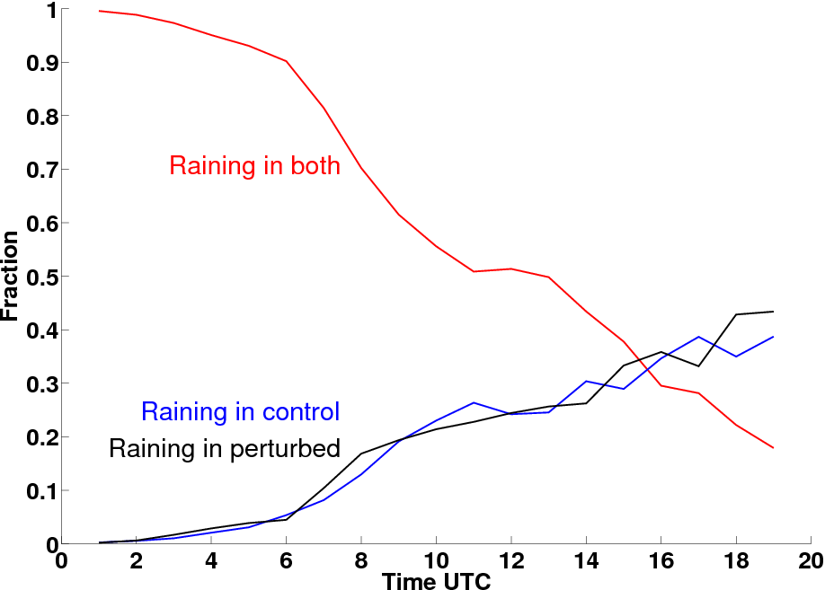
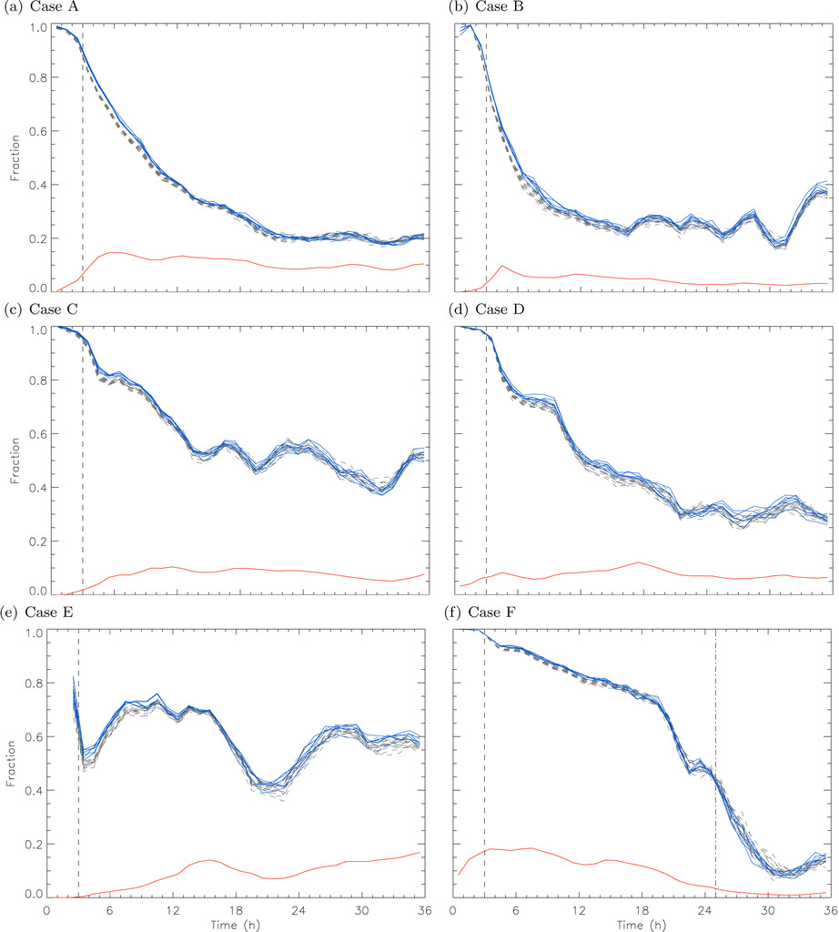
Phase 1
Shift the location or timing of convective cells
CSIP IOP18, after 10h, 50% are different
Leoncini et al, 2010
Fall off is faster and saturates at lower values when convection is more equilibrium like
Flack et al, 2018

Slide 6
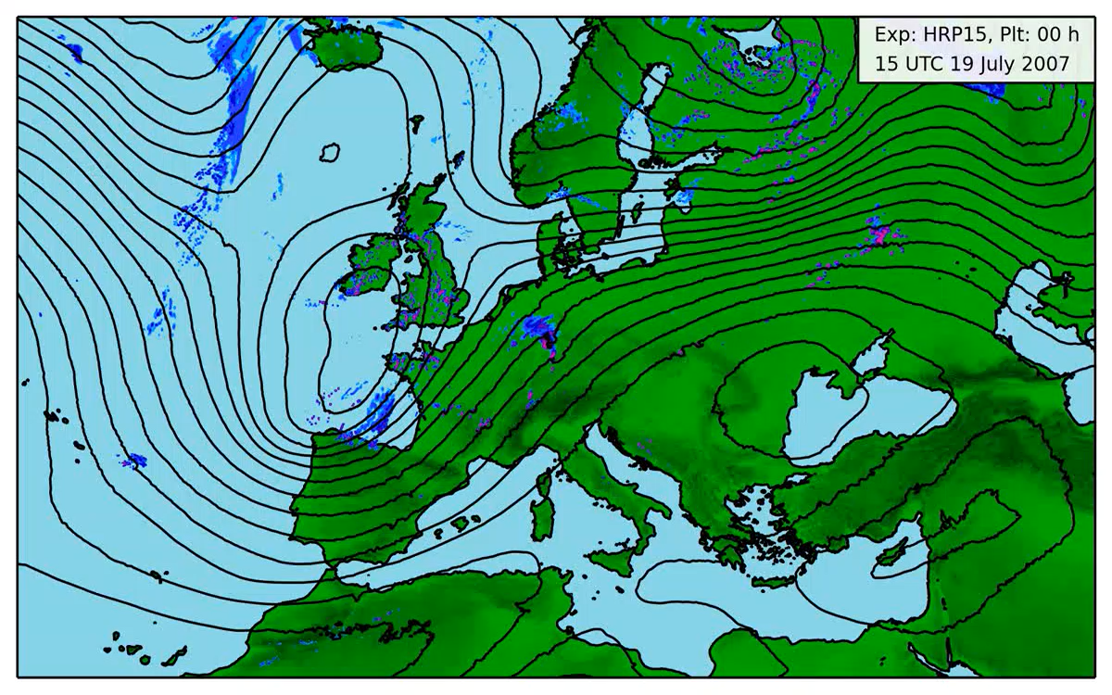
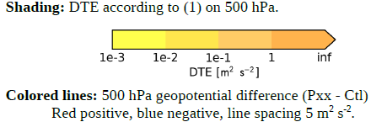
Phase 2 and towards 3
Selz and Craig, 2015

Slide 7
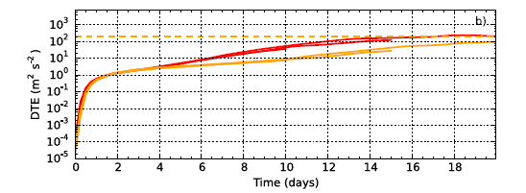
Ultimately to global saturation (stage 4)
Global 4km model
Initial burst, stages 1 and 2, with slope decreasing monotonically
Quasi-exponential error growth, stage 3, to ~ 12 days
Saturated at day 17
Judt, 2018
Notes:
Global 4km

Slide 8
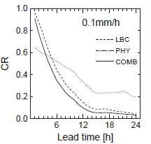
Do we capture phase 3 (or even 2)?
The air mass spends a time ~ L/U in the domain
This limits growth of locally-induced perturbations
LBC differences will dominate at times ≥ this
Physics dominates for 6h, LBC afterwards
CR = N(GP_{all}) / N(GP_{≥ 1}), numbers of grid points with rain in all / ≥ 1 member
Gerbhardt et al, 2009

Slide 9
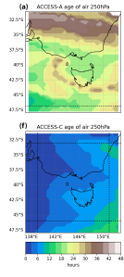
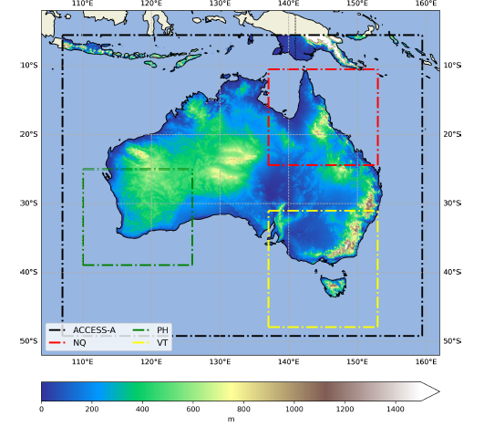
Monitoring this issue
Analysis includes LBC variations
Or can estimate L/U
Or use an age of air back trajectory
Or use tracers
Warner et al, 2025
Notes:
T+42 h simulation, age of air in black domain at top, air of air in yellow domain at bottom

Slide 10
Do we capture phase 1?
Variability associated with individual convective cells is required
Should be present if convection-resolving or convection-permitting
But phase 1 error growth is much weaker with deterministic parameterized convection
Q: can a stochastic representation of convection capture such variability and replicate phase 1 growth?

Slide 11
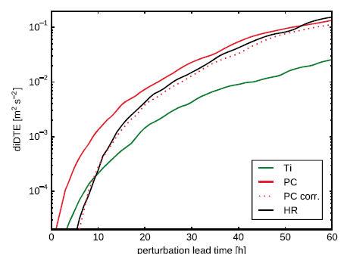
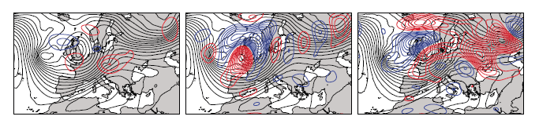
Capturing phase 1?
A: yes!
Δx=2.8km vs 28km with Tiedtke or Plant-Craig
Plant-Craig reproduces 2.8km growth curve with a timing difference of a few hours because it imposes phase 1 differences directly rather than growing them from noise
Selz and Craig, 2015
Notes:
2.8km high resolution, 28km parameterized
60h simulation
Final (60 h) large-scale 500hPa geopotential perturbation of three different experiments. (left) Tiedtke, (middle) Plant-Craig, and (right) no convection scheme but high resolution, each perturbed 15 h after forecast start. The colored lines show the difference between the perturbation experiment and the corresponding control run (red positive and blue negative, line spacing 5m2 s−2). The black lines show the 500hPa geopotential of the control run (line spacing 250m2 s−2).
COSMO domain enlarged to a size of about 7000 km by 4250 km, which covers several times the Rossby radius of deformation.

Slide 12
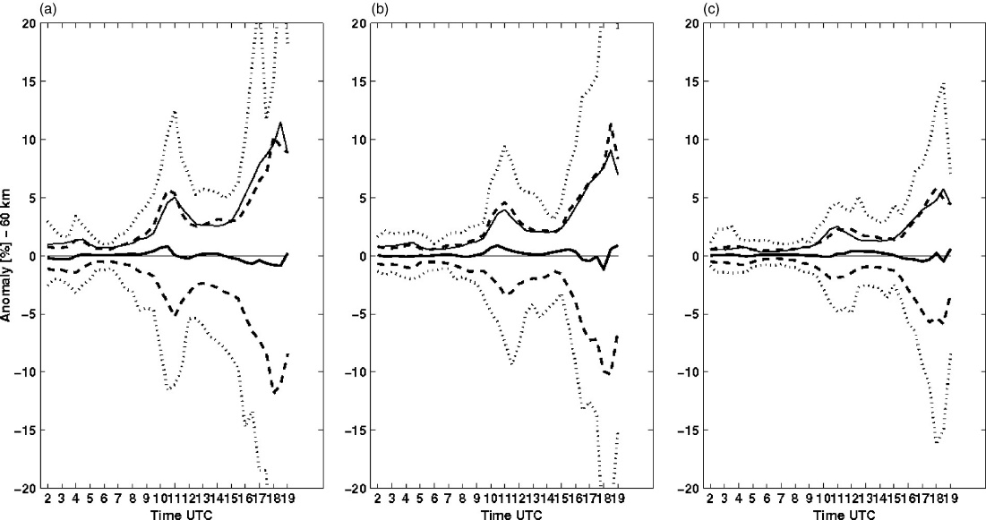
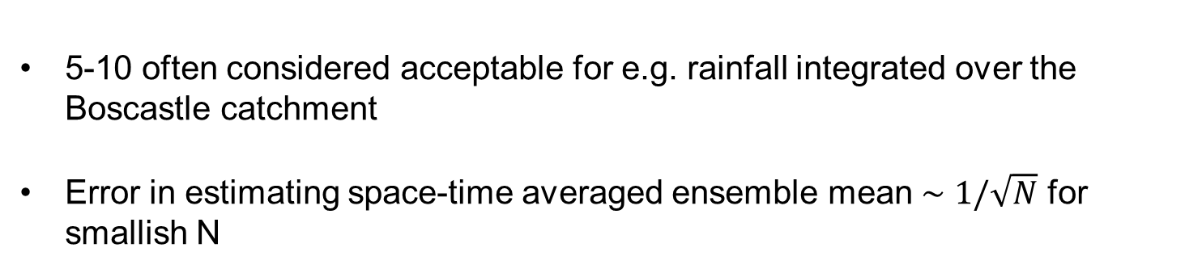
How many members?
5-10 often considered acceptable for e.g. rainfall integrated over the Boscastle catchment
Error in estimating space-time averaged ensemble mean $∼1/\sqrt{N}$ for smallish N
N=5
N=8
N=20
Std dev
Extreme
Bootstrap sampling of 50 members
Leoncini et al, 2012
Notes:
Time evolution of the anomaly (%) relative to the 50-member ensemble mean of the target-area accumulation estimated with (a) 5, (b) 8, and (c) 20 ensemble members randomly chosen from the full 50-member ensemble. Solid thick lines are anomalies averaged over 50 samplings from the full ensemble; thin solid lines are the error of the mean; dashed lines denote one standard deviation of those samples; dotted lines denote their range (see text for more details).

Slide 13
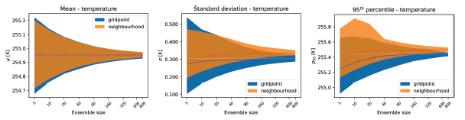
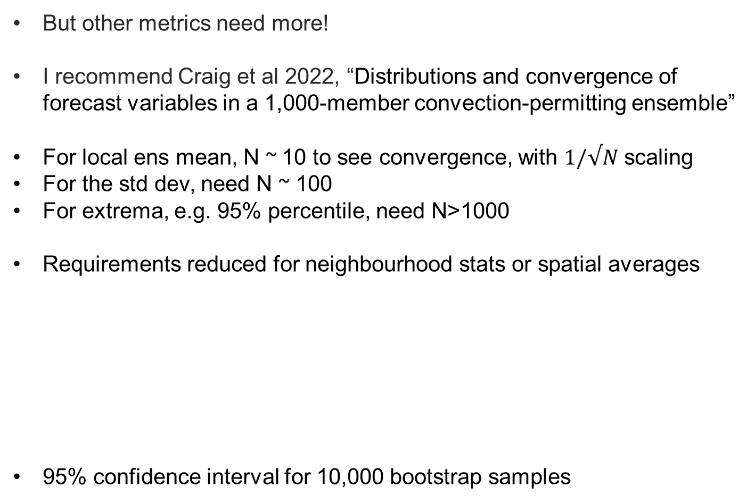
How many members?
But other metrics need more!
I recommend Craig et al 2022, “Distributions and convergence of forecast variables in a 1,000-member convection-permitting ensemble”
For local ens mean, N ~ 10 to see convergence, with $1/√N$ scaling
For the std dev, need N ~ 100
For extrema, e.g. 95% percentile, need N>1000
Requirements reduced for neighbourhood stats or spatial averages
95% confidence interval for 10,000 bootstrap samples
Notes:
Mean, standard deviation and 95th percentile of 500 hPa temperature
The bands show the 95% confidence interval determined for the 10,000 bootstrapped samples (bounded by 2.5% and 97.5% quantiles), while the solid lines show the respective median values. The dashed white horizontal line indicates the median of the distribution computed using all 1000 members. Grid point: single grid point forecast, neighborhood: 45-km neighborhood forecast

Slide 14
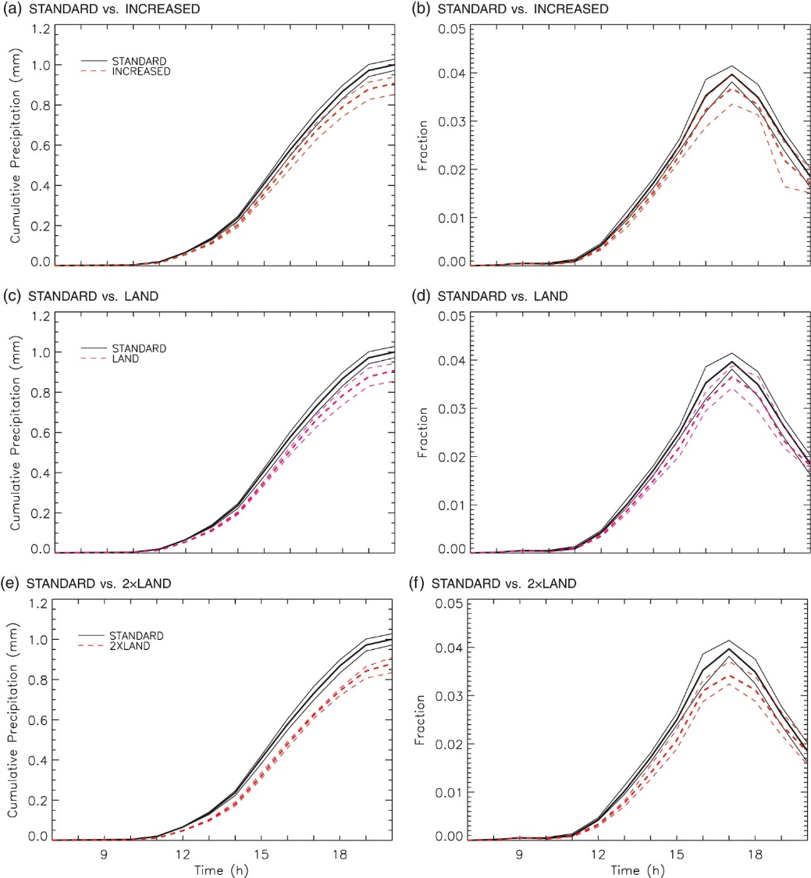
For a straightforward example
Flack et al, 2019,
Compares 7 member ensembles
Q: does a change to the aerosol treatment systematically affect rainfall in CSIP IOP8?
A: Yes, but marginally, with differences being > than but ≈ range of ensemble
Also suggest Flack et al, 2021 for analysis of spatial scales of impact due to parameterization change
Rain amount
Rain fraction
Notes:
(a, c, e) cumulative precipitation in the ensemble simulations, and (b, d, f) the fraction of points with precipitation exceeding an hourly accumulation of 0.125 mm, for the STANDARD CDNC ensemble (solid lines). The dashed lines are for (a, b) the INCREASED CDNC ensemble, (c, d) the LAND CDNC ensemble and (e, f) the 2×LAND CDNC ensemble. The bold lines represent the ensemble mean and the thinner lines the extremes of the ensemble.

Slide 15
Considerations in assessing parameterization changes
Is your newly parameterized simulation just like “another member of the ensemble” ?
How do the simulation differences compare with those expected from upscale error growth?
3 (5) stages of upscale error growth – which ones are / should be active in your simulations?
  Think about domain size
  Will you see phase 1, or are you trying to induce it?
A small ensemble size may be ok, but that depends on your metrics
Assuming a small number of cases, go for contrasting ones (esp. equilibrium vs non-equilibrium convection)

