Slide 1

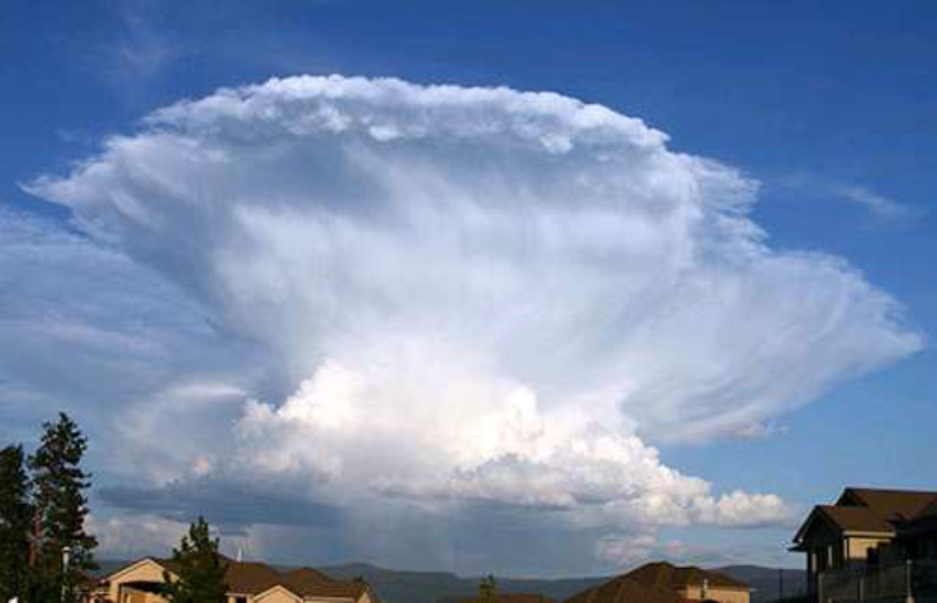
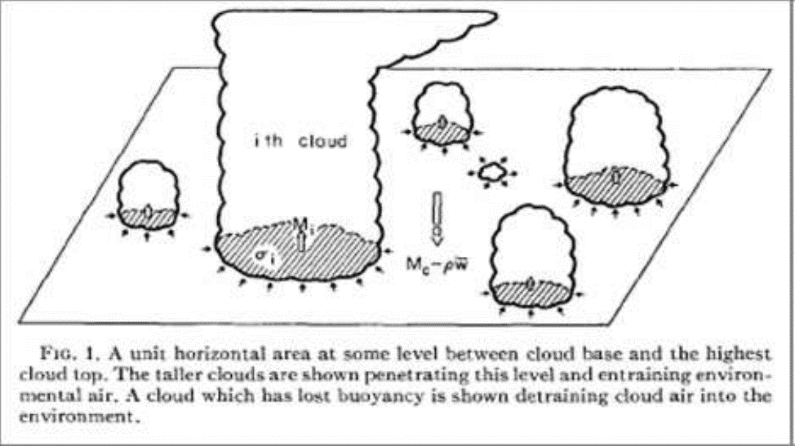
Convection and parameterization
Bob Plant, with thanks to many others!
Department of Meteorology, University of Reading
NCAS Climate Modelling Summer School,
Cambridge
8 - 19 September 2025

Slide 2
Overview
Convection in the climate system
The need for parameterization
The mass flux approach
  The plume model
  Entrainment and detrainment
  Closure
Convection in models
Convection permitting models
A look ahead

Slide 3
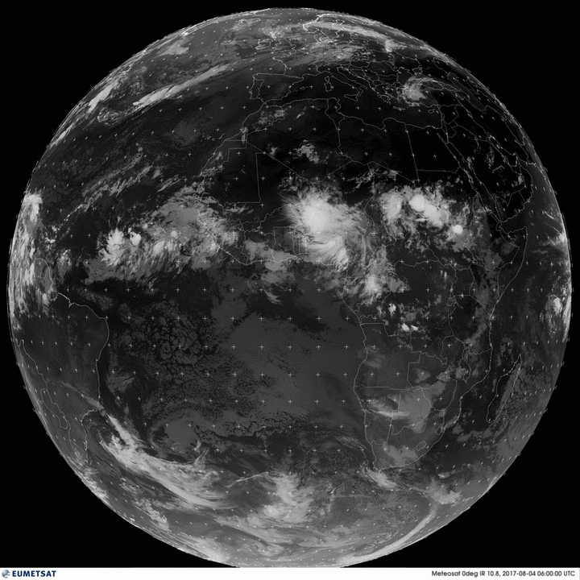
Convection in the climate system
Convection is important
It plays a leading role in planetary budgets of heat, moisture and momentum
An isolated thunderstorm may be 1-2 km across
But organized into long lived systems such as squall lines and MCS
Full-disk infrared METEOSAT Zero-Degree images from EUMETSAT http://oiswww.eumetsat.org/IPPS/html/MSG/IMAGERY/UMETSAT

Slide 4
Convection in the climate system
Associated warming patterns drive tropical circulations:
  e.g., monsoons, the Walker circulation
  synoptic features, e.g. tropical cyclones
Production of extreme events, e.g. floods
Associated clouds are an important component of the Earth’s radiation budget

Slide 5
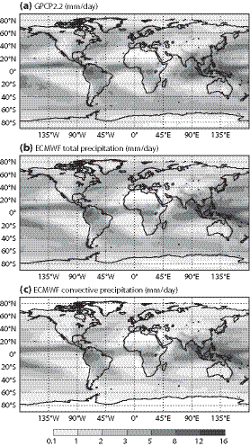
Global rainfall
Around 2.8mm/day globally, but higher in tropics
60% of global precip from convection parameterization
75% in tropics (and much of the rest from associated anvil cloud)
Observations
ECMWF,
total precip
ECMWF, convective precip
Bechtold, 2015

Slide 6
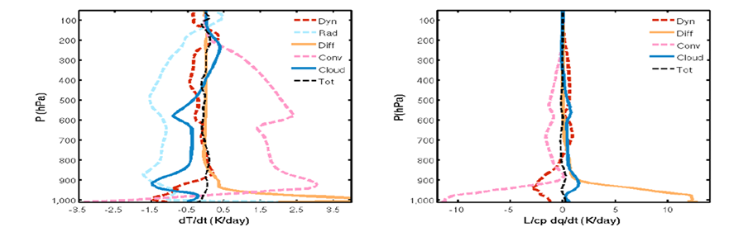
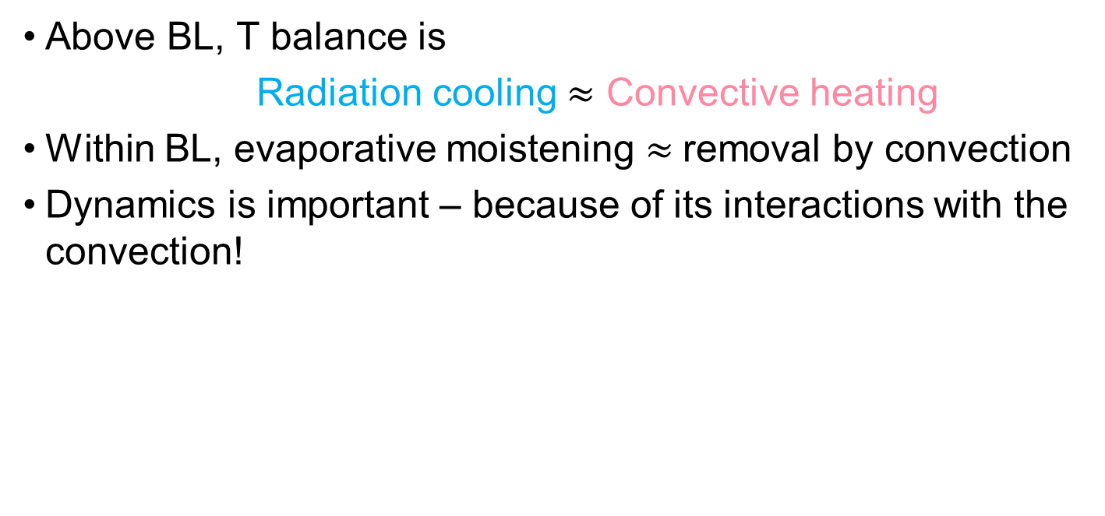
Tropical heat and moisture budgets
Above BL, T balance is
  Radiation cooling $≈$ Convective heating
Within BL, evaporative moistening $≈$removal by convection
Dynamics is important – because of its interactions with the convection!

Slide 7
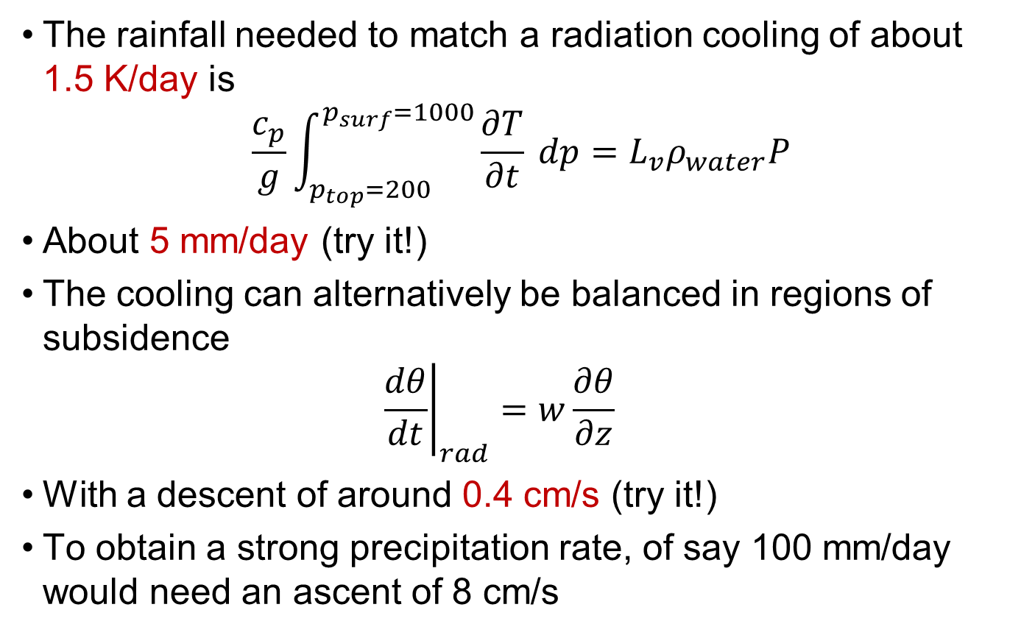
Simple heating estimates
The rainfall needed to match a radiation cooling of about 1.5 K/day is
$$\frac{c_{p}}{g}\int_{p_{top}=200}^{p_{surf}=1000}{\frac{∂T}{∂t} dp}=L_{v}ρ_{water}P$$
About 5 mm/day (try it!)
The cooling can alternatively be balanced in regions of subsidence
  $${\left.\frac{dθ}{dt}\right|}_{rad}=w\frac{∂θ}{∂z}$$
With a descent of around 0.4 cm/s (try it!)
To obtain a strong precipitation rate, of say 100 mm/day would need an ascent of 8 cm/s

Slide 8
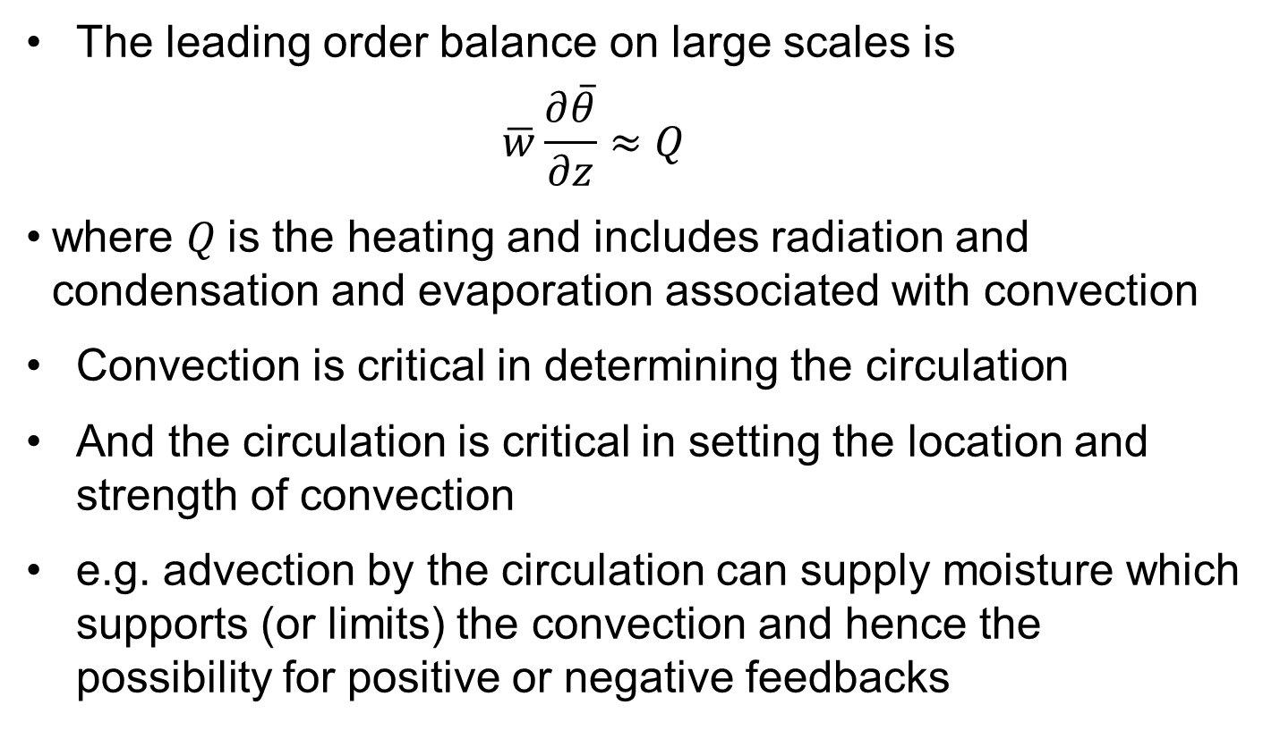
Tropical heat and moisture budgets
The leading order balance on large scales is
  $$\overline{w}\frac{∂\overline{θ}}{∂z}≈Q$$
where $Q$is the heating and includes radiation and condensation and evaporation associated with convection
Convection is critical in determining the circulation
And the circulation is critical in setting the location and strength of convection
e.g. advection by the circulation can supply moisture which supports (or limits) the convection and hence the possibility for positive or negative feedbacks

Slide 9
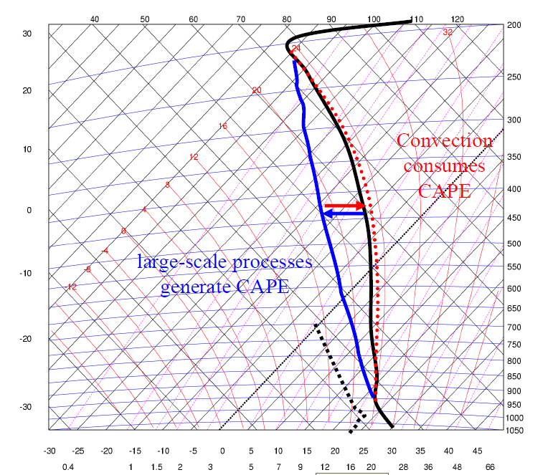
Convective Equilibrium
In equilibrium, convection balances large-scale forcing
  A good approximation over large areas / long times
  May work on smaller scales too
In other cases, a CAPE build up may be hard to release
  A key factor is to overcome CIN (possibly large uncertainty in occurrence)
Notes:
Black is the environmental sounding. Red shows warning caused by convection, which would drive the sounding towards a parcel ascent (not shown). So the CAPE is reduced. Blue shows the large-scale cooling the surroundings, driving the sounding towards the left of the tephigram and so increasing the CAPE.

Slide 10
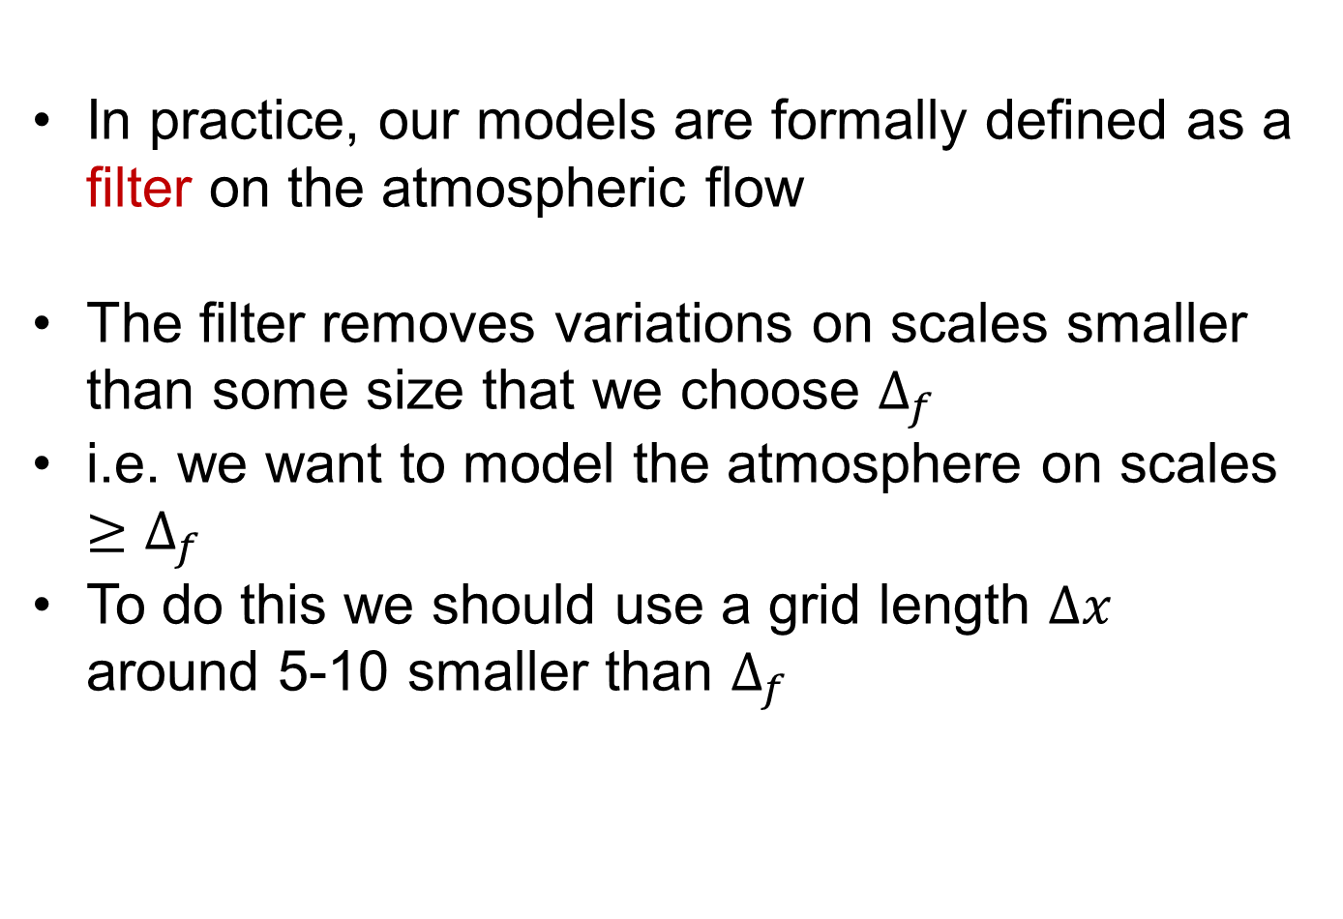
Filtering
In practice, our models are formally defined as a filter on the atmospheric flow
The filter removes variations on scales smaller than some size that we choose $Δ_{f}$
i.e. we want to model the atmosphere on scales $≥Δ_{f}$
To do this we should use a grid length $Δx$ around 5-10 smaller than $Δ_{f}$

Slide 11
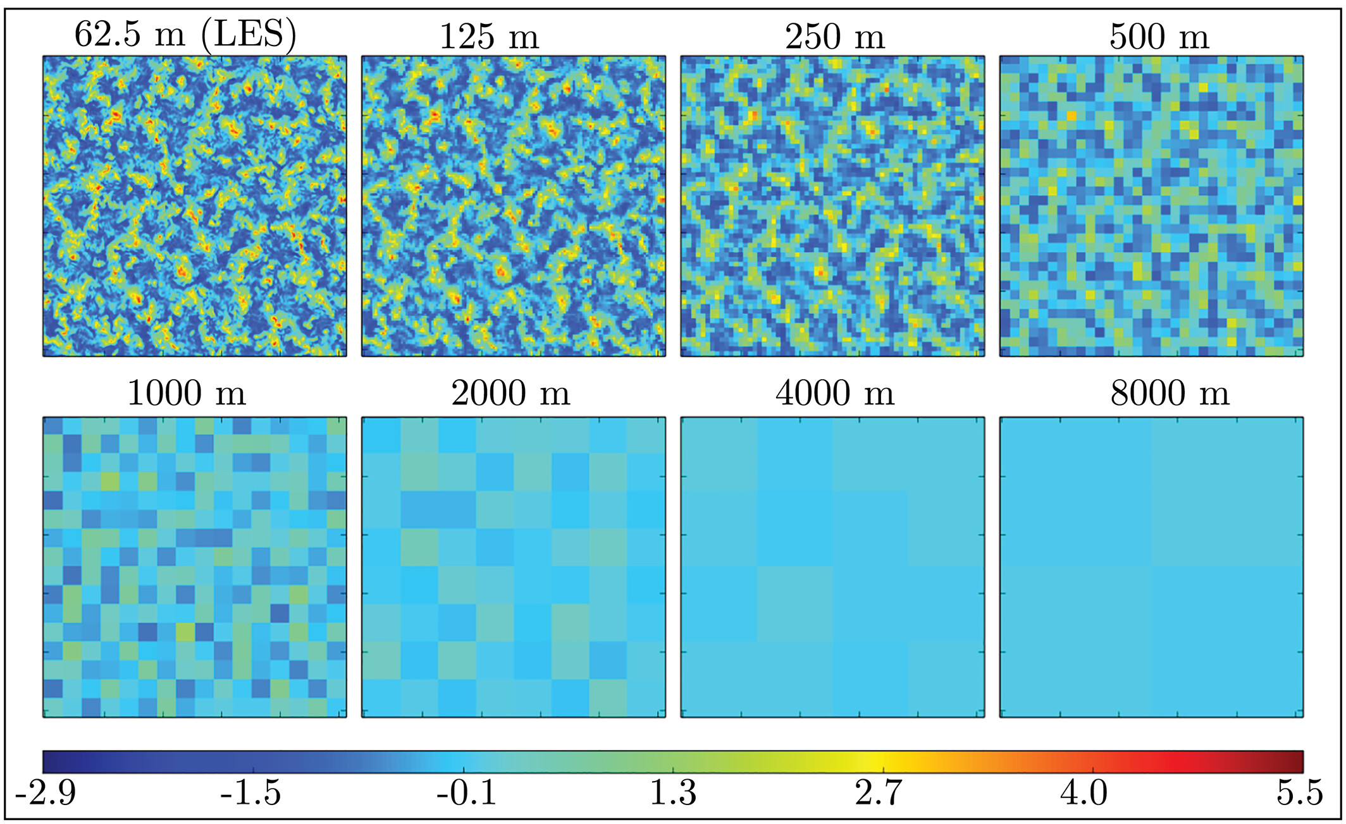
Parameterization
Successive averaging of w data from a high-resolution simulation of the dry CBL

Slide 12
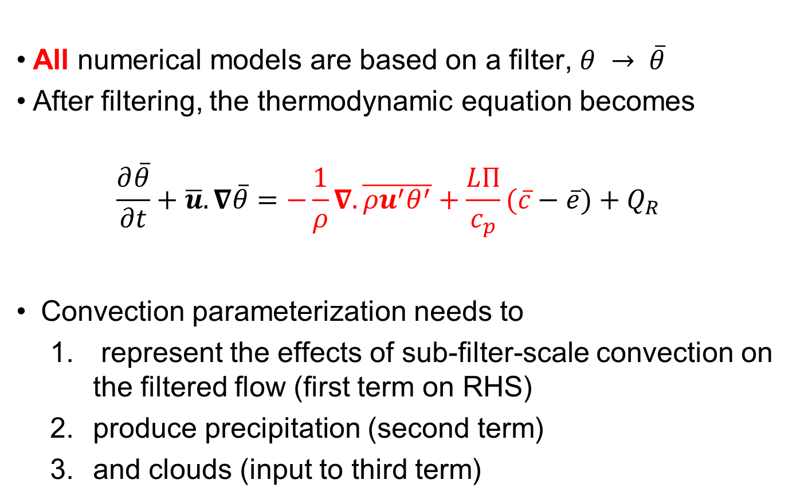
How parameterization enters the equations
All numerical models are based on a filter, $θ → \overline{θ}$
After filtering, the thermodynamic equation becomes
  $$\frac{∂\overline{θ}}{∂t}+\overline{u}.∇\overline{θ}=−\frac{1}{ρ}∇.\overline{{ρu}^{′}θ^{′}}+\frac{LΠ}{c_{p}}(\overline{c}−\overline{e})+Q_{R}$$
Convection parameterization needs to
  represent the effects of sub-filter-scale convection on the filtered flow (first term on RHS)
  produce precipitation (second term)
  and clouds (input to third term)

Slide 13
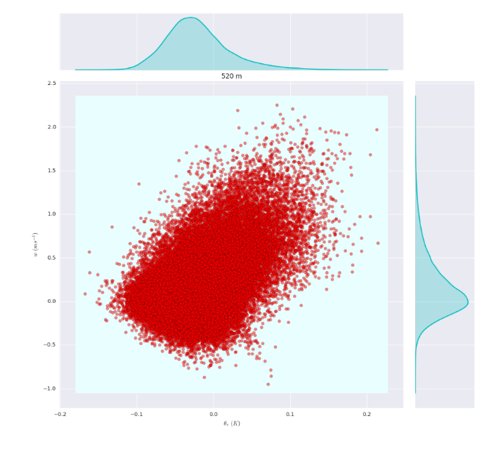
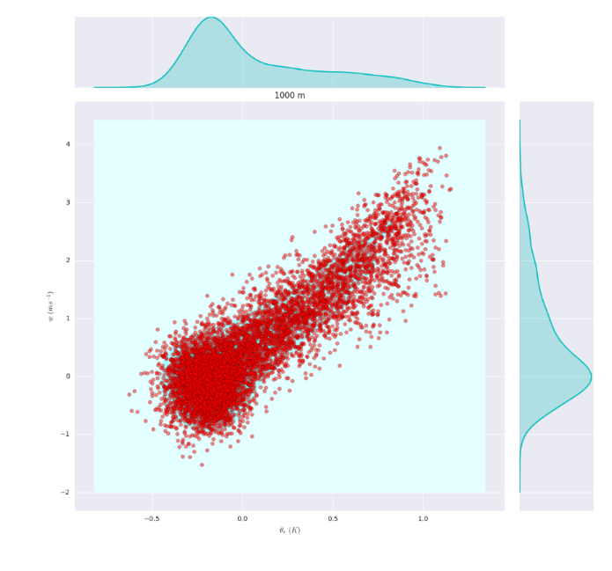
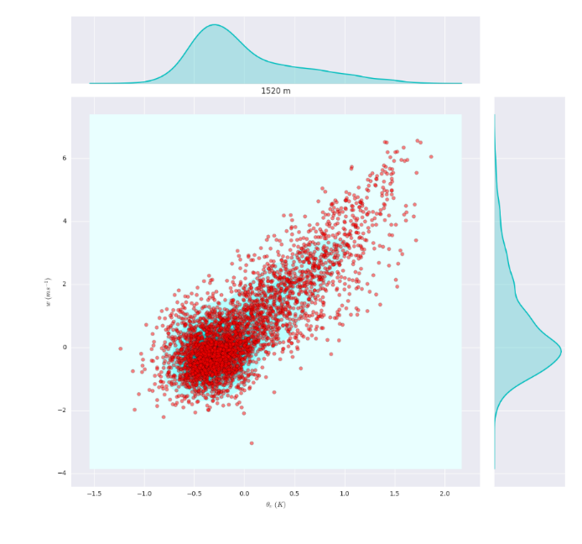
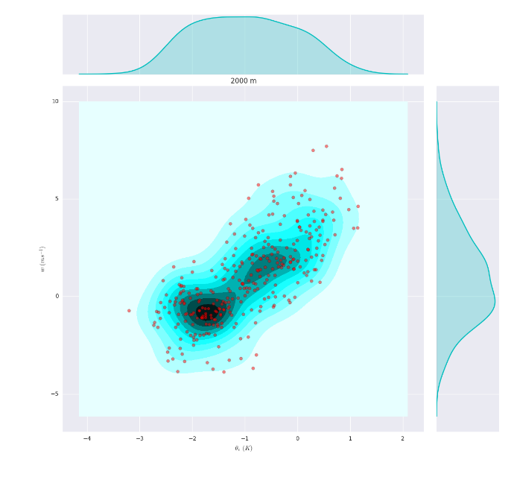


Fluxes in LES of maritime clouds
$$w′$$
In cloud layer, 1000m
Cloud base, 500m
$$θ_{v}′$$
Cloud top, 2000m
In cloud layer, 1500m
Useful to have a physical picture of cloud development to describe how changes with height

Slide 14
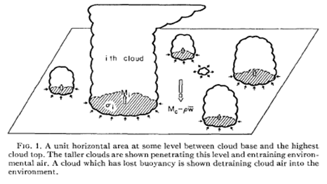
Representation depends on filter
Parameterized
Δx ~ 100km or larger
Many clouds in a grid cell
Represent the effect of all clouds on mean properties of the grid
Explicit (large-eddy modelling)
Δx ~ 100m or smaller
Many cells for each cloud
Each cloud well resolved
Grey zone
Δx ~ 1-10 km
Not enough clouds for parameterization
Not enough cells to resolve clouds
Representation should be scale-aware and stochastic
Notes:
Grey zone: some clouds may be close to being resolved; there are only a few or even 1 cloud in some boxes and each of these clouds is different; there may be no clouds in some boxes.

Slide 15
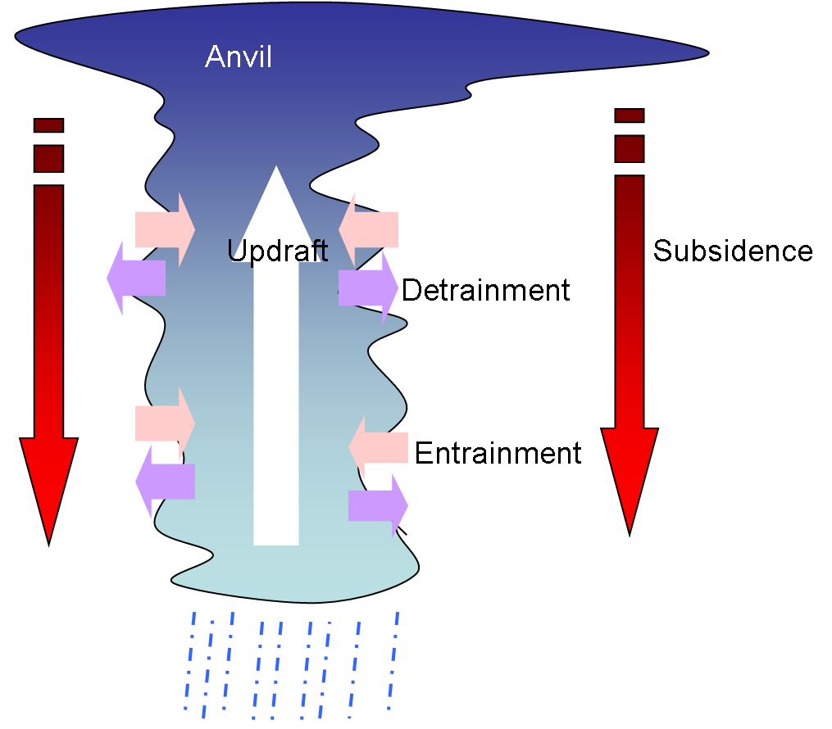
Convection Parameterization
Purpose is to feedback the effects of the unresolved flow on the resolved flow
Based on a simplified physical picture of multiple convective clouds within each grid cell
Real atmospheric convection is 3+1 dimensional (space + time varying)
Parameterization thinking claims that there is an important regime with sufficient horizontal and time filtering to render the problem 1+0 dimensional (vertical + diagnostic)

Slide 16
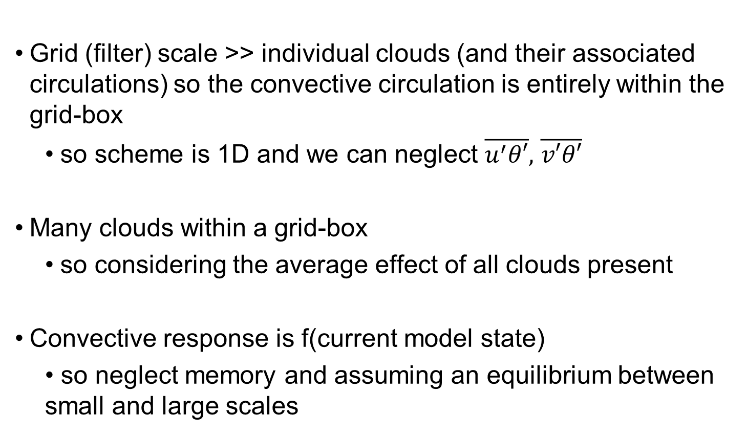
Traditional assumptions
Grid (filter) scale >> individual clouds (and their associated circulations) so the convective circulation is entirely within the grid-box
  so scheme is 1D and we can neglect $\overline{u^{′}θ′},$ $\overline{v′θ′}$
Many clouds within a grid-box
  so considering the average effect of all clouds present
Convective response is f(current model state)
  • so neglect memory and assuming an equilibrium between small and large scales

Slide 17
Mass flux approach
There are many convection parameterizations used
The large majority take a mass flux approach (at least for “deep” precipitating convection)
I am not describing any particular scheme but will discuss the typical structure of a traditional mass flux scheme
Alison Stirling will discuss a new, modern scheme, CoMorph

Slide 18
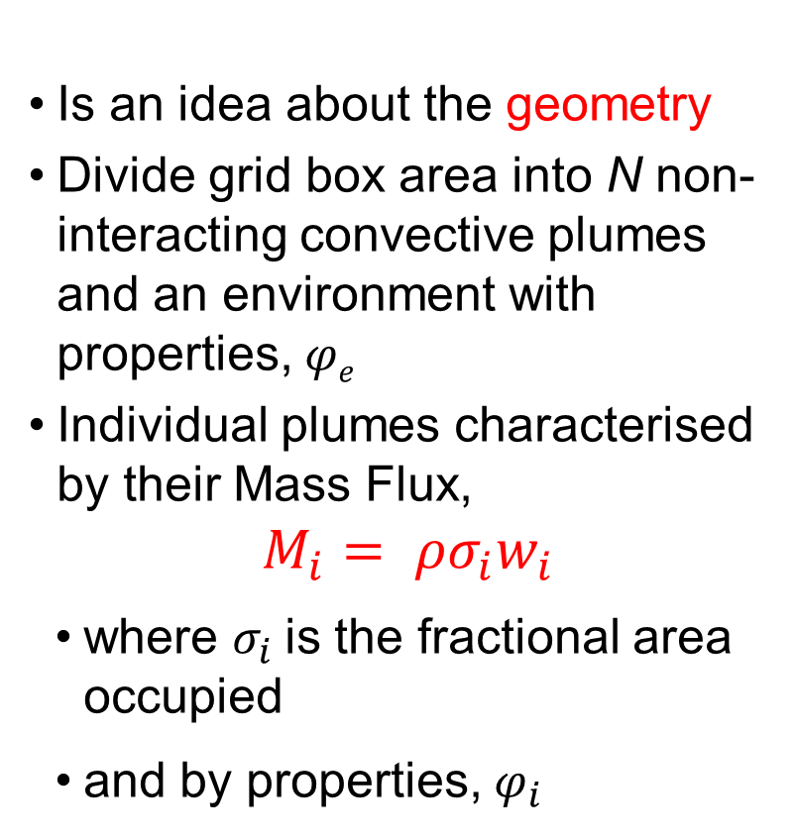
The mass flux idea
Is an idea about the geometry
Divide grid box area into N non-interacting convective plumes and an environment with properties, 𝜑_{𝑒}
Individual plumes characterised by their Mass Flux,
$$M_{i}= ρσ_{i}w_{i}$$
where $σ_{i}$is the fractional area occupied
and by properties, $φ_{i}$
e.g. Arakawa and Schubert, 1974

Slide 19
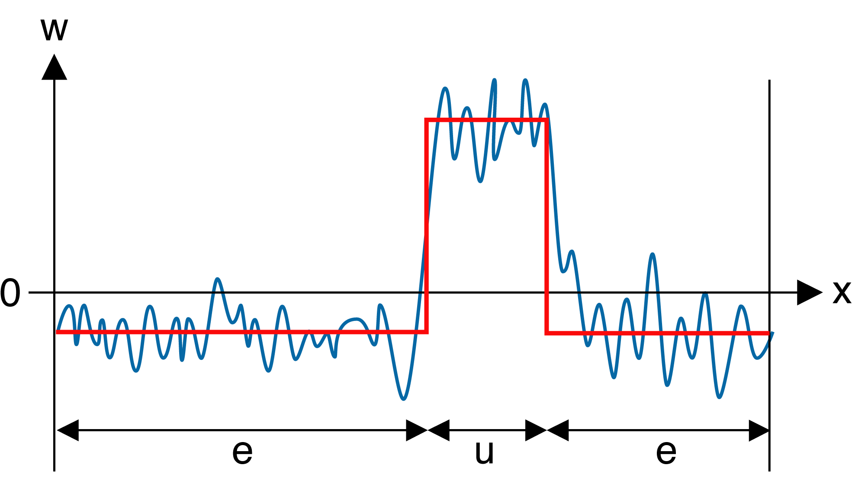




Example, using one element only
$$φ_{u}=\overline{φ_{u}}+φ_{u}^{′}$$
$$φ_{e}=\overline{φ_{e}}+φ_{e}^{′}$$
$$\overline{φ}=σ\overline{φ_{u}}+(1−σ)\overline{φ_{e}}$$
$$\overline{w}=σ\overline{w_{u}}+\left(1−σ\right)\overline{w_{e}}=0$$
Partition the flow into an updraught and its environment
After algebra (try it!) total flux is:
$ρ\overline{w^{′}φ^{′}}=ρσ\overline{w_{u}^{′}φ_{u}^{′}}+ρ\left(1−σ\right)\overline{w_{e}^{′}φ_{e}^{′}}+ρσ\overline{w_{u}}(\overline{φ_{u}}−\overline{φ_{e}}$)
First 2 terms due to variability within updraught and environment – ignore!

Slide 20
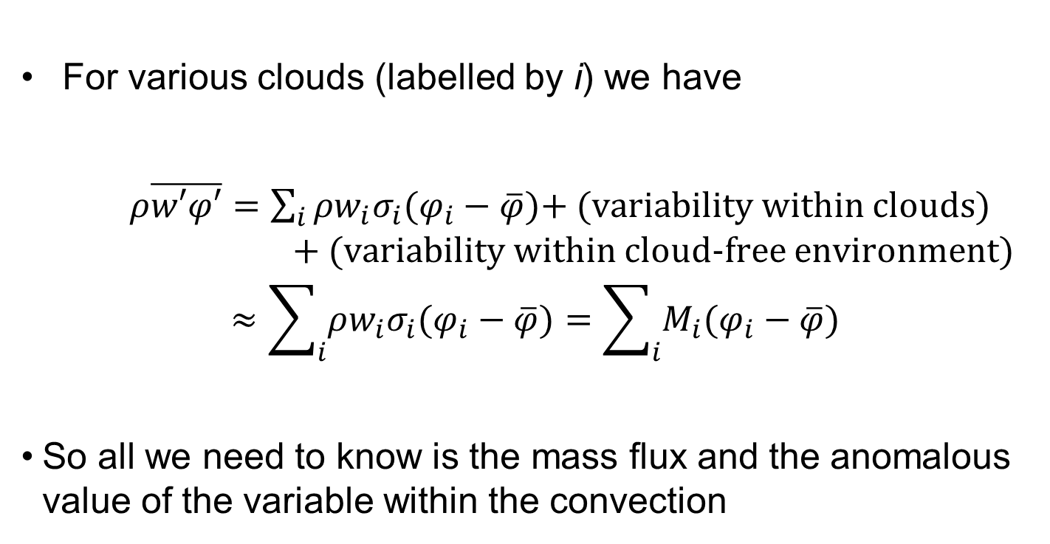
More generally
For various clouds (labelled by i) we have
  $ρ\overline{w′φ′}=$ $\sum_{i}{ρ{w_{i}σ}_{i}(φ_{i}−\overline{φ})}$+ (variability within clouds) + (variability within cloud-free environment)
$$≈\sum_{i}{ρ{w_{i}σ}_{i}(φ_{i}−\overline{φ})}=\sum_{i}{M_{i}(φ_{i}−\overline{φ})}$$
So all we need to know is the mass flux and the anomalous value of the variable within the convection

Slide 21
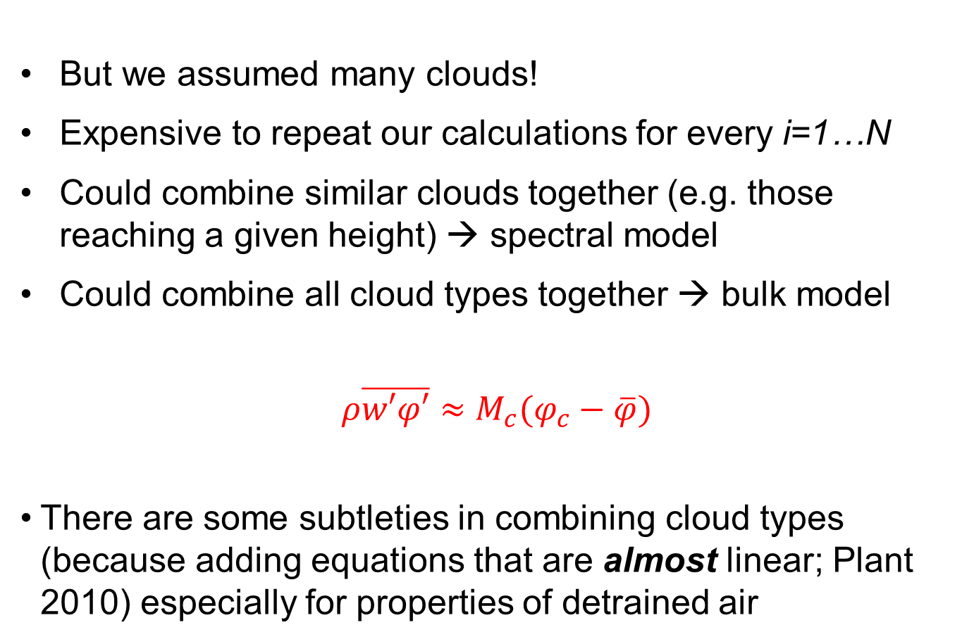
The composite “bulk” plume
But we assumed many clouds!
Expensive to repeat our calculations for every i=1…N
Could combine similar clouds together (e.g. those reaching a given height) → spectral model
Could combine all cloud types together → bulk model
$$ρ\overline{w′φ′}≈M_{c}(φ_{c}−\overline{φ})$$
There are some subtleties in combining cloud types (because adding equations that are almost linear; Plant 2010) especially for properties of detrained air

Slide 22
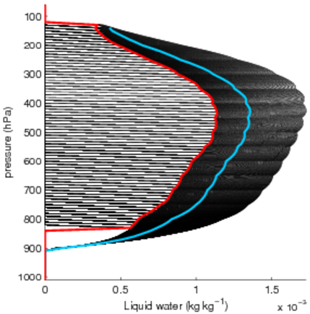
Overestimation of liquid water
Bulk parameterization scheme ansatz
The liquid water detrained from each individual plume is given by the bulk value:
N = 350 plumes
Ensemble detrained liquid water
Bulk liquid water
(typical tropical sounding)

Slide 23
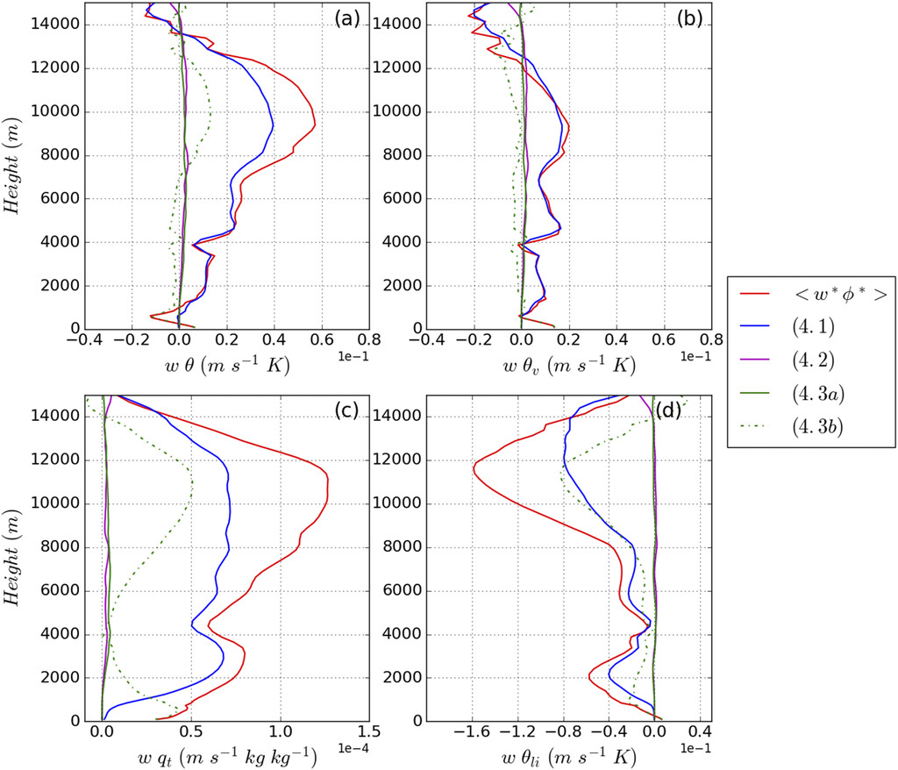
How well does it work?
Applying mass flux decomposition to LES data
Red = total flux
Blue = best bulk approximation
Green dashed = environmental variability
Green solid = within-cloud variability
Purple = between cloud variability
2 convection types better than 1
3+ types not much better
Gu et al 2020

Slide 24
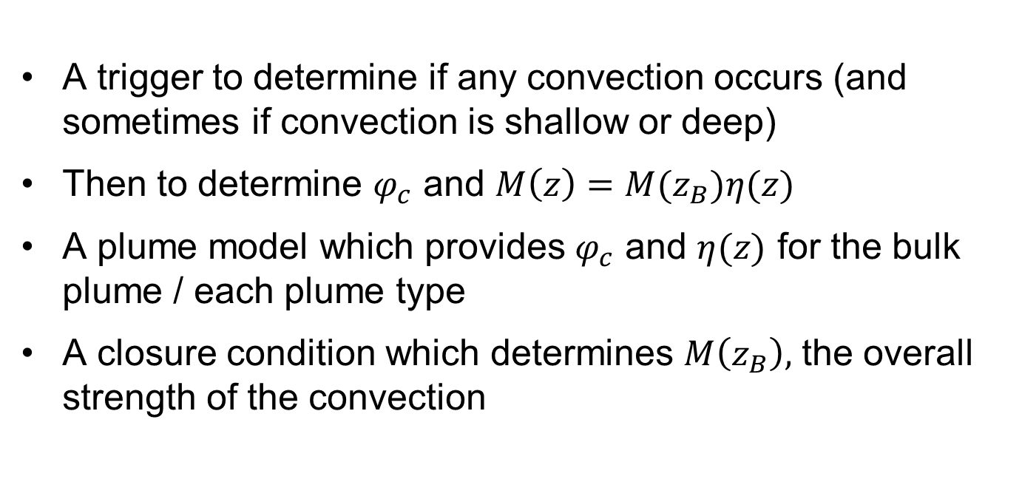
Components of mass flux scheme
A trigger to determine if any convection occurs (and sometimes if convection is shallow or deep)
Then to determine $φ_{c}$ and $M\left(z\right)=M(z_{B})η(z)$
A plume model which provides $φ_{c}$ and $η(z)$ for the bulk plume / each plume type
A closure condition which determines $M\left(z_{B}\right),$ the overall strength of the convection

Slide 25
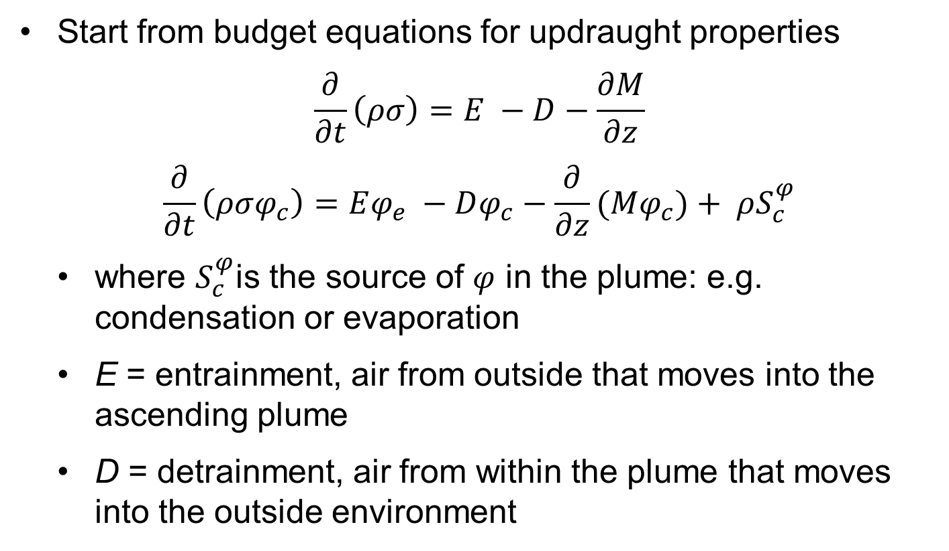
The Plume Model
Start from budget equations for updraught properties
$$\frac{∂}{∂t}\left(ρσ\right)=E −D−\frac{∂M}{∂z}$$
$$\frac{∂}{∂t}\left(ρσφ_{c}\right)=Eφ_{e} −Dφ_{c}−\frac{∂}{∂z}(Mφ_{c})+ ρS_{c}^{φ}$$
where $S_{c}^{φ}$is the source of $φ$ in the plume: e.g. condensation or evaporation
E = entrainment, air from outside that moves into the ascending plume
D = detrainment, air from within the plume that moves into the outside environment

Slide 26
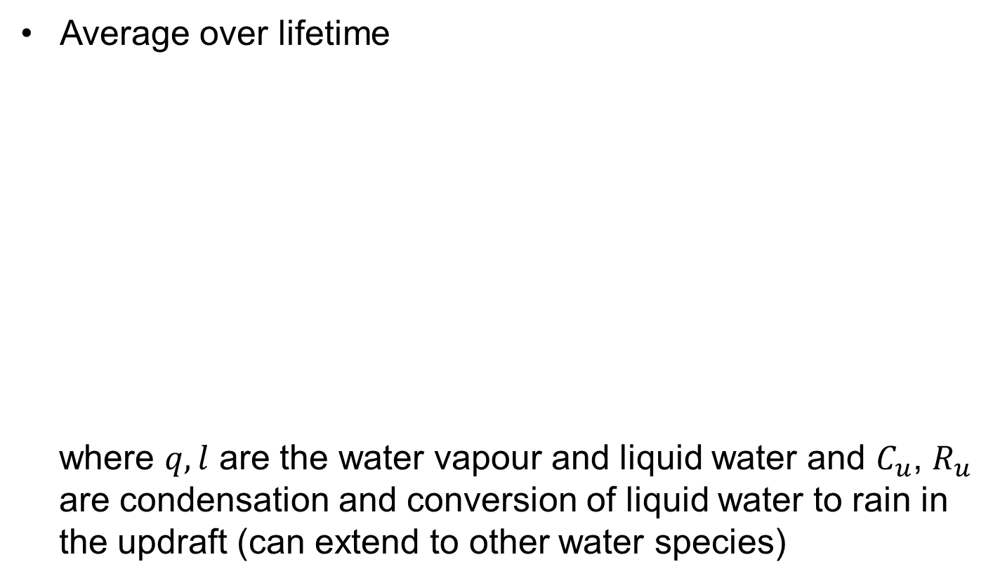

The Plume Model
Average over lifetime
where $q,l$ are the water vapour and liquid water and $C_{u}$, $R_{u}$ are condensation and conversion of liquid water to rain in the updraft (can extend to other water species)
$$\frac{∂M}{∂z}=E −D$$
$$\frac{∂}{∂z}(Mθ_{c})=E\overline{θ} −Dθ_{c}+ ρ\frac{LΠ}{C_{p}}C_{u}$$
$$\frac{∂}{∂z}(Mq_{c})=E\overline{q} −Dq_{c}−C_{u}$$
$$\frac{∂}{∂z}\left(Ml_{c}\right)=−Dl_{c}+C_{u}−R_{u}$$

Slide 27
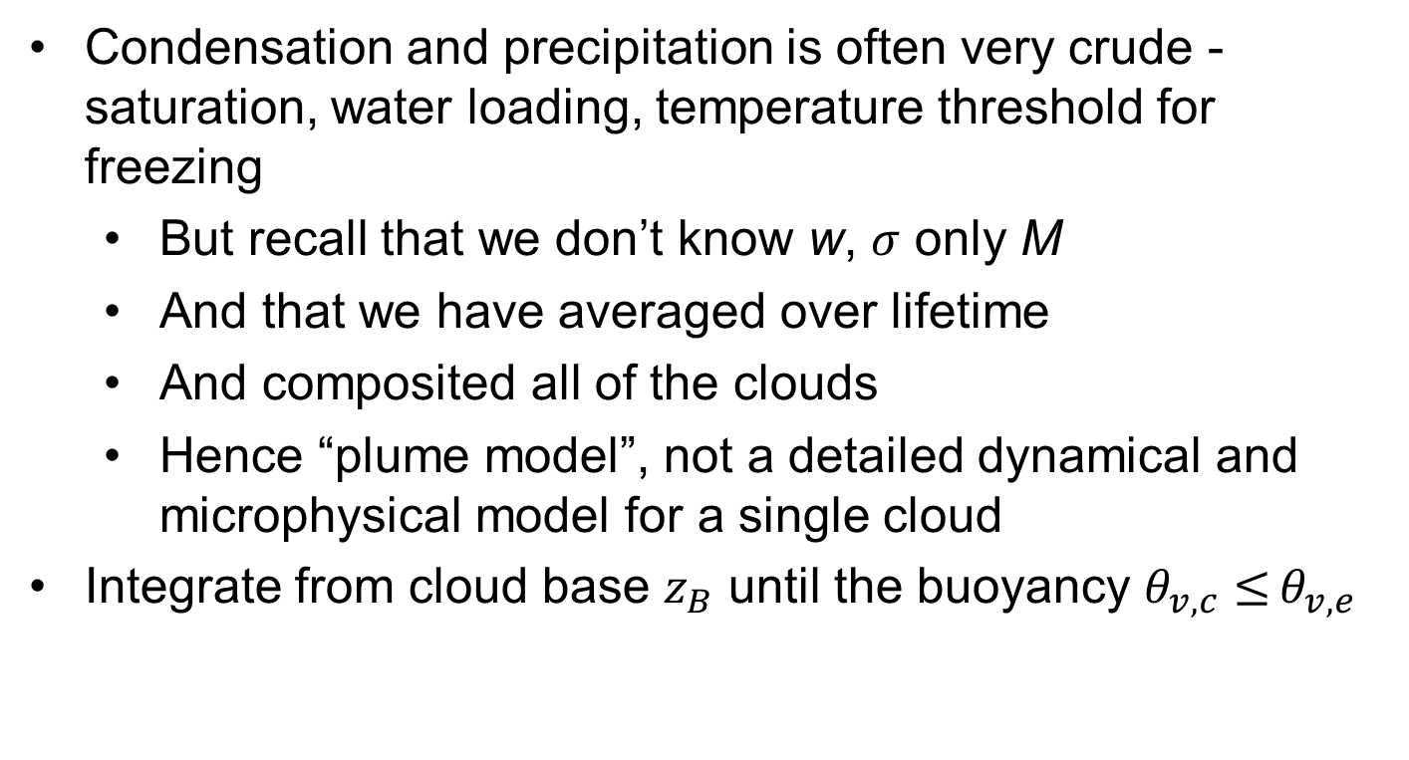
The Plume Model
Condensation and precipitation is often very crude - saturation, water loading, temperature threshold for freezing
  But recall that we don’t know w, $σ$ only M
  And that we have averaged over lifetime
  And composited all of the clouds
  Hence “plume model”, not a detailed dynamical and microphysical model for a single cloud
Integrate from cloud base $z_{B}$ until the buoyancy $θ_{v,c}≤$ $θ_{v,e}$

Slide 28
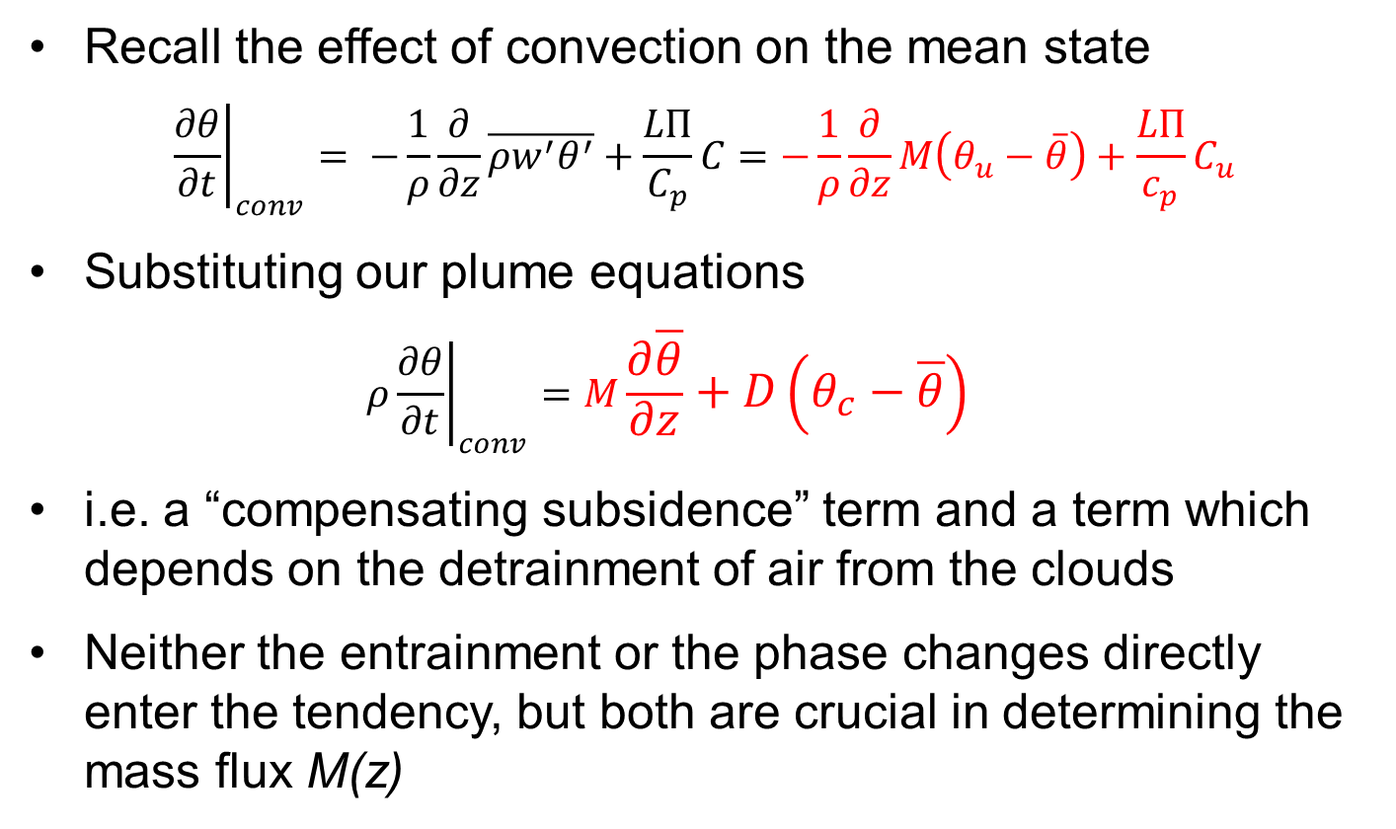
Impact on Environment: Interpretation
Recall the effect of convection on the mean state
$${\left.\frac{∂θ}{∂t}\right|}_{conv}= −\frac{1}{ρ}\frac{∂}{∂z}\overline{ρw^{′}θ^{′}}+\frac{LΠ}{C_{p}}C=−\frac{1}{ρ}\frac{∂}{∂z}M\left(θ_{u}−\overline{θ}\right)+\frac{LΠ}{c_{p}}C_{u}$$
Substituting our plume equations
  $$ρ{\left.\frac{∂θ}{∂t}\right|}_{conv}=M\frac{∂\overline{θ}}{∂z}+D\left(θ_{c}−\overline{θ}\right)$$
i.e. a “compensating subsidence” term and a term which depends on the detrainment of air from the clouds
Neither the entrainment or the phase changes directly enter the tendency, but both are crucial in determining the mass flux M(z)

Slide 29
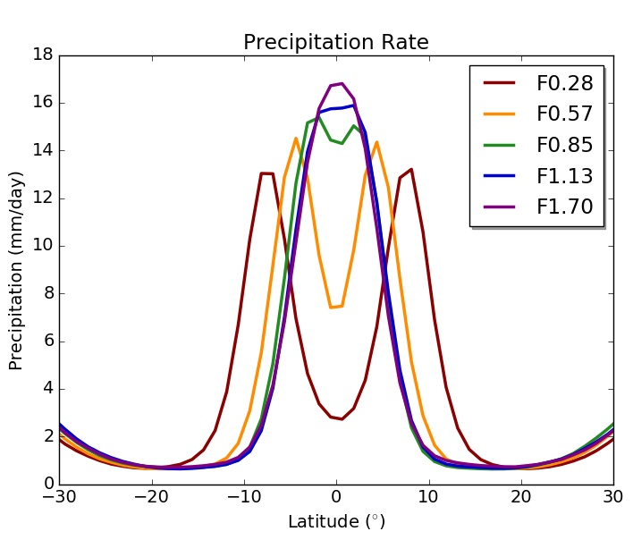
Sensitivity to Entrainment
Climate models are very sensitive to choices of E and D
ITCZ sensitivity in an aquaplanet UM (Talib et al 2018)
Sensitivities of MJO (Klingaman and Woolnough, 2014), equatorial waves (Peatman et al, 2018) and monsoons (Bush et al, 2015)
Often there is a conflict between mean state (low E) and variability (high E)
Factor F applied to default E

Slide 30
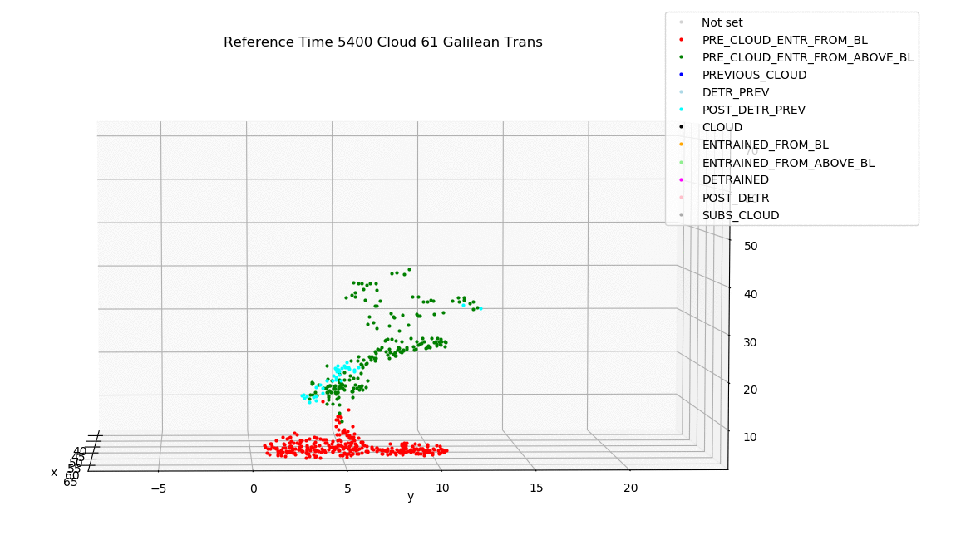
Entrainment and detrainment
For a single cloud, E and D encapsulate the exchange between updraft and the surrounding air
In a bulk model, they also encapuslate the cloud spectrum
e.g. the detrainment must capture the loss of updraft air at cloud tops
Can be estimated (with difficulty) from LES
Here with parcel trajectories for shallow convection simulation with 10m grid length
Clark et al, submitted

Slide 31
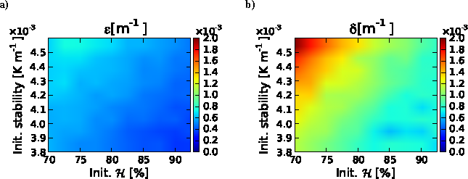
Entrainment and detrainment
• Entrainment often expressed as E/M ~ 1/r (smaller clouds as they have higher surface area to volume ratio)
• Not enough sensitivity to environmental RH (Derbyshire et al 2004, Bechtold et al 2008)
• More variation in detrainment than entrainment rates
This is linked to different cloud reaching different heights
• e.g. adaptive detrainment scheme of Derbyshire et al 2011
E/M and D/M dependence on RH and stability
Boing et al 2012

Slide 32
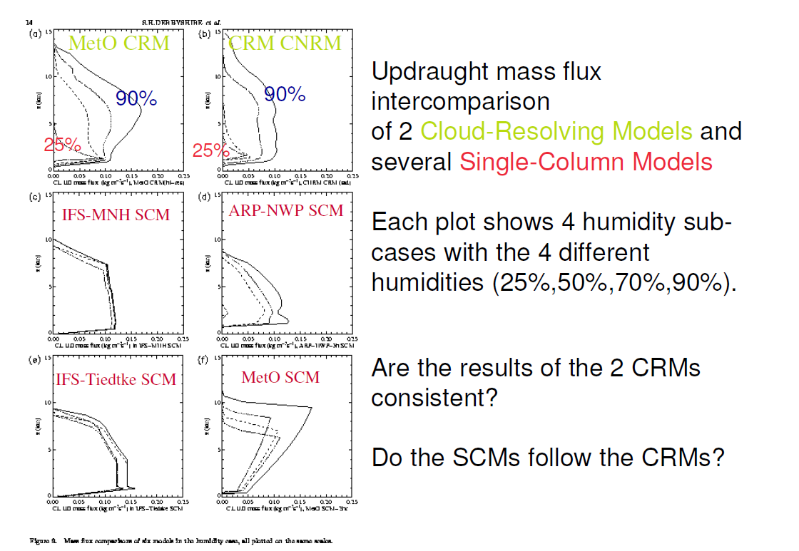

Slide 33
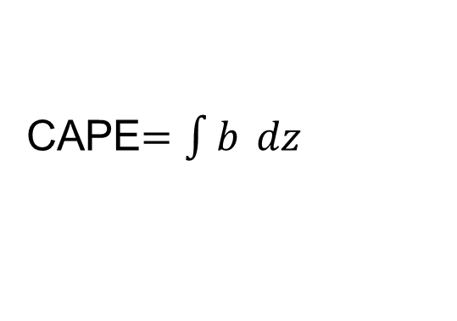
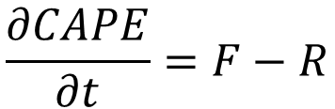
Closure
• The CAPE is the buoyancy of a parcel ascent integrated from LFC to LNB
Now take time derivative and use plume model equations for b. After some (lots of!) algebra (Arakawa and Schubert, 1974;Yano and Plant, 2016)….
F = large-scale generation or “forcing,” terms independent of M(z_{B})
R = response of convection: terms depending on M(z_{B}) (proportional for entraining plumes with simple microphysics)
CAPE$=\int{b }dz$
$$\frac{∂CAPE}{∂t}=F−R$$

Slide 34

Equilibrium Closures
Quasi-equilibrium (Arakawa and Schubert, 1974) is the assumption that $∂CAPE$/$∂t ≈0$ so F = R
$f=ρq$ Moisture convergence balanced by precip (Kuo, 1974)
$f=b$ CAPE closure with b for non-entraining parcel
$f=b$ dilute CAPE closure with b for entraining plume
$f=b$ Parcel-environment closure with BL excluded from integral (Zhang, 2003)
$f=b$ CIN closure with troposphere excluded from integral (Mapes, 2000)
$f=ρb$ PCAPE closure used at ECMWF (Bechtold 2015)
$f=ηb$ Cloud work function closure (Arakawa and Schubert, 1974)
In practice, many schemes do not impose a strict equilibrium, but relax towards it on a timescale of ~1-3h

Slide 35
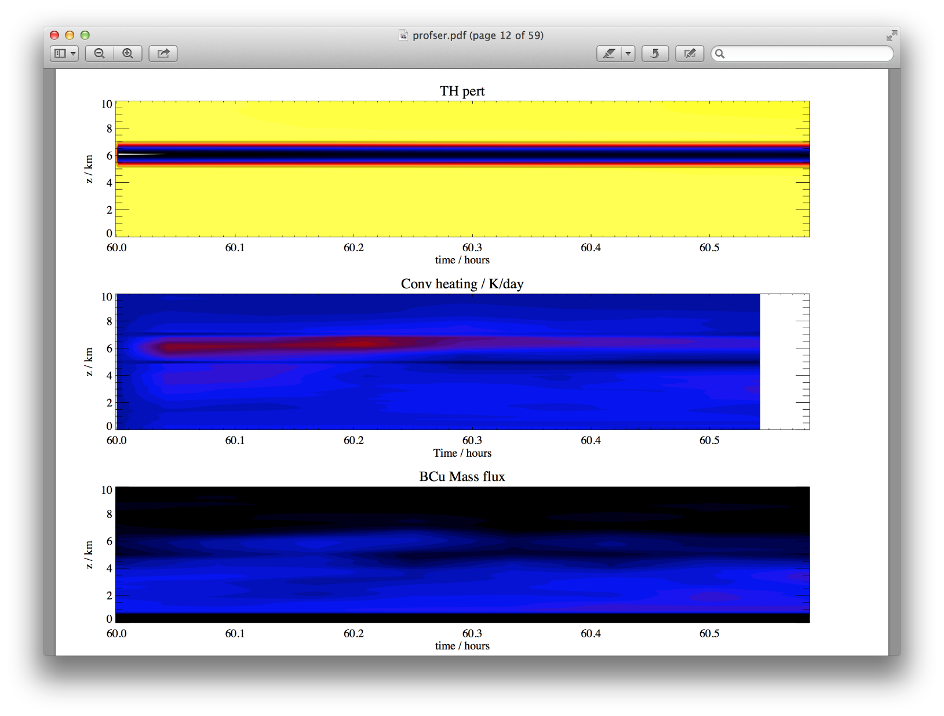
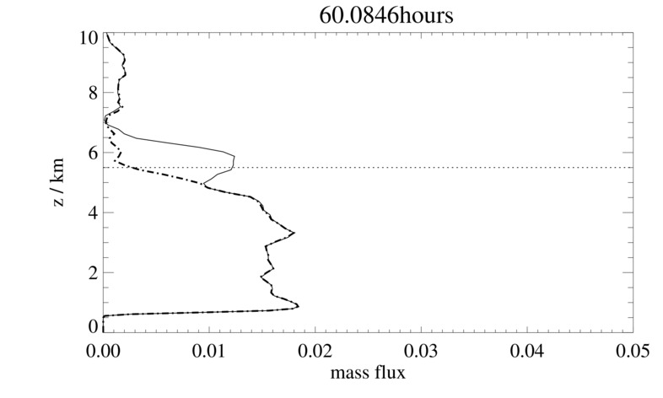
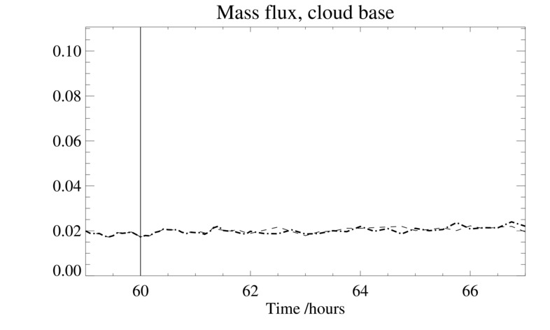
Limitations
Run an LES to equilibrium and then apply an extra jolt of upper level cooling
There is a response at that level, but mass flux at cloud base not affected
Adjustment to equilibrium can be slow, especially at upper levels
Mass flux more directly set by boundary-layer processes
From Alison Stirling

Slide 36
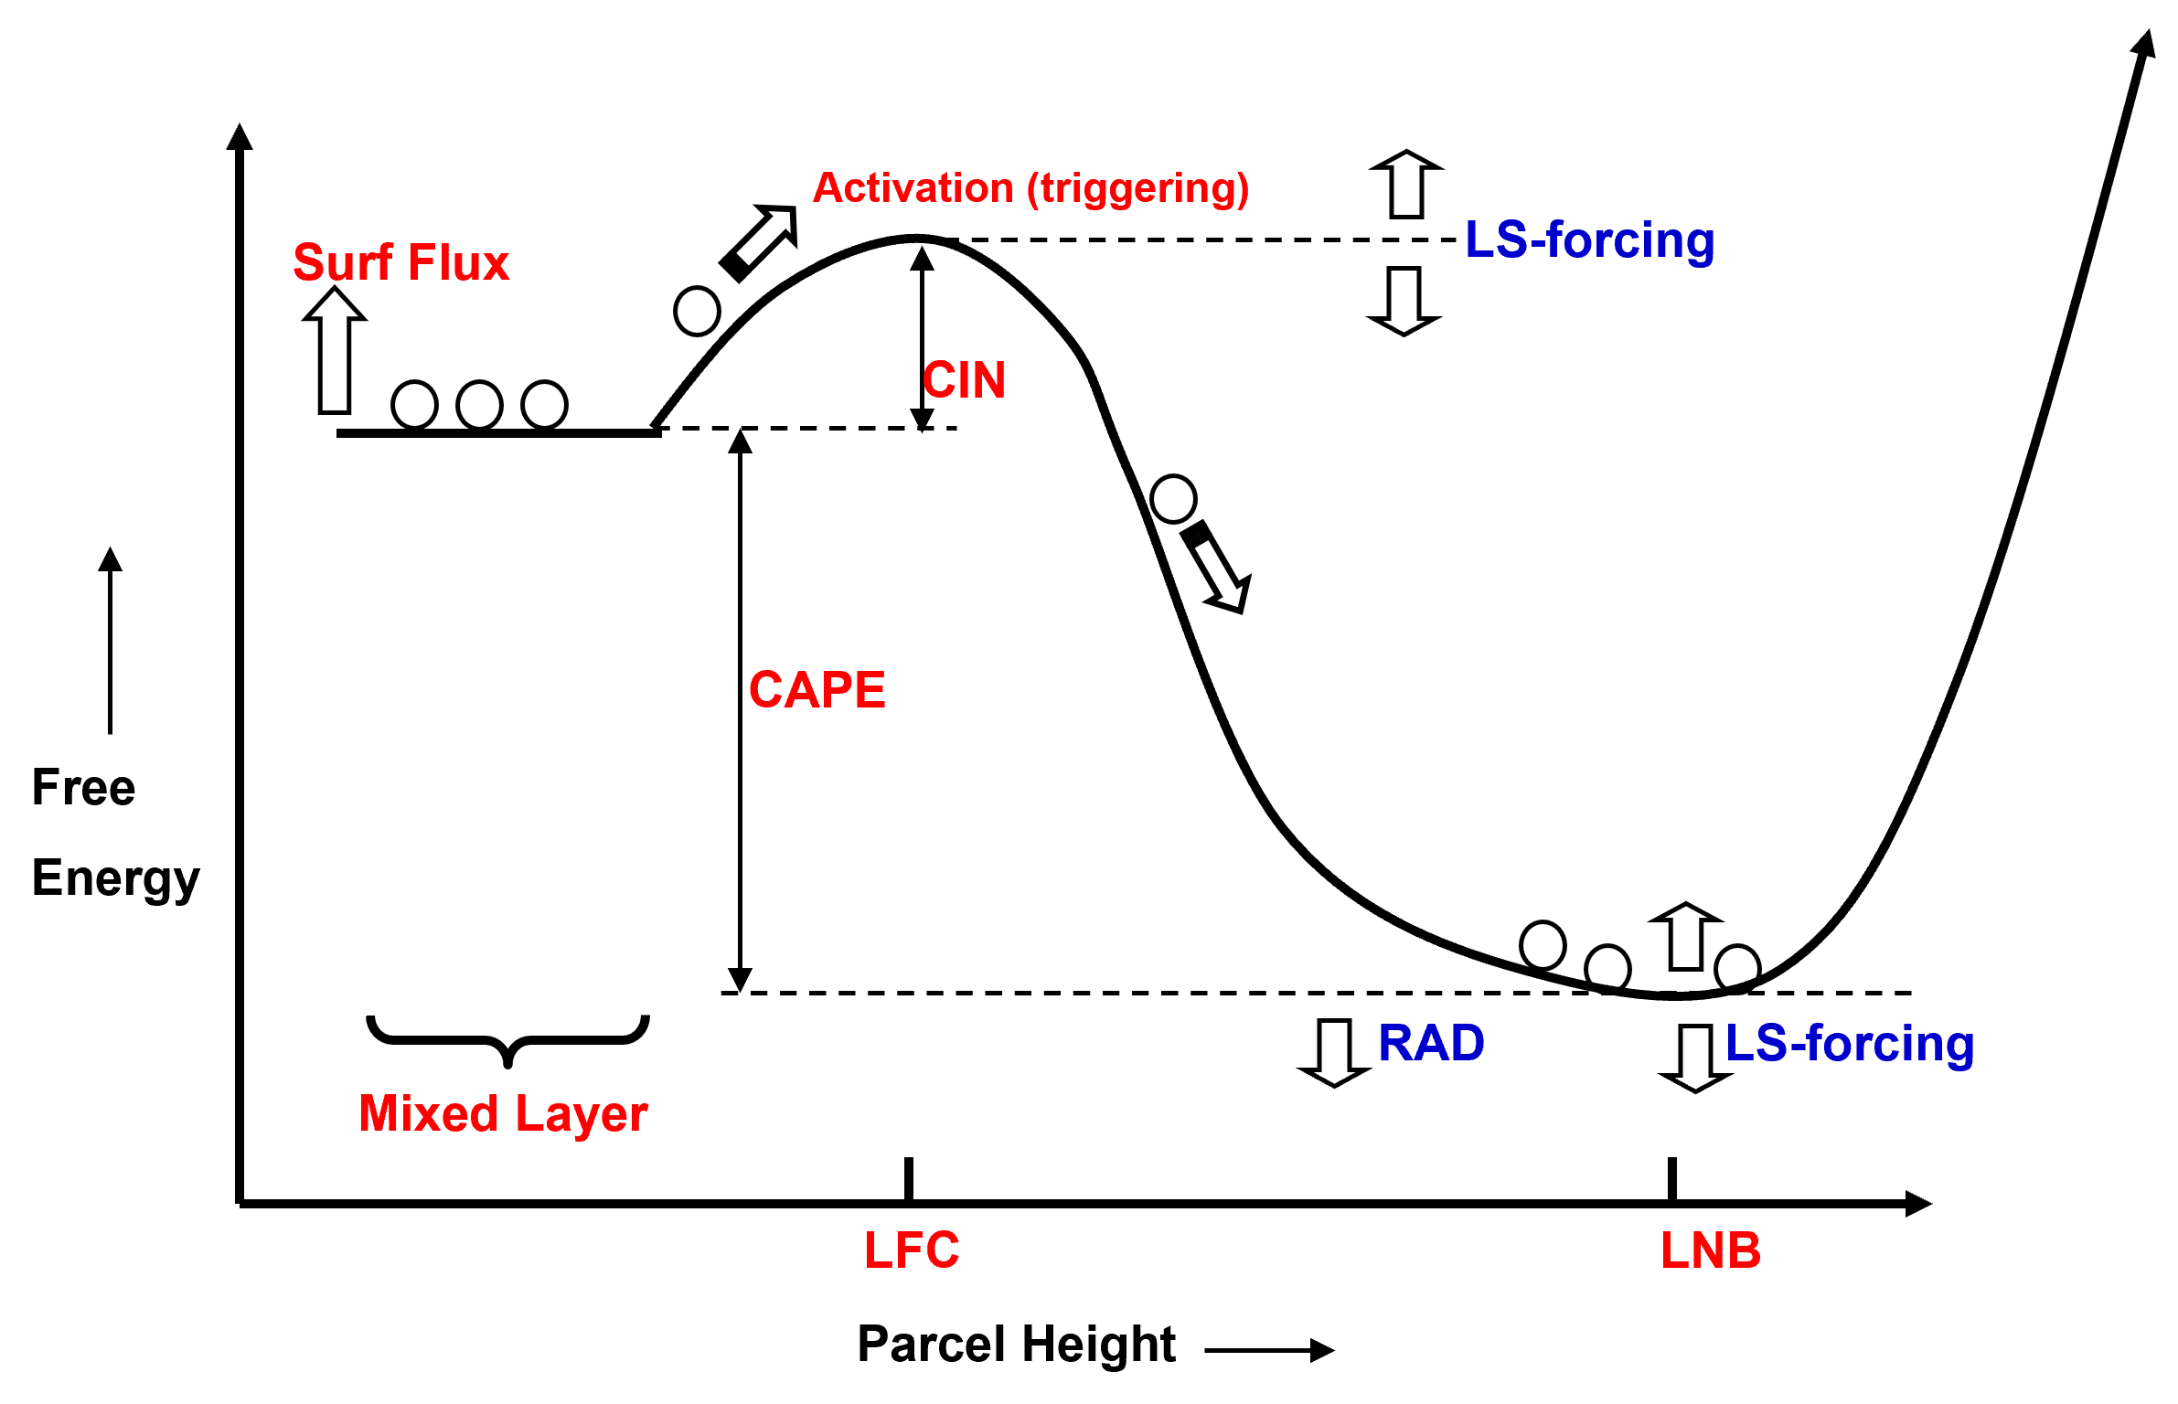
Closure
• Alternative perspective – can we overcome the CIN?
Mapes, 1997

Slide 37
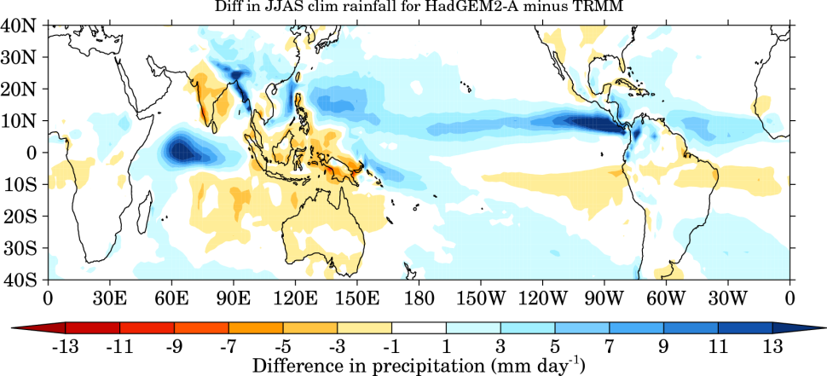
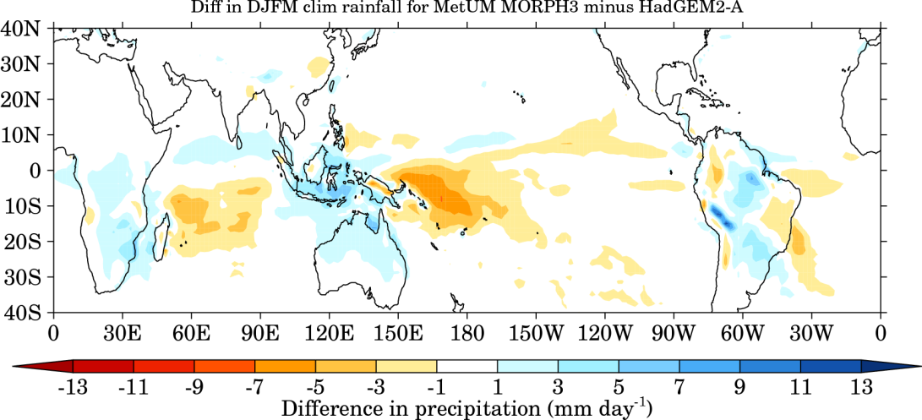
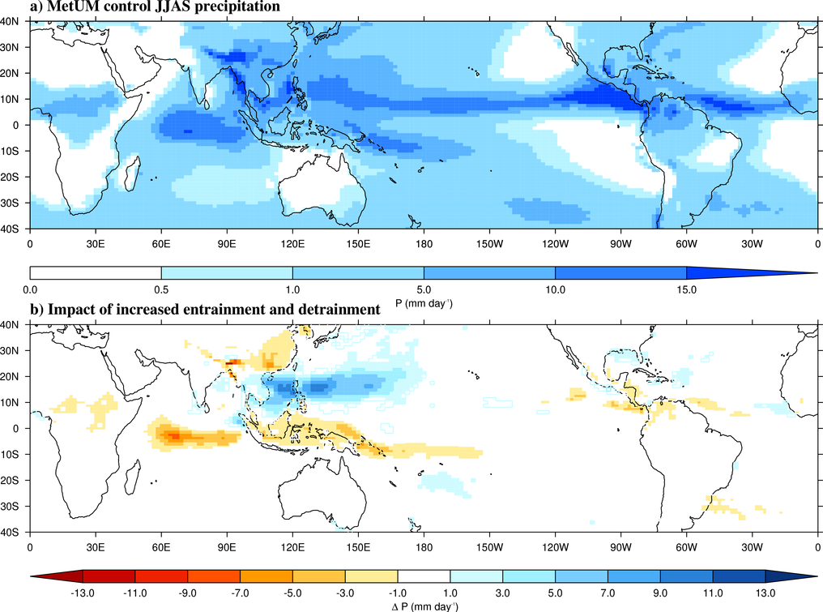
Convection in Models: Biases
Top: model precip bias
In places, error ~ mean
Middle: new model version with revised convection
Bottom: changing one parameter
Slide from Woolnough

Slide 38
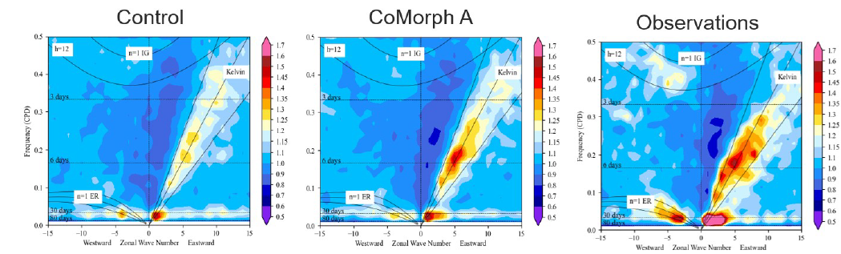
CoMorph-A Tropical Waves
Slightly stronger MJO
Improved Kelvin wave strength
N96, atmosphere only.
Improved coupling to lower tropospheric moisture has led to improvements in tropical waves and MJO
Observations (left), current UM (centre), with CoMorph (right).
Notes:
N96, atmosphere only. Tropical wavenumber-frequency spectrum for precipitation

Slide 39
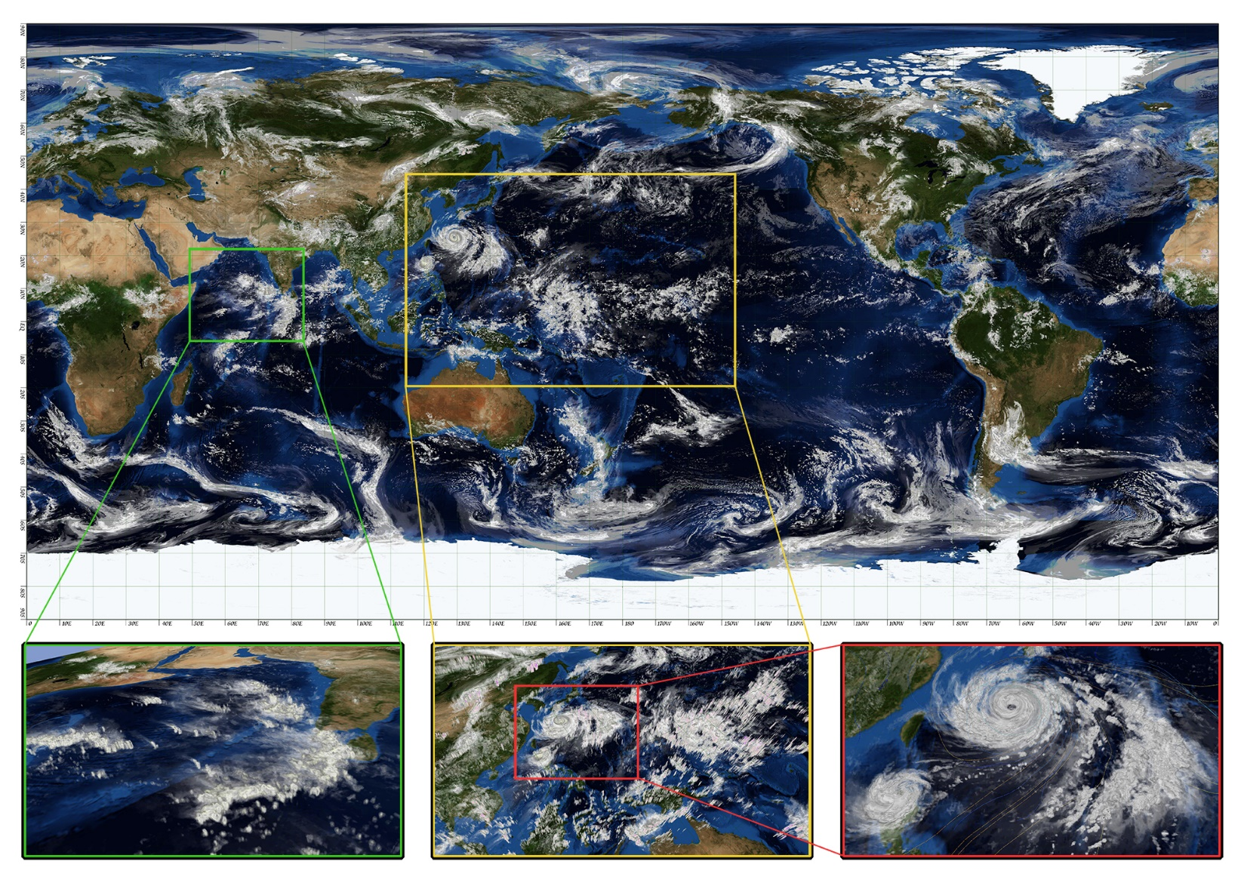
Modelling without convection parameterization
48h global simulation
870m grid spacing
4.5h real time for 1h simulation
320TB data needing days to process
Miyamoto et al, 2013
Notes:
AFESP ambition is for 1 month global forecasts at 1km to be achievable in 10-15 years time

Slide 40
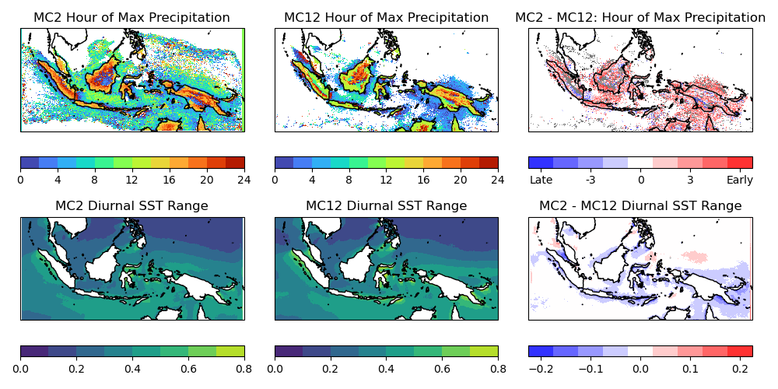
Benefits of convection-permitting grids
Better diurnal cycle (usually!)
UM at 2km (explicit) and 12km (parameterized)

Slide 41
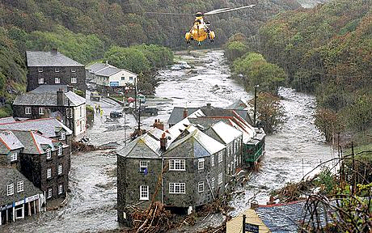
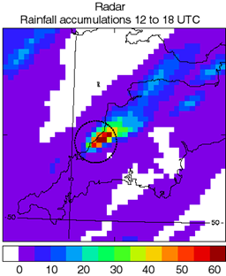
Benefits of convection-permitting grids
Short-range forecasting, especially for flash floods
Boscastle flood of 16 August 2004
Historically important for UK development of convective-scale NWP
Also good for fog, orographic flows, bush fires
Radar observations (mm)
on 4 km grid

Slide 42



Boscastle hindcasts
Very good positioning at 1km but still errors at cloud scale – too little rain
Radar
12 km parameterized
4 km explicit
1 km explicit

Slide 43


Higher resolution not a panacea
Average over shower cases
Average over deep cases
500-m model best
Hanley et al, 2015
200-m model best
200-m model best
Cells are identified using an area threshold of 10 km² and a rain rate threshold of 4 mm/hr
Cells smaller on average as grid length reduces
Sensitive to turbulent mixing length

Slide 44
Current and future challenges
Global NWP is near grey zone resolutions ~10km
Regional NWP is at ~2-5km, deep into grey zone
Traditional assumptions for parameterization break down
But explicit convection is not well resolved
Scheme-off and scheme-on are both problematic

Slide 45

Retain modified parameterization?
Example from ECMWF
Convection scheme ON or OFF problematic at km scales
Goldilocks solution with it partially active
We propose to damp CoMorph depending on cloud spacing / Δx and cloud size / Δx
Plot courtesy Becker, 2022, WGNE workshop on systematic errors
Notes:
Illustrate problems with an all-parameterized or all not-parameterized approach
Scheme off is better for mesoscale organization and (usually) diurnal cycle. But often generates excessive precip locally and overall

Slide 46
Summary I
Convection is a critical component of the (tropical) climate system
Climate models depend on parameterizations to represent convection
This is a major challenge due to the range of scales and tight interactions with dynamics and other parameterizations
The mass flux approach is the most common method
Performance very sensitive to choices for e.g. entrainment
Models have significant biases in the representation of tropical climate, and its variability

Slide 47
Summary II
Moving towards models of few km which can have an explicit representation of convection
Some improvements but weaknesses require development of parameterizations for the grey zone
Even at sub-km scales models have difficulties in representing convection (new programme ParaChute)
  e.g. boundary layer turbulence parameterization enters its own grey zone
The parameterization problem will never be “solved” in climate models but will continue to change its character

Slide 48
References I
Arakawa, A. and W. H. Schubert, 1974. Interaction of a Cumulus Cloud Ensemble with the Large-Scale Environment, Part I. J. Atmos. Sci., 31, 674-701
Bechtold, P., M. Köhler, T. Jung, F. Doblas-Reyes, M. Leutbecher, M. J. Rodwell, F. Vitart and G. Balsamo, 2008. Advances in simulating atmospheric variability with the ECMWF model: From synoptic to decadal time-scales. Quart. J. Roy. Meteorol. Soc., 134, 1337-1351
Bechtold, P. 2015. Convection in global numerical weather prediction. Chp. 15 of Parameterization of Atmosphere Convection, Plant, R. S and Yano, J.-I. (eds.)
Boing, S. J, A. P. Siebesma, J. D. Korpershoek and H. J. J. Jonker, 2012. Detrainment in deep convection. Geophys. Res. Lett., 39, 2012GL053735.
Bush, S.J., A. G. Turner, S. J. Woolnough, G. M. Martin and N. P. Klingaman, 2015. The effect of increased convective entrainment on Asian monsoon biases in the MetUM general circulation model. Quart. J. Roy. Met. Soc., 141, 311-326.
Derbyshire, S. H., I. Beau, P. Bechtold, J.-Y. Grandpeix, J.-M. Piriou, J.-L. Redelsperger and P. M. M. Soares, 2004. Sensitivity of moist convection to environmental humidity. Quart. J. Roy. Met. Soc., 130, 178-196.
Derbyshire, S. H., A. V. Maidens, S. F. Milton, R. A. Stratton and M. R. Willett, 2011. Adaptive detrainment in a convective parameterization. Quart. J. Roy. Met. Soc.,137, 1856-1871.

Slide 49
References II
Gu, J.-F., R. S. Plant, C. E. Holloway, T. R. Jones, A. Stirling, P. A. Clark, S. J. Woolnough, and T. L. Webb, 2020. Evaluation of the bulk mass flux formulation using large eddy simulations. J. Atmos. Sci., 77, 2115-2137.
Hanley, K. E., R. S. Plant, T. H. M. Stein, R. J. Hogan, H. W. Lean, C. Halliwell, and P. A. Clark, 2015. Mixing length controls on high resolution simulations of convective storms. Quart. J. Roy. Met. Soc., 141, 272-284.
Honnert, R., G. A. Efstathiou, R. J. Beare, J. Ito, A. Lock, R. Neggers, R. S. Plant, H. H. Shin, L. Tomassini, and B. Zhou, 2020. The Atmospheric Boundary Layer and the "Gray Zone" of Turbulence: A Critical Review. J. Geophys. Res.: Atmospheres, 125:e2019JD030317.
Klingaman, N.P. and S. J. Woolnough, 2014. Using a case-study approach to improve the Madden–Julian oscillation in the Hadley Centre model. Quart. J. Roy. Met. Soc., 140, 2491-2505.
Kuo, H.-L., 1974. Further studies of the parameterization of the influence of cumulus convection on large-scale flow. J. Atmos. Sci., 31, 1232-1240.
Mapes, B. E., 1997. Equilibrium vs activation controls of large-scale variations of tropical deep convection. In: The Physics and Parameterization of Moist Convection, Smith, R. K. (ed.)
Mapes, B. E., 2000. Convective inhibition, subgrid-scale triggering energy, and stratiform instability in a toy tropical wave model. J. Atmos. Sci., 57, 1515-1535.

Slide 50
References III
Miyamoto, Y., Y. Kajikawa, R. Yoshida, T. Yamaura, H. Yashiro and H. Tomita, 2013. Deep moist atmospheric convection in a subkilometer global simulation, Geophys. Res. Lett., 40, 4922-4926.
Peatman, S. C., J. Methven, and S. J. Woolnough, 2018. Isolating the Effects of Moisture Entrainment on Convectively Coupled Equatorial Waves in an Aquaplanet GCM. J. Atmos. Sci., 75, 3139–3157.
Plant, R. S. 2010 A review of the theoretical basis for bulk mass flux convective parameterization. Atmos. Chem. Phys., 10, 3529-3544.
Stirling, A. and R. A. Stratton, 2012. Entrainment processes in the diurnal cycle of deep convection over land. Quart. J. Roy. Met. Soc., 138, 1135-1149.
Talib, J., S. J. Woolnough, N. P. Klingaman, and C. E. Holloway, 2018. The Role of the Cloud Radiative Effect in the Sensitivity of the Intertropical Convergence Zone to Convective Mixing. J. Climate, 31, 6821–6838.
Whitall, M., R. Stratton, M. Willett, S. Derbyshire, R. Wong and G. G. Rooney, 2022. Convection Schemes. Unified Model Documentation Paper 027
J.-I. Yano and R. S. Plant, 2016. Generalized Convective Quasi-Equilibrium Principle. Dyn. Atmos. Ocean., 73, 10-33.
Zhang, G. J., 2003. Convective quasi-equilibrium in the tropical western Pacific: Comparison with midlatitude continental environment. J. Geophys. Res., 108, 2003JD003520.

