Slide 1

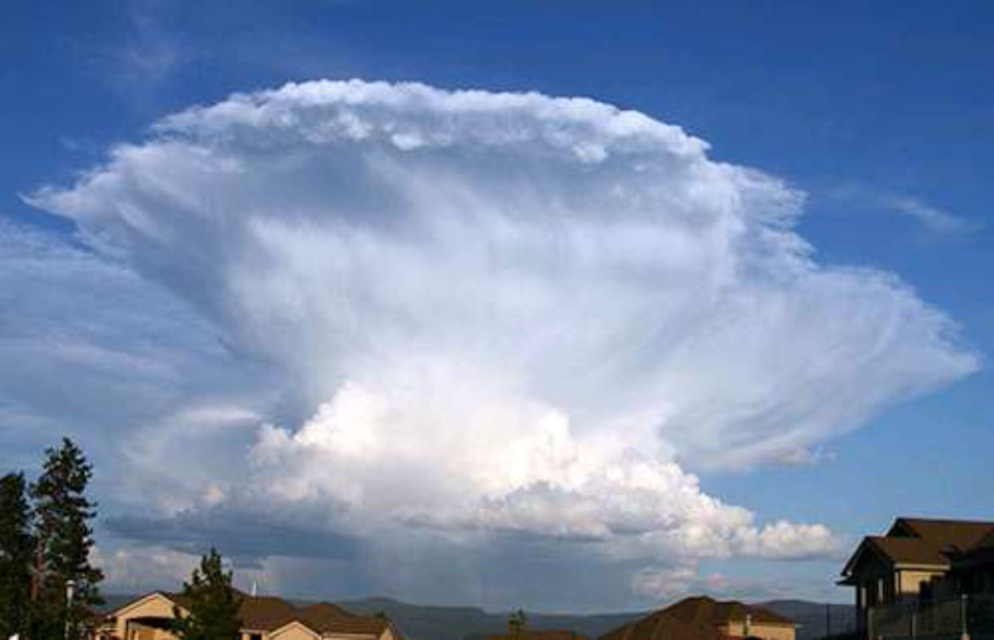
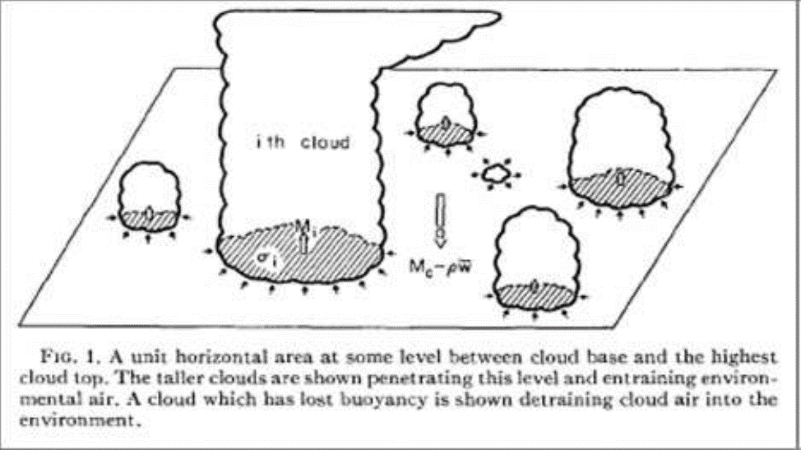
Convection and parameterization
Robert Plant
Department of Meteorology, University of Reading
NCAS Climate Modelling Summer School,
Cambridge
11 - 22 September 2023

Slide 2
Overview
Convection in the climate system
The need for parameterization
The mass flux approach
  The plume model
  Entrainment and detrainment
  Closure
Convection in models
Convection permitting models
A look ahead

Slide 3
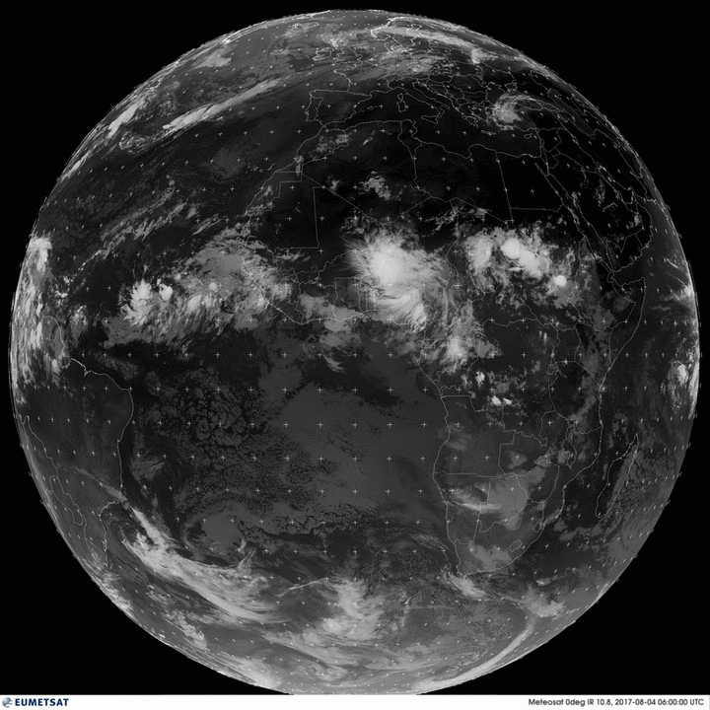
Convection in the climate system
Convection is important
It plays a leading role in planetary budgets of heat, moisture and momentum
An isolated thunderstorm may be 1-2 km across
But organized into long lived systems such as squall lines and MCS
Full-disk infrared METEOSAT Zero-Degree images from EUMETSAT http://oiswww.eumetsat.org/IPPS/html/MSG/IMAGERY/UMETSAT

Slide 4
Convection in the climate system
Associated warming patterns drive tropical circulations:
  e.g., monsoons, the Walker circulation
  synoptic features, e.g. tropical cyclones
Production of extreme events, e.g. floods
Associated clouds are an important component of the Earth’s radiation budget

Slide 5
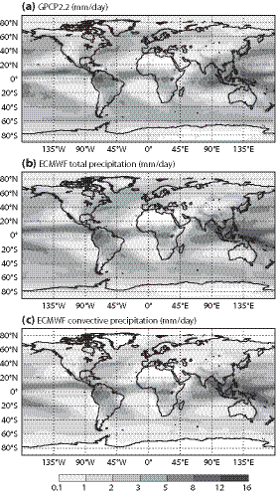
Convection in climate models
Observations
60% of global precip from convection parameterization
75% in tropics (and much of the rest from associated anvil cloud)
ECMWF,
total precip
ECMWF, convective precip
Bechtold, 2015

Slide 6
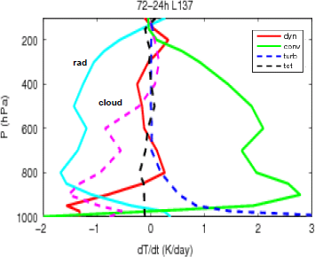
Convection in climate models
Tropical T budget in free troposphere within models is dominated by
Radiation scheme cooling = Convection scheme heating
Dynamics is important – because of its interactions with the convection!
ECMWF model; from Peter Bechtold

Slide 7
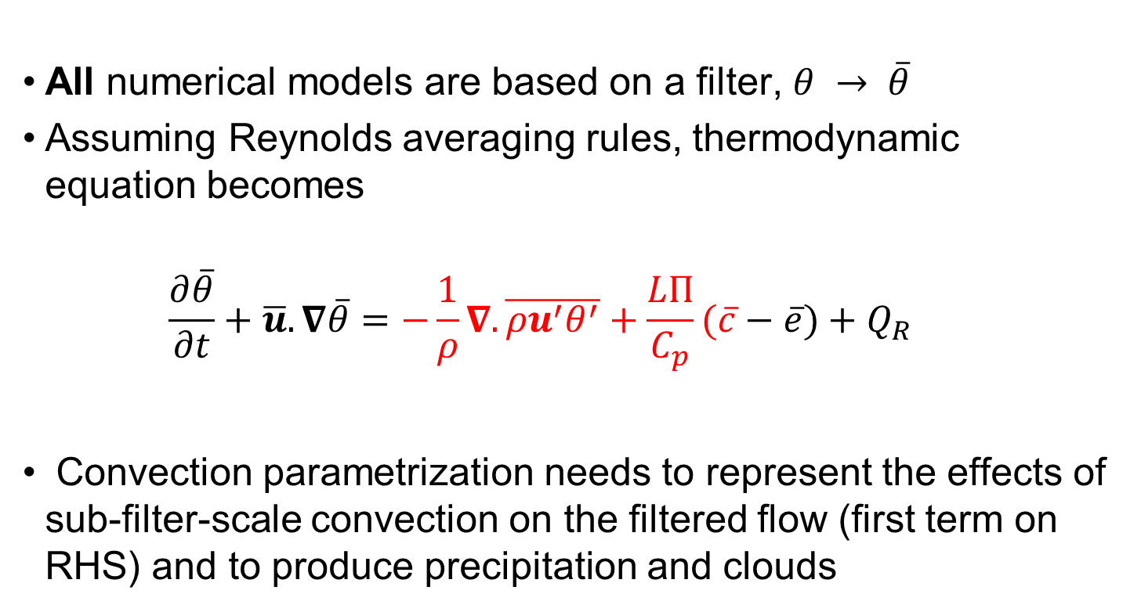
How a parameterization enters in the equations
All numerical models are based on a filter, $θ → \overline{θ}$
Assuming Reynolds averaging rules, thermodynamic equation becomes
  $$\frac{∂\overline{θ}}{∂t}+\overline{u}.∇\overline{θ}=−\frac{1}{ρ}∇.\overline{{ρu}^{′}θ^{′}}+\frac{LΠ}{C_{p}}(\overline{c}−\overline{e})+Q_{R}$$
Convection parametrization needs to represent the effects of sub-filter-scale convection on the filtered flow (first term on RHS) and to produce precipitation and clouds

Slide 8
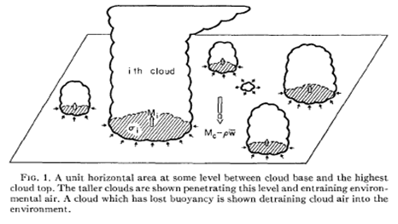
Representation depends on filter
Parameterized
Δx ~ 100km or larger
Many clouds in a grid cell
Represent the effect of all clouds on mean properties of the grid
Explicit (large-eddy modelling)
Δx ~ 100m or smaller
Many cells for each cloud
Each cloud well resolved
Grey zone
Δx ~ 1-10 km
Not enough clouds for parameterization
Not enough cells to resolve clouds
Representation should be scale-aware and stochastic
Notes:
Grey zone: some clouds may be close to being resolved; there are only a few or even 1 cloud in some boxes and each of these clouds is different; there may be no clouds in some boxes.

Slide 9
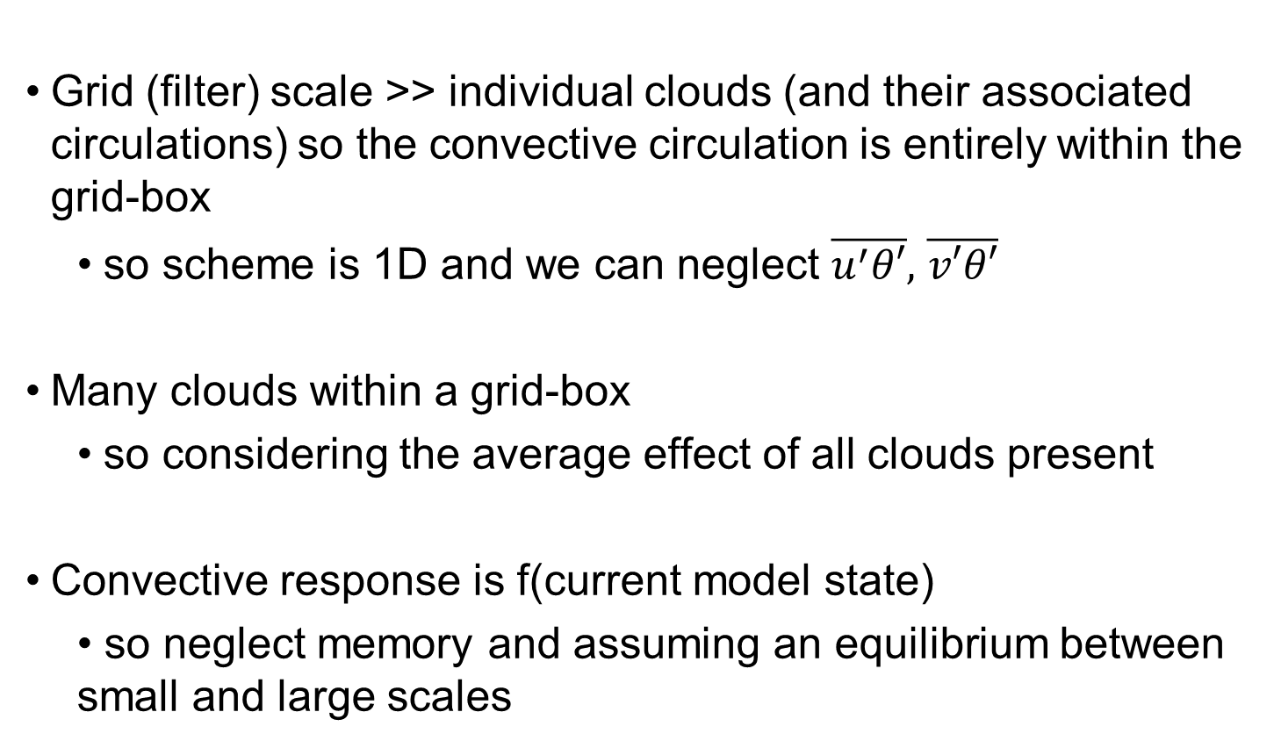
Traditional assumptions
Grid (filter) scale >> individual clouds (and their associated circulations) so the convective circulation is entirely within the grid-box
  so scheme is 1D and we can neglect $\overline{u^{′}θ′},$ $\overline{v′θ′}$
Many clouds within a grid-box
  so considering the average effect of all clouds present
Convective response is f(current model state)
  • so neglect memory and assuming an equilibrium between small and large scales

Slide 10
Mass flux approach
There are many convection parameterizations used
The large majority take a mass flux approach (at least for “deep” precipitating convection)
I am not describing any particular scheme but will discuss the typical structure of a mass flux scheme

Slide 11
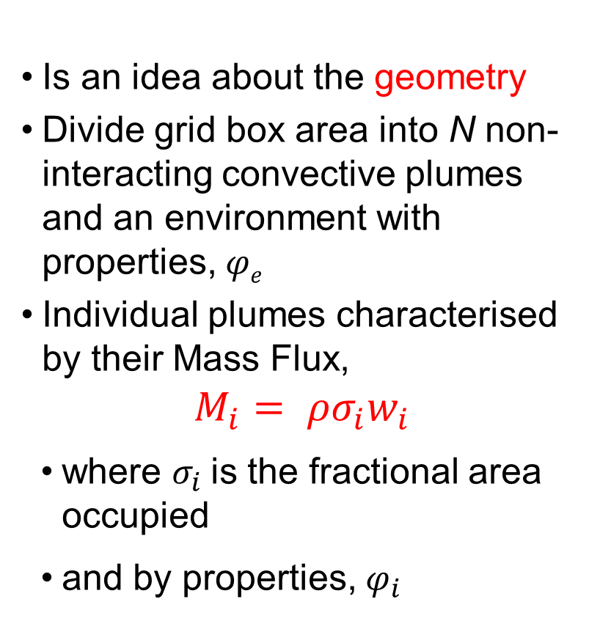
The mass flux idea
Is an idea about the geometry
Divide grid box area into N non-interacting convective plumes and an environment with properties, 𝜑_{𝑒}
Individual plumes characterised by their Mass Flux,
$$M_{i}= ρσ_{i}w_{i}$$
where $σ_{i}$is the fractional area occupied
and by properties, $φ_{i}$
e.g. Arakawa and Schubert, 1974

Slide 12
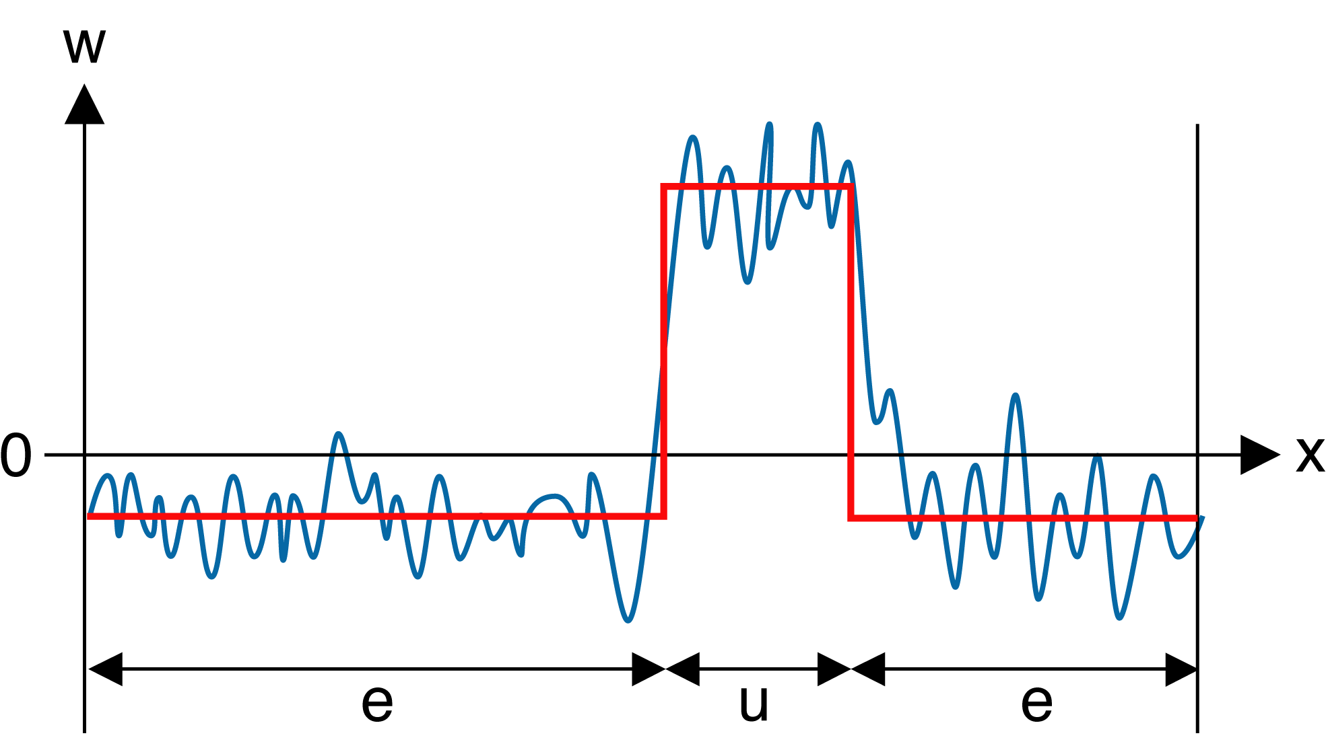



Example, using one type
$$φ_{u}=\overline{φ_{u}}+φ_{u}^{′}$$
$$φ_{e}=\overline{φ_{e}}+φ_{e}^{′}$$
$$\overline{φ}=σ\overline{φ_{u}}+(1−σ)\overline{φ_{e}}$$
Partition the flow into an updraught and its environment
The total flux is:
$ρ\overline{w^{′}φ^{′}}=ρσ\overline{w_{u}^{′}φ_{u}^{′}}+ρ\left(1−σ\right)\overline{w_{e}^{′}φ_{e}^{′}}+ρσ\overline{w_{u}}(\overline{φ_{u}}−\overline{φ_{e}}$)
First 2 terms due to variability within updraught and environment – ignore!

Slide 13
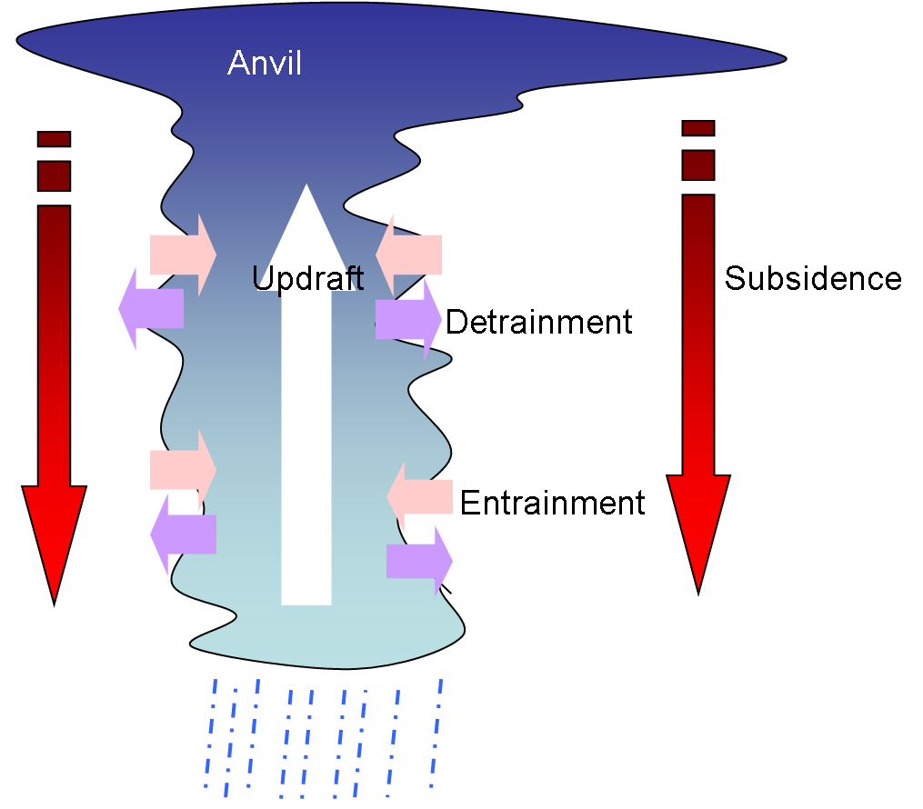
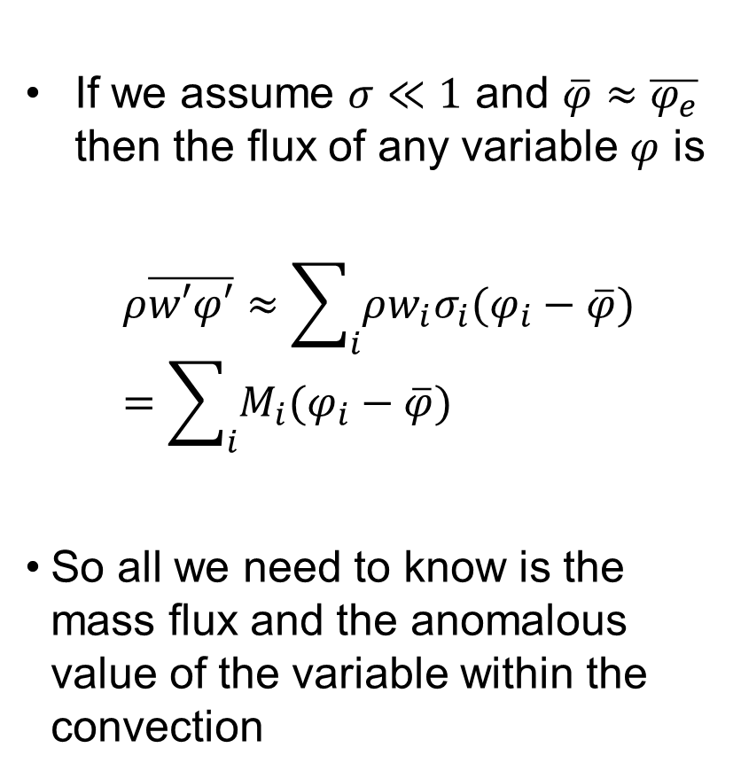
More generally
If we assume $σ≪1$ and $\overline{φ}≈\overline{φ_{e}}$ then the flux of any variable $φ$ is
$$ρ\overline{w′φ′}≈\sum_{i}{ρ{w_{i}σ}_{i}(φ_{i}−\overline{φ})}=\sum_{i}{M_{i}(φ_{i}−\overline{φ})}$$
So all we need to know is the mass flux and the anomalous value of the variable within the convection

Slide 14
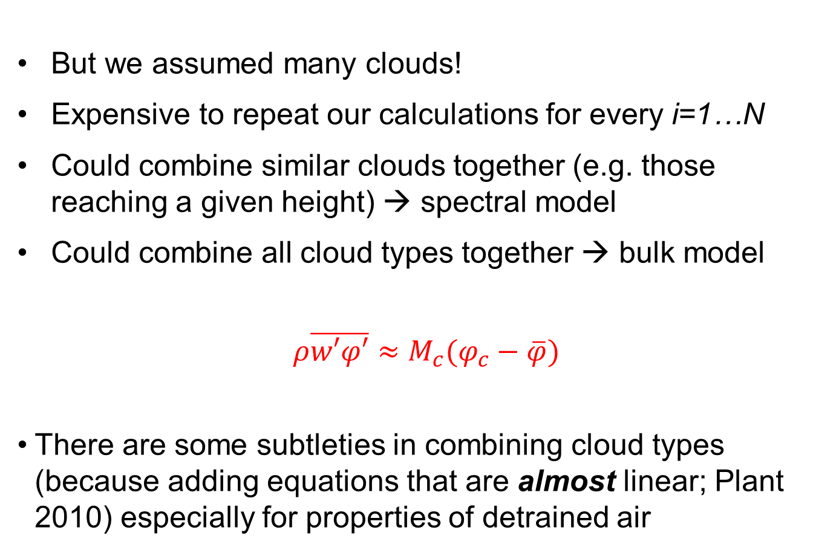
The composite “bulk” plume
But we assumed many clouds!
Expensive to repeat our calculations for every i=1…N
Could combine similar clouds together (e.g. those reaching a given height) → spectral model
Could combine all cloud types together → bulk model
$$ρ\overline{w′φ′}≈M_{c}(φ_{c}−\overline{φ})$$
There are some subtleties in combining cloud types (because adding equations that are almost linear; Plant 2010) especially for properties of detrained air

Slide 15
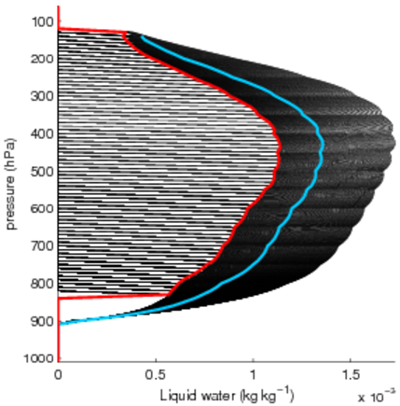
Overestimation of liquid water
Bulk parameterization scheme ansatz
The liquid water detrained from each individual plume is given by the bulk value:
N = 350 plumes
Ensemble detrained liquid water
Bulk liquid water
(typical tropical sounding)

Slide 16
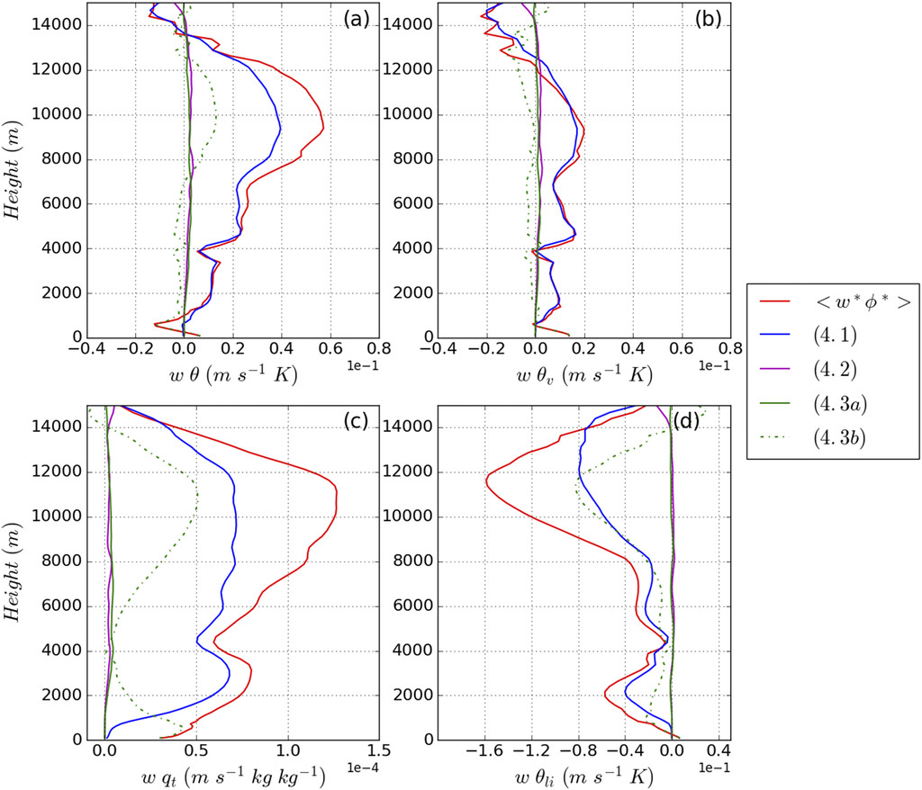
How well does it work?
Applying mass flux decomposition to LES data
Red = total flux
Blue = best bulk approximation
Green dashed = environmental variability
Green solid = within-cloud variability
Purple = between cloud variability
2 convection types better than 1
3+ types not much better
Gu et al 2020

Slide 17
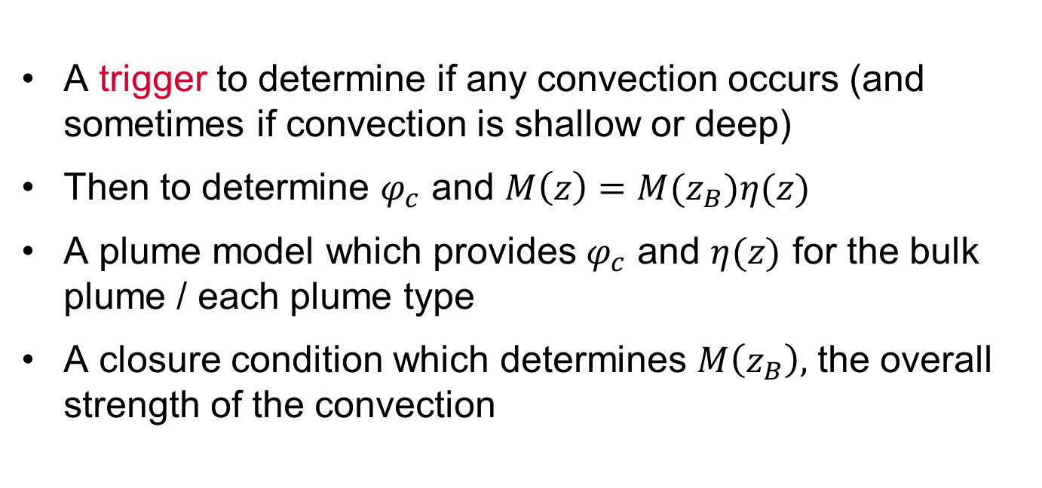
Components of mass flux scheme
A trigger to determine if any convection occurs (and sometimes if convection is shallow or deep)
Then to determine $φ_{c}$ and $M\left(z\right)=M(z_{B})η(z)$
A plume model which provides $φ_{c}$ and $η(z)$ for the bulk plume / each plume type
A closure condition which determines $M\left(z_{B}\right),$ the overall strength of the convection

Slide 18
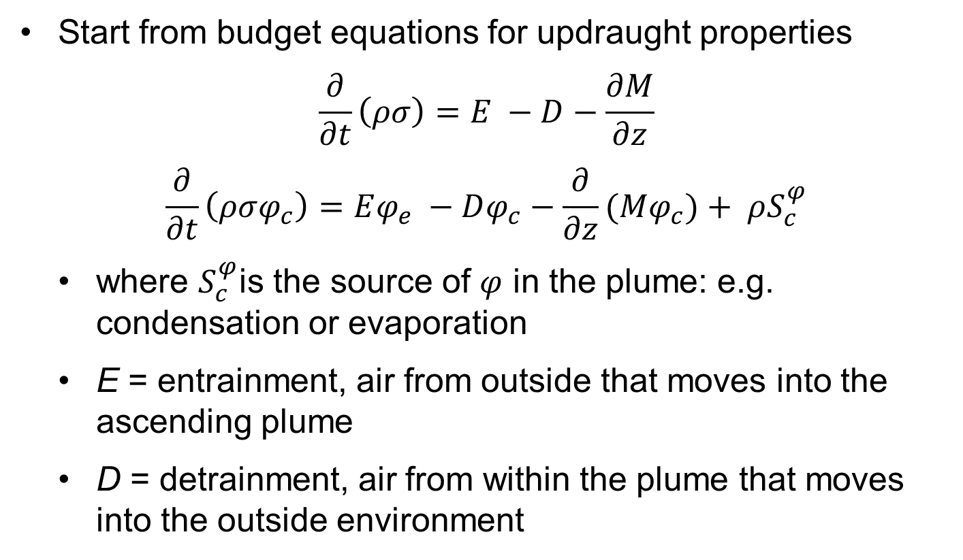
The Plume Model
Start from budget equations for updraught properties
$$\frac{∂}{∂t}\left(ρσ\right)=E −D−\frac{∂M}{∂z}$$
$$\frac{∂}{∂t}\left(ρσφ_{c}\right)=Eφ_{e} −Dφ_{c}−\frac{∂}{∂z}(Mφ_{c})+ ρS_{c}^{φ}$$
where $S_{c}^{φ}$is the source of $φ$ in the plume: e.g. condensation or evaporation
E = entrainment, air from outside that moves into the ascending plume
D = detrainment, air from within the plume that moves into the outside environment

Slide 19


The Plume Model
Average over lifetime
where $q,l$ are the water vapour and liquid water and $C_{u}$, $R_{u}$ are condensation and conversion of liquid water to rain in the updraft (can extend to other water species)
$$\frac{∂M}{∂z}=E −D$$
$$\frac{∂}{∂z}(Mθ_{c})=E\overline{θ} −Dθ_{c}+ ρ\frac{LΠ}{C_{p}}C_{u}$$
$$\frac{∂}{∂z}(Mq_{c})=E\overline{q} −Dq_{c}−C_{u}$$
$$\frac{∂}{∂z}\left(Ml_{c}\right)=−Dl_{c}+C_{u}−R_{u}$$

Slide 20
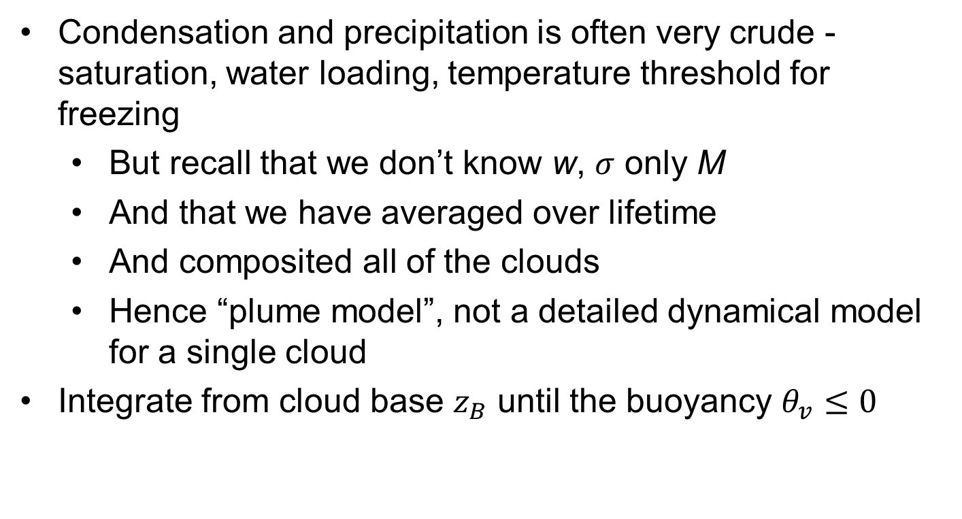
The Plume Model
Condensation and precipitation is often very crude - saturation, water loading, temperature threshold for freezing
  But recall that we don’t know w, $σ$ only M
  And that we have averaged over lifetime
  And composited all of the clouds
  Hence “plume model”, not a detailed dynamical model for a single cloud
Integrate from cloud base $z_{B}$ until the buoyancy $θ_{v}≤0$

Slide 21
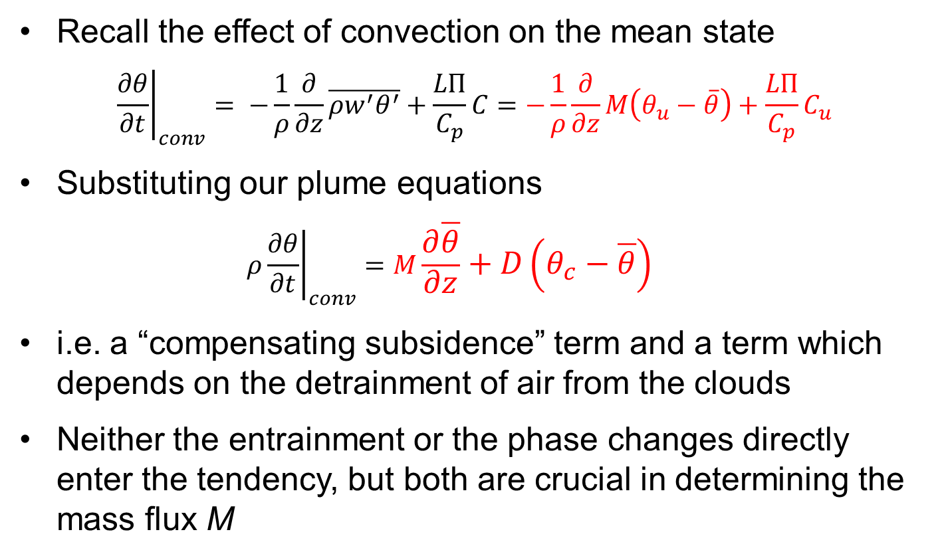
Impact on Environment: Interpretation
Recall the effect of convection on the mean state
$${\left.\frac{∂θ}{∂t}\right|}_{conv}= −\frac{1}{ρ}\frac{∂}{∂z}\overline{ρw^{′}θ^{′}}+\frac{LΠ}{C_{p}}C=−\frac{1}{ρ}\frac{∂}{∂z}M\left(θ_{u}−\overline{θ}\right)+\frac{LΠ}{C_{p}}C_{u}$$
Substituting our plume equations
  $$ρ{\left.\frac{∂θ}{∂t}\right|}_{conv}=M\frac{∂\overline{θ}}{∂z}+D\left(θ_{c}−\overline{θ}\right)$$
i.e. a “compensating subsidence” term and a term which depends on the detrainment of air from the clouds
Neither the entrainment or the phase changes directly enter the tendency, but both are crucial in determining the mass flux M

Slide 22
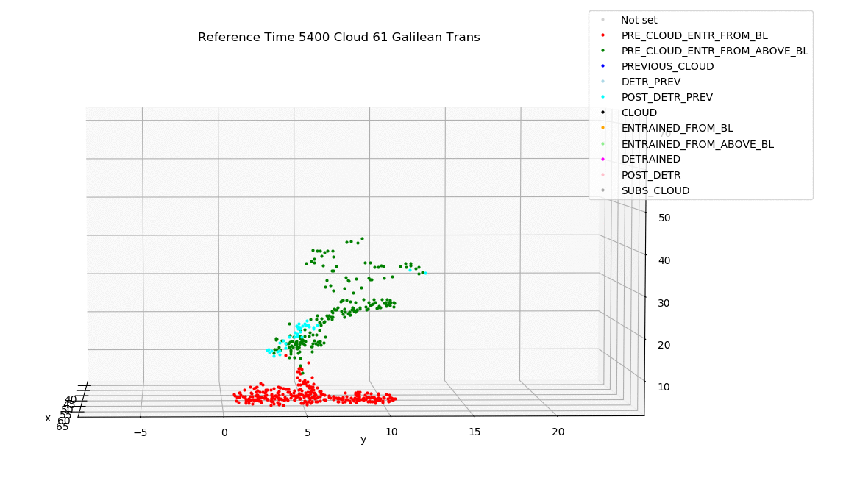
Entrainment and detrainment
For a single cloud, E and D encapsulate the exchange between updraft and the surrounding air
In a bulk model, they also encapuslate the cloud spectrum
e.g. the detrainment must capture the loss of updraft air at cloud top
Can be estimated (with difficulty) from LES
Here with parcel trajectories for shallow convection simulation with 10m grid length
Clark et al, submitted

Slide 23
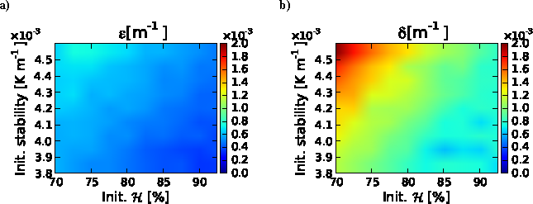
Entrainment and detrainment
• Entrainment often expressed as E/M ~ 1/r (smaller clouds as they have higher surface area to volume ratio)
• Not enough sensitivity to environmental RH (Derbyshire et al 2004, Bechtold et al 2008)
• More variation in detrainment than entrainment rates
• e.g. adaptive detrainment scheme of Derbyshire et al 2011
E/M and D/M dependence on RH and stability
Boing et al 2012

Slide 24
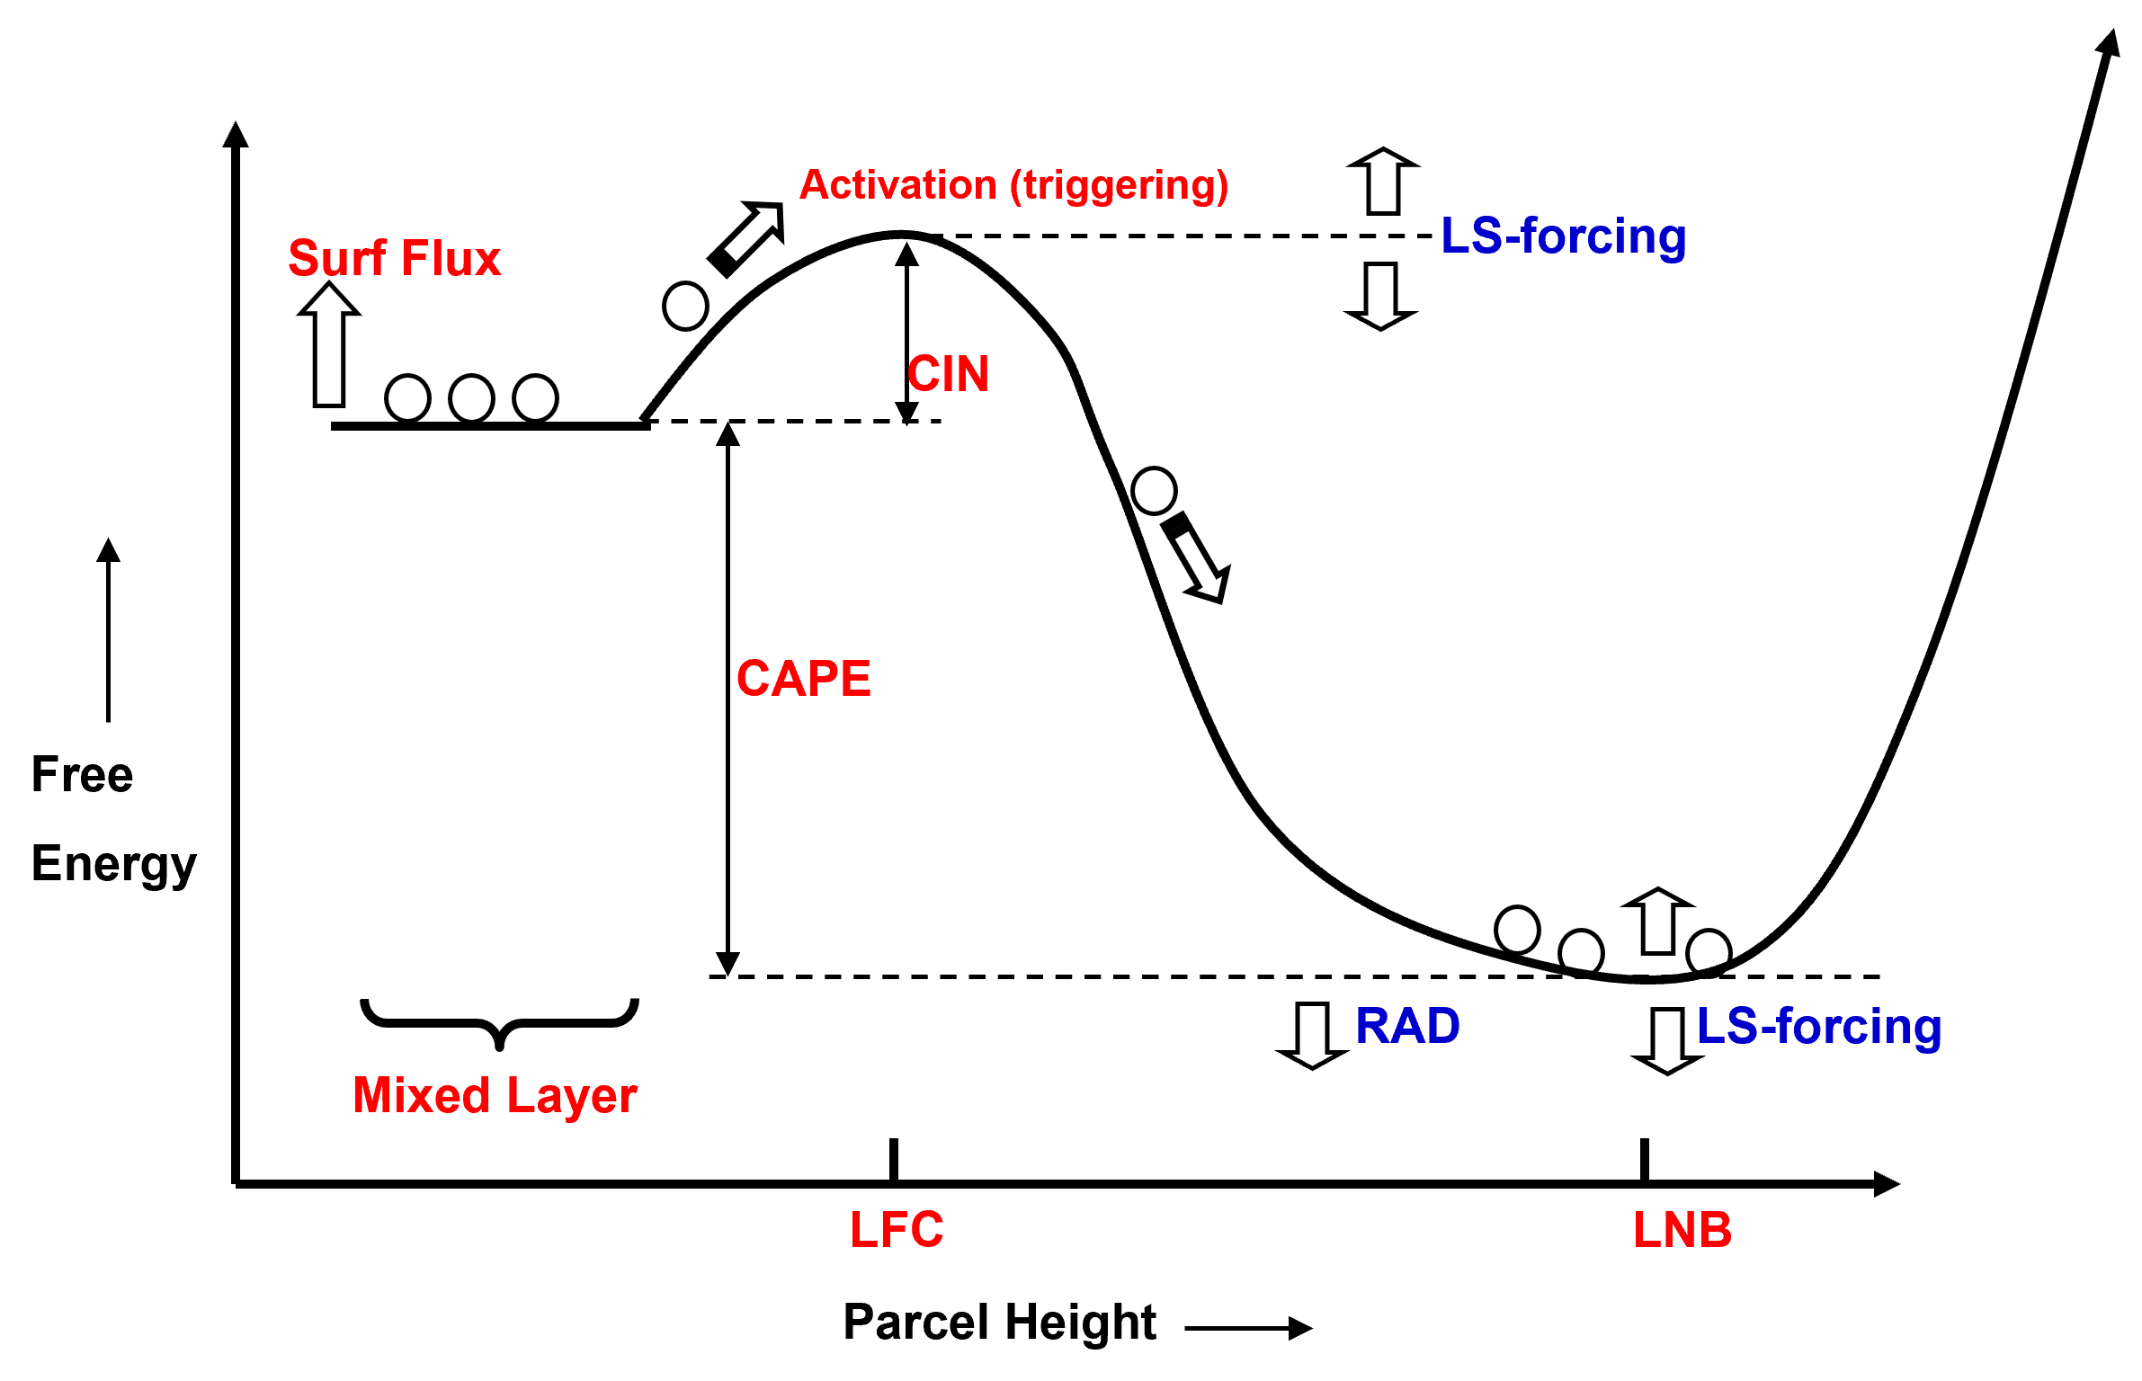
Closure
• Need to estimate overall amplitude of convection, via M(z_{B})
Mapes, 1997

Slide 25


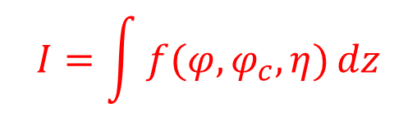
Closure
• More generally, consider a function of large-scale variables, $φ$, convective variables, $φ_{c}$, and profile, $η$, and integrate in z
Now take time derivative. After some algebra (Yano and Plant, 2016)….
where F= large-scale generation or “forcing,” terms independent of M(z_{B})
R=response of convective processes: terms dependent on M(z_{B}) (proportional for entraining plumes with simple microphysics)
$$I=\int{f(φ,φ_{c},η)}dz$$
$$\frac{∂I}{∂t}=F−R$$

Slide 26

Equilibrium Closures
Quasi-equilibrium (Arakawa and Schubert, 1974) is the assumption that $∂I$/$∂t ≈0$
$f=ρq$ Moisture convergence balanced by precip (Kuo, 1974)
$f=b$ CAPE closure with b for non-entraining parcel
$f=b$ dilute CAPE closure with b for entraining plume
$f=b$ Parcel-environment closure with BL excluded from integral (Zhang, 2003)
$f=b$ CIN closure with troposphere excluded from integral (Mapes, 2000)
$f=ρb$ PCAPE closure used at ECMWF (Bechtold 2015)
$f=ηb$ Cloud work function closure (Arakawa and Schubert, 1974)
In practice, many schemes do not impose a strict equilibrium, but relax towards it on a timescale of ~1-3h

Slide 27
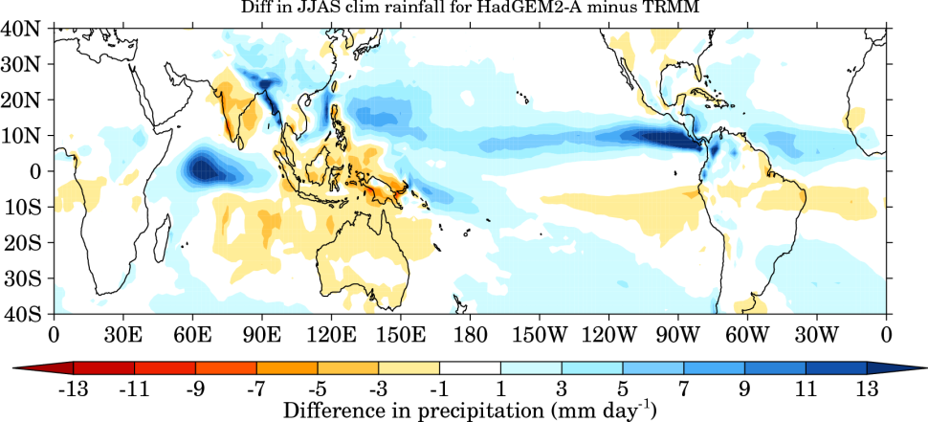
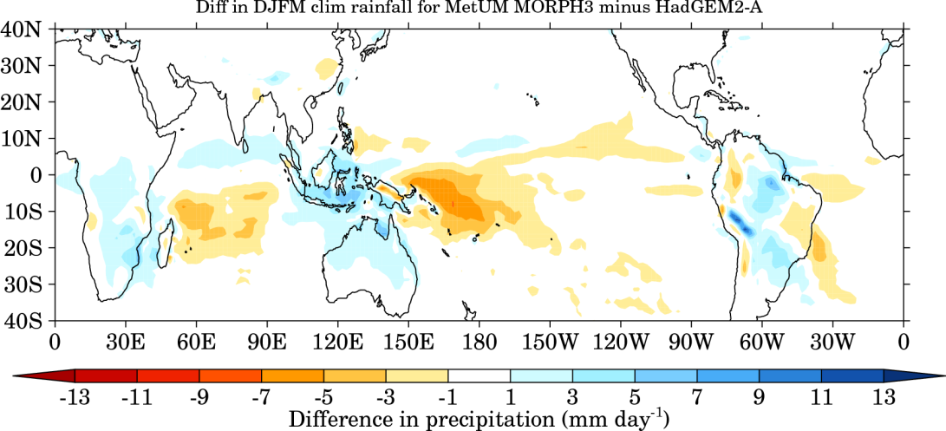
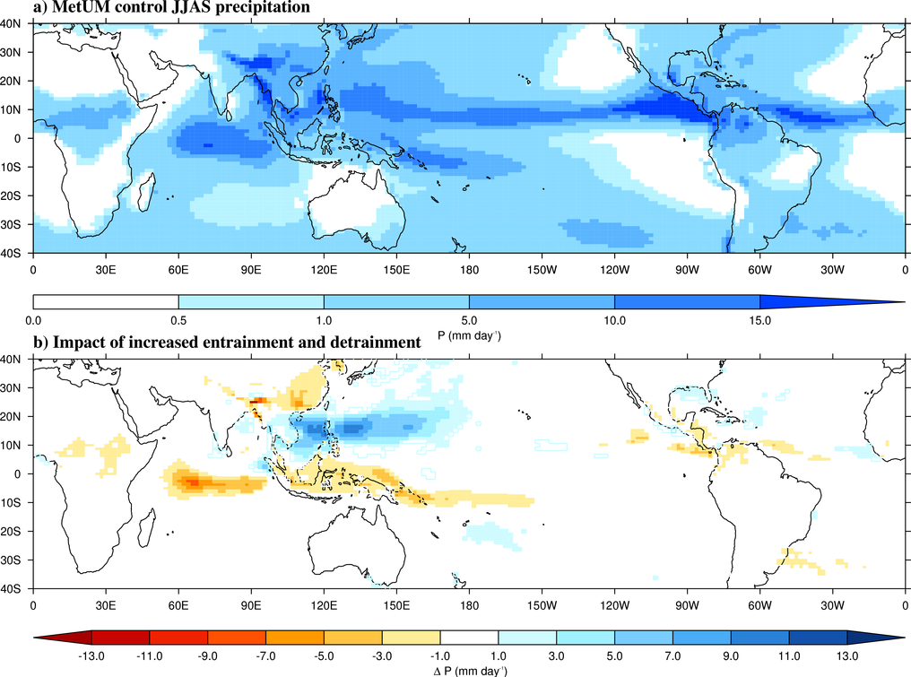
Convection in Models: Biases
Top: model precip bias
In places, error ~ mean
Middle: new model version with revised convection
Bottom: changing one parameter
Slide from Woolnough

Slide 28
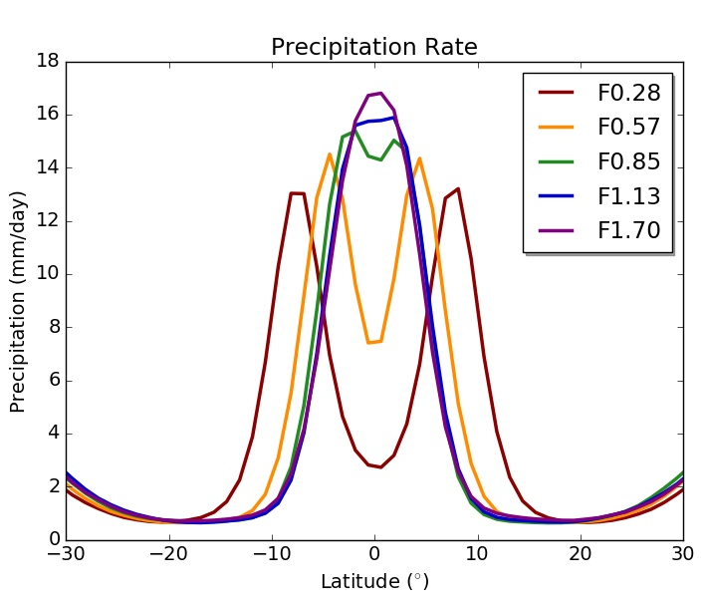
Sensitivity to Entrainment I
Climate models are very sensitive to choices of E and D
ITCZ sensitivity in an aquaplanet UM (Talib et al 2018)
Sensitivities of MJO (Klingaman and Woolnough, 2014), equatorial waves (Peatman et al, 2018) and monsoons (Bush et al, 2015)
Often there is a conflict between mean state (low E) and variability (high E)
Factor F applied to default E

Slide 29
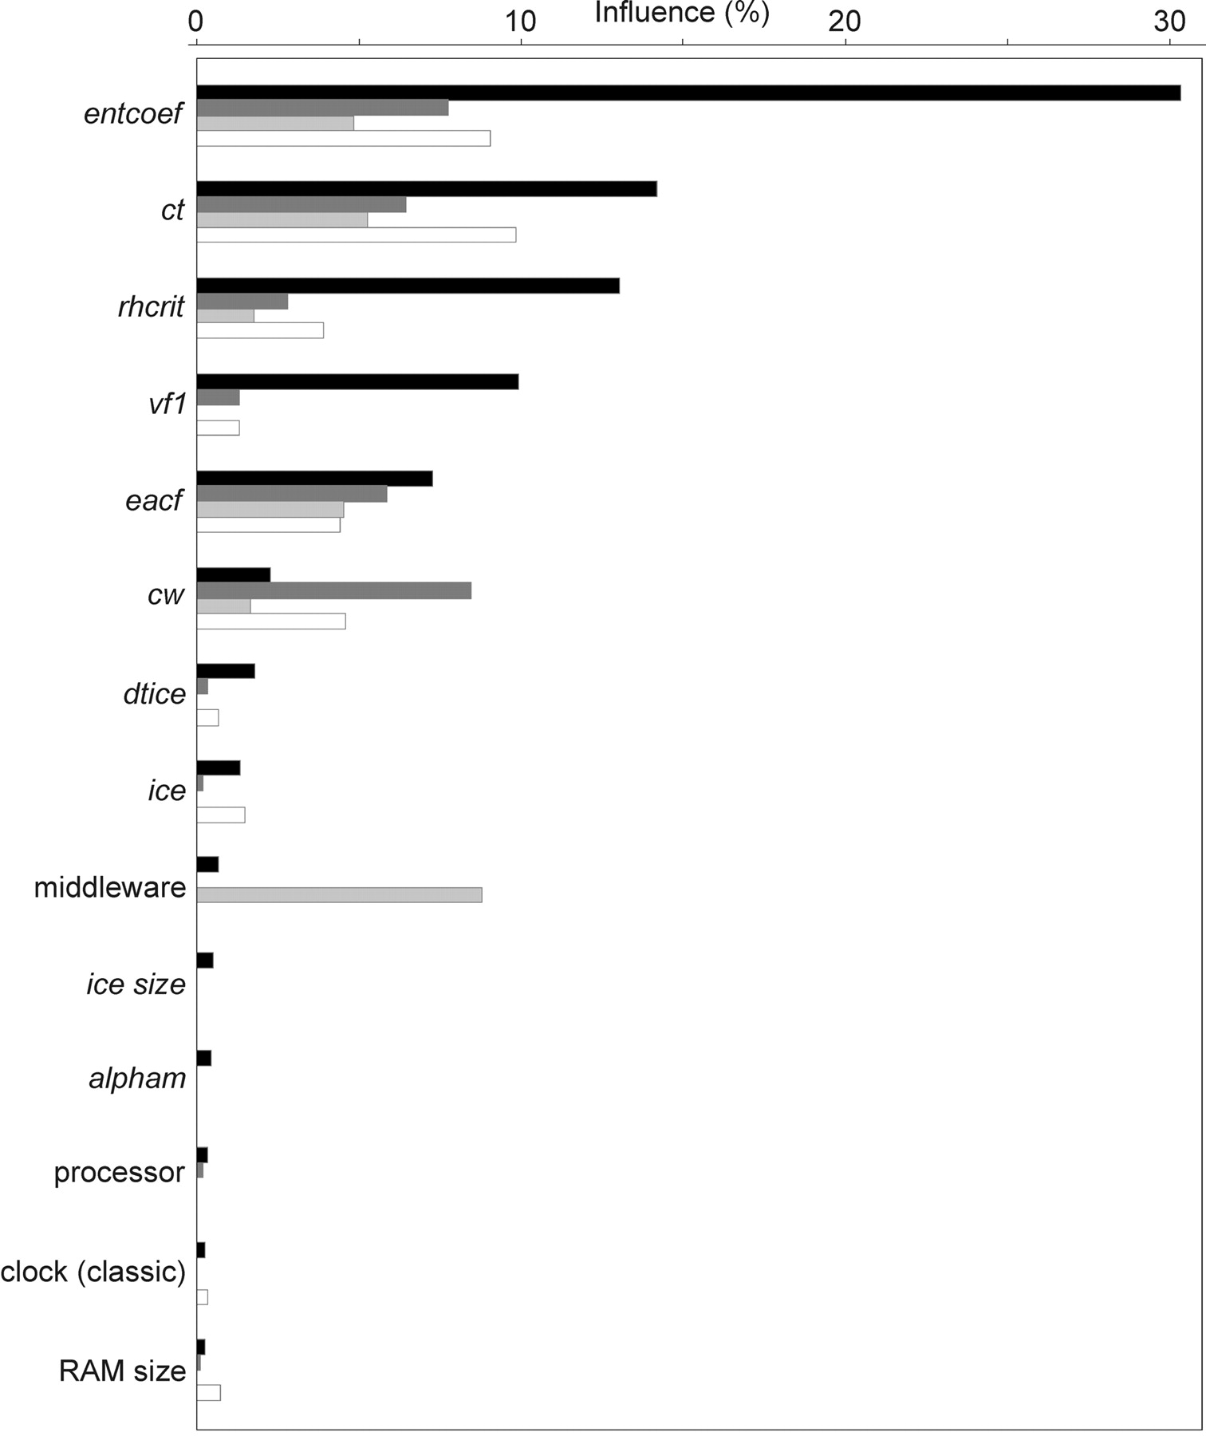
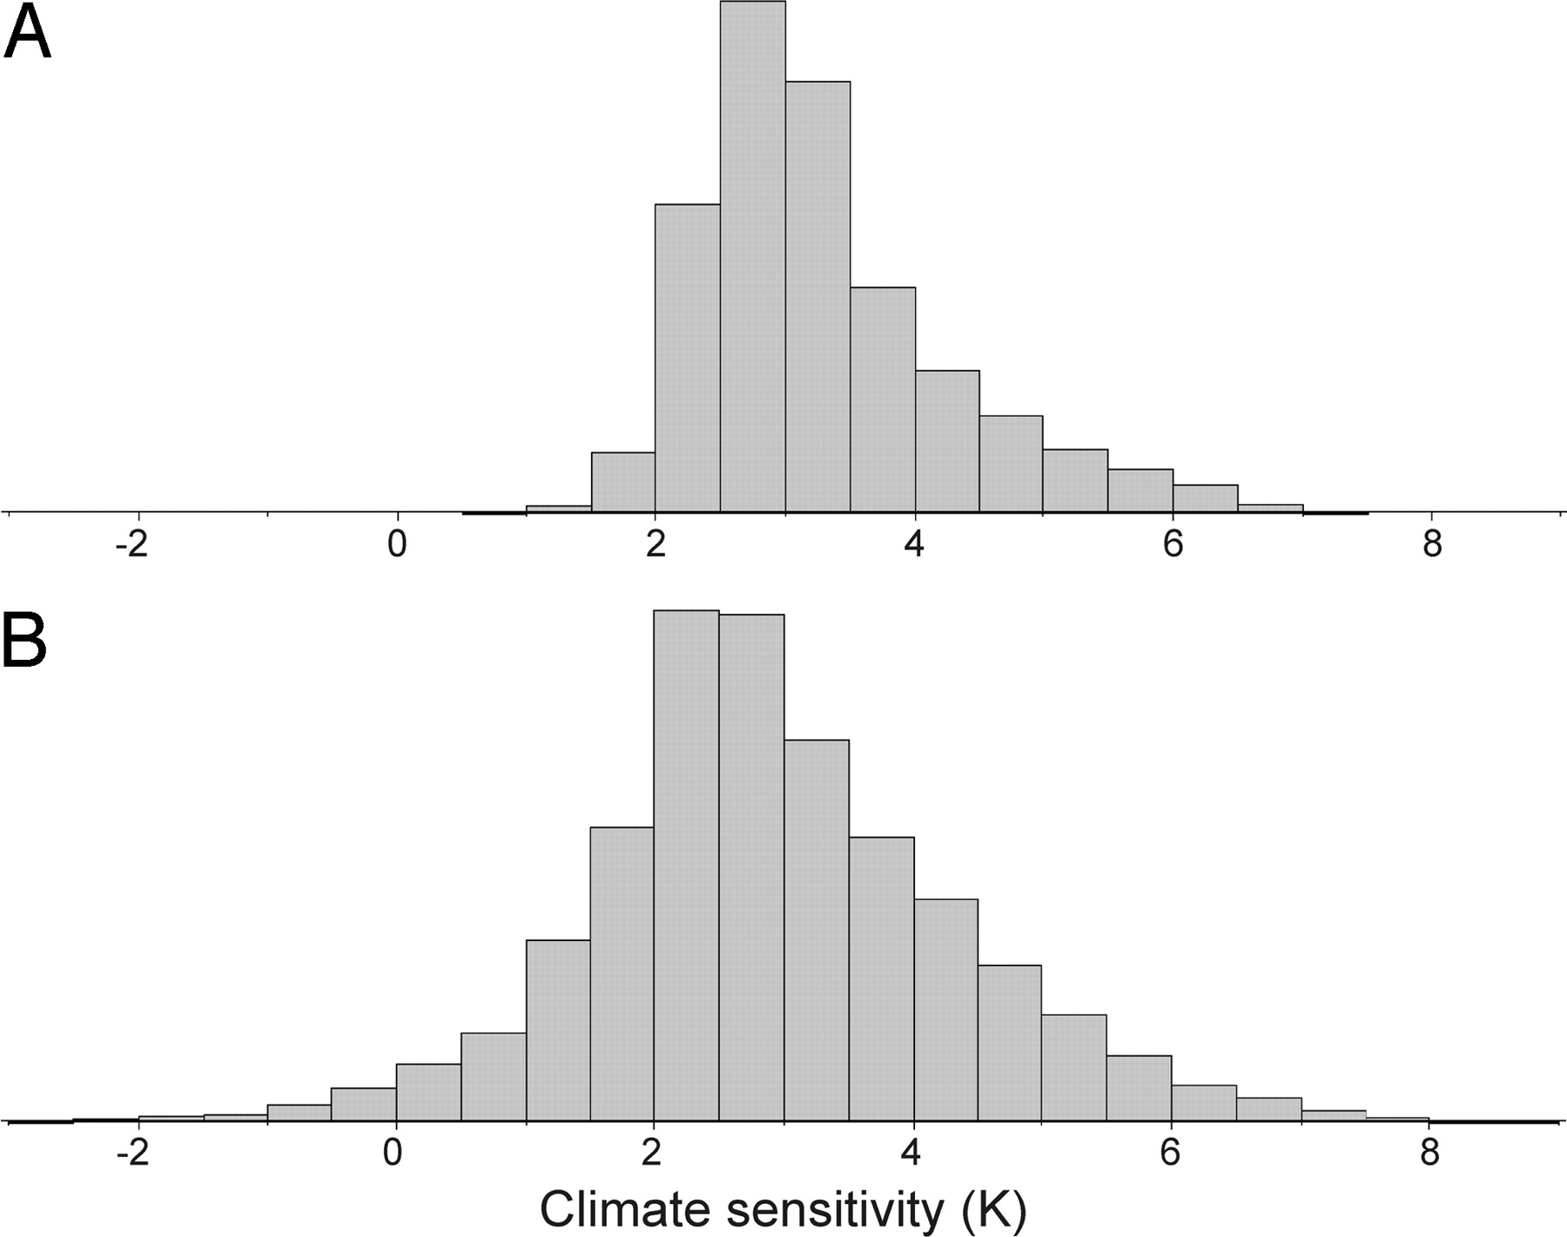
Sensitivity to Entrainment II
Large multi-parameter experiment, 30% of variation in climate sensitivity to 2xCO₂ attributed to E
But both high and low E can give high sensitivity
Knight et al, 2007

Slide 30
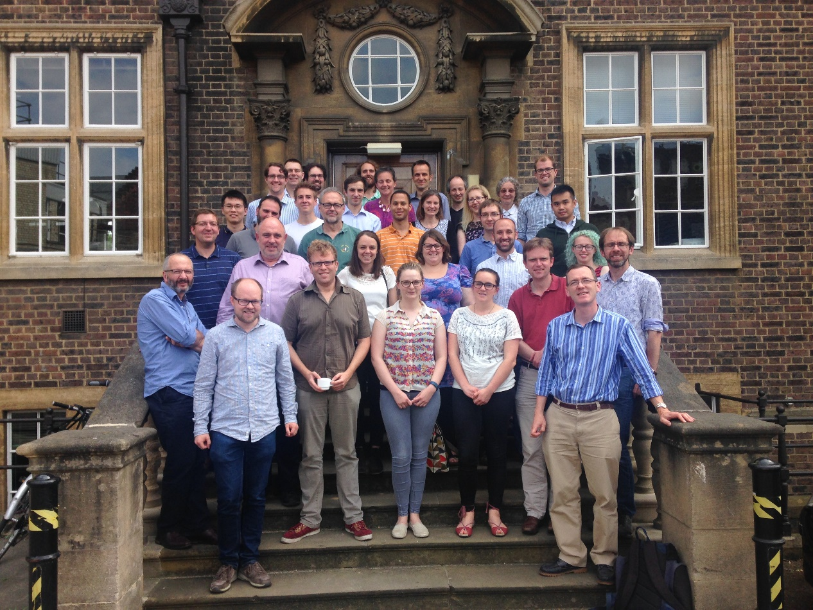
CoMorph-A Scheme
New Met Office scheme developed by Mike Whitall and others within ParaCon, a joint Met Office / UK universities consortium
Competitive with operational UM scheme, but not yet replaced it

Slide 31
CoMorph-A Scheme
Key features include:
  Initiated at any level, proportional to buoyant instability
  No distinction between shallow, deep and mid-level
  Entrainment rate depends on the turbulent mixing-length in the source layer, and on precipitation in the previous timestep (i.e., simple memory effect)
  Separate consideration of cloud-mean and cloud-core properties in detrainment calculations
  Implicit numerics prevent artificial on/off noise
Under development:
  CoMorph-B, 2 convection types, improved diurnal cycle
  CoMorph-C, adaptations for grey-zone including stochastic aspects

Slide 32

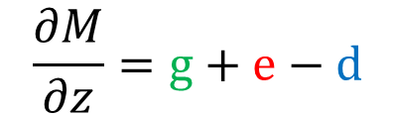



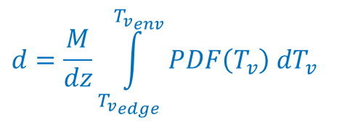
CoMorph Mass Flux Budget
$$\frac{∂M}{∂z}=g+e−d$$
Initiating mass-source
depends on local(dry or moist)
Entrainment rate
Radius proportional to turbulence length-scale, with enhancement from previous precip
Detrainment rate
Based on buoyancy sorting for an assumed-PDF of in-plume properties
$$g=\frac{1}{4}ρ\sqrt{−N^{2}}$$
$$e=M\frac{0.2}{R}$$
$$R_{init}=αh_{BL}$$
$$α=α_{0}+\frac{pr/q}{pr_{max}/q_{ref}⁡}{(α}_{max}−α_{0})$$
Mike Whitall
$$d=\frac{M}{dz}\int_{{T_{v}}_{edge}}^{{T_{v}}_{env}}{PDF\left(T_{v}\right) dT_{v}}$$

Slide 33
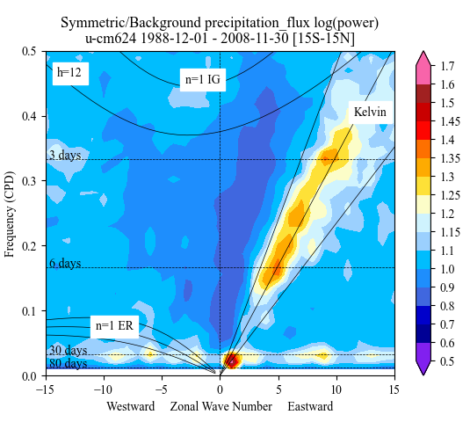
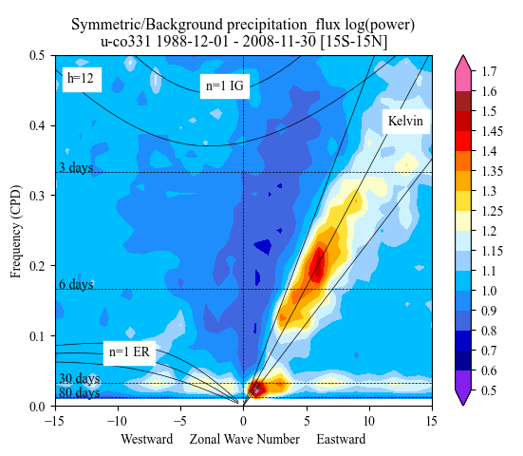
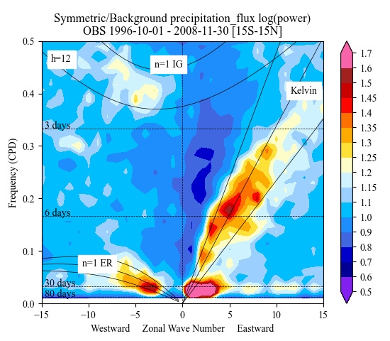
Tropical waves with CoMorph-A
Climate models typically underestimate tropical variability associated with equatorial waves
Waves depend critically on the coupling between convection and circulation
Adrian Lock
Ctrl (GAL9)
CoMA9
Observations
A CoMorph test
Slightly stronger MJO
Improved Kelvin wave strength
Tropical wavenumber-frequency spectrum for precipitation
MJO

Slide 34
Diurnal Cycle: a problem, but improving
Climate models have a long-standing problem with the diurnal cycle of convection over land
Convection tends to peak at or near local noon in models but later in observations
Can be improved by revised trigger (Xie et al 2019), revised closure (Bechtold 2015) or revised entrainment rate (Stirling and Stratton 2012)

Slide 35
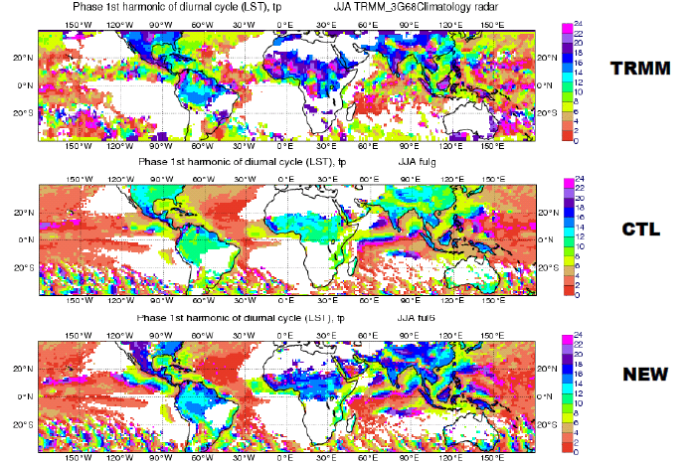
Diurnal Cycle: a problem, but improving
e.g. Bechtold closure approach distinguishes between PCAPE forcing in BL and free tropospheric and allows equilibriation at different rates

Slide 36
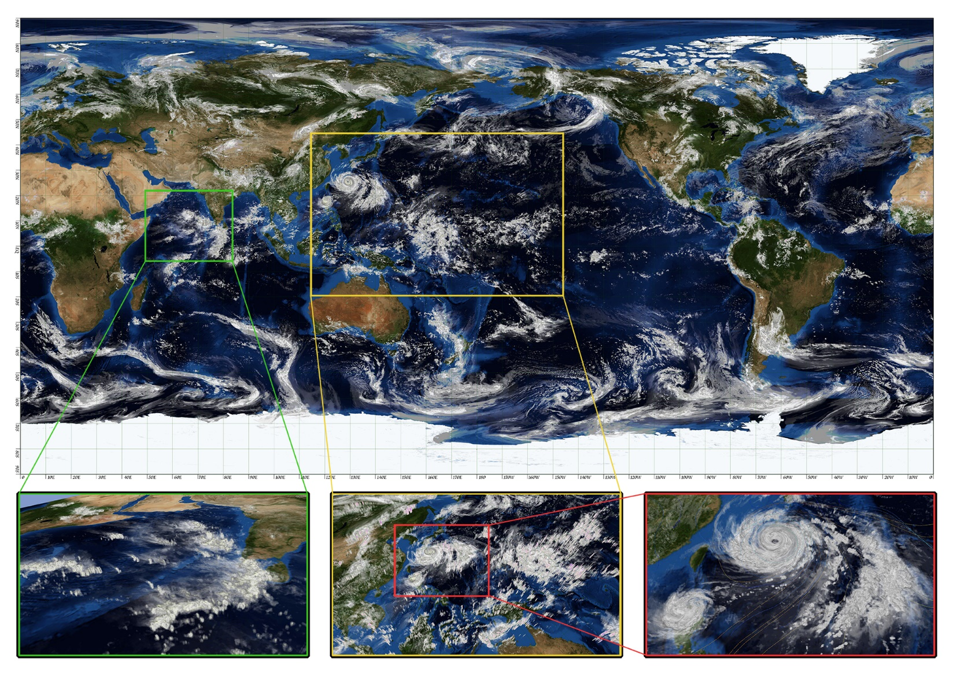
Modelling without convection parameterization
48h global simulation
870m grid spacing
4.5h real time for 1h simulation
320TB data needing days to process
Miyamoto et al, 2013
Notes:
AFESP ambition is for 1 month global forecasts at 1km to be achievable in 10-15 years time

Slide 37
Current and future challenges
Global NWP is near grey zone resolutions ~10km
Regional NWP is at ~2-5km, deep into grey zone
Traditional assumptions for parameterization break down
But explicit convection is not well resolved
Scheme-off and scheme-on are both problematic

Slide 38
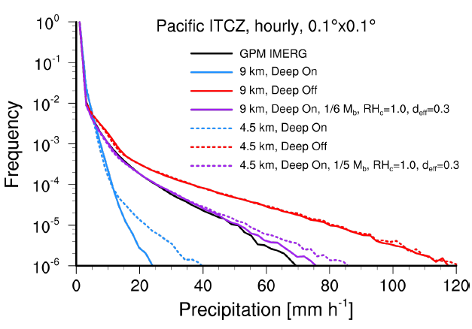
Retain modified parameterization
Example from ECMWF
Convection scheme ON or OFF problematic at km scales
Goldilocks solution with it partially active
Various km scale studies using damped convection schemes but typically as ad hoc function of Δx
Plot courtesy Becker, 2022, WGNE workshop on systematic errors
Notes:
Illustrate problems with an all-parameterized or all not-parameterized approach
Scheme off is better for mesoscale organization and (usually) diurnal cycle. But often generates excessive precip locally and overall

Slide 39
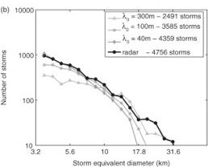
Higher resolution not a panacea
UM at 200m
Too many small, fragmented clouds
Storm numbers and sizes sensitive to turbulent mixing length
Cannot just be tuned
Hanley et al, 2015

Slide 40
Summary I
Convection is a critical component of the (tropical) climate system
Climate models depend on parameterizations to represent convection
This is a major challenge due to the range of scales and tight interactions with dynamics and other parameterizations
The mass flux approach is the most common method
Performance very sensitive to choices for e.g. entrainment
Models have significant biases in the representation of tropical climate, and its variability

Slide 41
Summary II
Moving towards models of few km which can have an explicit representation of convection
Some improvements but weaknesses require development of parameterizations for the grey zone
Even at sub-km scales models have difficulties in representing convection (new programme ParaChute)
  e.g. boundary layer turbulence parameterization enters its own grey zone
The parameterization problem will never be “solved” in climate models but will continue to change its character

Slide 42
References I
Arakawa, A. and W. H. Schubert, 1974. Interaction of a Cumulus Cloud Ensemble with the Large-Scale Environment, Part I. J. Atmos. Sci., 31, 674-701
Bechtold, P., M. Kohler, T. Jung, F. Doblas-Reyes, M. Leutbecher, M. Rodwell, F. Vitart and G. Balsamo, 2008. Advances in simulating atmospheric variability with the ECMWF model: From synoptic to decadal timescales. Quart. J. Roy. Met. Soc., 134, 1337-1351.
Bechtold, P. 2015. Convection in global numerical weather prediction. Chp. 15 of Parameterization of Atmosphere Convection, Plant, R. S and Yano, J.-I. (eds.)
Boing, S. J, A. P. Siebesma, J. D. Korpershoek and H. J. J. Jonker, 2012. Detrainment in deep convection. Geophys. Res. Lett., 39, 2012GL053735.
Bush, S.J., A. G. Turner, S. J. Woolnough, G. M. Martin and N. P. Klingaman, 2015. The effect of increased convective entrainment on Asian monsoon biases in the MetUM general circulation model. Quart. J. Roy. Met. Soc., 141, 311-326.
Derbyshire, S. H., I. Beau, P. Bechtold, J.-Y. Grandpeix, J.-M. Piriou, J.-L. Redelsperger and P. M. M. Soares, 2004. Sensitivity of moist convection to environmental humidity. Quart. J. Roy. Met. Soc., 130, 178-196.
Derbyshire, S. H., A. V. Maidens, S. F. Milton, R. A. Stratton and M. R. Willett, 2011. Adaptive detrainment in a convective parameterization. Quart. J. Roy. Met. Soc.,137, 1856-1871.

Slide 43
References II
Gu, J.-F., R. S. Plant, C. E. Holloway, T. R. Jones, A. Stirling, P. A. Clark, S. J. Woolnough, and T. L. Webb. Evaluation of the bulk mass flux formulation using large eddy simulations. J. Atmos. Sci., 77, 2115-2137.
Hanley, K. E., R. S. Plant, T. H. M. Stein, R. J. Hogan, H. W. Lean, C. Halliwell, and P. A. Clark, 2015. Mixing length controls on high resolution simulations of convective storms. Quart. J. Roy. Met. Soc., 141, 272-284.
Klingaman, N.P. and S. J. Woolnough, 2014. Using a case-study approach to improve the Madden–Julian oscillation in the Hadley Centre model. Quart. J. Roy. Met. Soc., 140, 2491-2505.
Knight, C. G., S. H. E. Knight, N. Massey, T. Aina, C. Christensen, D. J. Frame, J. A. Kettleborough, A. Martin, S. Pascoe, B. Sanderson, D. A. Stainforth, and M. R. Allen, 2007. Association of parameter, software, and hardware variation with large-scale behavior across 57,000 climate models. PNAS 104, 12259-12264.
Kuo, H.-L., 1974. Further studies of the parameterization of the influence of cumulus convection on large-scale flow. J. Atmos. Sci., 31, 1232-1240.
Mapes, B. E., 1997. Equilibrium vs activation controls of large-scale variations of tropical deep convection. In: The Physics and Parameterization of Moist Convection, Smith, R. K. (ed.)

Slide 44
References III
Mapes, B. E., 2000. Convective inhibition, subgrid-scale triggering energy, and stratiform instability in a toy tropical wave model. J. Atmos. Sci., 57, 1515-1535.
Miyamoto, Y., Y. Kajikawa, R. Yoshida, T. Yamaura, H. Yashiro and H. Tomita, 2013. Deep moist atmospheric convection in a subkilometer global simulation, Geophys. Res. Lett., 40, 4922-4926.
Peatman, S. C., J. Methven, and S. J. Woolnough, 2018. Isolating the Effects of Moisture Entrainment on Convectively Coupled Equatorial Waves in an Aquaplanet GCM. J. Atmos. Sci., 75, 3139–3157.
Plant, R. S. 2010 A review of the theoretical basis for bulk mass flux convective parameterization. Atmos. Chem. Phys., 10, 3529-3544.
Stirling, A. and R. A. Stratton, 2012. Entrainment processes in the diurnal cycle of deep convection over land. Quart. J. Roy. Met. Soc., 138, 1135-1149.
Talib, J., S. J. Woolnough, N. P. Klingaman, and C. E. Holloway, 2018. The Role of the Cloud Radiative Effect in the Sensitivity of the Intertropical Convergence Zone to Convective Mixing. J. Climate, 31, 6821–6838.
Whitall, M., R. Stratton, M. Willett, S. Derbyshire, R. Wong and G. G. Rooney, 2022. Convection Schemes. Unified Model Documentation Paper 027

Slide 45
References IV
Xie, S., Y.-C. Wang, W. Lin, H.-Y. Ma, Q. Tang, S. Tang, X. Zheng, J.-C. Golaz, G. J. Zhang and M. Zhang, 2019. Improved Diurnal Cycle of Precipitation in E3SM with a Revised Convective Triggering Function. J. Adv. Model. Earth Syst, 2019MS001702.
J.-I. Yano and R. S. Plant, 2016. Generalized Convective Quasi-Equilibrium Principle. Dyn. Atmos. Ocean., 73, 10-33.
Zhang, G. J., 2003. Convective quasi-equilibrium in the tropical western Pacific: Comparison with midlatitude continental environment. J. Geophys. Res., 108, 2003JD003520.

