Slide 1
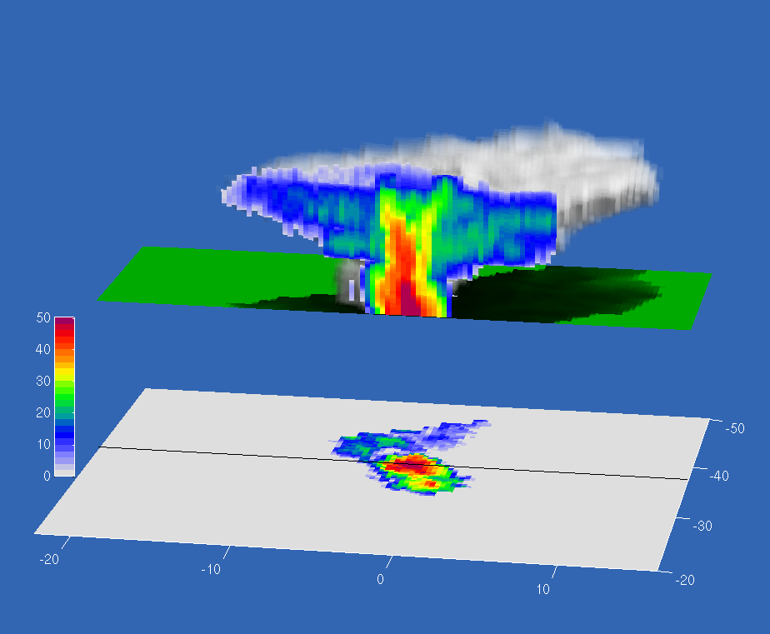

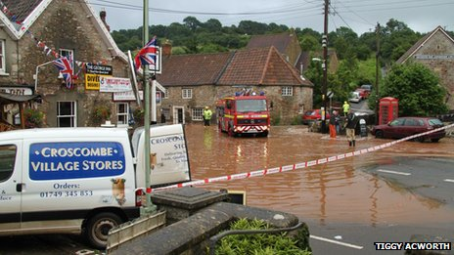
The three-dimensional structure of convective storms
Thorwald Stein (t.h.m.stein@reading.ac.uk)
Robin Hogan
John Nicol
Robert Plant
Peter Clark
Kirsty Hanley
Carol Halliwell
Humphrey Lean
(UK Met Office)

Slide 2
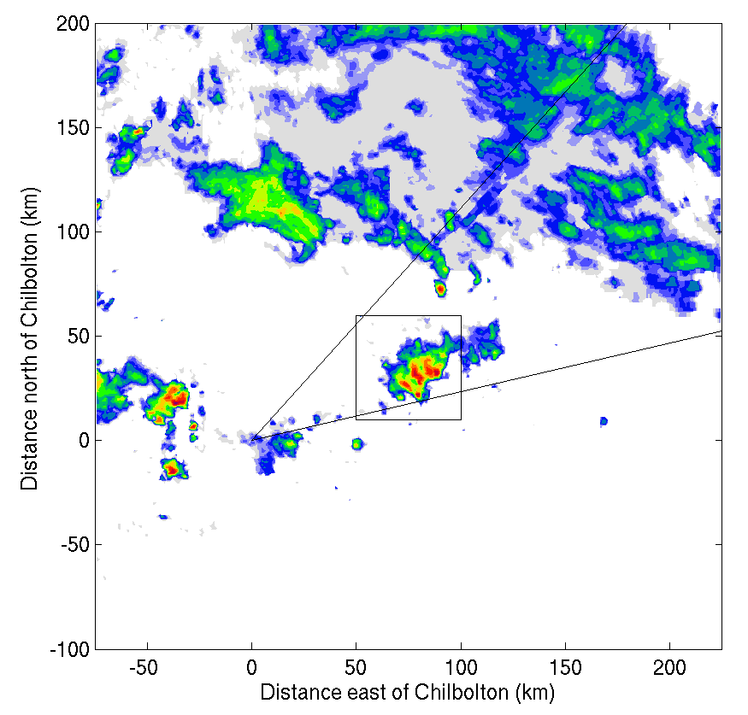
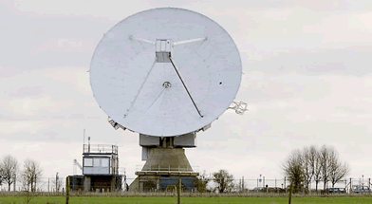
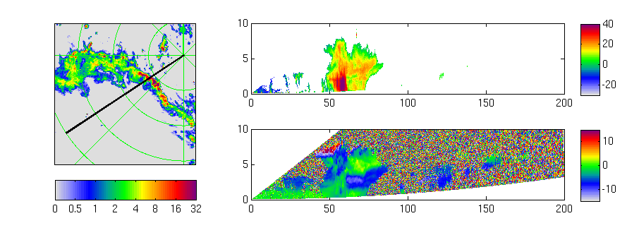
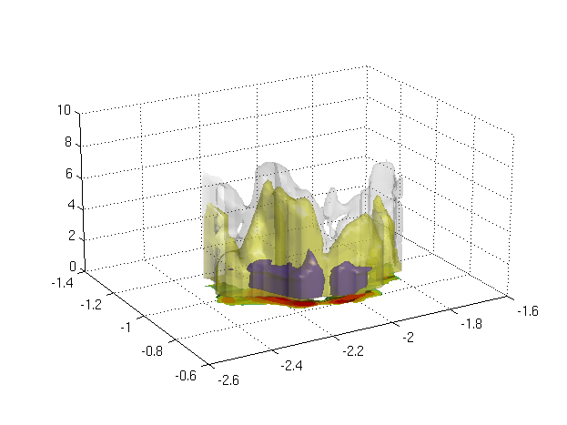
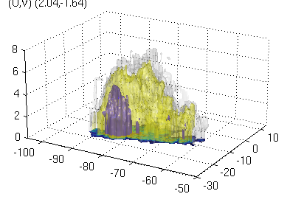
The DYMECS approach: beyond case studies
Track storms in real time and automatically scan Chilbolton radar
Derive properties of hundreds of storms on ~40 days:
Vertical velocity
3D structure
Rain & hail
Ice water content
TKE & dissipation rate
NIMROD radar network rainfall
Evaluate these properties in model varying:
Resolution
Microphysics scheme
Sub-grid turbulence parametrization

Slide 3
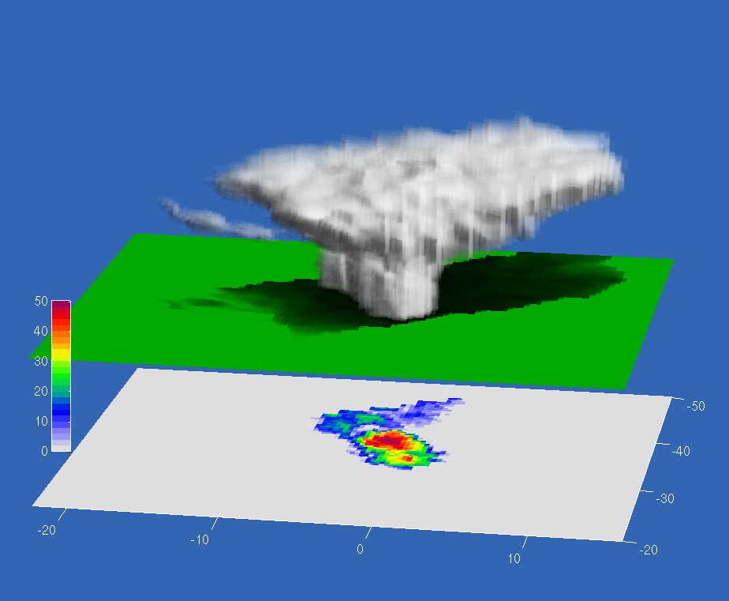
Storm structure from radar
40 dBZ
Radar reflectivity (dBZ)
20 dBZ
0 dBZ
Distance north (km)
Distance east (km)

Slide 4
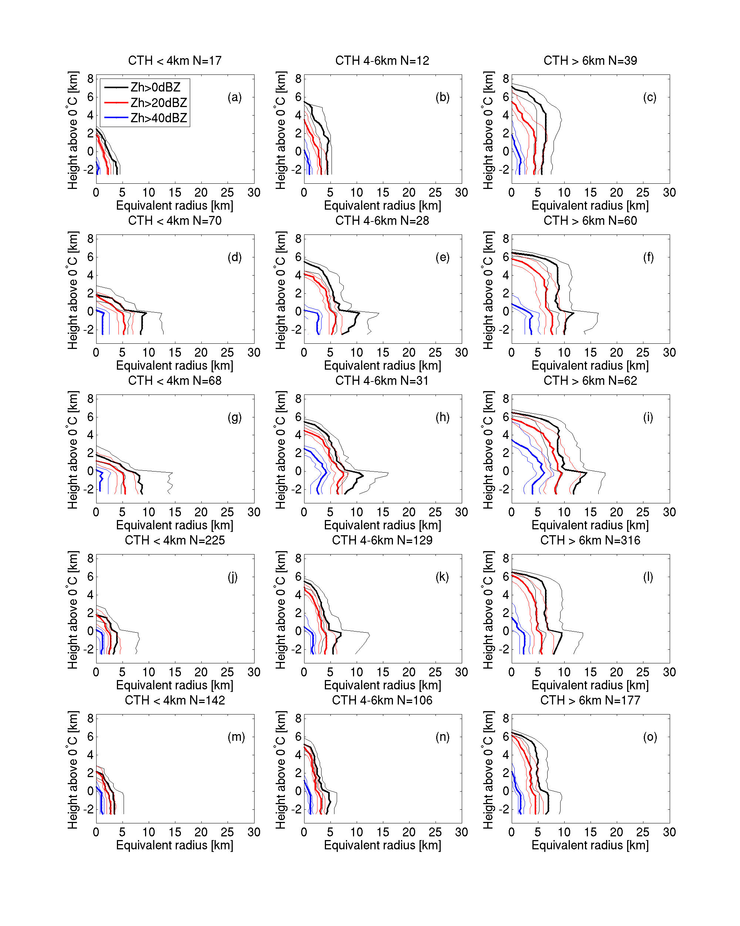
Median storm diameter with height
Observations
UKV 1500m
200m
Drizzle from nowhere?
“Shallow”
Lack of anvils?
“Deep”

Slide 5
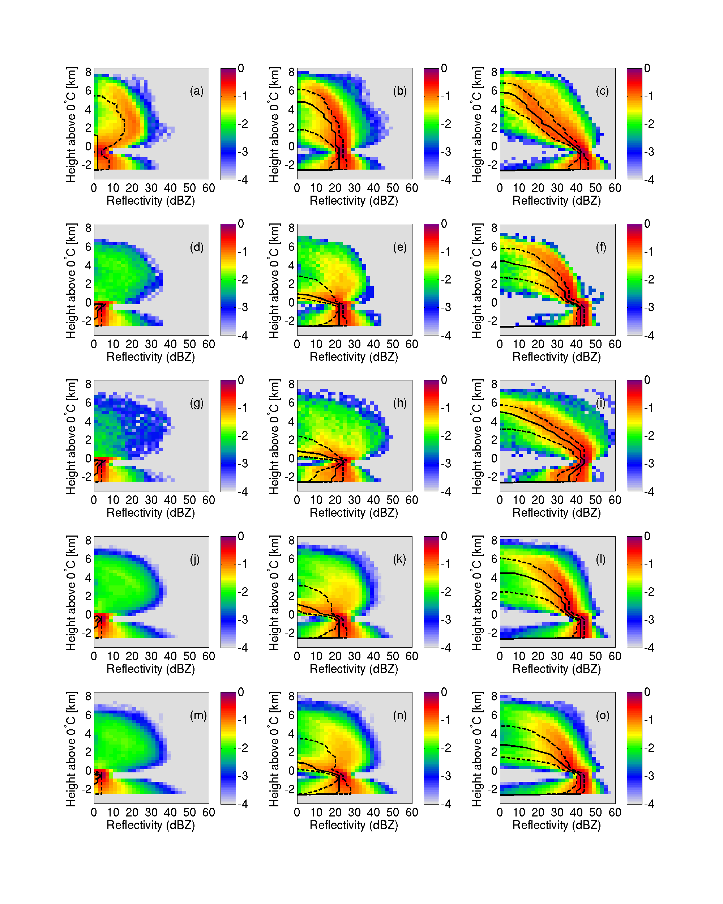
Vertical profiles of reflectivity
Conditioned on average
reflectivity at 200-1000m
below 0ºC.
Reflectivity distributions for
profiles with this
mean Z 40-45 dBZ are shown.
1.5-km
1.5-km + graupel
Model:
High rainfall rate from shallow storms.
Or ice cloud dBZ<0
200-m
500-m
Observations

Slide 6
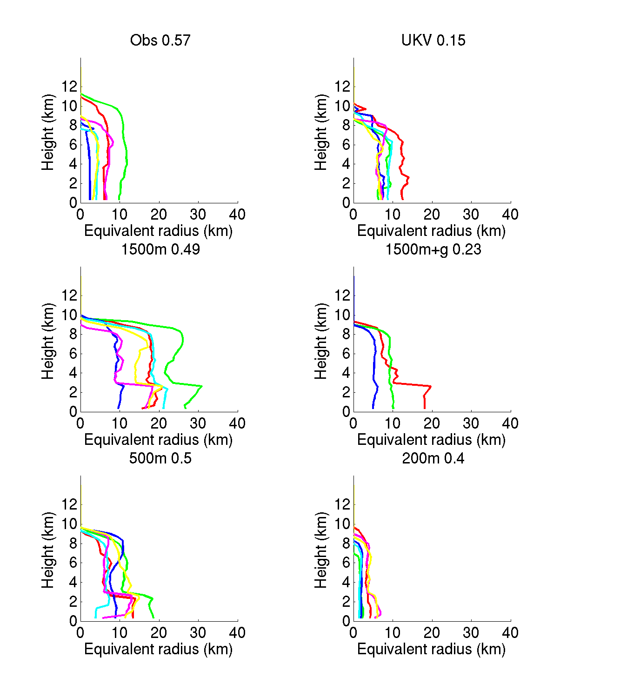
Missing anvils?
z
Define anvil as cloud above 6km with diameter larger than storm diameter at 3km.
More than 40% of storms above 6km have anvil (model and observations).
6
3
T=0ºC
R
Observations
UKV 1500m
200m
A selection of individual profiles shows
anvil factors will be small (close to 1)

Slide 7
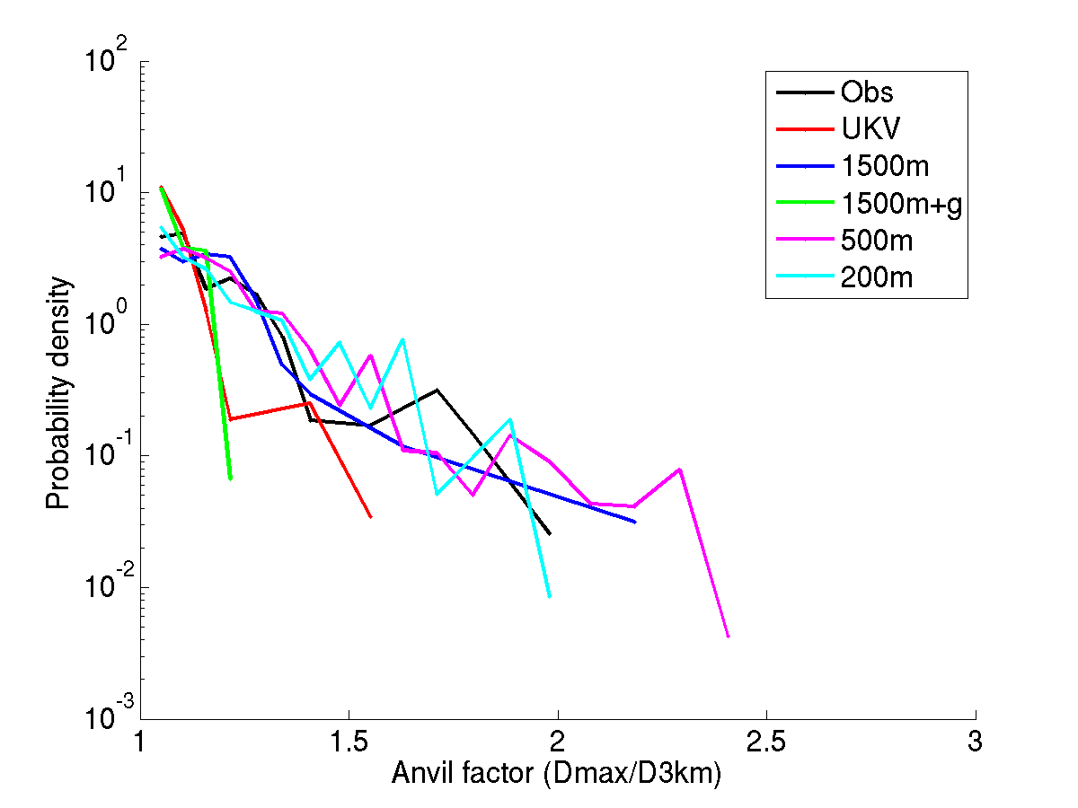
Missing anvils?
z
Define anvil as cloud above 6km with diameter larger than storm diameter at 3km.
Dmax
6
3
T=0ºC
PDF of anvil factor
Dmax/D3km
R

Slide 8
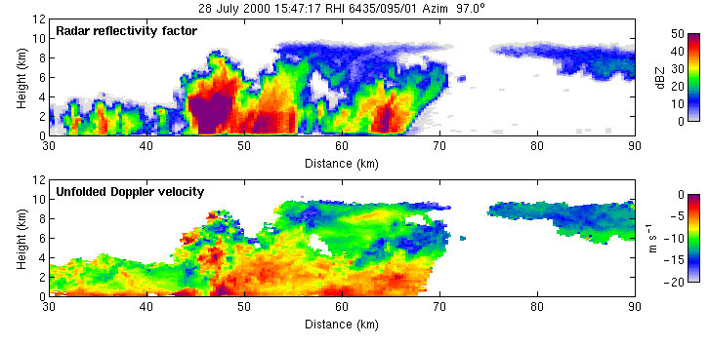
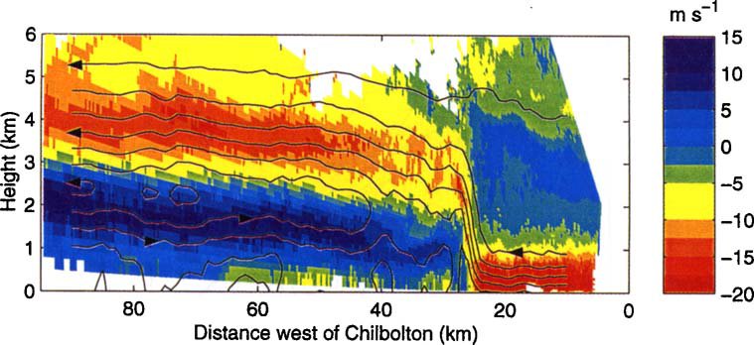
Updraft retrieval
Hogan et al. (2008)
  Track features in radial velocity from scan to scan
Chapman & Browning (1998)
  In quasi-2D features (e.g. squall lines) can assume continuity to estimate vertical velocity

