Slide 1

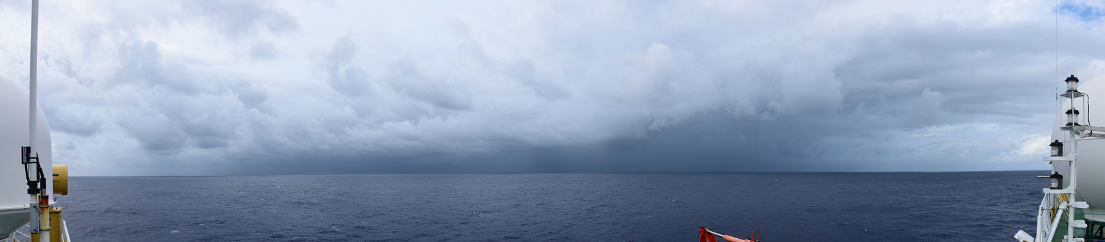
A climatology of tropical wind shear produced by clustering wind profiles from a climate model
Mark Muetzelfeldt
Supervisors: Robert Plant, Peter Clark, Steven Woolnough, Alison Stirling (Met Office CASE supervisor)
Taken by Oliver Sievers (DWD) over tropical Atlantic on the RV Polarstern

Slide 2
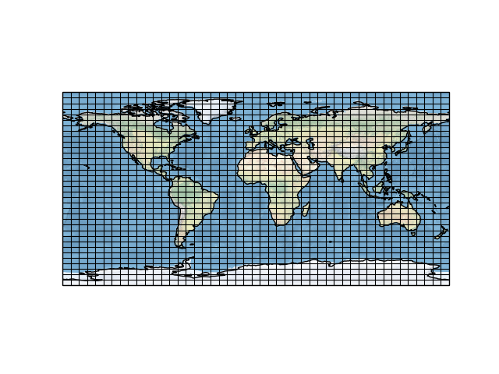
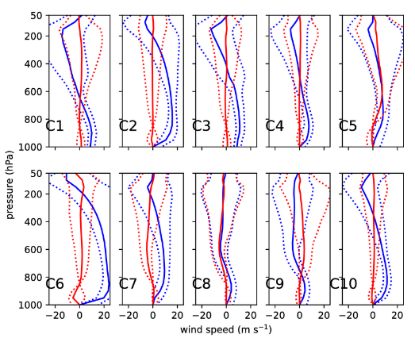
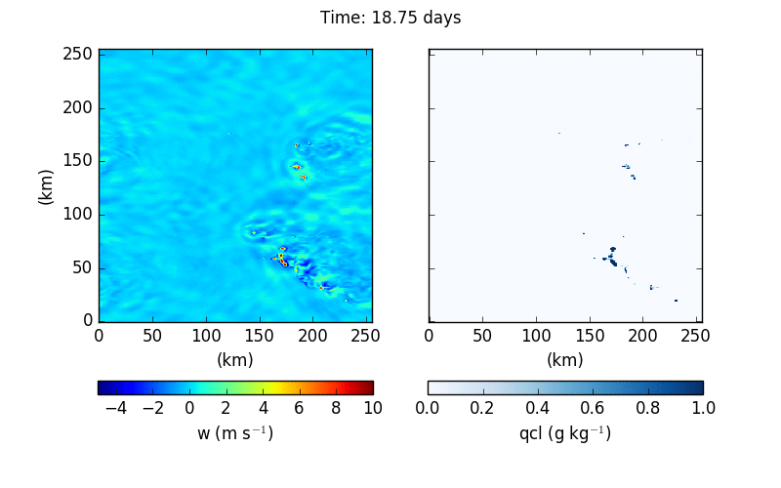
GCM
Representative Wind Profiles (RWPs)
Modifications to convective parametrization scheme
Cloud lifetime
Entrainment rate
Cloud statistics
High-resolution simulations

Slide 3
Motivation
Shear is important factor in the formation of Mesoscale Convective Systems (MCSs) , including squall lines
  (Rotunno et al. 1988, Houze 2004)
Shear often seen in case studies of squall lines and MCSs
Understanding where shear conditions are prevalent can lead to a better understanding of where organization of convection, through MCSs, is likely
Precipitation from MCSs forms an important part of the total precipitation in many regions
Extremes in precipitation are often due to MCSs
Effects of MCSs not well represented in climate model convection parametrization schemes
  Attempts to do so: Donner 1993, Gray 2000

Slide 4
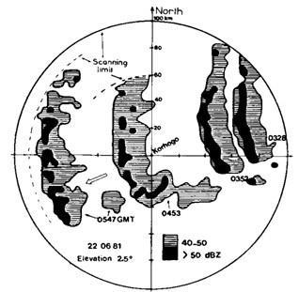
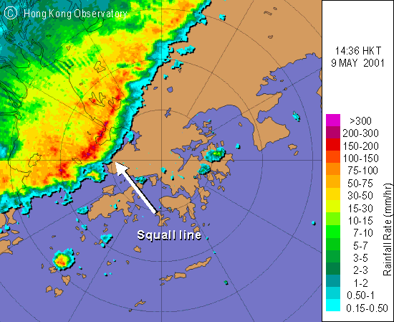
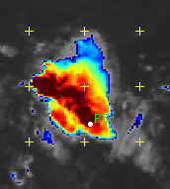
MCSs
Defined as being a contiguous area of precipitation, with length of 100 km or more in one direction
Occur over the tropics (and mid-latitudes)
Occur over both land and sea
More frequent at sunrise over oceans, sunset
over continental land (Mohr and Zipser 1996)
Low-level shear important for formation of squall lines
  LeMone et al. 1998
  Rotunno et al. 1988, Thorpe et al. 1982
  E.g. Interaction of LLS and cold pools
Mid-level shear of secondary importance
  Shear-parallel lines (LeMone et al. 1998)

Slide 5
Model setup
GCM
UM 10.9 GA7.0 science configuration
N96 resolution (~200 km at equator E-W)
5 year simulation: Sep 1988 – Aug 1993
u, v, CAPE output every 6 hours
u, v output on 20 pressure levels:
  1000 – 50 hPa in steps of 50 hPa

Slide 6
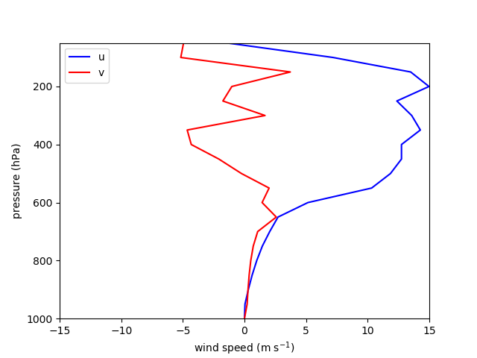
Parameter space
One profile

Slide 7
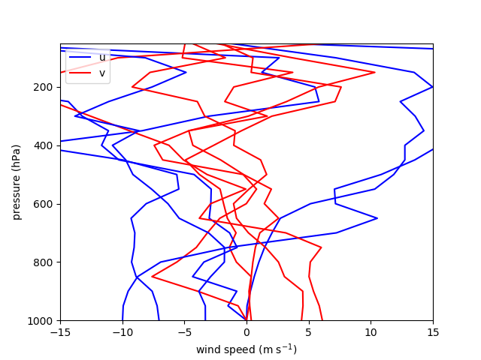
Parameter space
One profile, 5

Slide 8
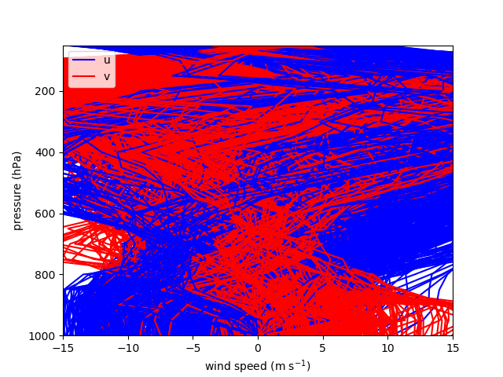
Parameter space
One profile, 5, 54 million (with 1000 shown)

Slide 9
Need for pre-processing
Cannot dive in and cluster the profiles: there are differences between them that are not so important (relative rotation) and features in them which are not of interest (high-level jets at higher lats)
Vertical resolution reduction (85 levels to 20)
Height restriction (1000 – 50 hPa, vertical resolution of 50 hPa)
Restriction to tropics (23N – 23S)
Filter based on:
  CAPE: > 100 J kg-1
  Max. Shear: In top 25 % of profiles
Favour the lower troposphere (below 500 hPa), as shear more important here
  But keep information from higher
Rotate all profiles so that wind vectors at 850 hPa are aligned

Slide 10
Clustering procedure outline
GCM output
u, v profiles
Filtering
Normalizing
PCA
Clustering
RWPs
CAPE
Reducing the number of profiles to analyse
Decide what differences between profiles are important
Reduce dimensions of problem from 40 to 7
Group like profiles together

Slide 11

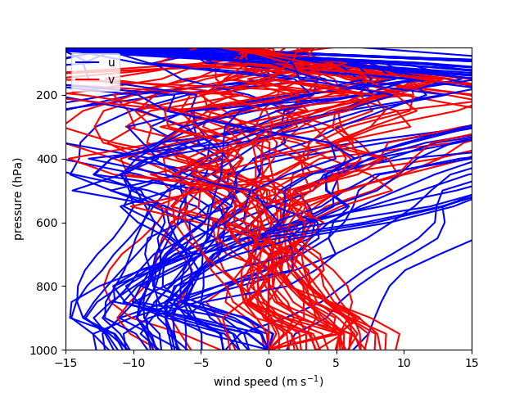
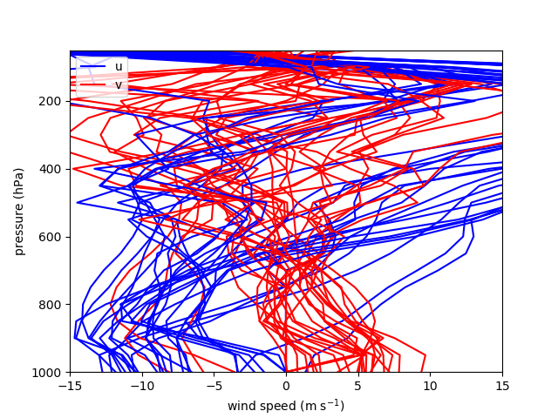
GCM output
u, v profiles
Filtering
Normalizing
PCA
Clustering
RWPs
CAPE
CAPE > 100 J kg⁻¹ (i.e. where there is likely to be convection)
  This filters out 95% of all profiles
Max shear for the profile in top 25% of profiles
Filters are independent (order unimportant)
CAPE and Max
shear
CAPE

Slide 12
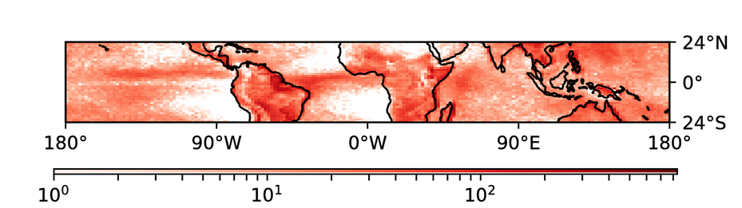
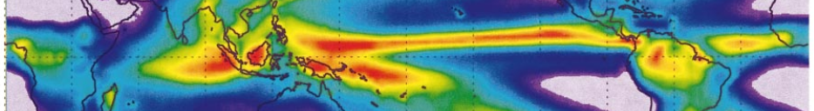
GCM output
u, v profiles
Filtering
Normalizing
PCA
Clustering
RWPs
CAPE
GPCP v2
Adler et al. 2003

Slide 13
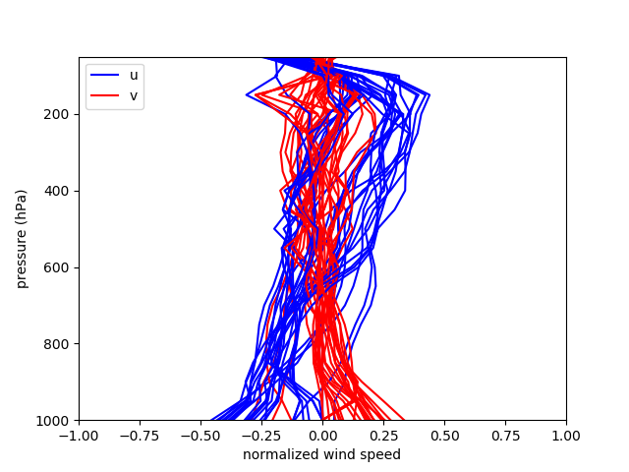
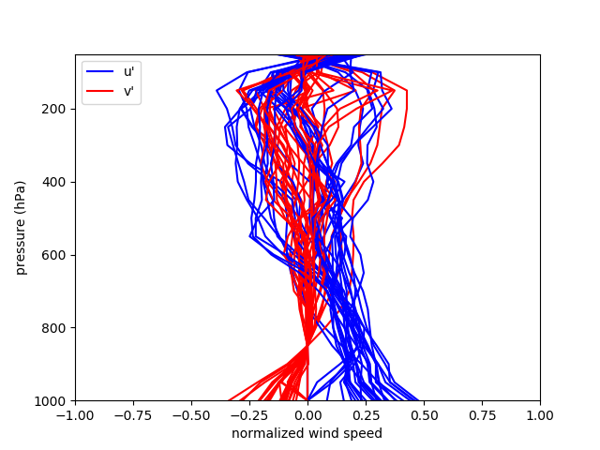

GCM output
u, v profiles
Filtering
Normalizing
PCA
Clustering
RWPs
CAPE
Magnitude: maximum magnitude ($√(u^{2}+v^{2})$) at each height level
Magnitude above 500 hPa decreased by factor of 4: favours lower troposphere
Rotation: wind vector at 850 hPa are aligned (in u’ direction)
Mag.
Rot.

Slide 14
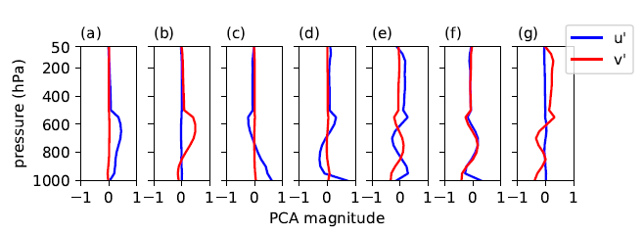
GCM output
u, v profiles
Filtering
Normalizing
PCA
Clustering
RWPs
CAPE
Number of components kept explain over 90% of the variance
Note reduction of PCs above 500 hPa (pressure above which weighting is decreased)

Slide 15
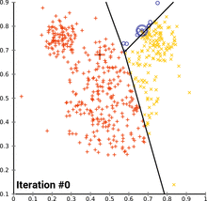
GCM output
u, v profiles
Filtering
Normalizing
PCA
Clustering
RWPs
CAPE
K-means clustering

Slide 16
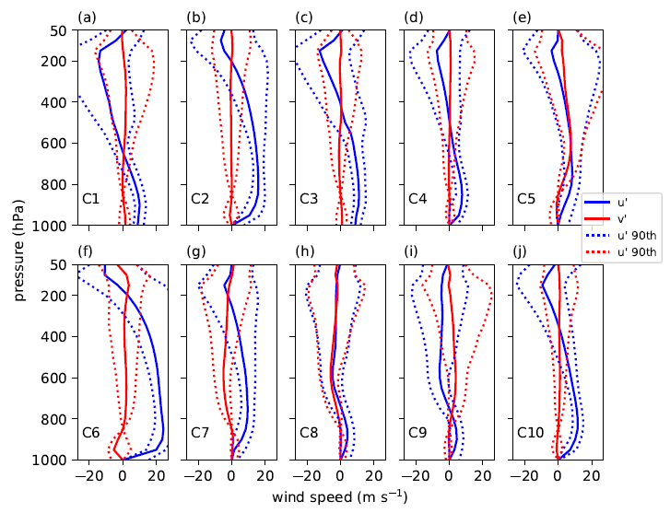
GCM output
u, v profiles
Filtering
Normalizing
PCA
Clustering
RWPs
CAPE
Normalized w.r.t. rotation but have proper magnitudes
Solid lines show median of each cluster
Dashed show 10th and 90th percentiles

Slide 17
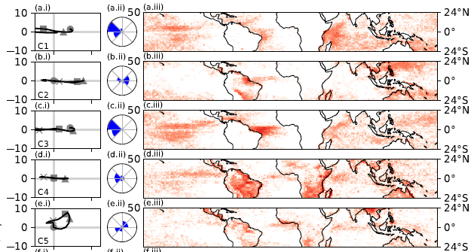



Geographical distribution

Slide 18
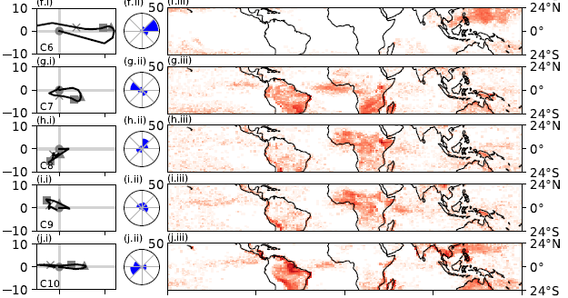
Geographical distribution

Slide 19
Geographical distribution
RWP | % Land | % Sea | # profiles
C1 | 9.2 | 90.8 | 14356
C2 | 53.7 | 46.3 | 15111
C3 | 6.4 | 93.6 | 15844
C4 | 75.3 | 24.7 | 29633
C5 | 70.4 | 29.6 | 11023
C6 | 14.2 | 85.8 | 5579
C7 | 74.5 | 25.5 | 16908
C8 | 76.2 | 23.8 | 11437
C9 | 75.6 | 24.4 | 11982
C10 | 81.3 | 18.7 | 27249

Slide 20
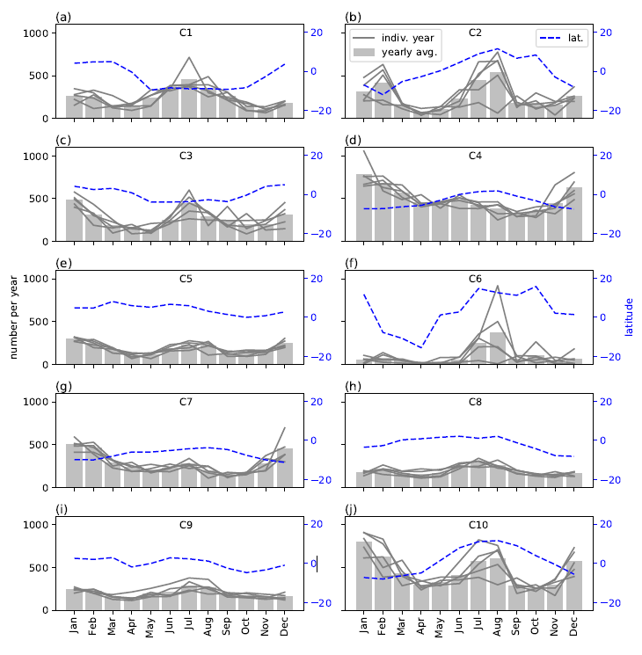
Temporal distribution

Slide 21
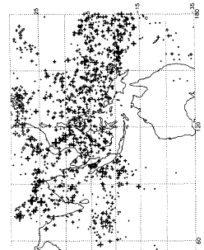
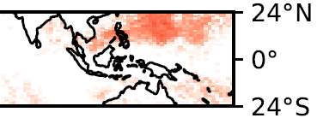
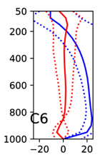
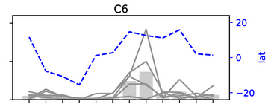

Comparison with sat. obs.
Sunrise pass, July 1993
Mohr and Zipser 1996

Slide 22
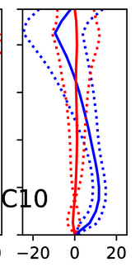
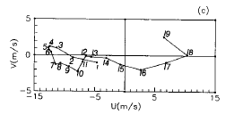
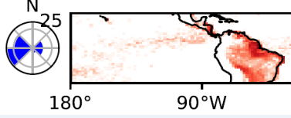
Comparison with obs. profiles
Cohen et al. 1995, Amazon
5: 800 hPa

Slide 23
Future Work
Use RWPs to drive high-resolution experiments
Gather statistics on how cloud field behaves for each RWP
Feed back into parametrization scheme
  Lifetime of cloud
  Entrainment rate
  Q1/Q2 (subgrid convective heating/moistening)
(Run GCM with modified parametrization scheme)
  Apply technique to higher resolution GCM
  Apply to reanalysis dataset
  Look at diurnal cycle
  Match wind profile to obs. (radiosondes? ADM-Aeolus?)

Slide 24
Conclusions
A new procedure for producing a climatology of shear (or any high-dimensional collection of variables) was presented
Applied to 5 year’s worth of data from a UM N96 simulation
Wind profiles pre-processed before applying PCA/K-Means clustering
  Filter: low CAPE/max. shear
  Normalize: w.r.t. magnitude and rotation, favouring lower troposphere
Resulting RWPs are spatially coherent, and patterns seen in temporal distributions
Possible to match up certain features to those seen in climatologies of MCSs, and RWPs with observed profiles from case studies of organization of convection
Gives some confidence that model is producing conditions associated with org in the right places

Slide 25
References
Rotunno, R., Klemp, J., and Weisman, M.: A theory for strong, long-lived squall lines, Journal of the Atmospheric Sciences, 45, 463–485, 1988.
Houze Jr, R. A.: Mesoscale convective systems, Reviews of Geophysics, 42, 2004.
Donner, L. J.: A cumulus parameterization including mass fluxes, vertical momentum dynamics, and mesoscale effects, Journal of the atmospheric sciences, 50, 889–906, 1993.
Gray, M.: Characteristics of numerically simulated mesoscale convective systems and their application to parameterization, Journal of the atmospheric sciences, 57, 3953–3970, 2000.
Mohr, K. I. and Zipser, E. J.: Mesoscale convective systems defined by their 85-GHz ice scattering signature: Size and intensity comparison over tropical oceans and continents, Monthly weather review, 124, 2417–2437, 1996.
LeMone, M. A., Zipser, E. 5 J., and Trier, S. B.: The role of environmental shear and thermodynamic conditions in determining the structure and evolution of mesoscale convective systems during TOGA COARE, Journal of the Atmospheric Sciences, 55, 3493–3518, 1998.
Thorpe, A., Miller, M., and Moncrieff, M.: Two-dimensional convection in non-constant shear: A model of mid-latitude squall lines, Quarterly Journal of The Royal Meteorological Society, 108, 739–762, 1982.
Cohen, J. C., Silva Dias, M. A., and Nobre, C. A.: Environmental conditions associated with Amazonian squall lines: A case study, Monthly Weather Review, 123, 3163–3174, 1995.

Slide 26
Extra - Previous climatology of shear work
E.g. Aiyyer and Thorncroft 2006: Climatology of vertical wind shear over the tropical Atlantic
  Interested in tropical cyclone formation
  Shear defined as difference in wind speed between 200 and 850 hPa
  Not enough detail to compare against
Houchi et al. 2010: Comparison of wind and wind shear climatologies derived from high-resolution radiosondes and the ECMWF model
  Compare ECMWF operational forecasts against radiosonde data
  Find shear reduced by 2.5-3 in ECMWF model
  Used to predict what ADM-Aeolus will see when operational (i.e. soon!)
Harder to find studies linking climatology of shear to MCSs

Slide 27
Extra - Sensitivity tests
Favour lower troposphere found to be important:
  Without this, analysis picks up jets at higher lats
Results qualitatively the same under:
  Changing CAPE thresh to 75, 125 J kg-1
  Changing shear percentile to 65, 85 %
  Changing favour factor to 3, 5 (applied to upper troposphere weighting)
Clustering not dependent on initial random seed
  Ran with 5 seeds, same 10 clusters picked out each time

Slide 28
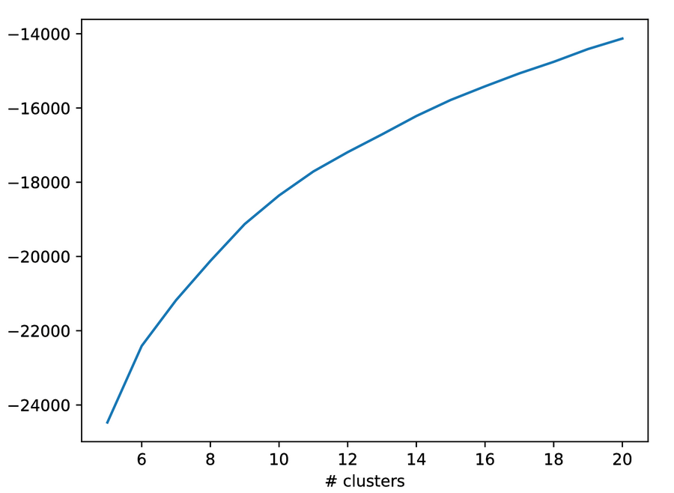
Extra – kmeans scores

Slide 29
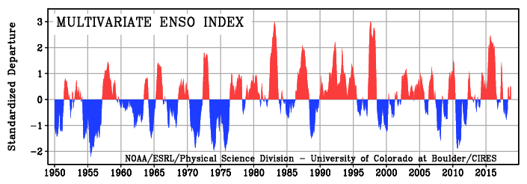
Extra – ENSO index

Slide 30
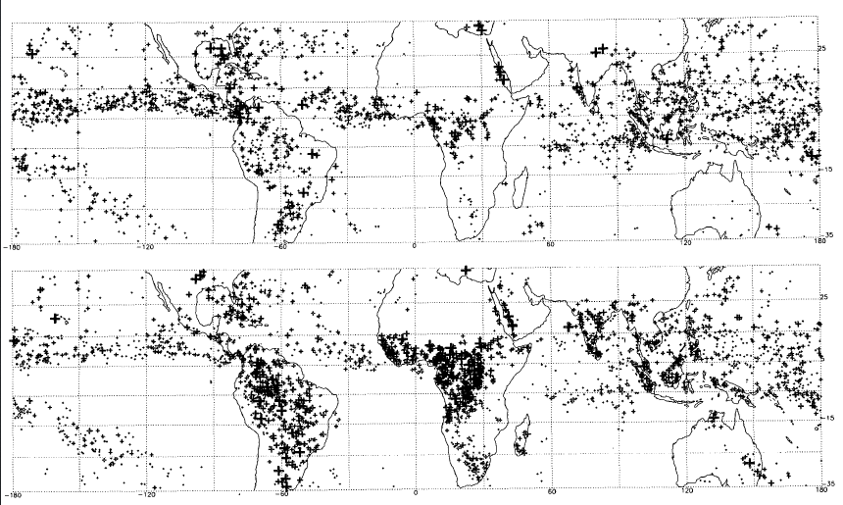
Extra - MCS distribution
Fig. 7, Mohr and Zipser 1996
Oct 1993
Sunrise
Sunset

