Slide 1
Capturing linear instability in two-fluid convection
Daniel Shipley, Peter Clark, Bob Plant, Hilary Weller
ParaCon Plenary, 13/12/2021

Slide 2
Overview
Recap of previous work on two-fluid Rayleigh-Bénard convection (RBC)
Linear stability problem for RBC
Comparison with fully nonlinear numerical results

Slide 3
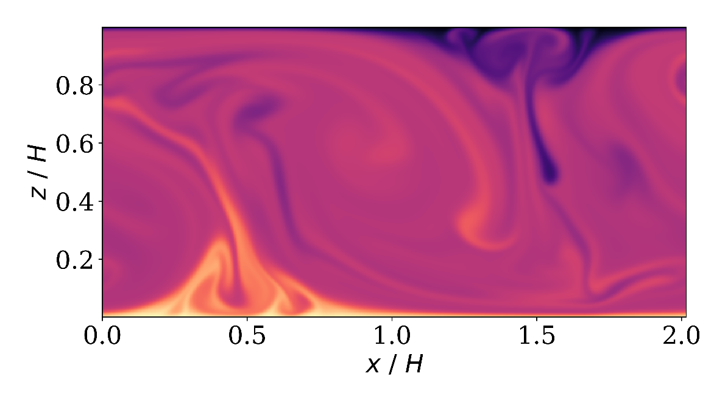
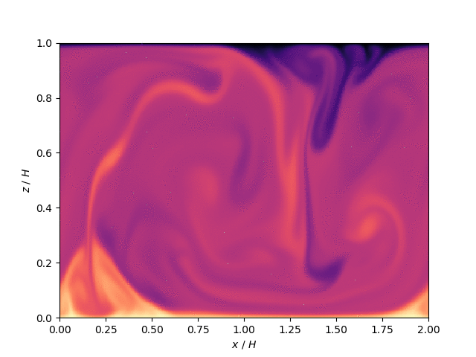




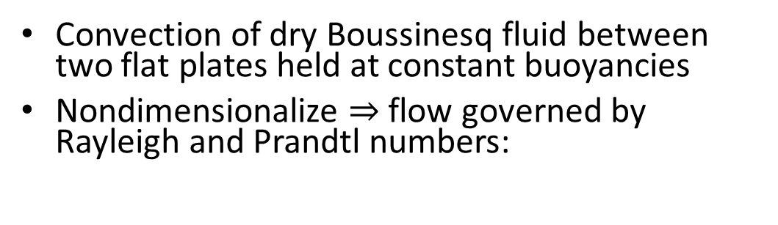



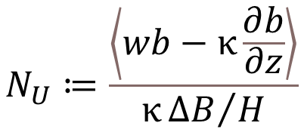
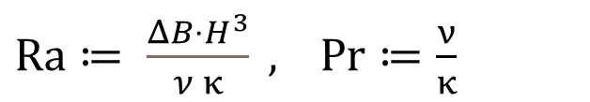





Rayleigh-Bénard convection (RBC)
$$b_{t}$$
Convection of dry Boussinesq fluid between two flat plates held at constant buoyancies
Nondimensionalize $⇒$ flow governed by Rayleigh and Prandtl numbers:
$$H$$
$$ν,κ$$
$Ra≔ \frac{ΔB⋅H^{3}}{ν κ} ,$ $Pr≔\frac{ν}{κ}$
$$b_{b}$$
Global response of the fluid (Pr) to applied forcing (Ra) is space-time averaged normalised heat flux:
$$N_{U}≔\frac{\left\langle wb−κ\frac{∂b}{∂z}\right\rangle }{κ{ΔB}/H}$$

Slide 4
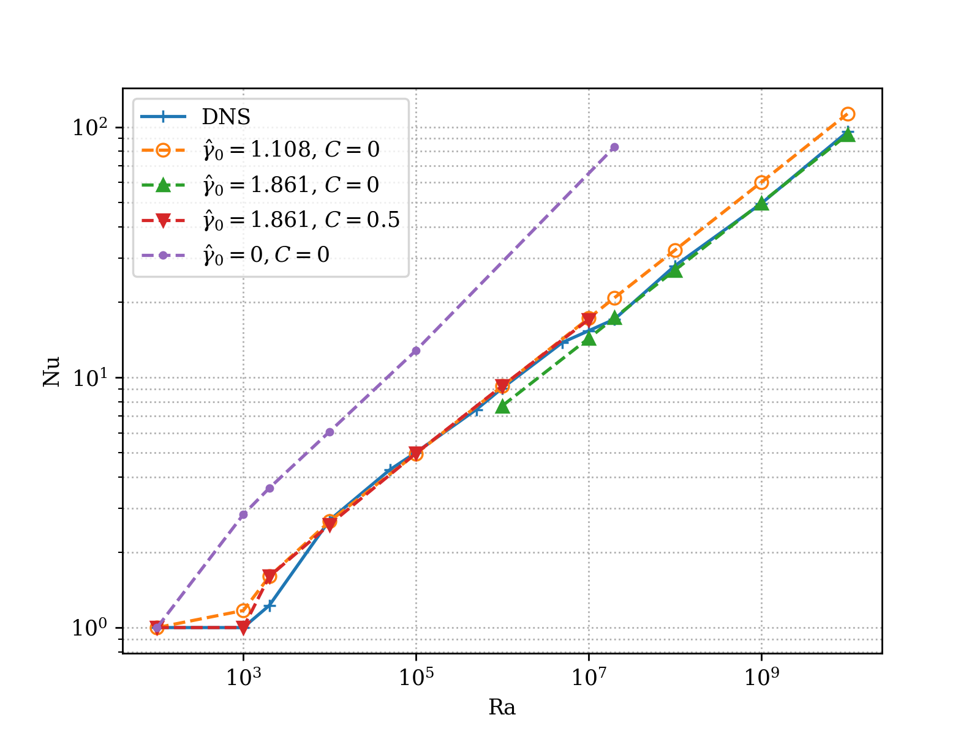
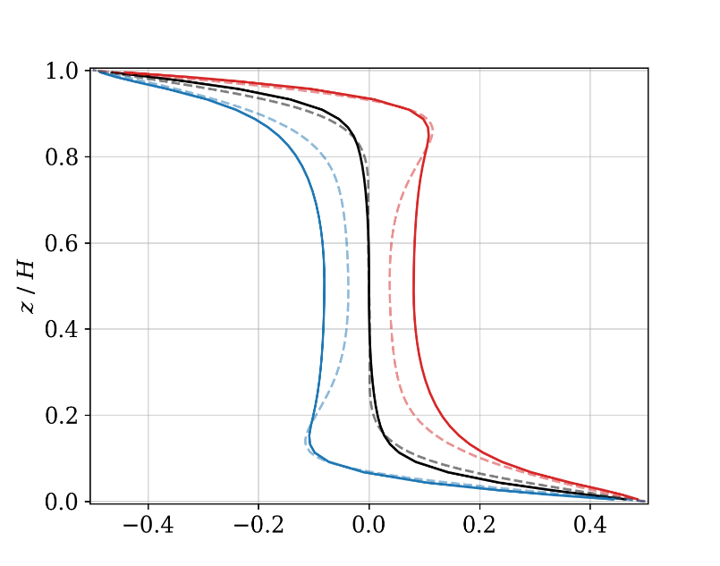
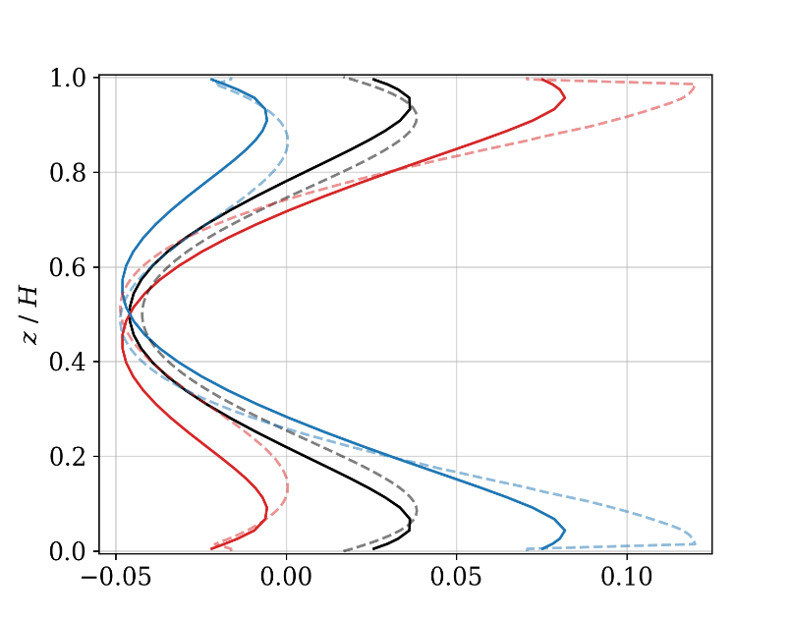
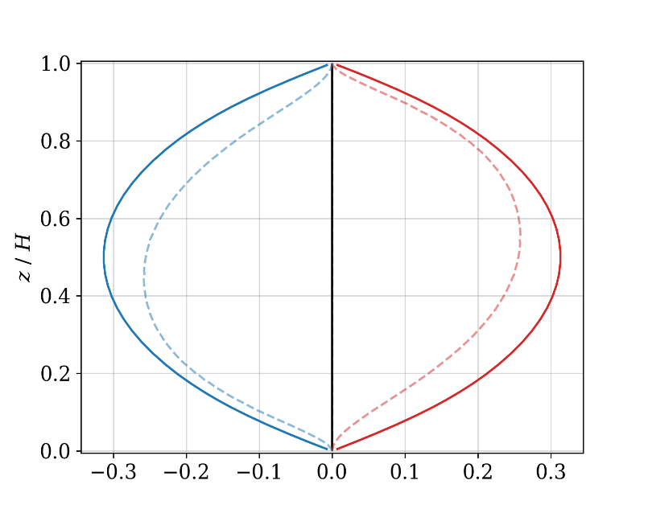
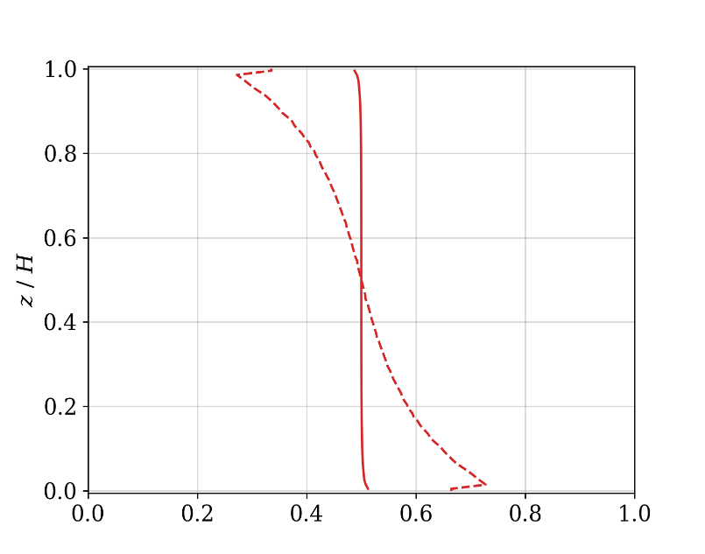
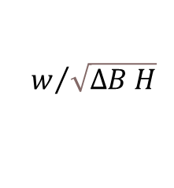
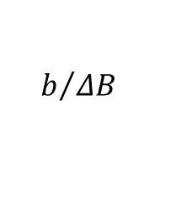
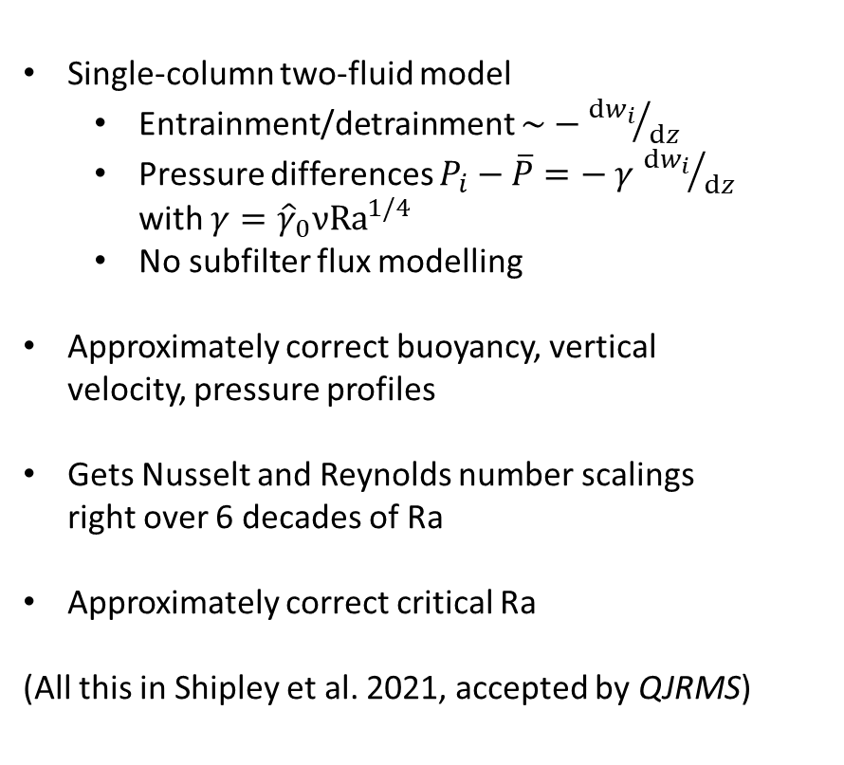
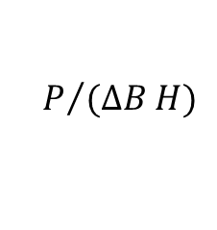

Two-fluid RBC recap
$$b/{ΔB}$$
$$P/{(ΔB H)}$$
Single-column two-fluid model
  Entrainment/detrainment $\sim −{dw_{i}}/{dz}$
  Pressure differences $P_{i}−\overline{P}=− γ$ ${dw_{i}}/{dz}$ with $γ={\hat{γ}}_{0}ν{Ra}^{1/4}$
  No subfilter flux modelling
Approximately correct buoyancy, vertical velocity, pressure profiles
Gets Nusselt and Reynolds number scalings right over 6 decades of Ra
Approximately correct critical Ra
(All this in Shipley et al. 2021, accepted by QJRMS)
$$w/{\sqrt{ΔB H}}$$
$$σ_{w>0}$$

Slide 5
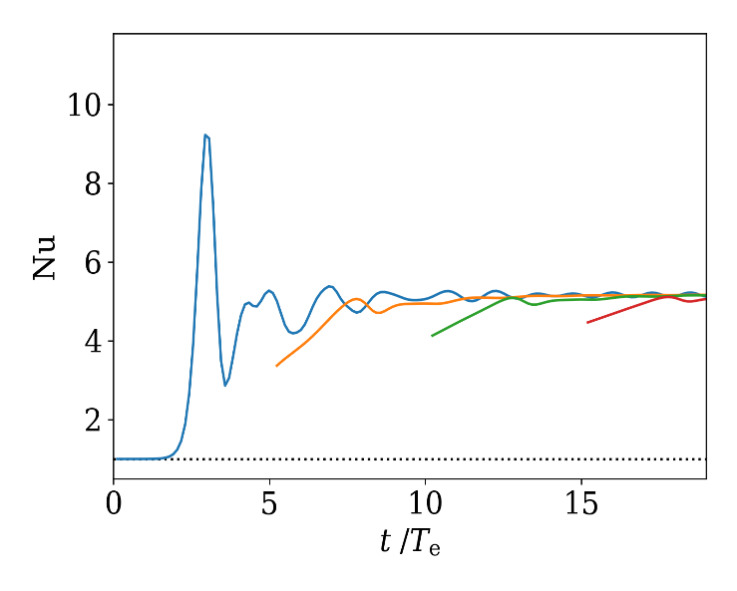
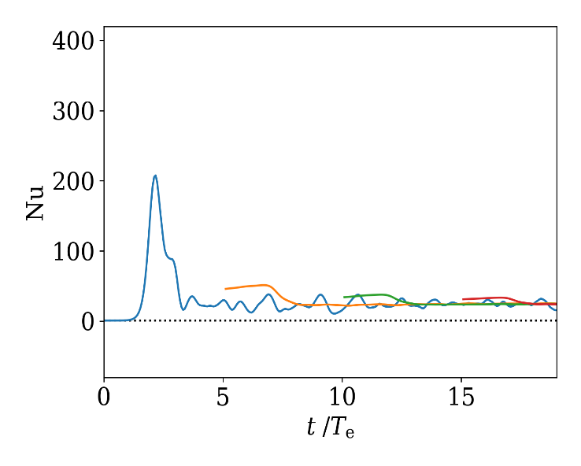
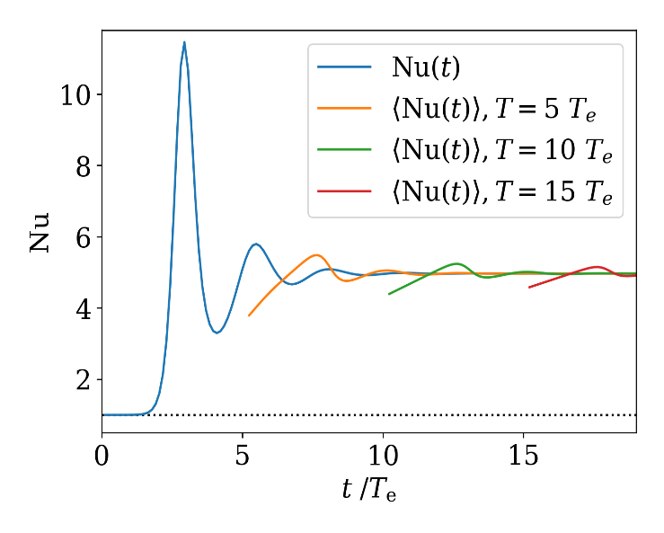
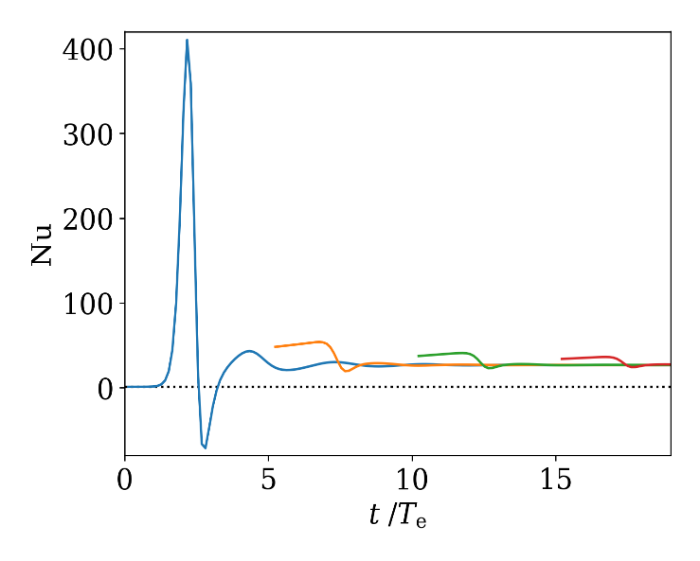


Two-fluid RBC: spin-up
$$Ra = {10}^{5}$$
$$Ra = {10}^{8}$$
Also noticed: spin-up seems approximately correct
Why?
DNS
Single-column

Slide 6

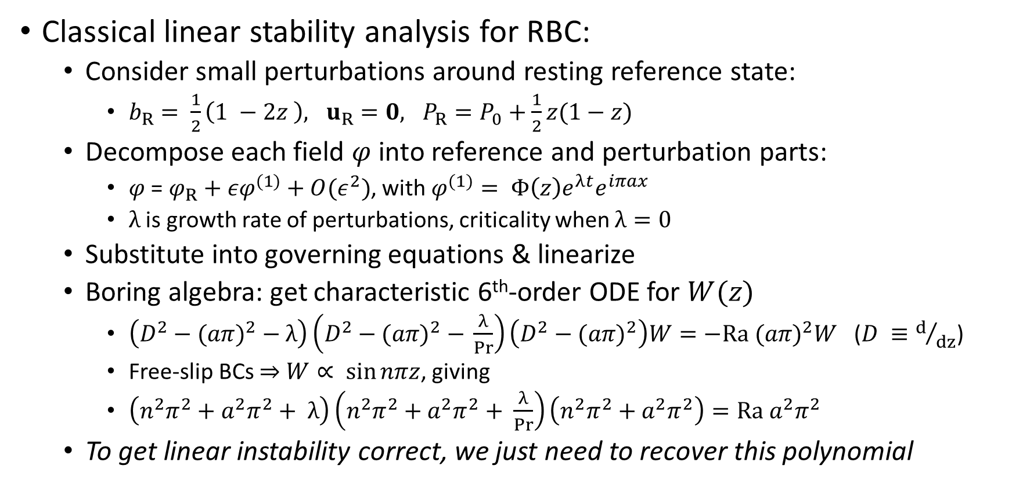


Linear stability in RBC
Classical linear stability analysis for RBC:
  Consider small perturbations around resting reference state:
    $b_{R}= \frac{1}{2}\left(1 −2z \right), u_{R}=0, P_{R}=P_{0}+\frac{1}{2}z(1−z)$
  Decompose each field $φ$ into reference and perturbation parts:
    $φ$ = $φ_{R}+{εφ}^{(1)}+O(ε^{2})$, with $φ^{(1)}= Φ\left(z\right)e^{λt}e^{iπax}$
    $λ$ is growth rate of perturbations, criticality when $λ=0$
  Substitute into governing equations & linearize
  Boring algebra: get characteristic 6th-order ODE for $W(z)$
    $\left(D^{2}−{(aπ)}^{2} − λ\right)\left(D^{2}−{(aπ)}^{2} − \frac{λ}{Pr}\right)\left(D^{2}−{(aπ)}^{2}\right)W=−Ra {(aπ)}^{2}W$ ($D ≡d/{dz}$)
    Free-slip BCs ⇒ $W∝ \sin{nπz}$, giving
    $\left(n^{2}π^{2}+a^{2}π^{2}+ λ\right)\left(n^{2}π^{2}+a^{2}π^{2}+ \frac{λ}{Pr}\right)\left(n^{2}π^{2}+a^{2}π^{2}\right)=Ra a^{2}π^{2}$
  To get linear instability correct, we just need to recover this polynomial
$$\left|Φ\right|$$
$$e^{iπax}$$
$$2/a$$

Slide 7

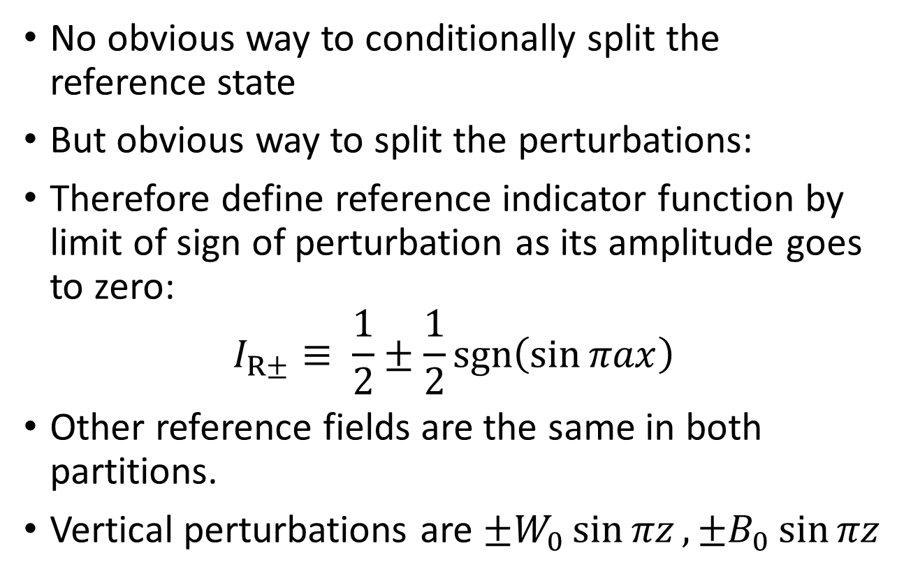
Linear stability in two-fluid RBC
No obvious way to conditionally split the reference state
But obvious way to split the perturbations:
Therefore define reference indicator function by limit of sign of perturbation as its amplitude goes to zero:
$$I_{R±}≡ \frac{1}{2}±\frac{1}{2}sgn\left(\sin{πax}\right)$$
Other reference fields are the same in both partitions.
Vertical perturbations are ${±W}_{0}\sin{πz}, {±B}_{0}\sin{πz}$
+ve
-ve
$$W_{0}$$

Slide 8
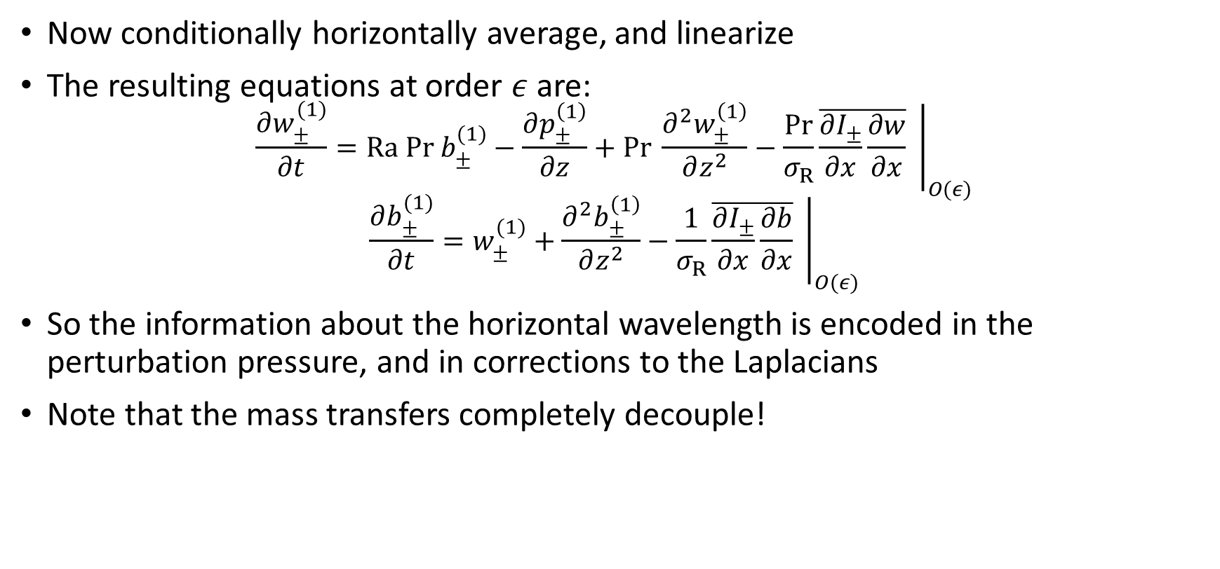
Linear stability in two-fluid RBC
Now conditionally horizontally average, and linearize
The resulting equations at order $ε$ are:
$$\frac{∂w_{±}^{(1)}}{∂t}=Ra Pr b_{±}^{(1)}−\frac{∂p_{±}^{\left(1\right)}}{∂z}+Pr \frac{∂^{2}w_{±}^{\left(1\right)}}{∂z^{2}}−\frac{Pr}{σ_{R}}{\left.\overline{\frac{∂I_{±}}{∂x}\frac{∂w}{∂x}} \right|}_{O(ε)}$$
$$\frac{∂b_{±}^{(1)}}{∂t}=w_{±}^{(1)}+\frac{∂^{2}b_{±}^{\left(1\right)}}{∂z^{2}}−\frac{1}{σ_{R}}{\left.\overline{\frac{∂I_{±}}{∂x}\frac{∂b}{∂x}} \right|}_{O(ε)}$$
So the information about the horizontal wavelength is encoded in the perturbation pressure, and in corrections to the Laplacians
Note that the mass transfers completely decouple!

Slide 9

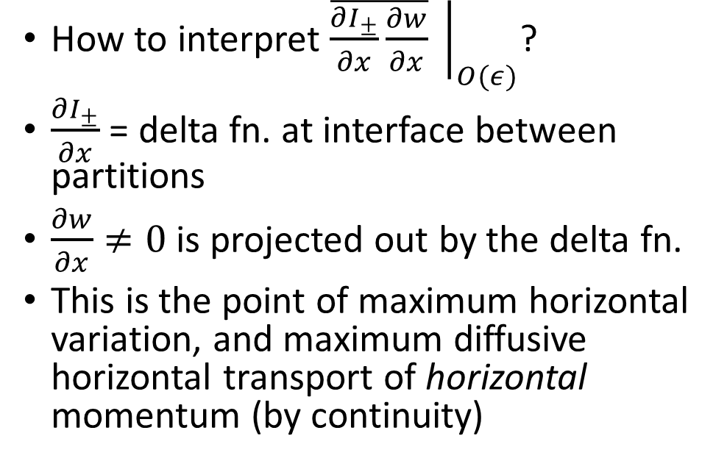


Linear stability in two-fluid RBC
How to interpret ${\left.\overline{\frac{∂I_{±}}{∂x}\frac{∂w}{∂x}} \right|}_{O(ε)}$?
$\frac{∂I_{±}}{∂x}$ = delta fn. at interface between partitions
$\frac{∂w}{∂x}≠0$ is projected out by the delta fn.
This is the point of maximum horizontal variation, and maximum diffusive horizontal transport of horizontal momentum (by continuity)
$$I_{+}=1$$
$$I_{+}=0$$
$$\frac{∂I_{+}}{∂x}$$

Slide 10
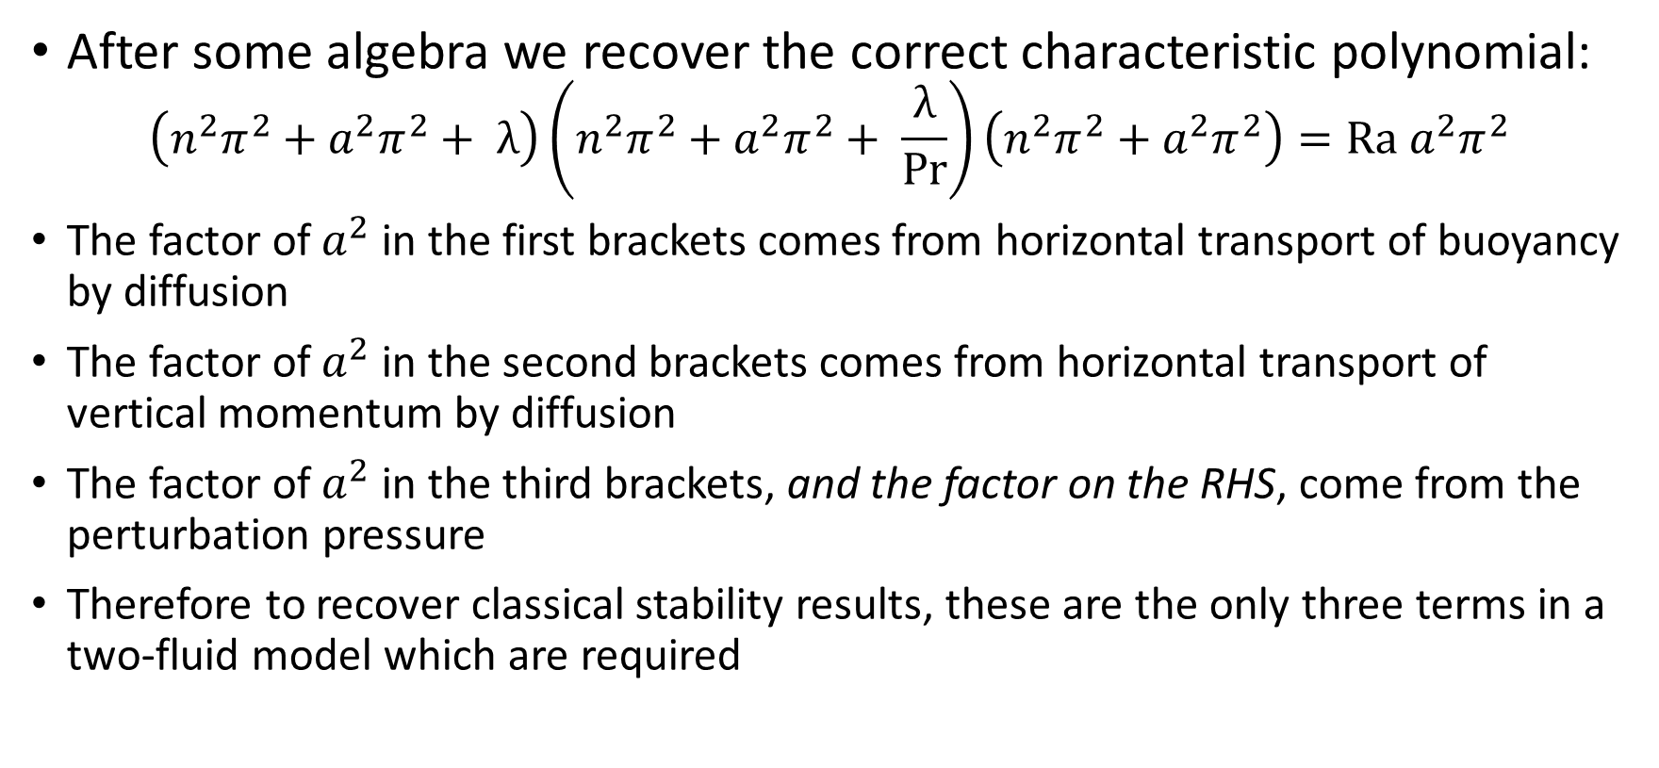
Linear instability in two-fluid RBC
After some algebra we recover the correct characteristic polynomial:
$$\left(n^{2}π^{2}+a^{2}π^{2}+ λ\right)\left(n^{2}π^{2}+a^{2}π^{2}+ \frac{λ}{Pr}\right)\left(n^{2}π^{2}+a^{2}π^{2}\right)=Ra a^{2}π^{2}$$
The factor of $a^{2}$ in the first brackets comes from horizontal transport of buoyancy by diffusion
The factor of $a^{2}$ in the second brackets comes from horizontal transport of vertical momentum by diffusion
The factor of $a^{2}$ in the third brackets, and the factor on the RHS, come from the perturbation pressure
Therefore to recover classical stability results, these are the only three terms in a two-fluid model which are required

Slide 11
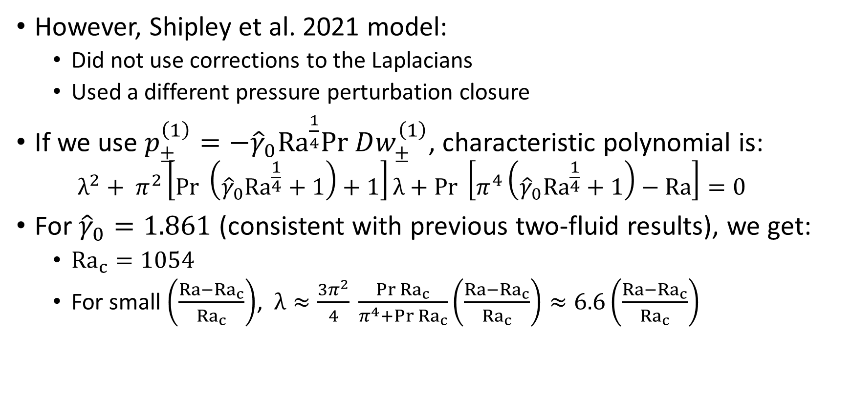
Linear instability in two-fluid RBC
However, Shipley et al. 2021 model:
  Did not use corrections to the Laplacians
  Used a different pressure perturbation closure
If we use $p_{±}^{\left(1\right)}=−{\hat{γ}}_{0}{Ra}^{\frac{1}{4}}Pr Dw_{±}^{\left(1\right)}$, characteristic polynomial is:
  $$λ^{2}+ π^{2}\left[Pr \left({\hat{γ}}_{0}{Ra}^{\frac{1}{4}}+1\right)+1\right]λ+Pr \left[π^{4}\left({\hat{γ}}_{0}{Ra}^{\frac{1}{4}}+1\right)−Ra\right]=0$$
For ${\hat{γ}}_{0}=1.861$ (consistent with previous two-fluid results), we get:
  ${Ra}_{c}=1054$
  For small $\left(\frac{Ra−{Ra}_{c}}{{Ra}_{c}}\right)$, $λ≈\frac{3π^{2}}{4} \frac{Pr{ Ra}_{c}}{π^{4}+Pr {Ra}_{c}}\left(\frac{Ra−{Ra}_{c}}{{Ra}_{c}}\right)≈6.6\left(\frac{Ra−{Ra}_{c}}{{Ra}_{c}}\right)$

Slide 12
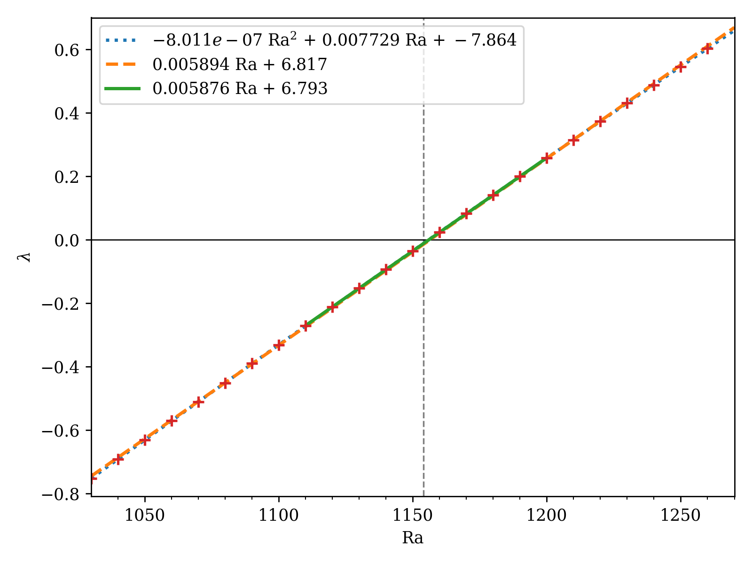
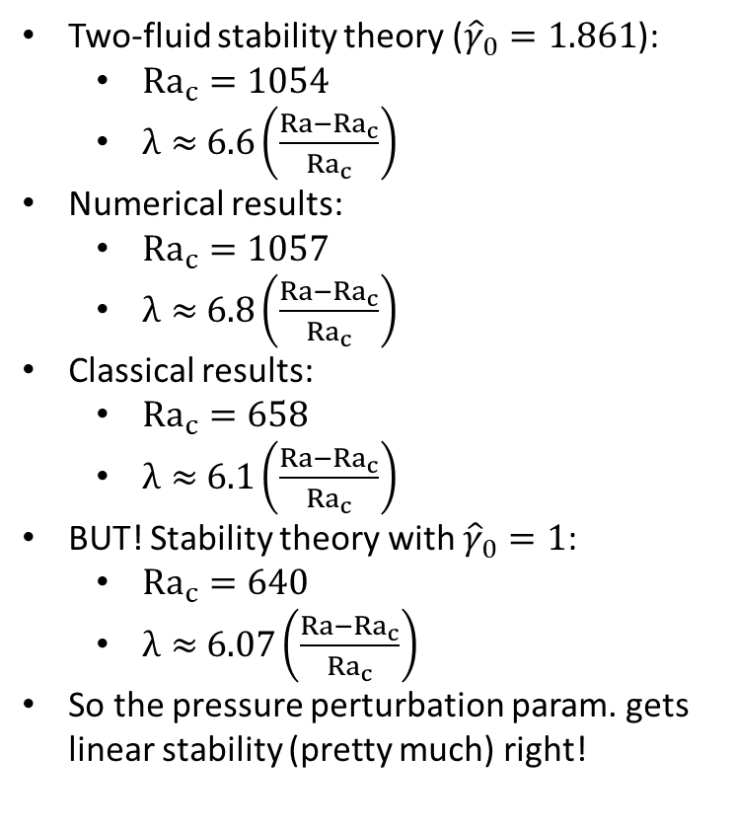
Numerical single-column results
Two-fluid stability theory (${\hat{γ}}_{0}=1.861$):
  ${Ra}_{c}=1054$
  $λ≈$ $6.6\left(\frac{Ra−{Ra}_{c}}{{Ra}_{c}}\right)$
Numerical results:
  ${Ra}_{c}=1057$
  $λ≈$ $6.8\left(\frac{Ra−{Ra}_{c}}{{Ra}_{c}}\right)$
Classical results:
  ${Ra}_{c}=658$
  $λ≈$ $6.1\left(\frac{Ra−{Ra}_{c}}{{Ra}_{c}}\right)$
BUT! Stability theory with ${\hat{γ}}_{0}=1$:
  ${Ra}_{c}=640$
  $λ≈$ $6.07\left(\frac{Ra−{Ra}_{c}}{{Ra}_{c}}\right)$
So the pressure perturbation param. gets linear stability (pretty much) right!

Slide 13
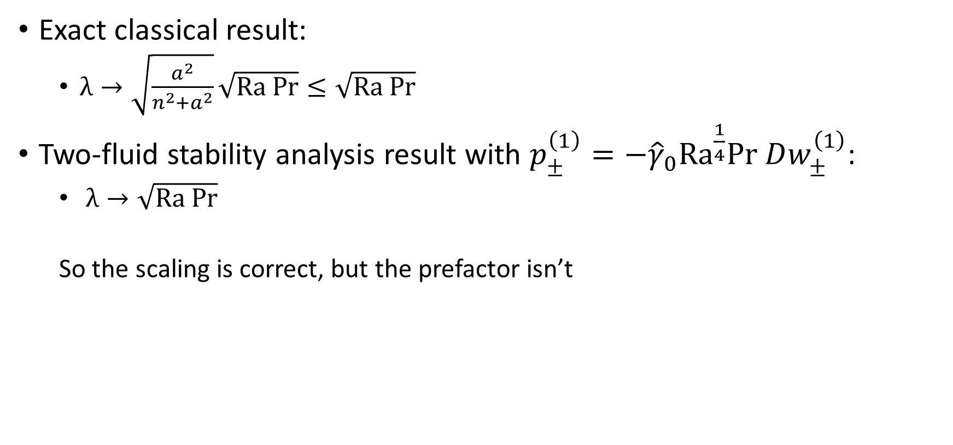
Linear growth rate at high Ra
Exact classical result:
  $λ→\sqrt{\frac{a^{2}}{n^{2}+a^{2}}}\sqrt{Ra Pr}≤\sqrt{Ra Pr}$
Two-fluid stability analysis result with $p_{±}^{\left(1\right)}=−{\hat{γ}}_{0}{Ra}^{\frac{1}{4}}Pr Dw_{±}^{\left(1\right)}$:
  $λ→\sqrt{Ra Pr}$
  So the scaling is correct, but the prefactor isn’t

Slide 14
Summary
Two-fluid single-column model can closely reproduce the classical linear instability results for RBC
  Including growth rate!
This helps explain why two-fluid SCM gets initiation approximately correct
High-Ra limit for growth rate scales correctly, but constant is bigger than true result
  This high-Ra limit is a very robust feature of the two-fluid analysis
Two-fluid SCM seems to capture some aspects of the convective stability problem almost “for free”
Possible future directions:
  finite filter width
  consequences for multi-moment modelling of initiation
  consequences for multi-fluid Laplacian correction terms

Slide 15
References
D. Shipley, H. Weller, P. Clark, W. McIntyre (2021) “Two-fluid single column modelling of Rayleigh-Bénard convection as a step towards multi-fluid modelling of atmospheric convection”, accepted by QJRMS. https://arxiv.org/abs/2106.09386

Slide 16
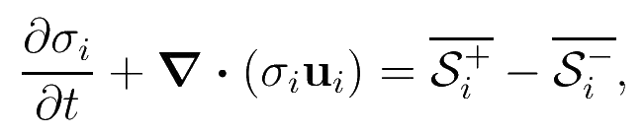
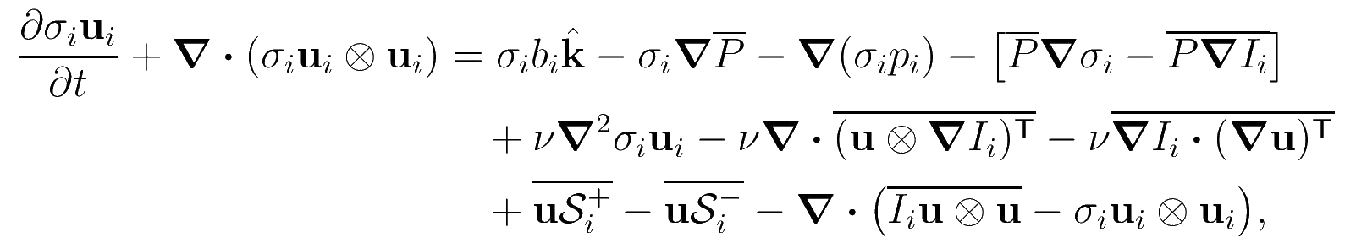
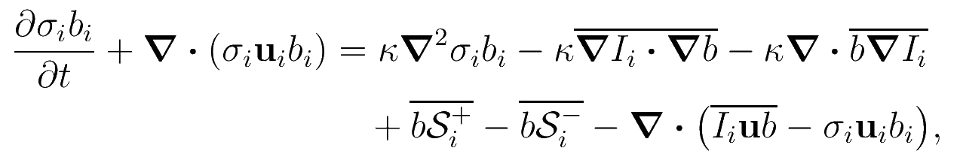
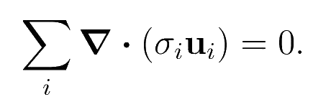
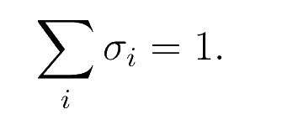

Viscous multi-fluid equations
Fluid fraction:
Entrainment/detrainment
Momentum:
Subfilter fluxes
Pressure drag
Residual viscous & diffusive fluxes
Buoyancy:
Perturbation pressures
Divergence constraint:
Sum constraint:
Lots of terms to parametrize!
($I_{i}=$ fraction of fluid $i$ in filter volume)

Slide 17


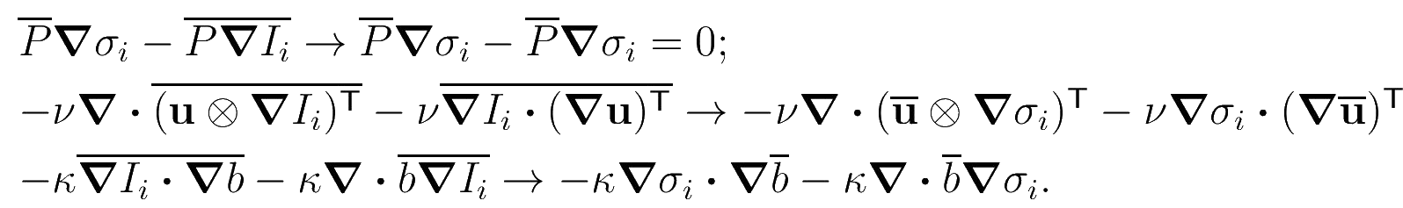

Closures
Want to develop simple two-fluid single-column model to capture the dominant overturning circulation
  Assume the multi-fluid split captures all of the subfilter flux at lowest order:
  ⇒ $≈0$, $≈0$
Assume “mean field” closures of residual pressure and viscous/diffusive terms consistent with sum rules:
  e.g.
Pressure perturbation and entrainment/detrainment terms are left

Slide 18
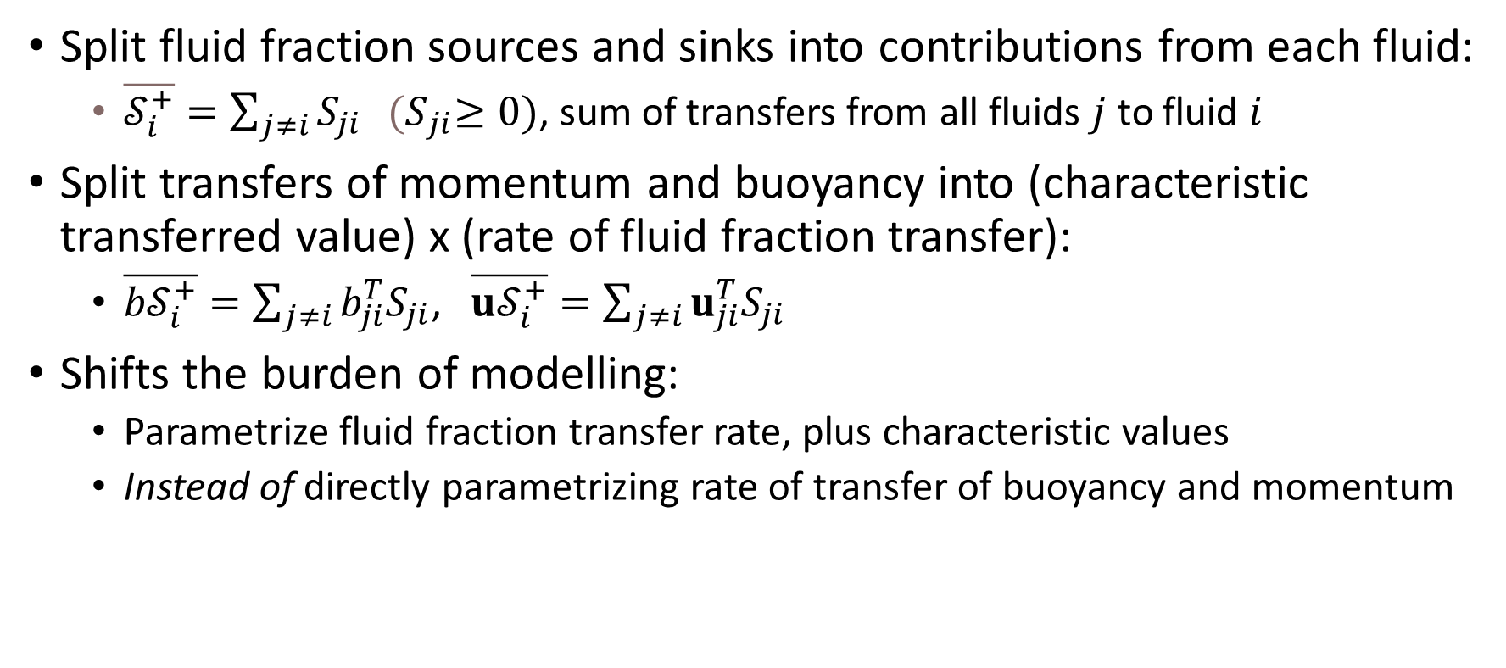
Closures – entrainment & detrainment
Split fluid fraction sources and sinks into contributions from each fluid:
  $\overline{𝒮_{i}^{+}}=\sum_{j≠i}{S_{ji}} {(S}_{ji}≥0)$, sum of transfers from all fluids $j$ to fluid $i$
Split transfers of momentum and buoyancy into (characteristic transferred value) x (rate of fluid fraction transfer):
  $\overline{{b𝒮}_{i}^{+}}=\sum_{j≠i}{b_{ji}^{T}S_{ji}}$, $\overline{{u𝒮}_{i}^{+}}=\sum_{j≠i}{u_{ji}^{T}S_{ji}}$
Shifts the burden of modelling:
  Parametrize fluid fraction transfer rate, plus characteristic values
  Instead of directly parametrizing rate of transfer of buoyancy and momentum

Slide 19


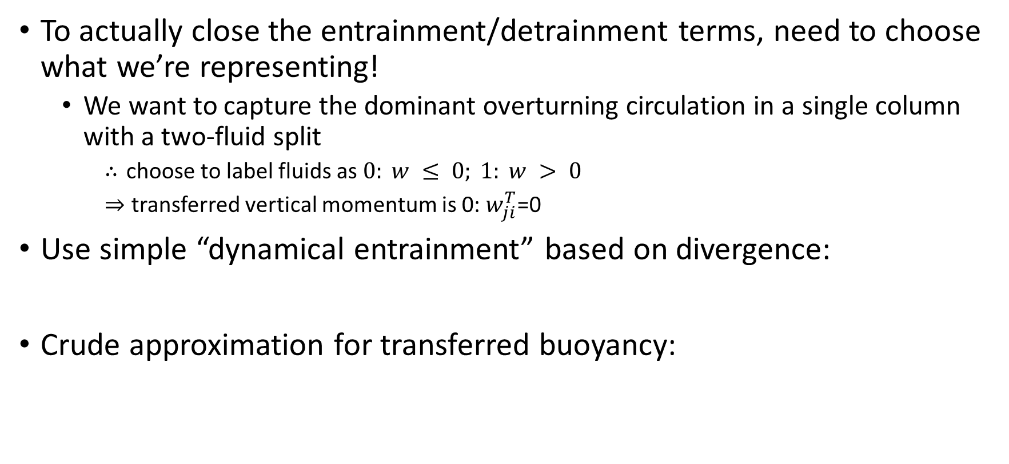

Closures – entrainment & detrainment
To actually close the entrainment/detrainment terms, need to choose what we’re representing!
  We want to capture the dominant overturning circulation in a single column with a two-fluid split
    choose to label fluids as $0: w ≤ 0; 1: w > 0$
    transferred vertical momentum is 0: $w_{ji}^{T}$=0
Use simple “dynamical entrainment” based on divergence:
Crude approximation for transferred buoyancy:
(exactly correct for first normal mode of RBC)
(expect $0≤C≤1$)

Slide 20
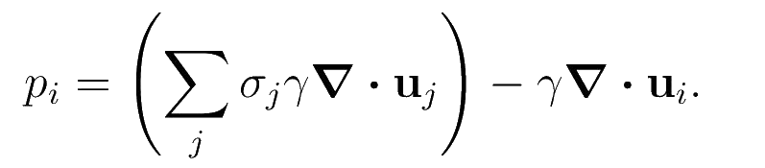
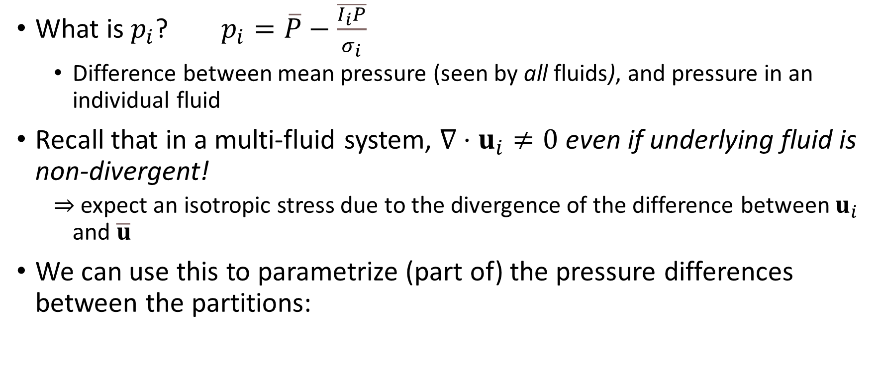

Closures – pressure perturbation
What is $p_{i}$? $p_{i}=\overline{P}−\frac{\overline{I_{i}P}}{σ_{i}}$
  Difference between mean pressure (seen by all fluids), and pressure in an individual fluid
Recall that in a multi-fluid system, $∇⋅u_{i}≠0$ even if underlying fluid is non-divergent!
  expect an isotropic stress due to the divergence of the difference between $u_{i}$ and $\overline{u}$
We can use this to parametrize (part of) the pressure differences between the partitions:
correction due to sum rules
How big should $γ$ be?

Slide 21
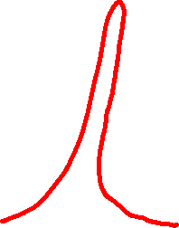

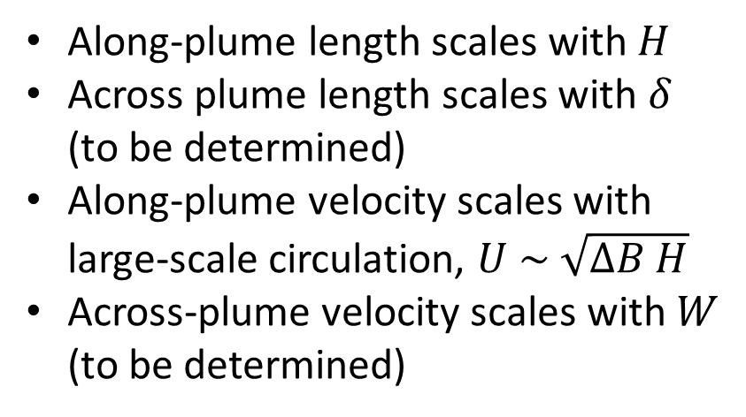
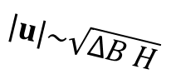




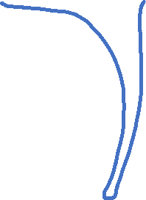
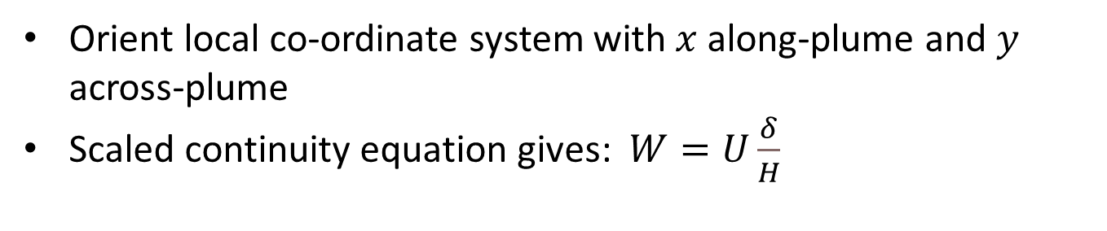

Closures – pressure perturbation
Split the convective flow into coherent plumes and a well-mixed environment:
Along-plume length scales with $H$
Across plume length scales with $δ$ (to be determined)
Along-plume velocity scales with large-scale circulation, $U \sim \sqrt{∆B H}$
Across-plume velocity scales with $W$ (to be determined)
plume
$$δ$$
$$H$$
$$\left|u\right|\sim \sqrt{ΔB H}$$
plume
Orient local co-ordinate system with $x$ along-plume and $y$ across-plume
Scaled continuity equation gives: $W=U\frac{δ}{H}$
$$x$$
$$y$$

Slide 22
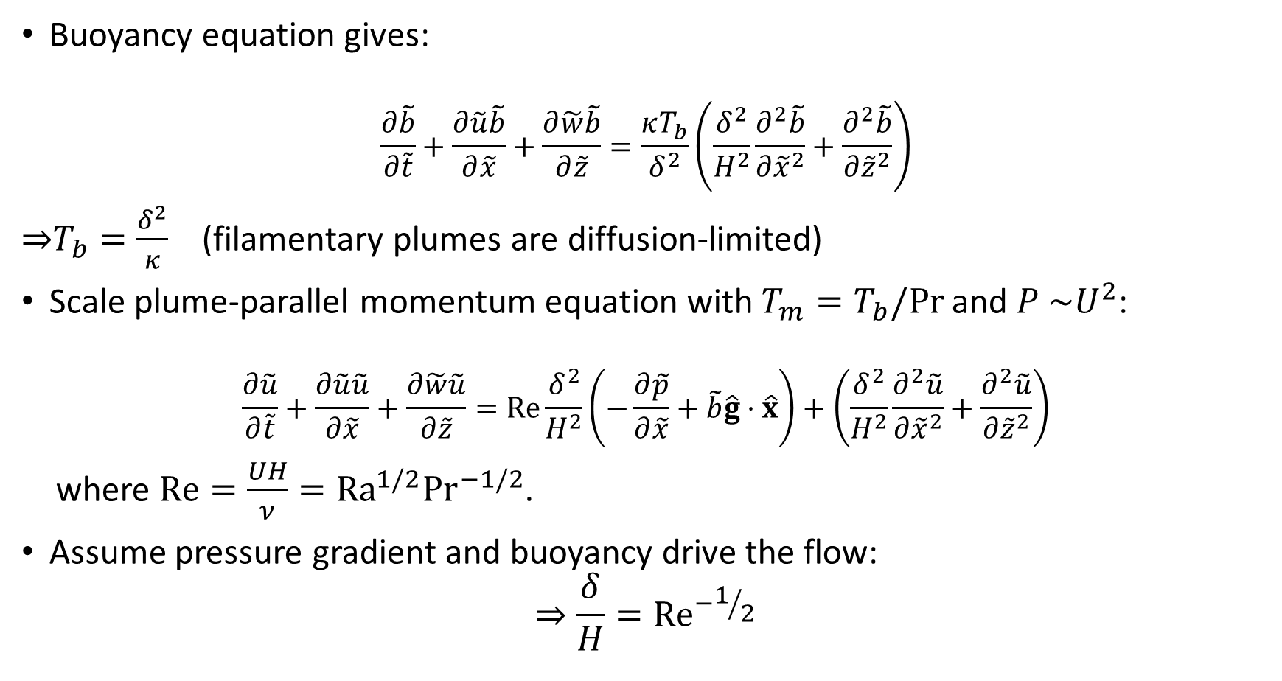
Closures – pressure perturbation
Buoyancy equation gives:
$$\frac{∂\tilde{b}}{∂\tilde{t}}+\frac{∂\tilde{u}\tilde{b}}{∂\tilde{x}}+\frac{∂\tilde{w}\tilde{b}}{∂\tilde{z}}=\frac{κT_{b}}{δ^{2}}\left(\frac{δ^{2}}{H^{2}}\frac{∂^{2}\tilde{b}}{∂{\tilde{x}}^{2}}+\frac{∂^{2}\tilde{b}}{∂{\tilde{z}}^{2}}\right)$$
$T_{b}=\frac{δ^{2}}{κ}$ (filamentary plumes are diffusion-limited)
Scale plume-parallel momentum equation with $T_{m}=T_{b}/Pr$ and $P \sim U^{2}$:
$$\frac{∂\tilde{u}}{∂\tilde{t}}+\frac{∂\tilde{u}\tilde{u}}{∂\tilde{x}}+\frac{∂\tilde{w}\tilde{u}}{∂\tilde{z}}=\operatorname{Re}{\frac{δ^{2}}{H^{2}}\left(−\frac{∂\tilde{p}}{∂\tilde{x}}+\tilde{b}\hat{g}⋅\hat{x}\right)}+\left(\frac{δ^{2}}{H^{2}}\frac{∂^{2}\tilde{u}}{∂{\tilde{x}}^{2}}+\frac{∂^{2}\tilde{u}}{∂{\tilde{z}}^{2}}\right)$$
where $Re=\frac{UH}{ν}=Ra^{1/2}Pr^{−1/2}$.
Assume pressure gradient and buoyancy drive the flow:
$$⇒\frac{δ}{H}={Re}^{−1/2}$$

Slide 23

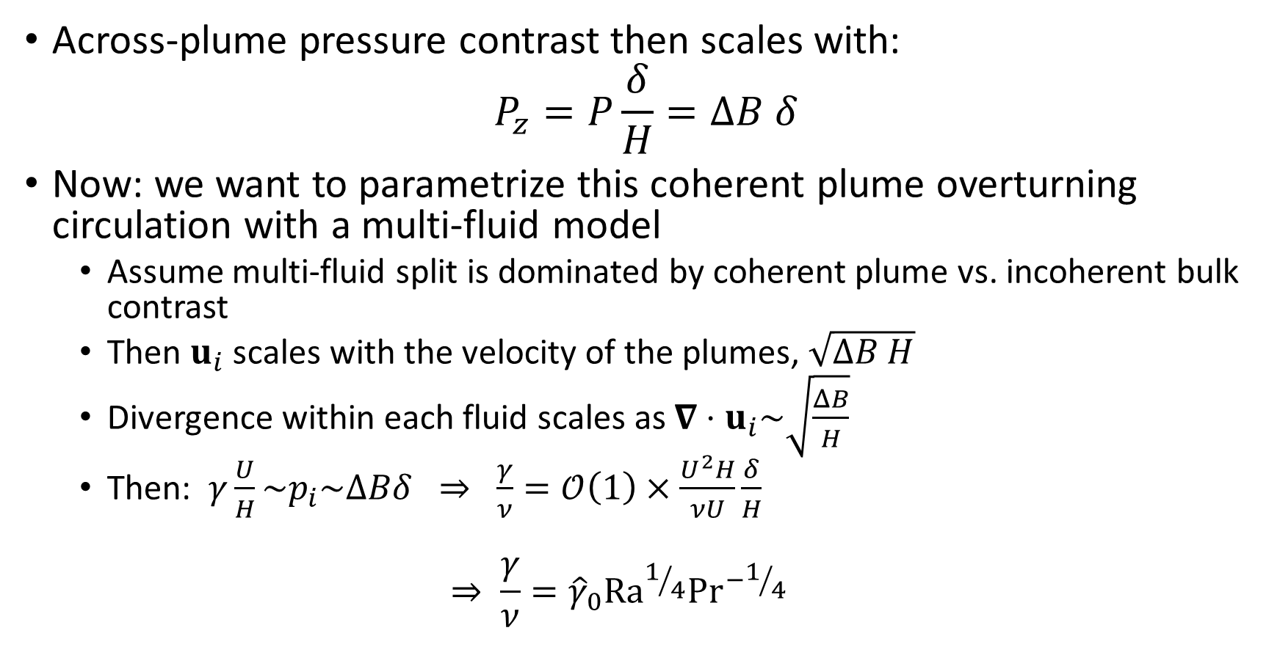
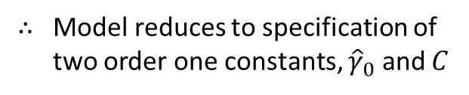
Closures – pressure perturbation
Across-plume pressure contrast then scales with:
$$P_{z}=P\frac{δ}{H}=ΔB δ$$
Now: we want to parametrize this coherent plume overturning circulation with a multi-fluid model
  Assume multi-fluid split is dominated by coherent plume vs. incoherent bulk contrast
  Then $u_{i}$ scales with the velocity of the plumes, $\sqrt{ΔB H}$
  Divergence within each fluid scales as $∇⋅u_{i}\sim \sqrt{\frac{ΔB}{H}}$
  Then: $γ\frac{U}{H}\sim p_{i}\sim ΔBδ ⇒ \frac{γ}{ν}=𝒪\left(1\right)×\frac{U^{2}H}{νU}\frac{δ}{H}$
  $$⇒ \frac{γ}{ν}={\hat{γ}}_{0}Ra^{1/4}Pr^{−1/4}$$
$${\hat{γ}}_{0}=𝒪\left(1\right)$$
Model reduces to specification of two order one constants, ${\hat{γ}}_{0}$ and $C$

