Slide 1
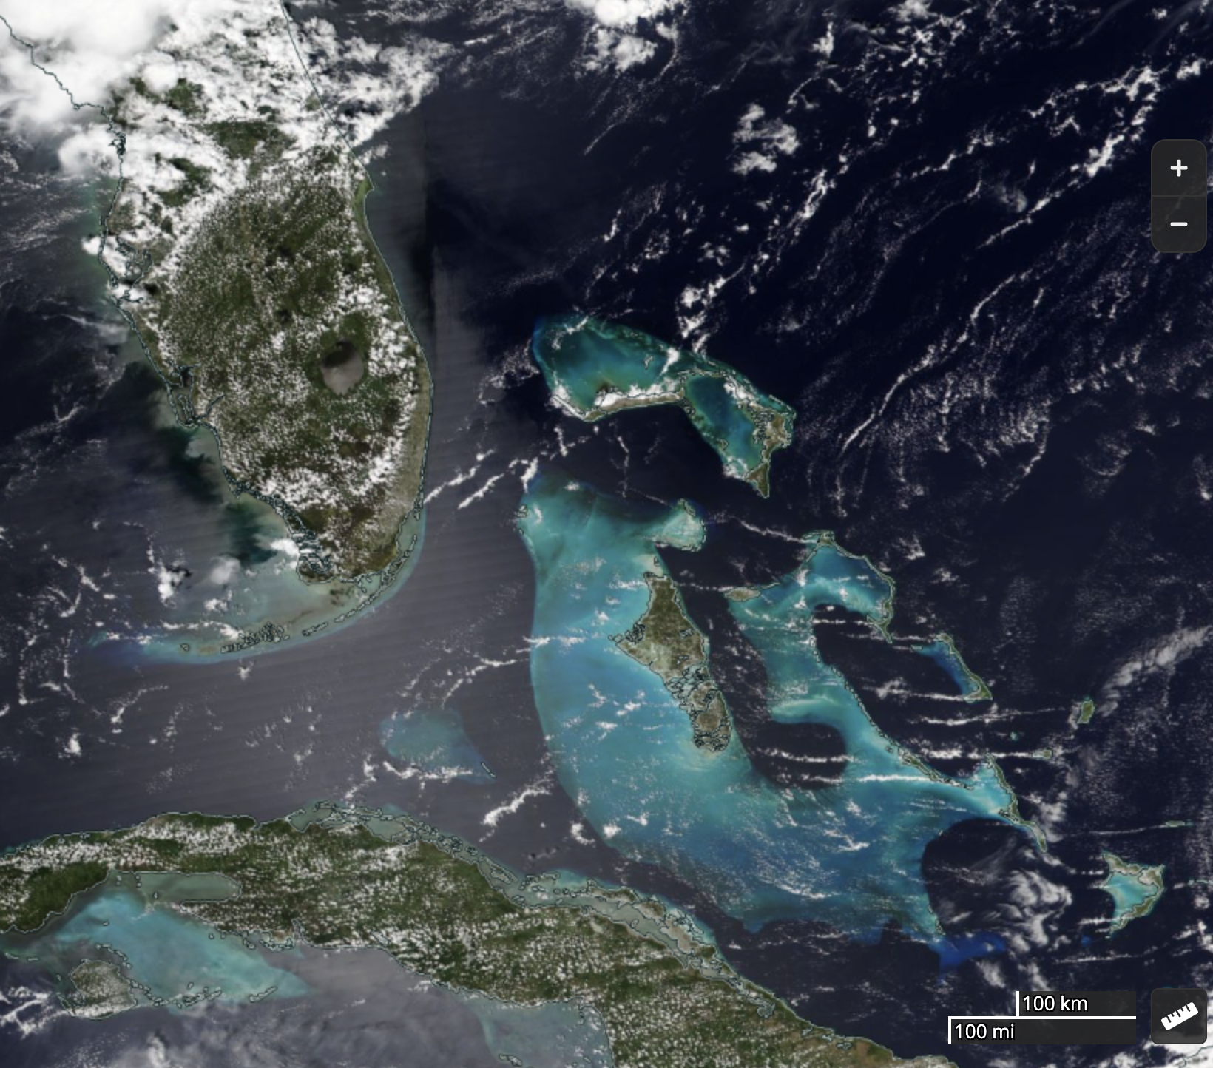

Role of Wind Speed in Organizing Shallow Convection on Small Islands in Idealized Simulations

Slide 2

Savijarvi & Matthews (2004)
Matthews et al. (2007)
Kirshbaum & Fairman (2015)
Wind speed decides sea breeze vs. cloud trail
The sea breeze circulation gets s t r e t c h e d downwind to become the cloud trail circulation by ‘strong’ winds over small islands
Sea breeze
Cloud trail

Slide 3
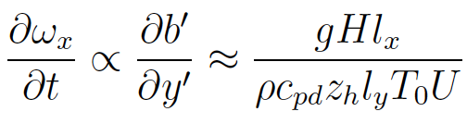
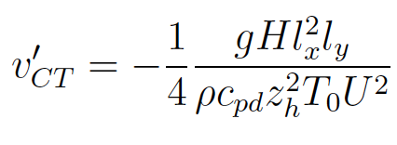
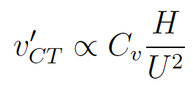
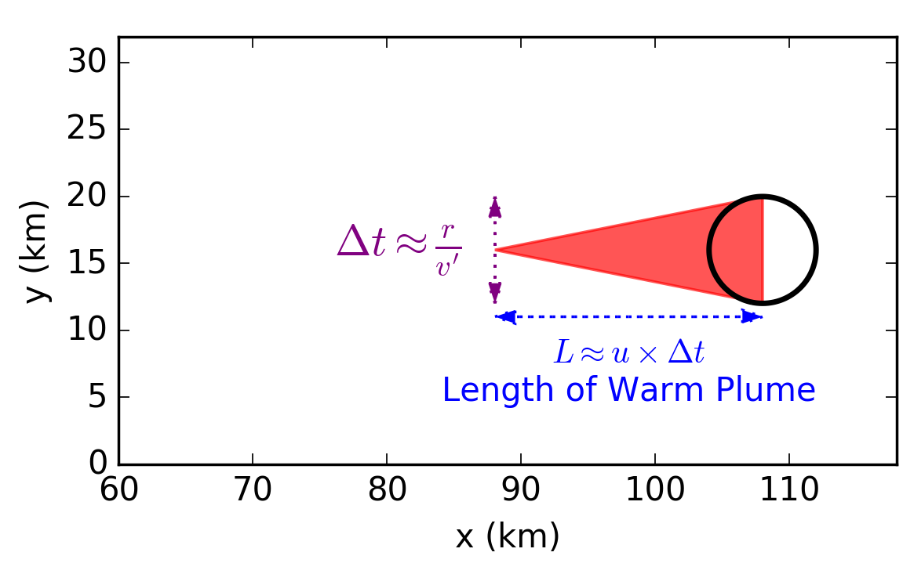
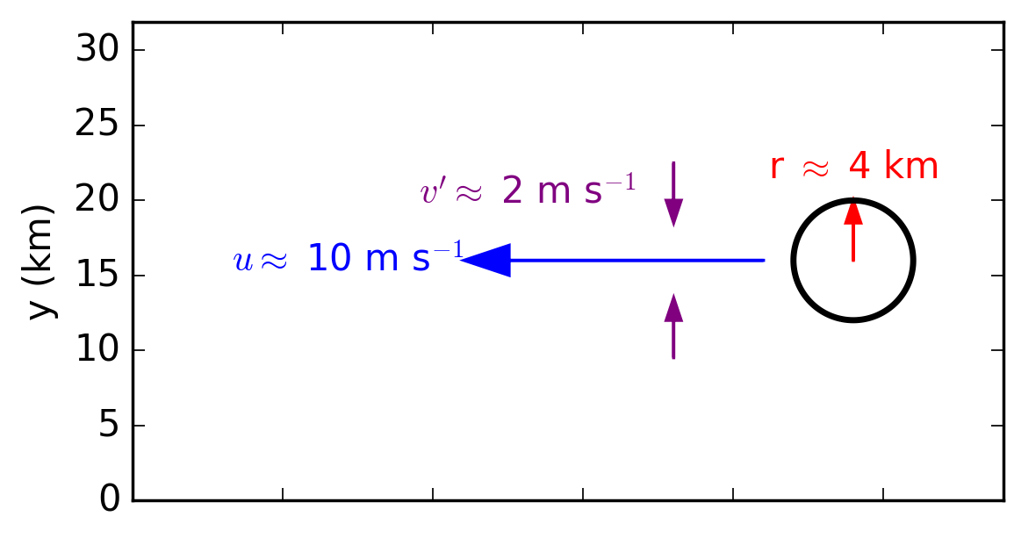
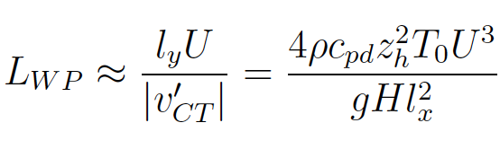
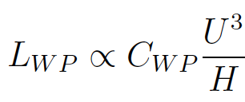
Scaling in theory
Horizontal vorticity tendency
Horizontal buoyancy gradient
(in terms of island geometry and control variables)

Slide 4


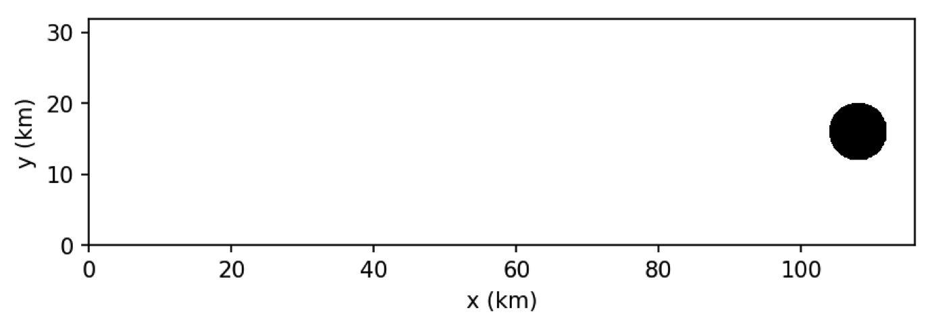

Experimental Design
island
8 km diameter, circular island “small island”
Prescribed diurnal cycle via surface fluxes
Periodic boundary conditions
MetOffice UMv10.9
100 m grid spacing
140 vertical levels

Slide 5
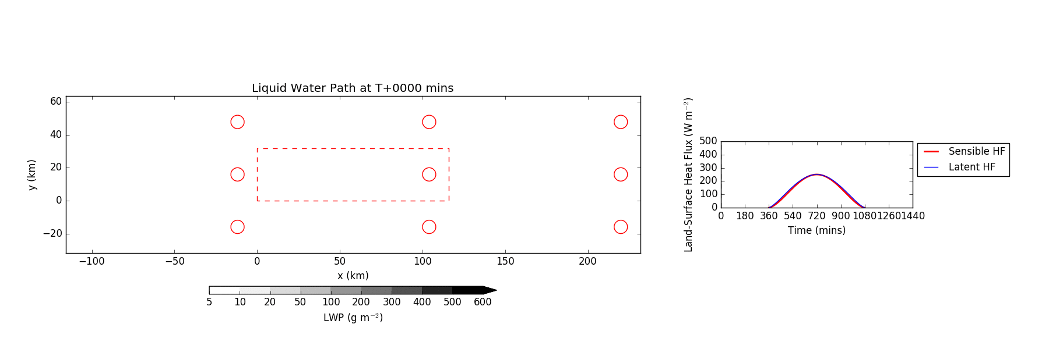
What does the transition between cloud trail and traditional sea breeze look like?

Slide 6
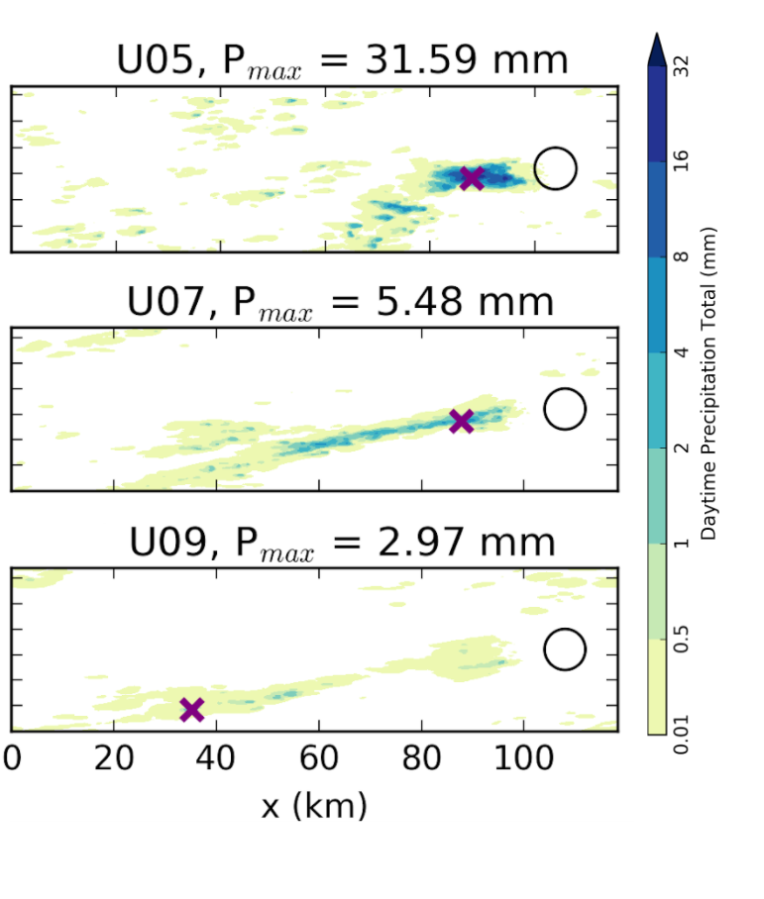
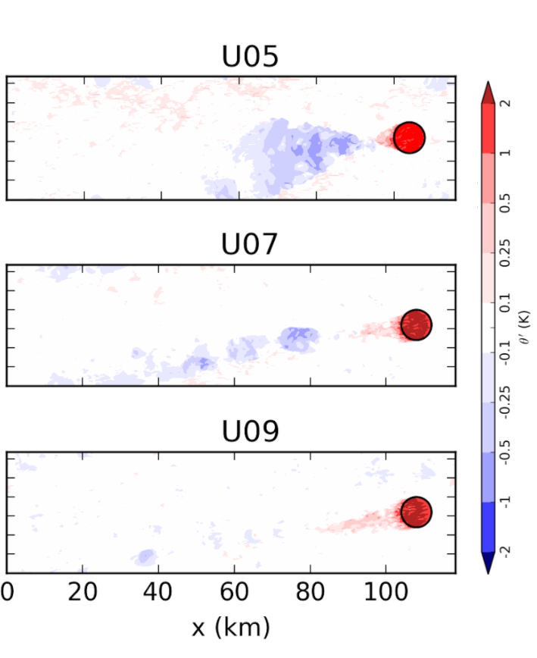
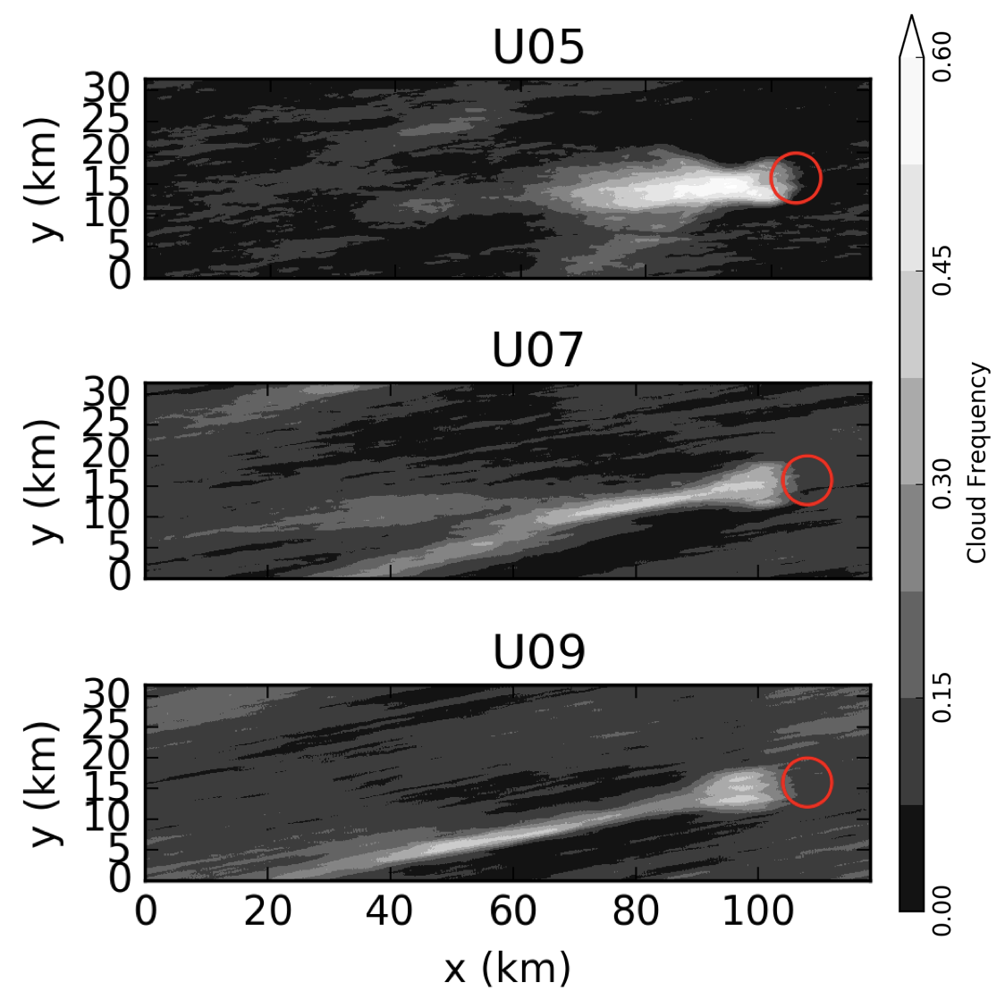



We see a smooth transition
Cloudiness
Precipitation
Theta Perturbation

Slide 7
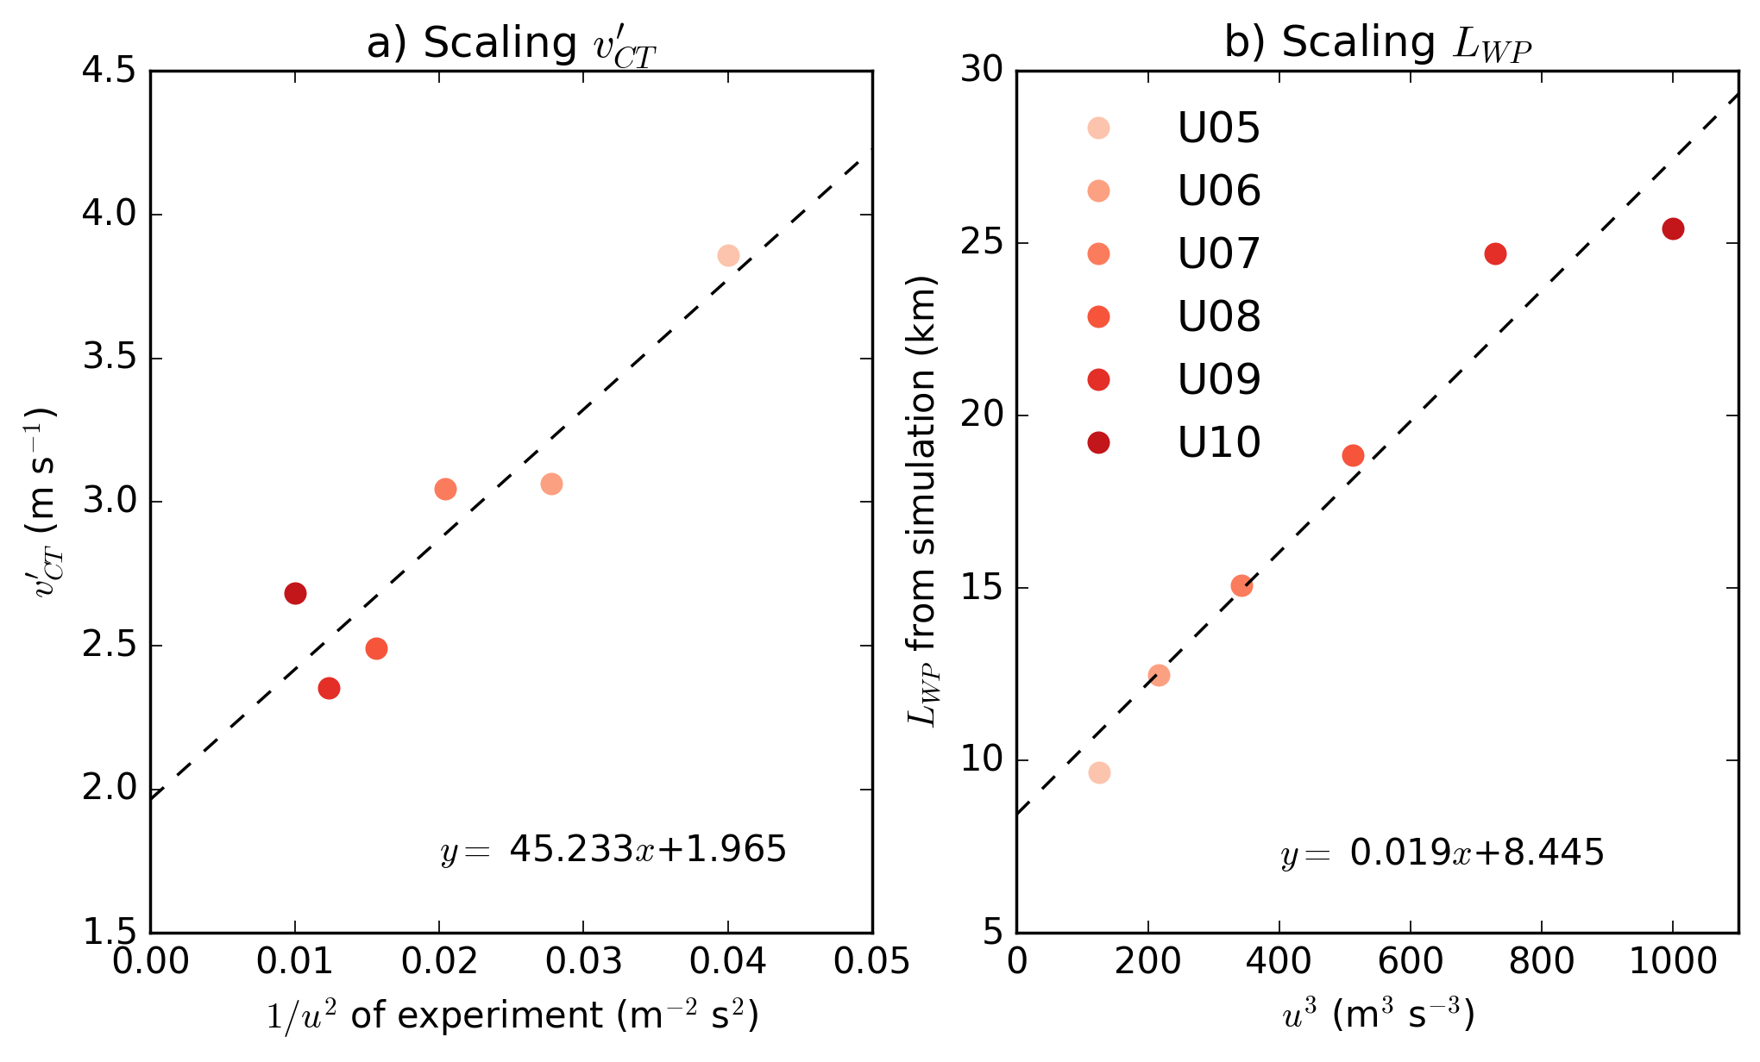
Scaling in simulations

Slide 8
Lighter winds shift peak forcing closer to coast, but forcing is stronger
Implications for convection parametrisation development
Small islands can generate convection with meaningful precipitation
Could potentially use information about sub-grid surface inhomogeneities to:
  Inform the convection triggering condition through the v’ scaling
  Design a ‘non-local’ convection scheme through the Lwp scaling

