Slide 1



“A view of the 2nd and 3rd August COPE cases using storm-permitting ensemble MOGREPS-UK”
S. Dey
Supervisors: R. Plant, N. Roberts and S. Migliorini
COPE science meeting
29/04/2014

Slide 2
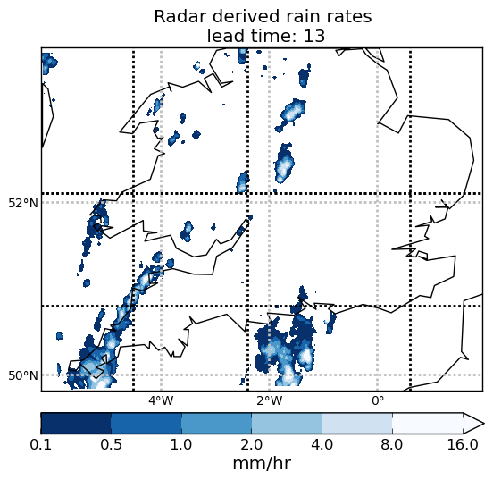
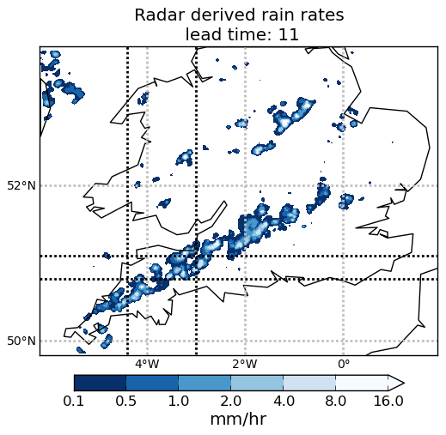
Cases
2nd August 16Z
3nd August 18Z
0.1 0.5 1.0 2.0 4.0 8.0 16.0 [mm/hr]
  Nimrod radar derived rain rates

Slide 3
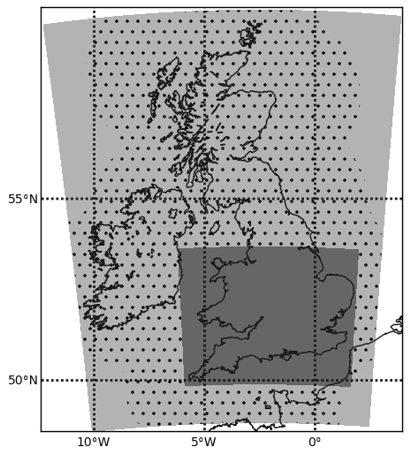
MOGREPS-UK
  2.2km resolution
  Convection permitting
  12 members
  Downscaled from MOGREPS-G
  Methods not specific to MOGREPS
Methods of ensemble characterization
  Spatial
  Vertical correlations
Notes:
Introduction to MOGPRES-UK
Stress that techniques could be applied to other ensembles

Slide 4
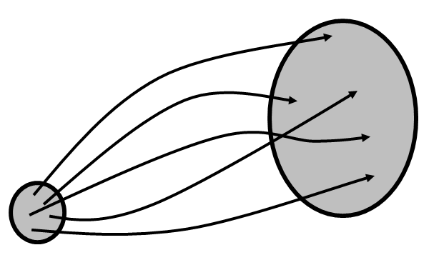


Motivation
Scale dependence
  Faster error growth at smaller scales
  (Hohenegger and Schär 2007, BAMS)
  Need ensembles at convective scale
Ensemble mean
  Not physically representative
Individual forecasts
Ensemble mean
Physical meaning
cv
1
2
3
Notes:
Why spatial methods are needed
Problems with physically interpreting ensemble mean

Slide 5
Method 1: spatial analysis
Over what spatial scales are the forecasts acceptably similar?
L
  Varies point by point
  Measure of spatial agreement
?
=
A
B
  Apply to different variables and different vertical levels.
Notes:
Methodology (qualitative)

Slide 6
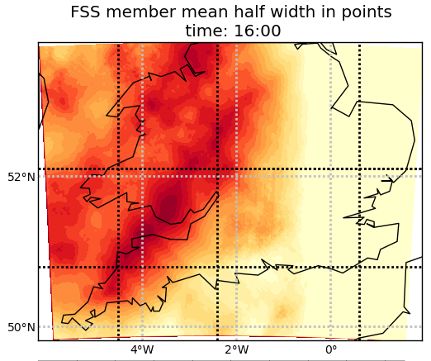
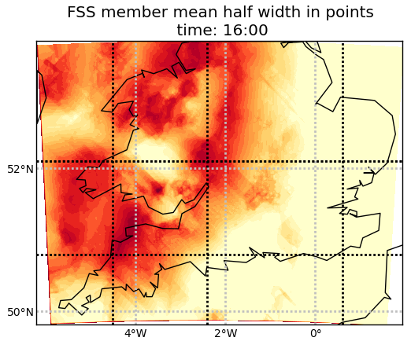
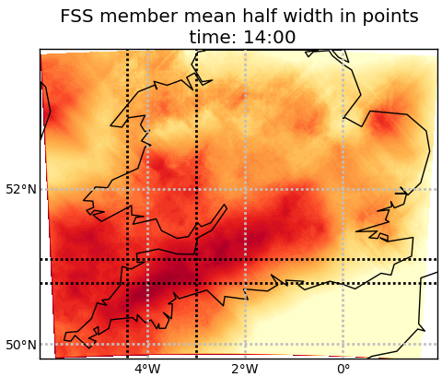
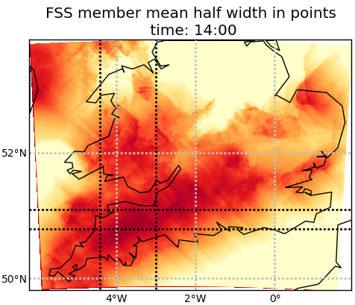
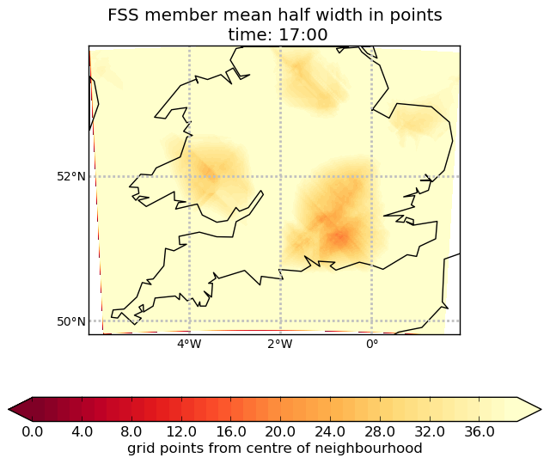
Spatial comparisons
Radar rain rates
Ensemble scales
Ensemble-radar scales
2nd August 16Z
3nd August 14Z
0.1 0.5 1.0 2.0 4.0 8.0 16.0 [mm/hr]
20 55 90 125 [ km]

Slide 7
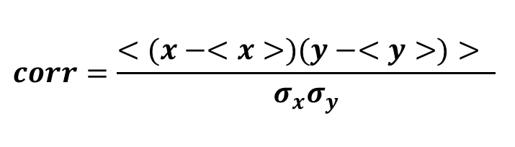
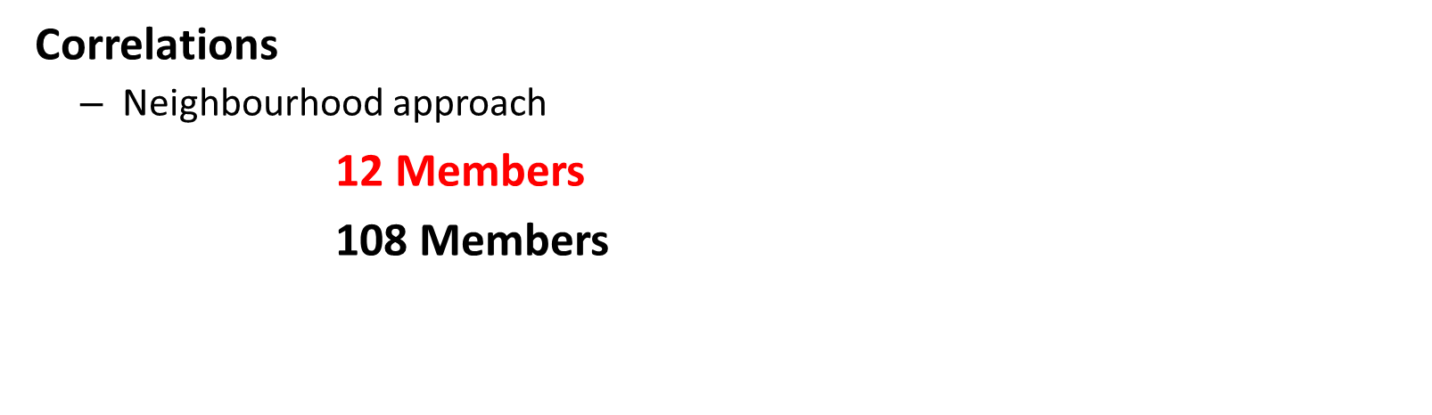
Method
Correlations
  Neighbourhood approach
12 Members
108 Members
$$corr=\frac{<(x−<x>)(y−<y>)> }{σ_{x}σ_{y}}$$
12
12
12
12
12
12
12
12
12
z
3D variables (A,B)
Horizontal divergence
Horizontal wind speed
Cloud fraction in each layer
Specific humidity
Temperature
Surface Rain rates- Temporal correlations (C)
A
B
C
Notes:
Correlations over area
Vertical correlations for 3D variables
Choose area
Temporal correlations with surface rain rates

Slide 8
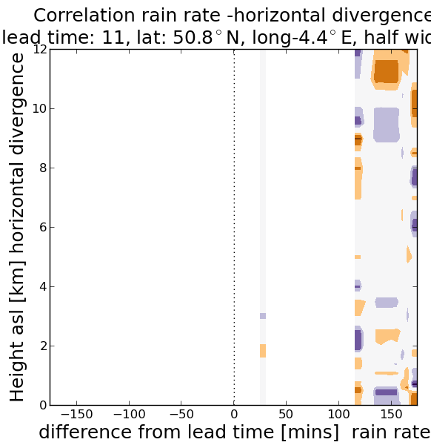
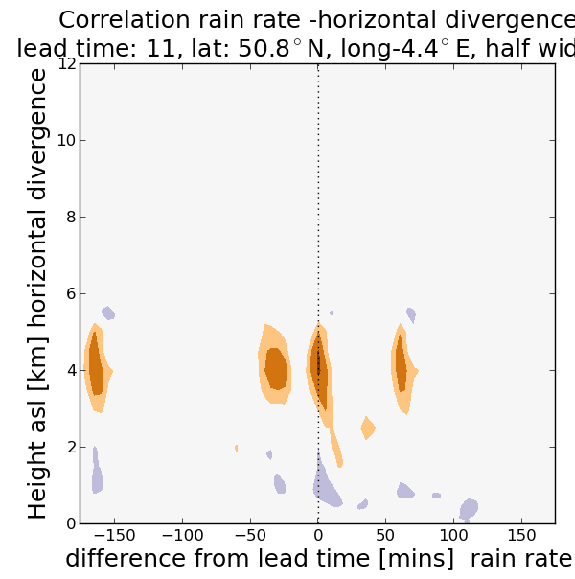
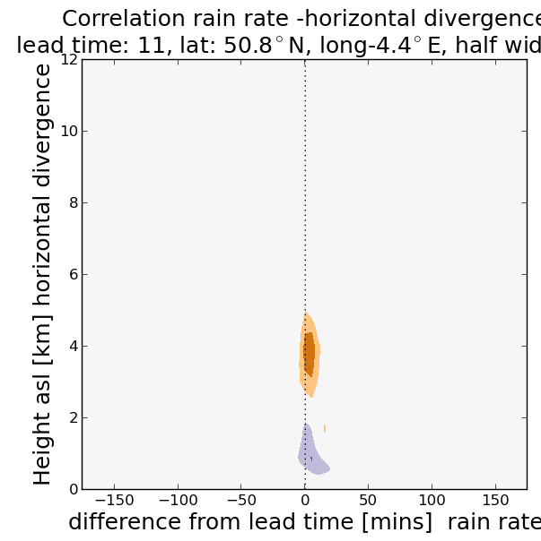
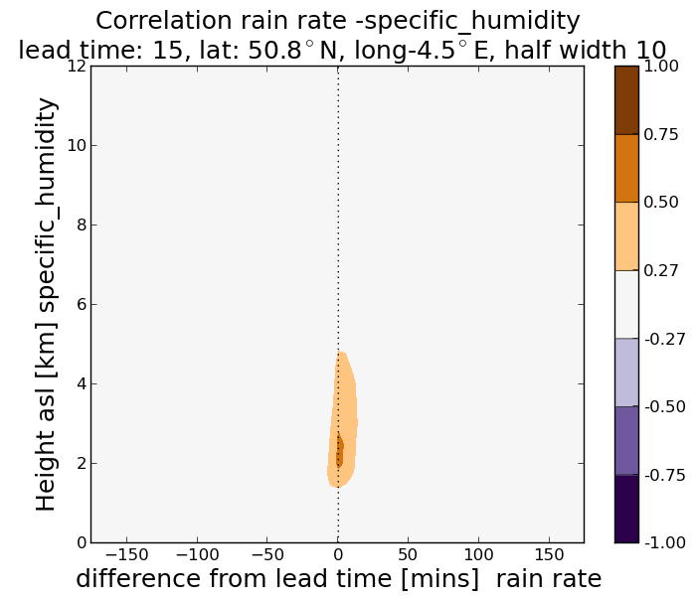
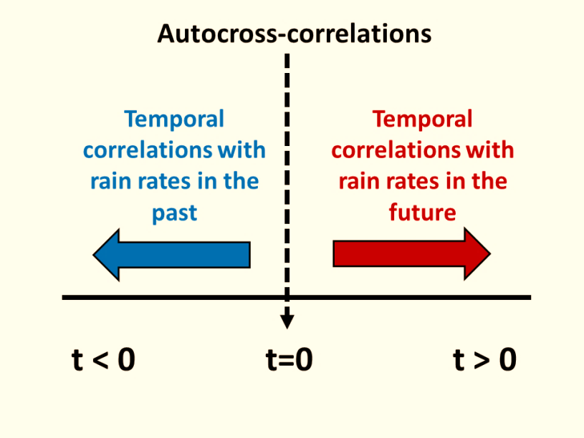
Correlations: 2nd August, 14Z
1 grid points (2.2km)
13x13 grid points (28.6km)
21x21 grid points (46.2km)
+ve correlation
Divergence
-ve correlation
Convergence
Notes:
Div-rain correlations
3 neighbourhood sizes
Noise->Individual cells->one cell

Slide 9
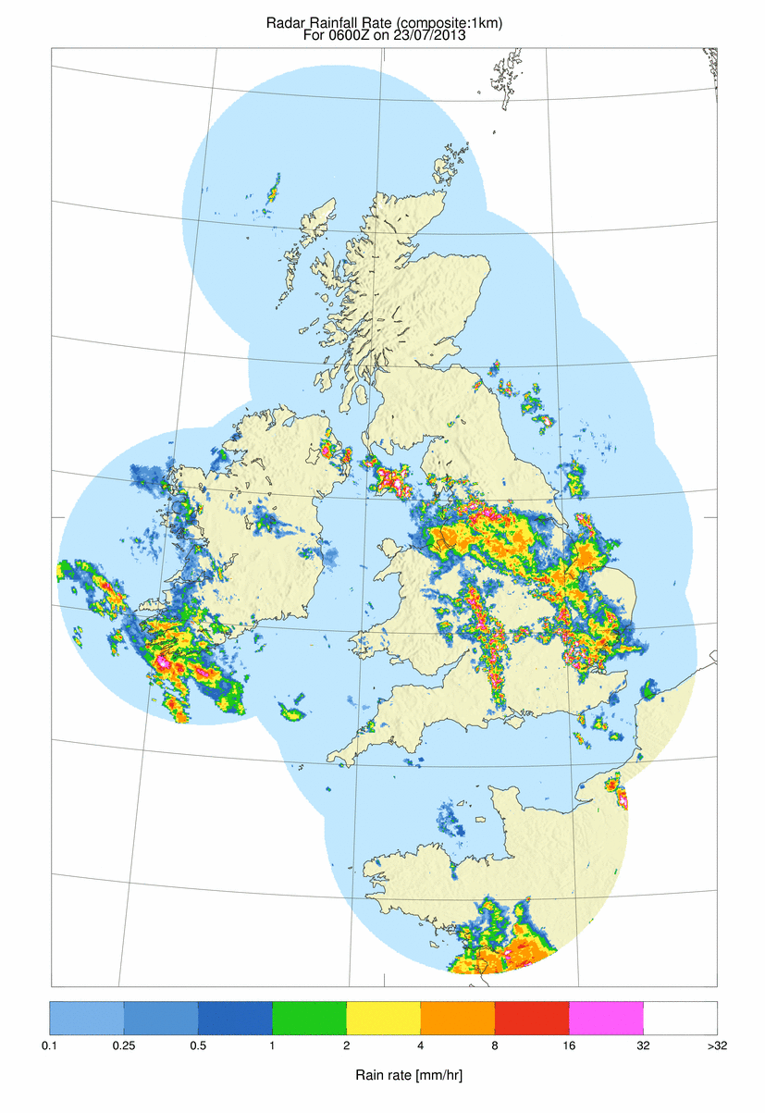
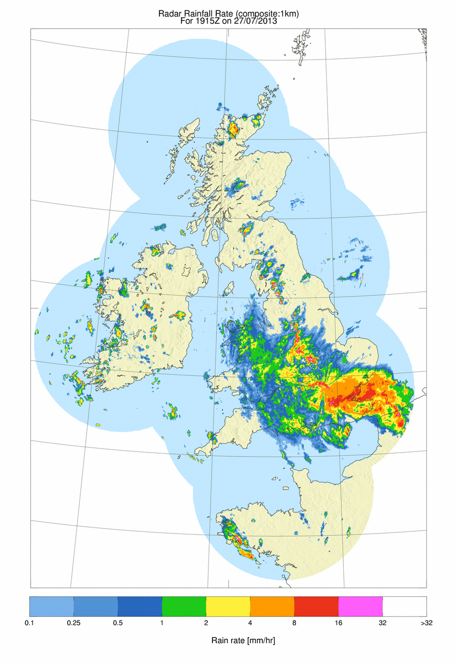
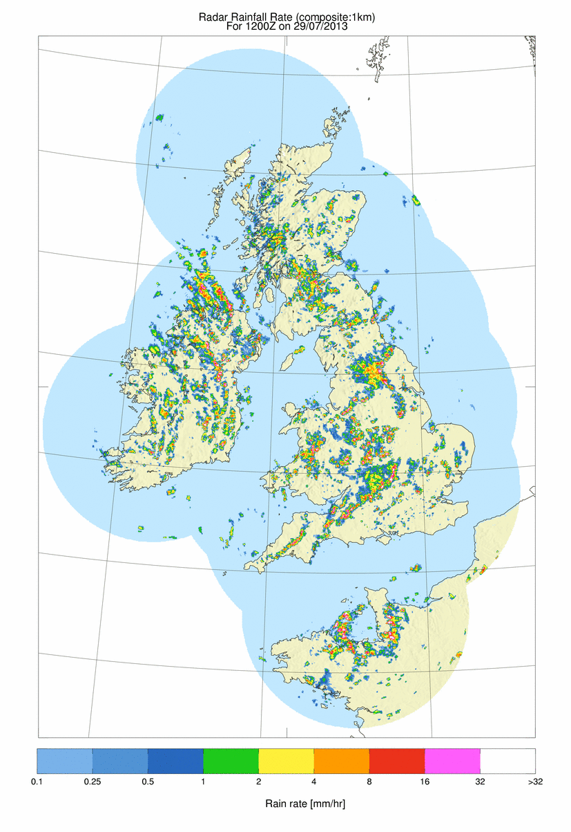
Summary
17th July | Organized thunderstorms (NOT COPE CASE)
23rd July | Bands of thunderstorms (IOP 5)
27th July | MCS (IOP 7)
29th July | Convective showers (IOP 9)
2nd August | Convection along SW peninsula (IOP 10)
3rd August | Convection along SW peninsula (IOP 11)
Bands of thunderstorms
23/07/2013
Mesoscale Convective System
27/07/2013
1
Scattered convection
29/07/2013
0.1 0.25 0.5 1 2 4 8 16 32 >32
Notes:
Alan’s slide 1

Slide 10
Main questions
Can we develop scale appropriate, multivariate and physically meaningful methods for obtaining information from convection permitting ensembles?
Techniques useful for assessing model changes
  Increased membership by time lagging?
  Including the UKV forecast in the ensemble?
  Global ensemble
  More statistical approach
Other interesting investigations?
  Verification of spatial scales for different variables
  Comparison of correlation results with observations
Notes:
Alan’s slide 2

