Slide 1
Quasi-Stationary Convective Systems in the UK:
A Case Study and a Climatology
Robert Warren
Supervised by Bob Plant, Humphrey Lean, and Dan Kirshbaum
With thanks to Sarah Alcock, Sylvia Bohnenstengel, Stephen Burt, Emilie Carter, Peter Clark, Terry Davies, Brian Golding, Nick Grahame, Caroline Halliwell, Will Hand, Rosalyn Hatcher, Roy Kershaw, Giovanni Leoncini, Adrian Lock, Suzanne Long, Willie McGinty, Nigel Roberts, Thorwald Stein, Maggie Summerfield, Dan Suri, Simon Vosper, Stuart Webster, Jonathan Wilkinson, and Steve Willington

Slide 2
Background

Slide 3
How do you pronounce ‘quasi-’?
Robert Warren
Lunchtime Seminar – 11/06/2013
3

Slide 4
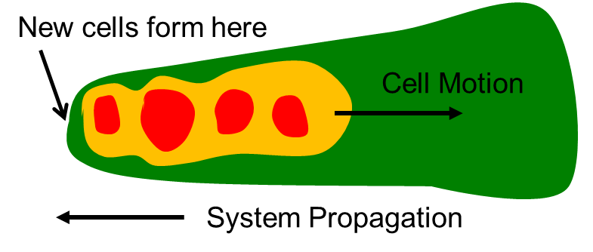
What do we mean by a QSCS?
Two perspectives:
‘Ground relative’ – Repeated initiation of cells in approximately the same location with cells maintaining a consistent trajectory
‘Storm relative’ – Cancellation between cell motion and system propagation vectors to give near-zero system motion
Three important terms:
Anchoring
Back-building
Echo training
Adapted from Schumacher and Johnson (2005)
Robert Warren
Lunchtime Seminar – 11/06/2013
4

Slide 5
The First Law of QPF
The heaviest precipitation occurs where the rainfall rate is the highest for the longest time.
– C. F. Chappell
$$P=\overline{R}×D$$
Precipitation duration
Total precipitation at a point
Mean rain rate
Doswell et al. (1996)
Robert Warren
Lunchtime Seminar – 11/06/2013
5

Slide 6
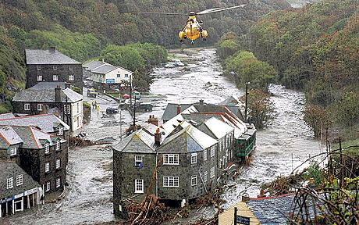
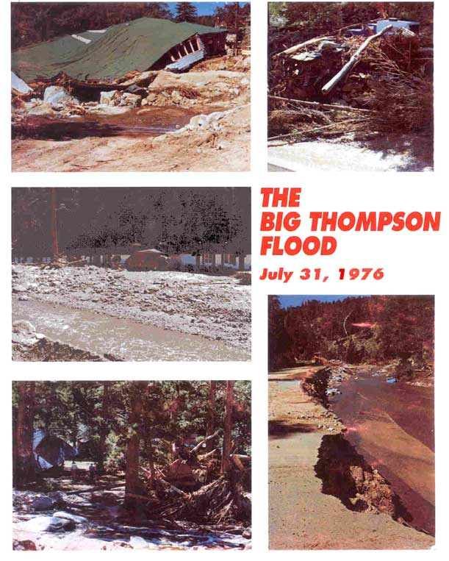
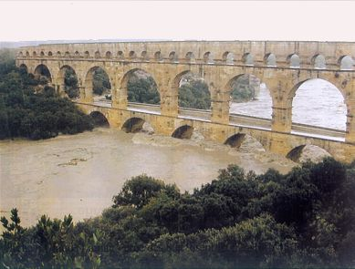
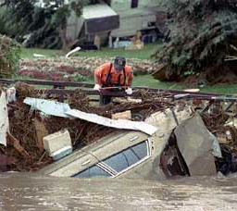
Flash flooding caused by QSCSs
Robert Warren
Lunchtime Seminar – 11/06/2013
6

Slide 7
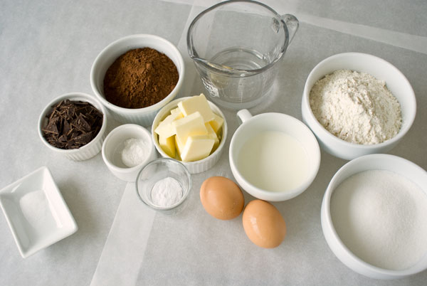
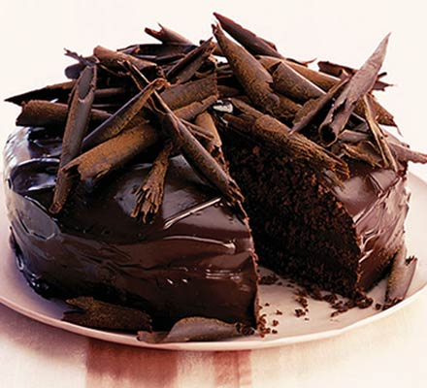
Ingredients for QSCSs
Deep moist convection has three main ingredients:
Instability
Moisture
Initiation mechanism
For a convective system to become quasi-stationary these ingredients must be present for an extended period of time (several hours)
The direction of cell motion must also remain roughly constant
Robert Warren
Lunchtime Seminar – 11/06/2013
7

Slide 8
QSCSs in the literature
Numerous case studies of flash flood-producing events caused by QSCSs, particularly in the USA and Mediterranean region
Climatologies of heavy precipitation events and their environments:
UK – Hand et al. (2004)
USA – Maddox et al. (1979), Schumacher and Johnson (2005, 2006)
Mediterranean Region – Nussier et al. (2011), Ricard et al. (2012)
Idealised simulations of QSCSs associated with particular forcing mechanisms:
Schumacher (2009) – latent-heating-forced gravity wave
Bresson et al. (2012) – direct orographic triggering and cold-pool triggering ahead of an orographic barrier (Massif Central)
Robert Warren
Lunchtime Seminar – 11/06/2013
8

Slide 9
Project questions
How common are QSCSs in UK?
How does their occurrence vary geographically and temporally?
Are there synoptic situations which specifically favour the development of QSCSs?
What are the typical mechanisms of storm anchoring?
How sensitive is storm anchoring to small changes in ambient conditions?
How well are QSCSs represented in NWP models at the highest resolutions currently used operationally?
Does this representation improve at higher resolutions?
Robert Warren
Lunchtime Seminar – 11/06/2013
9

Slide 10
Part I: Case Study
See Warren et al. (2013), QJRMS for the full story!

Slide 11
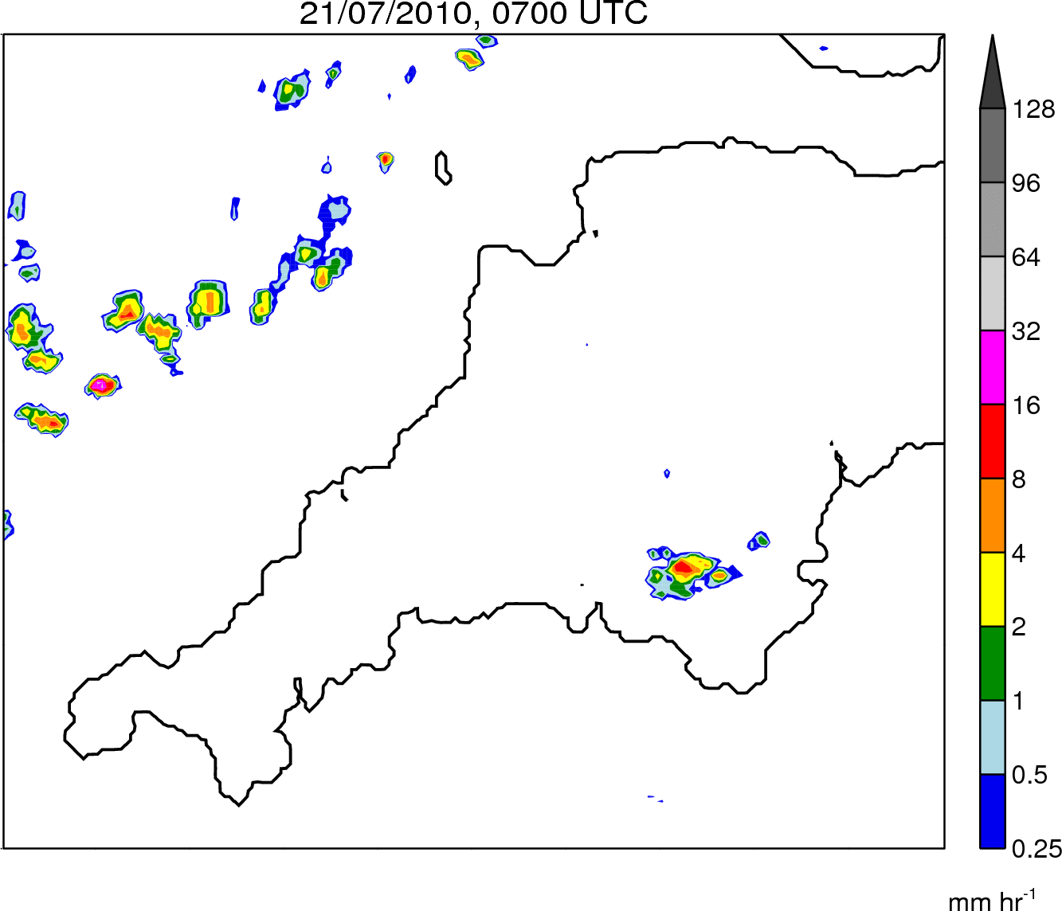
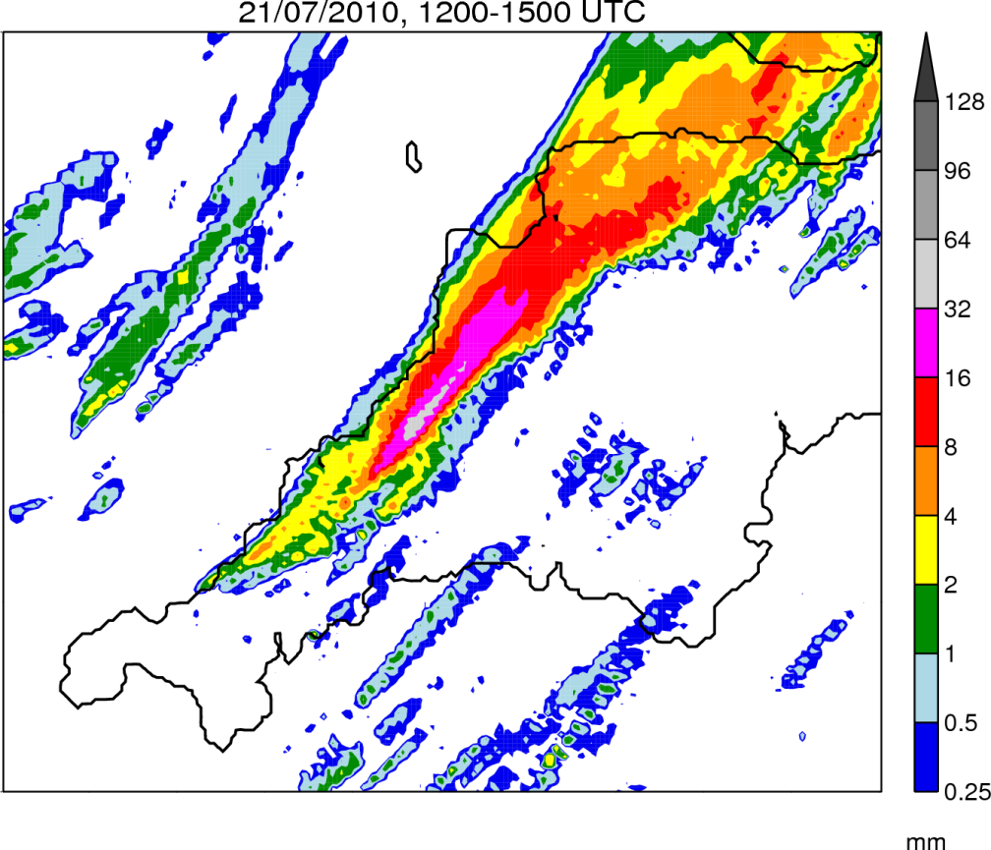
The Case: 21/07/2010
Rain Rate
0700–1900 UTC
Rain Accumulation
1200–1500 UTC
Robert Warren
Lunchtime Seminar – 11/06/2013
11

Slide 12
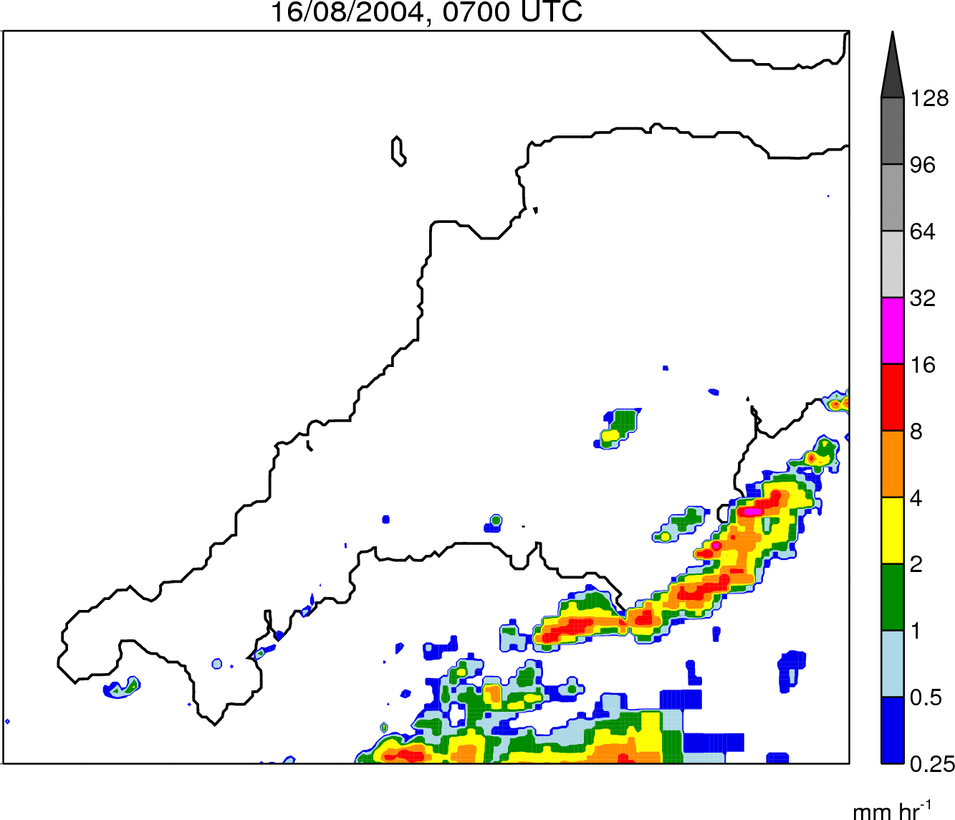
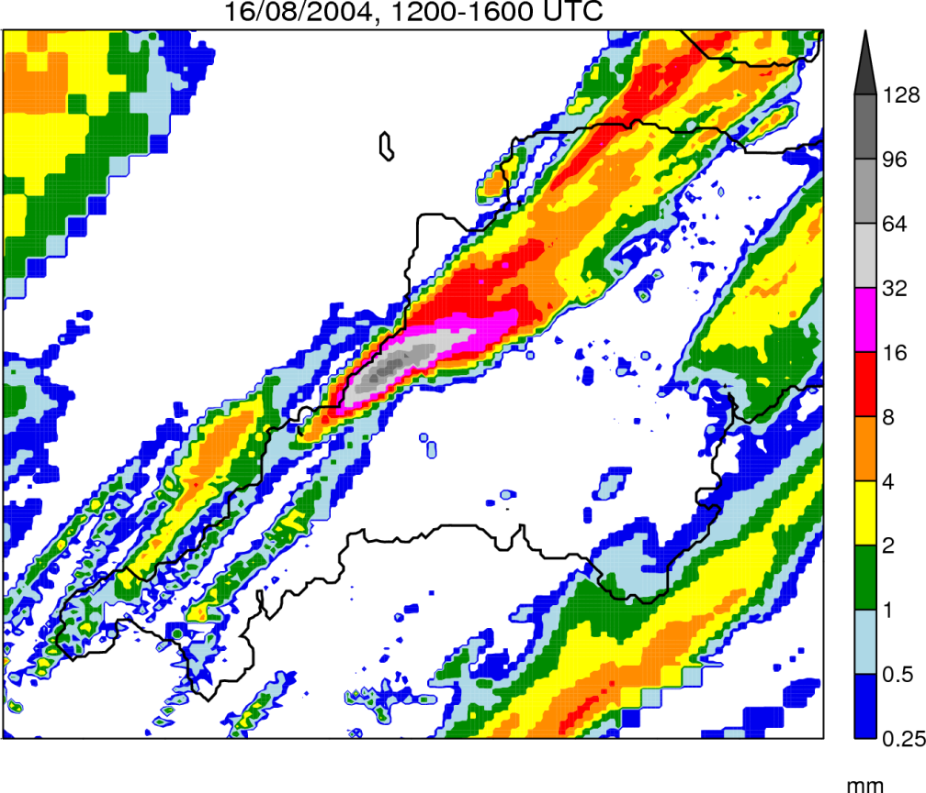
The ‘Boscastle’ storm
Rain Rate
0700–1900 UTC
Rain Accumulation
1200–1600 UTC
For further details of the event see Burt (2005), Golding et al. (2005), and Golding (2005).
Robert Warren
Lunchtime Seminar – 11/06/2013
12

Slide 13
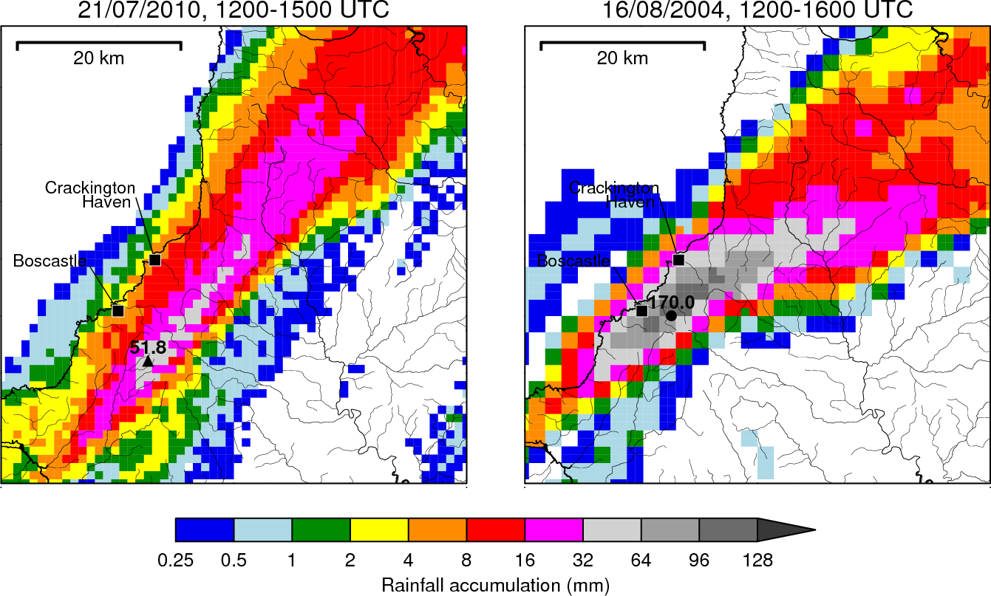
Rainfall comparison 1
Robert Warren
Lunchtime Seminar – 11/06/2013
13

Slide 14
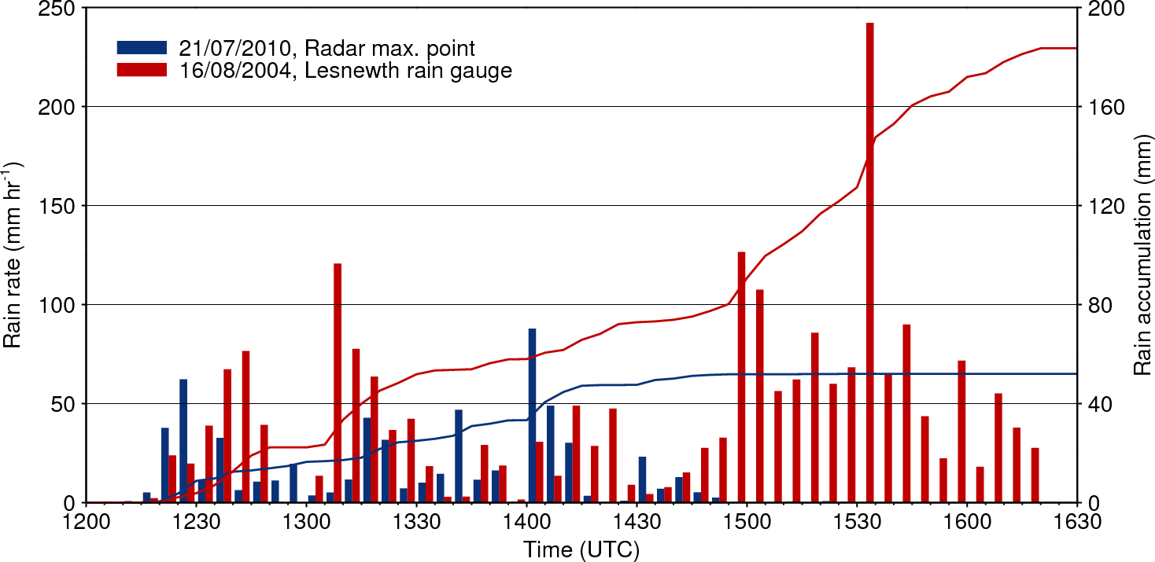
Rainfall comparison 2
Corrected Lesnewth gauge data courtesy of Stephen Burt. See Burt (2005) for methodology.
Robert Warren
Lunchtime Seminar – 11/06/2013
14

Slide 15
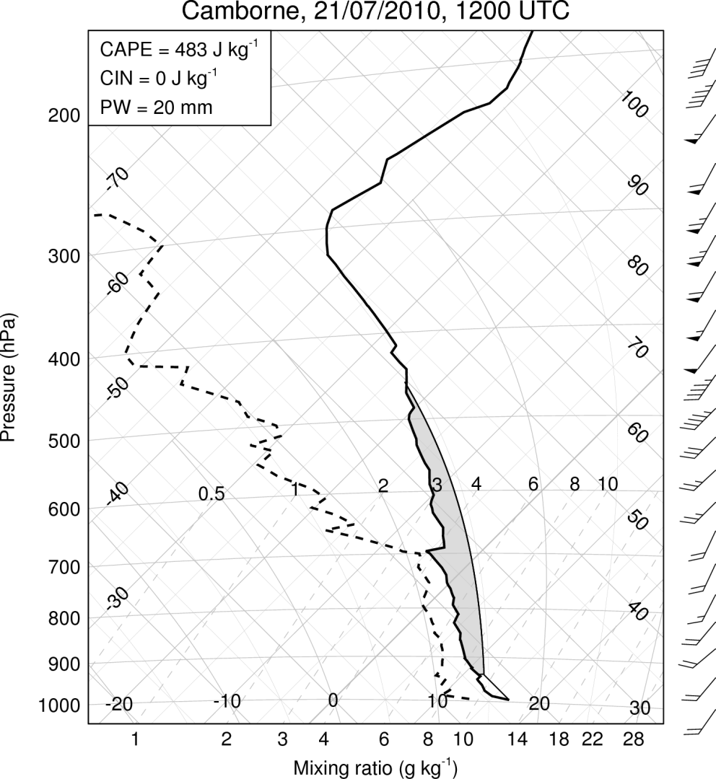
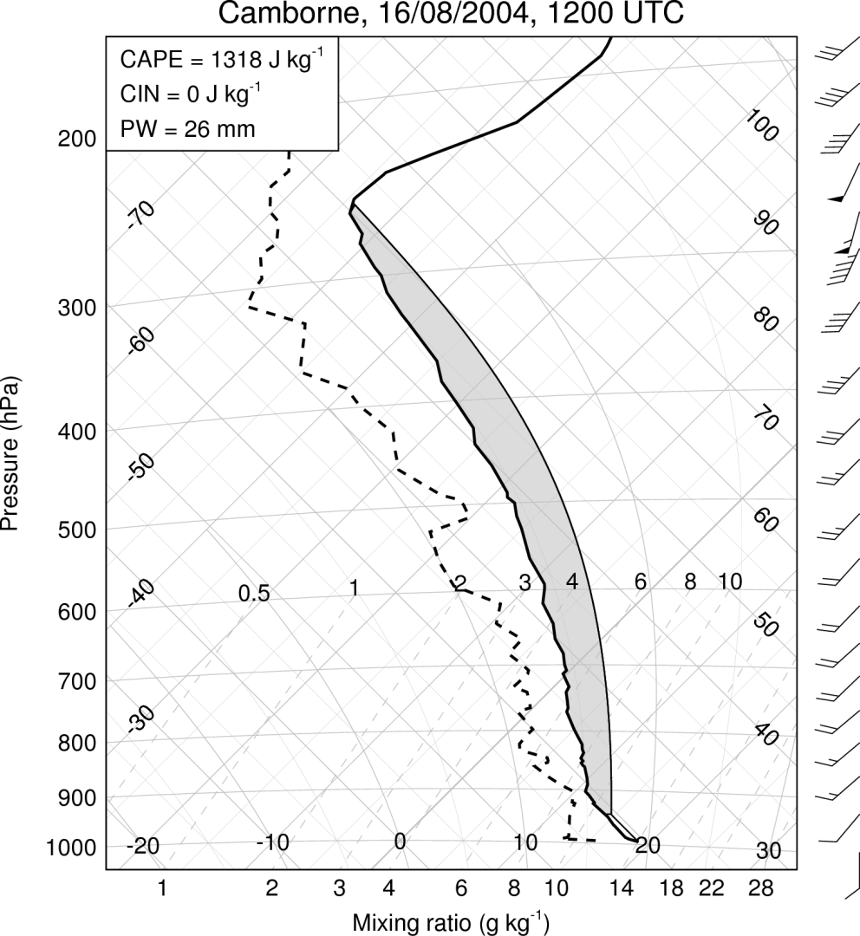
Tephigram comparison: 12 UTC
Robert Warren
Lunchtime Seminar – 11/06/2013
15

Slide 16
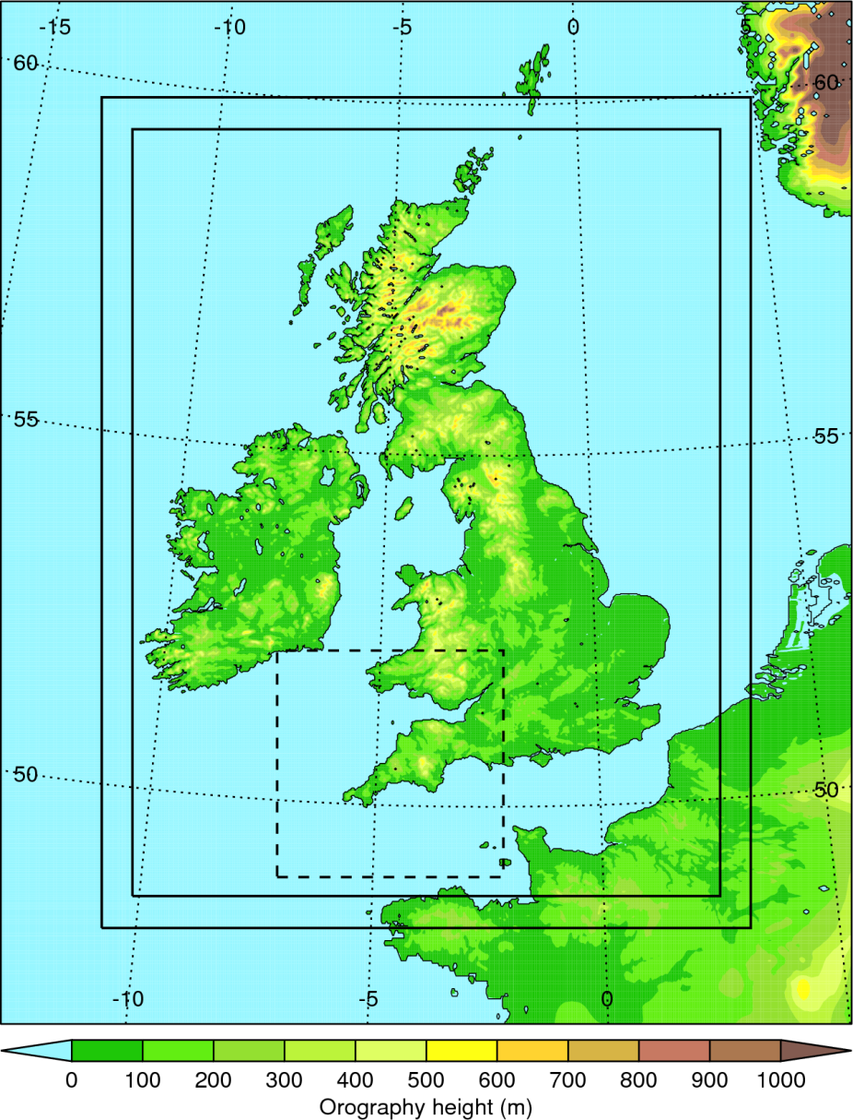
Simulation strategy
Met Office Unified Model (UM)
UKV configuration from PS22 (operational 07/2009 to 03/2010):
1.5 km grid spacing over UK
Explicit convection
Runs initialised from 0400 UTC operational UKV analysis
LBCs from 0000 UTC NAE run
Runs performed on smaller domain nested within UKV model
Robert Warren
Lunchtime Seminar – 11/06/2013
16

Slide 17
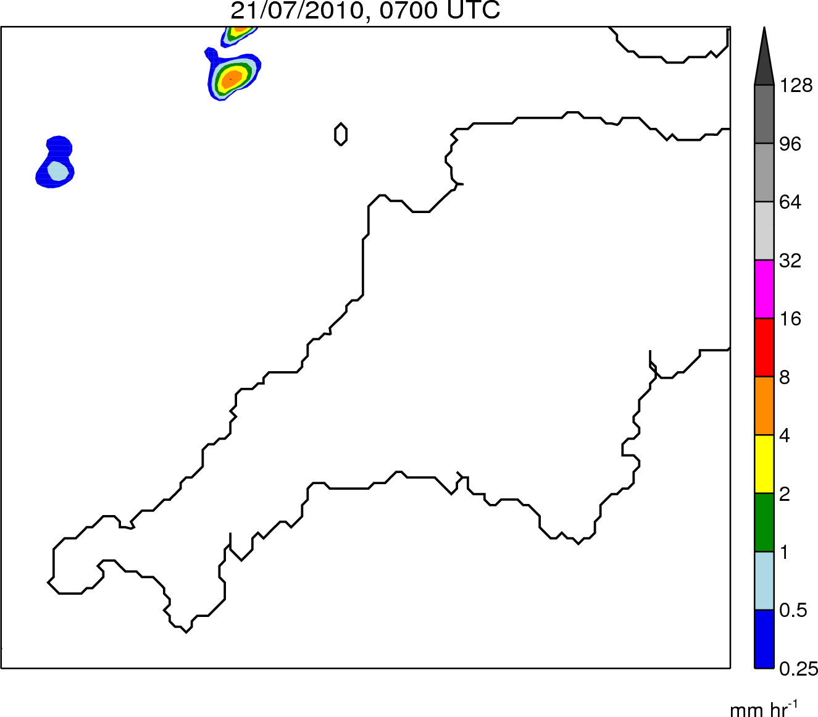
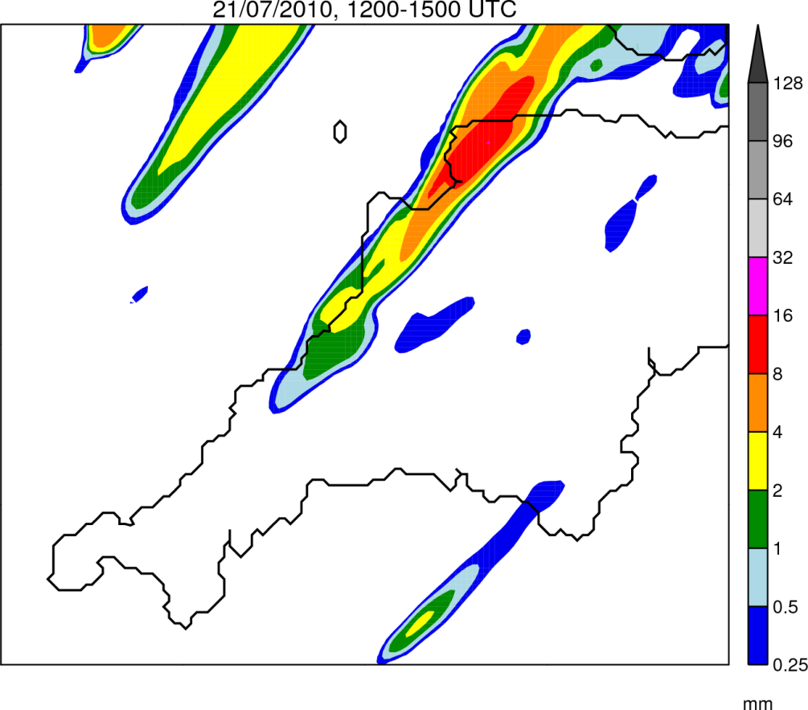
Control simulation: Rainfall
Rain Rate
0700–1900 UTC
Rain Accumulation
1200–1500 UTC
Robert Warren
Lunchtime Seminar – 11/06/2013
17

Slide 18
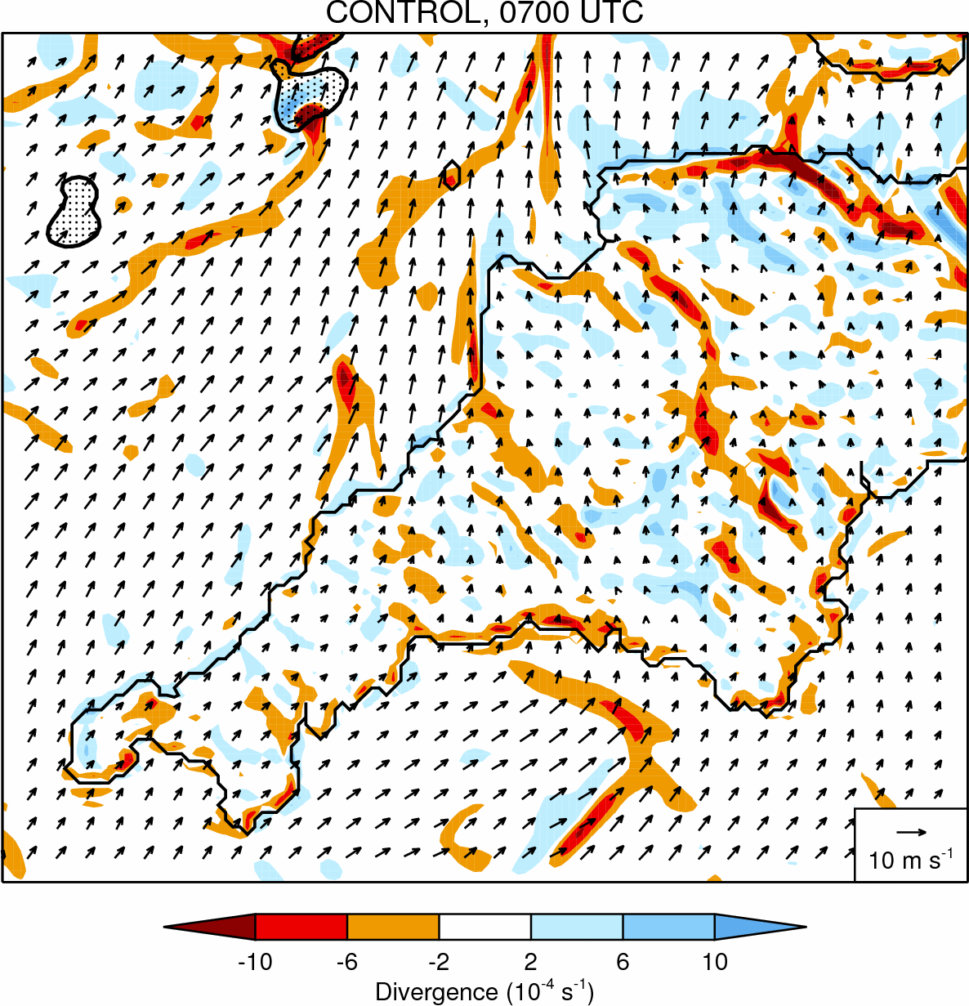
Control simulation: Divergence
Robert Warren
Lunchtime Seminar – 11/06/2013
18

Slide 19
Sensitivity tests: Methodology
NAME | Factor under investigation | Methodology
WEAKSUN | Differential surface heating | Solar constant reduced to 400 W m⁻²
SAMEROUGH | Differential surface roughness | Roughness length for momentum over land and sea fixed to 4 x 10⁻⁵ m
NOOROG | Orography | Land height over Southwest Peninsula set to zero
NOOUTFLOW | Convective outflow | Latent cooling due to evaporation of rain and melting of snow switched off
Robert Warren
Lunchtime Seminar – 11/06/2013
19

Slide 20
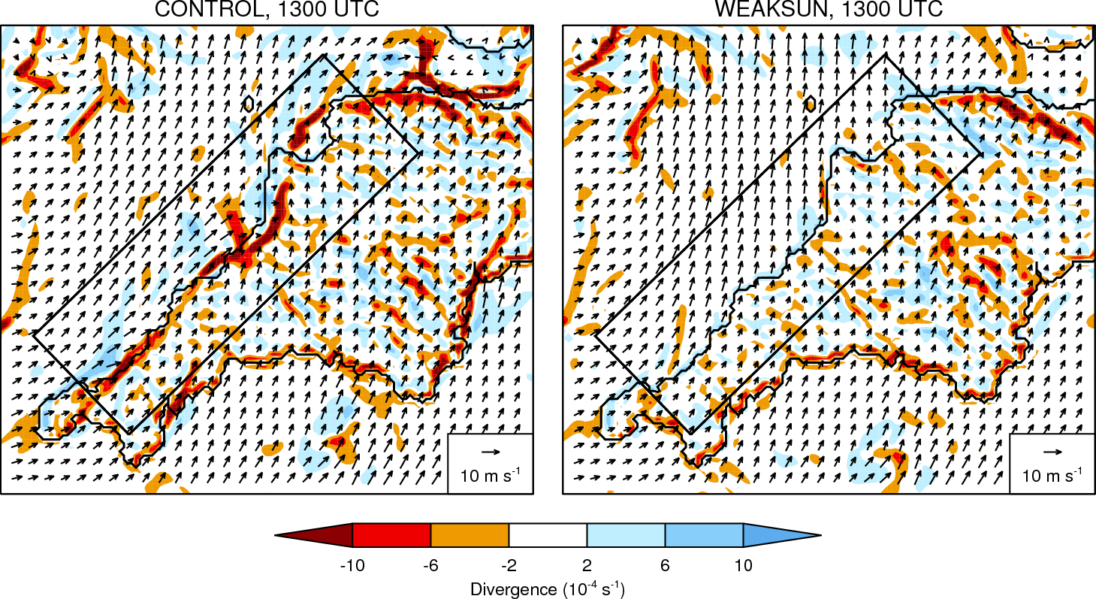
WEAKSUN run: Divergence
Robert Warren
Lunchtime Seminar – 11/06/2013
20

Slide 21
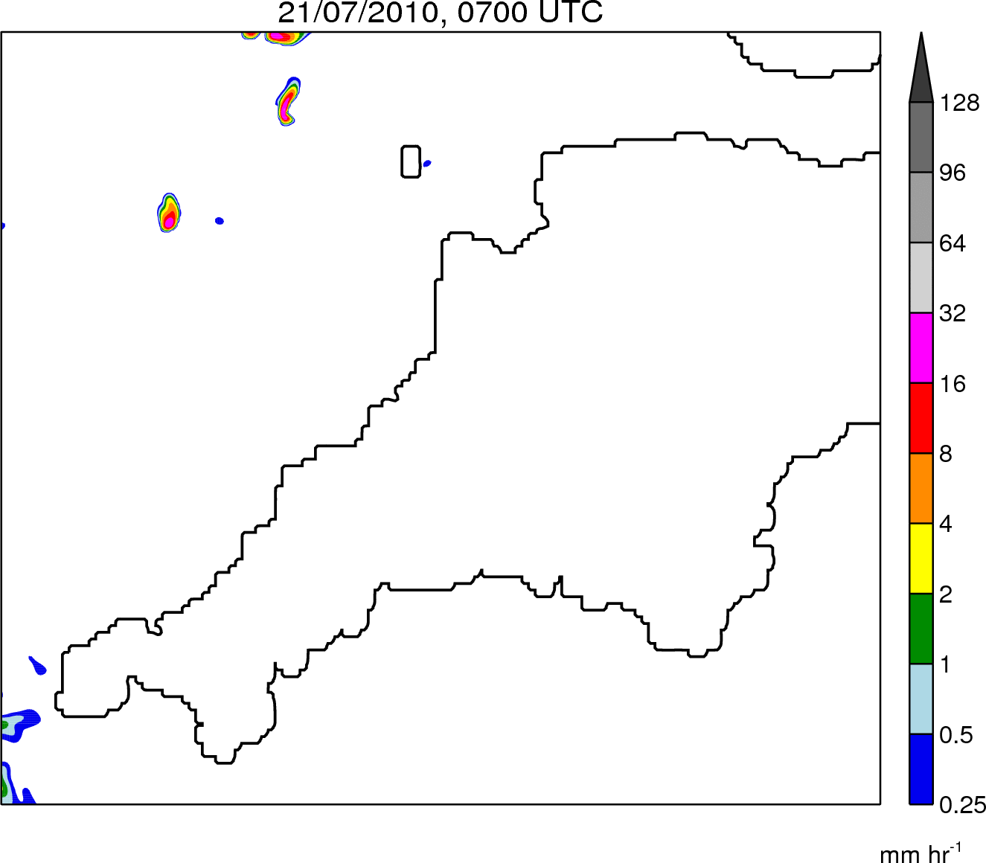
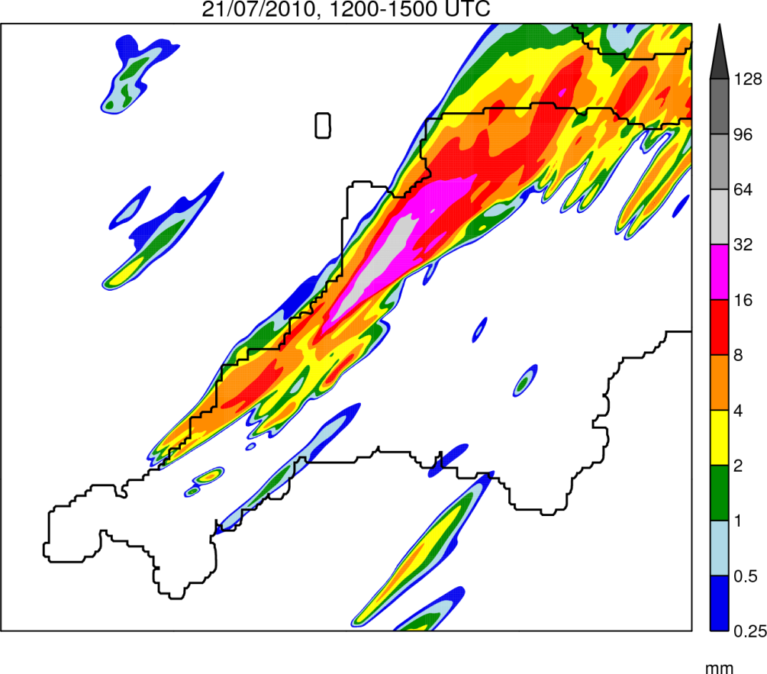
500m simulation: Rainfall
Rain Rate
0700–1900 UTC
Rain Accumulation
1200–1500 UTC
Robert Warren
Lunchtime Seminar – 11/06/2013
21

Slide 22
Full comparison
Robert Warren
Lunchtime Seminar – 11/06/2013
22

Slide 23
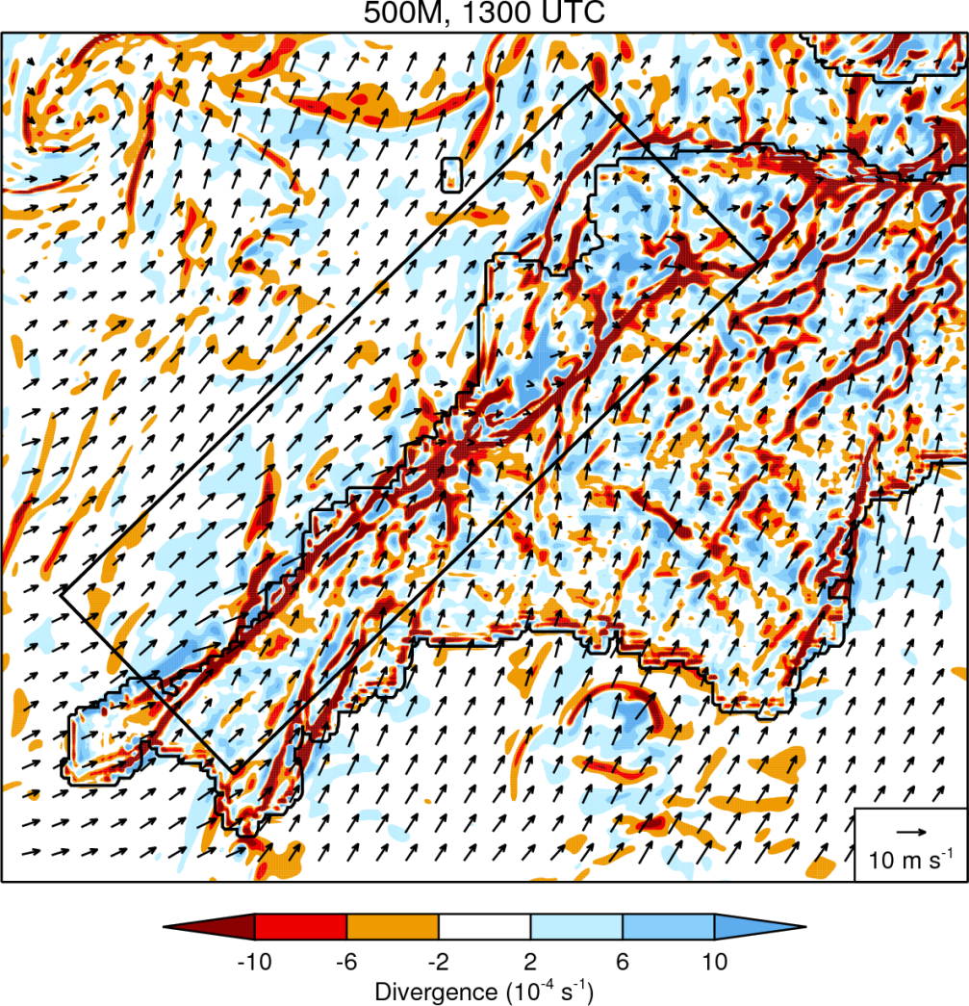
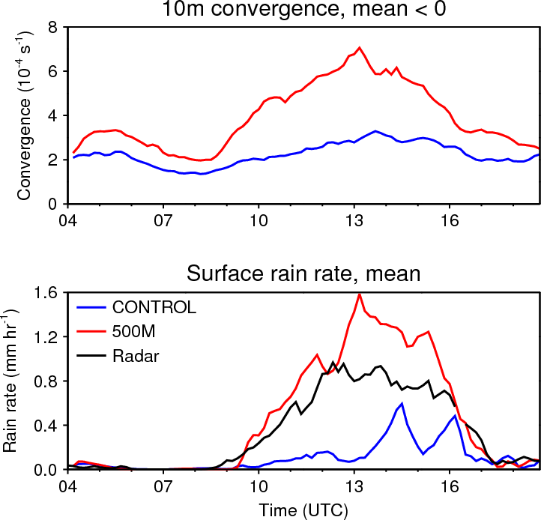
500m simulation: Divergence
$$D=\frac{∆u}{∆x}+\frac{∆v}{∆y}$$
Robert Warren
Lunchtime Seminar – 11/06/2013
23

Slide 24
Summary of results
Comparison of 21/07/2010 and Boscastle cases:
QSCSs were very similar in their location and structure
Much higher rainfall accumulations in the Boscastle case due to higher rain rates and a longer system duration
Rainfall was also distributed over fewer river catchments
Numerical simulations of 21/07/2010 case:
QSCS was forced by convergence along a quasi-stationary sea breeze front, maintained in place by an offshore-directed background wind
At 1.5 km grid spacing, the system is poorly represented; significant improvements result from using 500 m grid spacing, in part due to the convergence line being better resolved
Robert Warren
Lunchtime Seminar – 11/06/2013
24

Slide 25
Part II: Climatology

Slide 26
Project questions revisited
How common are QSCSs in UK?
How does their occurrence vary geographically and temporally?
Are there synoptic situations which specifically favour the development of QSCSs?
What are the typical mechanisms of storm anchoring?
How sensitive is storm anchoring to small changes in ambient conditions?
How well are QSCSs represented in NWP models at the highest resolutions currently used operationally?
Does this representation improve at higher resolutions?
Robert Warren
Lunchtime Seminar – 11/06/2013
26

Slide 27
Data and algorithm requirements
Data requirements:
Must cover the entire UK
Must have sufficient resolution for storms to be identified
Must be available for a long enough period to create a robust climatology
Algorithm requirements:
Must be able to distinguish between (deep) convective and stratiform precipitation
Must be able to isolate stationary precipitation features
Must be fast – able to process several years worth of data in a ‘reasonable’ amount of time
Robert Warren
Lunchtime Seminar – 11/06/2013
27

Slide 28
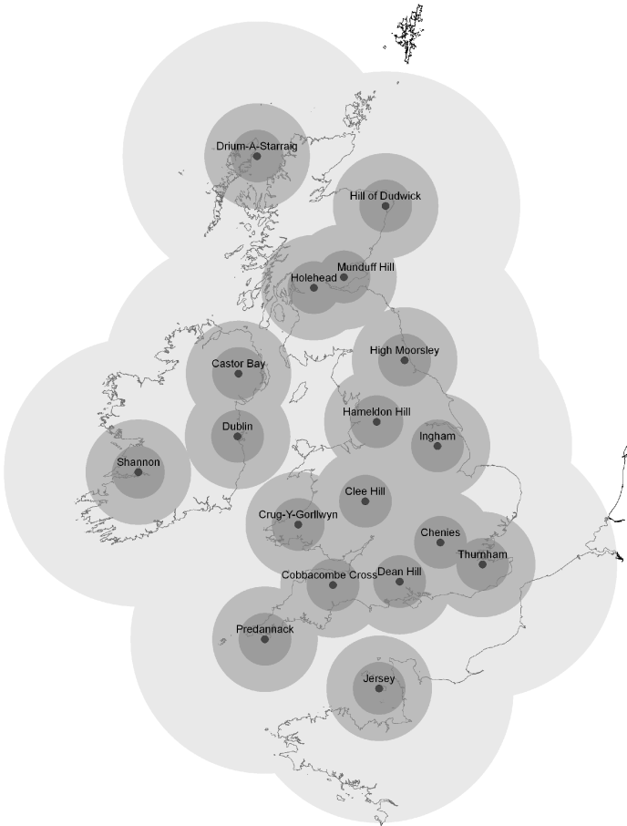
Data: The UK 1km radar composite
18 C-band radars, scanning every 5mins with a resolution of 600m x 1° out to 255 km range
QC steps to remove spurious echoes, correct for attenuation, account for variations in the VPR, and adjust to rain gauges (Harrison et al. 2012)
Reflectivity converted to rain rate according to $Z=200R^{1.6}$
Individual radar scans composited on a 1 km x 1 km Cartesian grid
Robert Warren
Lunchtime Seminar – 11/06/2013
28

Slide 29
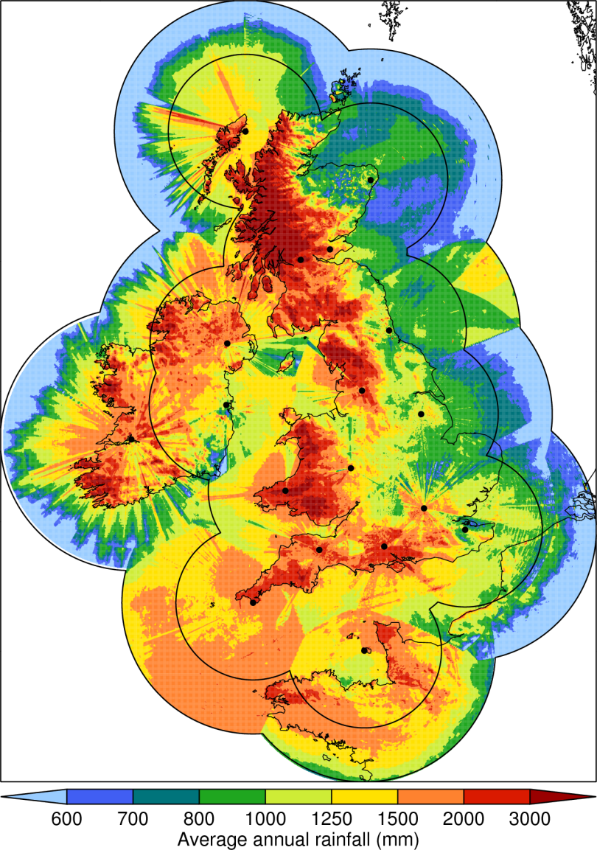
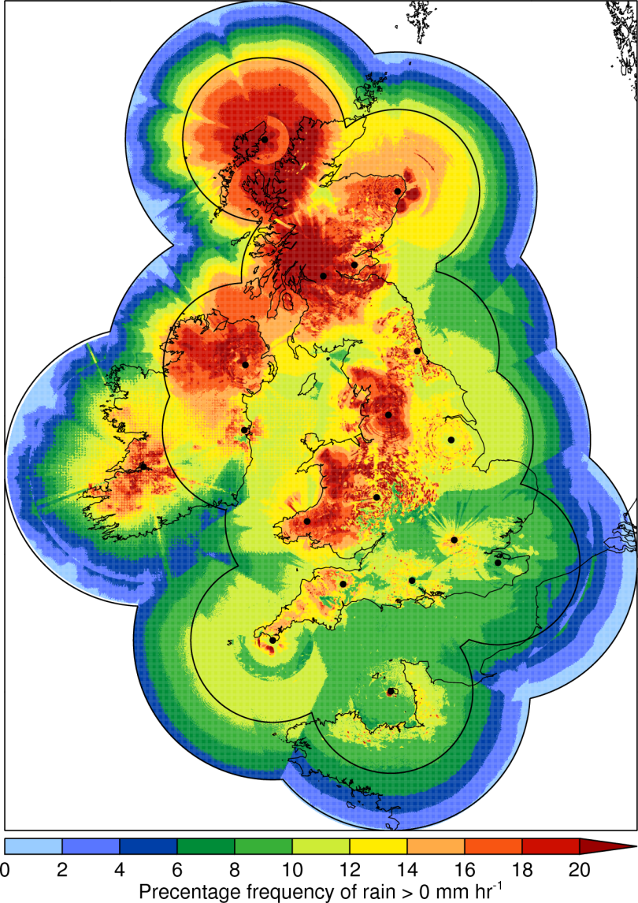
Data issues
Robert Warren
Lunchtime Seminar – 11/06/2013
29

Slide 30
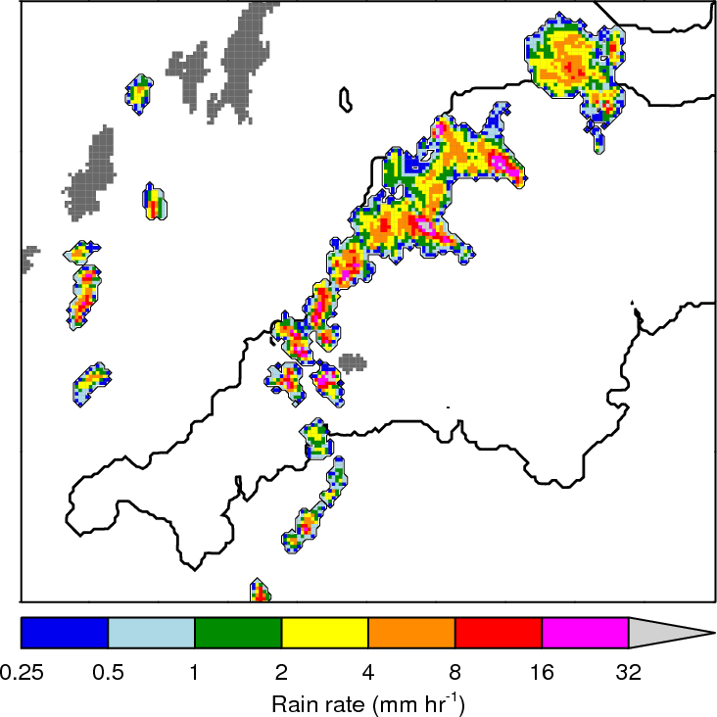
Identification of convective rainfall
Premise:
Precipitation associated with deep convection is typically characterised by strong rainfall gradients
Method:
Identify rainfall objects
Determine rainfall gradients
Retain only those objects with a high fraction of large-gradient pixels
Robert Warren
Lunchtime Seminar – 11/06/2013
30

Slide 31
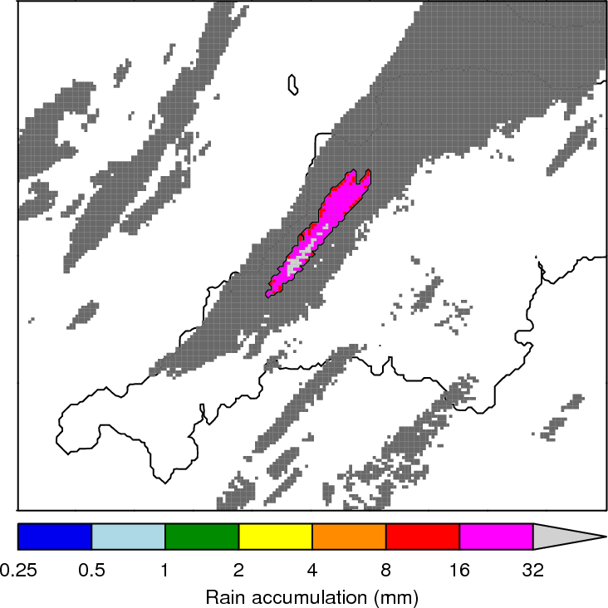
Identification of stationary features
Premise:
QS features will produce areas of large rainfall accumulation. Within these, rain will be present during most of the accumulation period.
Method:
Identify accumulation objects
Compute the duration and persistence of rainfall within these
Retain only those objects with long-duration persistent rainfall
Robert Warren
Lunchtime Seminar – 11/06/2013
31

Slide 32
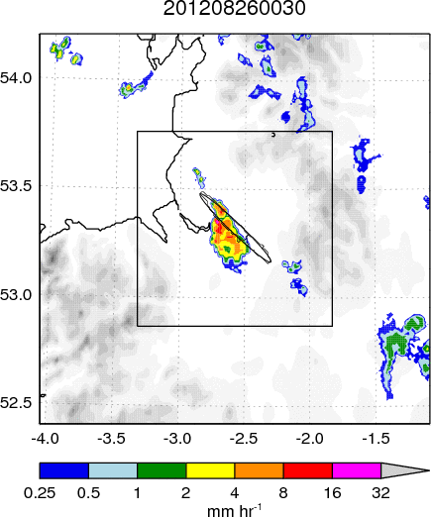
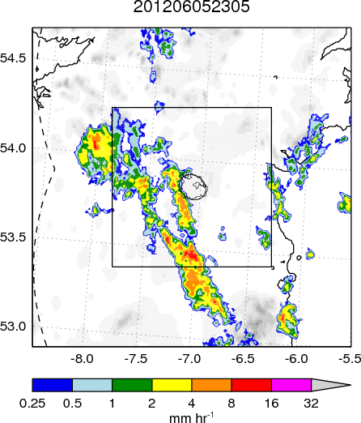
Identification examples
Robert Warren
Lunchtime Seminar – 11/06/2013
32

Slide 33
Event classifications
(1)
(2)
New cells form here
Cell motion
System motion ≈ cell motion
(4)
New cells form here
(3)
(5)
Cell motion
System motion
Robert Warren
Lunchtime Seminar – 11/06/2013
33

Slide 34
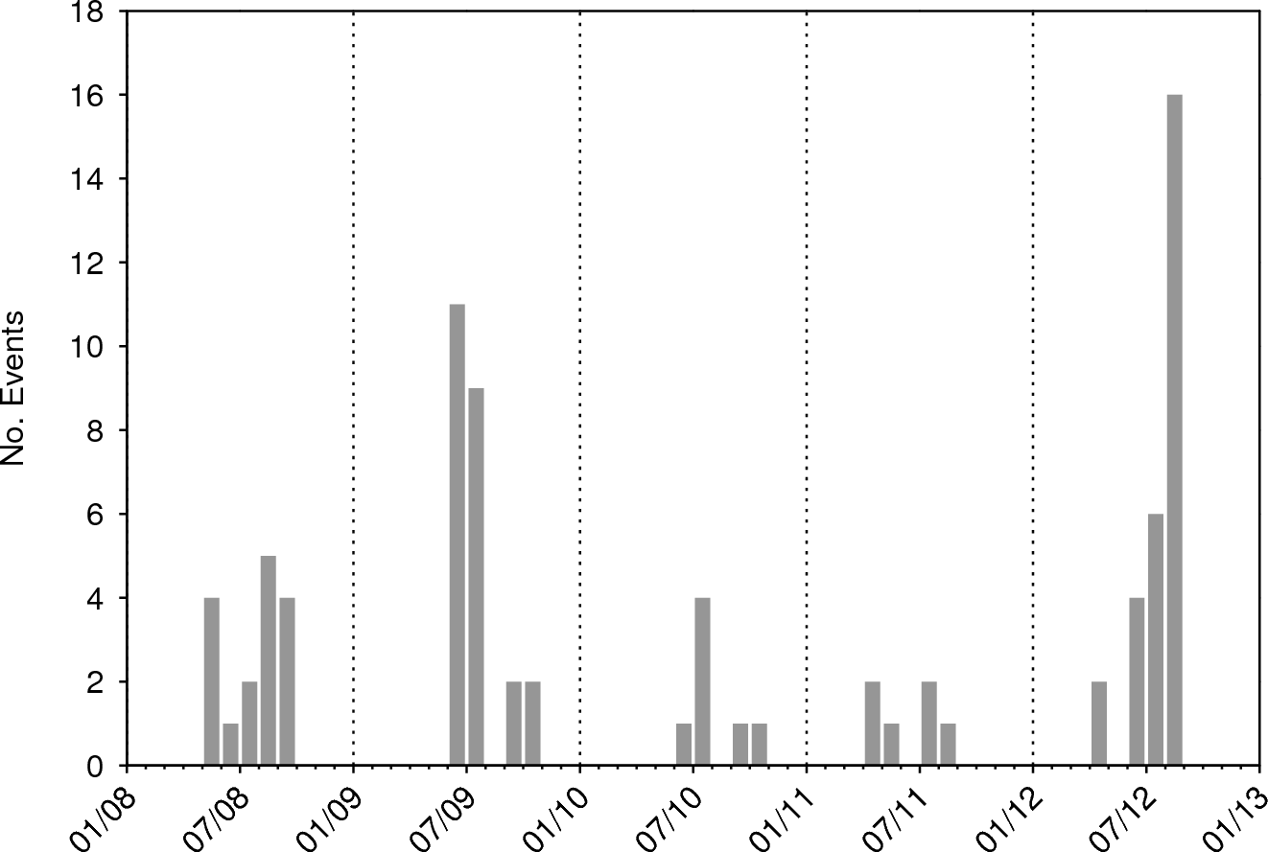
QSCS (Type 1) climatology
Robert Warren
Lunchtime Seminar – 11/06/2013
34

Slide 35
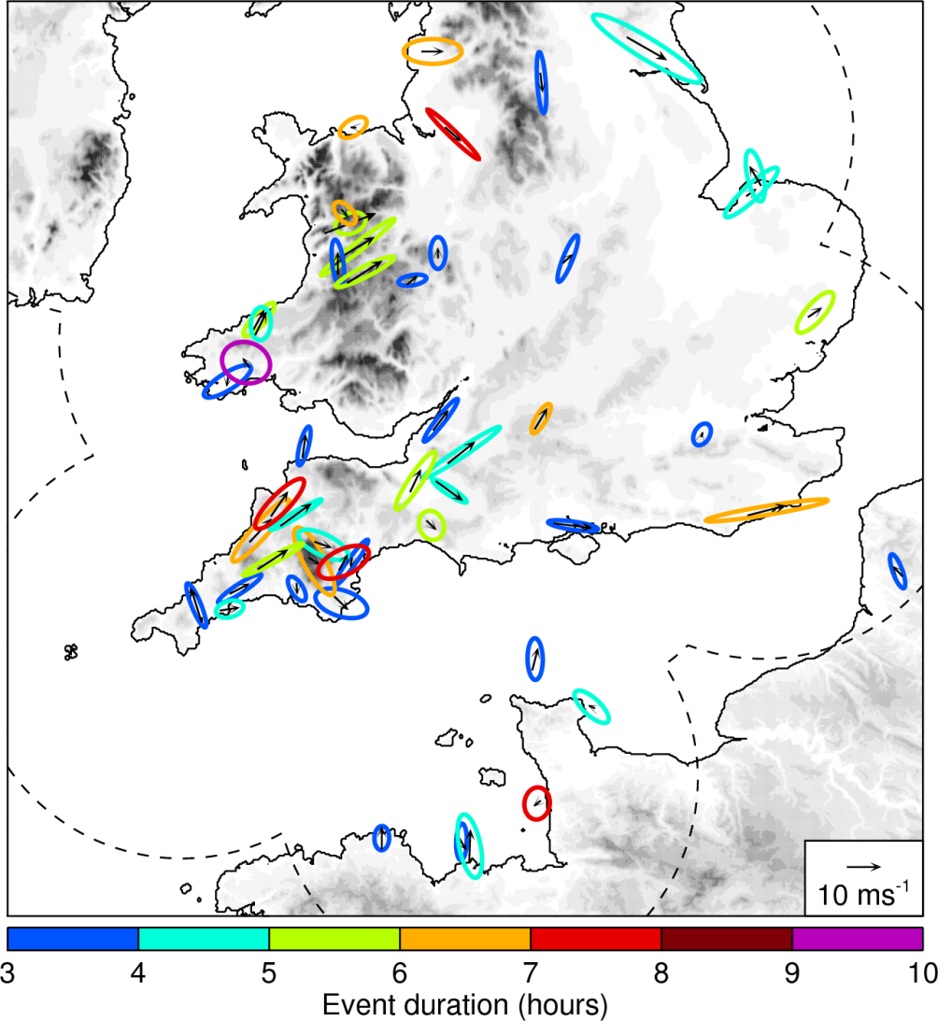
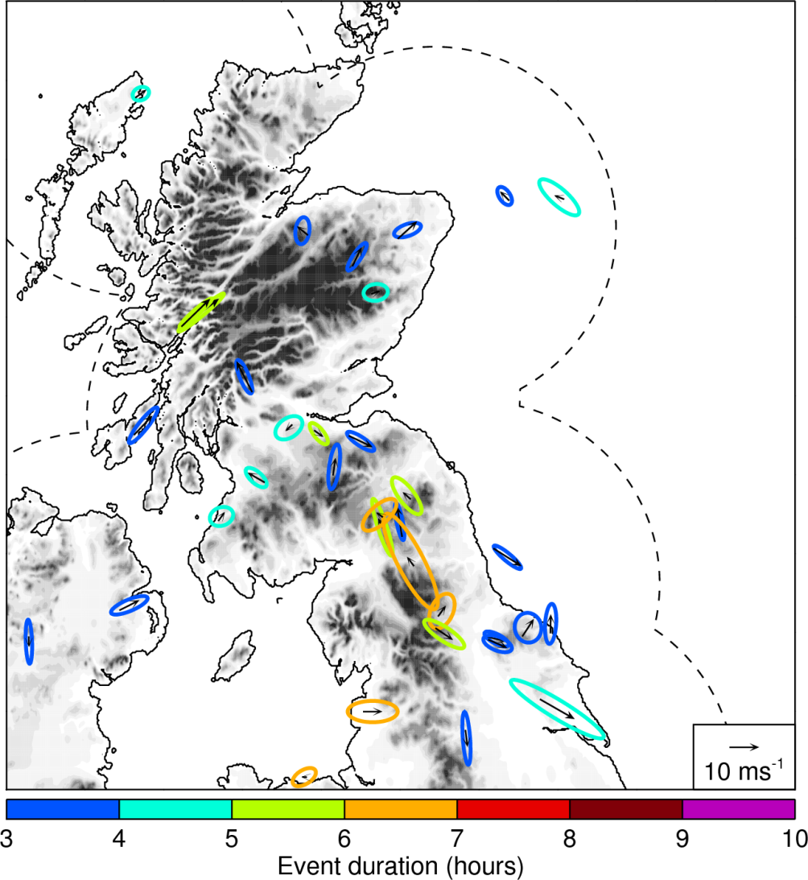
Geographical variation
Robert Warren
Lunchtime Seminar – 11/06/2013
35

Slide 36
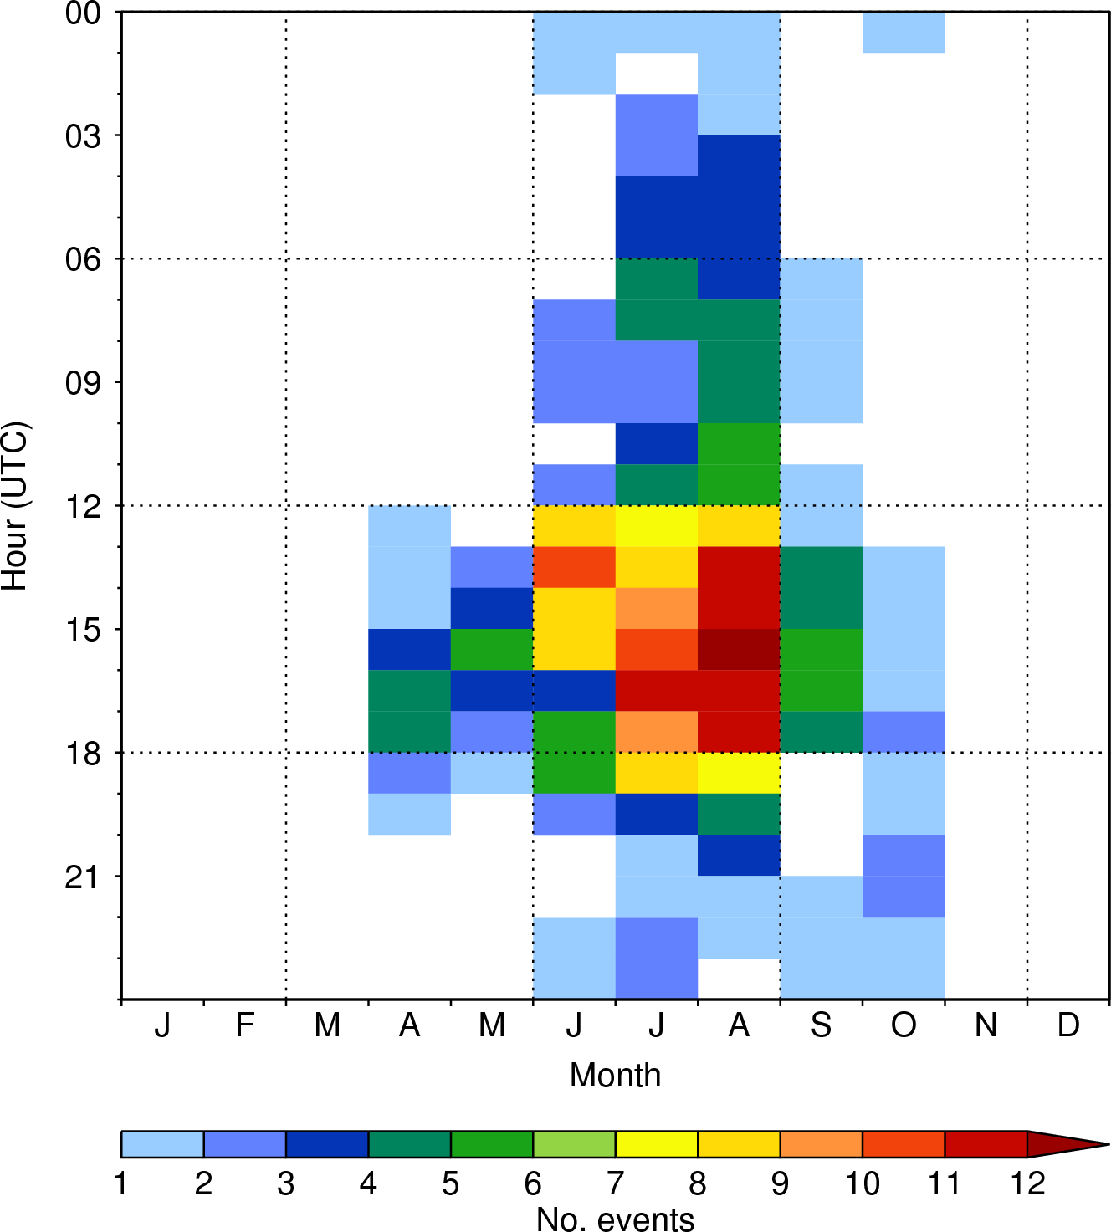
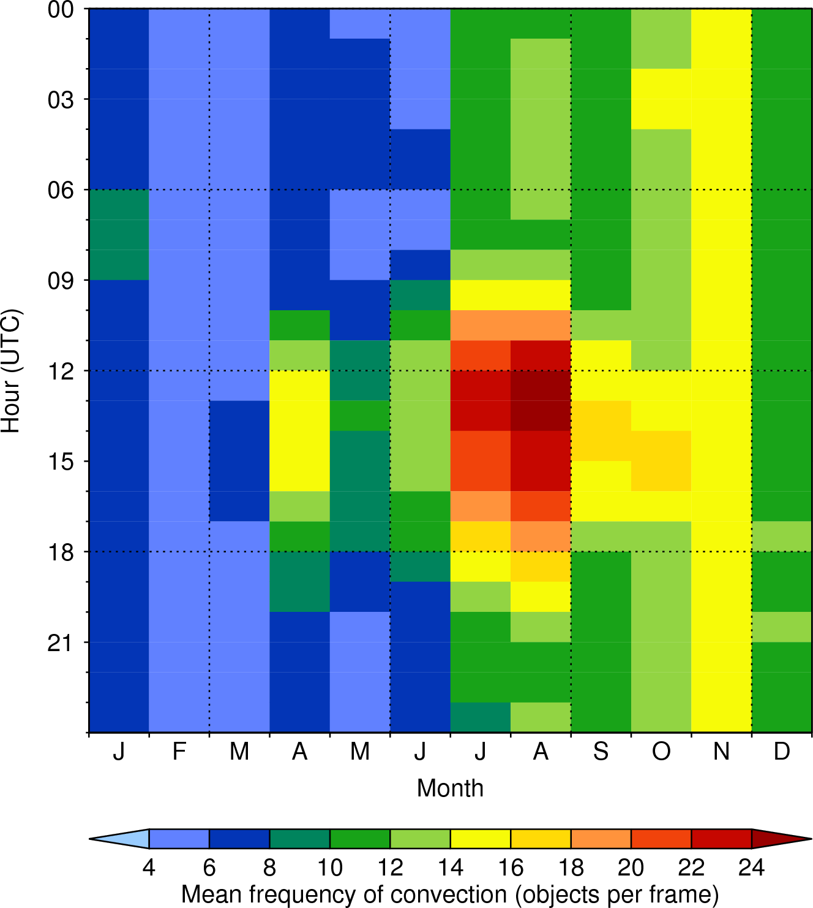
Temporal variation
Robert Warren
Lunchtime Seminar – 11/06/2013
36

Slide 37
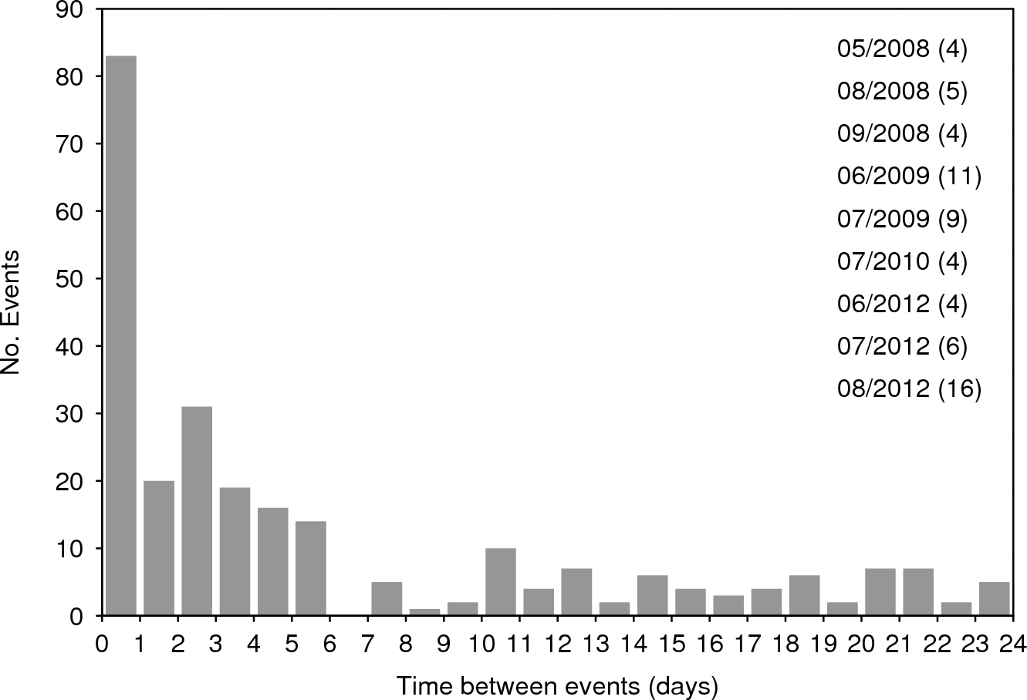
Temporal variation
Multi-event days
Robert Warren
Lunchtime Seminar – 11/06/2013
37

Slide 38
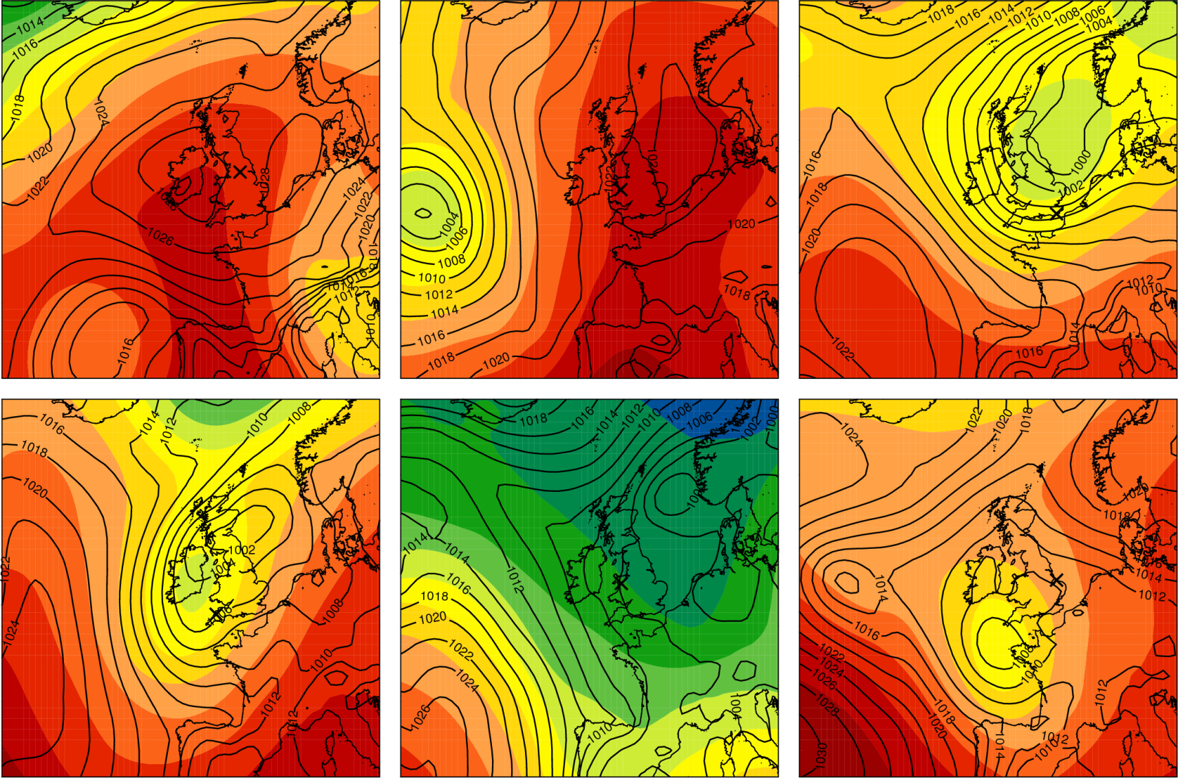
Synoptic environment: Map plots
Robert Warren
Lunchtime Seminar – 11/06/2013
38

Slide 39
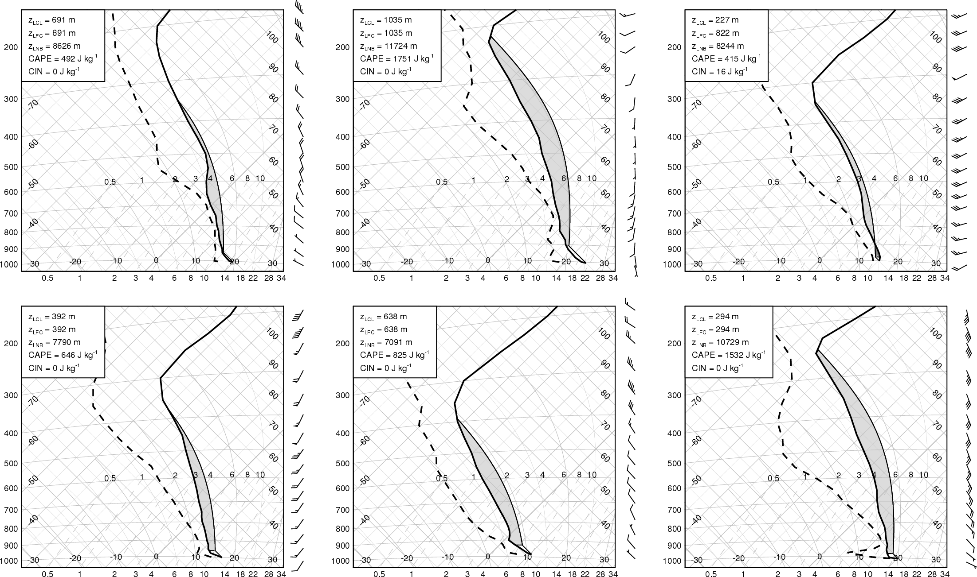
Local environment: Tephigrams
Robert Warren
Lunchtime Seminar – 11/06/2013
39

Slide 40
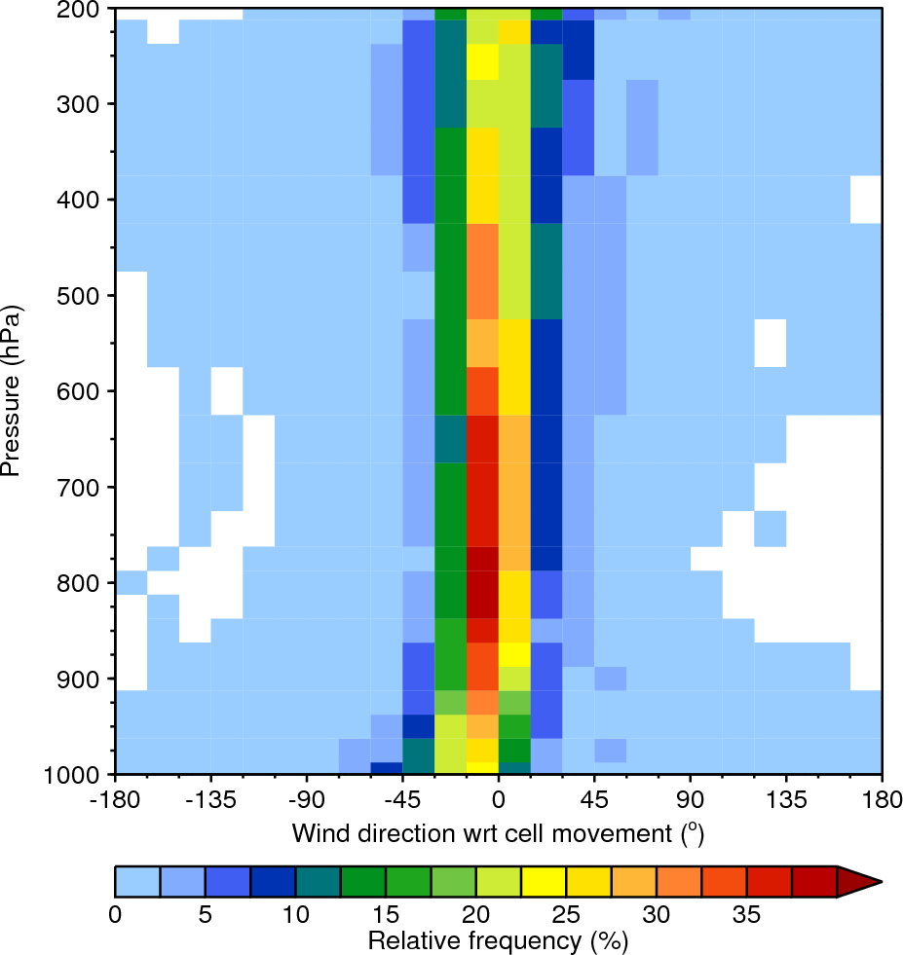
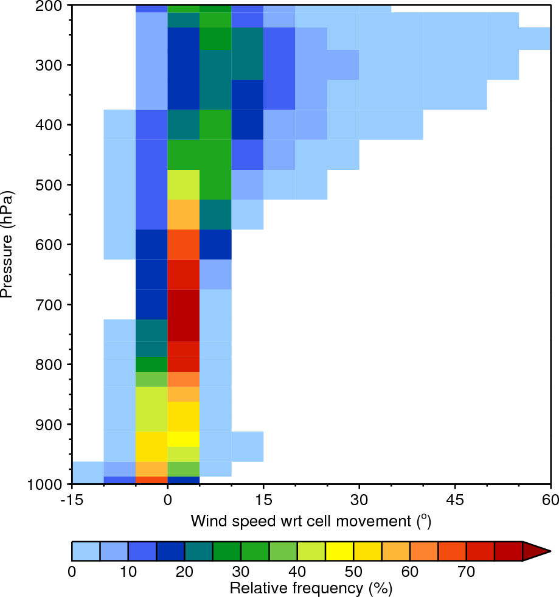
Ongoing work: summarising the data
Robert Warren
Lunchtime Seminar – 11/06/2013
40

Slide 41
Conclusions so far
The ‘gradient method’ provides a simple and reasonably effective way of isolating rainfall areas associated with deep convection
Our algorithm successfully identifies long-duration convective rain events; however, further manual analysis is needed to isolate QSCSs
QSCSs occur across most of the country but are most common in the vicinity of coastlines and orographic features
QSCSs occur under a wide range of synoptic conditions but their local environment typically features deep instability and an approximately unidirectional wind profile
Robert Warren
Lunchtime Seminar – 11/06/2013
41

Slide 42
Summary and Future Work

Slide 43
Take home messages
Case study
The highest resolutions currently used in operational NWP may still be insufficient to capture convective storms which are forced by narrow zones of boundary layer convergence. In these cases, improved initial conditions and the use of high-resolution ensembles may provide little benefit.
Climatology
There may not be anything particularly special about the environments in which QSCSs form, other than that they are conducive to deep, moist convection. Provided that conditionally unstable air is continuously lifted (either by a fixed surface feature or some quasi-steady atmospheric process) and that cell motion remains near-constant, convective cells will repeatedly initiate and train across the same area.
Robert Warren
Lunchtime Seminar – 11/06/2013
43

Slide 44
Future work
Climatology
Find further meaningful was to summarise environment data
Investigate whether certain environment characteristics common to QSCS events (e.g. unidirectional wind profile) are ‘unusual’
Look specifically at the environments on multiple-event days – is there something unique about them
Idealised simulations
Investigate the conditions under which quasi-stationary coastal convergence zones form along a simplified peninsula
Vary the land surface heat flux and ambient wind velocity
Examine the sensitivity to other factors (peninsula width, latitude, etc.)
Robert Warren
Lunchtime Seminar – 11/06/2013
44

Slide 45
References
Bresson, E., V. Ducrocq, O. Nuissier, D. Ricard, and C. de Saint-Aubin, 2012: Idealized numerical simulations of quasi-stationary convective systems over the Northwestern Mediterranean complex terrain. Q. J. R. Meteor. Soc., 138, 1751–1763.
Burt, S., 2005: Cloudburst upon Hendraburnick Down: The Boscastle storm of 16 August 2004. Weather, 60, 219–227.
Doswell, C. A., III, H. E. Brooks, and R. A. Maddox, 1996: Flash flood forecasting: An ingredients based methodology. Wea. Forecasting, 11, 560–581.
Golding, B., 2005: ‘Boscastle and North Cornwall post-flood event study: Meteorological analysis of the conditions leading to flooding on 16 August 2004’. Forecasting Research Technical Report No. 459. Met Office, Exeter, UK.
Golding, B., P. A. Clark, and B. May, 2005: The Boscastle flood: Meteorological analysis of the conditions leading to flooding on 16 August 2004. Weather, 60, 230–235.
Harrison, D. L., N. Gaussiat, C. Pierce, and K. Norman, 2012: Radar products for hydrological applications in the UK. Proc. Inst. Civil Eng. – Water Manag., 165, 89–103.
Hand, W. H., N. I. Fox, and C. G. Collier, 2004: A study of twentieth-century extreme rainfall events in the United Kingdom with implications for forecasting. Meteor. Appl., 11, 15–31.
Maddox, R. A., C. F. Chappell, and L. R. Hoxit, 1979: Synoptic and meso-α scale aspects of flash flood events. Bull. Amer. Meteor. Soc., 61, 1374–1387.
Nuissier, O., B. Joly, A. Joly, V. Ducrocq, and P. Arbogast, 2011: A statistical downscaling to identify the large-scale circulation patterns associated with heavy precipitation events over southern France. Q. J. R. Meteor. Soc., 137, 1812–1827.
Ricard, D., V. Ducrocq, and L. Auger, 2012: A climatology of the mesoscale environment associated with heavily precipitating events over a northwestern Mediterranean area. J. Appl. Meteor. Climatol., 51, 468–488.
Schumacher, R. S., 2009: Mechanisms for quasi-stationary behavior in simulated heavy-rain-producing convective systems. J. Atmos. Sci., 66, 1543–1568.
Schumacher, R. S. and R. H. Johnson, 2005: Organization and environmental properties of extreme-rain-producing mesoscale convective systems. Mon. Wea. Rev.,133, 961–976.
Schumacher, R. S. and R. H. Johnson, 2006: Characteristics of U.S. extreme rain events during 1999–2003. Wea. And Forecasting, 21, 69–85.
Robert Warren
Lunchtime Seminar – 11/06/2013
45

Slide 46
Extra slides

Slide 47
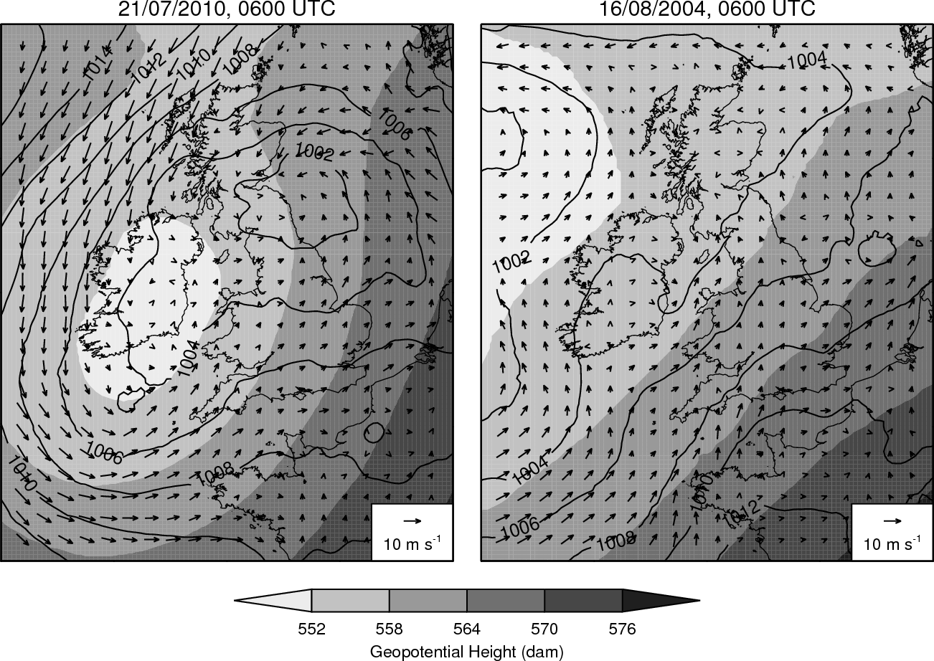
Synoptic comparison: 06 UTC
Robert Warren
Lunchtime Seminar – 11/06/2013
47

Slide 48
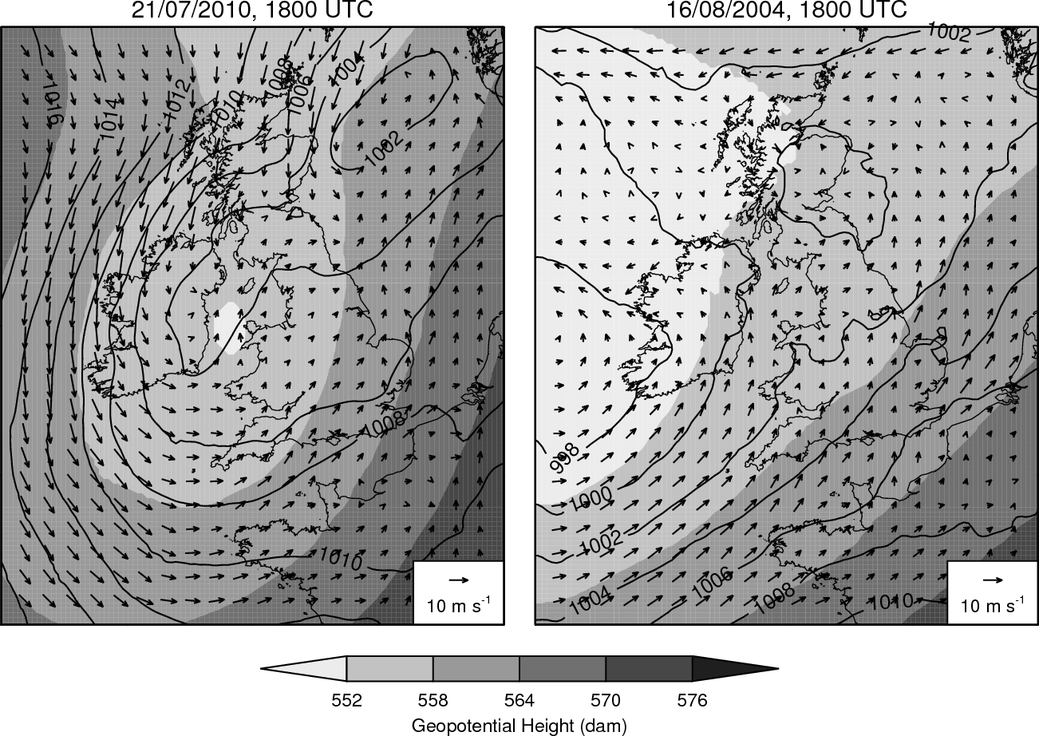
Synoptic comparison: 18 UTC
Robert Warren
Lunchtime Seminar – 11/06/2013
48

Slide 49
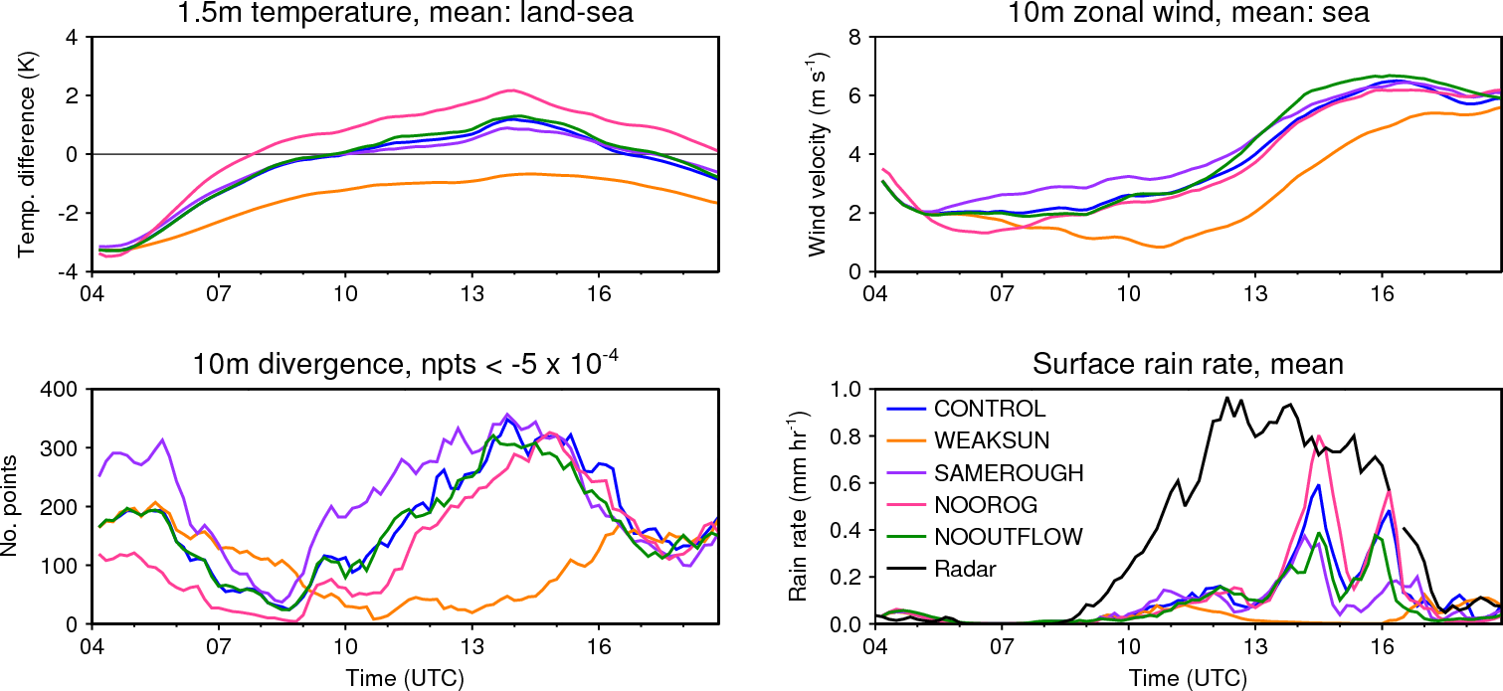
Sensitivity results summary
Robert Warren
Lunchtime Seminar – 11/06/2013
49

Slide 50
Identification of convective rainfall
$$j=1$$
$j=$2
$$j=3$$
$$j=8$$
$$i$$
$j=$4
$$j=7$$
$$j=6$$
$$j=5$$
$$G=\left|R_{M}−R_{7}\right|$$
Robert Warren
Lunchtime Seminar – 11/06/2013
50

Slide 51
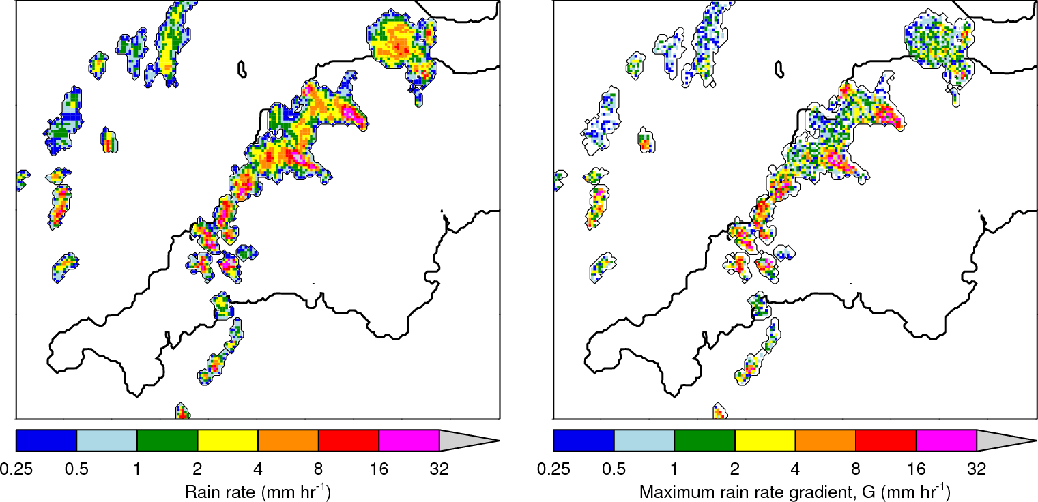
Example 1: Convective rain
Robert Warren
Lunchtime Seminar – 11/06/2013
51

Slide 52
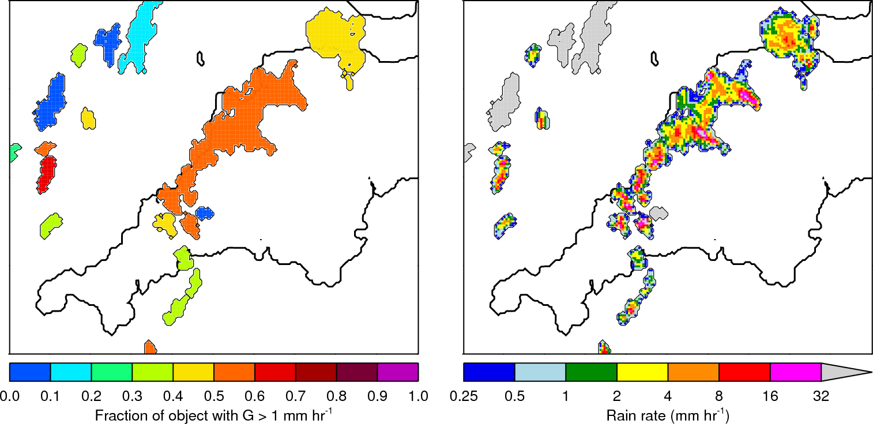
Example1: Convective rain
Robert Warren
Lunchtime Seminar – 11/06/2013
52

Slide 53
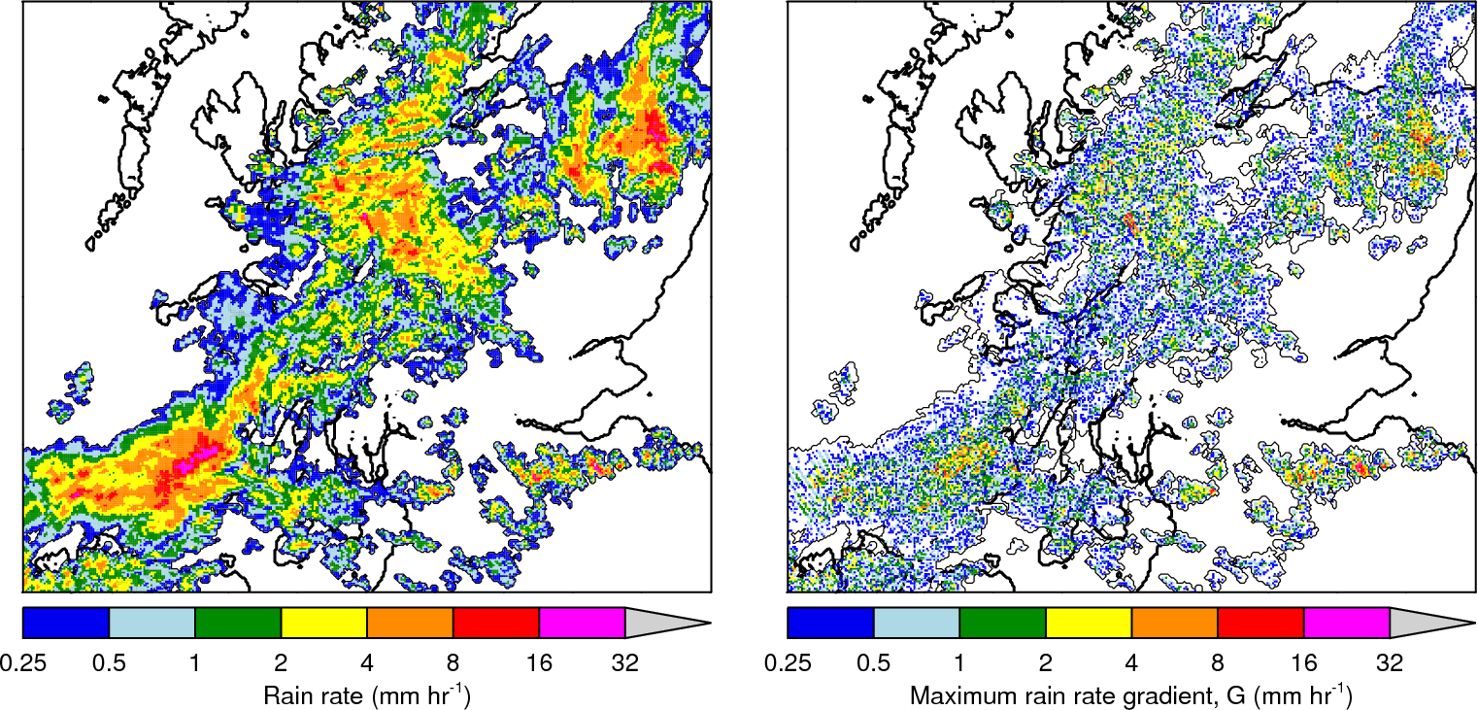
Example 2: Stratiform rain
Robert Warren
Lunchtime Seminar – 11/06/2013
53

Slide 54
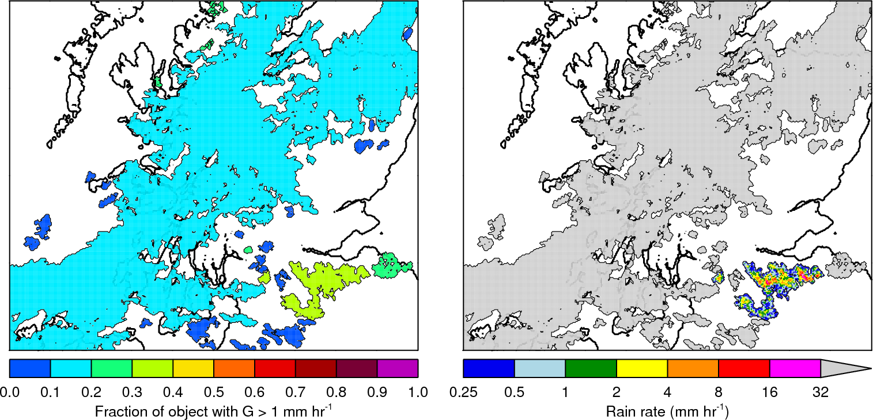
Example 2: Stratiform rain
Robert Warren
Lunchtime Seminar – 11/06/2013
54

Slide 55
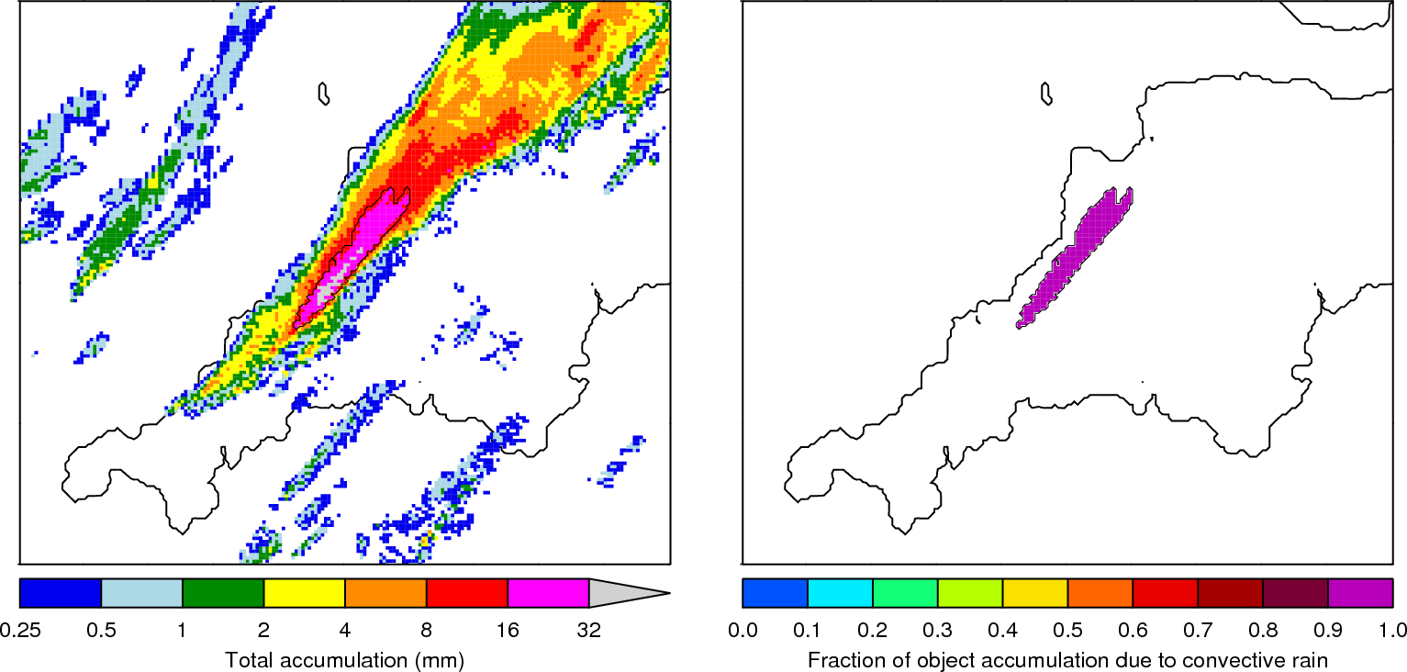
Example: Convection test
Robert Warren
Lunchtime Seminar – 11/06/2013
55

Slide 56
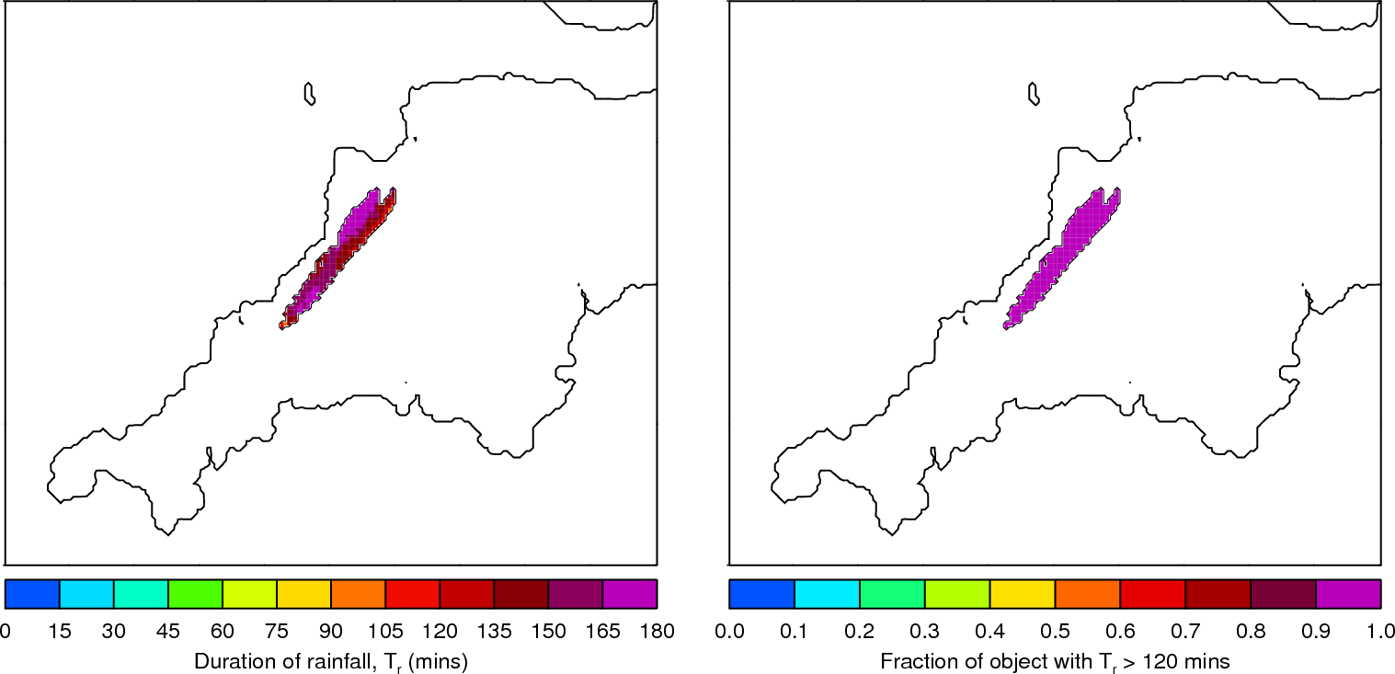
Example: Duration test
Robert Warren
Lunchtime Seminar – 11/06/2013
56

Slide 57
Example: Persistence test
Robert Warren
Lunchtime Seminar – 11/06/2013
57

Slide 58
Full algorithm
Accumulate rainfall over a 3 h period and identify objects using a threshold of 15 mm
Determine whether this rainfall was the result of a long-duration convective event using thresholds on previously defined fractions
Temporarily store candidate objects
Links candidate objects from adjacent accumulation periods based on their spatial and temporal proximity
For the resulting linked objects, apply additional thresholds for size, duration, and stationarity
Store data on those objects that meet the criteria
Robert Warren
Lunchtime Seminar – 11/06/2013
58

Slide 59
Examining the synoptic environment
12 panel figures produced for each case
ERA-Interim data used ($∆x≈$ 70 km; $∆p=$ 25–50 hPa)
Plots include:
MSLP, 500 hPa $Z$ and fronts
Tephigram
Precipitable water
Vertical velocity
Cross-sections of PV and $θ$
Robert Warren
Lunchtime Seminar – 11/06/2013
59

Slide 60
Future work: Idealised simulations
Aim: investigate the occurrence of quasi-stationary coastal convergence associated with peninsulas
Prescribed vertical profiles, SSTs, and surface fluxes
Vary land surface heat flux and ambient wind velocity
Investigate sensitivity to other factors (e.g. roughness length, peninsula width, latitude)
Robert Warren
Lunchtime Seminar – 11/06/2013
60

