Slide 1
Quasi-stationary Convective Storms in the UK: A Case Study
Robert Warren
Supervised by Bob Plant, Humphrey Lean & Dan Kirshbaum
Notes:
This is the title slide, PowerPoint will automatically format the first slide with the title master, although this can be changed in the design palette.

Slide 2
Background
First Law of Quantitative Precipitation Forecasting :
“The heaviest precipitation occurs where the rainfall rate is highest for the longest time” – C. F. Chappell
Quasi-stationary convective systems (QSCSs):
  Repeated initiation and training of cells over a localised region
  Can produce extreme rainfall accumulations and flash flooding
Ingredients for deep, moist convection
  Instability (CAPE)
  Moisture
  Lifting mechanism
Must be present for an extended period of time
Notes:
This is a basic slide based on the slide master. To create a slide just insert a new slide (Ctrl+M) and PowerPoint will automatically format the slide with the slide master. Text will automatically placed in bullets. The bullets have five different levels of nesting, to get the next level down you simply use the tab key.

Slide 3
My PhD Project
Quasi-stationary convective storms in the UK
Motivation
  Numerous case studies of QSCS from USA and Mediterranean region; comparatively little work from the UK
  Want to improve understanding of and ability to forecast QSCSs
Key project questions:
  How common are QSCSs in the UK and how does their occurrence vary seasonally, geographically and with synoptic conditions?
  What are the typical mechanisms of storm anchoring in UK QSCSs?
  How well are QSCSs represented in a high-resolution operational NWP model (MetUM, UKV)?
Climatology
Case studies
Notes:
This is a basic slide based on the slide master. To create a slide just insert a new slide (Ctrl+M) and PowerPoint will automatically format the slide with the slide master. Text will automatically placed in bullets. The bullets have five different levels of nesting, to get the next level down you simply use the tab key.

Slide 4
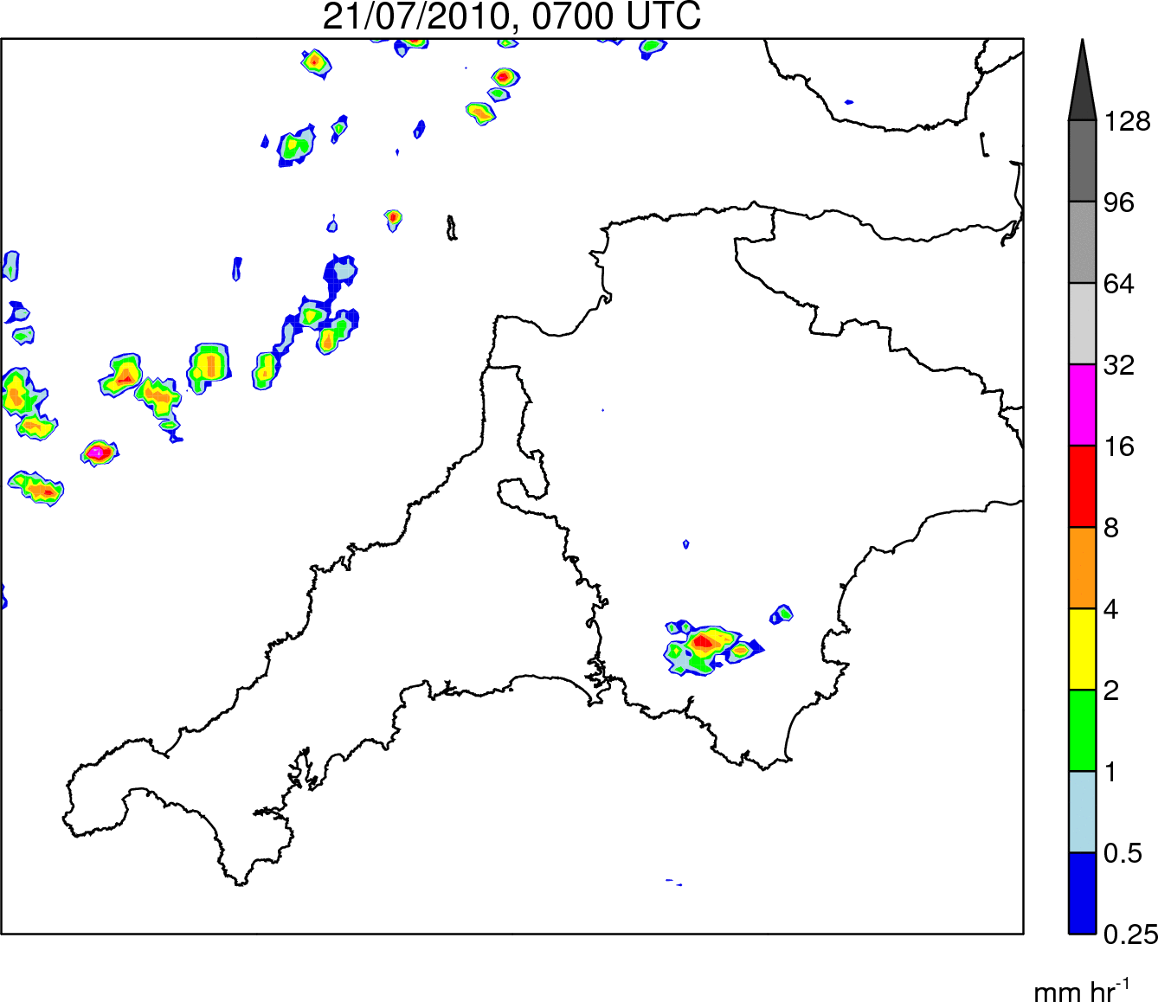
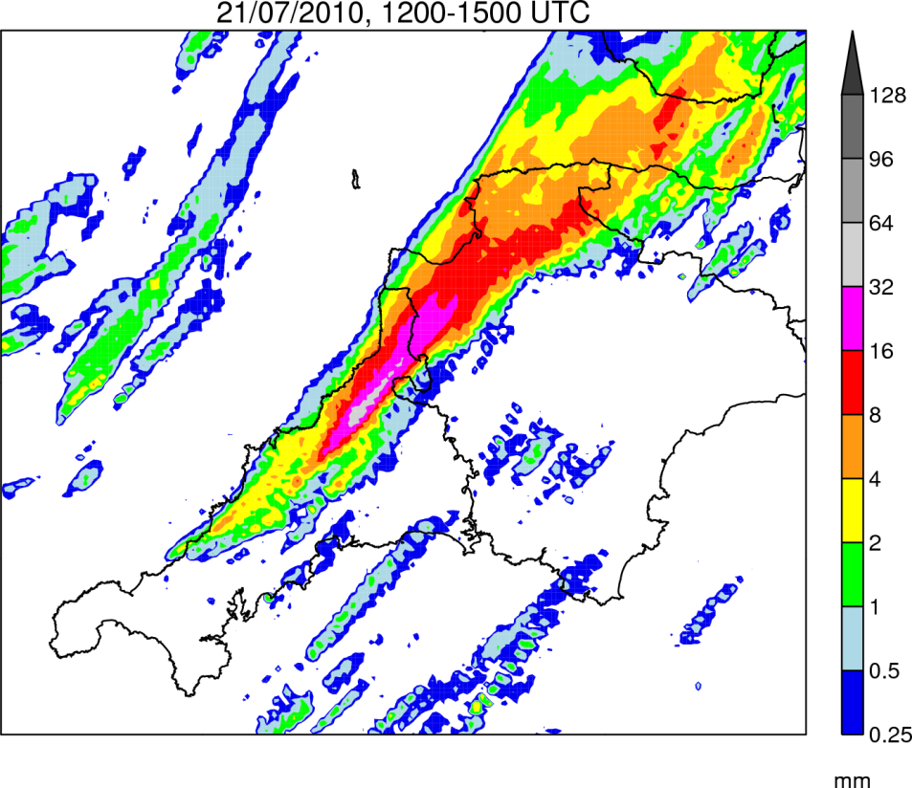
Case Study: 21 July 2010
Rain Rate
0700–1900 UTC
Rain Accumulation
1200–1500 UTC
Notes:
This is a basic slide based on the slide master. To create a slide just insert a new slide (Ctrl+M) and PowerPoint will automatically format the slide with the slide master. Text will automatically placed in bullets. The bullets have five different levels of nesting, to get the next level down you simply use the tab key.

Slide 5
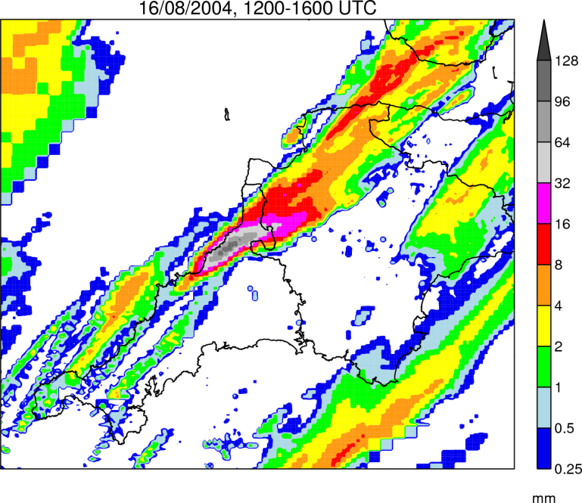
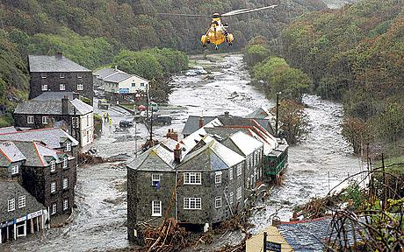
Key Questions
How does this event compare with the Boscastle storm of 16 August 2004?
By what mechanism were storms repeatedly triggered in the same location?
What caused the line of storms to propagate inland after 1500 UTC?
How well is the event simulated by the Met Office UKV model?
Notes:
This is a basic slide based on the slide master. To create a slide just insert a new slide (Ctrl+M) and PowerPoint will automatically format the slide with the slide master. Text will automatically placed in bullets. The bullets have five different levels of nesting, to get the next level down you simply use the tab key.

Slide 6
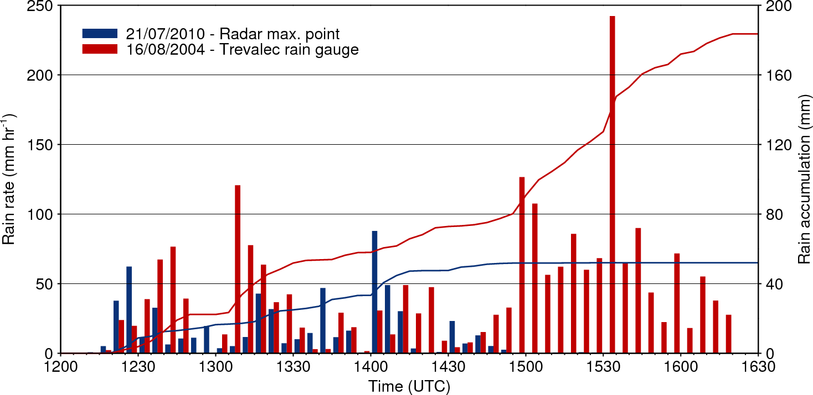
Comparison with Boscastle Storm
Warmer, moister atmospheric column → higher rain rates
Slow evolution of large-scale flow → more stationary system
Notes:
This is a basic slide based on the slide master. To create a slide just insert a new slide (Ctrl+M) and PowerPoint will automatically format the slide with the slide master. Text will automatically placed in bullets. The bullets have five different levels of nesting, to get the next level down you simply use the tab key.

Slide 7
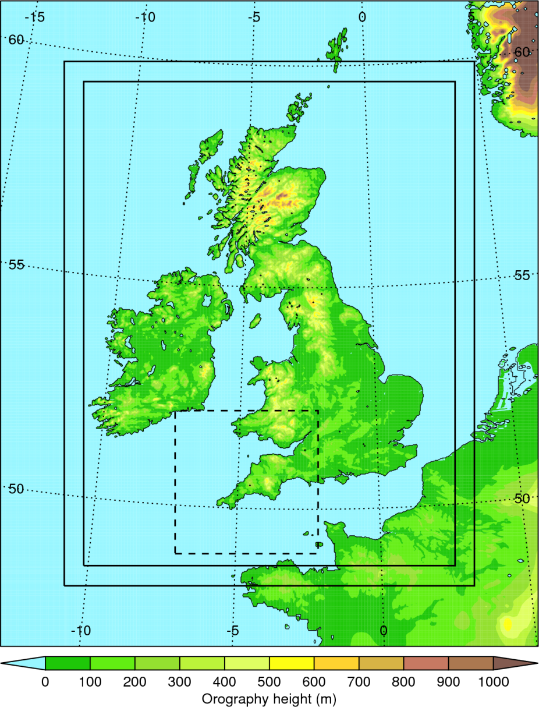
Simulation Strategy
MetUM - UKV model:
  Resolution: 1.5 km inner domain stretching to 4 km outer domain
  Explicit convection
  70 vertical levels
Initialised from operational 0400 UTC UKV analysis
LBCs from operational NAE run
Smaller domain with same resolution nested within UKV to reduce expense
Notes:
This is a basic slide based on the slide master. To create a slide just insert a new slide (Ctrl+M) and PowerPoint will automatically format the slide with the slide master. Text will automatically placed in bullets. The bullets have five different levels of nesting, to get the next level down you simply use the tab key.

Slide 8
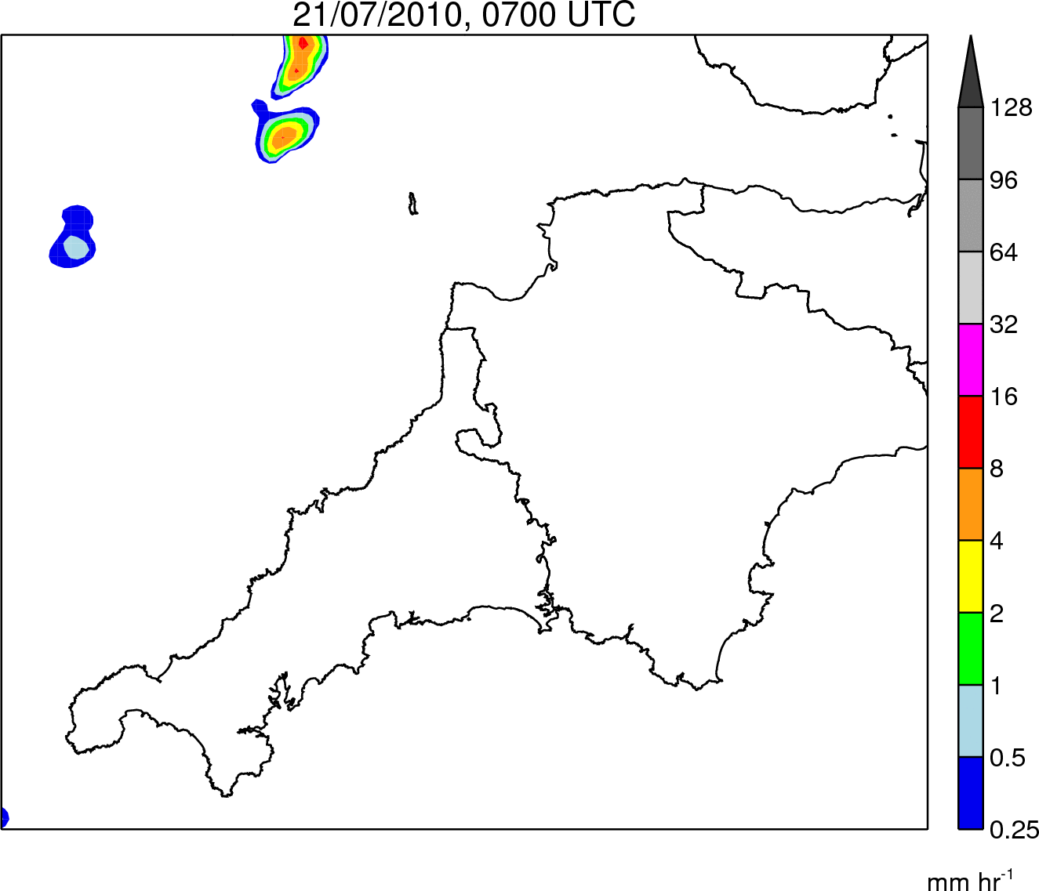
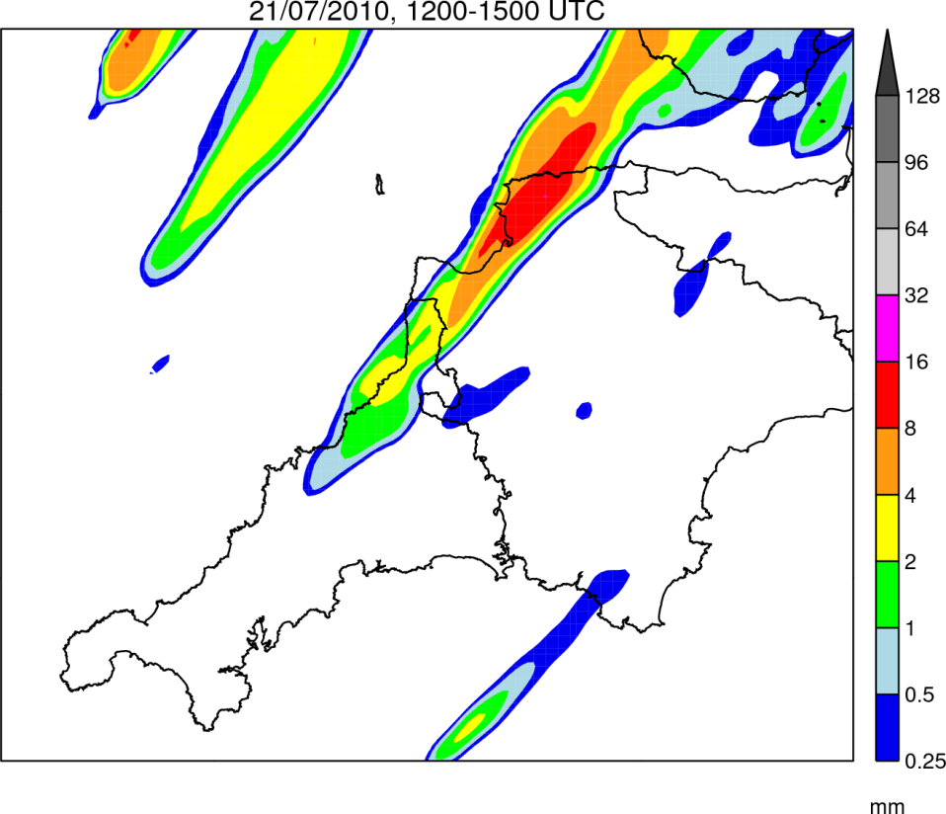
Control simulation: Rainfall
Rain Rate
0700–1900 UTC
Rain Accumulation
1200–1500 UTC
Notes:
This is a basic slide based on the slide master. To create a slide just insert a new slide (Ctrl+M) and PowerPoint will automatically format the slide with the slide master. Text will automatically placed in bullets. The bullets have five different levels of nesting, to get the next level down you simply use the tab key.

Slide 9
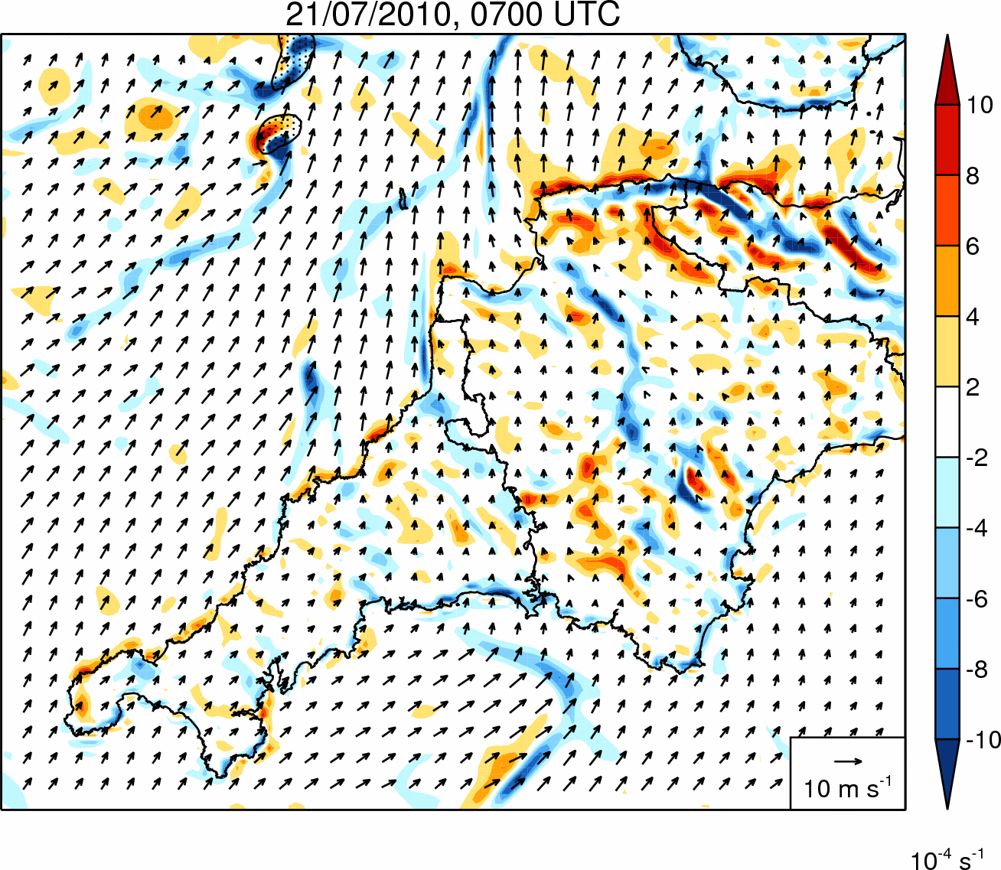
Control simulation: Divergence
Notes:
This is a basic slide based on the slide master. To create a slide just insert a new slide (Ctrl+M) and PowerPoint will automatically format the slide with the slide master. Text will automatically placed in bullets. The bullets have five different levels of nesting, to get the next level down you simply use the tab key.

Slide 10
Sensitivity Tests – Methodology
Aim: To investigate the factors controlling the development and maintenance of the coastal convergence line
Name | Factor under investigation | Methodology
WEAKSUN | Differential surface heating | Solar constant reduced to 400 Wm⁻²
SAMEROUGH | Differential surface roughness | Roughness length for momentum over land fixed to sea value
NOOROG | Orography | Land height over southwest peninsula set to zero
NOOUTFLOW | Cold pools | Latent cooling in microphysics scheme switched off
Notes:
This is a basic slide based on the slide master. To create a slide just insert a new slide (Ctrl+M) and PowerPoint will automatically format the slide with the slide master. Text will automatically placed in bullets. The bullets have five different levels of nesting, to get the next level down you simply use the tab key.

Slide 11
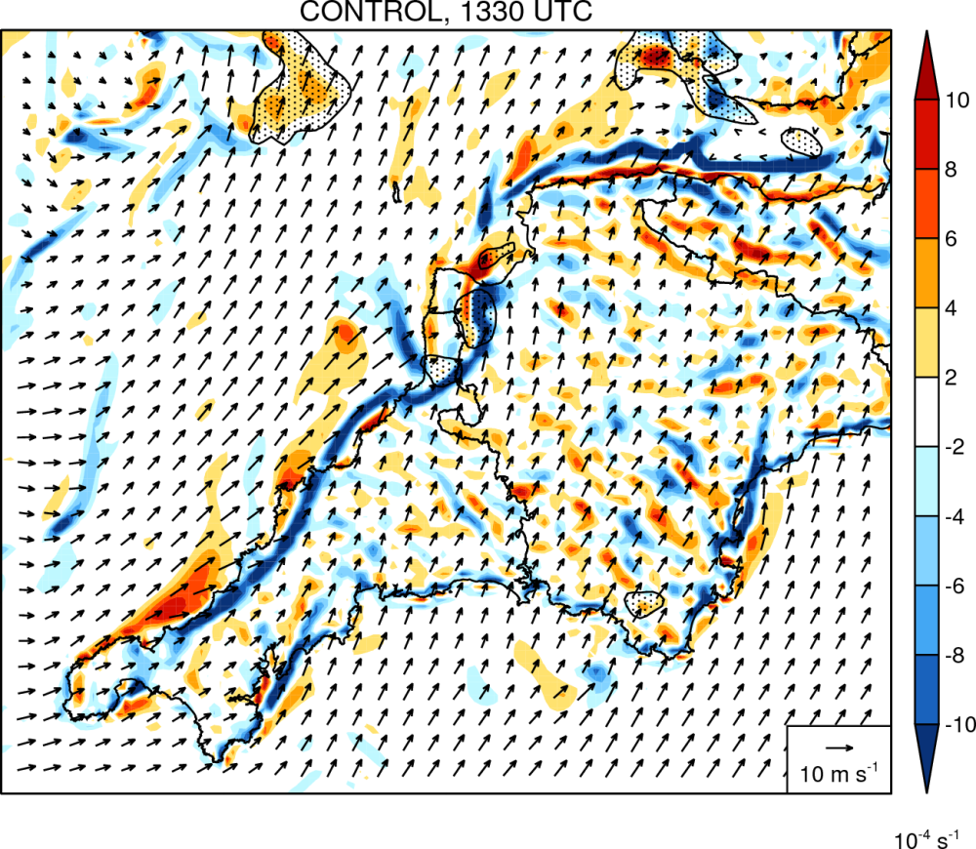
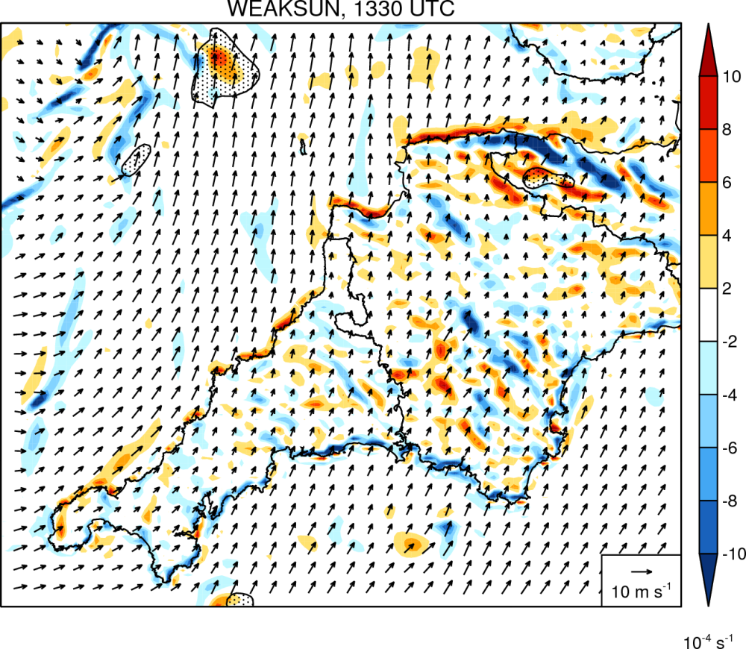
WEAKSUN simulation: Divergence
Differential surface heating is a necessary condition for the convergence line to form → convergence line was a sea-breeze front
Notes:
This is a basic slide based on the slide master. To create a slide just insert a new slide (Ctrl+M) and PowerPoint will automatically format the slide with the slide master. Text will automatically placed in bullets. The bullets have five different levels of nesting, to get the next level down you simply use the tab key.

Slide 12
Key Questions Revisited
How does this event compare with the Boscastle storm of 16/08/2004?
  Higher rain rates (due to a warmer, moister profile) and a longer storm duration (due to slower evolution of the large-scale flow) generated significantly higher accumulations and flash flooding in the Boscastle case.
By what mechanism were storms repeatedly triggered in the same location?
    A persistent, narrow convergence line, which appears to be a sea breeze front maintained along the coastline by a slight offshore wind component (c.f. Golding et al. 2005).
What caused the line to propagate inland after 1500 UTC?
    Veering of low-level wind ahead of an approaching surface low.
How well is the event simulated by the Met Office UKV model?
    Repeated initiation of storms is captured but these form too late, too far north along coast, evolve too slowly and become too intense.
Notes:
This is a basic slide based on the slide master. To create a slide just insert a new slide (Ctrl+M) and PowerPoint will automatically format the slide with the slide master. Text will automatically placed in bullets. The bullets have five different levels of nesting, to get the next level down you simply use the tab key.

Slide 13
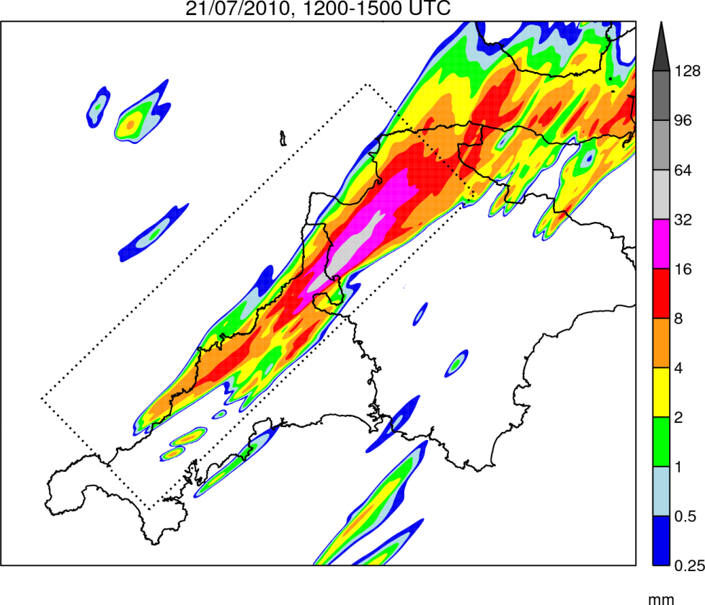
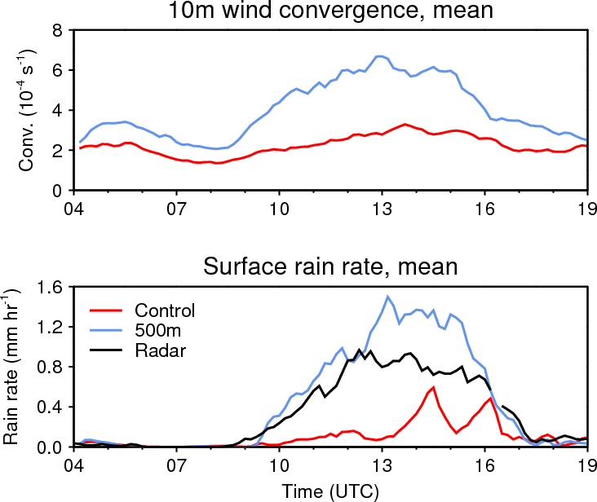
500m Simulation
Convergence line is better resolved at 500m resolution → timing and pattern of convective initiation is significantly improved
Notes:
This is a basic slide based on the slide master. To create a slide just insert a new slide (Ctrl+M) and PowerPoint will automatically format the slide with the slide master. Text will automatically placed in bullets. The bullets have five different levels of nesting, to get the next level down you simply use the tab key.

Slide 14
Conclusions & Future Work
Conclusions
  The 21 July 2010 Southwest Peninsula QSCS was forced by a quasi-stationary sea breeze front which developed in response to differential surface heating and an offshore geostrophic wind
  Differential surface roughness, orography, and storm outflow do not appear to have played a significant role in this case
  The Boscastle storm formed in a very similar way but produced extreme precipitation due to higher rain rates and a longer duration
  At 1.5-km resolution, BL convergence may be insufficiently resolved to accurately forecast convective initiation (c.f. Barthlott et al. 2010)
Future work
  Climatology of QSCSs in the UK
  Idealised modelling of quasi-stationary sea-breeze fronts
Notes:
This is a basic slide based on the slide master. To create a slide just insert a new slide (Ctrl+M) and PowerPoint will automatically format the slide with the slide master. Text will automatically placed in bullets. The bullets have five different levels of nesting, to get the next level down you simply use the tab key.

Slide 15
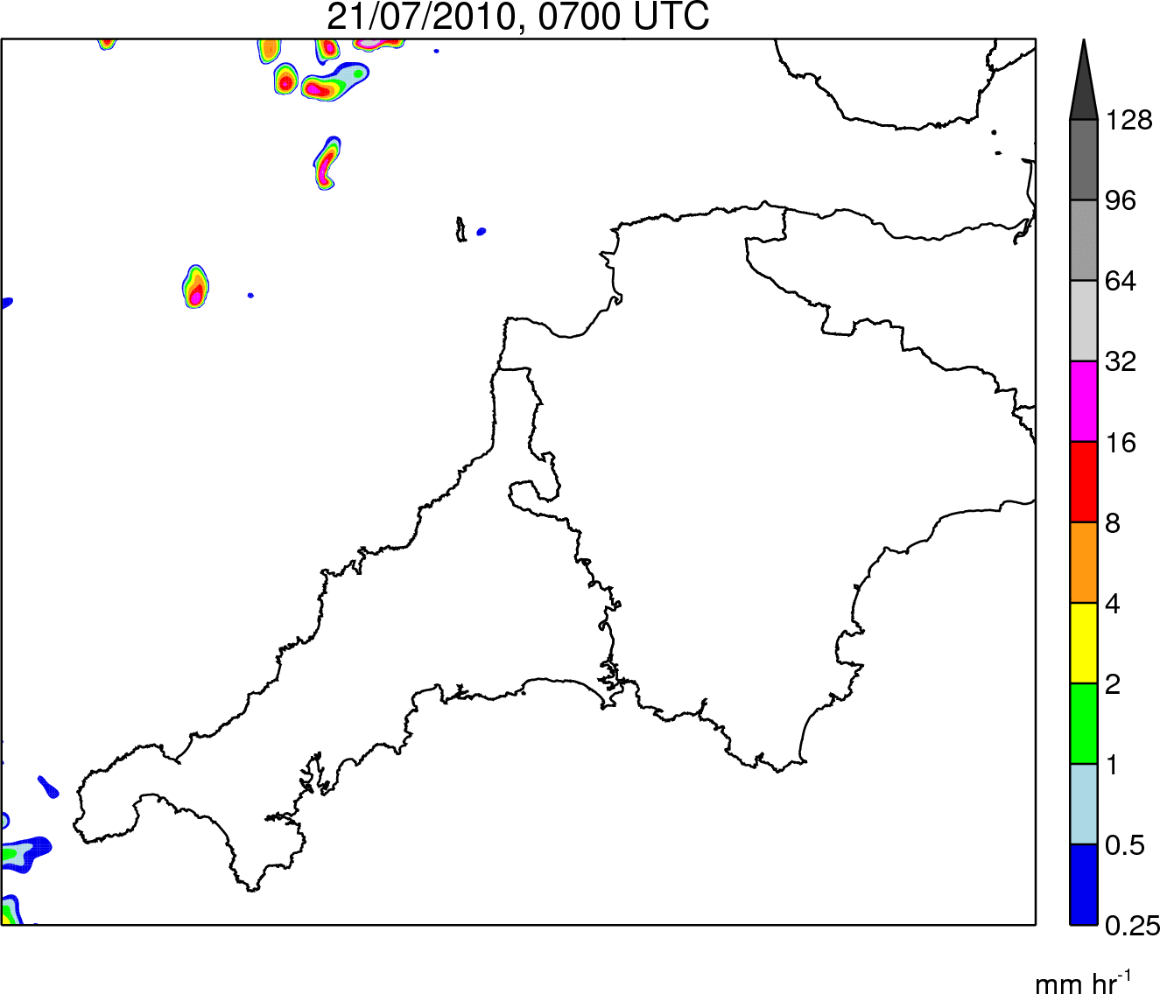
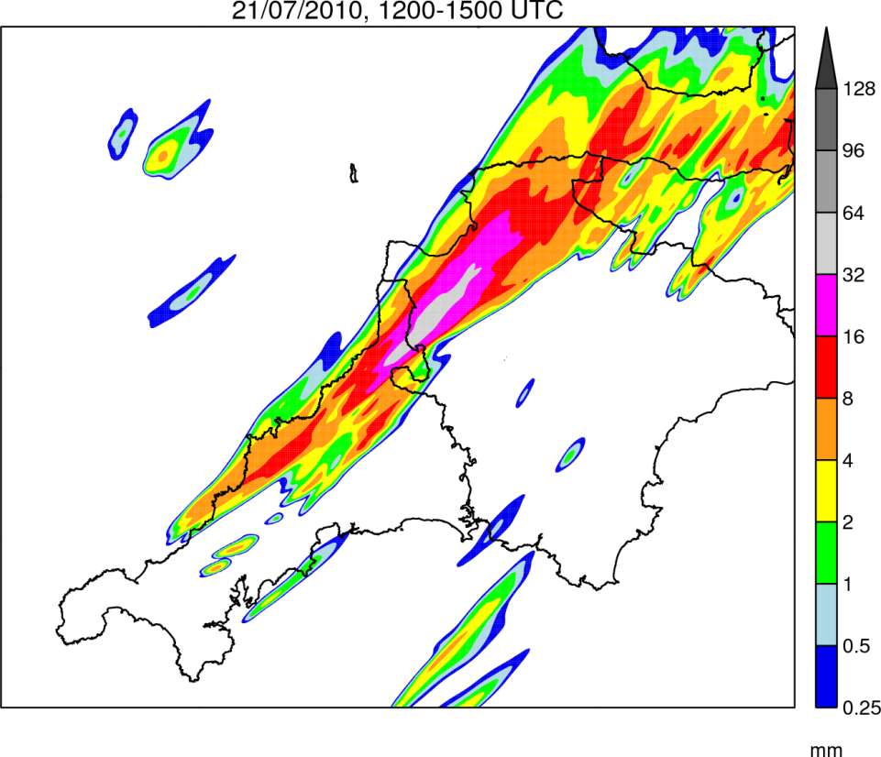
500m simulation: Rainfall
Rain Rate
0700–1900 UTC
Rain Accumulation
1200–1500 UTC
Notes:
This is a basic slide based on the slide master. To create a slide just insert a new slide (Ctrl+M) and PowerPoint will automatically format the slide with the slide master. Text will automatically placed in bullets. The bullets have five different levels of nesting, to get the next level down you simply use the tab key.

Slide 16
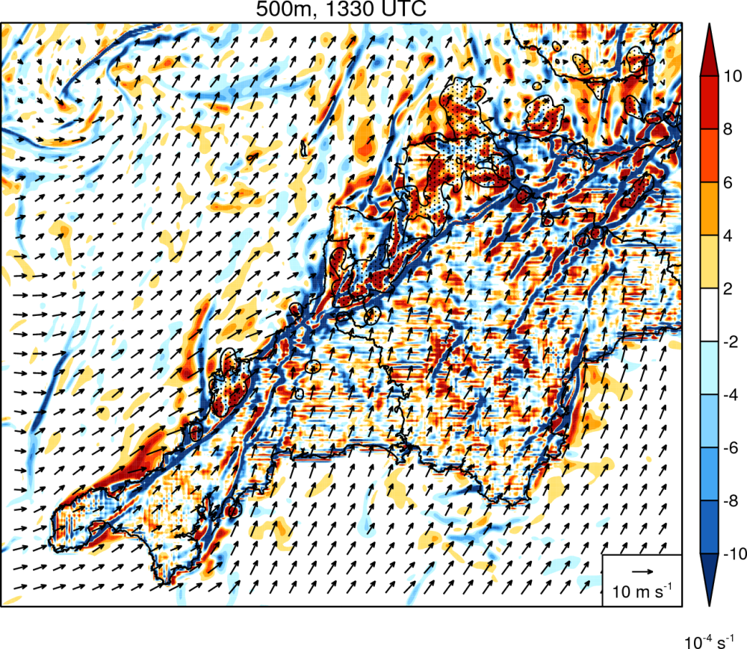
500m simulation: Divergence
Differential surface heating is a necessary condition for the convergence line to form → convergence line was a sea-breeze front
Notes:
This is a basic slide based on the slide master. To create a slide just insert a new slide (Ctrl+M) and PowerPoint will automatically format the slide with the slide master. Text will automatically placed in bullets. The bullets have five different levels of nesting, to get the next level down you simply use the tab key.

Slide 17
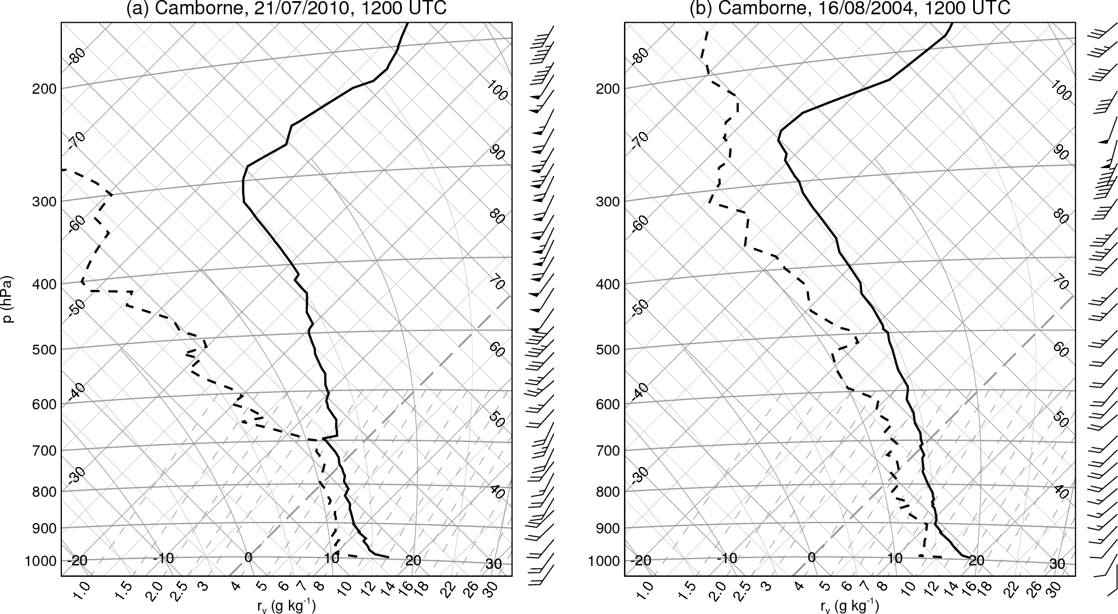
Tephigram comparison
Notes:
This is a basic slide based on the slide master. To create a slide just insert a new slide (Ctrl+M) and PowerPoint will automatically format the slide with the slide master. Text will automatically placed in bullets. The bullets have five different levels of nesting, to get the next level down you simply use the tab key.

Slide 18
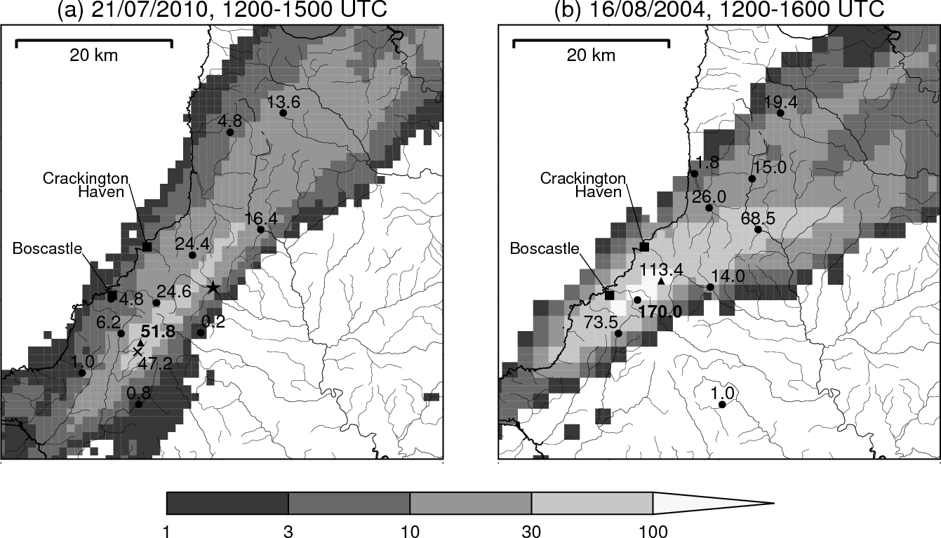
Accumulation comparison
Notes:
This is a basic slide based on the slide master. To create a slide just insert a new slide (Ctrl+M) and PowerPoint will automatically format the slide with the slide master. Text will automatically placed in bullets. The bullets have five different levels of nesting, to get the next level down you simply use the tab key.

Slide 19
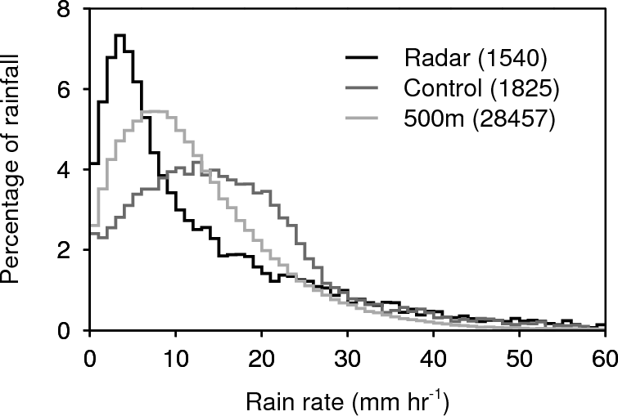
Rain intensity bias
Notes:
This is a basic slide based on the slide master. To create a slide just insert a new slide (Ctrl+M) and PowerPoint will automatically format the slide with the slide master. Text will automatically placed in bullets. The bullets have five different levels of nesting, to get the next level down you simply use the tab key.

Slide 20
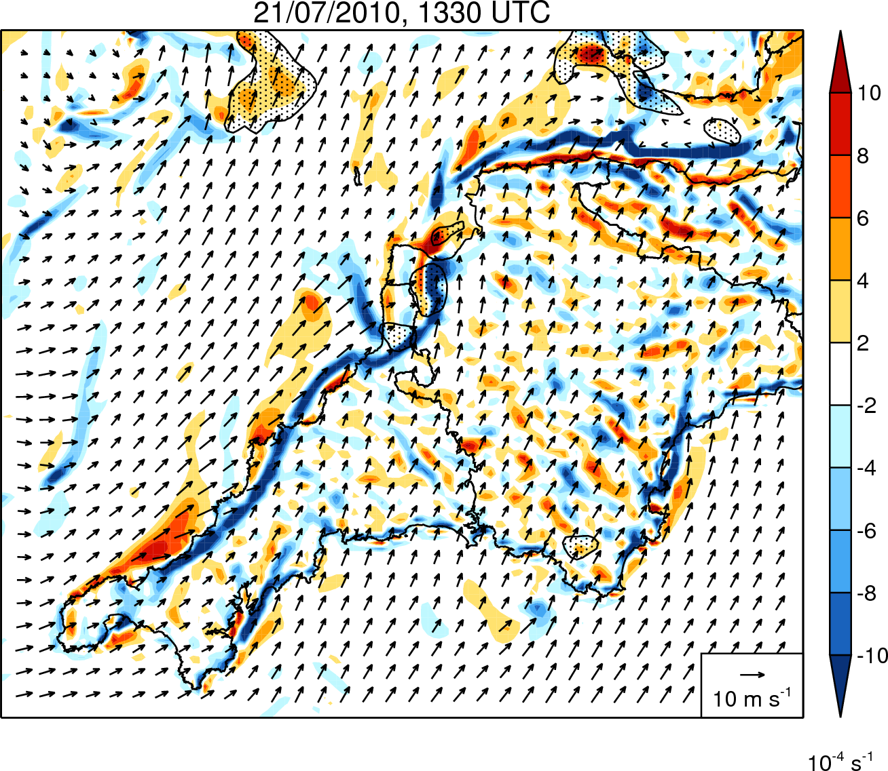
Control simulation: Divergence
Precipitation
Convergence line
Divergence offshore
Notes:
This is a basic slide based on the slide master. To create a slide just insert a new slide (Ctrl+M) and PowerPoint will automatically format the slide with the slide master. Text will automatically placed in bullets. The bullets have five different levels of nesting, to get the next level down you simply use the tab key.

