Slide 1
Quasi-stationary convective systems in the UK: A ‘Boscastle-type’ case
Robert Warren
Supervised by Bob Plant, Humphrey Lean & Dan Kirshbaum
With thanks to Sarah Alcock, Sylvia Bohnenstengel, Stephen Burt, Emilie Carter, Terry Davies, Brian Golding, Nick Graham, Rosalyn Hatcher, Roy Kershaw, Giovanni Leoncini, Adrian Lock, Suzanne Long, Maggie Summerfield, Dan Suri, Simon Vosper, Stuart Webster, Jonathan Wilkinson, Steve Willington
Notes:
This is the title slide, PowerPoint will automatically format the first slide with the title master, although this can be changed in the design palette.

Slide 2
Outline
Introduction to QSCSs & my PhD project
The case study: 21 July 2010
Comparison with the Boscastle case
Numerical simulations
Conclusions & future work
Notes:
Floods clockwise from top-left: Boscastle, Cornwall, UK, 16 August 2004; Gard, Southern France, 8-9 September 2002; Fort Collins, Colorado, USA, 28 July 1997; Rapid City, South Dakota, USA, 9 June 1972.

Slide 3
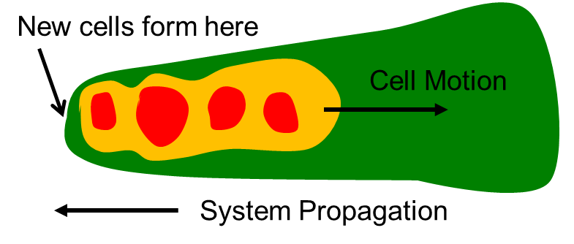
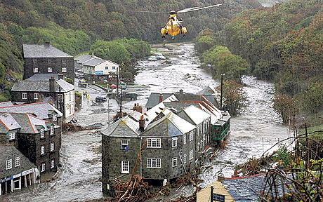
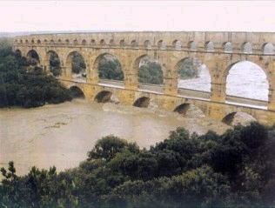
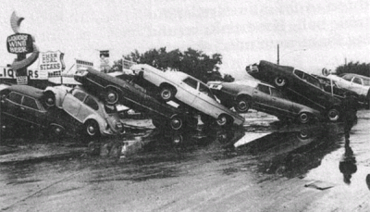
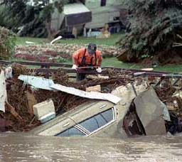
Quasi-stationary convective systems
Lines/clusters of convective cells which remain in roughly the same place for several hours or more
Occur when cell motion is equal and opposite to system propagation: “back-building”
Can lead to very large rainfall accumulations and flash flooding
Many devastating flash floods around the world caused by QSCSs
Aim of my PhD project: Improve understanding of and ability to predict QSCSs in the UK
Adapted from Schumacher and Johnson (2005)
Notes:
Floods clockwise from top-left: Boscastle, Cornwall, UK, 16 August 2004; Gard, Southern France, 8-9 September 2002; Fort Collins, Colorado, USA, 28 July 1997; Rapid City, South Dakota, USA, 9 June 1972.

Slide 4
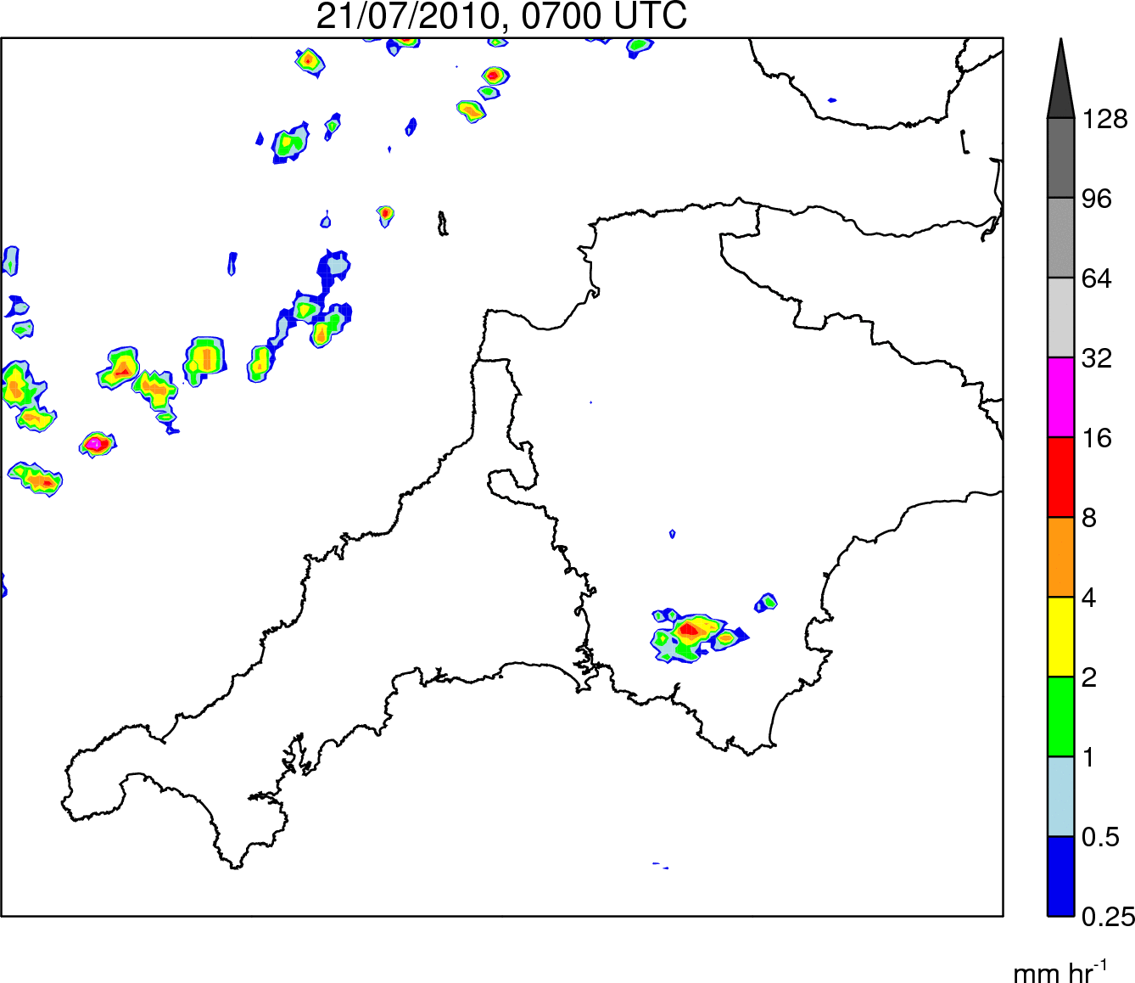
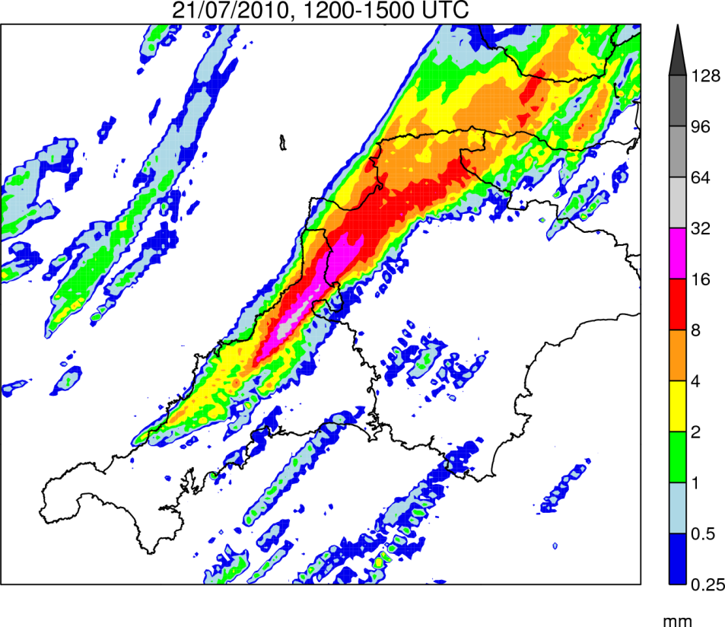
Case Study: 21 July 2010
Rain Rate
0700–1900 UTC
Rain Accumulation
1200–1500 UTC
Notes:
This is a basic slide based on the slide master. To create a slide just insert a new slide (Ctrl+M) and PowerPoint will automatically format the slide with the slide master. Text will automatically placed in bullets. The bullets have five different levels of nesting, to get the next level down you simply use the tab key.

Slide 5
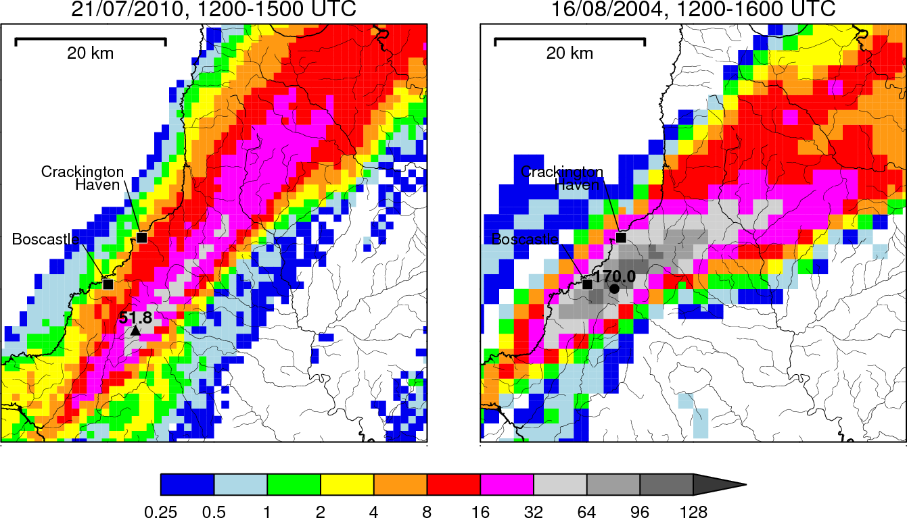
Comparison (1) – Rain accumulations
Adjusted Lesnewth gauge data courtesy of Stephen Burt (see Burt, 2005 for method)
Notes:
This is a basic slide based on the slide master. To create a slide just insert a new slide (Ctrl+M) and PowerPoint will automatically format the slide with the slide master. Text will automatically placed in bullets. The bullets have five different levels of nesting, to get the next level down you simply use the tab key.

Slide 6
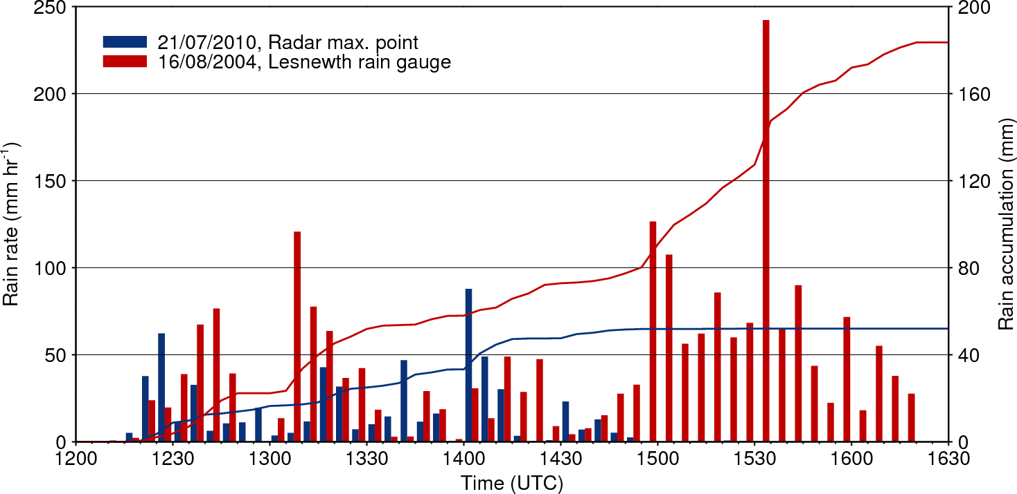
Comparison (2) – Rainfall time series
Adjusted Lesnewth gauge data courtesy of Stephen Burt (see Burt, 2005 for method)
Notes:
This is a basic slide based on the slide master. To create a slide just insert a new slide (Ctrl+M) and PowerPoint will automatically format the slide with the slide master. Text will automatically placed in bullets. The bullets have five different levels of nesting, to get the next level down you simply use the tab key.

Slide 7
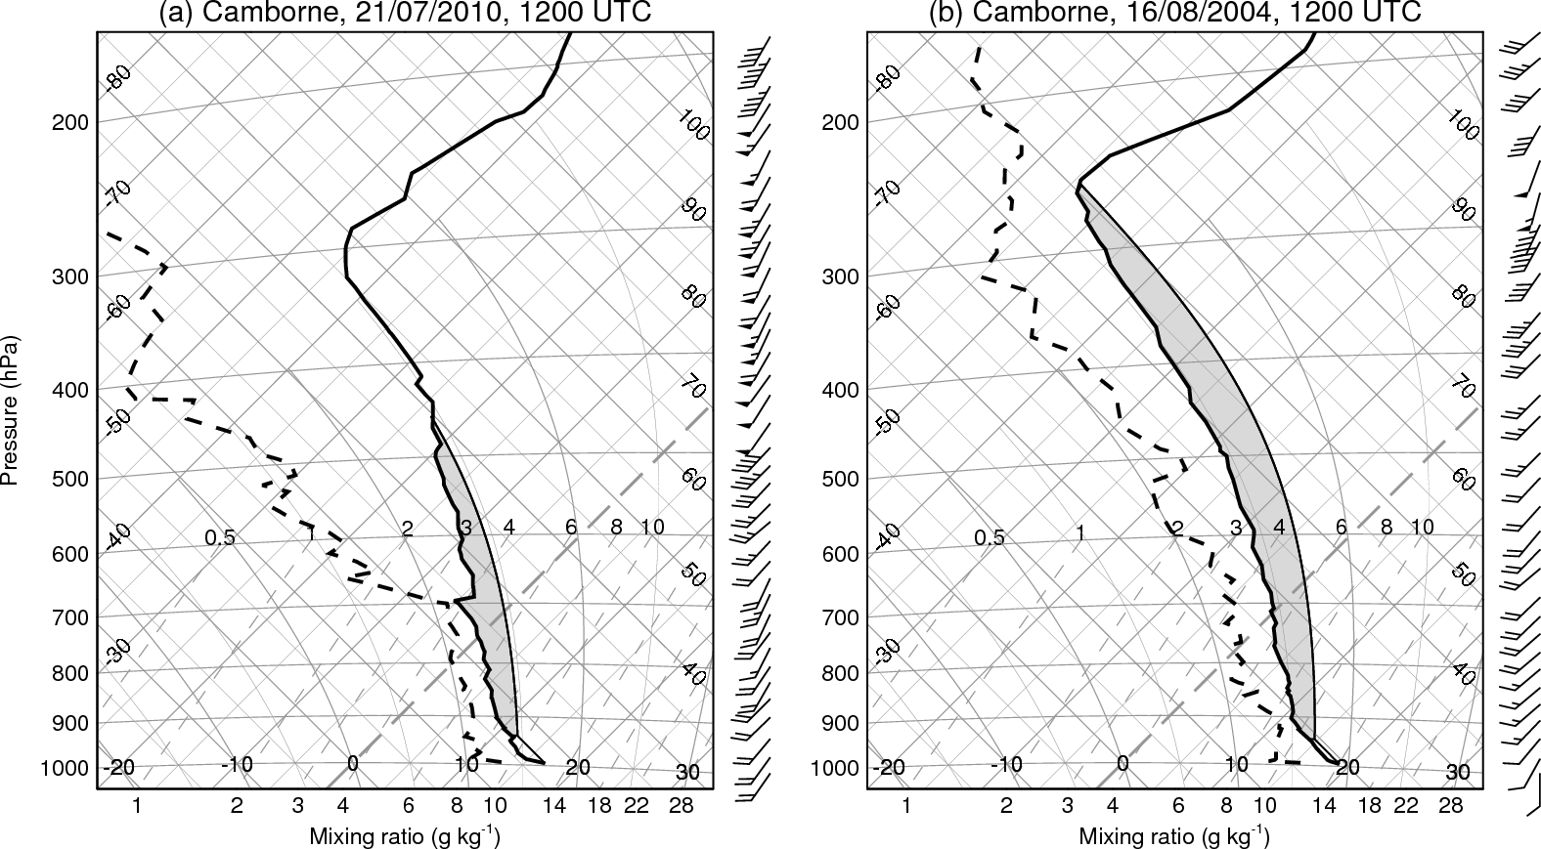
Comparison (3) – Tephigrams
CAPE = 483 J kg⁻¹
CAPE = 1318 J kg⁻¹
Notes:
This is a basic slide based on the slide master. To create a slide just insert a new slide (Ctrl+M) and PowerPoint will automatically format the slide with the slide master. Text will automatically placed in bullets. The bullets have five different levels of nesting, to get the next level down you simply use the tab key.

Slide 8
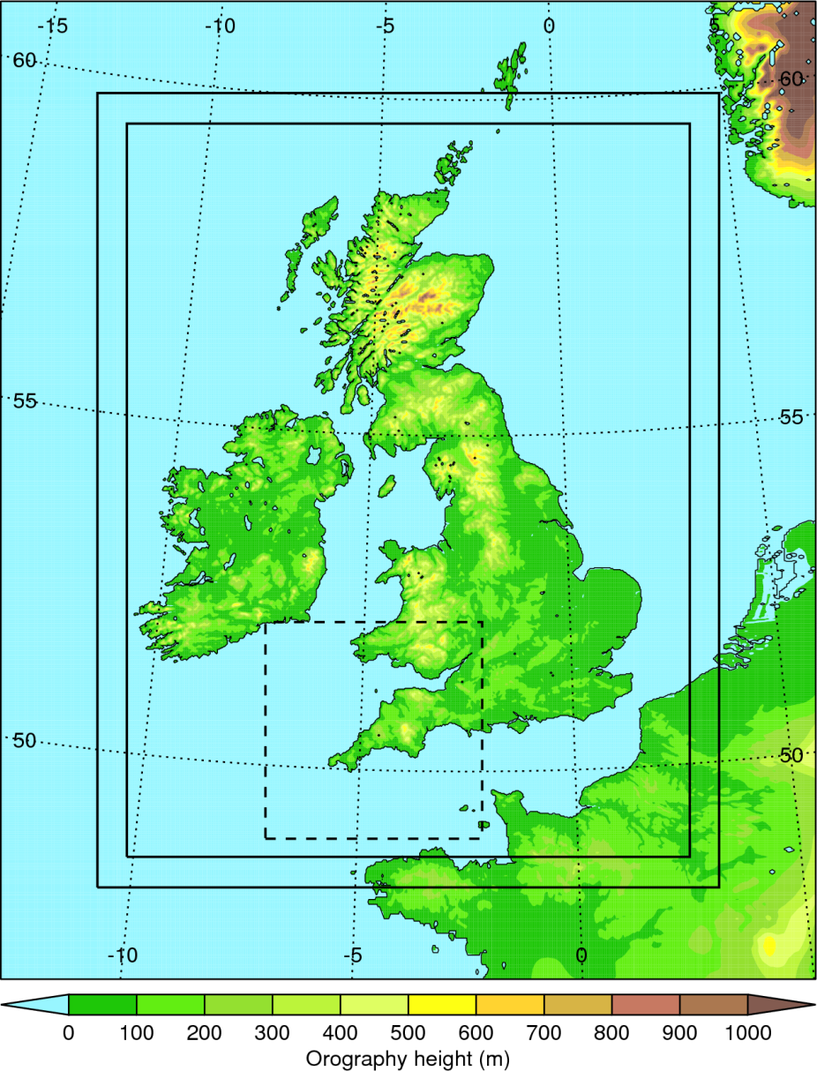
Numerical simulations
Simulations performed using the UKV configuration of the Met Office Unified Model
Currently the highest resolution operational model run: 1.5-km grid spacing over the UK
70 vertical levels
No convection parameterisation
Boundary conditions from North Atlantic European (NAE) model
Smaller domain with same resolution nested within UKV model to reduce computational expense
Notes:
This is a basic slide based on the slide master. To create a slide just insert a new slide (Ctrl+M) and PowerPoint will automatically format the slide with the slide master. Text will automatically placed in bullets. The bullets have five different levels of nesting, to get the next level down you simply use the tab key.

Slide 9
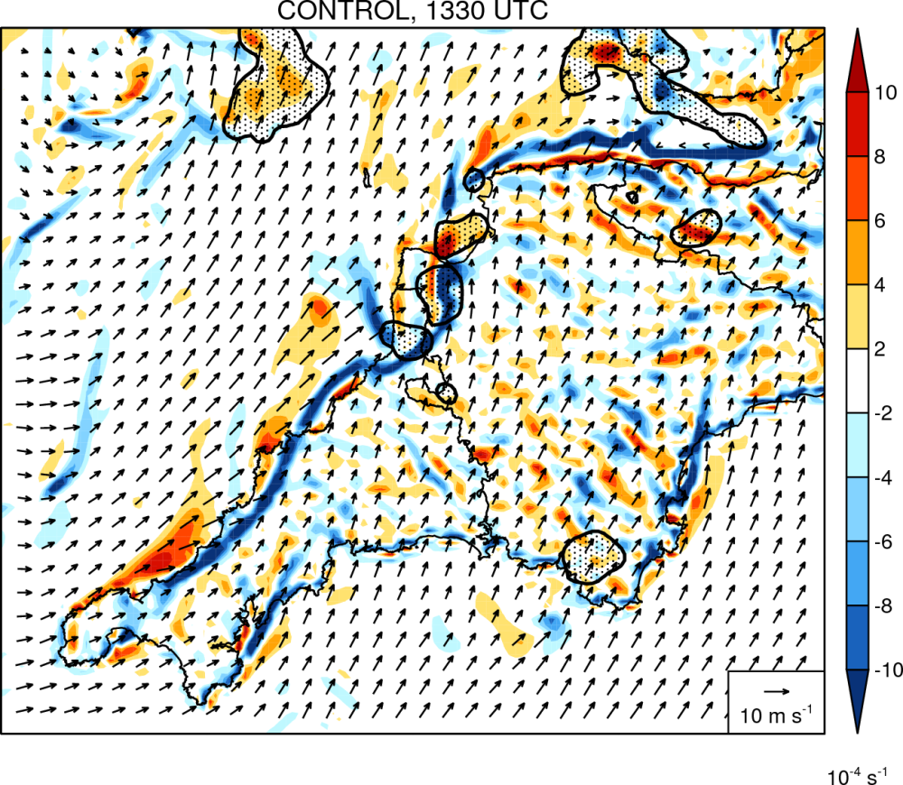
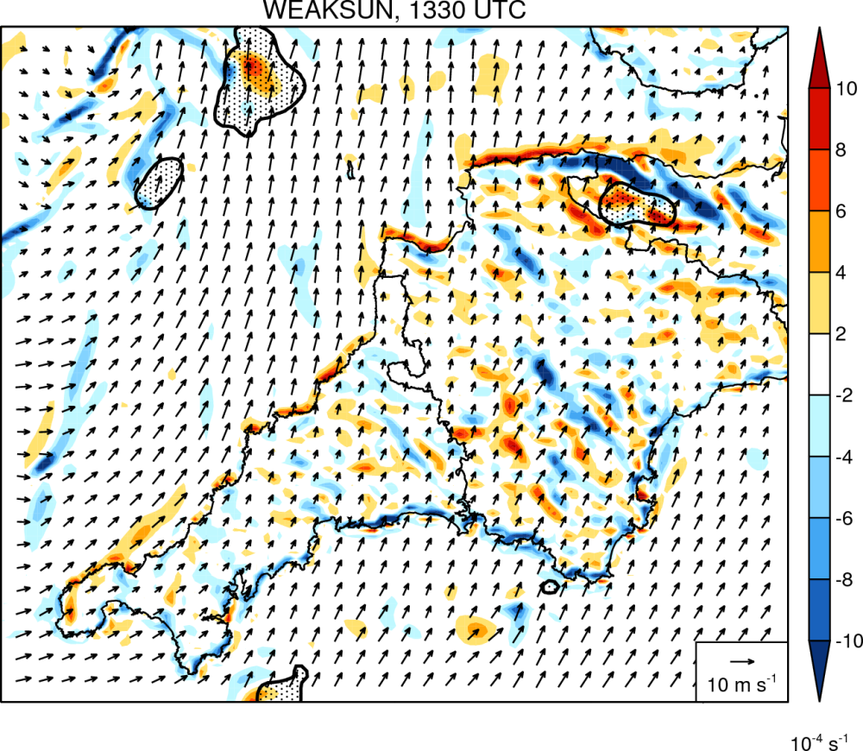
Initiation mechanism
Colours = 10m wind divergence
Vectors = 10m wind
Stippling = rainfall > 0.25 mm hr⁻¹
Control simulation
Reduced land-sea T contrast
Notes:
This is a basic slide based on the slide master. To create a slide just insert a new slide (Ctrl+M) and PowerPoint will automatically format the slide with the slide master. Text will automatically placed in bullets. The bullets have five different levels of nesting, to get the next level down you simply use the tab key.

Slide 10
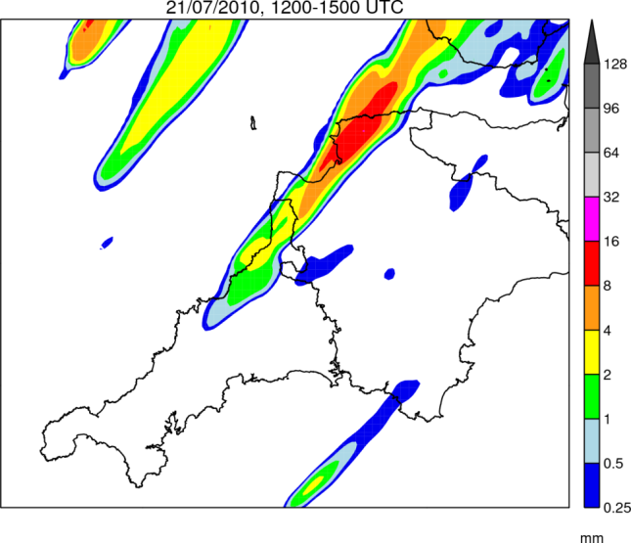
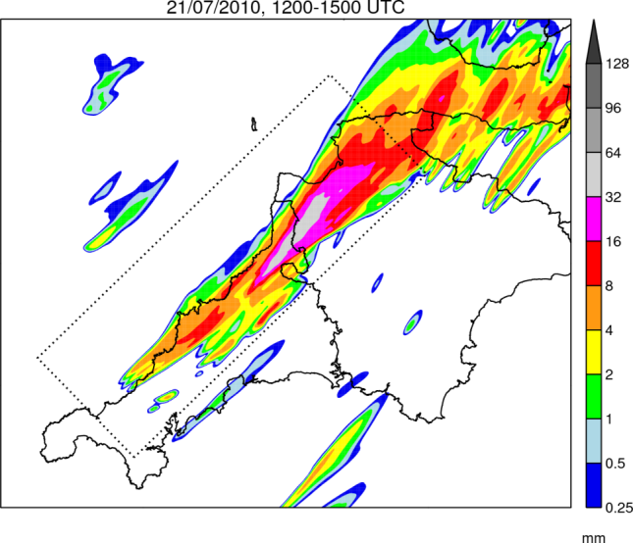
Importance of horizontal resolution
Radar
1.5-km Model
500-m Model
Notes:
This is a basic slide based on the slide master. To create a slide just insert a new slide (Ctrl+M) and PowerPoint will automatically format the slide with the slide master. Text will automatically placed in bullets. The bullets have five different levels of nesting, to get the next level down you simply use the tab key.

Slide 11
Conclusions
Comparison of 21 July 2010 and Boscastle cases:
QSCSs were very similar in their location and structure
Both characterised by moderate instability and deep southwesterly flow
Much higher rainfall accumulations in the Boscastle case due to higher rain rates and a longer system duration
Rainfall was also distributed over fewer river catchments, exacerbating the flood potential
Numerical simulations:
Like the Boscastle QSCS, the July 2010 storm was forced by a quasi-stationary boundary layer convergence line
Sensitivity experiments show that this feature was a sea breeze front maintained in place by an offshore-directed background wind
At 1.5-km grid spacing, the system is poorly represented; significant improvements result from using 500-m grid spacing, in part due to the convergence line being better resolved

Slide 12
Current + Future Work
Paper
A Boscastle-type quasi-stationary convective system over the UK Southwest Peninsula
Currently being revised; should be published next year in the Quarterly Journal of the Royal Meteorological Society
A climatology of QSCSs for the UK:
Developing a methodology for the automatic identification of these storms in the 1-km UK radar composite images
Will eventually run it on several years worth of data
Should provide useful information on the geographical and seasonal distribution of QSCSs in the UK
Idealised simulations of quasi-stationary sea breeze fronts:
Simplified peninsula coastline; typical summertime land-sea T contrast
Vary the wind direction and observe sensitivities

Slide 13
Extra slides…

Slide 14
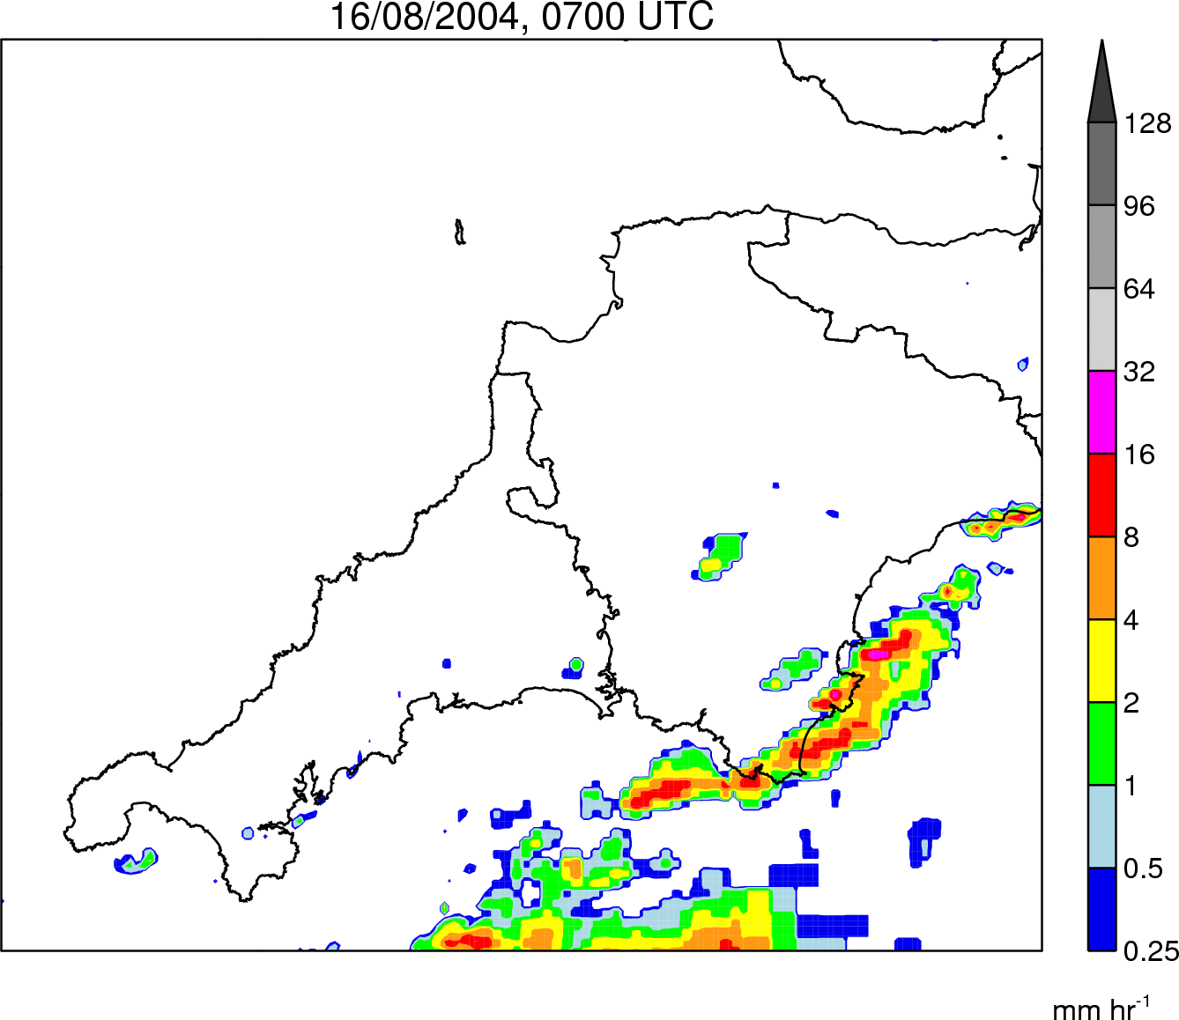
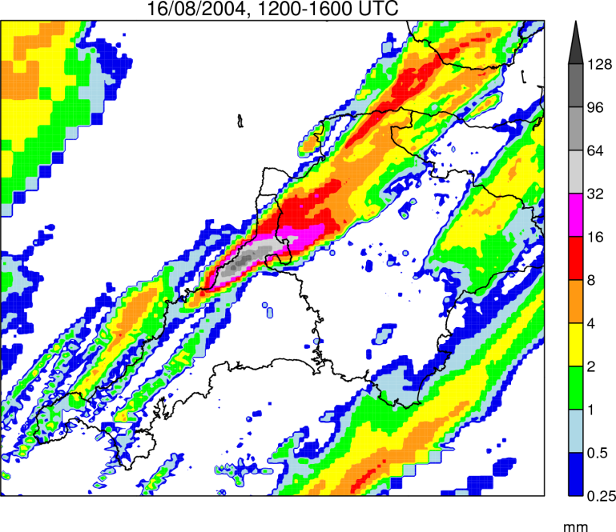
The Boscastle Case: 16 August 2004
Rain Rate
0700–1900 UTC
Rain Accumulation
1200–1600 UTC
Notes:
This is a basic slide based on the slide master. To create a slide just insert a new slide (Ctrl+M) and PowerPoint will automatically format the slide with the slide master. Text will automatically placed in bullets. The bullets have five different levels of nesting, to get the next level down you simply use the tab key.

Slide 15
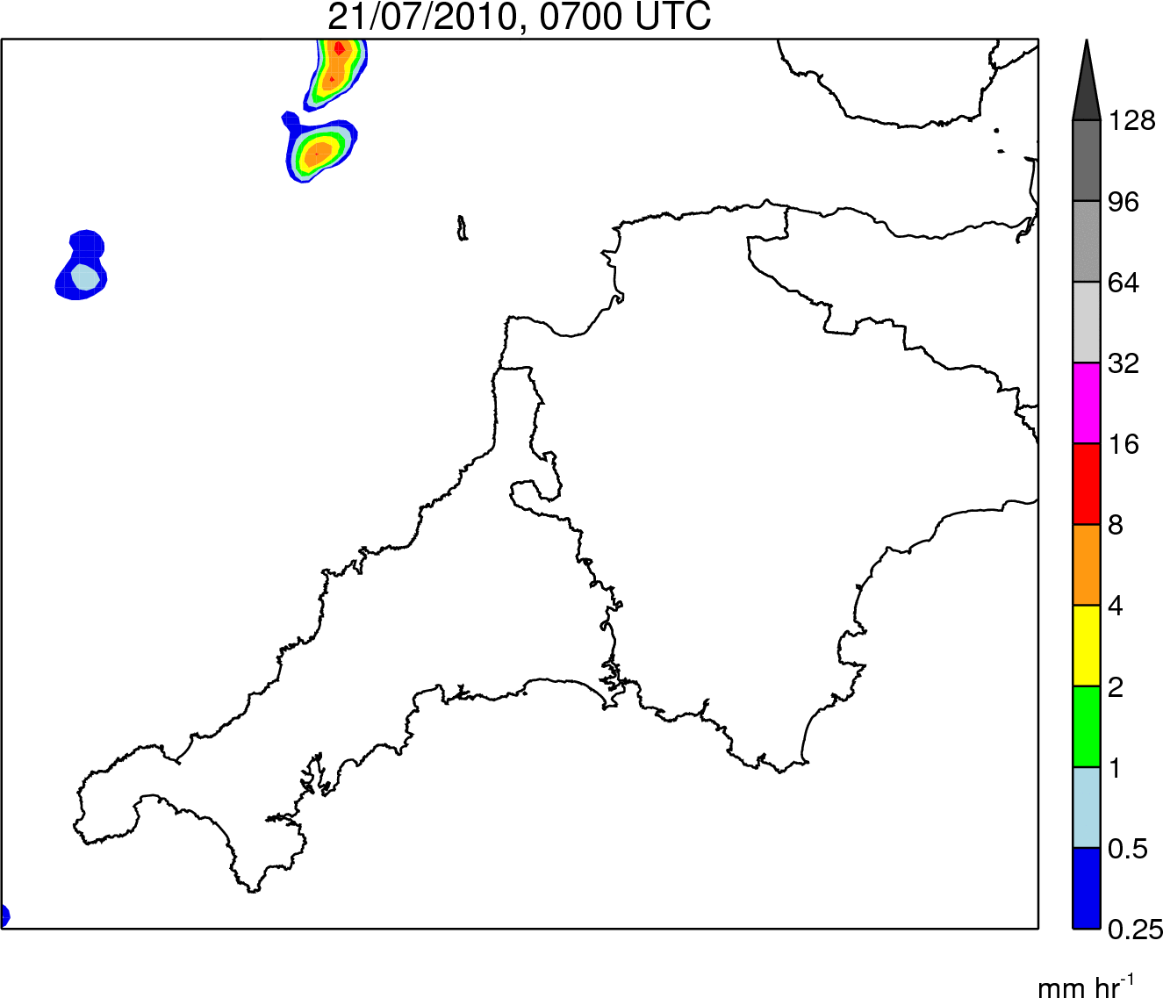
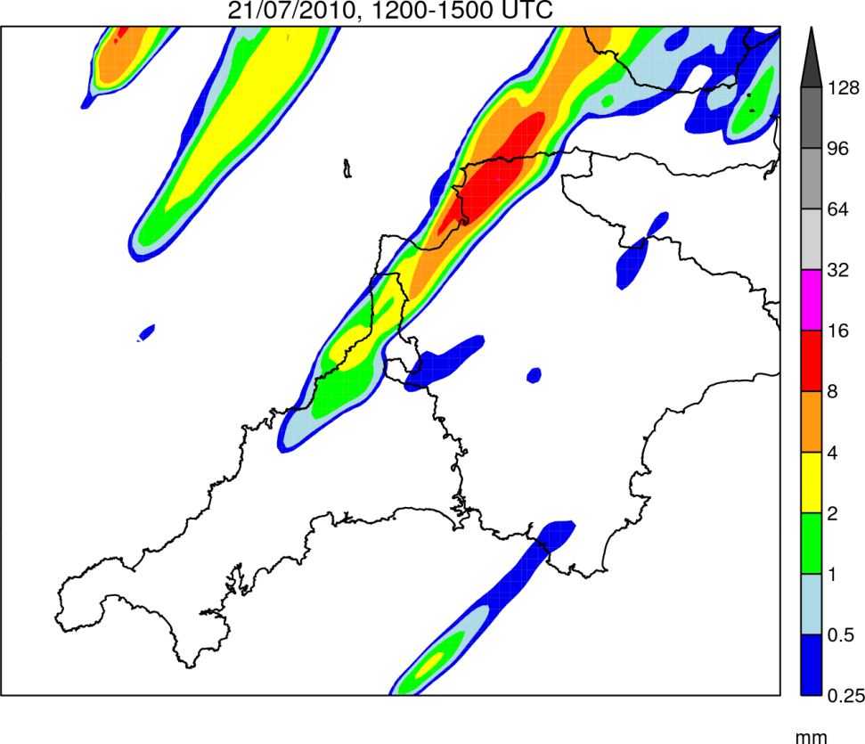
Control simulation: Rainfall
Rain Rate
0700–1900 UTC
Rain Accumulation
1200–1500 UTC
Notes:
This is a basic slide based on the slide master. To create a slide just insert a new slide (Ctrl+M) and PowerPoint will automatically format the slide with the slide master. Text will automatically placed in bullets. The bullets have five different levels of nesting, to get the next level down you simply use the tab key.

Slide 16
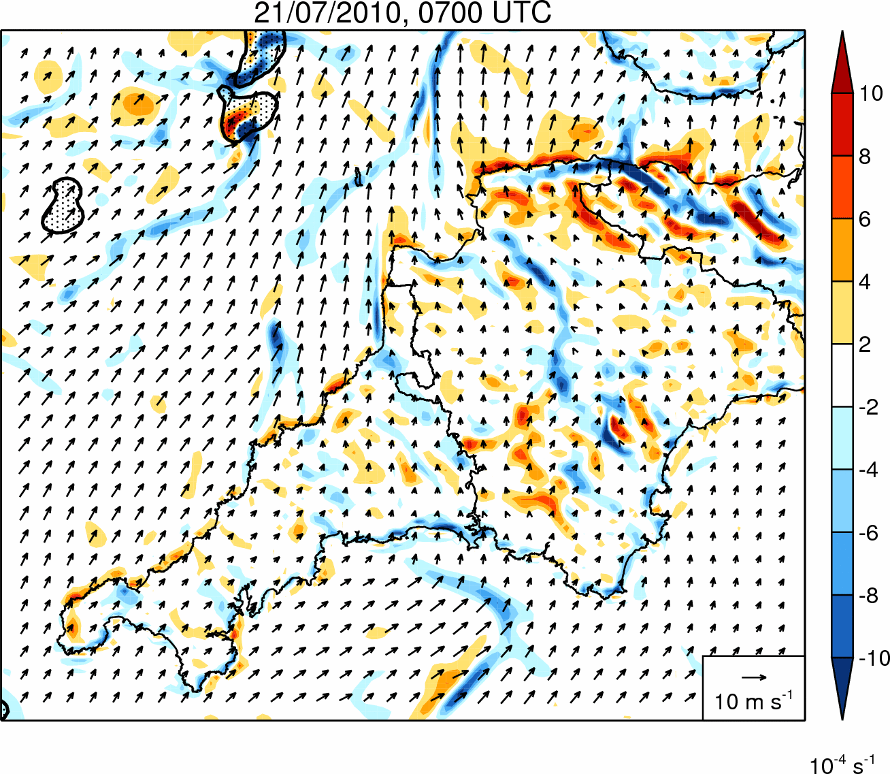
Control simulation: Divergence
Notes:
This is a basic slide based on the slide master. To create a slide just insert a new slide (Ctrl+M) and PowerPoint will automatically format the slide with the slide master. Text will automatically placed in bullets. The bullets have five different levels of nesting, to get the next level down you simply use the tab key.

Slide 17
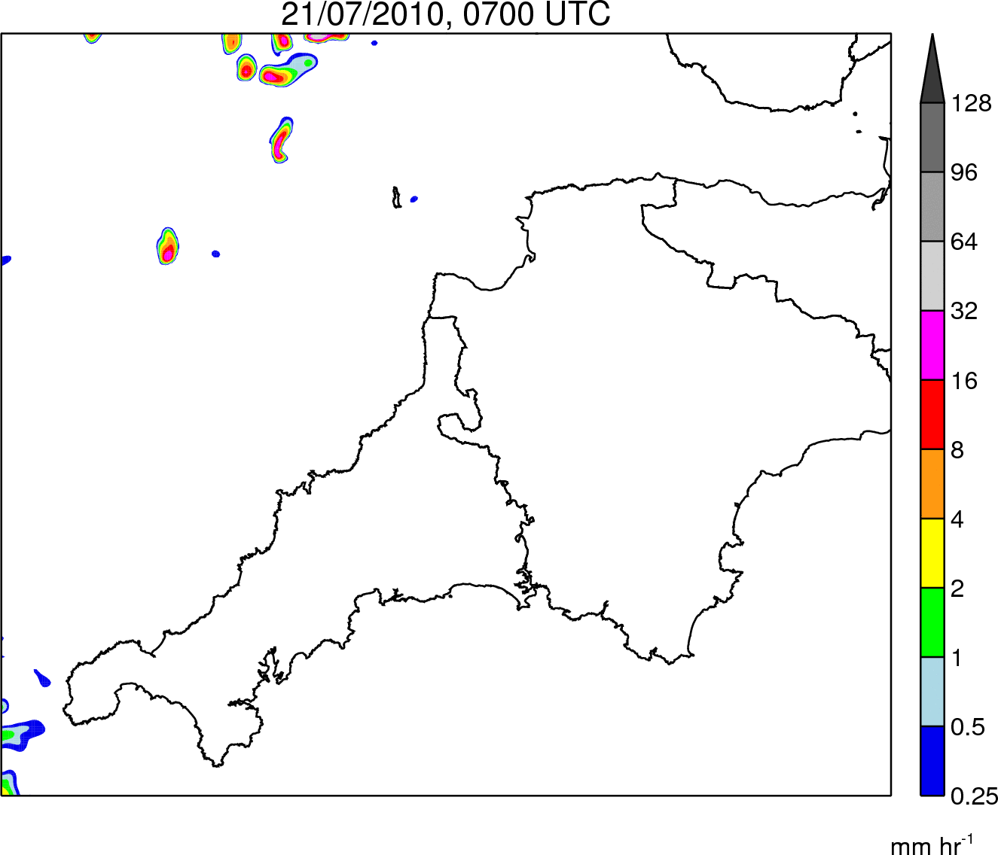
500m simulation: Rainfall
Rain Rate
0700–1900 UTC
Rain Accumulation
1200–1500 UTC
Notes:
This is a basic slide based on the slide master. To create a slide just insert a new slide (Ctrl+M) and PowerPoint will automatically format the slide with the slide master. Text will automatically placed in bullets. The bullets have five different levels of nesting, to get the next level down you simply use the tab key.

Slide 18
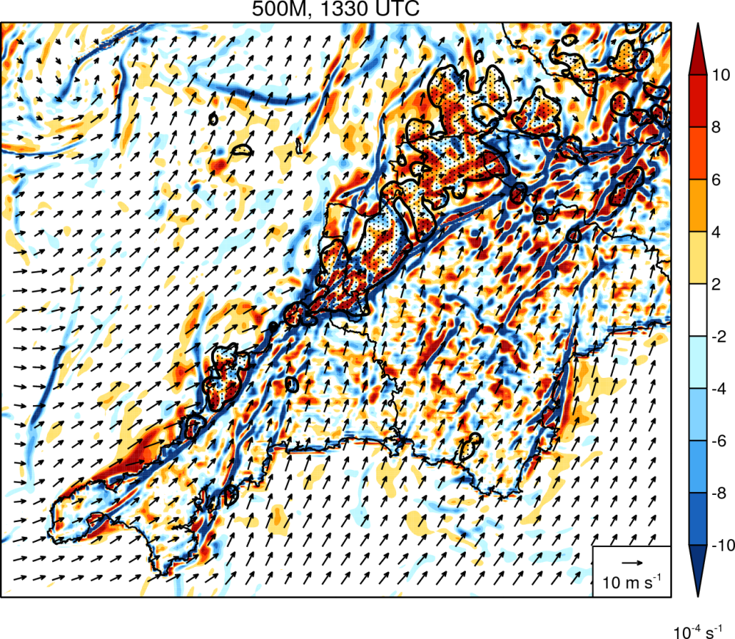
500m simulation: Divergence
Notes:
This is a basic slide based on the slide master. To create a slide just insert a new slide (Ctrl+M) and PowerPoint will automatically format the slide with the slide master. Text will automatically placed in bullets. The bullets have five different levels of nesting, to get the next level down you simply use the tab key.

Slide 19
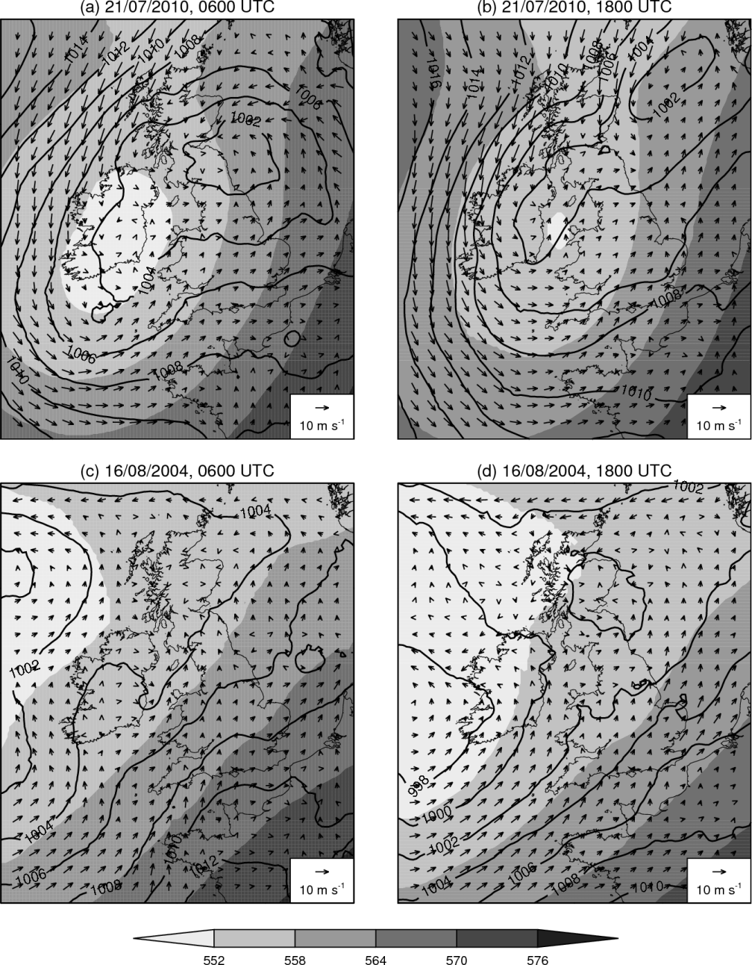
Synoptic setting comparison
Notes:
This is a basic slide based on the slide master. To create a slide just insert a new slide (Ctrl+M) and PowerPoint will automatically format the slide with the slide master. Text will automatically placed in bullets. The bullets have five different levels of nesting, to get the next level down you simply use the tab key.

Slide 20
Sensitivity Tests
Aim: To investigate the factors controlling the development and maintenance of the coastal convergence line
Name | Factor under investigation | Methodology
WEAKSUN | Differential surface heating | Solar constant reduced to 400 Wm⁻²
SAMEROUGH | Differential surface roughness | Roughness length for momentum over land fixed to sea value
NOOROG | Orography | Land height over southwest peninsula set to zero
NOOUTFLOW | Convective outflow | Latent cooling in microphysics scheme switched off
Notes:
This is a basic slide based on the slide master. To create a slide just insert a new slide (Ctrl+M) and PowerPoint will automatically format the slide with the slide master. Text will automatically placed in bullets. The bullets have five different levels of nesting, to get the next level down you simply use the tab key.

Slide 21
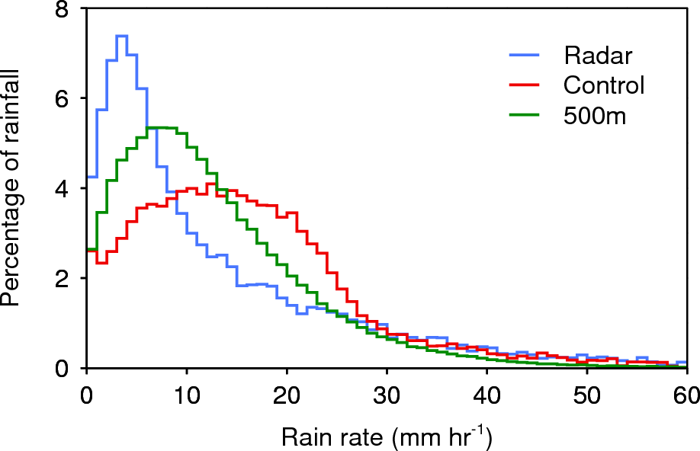
Rain intensity bias
Notes:
This is a basic slide based on the slide master. To create a slide just insert a new slide (Ctrl+M) and PowerPoint will automatically format the slide with the slide master. Text will automatically placed in bullets. The bullets have five different levels of nesting, to get the next level down you simply use the tab key.

Slide 22
Control simulation: Divergence
Precipitation
Convergence line
Divergence offshore
Notes:
This is a basic slide based on the slide master. To create a slide just insert a new slide (Ctrl+M) and PowerPoint will automatically format the slide with the slide master. Text will automatically placed in bullets. The bullets have five different levels of nesting, to get the next level down you simply use the tab key.

Slide 23
QSCS Cartoon
New cells form here
Cell Motion
System Propagation
Notes:
This is a basic slide based on the slide master. To create a slide just insert a new slide (Ctrl+M) and PowerPoint will automatically format the slide with the slide master. Text will automatically placed in bullets. The bullets have five different levels of nesting, to get the next level down you simply use the tab key.

