Slide 1
A quasi-stationary convective system over the UK Southwest Peninsula
Robert Warren¹
Supervised by Bob Plant¹, Humphrey Lean² & Dan Kirshbaum³
¹ Department of Meteorology, University of Reading, Reading, UK
² MetOffice@Reading, University of Reading, Reading, UK
³ Department of Atmospheric and Oceanic Sciences, McGill University, Montreal, Quebec, Canada
Notes:
This is the title slide, PowerPoint will automatically format the first slide with the title master, although this can be changed in the design palette.

Slide 2
Background
First Law of Quantitative Precipitation Forecasting :
“The heaviest precipitation occurs where the rainfall rate is highest for the longest time” – C. F. Chappell
Quasi-stationary convective systems (QSCSs):
Repeated initiation and training of cells over the same area
Can produce extreme rainfall accumulations and flash flooding
Ingredients for deep, moist convection
Instability (CAPE)
Moisture
Lifting mechanism
Must be present for an extended period of time
Notes:
This is a basic slide based on the slide master. To create a slide just insert a new slide (Ctrl+M) and PowerPoint will automatically format the slide with the slide master. Text will automatically placed in bullets. The bullets have five different levels of nesting, to get the next level down you simply use the tab key.

Slide 3
My PhD Project
Quasi-stationary convective systems in the UK
Motivation
Numerous case studies of QSCS from USA and Mediterranean region; comparatively little work from the UK
Want to improve understanding of and ability to forecast QSCSs
Key project questions:
How common are QSCSs in the UK and how does their occurrence vary seasonally, geographically and with synoptic conditions?
What are the typical mechanisms by which QSCSs in the UK form?
How well are QSCSs represented in a high-resolution operational NWP model (MetUM, UKV)?
Climatology
Case studies
Notes:
This is a basic slide based on the slide master. To create a slide just insert a new slide (Ctrl+M) and PowerPoint will automatically format the slide with the slide master. Text will automatically placed in bullets. The bullets have five different levels of nesting, to get the next level down you simply use the tab key.

Slide 4
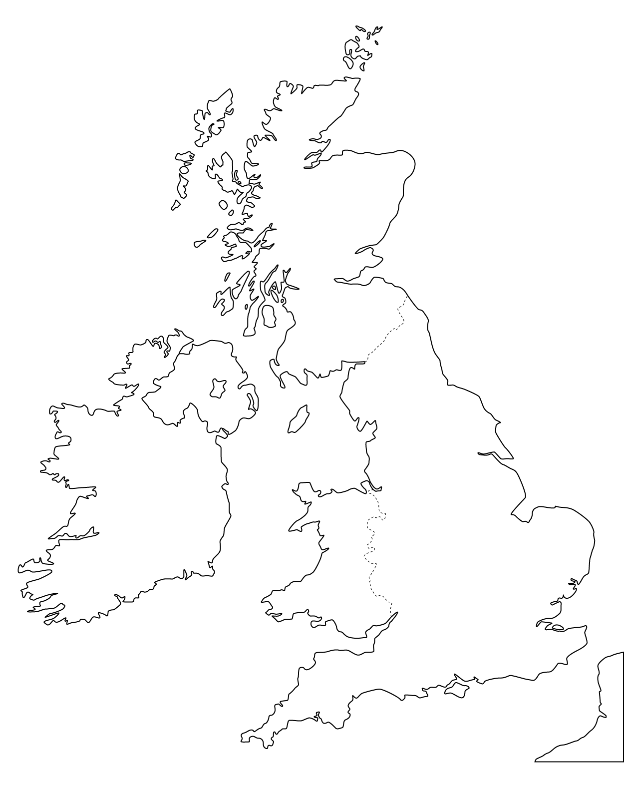
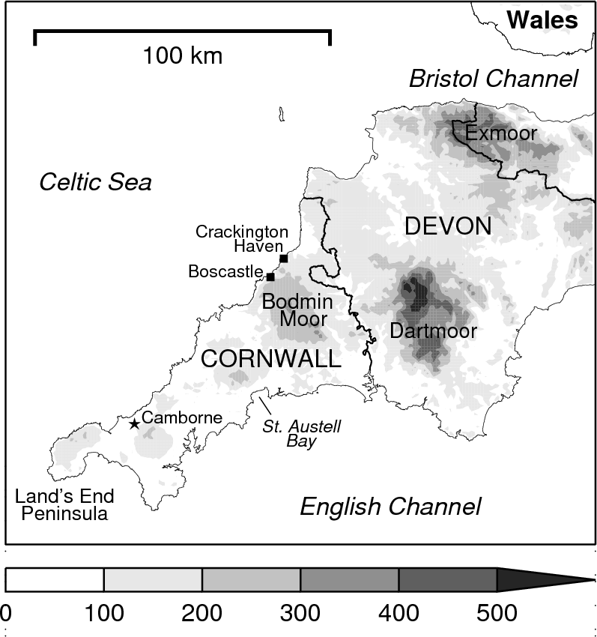
A bit of geography…
Orography height (m)
Notes:
This is a basic slide based on the slide master. To create a slide just insert a new slide (Ctrl+M) and PowerPoint will automatically format the slide with the slide master. Text will automatically placed in bullets. The bullets have five different levels of nesting, to get the next level down you simply use the tab key.

Slide 5
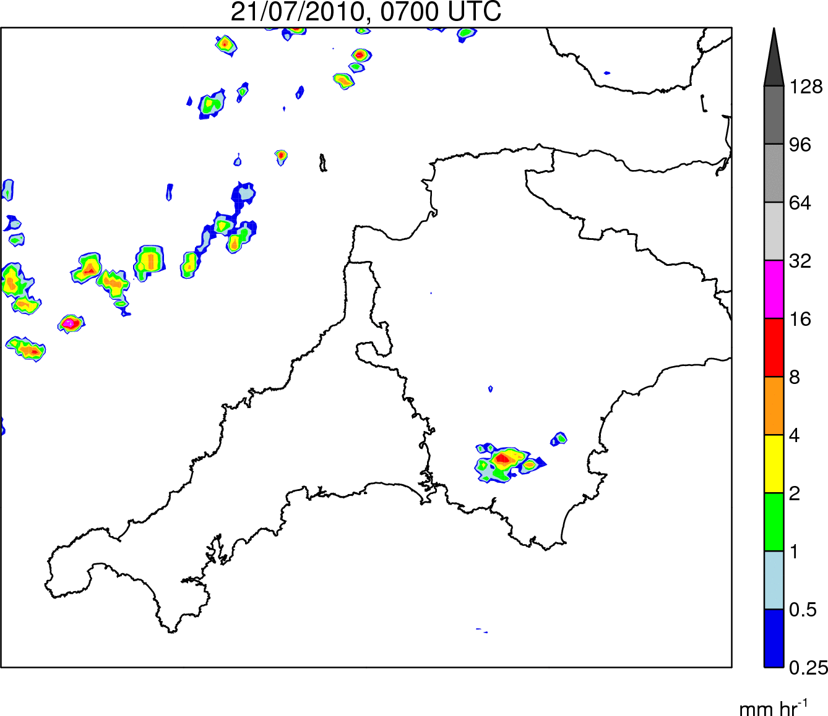
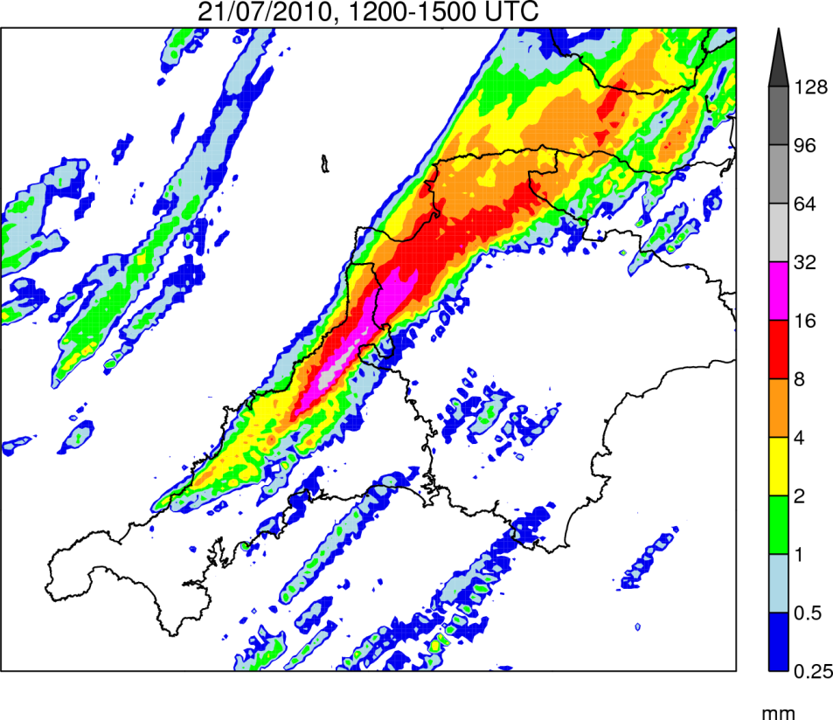
Case Study: 21 July 2010
Rain Rate
0700–1900 UTC
Rain Accumulation
1200–1500 UTC
Notes:
This is a basic slide based on the slide master. To create a slide just insert a new slide (Ctrl+M) and PowerPoint will automatically format the slide with the slide master. Text will automatically placed in bullets. The bullets have five different levels of nesting, to get the next level down you simply use the tab key.

Slide 6
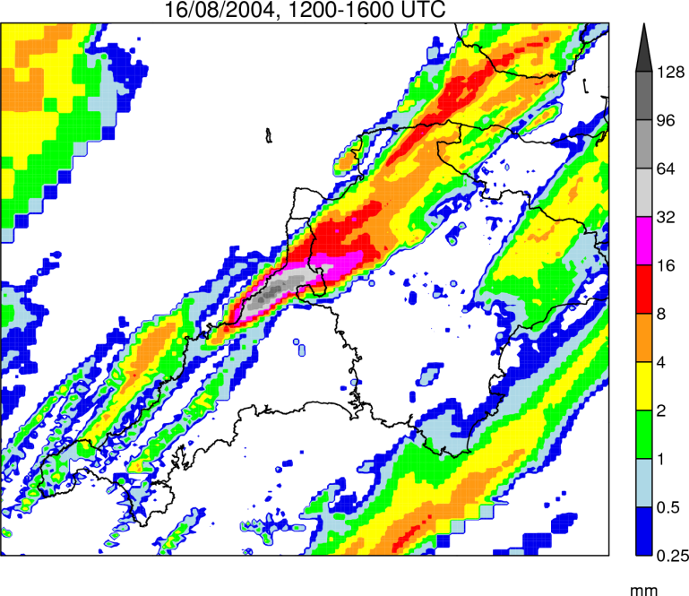
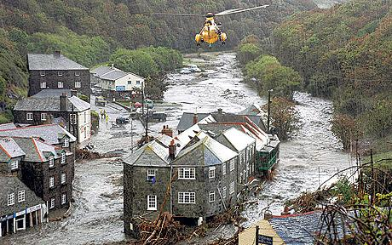
Key Questions
Why was the Boscastle event so much more severe than the 2010 event?
By what mechanism were convective cells repeatedly triggered in the same location?
What caused the system to propagate inland after 1500 UTC?
How well is the event simulated by the Met Office UKV model?
Notes:
This is a basic slide based on the slide master. To create a slide just insert a new slide (Ctrl+M) and PowerPoint will automatically format the slide with the slide master. Text will automatically placed in bullets. The bullets have five different levels of nesting, to get the next level down you simply use the tab key.

Slide 7
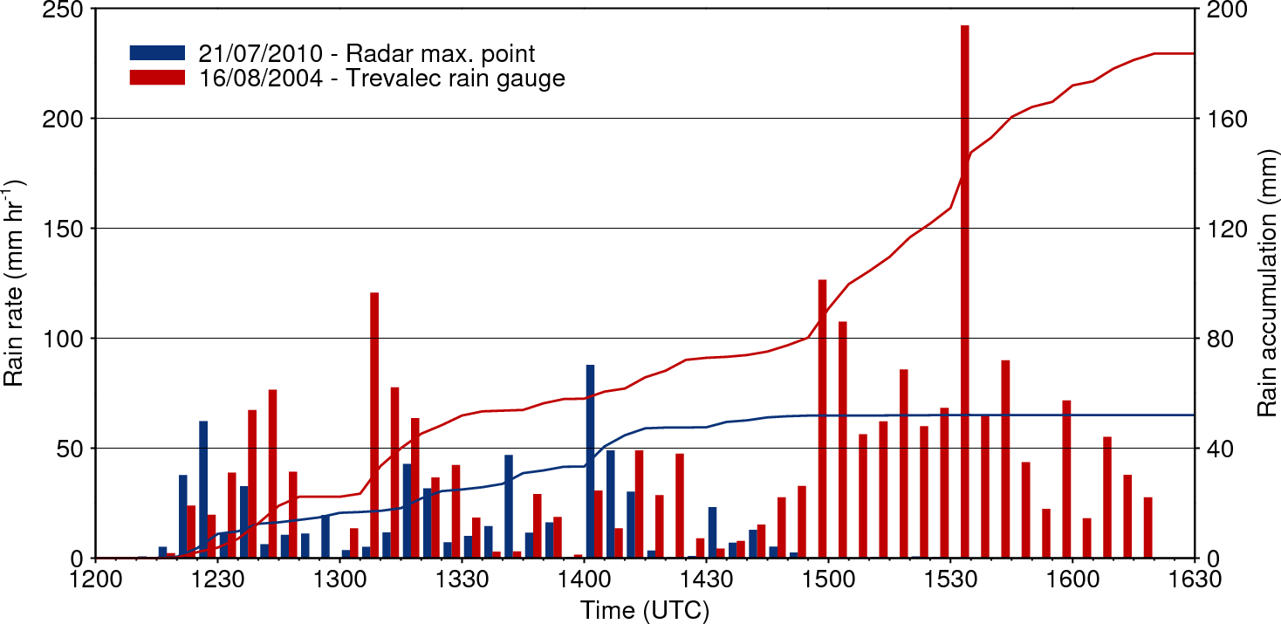
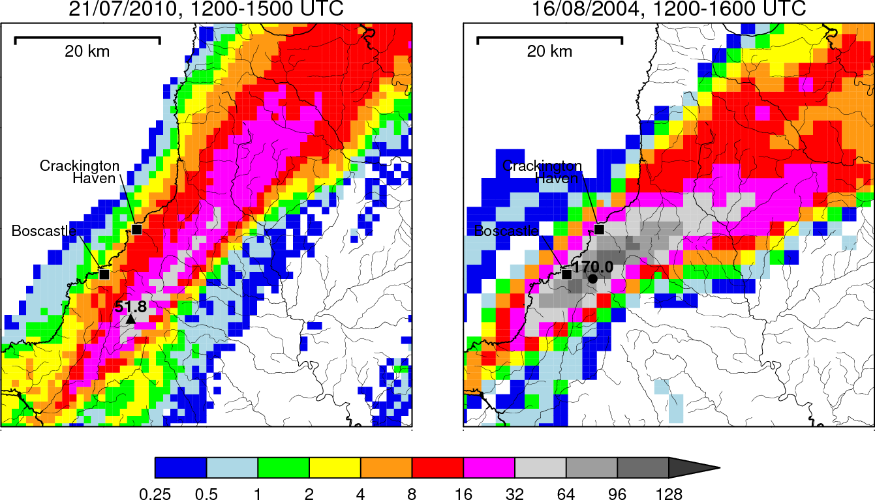
Comparison with Boscastle Storm
Warmer, moister atmospheric column → higher rain rates
Slow evolution of large-scale flow → more stationary system
Notes:
This is a basic slide based on the slide master. To create a slide just insert a new slide (Ctrl+M) and PowerPoint will automatically format the slide with the slide master. Text will automatically placed in bullets. The bullets have five different levels of nesting, to get the next level down you simply use the tab key.

Slide 8
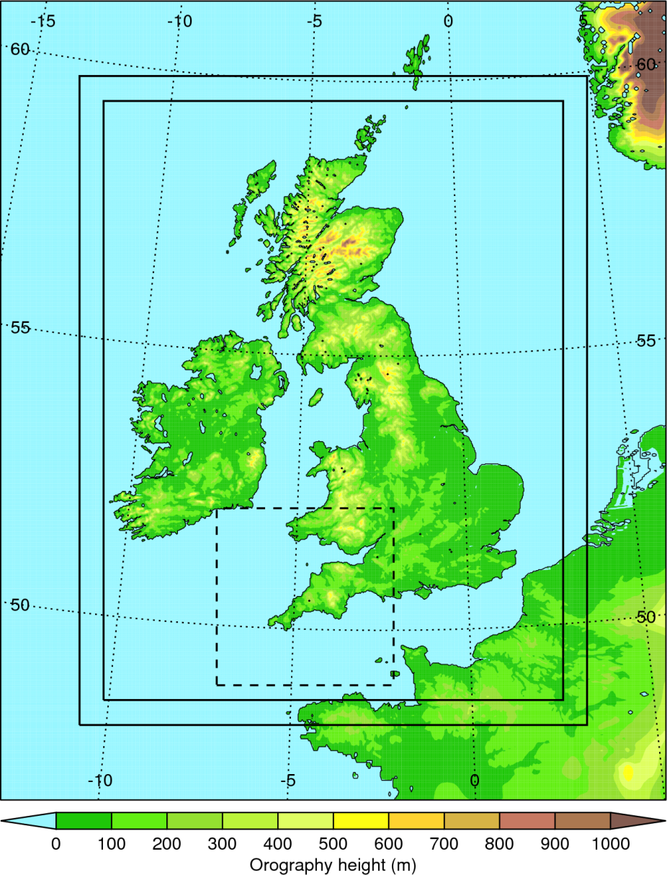
Simulation Strategy
MetUM - UKV model:
Grid spacing: 1.5-km inner domain stretching to 4-km outer domain
Explicit convection
70 vertical levels
Initialised from operational 0400 UTC UKV analysis
LBCs from operational NAE run
Smaller domain with same resolution nested within UKV to reduce expense
Notes:
This is a basic slide based on the slide master. To create a slide just insert a new slide (Ctrl+M) and PowerPoint will automatically format the slide with the slide master. Text will automatically placed in bullets. The bullets have five different levels of nesting, to get the next level down you simply use the tab key.

Slide 9
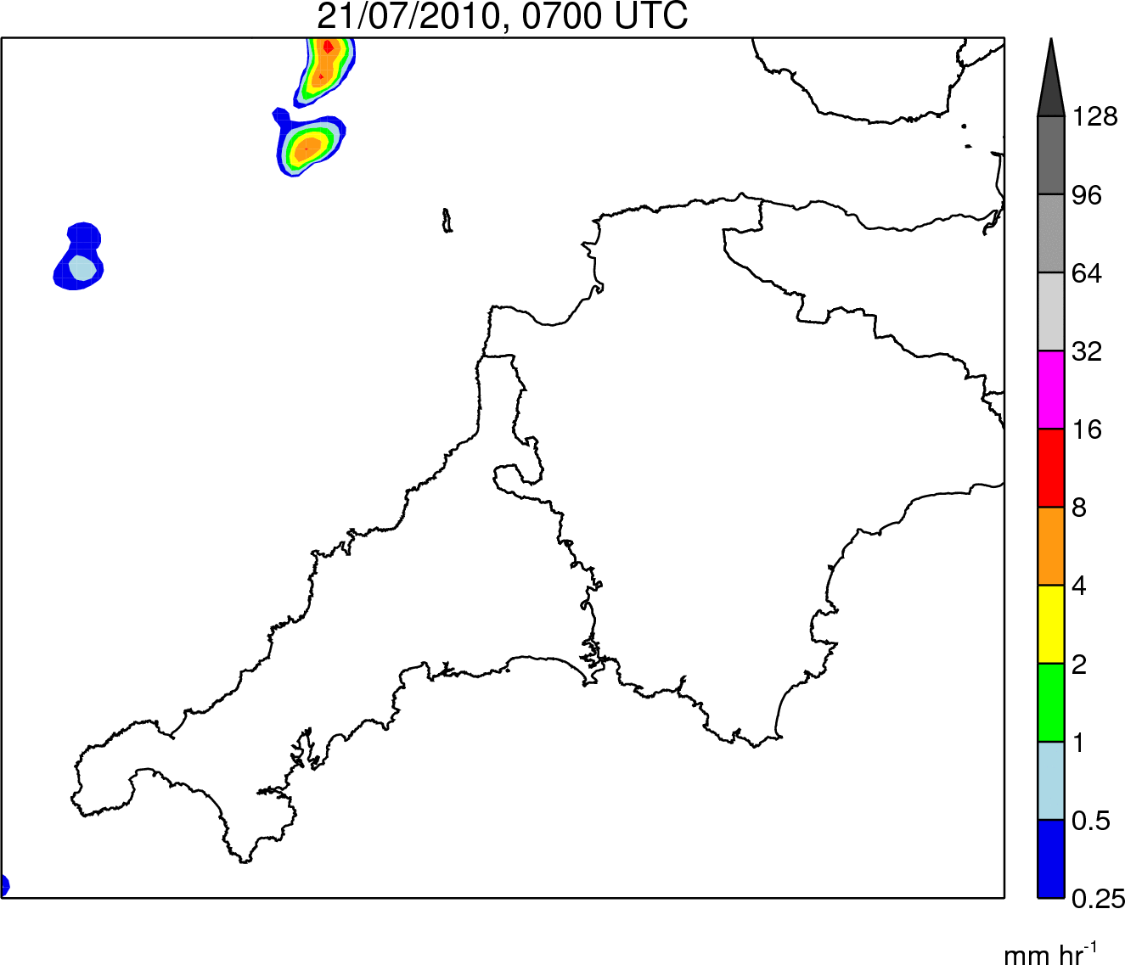
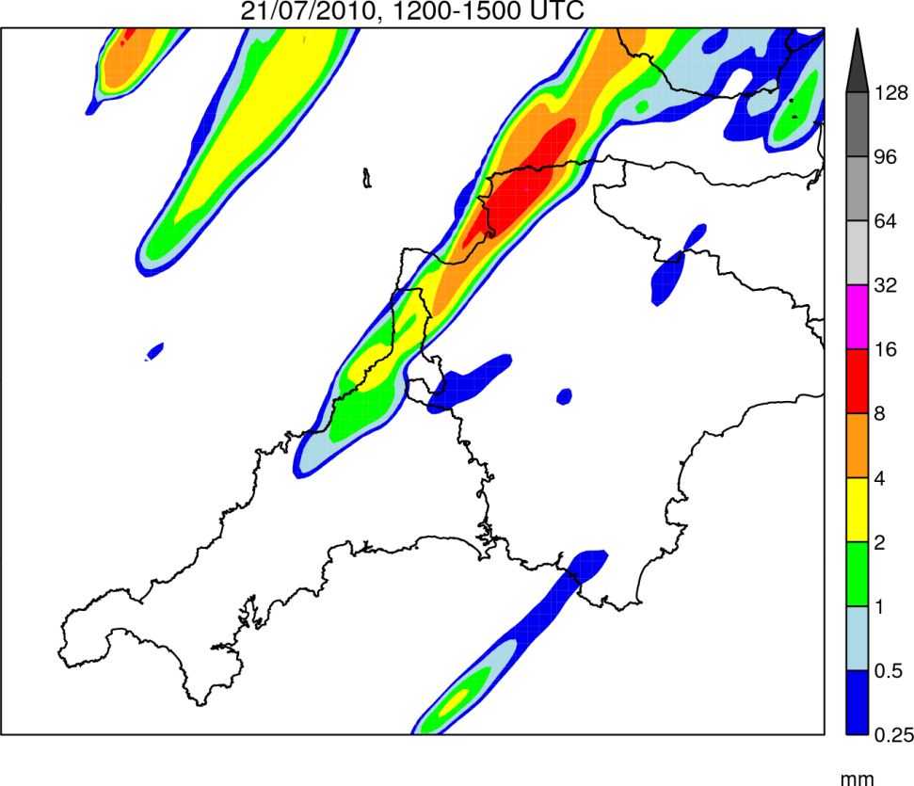
Control simulation: Rainfall
Rain Rate
0700–1900 UTC
Rain Accumulation
1200–1500 UTC
Notes:
This is a basic slide based on the slide master. To create a slide just insert a new slide (Ctrl+M) and PowerPoint will automatically format the slide with the slide master. Text will automatically placed in bullets. The bullets have five different levels of nesting, to get the next level down you simply use the tab key.

Slide 10
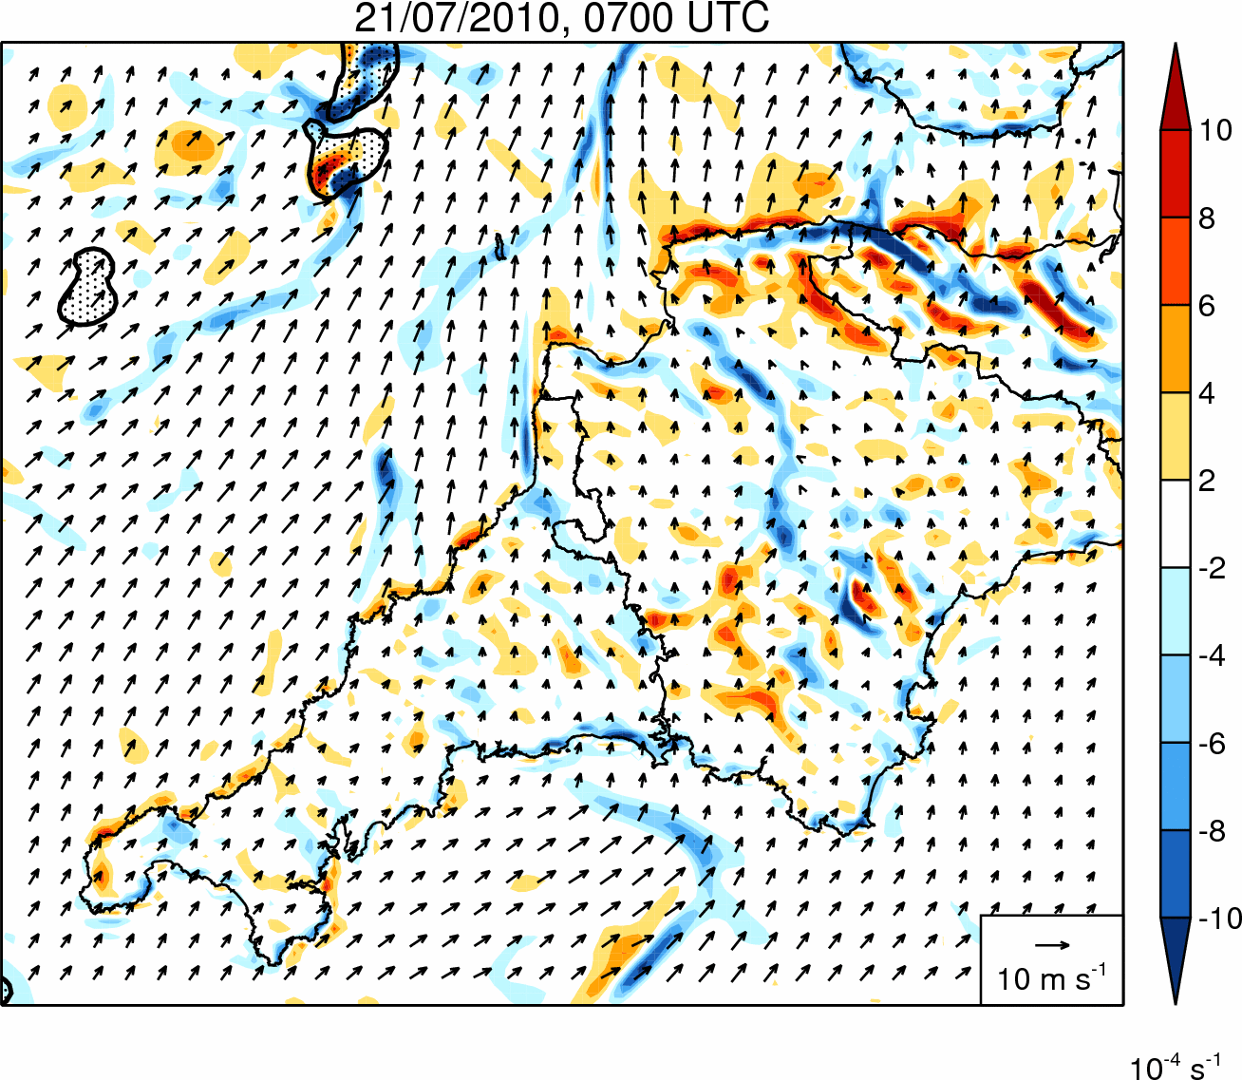
Control simulation: Divergence
Notes:
This is a basic slide based on the slide master. To create a slide just insert a new slide (Ctrl+M) and PowerPoint will automatically format the slide with the slide master. Text will automatically placed in bullets. The bullets have five different levels of nesting, to get the next level down you simply use the tab key.

Slide 11
Sensitivity Tests – Methodology
Aim: To investigate the factors controlling the development and maintenance of the coastal convergence line
Name | Factor under investigation | Methodology
WEAKSUN | Differential surface heating | Solar constant reduced to 400 Wm⁻²
SAMEROUGH | Differential surface roughness | Roughness length for momentum over land fixed to sea value
NOOROG | Orography | Land height over southwest peninsula set to zero
NOOUTFLOW | Cold pools | Latent cooling in microphysics scheme switched off
Notes:
This is a basic slide based on the slide master. To create a slide just insert a new slide (Ctrl+M) and PowerPoint will automatically format the slide with the slide master. Text will automatically placed in bullets. The bullets have five different levels of nesting, to get the next level down you simply use the tab key.

Slide 12
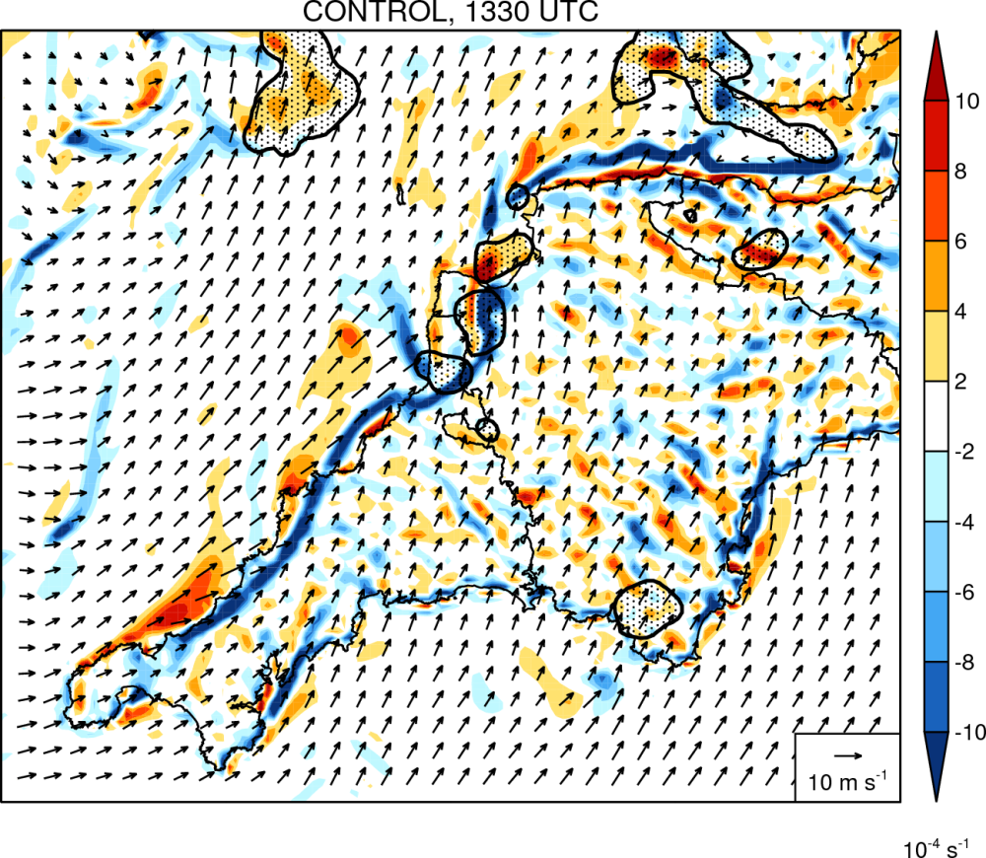
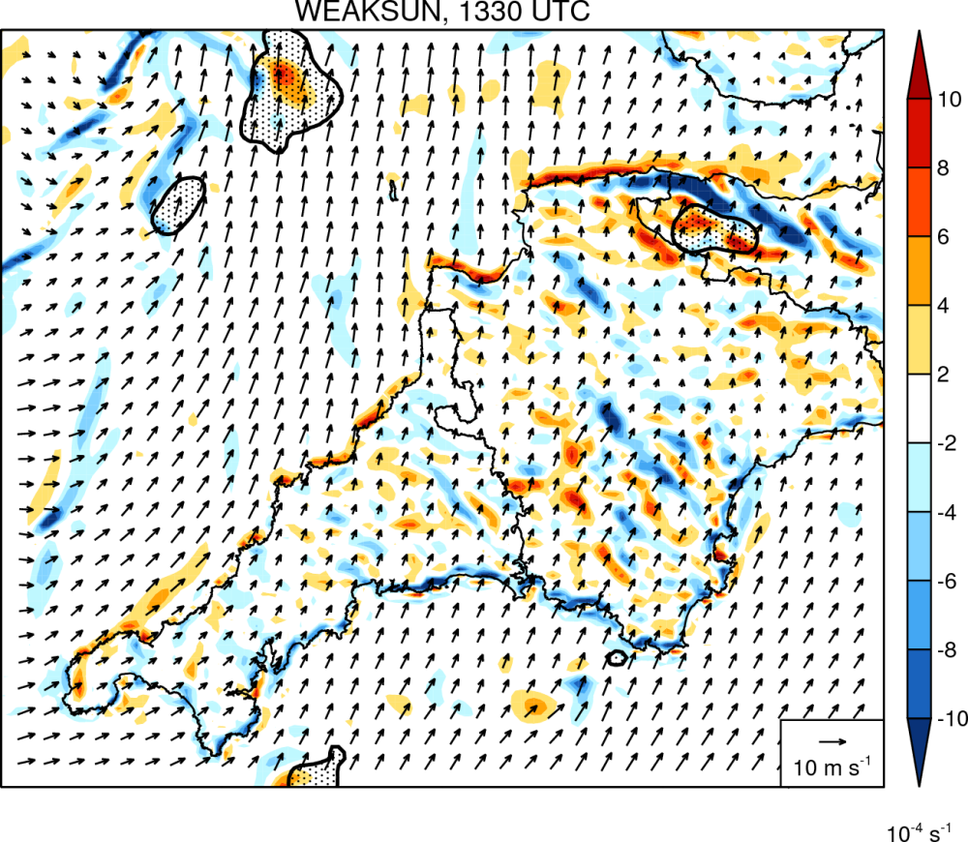
WEAKSUN simulation: Divergence
Differential surface heating is a necessary condition for the convergence line to form → convergence line was a sea-breeze front
Notes:
This is a basic slide based on the slide master. To create a slide just insert a new slide (Ctrl+M) and PowerPoint will automatically format the slide with the slide master. Text will automatically placed in bullets. The bullets have five different levels of nesting, to get the next level down you simply use the tab key.

Slide 13
Key Questions Revisited
Why was the Boscastle event so much more severe than the 2010 event?
Higher rain rates (due to a warmer, moister profile) and a longer system duration (due to slower evolution of the large-scale flow) generated much higher accumulations in the Boscastle case. This, combined with distribution of the rain over fewer river catchments, lead to severe flash flooding.
By what mechanism were storms repeatedly triggered in the same location?
A persistent, narrow convergence line which appears to be a sea breeze front which temporarily stalled along the coastline due to the retarding influence of an offshore-directed background wind component (c.f. Golding et al. 2005).
What caused the system to propagate inland after 1500 UTC?
Veering of low-level wind ahead of an approaching surface low.
How well is the event simulated by the Met Office UKV model?
Repeated initiation of storms is captured but these form too late, evolve too slowly, are too widely spaced, and become too intense.
Notes:
This is a basic slide based on the slide master. To create a slide just insert a new slide (Ctrl+M) and PowerPoint will automatically format the slide with the slide master. Text will automatically placed in bullets. The bullets have five different levels of nesting, to get the next level down you simply use the tab key.

Slide 14
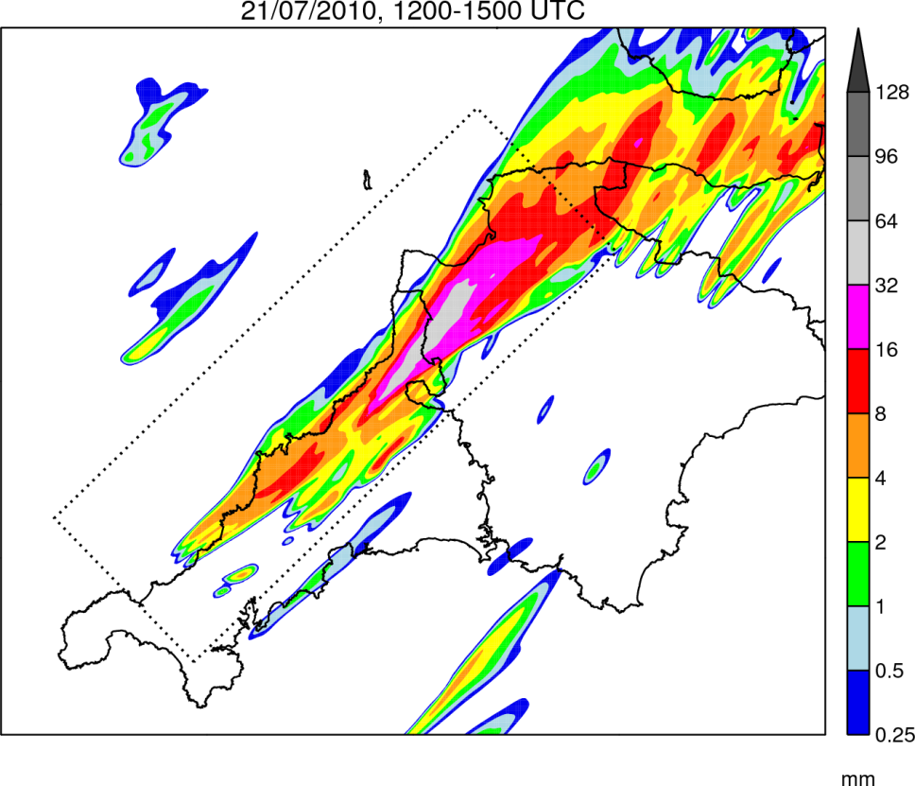
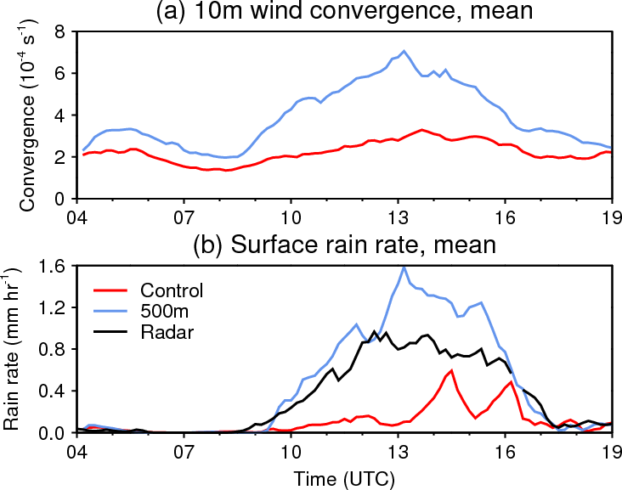
500m Simulation
Convergence line is better resolved at 500m resolution → timing and pattern of convective initiation is significantly improved
Notes:
This is a basic slide based on the slide master. To create a slide just insert a new slide (Ctrl+M) and PowerPoint will automatically format the slide with the slide master. Text will automatically placed in bullets. The bullets have five different levels of nesting, to get the next level down you simply use the tab key.

Slide 15
Conclusions & Future Work
Conclusions
The 21 July 2010 Southwest Peninsula QSCS was forced by a quasi-stationary sea breeze front which developed in response to differential surface heating and an offshore-directed background wind component
Differential surface roughness, orography, and storm outflow do not appear to have played a significant role in this case
The Boscastle storm formed under similar conditions but produced severe flash flooding due to higher rain rates, a longer system duration, and distribution of the heaviest rainfall over fewer river catchments
With 1.5-km horizontal grid spacing, boundary layer convergence may be insufficiently resolved to accurately forecast convective initiation (c.f. Barthlott et al. 2010)
Future work
Climatology of QSCSs in the UK
Idealised modelling of quasi-stationary sea breeze fronts
Notes:
This is a basic slide based on the slide master. To create a slide just insert a new slide (Ctrl+M) and PowerPoint will automatically format the slide with the slide master. Text will automatically placed in bullets. The bullets have five different levels of nesting, to get the next level down you simply use the tab key.

Slide 16
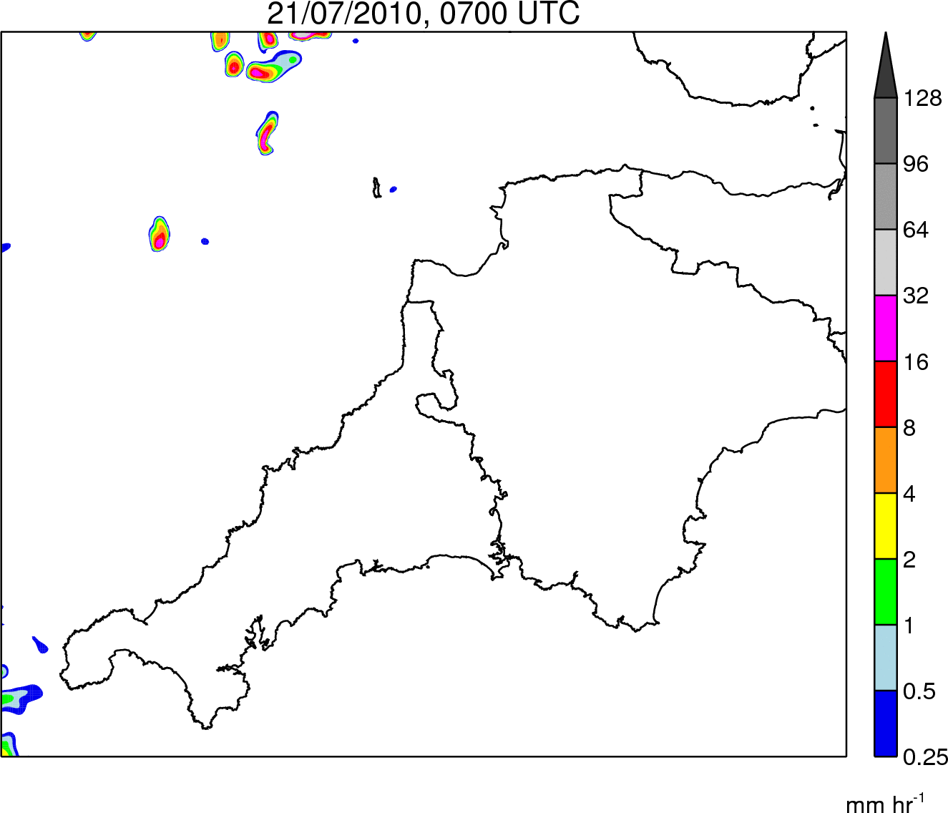
500m simulation: Rainfall
Rain Rate
0700–1900 UTC
Rain Accumulation
1200–1500 UTC
Notes:
This is a basic slide based on the slide master. To create a slide just insert a new slide (Ctrl+M) and PowerPoint will automatically format the slide with the slide master. Text will automatically placed in bullets. The bullets have five different levels of nesting, to get the next level down you simply use the tab key.

Slide 17
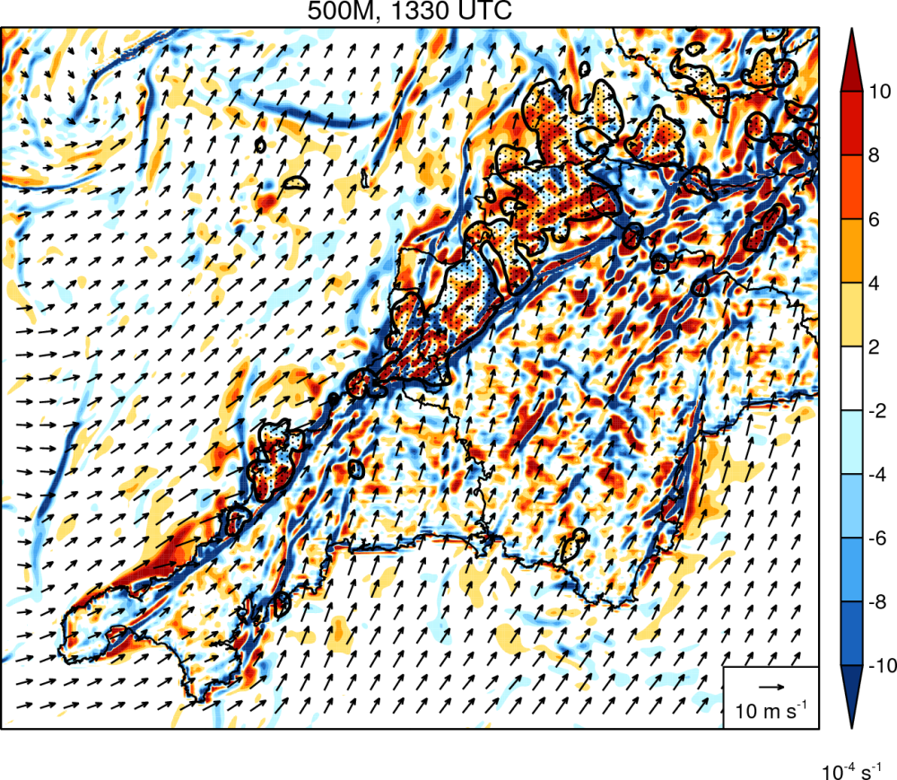
500m simulation: Divergence
Notes:
This is a basic slide based on the slide master. To create a slide just insert a new slide (Ctrl+M) and PowerPoint will automatically format the slide with the slide master. Text will automatically placed in bullets. The bullets have five different levels of nesting, to get the next level down you simply use the tab key.

Slide 18
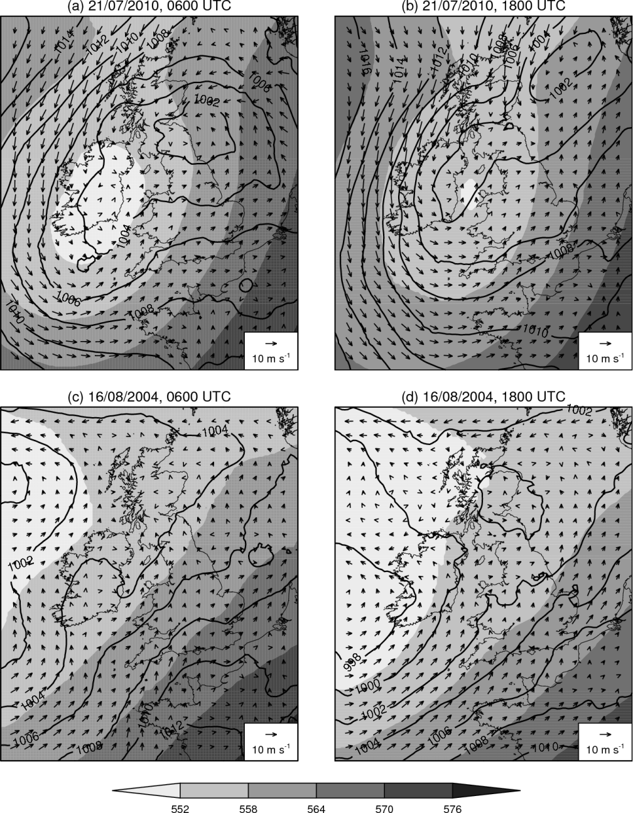
Synoptic setting comparison
Notes:
This is a basic slide based on the slide master. To create a slide just insert a new slide (Ctrl+M) and PowerPoint will automatically format the slide with the slide master. Text will automatically placed in bullets. The bullets have five different levels of nesting, to get the next level down you simply use the tab key.

Slide 19
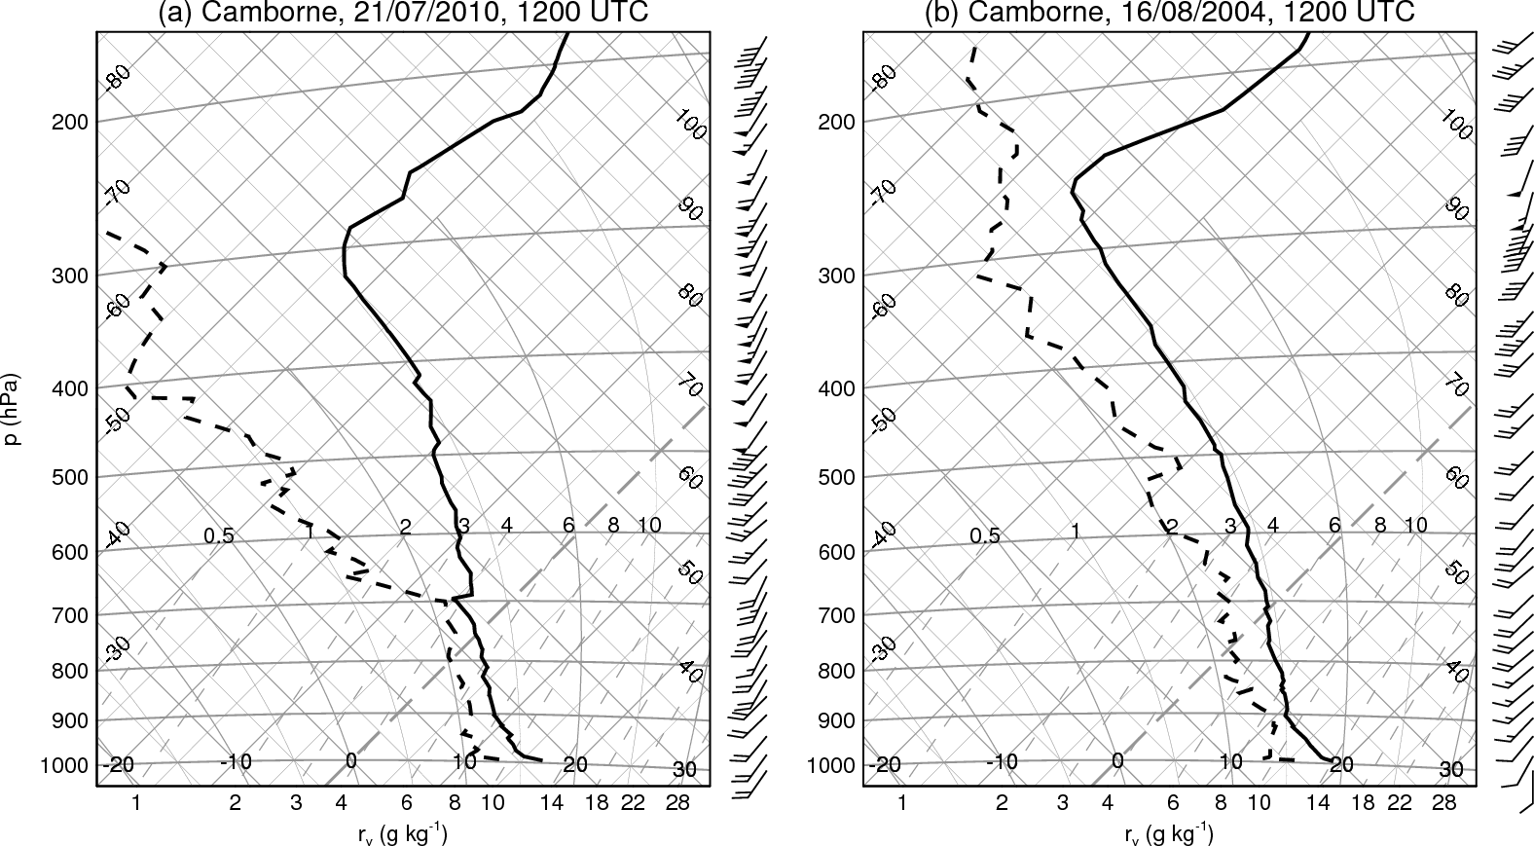
Tephigram comparison
Notes:
This is a basic slide based on the slide master. To create a slide just insert a new slide (Ctrl+M) and PowerPoint will automatically format the slide with the slide master. Text will automatically placed in bullets. The bullets have five different levels of nesting, to get the next level down you simply use the tab key.

Slide 20
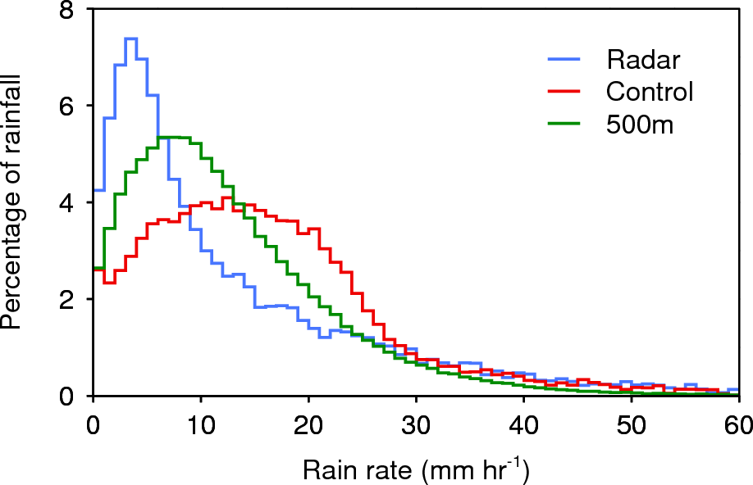
Rain intensity bias
Notes:
This is a basic slide based on the slide master. To create a slide just insert a new slide (Ctrl+M) and PowerPoint will automatically format the slide with the slide master. Text will automatically placed in bullets. The bullets have five different levels of nesting, to get the next level down you simply use the tab key.

Slide 21
Control simulation: Divergence
Precipitation
Convergence line
Divergence offshore
Notes:
This is a basic slide based on the slide master. To create a slide just insert a new slide (Ctrl+M) and PowerPoint will automatically format the slide with the slide master. Text will automatically placed in bullets. The bullets have five different levels of nesting, to get the next level down you simply use the tab key.

