Slide 1
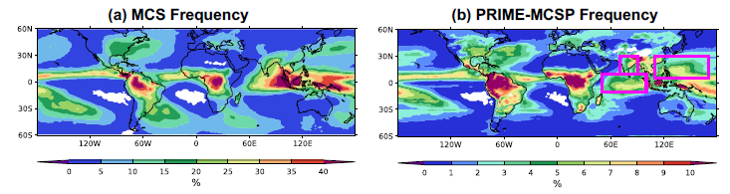
Parameterization of Mesoscale
Convective Systems
R. S. Plant¹, M. R. Muetzelfeldt¹, Z. Zhang², H. M. Christensen², T. Woollings², C.-C. Chen³, Z. Feng⁴, P. Li⁵, M. W. Moncrieff³, A. J. Stirling⁶, M. A. Whitall⁶
1: Reading 2: Oxford 3: NCAR 4: PNNL 5: Chinese Academy of Sciences 6: Met Office
2nd Annual UFS Physics Workshop. Norman, Oklahoma
9-12 July, 2024

Slide 2
Structure
Parameterizing MCS – general remarks
The MCSP scheme of Moncrieff et al
Our ideas
Coupling to CoMorph / MetUM
  Results in climate mode
  Results in NWP mode
Better MCS triggering
  A first look
Better MCS tendencies

Slide 3
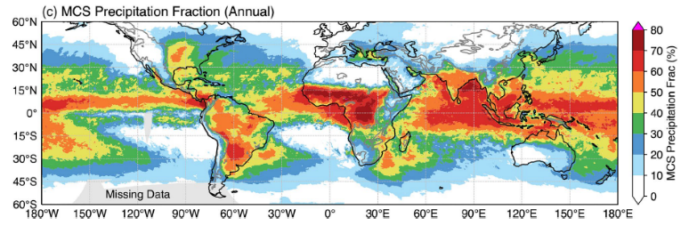
MCS in models
Mesoscale Convective Systems responsible for >50% of rainfall in large areas of tropics
MCSs alter convective heating profile. Can alter coupling to dynamics and reshape large-scale circulations
Global models struggle to represent the stratiform part
Also problematic with explicit convection

Slide 4
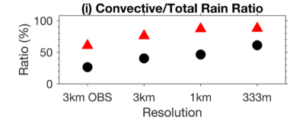
Resolution not a panacea
Also problematic with explicit convection (Varble et al, 2014; Becker et al 2021)
Convection, microphysics, radiation & turbulence all relevant
Upscale transports necessary for large-scale phenomena may be damaged if parameterizations incorrectly couple to model dynamics (and to each other)
Zhang et al 2024
Notes:
Becker et al 2021 is an example of the issues with explicit convection https://rmets.onlinelibrary.wiley.com/doi/full/10.1002/qj.4185
Varble 2014 TWP-ICE intercomparison “Peak vertical velocities in deep convective updrafts are greater than dual-Doppler-retrieved values, especially in the upper troposphere. Freezing of liquid condensate, often rain, lofted above the freezing level in simulated updraft cores greatly contributes to these excessive upper tropospheric vertical velocities. … Decreasing horizontal grid spacing from 900 to 100 m slightly weakens deep updraft vertical velocity and moderately decreases the amount of condensate aloft but not enough to match observational retrievals. Therefore, overly intense simulated updrafts may additionally be a product of unrealistic interactions between convective dynamics, parameterized microphysics, and large-scale model forcing that promote different convective strengths than observed.”
Zhang et al 2021 “overly-intense updrafts are too efficient in producing rimed ice and precipitating moisture in convective regions, resulting in fewer ice hydrometers aloft for feeding stratiform precipitation”
Zhang et al 2024 “Underestimates stratiform rainfall by 46% and overestimates convective rainfall by 43%”
Based on case study simulations for two periods representing low CAPE (< 300 J kg-1) and high CAPE conditions (> 1000 J kg-1).

Slide 5
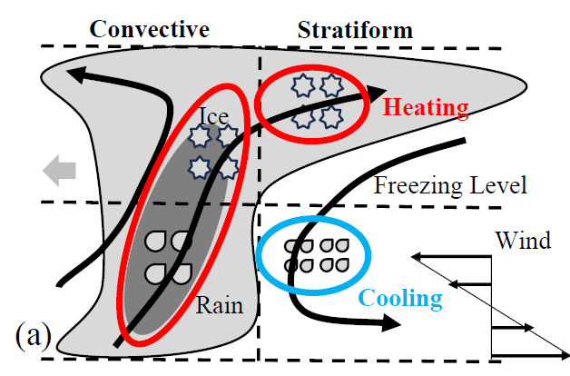
What is missing?
Stratiform component has heating aloft (deposition of vapour onto ice)
And cooling in lower troposphere, where melting and evaporation occur
Net effect is a top-heavy heating profile
Notes:
Deposition facilitated by ice hydrometeors transported from convective regions (Han et al., 2019).

Slide 6
Background – earlier work
Various attempts to account for MCS effects (or more broadly effects of convective organization) but without yet becoming mainstream in modelling practice
e.g….
Cellular automata - Bengtsson et al (2021)
Stochastic upper-level vorticity increments – Shutts in Bowler et al (2008)
Stochastic multi-mode models - Khouider and Majda (2008)
As a feedback on entrainment – Mapes and Neale (2011)
Cold pool representations – Park (2014); Rooney et al (2022)

Slide 7
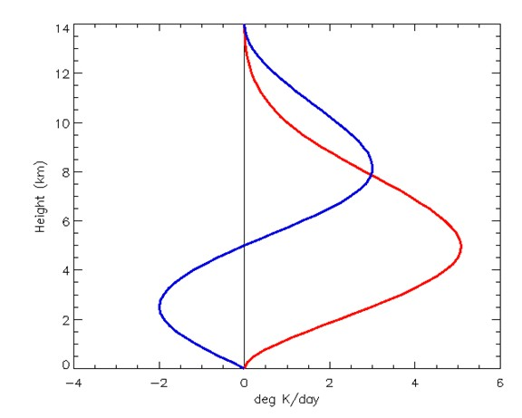
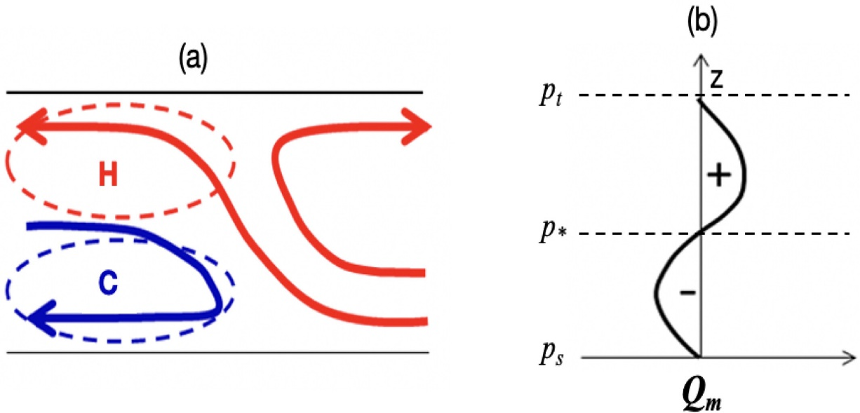
MCSP scheme
Multiscale Coherent Structure Parameterization (Moncrieff et al 2017) makes heating profile more top-heavy and provides additional momentum transports
Idealization of slantwise overturning MCS model
Scaled by integrated heating from convection scheme
Stratiform
Height
Convective
Houze (2004)
Heating
Notes:
The slantwise ascending layer in the center aligns with the convective region, where condensational heating is driven by updrafts loaded with raindrops below and ice condensates starting above the freezing level. The updrafts that curve horizontally to the right carry ice condensates aloft, aiding in the horizontal growth of the stratiform region. In the stratiform region, the ice condensates undergo depositional growth, which releases latent heat in the upper atmosphere. As these particles fall below the freezing level, they melt into raindrops. This melting process, followed by evaporation, induces cooling in the stratiform region’s lower levels

Slide 8
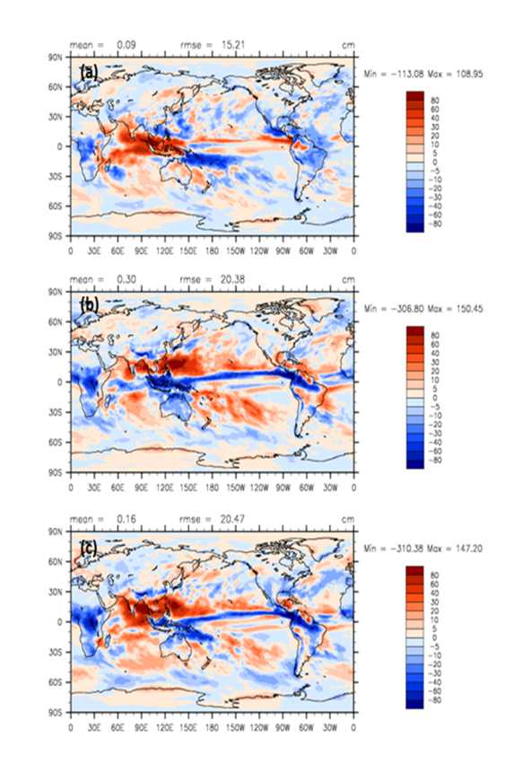
Effects on precipitation
(a) Momentum transport
(b) Heating
(c) Both
Improvements across ITCZ and maritime continent in CAM, E3SM
Moncrieff et al, 2017
Notes:
“Both top-heavy heating and momentum transport decrease the rainfall rate over equatorial Africa.
The precipitation rate over the Maritime Continent is reduced by momentum transport but substantially increased by the top-heavy heating. “
Chen 2021: “Implementation of the heating component of MCSP in E3SMv1 provides substantial improvement in MJO in terms of stronger eastward propagation of precipitation and OLR in the Indian Ocean basin and increased power in the eastward spectra for periods between 30 and 90 days.”

Slide 9
Improving the MCSP approach?
Impacts are clear and broadly encouraging
Want to target the method to MCS structures rather than apply indiscriminately
  A simple shear threshold was beneficial in E3SM (Chen et al, 2021)
Want to revisit the associated additional tendencies
Take a probabilistic approach
Focus on heating part, motivated by idealized CMT studies with CoMorph at MO where correct heating was of leading order importance

Slide 10
MCS scheme envisaged
Call existing convection parameterization
No convection
New part, informed by observational
dataset
Convection
Test for conducive environmental conditions
No MCS
Modified, informed by DA system
MCS
Call MCS scheme
Final convection tendency sum of output from convection scheme and MCS scheme

Slide 11
CoMorph-A Convection Scheme
New mass flux scheme for the Unified Model
Beneficial (Lock et al 2024) but not yet operational
Initiated at any level, proportional to buoyant instability
No distinction between shallow, deep and mid-level
Entrainment rate depends on the turbulent mixing-length in the parcel’s source layer, and on precipitation in the previous timestep (i.e., simple memory effect)
Separate consideration of cloud-mean and cloud-core properties in detrainment calculations
Implicit detrainment calculation prevent artificial on/off noise
Developed through large Met Office / university partnership, ParaCon, but especially by Mike Whitall

Slide 12
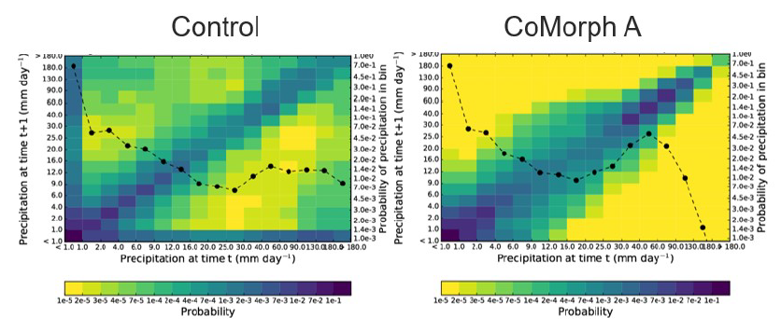
Autocorrelations
P(pecip rate at t+Δt | precip rate at t) in N96 AMIP
High values along axes show 2 Δt noise
Lock et al, 2024
Notes:
The dashed lines show the one-dimensional histogram of the binned precipitation, using the right-hand vertical axis.

Slide 13
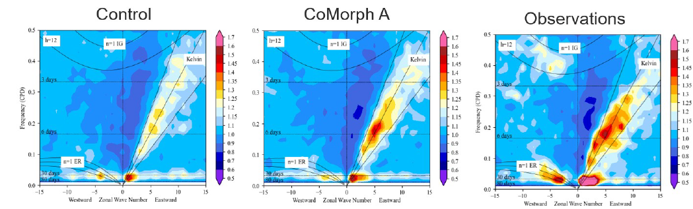
CoMorph Tropical Waves
Slightly stronger MJO
Improved Kelvin wave strength
Improved coupling to lower tropospheric moisture has led to improvements in tropical waves and MJO
Observations (left), current UM (centre), with CoMorph (right).
Notes:
N96, atmosphere only. Tropical wavenumber-frequency spectrum for precipitation

Slide 14
When to implement
MCS requires deep convection
  Cloud top temperature < 0ºC
  Cloud base pressure > 600 mb
  Cloud base and top pressure difference > 300 mb
And requires some wind shear
  Wind difference (600mb – lowest level) > 3 ms⁻¹

Slide 15
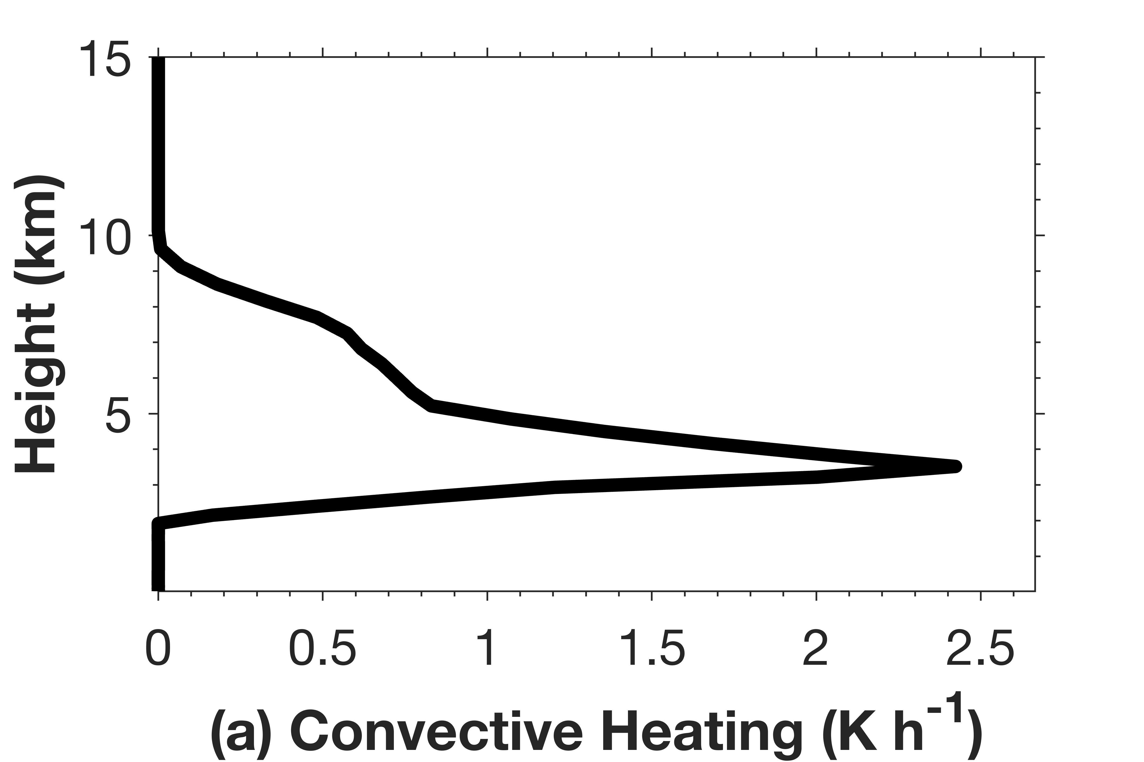
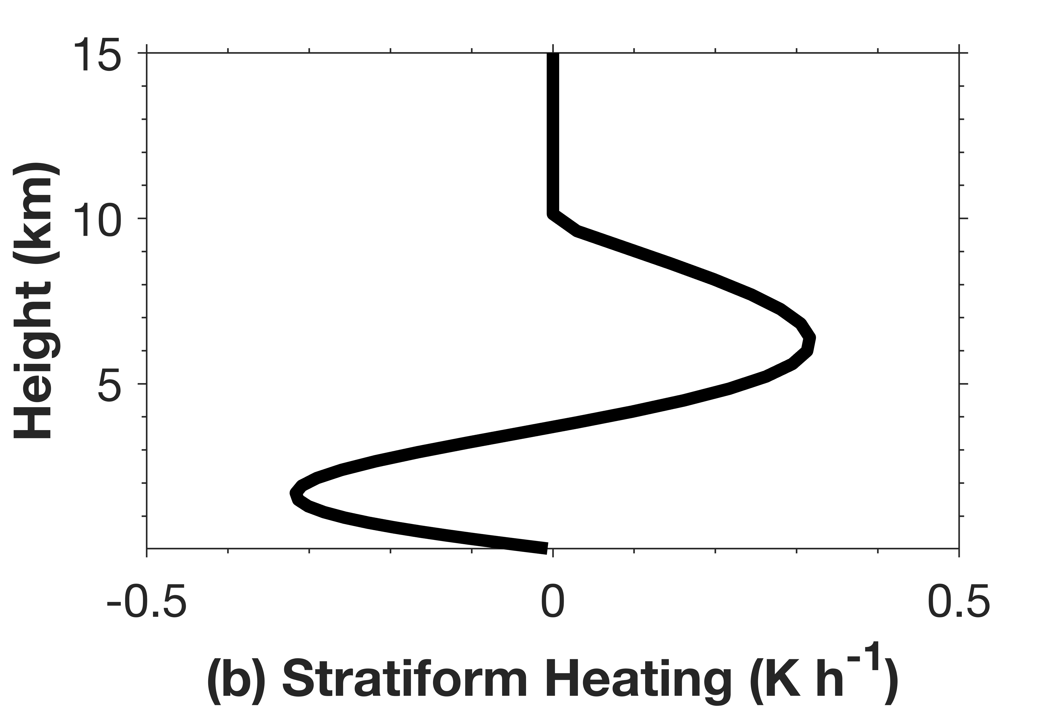

Additional stratiform tendency
Example CoMorph output
Emulated stratiform
$$Q_{strat}(p)=α\overline{Q_{conv}}\sin\left(2π\frac{p_{top}−p}{p_{top}−p_{surf}}\right)$$
where $\overline{Q_{conv}}$ is vertically integrated heating, $α$=0.5 or f(T_{top})
Notes:
Alpha =0.3 to 0.5 is estimated by Chen et al (2021) based on some high-res WRF simulations

Slide 16
Climate simulation
Uses UM v13 in its AMIP6 configuration, with convection scheme replaced by CoMorph-A and with MCS tendencies
N96 ∼135 km grid spacing, 85 vertical levels, 20 min timestep
20 years simulation

Slide 17
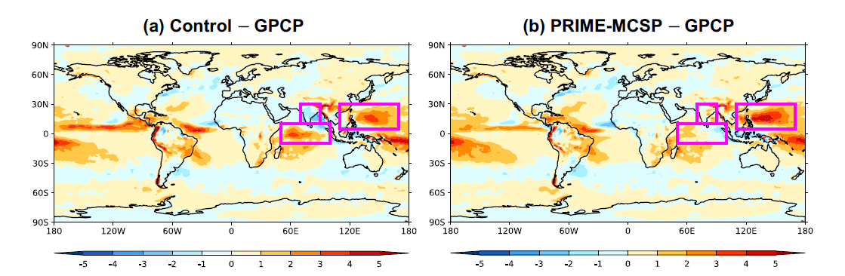
Rainfall pattern
Increases rainfall over India and West Pacific
Reduces it over Indian Ocean
Emphasizes changes with CoMorph-A compared to old UM scheme

Slide 18
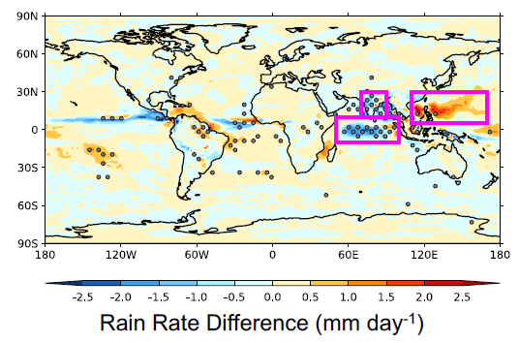
Change in bias
Increase of wet bias
Decrease of dry bias
Mitigate wet bias
This plot is for variable α run, our preferred configuration, which dampens the scheme effects
Notes:
PRIME-MCSP reduces dry bias over India and mitigates wet bias over the Indian Ocean, albeit amplifying it over the Western Pacific.
T-test at each point, control vs MCSP data, start with monthly data, randomly choose 20x12 values and calculate mean, and compare mean, repeat this 10,000 times
Areas with significant changes (p values < 5%) in rainfall bias are marked with stipples
Improvements over India and the Indian Ocean are statistically significant. In contrast, the Western Pacific shows high internal
variability such that the apparent bias amplification could be due to chance.
2 figures added here are for vanilla left and variable alpha right

Slide 19
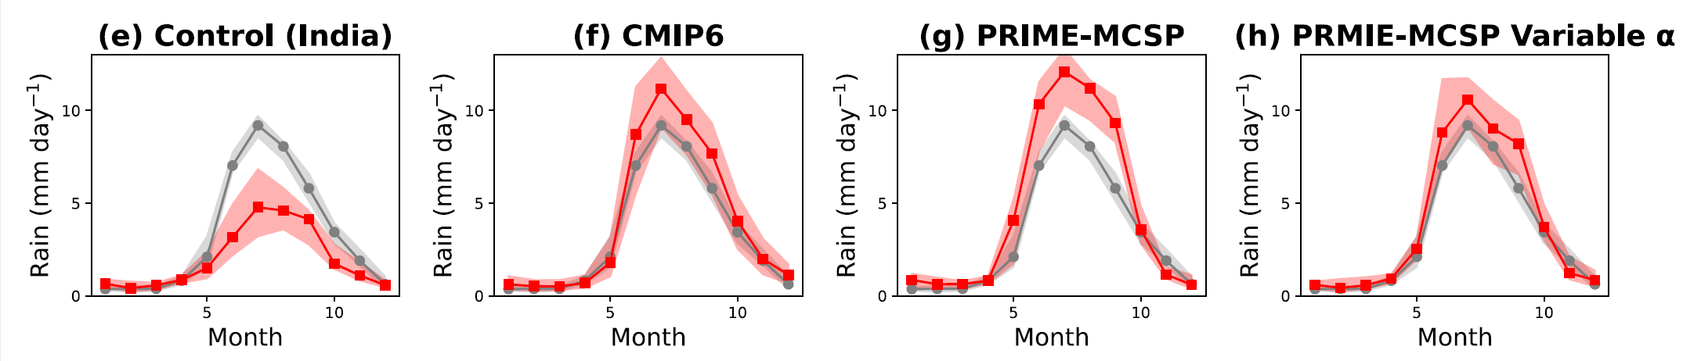
Indian monsoon
Grey = GPCP obs
Red = model
Enhanced monsoon amplitude (a longstanding UM issue)
Notes:
The bands and lines indicate the IQR ranges and median values respectively.
For cmip, variability is due to 20 years of data AND 26 different models
For control and prime, variation over the 20 years of this monthly area-averaged rainfall data

Slide 20
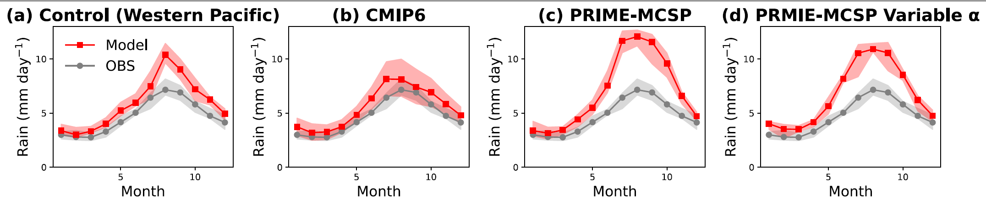
Western Pacific seasonality
Amplifies seasonality, here a degradation
Timing and shape are good

Slide 21
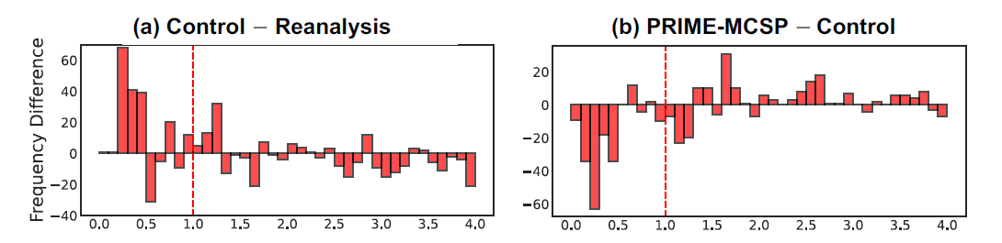
Enhanced MJO
Relative stabilization at low levels discourages stationarity / encourages eastward progression of convection
Better representation of OLR anomalies before reaching the maritime continent
And better able to propagate through it
Notes:
Wheeler and Hendon (2004) definition, https://journals.ametsoc.org/view/journals/mwre/132/8/1520-0493_2004_132_1917_aarmmi_2.0.co_2.xml Also discussed at ECMWF link at e.g. https://charts.ecmwf.int/products/mofc_multi_mjo_family_index?base_time=202307270000
The MJO index is calculated following Wheeler and Hendon (2004) approach, which uses 15°S to 15°N averaged 850-hPa zonal wind, 200-hPa zonal wind, and OLR at the TOA. Daily fields are filtered to leave the 20–100 days MJO components, before they are projected onto the same multiple-variable Empirical Orthogonal Functions computed from the reanalysis data. Two principal components are derived to depict the east-west and north-south progression of the MJO. The magnitude of the vector formed by these components serves as the MJO index
When the MJO index exceeds a value of 1, these components are employed to categorize data into eight MJO phases
Control run exhibits too many weak MJO events
PRIME-MCSP run reduces the occurrence of these weaker while increasing the frequency of stronger events

Slide 22
NWP simulations
N216 ∼60 km grid spacing, 70 vertical levels, 7.5 min timestep, 8 ensemble members
Restart from 8 perturbed members of the MOGREPS-G NWP configuration
48h from 1 July 2020
Is the scheme behaving as intended?

Slide 23
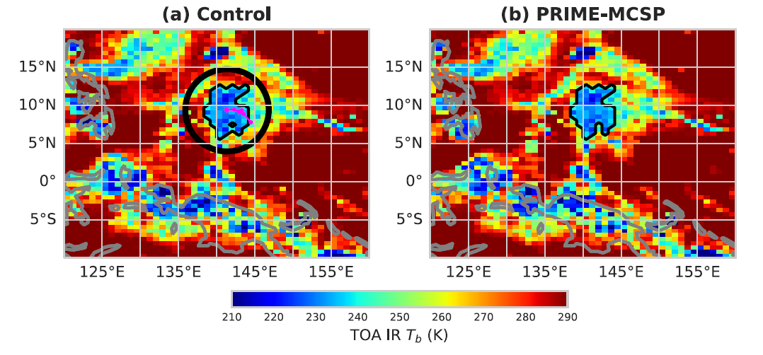
Track the simulated MCS
Using PyFLEXTRKR (Feng et al 2023) based on Tb and rain rates
MCS are matched between control and new scheme runs if ≥ 80% area overlap at initiation
Compare properties over MCS area and surrounding 200km environment
Notes:
Based on hourly maps of TOA IR Tb and surface rain rates.
Conversion to IR Tb is achieved through the empirical correlation of Yang and Slingo (2001)
Cold cloud shield below 241 K gives rainfall area and the mean rain rate underneath the MCS.
Minimum area 60,000 km2 at peak of its lifecycle and duration > 6 h.

Slide 24
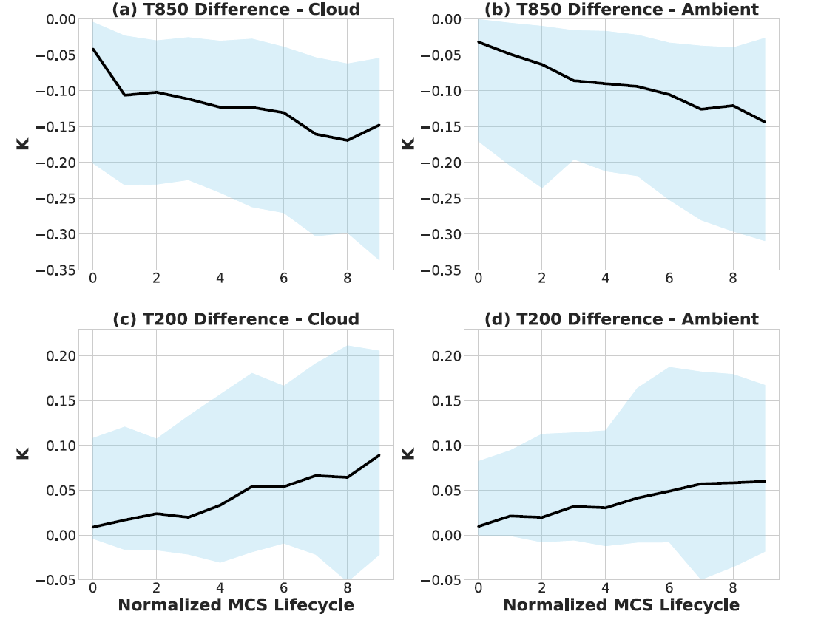
Direct scheme impacts
Low-level cooling and upper-level warming (~0.1K in median) that extends to the environment

Slide 25
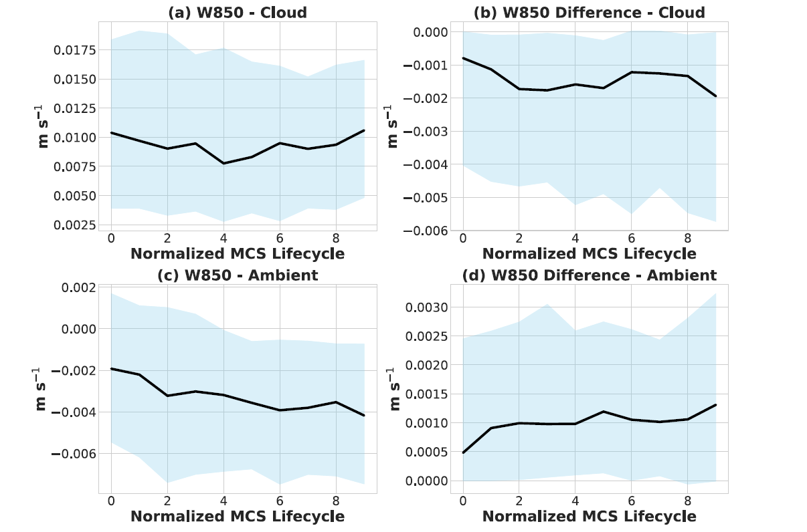
Modulates explicit circulation
reduces w by ~ 10-20%
i.e. it’s a grey-zone scheme that acts where the overturning is and helps control its amplitude

Slide 26
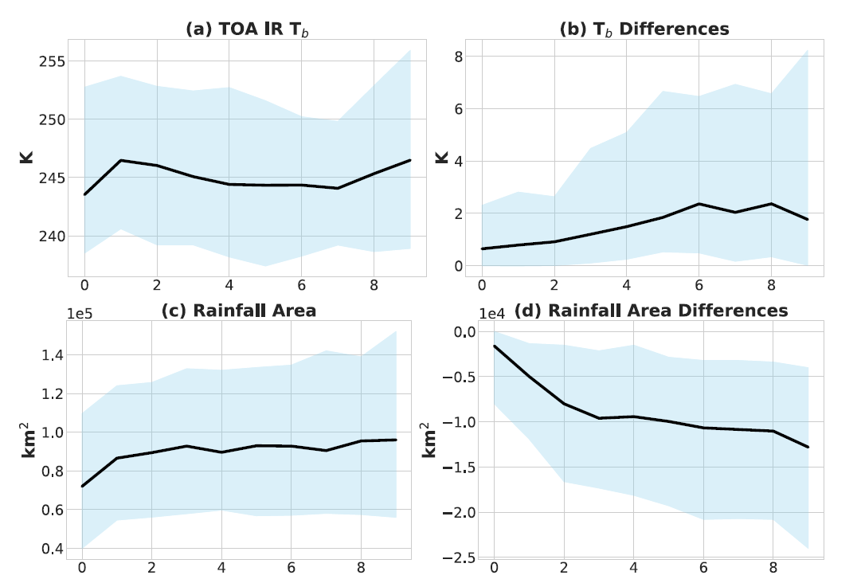
MCS’s smaller and shallower
~10% area reduction and ~2K warmer in Tb

Slide 27
MCS Database (Feng et al)
Based on geostationary satellite Tb data
Combined with IMERG satellite precipitation data
Continuous global coverage from 60°S to 60°N with resolution ~4 km (0.1°) and 1h
MCS identification / tracking validated against weather radar data from US and China
Cold cloud (<241K) shield >of area 4x10⁴ km² containing core (<225K) and precipitation feature >100 km
PyFLEXTRKR used to track cloud objects
PF area, mean rain rate, rain rate skewness, and heavy rain volume ratio > than lifetime dependent thresholds
CCS and PF exist continuously for > 4 h
Notes:
The 4-km 𝑇𝑏 dataset is upscaled to the 0.1° resolution of IMERG.

Slide 28
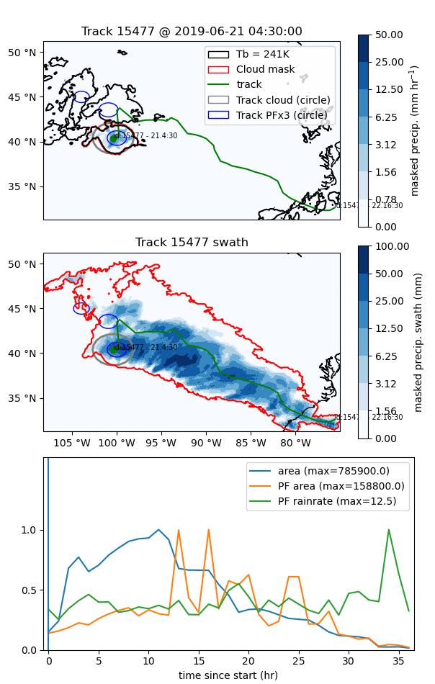
An example,
21/06/19 over US
Top: brightness temp (black), the MCS (red) and its path (green). Cloud area (grey circle) and precip cores (blue circles).
Middle: Precip swath and outline of cloud mask over MCS lifetime
Bottom: MCS area, precipitation feature (PF) area, and PF rainrate

Slide 29
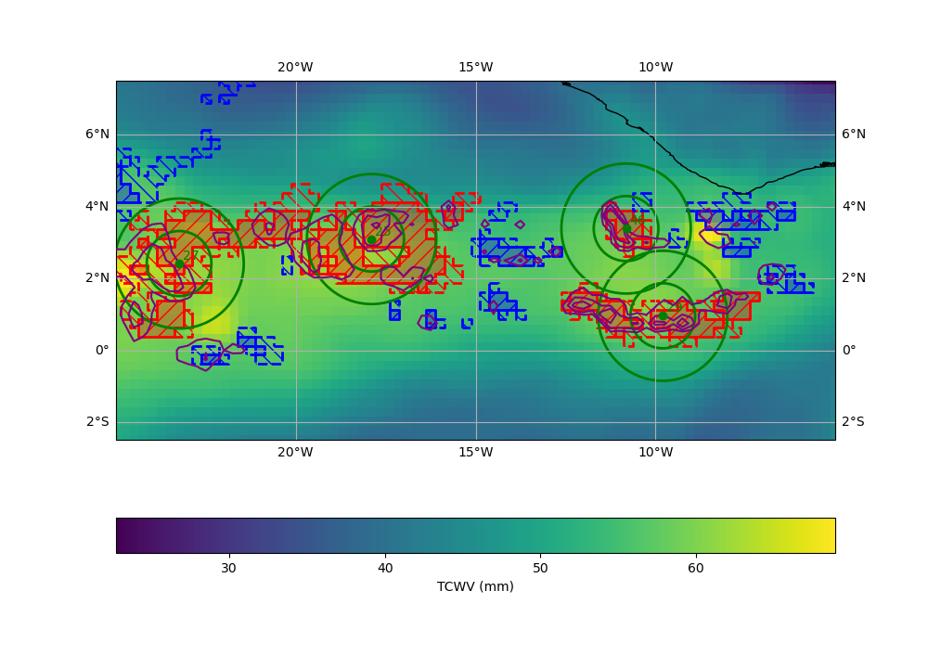
Analysis regions overlayed on TCWV
Core < 225K (solid)
225K < Shield < 241K (dashed)
Red=MCS
Blue=deep convective, but not MCS
Green circles: 100, 200km, environment
Background = TCWV from ERA5
Notes:
we use ERA5 (Hersbach et al. 2020), which is available for the 20 years of our study.
ERA5 variables are available on a 0.25° grid, at hourly frequency (on the hour, so interpolate to half hour)
An MCS covers at least 50 ERA5 grid cells

Slide 30
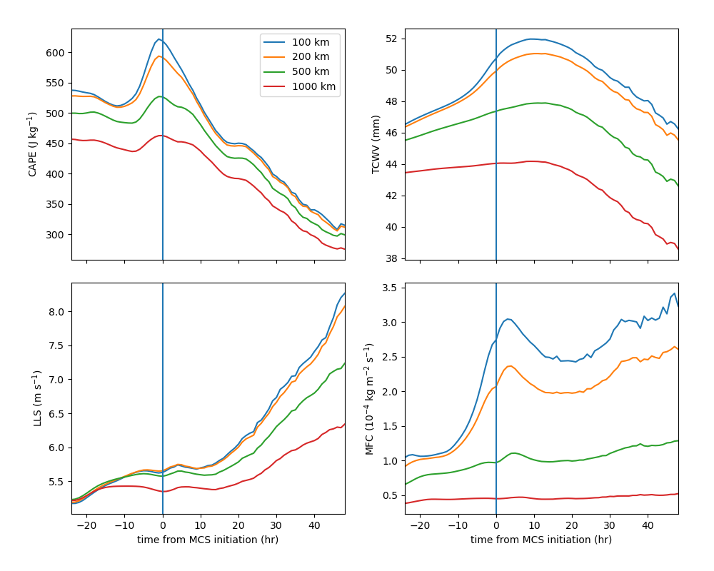
Evolution of composite MCS environment
Before MCS initiation, use initation centroid
After MCS initiation, use track centroid
Increases in CAPE, TCWV and MFC 5-10 hr beforehand. Smallest spatial scale has the largest change.
Low-level shear shows a weak increase, but stronger increase over the next 15h
CAPE
TCWV
LLS
MFC
Notes:
The initiation point is defined as the first cloud which is tracked in the MCS tracking dataset and which goes on to form an MCS.
We only consider MCSs that have not formed as the result of a split from an existing MCS, as this ensures that the precursor environment does not contain an MCS. Including those too just dampens the signals.

Slide 31
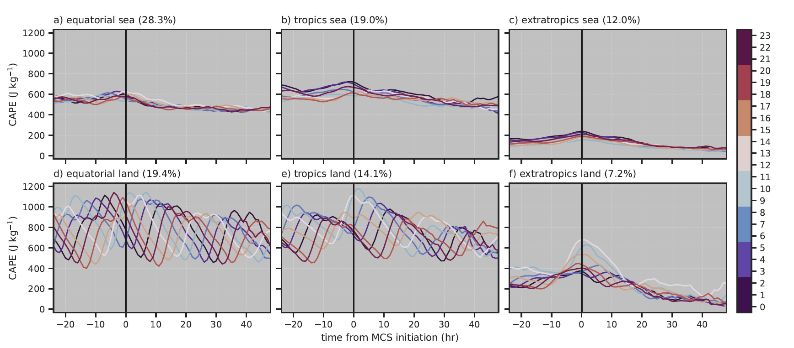
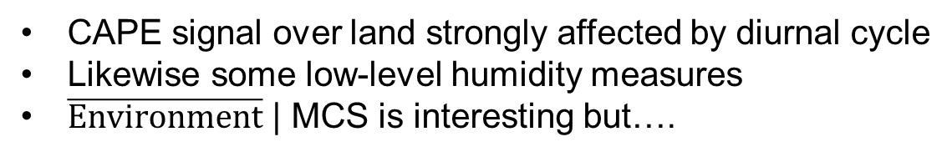
Dependence on region
Decompose into land/sea, by season, latitude bands, diurnal cycle etc
CAPE
CAPE
CAPE signal over land strongly affected by diurnal cycle
Likewise some low-level humidity measures
$\overline{Environment}$ | MCS is interesting but….

Slide 32
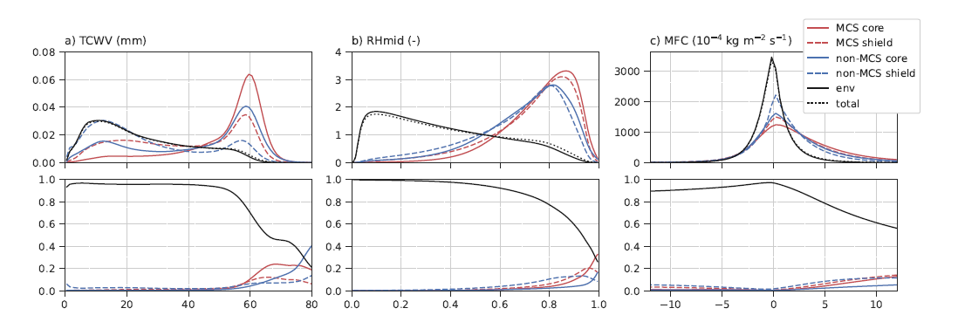
Distinctions between MCS, non-MCS and environment
Top: distributions of variables
Bottom: probability of being in MCS, deep-non-MCS or environment given a value for that variable

Slide 33
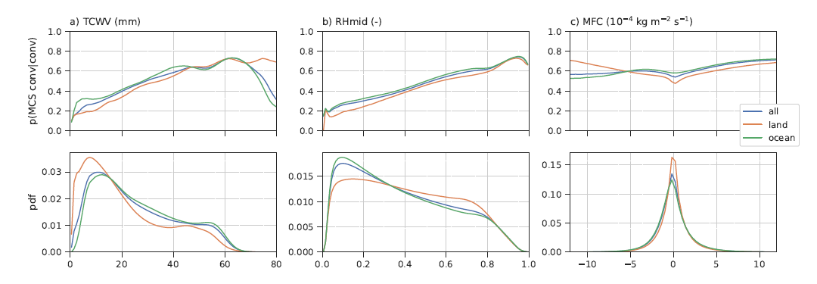
We need P (MCS | conv, variable)
  Top: the conditional probability
  Bottom: the pdf of the variable
  TCWV and RHmid were the most promising at distinguishing MCS from non-MCS deep convection
  Use for stochastic trigger of the MCS parametrization

Slide 34
Stochastic trigger
For initial tests of the stochastic trigger we choose to work with TCWV
This gives the most robust signals when decomposed by region, season etc
We use random numbers that are correlated in space and time following pattern generators used by other stochastic methods in the model
But choose scales appropriate for MCS
Notes:
agrees with Chen et al. (2017) TCWV is strongest predictor of precipitation produced by large-scale precipitation features (roughly equivalent to MCSs), with relative humidity (RH) at low- and mid-levels and low-level shear also having predictive value.
Other studies have shown links between TCWV and MCS or MCS precipitation (e.g., Peters et al. 2009; Ahmed and Schumacher 2015; Schiro et al. 2020; Chen et al. 2022).

Slide 35
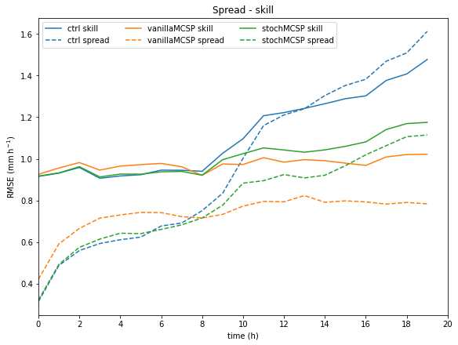
First look with N216 ensemble
Early growth of RMS of tropical precip at grid-scale in one case
RMSE (mm/h)
T+4
T+12
T+24
Notes:
after about 8 hours, using either MCSP appears to slow or stop the decrease in skill over the tropics. A look at rainfall patterns suggests simply that some small but intense oceanic features are displaced from the obs around this time.
vanillaMCSP remains underdispersed, whereas stochMCSP improves this

Slide 36
What MCS tendencies?
The missing heating anomalies associated with MCS are available in the operational archive of analysis increments
How do such increments compare with MCSP?
Can we improve on the characterization of systematic errors and/or introduce probabilistic dependency of the MCS-associated tendencies on environmental variables?
Analogous to a targetted version of additive inflation (e.g. Piccolo et al 2019) for perturbing an ensemble

Slide 37
Additive inflation
Scheme for inflating ensemble spread in the MO global short-to-medium range ensemble at all lead-times
Samples an archive of 4DVar analysis increments and inserts these as tendencies over a 6-h period in each ensemble member
Includes a 3-month-mean bias-correction
The concept is that the analysis increments represent “model error”
Notes:
Piccolo C, Cullen MJP, Tennant WJ, Semple AT. Comparison of different representations of model error in ensemble forecasts. Q J R Meteorol Soc. 2019; 145: 15–27 From Piccolo et al 2018, “the scheme proposed by Piccolo and Cullen (2016) uses an archive of analysis increments computed over a training period with the same model. Since model error is unknowable a priori, it can only be characterized by comparing the model evolution with observations. Use of increments from data assimilation allows the use of all available observations with proper allowance for observation error. However, since only a single true state is observed at each time, the statistics of model error can only be inferred by accumulation over a large number of cases. Random analysis increments drawn from an archive are then used to force each member of the ensemble forecast. This method is designed to produce reliable ensembles, provided that it is also used in an ensemble data assimilation system which generates the initial conditions, because a reanalysis trajectory generated using the ensemble data assimilation will then be statistically indistinguishable from a randomly chosen model trajectory. The successful use of this method thus requires the observation network to be good enough for a reanalysis to be an adequate proxy for the truth.” “simulates model error by adding, every time step (and constant over a 6 h period), random increments (Piccolo and Cullen, 2016) drawn from an archive of analysis increments generated by the operational 4D-Var assimilation scheme for the appropriate season (Rawlins et al. 2007). No temporal correlation is introduced in the perturbations: the perturbations are fully correlated for 6 h (the length of 4D-Var assimilation window) and they are redefined every 6 h by using a new random analysis increment.”
Rushley, S. S., M. A. Janiga, W. Crawford, C. A. Reynolds, W. Komaromi, and J. McLay, 2024: The Impact of Analysis Correction-Based Additive Inflation on Subseasonal Tropical Prediction in the Navy Earth System Prediction Capability. Wea. Forecasting, 39, 421–440…. “The systematic component resulted in larger bias corrections for the upper and lower level winds while the stochastic component resulted in larger bias corrections for the temperature field. Some degradation in skill occurred at longer lead times, particularly when the bias tended to change sign or trend toward zero at longer lead times, resulting in an overcorrection by ACAI (Crawford et al. 2020). In the fully coupled version of the Navy ESPC, ACAI had a beneficial effect on integrated vapor transport forecast bias (Reynolds et al. 2022). While ACAI reduced biases in both the forecasted winds and moisture fields, the reduction in integrated vapor transport bias was due primarily to the reduction in the wind speed bias. As in Crawford et al. (2020), Reynolds et al. (2022) found that ACAI was less effective or even had a negative impact on forecast biases in regions where the bias changed with forecast lead time, and in regions where biases were dependent on intraseasonal or seasonal variability, such as the South Asian monsoon region.” where here Crawford paper is Crawford, W., S. Frolov, J. McLay, C. A. Reynolds, N. Barton, B. Ruston, and C. H. Bishop, 2020: Using analysis corrections to address model error in atmospheric forecasts. Mon. Wea. Rev., 148, 3729–3745 also “The ACAI perturbations are comprised of a mean component aimed at reducing systematic error and a stochastic component aimed at improved ensemble spread–skill. The mean component of the ACAI perturbation is calculated using a multimonth average analysis correction and the stochastic component is from a random analysis correction selected from the same multimonth time period used to compute the average correction”
From the 2020 paper, “However, while the method does provide
some significant improvement to forecast skill, some degradation in bias can occur at later lead times when the
average bias at analysis time trends toward zero over the length of the forecast, leading to an overcorrection
by the analysis correction–based additive inflation (ACAI) method. Additionally, it is shown that both the
mean and random component of the ACAI perturbations play a role in adjusting the model bias, and that the
two components can have a complicated and sometimes nonlinear interaction. Recent work by Bowler et al. (2017) proposed a novel
way to account for model error in an ensemble forecast.
In their work, which we will refer to as analysis
correction–based additive inflation (ACAI), an estimate
of model error is derived from an archive of analysis
corrections and added as a tendency term to the model
equations every six hours of the model integration.
The ACAI method assumes that analysis corrections
represent a reasonable approximation to the short-term
model error. Piccolo et al.
(2019) illustrate the utility of using random analysis in-
crements to account for model uncertainty in ensembleCorresponding author: william.crawford@nrlmry.navy.mil
SEPTEMBER 2020 C R A W F O R D E T A L . 3729
DOI: 10.1175/MWR-D-20-0008.1
Ó 2020 American Meteorological Society. For information regarding reuse of this content and general copyright information, consult the AMS Copyright
Policy (www.ametsoc.org/PUBSReuseLicenses).
Brought to you by NOAA Central Library | Unauthenticated | Downloaded 07/06/21 07:06 PM UTC
forecasts and present a comparison with other stochastic
methods (i.e., SKEB and SPT). Their results indicate
that the analysis increment method outperforms other
methods in terms of ensemble spread and reliability.
Both in deterministic and ensemble forecasts, the ACAI
method demonstrates added skill and reduced forecast
bias in short-term model forecasts. The method intro-
duced by Bowler et al. (2017) combines these prior ap-
plications to simultaneously address model bias and
model uncertainty.
In this paper, we further examine the applicability of
the ACAI method to error reduction in short-term
forecasts, but also, for the first time, up to 10-day
model forecasts. ”

Slide 38
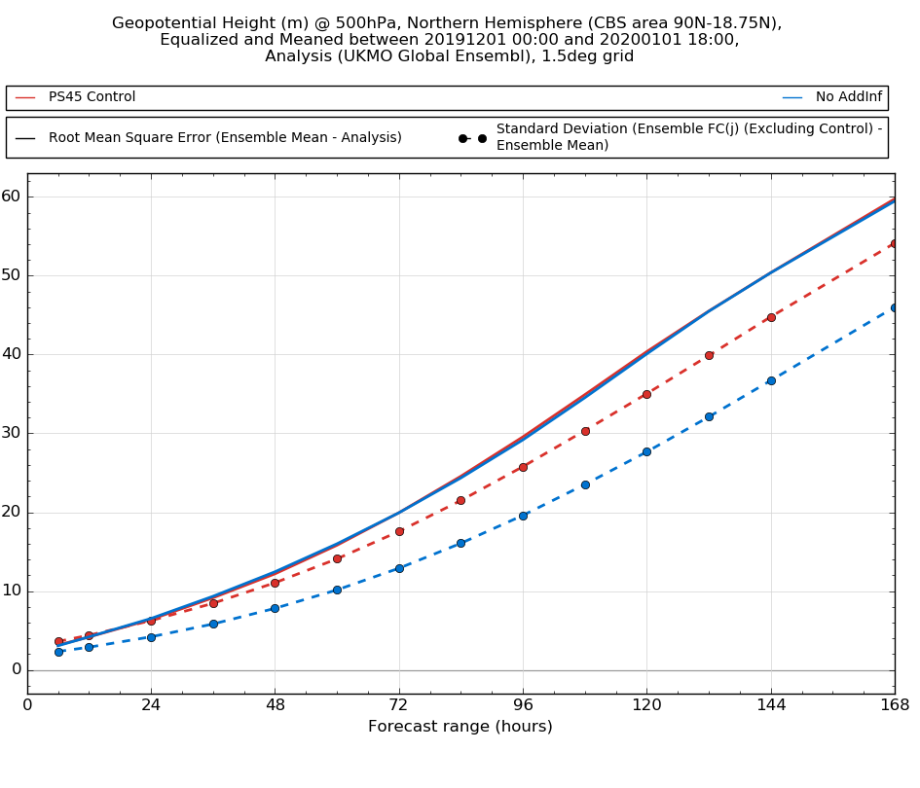
Additive inflation
Improves ensemble spread and ensemble-based skill measures
Though degrades some deterministic skill measures (not flow dependent)
Z500 N hem
Ens mean RMSE in solid; ens spread dotted
With inflation and without
WarrenTennant

Slide 39
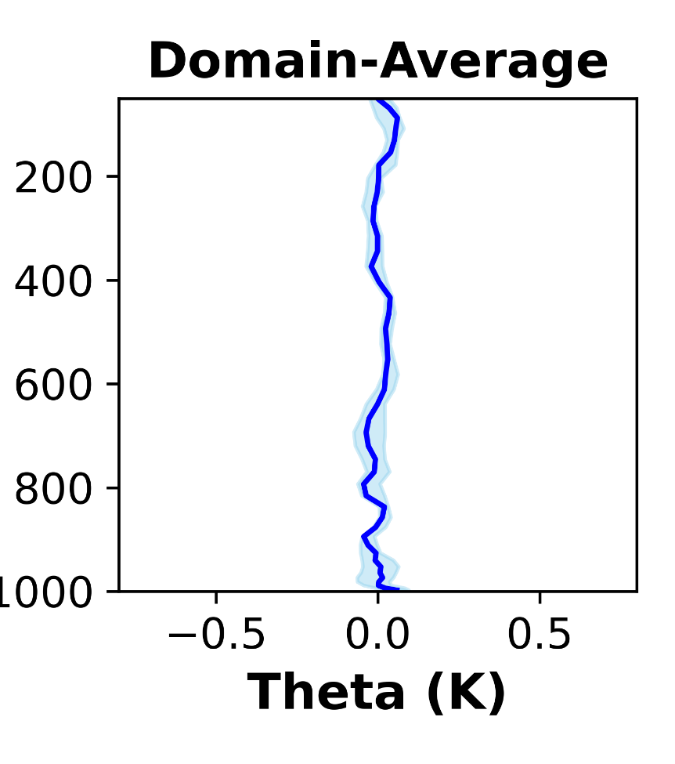
One month of operational ensemble
Identify MCS in model initial conditions and in the observational database, requiring > 60% area overlap
We want the DA increments that tell us about misrepresentation of MCSs, not their incorrect presence or absence
Model is unbiased in the mean

Slide 40
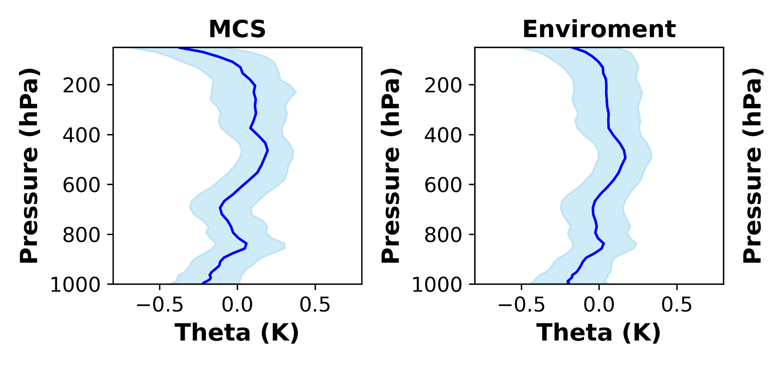
DA increments in matched MCS
Upper troposphere: warming
Lower troposphere: cooling (and drying)

Slide 41
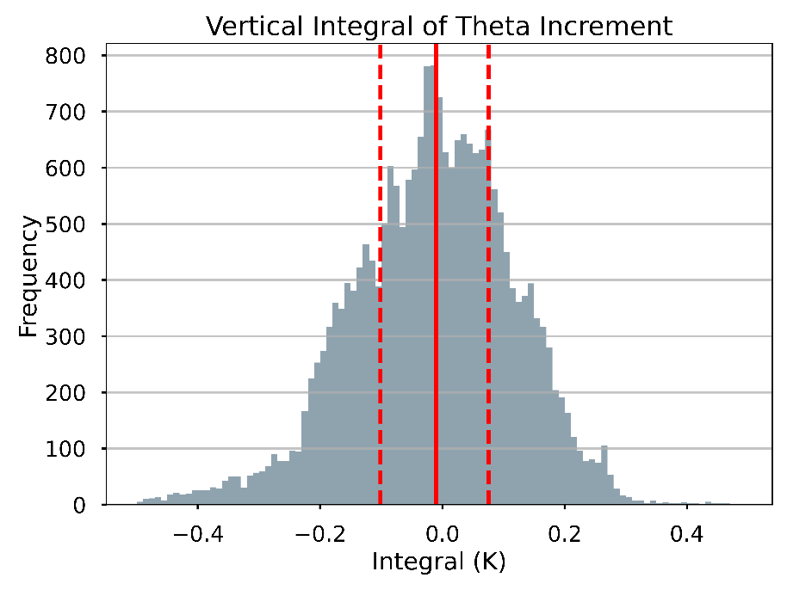
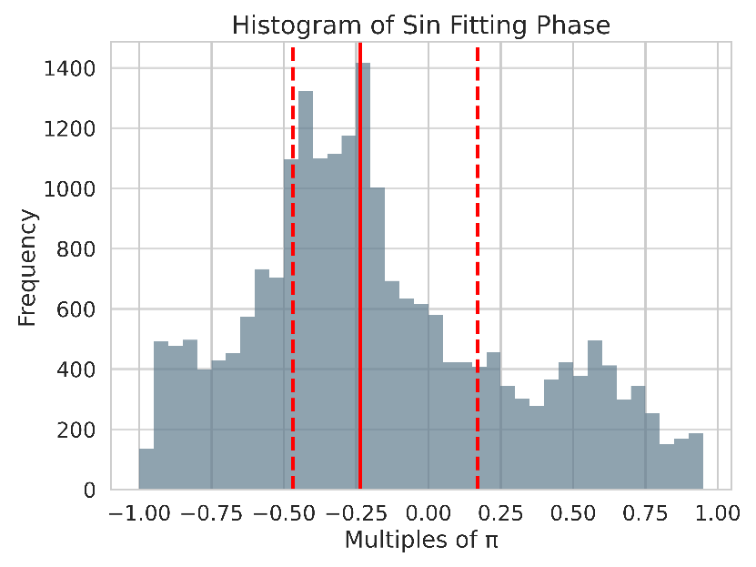
Tests of MCSP assumptions
Vertical integral of 6h increment within 0.1K in half of cases
Most profiles can be reasonably fit to a sine profile but have a phase shift that pushes zero of heating closer to surface
Notes:
Over 75% of profiles align with a sine model.
More than half exhibit a vertical integral below 0.1 K, upholding static energy conservation; fitting becomes worse with larger vertical integrals.

Slide 42
Conclusions
A parameterization of MCS effects has substantial potential to improve global NWP and climate models
  Modulates explicit motions
  Improves seasonal cycle of Indian monsoon and MJO
  Reduced bias over Bay of Bengal
  But amplifies a bias over the western Pacific
Decision to activate the MCS effects reformulated based on observed P(MCS | convection, env state)
  We don’t assume all parameterized convection is MCS-like (or non-MCS-like!)
  Testing of stochastic trigger under way
Pursuing a revision of MCS tendencies with guidance from DA increments associated with MCS

Slide 43
References
Bengtsson, L., Dias, J., Tulich, S., Gehne, M., & Bao, J.-W., 2021. A stochastic parameterization of organized tropical convection using cellular automata for global forecasts in NOAA's Unified Forecast System. J. Adv. Model. Earth Syst, 13, e2020MS002260
Bowler, N.E., Arribas, A., Mylne, K.R., Robertson, K.B. and Beare, S.E., 2008. The MOGREPS short-range ensemble prediction system. Q. J. R. Meteorol. Soc., 134, 703-722
Chen, C.-C., Richter, J. H., Liu, C., Moncrieff, M. W., Tang, Q., Lin, W., et al.,2021: Effects of organized convection parameterization on the MJO and precipitation in E3SMv1. Part I: Mesoscale heating. J. Adv. Model. Earth Syst., 13, e2020MS002401
Feng, Z., Leung, L. R., Liu, N., Wang, J., Houze, R. A., Li, J., et al., 2021: A global high-resolution mesoscale convective system database using satellite-derived cloud tops, surface precipitation, and tracking. J. Geophys. Res., 126, e2020JD034202.
Feng, Z., Hardin, J., Barnes, H. C., Li, J., Leung, L. R., Varble, A., and Zhang, Z, 2023: PyFLEXTRKR: A flexible feature tracking Python software for convective cloud analysis. Geosci. Model Devel., 16, 2753–2776.
Houze, R. A., 2004: Mesoscale convective systems. Rev. Geophys., 42, RG4003

Slide 44
References II
Khouider, B., and A. J. Majda, 2008: Multicloud Models for Organized Tropical Convection: Enhanced Congestus Heating. J. Atmos. Sci., 65, 895–914
Liu, N., L. R. Leung, and Z. Feng, 2021: Global Mesoscale Convective System Latent Heating Characteristics from GPM Retrievals and an MCS Tracking Dataset. J. Climate, 34, 8599–8613.
Mapes, B., and R. Neale, 2011. Parameterizing Convective Organization to Escape the Entrainment Dilemma, J. Adv. Model. Earth Syst., 3, M06004.
Lock, A. P., Whitall, M., Stirling, A. J., Williams, K. D., Lavender, S. L., Morcrette, C., et al. 2024: The performance of the CoMorph-A convection package in global simulations with the Met Office Unified Model. To appear in: Q. J. R. Meteorol. Soc., 10.1002/qj.4781
Moncrieff, M. W. and C. Liu, 2006: Representing Convective Organization in Prediction Models by a Hybrid Strategy. J. Atmos. Sci., 63, 3403-3420.
Moncrieff, M. W., C. Liu, and P. Bogenschutz, 2017: Simulation, Modeling, and Dynamically Based Parameterization of Organized Tropical Convection for Global Climate Models. J. Atmos. Sci., 74, 1363–1380.
Park, S., 2014: A Unified Convection Scheme (UNICON). Part I: Formulation. J. Atmos. Sci., 71, 3902–3930

Slide 45
References III
Piccolo, C, Cullen, M. J. P., Tennant, W. J., Semple, A. T. 2019. Comparison of different representations of model error in ensemble forecasts. Q J .R. Meteorol. Soc. 145, 15– 27.
Rooney, G.G., Stirling, A.J., Stratton, R.A. & Whitall, M., 2022. C-POOL: A scheme for modelling convective cold pools in the Met Office Unified Model. Q J R Meteorol Soc, 962–980.
Zhang, Z., Varble, A., Feng, Z., Marquis, J., Hardin, J., and Zipser, E., 2024: Dependencies of Simulated Convective Cell and System Growth Biases on Atmospheric Instability and Model Resolution. Submitted to: J. Geophys. Res.

Slide 46
Extras… in case useful

Slide 47
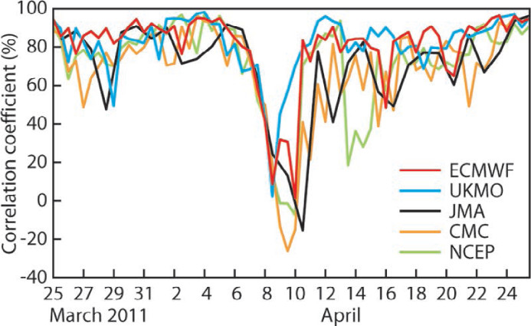
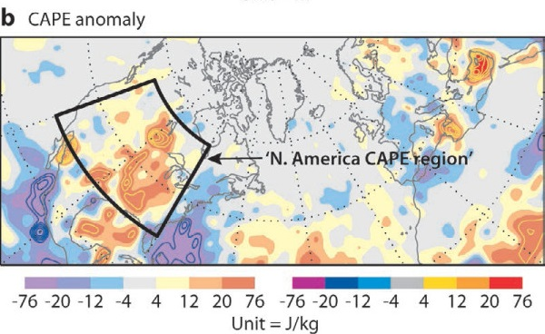
Forecast busts
NWP skill drop outs over Europe attributed to misrepresentations of MCS over US several days earlier
Spatial anomaly correlation of Z500 over Europe in T+6 day forecasts
Composite CAPE anomaly in the initial conditions for 584 busts
Rodwell et al, 2013

Slide 48
CoMorph Detrainment
Assumes power-law PDF within the bulk plume
Separate ascent calculations for in-plume mean properties, and a less dilute parcel “core”
At each level, detrain the fraction of the PDF which becomes non-buoyant
Detrained fraction f_{det}
m
odel
level
k+1
Tv
’ edge
Tv
’ mean
Tv
’ core
Tv
PDF
model
level
k
0
Tv
’ mean
Tv
’ core
Tv
How to define T_{v env} when it is changing due to the convective increment?
I may take this out depending on Alison’s talk which is earlier on the same day
For smooth behaviour. need implicit-in-time discretization, accounting for the convective heating
T_{v}’ = T_{v parcel} – T_{v env}

Slide 49
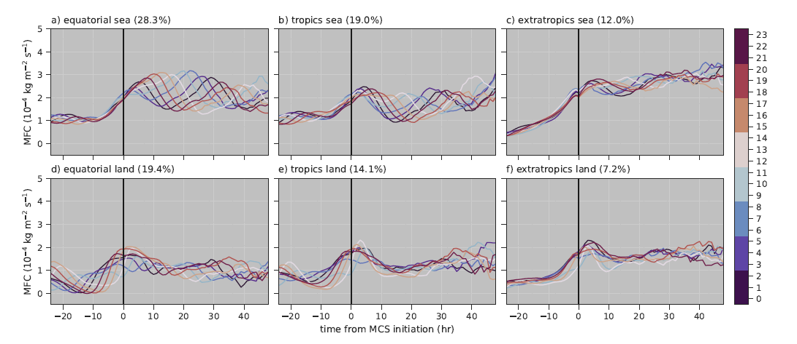
Dependence on region
Decompose into land/sea, by season, latitude bands, diurnal cycle etc
MFC
MFC
CAPE signal over land strongly affected by diurnal cycle
Likewise some low-level humidity measures
$\overline{Environment}$ | MCS is interesting but….

Slide 50
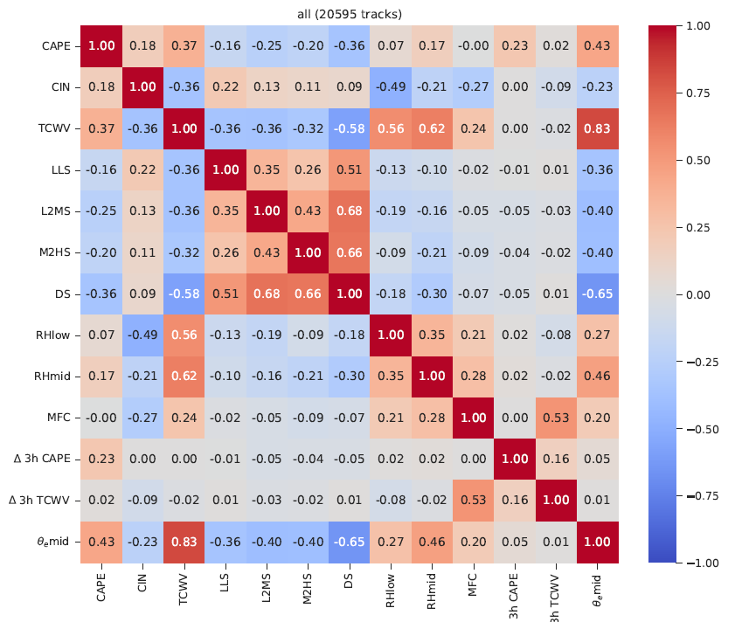
Correlations at MCS initiation

