Slide 1



Understanding the mesoscale structure of extratropical cyclones
Three Case Studies during the DIAMET Project
Lunchtime seminar
Department of Meteorology
University of Reading
29 May 2013
Oscar Martínez-Alvarado
Bob Plant, Laura Baker, Jeffrey Chagnon, Sue Gray, John Methven
Department of Meteorology
University of Reading
Hanna Joos, Maxi Böttcher, Heini Wernli
ETH Zurich

Slide 2
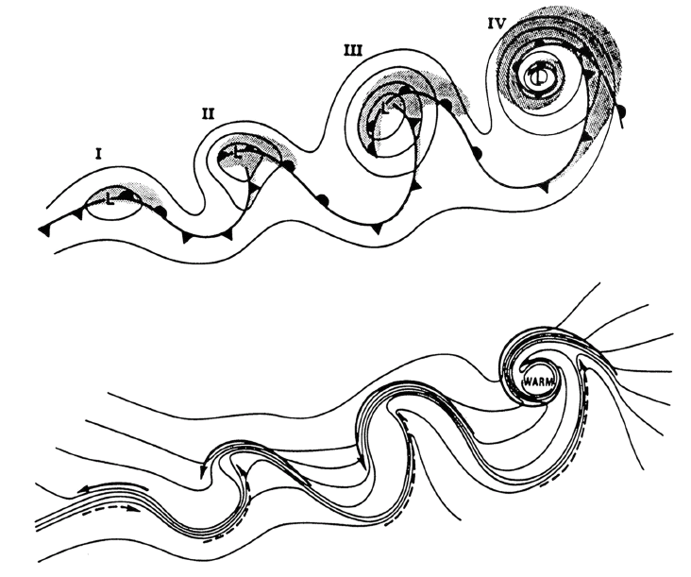
The conveyor belt paradigm – I
Shapiro – Keyser model of a cyclone life-cycle
Shapiro and Keyser (1990)
Occlusion is not precluded in this model (Schultz and Vaughan 2011)
In the following the Shapiro – Keyser conceptual model of cyclogenesis will be regarded as a general model of a cyclone life-cycle
Warm
seclusion
Frontal
fracture
Incipient
cyclone
T-bone
Browning (2004) after Shapiro and Keyser (1990)

Slide 3
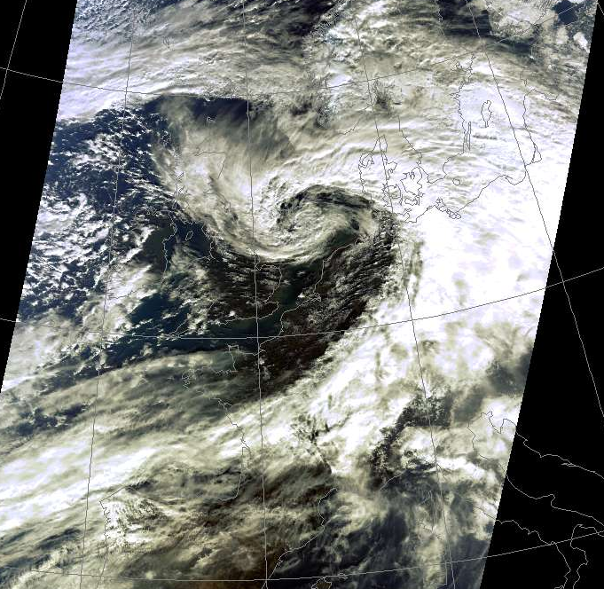
The conveyor belt paradigm – II
RGB Composite 1104 UTC 26 February 2002
Many people have contributed to the development of this model (e.g. Browning and Harrold 1971, Harrold 1973, Carlson 1980, Young et al. 1987, Browning and Roberts 1994, Schultz 2001)
First analyses: isentropic surface analysis based on radar and radiosonde observations
Later on: as model resolution increased, a new very useful tool became available: trajectory analysis (Wernli and Davies 1997, Wernli 1997)
Satellite image courtesy of NERC Satellite Receiving Station, Dundee University, Scotland http://www.sat.dundee.ac.uk

Slide 4
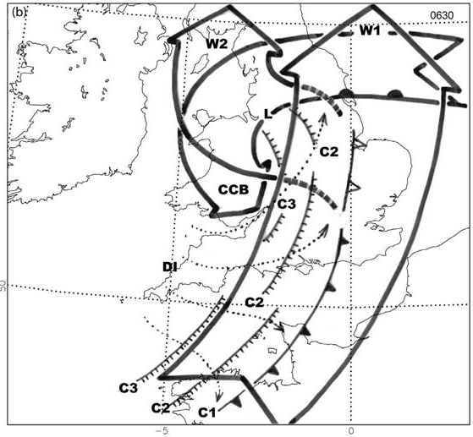
The conveyor belt paradigm – III
Four distinct air streams:
DI – dry intrusion
W1 – primary warm conveyor belt
W2 – secondary warm conveyor belt
CCB – cold conveyor belt
Browning (2005)

Slide 5
The conveyor belt paradigm – IV
Four distinct air streams:
DI – dry intrusion
W1 – primary warm conveyor belt
W2 – secondary warm conveyor belt
CCB – cold conveyor belt
In the next slides I will discuss about W1 and W2 (re-labelled as WCB1 and WCB2) and CCB using three case studies in the framework of the DIAMET project
Browning (2005)

Slide 6
Outline
The DIAMET project
Three case-studies
  Case-study I: 23-25 November 2009
  Case-study II: 30 September 2011
  Case-study III: 8 December 2011
  Methods
  Trajectory analysis
  Tracers
The warm conveyor belt
  The split of the warm conveyor belt (WCB1 and WCB2)
  Altering the parameterised v resolved convection partition
  The cold conveyor belt
  Strong winds near the cyclone centre
  Relationship with other streams: sting jets

Slide 7
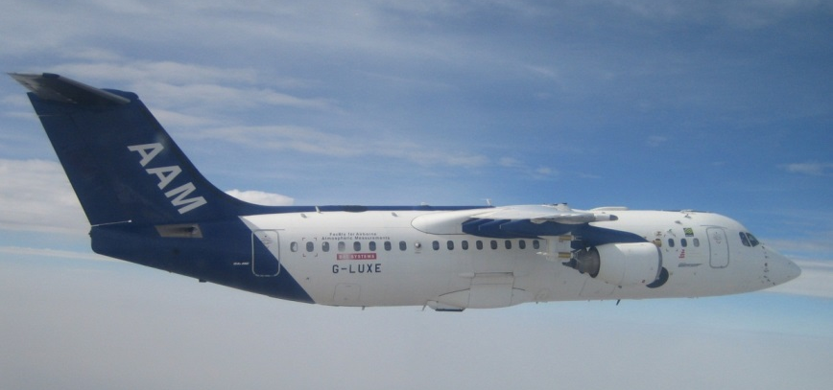
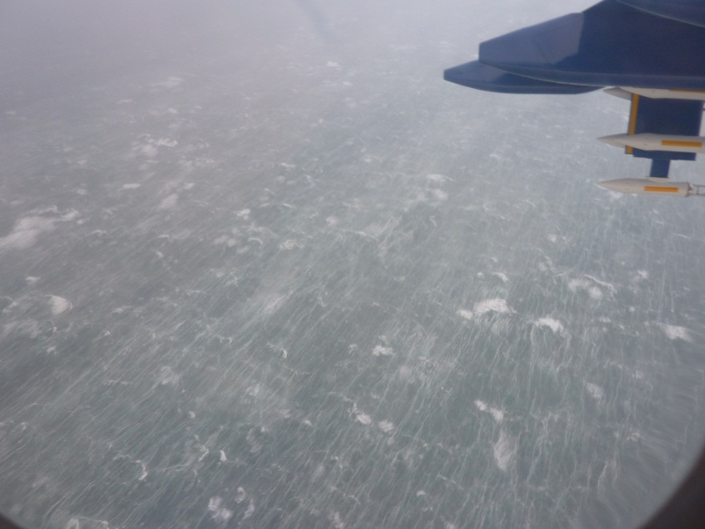
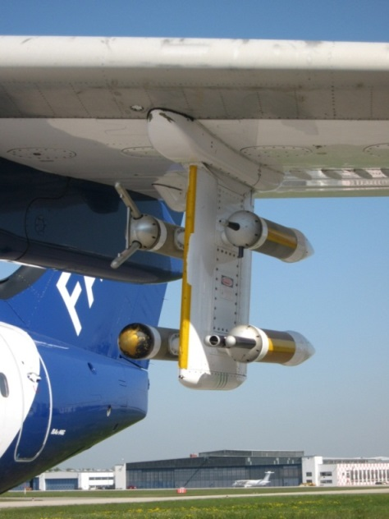
DIAMET
DIAbatic influences on Mesoscale structures in ExtraTropical storms
Overarching theme is the role of diabatic processes in generating mesoscale PV and moisture anomalies in cyclones, and the consequences of those anomalies for weather forecasts.
Modelling component
Strong observational component
FAAM research aircraft
Some of these observations will be used in the following

Slide 8
CASE-STUDIES

Slide 9
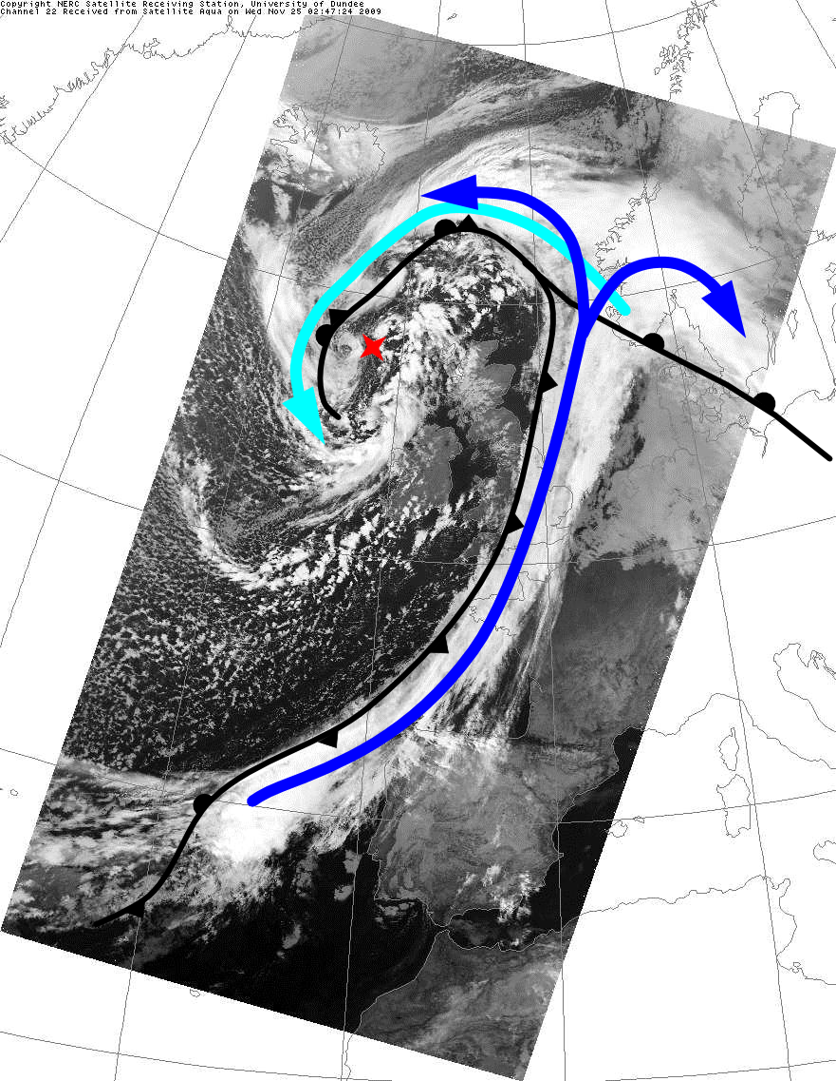
Case-Study I:
23-25 November 2009
Channel 22, satellite Aqua
0247 UTC 25 Nov 2009
The surface low formed in the North Atlantic on 23 November 2009 along an east-west oriented baroclinic zone
The low deepened from 0000 UTC 23 November to 0000 UTC 25 November 2009 and moved eastward.
The downstream ridge and downstream trough also amplified during this period.
By 0000 UTC 25 November, the system was occluded and had undergone “frontal fracture”.
Precipitation was heavy and continuous along the length of the cold front during the period 23-25 November 2009. As such, this is an ideal case for examining diabatic heating in a WCB.
Cold conveyor belt
Cyclone’s low pressure centre
Warm conveyor belt
Satellite image courtesy of NERC Satellite Receiving Station, Dundee University, Scotland http://www.sat.dundee.ac.uk
Surface fronts based on the Met Office analysis at 00 UTC 25 Nov 2009 (archived by http://www.wetter3.de/fax)

Slide 10
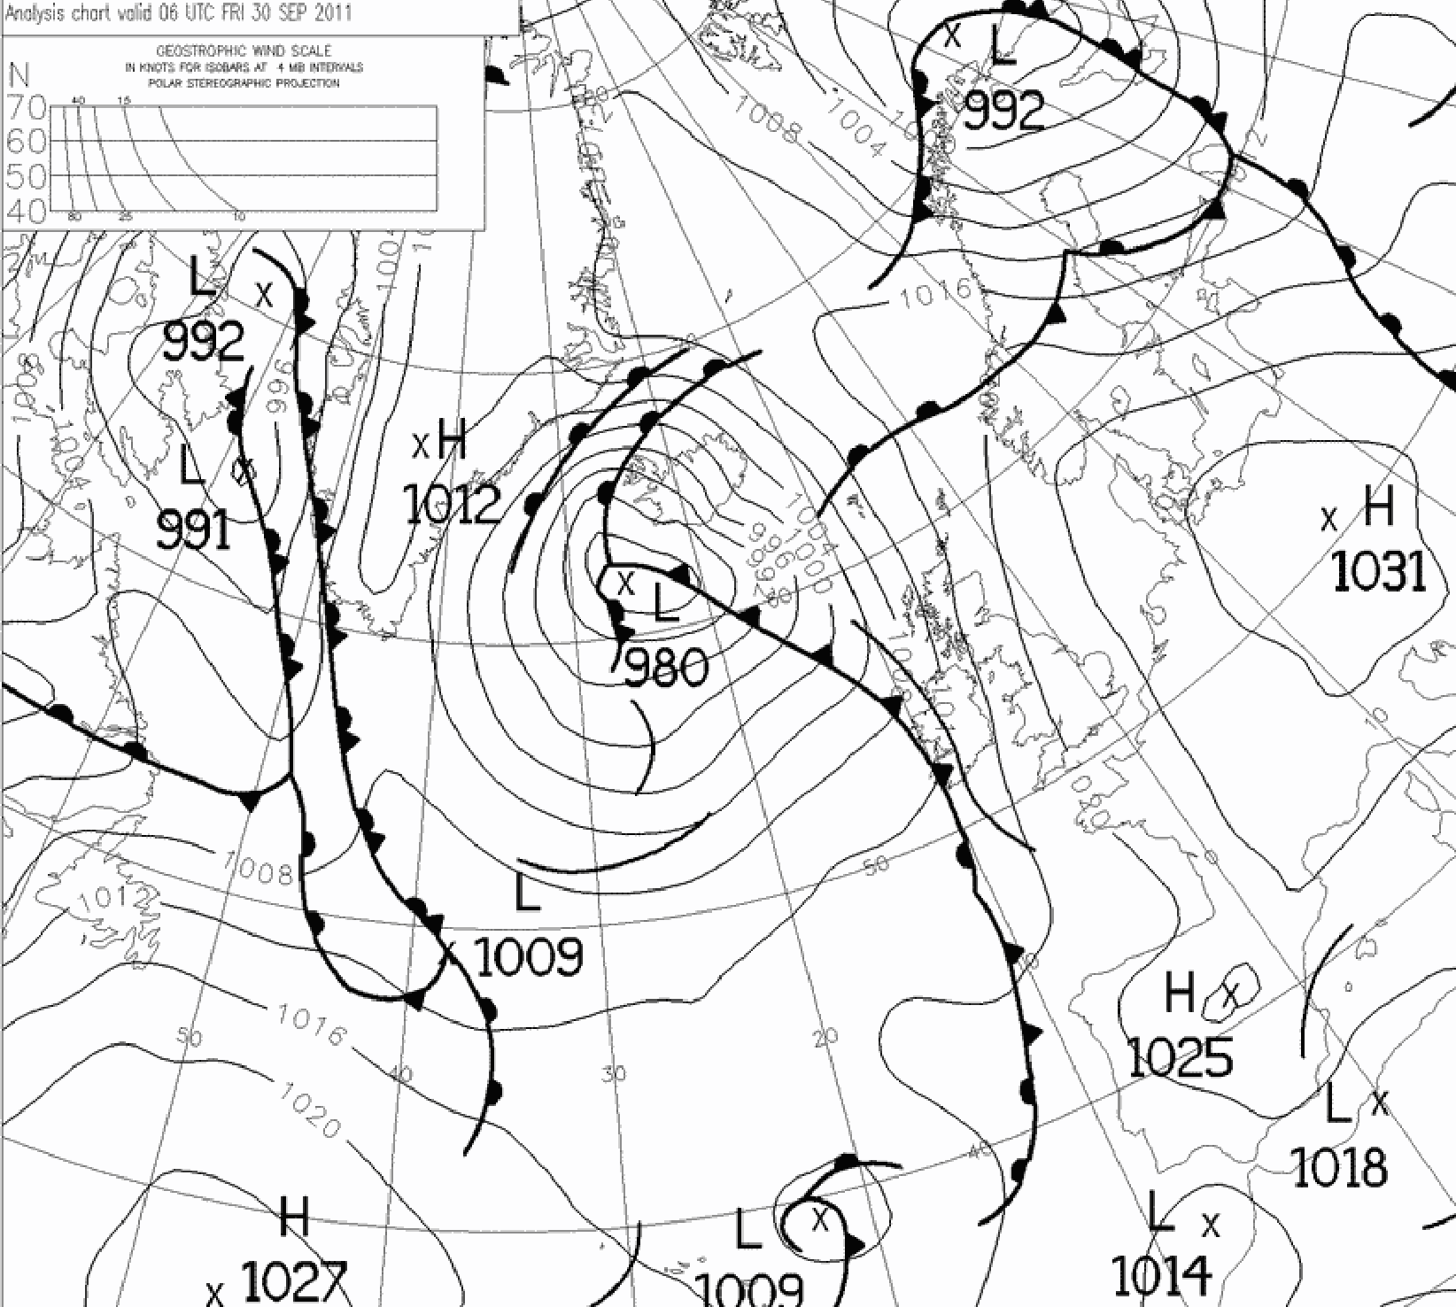
Case-Study II:
30 September 2011
Low-pressure system centred to the southwest of Iceland with a long-trailing cold front.
Development began 0600 UTC 28 September 2011 at 43°N 28°W.
From there it travelled northwards to be located around 62°N 25°W at 1200 UTC 30 September 2011, deepening from 997 hPa to 973 hPa in 54 hours.
Analysis of parameterised v resolved convection
Met Office operational analysis chart at 06 UTC 30 Sep 2011
(archived by http://www.wetter3.de/fax)

Slide 11
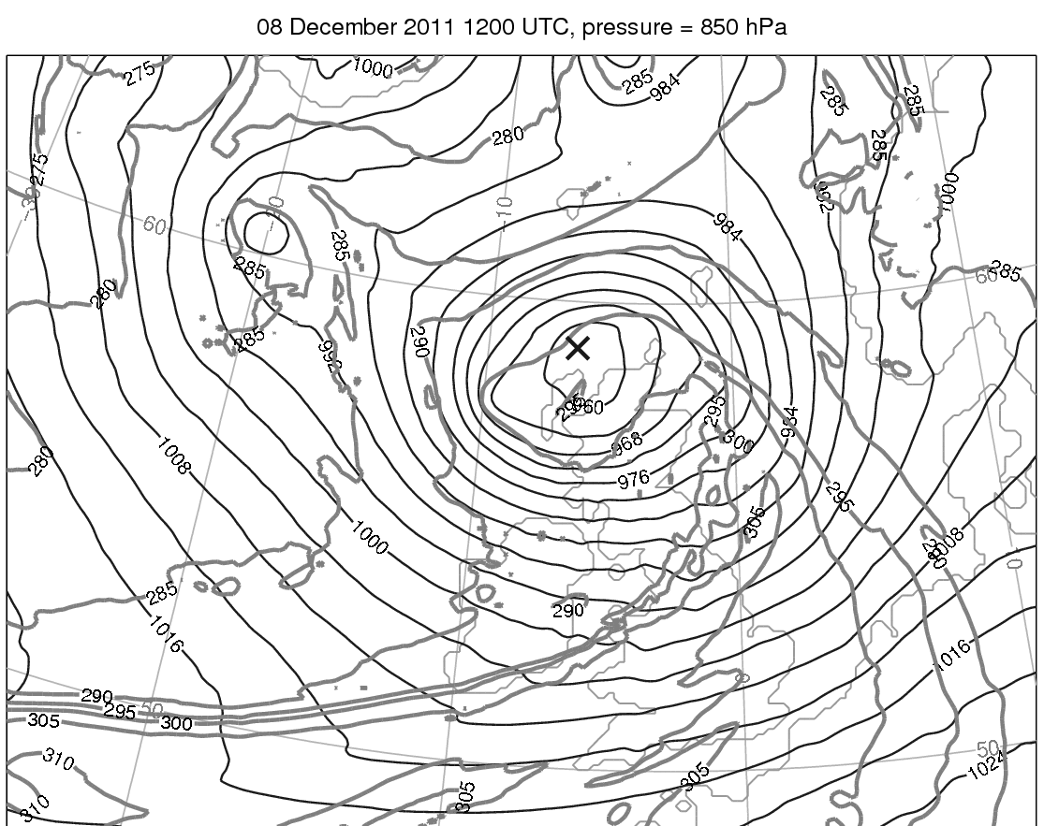
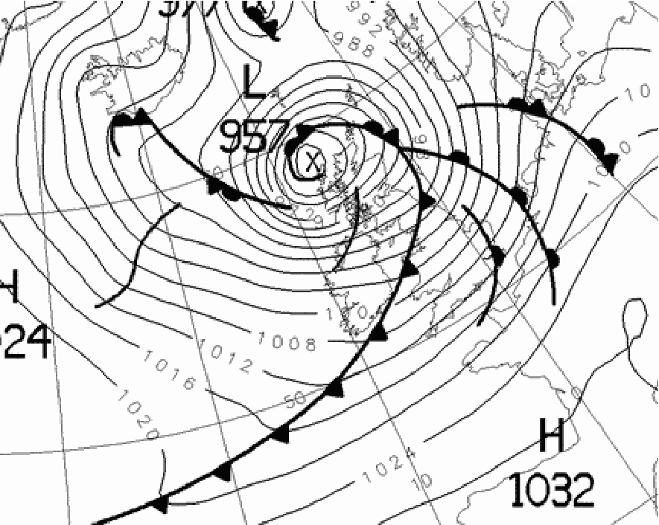
Case-Study III:
8 December 2011
Analysis of the causes of very strong near-surface winds
Met Office Analysis Chart valid at 1200 UTC 8 Dec 2011
Model MSLP (thin black) and 850-hPa equivalent potential temperature (grey bold) at 1200 UTC 8 Dec 2011

Slide 12
METHODS

Slide 13
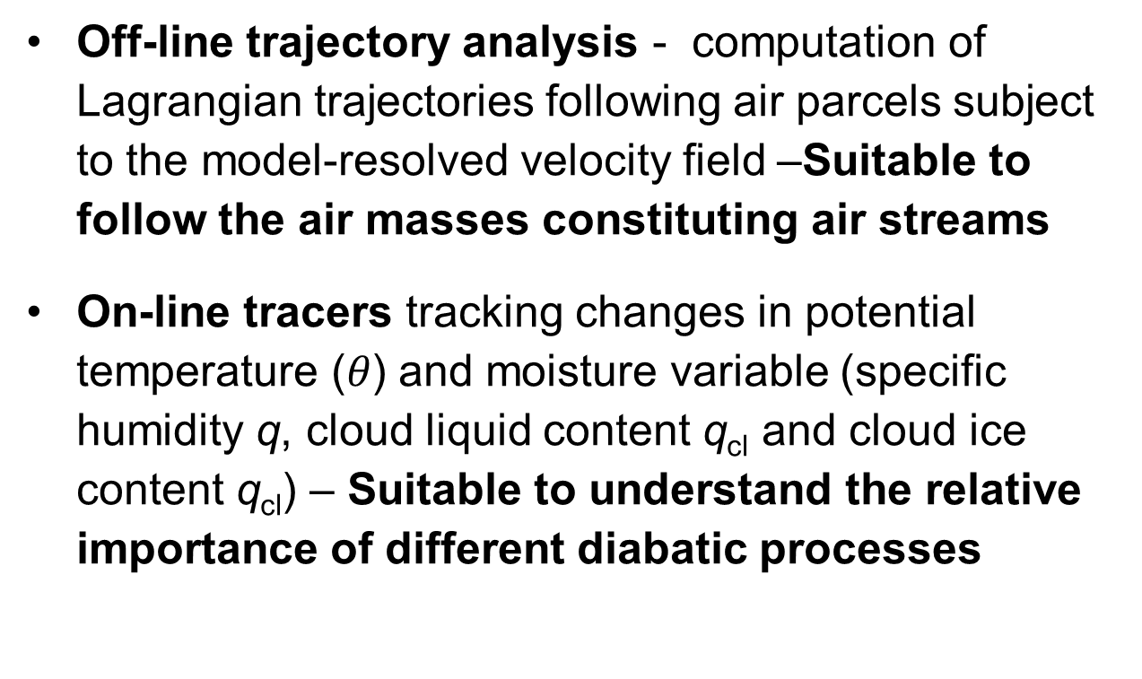
Methods
Off-line trajectory analysis - computation of Lagrangian trajectories following air parcels subject to the model-resolved velocity field –Suitable to follow the air masses constituting air streams
On-line tracers tracking changes in potential temperature ($θ$) and moisture variable (specific humidity q, cloud liquid content q_{cl} and cloud ice content q_{cl}) – Suitable to understand the relative importance of different diabatic processes

Slide 14
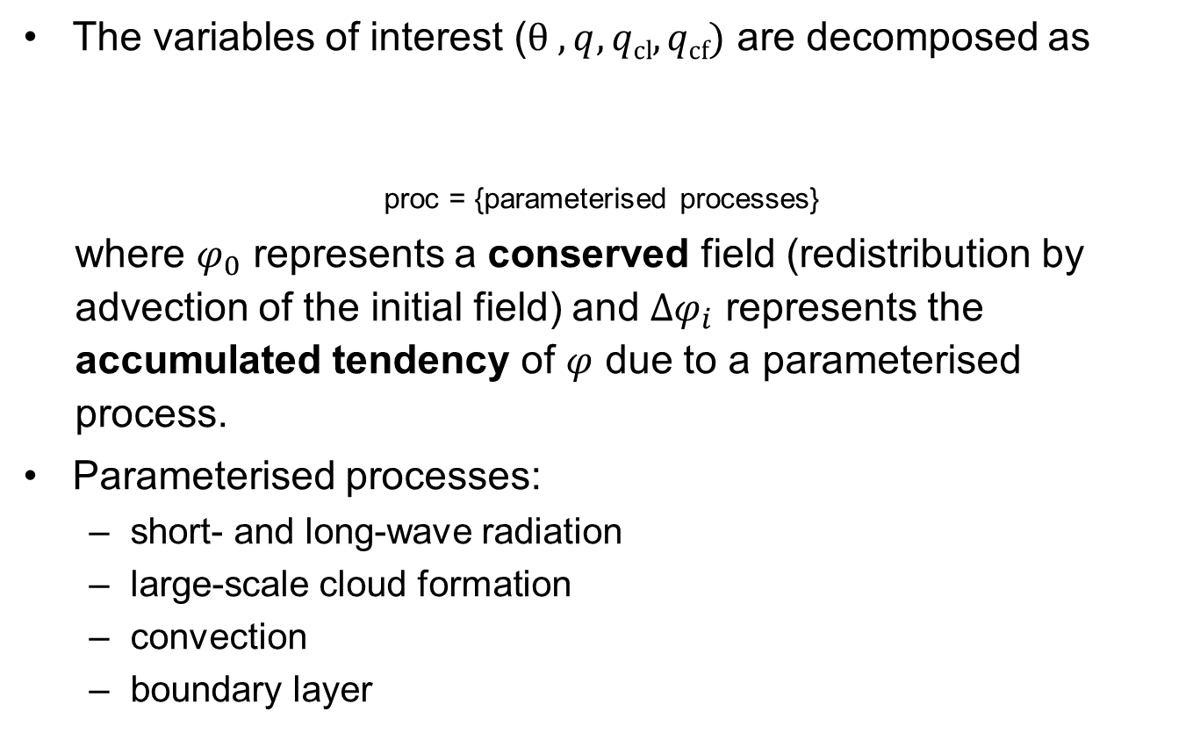
Tracers (I)
The variables of interest ($θ , q, qcl, qcf)$ are decomposed as
proc = {parameterised processes}
where $φ_{0}$ represents a conserved field (redistribution by advection of the initial field) and $∆φ_{i}$ represents the accumulated tendency of $φ$ due to a parameterised process.
Parameterised processes:
  short- and long-wave radiation
  large-scale cloud formation
  convection
  boundary layer

Slide 15
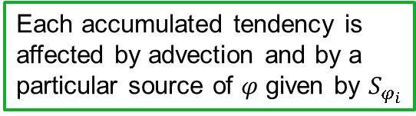

Tracers (II)
Thus, there are evolution equations for $φ_{0}$ and for each $∆φ_{i}$
The evolution equation for the relevant variables can then be written as
The conserved field is affected by advection only
Each accumulated tendency is affected by advection and by a particular source of $φ$ given by $S_{φ_{i}}$
Total rate of change
Sources
Advection of conserved field
Advection of accumulated tendencies

Slide 16
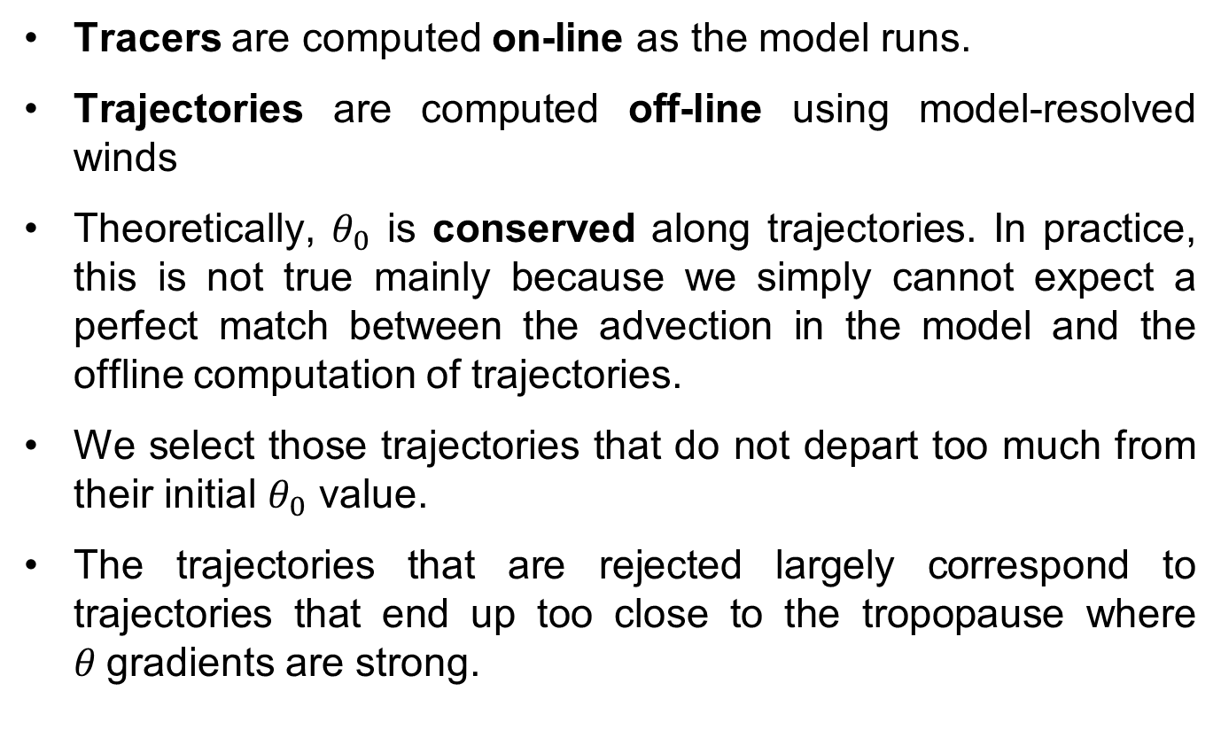
Consistency between tracers and trajectories
Tracers are computed on-line as the model runs.
Trajectories are computed off-line using model-resolved winds
Theoretically, $θ_{0}$ is conserved along trajectories. In practice, this is not true mainly because we simply cannot expect a perfect match between the advection in the model and the offline computation of trajectories.
We select those trajectories that do not depart too much from their initial $θ_{0}$ value.
The trajectories that are rejected largely correspond to trajectories that end up too close to the tropopause where $θ$gradients are strong.
10

Slide 17
THE WARM CONVEYOR BELT

Slide 18
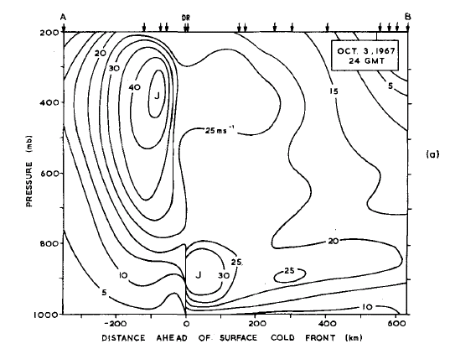
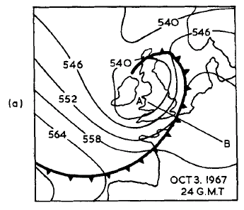
The warm conveyor belt – I
“[A] well-defined stream of air bounded at the top by air of different origin advecting over the cold front, in the west by the cold front and in the east by the edge of the significant northward flow of air; farther east the relative flow is light and rather variable in direction above the friction layer. However, within the friction layer some air enters the belt from the east and such air can at times constitute most of the inflow to the conveyor belt.” Harrold (1973)
Browning and Pardoe (1973)

Slide 19
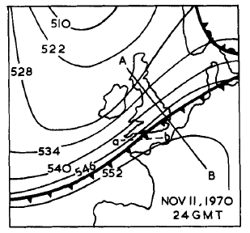
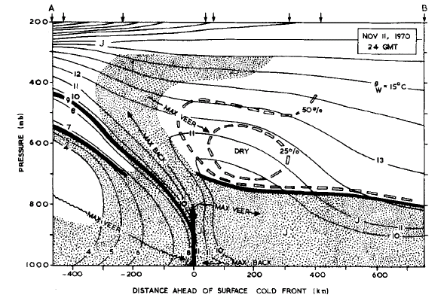
The warm conveyor belt – II
“[A] well-defined stream of air bounded at the top by air of different origin advecting over the cold front, in the west by the cold front and in the east by the edge of the significant northward flow of air; farther east the relative flow is light and rather variable in direction above the friction layer. However, within the friction layer some air enters the belt from the east and such air can at times constitute most of the inflow to the conveyor belt.” Harrold (1973)
Browning and Pardoe (1973)

Slide 20
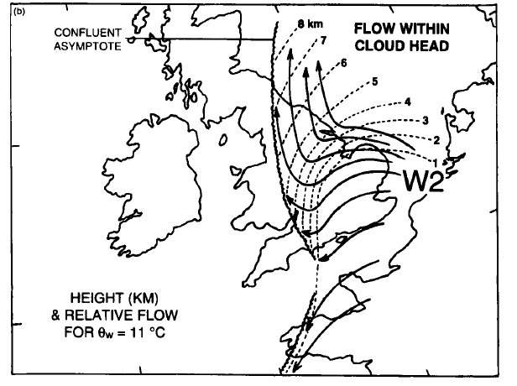
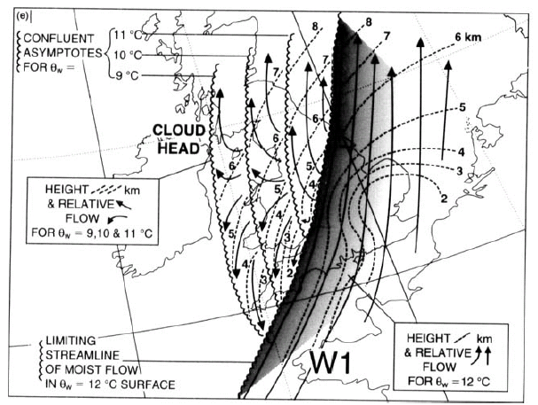
The warm conveyor belt – III
Isentropic analysis
Browning and Roberts (1994)

Slide 21
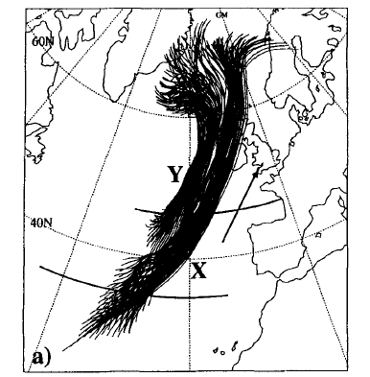
The warm conveyor belt – IV
Trajectory analysis
Introduced by Wernli and Davis (1997) preceded in a different form by Schär and Wernli (1993).
Form the basis of a number of studies about warm conveyor belts (e.g. Eckhardt et al. 2004, Joos and Wernli 2012)
WCB trajectories are identified by their total ascent in term of the tropopause height or by a fixed threshold, for example
  Δp > 600 hPa
Wernli (1997)

Slide 22
The split of the wcb
Case-study I: 23-25 November 2009

Slide 23
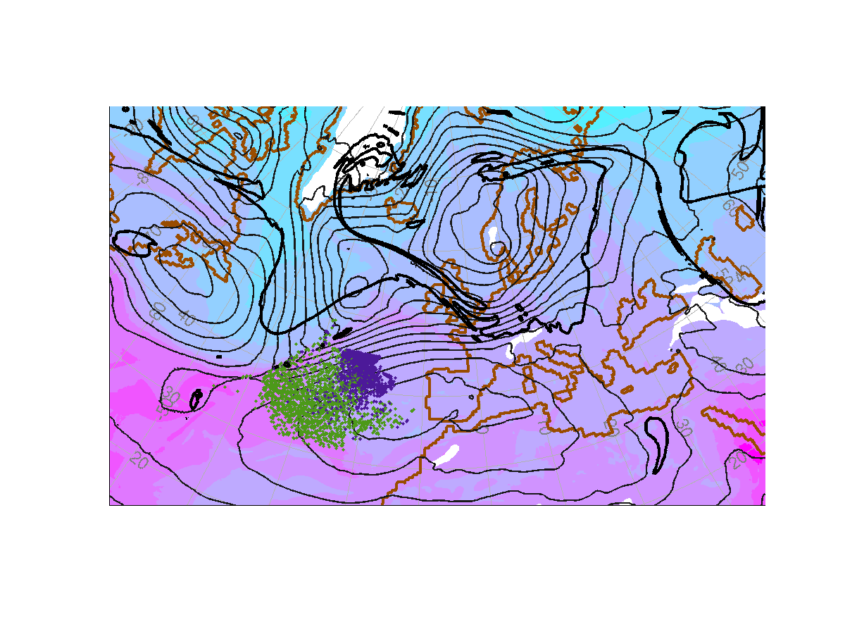
WCB in case-study I
Colour shading – 850-hPa equivalent potential temperature: pink – warm, blue – cold
Black thin lines – mean sea level pressure
Dynamic tropopause – 2-PVU contour on the 315-K isentropic surface
Both streams start in the boundary layer

Slide 24
WCB in case-study I
Colour shading – 850-hPa equivalent potential temperature: pink – warm, blue – cold
Black thin lines – mean sea level pressure
Dynamic tropopause – 2-PVU contour on the 315-K isentropic surface
Both streams start in the boundary layer
WCB1 turns anticyclonically – following the upper-level ridge
WCB2 turns cyclonically – into the cyclone centre

Slide 25
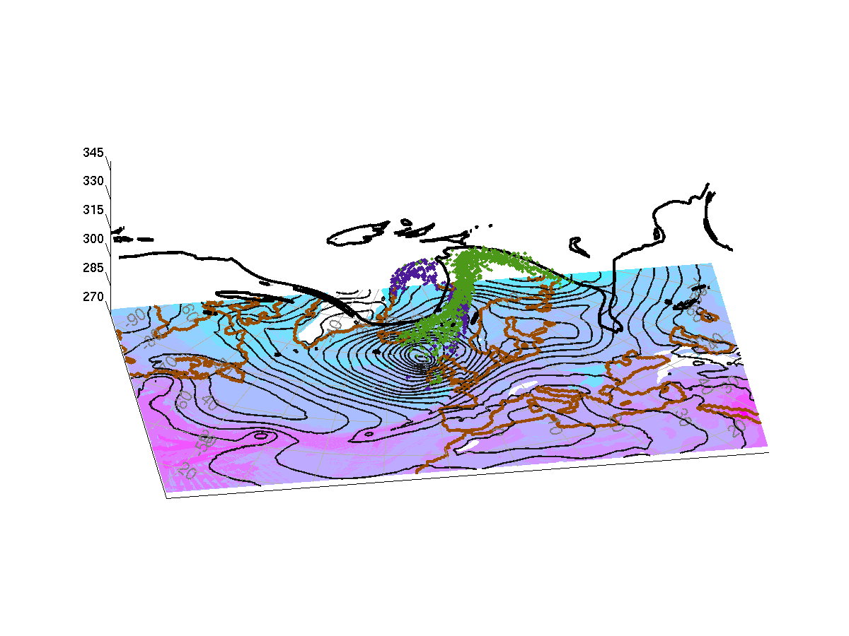
WCB in case-study I
Colour shading – 850-hPa equivalent potential temperature: pink – warm, blue – cold
Black thin lines – mean sea level pressure
Dynamic tropopause – 2-PVU contour on the 315-K isentropic surface
Both streams start in the boundary layer
WCB1 turns anticyclonically – following the upper-level ridge
WCB2 turns cyclonically – into the cyclone centre

Slide 26
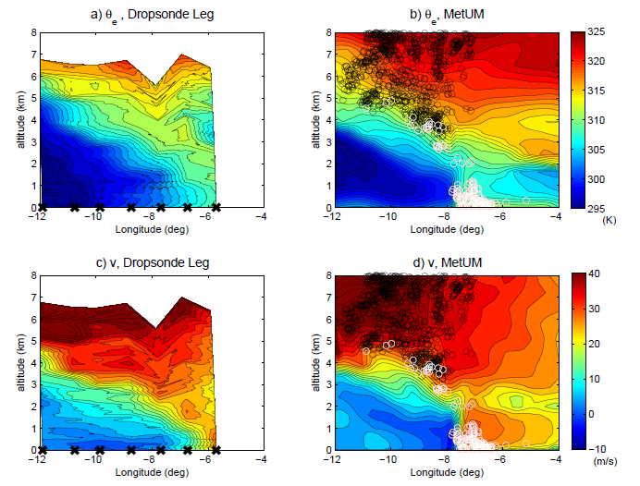
Dropsonde observations
WCB1
WCB2
WCB1
WCB2
Martínez-Alvarado et al. (2013, in preparation)
Figure courtesy Jeffrey Chagnon

Slide 27
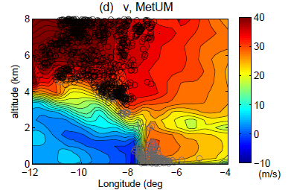
Dropsonde observations
WCB1
WCB2
Browning and Pardoe (1973)
Martínez-Alvarado et al. (2013, in preparation)
Figure courtesy Jeffrey Chagnon

Slide 28
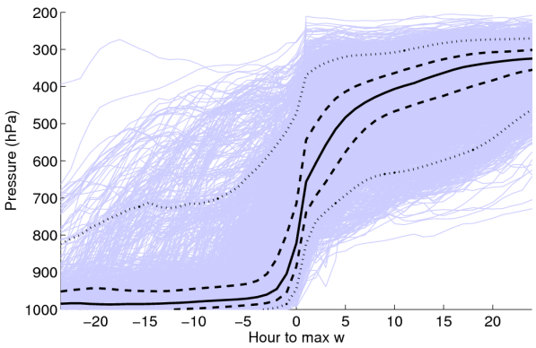
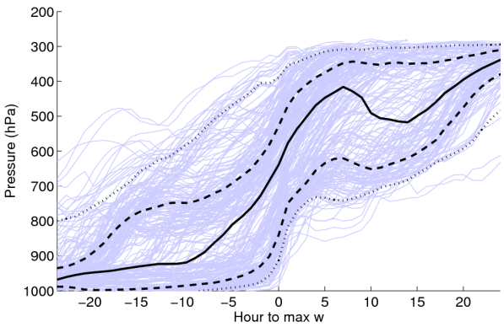
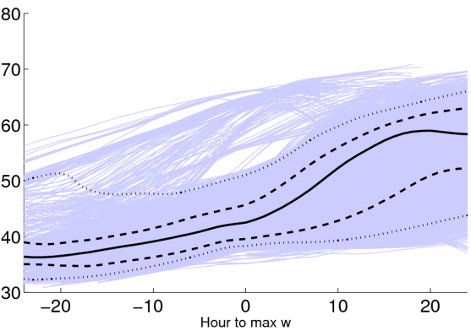
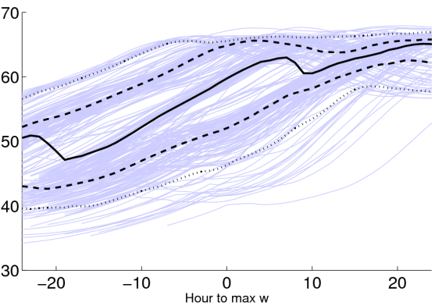
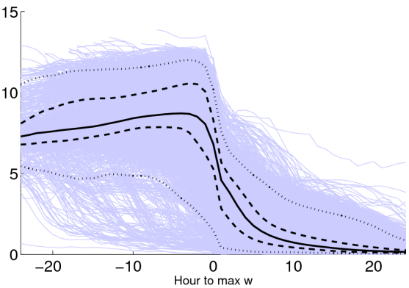
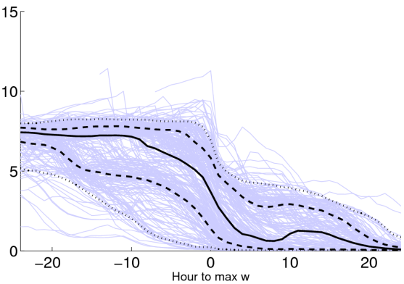
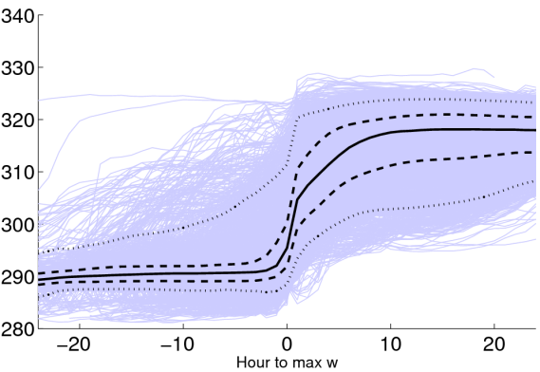
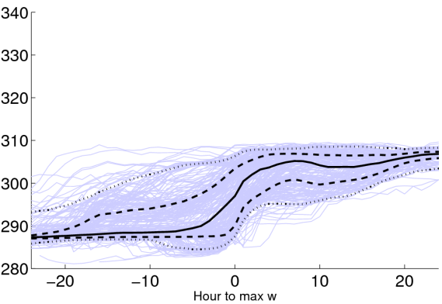
WCB1
WCB2
Time zero:
defined as the time of maximum ascent for each trajectory
Solid black:
trajectory-ensemble median
Dashed black:
25-th, 75-th percentiles
Dotted black:
5-th, 95th percentiles
Purple/blue:
Individual trajectories (only showing 1 in 10)
Pressure (hPa)
Pressure (hPa)
Latitude (degN)
Latitude (degN)
q (g kg⁻¹)
q (g kg⁻¹)
Theta (K)
Theta (K)

Slide 29
WCB1
WCB2
Time zero:
defined as the time of maximum ascent for each trajectory
Solid black:
trajectory-ensemble median
Dashed black:
25-th, 75-th percentiles
Dotted black:
5-th, 95th percentiles
Purple/blue:
Individual trajectories (only showing 1 in 10)
Pressure (hPa)
Pressure (hPa)
Latitude (degN)
Latitude (degN)
q (g kg⁻¹)
q (g kg⁻¹)
Why do we find these differences between WCB1 and WCB2?
Theta (K)
Theta (K)

Slide 30
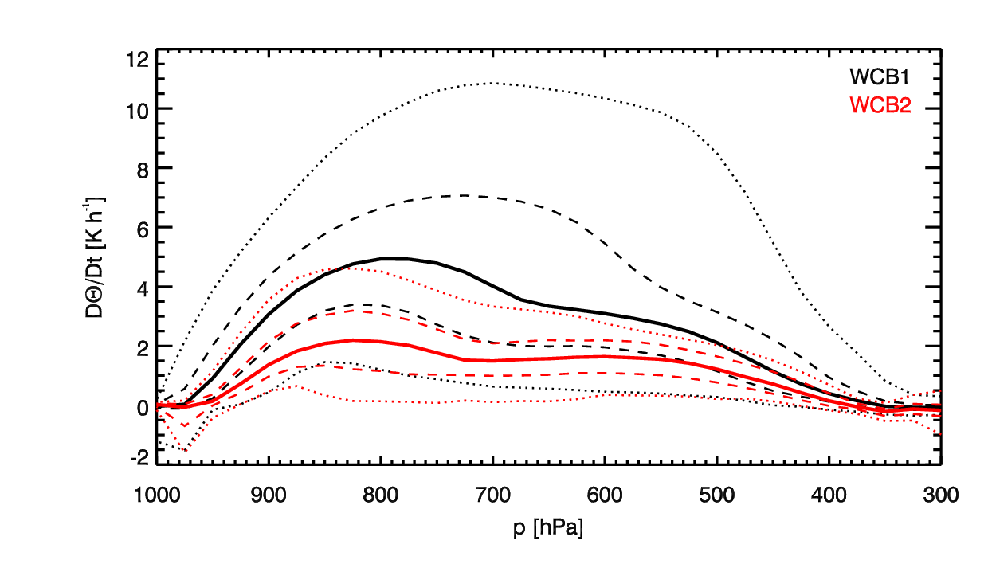
Heating rates and the WCB split
Total heating rate in the MetUM
Two models:
Reading: Met Office Unified Model (MetUM)
ETH Zürich: the COSMO model
Same initial conditions
ECMWF operational analysis
Similar resolutions
MetUM 12-km grid spacing
COSMO model: 17-km grid spacing
Different dynamical core and parameterisation schemes
Martínez-Alvarado et al. (2013, in preparation)
Figure courtesy Hanna Joos

Slide 31
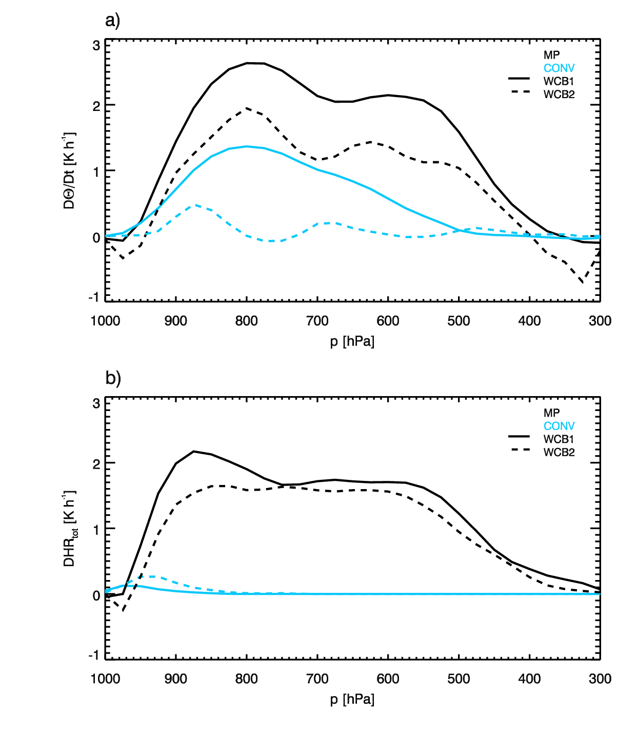
Heating rates and the WCB split
Total heating rate in the MetUM
MetUM
The COSMO model
One of the most important differences appears to be in the convection schemes
MetUM: Gregory and Rowntree (1990)
COSMO model: Tiedtke (1989)
This leads to differences in the partition between parameterised and resolved convection in this case
Martínez-Alvarado et al. (2013, in preparation)
Figure courtesy Hanna Joos

Slide 32
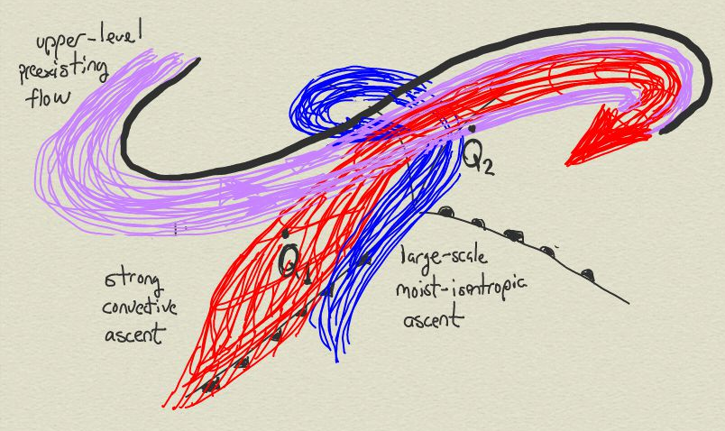
The warm conveyor belt
Summary
WCB1 and WCB2 exhibited distinct behaviour due to differences in diabatic processes acting upon them.
WCB1 was subject to strong line convection along the southern end of the cold front.
WCB2 was mainly subject to large-scale ascent close the cyclone centre and the warm front.
The models used to simulate this cyclone dealt with these processes differently leading to differences in the parameterised v resolved convection partition

Slide 33
The warm conveyor belt
Summary
WCB1 and WCB2 exhibited distinct behaviour due to differences in diabatic processes acting upon them.
WCB1 was subject to strong line convection along the southern end of the cold front.
WCB2 was mainly subject to large-scale ascent close the cyclone centre and the warm front.
The models used to simulate this cyclone dealt with these processes differently leading to differences in the parameterised v resolved convection partition
What should we expect if the parameterised v resolved convection partition is changed in a model?
25

Slide 34
Convection parameterisation
Case-study II: 30 September 2011

Slide 35
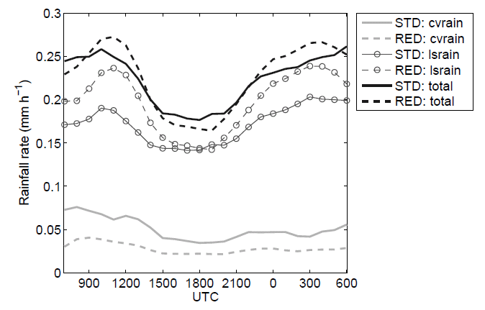
Convective–large-scale (resolved) precipitation partition
Case-study II: 30 September 2011
Two model runs for the same case
  one with standard convection STDCON and
  a second one with reduced convection REDCON
Under certain conditions this does not result in unrealistic behaviour (Done et al 2006).
Rain rate averaged over an area of 1500-km radius centred on the low pressure centre, showing the contributions from convective (cvrain) and large-scale rain (lsrain) to the total precipitation (total) for STDCON and REDCON.

Slide 36
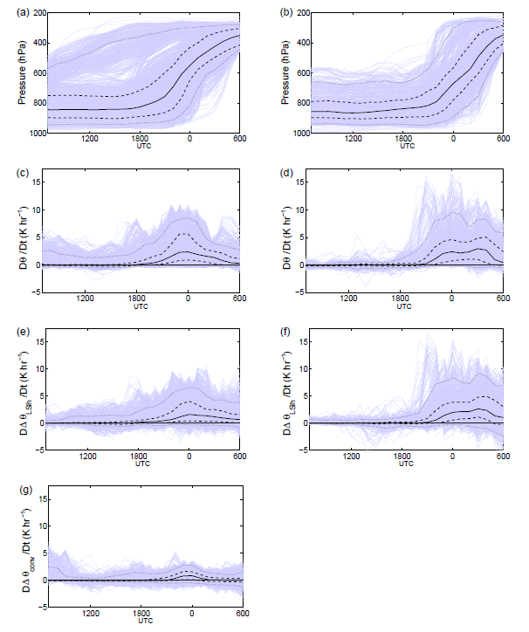
Trajectory analysis
STD CON
RED CON
Pressure
Evolution along trajectories that have strong accumulated heating.
Solid lines represent the median
Dashed lines represent the 25th and 75th percentiles
Dotted lines represent the 5th and 95th percentiles of the trajectory ensemble
Purple lines represent individual trajectories.
Total heating rate
Heating rate due to large-scale latent heat
Heating due to parameterised convection

Slide 37
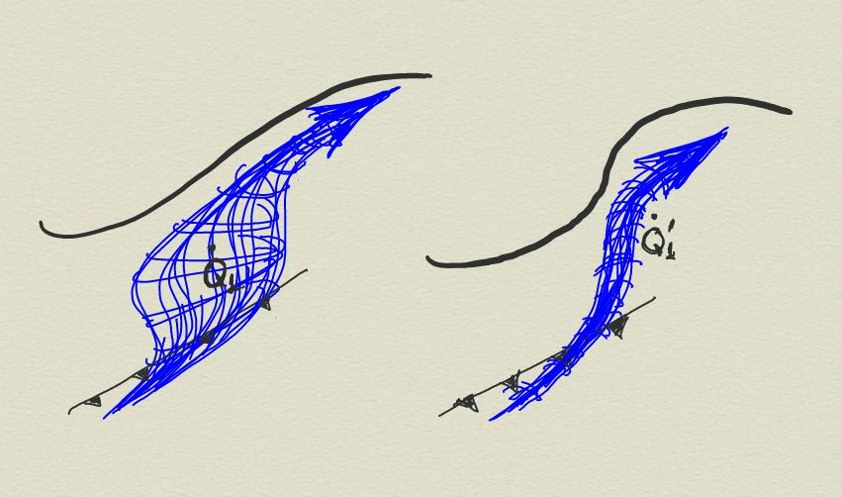
Perturbed parameterised – resolved convection partition
Standard parameterised
convection
Reduced parameterised convection

Slide 38
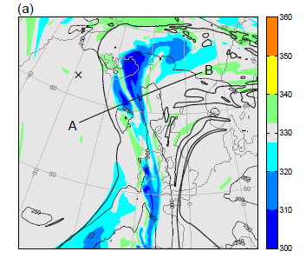
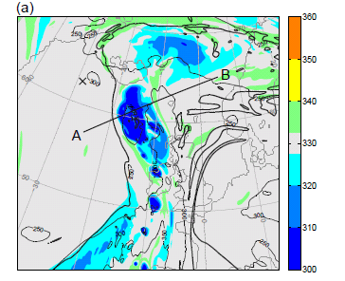
Perturbed parameterised – resolved convection partition
Case-study II: 30 September 2011
STDCON – θ₀ at 330 K
REDCON – θ₀ at 330 K
K
K
Interpretation:
Cold colours: air masses at lower levels at the start of the simulation - ascent
Warm colours: air masses at upper levels at the start of the simulation - descent
30

Slide 39
Low levels
Case-study III: 8 December 2011

Slide 40
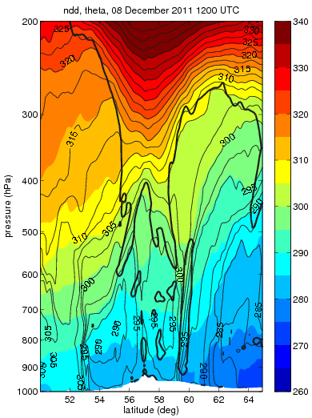
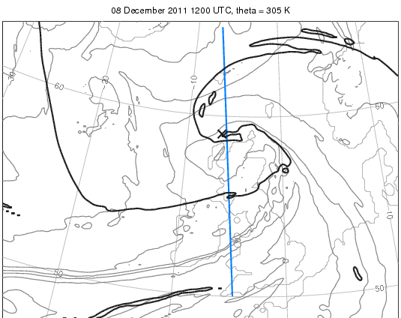
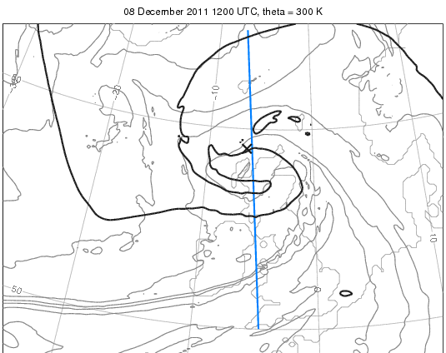
Cyclone vertical structure
N
S
N
305-K
WCB1
WCB1
WCB2
S
300 K
N
CCB
WCB2
Cold front
Warm front
S

Slide 41
Cyclone vertical structure
N
S
N
305-K
WCB1
WCB1
WCB2
S
300 K
N
Low-level strong winds
CCB
WCB2
Frontal fracture zone
Cold front
Warm seclusion
Warm front
S

Slide 42
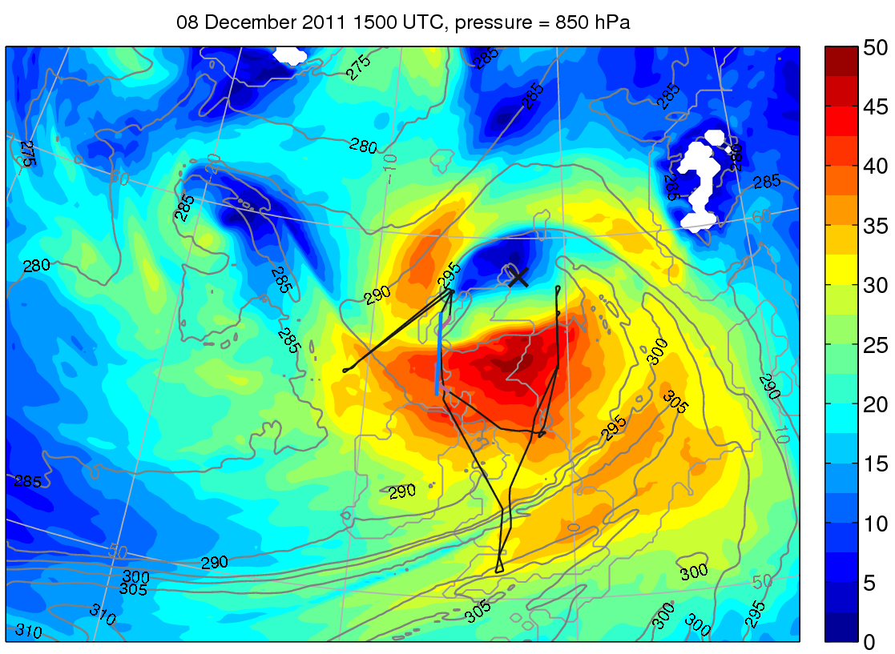
Strong winds near the cyclone centre – case-study III
1500 UTC 8 December 2011
Colour shading – 850-hPa wind speed in m s⁻¹
Thin grey – 850-hPa equivalent potential temperature
Thin black – Research aircraft flight track
Blue – vertical section to be shown later

Slide 43
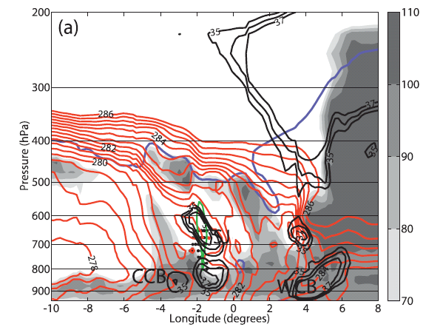
The vertical structure of the frontal fracture zone
Cyclone Anna on 26 February 2002
Wet-bulb potential temperature
Wind speed
Negative vertical velocity
Dynamical tropopause
Relative humidity wrt ice (%)
What stream originates this maxima in wind speed?
Martínez-Alvarado et al. (2010)

Slide 44
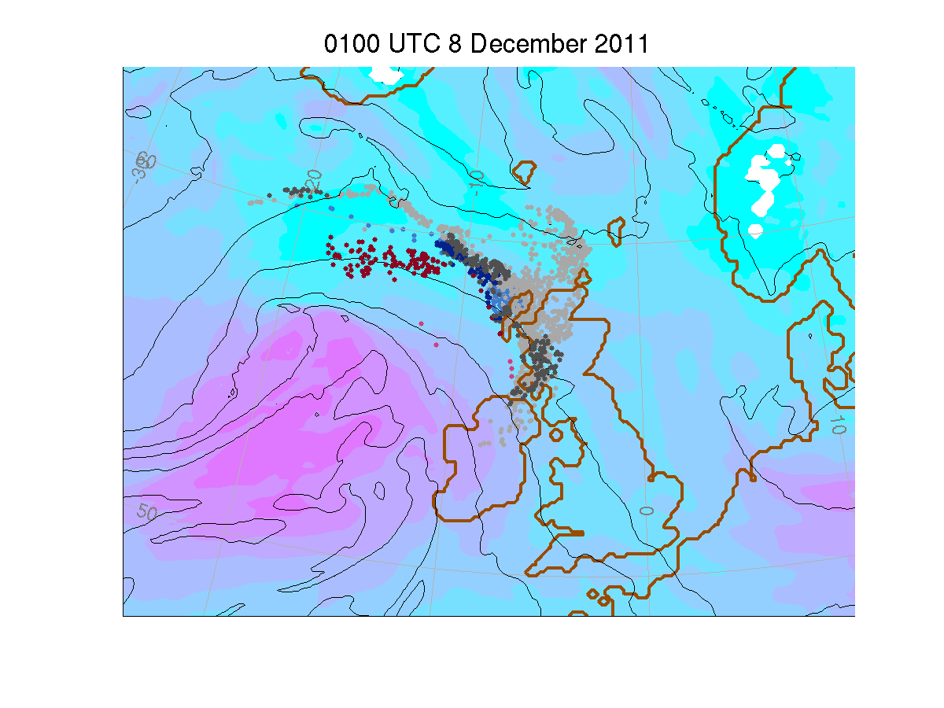
Air streams near the cyclone centre – case-study III
Colour shading – wind speed: pink – strong, blue – weak
Thin black: 850-hPa equivalent potential temperature
Three streams:
Cold conveyor belt: S1@16
Sting jet: S2@16:
Second cold conveyor belt: S3@16:

Slide 45
Air streams near the cyclone centre – case-study III
Colour shading – wind speed: pink – strong, blue – weak
Thin black: 850-hPa equivalent potential temperature
Three streams:
Cold conveyor belt: S1@16
Sting jet: S2@16:
Second cold conveyor belt: S3@16:

Slide 46
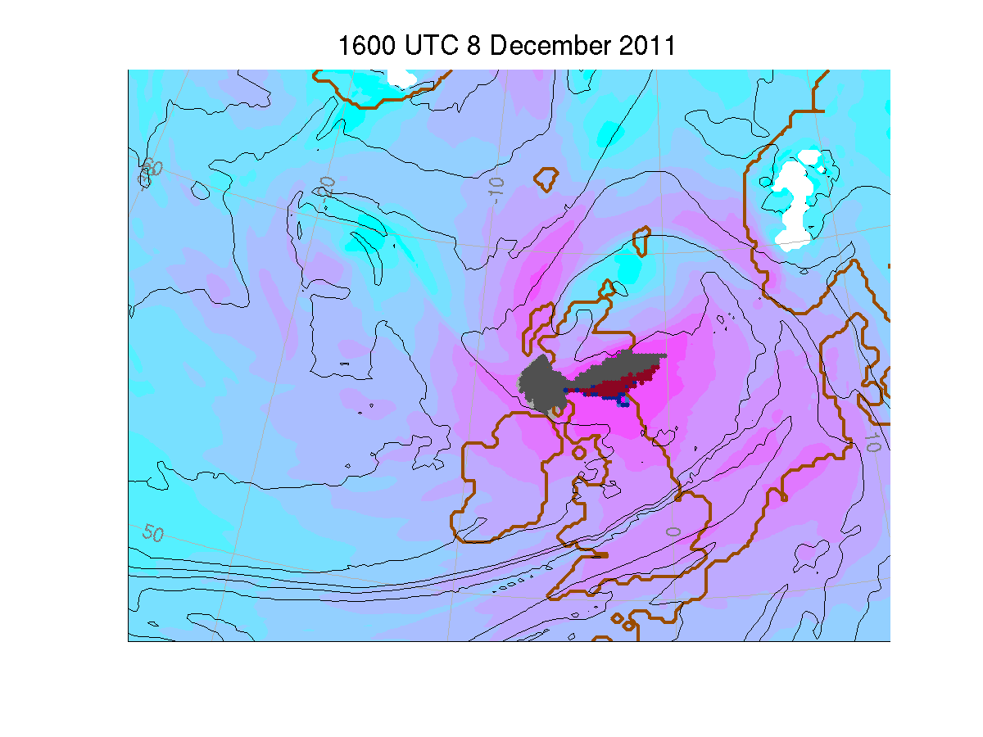
Air streams near the cyclone centre – case-study III
Colour shading – wind speed: pink – strong, blue – weak
Thin black: 850-hPa equivalent potential temperature
Three streams:
Cold conveyor belt: S1@16
Sting jet: S2@16:
Second cold conveyor belt: S3@16:

Slide 47
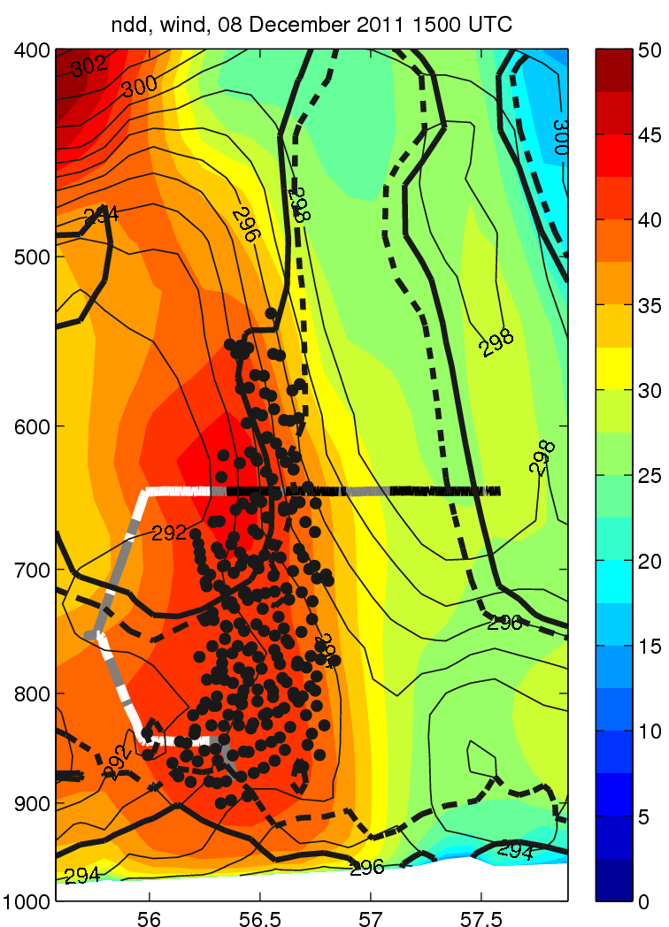


Air masses arriving in strong-wind regions
1500 UTC
S1@16
S2@16
S3@16
Flight track coloured by measured CO simply ranked as low (black) medium
(grey) and high (white)

Slide 48



Variables along trajectories showing the trajectory-ensemble median for the identified air masses

Slide 49





Physical processes
Rate of change of θ
Rate of change of q
Microphysics
Convection
BL mixing
S1@16
S2@16
S3@16

Slide 50

Strong winds near the cyclone centre

Slide 51

Strong winds near the cyclone centre

Slide 52

Strong winds near the cyclone centre

Slide 53

Strong winds near the cyclone centre

Slide 54

Strong winds near the cyclone centre

Slide 55

Strong winds near the cyclone centre

Slide 56

Strong winds near the cyclone centre

Slide 57

Strong winds near the cyclone centre

Slide 58

Strong winds near the cyclone centre
Three streams converging in regions of strong winds were identified at several times during the cyclone life-cycle
These satisfied the description of
  Cold conveyor belts
  Sting jets
The cold conveyor belts start behind the warm front but are subject to diabatic processes at low levels that made them move towards the cyclone centre
In comparison, sting jets experience less variation in equivalent potential temperature

Slide 59

Concluding remarks
The conveyor belt paradigm is a powerful conceptual viewpoint that remains largely unchanged since its origins in the 1970s
The availability of new tools in terms of observations, model resolution and computing power enables us to add more details especially into the smaller scales
Improved knowledge of diabatic processes acting on these streams
Better understanding on how well our models behave
Hopefully leading to better ways of representing the real atmosphere
40

Slide 60
Concluding remarks
The conveyor belt paradigm is a powerful conceptual viewpoint that remains largely unchanged since its origins in the 1970s
The availability of new tools in terms of observations, model resolution and computing power enables us to add more details especially into the smaller scales
Improved knowledge of diabatic processes acting on these streams
Better understanding on how well our models behave
Hopefully leading to better ways of representing the real atmosphere
THE END

